Slide 1


Windows drive for EOS-wnc
EOS Client for Windows
Gregor Molan
gregor@comtade.com
gregor.molan@cern.ch

Slide 2
Topics
Windows drive for EOS-wnc
  Comtrade:
  Development of EOS-wnc
  EOS cluster communication design
  EOS-wnc: Command line interface (CLI)
  EOS-wnc Windows drive: Demo
  EOS-wnc: Future work

Slide 3

Comtrade: Development of EOS-wnc
Windows drive for EOS-wnc

Slide 4
Background about EOS-wnc development 1/2
Comtrade: Development of EOS-wnc
  Comtrade: CERN openlab associate
  Storage solutions since 1990
  Actively involved in EU research
  EOS productisation since 2015
  More than 2500 software developers in 2020
  Issues with porting from Linux
  Networking issue
  Security issue
  Development direction
  EOS client for Linux built within WSL
  Porting XRootD to Windows
  Completely new Windows EOS client

Slide 5
Background about EOS-wnc development 2/2
Comtrade: Development of EOS-wnc
  EOS-wnc communication design
  Protocol Buffers
  gRPC
  cURL
  EOS-wnc access points
  EOS-wnc: Productisation project
  MS Visual Studio environment
  Optimal Implementation Phase (OIP)
  Presented at CS3 2021
  EOS-wnc: EOS Client for Windows
  https://indico.cern.ch/event/970232/contributions/4158376/

Slide 6

EOS cluster communication design
Windows drive for EOS-wnc

Slide 7
EOS-wnc communication design
EOS cluster communication design
Linux
Storage
Server
FST
MQ
FST
Sync
MGM
MGM
Server
Backup Server
DATA
DATA
Clients
DATA (http, WebDAV, S3)
Client
Client
Samba
Operating systems:
DATA
Win Client
Win
Client
Linux
Microsoft Windows

Slide 8
EOS-wnc connection to Windows disk
EOS cluster communication design
Win
Client
DATA (http, WebDAV, S3)
Windows drive
CLI commands

Slide 9
EOS-wnc connection to Windows disk
EOS cluster communication design
Win
Client
DATA (http, WebDAV, S3)
Windows driver
CLI commands

Slide 10

EOS-wnc:
Windows Driver for EOS
Windows drive for EOS-wnc

Slide 11
Windows Driver for EOS design
EOS-wnc: Windows Driver for EOS
Windows Driver Frameworks (WDF)
UMDF: User-Mode Driver Framework
KMDF: Kernel-Mode Driver Framework
Thin driver for EOS-wnc
Transfers commands
Prevents complex bugs
Device driver bugs are extremely expensive

Slide 12
EOS Windows Driver architecture
EOS-wnc: Windows Driver for EOS
Windows host
Windows user mode
Windows
disk
E:
Windows kernel mode
EOS cluster
Dokan
WDF
driver
Disk
Device
API
EOS-wnc

Slide 13

EOS-wnc drive: Demo
Windows drive for EOS-wnc

Slide 14
Prerequisite: Installed EOS-wnc
PS> dir
Directory: C:\eos\wnc
Mode LastWriteTime Length Name
---- ------------- ------ ----
-a---- 15. 01. 2021 12:28 203776 curlpp.dll
-a---- 15. 01. 2021 13:33 104960 dokan1.dll
-a---- 25. 02. 2021 21:02 5006336 eos-drive.exe
-a---- 24. 02. 2021 17:13 98238 EOS-Drive.ico
-a---- 24. 02. 2021 17:13 2578432 libcrypto-1_1.dll
-a---- 24. 02. 2021 17:13 472576 libcurl.dll
-a---- 24. 02. 2021 17:13 535040 libssl-1_1.dll
-a---- 15. 01. 2021 12:28 138240 readline.dll
-a---- 15. 01. 2021 12:28 74752 zlib1.dll
PS>

Slide 15
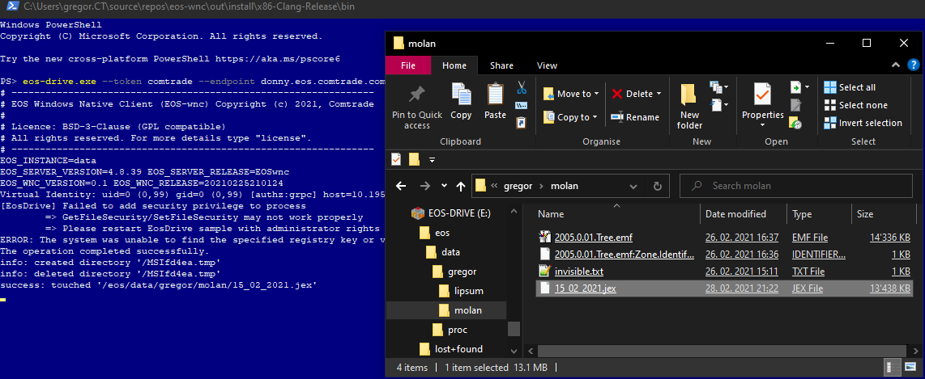
Demo

Slide 16

EOS-wnc: Future work
Windows drive for EOS-wnc

Slide 17
Planned actions for 2021
EOS-wnc: Future work
  Installation
    Windows Installer
    Setup.exe
    EOS-wnc.msi
    The Windows Store
  Documentation
    EOS-wnc guidelines
    EOS-wnc how to guide
    EOS-wnc complete docs
  Productisation
    Appropriate quality
    Professional development process

Slide 18
Windows drive for EOS-wnc
Gratitude
  Special thanks to CERN:
  Alberto Di Meglio
  Thanks to Comtrade:
  Veselin Jevrosimović
  Alexis Lope-Bello
EOS-wnc team
  Gregor Molan
  Branko Blagojević
  Ivan Arizanović
  Svetlana Milenković

Slide 19
EOS-wnc console: Demo slides
Windows drive for EOS-wnc

