Slide 1


OSD-Model implementation on EOS-wnc
EOS Client for Windows
Gregor Molan
gregor@comtade.com
gregor.molan@cern.ch

Slide 2
Topics
OSD-Model implementation on EOS-wnc
  Introduction
  Background
  OSD-Model
  OSD algorithms
  Conclusion and future work

Slide 3
Introduction
It is the outlook of the theoretical background for EOS-wnc software development process management.

Slide 4
Background
Theoretical definitions and methodology

Slide 5
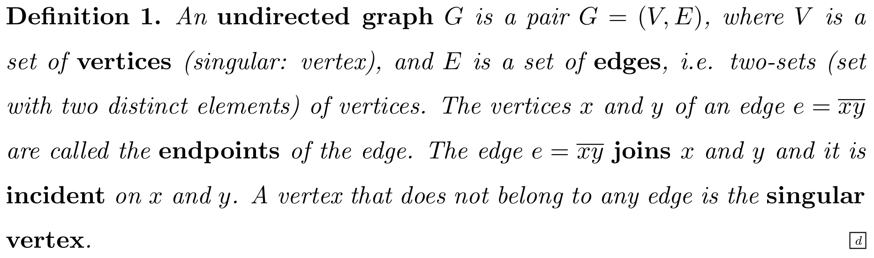
Graph theory

Slide 6
Lean software development
Follow simple principles:
  Eliminate waste
  Amplify learning
  Decide as late as possible
  Deliver as fast as possible
  Empower the team
  Build integrity in
  Optimize the whole

Slide 7
Kanban method
Upgrade of the lean software development
Kanban boards
Managing workflow
Kanban metrics

Slide 8
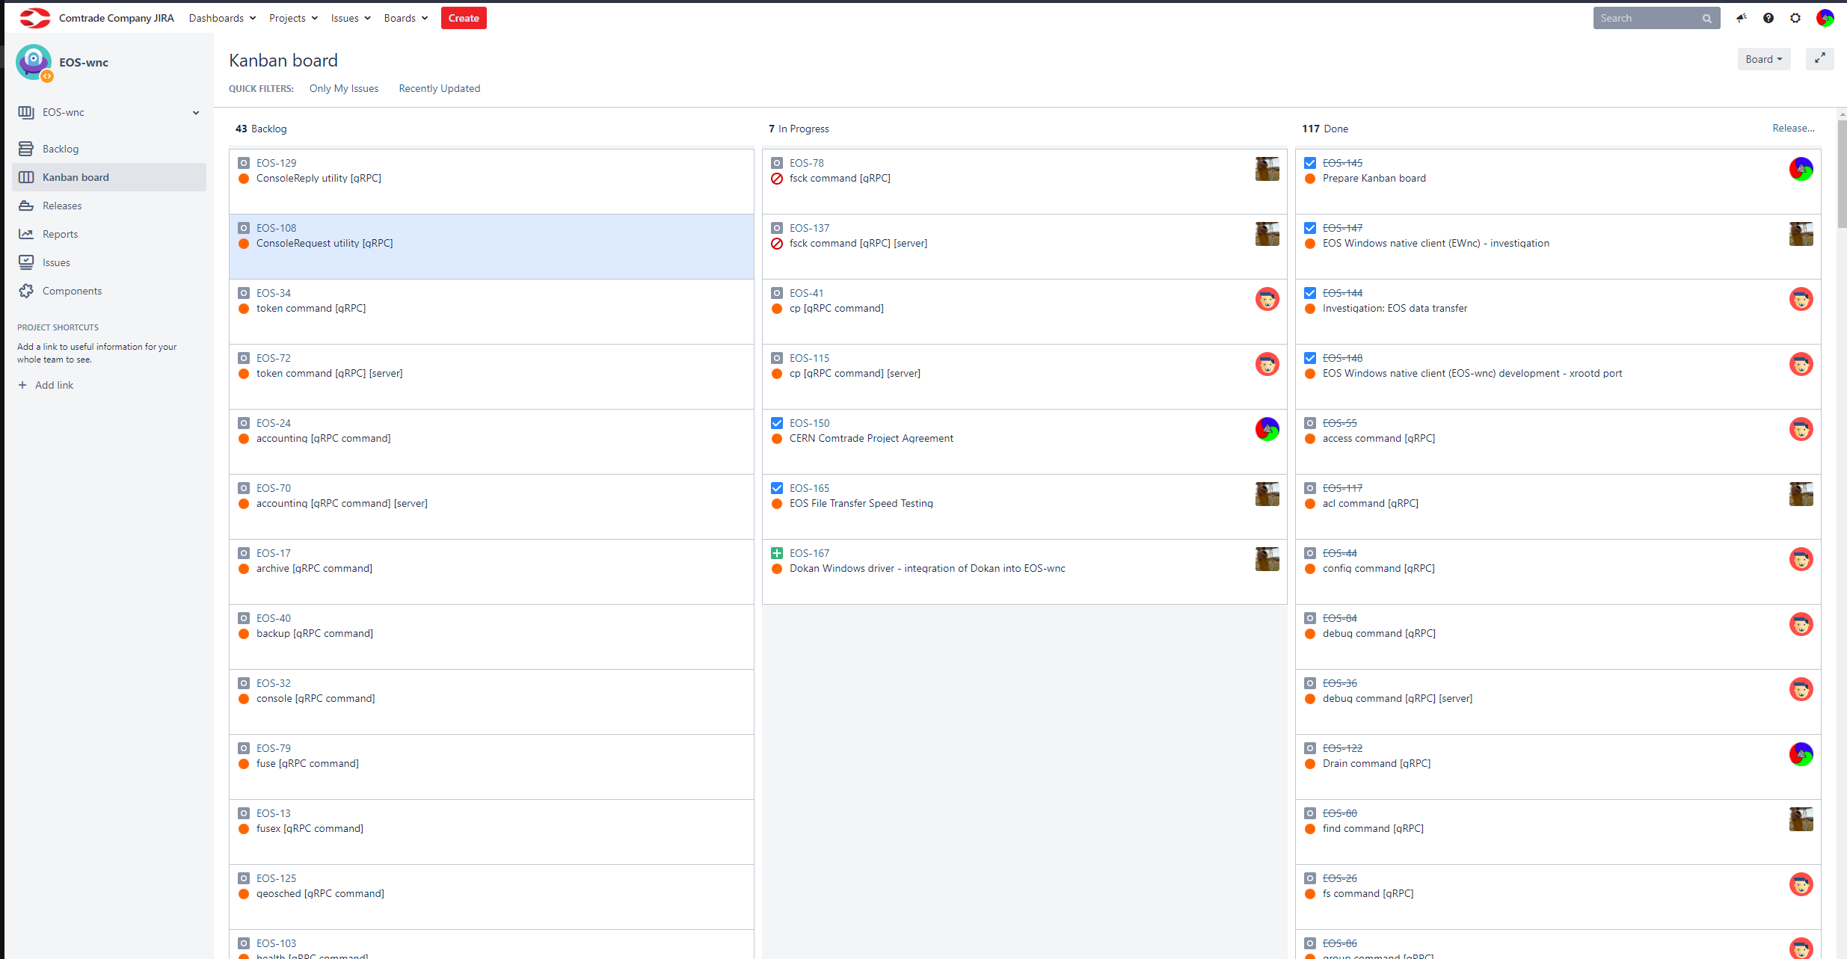
JIRA project management tool

Slide 9
OSD-model

Slide 10
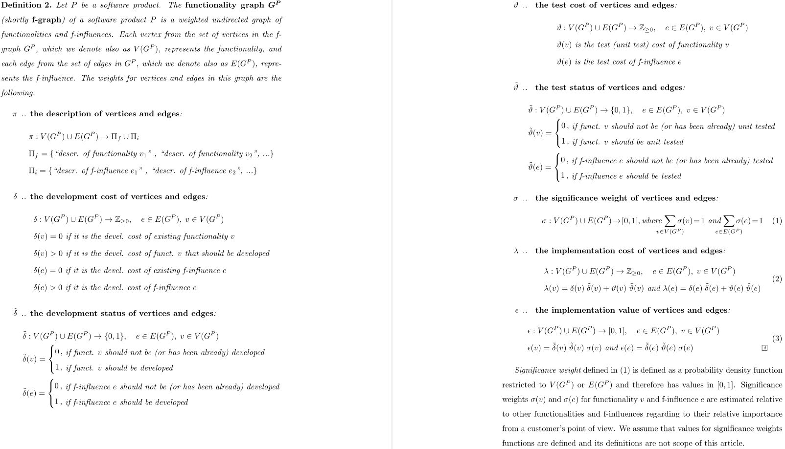
Functionality graph (f-graph)

Slide 11
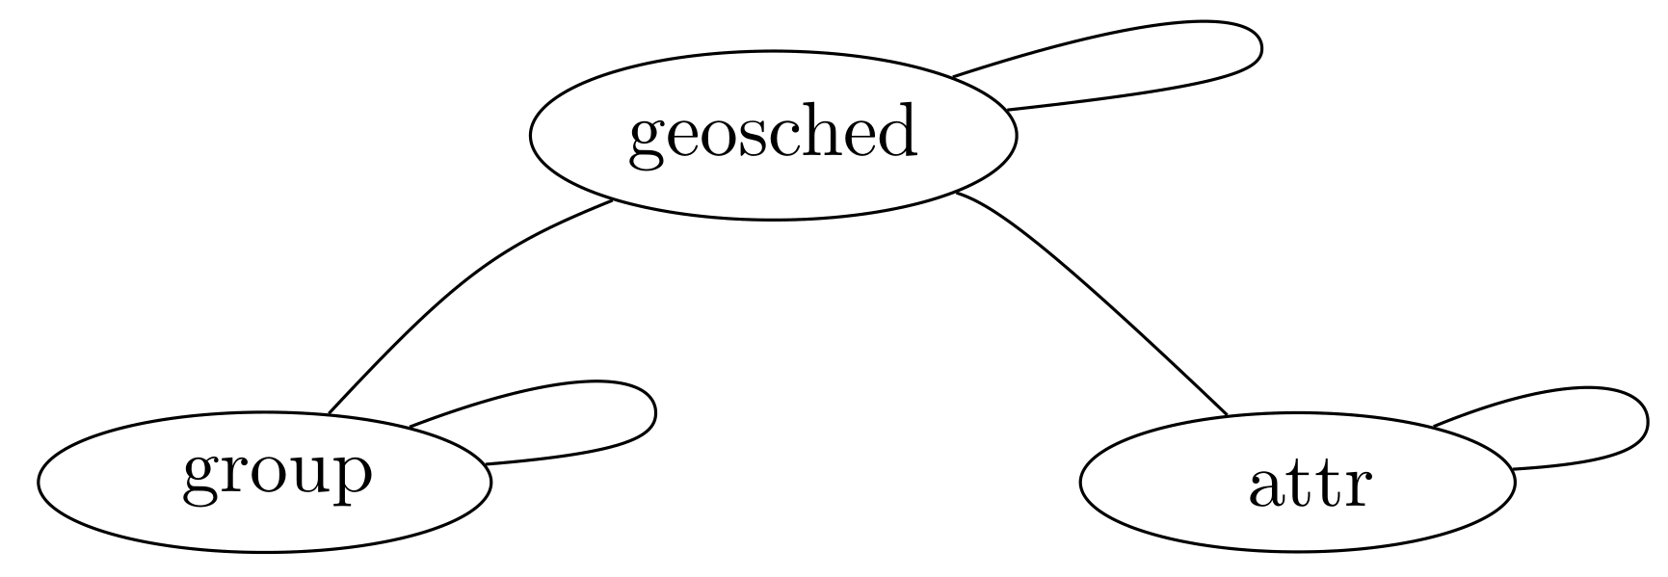
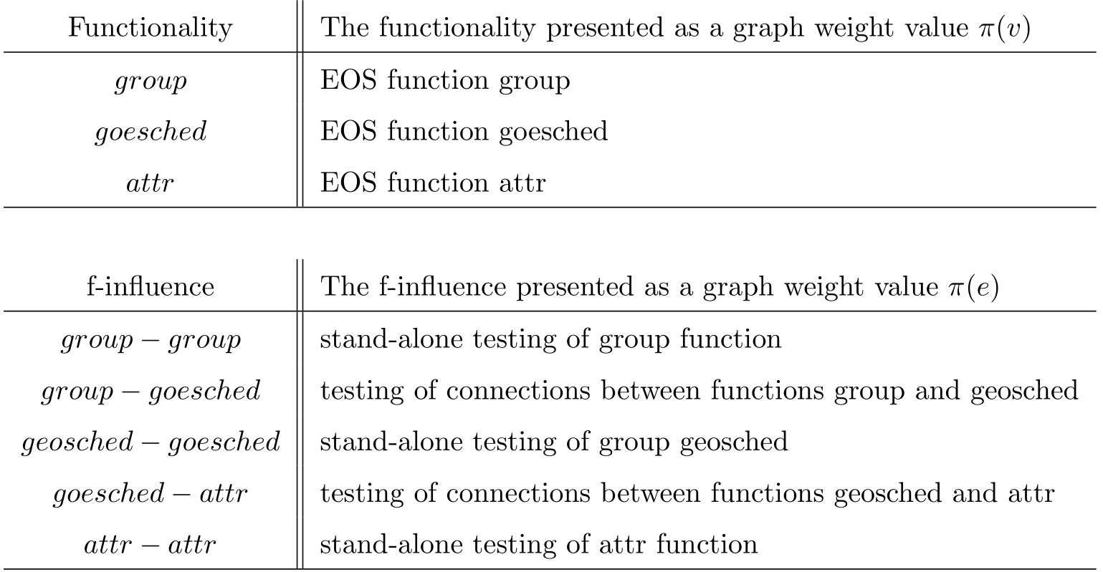
Example of the f-graph

Slide 12
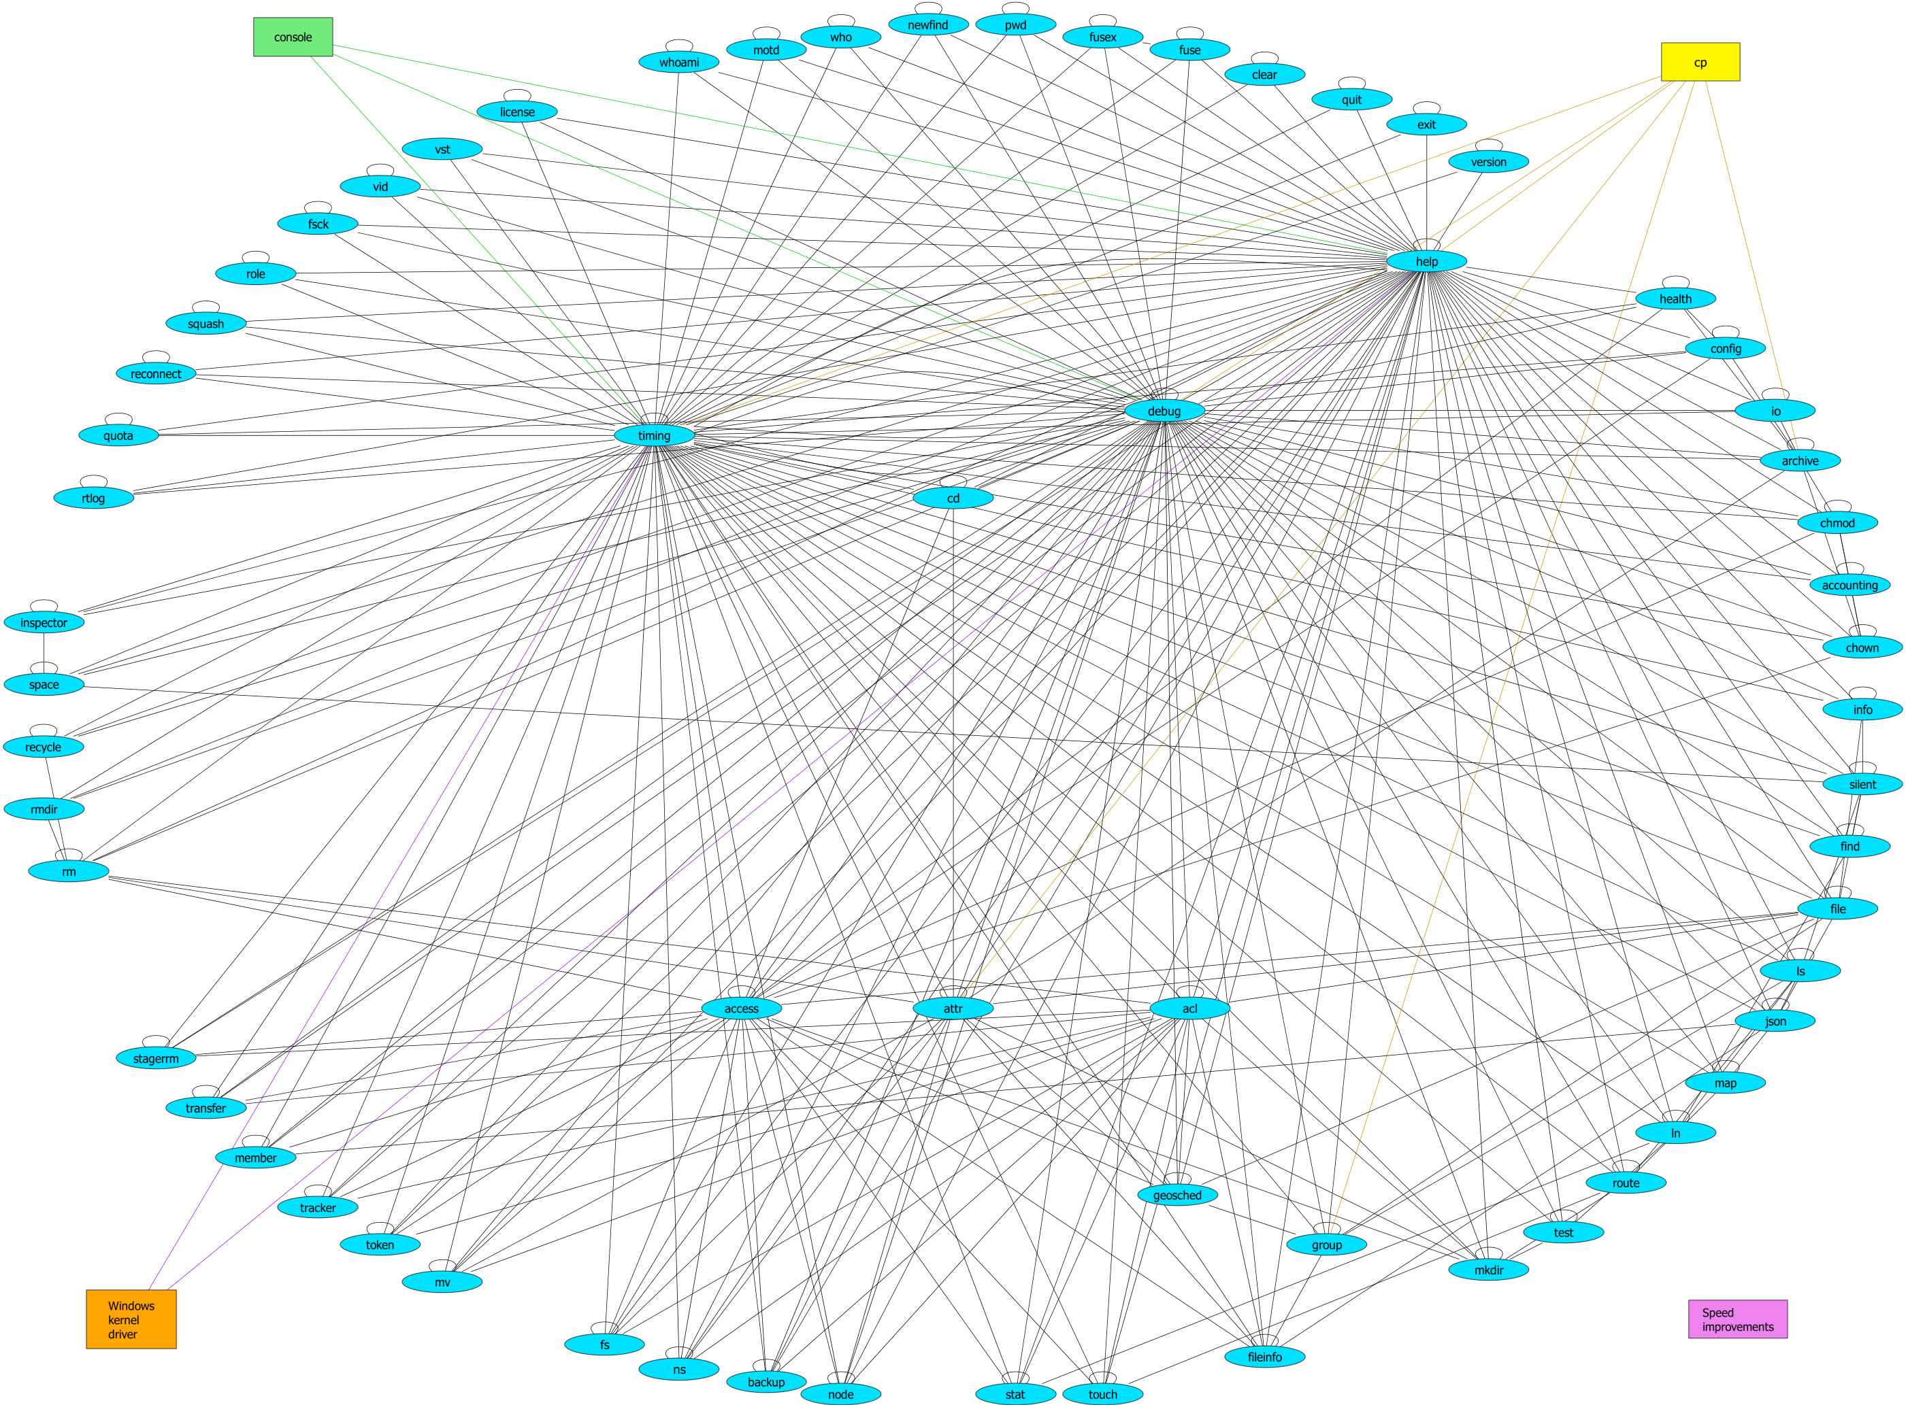
f-graph for the EOS-wnc

Slide 13
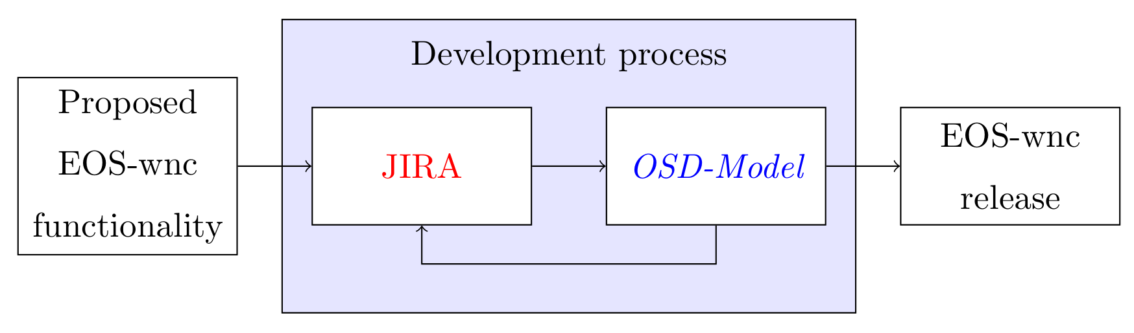
JIRA integration

Slide 14
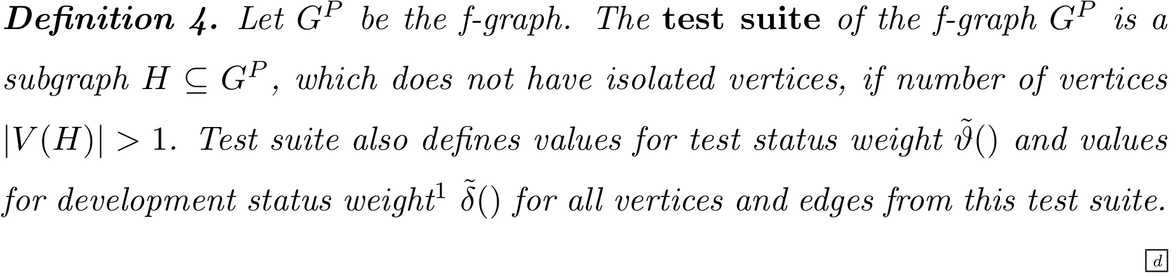
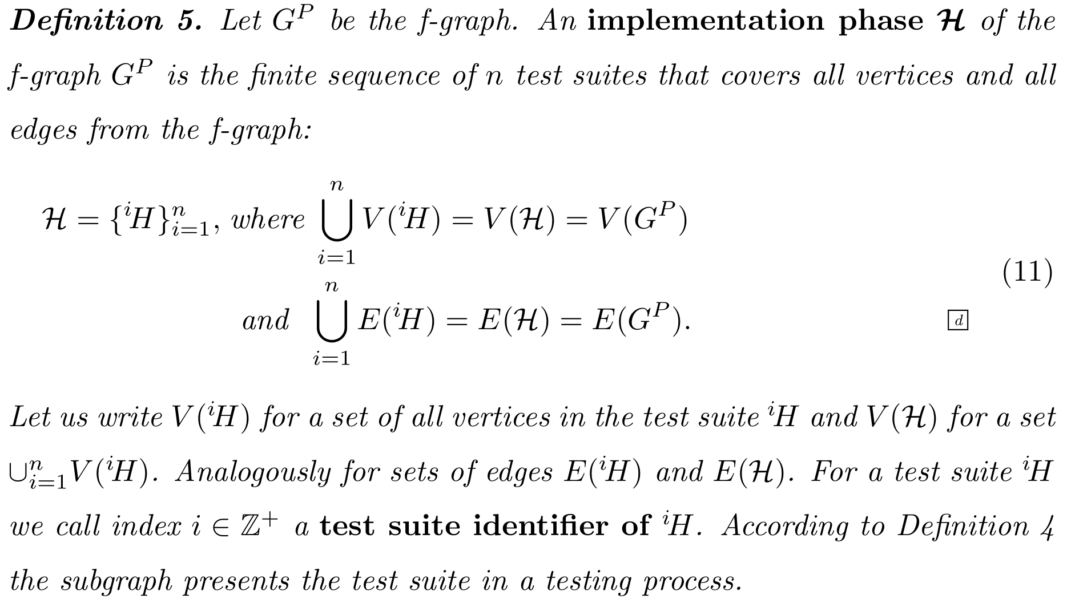
Implementation phase

Slide 15
OSD algorithms

Slide 16
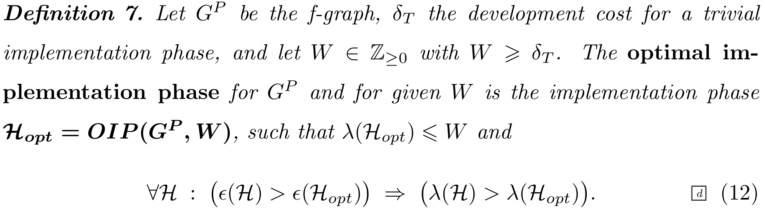
Optimum software development (OSD)

Slide 17
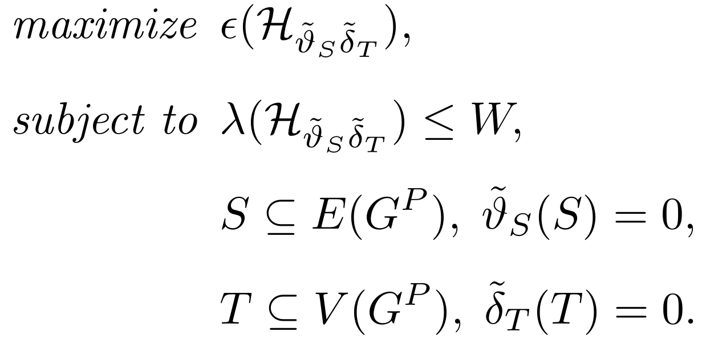
OSD algorithms

Slide 18
Conclusion and future work
Theoretical background is successfully used in EOS-wnc software development process.
Future work: Software integration of OSD algorithms with JIRA.

