Slide 1


AD-CONS / ELENA Projects
ADUC 19th January 2021
AD facility consolidation
François BUTIN – BE-EA

Slide 2
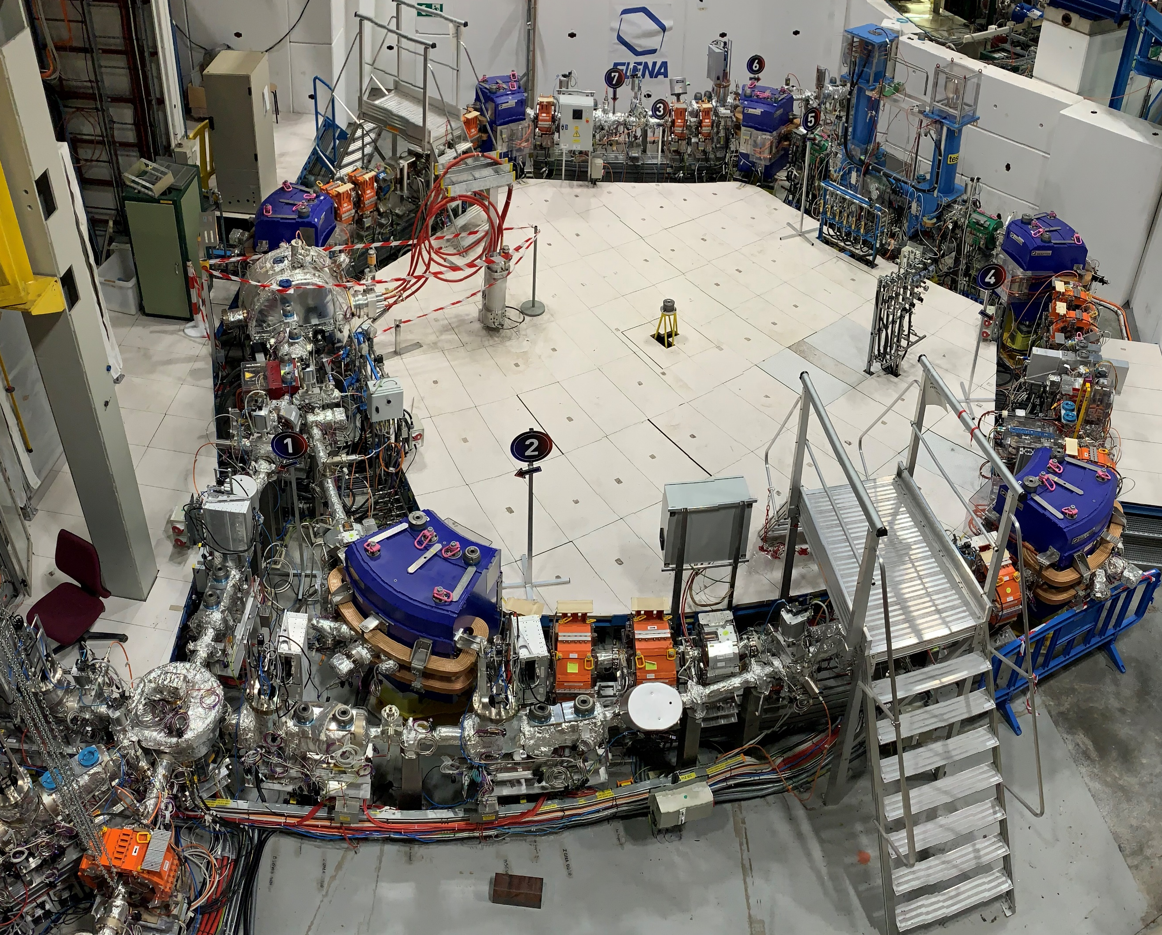
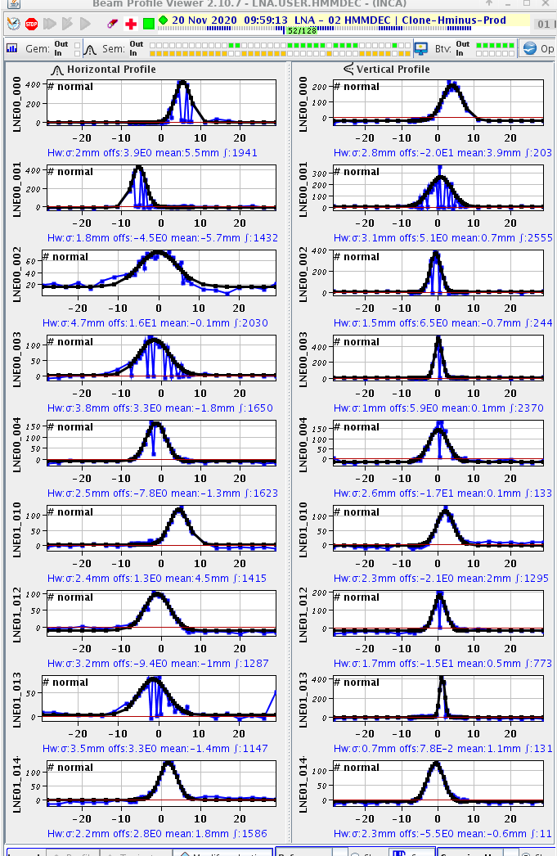
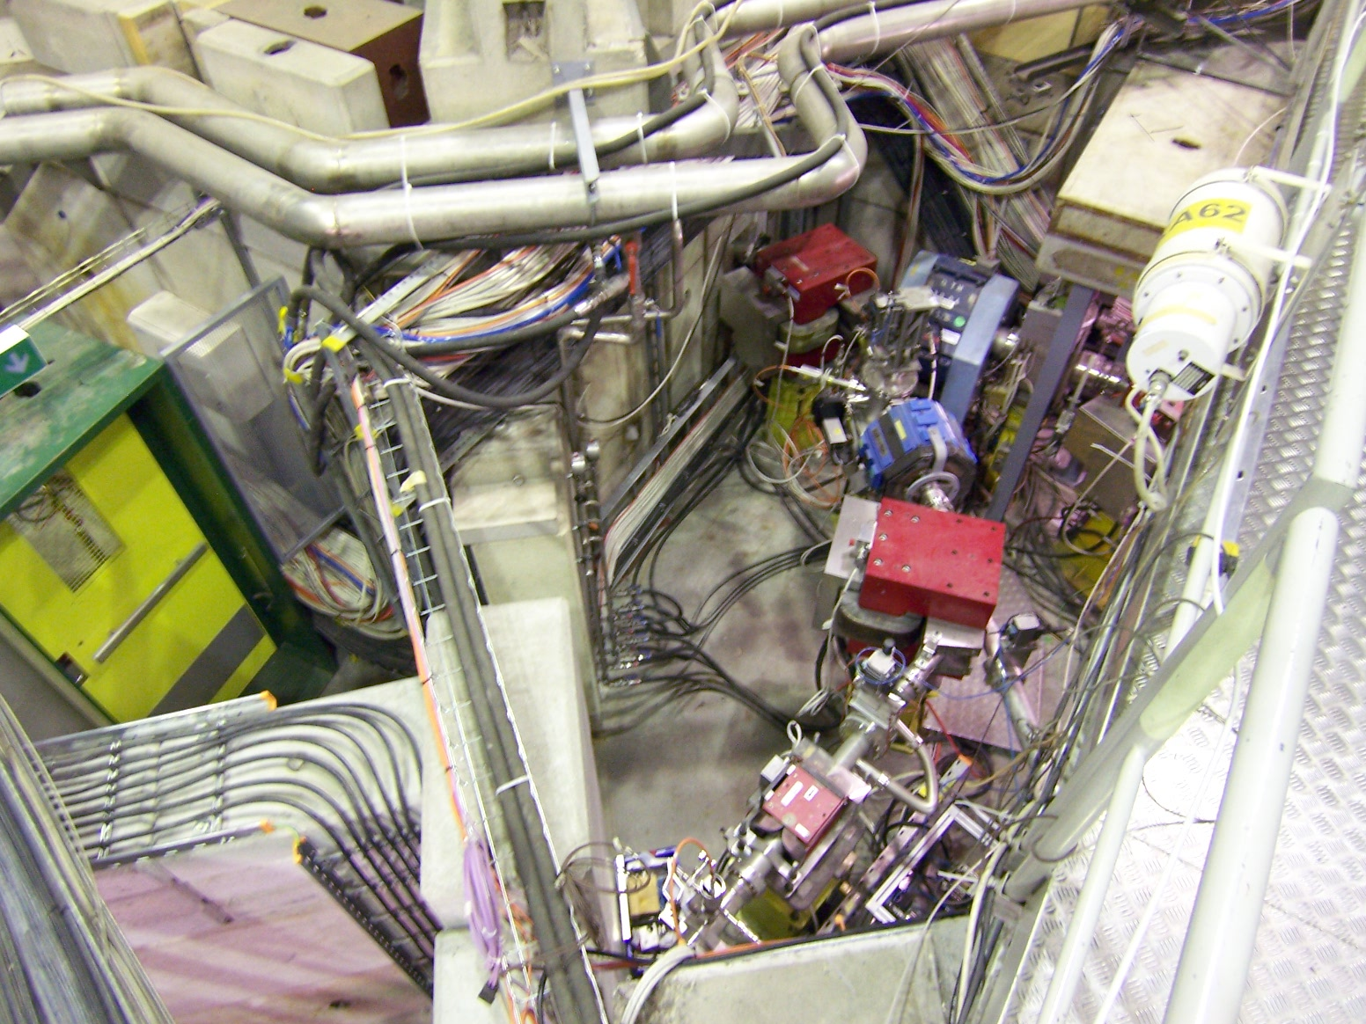
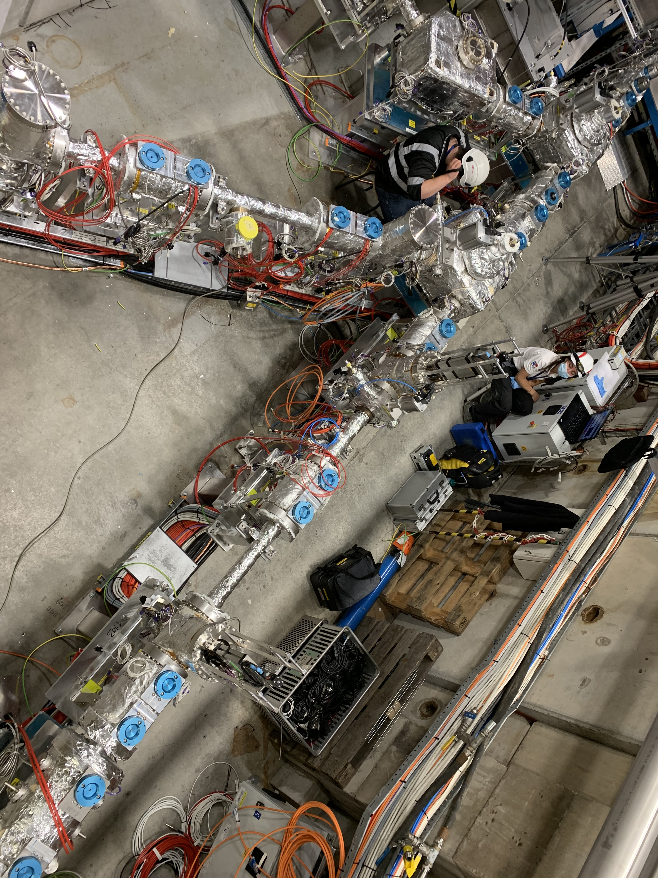
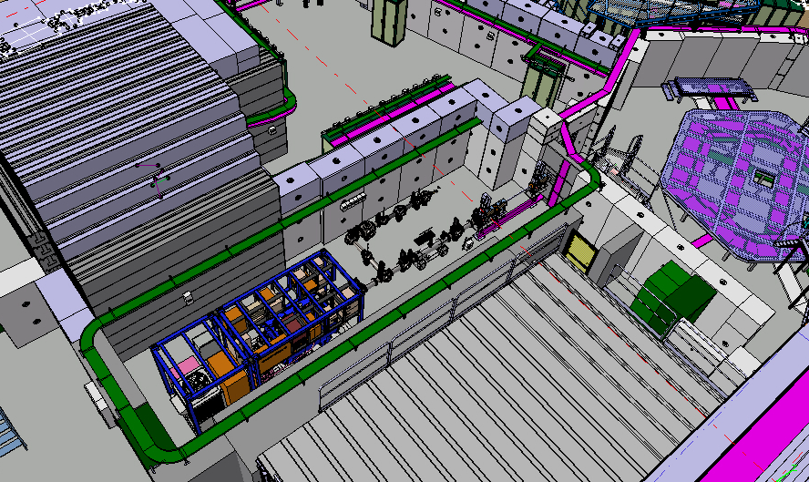
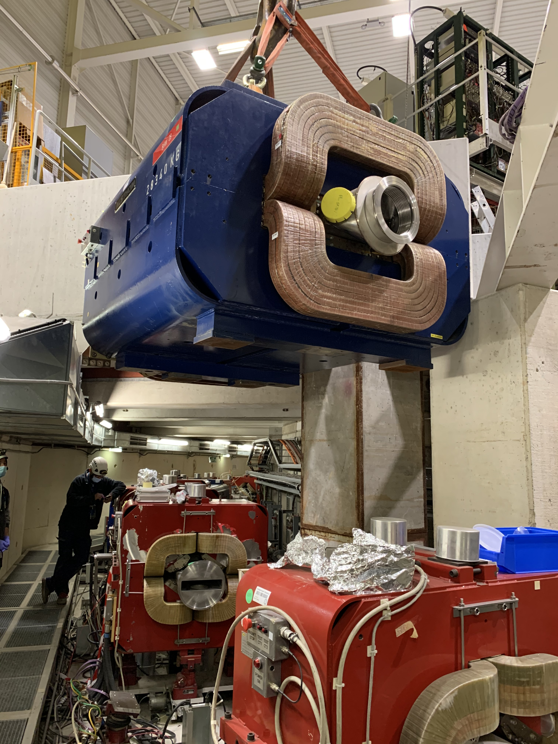
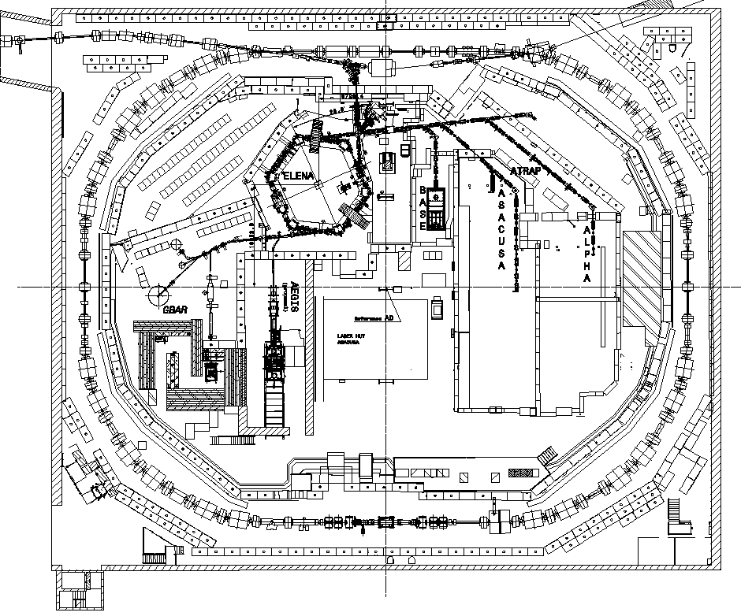

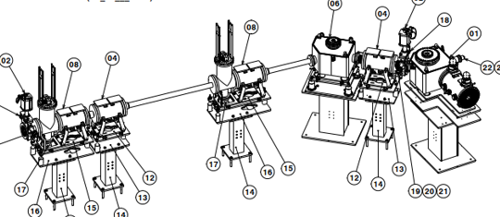
2020 Highlights at AD
Beam profiles in TL’s
August 2020
ELENA
Ring + TL’s
Run-in
ELENA
New TL’s
installation
November 2018
ELENA ring
25 AD ring magnets refurbished
PUMA new exp area
30 t dipole extraction
PUMA new TL + exp area design
LNE51 TL
BHW09

Slide 3
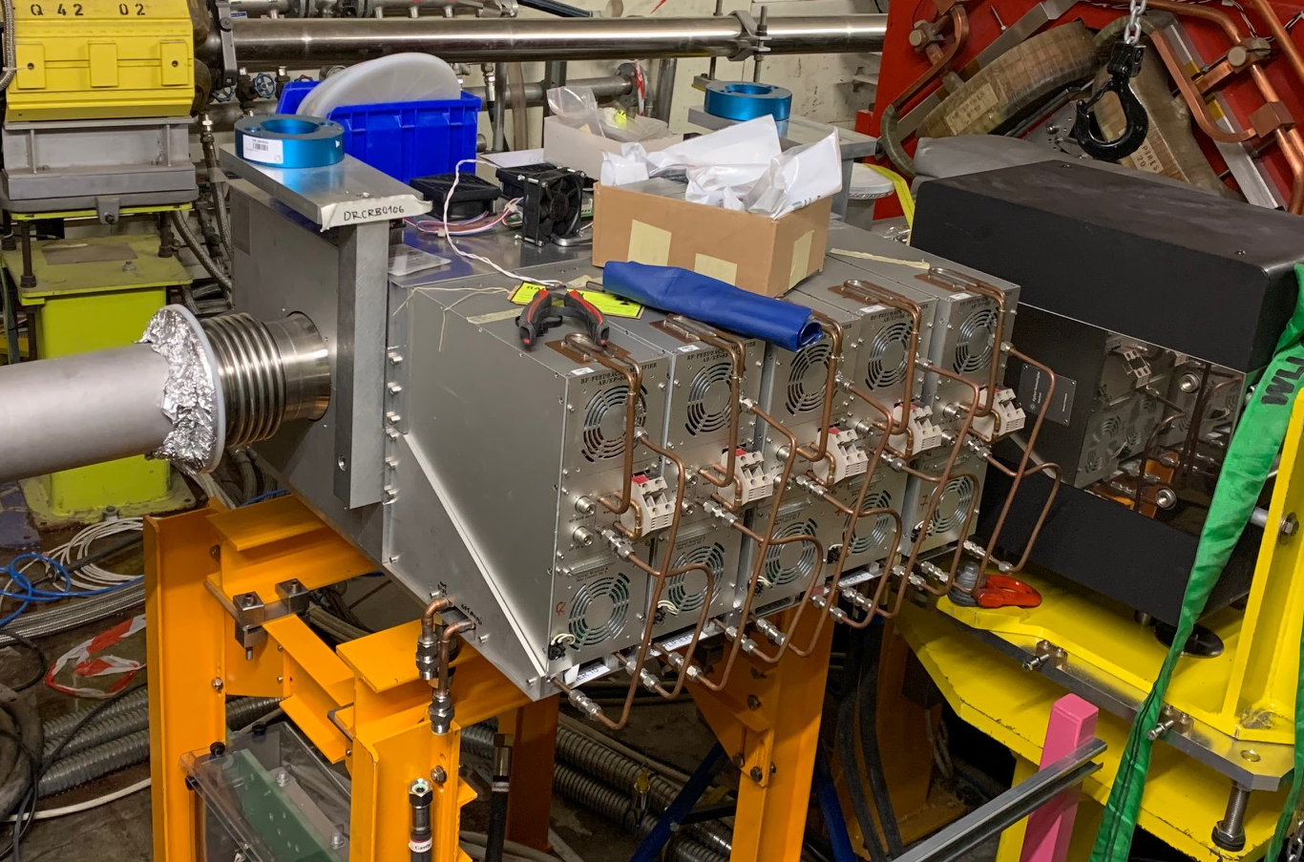
AD-CONS WP’s
-Magnets refurbishment:
-status: LS2 program is complete, will continue till LS3 included
-Difficulties: extraction uneasy, many concrete blocks moved in tight environment
-Next: evaluate possibilities during (short) YETS 21-22 (2 quads, QDN12 and 13 ?)
-RF systems:
-Status: C02 cavity replaced by Finemet type (from PSB), LLRF integration with ELENA, C10 tubes being replaced
-Difficulties: qualified personnel availability in concurrence with PSB, LEIR
-Next: evaluate C10 future operation, review long term needs, extra budgets likely needed
-Vacuum:
-Status: ion pumps replacement: complete
-Difficulties: bake-out planning in concurrence with LHC
-Next: complete, no more needs foreseen
-AD e-cooler:
-Status: collector replacement production complete, tests in progress, some delays
-Difficulties: uncertainty on availability in time
-Next: decide on installation of new collector in April 21, depending on delays
New Finement cavity

Slide 4
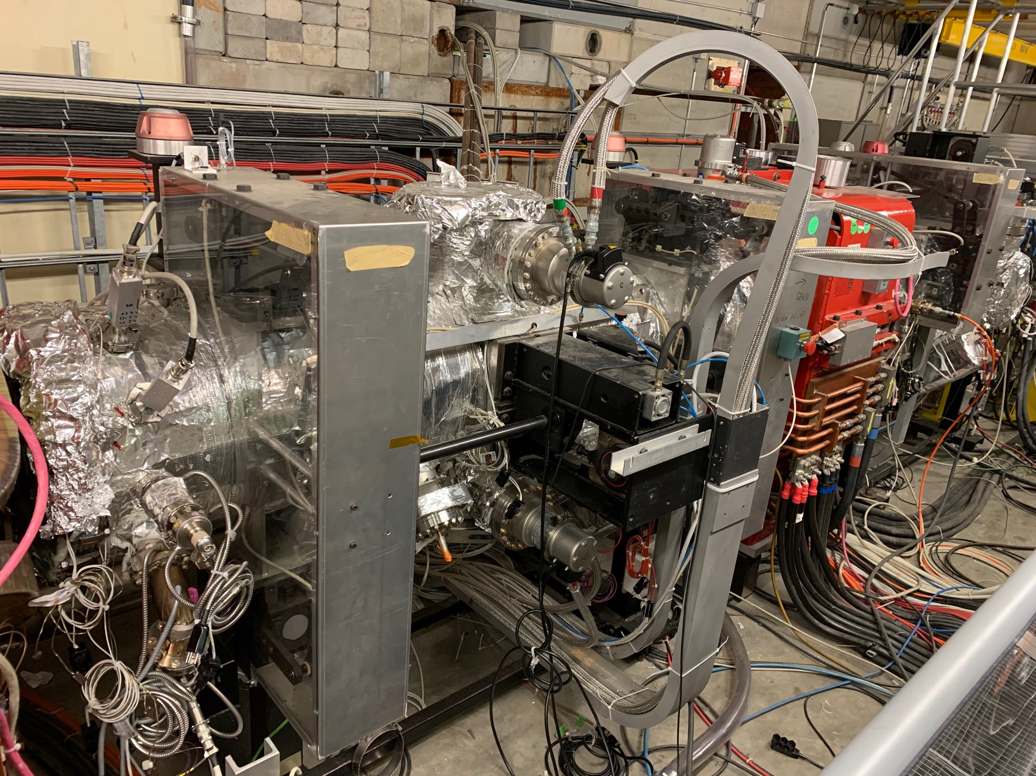
AD-CONS WP’s (Continued)
-Stochastic cooling:
-Status: amplifiers re-installation in progress
-Difficulties: no visibility on program till and including LS3 (pick-up + kicker refurbishment likely needed), loss of knowledge
-Next: review project, date, define budgets needed
-Target renovation:
-Status: in progress
-Difficulties: some delays COVID related, impact on physics restart
-Next: Commissioning expected to start in June 2021
-Cryo distribution system:
-Status: project launched, fellow started gathering info and designing system
-Difficulties: get adequate priority level withing CRG projects
-Next: get technical spec in summer 2021
-Cooling and ventilation:
-Status: stalled
-Difficulties: get required priority level
-Next: refine cost estimates, get project schedule for summer 2021
Stoch cooling

Slide 5
AD-CONS WP’s (continued)
-AD cranes refurbishment:
-Status: planned for 2022-2023
-Difficulties: none
-Next: review project end 2021
-Magnetic Horn:
-Status: complete
-Difficulties: none
-Next: power cables and transmission line were mentioned as additional work, but not confirmed
-AD-CONS project management:
-Status: WPs update summary document ready, distributed in Eng check
-Project Management Plan document ready to be circulated for Eng check
-C&S review to be planned for 2021

Slide 6
Ring magnets refurbishment
1 bending + 1 quad + 1 septum
1 bending + 4 quads
2 bendings
2 bending + 1 quad
YETS 21-22 2 Quads
1 Quad
3 Quads
1 bending
2 bending + 1 quad
2 bending
1 Quad
2 bending
Work consists in opening magnets, replace shimming , check insulation, cooling, connectors,
Perform measurement and certification
All connections will now be protected to be IP3 (fully exposed till now)

Slide 7
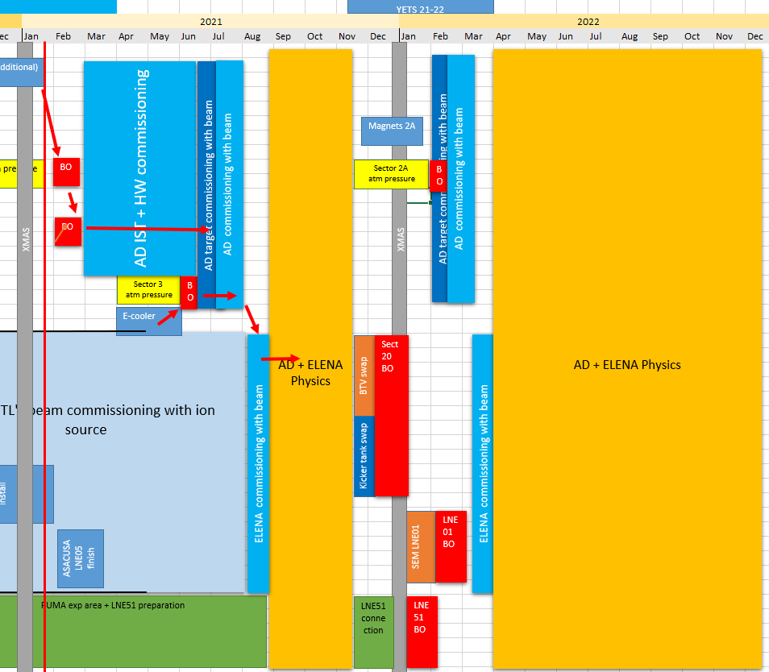
Context 2021 restart …and stop
DRAFT !
MY GUESS ONLY !!!

Slide 8
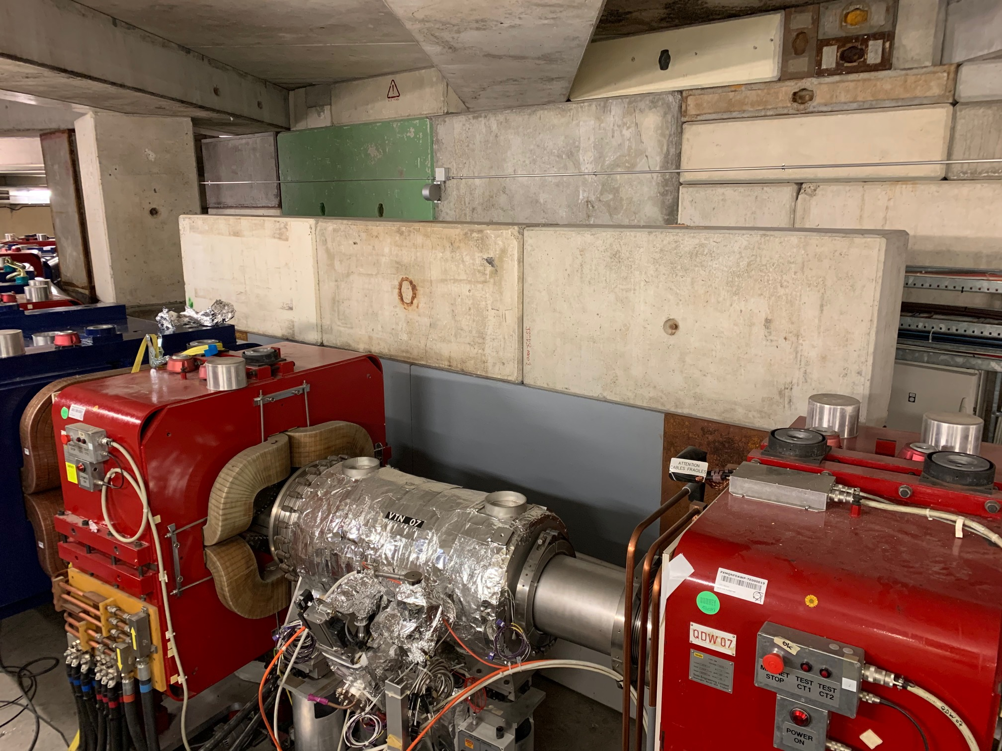
Aegis exp area improvement
New wall to protect
Aegis exp area

Slide 9
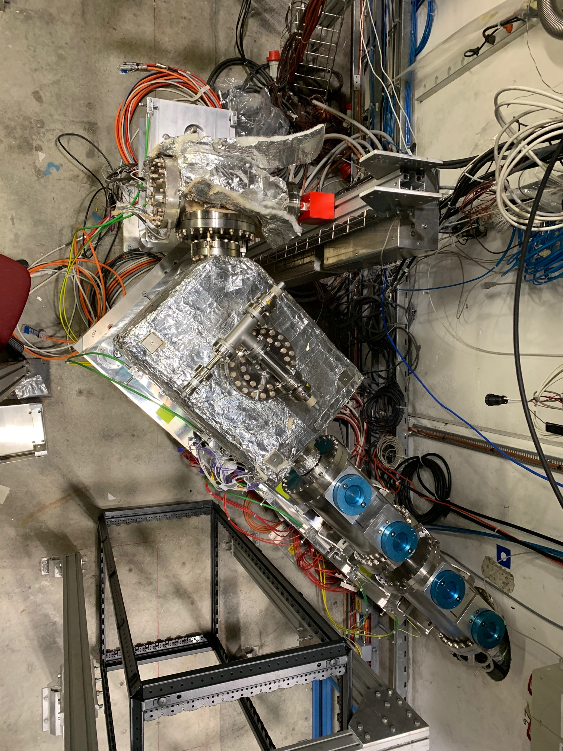
LNE02 (Aegis) TL installation
Missing
transition piece + valve
Exp end January

Slide 10
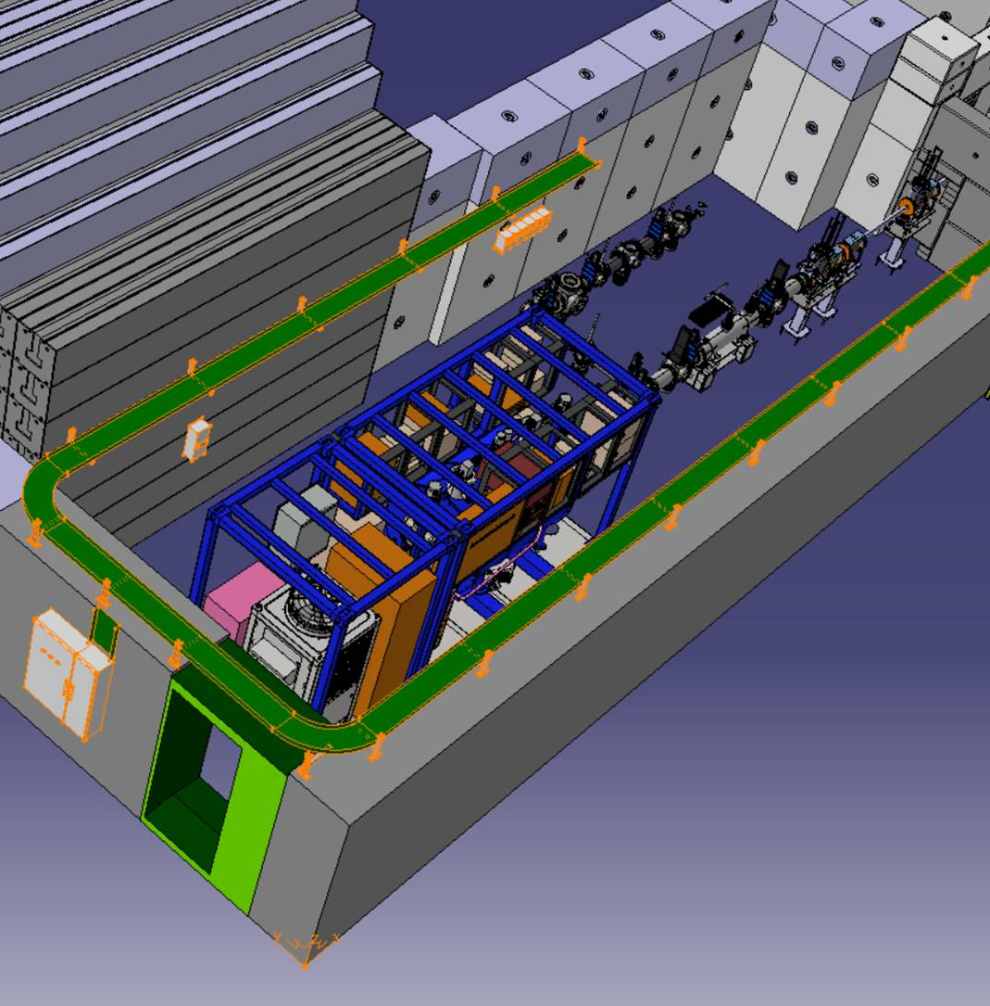
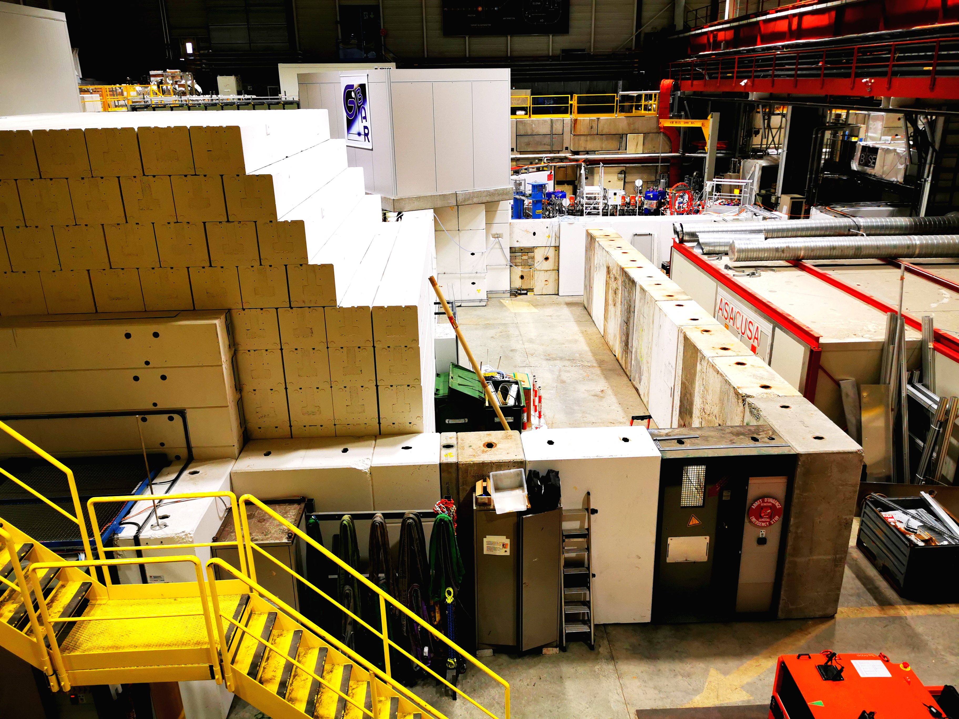
PUMA exp area installation
PUMA is approved at AD
Experimental area being installed, expected complete in April
New transfer line LNE51 installation about to start, expected complete in July – connection to ELENA ring in November
Start of experiment components installation as of Autumn
PUMA trap delivery date to be confirmed

Slide 11
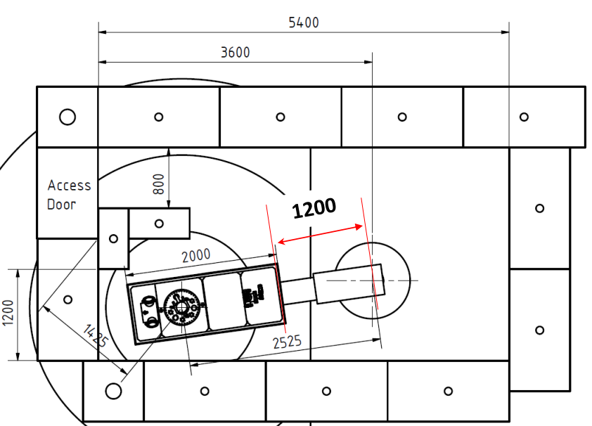
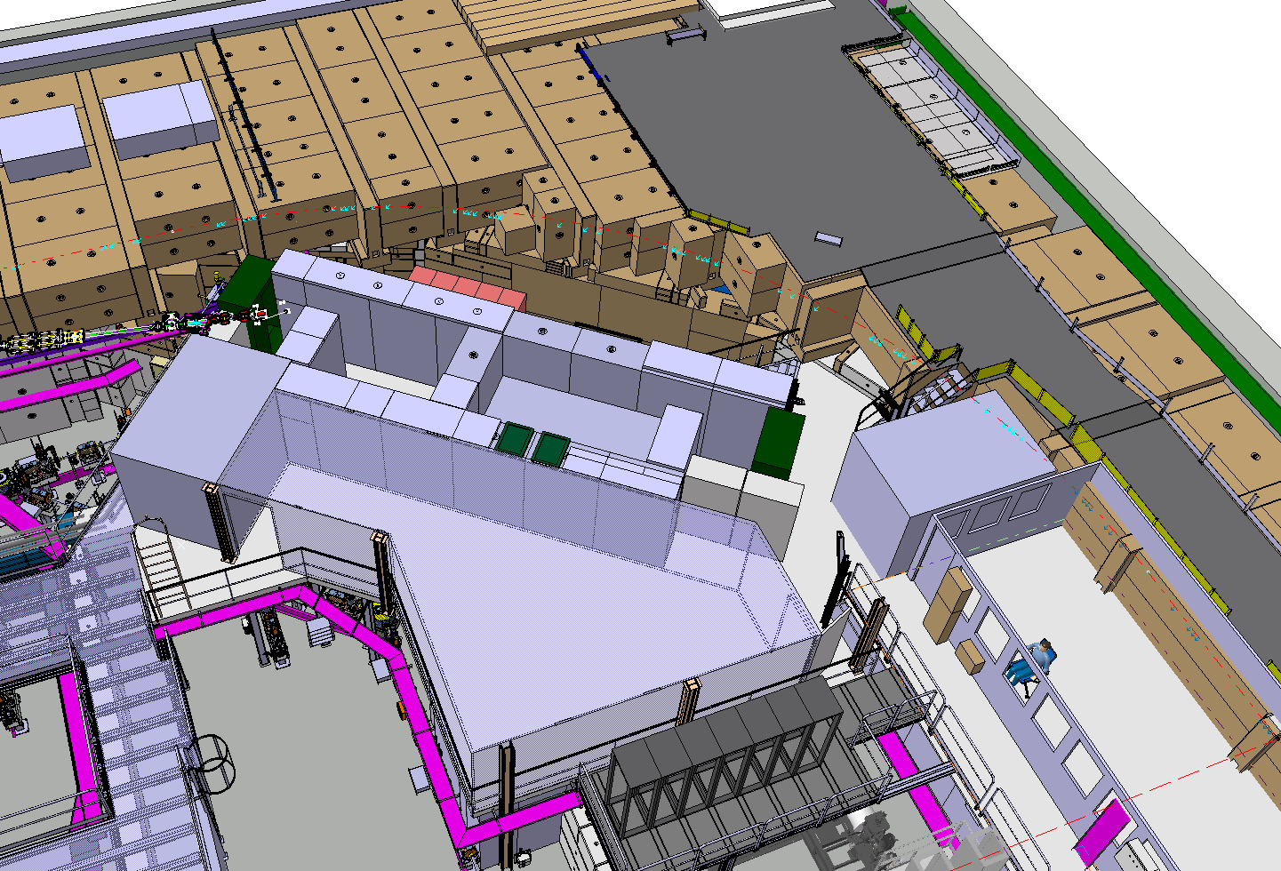
STEP status
STEP not yet approved, but soon !
Encouraged to start preparing exp area
Site of ex-ATRAP1 chosen (LNE01 ELENA transfer line)
Detailed installation planning to be clarified
Aiming at pbars trapping in 2023
Transfer gate
STEP location

Slide 12
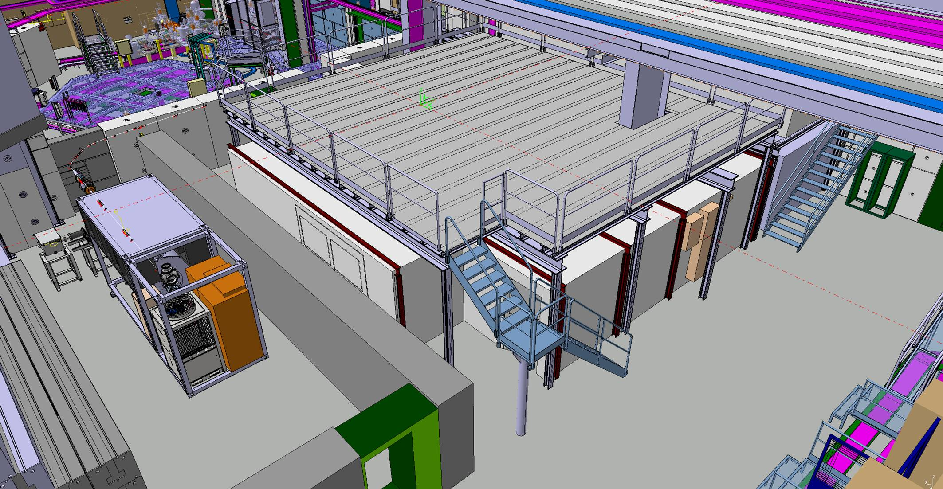
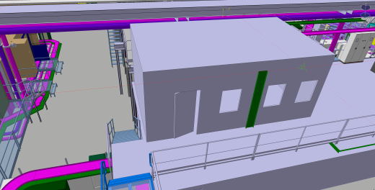
Also on 2021 menu
ALPHA barrack
YETS 22-23
New platform
(PUMA / BASE / ASACUSA)
Spring 21
BIG cleaning of AD hall initiated
-ELENA zone done
-Remaining zones in February
-PLEASE CLEAR AS MUCH STUFF
as possible to make the cleaning
process effective
ASACUSA barrack
Remodelling
YETS 21-22

Slide 13
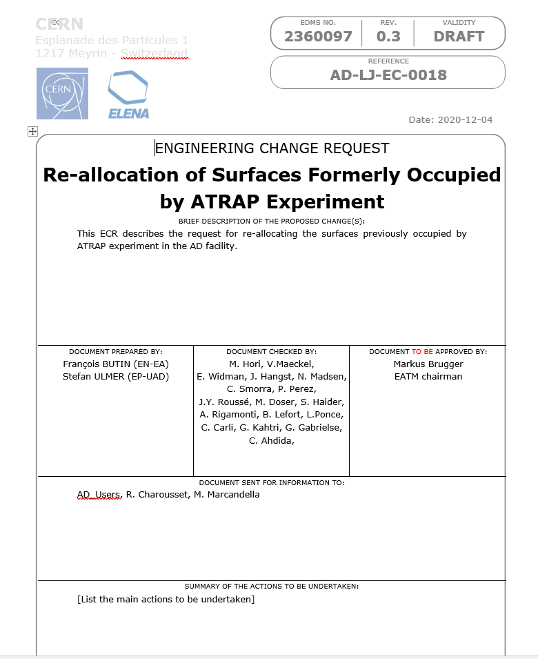
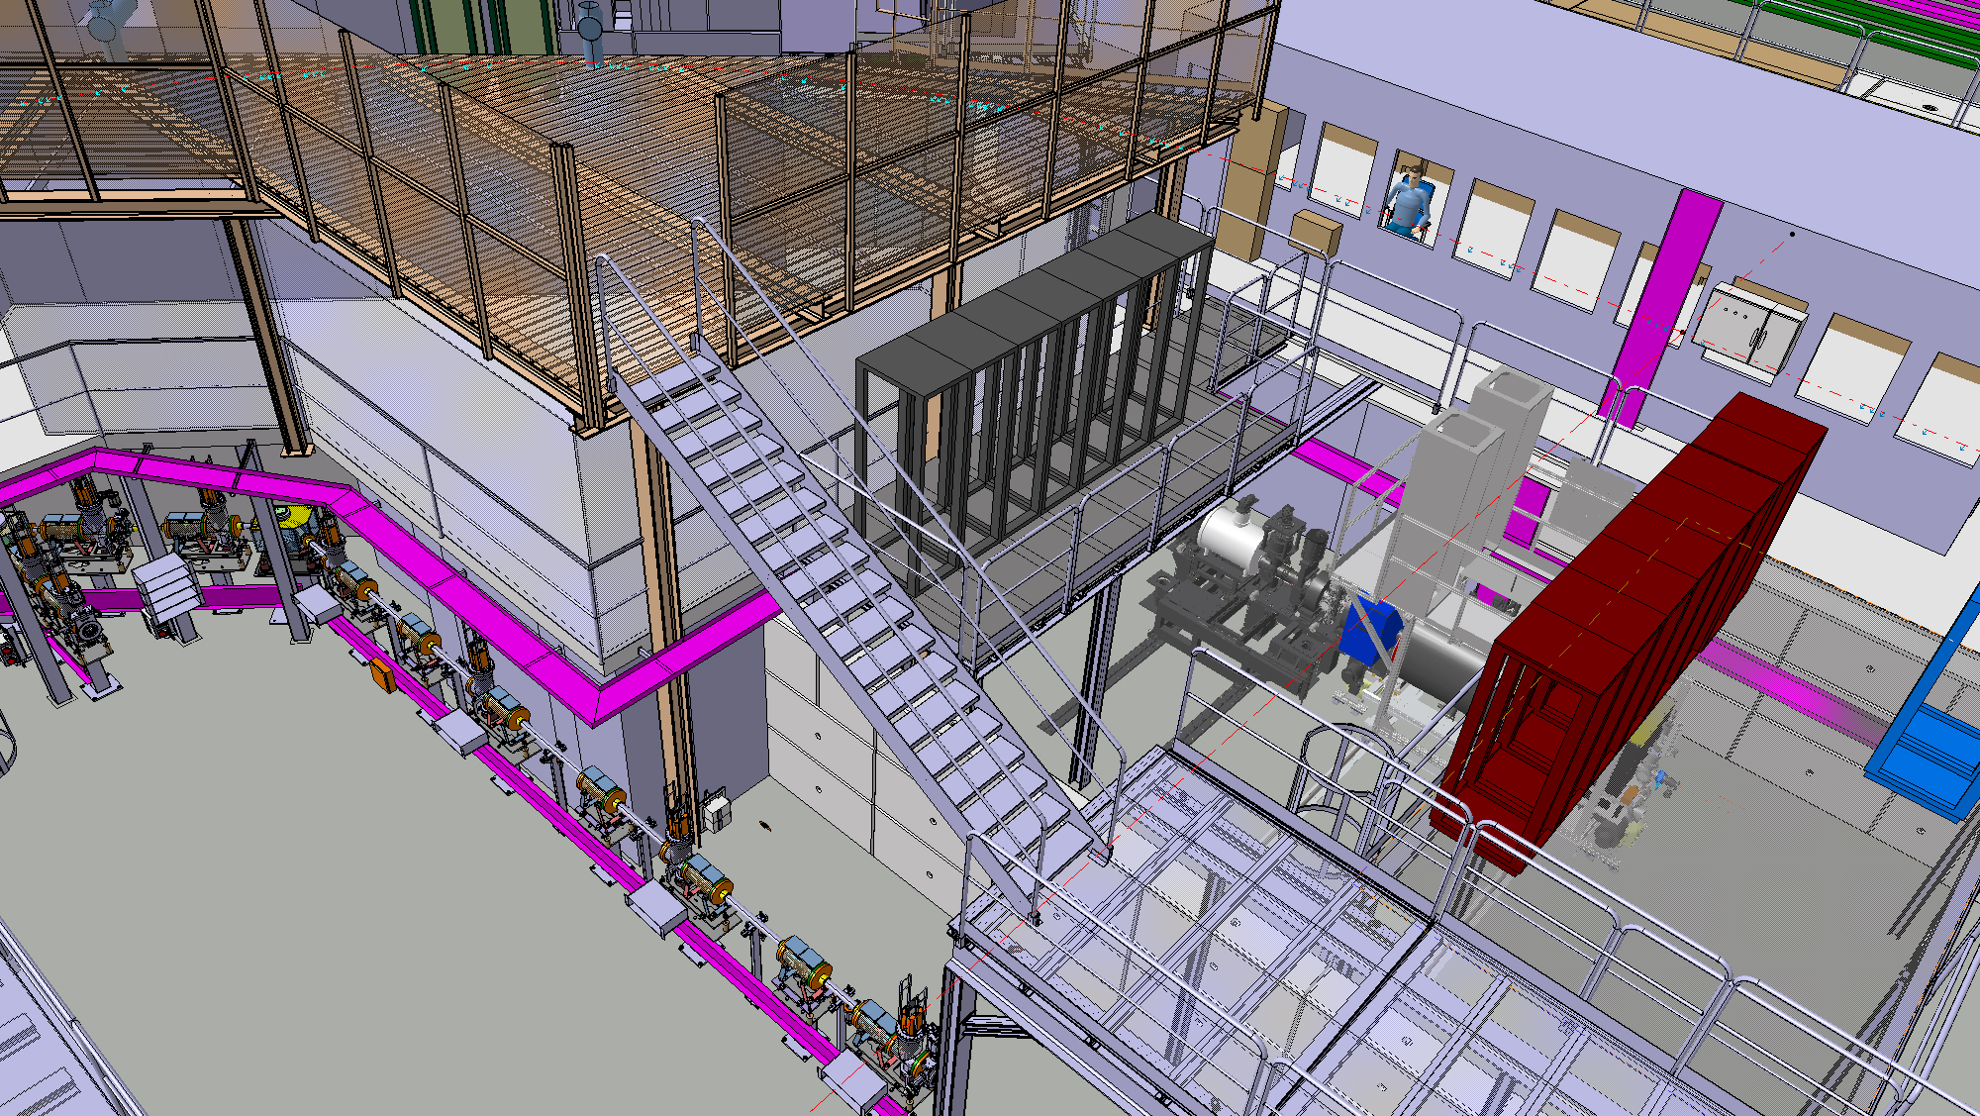

ATRAP space re-allocation
Converging to an approved doc
Only snagging point is access to platform above ex-ATRAP laser room
Proposed to be from ASACUSA rack platform
Storage platform
Laser room
New stairs

