Slide 1
Beam feedbacks in end-to-end simulations
s
Meeting on PS LLRF developments
14/01/2021
A. Lasheen
Acknowledgements: H. Damerau, BLonD dev team

Slide 2
Outline
Introduction
  Conventions in the BLonD tracking code
  General remarks on LLRF modelling in BLonD
Beam control loops (phase loop, radial loop)
  Beam signal generation and “acquisition”
  Signal processing, feedback gain
Coupled-bunch feedback
  Mode analysis
  Signal processing, feedback gain
Cavity impedance feedbacks
  Direct feedback, 1-TFB, MHFB
  Specificities of the cavity impedance feedbacks
Effect on the beam in end-to-end simulations
  Adjustment of gains in end-to-end simulations
  Benefits and flaws of present implementation
Conclusions

Slide 3
Introduction
Feedback implementation in beam dynamics simulations is essential to
Damp oscillations due to mismatches/instabilities, like in the machine
  E.g. injection oscillations, transition crossing, quadrupolar oscillations…
Reproduce perturbations due to feedbacks that could be responsible for blow-up or seed instabilities
  E.g. phase loop handovers during RF manipulations, oscillations at synchronization with SPS…
Answer some questions about the interplay between feedbacks and impedance effects
  E.g. phase loop during bunch rotation, influence of 1-turn delay feedback on coupled bunch instabilities...
Most of the feedbacks are already implemented in simulations with simplified considerations
A better consideration of the signal generation, processing, and implementation is necessary to better reproduce transient effects and perform end-to-end simulations

Slide 4
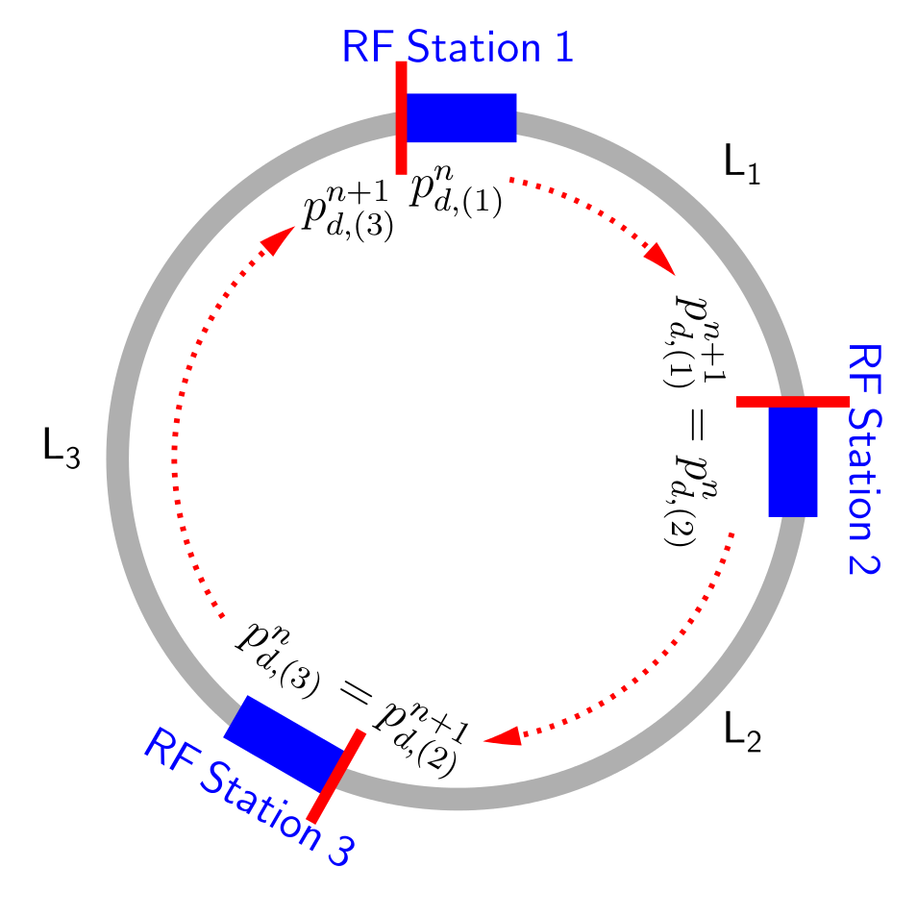
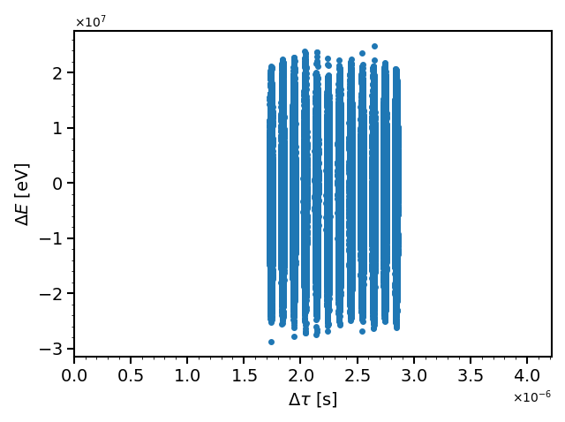
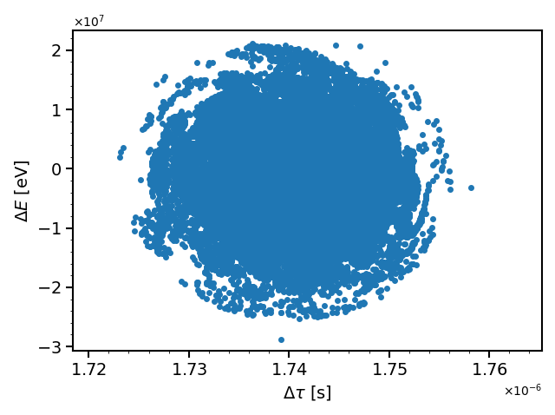
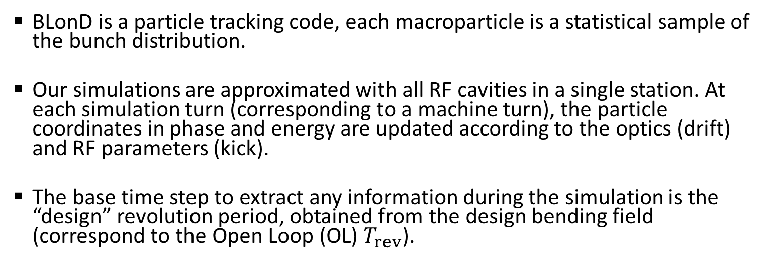
BLonD simulation code
BLonD is a particle tracking code, each macroparticle is a statistical sample of the bunch distribution.
Our simulations are approximated with all RF cavities in a single station. At each simulation turn (corresponding to a machine turn), the particle coordinates in phase and energy are updated according to the optics (drift) and RF parameters (kick).
The base time step to extract any information during the simulation is the “design” revolution period, obtained from the design bending field (correspond to the Open Loop (OL) $T_{rev}$).

Slide 5
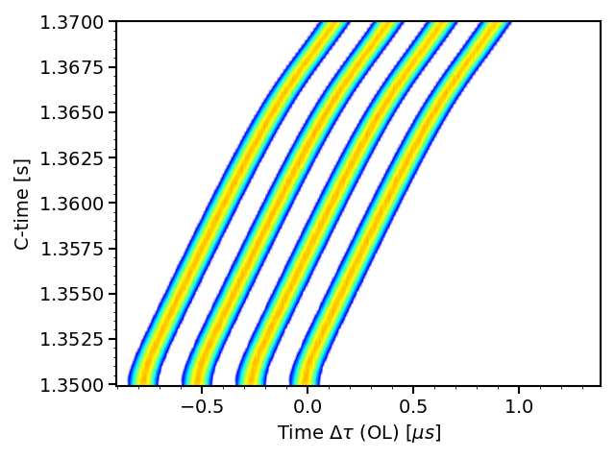
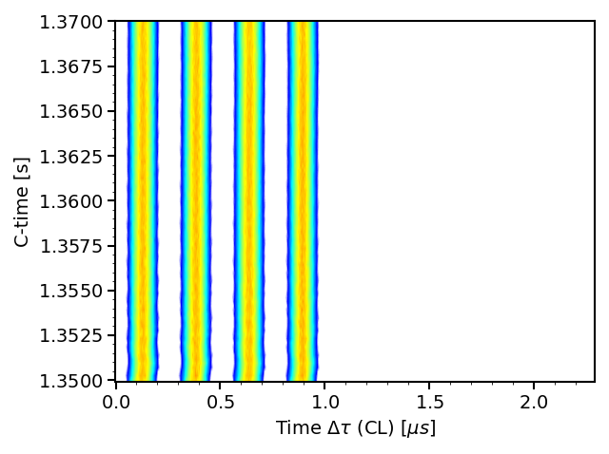
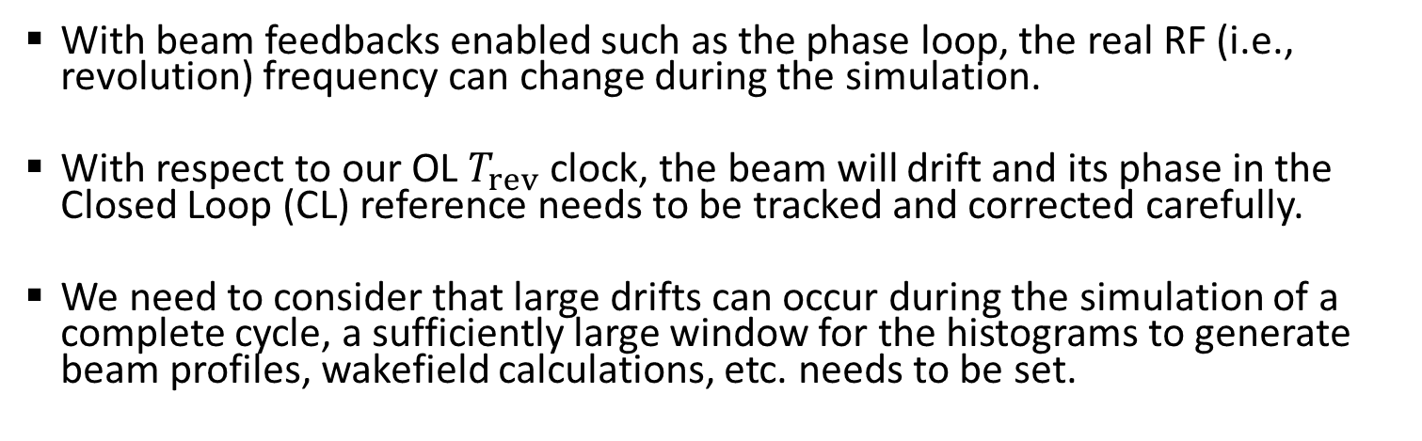
Reference coordinate, “design” vs. real clock
BLonD ref
“design clock”
Machine LLRF ref
“effective RF clock”
With beam feedbacks enabled such as the phase loop, the real RF (i.e., revolution) frequency can change during the simulation.
With respect to our OL $T_{rev}$clock, the beam will drift and its phase in the Closed Loop (CL) reference needs to be tracked and corrected carefully.
We need to consider that large drifts can occur during the simulation of a complete cycle, a sufficiently large window for the histograms to generate beam profiles, wakefield calculations, etc. needs to be set.

Slide 6
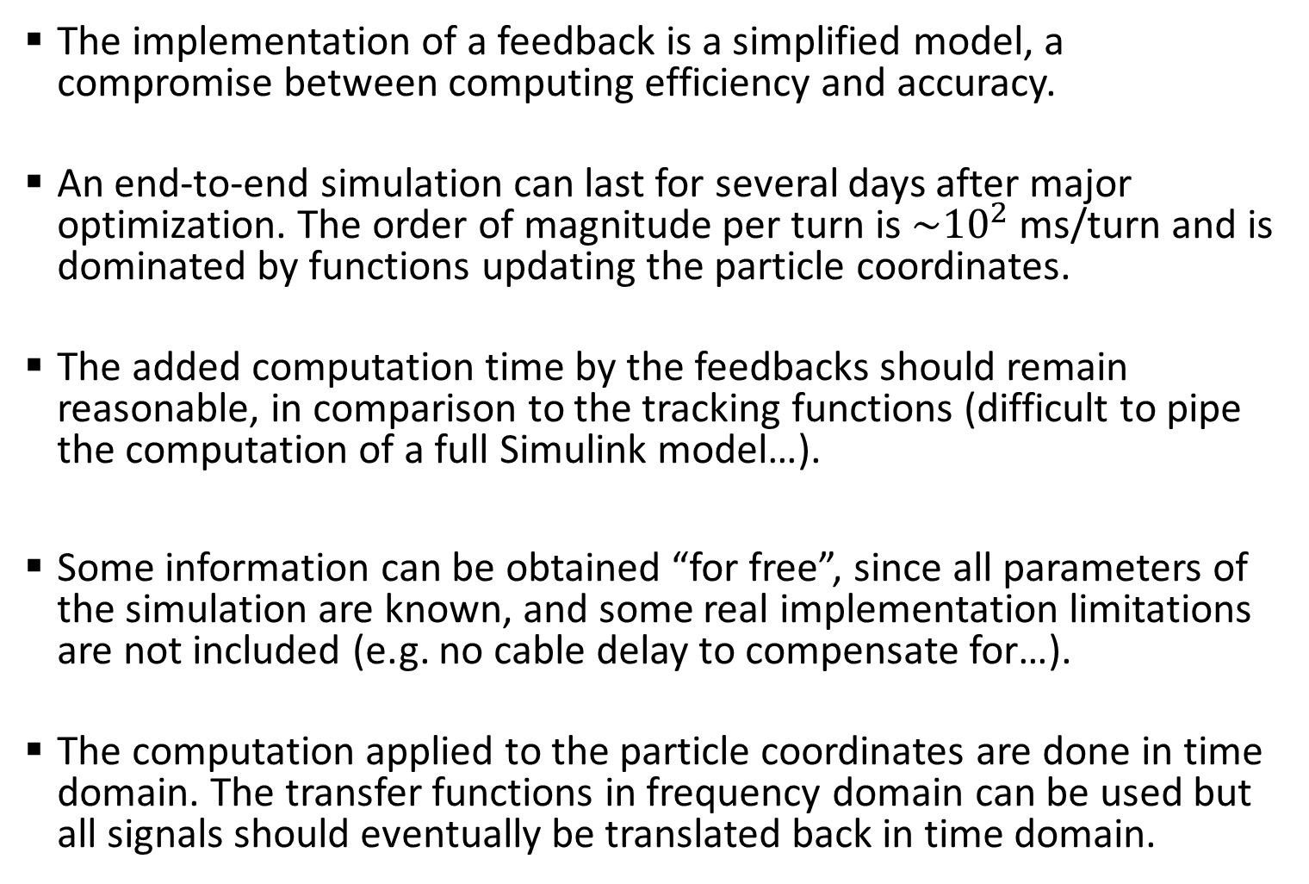
General remarks about LLRF implementation
The implementation of a feedback is a simplified model, a compromise between computing efficiency and accuracy.
An end-to-end simulation can last for several days after major optimization. The order of magnitude per turn is ${\sim 10}^{2}$ ms/turn and is dominated by functions updating the particle coordinates.
The added computation time by the feedbacks should remain reasonable, in comparison to the tracking functions (difficult to pipe the computation of a full Simulink model…).
Some information can be obtained “for free”, since all parameters of the simulation are known, and some real implementation limitations are not included (e.g. no cable delay to compensate for…).
The computation applied to the particle coordinates are done in time domain. The transfer functions in frequency domain can be used but all signals should eventually be translated back in time domain.

Slide 7
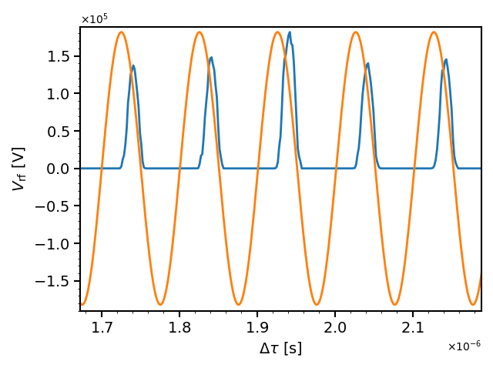

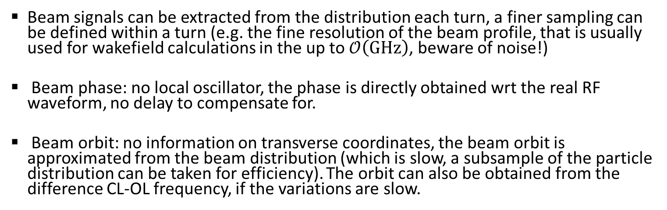

Beam phase and orbit for beam control
RF vs. beam profile
Phase computation, directly wrt the RF
Orbit computation, taken from the beam mean energy
$$\left\langle ΔR\right\rangle =αR_{0}\frac{\left\langle ΔE\right\rangle }{E_{0}}$$
Beam signals can be extracted from the distribution each turn, a finer sampling can be defined within a turn (e.g. the fine resolution of the beam profile, that is usually used for wakefield calculations in the up to $𝒪\left(GHz\right)$, beware of noise!)
Beam phase: no local oscillator, the phase is directly obtained wrt the real RF waveform, no delay to compensate for.
Beam orbit: no information on transverse coordinates, the beam orbit is approximated from the beam distribution (which is slow, a subsample of the particle distribution can be taken for efficiency). The orbit can also be obtained from the difference CL-OL frequency, if the variations are slow.

Slide 8
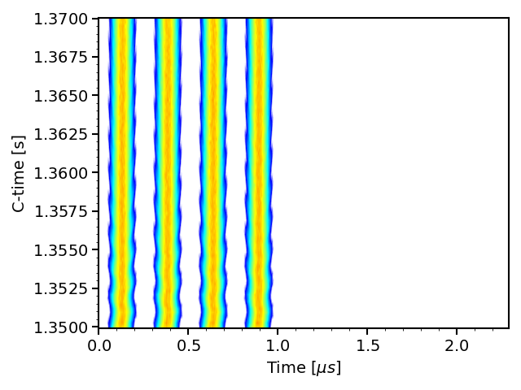
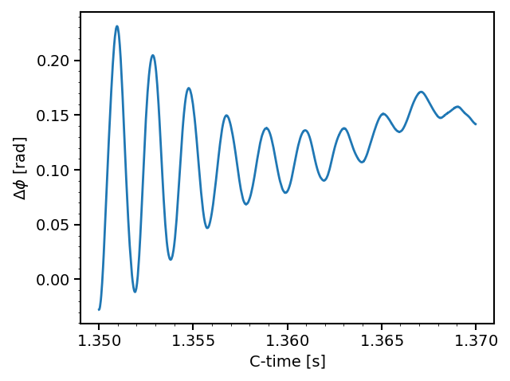

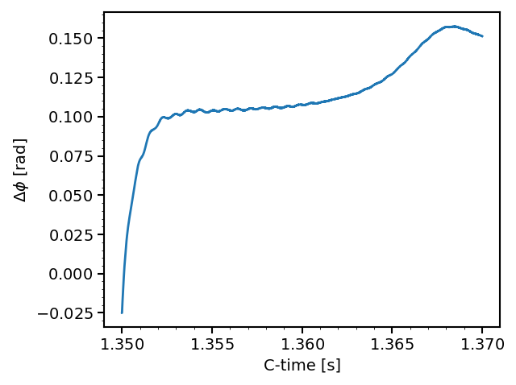
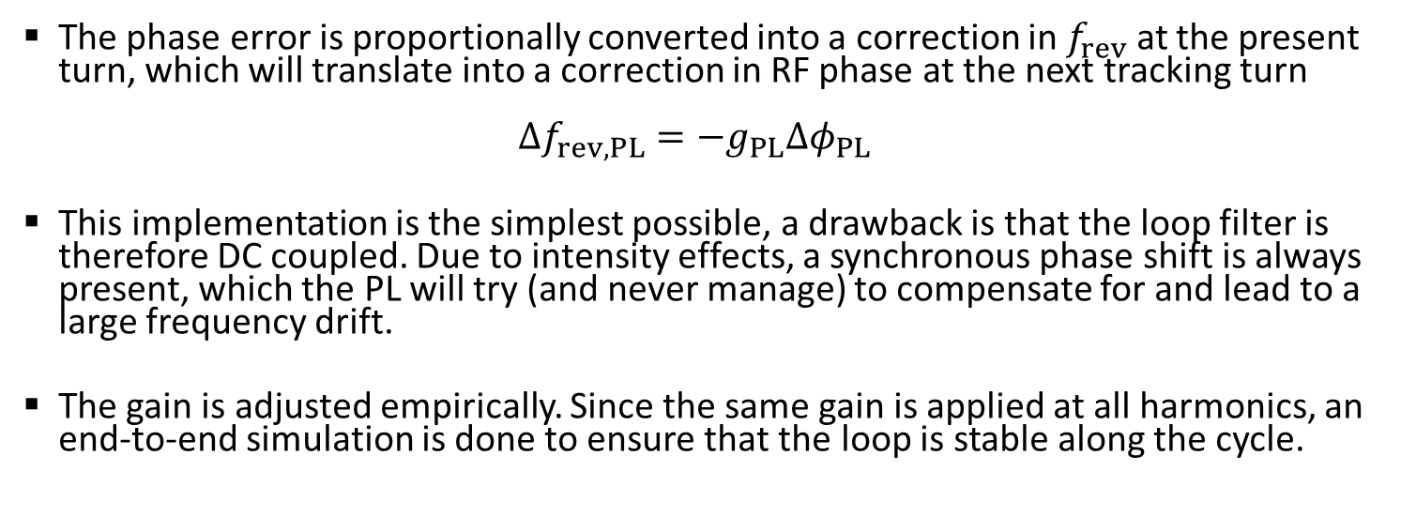
Phase loop (PL, @ injection oscillations)
No PL
With PL
The phase error is proportionally converted into a correction in $f_{rev}$ at the present turn, which will translate into a correction in RF phase at the next tracking turn
$Δf_{rev,PL}=−g_{PL}Δφ_{PL}$
This implementation is the simplest possible, a drawback is that the loop filter is therefore DC coupled. Due to intensity effects, a synchronous phase shift is always present, which the PL will try (and never manage) to compensate for and lead to a large frequency drift.
The gain is adjusted empirically. Since the same gain is applied at all harmonics, an end-to-end simulation is done to ensure that the loop is stable along the cycle.

Slide 9
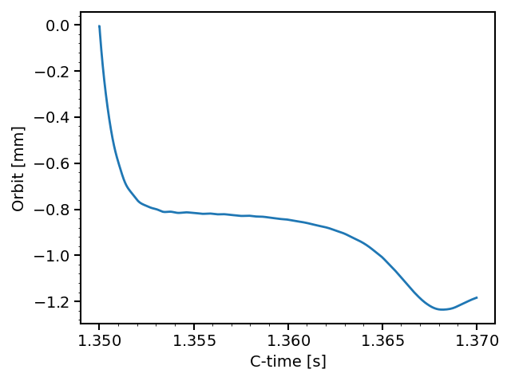
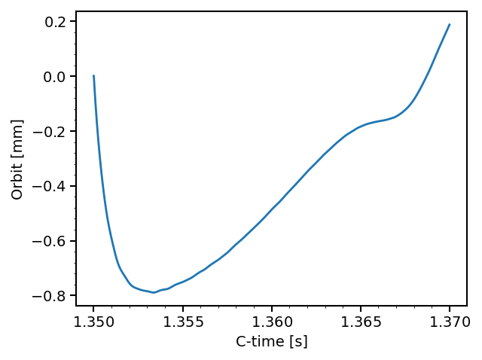
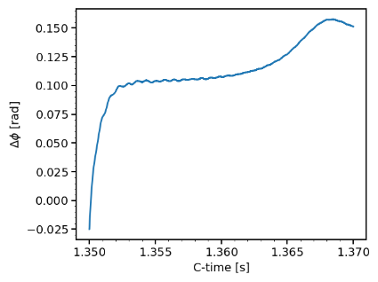
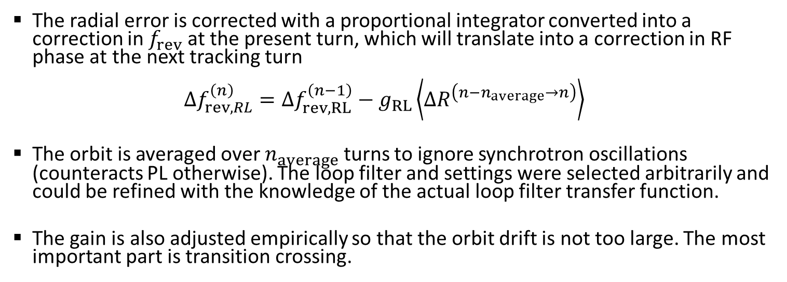
Radial loop (RL, @ injection oscillations)
With strong RL, to compensate for the DC PL
Weak RL
The radial error is corrected with a proportional integrator converted into a correction in $f_{rev}$ at the present turn, which will translate into a correction in RF phase at the next tracking turn
$Δf_{rev,RL}^{\left(n\right)}=Δf_{rev,RL}^{\left(n−1\right)}−g_{RL}\left\langle ΔR^{\left(n−n_{average}→n\right)}\right\rangle$
The orbit is averaged over $n_{average}$ turns to ignore synchrotron oscillations (counteracts PL otherwise). The loop filter and settings were selected arbitrarily and could be refined with the knowledge of the actual loop filter transfer function.
The gain is also adjusted empirically so that the orbit drift is not too large. The most important part is transition crossing.

Slide 10
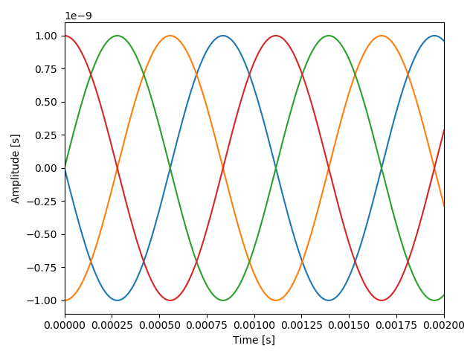
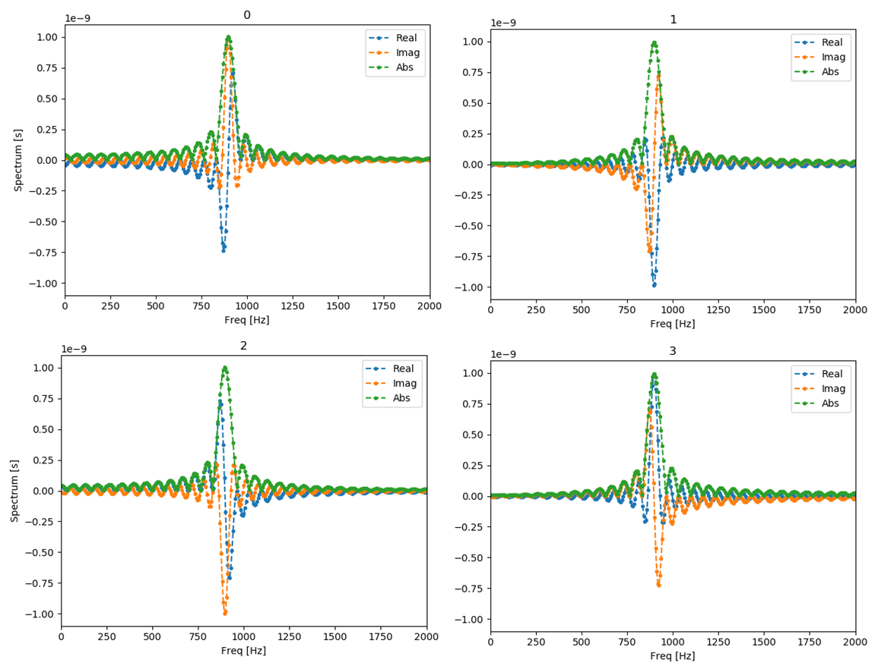
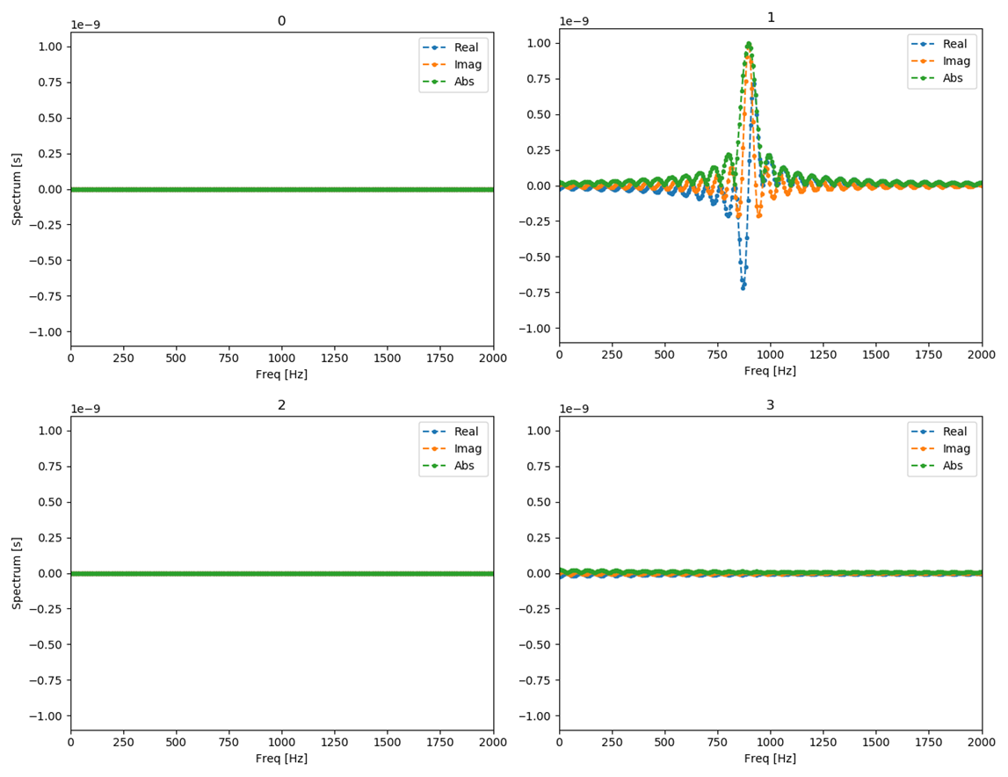


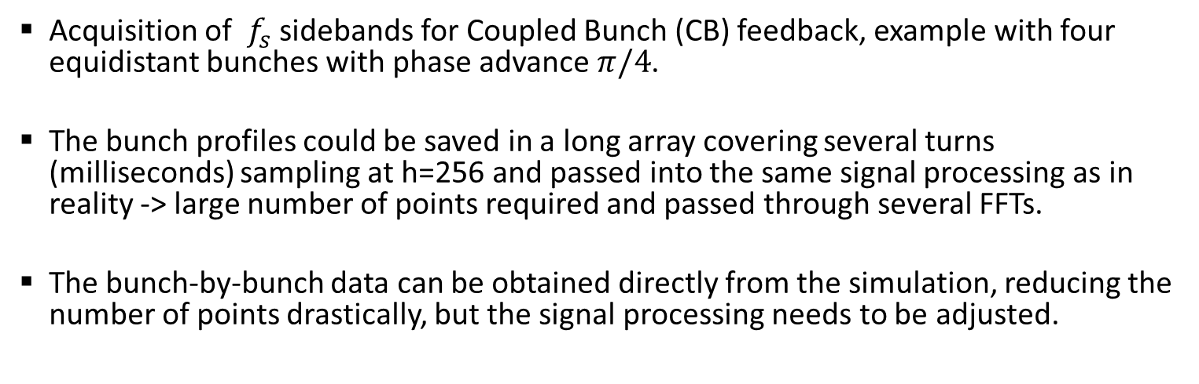
Mode analysis for CB feedback
Oscillations of four bunches
FFT based mode analysis
$$A_{μ,n}e^{−j\left(ω_{n}t+φ_{μ,n}\right)}=\frac{2}{N_{b}N_{s}}\sum_{b=0}^{N_{b}−1}{e^{−j\frac{2πμb}{N_{b}}}\sum_{k=0}^{N_{s}−1}{A_{b,k}e^{−j\frac{ω_{n}k}{N_{s}}}}}$$
Bunch osc. spectra
CB Modes, $f_{s}$ sidebands
Acquisition of $f_{s}$ sidebands for Coupled Bunch (CB) feedback, example with four equidistant bunches with phase advance $π/4$.
The bunch profiles could be saved in a long array covering several turns (milliseconds) sampling at h=256 and passed into the same signal processing as in reality -> large number of points required and passed through several FFTs.
The bunch-by-bunch data can be obtained directly from the simulation, reducing the number of points drastically, but the signal processing needs to be adjusted.

Slide 11
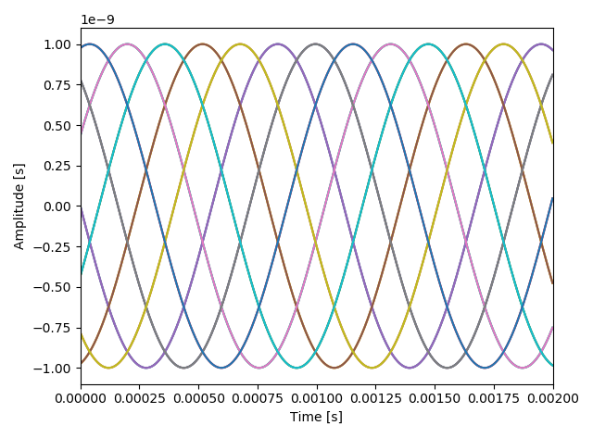
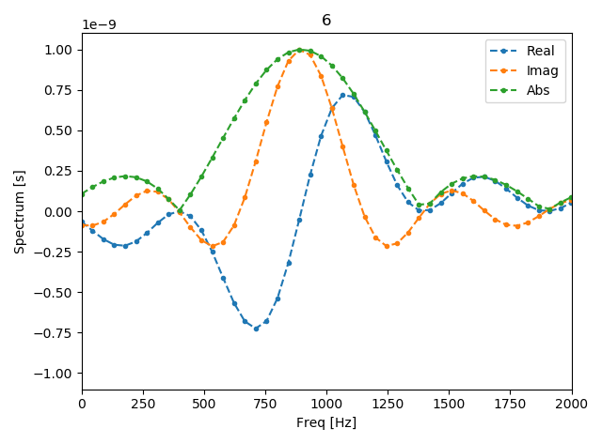
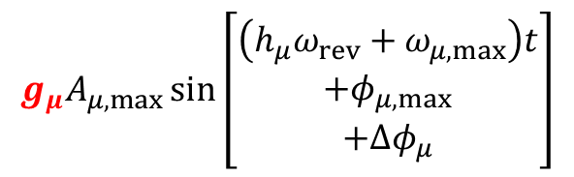
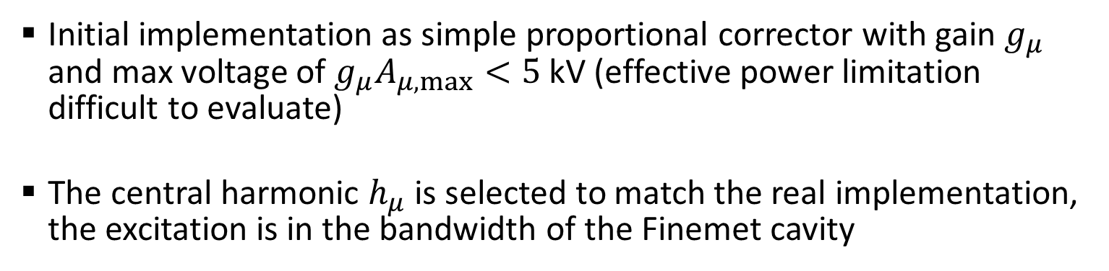





CB feedback implementation (1)
BLonD simulation timeline, 1 turn = $t_{rev}$
Current turn
$$\sum_{μ}{V_{μ}}$$
Previous 10000 turns
sampled (~ 2ms)
$$A_{μ,max}$$
$$φ_{μ,max}$$
$$g_{μ}A_{μ,max}\sin\left[\begin{aligned}\left(h_{μ}ω_{rev}+ω_{μ,max}\right)t \\ +φ_{μ,max} \\ +Δφ_{μ}\end{aligned}\right]$$
All 21 modes analyzed
$$ω_{μ,max}$$
Initial implementation as simple proportional corrector with gain $g_{μ}$ and max voltage of $g_{μ}A_{μ,max}<5$ kV (effective power limitation difficult to evaluate)
The central harmonic $h_{μ}$ is selected to match the real implementation, the excitation is in the bandwidth of the Finemet cavity

Slide 12
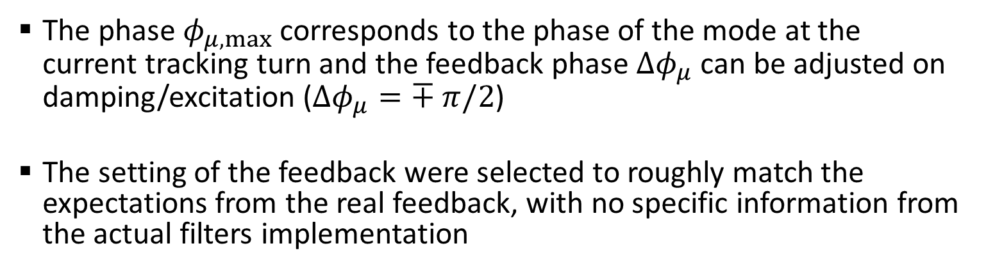
CB feedback implementation (2)
BLonD simulation timeline, 1 turn = $t_{rev}$
Current turn
$$\sum_{μ}{V_{μ}}$$
Previous 10000 turns
sampled (~ 2ms)
$$A_{μ,max}$$
$$φ_{μ,max}$$
$$g_{μ}A_{μ,max}\sin\left[\begin{aligned}\left(h_{μ}ω_{rev}+ω_{μ,max}\right)t \\ +φ_{μ,max} \\ +Δφ_{μ}\end{aligned}\right]$$
All 21 modes analyzed
$$ω_{μ,max}$$
The phase $φ_{μ,max}$ corresponds to the phase of the mode at the current tracking turn and the feedback phase $Δφ_{μ}$ can be adjusted on damping/excitation ($Δφ_{μ}=∓ π/2$)
The setting of the feedback were selected to roughly match the expectations from the real feedback, with no specific information from the actual filters implementation

Slide 13
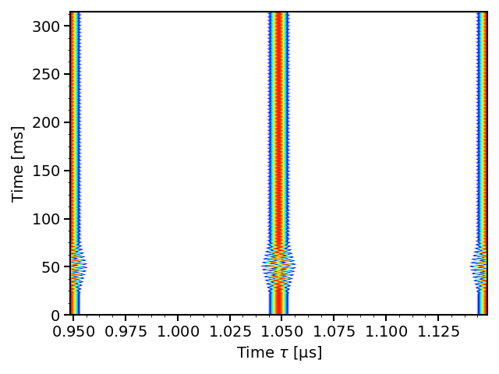
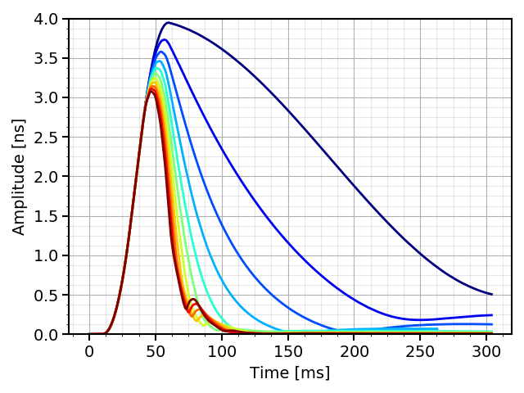
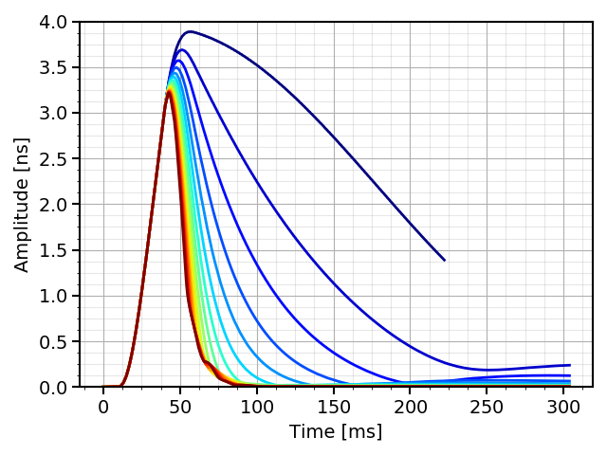
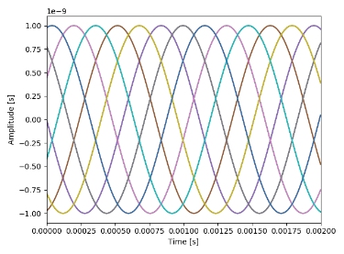
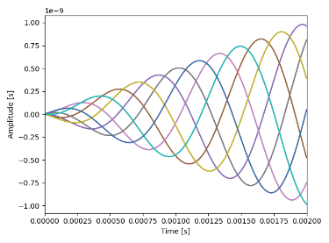
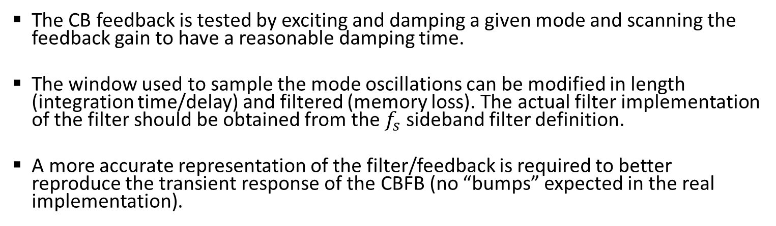
Filtering the bunch oscillation
2 ms frame – no filter
2 ms frame – linear memory loss
The CB feedback is tested by exciting and damping a given mode and scanning the feedback gain to have a reasonable damping time.
The window used to sample the mode oscillations can be modified in length (integration time/delay) and filtered (memory loss). The actual filter implementation of the filter should be obtained from the $f_{s}$ sideband filter definition.
A more accurate representation of the filter/feedback is required to better reproduce the transient response of the CBFB (no “bumps” expected in the real implementation).

Slide 14
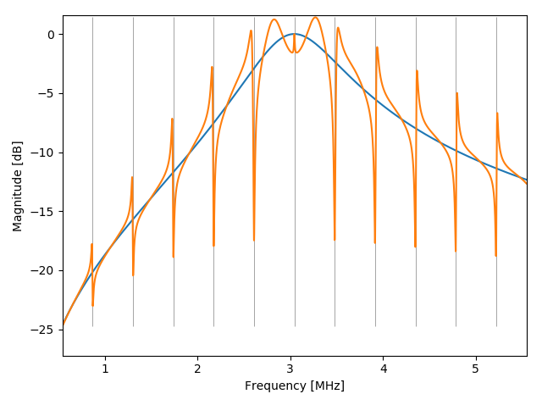
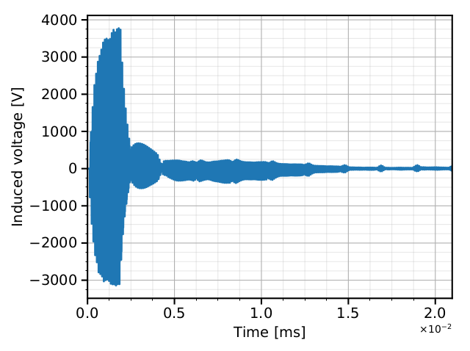
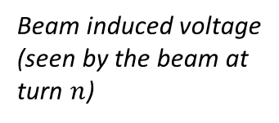

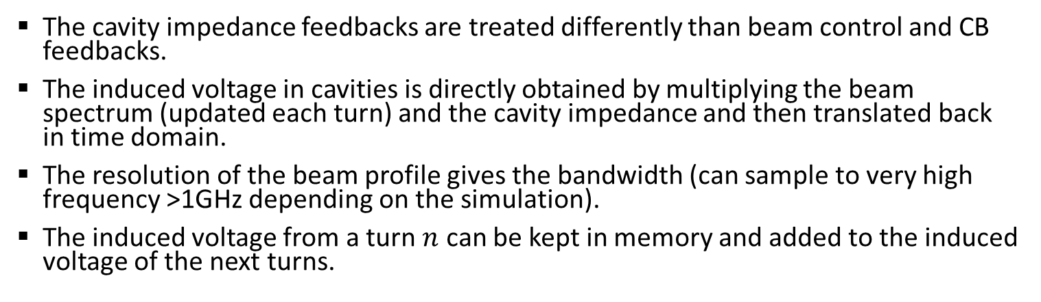
Cavity impedance FB, general remarks (1)
Beam induced voltage
(seen by the beam at turn $n$)
One turn delay response (kept in memory and added to beam induced voltage the next turn)
$$Z_{fb}\left(ω\right)=\frac{Z_{C}\left(ω\right)}{1+Z_{C}\left(ω\right) G H\left(ω\right) e^{jωτ}}$$
The cavity impedance feedbacks are treated differently than beam control and CB feedbacks.
The induced voltage in cavities is directly obtained by multiplying the beam spectrum (updated each turn) and the cavity impedance and then translated back in time domain.
The resolution of the beam profile gives the bandwidth (can sample to very high frequency >1GHz depending on the simulation).
The induced voltage from a turn $n$ can be kept in memory and added to the induced voltage of the next turns.

Slide 15
Cavity impedance FB, general remarks (2)
Beam induced voltage
(seen by the beam at turn $n$)
One turn delay response (kept in memory and added to beam induced voltage the next turn)
$$Z_{fb}\left(ω\right)=\frac{Z_{C}\left(ω\right)}{1+Z_{C}\left(ω\right) G H\left(ω\right) e^{jωτ}}$$
Feedbacks are directly represented as a modification of the cavity impedance, instead of modelling the complete feedback loop (measurement of the cavity return, comparison with drive voltage and feedback).
The impulse response of the cavity+feedback is multiplied with the beam spectrum, and the transient behavior of the feedback is obtained by keeping in memory several turns of induced voltage.
If the revolution frequency is changing due to other feedbacks or acceleration, the impedance can be updated every tracking turn (e.g. frequency of notch filters).
No power limitation is considered here.

Slide 16
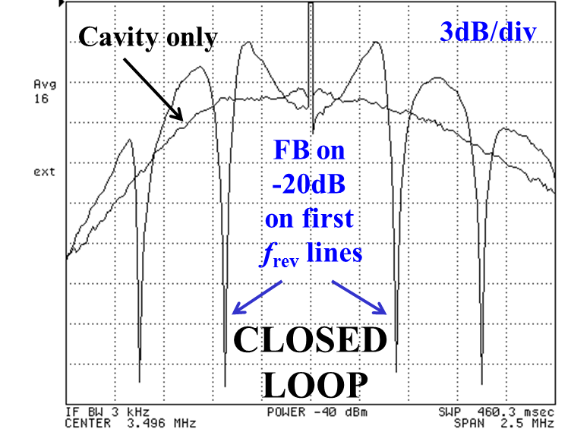
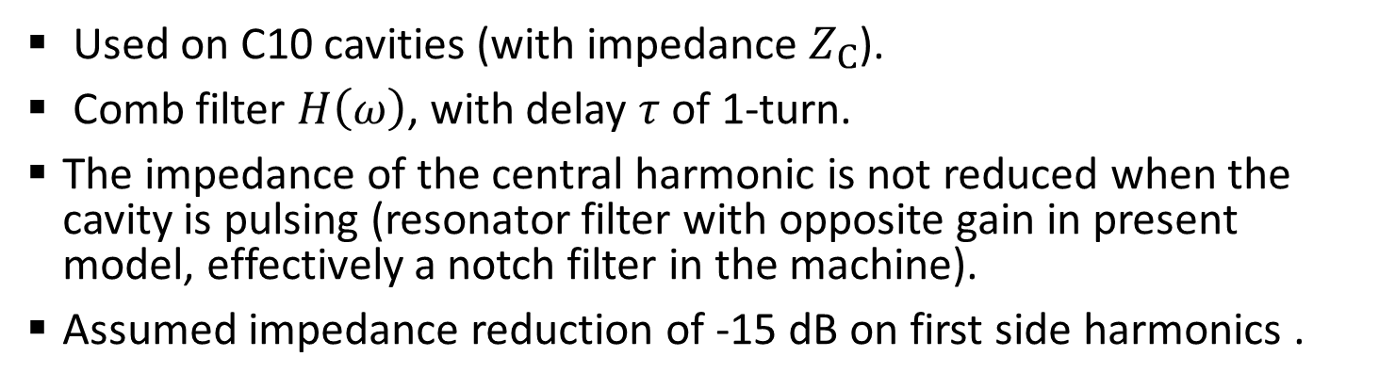
One-turn delay feedback
$$Z_{fb}\left(ω\right)=\frac{Z_{C}\left(ω\right)}{1+Z_{C}\left(ω\right) G H\left(ω\right) e^{jωτ}}$$
D. Perrelet https://indico.cern.ch/event/299470/contributions/686507/
Used on C10 cavities (with impedance $Z_{C}$).
Comb filter $H\left(ω\right)$, with delay $τ$ of 1-turn.
The impedance of the central harmonic is not reduced when the cavity is pulsing (resonator filter with opposite gain in present model, effectively a notch filter in the machine).
Assumed impedance reduction of -15 dB on first side harmonics .

Slide 17
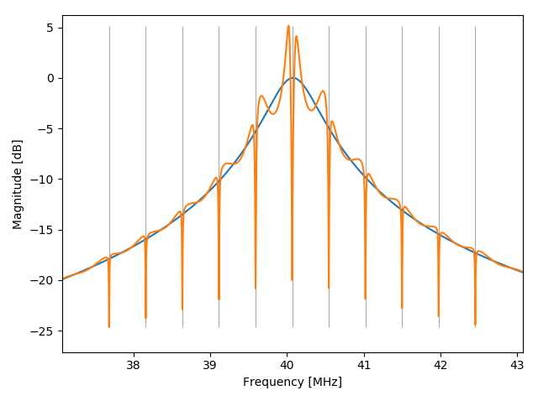
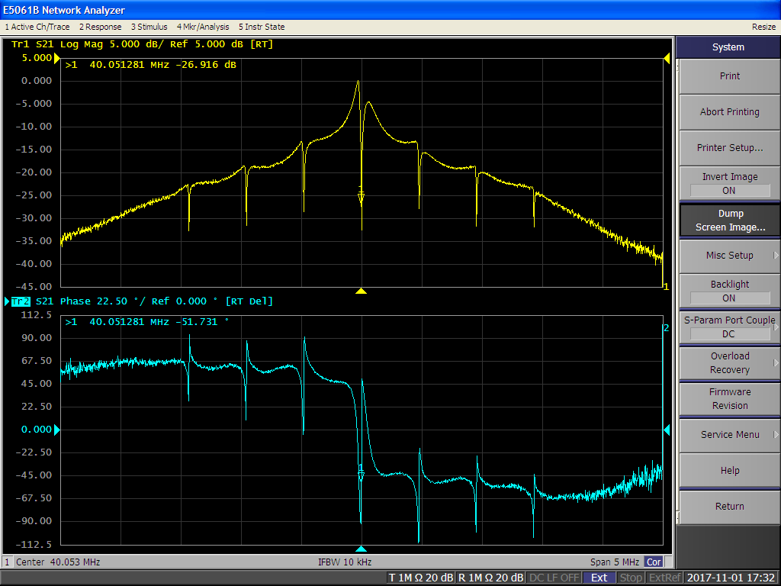
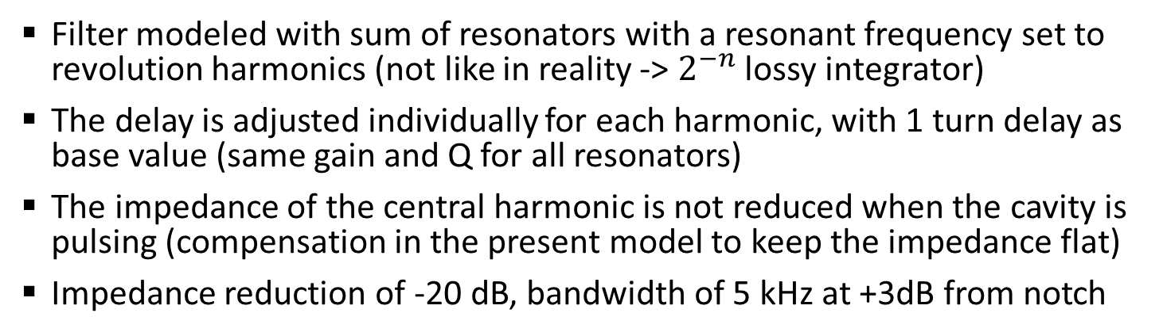
Multi-harmonic feedback
$$Z_{fb}\left(ω\right)=\frac{Z_{C}\left(ω\right)}{1+Z_{C}\left(ω\right) G\sum_{h}{H_{h}\left(ω\right) e^{jωτ_{h}}}}$$
F. Bertin https://indico.cern.ch/event/752919/contributions/3119021/
Filter modeled with sum of resonators with a resonant frequency set to revolution harmonics (not like in reality -> $2^{−n}$ lossy integrator)
The delay is adjusted individually for each harmonic, with 1 turn delay as base value (same gain and Q for all resonators)
The impedance of the central harmonic is not reduced when the cavity is pulsing (compensation in the present model to keep the impedance flat)
Impedance reduction of -20 dB, bandwidth of 5 kHz at +3dB from notch

Slide 18
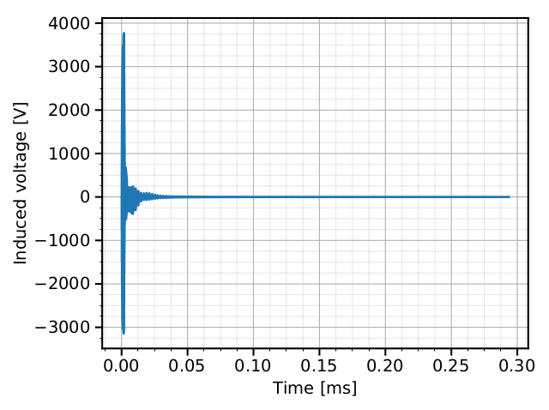
Implementation in BLonD
Full induced voltage memory
Zoom in first turns
Beam induced voltage
(seen by the beam at turn $n$)
One turn delay response (kept in memory and added to beam induced voltage the next turn)
Impedance with feedback treated in frequency domain
Using multi-turn memory for induced voltage, with 100-200 turns of memory (compromise to have good resolution, and reasonable sim time)
Transient effect along the batch and with long delay (multiple turns) are represented

Slide 19
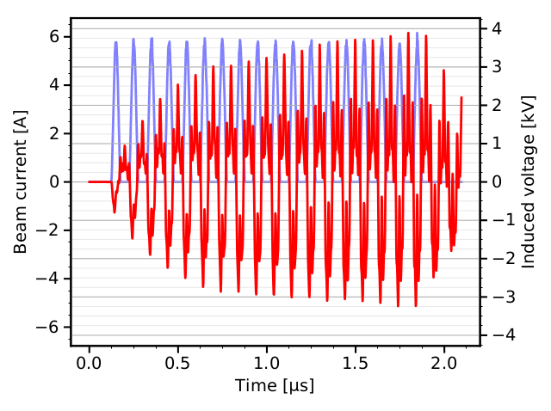
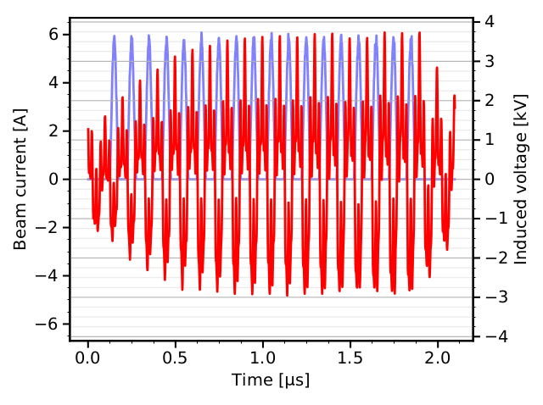
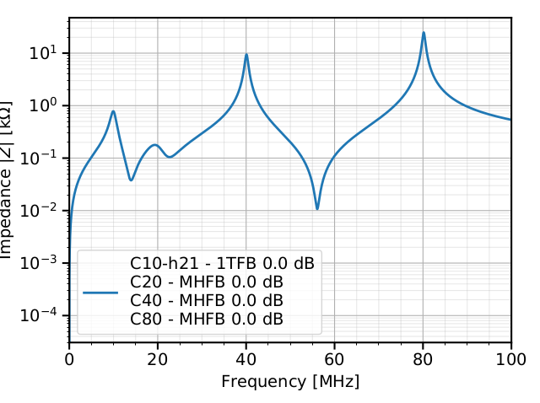
Induced voltage in sim without long delay FB
Induced voltage at first turn
After 140 turns
No FB
Example of beam loading before double splittings with no long delay FB

Slide 20
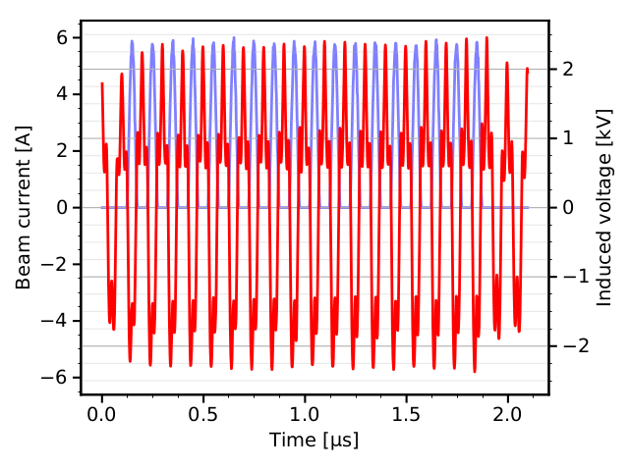
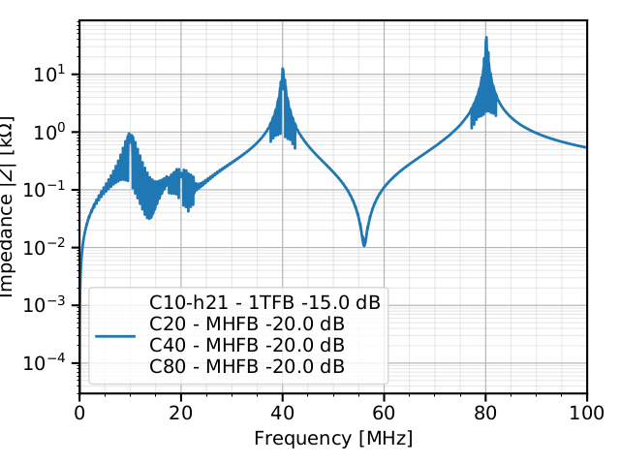
Induced voltage in sim with long delay FB
Induced voltage at first turn
After 140 turns
With FB
Reduction in amplitude
Reduction of transient along the batch
No imp. reduction on harmonics where cavities are pulsing
Example of beam loading before double splittings with long delay FB on harmonics except the central ones

Slide 21
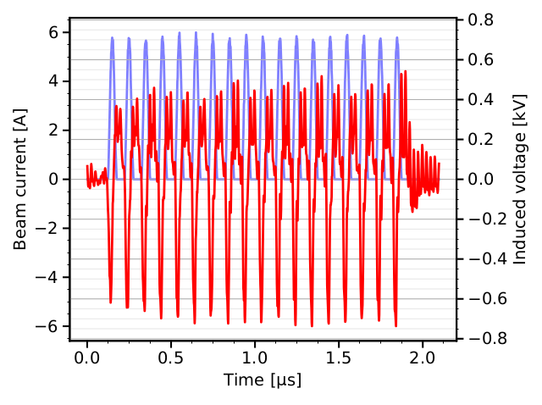

Induced voltage in sim with long delay FB
Induced voltage at first turn
After 140 turns
With FB,
if all harmonics were treated
Very small amplitude
Example of beam loading before double splittings with long delay FB on all harmonics, even the central harmonics

Slide 22


End to end simulations
A BLonD simulation including the complete cycle, including intensity effects and feedbacks was built (6k+ lines of codes, not including the external packages like BLonD or the impedance model…).
Almost all features are represented, but the adjustment of the feedbacks and gains is relevant to avoid unrealistic emittance blow-up due to mismatches, or excessive damping (could change the beam instability threshold in both ways, making difficult quantitative comparison with measurements).

Slide 23


Radial loop, injection vs. transition
Weak RL
Strong RL gain
At transition crossing, a too strong radial loop gain will lead to unrealistic radial oscillations after transition.
A reduced gain gives less radial excursion after transition, but the orbit before transition is changed -> change in energy of transition crossing, which can lead to other kind of mismatch which eventually gives emittance blow-up, seed instabilities…
Reminder: The DC coupled phase loop lead to a systematic radial displacement.

Slide 24


Phase loop offset during RF manipulations
An offset is present during the handover from one harmonic to the next during RF manipulations.
The mismatch will lead to generation of tails, which will propagate all along the cycle (important for beam dynamics studies).
An offset can be included in the modelling of the phase loop to compensate for the error, just like in the real machine.
The DC coupled phase loop lead to a systematic radial displacement if a phase loop offset is applied to compensate for the phase error during the handover from one harmonic to the next.

Slide 25





Synchronization, oscillations and drift
During synchronization
During splittings
Start synchro, with an simulated offset
Target is $π$
$V_{rf}$ reduction, phase shift in PL counteracts SL
The SL gives up against the PL…
The synchronization is also implemented by a proportional feedback to bring the beam at a given phase in the OL $f_{rev}$ (considering that the OL $f_{rev}$in the PS corresponds to one provided by the SPS).
The gain of the SL can be increased, but the present implementation is not filtering phase oscillations and will directly compensate the action of the PL.
A more realistic implementation of the PL and SL loop filters is required to have an accurate representation of the synchronization.

Slide 26


Cavity transfer function distortion
The notches can be adjusted in order to get a -20 dB impedance reduction at h=84 at injection energy.
In that case, the impedance response at the central frequency of the C40 RF cavity (with the impedance already reduced by the direct FB) is completely distorted.
The notch filter represented by a resonator does not decay sufficiently, far from the notch central frequency (-40dB is not seem sufficient when multiplied by the amplitude of the impedance at the central frequency of the cavity).
The effective implementation of the notch filter and comparison with the measured transfer function is required to avoid unrealistic response of the feedback.

Slide 27



Cavity transfer function distortion
$$1+Z_{C}\left(ω\right) G\sum_{h}{H_{h}\left(ω\right) e^{jωτ_{h}}}$$
The notches can be adjusted in order to get a -20 dB impedance reduction at h=84 at injection energy.
In that case, the impedance response at the central frequency of the C40 RF cavity (with the impedance already reduced by the direct FB) is completely distorted.
The notch filter represented by a resonator does not decay sufficiently, far from the notch central frequency (-40dB is not seem sufficient when multiplied by the amplitude of the impedance at the central frequency of the cavity).
The effective implementation of the notch filter and comparison with the measured transfer function is required to avoid unrealistic response of the feedback.

Slide 28
Conclusions
The present modelling of the LLRF in PS end-to-end simulation is a reasonable start, but require refinement based on the real implementation to better reproduce transient effects.
The main step of that process are
Checking the signal generation and ensuring that the simplifications done are reasonable compared to the runtime of the simulation, and not adding/removing important information
(e.g. peak detection is not perfectly equivalent to bunch length to get quadrupolar oscillations)
Checking the loop filters by measuring the transfer functions of the analog modules or from the design for the digital ones.
The loop filters may need to be adjusted based on the simplifications done from the signal generation.
Calibrating the gains from beam-based measurements. The quantitative signal levels, attenuation, delays in LLRF modules are difficult to model.
Remaining feedbacks to be included: AVC loop, Hereward damping…

Slide 29
BKUP

Slide 30

Feedback layout and implementation
“Real implementation” approach
Store the bunch profiles sampled at h=256 at each simulation turn and pass through the real signal processing
  Complex signal processing (down-conversion, filtering, up-conversion)
  Pass the samples in the filter in time or frequency domain (time domain a priori preferred to avoid the resolution of narrow notches, large FFTs)
  No mode analysis required

Slide 31
Feedback layout and implementation
Simplified
“Simplified” approach
Store the rms bunch position/length of each bunch, every few turns (sufficient to resolve synchrotron periods), apply the mode analysis
  Reduced number of points for computation
  Need to abstract the implementation of the filter to get its time constant
  Mode analysis is required

Slide 32

Coupled-bunch mode analysis
The mode analysis is usually done using a DFT on fitted bunch oscillations
$$A_{μ}\sin\left(mω_{s}t+φ_{μ}\right)=\frac{1}{N_{b}}\sum_{b=0}^{N_{b}−1}{A_{b}\sin\left(mω_{s}t+φ_{b}−\frac{2π μ b}{N_{b}}\right)}$$
The mode analysis was extended using FFT on bunch oscillations
$$A_{μ,n}e^{−j\left(ω_{n}t+φ_{μ,n}\right)}=\frac{2}{N_{b}N_{s}}\sum_{b=0}^{N_{b}−1}{e^{−j\frac{2πμb}{N_{b}}}\sum_{k=0}^{N_{s}−1}{A_{b,k}e^{−j\frac{ω_{n}k}{N_{s}}}}}$$
The fitting routine is avoided (computing time depends on initial conditions)
Doesn’t require precise knowledge of $ω_{s}$ (vary along the ramp, as a function of bunch length, intensity and their spread)
Computation time is deterministic and fast

Slide 33




Excitation of CB oscillations
Bunch position oscillations
Mode amplitude vs. time
Tests at flat top with 21 bunches in h=21 at $V_{RF}=100$ kV, with parabolic bunches with $τ_{l}=10$ ns (short bunches)
The initial oscillations are excited by adding an rf wave at an $f_{s}$ sideband (without using the CBFB), the excitation is switched off at t=50 ms
In that example, the damping is natural due to the synchrotron frequency spread (decoherence)

Slide 34




Damping of CB oscillations with CBFB
Bunch position oscillations
Mode amplitude vs. time
The CBFB is enabled at t=50 ms with a gain of $g_{μ}=0.24$ kV/ns
The damping is efficient (x6.6 faster that natural damping in this example)
After damping, some residual oscillations to be analyzed (high feedback gain? Un-realistic features of the implementation?)

Slide 35



Scanning the CBFB mode and phase (21b)
CBFB phase scan
Mode excitation matrix
The parameters of the CBFB were scanned to check all possible cases
The phase of the CBFB was scanned and oscillations are excited with $Δφ_{μ}=π/2$ as expected. The tolerance of the phase setting is large.
All CB modes $μ$ were tested and are equally damped/excited

Slide 36


Scanning the CBFB mode and phase (18b)
CBFB phase scan
Mode excitation matrix
The same results are obtained for 18 bunches instead of 21 bunches
The CBFB always works on the h=21 basis, the mode analysis is done with 21 bunches with 0 contributions from the 3 empty buckets.

Slide 37

Scanning the CBFB mode and phase (18b)
CBFB phase scan
Mode excitation matrix
In practice for data analysis, the mode analysis is done on the actual number of bunches. The corresponding mode numbers can be obtained with $μ_{n_{b}=18}=μ_{n_{b}=21}⋅\left(18/21\right)$
The excitation/damping of some modes is not optimal with empty buckets -> e.g. excitation of mode $μ_{n_{b}=18}=3→μ_{n_{b}=21}=4$ effectively excites modes $μ_{n_{b}=18}=3$ and $4$

