Slide 1
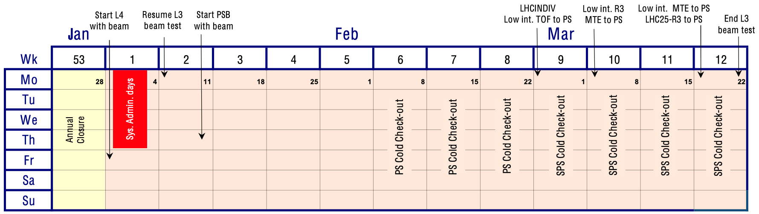
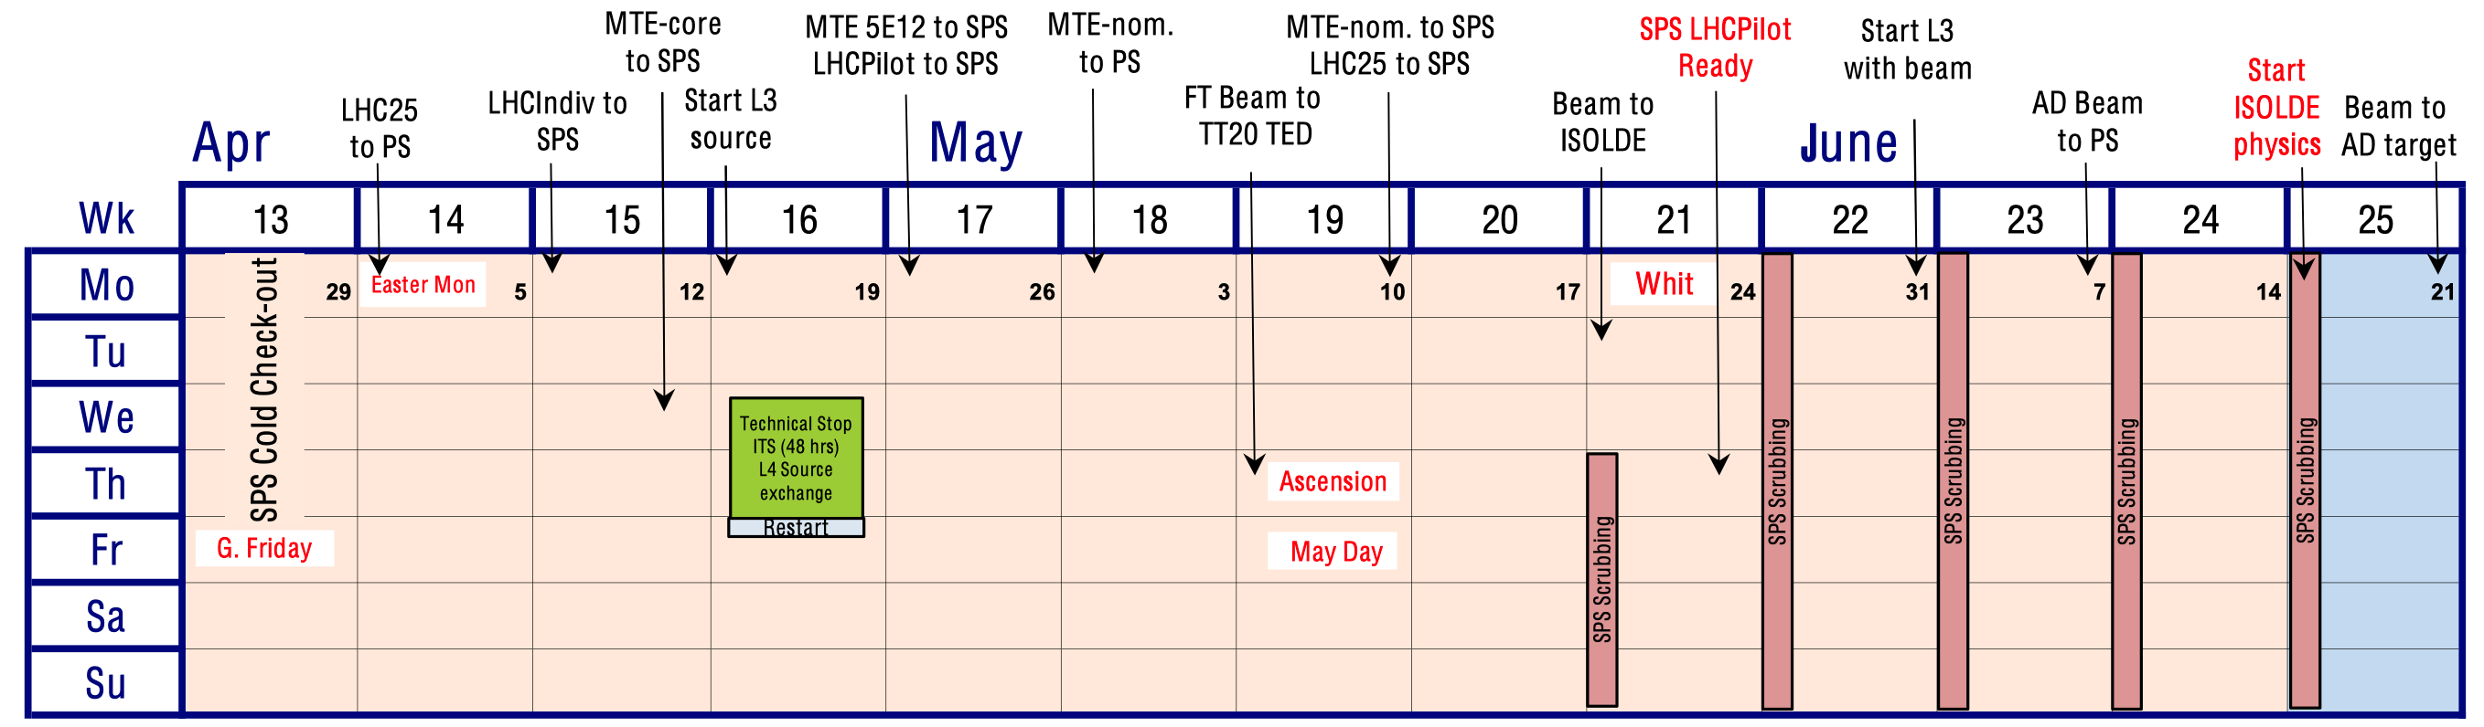
2021 accelerator schedule: Q1-Q2
Presented by R. Steerenberg in IEFC, IPP, FOM, approved by SPSC

Slide 2
Main priorities for early 2021
Items to completed/prepared before start with beam
  Pulse 40 MHz cavity: early February
    Digital cavity controller together
    AVC surveillance prototype module
    Need clear path for operational roll out during 2021 run
  Pulse 200 MHz system with μTCA controller: February
    Proof-of-principle with prototypes
    Validate mTCA cavity controller
    Define strategy for operational implementation in YETS21/22
  Prepare phase measurement of digital beam control: March
    Open loop phase between beam and 10 MHz cavity vector sum
    Two harmonic simultaneously
    Following harmonic number changes
    Validate major parts of digital beam control

Slide 3
Status of activities in PS CB and nearby (b. 151)
Coupled-bunch feedback
  Re-cabling/testing of coupled-bunch feedback ongoing
  Synchronization tests → Jan
Barrier bucket generation
  To be re-cabled → Mihaly
Remaining cabling
  PA.GSVPC78
  Distribution of stable phase, φ_{S} program PA.GSPPROGRT
    Replace APP (Automatic Phase Program) module
  Function to control phase loop gain PA.GSPLGAIN(RT)
    Lower gain before injection (and at h = 84)
  Phase program and phase loop gain functions ready
  MakeRule for virtual start-stops, transition and scaling to be completed → Denis

Slide 4
Re-commissioning of LLRF equipment
  RF CPS eLogbook: http://elogbook.cern.ch/eLogbook/eLogbook.jsp?lgbk=382
  Ongoing and next steps
  Wall current monitor (WCM95) distribution → Ben, Pierre
    Replacement of aging distribution amplifiers
  Digital cavity controller 40 MHz and 80 MHz power systems → Ben
    Multi-harmonic feedback working
    Controls request: phase and tuning functions, acquisition timings
  2 GeV cycle with appropriate timing tree → Denis, Heiko
    BCMS setting-up
    Cavities pulsing with pre-/post LS2 cycles
  Cycle timing tree and function generation for other cycles
  → Denis, Heiko
    TOF (TREEH8) → MTE (TREEH8H16)
    Conventional LHC (triple splitting only, TREEH21)

Slide 5
Re-commissioning of LLRF equipment
  RF CPS eLogbook: http://elogbook.cern.ch/eLogbook/eLogbook.jsp?lgbk=382
  Ongoing and next steps
  10 MHz cavities
    Cavity returns signals all delivering signals (eLogbook)
  Recovery from Christmas break
    Cooling water ‘eau glacée’ back on 04/01
    Equipment back on 07/08
      Two broken NIM power supplies replaced
      cfv-151-allbbcwb has no clock yet → Mihaly
      SVEC in cfv-353-allrfp2 in boot loop → Nathan
    First 10 MHz cavities pulsing again
  Week 1 in 2021
    04-07/01 Controls maintenance days (‘Note de Coupure’)
    07-08/01 Final RF bypass check (with magnet covers) in
    PS switchyard

Slide 6
Re-commissioning of LLRF equipment
  RF CPS eLogbook: http://elogbook.cern.ch/eLogbook/eLogbook.jsp?lgbk=382
  Ongoing and next steps
  Extraction train distribution → Diego
    Lab tests well advanced (non-blocking issue with fsync measurement)
    Move front-end to b. 353 in week 3 and connect
  AVC surveillance → Stephane
    Completion of prototype firmware and lab tests
    Interlock check with power system: week 4
    Tests with C40-77: weeks 5/6
  200 MHz AVC loop → Matteo
    1st 200 MHz cavity to be handed over by RF-AC on 29/01, all on 12/02
    Completion of prototype firmware and lab tests
    Tests with single 200 MHz cavity week 6
  Final preparation of LLRF for beam week 7/8

Slide 7
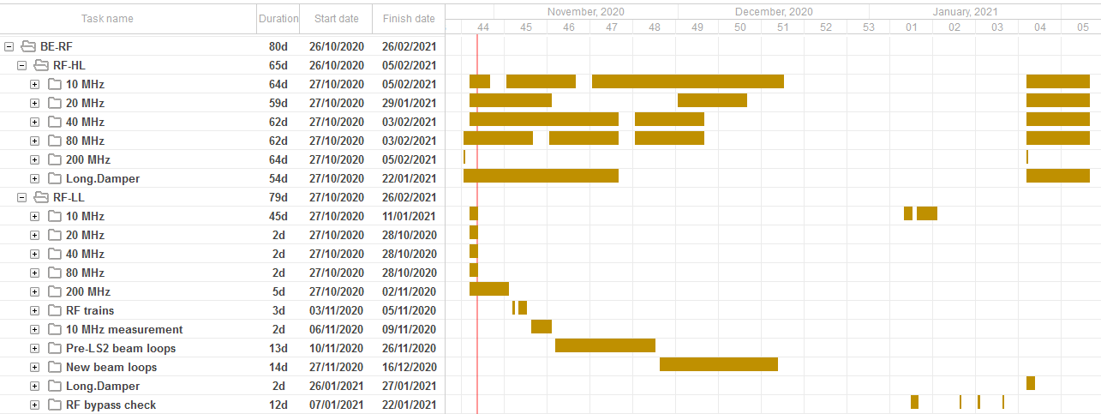
Hardware commissioning schedule
RF agenda during hardware commissioning phase
Detailed online schedule at https://oss-coordination.web.cern.ch/gantt/latest

Slide 8
LS2 feedback and activities for YETS2021-22
Joint Coordination Meeting for the PS Complex
LS2 feedback for ISTs and HWC
  Extremely useful to have clear agenda for availability of services:
  air conditioning and electricity
  IST period allowed to perform many checks at an early stage
  Planning when other systems required signals from LLRF
  Difference IST/HWC not fully clear for LLRF systems: outside ring with no impact on safety
  Online schedule (https://oss-coordination.web.cern.ch/gantt/latest)
    Overwhelming for non-experts, difficult to browse
  System validation too early with respect to operational
    ‘OK when tested, already broken when really needed’
EYETS2021/22 activities
  Installation of digital cavity controllers on all 200 MHz systems
    Services in b. 151 and 5 days of power tests with cavities
  Fix items discovered during 2021 run
    Expect minor cabling and installation of LLRF modules in b. 353

