Slide 1
HTS Solenoid as a Flux Concentrator
Jaap Kosse & Bernhard Auchmann :: Paul Scherrer Institute
An initial concept, v2

Slide 2
Design aspects
Electromagnetic
Thermal
Mechanical
Radiation
So far, only focus on this
Any of these could be showstoppers…

Slide 3
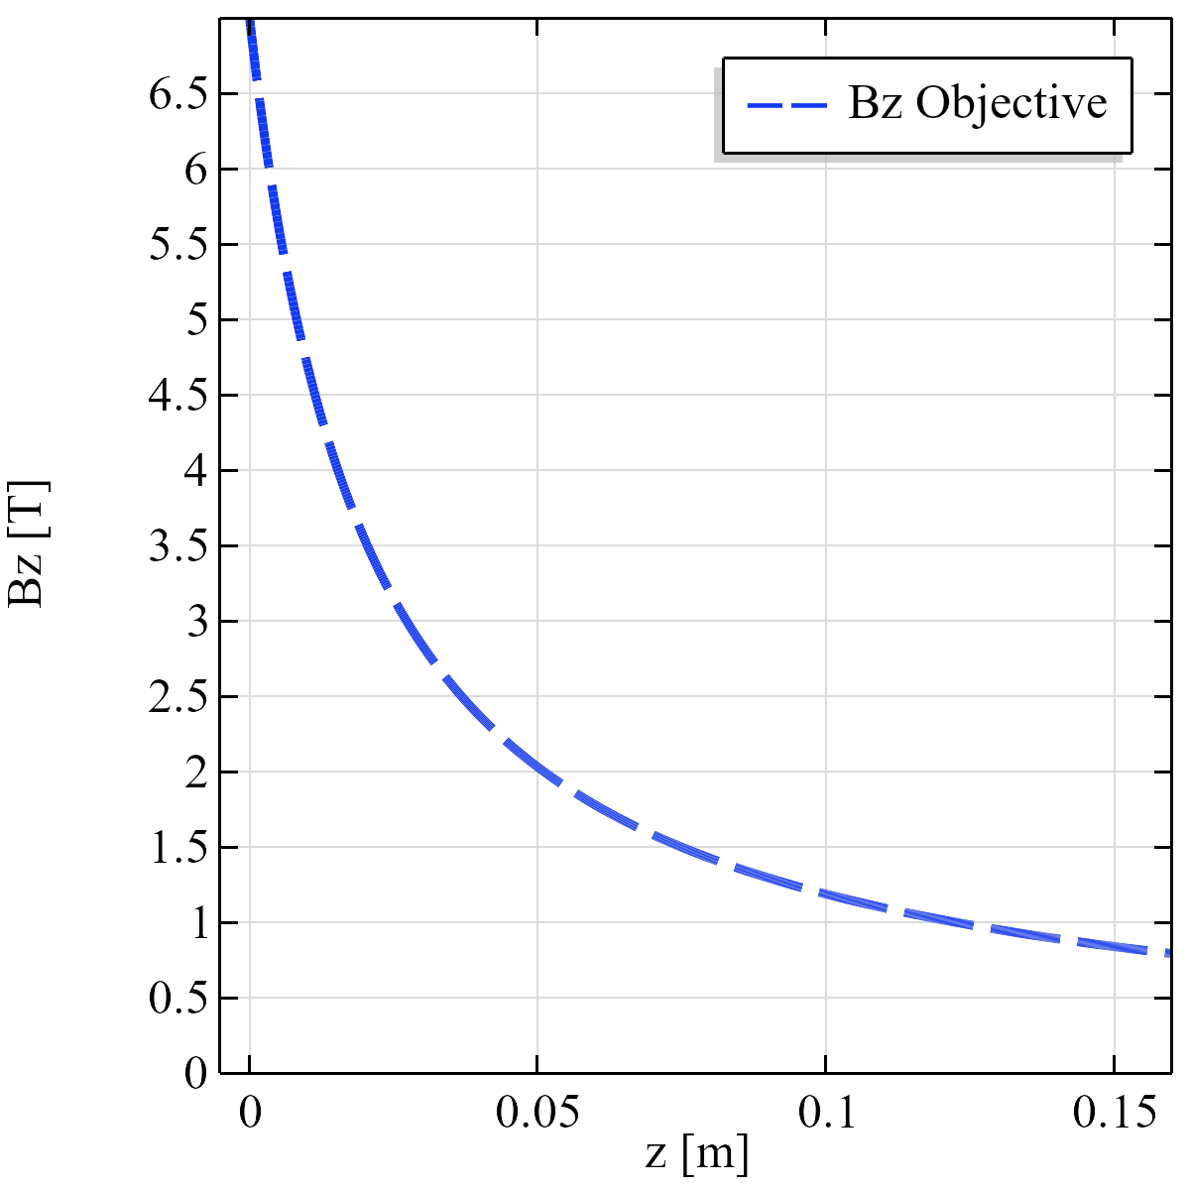
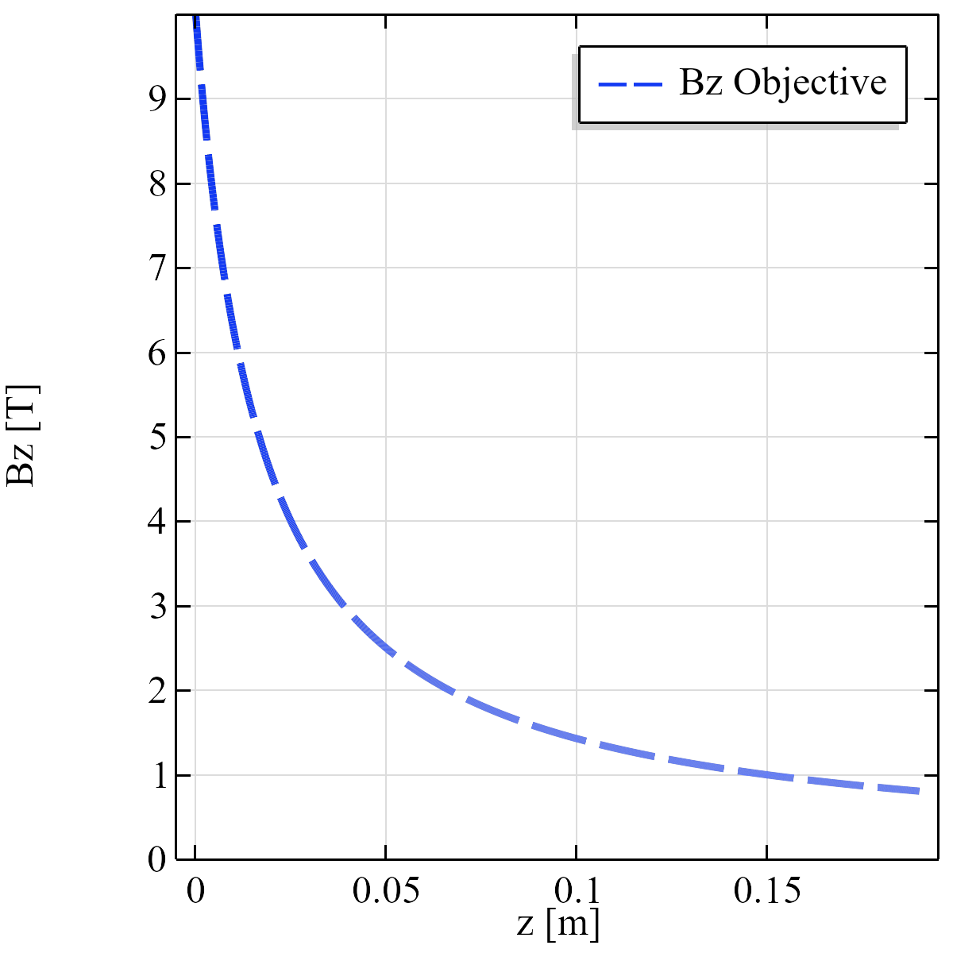
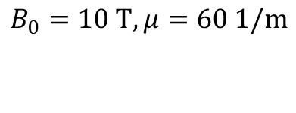
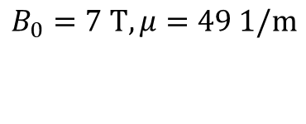
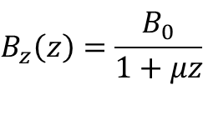
Examples: 7 T and 10 T
$$B_{z}\left(z\right)=\frac{B_{0}}{1+μz}$$
objective:
$$B_{0}=7 T, μ=49 1/m$$
$$B_{0}=10 T, μ=60 1/m$$

Slide 4
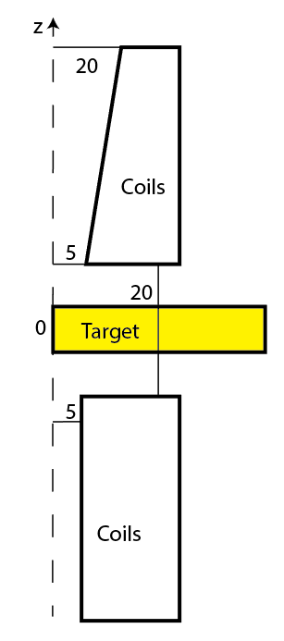

Design freedom
20 mm gap between coil sections,
z=0 placed in middle of gap
“upstream” 10 mm aperture
“downstream” $10→40$ mm aperture
“downstream”
“upstream”

Slide 5
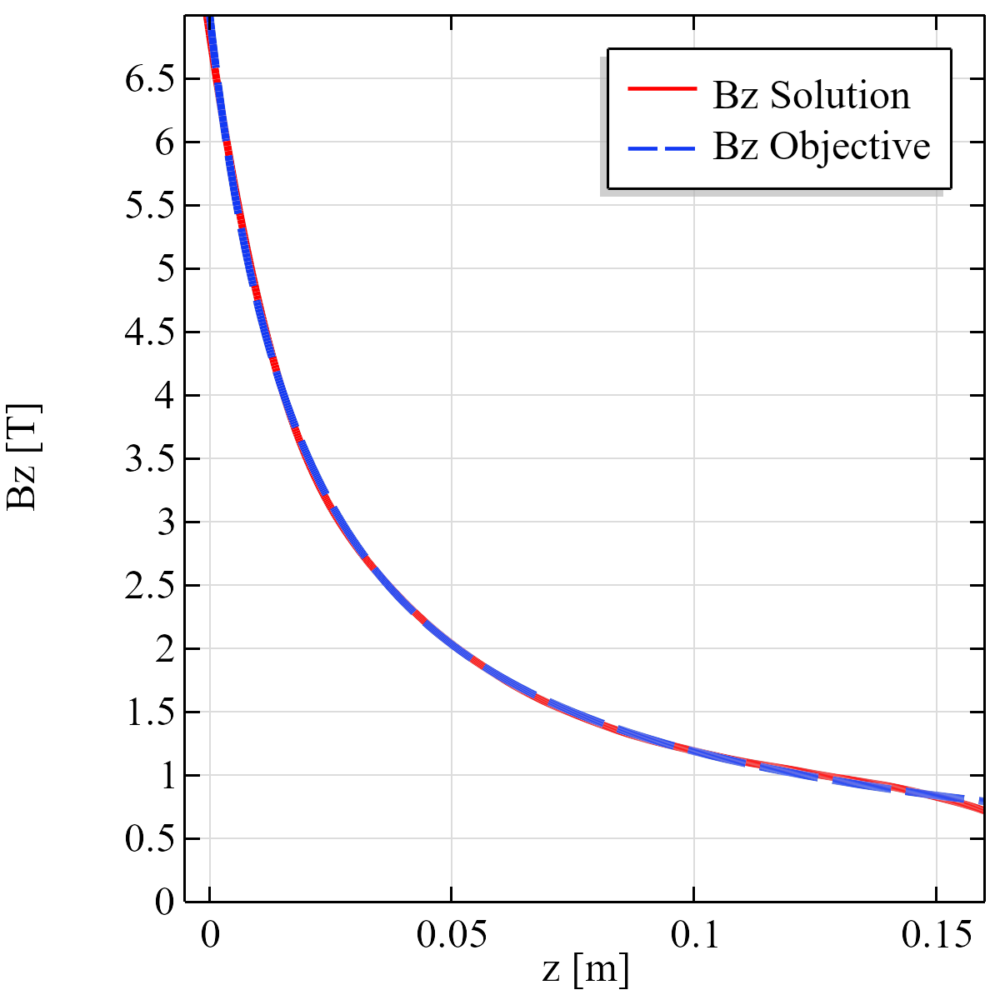
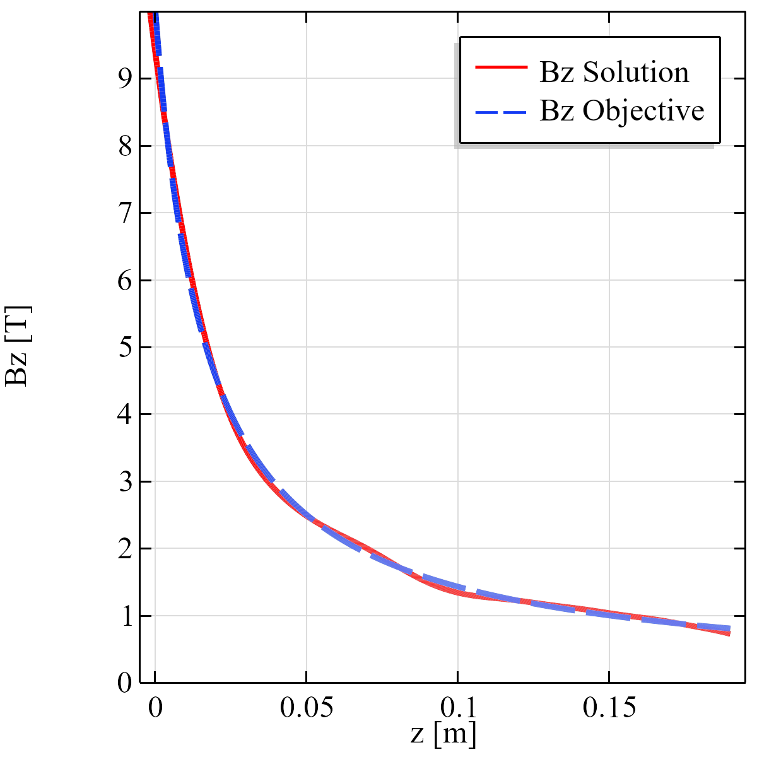
Result of initial optimization attempt
7 T solution closer fit than 10 T solution (so far)

Slide 6
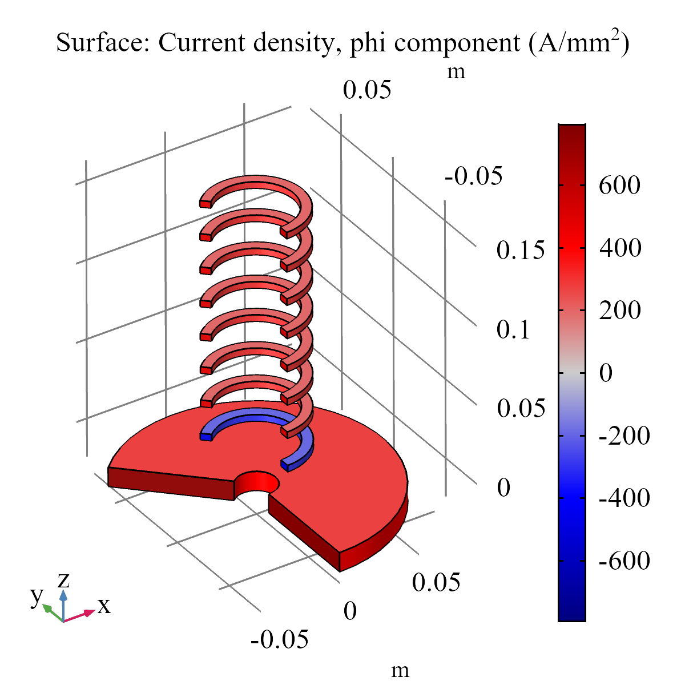
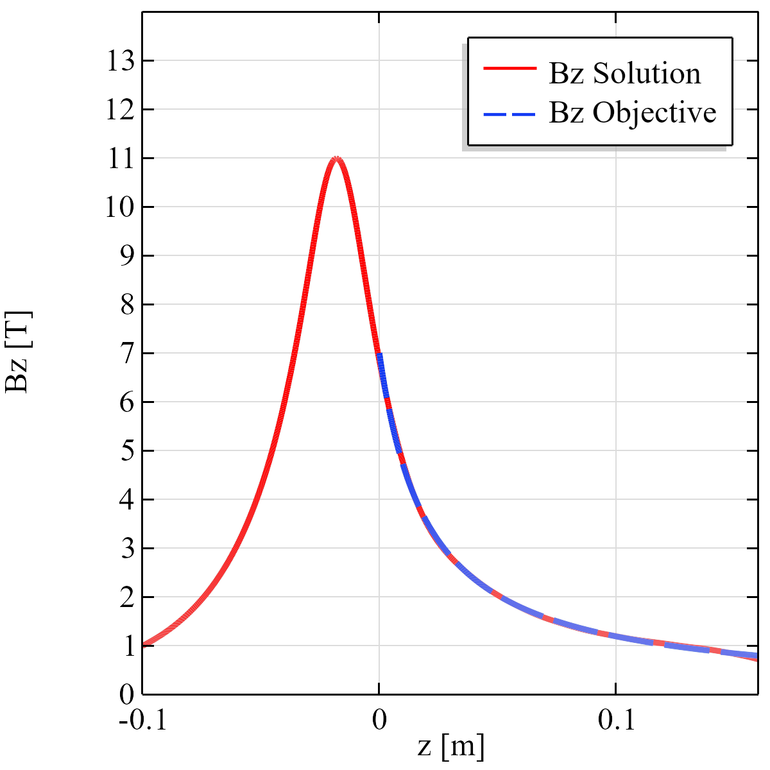
7 T coil layout
Main field coil
Correction coil
Background coils

Slide 7
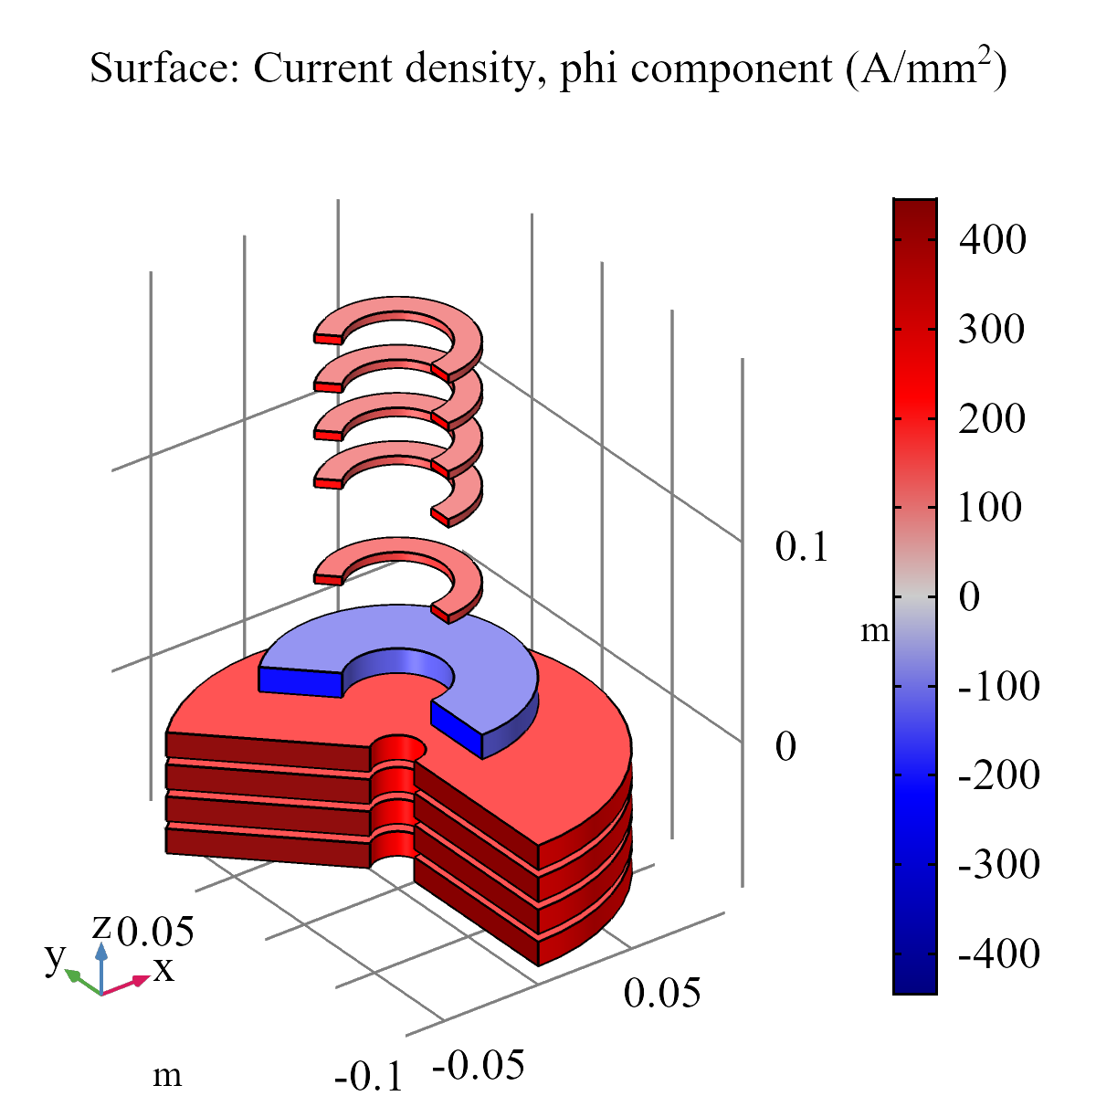
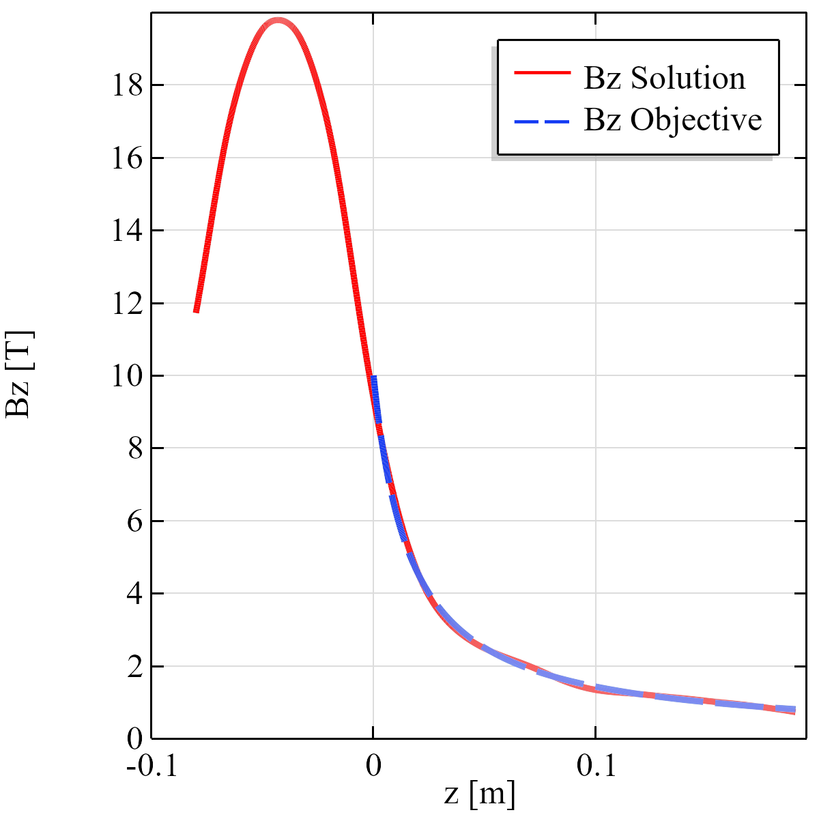
10 T coil layout

Slide 8
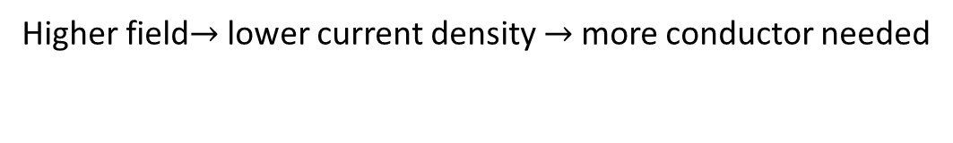
Why is 10 T coil layout different from 7 T?
Max current density in coils limited by
Temperature (assume 30 K operation)
Magnetic field
(stress)
Higher field$→$ lower current density $→$ more conductor needed

Slide 9
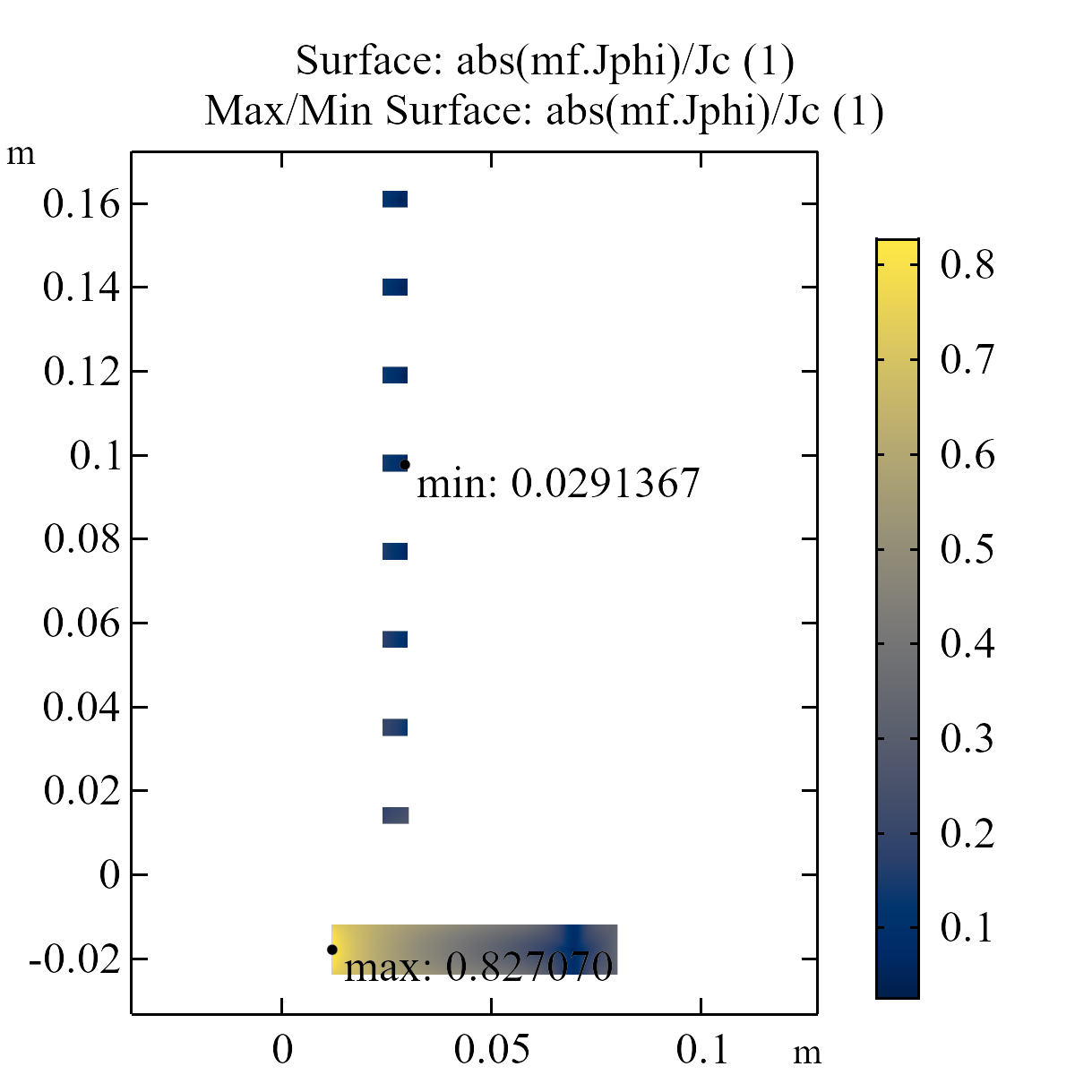
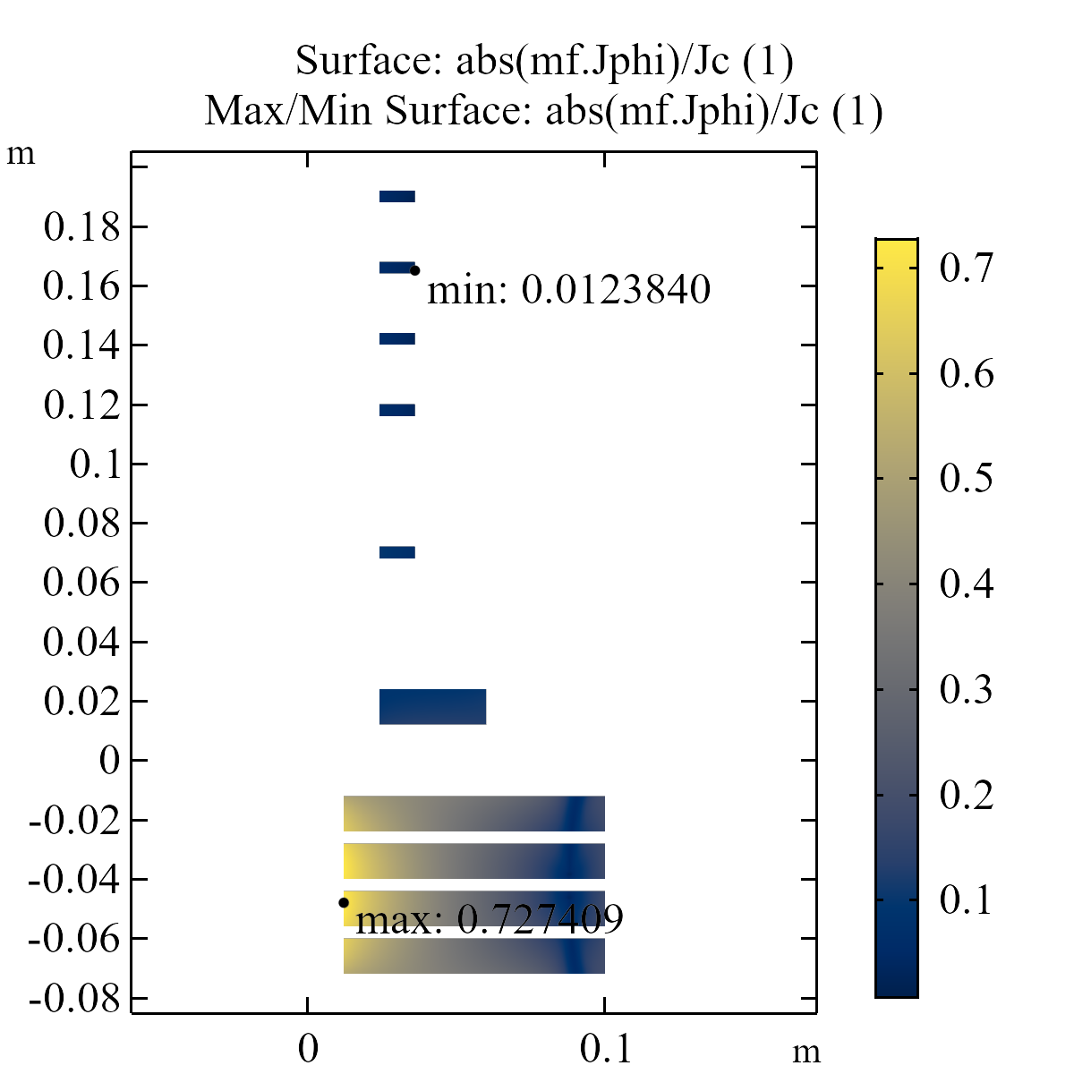
Current density/ max current density
7 T
10 T
Large margin on
downstream coils
83% percent of maximum
73% percent of maximum
For insulated coils: try to stay below ~80%, for us, using non-isulated, we might go higher

Slide 10
Design aspects
Electromagnetic
Thermal
Mechanical
Radiation
Reasonable results?
Propose to exchange obtained profiles
Any of these could be showstoppers…

