Slide 1
Experience with MicroMegas chambers with resistive strips
Givi Sekhniaidze
INFN sezione di Napoli
On behalf of the ATLAS MicroMegas community
(MAMMA)

Slide 2
Overview
Tests of the resistive chambers in different gas mixtures and different conditions
    Structure of chamber with resistive strips
    Laboratory tests
      ⁵⁵Fe source
      X-ray gun
      Spark shape and characteristics
      Neutron beam tests at Demokritos laboratory in Athens:
        Neutron beam spectra
        V-I characteristics under neutron beam
        Spark probability
        Beam tests at H6:
          V-I characteristics
          Spark probability

Slide 3
R11, R12 and R13 (1)
Small 100 x 100 mm² chamber with 100 mm long strips and 250 µm strip pitch (similar to the previous prototypes – S3, R9, R10), 360 strips in total
Mesh
Characteristics:
Resistive strips connected to the ground
Thin insulating layer between of the resistive and readout strips
AC coupling of signals
Sparks are neutralized through the resistive strips to the ground
Resistive paste
d=128 µm/E≈50 kV/cm
Insulator
PCB
Readout strip
Rground
Insulator
≈0.5, 2, 5 MΩ/cm
PCB
R
1 MΩ

Slide 4
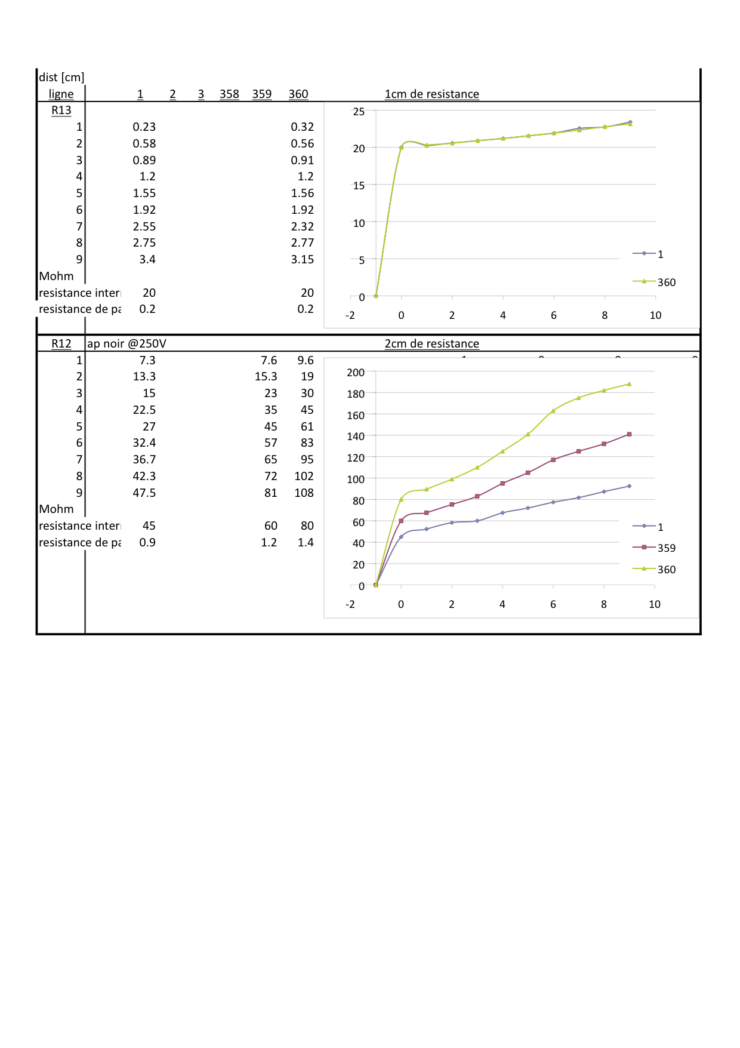
R11, R12 and R13 (2)
Resistive characteristics of the
chambers
CHAMBER | R11 | R12 | R13
Resistance to Ground (MΩ) | 15 | 45 | 20
Resistance along strip (MΩ/cm) | 2 | 5 | 0.5

Slide 5
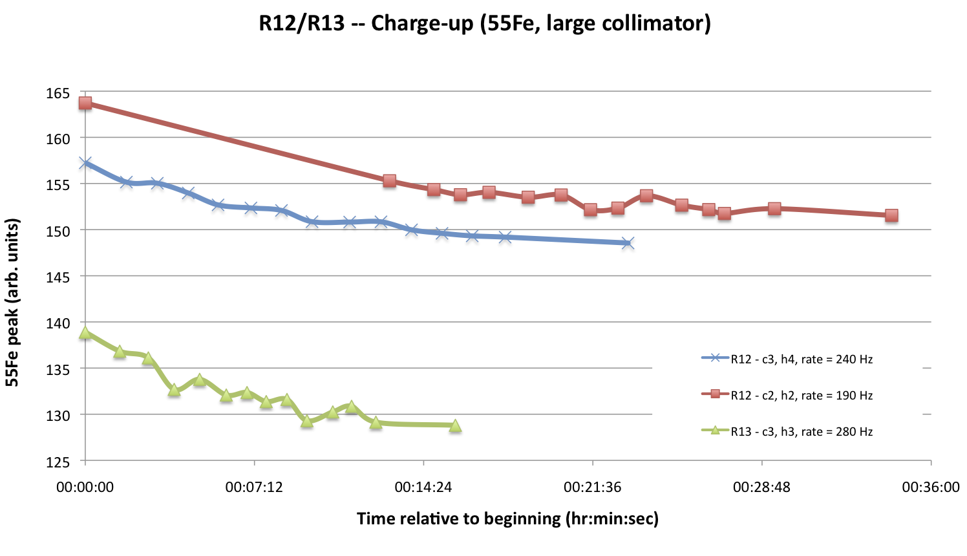
Laboratory tests (1)

Slide 6
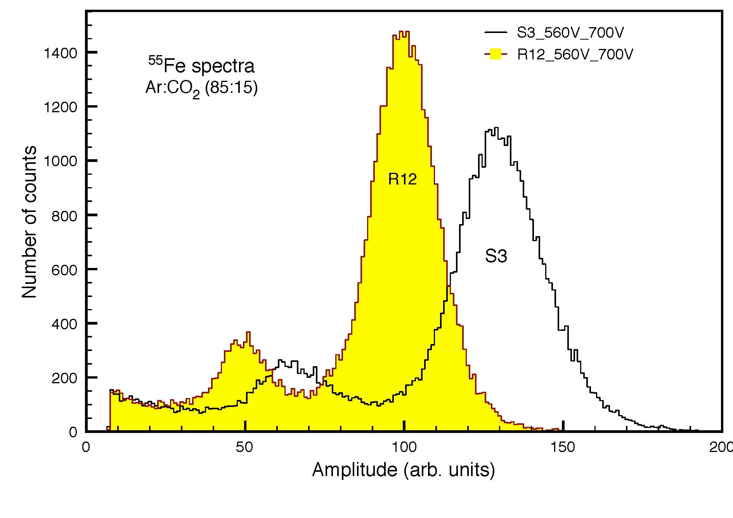
Laboratory tests (2)

Slide 7
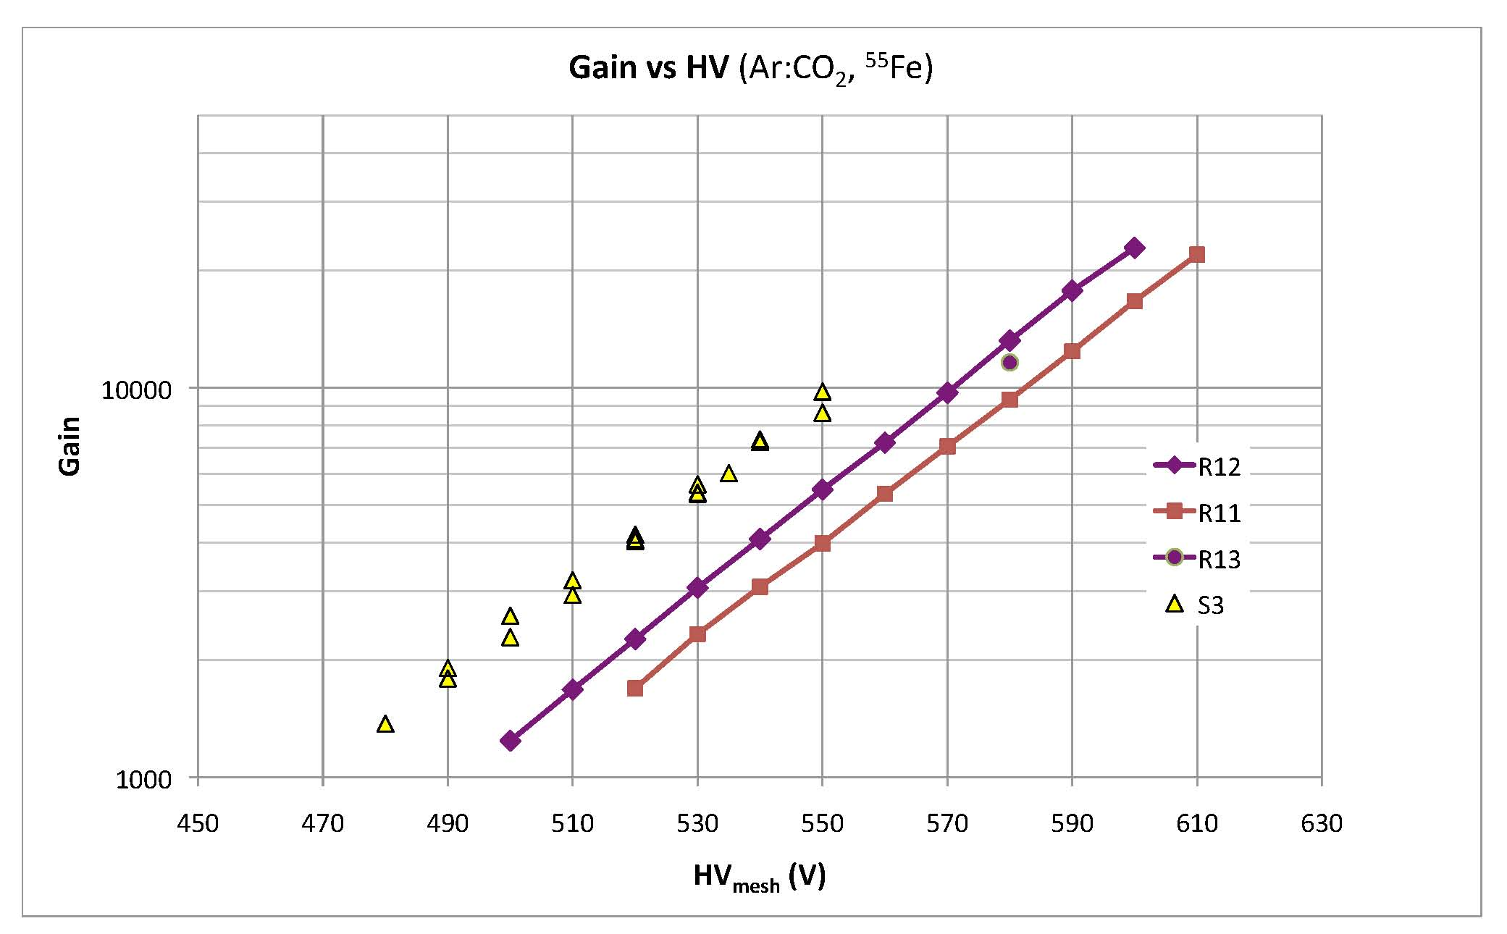
Laboratory tests (3)

Slide 8
Laboratory tests (4)

Slide 9
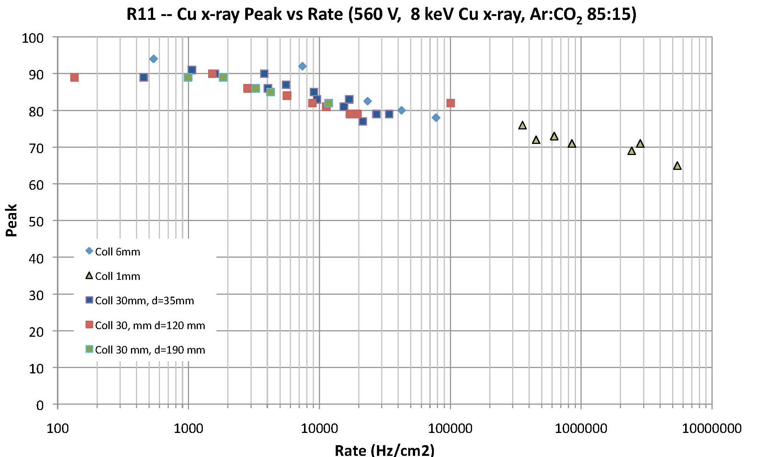
Laboratory tests (5)

Slide 10
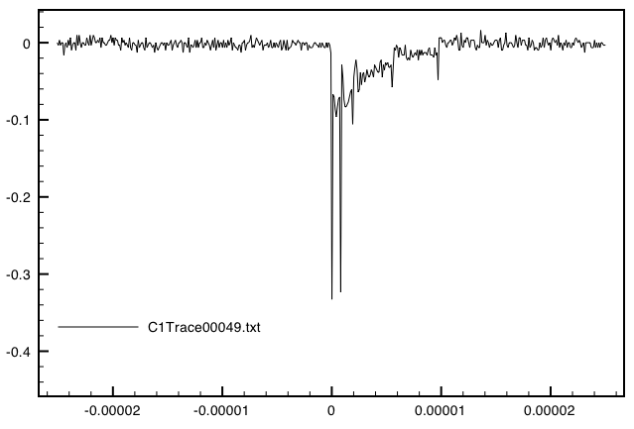
Spark shape & characteristics – R11
Laboratory tests (6)
[V]
R11
10 µs
Time (s)

Slide 11
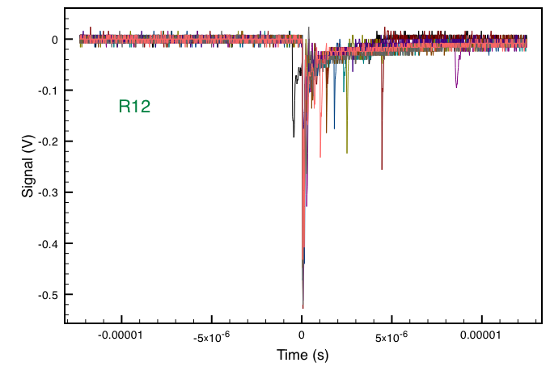
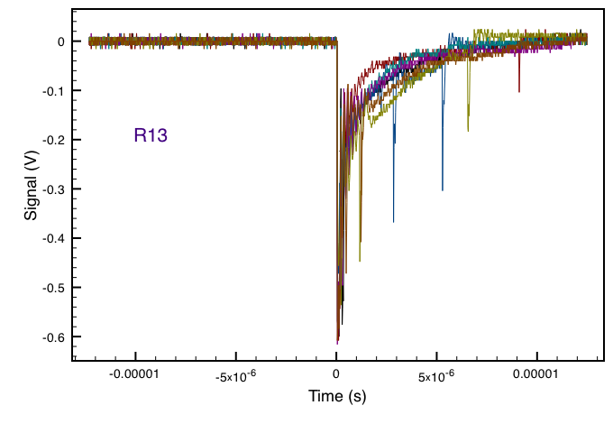
Spark shape & characteristics – R12 & R13
Laboratory tests (7)
10 µs
10 µs

Slide 12
Homogeneity of chambers
Laboratory tests (8)
⁵⁵Fe source, Ar:CO₂ (85:15)

Slide 13
Conclusions from the laboratory tests
R11, R12 and R13 are working fine with the ⁵⁵Fe source and with X-ray gun.
Very good homogeneity along the strips
Low spark rate
Spark current is the order of 10-20 nA, almost 1000 times less than for S3 chamber (non-resistive)
No HV breakdown, no dead time

Slide 14
Neutron beam test at
Demokritos National Research Center
Exposed R11 and a standard MM in first week of May to neutron beam at Demokritos NRC (Athens)
Neutrons of 5.5 MeV with fluxes up to 1.5 x 10⁶ n/cm²
R11 & sMM were read out through
  Single preamplifier (OR of 72 or all 360 strips)
  Single preamplifier (mesh current)
  64 individual strips connected to Gassiplex readout system (under analysis, not reported here)
Gas mixtures tested: Ar:CO₂ (85:20; 85:15, 93:7)

Slide 15
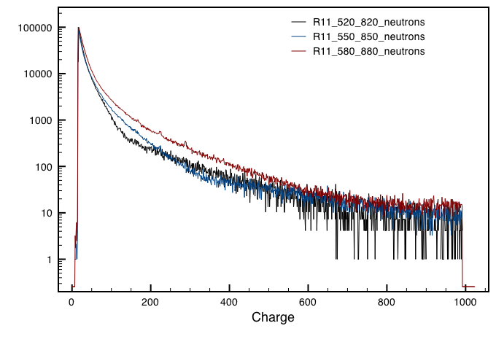
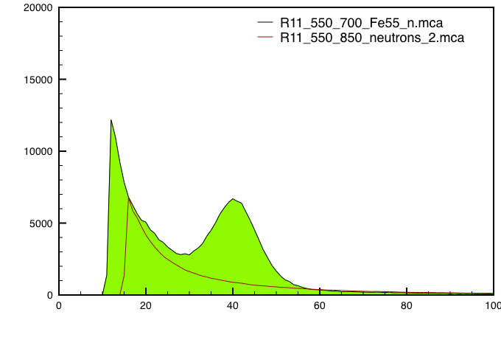
Neutron beam test (1)
Neutron spectra in R11
Typical charge spectra recorded in neutron beam
⁵⁵Fe spectrum taken under neutron irradiation
Gas: Ar:CO₂ (85:15)

Slide 16
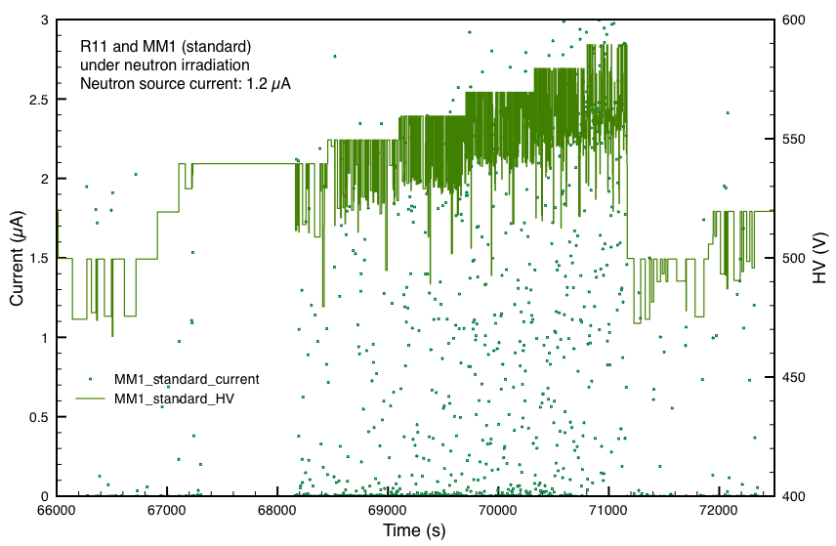
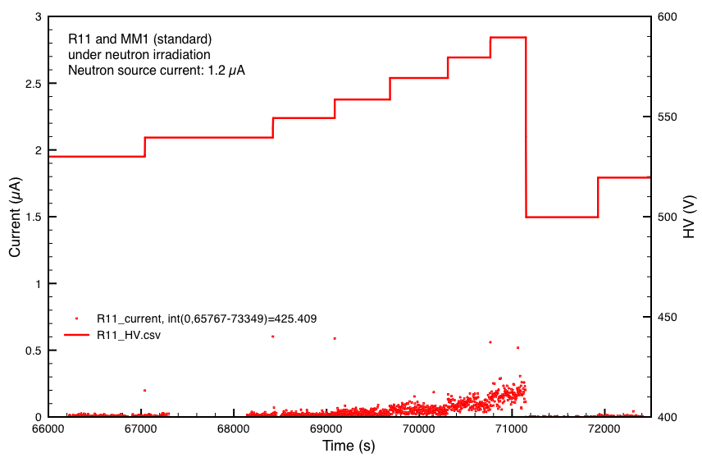
Neutron beam test (2)
MM mesh currents in neutron beam
Gas: Ar:CO₂ (85:15) Neutron flux: ≈ 10⁶ n/cm²
Standard MM:
Large currents
Large HV drops, recovery time O(1s)
Chamber could not be operated stably
R11:
Low currents
Despite discharges, but no HV drop
Chamber operated stably up to max HV

Slide 17
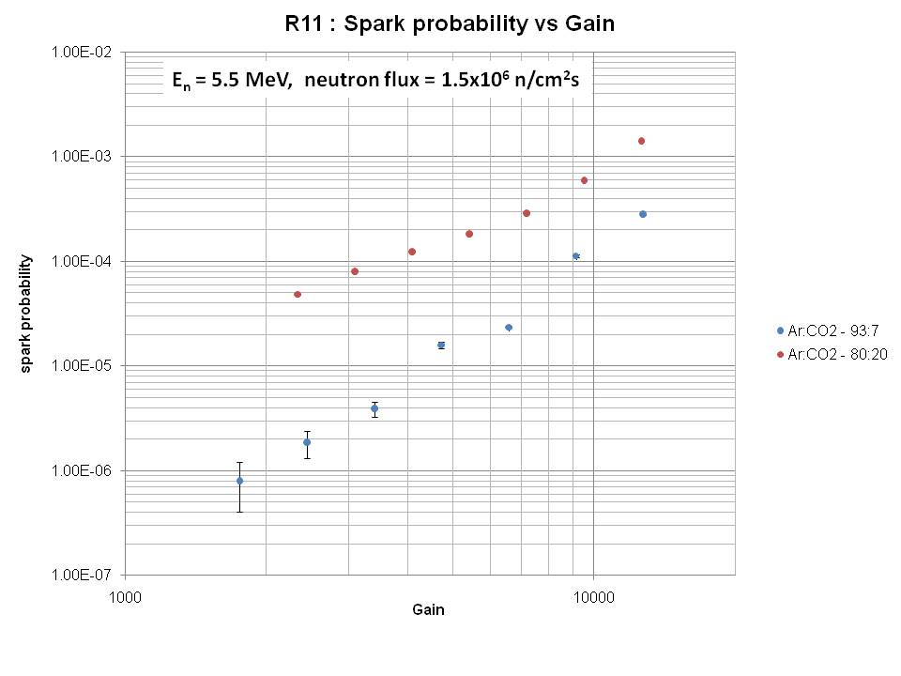
Neutron beam test (3)
Spark rates

Slide 18
Conclusions from neutron test (R11)
R11 worked fine in a neutron flux of up to 1.5 x 10⁶ n/cm²
Despite sparks, no HV breakdown, no dead time
Clear signal from a ⁵⁵Fe source under neutron irradiation
Measured three Ar:CO₂ gas mixtures, 93:7 looks very interesting, with a spark rate almost a factor 10 lower than for 80:20

Slide 19
Beam test in H6
5-18 July 2010
R11, R12, R13, and P3 chambers were tested in +120 GeV pion beam (intensities 40 kHz & 5 kHz) for two Ar:CO₂ mixtures, 85:15 and 93:7
Main goals:
  Study HV and current behaviour of resistive and non-resistive chambers in a hadron beam
  Measure performance (spatial resolution and efficiency) of resistive chambers
  Study performance of long strips (0.4 m & 1m, non-resistive)
A few million of events to be analyzed

Slide 20
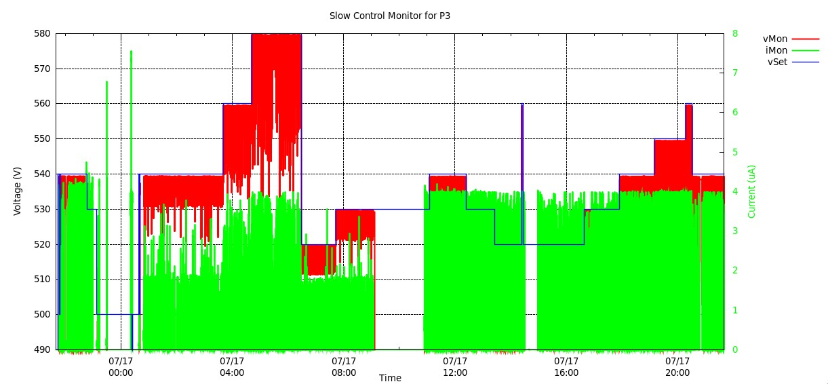
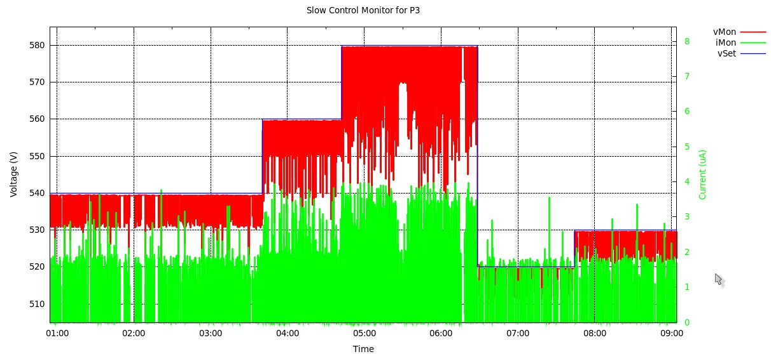
Beam test in H6 (1)
Ar:CO2 – 85:15

Slide 21
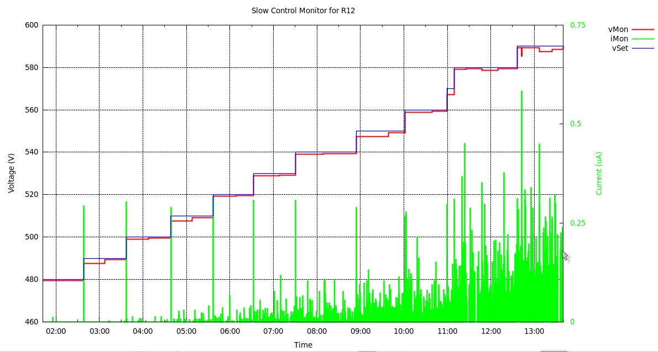
Beam test in H6 (2)
Ar:CO2 – 85:15

Slide 22
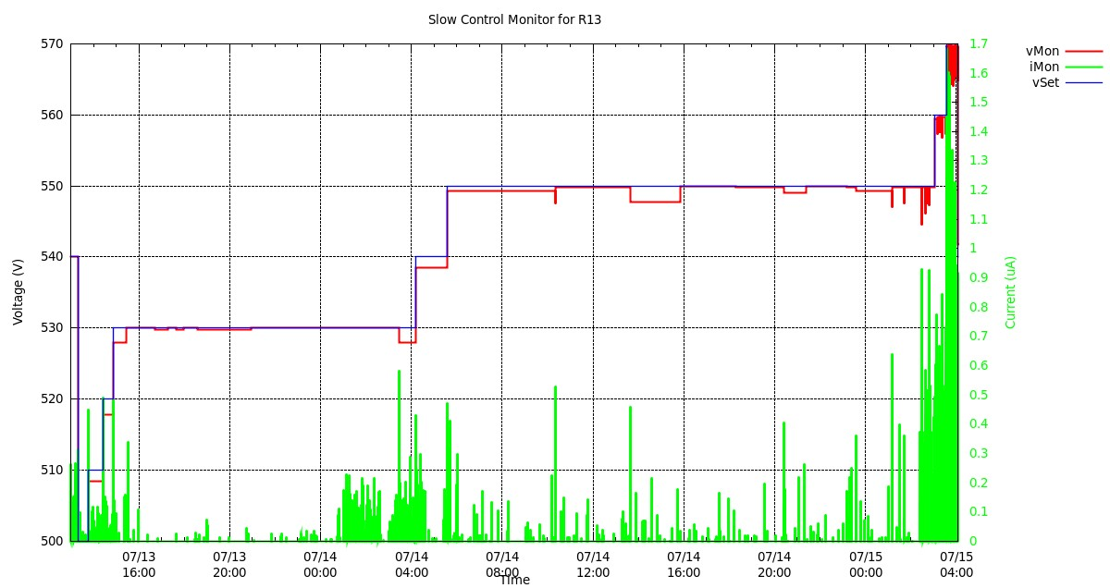
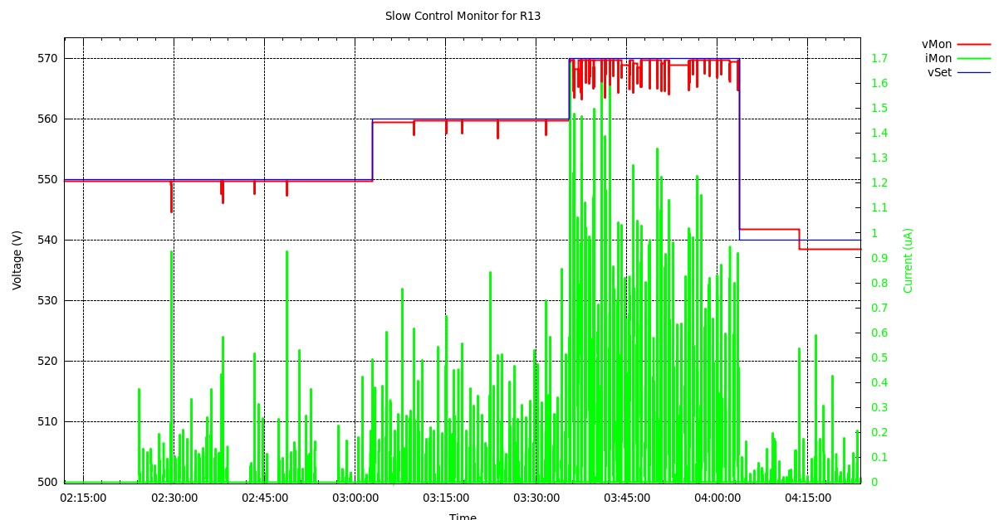
Beam test in H6 (3)
Ar:CO2 – 93:7

Slide 23
Beam test in H6 (4)

Slide 24
Beam test in H6 (5)

Slide 25
Overall conclusions
R11, R12 and R13 show very similar behavior
Robust & stable, no breakdown at all, excellent performance in neutron and hadron beams
Signals are clean, good gas gain and energy resolution (slightly better for R12)
Charge-up reduces signal by less than 10%
Homogeneity across chamber good
Short and small spark signals and fast recovery time
Ar:CO₂ mixture 93:7 gives a factor 10 lower spark rate under neutron irradiation compared to 80:20 (no difference in hadron beam with 85:15)

