Slide 1
Development of GEM DHCAL
Jae Yu
For GEM/DHCAL Group
July 20, 2010
RD51 Mini Week, CERN
Introduction
What has been done?
2D readout with KPiX chip
Future Plans
Summary

Slide 2
Introduction
Precise jet quantity measurements required for physics at future experiments
  Efficient jet separation and reconstruction
  Excellent jet energy resolution
  Excellent jet-jet mass resolution
Particle Flow Algorithm is a solution to this
  Use momenta measured in trackers for charged particles
  Measure EM and neutral hadron energies using calorimeters
  Require fine calorimeter granularity
  Digital (one – two bit) readout a way to control costs

Slide 3
Why GEM?
Flexible configurations: allows small anode pads for high granularity
Robust: survives ~10¹² particles/mm² with no performance degradations
Based on electron collection, ~few ns rise time
Short recovery time ➔ can handle high rates
Uses simple gas (Ar/CO₂) – no long-term issues
Runs at relatively low HV ( ~400V across a foil)
Stable operations

Slide 4
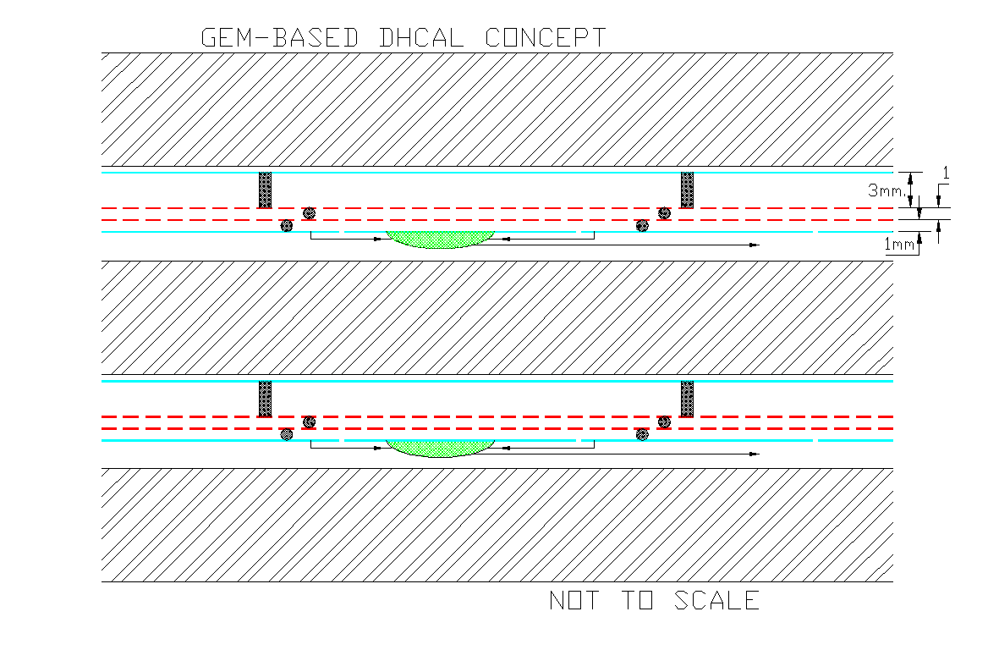
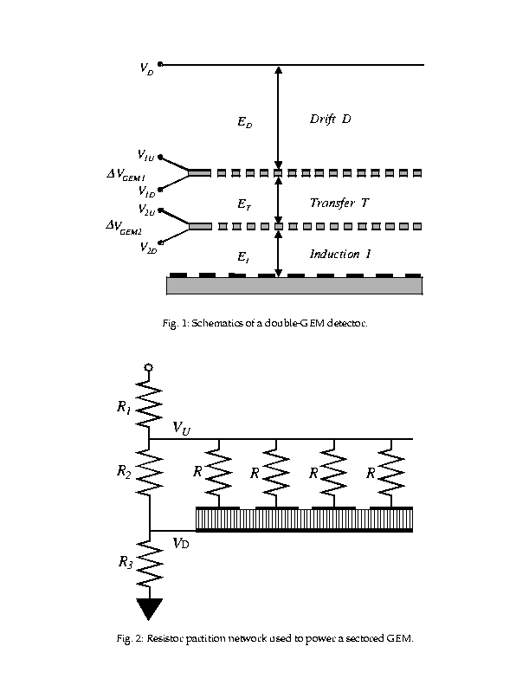
GEM-based Digital Calorimeter Concept
Use Double GEM layers
{
-2100V
~6.5mm
∆V ~400V
∆V ~400V
0V

Slide 5
What have been done so far?
Bench tested with various source and cosmic ray
  Used QPA02 chip based preamp
  Verified the signal shape, responses and gain
Took a beam test at a high flux electron beam
  Prototype chamber built with 3M’s 30cmx30cm GEM
  Used QPA02 chip based preamp
  Verified that the chamber can survive
Took two beam tests at FNAL’s MTBF
  Used QPA02 chip based preamp
  8 GeV pion beams and 120GeV proton beams
  Measured chamber responses, efficiencies and gain

Slide 6
KPiX Analog Readout for GEM DHCAL
Dynamic gain select (GEM/Si)
13 bit A/D
DHCAL anode pad
Storage until end of train.
Pipeline depth presently is 4
Leakage current subtraction
New version equipped with self and ext. trigger
Event triggered by the ILC clock
calibration
1024 channel 13 bit ADC chip
Developed for Si/W ECAL@ SLAC
Notes:
6

Slide 7
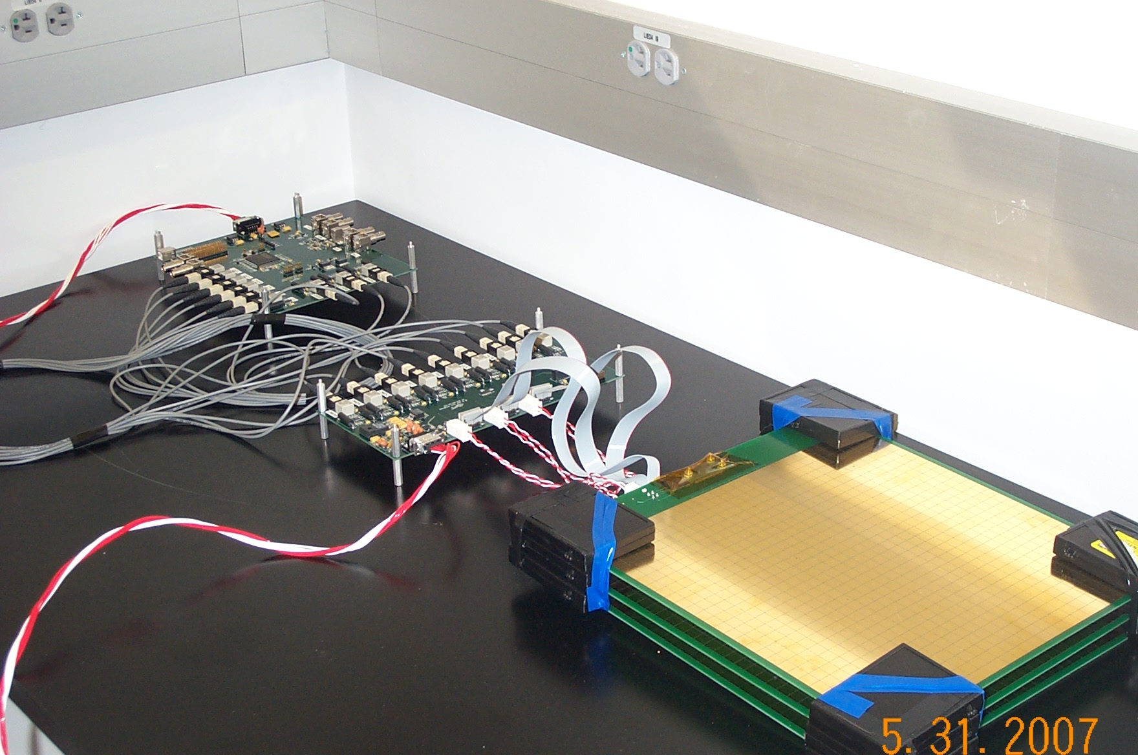
GEM-DHCAL/KPiX boards with Interface and FPGA boards

Slide 8
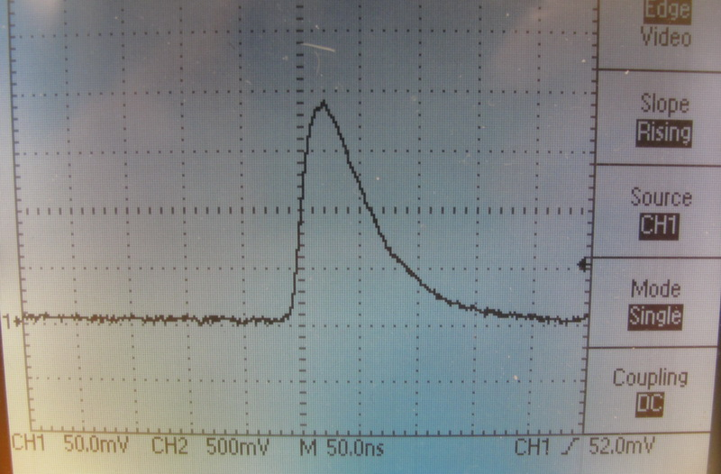
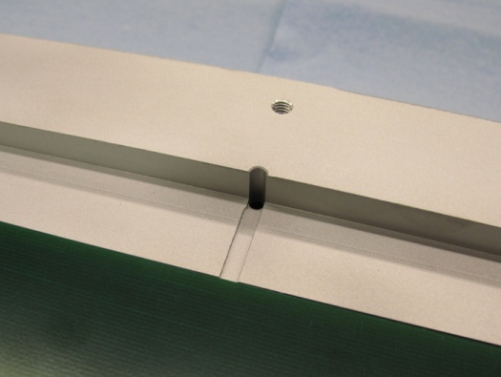
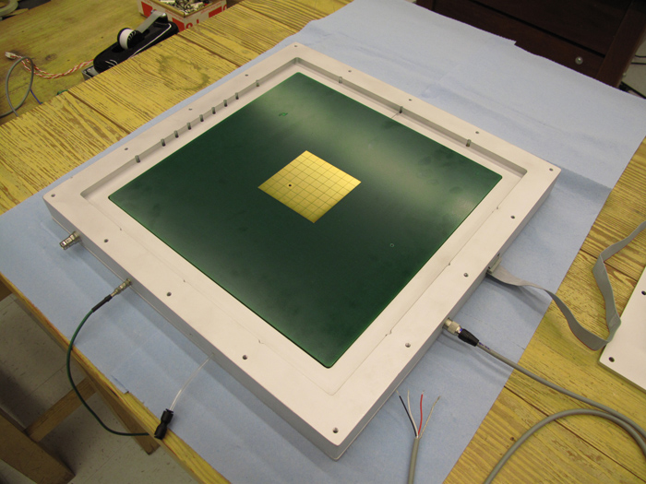
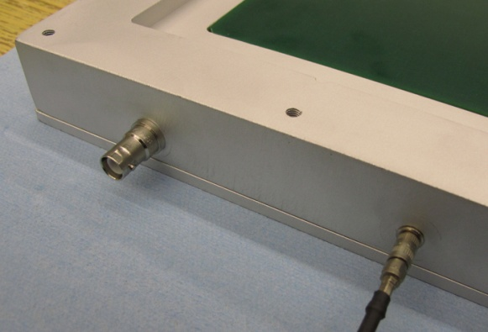
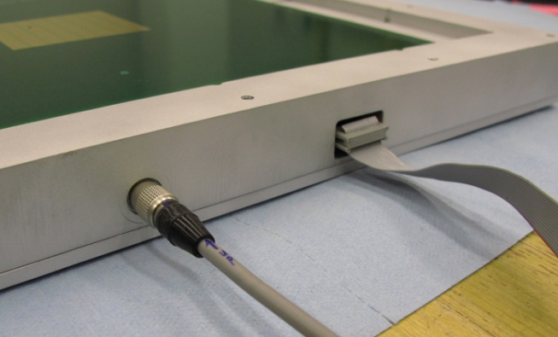
Fe55 Source Signal
Gas outlet
Top side
Data cable
HV power
Analog signal
LV power

Slide 9
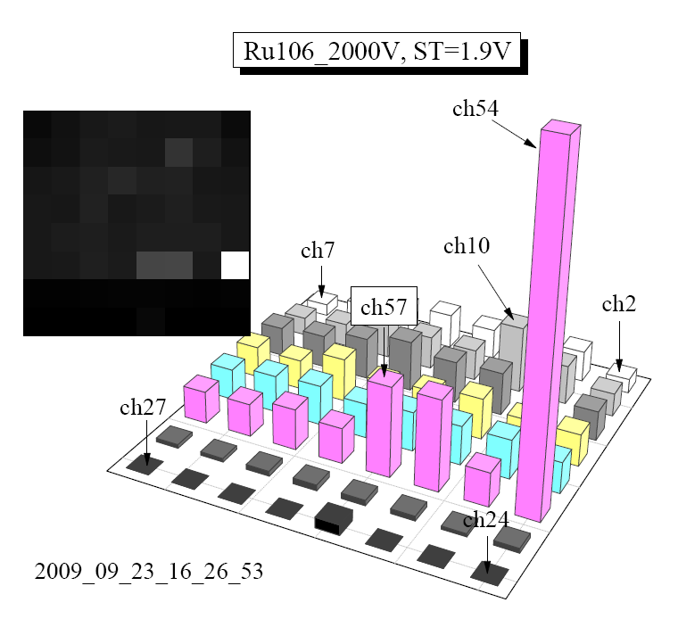
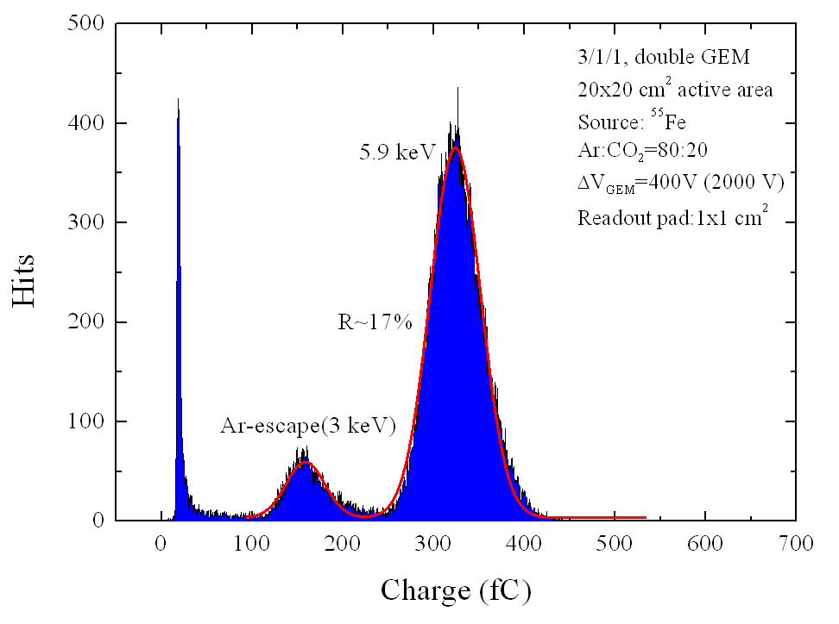
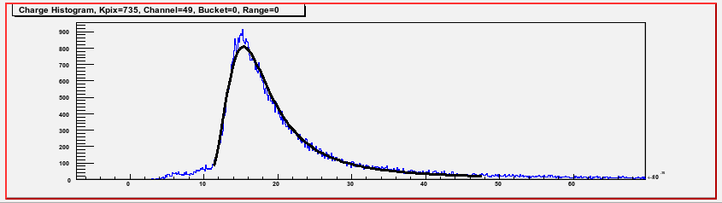
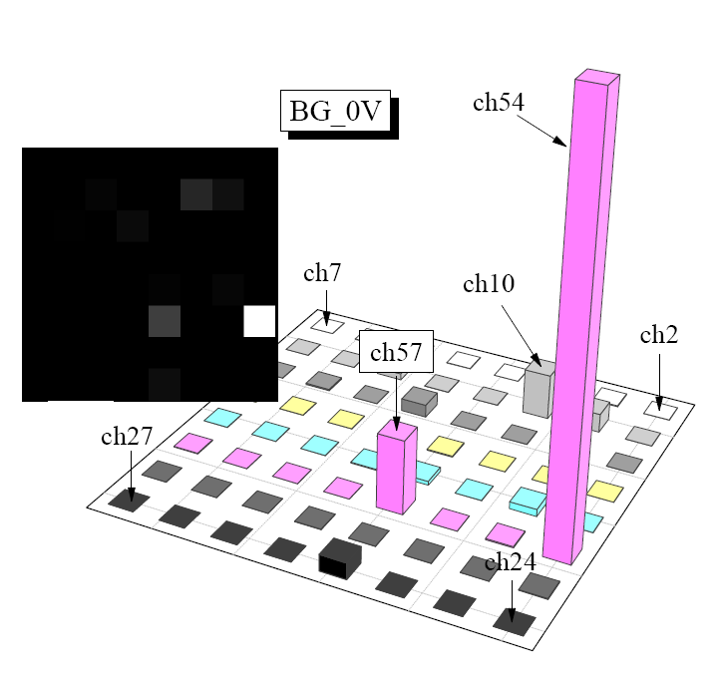
GEM+kPiX Fe⁵⁵ and Ru¹⁰⁶ Spectra
Fe⁵⁵
Ru¹⁰⁶
Good conformation to characteristic Minimum Ionizing Landau fit

Slide 10
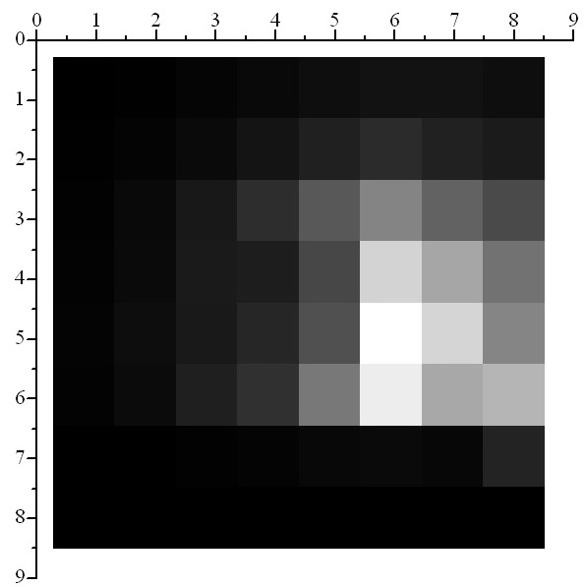
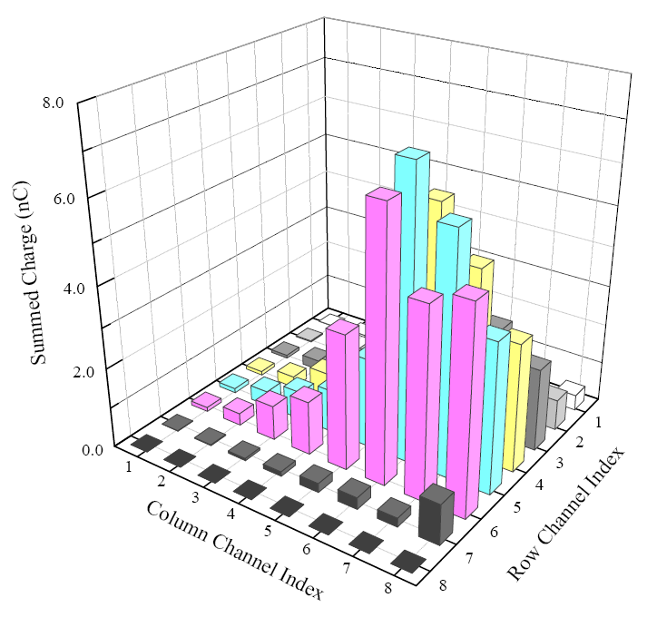
Charge Weighted Lego for Fe55
Inactive area
(HV not applied)
HV=1960 V, Self Trigger Th=1.8 V= 14fC

Slide 11
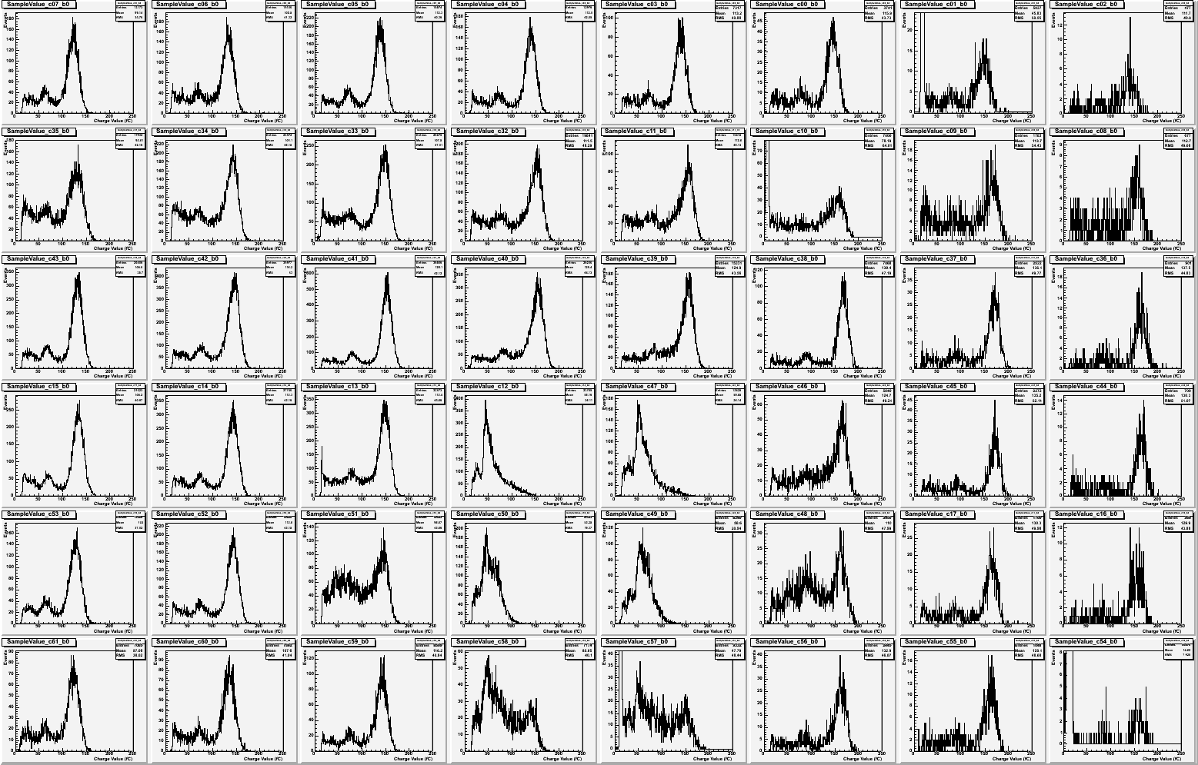
Histogram Map for Fe55
HV=1960 V, Self Trigger Th=1.8 V= 14fC

Slide 12
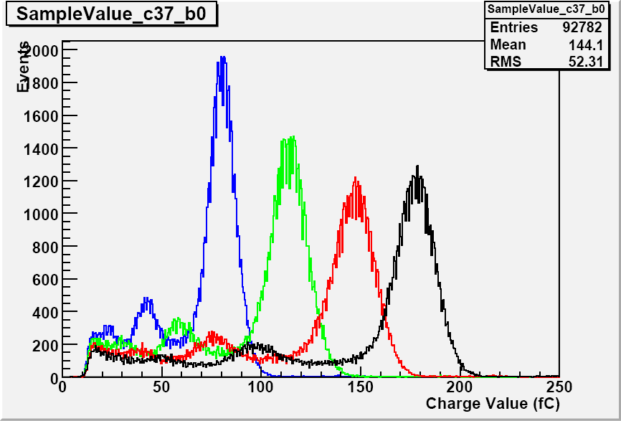
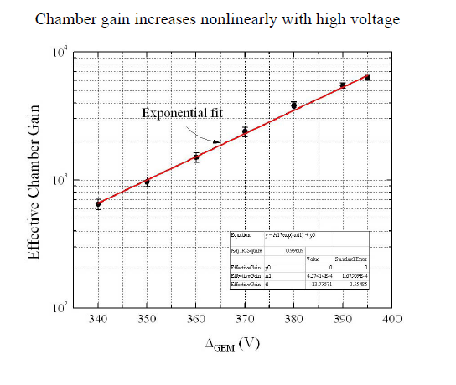
1860V
1900V
1930V
1960V
Typical operating point: Gain ~6000

Slide 13
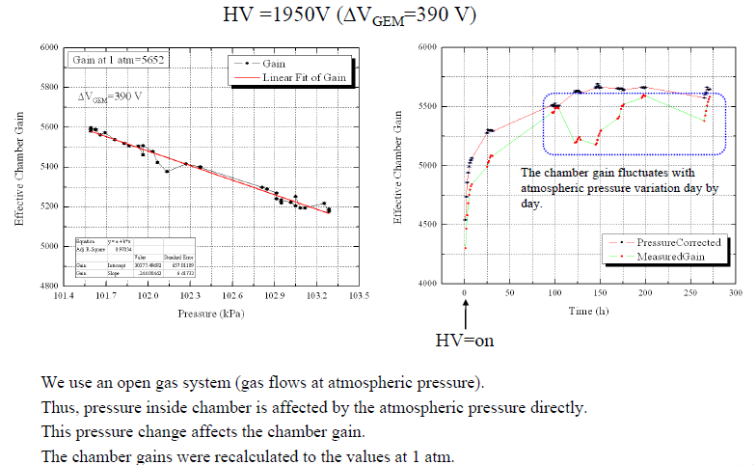
Pressure Dependence of Gain

Slide 14
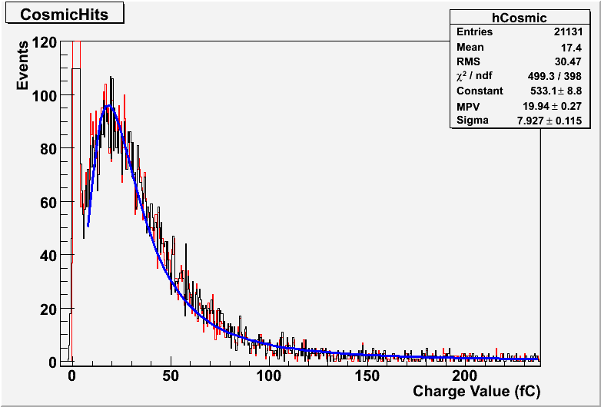
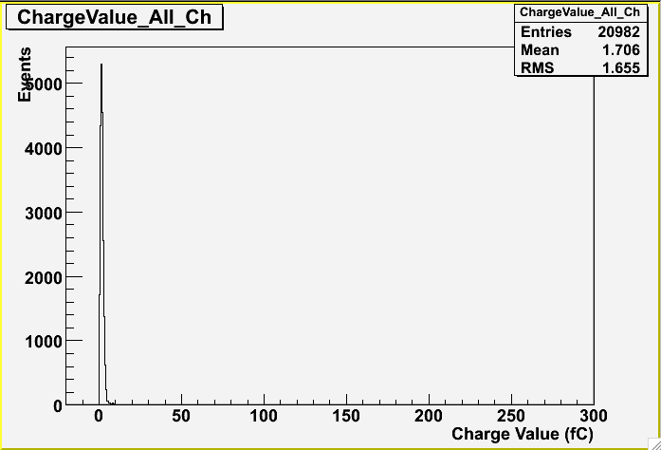
Cosmic Ray Data with External Trigger
Noise spectrum

Slide 15
GEM DHCAL Plans
Phase I ➔ Completion of 30cm x 30cm characterization
  Mid 2010: using one to two planes of 30cm x 30cm double GEM chamber with 64 channel KPiX7 and DCAL chips
  Joint Test with THGEM/KPiX at CERN
Phase II ➔ 33cm x 100cm unit chamber construction and characterization
  Mid 2010 – late 2011 at MTBF: Using available KPiX chips and DCAL chips
Phase III ➔ 100cm x 100cm plane GEM DHCAL performances in the CALICE stack
  Mid 2011 – Early 2012 at Fermilab’s MTBF or CERN
  Five 100cm x 100cm planes inserted into existing CALICE calorimeter stack and run with either Si/W or Sci/W ECALs, and RPC or other technology planes in the remaining HCAL

Slide 16
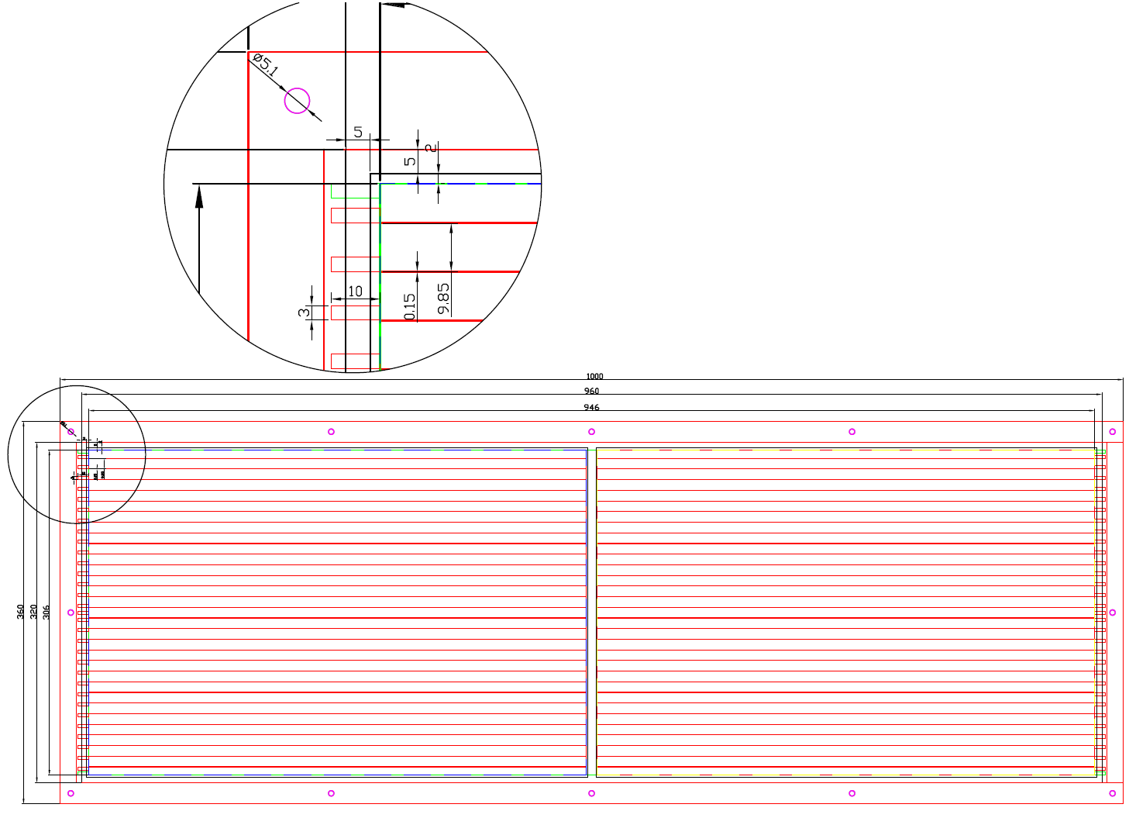
33cmx100cm GEM Foils Design
Active area 468x306x2 mm²
Number of HV sectors = 32x2=64
HV sector dimension= 9.9x479.95 mm²

Slide 17
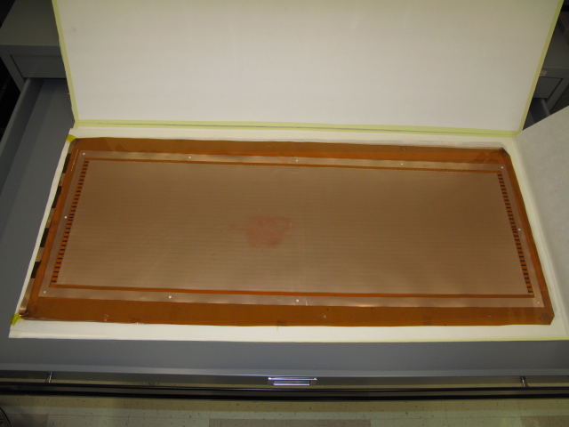
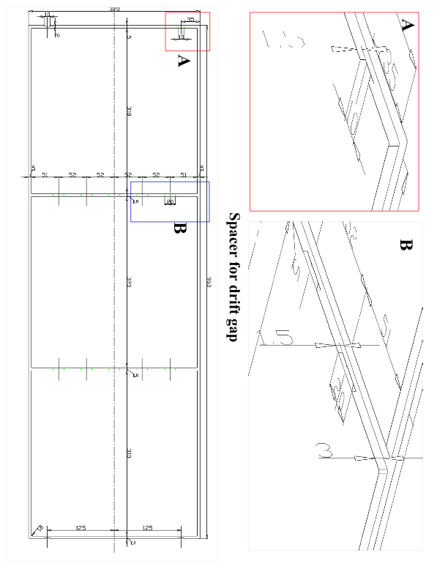
33cmx100cm Large Area GEM
First 5 of 33cmx100cm GEM foils delivered early July, 2010
Design for Large Area GEM detector frames

Slide 18
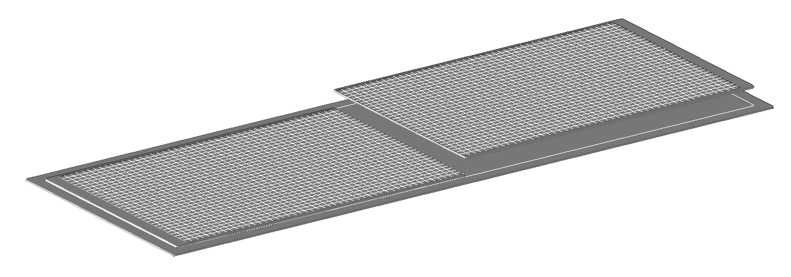
33cmx100cm DHCAL Unit Chamber Construction
Readout Board
330x500 mm²
1000 mm
Base steel plate, t=2 mm
330 mm
2mm steel strong-back + thin cathode layer
1cm thick support from G10 spacers
3mm
1mm
1mm
1mm pad board
2mm FE board
1mm assister strong back

Slide 19
UTA’s 33cm x 100cm DHCAL Unit Chamber

Slide 20
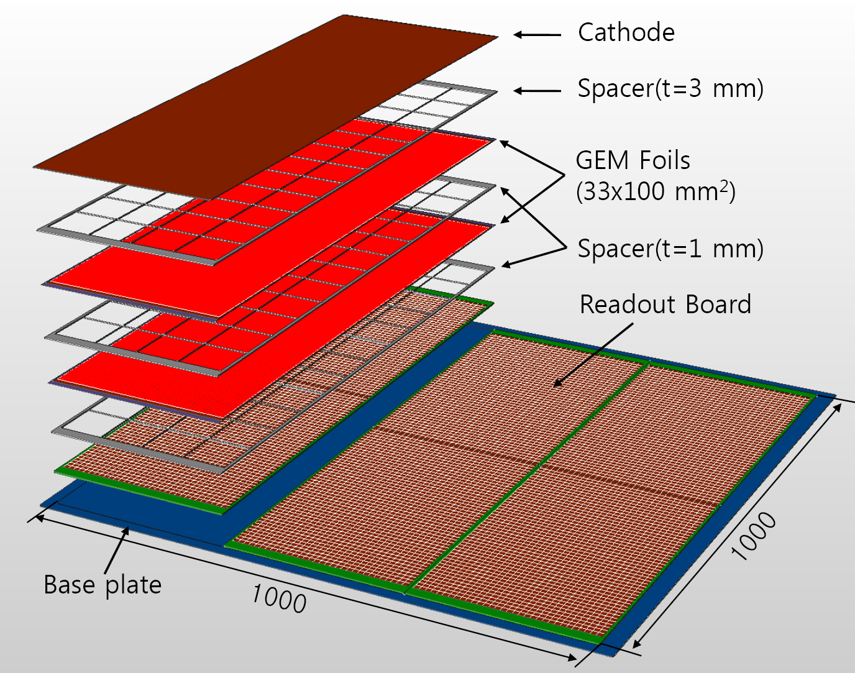
UTA’s 100cmx100cm Digital Hadron Calorimeter Plane
100cm
32cm
96cm
96 ~ 97cm
100cm

Slide 21
Summary
Impressive progress has been made reading out 30cmx30cm GEM prototype chambers with 64 channel KPiX v7 chips
  Observed clean characteristic peaks from Fe⁵⁵ and Ru¹⁰⁶ sources as well as cosmic ray muons
  2-D readout of the chamber routine now…
  Higher channel count KPiX chips being developed
  Pressure dependence measured and corrected
Cosmic ray and source data taking and analysis in progress
33cmx100cm unit chamber construction proceeding
  First 5 foils of 33cmx100cm delivered!!
Mechanical design being worked out for constructing 1mx1m planes for DHCAL testing

