Slide 1
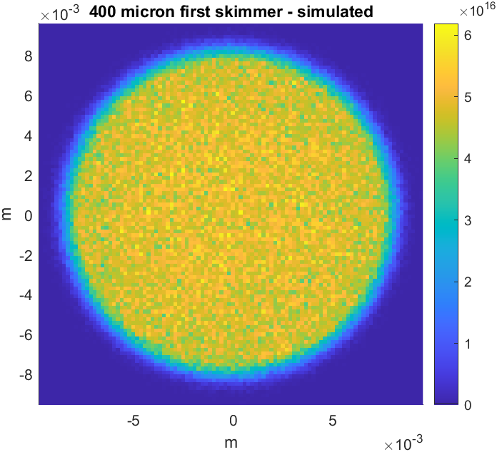
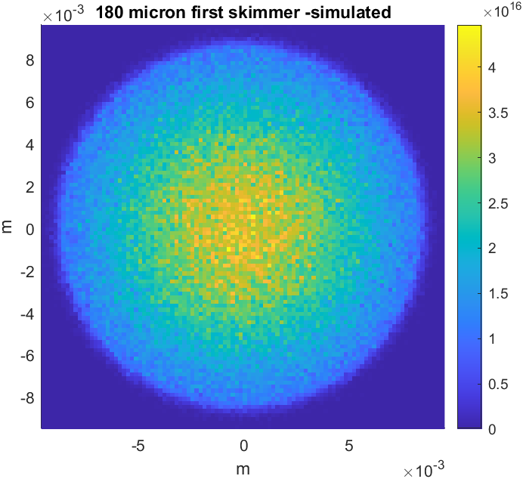
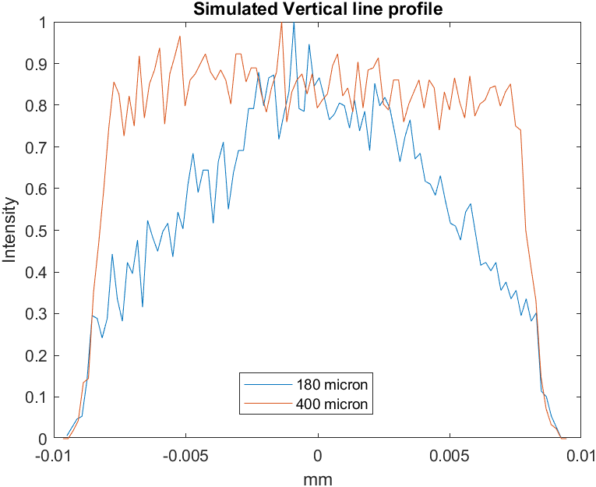
Next step → A more uniform jet
Original arrangement:
  30 micron nozzle
  180 micron first skimmer
  400 micron second skimmer
Current arrangement
  30 micron nozzle
  180 micron first skimmer
  2mm second skimmer
Next step
  30 micron nozzle
  400 micron first skimmer
  2mm second skimmer

Slide 2
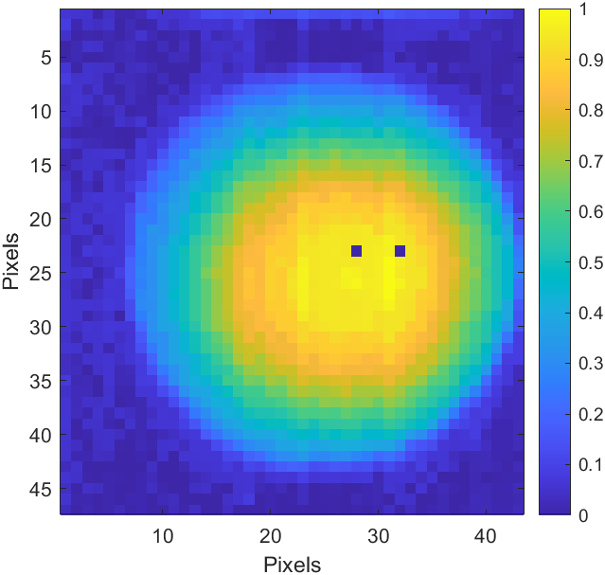
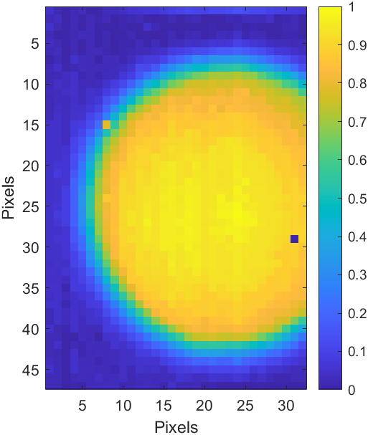
2D density scan (between the 2nd skimmer and 3rd skimmer
Old configuration:
Nozzle : 30micron
Skimmer I : 180 micron
Skimmer II: 2mm
New configuration:
Nozzle : 30micron
Skimmer I : 400 micron
Skimmer II: 2mm

Slide 3
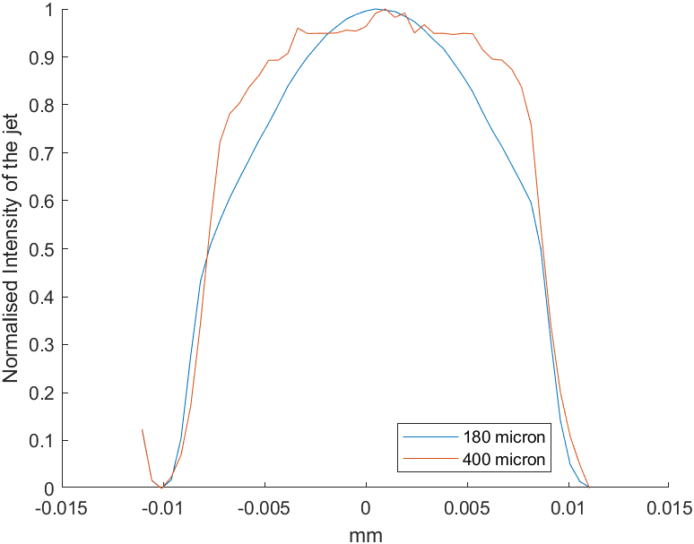
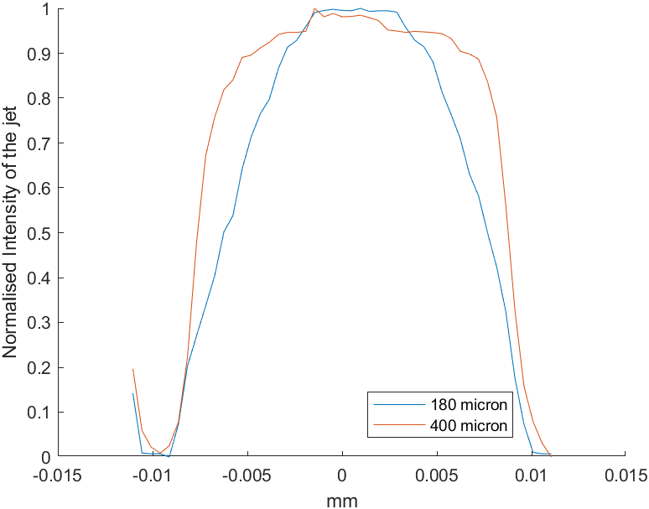
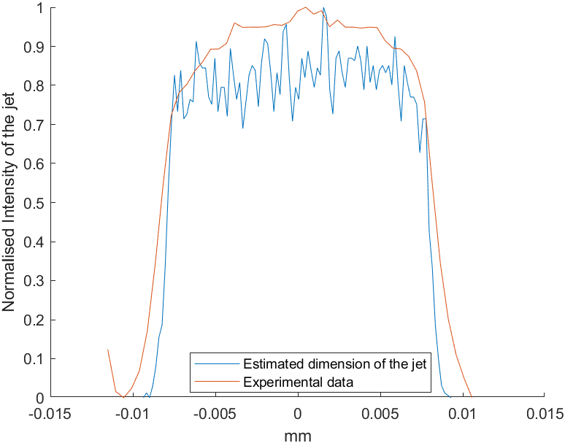
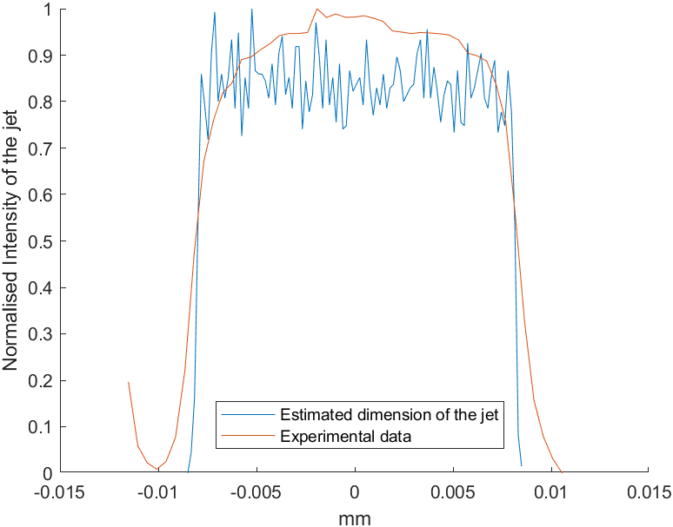
Vertical Line scans
1- Line scan of Nitrogen at 5bar Inlet pressure
2- Line scan of Neon at 5bar Inlet pressure
Figures 1 and 2 : Line scan through the centre of the jet using the movable gauge. 180micron first skimmer is being compared to the 400micron first skimmer
3- Estimations vs measurements (Nitrogen)
4- Estimations vs measurements (Neon)
Figures 3 and 4: Experimental data being compared to the theoretical estimates

Slide 4
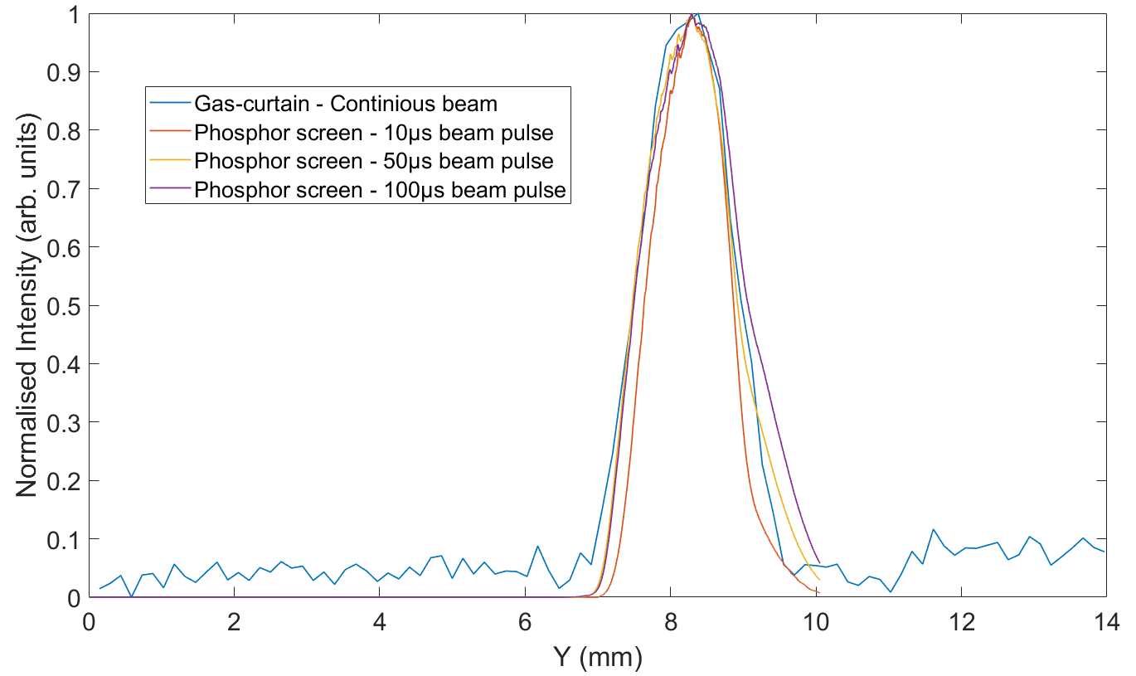
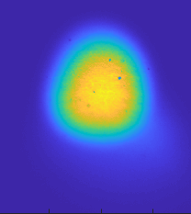
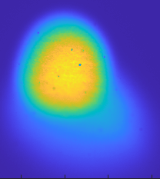
Future plan
Increasing the pulse duration of the e-beam increases the width measured by the phosphor screen.
Suggestions from the collaboration meeting:
  Removing the Intensifier.
  Grounding of the Phosphor screen.
  Taking Gas-jet data with a pulsed e-beam.
  Retaking the phosphor screen measurements with delayed CCD.

Slide 5
Items
Frames and support (ready)
Imaging system (ready)
off-line alignment system (ready)
on-line alignment system (waiting for injection mirror flange)
Chambers (ready, two are under inspection)
nozzle-skimmer assembly (missing the bellows)
Gate valve and its control system (ready)
Pumps (A type of cables is missing for TMP)
Pump control system (in progress)
New gas density measurement system (with manufacturer)
For the whole assembly ( A4-100 silver plated screw are expected)

Slide 6
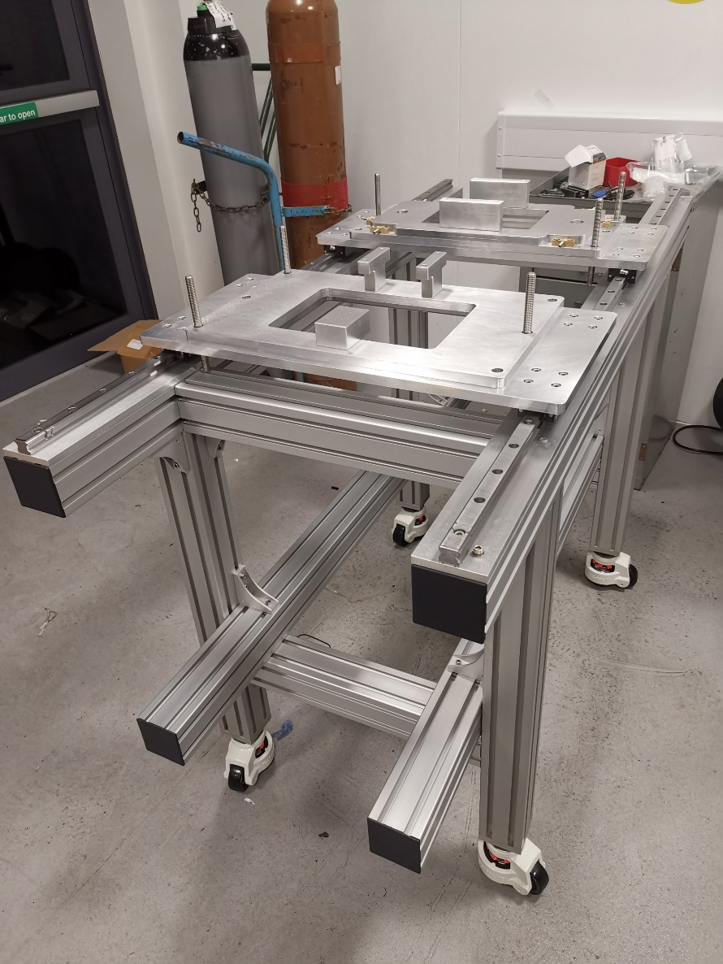
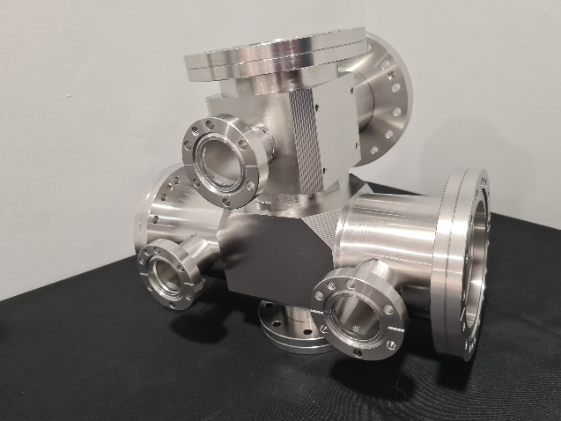
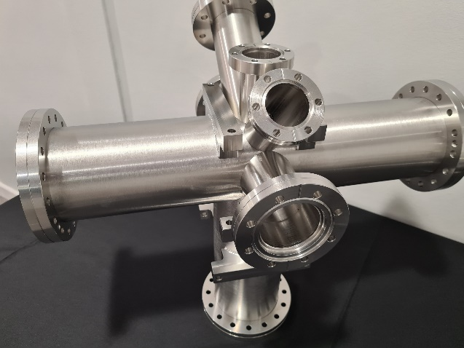
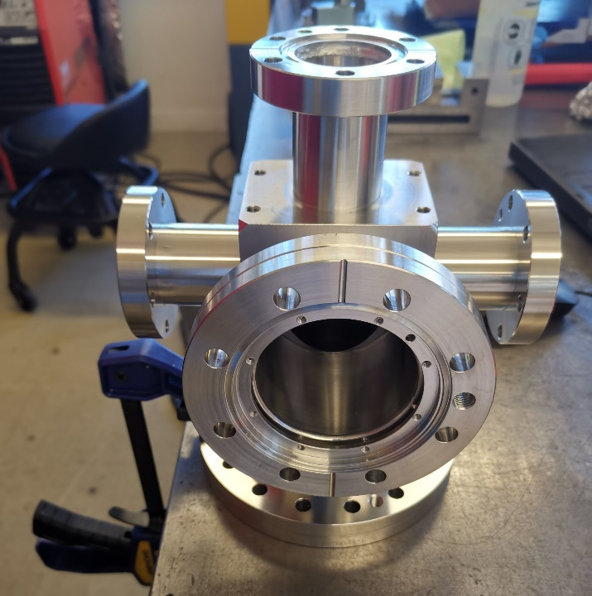
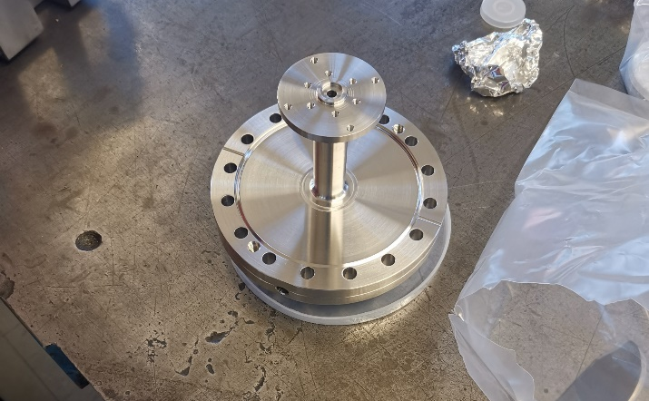
Frame, support and chambers
Interaction chamber
Injection chamber
Injection flange
dump chamber

Slide 7
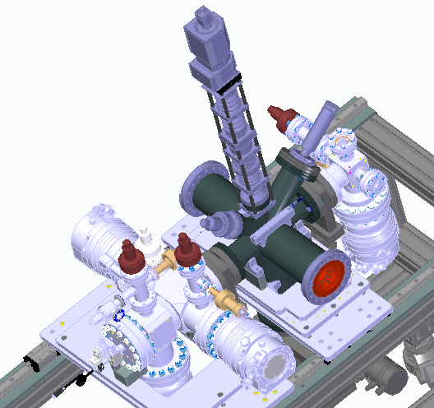
Summary for v3
Active gauge used in CI, will be changed to modular one after shipping to CERN.
T-flange ordered, but will not be used in CI test? (Pirani gauges and leaking valve are recently added to the drawing)
Dump chamber, injection flange, mirror flange being manufactured (Ready)
A4-100 silver plated screw, washer and nuts (Ordered, some need to be specially made)

Slide 8
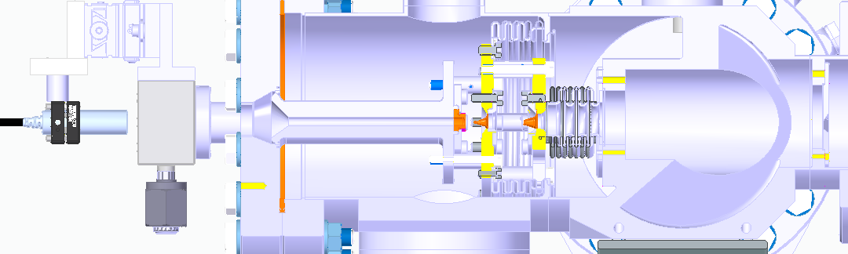
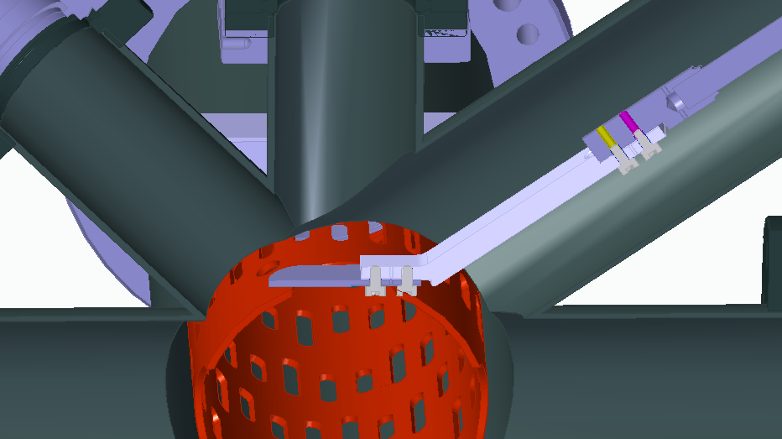
Special gas injection flange: ordered by CERN (waiting)
Nozzle: ordered from oxford by CERN (ready)
Bellows: ordered by CERN (waiting)
2nd skimmer and 3rd skimmer (ready)
Target and adaptor (ready)

Slide 9
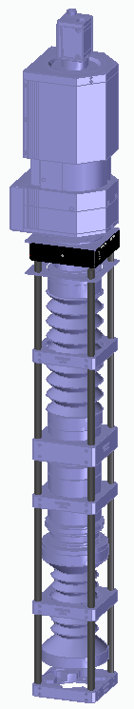
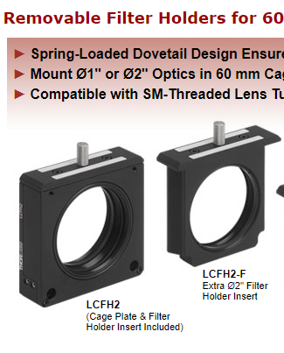
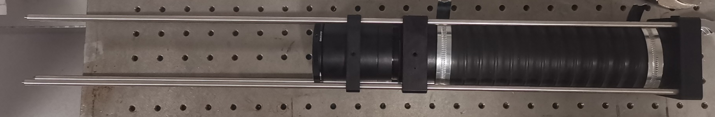
Imaging system
Removable filter for CI test
Motorized filter needed for CERN (New action)
Motorize the whole imaging system for ~42 mm movement (from target location to the interaction point) (New action)

Slide 10
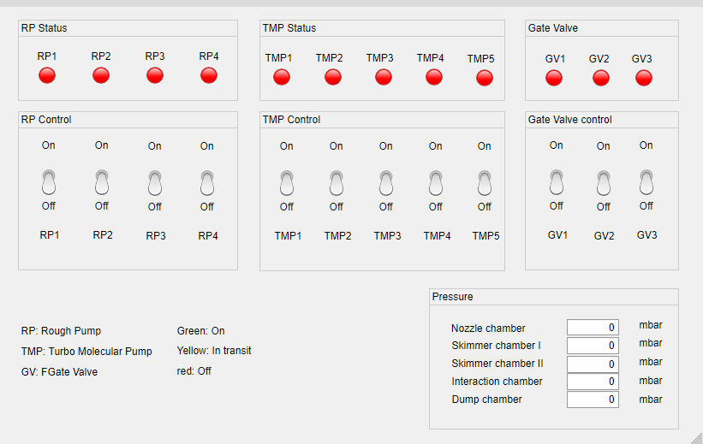
Vacuum control system

Slide 11
Vacuum control system
Normally closed
power outrage
Rough pump
Electrical valve
TMP
Normally closed
RS485 protocol
Solenoid valve (48V control)
Pneumatic
Pressure
PC
Gate valve
RS232 protocol
USB/Arduino
USB/Arduino

Slide 12
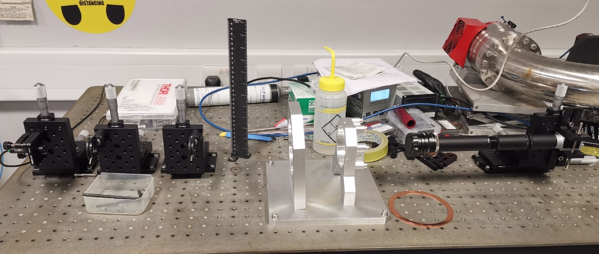
Offline alignment system

Slide 13
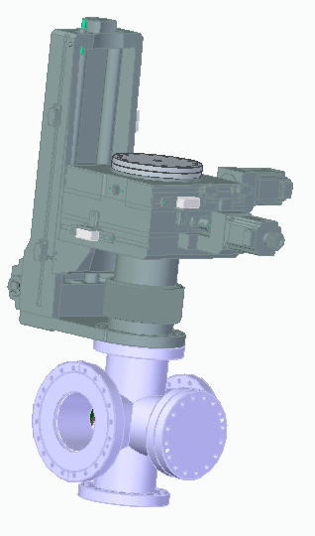
New gas density measurement system

Slide 14
Extra Slides
Pressures in each chamber for Nitrogen at 5bar :
Skimmer size | Nozzle chamber | Skimmer chamber I | Skimmer chamber II
400micron | 5.56e-3 | 1.13e-5 | 1.52e-6
180micron | 5.9e-3 | 7.91e-6 | 8.03e-7

