Slide 1
Items
Frames and support (ready)
Imaging system (ready)
off-line alignment system (ready)
on-line alignment system (waiting for injection mirror flange)
Chambers (ready, two are under inspection)
nozzle-skimmer assembly (missing the bellows)
Gate valve and its control system (ready)
Pumps (A type of cables is missing for TMP)
Pump control system (in progress)
New gas density measurement system (with manufacturer)
For the whole assembly ( A4-100 silver plated screw are expected)

Slide 2
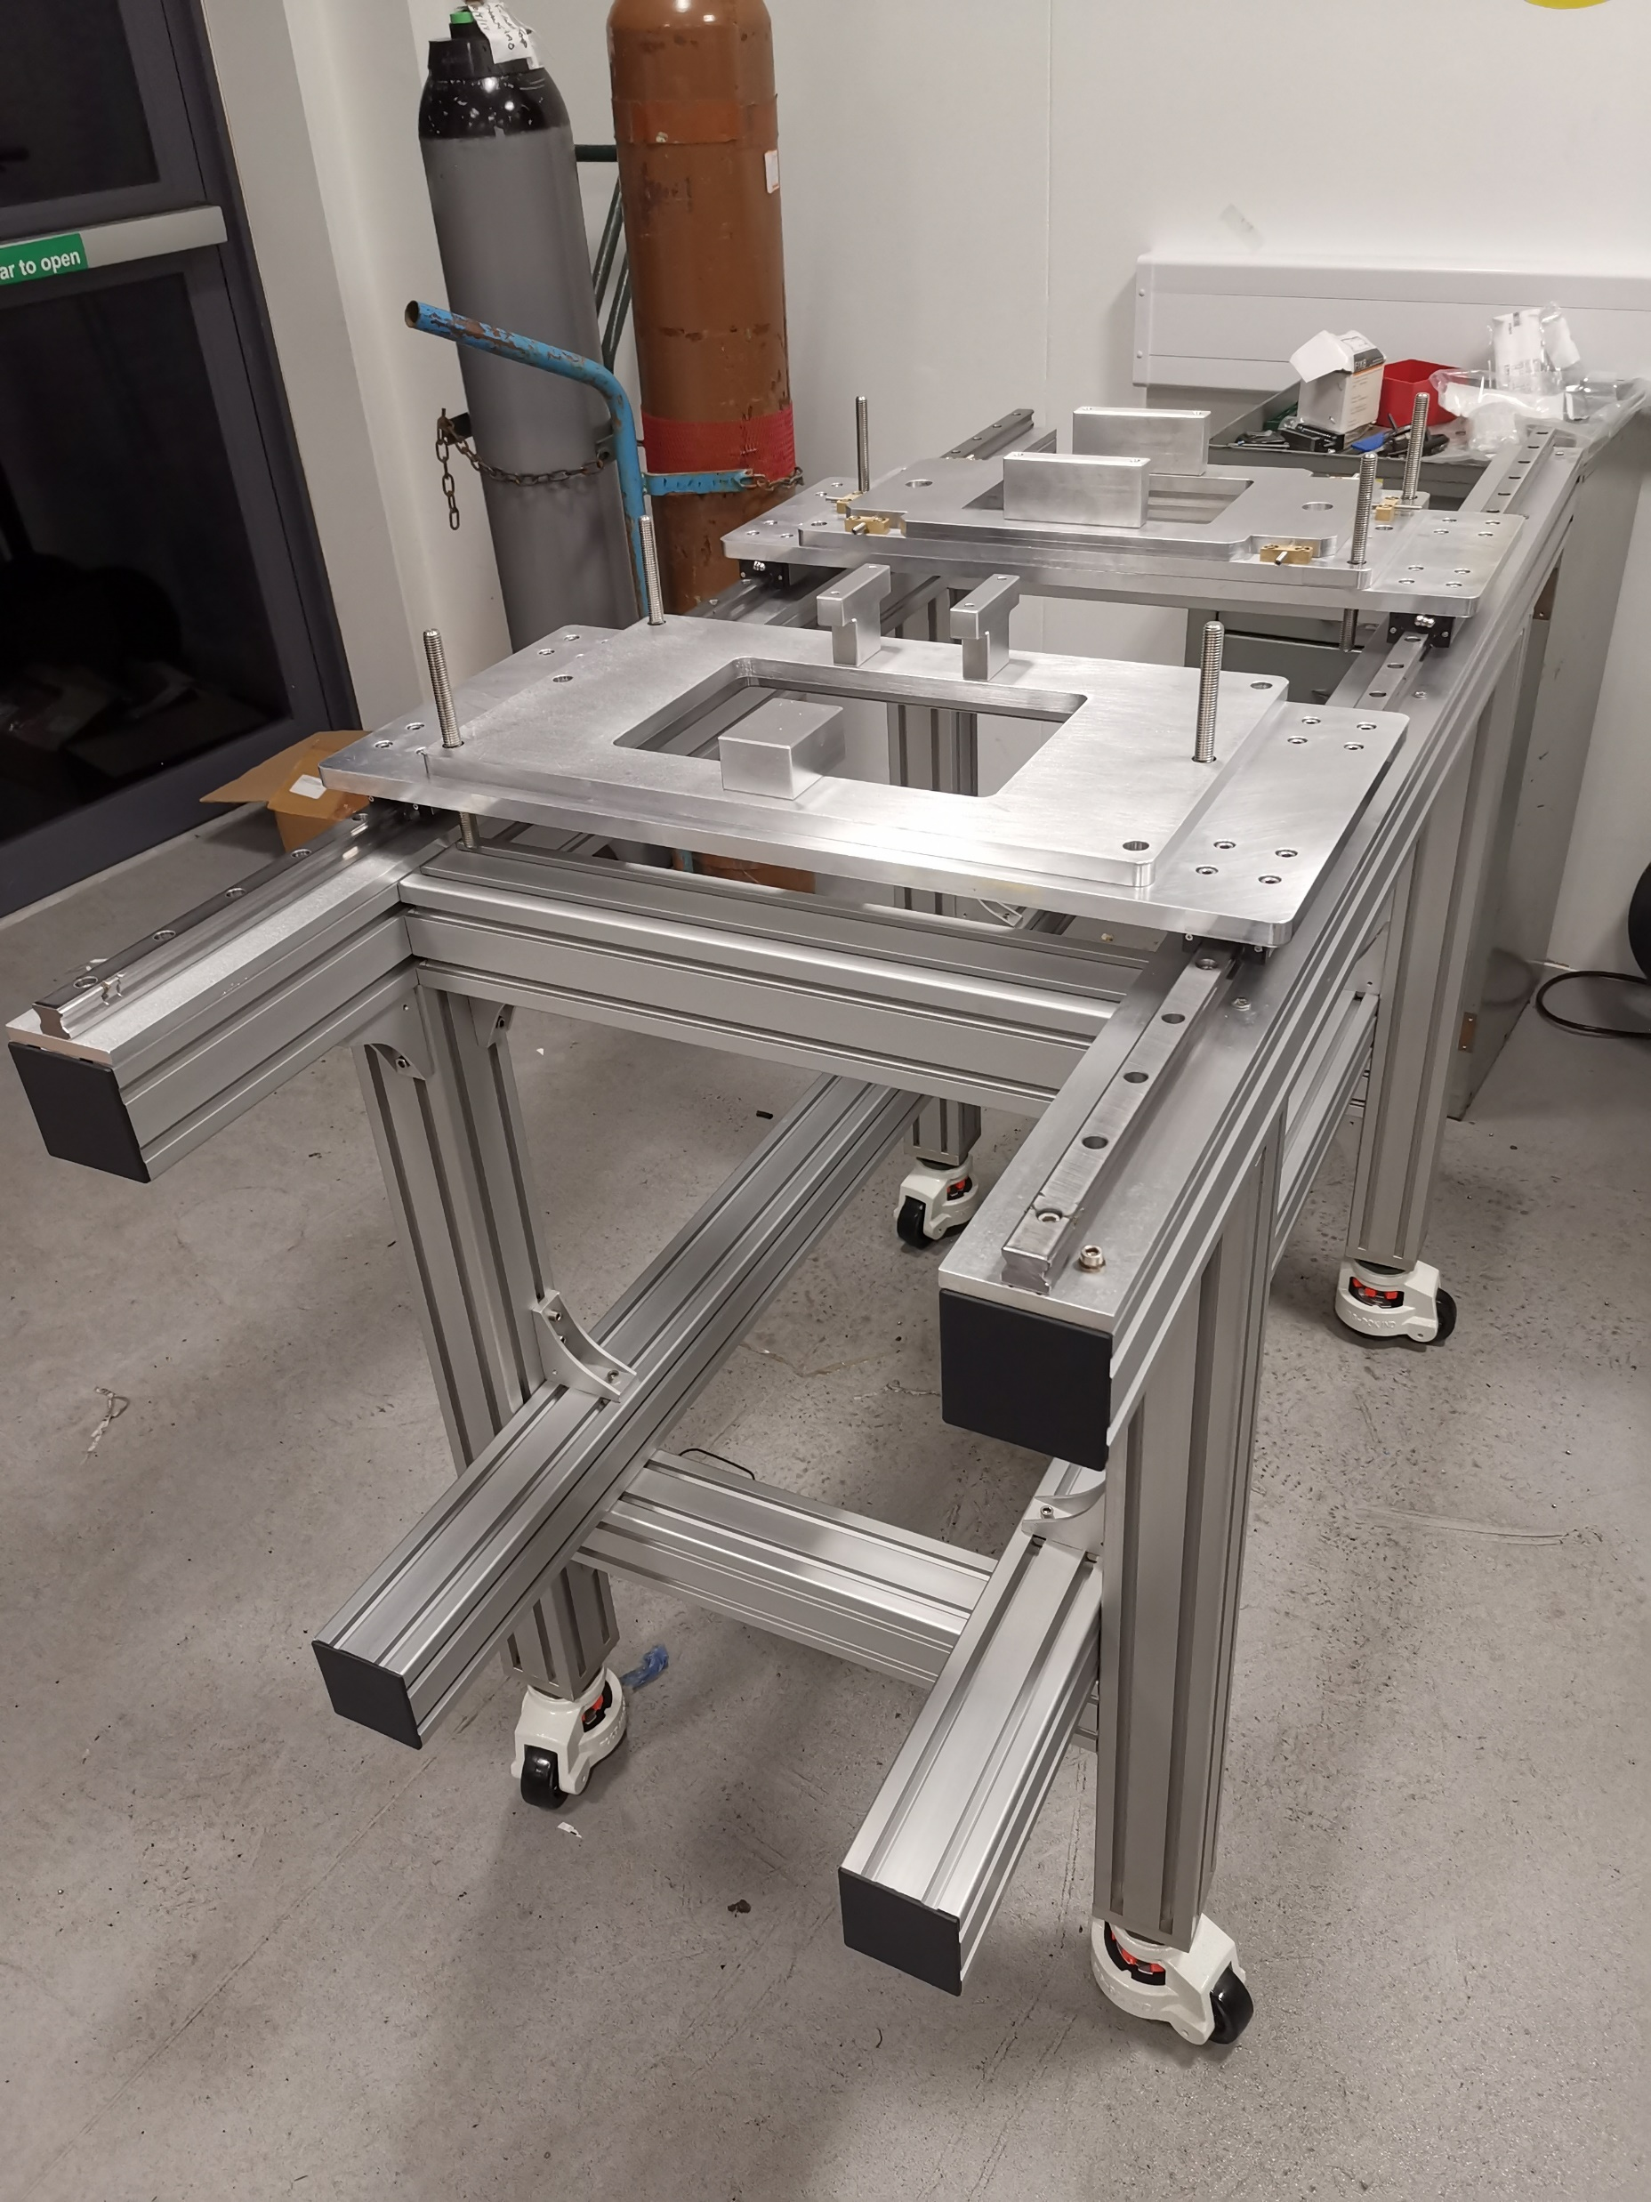
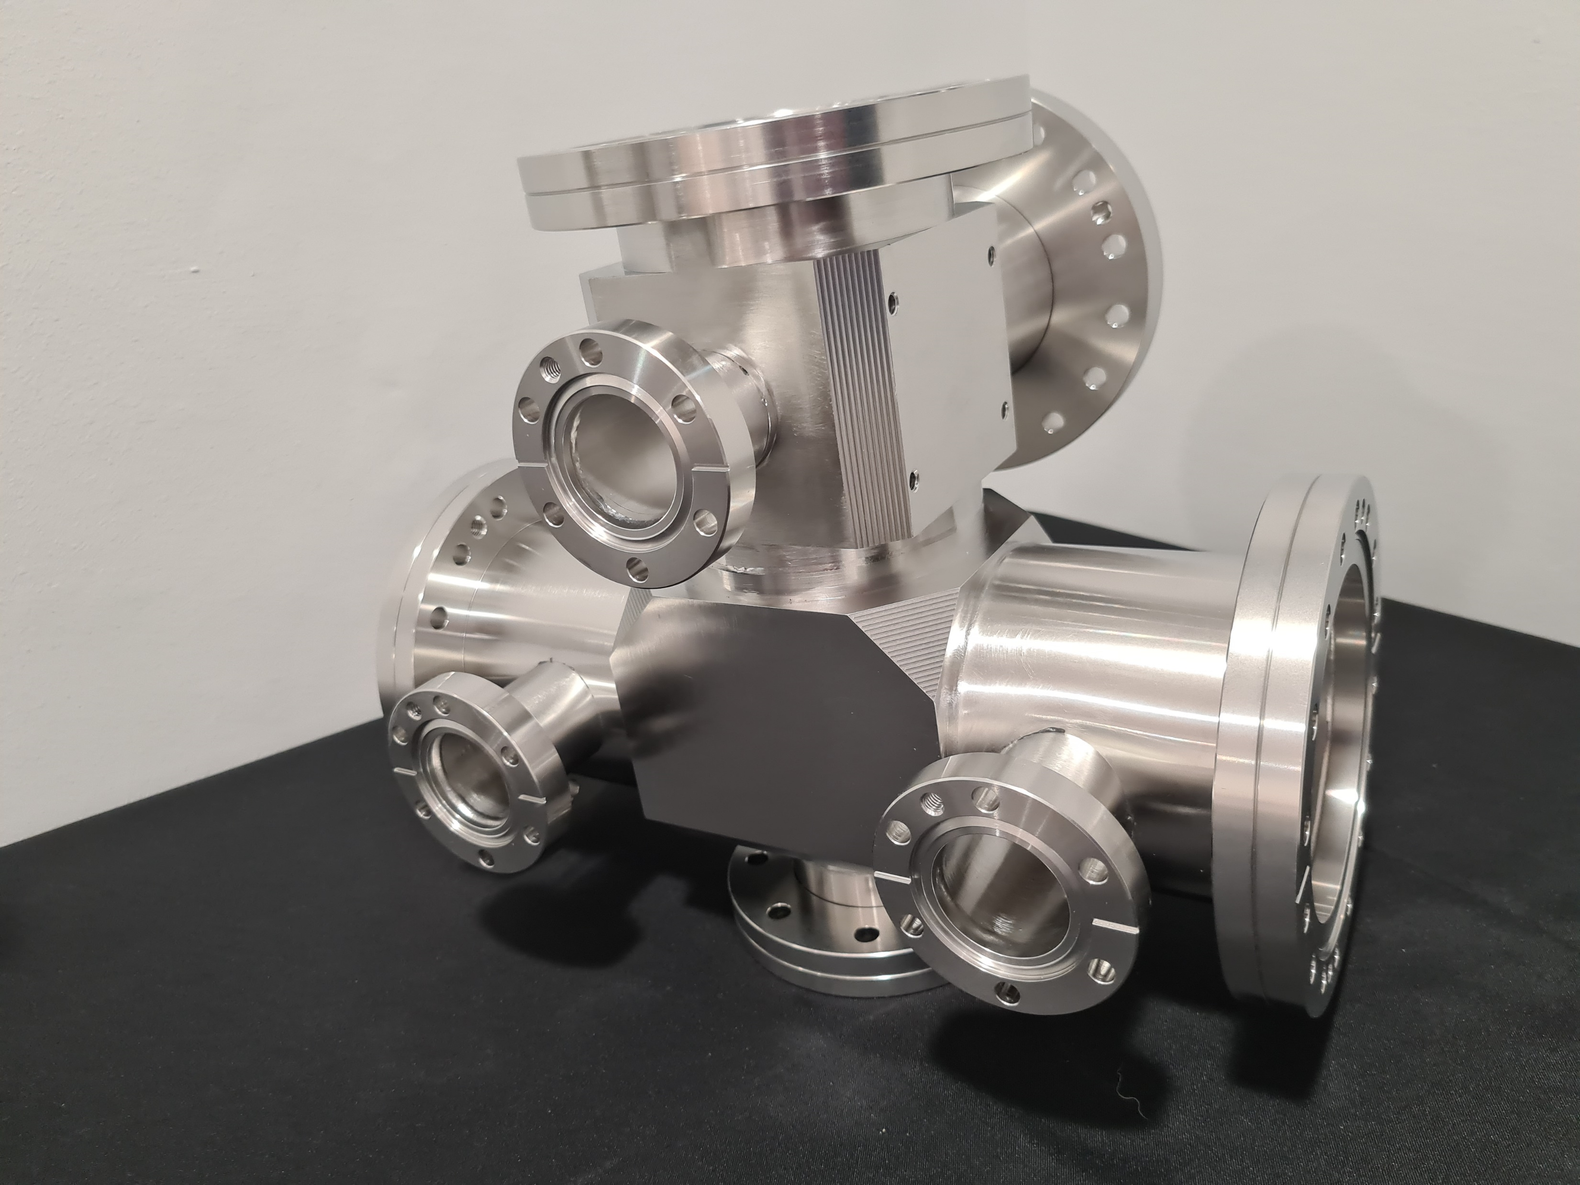
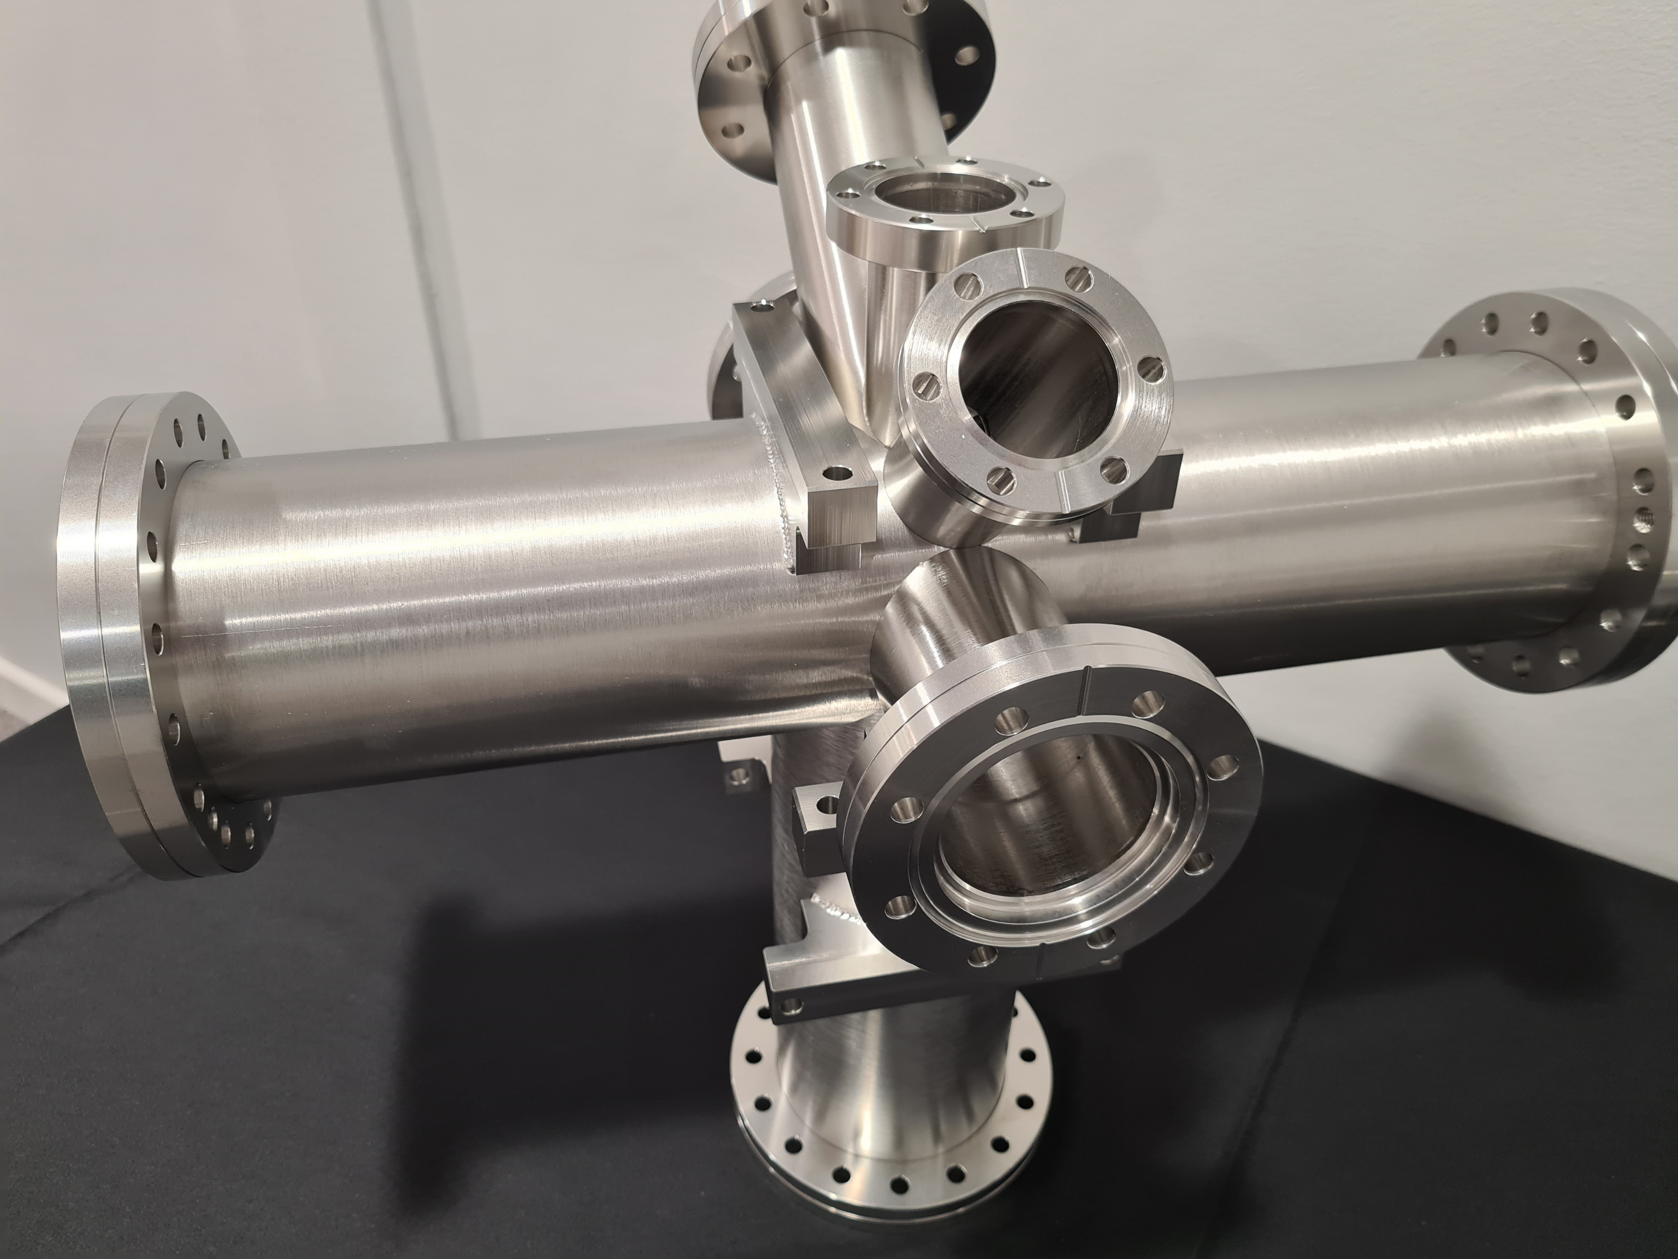
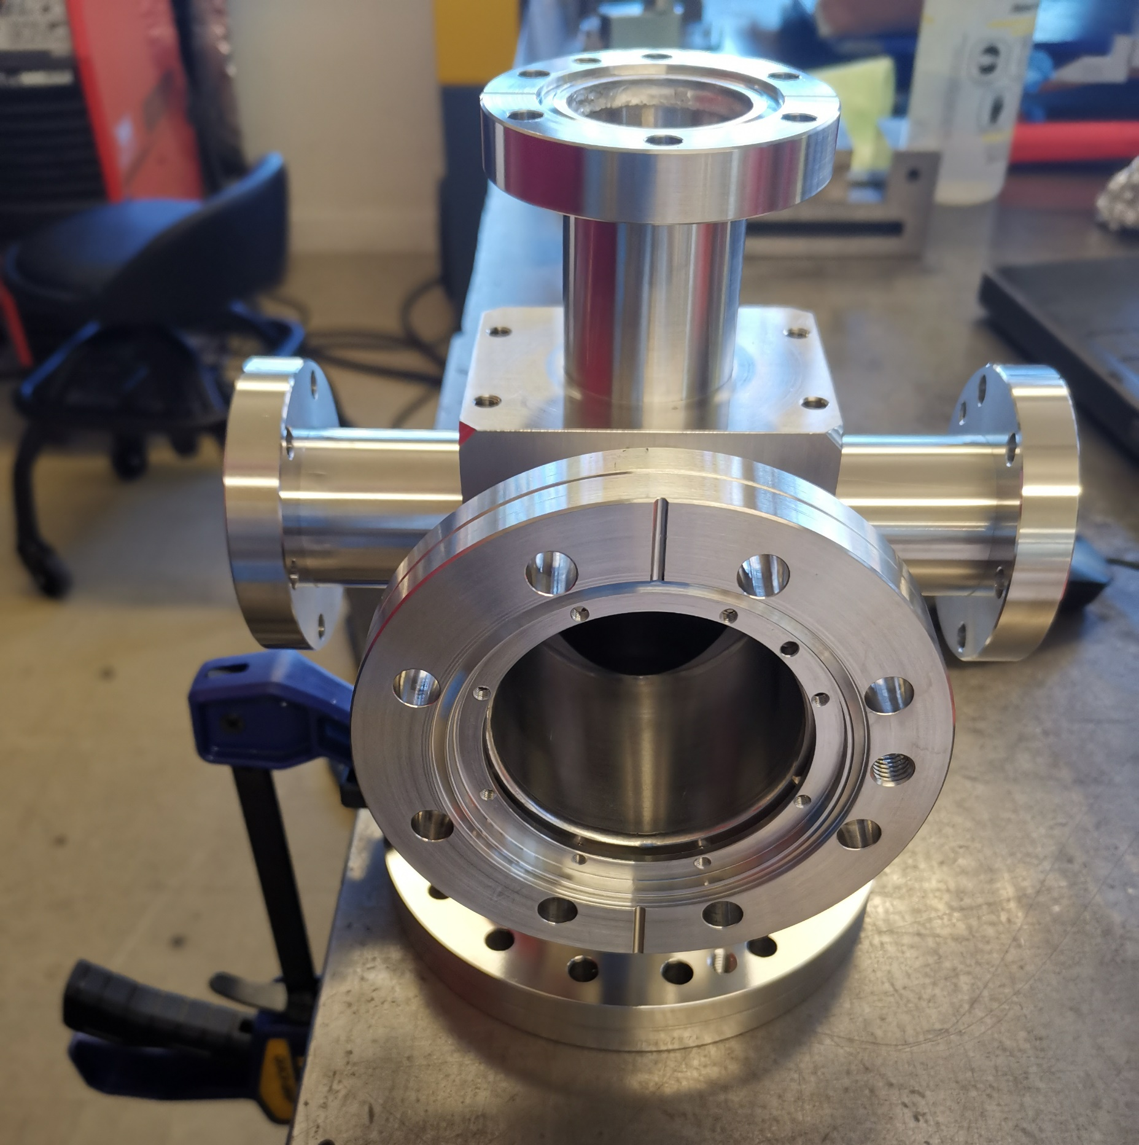
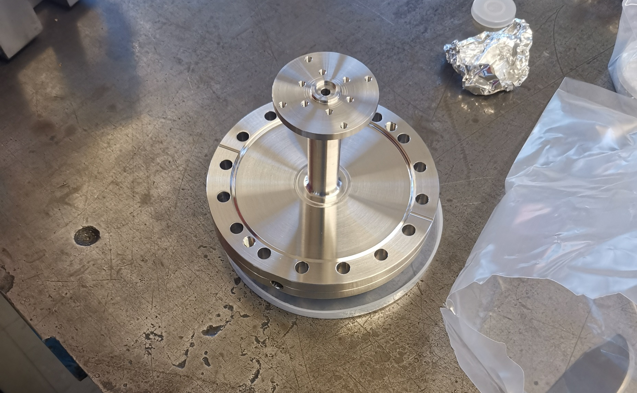
Frame, support and chambers
Interaction chamber
Injection chamber
Injection flange
dump chamber

Slide 3
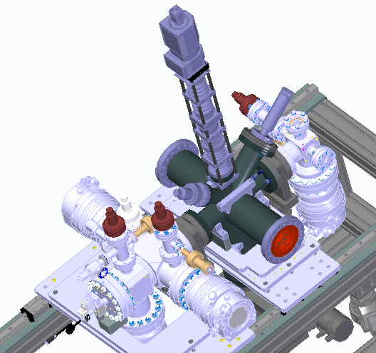
Summary for v3
Active gauge used in CI, will be changed to modular one after shipping to CERN.
T-flange ordered, but will not be used in CI test? (Pirani gauges and leaking valve are recently added to the drawing)
Dump chamber, injection flange, mirror flange being manufactured (Ready)
A4-100 silver plated screw, washer and nuts (Ordered, some need to be specially made)

Slide 4
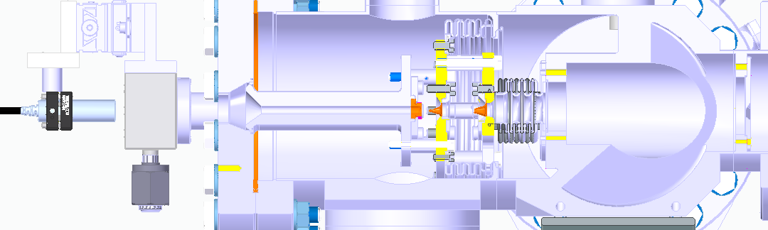
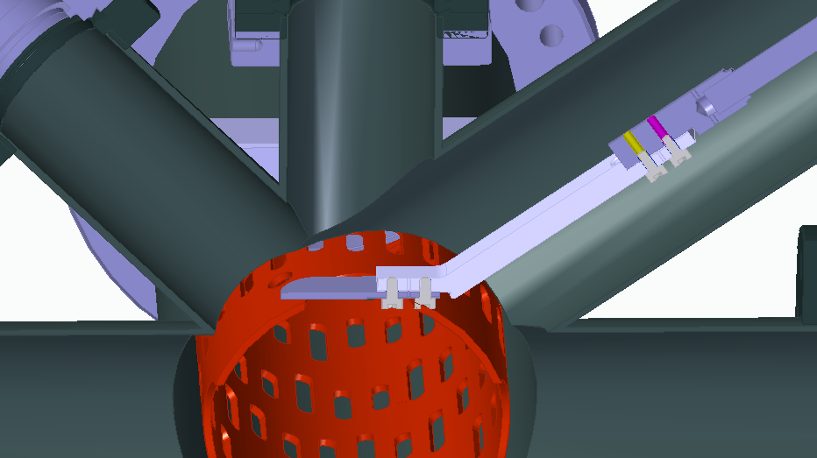
Special gas injection flange: ordered by CERN (waiting)
Nozzle: ordered from oxford by CERN (ready)
Bellows: ordered by CERN (waiting)
2nd skimmer and 3rd skimmer (ready)
Target and adaptor (ready)

Slide 5
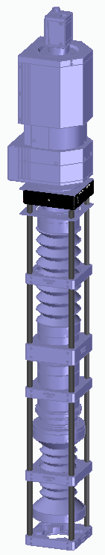
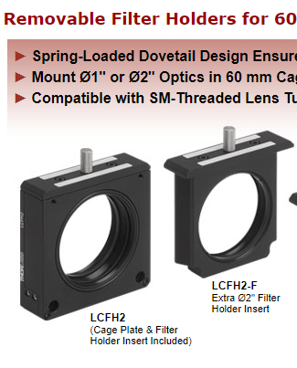
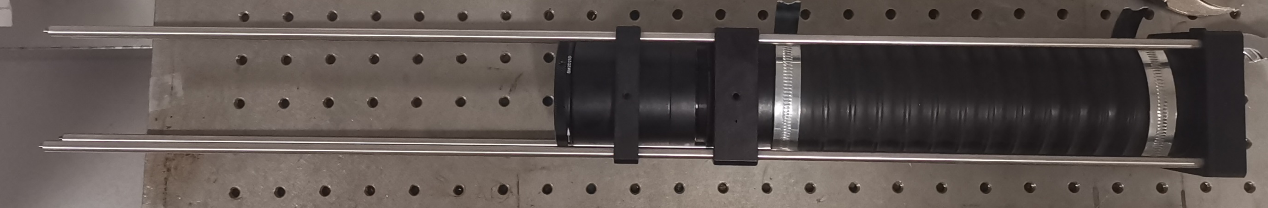
Imaging system
Removable filter for CI test
Motorized filter needed for CERN (New action)
Motorize the whole imaging system for ~42 mm movement (from target location to the interaction point) (New action)

Slide 6
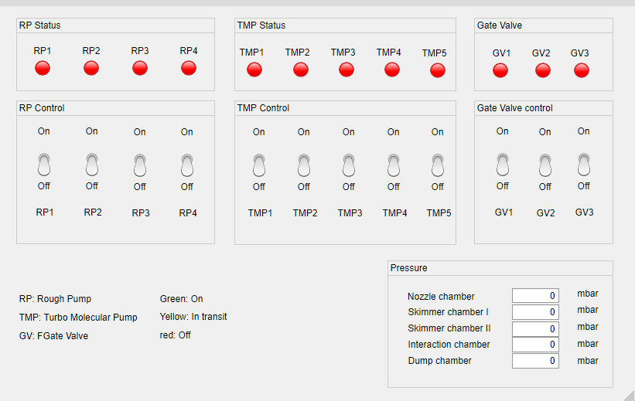
Vacuum control system

Slide 7
Vacuum control system
Normally closed
power outrage
Rough pump
Electrical valve
TMP
Normally closed
RS485 protocol
Solenoid valve (48V control)
Pneumatic
Pressure
PC
Gate valve
RS232 protocol
USB/Arduino
USB/Arduino

Slide 8
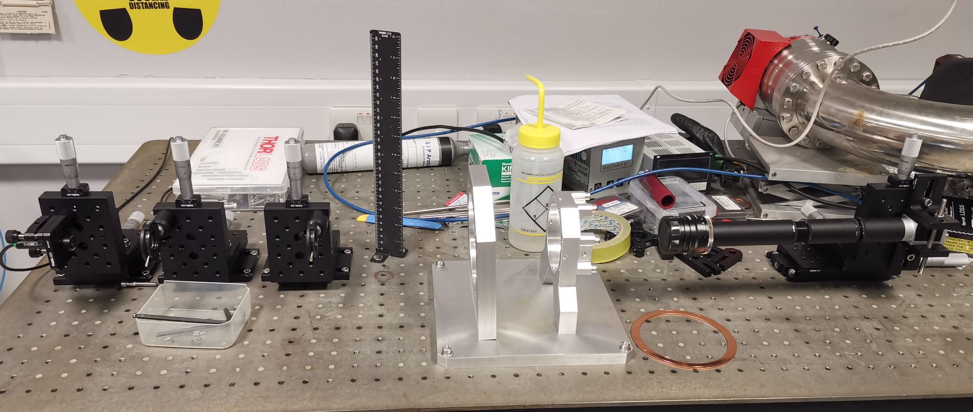
Offline alignment system

Slide 9
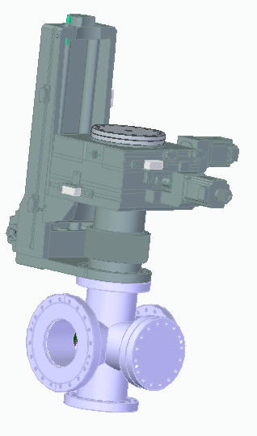
New gas density measurement system

