Slide 1
Illumination of camera due to
beam-gas-interaction
&
Synchrotron radiation on BGC
Noah Jens – 26.02.2021

Slide 2
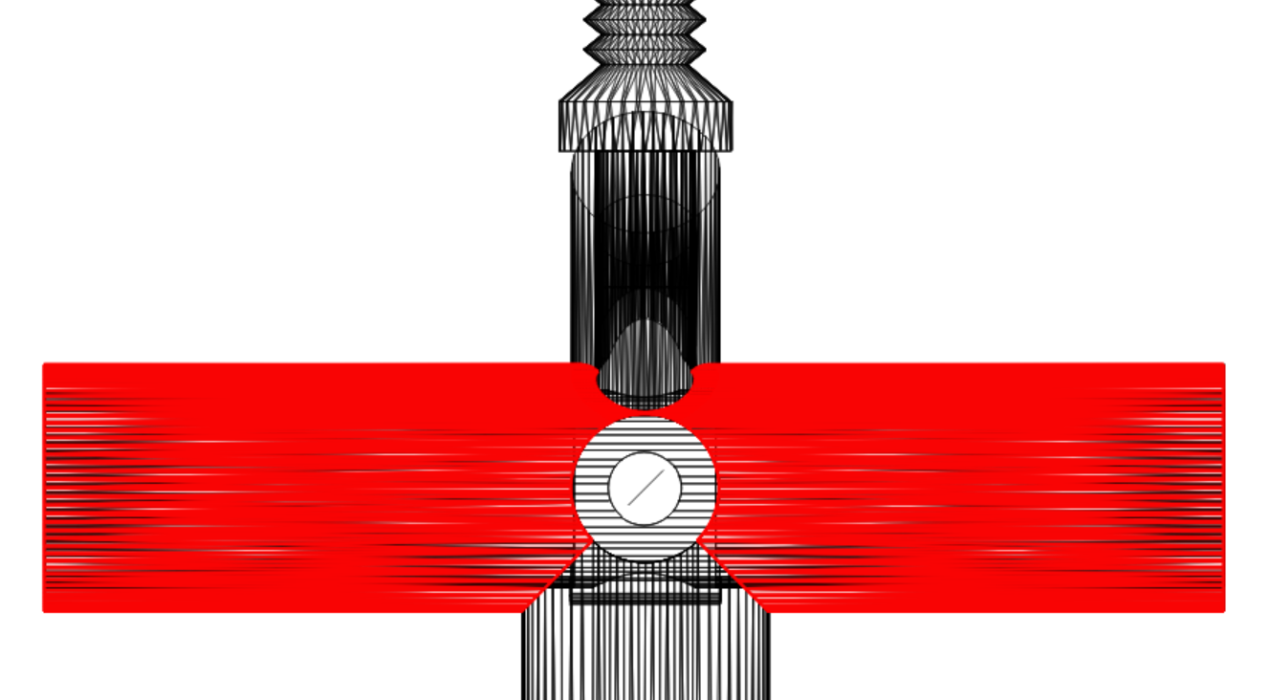
AC-coating of BGC
Only the part parallel to the beam axis is coated
Steel
AC-coated

Slide 3
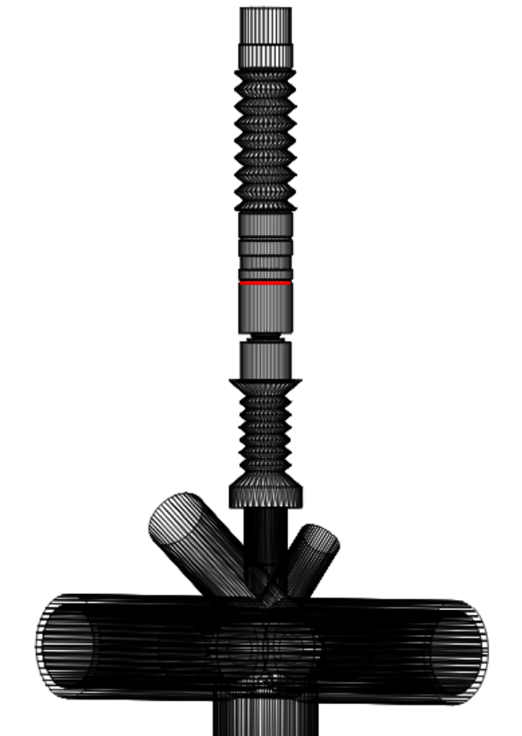
Plane of measurement
Measurement at “lens plane”
Photons with low incident angle in respect to the normal are expected to end up in the camera

Slide 4
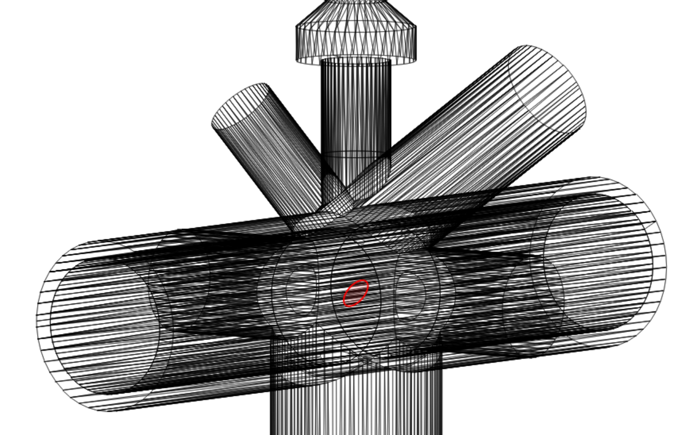
Emitting facet for BGI
At interaction point of beams and gas jet
Projection of beams (14mm Ø) on gas jet plane (45° tilted)
Uniform distribution of emission

Slide 5
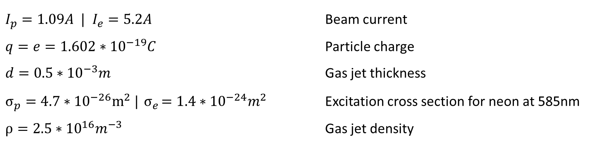
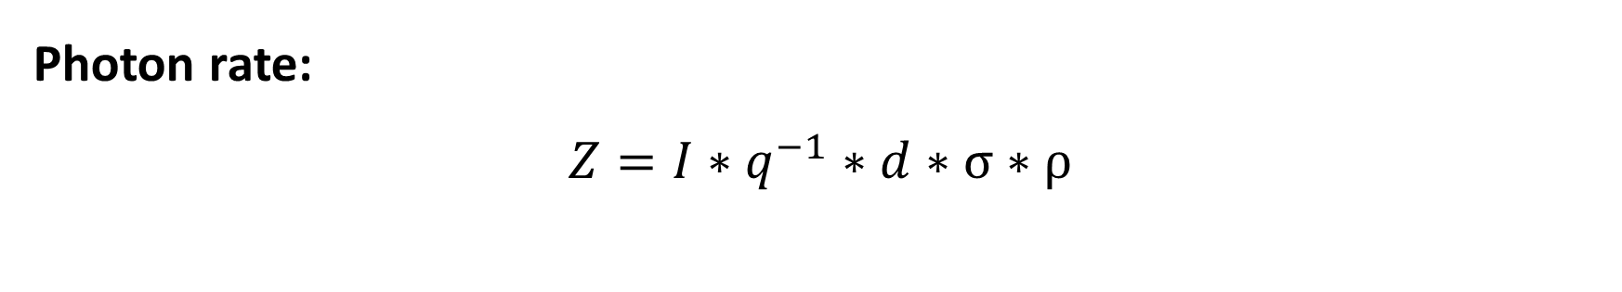
Spontaneous emission from BGI
Photon rate:
$$Z=I∗q^{−1}∗d∗σ∗ρ$$
$I_{p}=1.09A |$ $I_{e}=5.2A$ Beam current
$q=e=1.602∗{10}^{−19}C$ Particle charge
$d=0.5∗{10}^{−3}m$ Gas jet thickness
$σ_{p}=4.7∗{10}^{−26}m^{2} |{ σ}_{e}=1.4∗{10}^{−24}m^{2}$ Excitation cross section for neon at 585nm
$ρ=2.5∗{10}^{16}m^{−3}$ Gas jet density

Slide 6
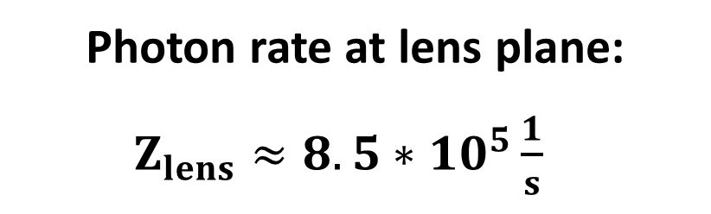
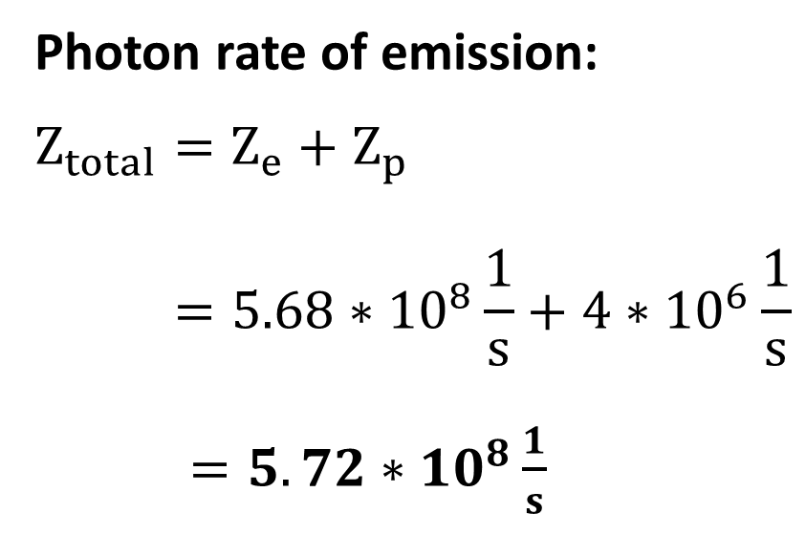
Spontaneous emission from BGI
Photon rate of emission:
$$Z_{total}=Z_{e}+Z_{p}$$
$$=5.68∗10^{8}\frac{1}{s}+4∗{10}^{6}\frac{1}{s}$$
$=5.72∗{10}^{8}\frac{1}{s}$ w
Photon rate at lens plane:
$Z_{lens}≈8.5∗{10}^{5}\frac{1}{s}$w

Slide 7
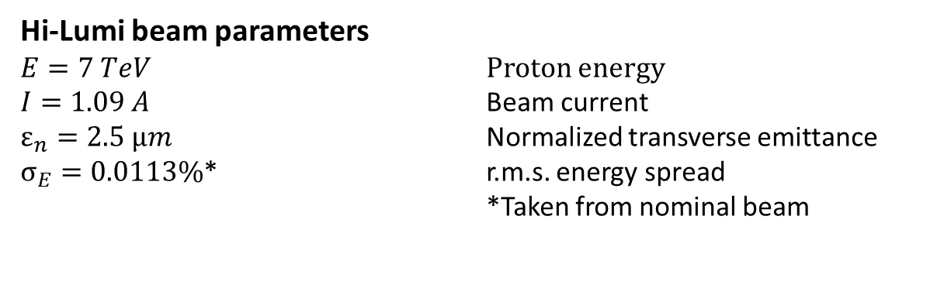
Synchrotron radiation parameters
Wavelengths: 585nm ± 5nm
Only magnet D4
Hi-Lumi beam parameters
$E=7 TeV$ Proton energy
$I=1.09 A$ Beam current
$ε_{n}=2.5 μm$ Normalized transverse emittance
$σ_{E}=0.0113\%$* r.m.s. energy spread
*Taken from nominal beam

Slide 8
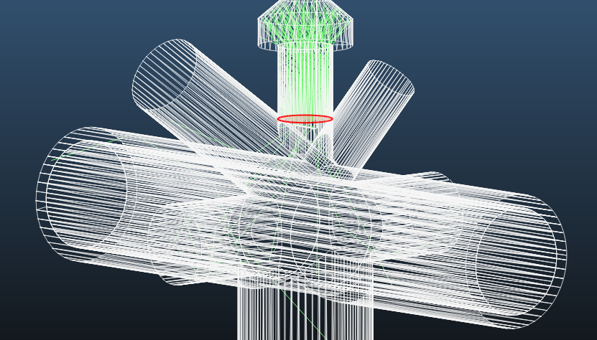
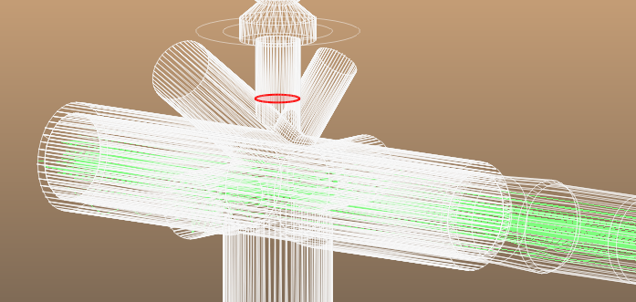
Transfering simulation into MolFlow
Recording in SynRad
Emission in MolFlow

Slide 9
Angular distribution of angle map recording
Less than 1000 photons recorded between 0° and 11°
Error due to iteration!

Slide 10
Angular distribution of SR at lens plane
(recorded in MolFlow)
Most of the photons have an incident angle of less than 11 degree (in respect to the facets normal)
They most likely will end up in the camera

Slide 11
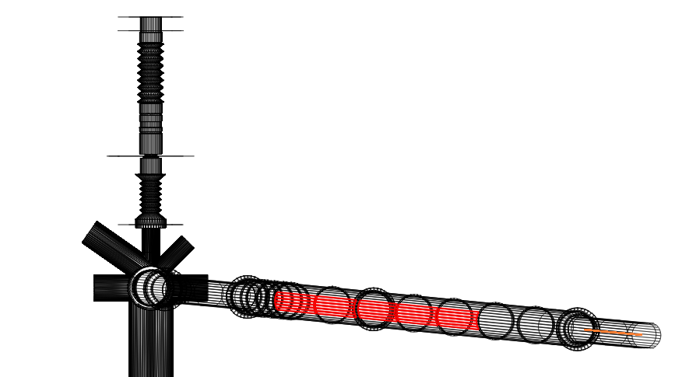
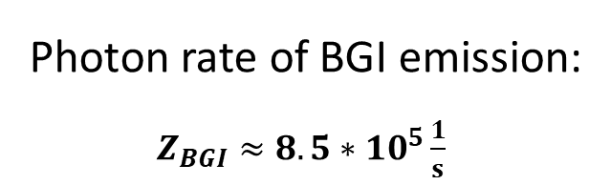

Comparison of BGI- and SR photon rate
Photon rate of BGI emission:
$Z_{BGI}≈8.5∗{10}^{5}\frac{1}{s}$
Photon rate of synchrotron radiation:
$Z_{SR}≈1.5∗{10}^{6}\frac{1}{s}$
$$Z_{SR_sawtooth}≈3.2∗{10}^{5}\frac{1}{s}$$
Sawtooth profile in drift chambers

