Slide 1

THE ONLINE LECTURE SEMINAR OR COLLOQUIUM TO SUPPLEMENT THE ASP TERM SCHOOLS.
University of Dschang, Cameroon
BIPOLARON, MAGNETOBIPOLARON AND EXCITON CHARACTERISTICS IN NANOSTRUCTURES
FOBASSO MBOGNOU Florette Corinne, PhD
Faculty of Sciences, University of Dschang
Condensed Matter Physics and Nanomaterials
E-mail: florettefobasso@yahoo.fr
<number>

Slide 2
PRESENTATION OF THE SPEAKER
<number>

Slide 3
Thesis defended on the 26 June 2020 (UDs)
Bipolaron,Magnetobipolaron and exciton characteristics in nanostructures
Supervision: Prof Lukong Cornelius Fai and Prof Fotue Alain Jervé
Domain of research : Condensed Matter Physics
Training of my junior colleagues
Part time lecturer
<number>

Slide 4
SYNTHESIS OF WORKS
<number>

Slide 5
This topic lies on the thematic
Study of correlated quantum systems
RESEARCH AXES
Quantum Bit Dynamics (qubits) in Semiconductor Nanostructures
Polarons (electron-phonon interaction) in semiconductor nanostructures
Exciton (electron-hole interaction) in semiconductors
METHODS
Lee Low Pines Method or modified Lee Low Pines Method
Pekar type method
Feynmann Path Integral
<number>

Slide 6
Figure 1: Phonon (artistic view)
<number>

Slide 7
polar medium
Notes:
<number>

Slide 8
Polar medium

Slide 9
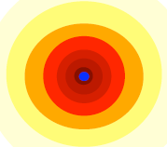
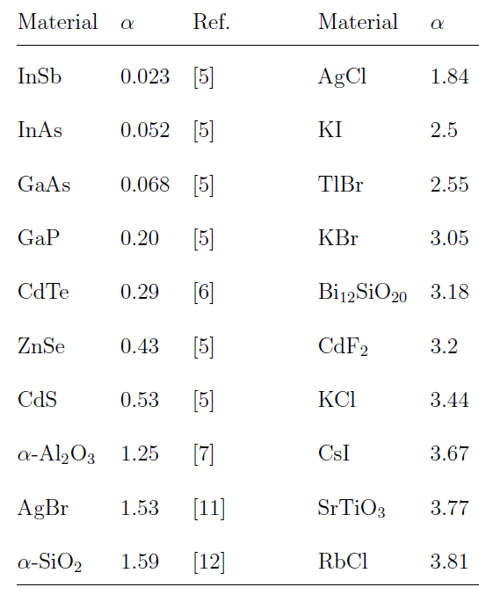
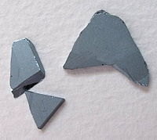
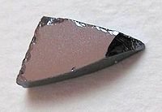
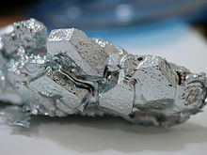

POLARON / BIPOLARON
Table 1: Electron- phonon coupling constant
Figure 2a: Polaron
2
1
Figure 4: Qubit
Figure 2b: Bipolaron
Arséniure d’Indium
(InAs)
Arséniure de Gallium
(GaAs)
Gallium (Ga)
Phosphore
Figure 3: semi-conductor types
<number>

Slide 10
What are we looking for?
THE PURPOSE OF THIS TALK IS TO USE LEE LOW PINES AND HUYBRECHTS METHODS TO DERIVE THE PROPERTIES OF POLARON IN NANOSTRUCRES
<number>

Slide 11
OUTLINE
1. LEE LOW AND PINES METHOD
2. HUYBRECHTS METHOD
3. APPLICATIONS
4. CONCLUSION
<number>

Slide 12
1.
LEE LOW AND PINES METHOD
<number>

Slide 13
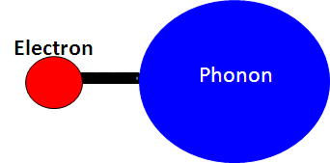
The total Hamiltonian of the system is described by
(1)
The kinetic energy of the electron is given by
(2)
the phonon energy evolves from the evolution of the lattice polarization vector
(3)
The energy of interaction of the charge e with the field is defined by
(4)
The electron potential in the crystal field is described by the equation
<number>

Slide 14

(5)
(6)
Where is the electric field displacement vector
is the static dielectric constant
the optical dielectric constant
The deformation potential energy of the ionic polarization of the crystal is given as follows
(7)
<number>

Slide 15
Then from equations (3 ) and (5) we obtain
(8)
(9)
Then the phonon energy becomes
(10)
<number>

Slide 16
(11)
<number>

Slide 17
The Hamiltonian of the Phonon in the second quantification
(12)
with
are respectively annihilation and creation bosonic operators
Let find now the the electron-phonon interaction Hamiltonian in the second quantization from equation (4)
<number>

Slide 18
We find from equation (5) that is conveniently solvable if we expand our function in a Fourier series
(13)
This permits us to have
(14)
4
Finally
(15)
The field Hamiltonian describing this interaction was described by Fröhlich as
Fröhlich Hamiltonian
<number>

Slide 19
(16)
(17)
By identification
<number>

Slide 20
since
is the electron-phonon coupling amplitude
<number>

Slide 21
Thus the complete Hamiltonian including the quantized deformation energy has the form
(18)
(19)
and
are
Lee-Low-Pines transformations
<number>

Slide 22
canonical transformations
and
(20)
Where is the vacuum state.
(21)
<number>

Slide 23
22
one can remove the essential part of the interaction term from the Hamiltonian by the displacement canonical transformation
23
Here is a variational function to be determined by minimizing of the
ground state energy i.e by solving the equations
<number>

Slide 24
Let us consider this
(24)
We may write
(25)
<number>

Slide 25
(26)
(27)
(28)
This second transformation was carried out by LLP and has the effect of displacing the phonon coordinates and
<number>

Slide 26
(29)
We find now the functional of the energy
(30)
Taking the functional derivative of this relation to be zero one arrives at
<number>

Slide 27
Therefore, the energy of the polaron has the form
(31)
The polaron effective mass is enhanced as
(32)
<number>

Slide 28
2.
HUYBRECHTS METHOD
<number>

Slide 29
(33)
Starting from the Unitary transformation
(34)
The polaron Hamiltonian can be transformed into
(35)
<number>
Notes:
<number>

Slide 30
In the limit
Strong coupling
In the case that equation gives the well known Lee-Low-Pines (LLP) transformation for weak electron-phonon interaction
Let us introduce the creation and annihilation operators and by
(36)
Where the index j refers to the x,y and z directions and is a variational parameter
By rewriting the Hamiltonian using these relations one can gets
<number>

Slide 31
with
(37)
and
(38)
<number>

Slide 32
By performing the second Lee-Low-Pine transformation
(39)
One gets
(40)
<number>

Slide 33


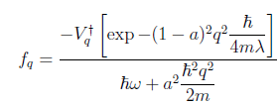

(41)
(42)
with
(43)
Energy of polaron for all coupling
(44)
<number>

Slide 34


Bipolaron in Nanostructure
(45)
<number>

Slide 35



(46)
(47)
<number>

Slide 36
SOME PROPERTIES OF THE QUASIPARTICLES
ELECTRONIC PROPERTIES
PROBABILITY DENSITY
The transition frequency
(b)
(a)
TRANSITION PROBABILITY
DECOHERENCE TIME
(c)
(d)
MOBILITY
POLARON LIFETIME
(e)
(f)
36
Notes:
<number>

Slide 37
SOME PROPERTIES OF THE QUASIPARTICLES
OPTICAL PROPERTIES
OPTICAL ABSORPTION
(g)
THERMAL PROPERTIES
SHANNON ENTROPY
TSALLIS ENTROPY
(h)
(i)
FREE ENERGY
INTERNAL ENERGY
HEAT CAPACITY
(j)
The partion function is given by
(k)
37
Notes:
<number>

Slide 38
3. Applications
<number>

Slide 39
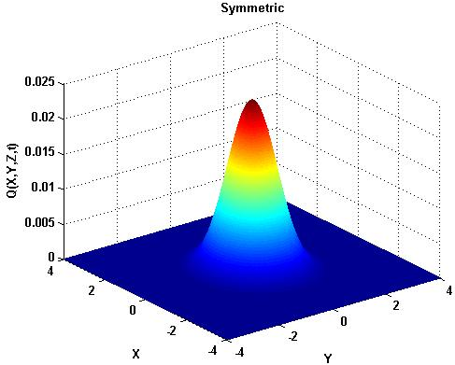
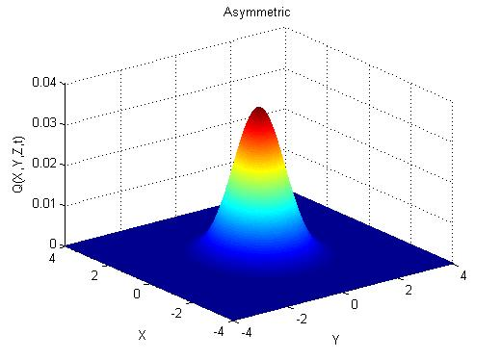
Asymmetric Potential effects on polaron
(48)
Figure 5:
Probability density for symmetric potential when the electron is in superposition states for strong coupling
Figure 6:
Probability density for asymmetric potential when the electron is in superposition states for strong coupling
Figure 8:
Decoherence time as a function of the confinement length for different values of the dispersion coefficient
Figure 7:
Decoherence time as a function of the confinement length for different values of the coupling constant
39
Notes:
<number>

Slide 40
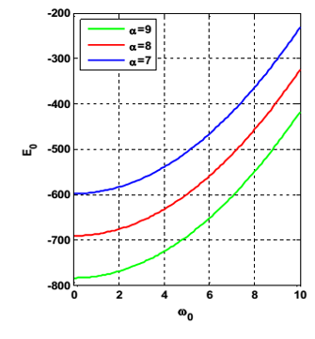
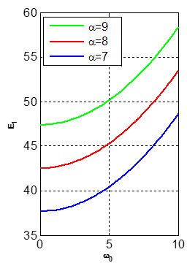
Quantum dot confining potential on bipolaron
(49)
Figure 9: Variation of the ground state energy as a function of the confinement potential for different values of the electron-phonon coupling coefficient
Figure 10: Variation of the first excited state energy as a function of the confinement potential for different values of the electron-phonon coupling coefficient
40
Notes:
<number>

Slide 41
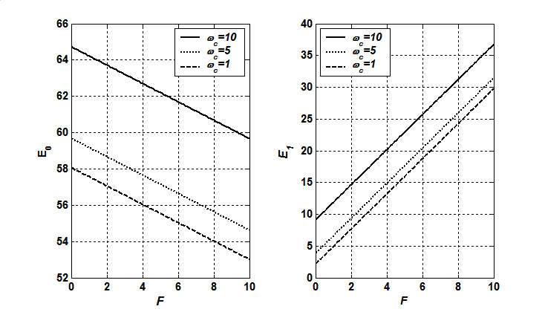
Electromagnetic field effects on bipolaron
(50)
Figure 11: Variations of the ground state energy and the first excited state energy as function of the electric field for several values of magnetic field
The electric and magnetic fields control the states energies
41
Notes:
<number>

Slide 42
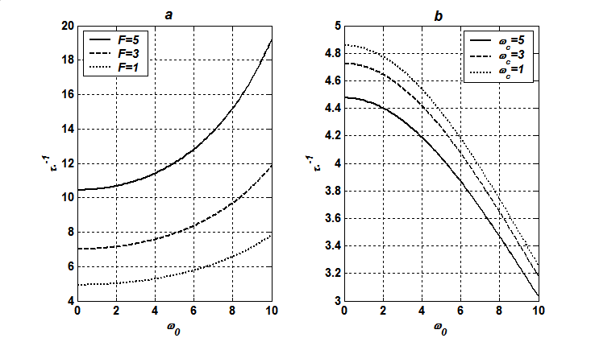
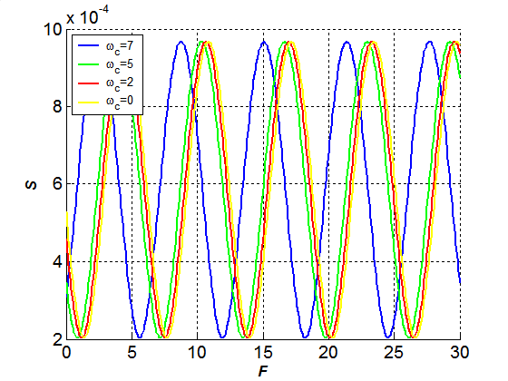
Electromagnetic field effects on bipolaron
Figure 12: Decoherence time of magneto-bipolaron as a function of the confinement strength
Figure 13: Entropy as a function of the strength electric field for different values of magnetic field
The system is more sensitive to the magnetic and electric fields
Coherence is restored and this is an ideal system that can serve in quantum computer.
42
Notes:
<number>

Slide 43
Laser effects on polaron
(51)
Figure 14: Decoherence time versus coupling constant at fixed laser frequency.
Figure 15: Decoherence time versus time at constant laser frequency
Figure 16: Time evolution of entropy at constant laser frequency.
The polaron can be trapped and cooled by laser
It is possible to realize Bose Einstein condensates
43
Notes:
<number>

Slide 44
Laser effects on bipolaron
(52)
Figures 17-18:
Ground state energy with laser frequency at constant confinement strength
Figures 19-20:
Ground state energy with laser frequency at constant coulomb interaction potential
44
Notes:
<number>

Slide 45
Laser effects on bipolaron
Figure 21: Coherence time of bipolaron as function of laser frequency for different values of the confinement strength
Figure 22: Coherence time of bipolaron as function of laser frequency for different values of the confinement strength
The confinement strength permits to prolong the coherence time
Laser can serve also to cool and trap a bipolaron
45
Notes:
<number>

Slide 46
Laser effects on magnetobipolaron
(53)
Figure 23:
Ground state energy with laser frequency at constant cyclotron frequency.
Figure 24:
Binding energy as function of confinement strength in the x-direction at constant laser frequency.
Figure 25:
Binding energy as function of confinement strength in the x-direction
Figure 26:
Coherence time as function of laser frequency for different values of magnetic field.
46
Notes:
<number>

Slide 47
APPLICATION TO GRAPHENE STRUCTURES
47
Notes:
<number>

Slide 48
APPLICATION OF BIPOLARON ON GRAPHENE
(54)
Figure 28:
Bipolaron mobility with wave number at constant laser frequency
Figure 27:
Bipolaron mobility with wave number at constant laser amplitude
Figure 29:
Effective mass of bipolaron with wave number at constant laser amplitude
Figure 30:
Effective mass of bipolaron with wave number at constant laser frequency
48
Notes:
<number>

Slide 49
APPLICATION OF BIPOLARON ON GRAPHENE
Graphene can produce light absorption
The reduction of absorption prove that the energy absorbed is dissipated into phonons and electron –hole pairs,
The structure can be thermalized.
Figure 31:
Bipolaron optical absorption as function of laser energy for different values of laser amplitude
Figure 32:
Tsallis entropy as function of temperature for different values of laser amplitude
Figure 33:
Tsallis entropy as function of temperature for different values of laser frequency
49
Notes:
<number>

Slide 50
APPLICATION OF BIPOLARON ON GRAPHENE
Figure 35:
Bipolaron internal energy as function of wave number for different values of laser frequency
Figure 34:
Bipolaron internal energy as function of wave number for different values of laser amplitude
Figure 36:
Bipolaron heat capacity as function of wave number for different values of laser amplitude
Figure 37:
Bipolaron heat capacity as function of wave number for different values of laser frequency
50
Notes:
<number>

Slide 51
SCREENING EFFECT ON AN EXCITONIC STATE IN EXTRINSIC SEMICONDUCTOR
51
Notes:
<number>

Slide 52
SCREENING EXCITONIC STATE BY PLASMONS USING FEYNMAN FUNCTIONAL METHOD
We examine the model of a crystal with two non-crossing zones where the extremal points of the zone are found within the Brillouin zone (Figure 93). We assume that the energy spectrum of the system is known at the lower energy spectrum and the upper
(i)
Figure 38a: Pure semiconductor
Figure 38b: Extrincec semiconductor where impurity in the conduction band produces free electrons and impurity in the valence band produces holes
(ii)
52
Notes:
<number>

Slide 53
SCREENING EXCITONIC STATE BY PLASMONS USING FEYNMAN FUNCTIONAL METHOD
So, we integrate over all Fermi fields in both zones:
(3i)
(4i)
Where
(5i)
is the electrostatic potential
The Fourier transform in the random phase approximation
From the Bethe-Salpeter equation
(6i)
Here, the polarization function is introduce because electron correlation is important.
53
Notes:
<number>

Slide 54
SCREENING EXCITONIC STATE BY PLASMONS USING FEYNMAN FUNCTIONAL METHOD
The polarization is a property of the occupied states of a Fermi gas at temperature T implying all states within a small energy domain around the Fermi energy
From here we can found the polarization bubble of electron-hole pair consisting of the product of two fermionic propagators with momentum and energy going in the opposite direction.
where
(7i)
(8i)
This is an important factor for accurate description of bonding between atoms. The polarization functions are important for reproducing chemical bonding.
Polarization functions give more room for the electrons to get away from each other to minimize electron-electron repulsion.
(9i)
Stability of the excitonic state is highlighted when the fluctuations are importants
54
Notes:
<number>

Slide 55
CONCLUSION
We show a possibility to self-trap polaron in semiconductors in weak coupling regime particularly for Cadmium telluride, Zinc selenide and Potassium chloride
We show that bipolarons are unstable in all weak couplings and intermediate couplings below 1.25. However, bipolarons are stable above this value for intermediate couplings and all strong couplings.
We have shown that in aluminum oxide, two polarons near each other tend to recombine into a stable bipolaron or unstable bipolaron tend to cleavage to two polarons.
It is seen that the Helium film thickness can be considered as a new confinement
We have shown that the life of the polaron is sensitive not only to the materials in which it moves but also to its environment. And the resulting decoherence of its states can be controlled by gradients.
<number>

Slide 56
Development Support
Improvement of information transmission in optical fibres
Securing information
Improvement of quantum cryptography
Information storage
Improving semiconductor performance
<number>

Slide 57
Publications
P1. Feddi, Kawtar; Kria, Mohamed ; El-Yadri, M.; Fobasso, Florette; Long, Gen; Tyutyunnyk, Anton; Perez, Laura; Laroze, David; Feddi, El Mustapha. (2020) “Geometrical confinement effects on fundamental thermal properties of rutile and anatase TiO2 cylindrical and tubular nanostructures” ACCEPTED IN Physica Scripta, PHYSSCR-111299.R1
P2. C. Kenfack-Sadem, W. A. Nganfo, M. C. Ekosso, S. N. Wopunghwo, M. F. C. Fobasso, A. J. Fotué, L. C. Fai Dynamics of Microtubule Pseudo-Spin under the Influence of External Electric Field. International Journal of Biophysics 2020, 10(1): 9-16 DOI: 10.5923/j.biophysics.20201001.02
P3. W. A. Nganfo, C. Kenfack-Sadem, M. C. Ekosso, S. N. Wopunghwo, M. F. C. Fobasso, A. J. Fotué, L. C. Fai, Effects of External Electric Field on the Thermodynamic Properties of Microtubules During Dynamic Instability, International Journal of Biophysics 2020, 10(1): 17-24 DOI: 10.5923/j.biophysics.20201001.03
P4. M.F.C. Fobasso, A.J. Fotue, S.C. Kenfack, and L.C. Fai 2020, « Thermal properties of magnetopolaron in a GaAs delta potential under Rashba effect », Physica E: Low-dimensional Systems and Nanostructures, 118, 113941
P5. C. Kenfack-Sadem, M.F.C. Fobasso, F. Amo-Mensah, E. Baloitcha, A.J. Fotue, and L.C. Fai 2020, « Polaron and bipolaron possibility in graphene nanoribons via laser », Physica E: Low-dimensional Systems and Nanostructures, 122, 114154
P6. M.F.C. Fobasso, C. Kenfack-Sadem, E. Baloitcha, A.J. Fotue,and L.C. Fai 2020, « Lifetime and dynamics of polaron and bipolaron in graphene nanoribbon under laser », Eur. Phys. J. Plus 135, 471
P7. G.T. Tedondje, A.J. Fotue, S.C. Kenfack, M.F.C. Fobasso, F. Fotio and L.C. Fai, 2020, « Modulation of the spin orbit interaction and the transition probability of polaron in disc quantum dot under electromagnetic field », Eur. Phys. J. Plus, 135:244
P8. A.J. Fotue, T.V. Diffo, E. Baloitcha, M.F.C. Fobasso, G.T. Tedondje, M.N. Hounkonnou, 2020 « Spin orbit interaction on the thermodynamics of three dimensional impurity magnetopolaron under strong parabolic potential », European Physical Journal Plus, 135-430, 6
P9. C. Kenfack-Sadem, S. Mounbou, S.I. Fewo, M.F.C. Fobasso, A.J. Fotue, L.C. Fai, 2020 « Optical Absorption and Tsallis Entropy of Polaron in Monolayer Graphene », Journal of Low Temperature Physics, https://doi.org/10.1007/s10909-020-02478-3
P10. C. Kenfack-Sadem, C.M. Ekengoue, J.E. Danga, M.F.C. Fobasso, V. Nguepnang, A.J. Fotue, L.C. Fai, 2020 « Laser control of magneto-polaron in transition metal dichalcogenides triangular quantum well », Physics Letters A, 384, 126662
P11. M.F.C. Fobasso, A.J. Fotue, S.C. Kenfack, C.M. Ekengue, C.D.G. Ngoufack, D. Akay and L.C. Fai 2019, « Laser light and external magnetic field control of Polaron in asymmetric quantum dot », Superlattices and Microstructures, 129, 77-90.
P12. S.C. Kenfack, S. Mounbou, N. Issofa, S.I. Fewo, A.V. Wirngo, F.C. Fobasso, A.J. Fotue and L.C. Fai, 2019, « Determination of the contribution of a phonon and a magnetic field to the chemical properties of the hydrogen molecule using the Density Functional Theory approach », Physica B: Condensed Matter, 560, 197-203.
P13. C.M. Ekengoue, S.C. Kenfack, A.J. Fotué, M.F.C. Fobasso, G.N. Bawe Jr. and L.C. Fai, 2018, « Decoherence of cooled and trapped polariton under magnetic field », Computational Condensed Matter, 14, 106-113.
P14. J.-R.D. Djomou, S.C. Kenfack, A.J. Fotue, M.F.C. Fobasso and L.C. Fai, 2018, « Contribution of bulk and surface phonons to the properties of polaron in a Zn1-CdSe-ZnSe heterojunction confined in a triangular potential », Journal of Physic B, 548, 58-70.
P15. M.F.C. Fobasso, A.J. Fotue, S.C. Kenfack, G.N. Bawe Jr., D. Akay and L.C. Fai, 2018, « Stability and coherence of strong-coupling magneto-bipolaron in asymmetric quantum dot under laser field effect », Physics Letters A, 382, 3490-3499.
P16. S.C. Kenfack, A.J. Fotué, M.F.C. Fobasso, G.N. Bawe Jr. and L.C. Fai, 2017, « Shannon entropy and decoherence of polaron in asymmetric polar semiconductor quantum wire », Superlattices and Microstructures, 111, 32-44.
<number>

Slide 58

<number>

