Slide 1
February 3, 2021 at the CAU Workshop on Beyond Standard Model, Online
Toward waveform modeling
for gravitational waves
from black hole encounters
Gungwon Kang (Chung-Ang University)

Slide 2
Outline
Motivation
NR Results for GW Capture
Waveform modeling with general eccentricity
Conclusion

Slide 3
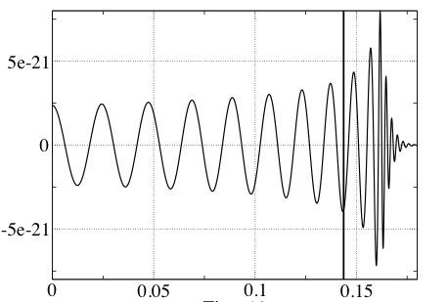
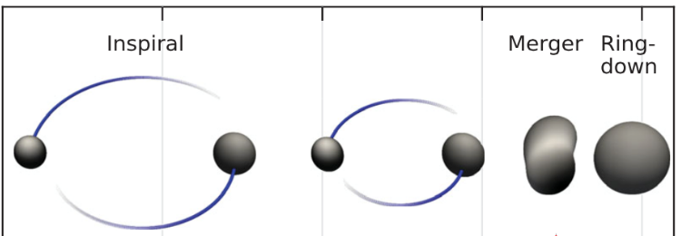
I. Motivation
BBHs are important sources for GW observations
50 observations so far
- O1 (2015/09/12~2016/01/13): 3 BBH
- O2 (2016/11/30~2017/08/25): 7 BBH +1 BNS
- O3a (2019/04/01~2019/10/01): 36 BBH +3 others
NR simulations and waveforms modeling have mostly focused on the last stage of coalescences, e.g., quasi-circular orbits.

Slide 4
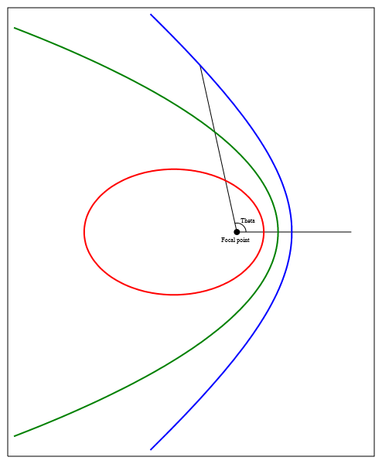
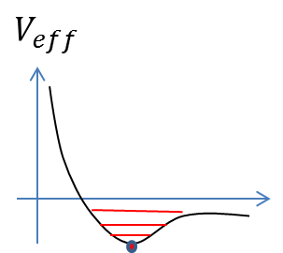
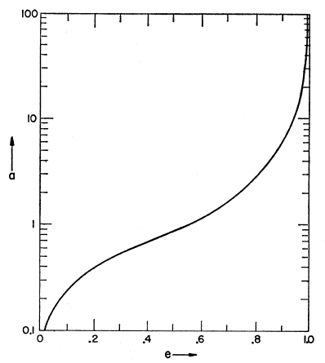



In general,
$$m_{2}$$
$$m_{1}$$
(E, L)
$$e:0\sim 1$$
“Circularization”:
Peters (1964): Evolution of eccentricity (‘2.5’PN)
Cao & Han (2017)

Slide 5
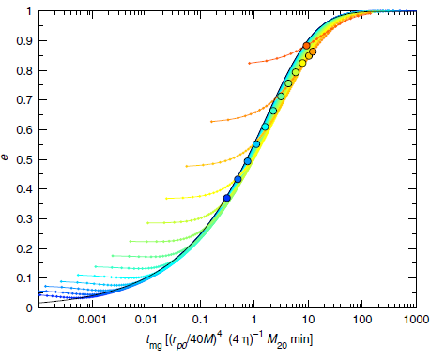
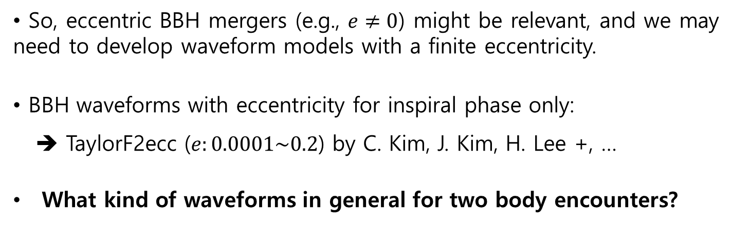
Higher-order (3.5) PN calculation: Kocsis & Levin (‘12)
“Modulated” inspiral waveform
So, eccentric BBH mergers (e.g., $e≠0$) might be relevant, and we may need to develop waveform models with a finite eccentricity.
BBH waveforms with eccentricity for inspiral phase only:
➔ TaylorF2ecc ($e:0.0001\sim 0.2$) by C. Kim, J. Kim, H. Lee +, …
What kind of waveforms in general for two body encounters?

Slide 6
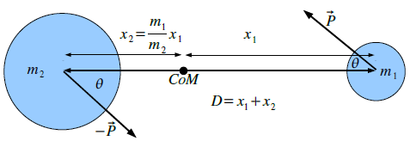
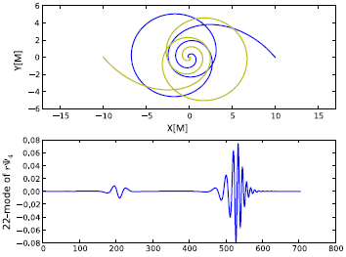
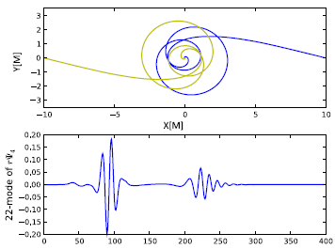
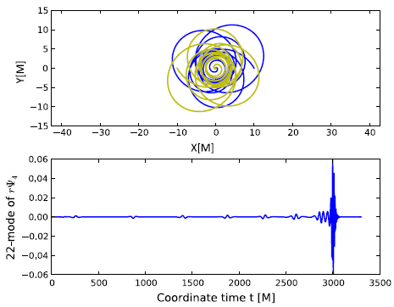
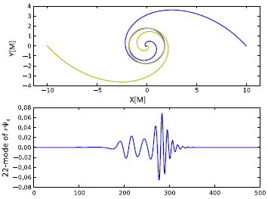
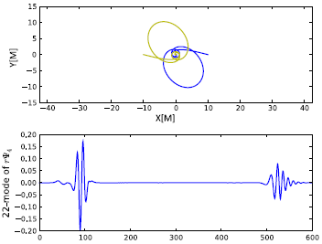
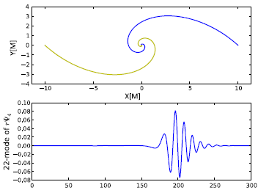
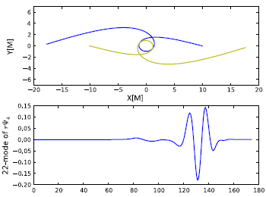
Gold & Brugmann (‘13):

Slide 7
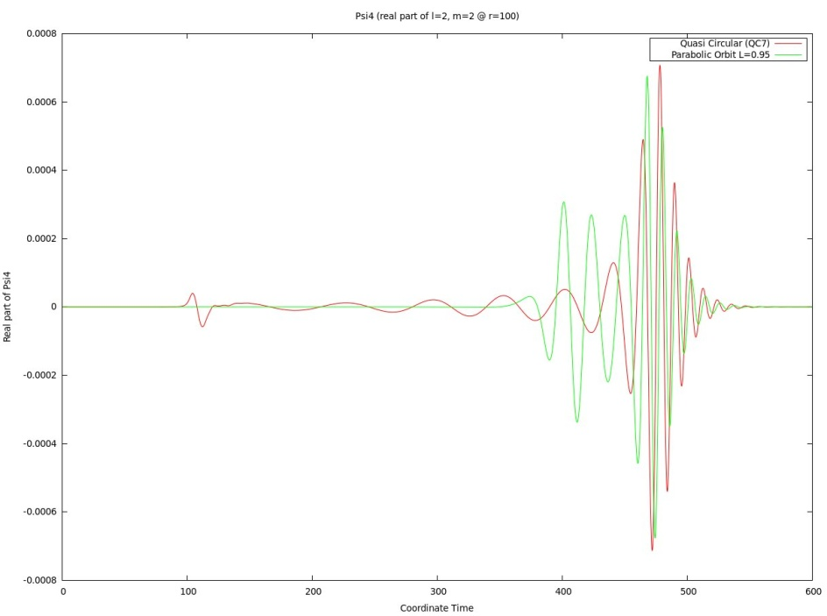
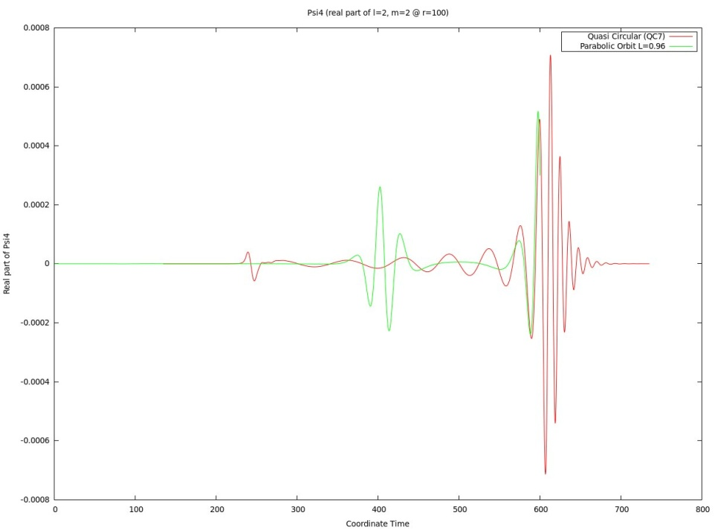
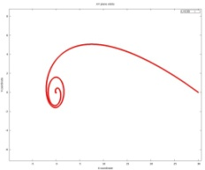
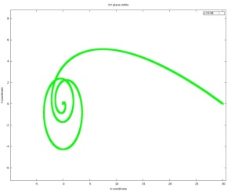
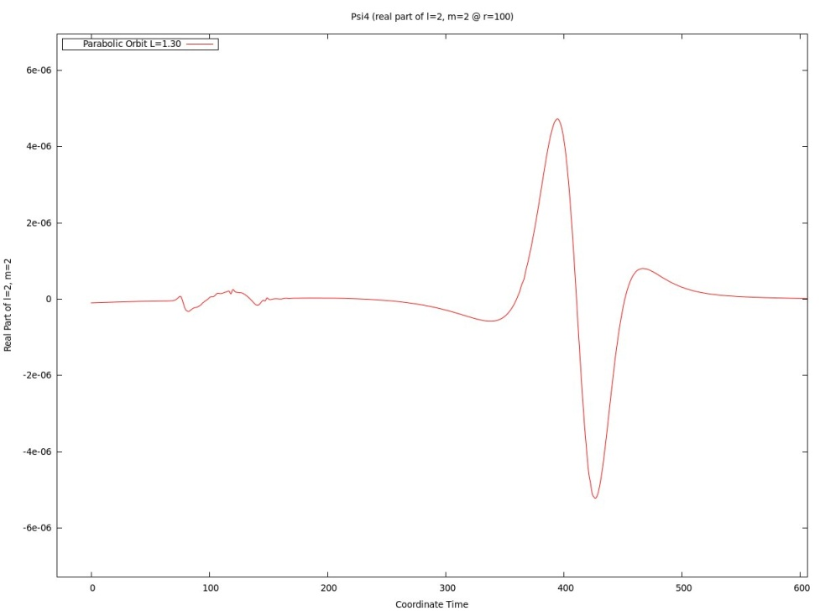
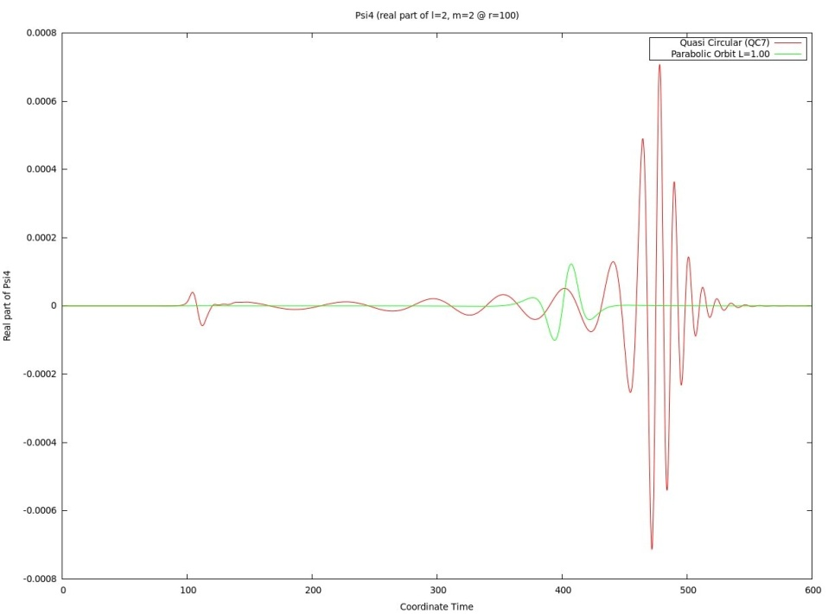
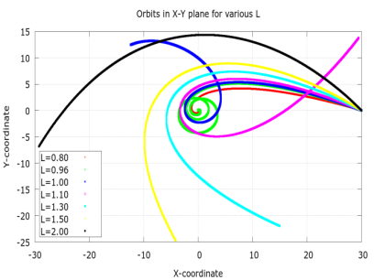


How weak?: w/ J. Hansen, P. Diener, F. Loefler & H. Kim (‘13)
Psi4 (Real part of l=2, m=2 @ r=100)
~7x10^-4
~3x10^-4
~2.7x10^-4
L=0.95
L=0.96
~5x10^-6
~1.3x10^-4
$$∆t\sim 100M\sim 0.5msec$$
L=1.0
$(M=0.5×{10}^{−5}\frac{M}{M_{⨀}}sec$)
L=1.3

Slide 8
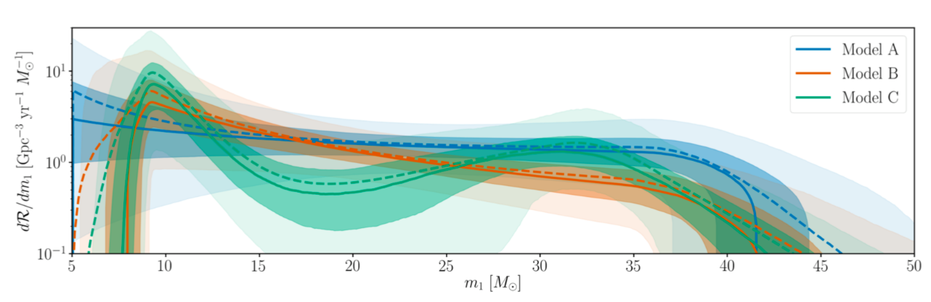
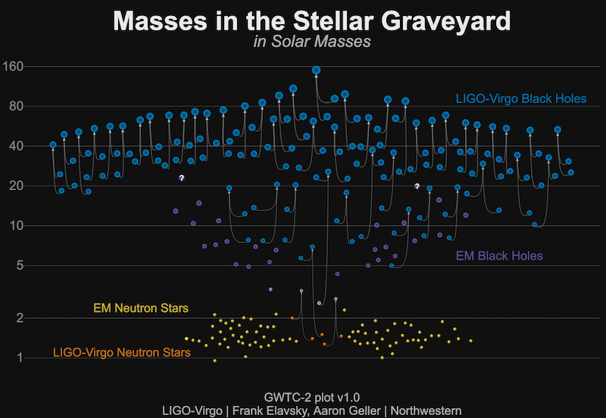
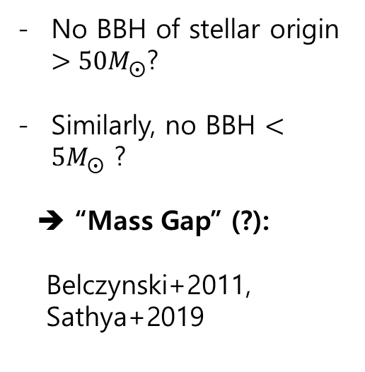
Masses in BBHs:
Abbott+19
(arXiv:1811.12940)
No BBH of stellar origin $>50M_{⨀}$?
Similarly, no BBH $<5M_{⨀}$ ?
➔ “Mass Gap” (?):
Belczynski+2011,
Sathya+2019

Slide 9


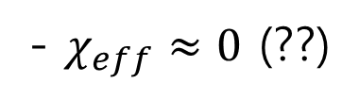
Effective spins of binary objects:
$$ℓ$$
- $χ_{eff}≈0$ (??)
Abbott+2019

Slide 10
So, some GWs from BH encounters could be detected in the future detectors, e.g., cosmic explorer or Einstein telescope!
  We need to prepare waveform models for highly eccentric BBH mergers.
What are the origins of non-stellar binary black holes?
What is the whole life of a two-body system and
the evolution of the waveform associated?

Slide 11
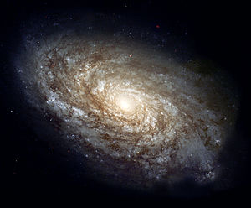
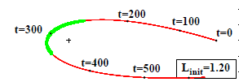
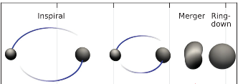
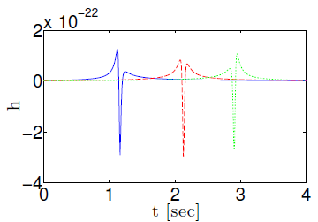
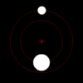


The whole life of a BBH system:
“Inspiral-Merger-Ringdown” is just a tiny part at the last moment of binary coalescences!
Levin, McWilliams & Contreras (‘11): 3.5PN
$$⋯$$
$$⋯$$
Formation of binary:
Unbound ➔ Bound
(Hyperbolic ➔ Elliptic)
Encounters
Precessions
Coalescence-IMR
“Construct a waveform model covering all of it, in particular, highly eccentric phases!”

Slide 12
Binary formation through gravitational radiation capture
Formation of compact binaries:
- Primordial binaries (Postnov & Yungelson 06)
- Three-body interactions (Aarseth & Heggie ‘76, Bae et al. 14)
- Gravitational radiation capturing processes
Gravitational radiation captures:
- Hansen ‘72, Quinlan & Shapiro ‘87, ‘89; Lee ‘95,
O’Leary et al. 09, Hong & Lee 15
- All in the context of Post-Newtonian theory
- How good are the Post-Newtonian results? When do
they break down?
➔ Numerical studies at the level of full general relativity

Slide 13
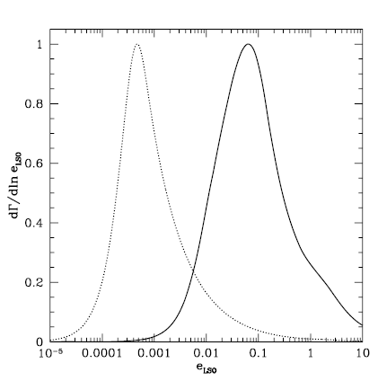
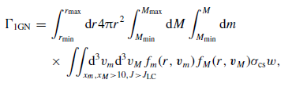
How often such captures occur?
  Direct capture could be rare: 0.02 ~ 5 yr⁻¹ Gpc⁻³ (Hong & Lee ‘15)
  How many binaries would be formed at a galaxy center w/ a SMBH?: O’Leary, Kocsis, Loeb (’09)
    ➔ Eccentricity distributions:
GC
1~1000/yr at aLIGO!
N-body simulations (Hong & Lee ’13): ~ 0.02~20/yr

Slide 14
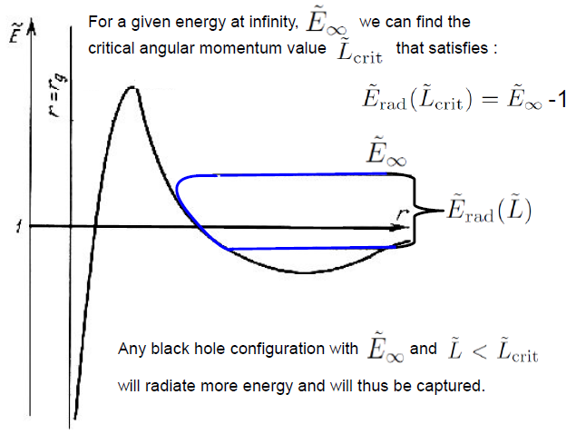



NR simulations
Gravitational Radiation Capture: “through GW emissions”
- The marginal capturing gives
$$(E,L)$$
“Capturing Cross-section”

Slide 15
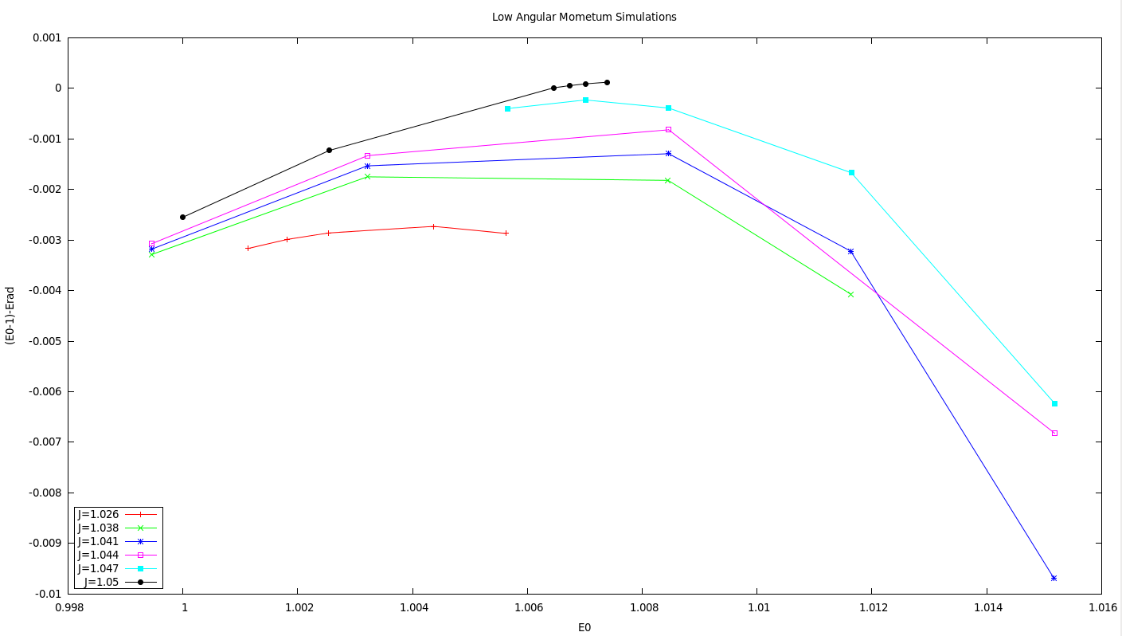
Two non-spinning equal mass black holes:
w/ J. Hansen, P. Diener, F. Loefler & H. Kim (‘13)
Identifying this point is computationally very expensive!

Slide 16

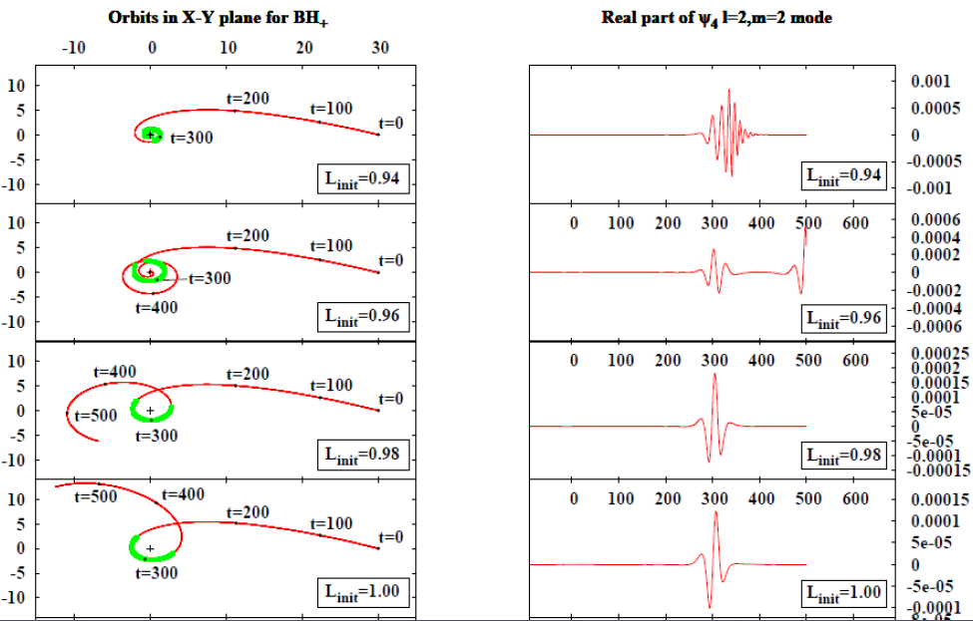
Features of orbits and waveforms:

Slide 17
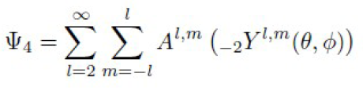
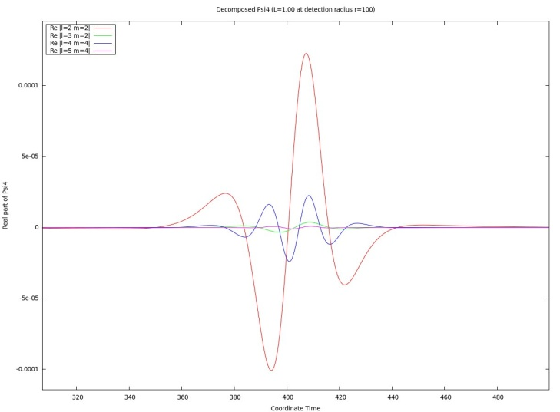
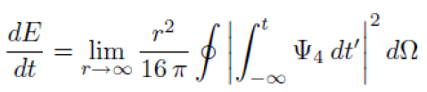
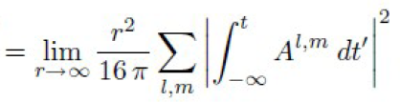

Eccentric orbits ➔ Non-negligible multi mode contributions?
Energy budget (L=1.00):
l=2: ~98.9%
l=3: ~0.1%
l=4: ~1%
Rest: less than 0.01%

Slide 18
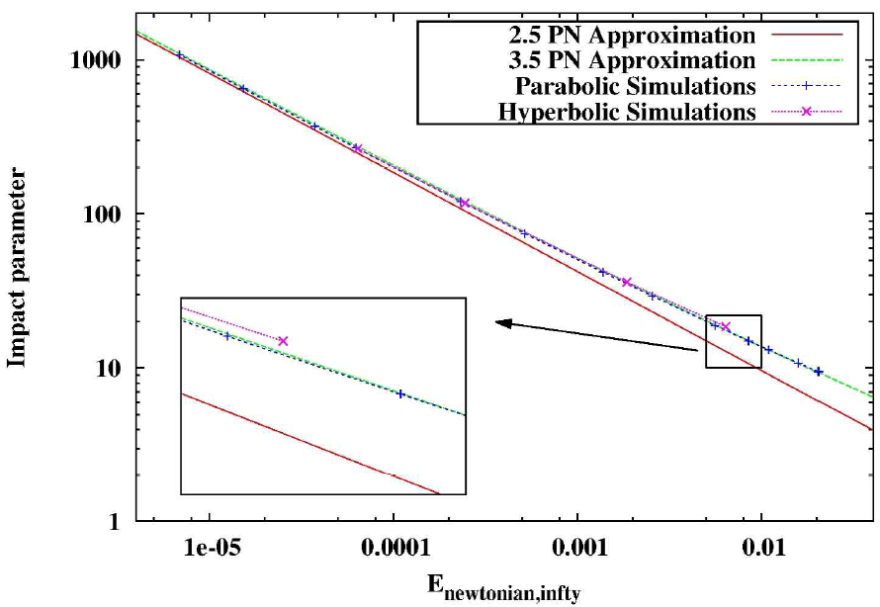
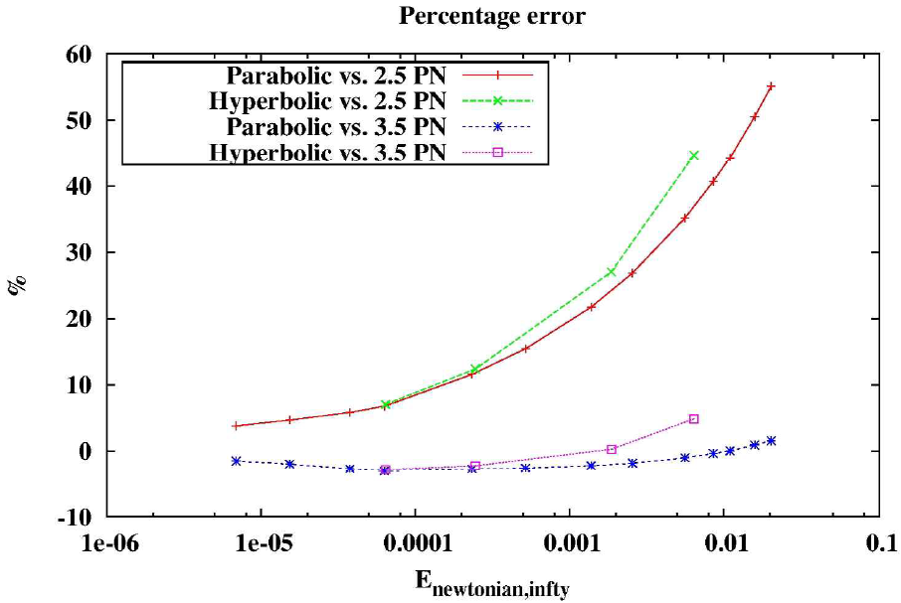
Maximum impact parameter or capturing cross-section:
bmax
Less capturing for large initial
energies
2.5PN deviates from NR as E
increases: ~40% maximally
But, 3.5PN is still in good
agreement with error less
than ~4%
For any given energy, the GR
result gives the strongest
capturing.
Percentage error

Slide 19
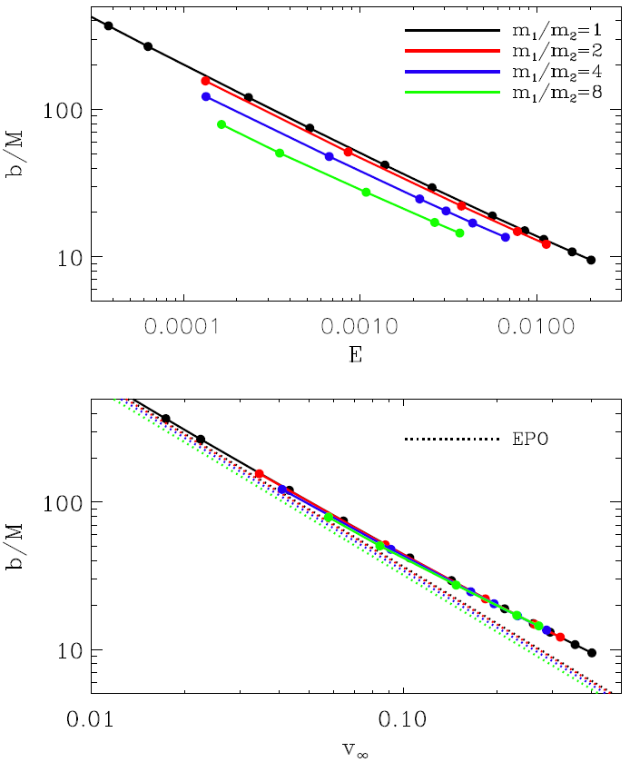
Un-equal masses without spin: w/ Y. Bae, H. Lee & J. Hansen (‘17)
- EPO (Exact parabolic orbit)
- PNCO (PN corrected orbit)
- NR orbit

Slide 20




Effects of spin with equal masses: w/ Y. Bae & H. Lee (‘20)
How to design the parameter space?:
  - Energy flux emitted at 2.5PN order
Radiated energy through a single encounter
$$ℓ$$
$$χ_{eff}^{(+)}=χ_{eff}=0$$
$$⋯$$
$$(\left|χ_{1}\right|=\left|χ_{2}\right|=0.5)$$

Slide 22
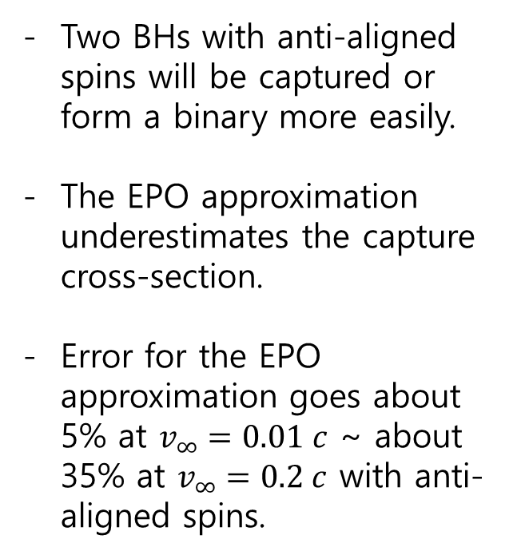
Two BHs with anti-aligned spins will be captured or form a binary more easily.
The EPO approximation underestimates the capture cross-section.
Error for the EPO approximation goes about 5% at $v_{∞}=0.01 c$ ~ about 35% at $v_{∞}=0.2 c$ with anti-aligned spins.

Slide 23









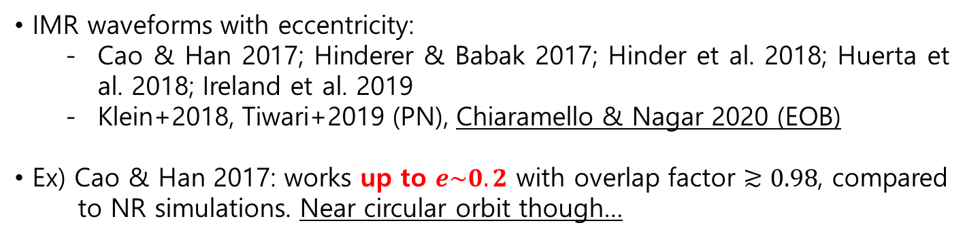
III. Waveform modeling with general
eccentricity
IMR waveforms with eccentricity:
  Cao & Han 2017; Hinderer & Babak 2017; Hinder et al. 2018; Huerta et al. 2018; Ireland et al. 2019
  Klein+2018, Tiwari+2019 (PN), Chiaramello & Nagar 2020 (EOB)
Ex) Cao & Han 2017: works up to $e\sim 0.2$ with overlap factor $≳0.98$, compared
to NR simulations. Near circular orbit though…
l=2, 3, …, 8
Conservative part
Same as SEOBNR’s
circular + eccentricity
for a circular orbit
SEOBNRE (Spinning EOBNR Eccentric)

Slide 24



3PM Hamiltonian:
Recently, Bern et al (PRL, ‘19) have obtained the Hamiltonian at the third post-Minkowskian (3PM) order describing the scattering amplitude for two massive spinless particles in the context of effective field theory.
$$m_{2}$$
$$×$$
$$m_{1}$$

Slide 25
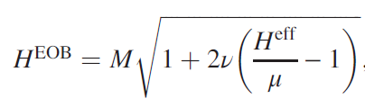



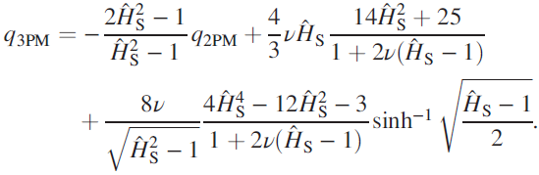




- An EOB Hamiltonian for a system of two BHs in general
$$m_{2}$$
$$×$$
$$m_{1}$$
For $ν=\frac{m_{1}m_{2}}{{(m_{1}+m_{2})}^{2}}→0$, i.e., $m_{1}≫m_{2}$, we know the answer
Antonelli, Buonanno+ 2019:
Then, the post-Schwazschild EOB Hamiltonian at 3PM would be
…
Angular momentum:

Slide 26
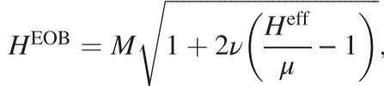





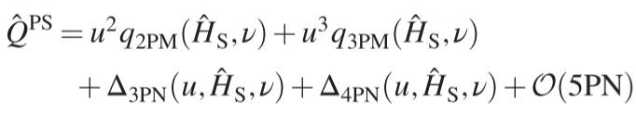
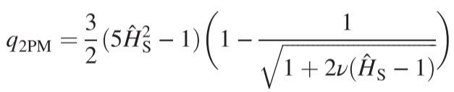




- PN/PM corrected:
$$H^{eff}=G^{0}\left(⋅⋅⋅+{\left(\frac{v}{c}\right)}^{2n}+⋅⋅⋅\right)$$
$$+G\left(⋅⋅⋅+{\left(\frac{v}{c}\right)}^{2n}+⋅⋅⋅\right)$$
$$+G^{2}\left(⋅⋅⋅+{\left(\frac{v}{c}\right)}^{2n}+⋅⋅⋅\right)$$
$$+G^{3}\left(⋅⋅⋅+{\left(\frac{v}{c}\right)}^{2n}+⋅⋅⋅\right)$$
$$+G^{4}\left(⋅⋅⋅+{\left(\frac{v}{c}\right)}^{2n}+⋅⋅⋅\right)$$
$$+ ⋅⋅⋅$$

Slide 27


Slide 28







- Scattering angles: NR vs Newtonian vs EOB vs 3PM

Slide 29








- Results:
Case: $\vec{P}=(P_{x}, P_{y})$ | NR | Newtonian | 3PM | EOB | $∆χ/χ$ (%)
(0.090, 0.099) | 90.13 | 87.97 | 90.34 | 89.78 | -0.388
$$(0.214, 0.058)$$ | $${165.11}^{°}$$ | $${155.00}^{°}$$ | $${165.73}^{°}$$ | 165.30 | 0.115
$$(0.0326, 0.015)$$ | $${300.11}^{°}$$ | 258.51 | 299.98 | 300.52 | 0.137
(0.0331, 0.015) | 299.08 | 257.63 | 299.12 | 299.67 | 0.197
(0.0376, 0.012) | 356.05 | 273.65 | 370.20 | 359.91 | 1.084
(0.043, 0.0185) | 376.41 | 262.64 | 359.44 | 384.72 | 2.208
(0.00957,0.004) (q=16) | 407.92 | 265.04 | 429.96 | 405.05 | -0.704

Slide 30

Design the parameter space in which we can check the validity of our EOB Hamiltonian:
  - High velocity and strong interaction
We have finished NR simulations for these parameters.
The analysis and comparisons with the predictions of the known waveform models, which are valid in the limited regimes, are currently work in progress.

Slide 31

IV. Conclusion
Gravitational radiation capture processes for two BHs have been analyzed numerically.
Effects of unequal masses (upto $m_{1}:m_{2}=1:16$) and spin configurations ($χ_{eff}^{(+)})$ are shown.
Scattering angles for BH encounters with arbitrary eccentricities are calculated in NR.
A 3PM/4PN EOB Hamiltonian for arbitrary eccentricities has been constructed and various tests with NR simulations are work in progress. (w/ Y.-H. Hyun & Y.-B. Bae)

Slide 32
THANKS!

