Slide 1


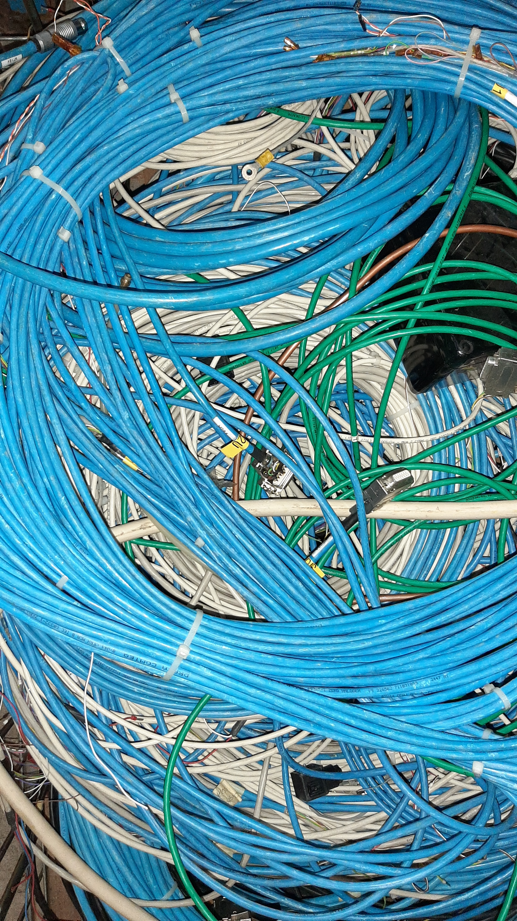
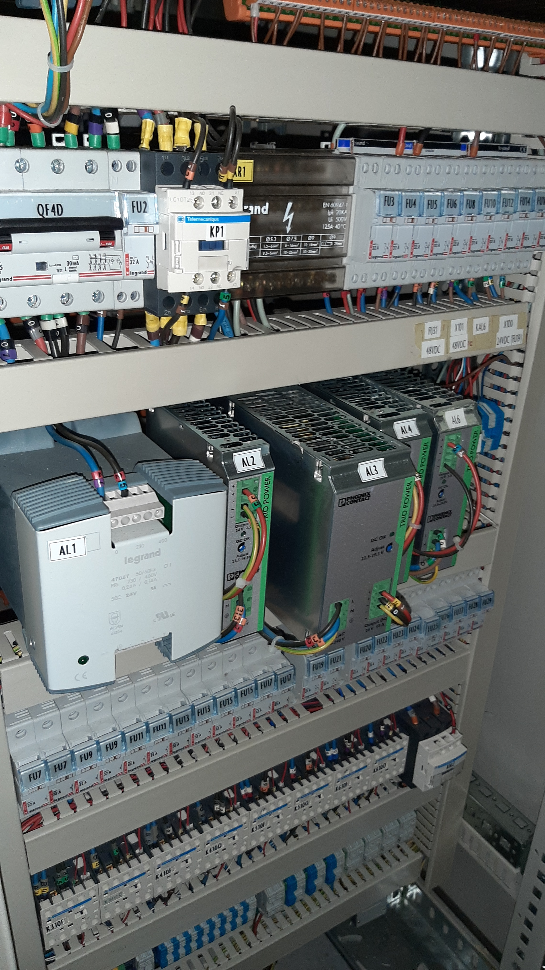
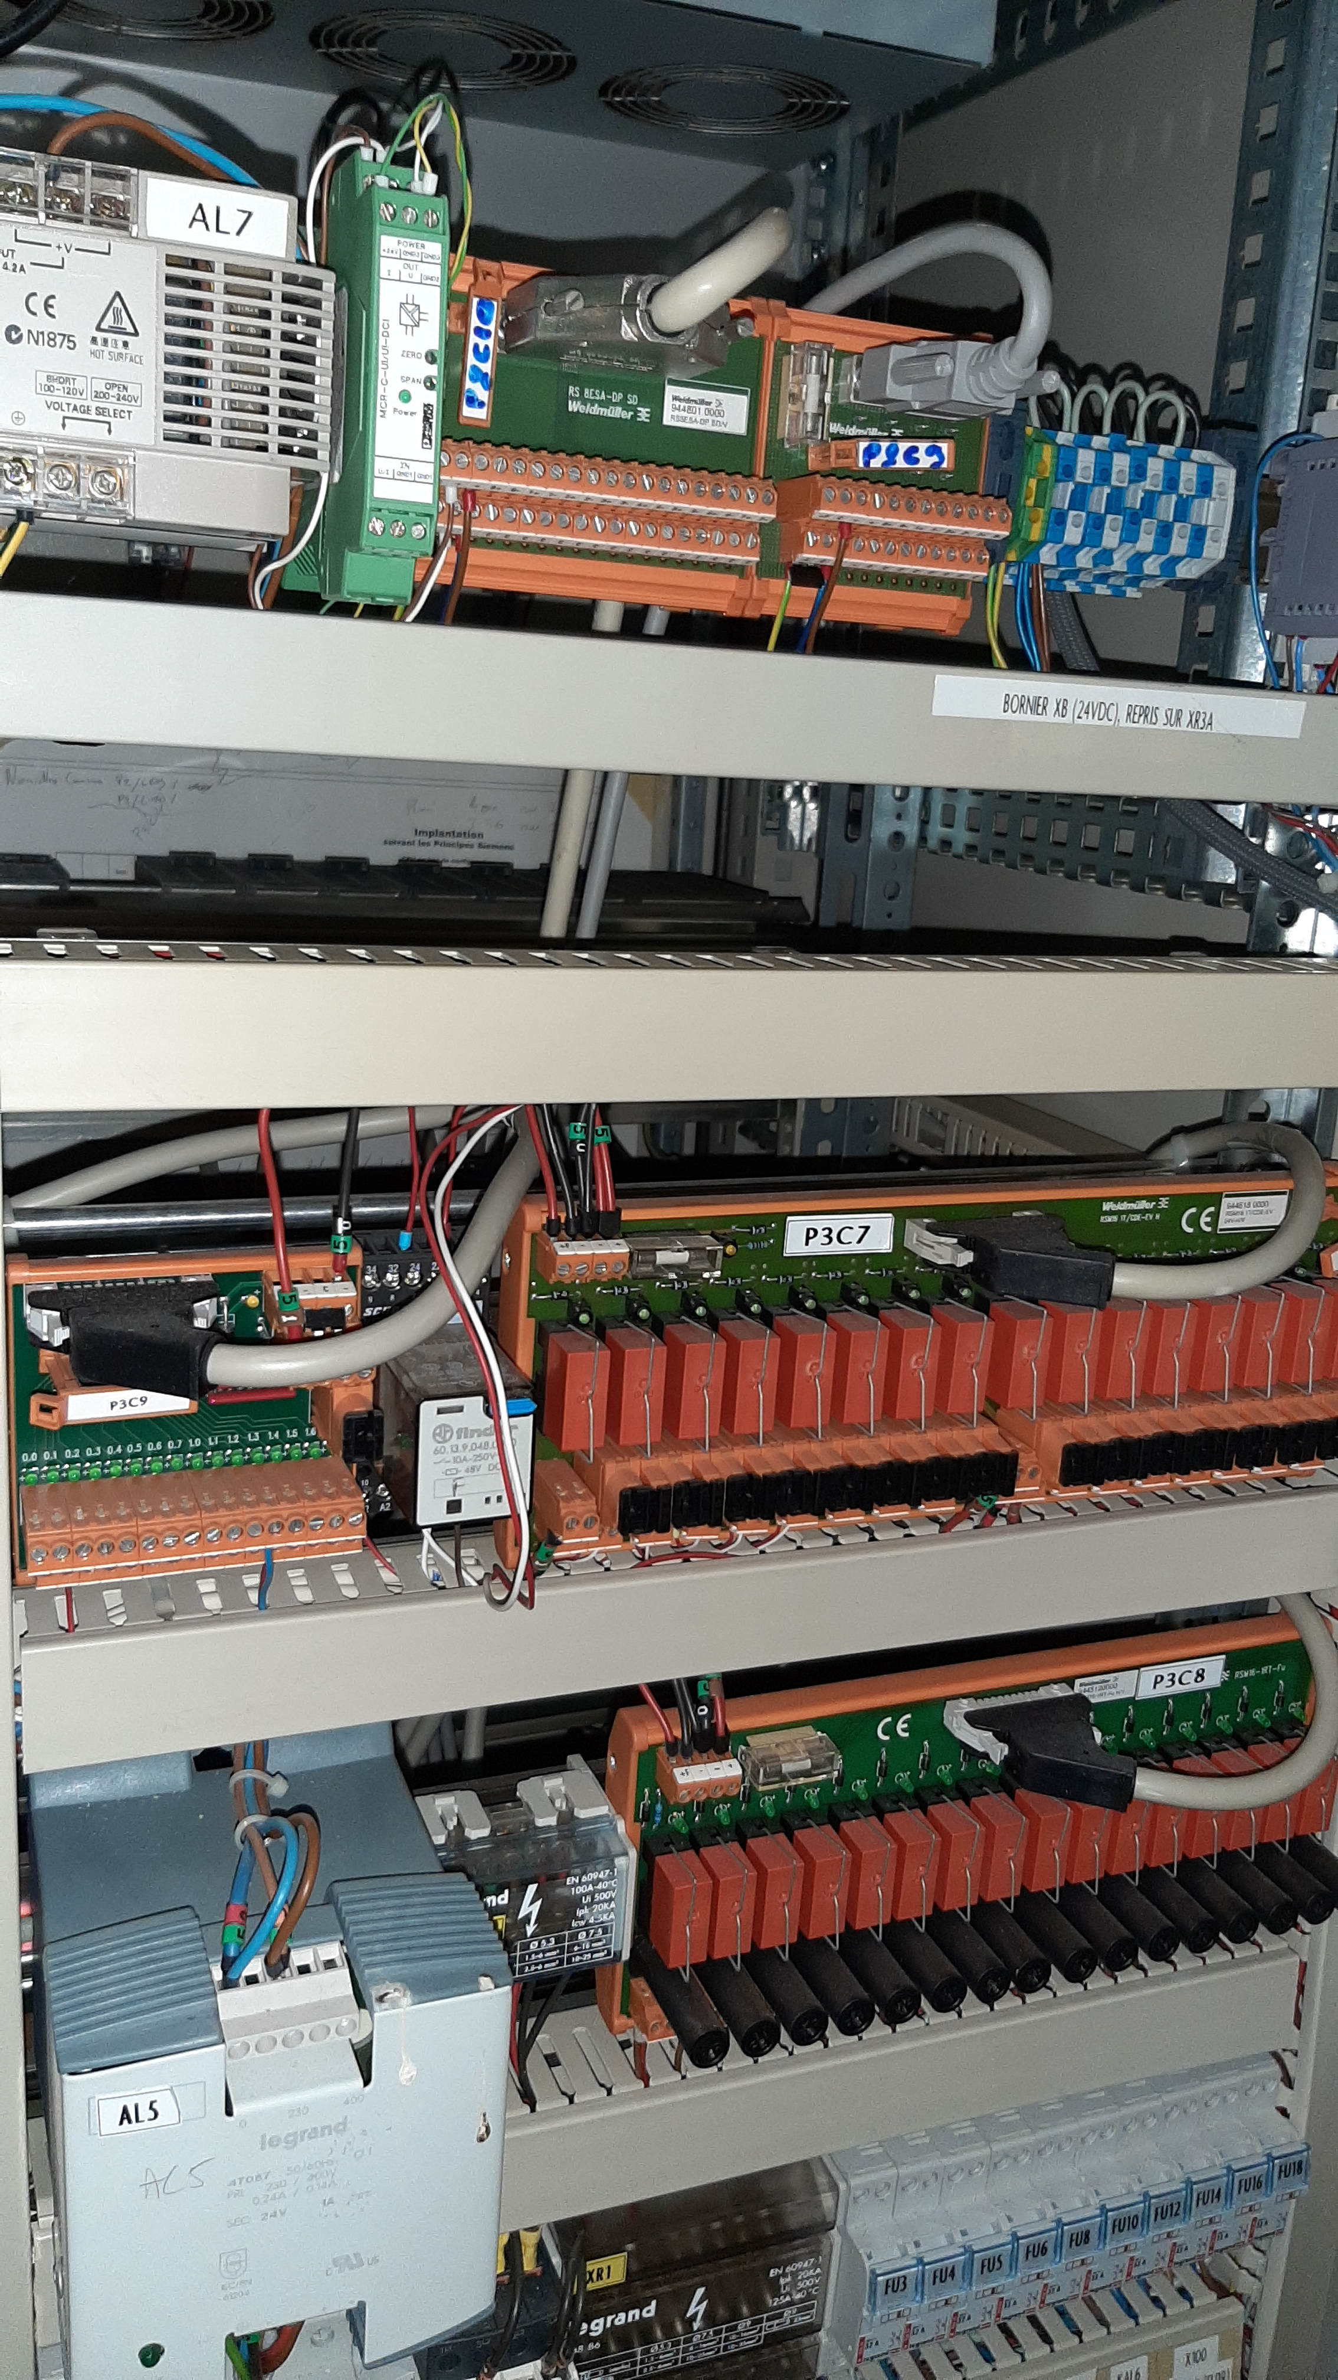
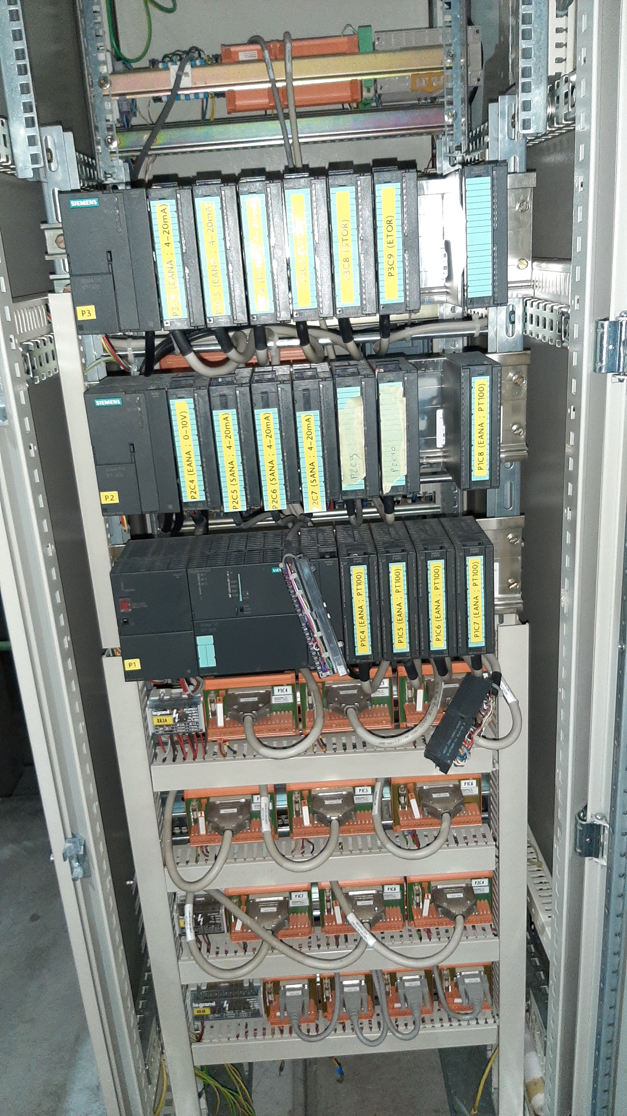
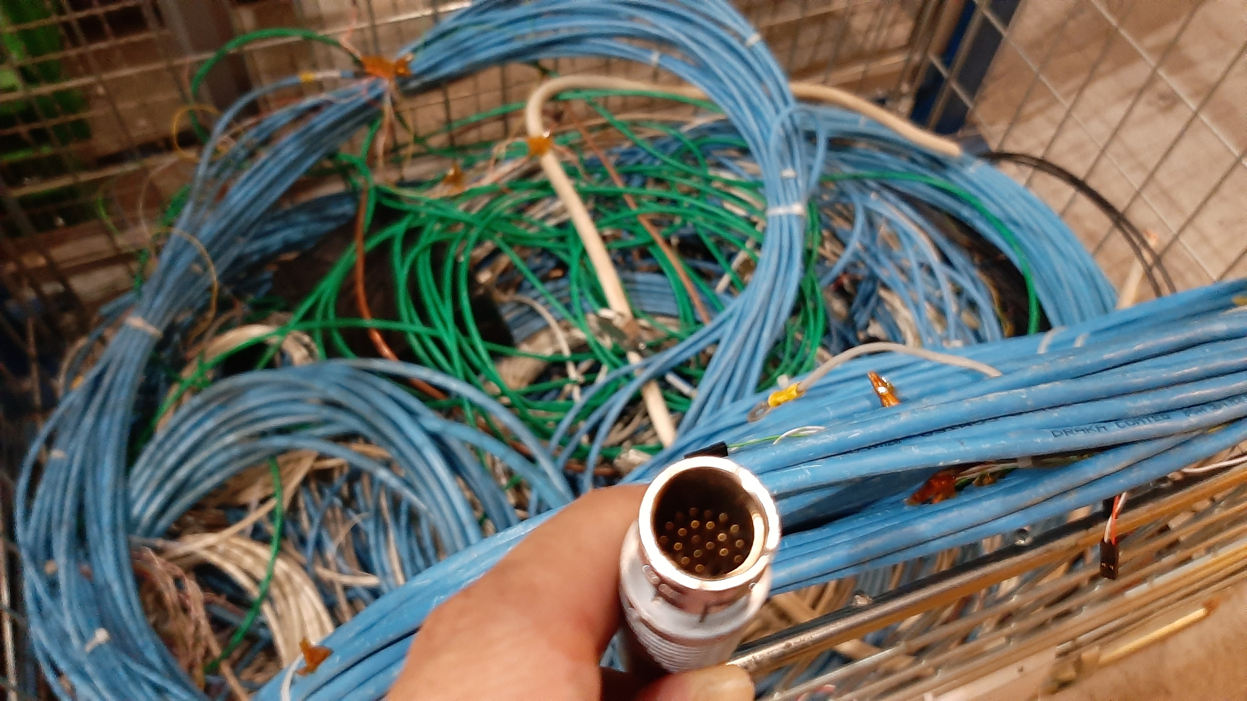
Cooling system of silicon trackers: status
At the last TB agreed to move the PLC cabinet and the Dewar to the clean room.
Stefano Levorato – CERN – 19 January 2021
1

Slide 2
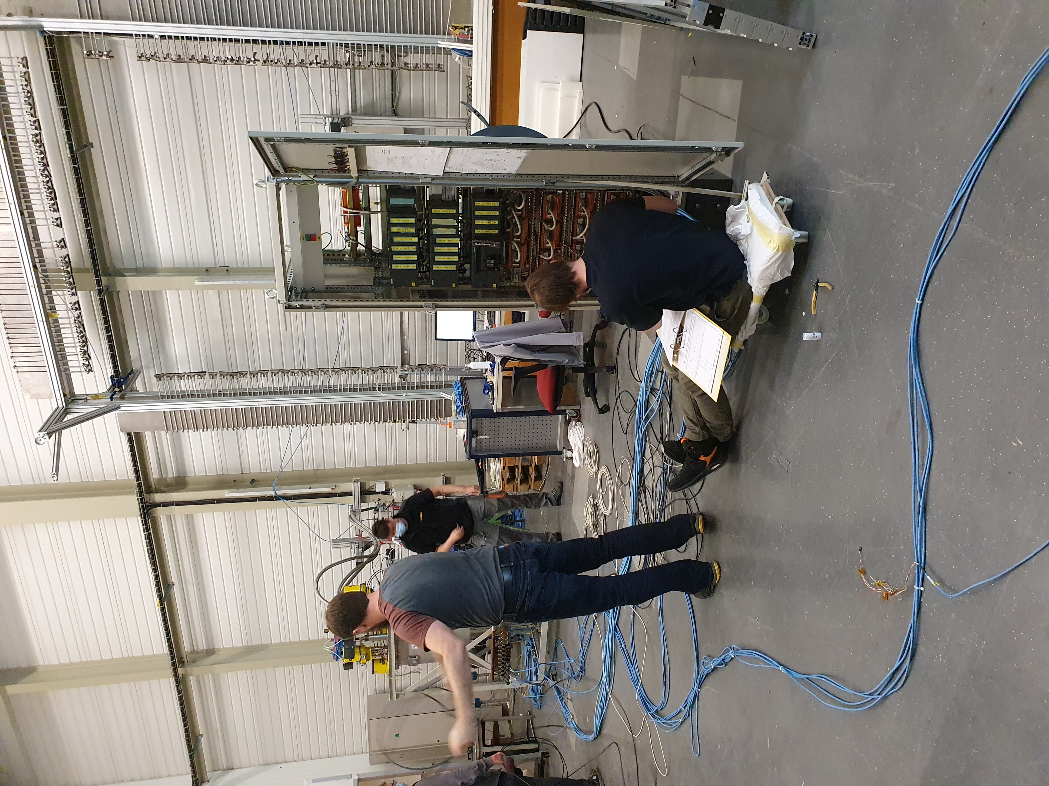
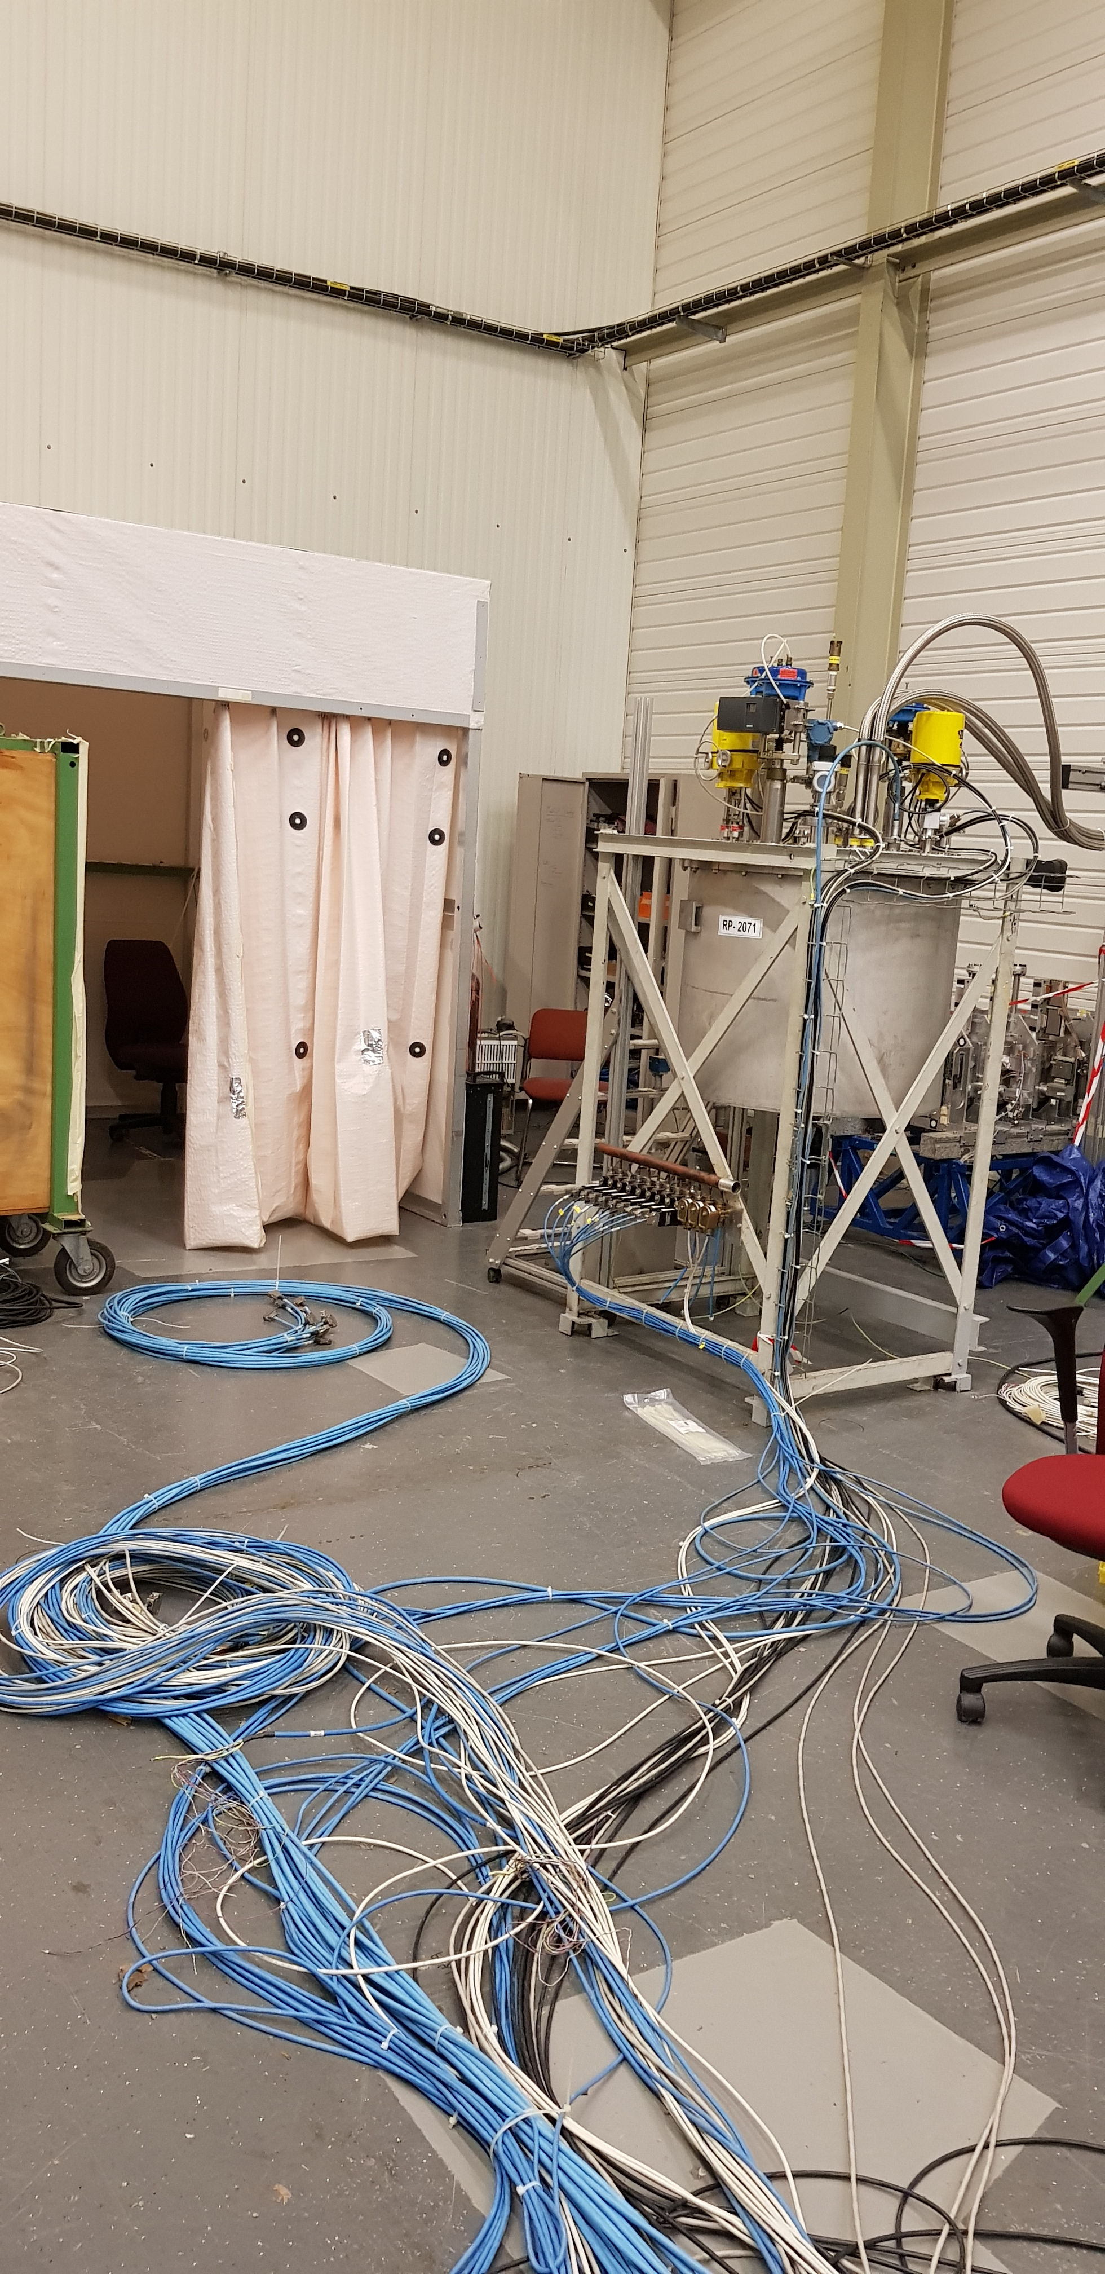
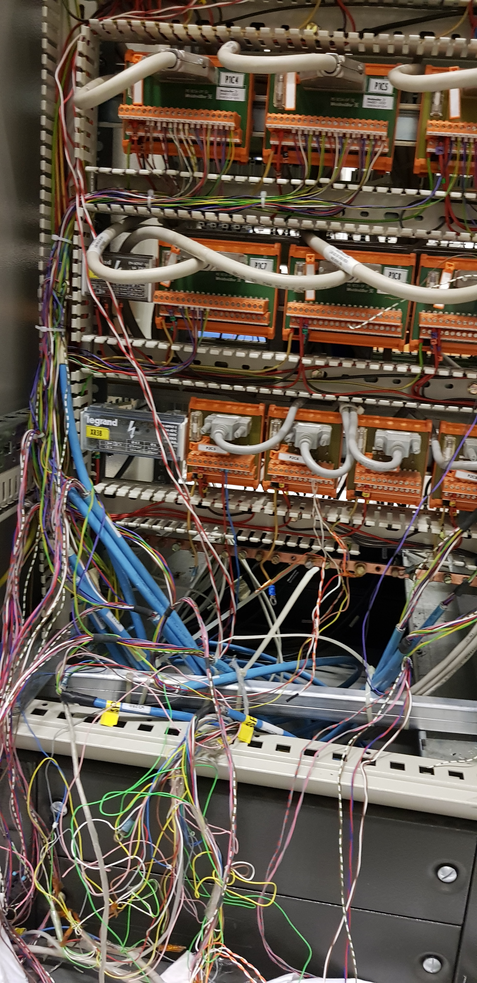
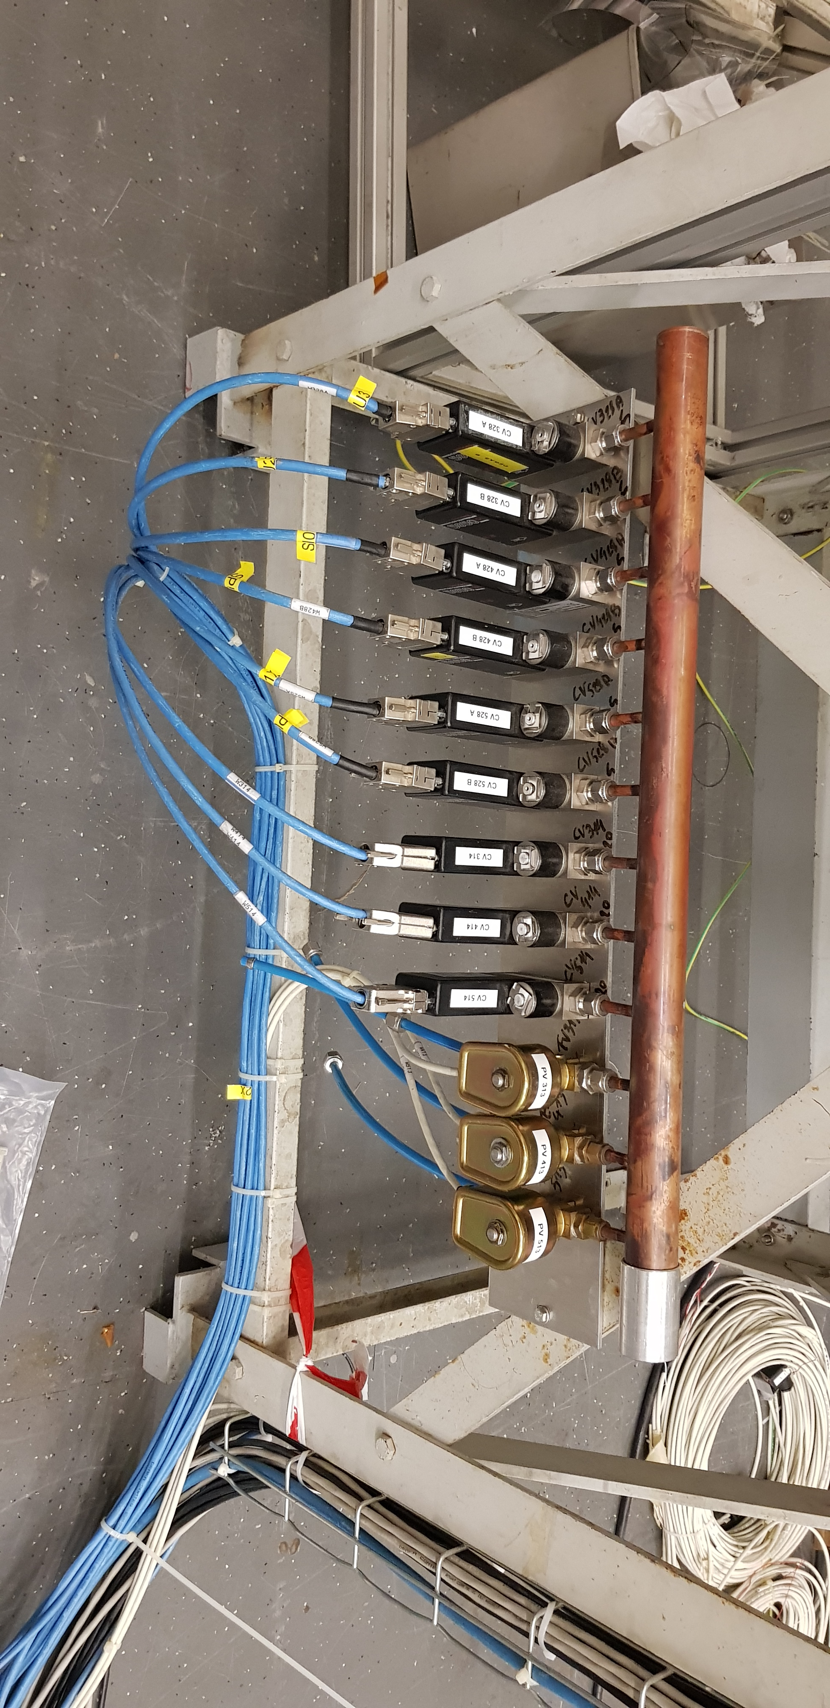
Cooling system of silicon trackers: status
Visits from Jean-Ives and several days spent by S. Ravat and L. Deront + young collaborator
Stefano Levorato – CERN – 19 January 2021
2

Slide 3
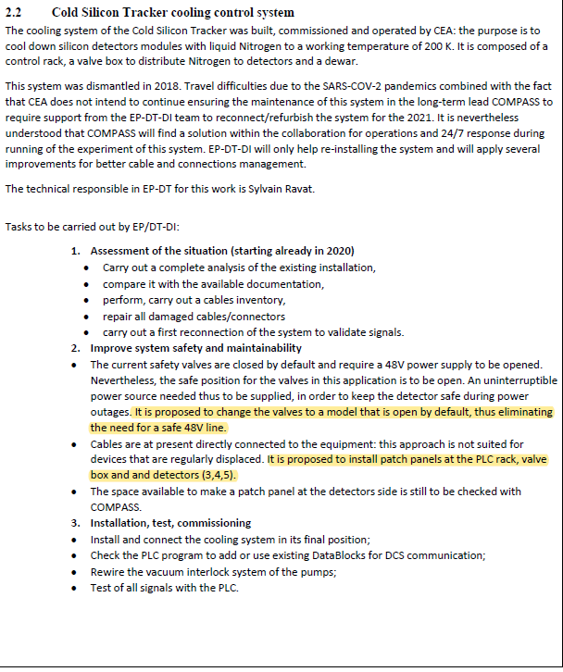
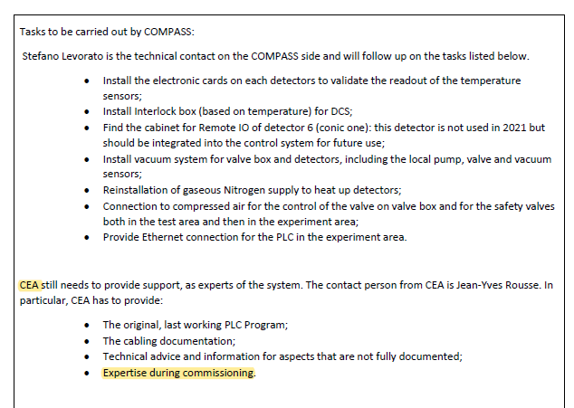
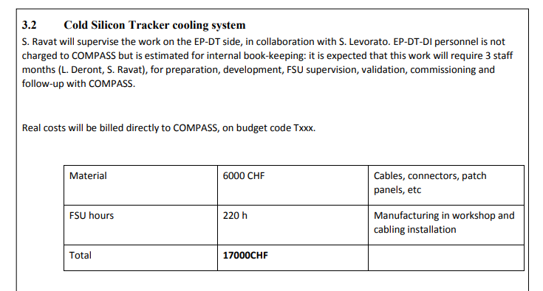
Cooling system of silicon trackers: WP
WP elaborated by EP-DT:
EDMS document(s)
2467122 v.1 "Workpackage agreement for EP-DT support to COMPASS" by Giovanna LEHMANN MIOTTO
Valves ordered already
TUM account
Stefano Levorato – CERN – 19 January 2021
3

