Slide 1
Status GEM Detectors
Bernhard Ketzer
COMPASS/AMBER Technical Board
19.01.2021

Slide 2
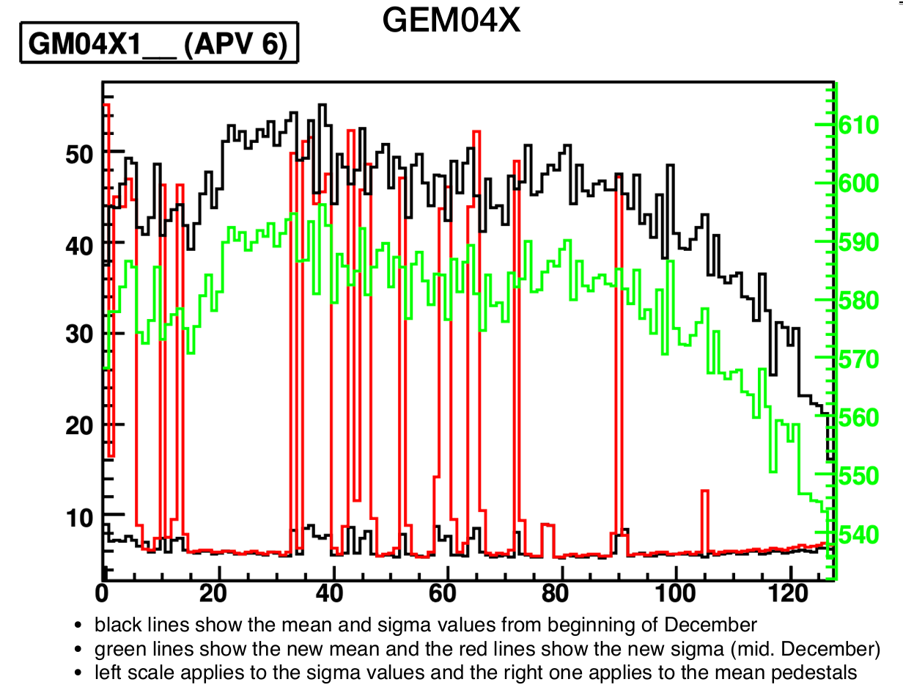
Test of R&S Power Supply during Dry Run
Noise spikes increased using the new power supply
New pedestals were taken and loaded

Slide 3
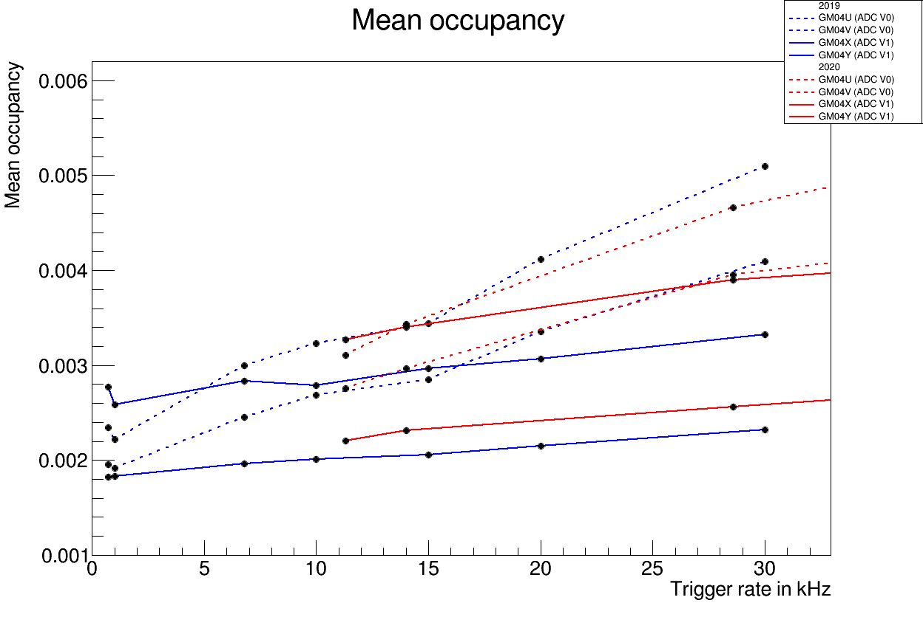
Occupancy compared to 2019
The occupancy has the same magnitude compared to 2019
XY is sligthly worse, U slightly better

Slide 4
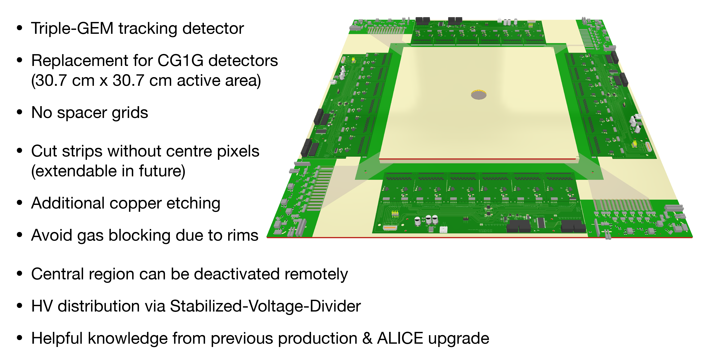
New Detectors for 2021 (G3G)

Slide 5
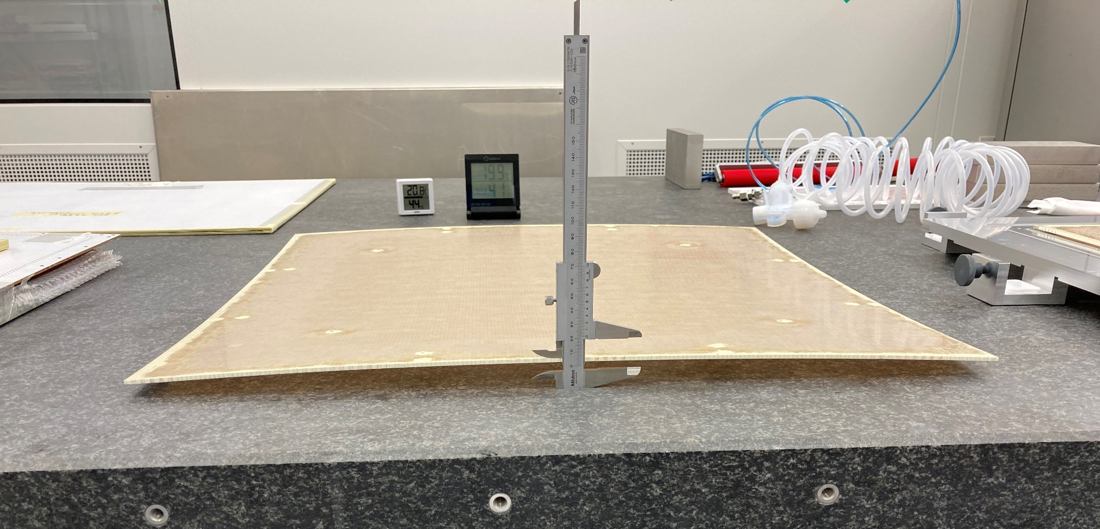
Status of Production
GEM foils and readout circuit for 2 detector received from CERN, optical test ok
frames for 2 detectors received, being prepared
support plates for 2 detectors received, strong bending of large ones observed, will be reproduced by company

Slide 6
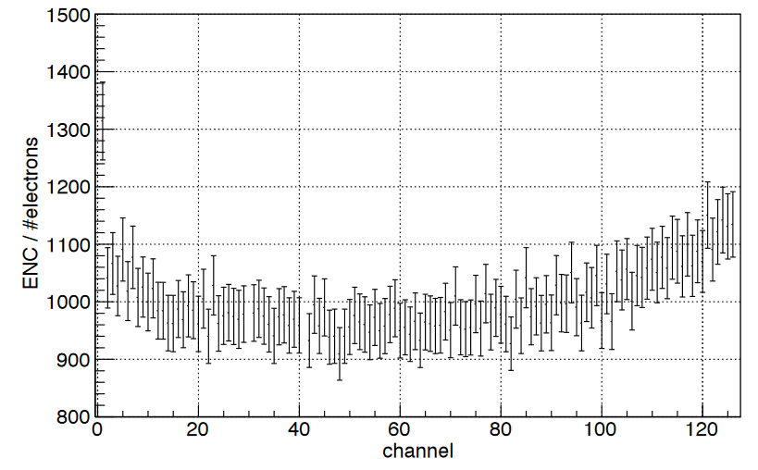
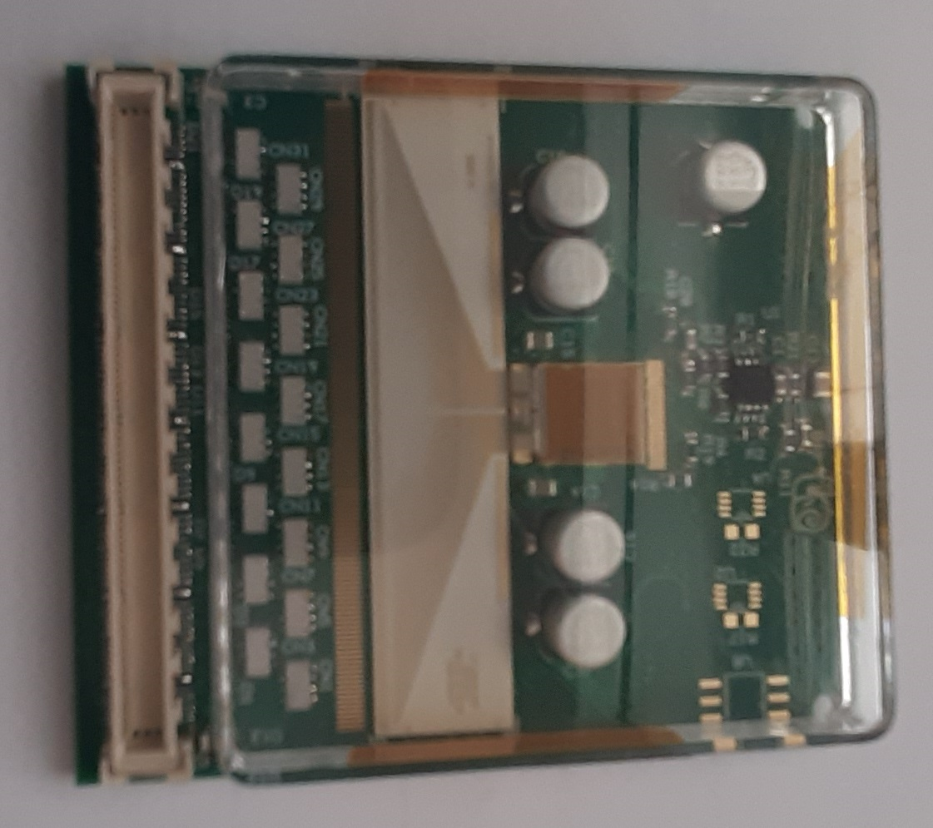
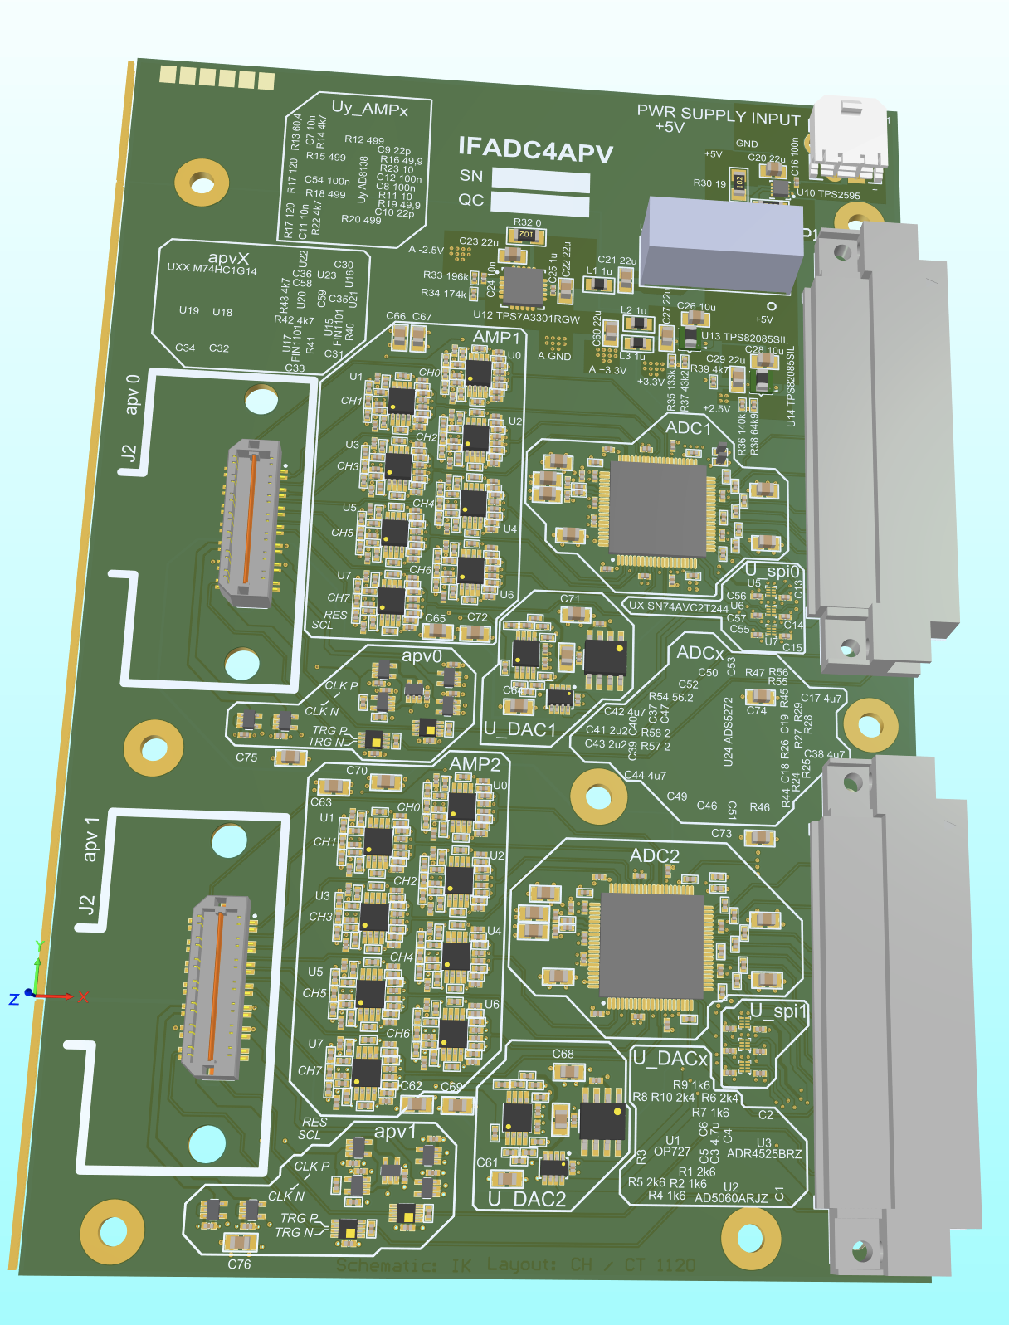
APV Frontend Cards
3 Prototypes tested, ENC measured
Tested with Test Station + existing ADC
54 more frontends in production.
New ADCs for APV Readout
16 Channels, 12 Bit, 65 MSPS
2 units needed for one GEM detector
Schematic: I. Konorov
Layout: C. Tezel, C. H.
Assembly: 3 Prototypes

Slide 7
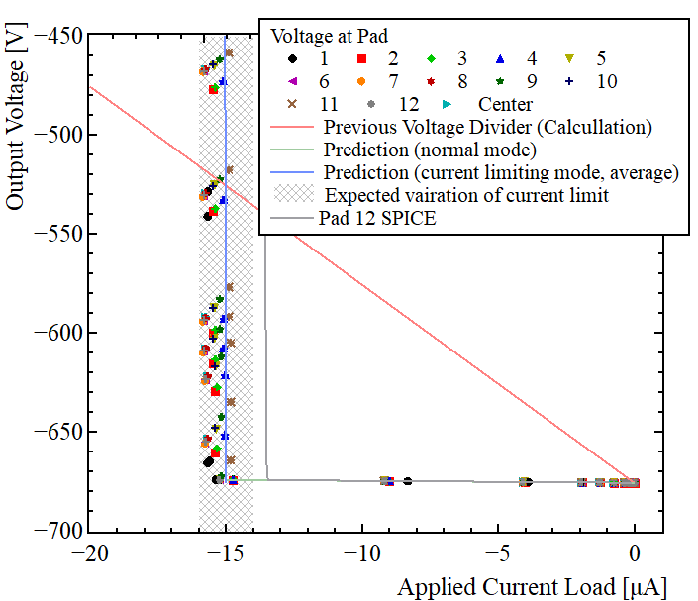
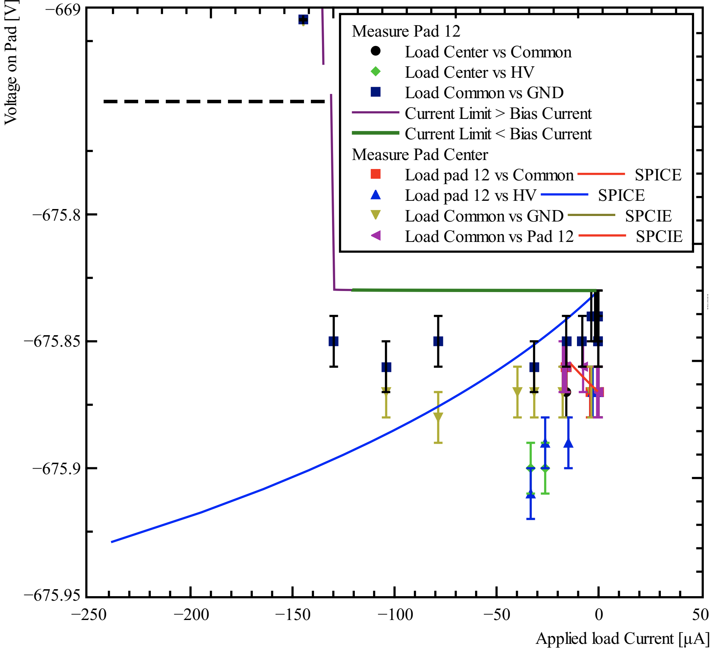
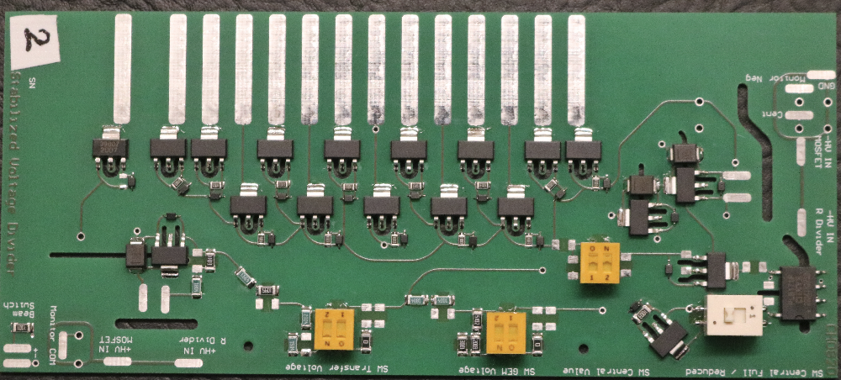
Stabilized Voltage Divider
Prototypes assembled + tested
  Output voltage stable for small loads
  Current limited (~15µA)
  even smaller voltage change when loading neighboring pad
Todo:
  Test in detector

Slide 8
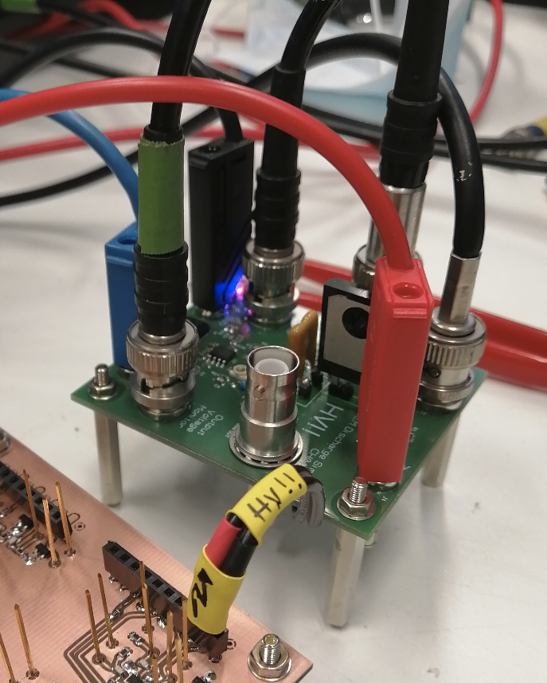
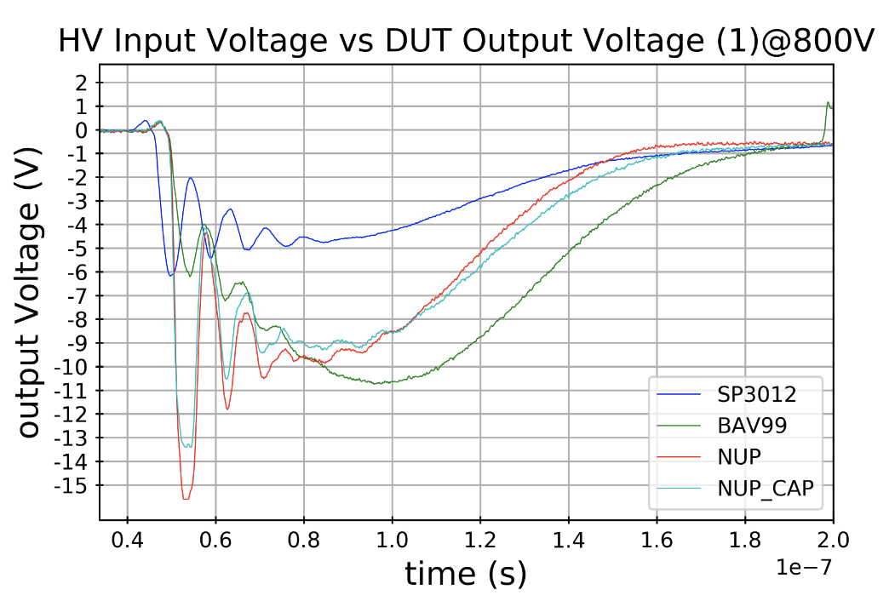
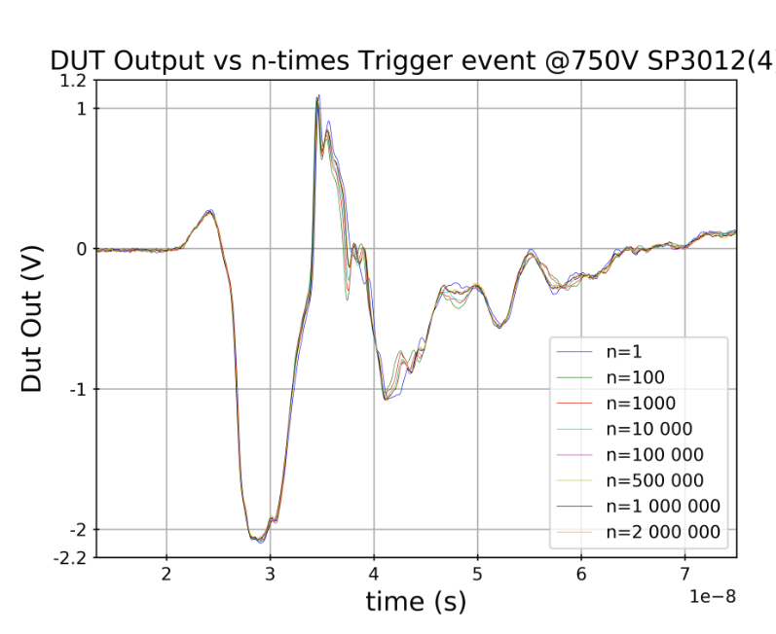
Discharge Simulator
Discharge Simulator
Up to 800V / 800nC
Monitoring Output
Measure Voltage/Current
Fast rise time
APV FE has protection against discharges
Different scenarios tested
  Discharge protection works
  Long-term stable

Slide 9
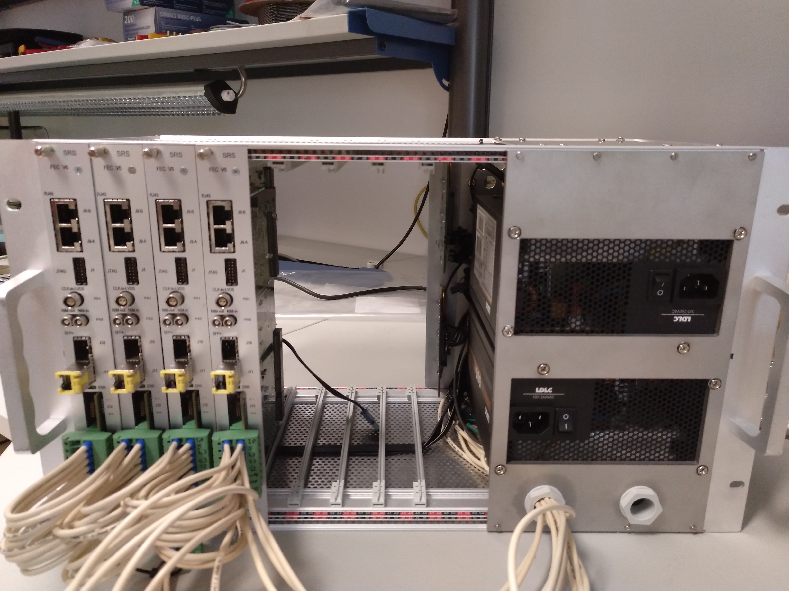
VMM Tests
Setup of an RD51 SRS VMM lab system:
Ordered electronics for one 30x30 cm² GEM prototype:
- 14 VMM hybrids, 1 DVMM, 1 CTF
- FECs and a crate from other group on loan
(we will order our own, when crates available in CERN store)
Status:
- 14 VMM hybrids currently in production, delivery expected in February
- DVMM, CTF ready at company SRS Technology, will be delivered with hybrids
- so far: few hybrids on loan, our own DVMM (prototype version)
- Michael assembled a new SRS create, almost complete

Slide 10
Spare Slides

Slide 11
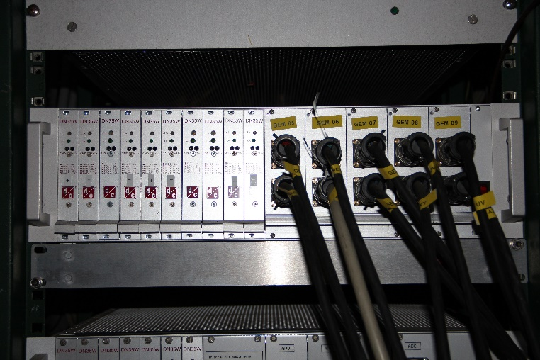
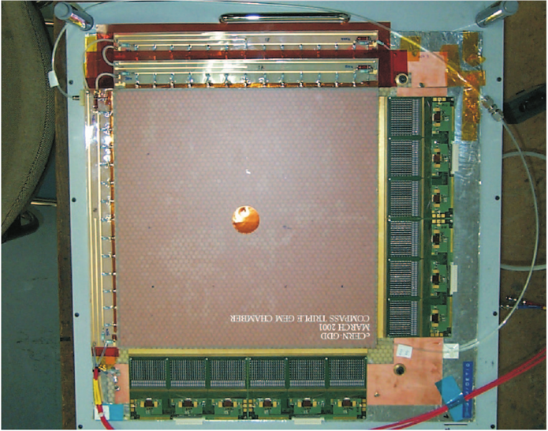
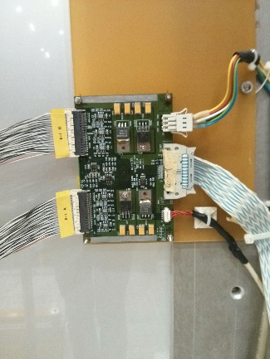
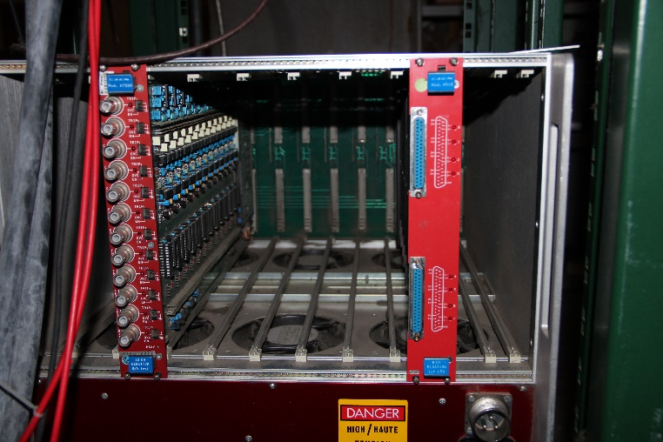
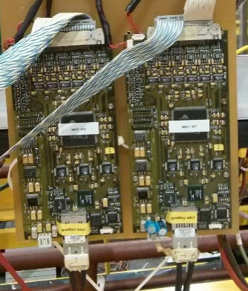
First Generation GEMs (CG1G)
1 station = 2 detectors = 4 planes
6 APV25 (S0/S1) per plane
Deutronics DN35W-5 (5.5V, 6A)
APV LV: 2ch per plane (± 3.5V, GND, -0.9A, +0.7A)
FLEX.COPPER CABLE 12x 2,5 mm2
TP Flat cable, 2x20 cond., max. 3 m
FLAT CABLE TWIST 40C 1.27MM AWG28
3M type 2100/40
S-HV cable HV COAX.CABLE HTC-50-1-1, 5kV,RED
type HTC-50-1-1
ADC Cards
(2 Detectors)
TP flat cable 2x25 cond., max. 60 cm
E - TWISTED PAIRS FLAT CABLES FOR IDC - PITCH 0.635 mm
3M type 79992-25P-270A
Repeater Card
CAEN SY527 Mainframe
TRG/CLK
SCREENED VIDEO CABLE, 4,7 mm, 2 PAIRS
type VB 04 P
HV Switch
ADC LV: 2ch per station (±5.5V, GND, +3.2A, -0.6A)
±12V
A732N (6kV, 1mA)
A516 (12V, 1.5A)

Slide 12
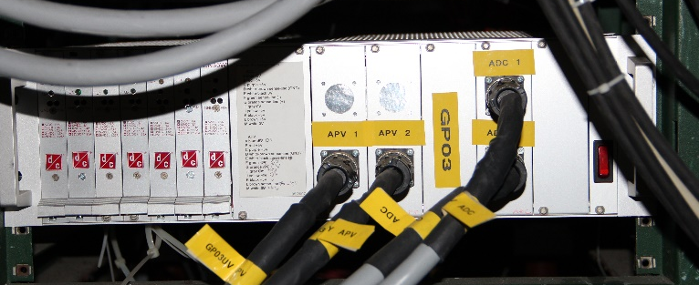
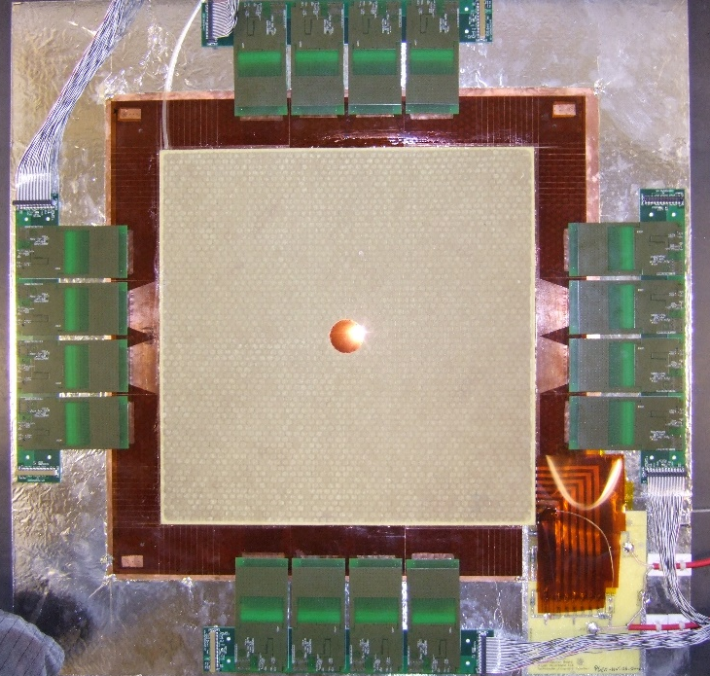
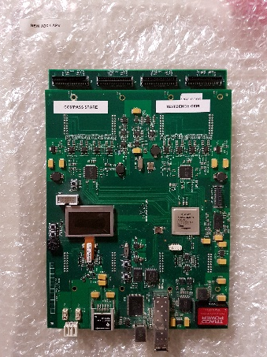
PixelGEMs (CG2G)
Deutronics DN35W-5 (5.5V, 6A)
TP flat cable 2x25 cond., max. 150 cm
E - TWISTED PAIRS FLAT CABLES FOR IDC - PITCH 0.635 mm
3M type 79992-25P-270A
LV APV: 2 ch. per det. (±5V, GND)
LV ADC: 3 ch. per station (2x +5V, 1x -5V, GND)
1 station = 2 detectors = 4 planes
8 APV25 (S1) per plane
Center
Drift
CAEN SY527 Mainframe
S-HV cable HV COAX.CABLE HTC-50-1-1, 5kV,RED
type HTC-50-1-1
A732N (6kV, 1mA)

Slide 13
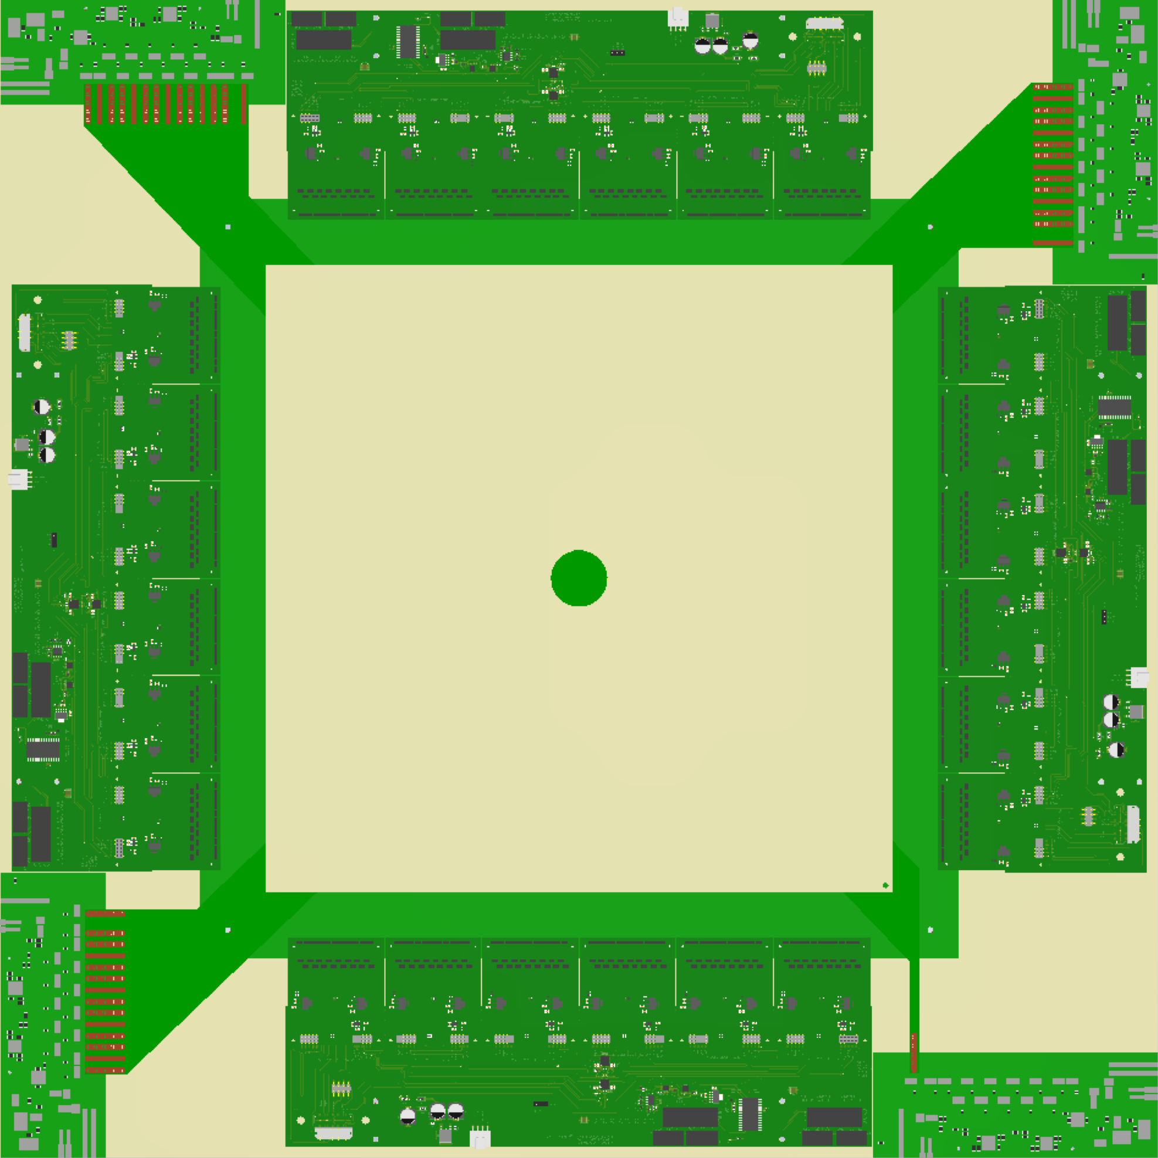
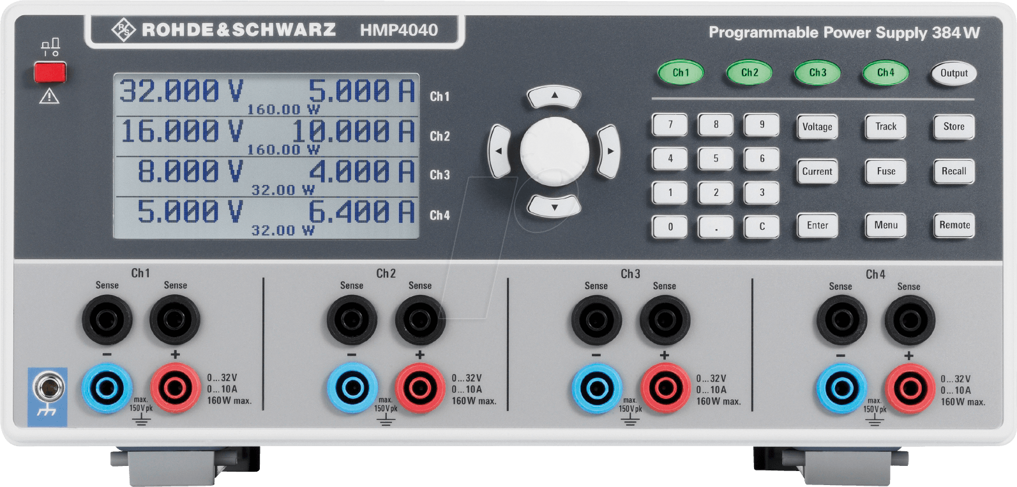
Upgraded Triple GEMs (CG3G)
1 station = 2 detectors = 4 planes
24 APV25 (S1) per plane
Required Power Supply Rails for 1 Detector:
4 kV, 1 mA for GEMs & Drift
3.3 V, 3 A (4x) for APV Supply
(floating, remote sense wires)
5 V, 3 A for each ADC
(floating)
New ADC chain (iFTDC)
(for 24 APVs in total)
Flat cable
EQDP-014-40.00-STR-SBL-5-B
Per ADC +5V & <3A
3,3V & 2x3A
S-HV cable HV COAX.CABLE HTC-50-1-1, 5kV,RED
type HTC-50-1-1
CAEN SY527 Mainframe
3,3V & 2x3A
Rohde&Schwarz HMP4040 | 4 chan. (each 10 A), 384 W
A732N (6kV, 1mA)

Slide 14
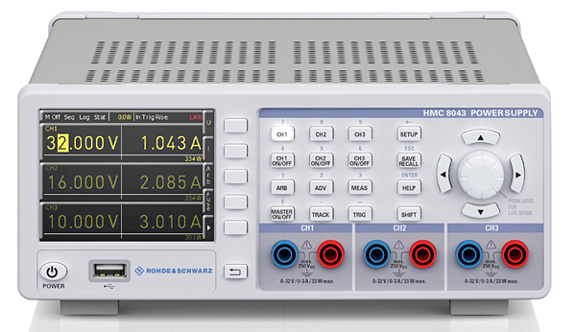
Triple GEMs with VMM (CG4G)
Rohde&Schwarz HMC8043 | 3 chan. (each 3 A), 99 W
Auxilary front-end electronics: (2.9 – 3.5) V, 2.4 A
→ 6.9 – 8.4 W
Deutronics DN35W-5 (5.5V, 6A)
Or
Example SRS VMM hybrid:
2 VMM ASICs, Aux.(FPGA, ...)
VMMs: (1.9-3.5) V @ 1.67 A
Aux.: (2.9-3.5) V @ 0.1 A
→ 24 hybrids/detector
Bare VMM ASIC: ~0.8 A @ 1.2 V
48 VMM ASICs need/detector
1 station = 2 detectors = 4 planes
24 VMM3a ASICS per plane
Required Power Supply Rails for 1 Detector:
4 kV, 1 mA for GEMs & Drift
VMM ASICs:
(1.9 – 3.5) V, 24 x 1.67 A grouped to 4 x 10 A
Auxilary front-end electronics:
(2.9 – 3.5) V, 2.4 A (all front-end boards)
S-HV cable HV COAX.CABLE HTC-50-1-1, 5kV,RED
type HTC-50-1-1
CAEN SY527 Mainframe
VMM ASIC Power: (1.9 – 3.5) V, 4 x 10 A
→ 76 – 140 W
Rohde&Schwarz HMP4040 | 4 chan. (each 10 A), 384 W
A732N (6kV, 1mA)

Slide 15
Does not work!
Old ADCs (CG1G) need 2ch with > 3A (?) per station
New ADCs (CG3G): 4 ADCs per station needed

Slide 16
LV Configurations
green: existing
dark orange: plan for 2021
light orange: possible future
Generation | p.s. type | GMnnU1 | GMnnV1 | GMnnX1 | GMnnY1
CG1G | APV: CAEN A516 | 2ch, ±3.5V, -0.9A, +0.7A | 2ch, ±3.5V, -0.9A, +0.7A | 2ch, ±3.5V, -0.9A, +0.7A | 2ch, ±3.5V, -0.9A, +0.7A
 | APV: HMP4040 | 2ch, ±3.5V, -1.8A, +1.4A |  | 2ch, ±3.5V, -1.8A, +1.4A
 | ADC: DN35-5 | 2ch, ±5V, +3.2A, -0.6A
CG2G (PGEM) | APV: DN35-5 | 2ch, ±3.5V, -1.8A, +1.4A |  | 2ch, ±3.5V, -1.8A, +1.4A
 | ADC: DN35-5 | 3ch, ±5V, +6A, -3A
CG3G | APV: HMP4040 | 1ch, +3.3V, 4-6A | 1ch, +3.3V, 4-6A | 1ch, +3.3V, 4-6A | 1ch, +3.3V, 4-6A
 | ADC: HMP4040 | 1ch, +5V, <3A | 1ch, +5V, <3A | 1ch, +5V, <3A | 1ch, +5V, <3A
CG4G | VMM (SRS): HMP4040 | 1ch, 1.9-3.5V, 9.6A | 1ch, 1.9-3.5V, 9.6A | 1ch, 1.9-3.5V, 9.6A | 1ch, 1.9-3.5V, 9.6A
 | Auxiliary | 1ch, 2.9-3.5V, 2.4A |  | 1ch, 2.9-3.5V, 2.4A
For Center HV switch: 1 ch 12V, no current ⇒ find simpler solution

Slide 17
Price Tags
Type | Web price | Needed per station
HMC8043 (3ch) | 1450 | 2 (Moritz‘ conf.)
HMP4040 (4ch) | 2310 | 1 (CG1G), 2 if also ADC
 |  | 2 (CG2G, CG3G)
but not sufficient for ADCs!
Note:
HMP4040 already in use for APVs at NA64 and in the lab
will perform rate test in the lab
compatibility with DCS?
connection on backside?

Slide 18
Occupancy vs Trigger Rate

Slide 19
Slides from Moritz: TB Nov. 12, 2019

