Slide 1


Joint COMPASS and COMPASS++/AMBER TB
19 January 2021
IKAR TPC installation
Stefano Levorato
Stefano Levorato – CERN – 19 January 2021

Slide 2
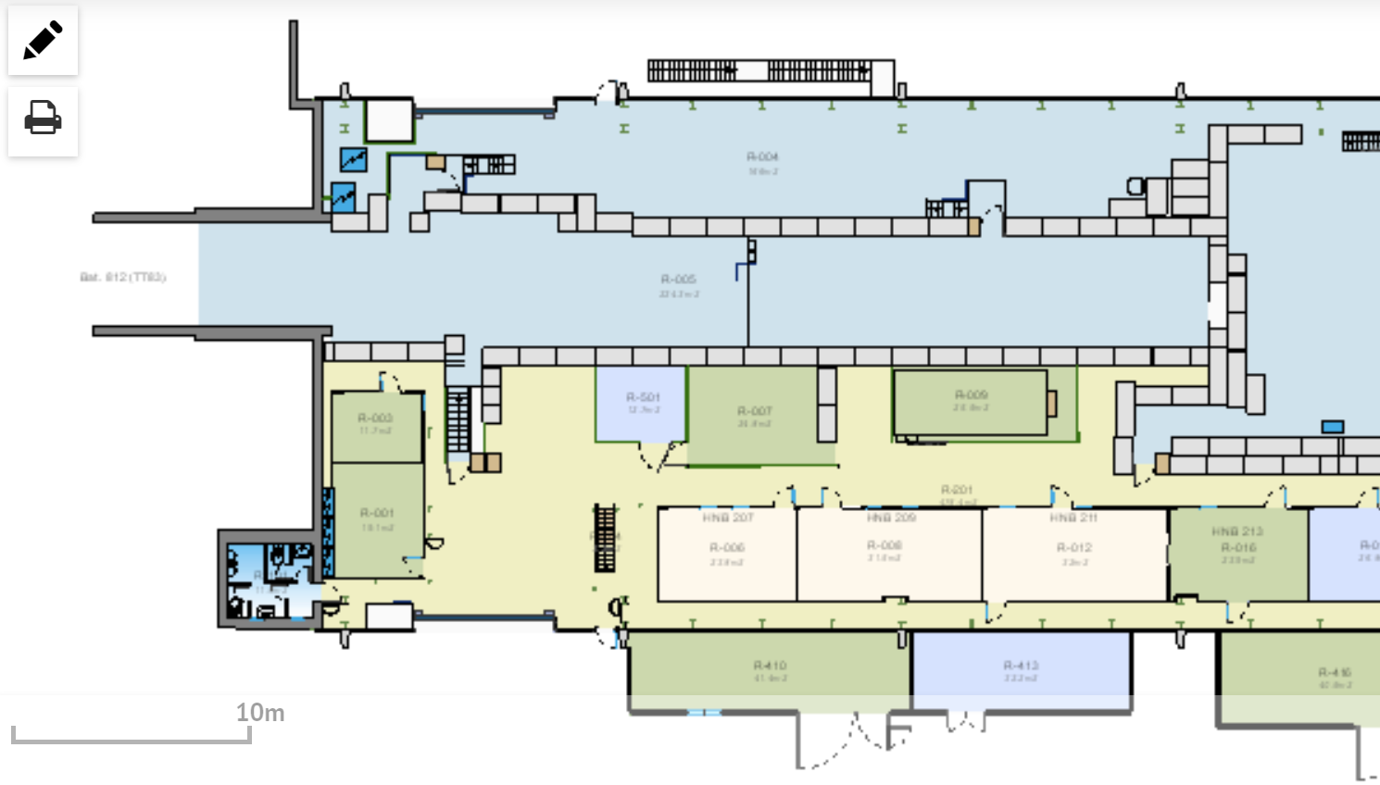
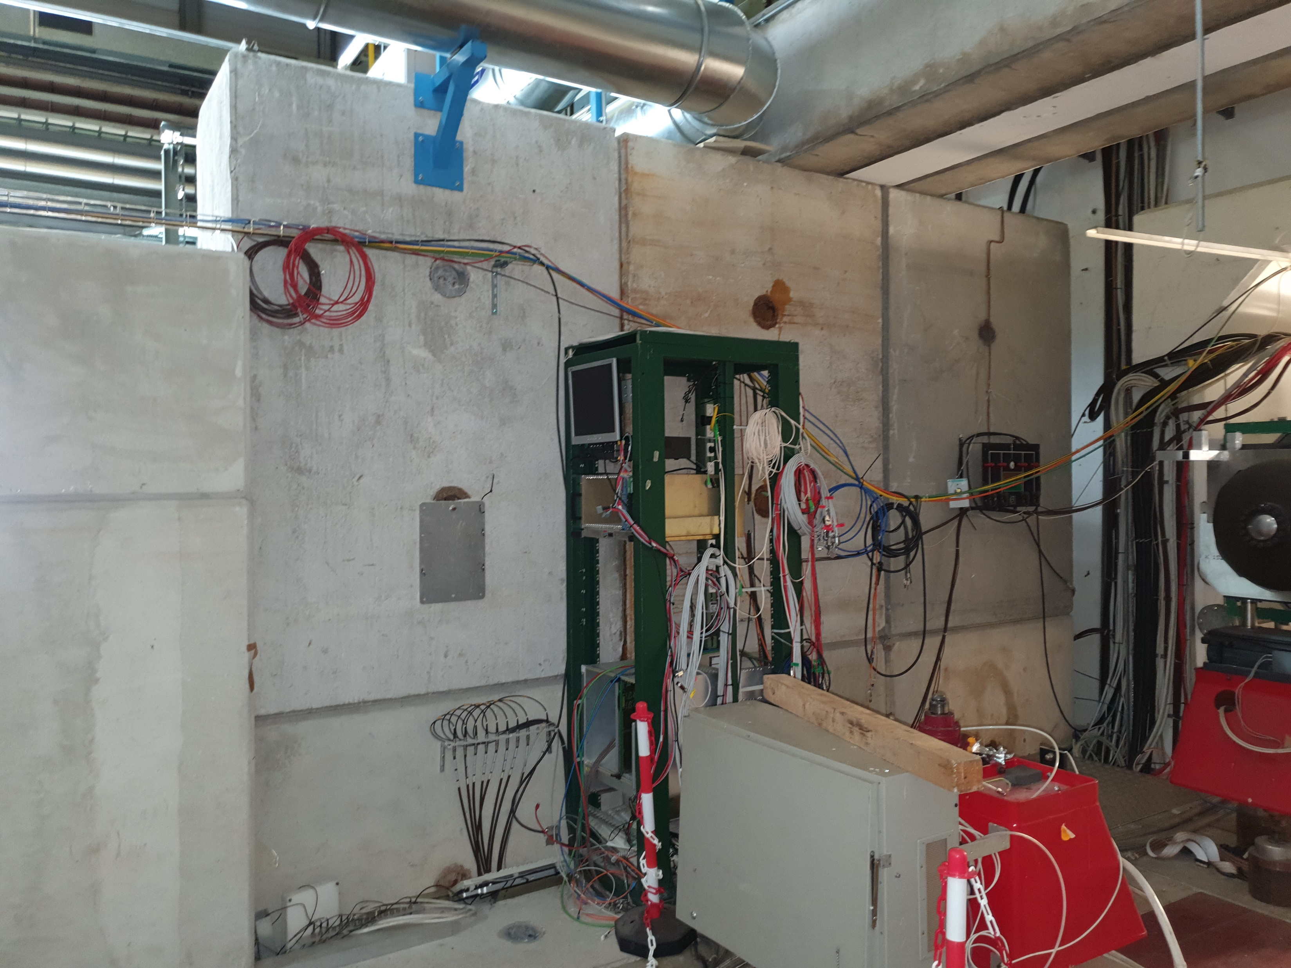
M2 beamline intervention: EN-EA
Few visits to define the M2 beamline intervention and to identify the positioning of the required services
( J. Bernhard → Dipanwita, + EN-CV, EN-EA-AS )
Rail system installation
Magnet failure moving out
Faster Changeover between setups
Service installation for the different setups
Fibers
Power distribution
Gas distribution (Helium, Nitrogen,Hydrogen,Argon)
Stefano Levorato – CERN – 03 November 2020

Slide 3

M2 beamline intervention: EN-EA
Few visits to define the M2 beamline intervention and to identify the positioning of the required services
( J. Bernhard → Dipanwita, + EN-CV, EN-EA-AS )
Shielding modification due
to radiation limits for DY
- Doubling of concrete wall or Iron
Shieling will be put in place
- Modification of the access to M2 beamline: chicane
Radiation background studies started
to define the shielding requirements
Concrete / Iron shielding
Stefano Levorato – CERN – 03 November 2020

Slide 4
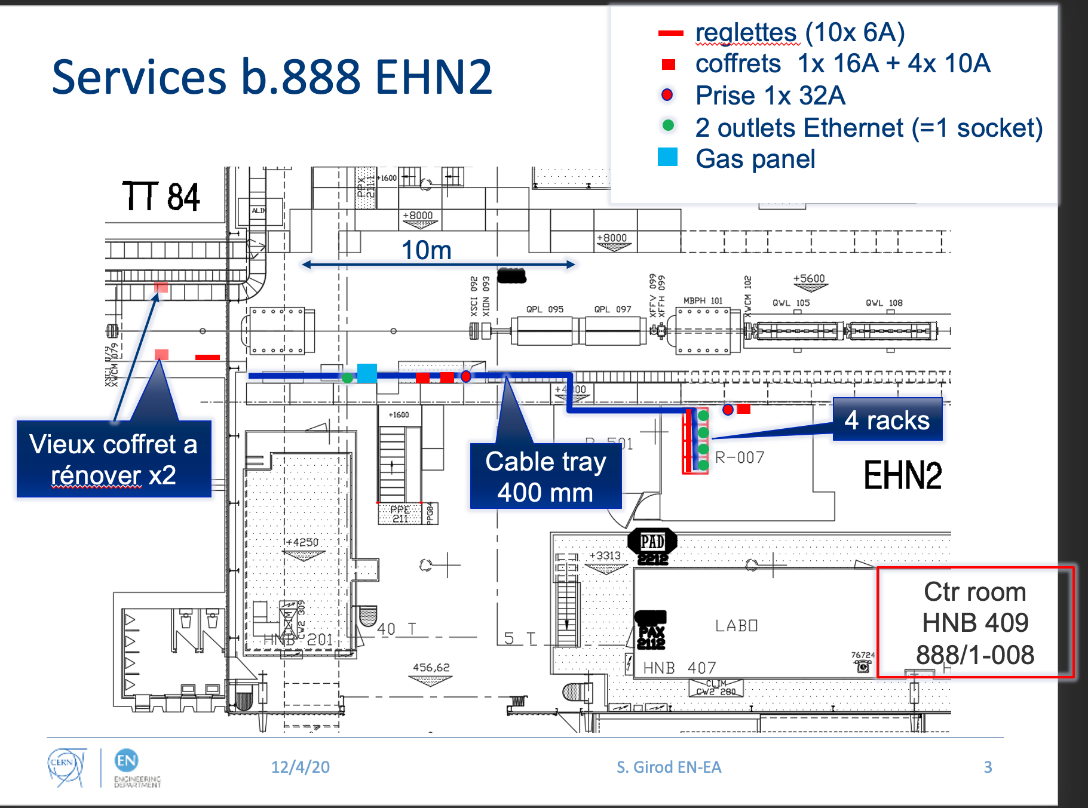
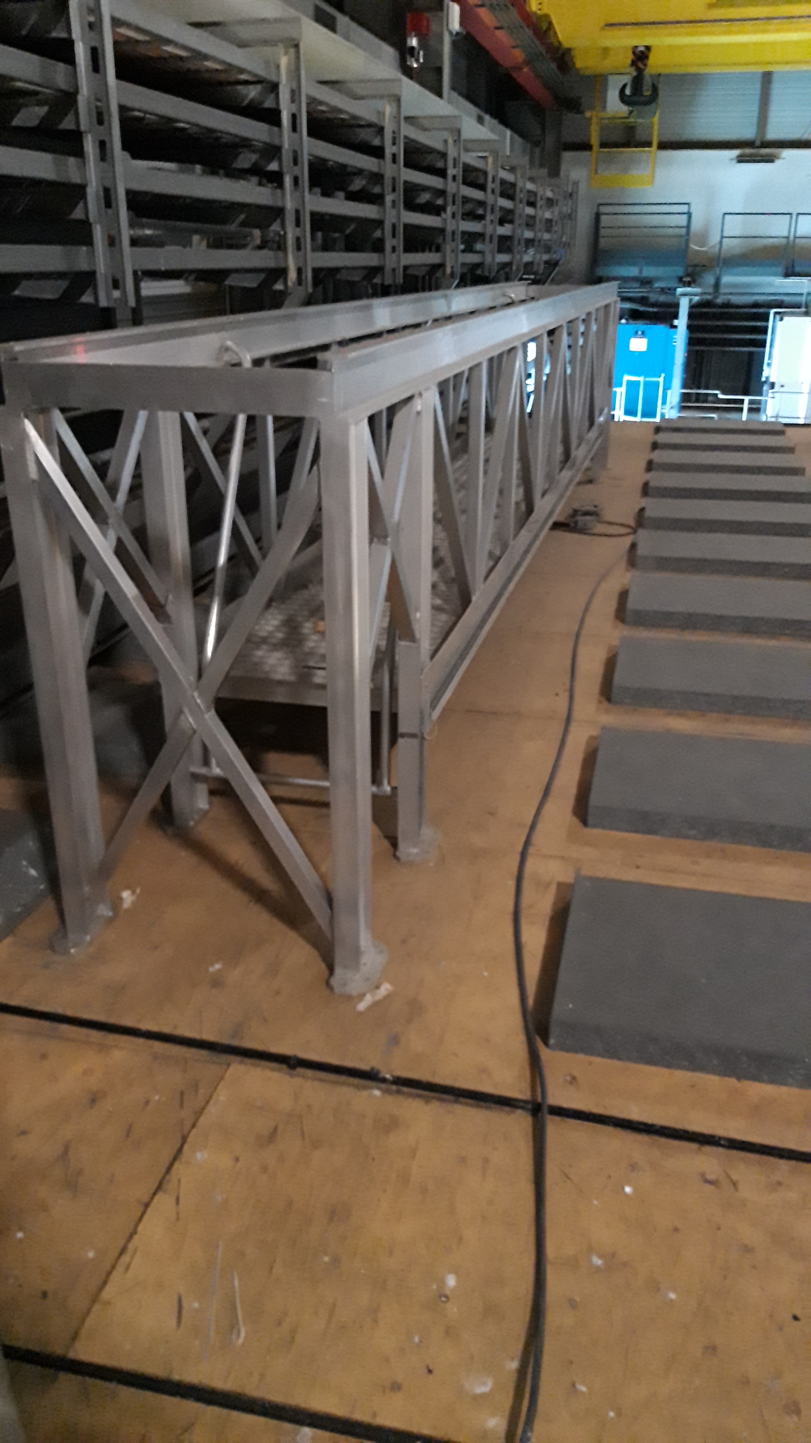
TPC → services only in beam position or outside (helium gas only) yellow mark position
to allow for test till beam time is allocated ?
Stefano Levorato – CERN – 19 January 2021
4

