Slide 1
TPC gas system
, Alexander Vasilyev, Aleksei Dziuba
NRC Kurchatov Institute – PNPI
COMPASS / AMBER TB Meeting, 16.11.2021

Slide 2
Two options for circulation system
Cryogenic circulation system
Absence of movable elements
No maintenance
United with purification system
More expensive
We have to approve device at CERN
Only Hydrogen (not possible to use Helium for tests)
Big consumption of liquid Nitrogen (necessary to control)
Impossible to have this system in 2022 for tests
2. Circulation system based on mechanical compressor
Cheaper solution
Simpler approval at CERN
Helium tests are possible
Possible to use without cryogenic liquids
Vibrations
Maintenance every 1000 hours
Our opinion: Circulation system based on mechanical compressor is preferable.

Slide 3
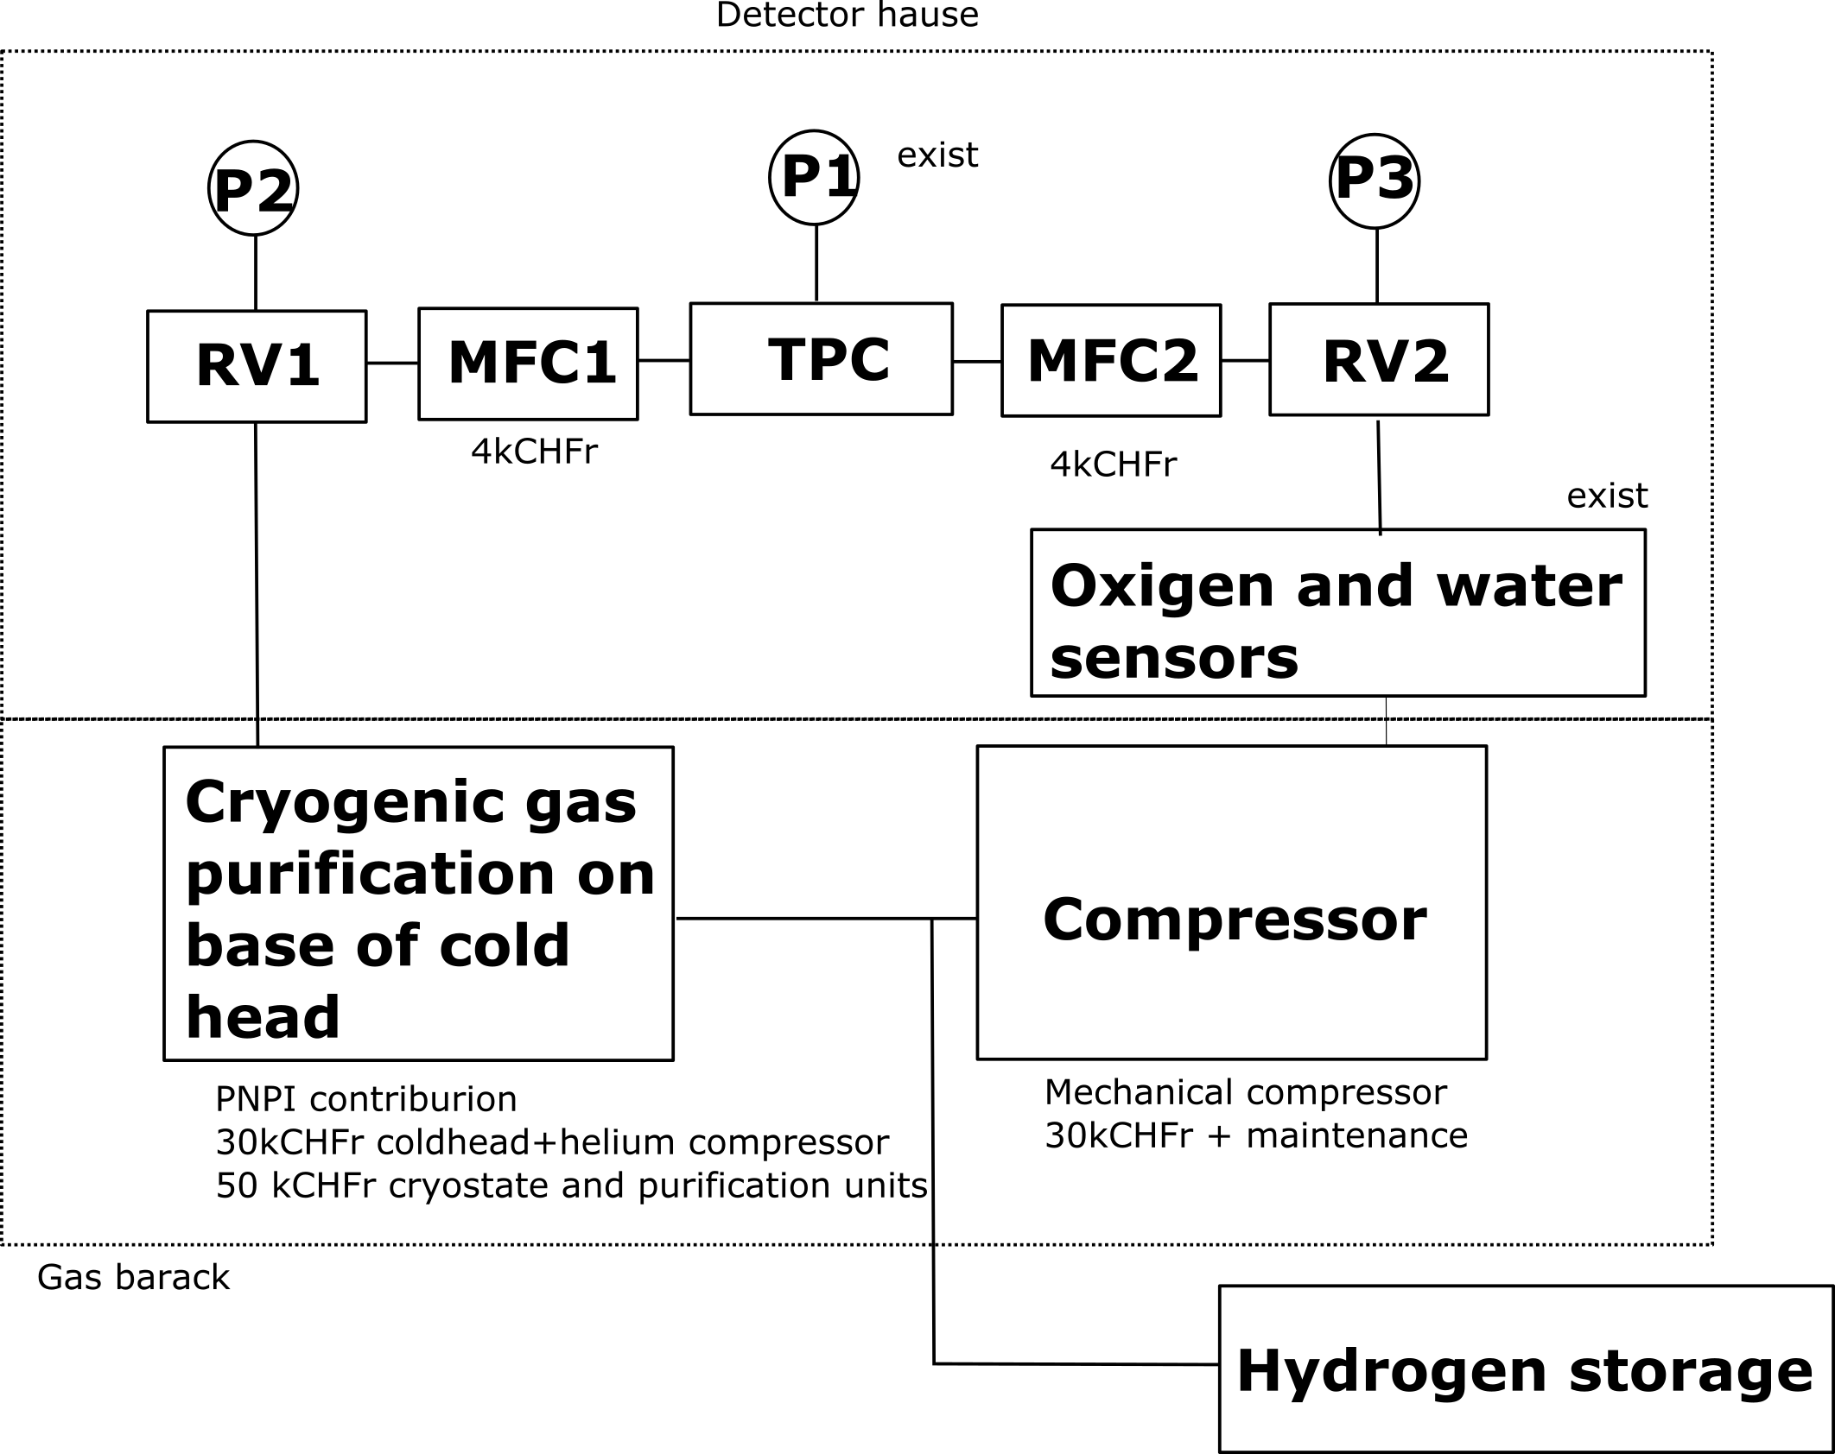
Proposed scheme

Slide 4
Planning and responsibilities (proposal)
Production of “Cryogenic gas purification subsystem”
- preliminary design – end 2021
approval by CERN - January-March 2022 (few iterations and visit to CERN)
production at PNPI – till end of September 2022
Ordering of components – till the end of September 2022 (?????)
Assembling TPC and circulation system – from September 2022 (after delivery all necessary
parts including main detector body)
Tests on Helium in TPC at suitable place in experimental Hall - on readiness

