Slide 1
Status GEM Detectors
Bernhard Ketzer
COMPASS/AMBER Technical Board
16.11.2021

Slide 2
GEM and PixelGEM system in 2021
New R&S power supplies for APV: 10 x 4ch R&S NGP804, to replace CAEN A516
  4 on gallery (GM01-GM04)
  5 under SM2 (GM05-GM09)
  1 on Saleve wall (GM10)
  Adapter cables produced by CERN workshop, modified in situ
  Slow Control implemented by Christophe Pires
GM01 reinstalled on DC4 on 12.7.
GM02 reinstalled on DC5 on 13.7., both very smoothly, thanks to Michael P., Vincent, Moritz, Christophe
Central switches: CAEN A516 modules replaced by LAN I/O modules
All detectors (GM01-10, GP02/03) operational on 15.7.
GM11 not used
GP02, GP03 operational

Slide 3
Issues during 2021 data taking
GP03XY: ADC transition card needed to be replaced (20.7.)
GM01 removed from DC04 (21.7.), re-installed on DC04 (4.8.)
GP02UV: ADC exchanged/changed back (26.-29.7.), problems still present,
problems with one chip on V plane (0x34), disabled
GM01UV: several HV trips, HV module ch 0 faulty, changed ch (18.8.)
GP02 center voltage trips, ramp-up speed adjusted
Latency scans (17.8., 26.8., 2.9.), final latencies set (4.9.), time calibration done (not yet uploaded to DB)
Mapping of center switches corrected (2.9.)
Detectors centered on beam, adjustments for GM03 and GM08
GM08UV: exchanged LV power supply for ADCs (deutronics => lab p.s.), errors disappeared (5.9.)
GM04XY: noise problem of one APV chip (18.9.), which is oscillating after it is programmed (0x2c)
need to also disable 2nd chip, which needs I2C broadcast (0x3f) in order to be programmed (0x24)
GM09/10 errors: disappeared after cleaning optical fiber and replugging LV vable (24.9.)

Slide 4
COMPASS GEM-3G (CG3G)
Size of active area: 30.7 × 30.7 cm2
Strips divided in center to reduce occupancy
Triple GEM, foils sectorized on top (13 sectors)
No spacer grids
Gas in/out on drift plate, internal distribution
Stabilized voltage divider: 3 +1 cards
6 × 4 front-end cards, 4 supply cards

Slide 5
Status of detector parts
CERN Batch 1: shipped 20.10.2020
  6 GEM foils (2μm Cu) ⇒ 1 bad (high current), 5 good
  3 drift foils (2μm Cu) ⇒ 3 good
  2+1 R/O foils ⇒ 3 good
CERN Batch 2:
  10 GEM foils (2μm Cu), shipped 30.8.2021 ⇒ 1 bad (high current), 7 good, 2 not yet tested
  2 drift foils (2μm Cu), shipped 30.8.2021 ⇒ 2 good
  2+1 R/O foils, shipped 27.10.2021 ⇒ 2 good, 1 bad (known)
Honeycomb plates (Piepenbrink)
  Batch 1a: 2 drift plates, 2 R/O plates (potted, bent) ⇒ re-treated, flattened
  Batch 1b: 2 R/O plates (GFK frame) ⇒ 2 good
  Batch 2: 2 drift plates, 2 R/O plates ⇒ good
GEM frames (local workshop):
  full frames for 3 detectors available (drift, transfer, induction)
  10 parts for 2,5 transfer frames available

Slide 6
Status of Stabilized Voltage Divider
First detector equipped with SVD
Several issues observed during operation:
  oscillations with capacitive load ⇒ solved by adding capacitors
  current limitation circuit broke, most likely because of a current spike that occurred before the circuit starts to work ⇒ solved by adding a series resistor (~30k)
  destruction of circuit could be recreated in test setup: transistor breaks w/o resistor
  components ordered; repair, modification, test on detector pending
Tests with single-channel SVD on detector, comparison to PVD ⇒ ongoing (Bachelor’s thesis)
Equip next detector with PVD instead
HV PCBs:
  SVD: 3 assembled (3+1 needed for prototype)
  PVD: 12 PCBs available, 1 assembled (4 per det.)

Slide 7
Status of detector production
 | Support plates | Frames | Drift foil | GEM foils | Readout PCB | HV board | Assembly | Calibration | Installation
CG3G01 | ✓ | ✓ | ✓ | ✓ | ✓ | SVD | ✓ | ✓ | Prototype
CG3G02 | ✓ | ✓ | ✓ | ✓ | ✓ | PVD | S3
CG3G03 | ✓ | ✓ | ✓ | ✓ | ✓ |  | QA
CG3G04 | ✓ |  | ✓ | ✓ | ✓ |  | QA
CG3G05 |  |  | ✓ |  | ✓
Assembly steps:
QA: quality assurance
G1, G2, G3: GEM i framed
RO: R/O PCB glued
D: drift foil glued
S1, S2, S3: stack i glued
DET: detector assembled
GAS: gas pipes + tight
HV: HV board assembled
Stations to be replaced for 2022: GM05, GM08 (GM04?)
Installation: March/April 2022

Slide 8
Front-end and readout electronics
Front-end cards (APV):
  APVs available for all detectors
  56 cards ready and tested (24 per det., 2 at TUM)
  Components and PCBs for 100 cards available, some delay in assembly
Supply cards:
  2 produced and being tested (at TUM)
  6 PCBs in production, components ordered
  bugfix for new PCBs: capacitor too high ⇒ add cut-outs
ADC cards:
  2 produced, 1 working (at TUM), tested with IFTDC, production of additional ones to be clarified!
  full system test with APV to be performed at CERN (DAQ lab)
  components for 10-15 cards available, 2 per det. needed, delay in assembly (Covid)
  9 IFTDC cards produced
  ADC firmware ported to Artix FPGA by S. Huber
  Slow control implemented in config_server by V. Frolov

Slide 9
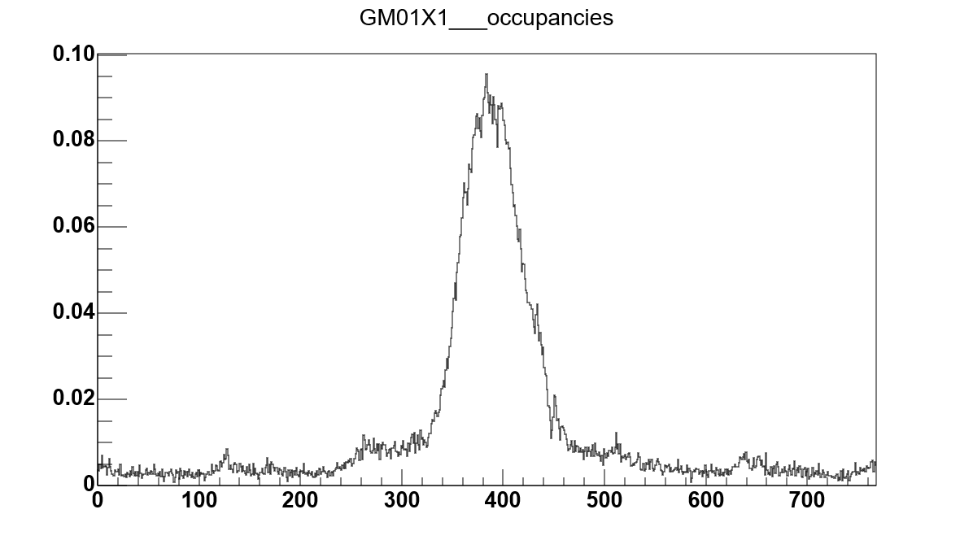
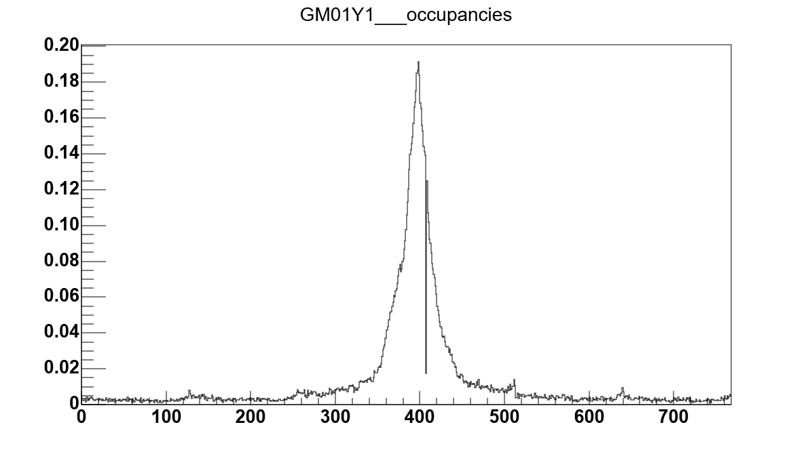
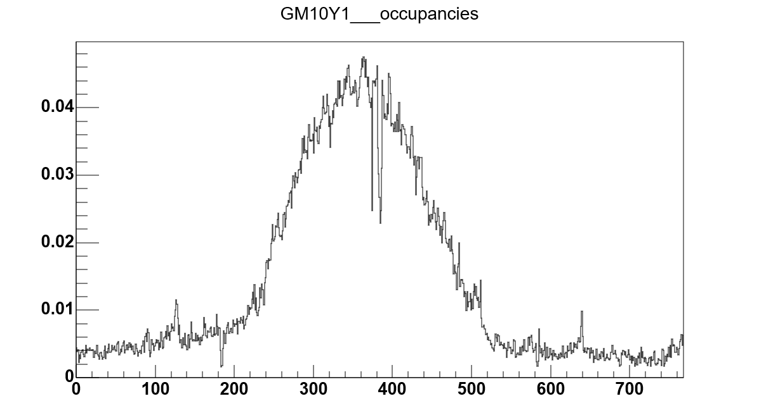
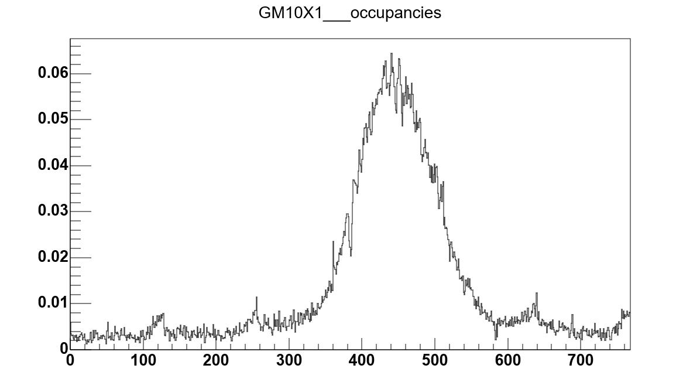
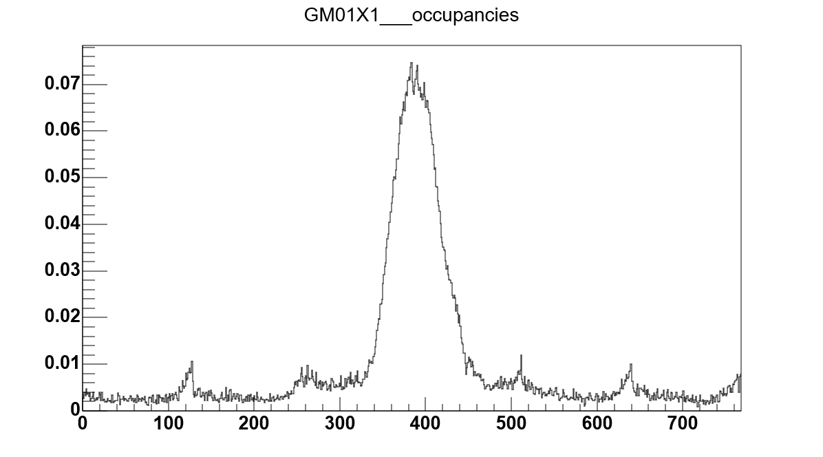
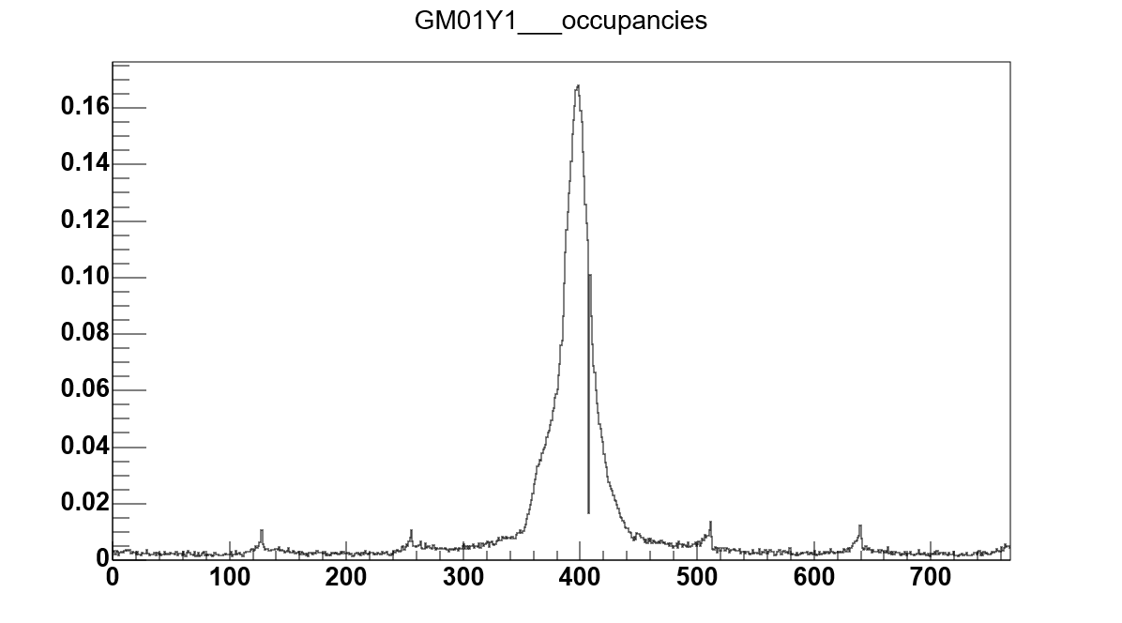
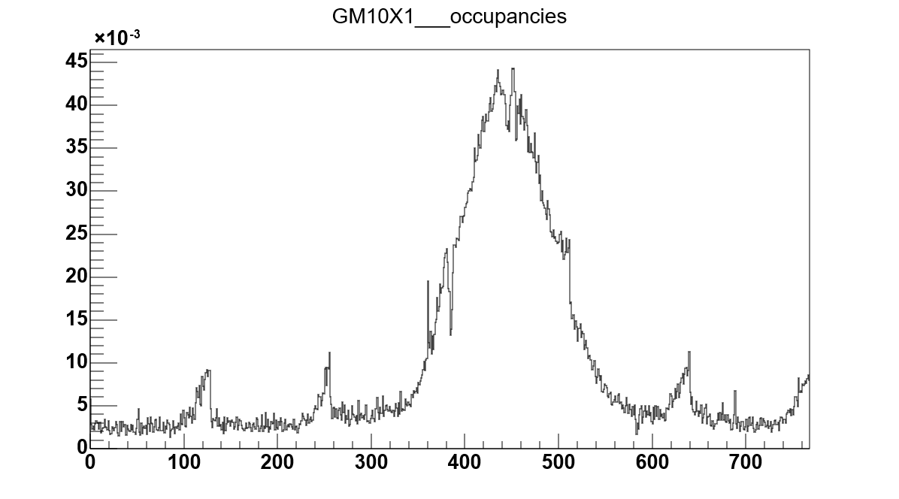
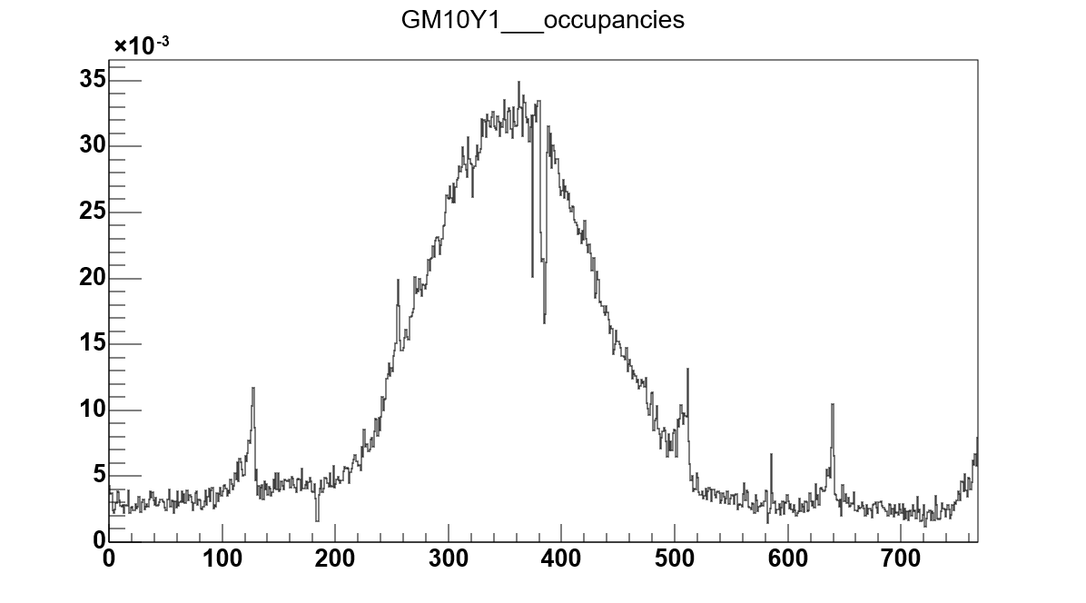
GEM Performance during PRM Pilot Run
Run 293211 (intensity scan, ion chamber 2.8E7 per spill)
Run 293293 (physics, ion chamber 9.9E6 per spill)

Slide 10
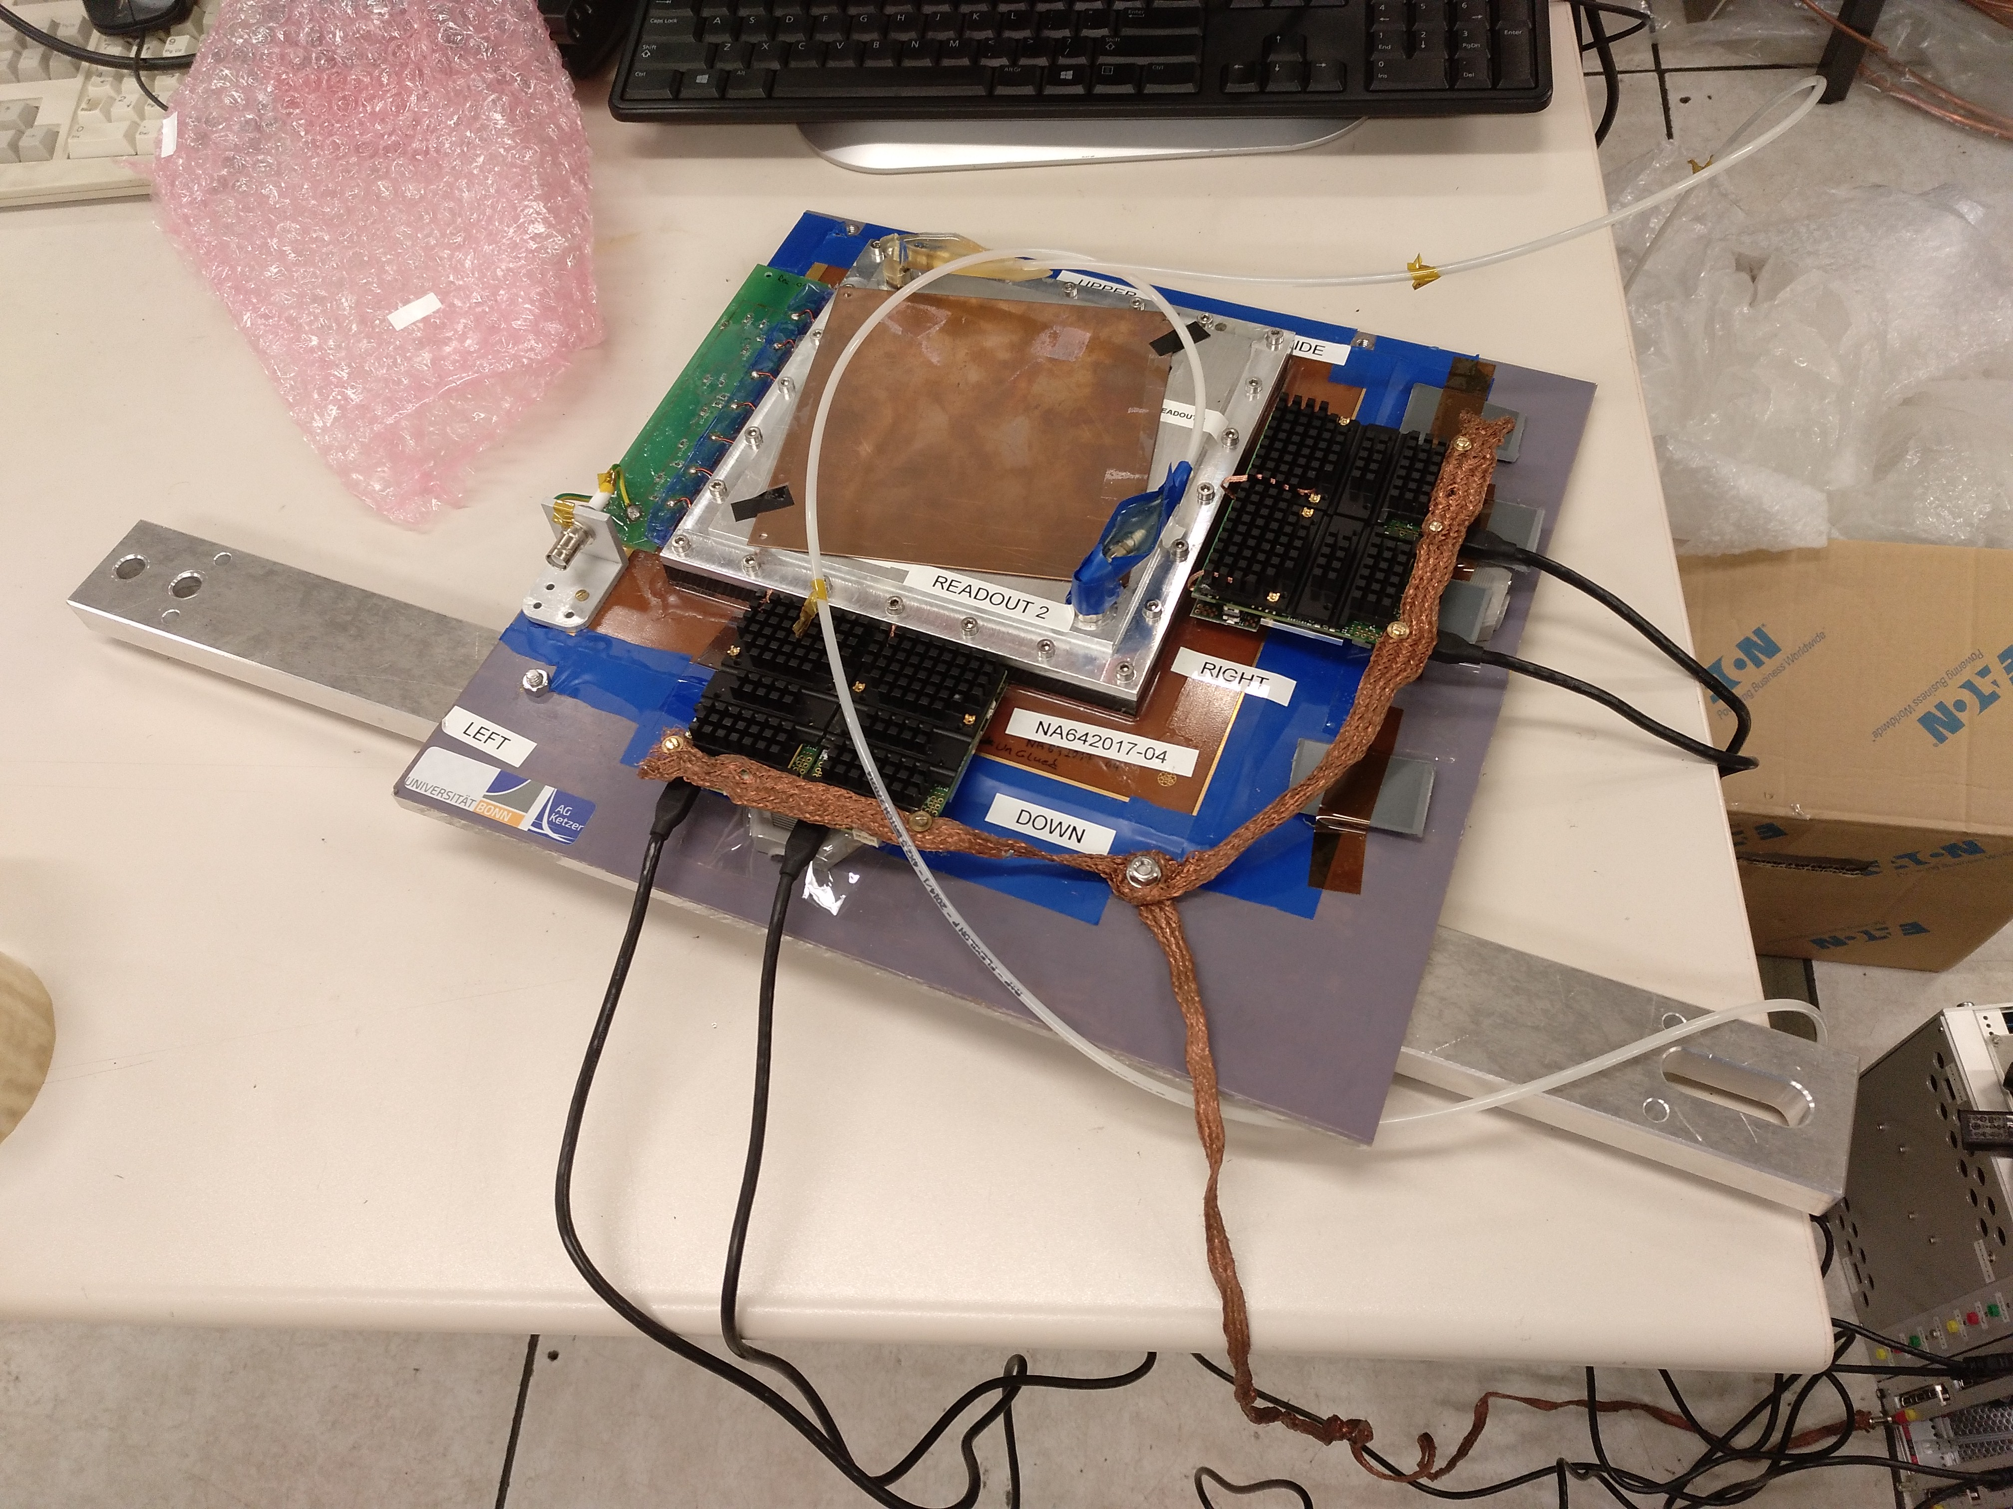
GEM with VMM readout
M. Lupberger
COMPASS style
Std. 10x10 cm² GEMs
3 mm drift
Readout 400 µm pitch
256 strips x
256 strips y

Slide 11
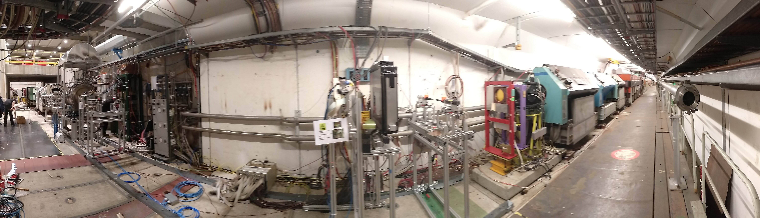
GEM with VMM readout
M. Lupberger
COMPASS
High-pressure H TPC (DUT)
Silicon (DUT)
SciFi station
M2 beam
Trigger scintillator
Trigger scintillator
VMM GEM (DUT)
4 x silicon (DUT)

Slide 12
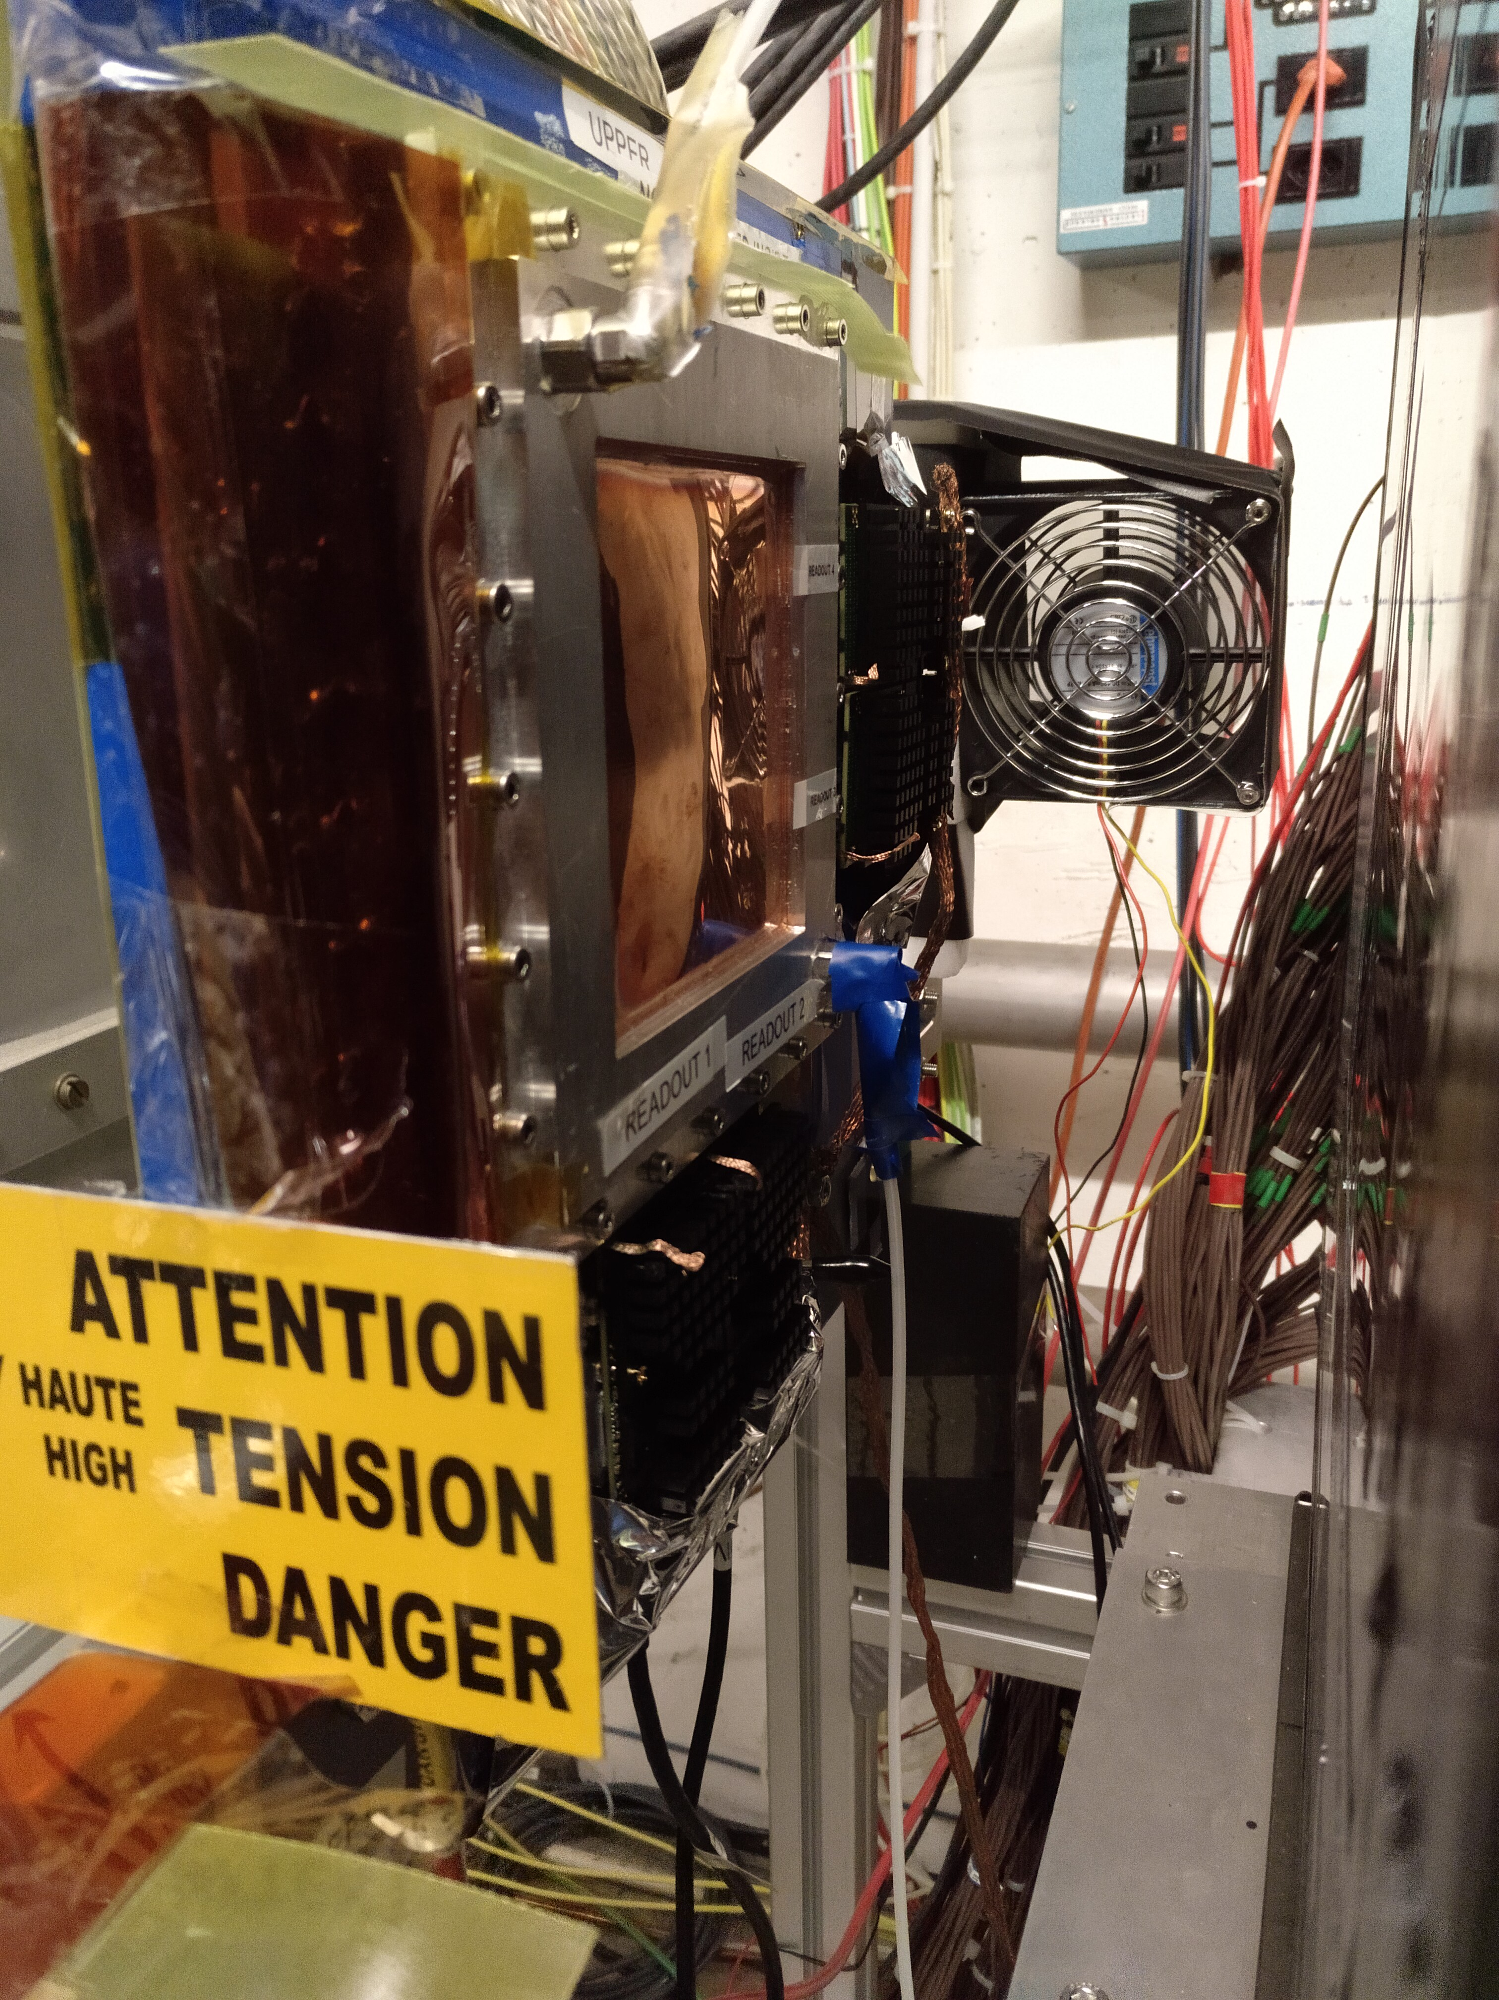
GEM with VMM readout
M. Lupberger
245 (b)
B
B
FEC1 HDMI1
243 (b)
B
C
FEC1 HDMI2
361 (a)
153 (b)
A A
B B
FEC2 HDMI3
FEC2 HDMI4

Slide 13
GEM with VMM readout
M. Lupberger
FLT ART EOS BOS
245 (b)
B
B
FEC1 HDMI1
243 (b)
Mainz trigger board
B
C
FEC1 HDMI2
224 (b)
361 (a)
153 (b)
Seperate VMM hybrid to record and time stamp COMPASS triggers
B C
A A
B B
FEC3 HDMI1
FEC2 HDMI3
FEC2 HDMI4
Power via HDMI

Slide 14
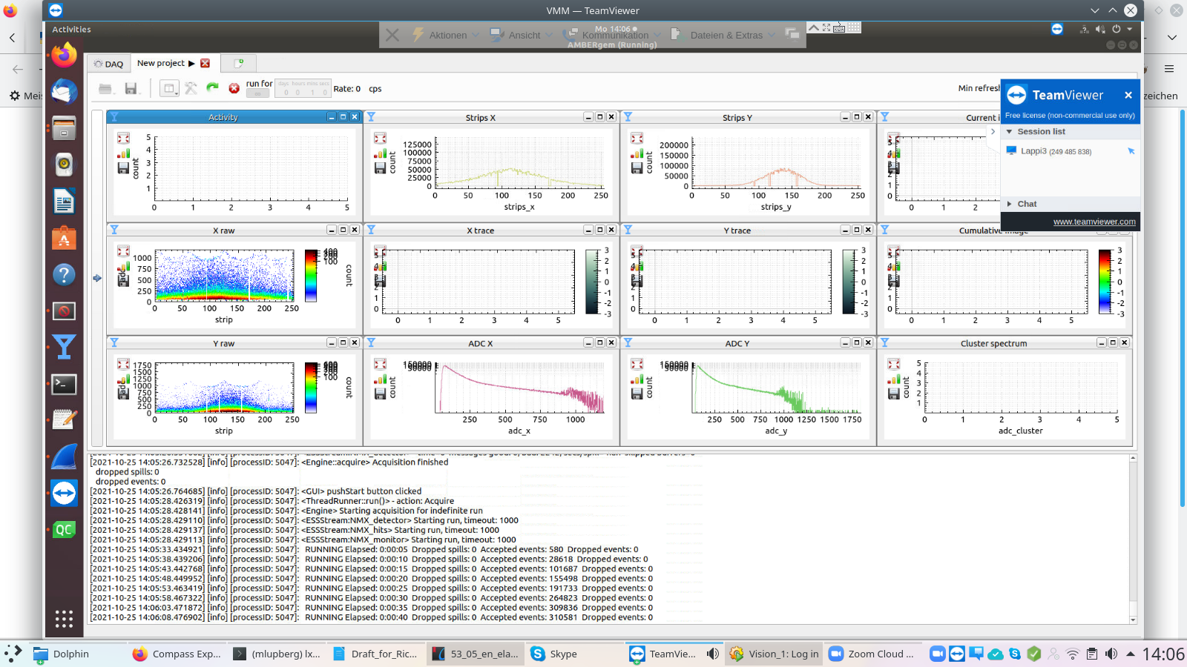
GEM with VMM readout
M. Lupberger
Neighbouring off
2 known dead channels
No saturation
(log scale)
Few bit errors
Working point:
- gain 3 mV/fC
- peaking time 200 ns
- low thresholds (~8-12 DAC above baseline + exceptions)

Slide 15
Spare Slides

Slide 16
LV Configurations
green: existing
dark orange: plan for 2021
light orange: possible future
Generation | p.s. type | GMnnU1 | GMnnV1 | GMnnX1 | GMnnY1
CG1G | APV: CAEN A516 | 2ch, ±3.5V, -0.9A, +0.7A | 2ch, ±3.5V, -0.9A, +0.7A | 2ch, ±3.5V, -0.9A, +0.7A | 2ch, ±3.5V, -0.9A, +0.7A
 | APV: NGP804 | 2ch, ±3.5V, -1.8A, +1.4A |  | 2ch, ±3.5V, -1.8A, +1.4A
 | ADC: DN35-5 | 2ch, ±5V, +3.2A, -0.6A
CG2G (PGEM) | APV: DN35-5 | 2ch, ±3.5V, -1.8A, +1.4A |  | 2ch, ±3.5V, -1.8A, +1.4A
 | ADC: DN35-5 | 3ch, ±5V, +6A, -3A
CG3G | APV: NGP804 | 1ch, +3.3V, 8-12A |  | 1ch, +3.3V, 8-12A
 | ADC: NGP804 | 1ch, +5V, <6A |  | 1ch, +5V, <6A
CG4G | VMM (SRS): NGP804 | 1ch, 1.9-3.5V, 19.2A |  | 1ch, 1.9-3.5V, 19.2A
 | Auxiliary | 1ch, 2.9-3.5V, 2.4A |  | 1ch, 2.9-3.5V, 2.4A
For Center HV switch: 1 ch 12V, no current ⇒ find simpler solution

