Slide 1
VMM3a related firmware activities in 2020 and 2021
ESS work on RD51 SRS components
Dorothea Pfeiffer (ESS)
Steven ALCOCK (ESS)
Sergei Odintsov (University of Talin)

Slide 2
Overview
Tallinn University Inkind project: Cleanup, refactoring and documentation of VMM3a hybrid firmware
Integration of RD51 VMM3a hybrid into ESS readout
SRS FEC firmware and slow control changes

Slide 3
Tallinn University: Refactoring firmware for RD51 VMM3a hybrid

Slide 4
Inkind project for NMX
Tallinn University: Refactoring firmware for RD51 VMM3a hybrid
Project between the electronics department of Tallinn University and ESS NMX, signed just before Xmas in 2019
Aim of the project was to clean up the hybrid firmware, refactor and document it
Person chosen: Sergei Odintsov, Electronics Engineer, FPGA expert, at the moment finishing his PhD
Original plan was, Sergei comes to CERN for a few weeks to get familiar with the SRS, and works together with Marek
But then came Corona…
We did not have a spare SRS system to send to Tallinn, therefore we set up a PC so that Sergei could have remote access to an SRS system via Teamviewer

Slide 5
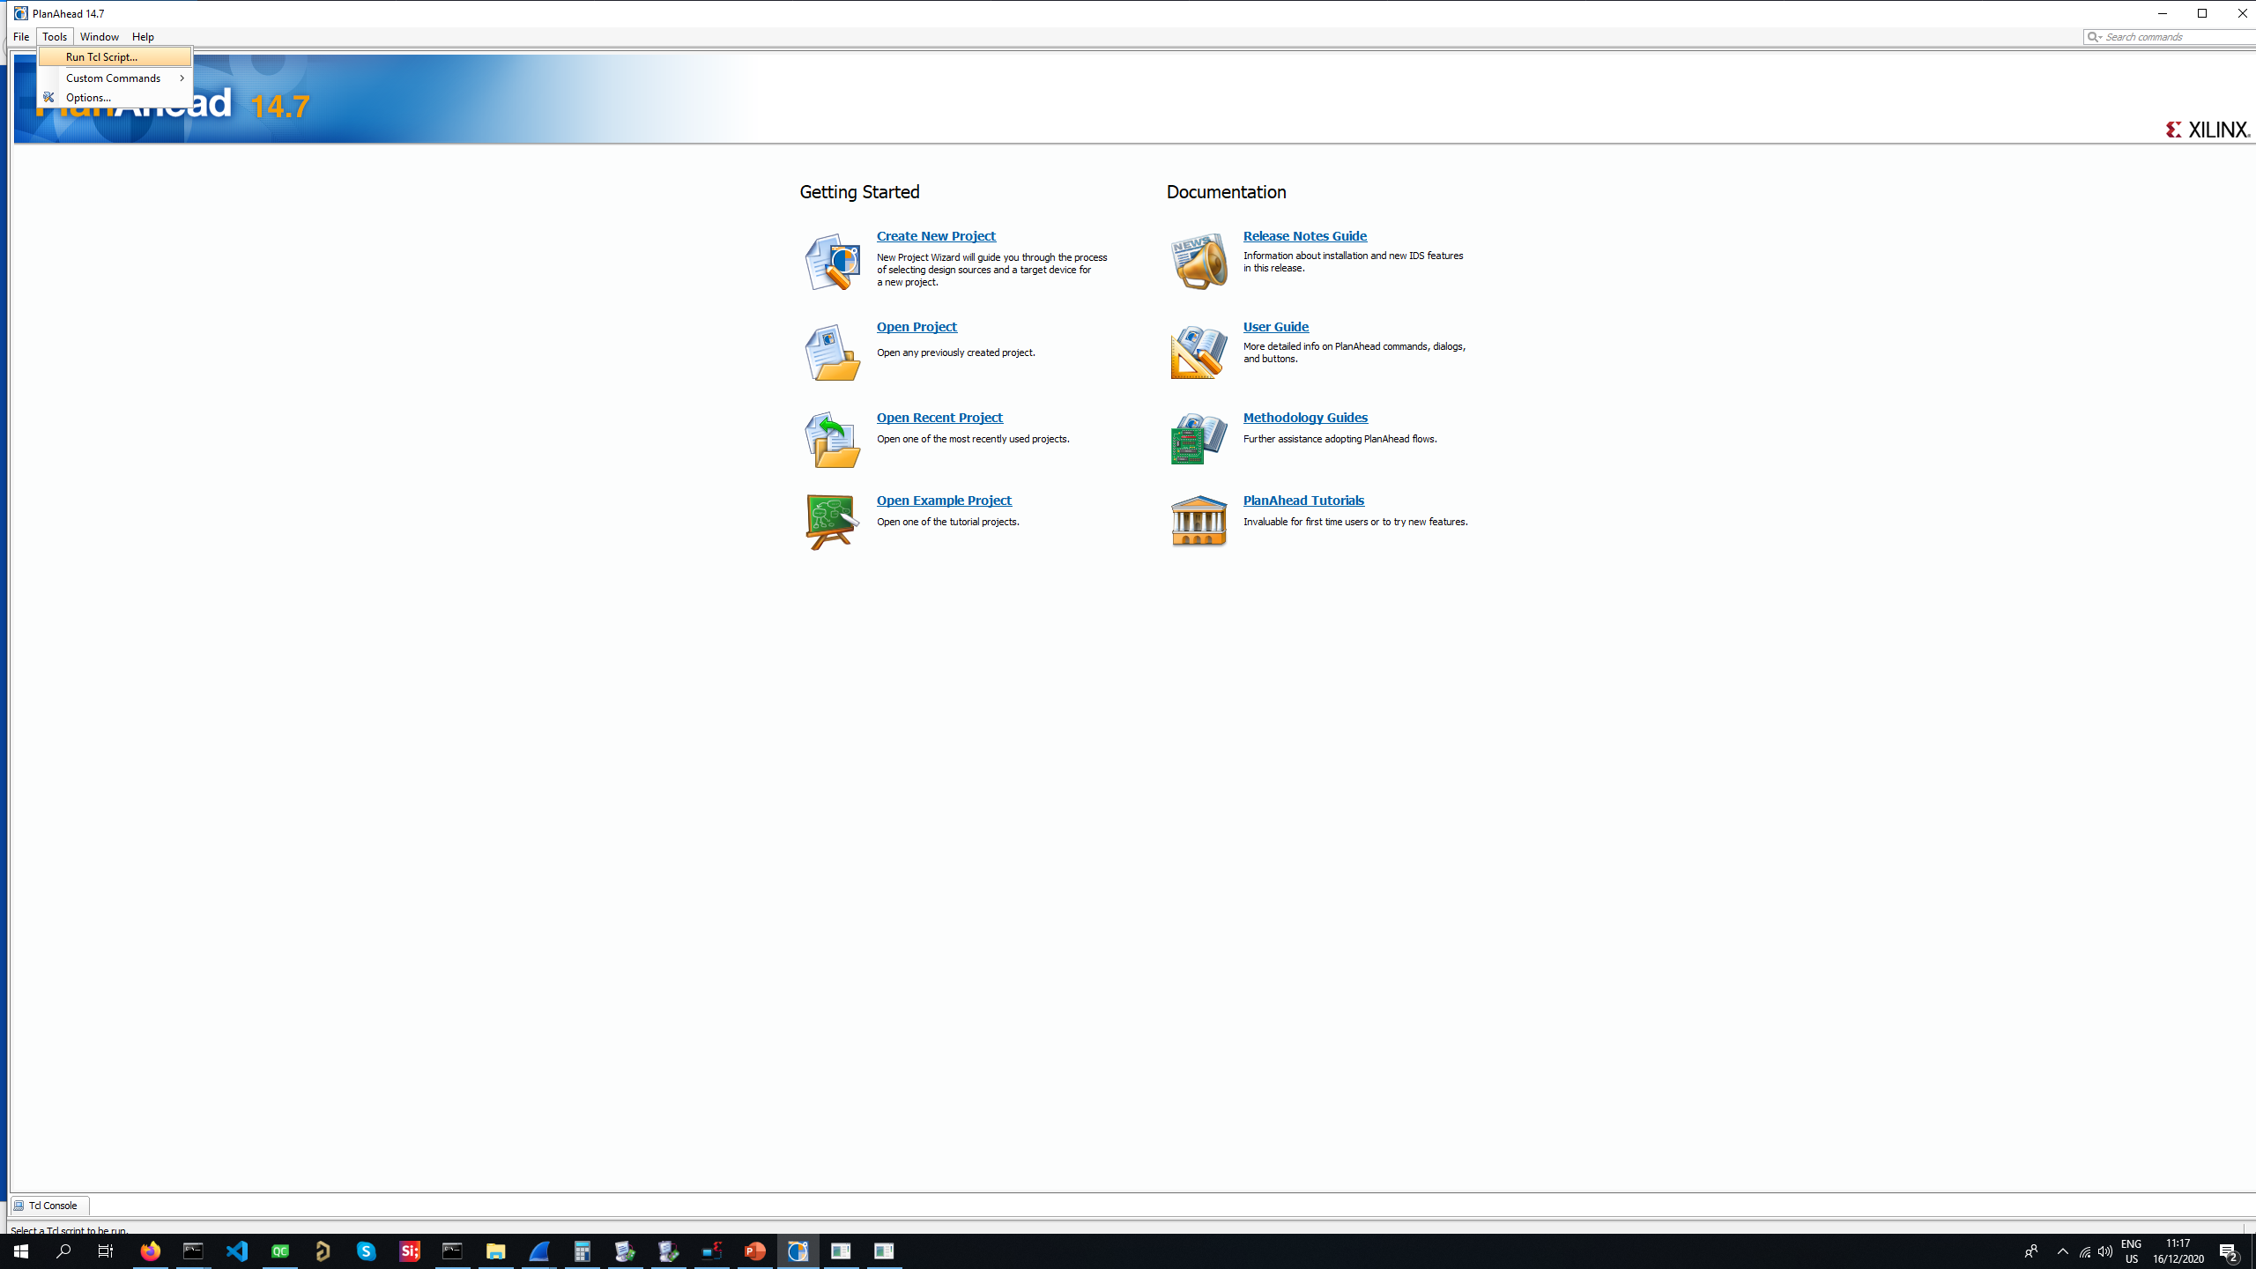
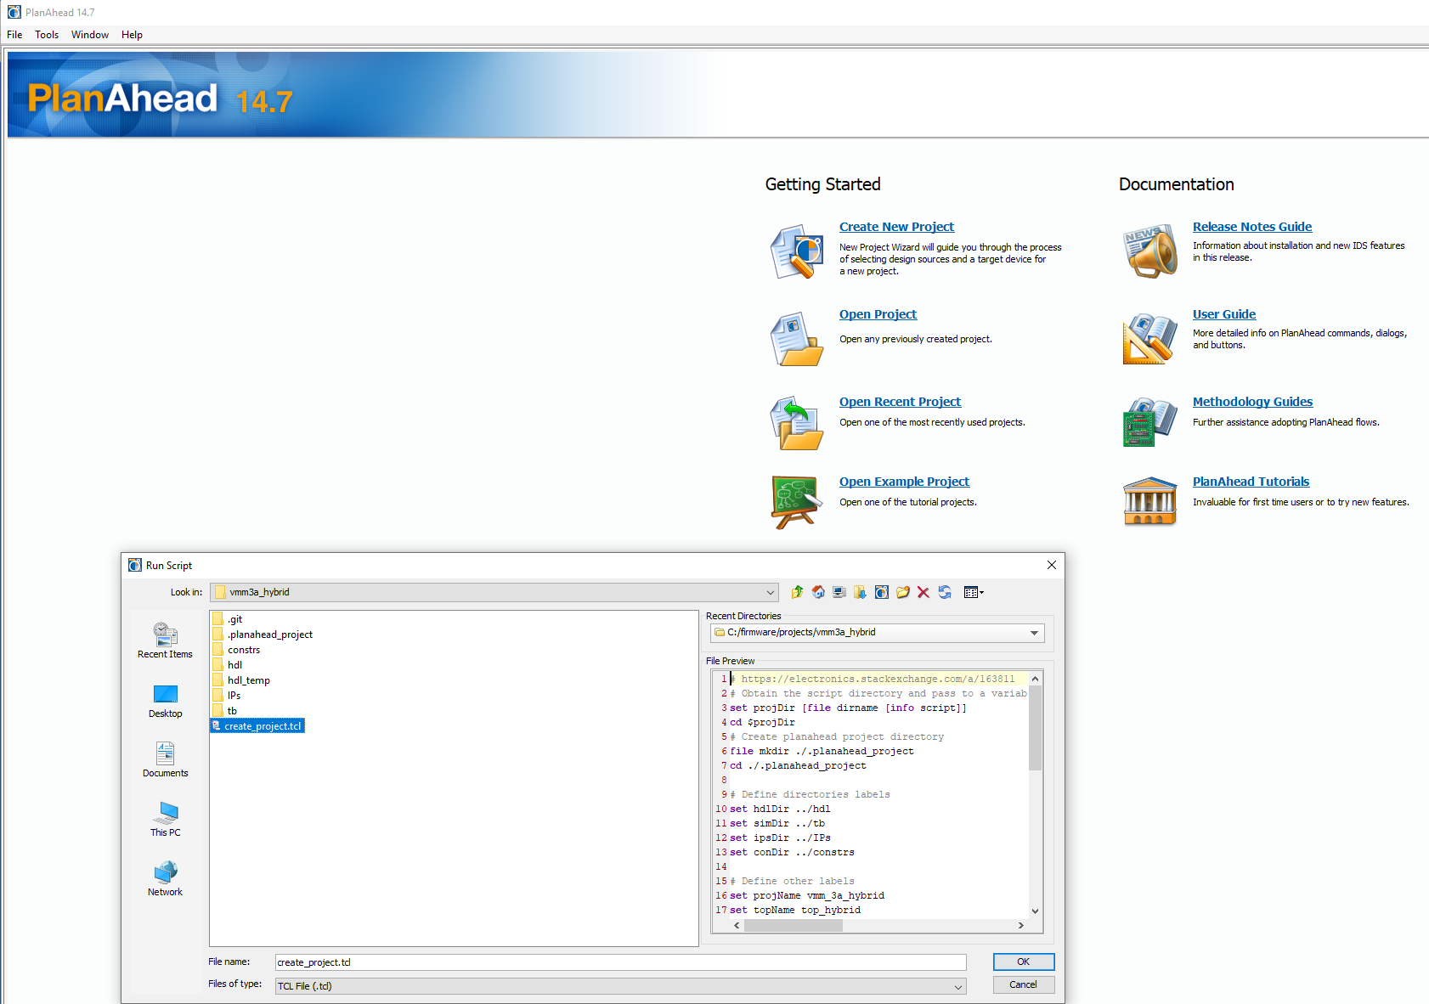
RD51 VMM3a hybrid firmware
Change of Xilinx tool
Xilinx Vivado (tool for series 7), the successor of the much hated ISE, was build using Planahead technology
Planahead can be used instead of ISE for Virtex 6 and Spartan 6
Repo does not store numerous ISE project files anymore, or even Planahead project, just tcl script (fun fact: Marek, Sergei and Steven came up in parallel with the same solution)
TCL script is executed in Planahead and creates the project

Slide 6
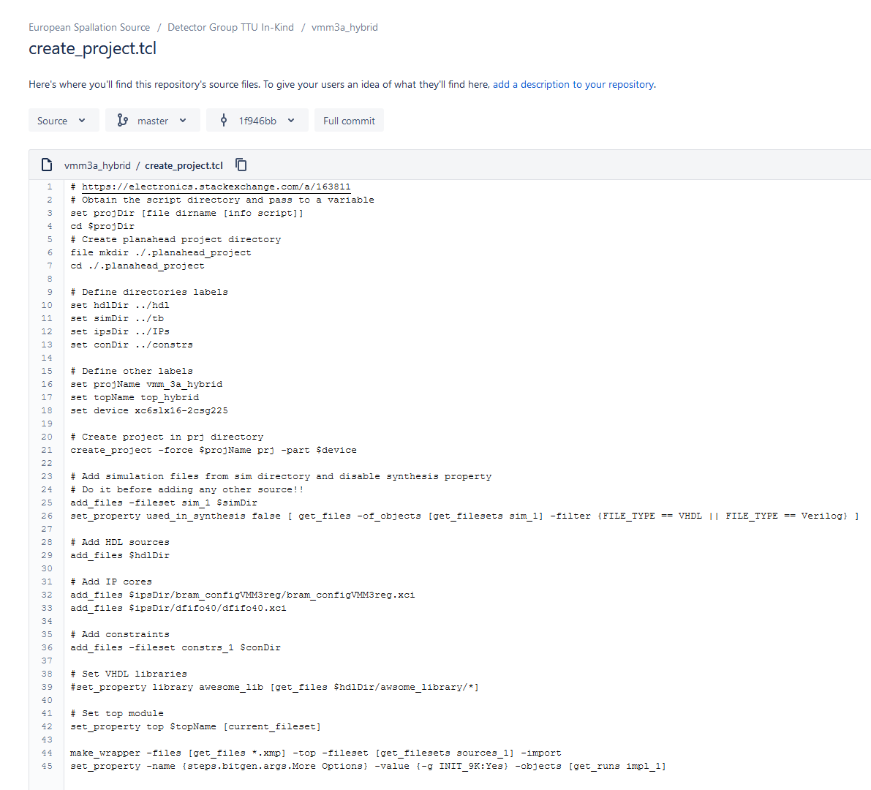
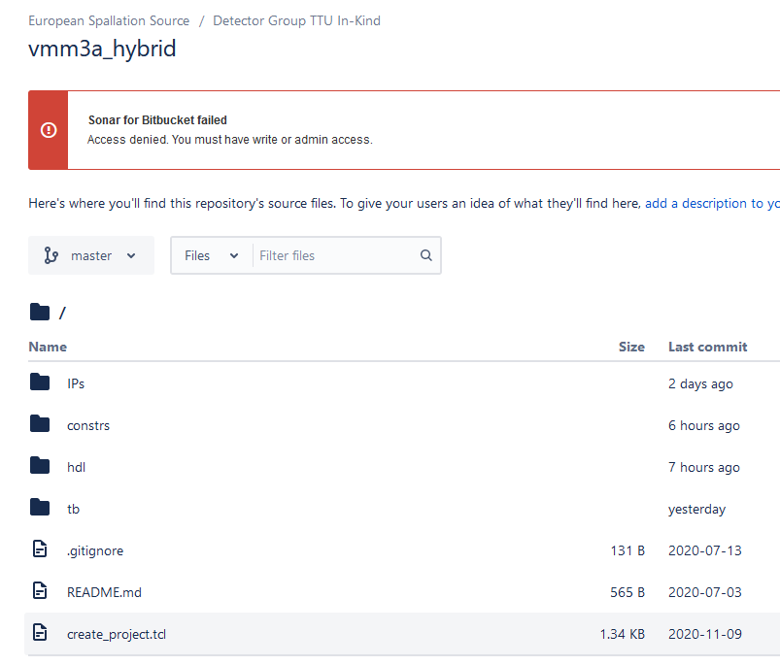
RD51 VMM3a hybrid firmware
Change of repository logic
create_project.tcl script is very simple, describes which directories and files are added to the project
Strategies for synthesis and implementation can be added, e.g. set_property strategy TimingWithIOBPacking [get_runs synth_1]
Since project is generated and not stored in repo, no more problems and errors due to temporary ISE project files (my computer was driving me insane, claiming insufficient rights all the time)
Repo contains only vhdl, verilog files and xci files for IP cores
Repo structure follows “quasi” standard: vhdl/Verilog files are in hdl, xci files for IP cores in IPs, ucf constraints files in constrs, and test benches in tb
Sub folders used in hdl to create logical structure of the source code

Slide 7
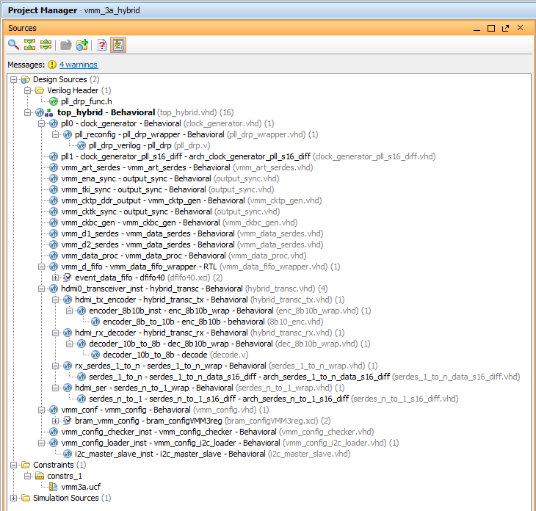
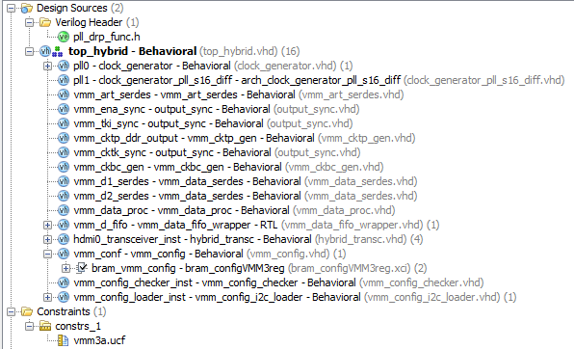
RD51 VMM3a hybrid firmware
Change of unit names and cleaning of code
Unused modules removed
Unused code in modules removed
Units were renamed so that names are consistent
Code structured in three major parts, PLLs, HDMI transceivers and VMM

Slide 8
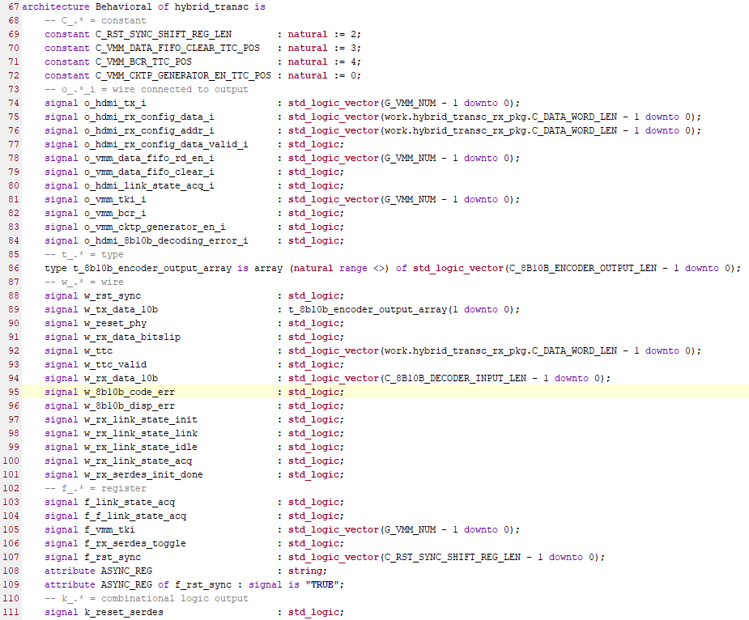
RD51 VMM3a hybrid firmware
Coding standard
Naming of signals according to following coding standard
    Constants: capital letters starting with C_
    Wires connected to output, i_ or o_ depending on direction
    Types: t_
    Internal wires: w_
    Registers: f_
    Outputs of combinatorial logic: k_
Components are changed to entities
Use of generics and constants instead of numbers
Reformatting of code
Correction of sensitivity lists of processes, replacing clk’event by rising_edge
Explanatory comments added
Structural changes to simplify code

Slide 9
RD51 VMM3a hybrid firmware
Status summary and future
Refactoring finished, documentation and writing of test benches still ongoing
Private bitbucket.com project https://bitbucket.org/europeanspallationsource/vmm3a_hybrid
Access can be granted to anybody, not limited to people with CERN or ESS email address
Project based on latest commit 5c5eb939 from Marek to gitlab.com (02.09.2020 - firmware flashed to new hybrids)
Firmware will now be ported to Spartan7
After porting, ESS firmware will evolve in different direction : No ART, different BC clock and data clock (ESS facility clock 88 MHz, hence BCCKL 44 MHz, SERDES for HDMI 440 MHz, CKDT 176 MHz DDR)

Slide 10
Integration of RD51 VMM3a hybrid into ESS Readout

Slide 11
RD51 VMM3a hybrid at ESS
Integration into the ESS readout
Since 2018 ESS has shown that VMM3a can also be used for non-MPGD gaseous detectors like Multigrid and Multiblade (analog and digital data taken)
Multigrid is basically grids of single wires, Multiblade is a cathode strip chamber
VMM3a is the electronics choice to read out the NMX (GEM), CSPEC (Multigrid), ESTIA, TREX and FREIA (all Multiblade) detectors
Successful Multigrid detector review in August, reviewers agree with the choice of RD51 VMM3a hybrid as front end
Only worry: Limitation of <= 4 Mhits/s per channel might be too low if ESS is operated at full power, in cases of very high instantaneous rates on grid, since a grid has a surface area of several cm²

Slide 12
Readout chain Multigrid
Frontend Assister card (FEA)
1 to n EFUs
DAQ software
Event Formation Unit (EFU)
at DMSC
Multigrid
Switch
Kintex 7
2x 100 Gbit/s
Ethernet (data)
FMC to
HDMI
card, max.
5 hybrids
FMC
to
SFP+
card
Wire and/or grid
channels
MFE
Ring 1
MFE
Connector/adapter
Backend
Master
module
VMM
VMM
Ethernet
(config)
RD51 hybrid
FEA
Master frontends
FPGA
(MFE)
Ring n
LVDS - HDMI cable
2 x 400 Mbit/s
(data/config)
ICS
FEA
Power
Fibre 2 x 6 Gbit/s
(data/config)
MFE
Ring 12
MFE

Slide 13
ESS Readout
Schematic drawing
ICS (timing/slow control)
DMSC (science data)
Steven Alcock, Detector Group, 2nd July 2019
Backend Master
MFE
Internal Routing and Aggregation
ICS
MFE
DMSC
MFE
MFE
MFE
MFE
Assister and
adapter
FEA
FEE
FEA
FEE
FEA
FEE
FEA
FEE
FEA
FEE
FEA
FEE
FEA
FEE
FEA
FEE
FEA
FEE
RD51 hybrid
ADC
ADC
ADC
ADC
ADC
ADC
ADC
ADC
ADC
…
…
…
…
…
…
…
…
…
Detector Channels
Readout Architecture is described in BrightnESS Deliverable D4.1:
https://dx.doi.org/10.17199/BRIGHTNESS.D4.1

Slide 14
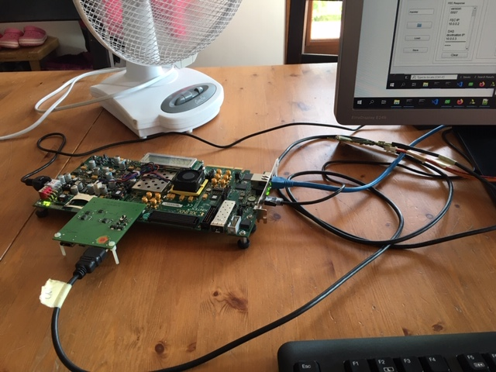
FEA for RD51 hybrid
Integration of RD51 hybrid into ESS readout
  Adapter card connects two RD51 hybrids to the FMC connector of the Kintex KC705 evaluation board
  Upgraded version will contain 5 HDMI ports
  RD51 SRS FEC Virtex6 firmware ported to FEA Kintex 7
  Substantial changes: E.g. new ethernet MAC since IP could not be ported
  No problems with FIFO IP
  Care needed with Xilinx components like SERDES and DELAY

Slide 15
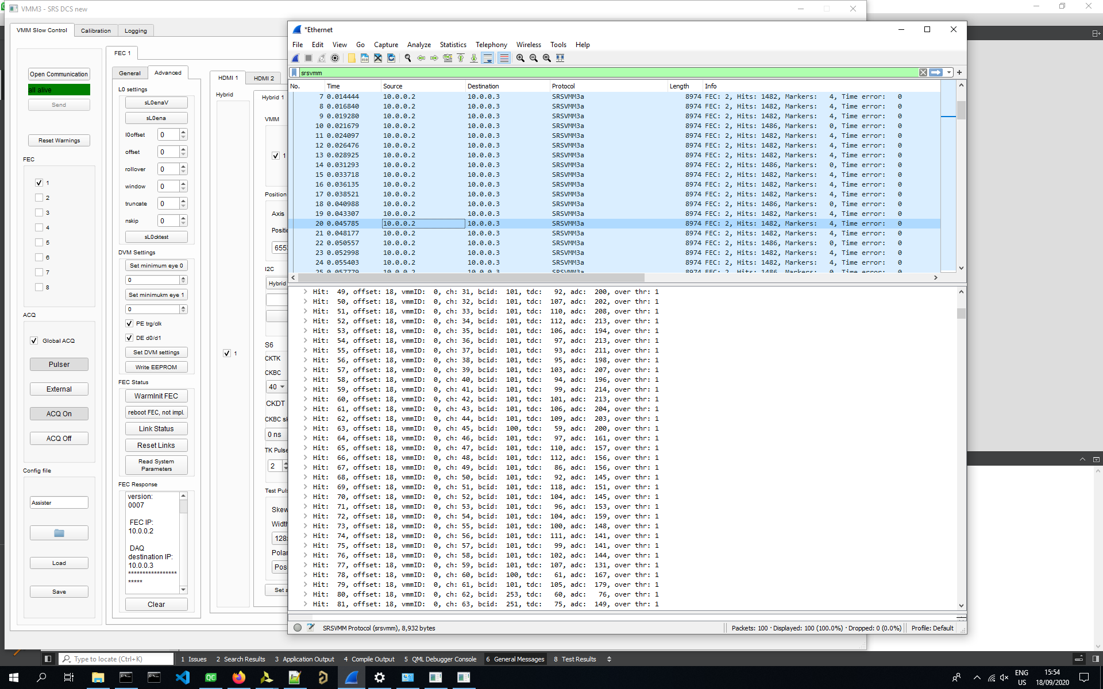
FEA for RD51 hybrid
Integration of RD51 hybrid into ESS readout
  Data transmission via UDP and configuration of VMMs operational
  Xilinx KCU 705 has now all functionalities of the RD51 SRS FEC that are compatible with the hardware of the evaluation board, and can be used with the slow control and ESS DAQ
  Now changing the data format to the ESS data format, and transfer data to the well established assister firmware so that the RD51 hybrid can be used with the full ESS readout (rings, backend)

Slide 16
SRS FEC firmware and slow control changes

Slide 17
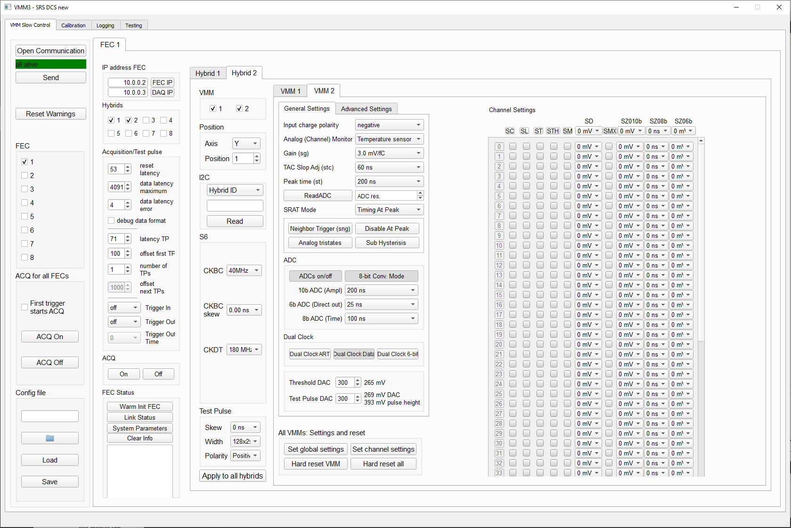
Slow control
Cleaning up and changes
Lucian created very nice new repo https://gitlab.cern.ch/rd51-slow-control/vmmsc
Major clean-up, restructuring and adding of new features
Hard reset for all VMMs, copy of channel settings to all VMMs, new calibration features
For fitting of data (linear and non-linear regression), integration of alglib (cross-platform numerical analysis and data processing library) https://www.alglib.net/
In ESS branch work in progress, implementation of new features, in master branch more stable version

Slide 18
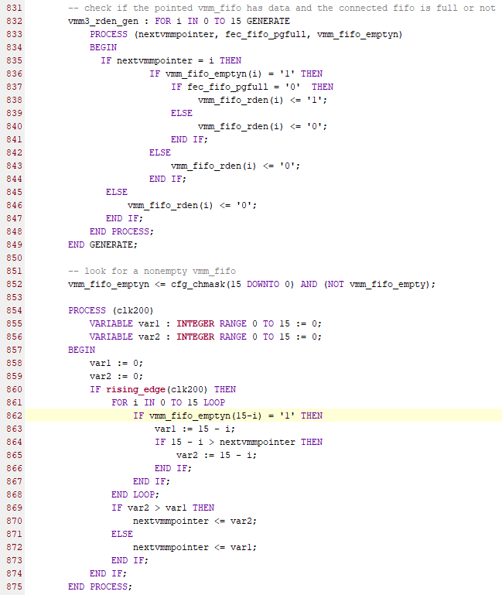
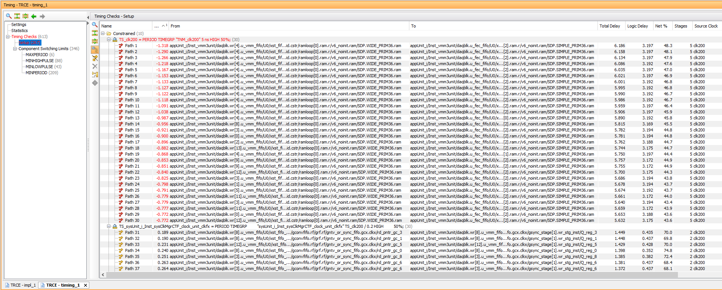
FEC firmware
Repo, project and timing errors
Change to Planahead project like hybrid firmware
Removal of unused modules, cleaning up code, cleaning up constraints file
Code not yet refactored like hybrid firmware
Aim of changes: reliable and fast continuous mode without timing errors
Main sources of timing errors (timing score of around 40000):
  Triggered mode (not correctly working anyway, compared non-gray encoded FEC trigger counter with gray encoded VMM BCID)
  FIFO logic in vmm3unit.vhd
  Due to use of DDR3 memory, logic that determines the next VMM FIFO to read is run at 200 MHz, combinatorial logic too slow to meet timing requirements

Slide 19
FEC firmware
VMM3unit.vhd – situation before and after changes
16 to 1 multiplexer
8 MHz
200 MHz
VMM FIFO 0 - 48 bit
200 MHz
…
125 MHz
125 MHz
8 MHz
200 MHz
FEC FIFO - 48 bit
UDP FIFO - 8 bit
VMM FIFO 15 - 48 bit
16 to 1 multiplexer
8 MHz
125 MHz
VMM FIFO 0 - 48 bit
125 MHz
…
125 MHz
125 MHz
8 MHz
125 MHz
FEC FIFO - 48 bit
UDP FIFO - 8 bit
VMM FIFO 15 - 48 bit
Bottleneck is UDP, 8bit send with125 MHz (1 Gbits/s ethernet)
Reading of the 48 bit VMM FIFOs with 200 MHz does not make sense, choosing VMM FIFO to read and write to FEC FIFO does not work at 200 MHz (logic too slow)
Performance stays the same, if VMM FIFOs are read with 125 MHz, and FEC FIFO is written with 125 MHz, timing is met

Slide 20
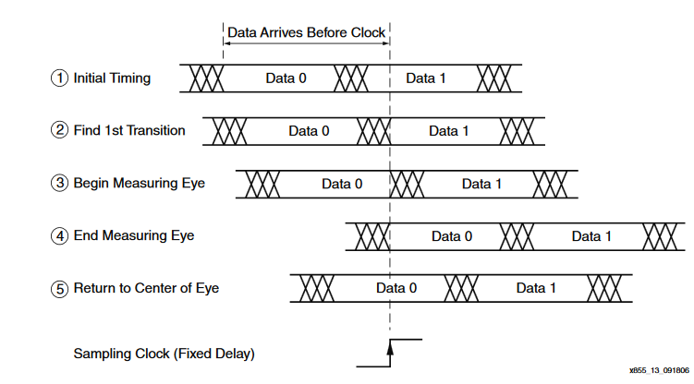
FEC firmware
Link status
HDMI SERDES use master and slave ISERDES_NODELAY together with IODELAY
IODELAY has 64 taps of 78 ps that can shift the data (tap 64 is identical to tap 0 again)
ISERDES can do bitslip to rearrange the 10 bits (after 10 bitslips one arrives again at the original word)
Aim of alignment: To be in the center of the eye and receive correct 8b/10b control word from Spartan 6 on hybrid (link control word)
Originally FEC was using bit align machine of Xilinx https://www.xilinx.com/support/documentation/application_notes/xapp855.pdf
Problem: If after finding the first transition, the second transition that is found is not on the other side of the window, but just the end of the same transition as the first, the center of the eye is not found
Therefore Xilinx released update https://www.xilinx.com/support/answers/38672.html
Now user has to set a parameter that specifies the minimum width of the eye, to avoid the identification of a transition as eye
With new DVM card, XAPP855 was unstable, thus successfully implemented update in spring 2020
Good: Correct transitions identified
Bad: Second transition not start of eye

Slide 21
FEC firmware
Link status
When using the CTF card, we still had problems to obtain a stable link status 4 (probably the minimum eye width parameter would have to be adapted per channel and would be different for use with CTF and without)
I implemented thus my own bit align code, based on firmware I wrote for the Kintex 7
On Kintex 7, the Xilinx bit align machine does not work anymore at all (no surprise, it was for Virtex 5)
IODELAY has only 32 taps of 78 ps, so that one cannot scan through the whole eye when running the SERDES with 400 MHz (delays between 0 and 2.418 ns possible), 400 MHz is slow for Series 7
New code measures all combinations of bitslip and tap and chooses setting in the center of the largest stable region
A tab /bit slip combination is stable if the correct link word has been received 128 times in a row
If e.g. at the same bit slip, taps 10-30 are stable, we have a stable region of 21 taps for this bit slip. The center of the window is then tap 20
After changes a very stable link status 4 is obtained with or without CTF on all HDMI ports

Slide 22
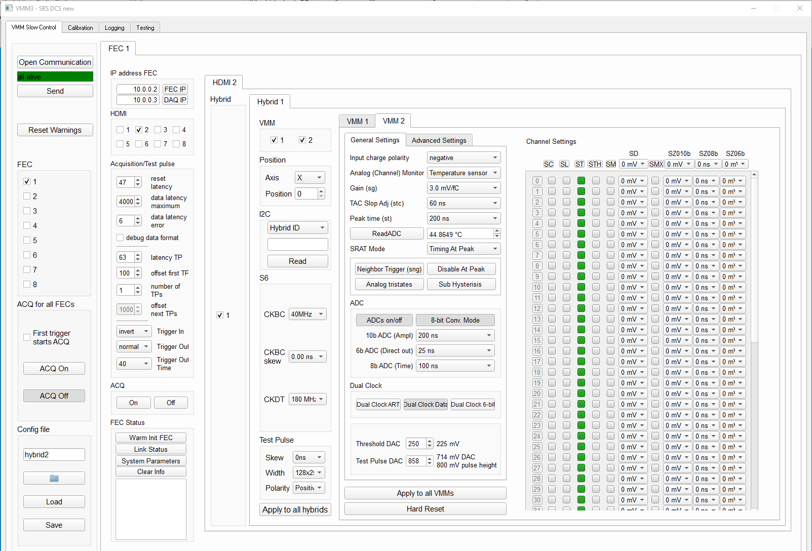
FEC and Slow control
NIM trigger and multiple test pulses
For trigger in and trigger out now the “polarity” of the digital signal can be set via the slow control
Trigger input can be given out on trigger output
Alternatively, trigger output can be configured to occur at any time in the cycle
Michael’s “Registering trigger timestamp feature” unchanged, just checkbox removed, as soon as the trigger input is activated in the slow control, timestamp is sent out
Instead of starting the acquisition directly after clicking “ACQ ON” in the slow control, feature to only start the acquisition with the arrival of the first NIM trigger
It is now possible to have several internal test pulses at defined times

Slide 23
FEC and Slow control
Continuous data taking without window
For the use at ESS (neutron time of flight measurements), we have to be able to take data all the time without regularly occurring dead time
BC clock at ESS will be derived from facility clock and have fixed relation with proton pulse
Problem so far has been the overflow of the BCID on the VMM
As a 12 bit value, the BCID on the VMM only covers times between 0 and 102.4 us (at 40 MHz)
Due to limited bandwidth, we do not add a higher order timestamp to the hits on the Spartan6, since then the hit size would considerably increase from 40 bits to >= 100 bits
Higher order 42 bit timestamp with 25 ns resolution and a BCID overflow counter (offset) is added upon arrival of the hits on the FEC

Slide 24
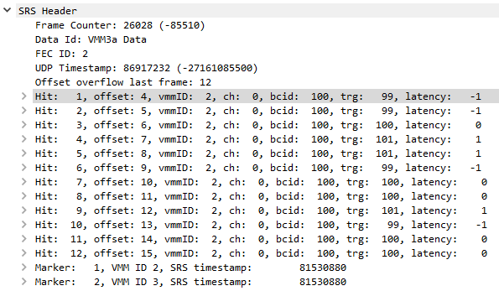
FEC and Slow control
Continuous data taking without window
Challenge: Since the data is read out out from the VMM via the Spartan6 and the HDMI in a serial fashion, there is a large difference between hits arriving with minimum and maximum latency
One solution to ensure data integrity is to use a acceptance window as before
New solution:
  The FEC has a clock counter (TRG) that counts for each BC clock frequency from 0 to 4095
  At the beginning of the acquisition, the BCID on the VMMs is reset (soft reset), and the S6 FIFO is emptied
  The moment, at which the reset is sent, can be determined with the field “reset latency”
  In the new debug data mode, the value of the FEC clock counter, at which the hit arrived, is sent out in the data instead of the ADC and TDC
Two steps to set things up:
  The “reset latency” has to be set in such a way, that the BCID and the TRG in Wireshark show the same value (please pulse only one channel)
  If TRG and BCID show the same value, but the BCID too large or too small (e.g. 105 instead of 100), then the “TP latency” has to be increased or decreased
FEC clock counter at which hit arrives

Slide 25
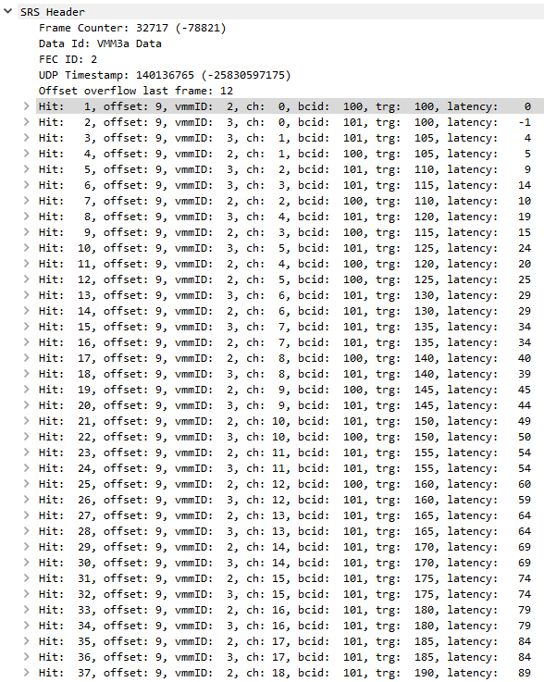
FEC and Slow control
Continuous data taking without window
The maximum latency setting now depends on the CKDT setting
With 180 MHz DDR one hits arrives every 5th 40 MHz clock cycles (yeah!! Thanks to Patrick!!)
If the 4 hit deep FIFO exists, the maximum latency is 64 x 4 x 5 clock cycles
If all 64 channels are pulsed 4 times in quick succession, the maximum latency is thus 1280 clock cycles
Last setting needed is “latency error”. We can see that there is a bit of jitter, sometimes a hit that normally arrives at 0 latency will arrive at -1 or +1. This might be due to the internal test pulses (let’s do measurements with external pulsers)
Algorithm for higher order time stamp:
Everything is set so that a single hit (minimum latency) arrives within the latency error at the same value of the FEC clock counter (TRG) as its BCID (after gray decoding)
  TRG >= BCID and TRG – BCID <= maximum latency: current offset
  TRG < BCID and BCID – TRG <= latency error: current offset
  TRG < BCID and BCID – TRG <= 4096 – maximum latency: previous offset
  Other cases: invalid
How cool, a new hit every 5 cycles !

Slide 26
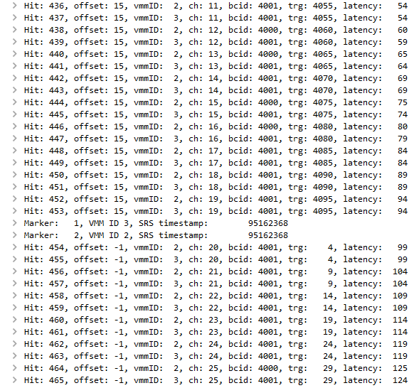
FEC and Slow control
Continuous data taking without window
If hits belong to previous offset, offset -1 is added as timestamp
Only problem arising if offset on the FEC is 0, and a new marker has already been generated
Then -1 is sent as offset
This means the 5 bit offset is not a unsigned number any more with valid entries going from 0 to 31, but a signed number with a valid range from -1 to 15
-16 is used as indicator for a hit that violates the latency conditions, these hits can be discarded by the DAQ (or directly on the FEC if needed)
Offset now 5bit signed number, to cover
cases where hits arrive after generation of new marker

Slide 27
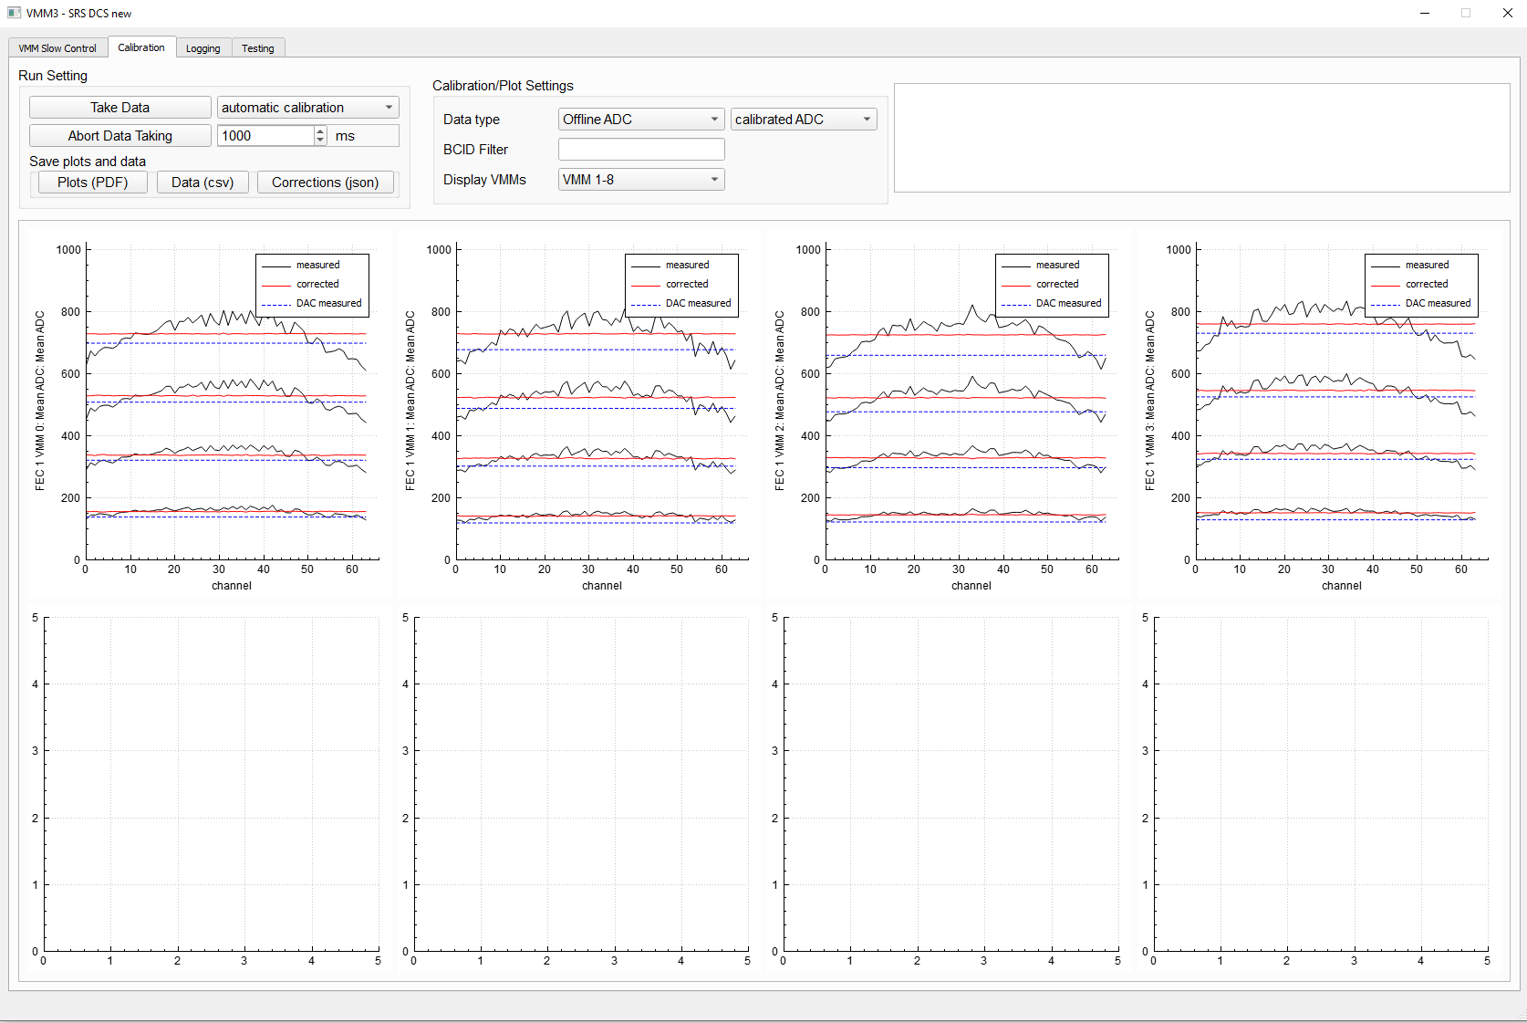
ADC calibration
New algorithm
Pulse all channels with internal test pulses
For 4 different pulse heights, measure ADC
Measure the actual level in mV of the pulser DAC (observation: using the same DAC values, different VMMs have quite different pulse heights)
Fit per channel with pulse height in mV on x-axis, ADC on y-axis and determine slope and offset off the fit
Calculate corrections per channel

Slide 28
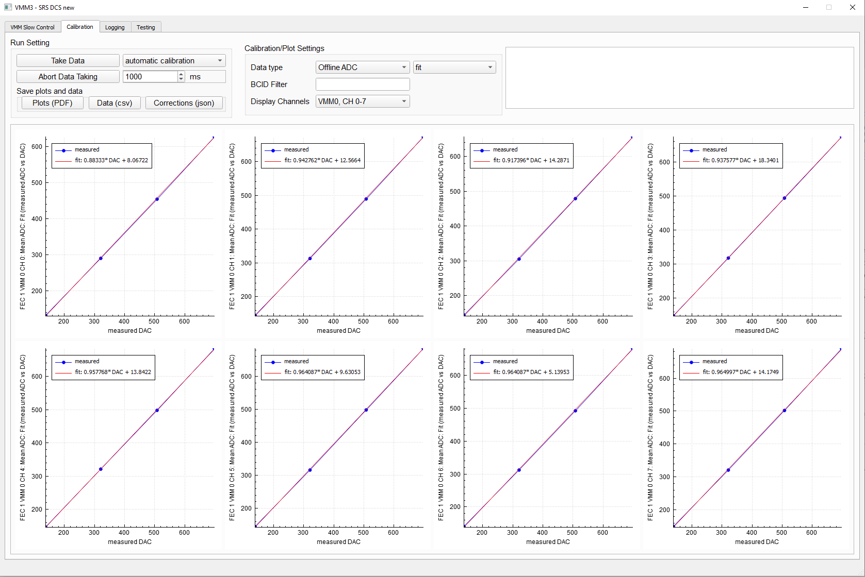
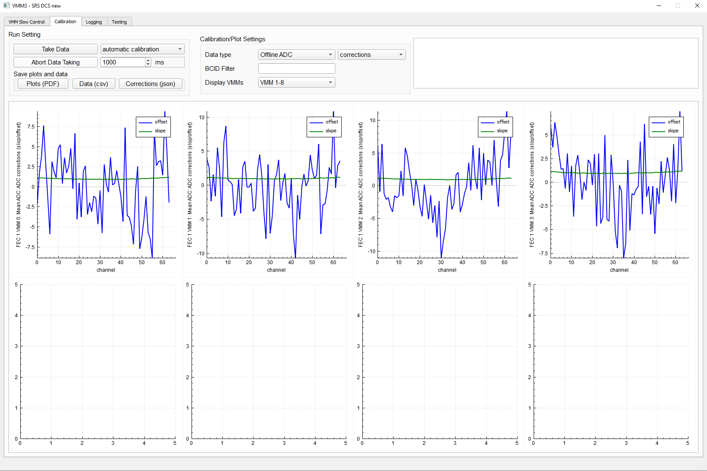
ADC calibration
Fit and corrections
Fit to determine offset and slope corrections
Plot per channel
Offset and slope corrections
Plot per VMM

Slide 29
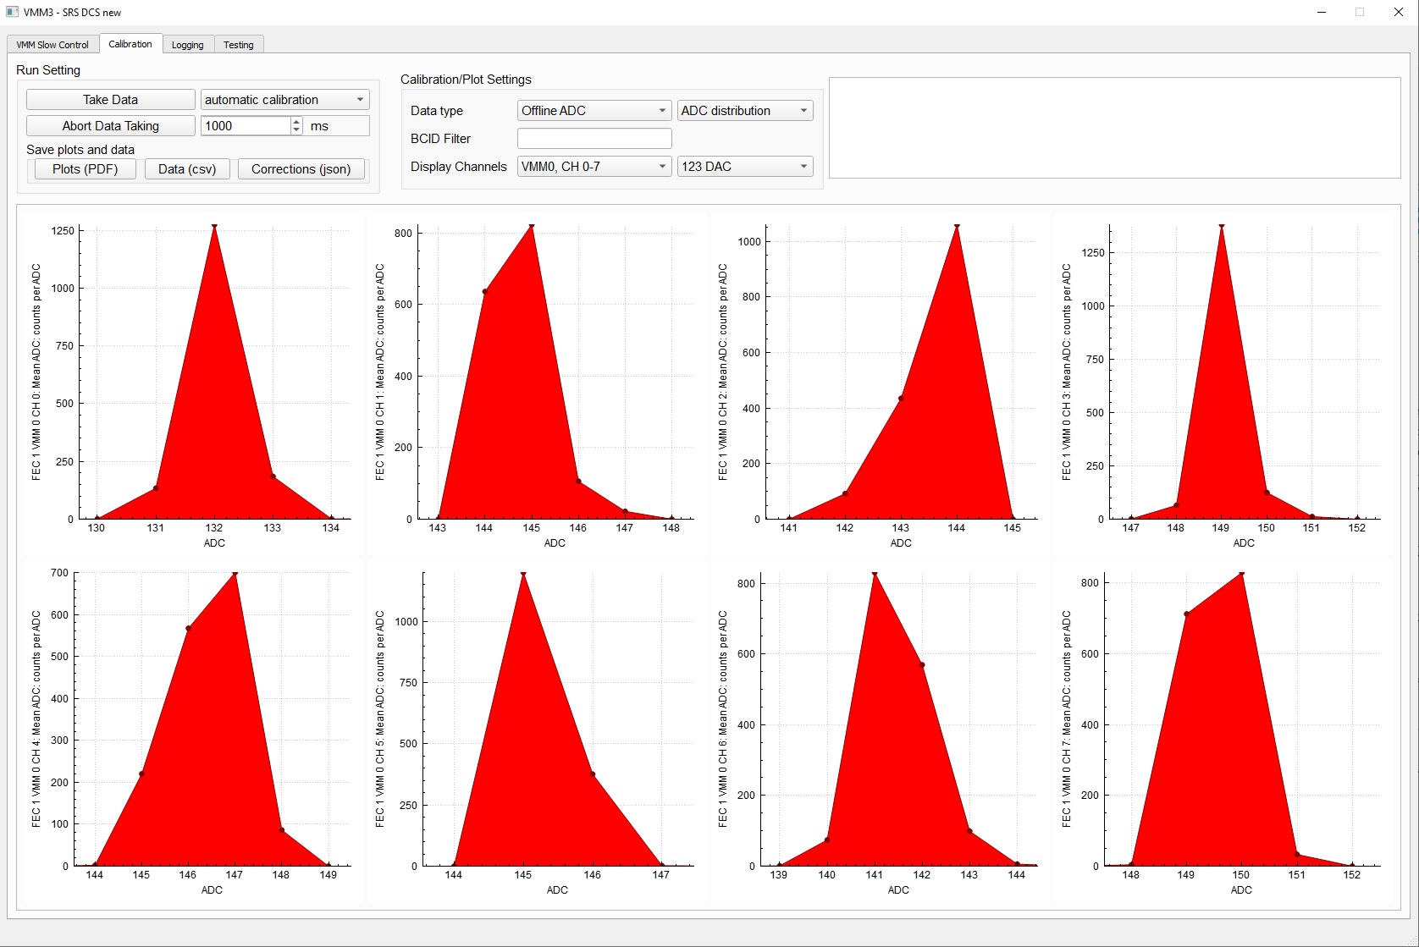
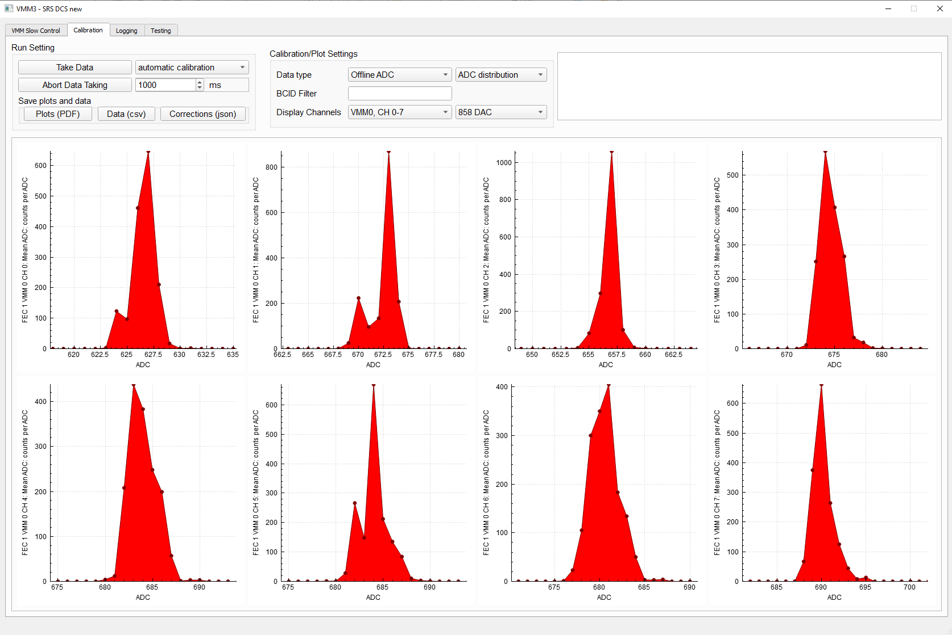
ADC calibration
ADC distribution
ADC distribution for DAC setting 123
Plot per channel
ADC distribution for DAC setting 858
Plot per channel

Slide 30
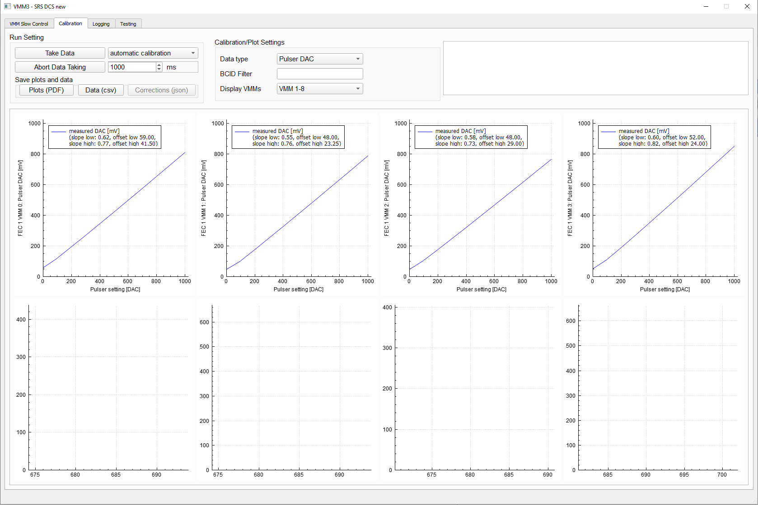
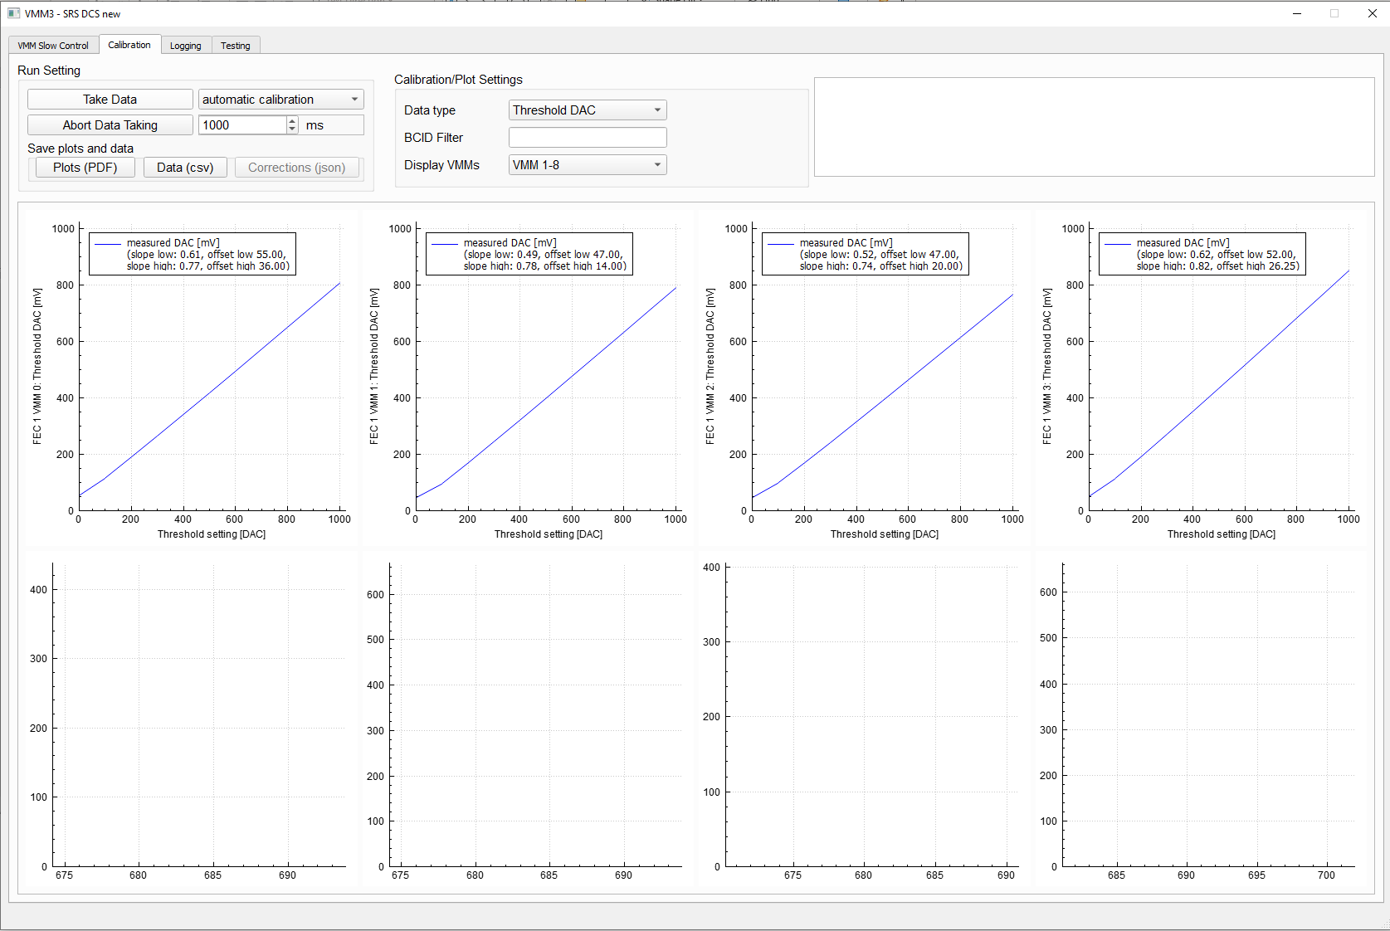
Pulser and Threshold DAC
Measurement of levels [mV]
Pulser DAC
Plot per VMM
Threshold DAC
Plot per VMM
Both DACs have piece-wise two different slopes!

Slide 31
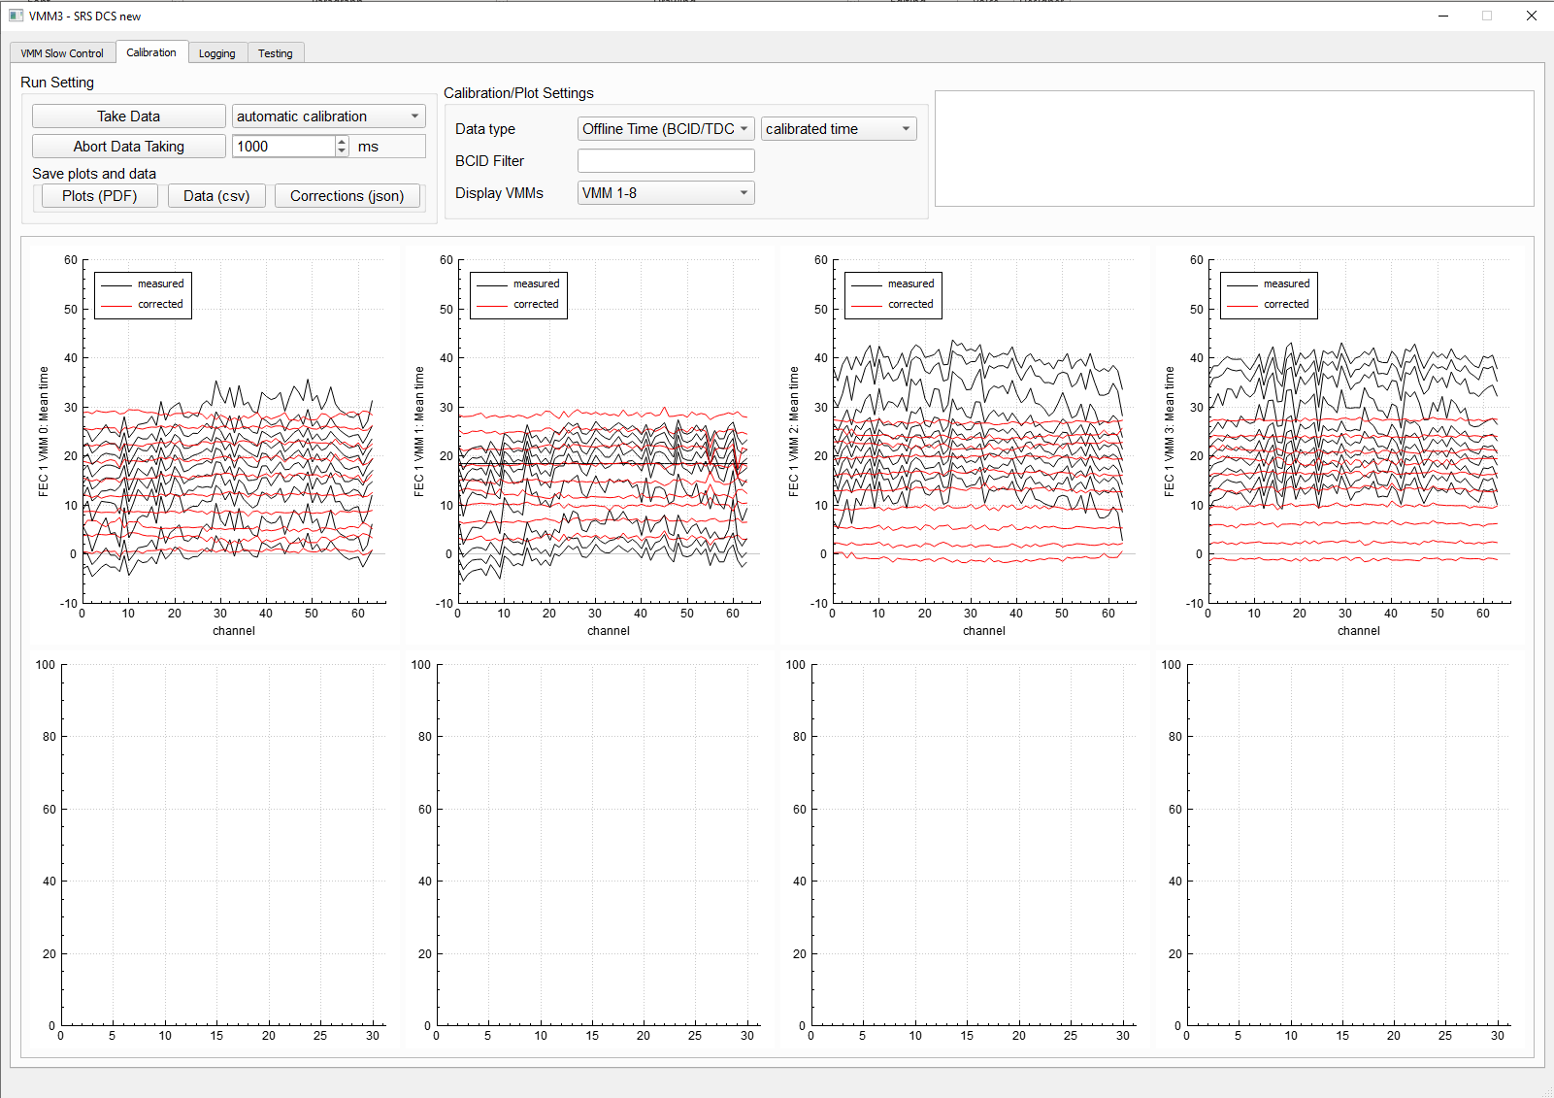
TDC calibration
New algorithm
Pulse all channels with internal test pulses
Shift test pulse between 0 ns and 31.25 ns
Measure TDC and the BCID for every channel
Look for the time shift where 50% of hits have BCID n and 50% have BCID n+1
At this point one has the largest TDC values for BCID n+1 and the smallest TDC values for BCID n
Setting 40 MHz Bc clock, TAC slope 60 ns, shaping time 200 ns

Slide 32
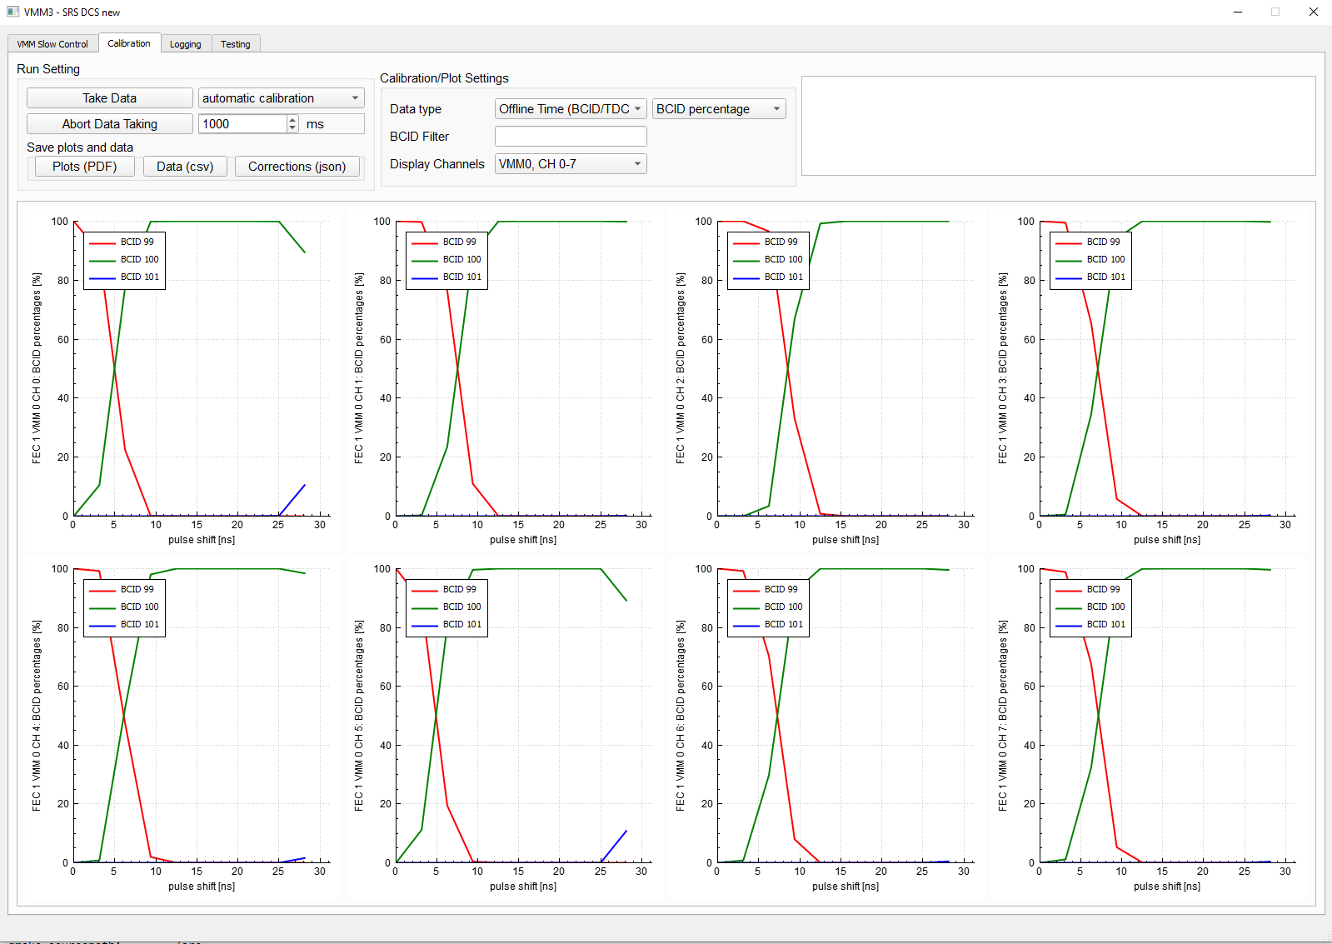
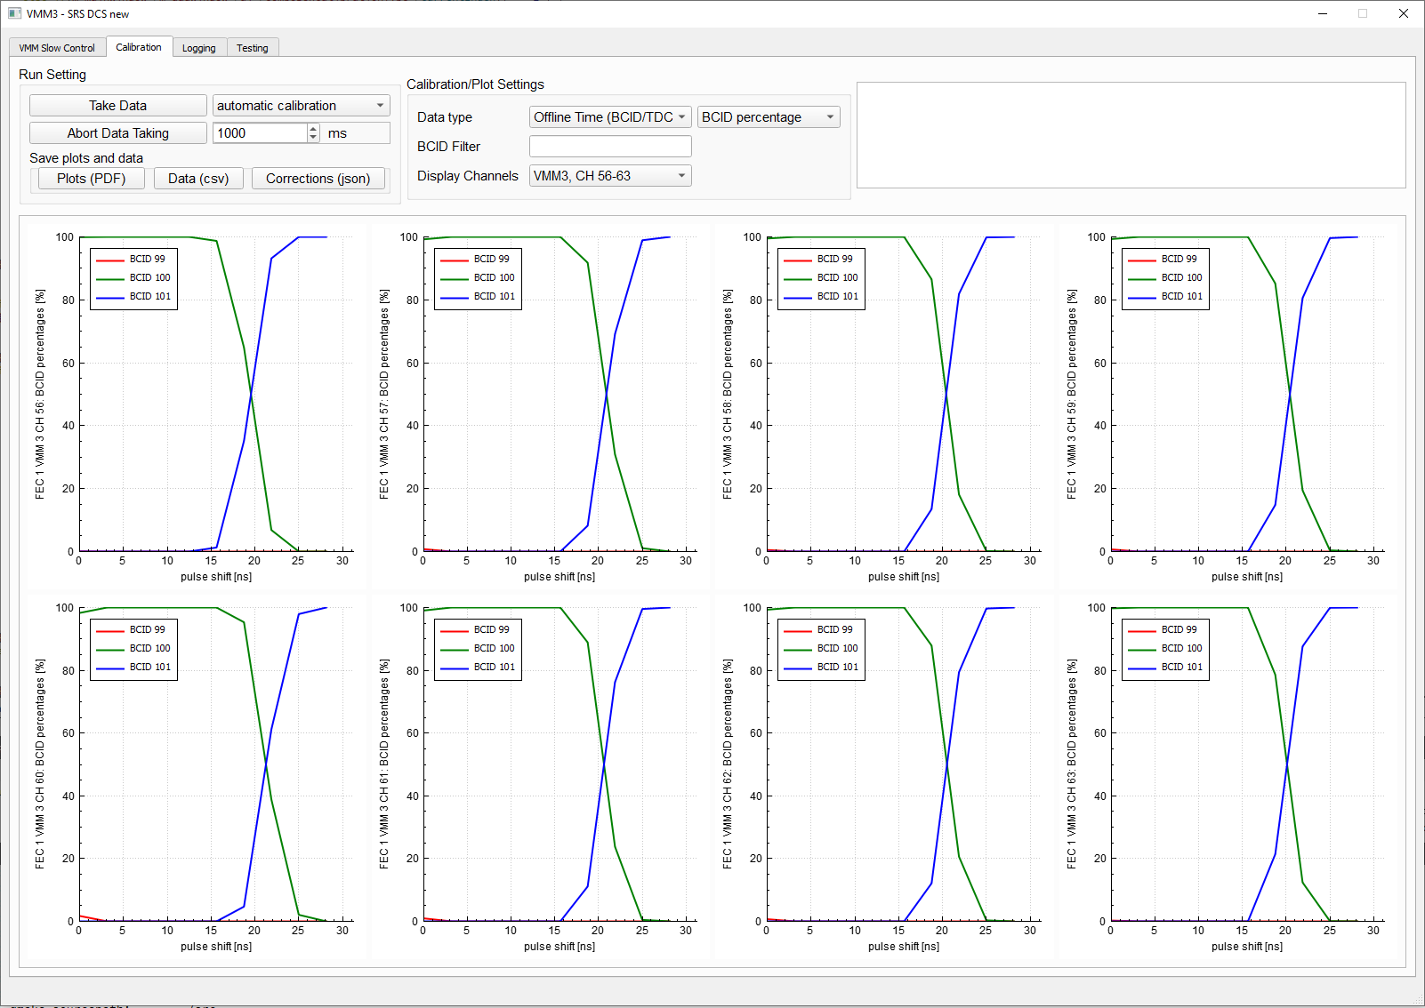
TDC calibration
BCID percentages
BCID percentage VMM0 (BCID 99-100)
BCID percentage VMM3 (BCID 100-101)

Slide 33
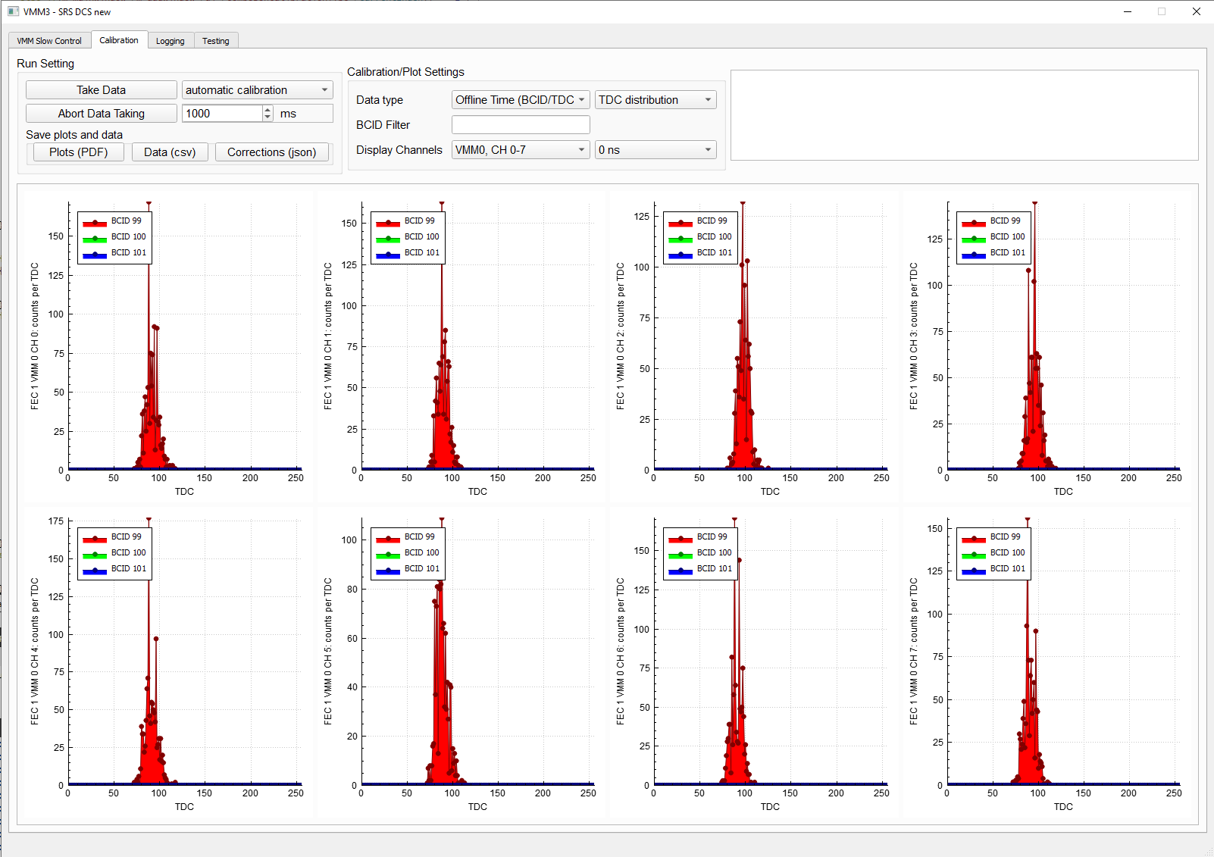
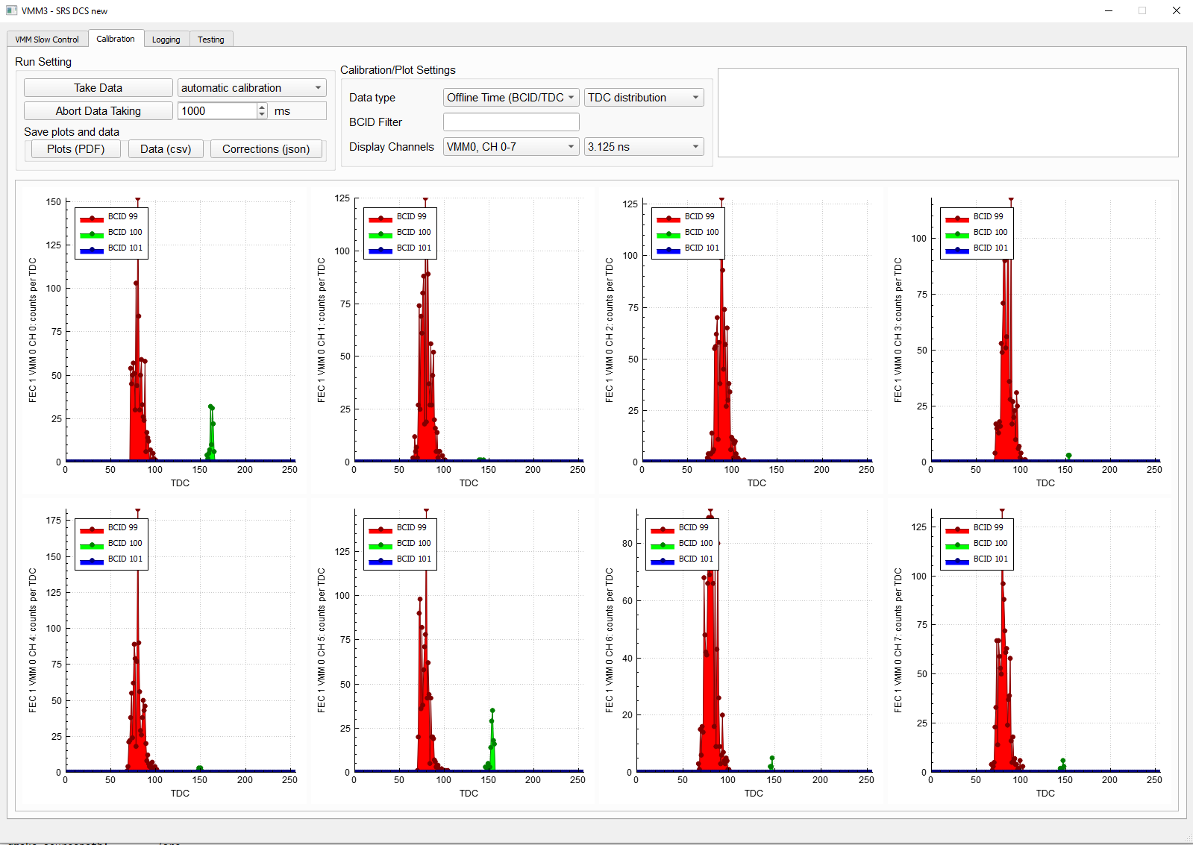
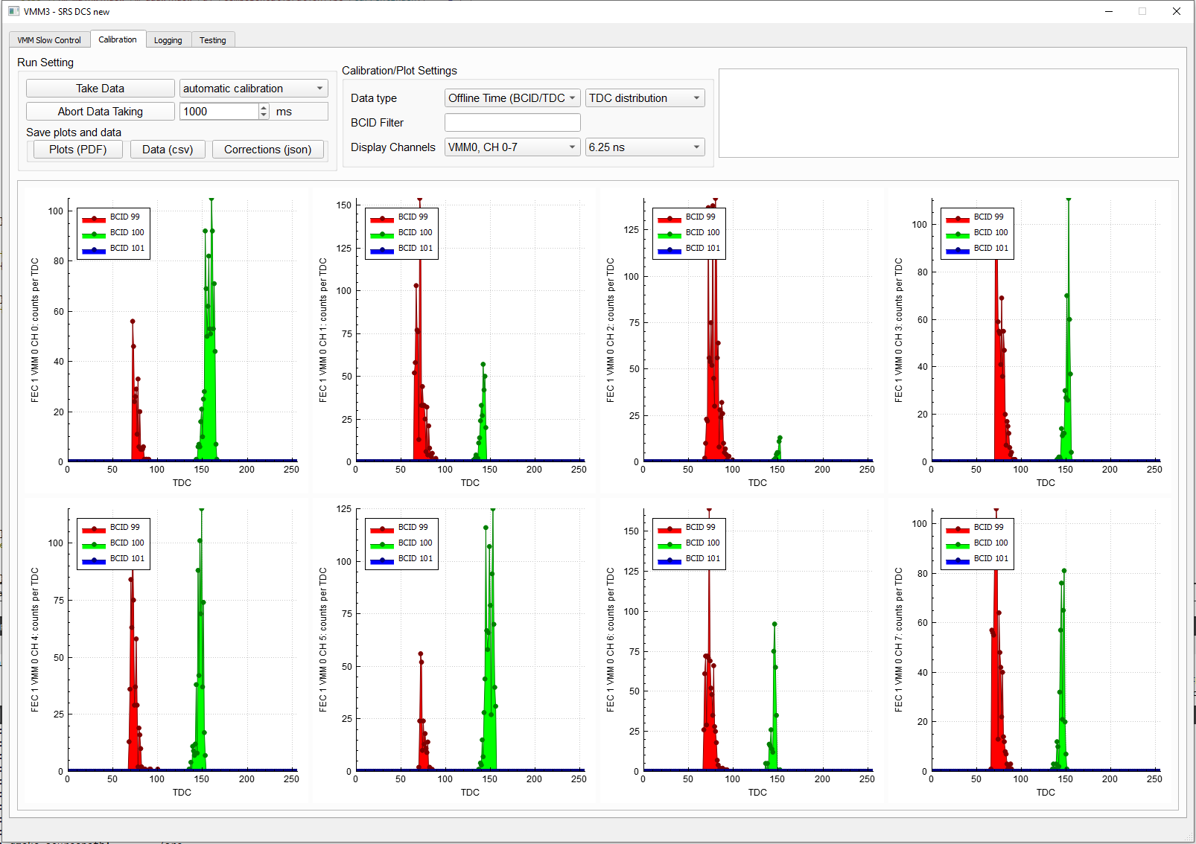
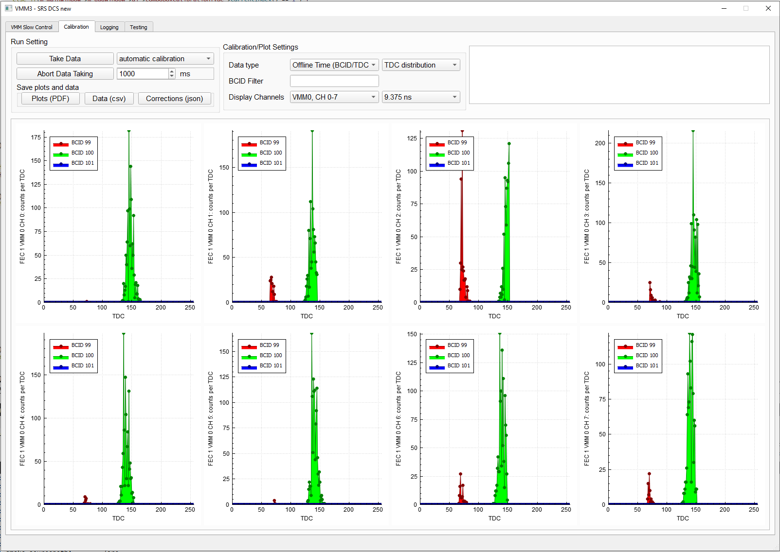
TDC calibration
TDC spectrum per BCID
0 ns
3.125 ns
6.125 ns
9.375ns
ADC distribution for DAC setting 123
Plot per channel

Slide 34
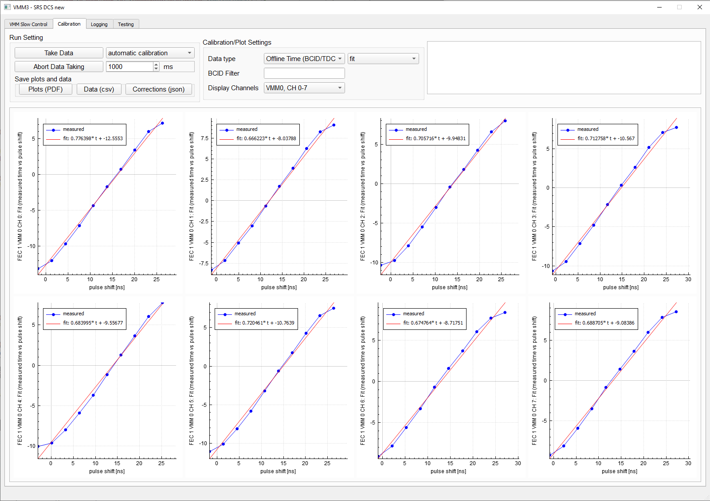
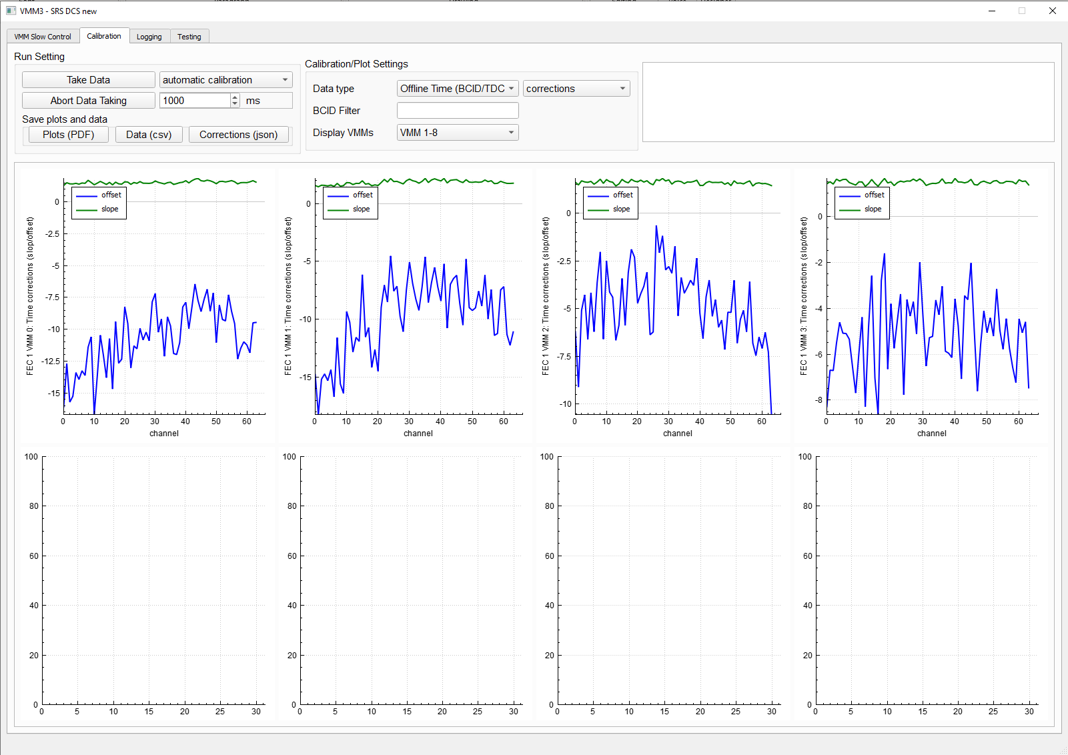
TDC calibration
Fit and corrections
Fit to determine offset and slope corrections
Plot per channel
Offset and slope corrections
Plot per VMM
To Do: compare different TAC slopes, shaping times, test whether corrections are stable over time

Slide 35
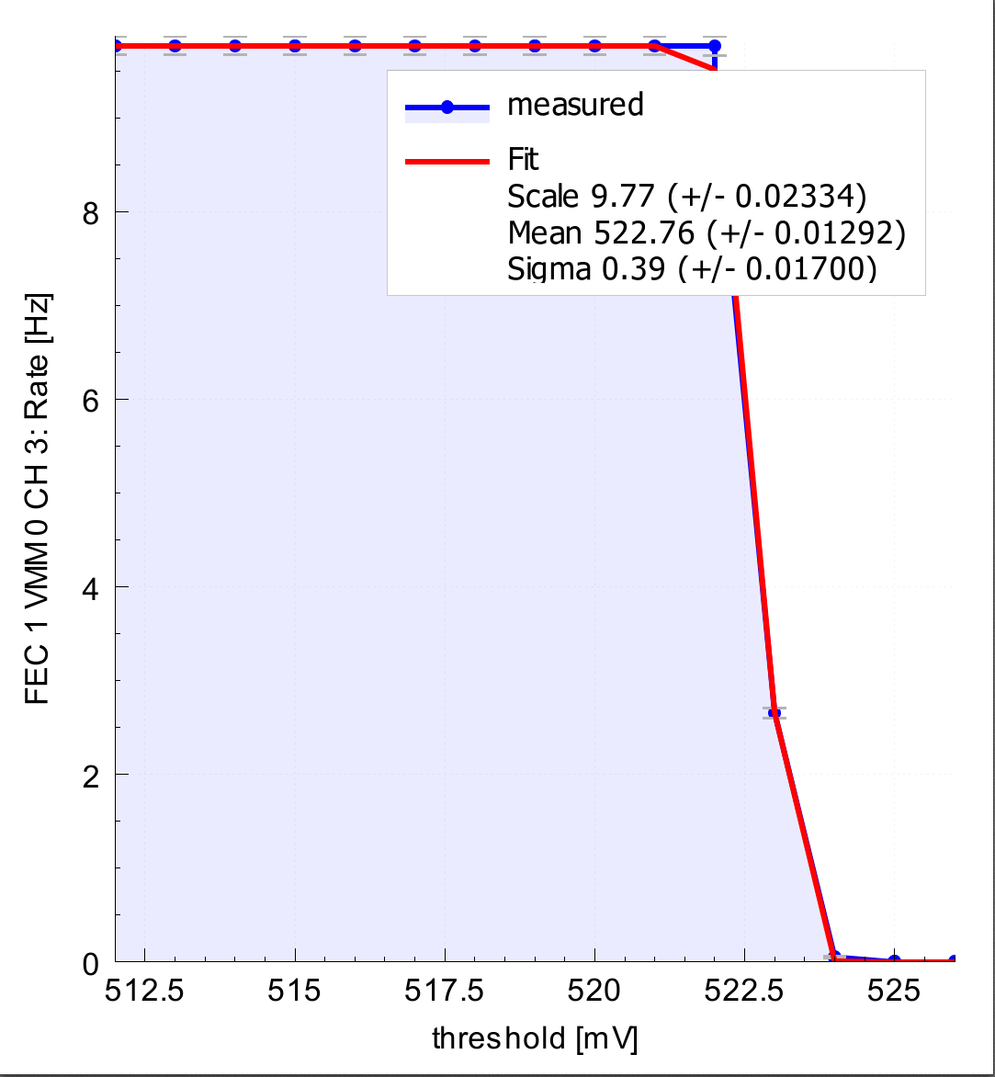
S-curve
Pulse all channels with internal test pulses
Shift the global threshold in steps of one DAC
Count the number of hits per channel per threshold setting
Fit complementary error function to data (alglib: nonlinear regression using function values and gradient)
On Windows, work only for a few channels at a time, otherwise rates do not reach 10 kHz
On Linux, works for a whole VMM (64 channels)
Problem: A step of 1 DAC is equivalent to about 0.8 mV, this is very coarse for channels with low noise, fit not always good for steep drop in rates

