Slide 1
New Results on Capacitive Sharing Large Pad Readout in Test Beam
Kondo Gnanvo,
University of Virginia, Charlottesville, US
RD51 Mini Week, February 16, 2021

Slide 2
Outline
  Principe of Capacitive-Sharing readout & applications
  Preliminary test beam results
  Spatial resolution studies

Slide 3

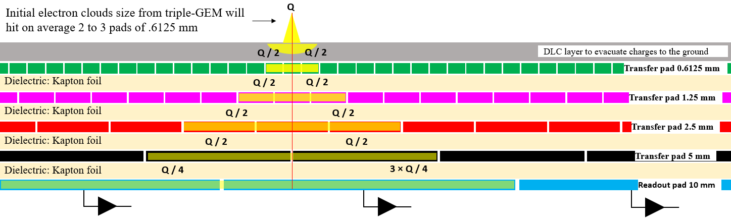
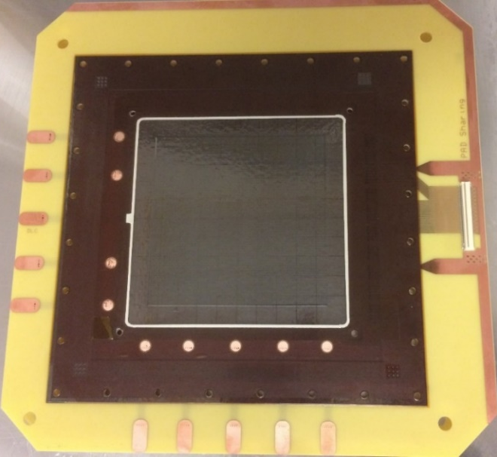
Principe of Capacitive Sharing readout PCB
Principle of capacitive-sharing large-pad Readout
Vertical stack of pad layers ⇨ Charge transfer from layer to layer via capacitive coupling
The pad size double from a layer (L_{i}) to the layer (L_{i+1}) below it
A given pad on L_{i} is either centered directly with a pad below it on L_{i+1} or at the boundary between two adjacent pads of L_{i+1} as shown on the sketch on the left
Charges from pad of L_{i} are either collected by a single pad or two adjacent pads on L_{i+1}
This spatial arrangement of the pads allows that two neighboring pads with charges of L_{i} are always transfer charges to 2 neighboring pads of L_{i+1} no mater the size of pads of of L_{i+1}
  Preservation of the position information i.e.. spatial resolution
  significant reduction of number of readout channels i.e. Low cost
  Flexible readout technology i.e. variety of possible applications for MPGD detectors
Signal readout layer (bottom) could be pad-based,1D, 2D strip, zigzag readout or a different readout scheme depending on the application
large-pad readout prototype @ UVa

Slide 4
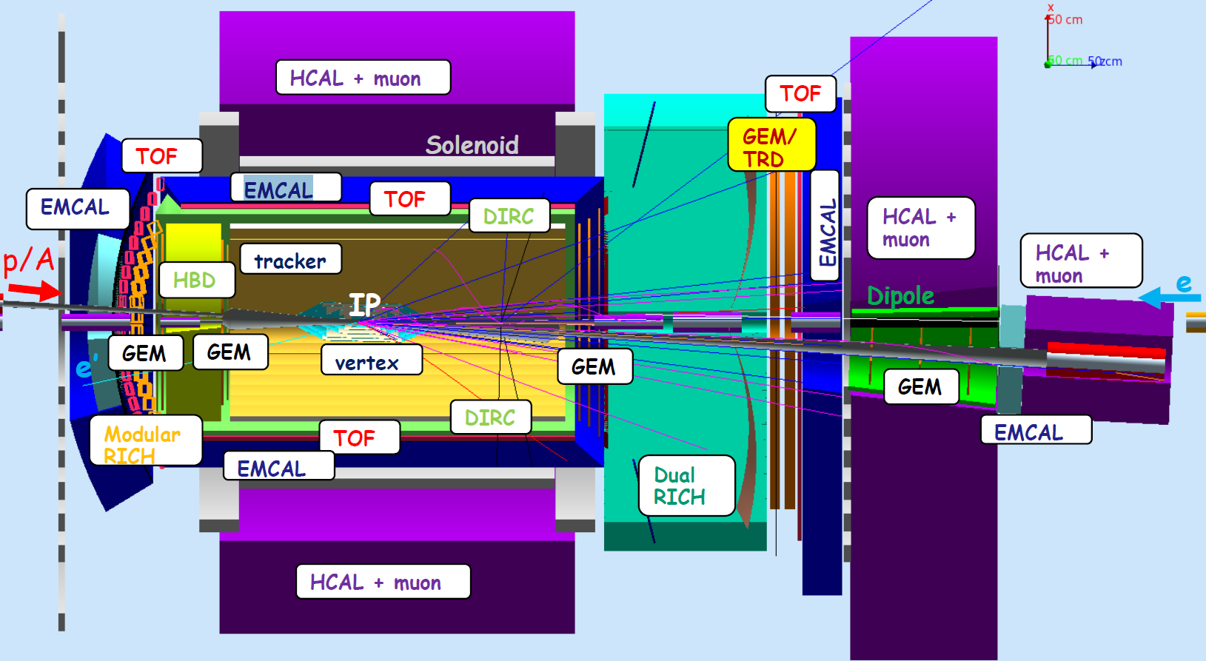
Potential Applications for EIC MPGD-based Tracking & PID Detector Options
EIC Detector Concept (JLEIC) Design
Several MPGD technologies under consideration for EIC tracking and PID
Tracking detectors options with MPGDs
  TPC for central tracking with GEM or hybrid MPGDs readout planes
  Multilayer Cylindrical MPGDs for the EIC barrel tracker
  Planar MPGD disc layers in both electron and hadron end caps
PID options with MPGDs
  Hybrid THGEMs & Micromegas for high momentum RICH in hadron end cap
  Short length GEM-RICH for high momentum RICH in hadron end cap
  GEM-TRD (Transition Radiation Detector) ⇨ both end caps
Why is large pads with capacitive sharing readout is an option for MPGD technologies for EIC application:
Moderate particle flux rate expected at the EIC tracking detectors in all eta regions (compared to LHC or fixed target experiment at JLab)
  Pile-up and multiple hit events are less of a concern
Flexibility of the readout concept: One can design the large-pad readout PCB parameters to address specific detector technology and application
  i.e. pad size for the top and / or bottom pad layers, numbers of layers, pad geometry and thickness … can be detector specific
The large pads with capacitive sharing readout technique is pretty straight forward: don’t anticipate an extensive R&D program to fully validate the concept
  Cost effective solution with low production risk

Slide 5

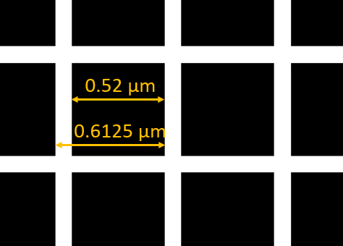
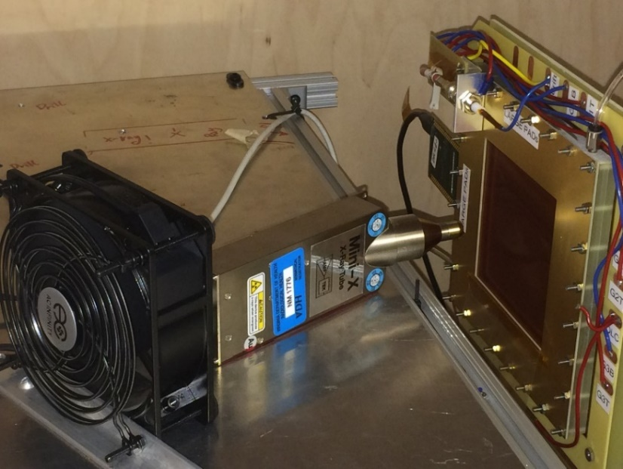
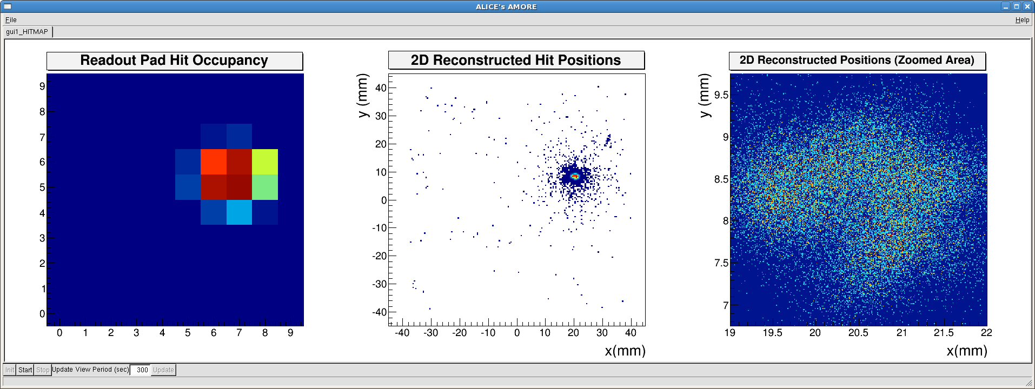
GEM prototype with capacitive sharing pad readout (1 cm × 1 cm pad size)
Bottom Layer: 1 cm × 1 cm pads
Top Layer : Pad pitch = 0.6125 µm × 1 0.6125 µm
5-layers capacitive-sharing pad readout prototype:
Top pad layer (define basic resolution performances):
  Pitch: 0.6125 mm × 0.6125 mm (0.1 mm inter-pad)
  Pad size: 0.52 mm × 0.52 mm
Bottom pad layer (readout pad):
  Pitch: 10 mm × 10 mm (0.1 mm inter-pad)
  Pad size: 9.9 mm × 9.9 mm
DLC layer with surface resistivity 10 - 20 MΩ
100 readout Pads
Single Panasonic connector
DLC ground ring
DLC layer
GEM prototype with capacitive-sharing pad in x-ray
Pad Occupancy & 2D hit reconstruction with x-ray
From hit on pads to reconstructed positions

Slide 6
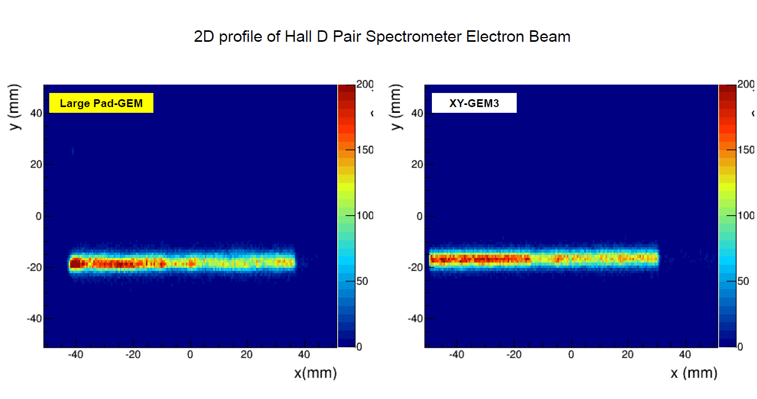
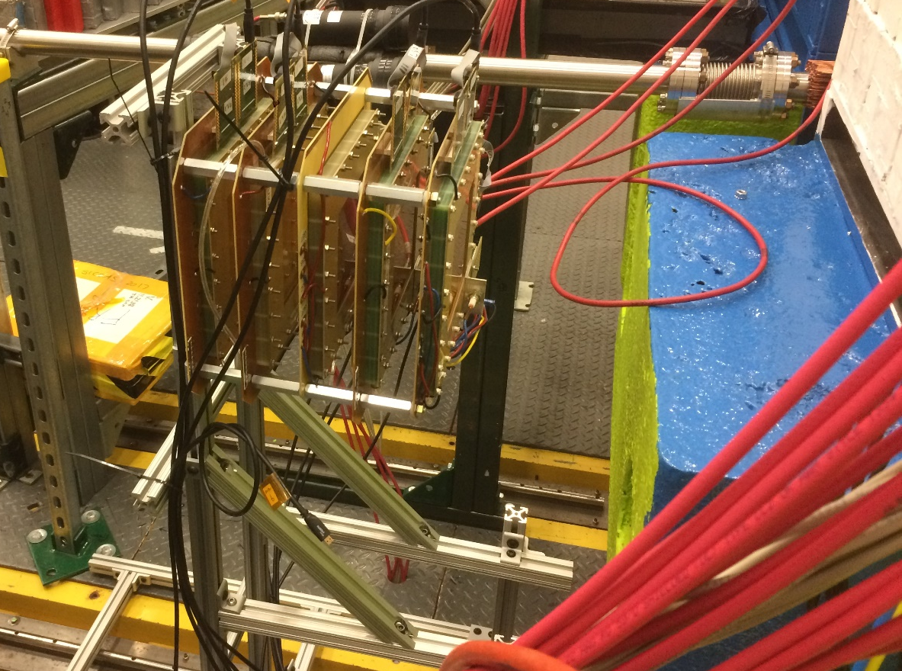
Test Beam in Hall D @ JLab
Test setup in the electron arm of Hall D Pair Spectrometer (PS) @ JLab.
Clean electron beam (3 to 6 GeV), incoming angle up to 8 degree
Large Pad GEM + 3 small X-Y CERN standard triple-GEM for tracking
APV25-SRS readout (DATE + AmoreSRS), trigger rate limited to 400Hz
Large volume of data for HV scan and for spatial resolution - Mid-September 2020
Beam line
Pair Spectrometer (PS)
e⁺
e⁻ (3 - 6 GeV)
Beam line
gamma
Electrons 3-6 GeV
TRK #4
TRK #3
TRK #1
TRK #2
Large Pad GEM
e⁻
Large Pad GEM Telescope

Slide 7
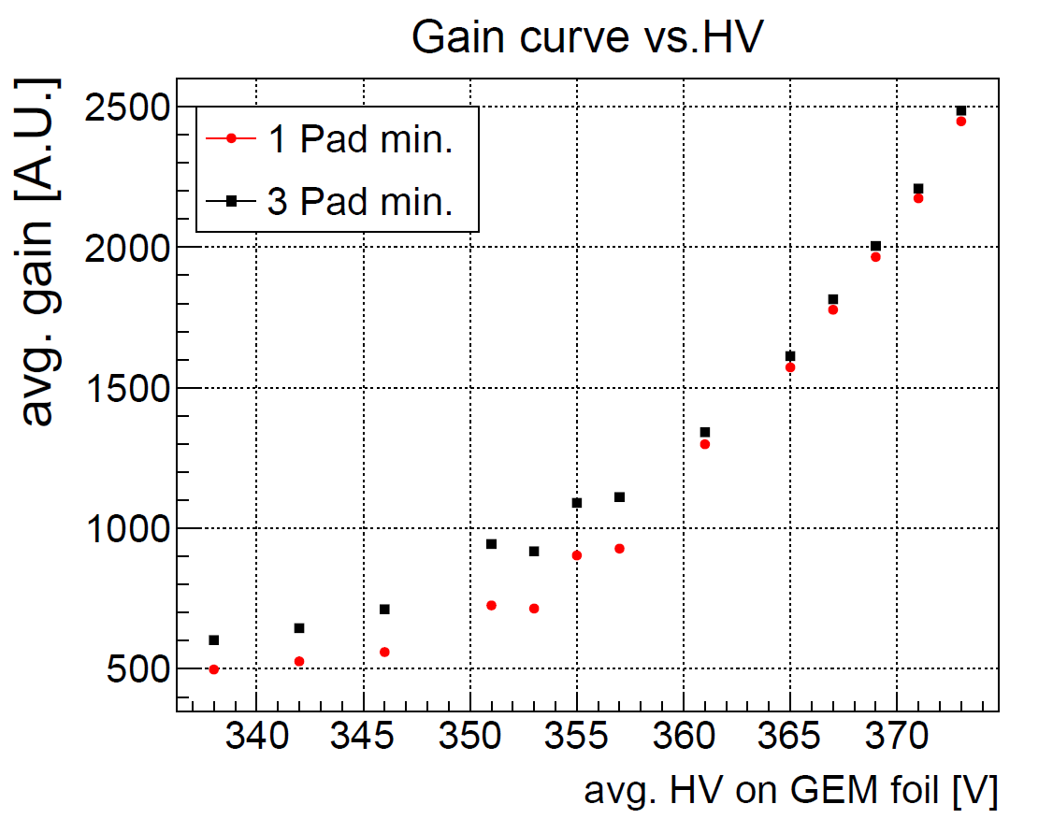
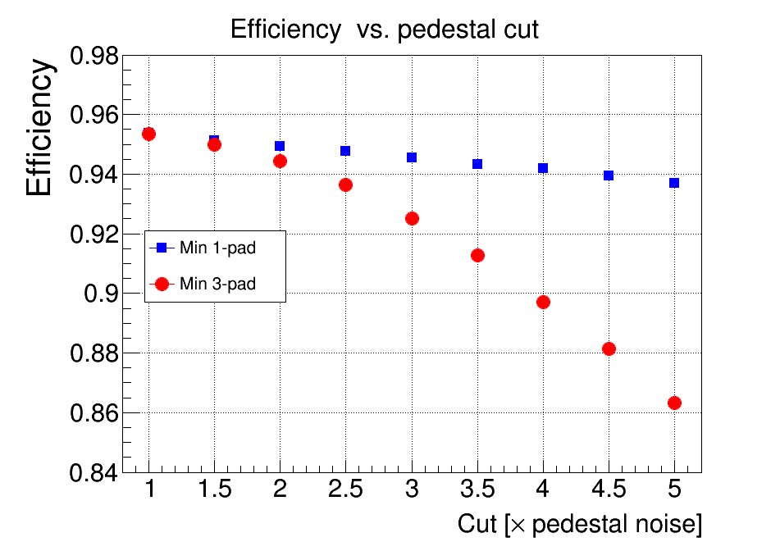
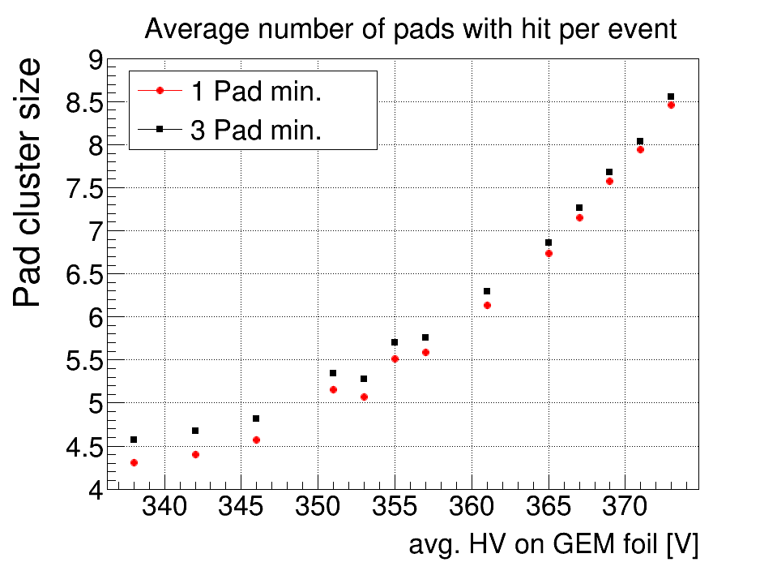
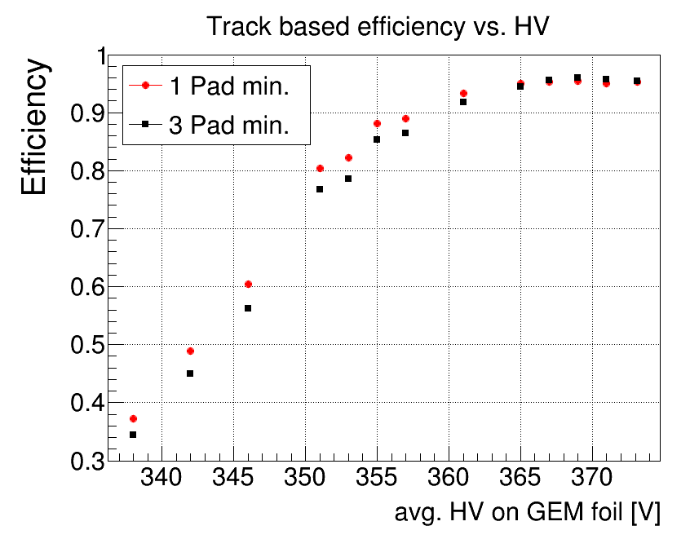
Basic performance of the prototype
HV scan from with 340 V to 375 V to GEM foils: (COMPASS GEM @ 4100 V = ~372 V)
  Track based efficiency studies: track from XY GEM trackers define the track
Full efficiency above 365V for zero suppression threshold =1.5 × σ (pedestal)
  1 Pad min.: all pads above threshold considered in analysis
  3 Pad min.: Only events with at least 3 pads above threshold are considered
Capacitive sharing performances @ 1.5 × σ pedestal cut
  Cluster size > 4 pads even at low gain (< 340 V on the GEM foils)
  Cluster size > 7 pads on average @ GEM voltage > 365V
  Efficiency drops 10% at 5 × σ pedestal cut with a 3 pad min requirement
Threshold:
1.5 × σ_{ped}
Efficiency vs. pedestal cut
Efficiency vs. HV
Avg. GEM HV 365V
Threshold:
1.5 × σ_{ped}
Threshold:
1.5 × σ_{ped}

Slide 8
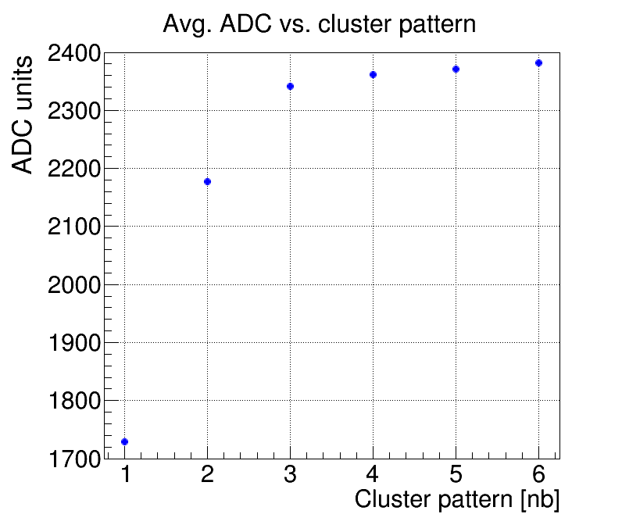
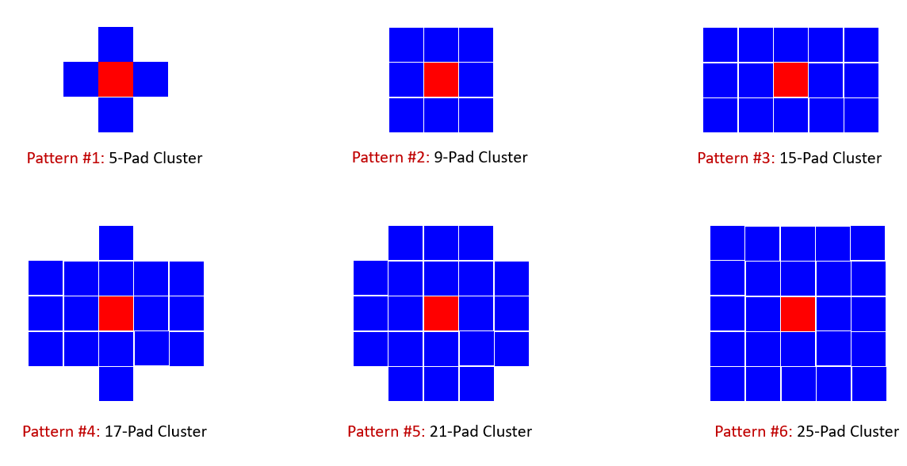
Cluster pattern definition
For each event, select the pad with the highest ADC values (shown in red on cartoon below)  this defined the central pad of the cluster
Form the cluster by identifying all neighboring pads around the central pad with ADC above pedestal and satisfying the rules defined by the pattern under consideration
  For example, for pattern #1, only look for the 4 immediate neighbors of the central pad
The number of pads of the pattern is the maximum number of pads per event,
  It is not the cluster size
We studied 6 patterns as shown on the cartoon of the figure below
  Pattern #1 allows up to 5 pads to form a cluster while pattern #6 can go up to 25 pads
These studies are performed when applying at (0 × σ) pedestal cut which mean only pads with ADC below pedestal level are removed from the analysis
Pattern #2 which is symmetric in x and y carries about 92% of the average ADC charges of pattern #3
Average cluster ADC vs. cluster pattern shows that starting from pattern #3, the additional pads of pattern #4, #5, #6 have a minor contribution to the total cluster ADC  about 1% of the total ADC
So Pattern #3 seems the optimal choice

Slide 9
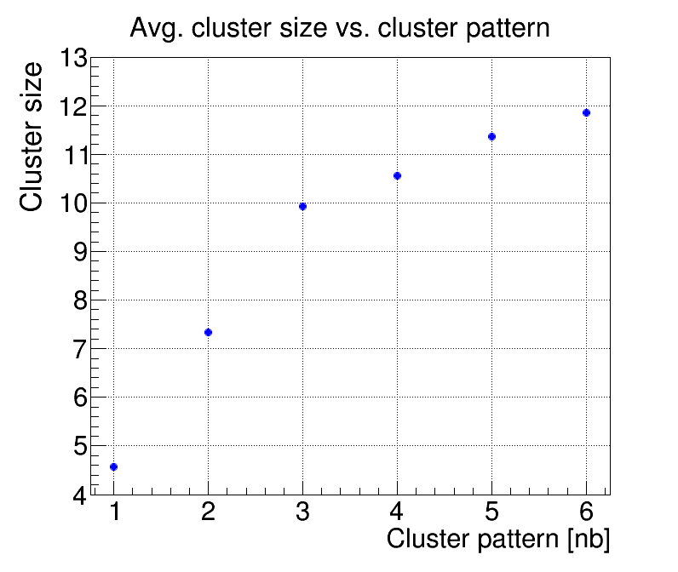
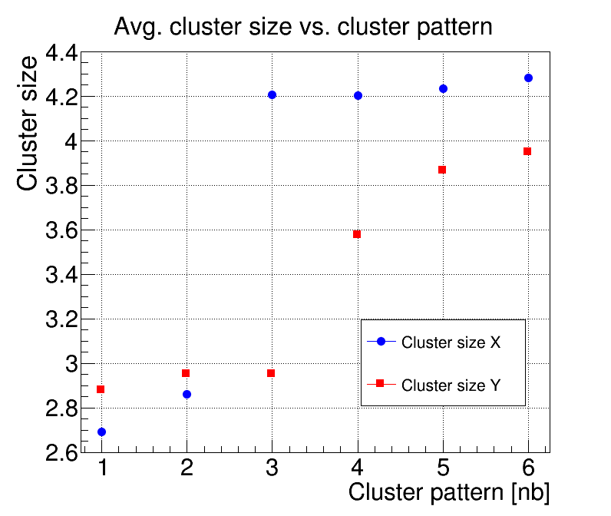
Cluster size vs. pattern definition
Average cluster size (2D) i.e. number of pad per events increases with pattern i,.e. maximum allowed pads in the cluster
However, the increase is not linear: cluster size of pattern #1 is about ~4.5 pads for 5 pads maximum allowed while cluster size for pattern #6 is ~12 for 25 pads allowed.
The cluster size is also plotted in 1D in x and y defined respectively as number of pad columns and number of pad rows
Cluster size in x for pattern #3 and #4 is equal ~4.2, the slight increase for pattern #5 and #6 suggests that we are including noisy pads in the selection of the cluster
Similarly the increase of cluster size in y for pattern #5 and #6 suggests that noisy pads are included in the cluster selection
we will see the impact later on the spatial resolution studies
Cluster size Y
Pad number in y
Cluster size X
Pad number in x
Noisy pads contribution

Slide 10
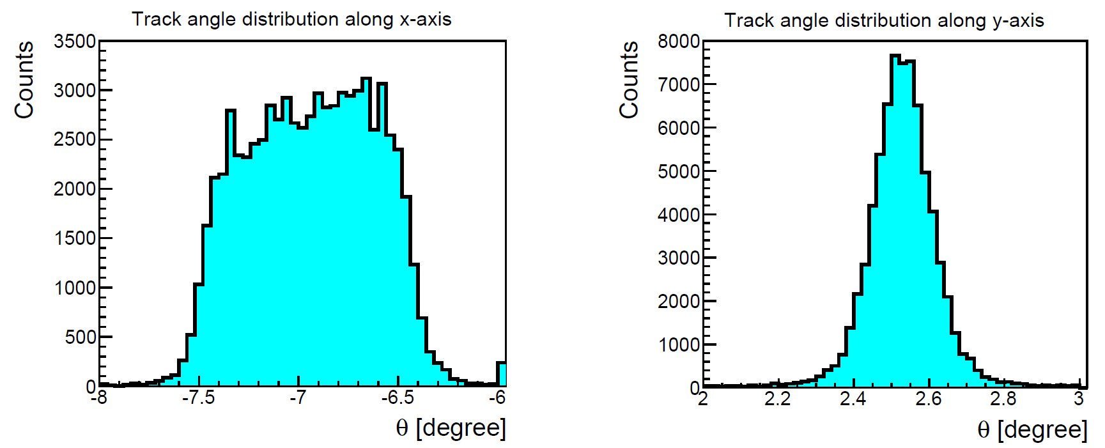
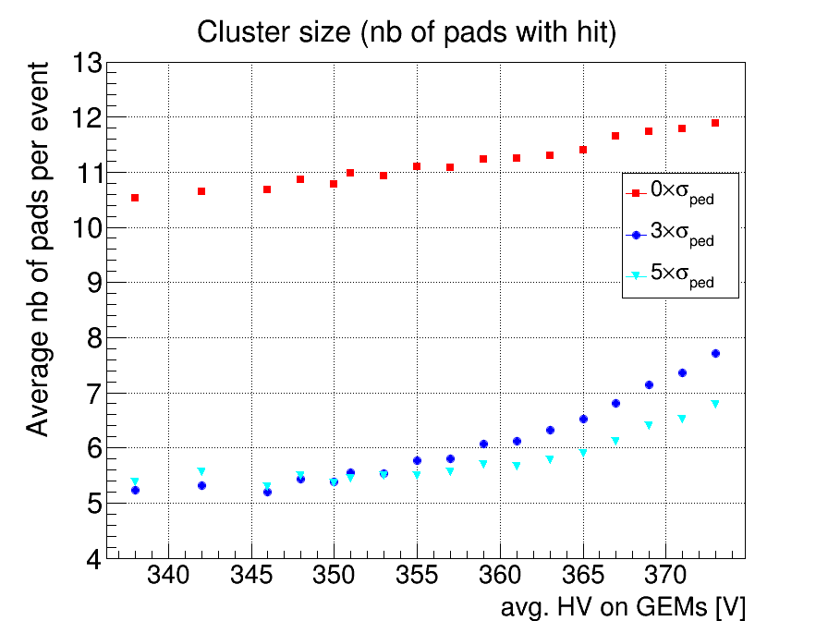
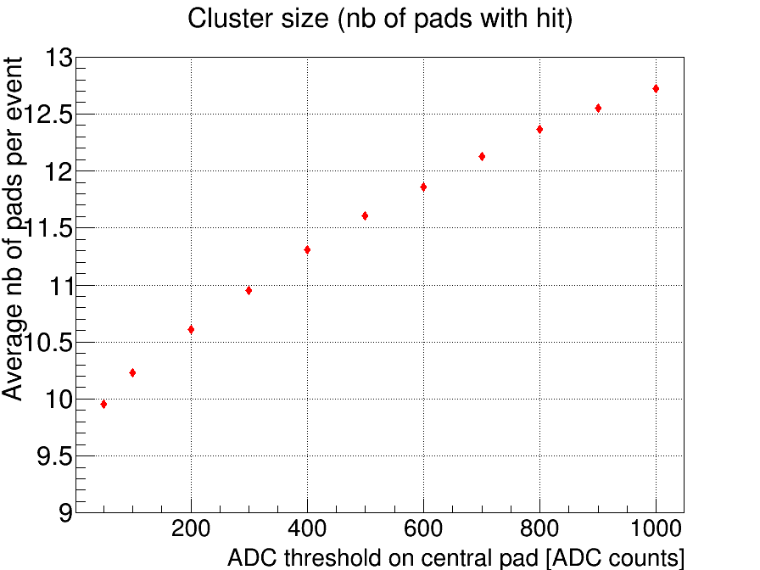
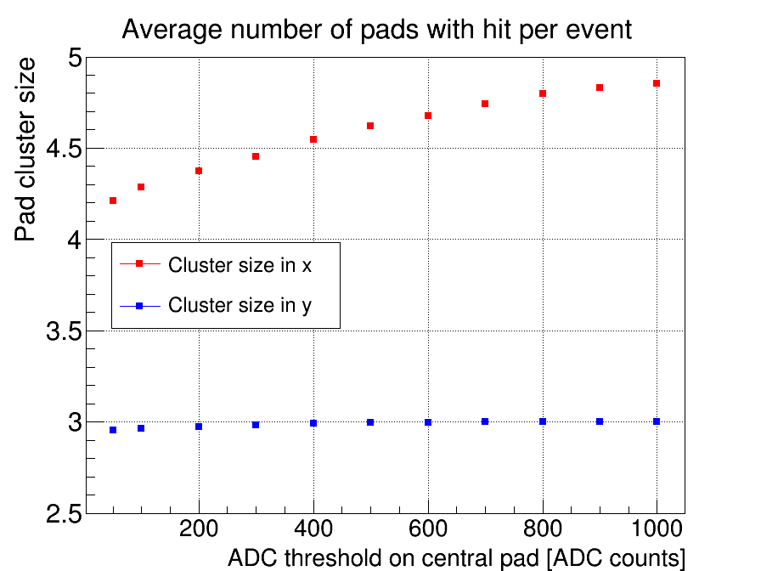
Cluster Size vs. avg. HV on GEMs
Strong variation of the cluster size with the HV when pedestal cut is applied
More moderate variation at (0 × σ)
When applying a selection based on the minimum ADC requirement on the central pads  Strong dependance of the cluster size on the ADC of the central pad
This dependance is driven by the cluster size in x direction  because of the larger angle of the tracks in x
Cluster size is independent of the ADC of central pad in y direction
Angular distribution of the tracks in x and y
Pattern #3
Pattern #3
Pattern #3

Slide 11
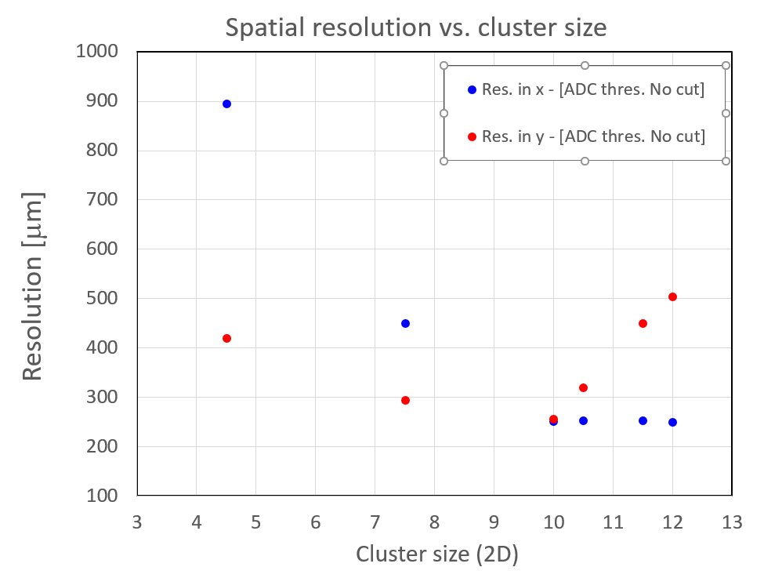
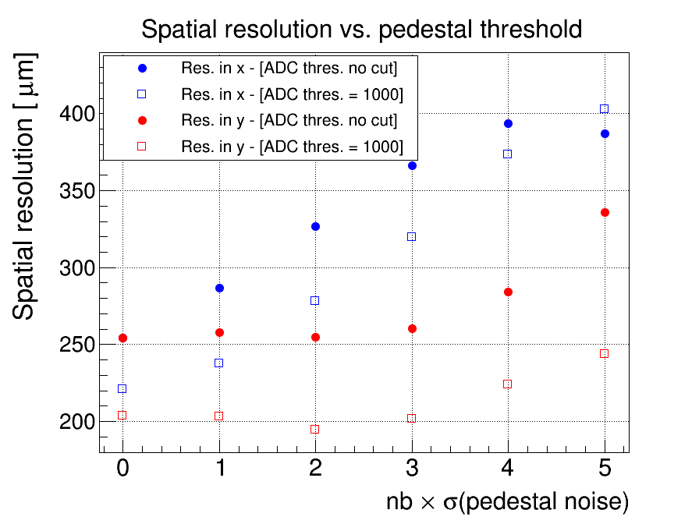
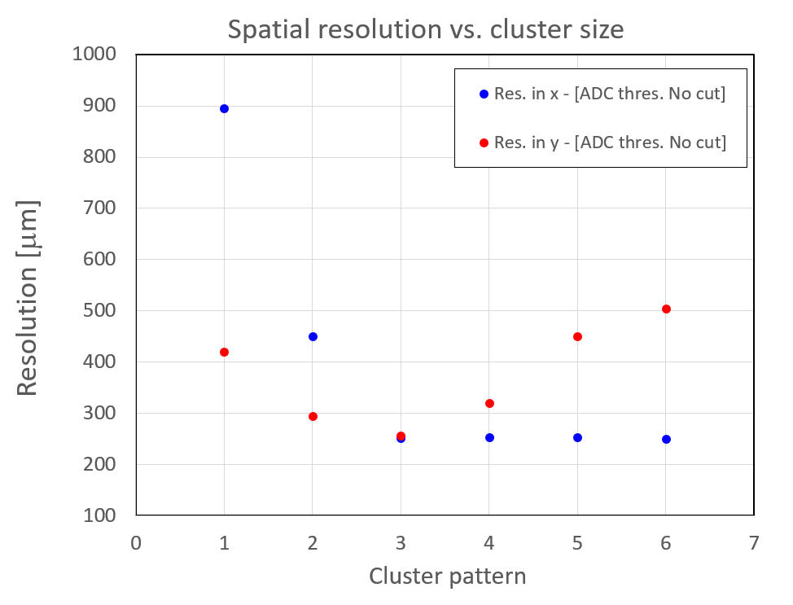
Spatial Resolution vs. cluster pattern
Spatial resolution as a function of the cluster pattern and cluster size
In x-direction, strong variation from 900 µm for pattern  #1 to 250 µm or pattern #3 and beyond
In y-direction, similar behavior but resolution starts degrading again for pattern #4 and beyond  noisy pads and cross-talk pads are included in the cluster formation
Resolution is very sensitive to noisy pads because even a small ADC contribution large pitch pad readout would lead to impact in the position accuracy
Cluster pattern #3

Slide 12
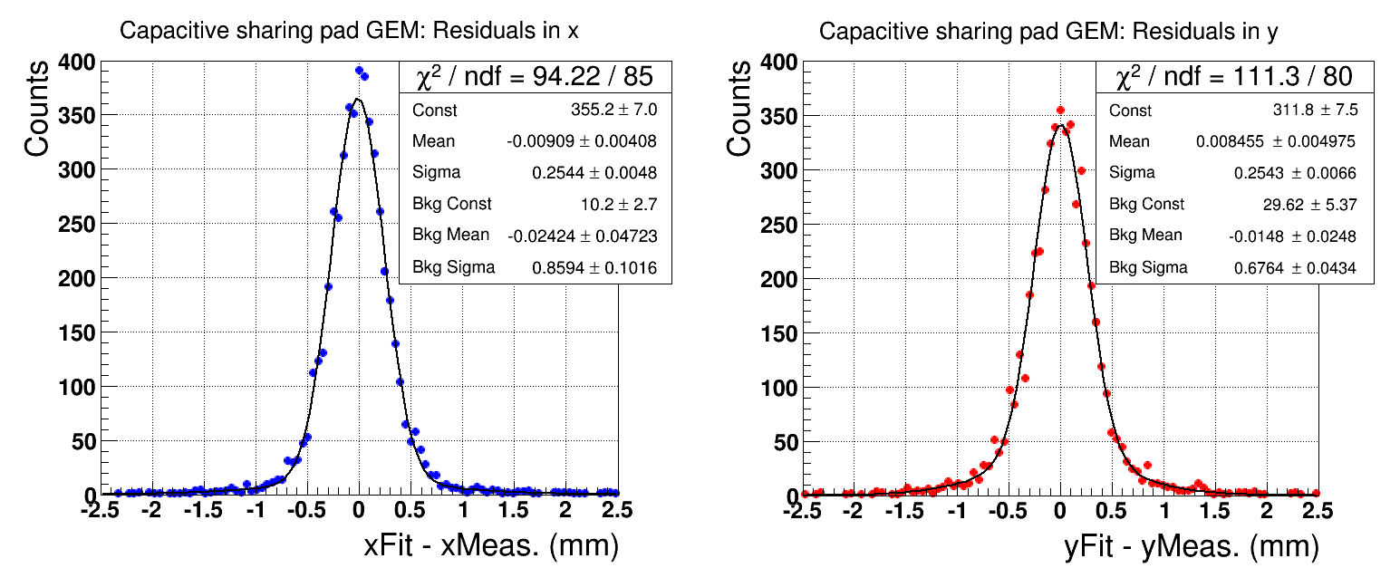
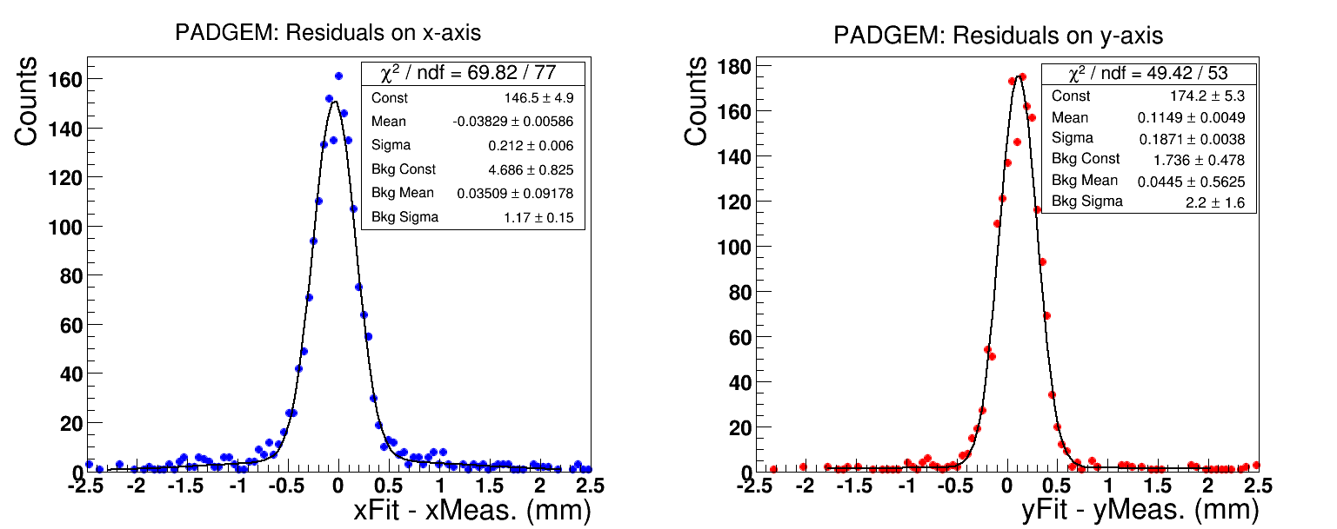
Spatial Resolution
Spatial resolution of 250 µm achieved in x and y without any cut for 1 cm x 1cm pad readout
When applying a selection on the minimum ADC on the central pad spatial resolution improves significantly  Performances can be improved with higher detector gain
Resolution in y is slightly better than in x because of the smaller angle distribution of the tracks
σ_{X} = 254 µm
σ_{Y} = 254 µm
σ_{X} = 212 µm
σ_{Y} = 187 µm
Minimm ADC requirement on the central pad  ADC = 1000

Slide 13
Conclusion
Very encouraging preliminary results on the performances of the large pad readout with capacitive sharing
Performances strongly depends on how the cluster of pads is formed
With capacitive sharing, the dependence of the position resolution with the angle is sensitive
Spatial resolution of 250 um is easily achieved with 1 cm x 1 cm pad readout without any cut applied to the data
Resolution can be vastly improves with increasing the detector gain
Resolution is very sensitive to noisy or cross talk pads
  capacitive sharing readout board should be optimized to minimize the occurrence of noisy and cross talk pads
Just received a new capacitive sharing readout boards with different characteristics to study further the performances of this concept

Slide 14
BACKUP

Slide 15
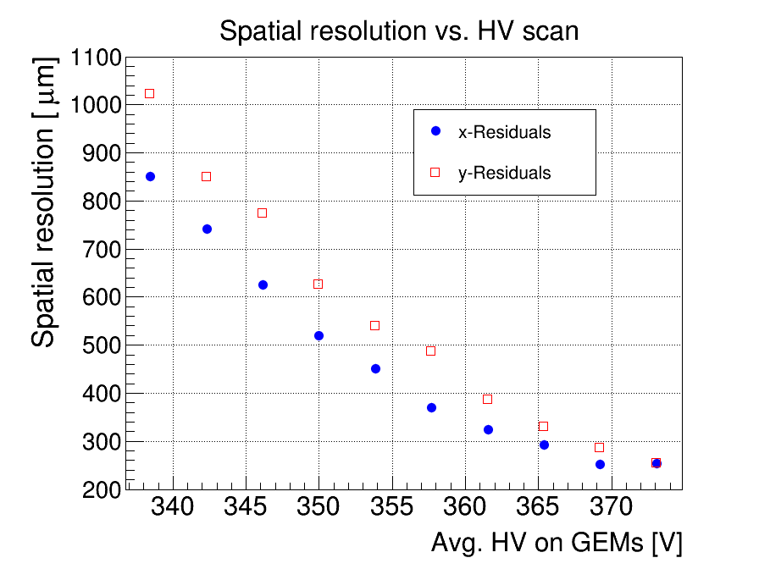
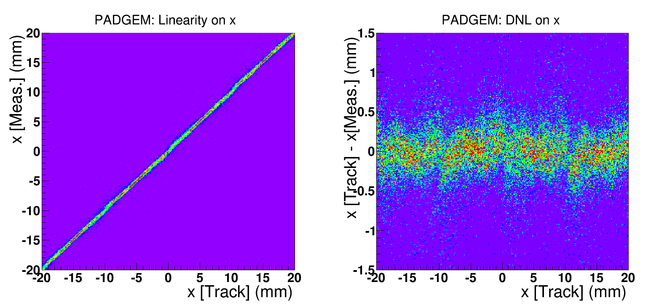
Spatial Resolution vs. Pedestal cut
Parasitic setup in the electron arm of Hall D Pair Spectrometer (PS) @ JLab.
Clean electron beam (3 to 6 GeV), incoming angle up to 8 degree
Large Pad GEM + 3 small X-Y CERN standard triple-GEM for tracking
APV25-SRS readout (DATE + AmoreSRS), trigger rate limited to 400Hz
Large volume of data for HV scan and for spatial resolution - Mid-September 2020
Cluster pattern #3

Slide 16
Spatial Resolution vs. Pedestal cut
Parasitic setup in the electron arm of Hall D Pair Spectrometer (PS) @ JLab.
Clean electron beam (3 to 6 GeV), incoming angle up to 8 degree
Large Pad GEM + 3 small X-Y CERN standard triple-GEM for tracking
APV25-SRS readout (DATE + AmoreSRS), trigger rate limited to 400Hz
Large volume of data for HV scan and for spatial resolution - Mid-September 2020
Cluster pattern #3

