Slide 1


Hydrodynamic Approach to
Simulate Avalanche and Streamer in
Gaseous Detectors
Presented By
Jaydeep Datta
Saha Institute of Nuclear physics, Kolkata, india
Homi Bhabha National Institute, Mumbai, India

Slide 2
Motivation
The gaseous detectors are known for their excellent time resolution, good spatial resolution. They have large area coverage and small response time. These advantages have made them an important tool of many present and future experiments.
Understanding the governing physics of these detectors help to improve them.
Moreover if one can simulate avalanche and streamer probability of the gaseous detectors it will help identifying potential alternative gas mixtures without carrying out experiments.
Many attempts have been made to simulate these detectors following Monte Carlo method or hydrodynamic approach. [W. Riegler et al NIM A 500 (2003) 144; D. Bosnjakovic et al., 2014 JINST 9 P09012; A. Moshaii et al, NIM A 661 (2012) S168; D. Bošnjakovic et al, J. Phys. D 49 (2016) 405201.]
Here a hydrodynamic approach will be described to simulate RPC and GEM. The simulated results have been compared with experimental data to validate the model.

Slide 3
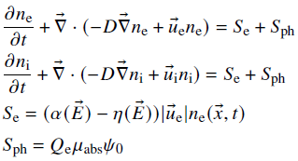



Simulation Framework
The basic idea was followed from the model described in RD51–NOTE-2011-005, by P. Fonte and in RD-51 Open Lectures - 12/12/17–CERN by Filippo Resnati.
The simulation framework utilizes hydrodynamic approach. The gas molecules, ions and electrons are considered as fluids.
MAGBOLTZ, electron transport properties
HEED, primary electron information
COMSOL Multiphysics, simulates avalanche and streamer.
Hydrodynamic equations
Equations for photon propagation
Ref:
1. J. Datta et al, JINST 15 C12006 (2020)
2. J. Capeillere et al, J. Phys. D 41 (2008) 234018.

Slide 4
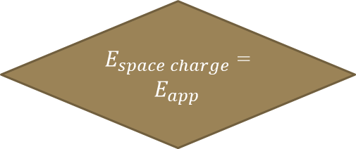
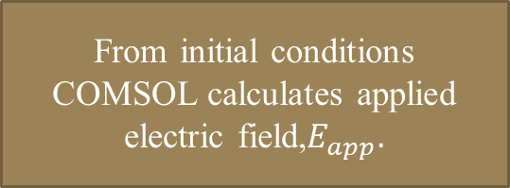
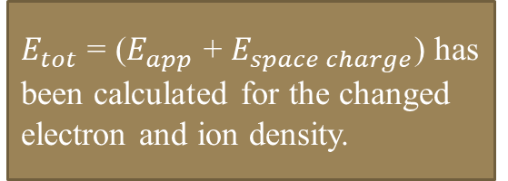
Simulation Flowchart
Information from HEED and MAGBOLTZ are passed to COMSOL Multiphysics
Electron number < 1
YES
Avalanche
NO
From initial conditions COMSOL calculates applied electric field,$E_{app}.$
$E_{space charge}$ = $E_{app}$
YES
STOP
Streamer
NO
Hydrodynamic equations are solved to calculate electron and ion density.
$E_{tot}$ = ($E_{app}$ + $E_{space charge}$) has been calculated for the changed electron and ion density.

Slide 5
Simulation for RPC
Ref: “Study of Streamer Development in Resistive Plate Chamber”, J. Datta et al 2020 JINST 15 C12006

Slide 6
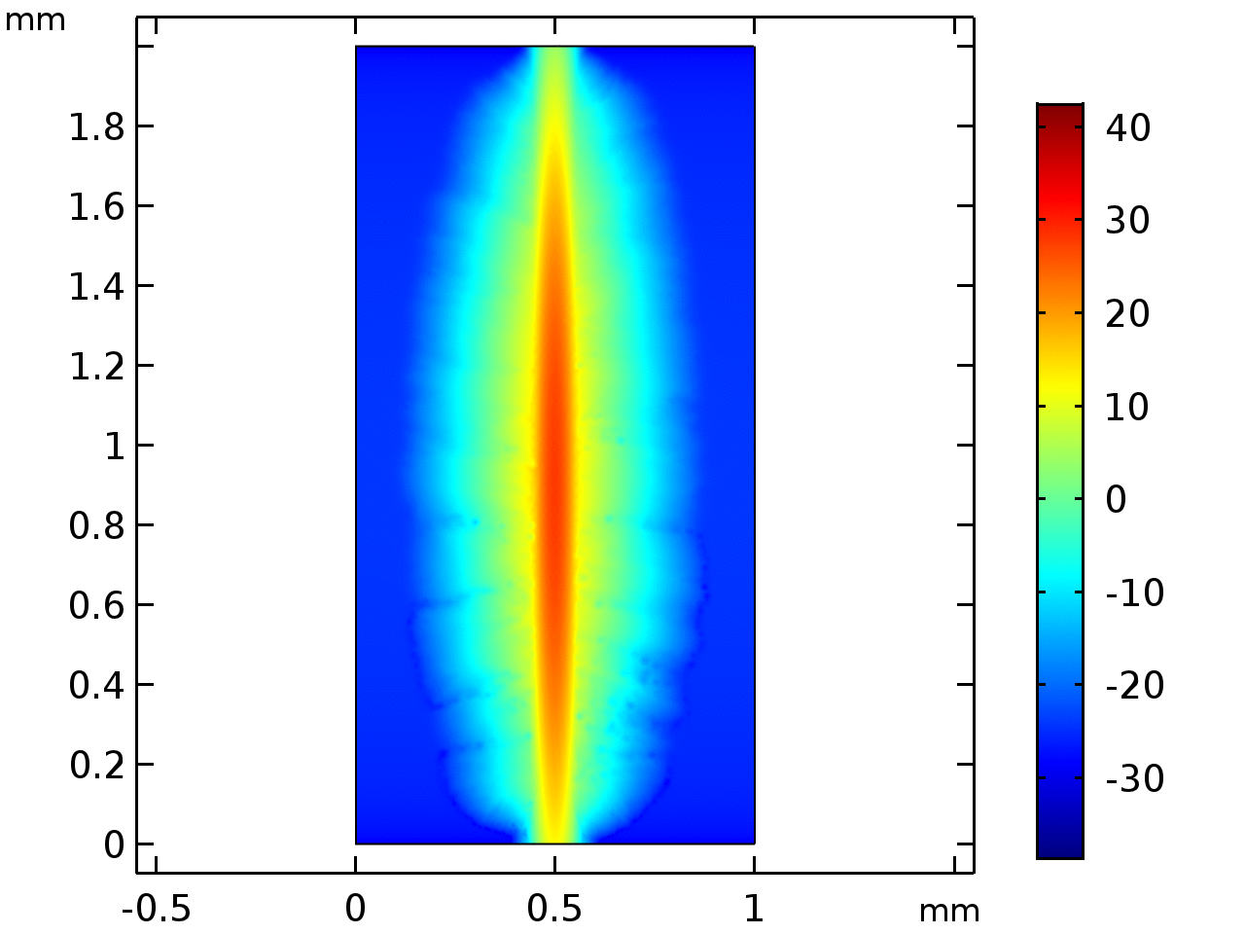
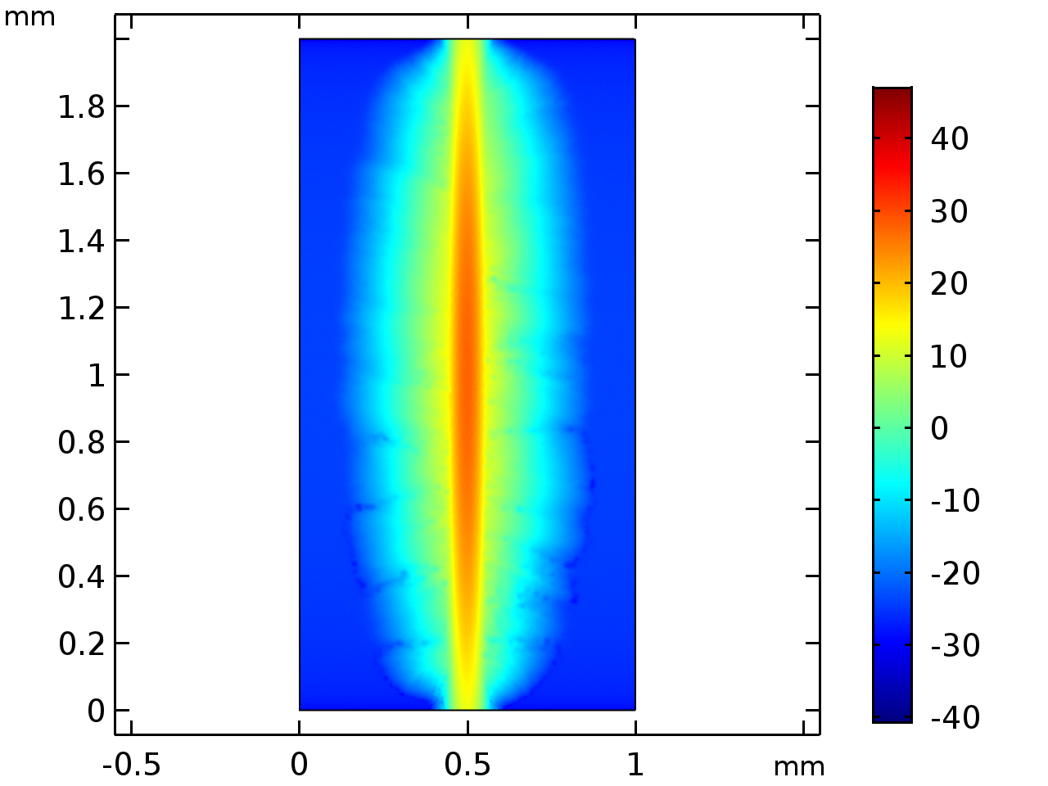
Avalanche and Streamer Event
Avalanche event
Cathode
Streamer event
Electron density in logarithmic scale
Anode
41 kV/cm, number of primaries 60, mean Z position 1 .0 mm
47 kV/cm, number of primaries 60, mean Z position 1 .0 mm

Slide 7
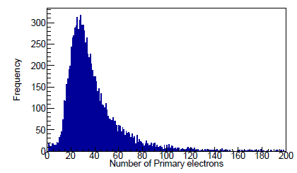
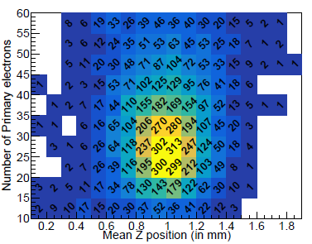
Calculation of Streamer Probability and Efficiency
Gas mixture R134a : butane = 97 : 3
Figure: 1 Number of primary electrons obtained
from HEED
10000 muon events, following cosmic muon flux have been simulated using HEED.
Number of primary electrons has been varied in steps of 5 between 10 to 60.
Position of the primary electrons has been varied in step of 0.1 mm between 0.1 mm and 1.9 mm.
From simulation it was found out, for each applied voltage, for what value of initial position and primary electron number, streamer occurs and the induced current crosses the threshold mark.
The induced current is calculated using Ramo’s theorem.
Figure 2: Variation of primary electron number
with mean Z-position
Ref: “Study of Streamer Development in Resistive Plate Chamber”, J. Datta, S. Tripathy, N. Majumdar, S. Mukhopadhyay, JINST 15 C12006 (2020)

Slide 8
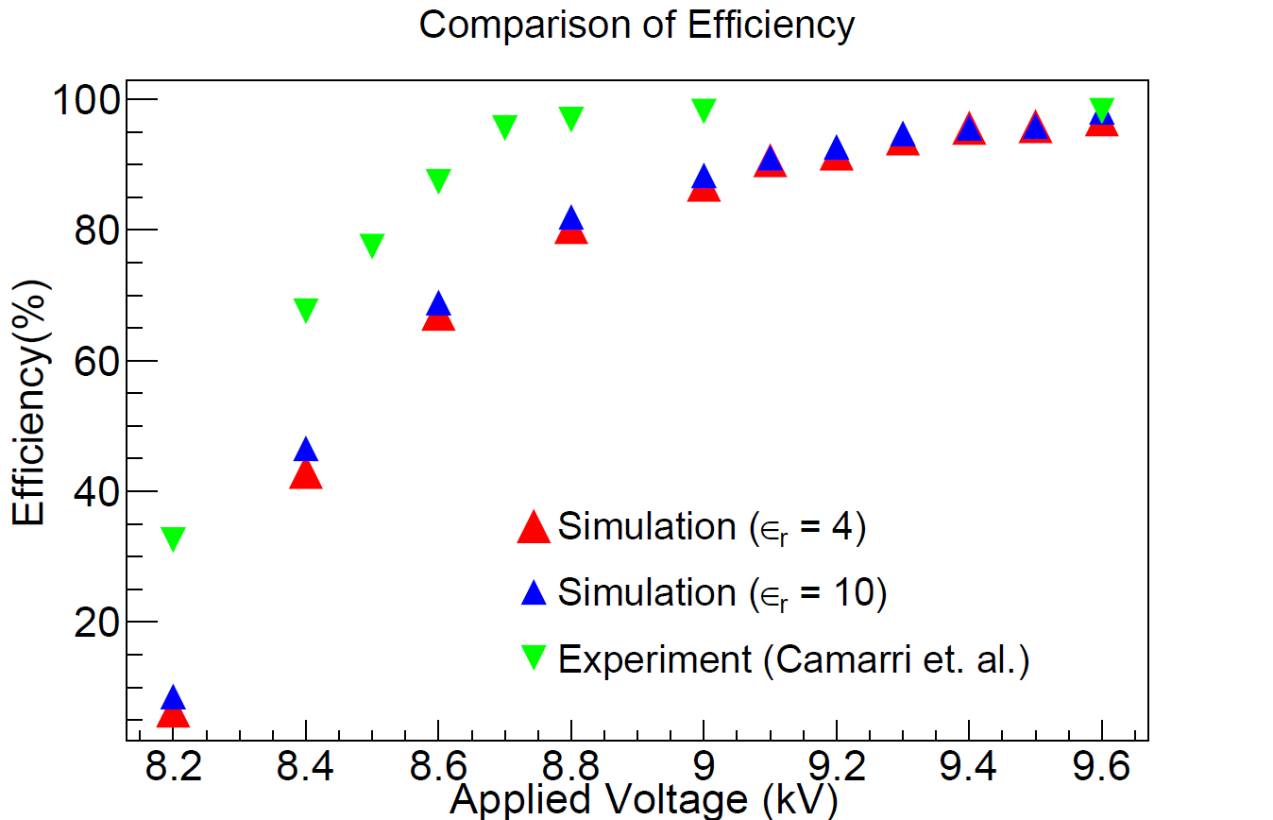
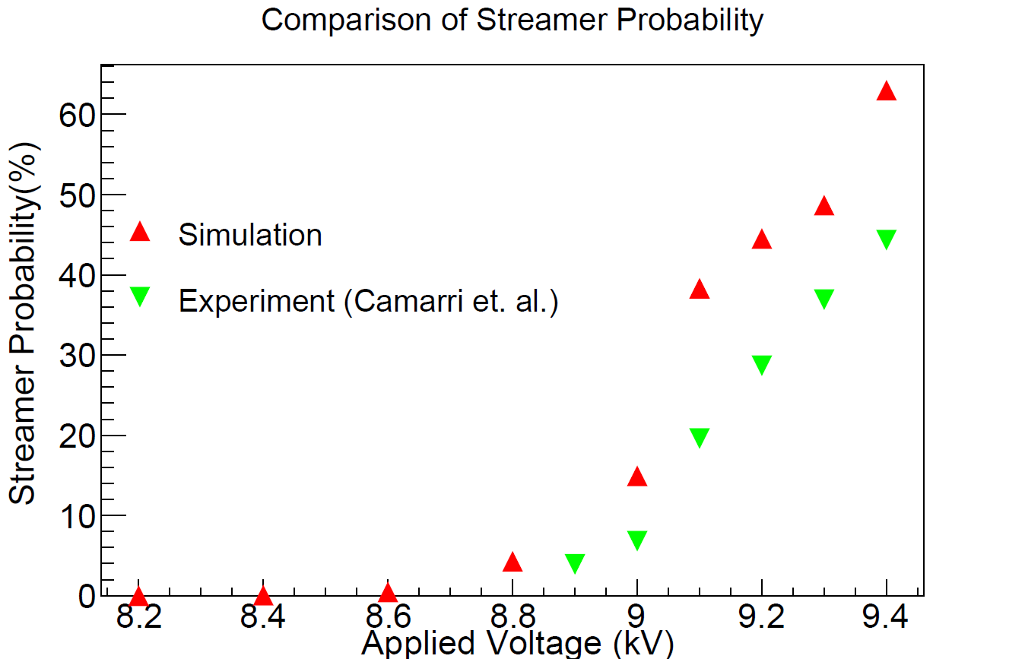
Result for R134a : butane = 97 : 3
References:
P. Camarri et al., NIM A, 414,(1998), 317.
J. Datta, S. Tripathy, N. Majumdar, S. Mukhopadhyay, JINST 15 C12006 (2020)

Slide 9
Simulation for GEM
Ref: “Fast simulation of avalanche and streamer in GEM detector using hydrodynamic approach” P.K. Rout et al 2021 JINST 16 P02018

Slide 10
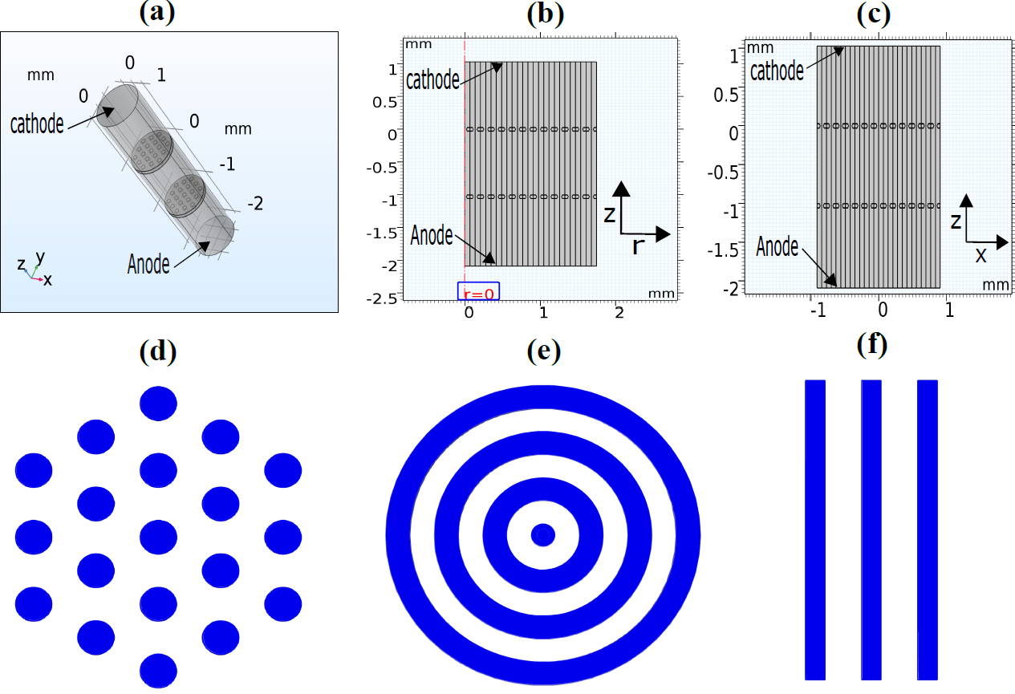
Choice of GEM Simulation Geometry
3D geometry of GEM
2D axisymmetric geometry
2D geometry of GEM
Top view of 3D GEM foil
Top view of 2D axisymmetric model
Top view of 2D model.
Ref: “Fast simulation of avalanche and streamer in GEM detector using hydrodynamic approach” P.K. Rout et al 2021 JINST 16 P02018

Slide 11
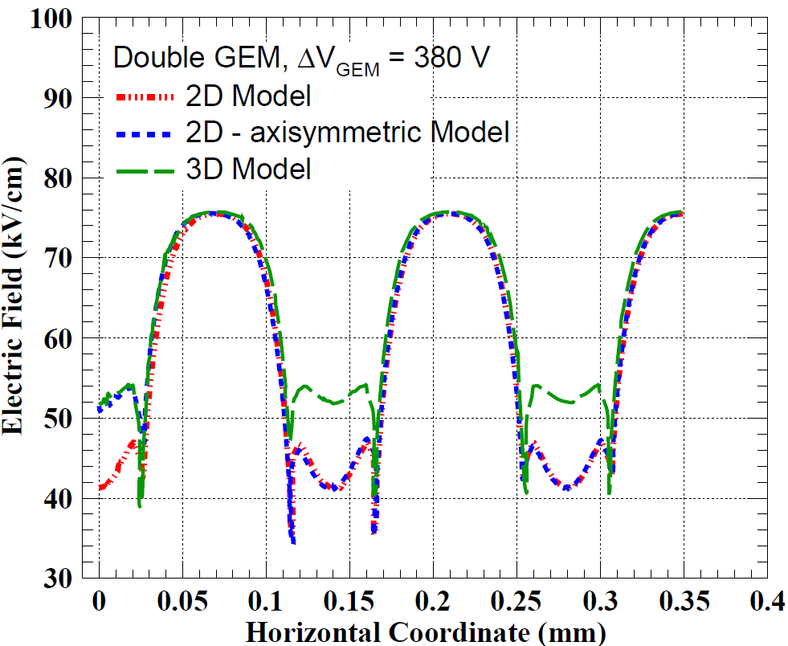
Electric Field configuration of different model
Using COMSOL Multiphysics the electric field for different configuration have been calculated.
For the Central hole of 3D and 2D-axisymmetric model the electric field configuration are in accordance but that of 2D model is far off.
Side holes (3D model)/ Channels (2D axisymmetric model, 2D model)
Central hole (3D, 2D axisymmetric model)/ Channel (2D model)
Ref: “Fast simulation of avalanche and streamer in GEM detector using hydrodynamic approach” P.K. Rout et al 2021 JINST 16 P02018

Slide 12
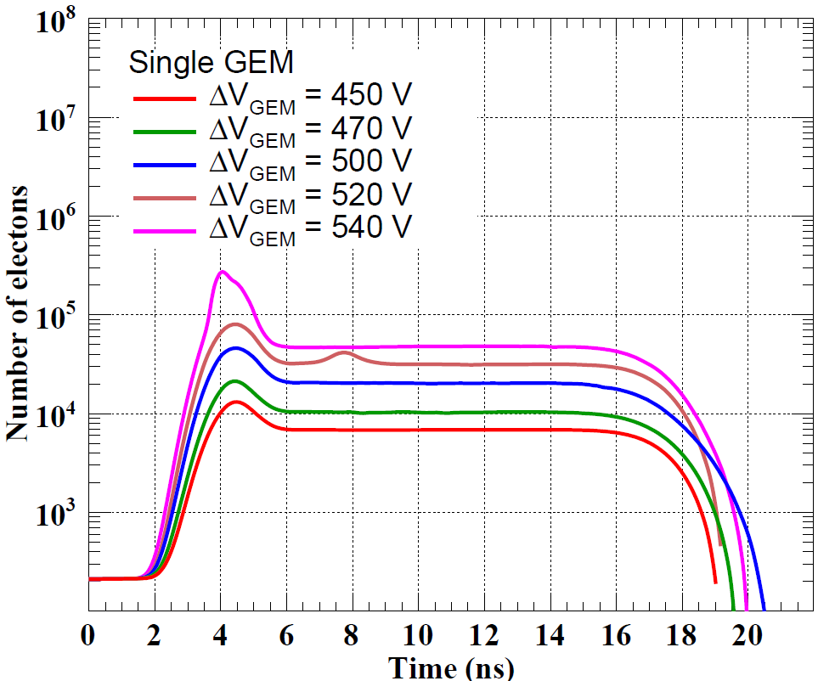
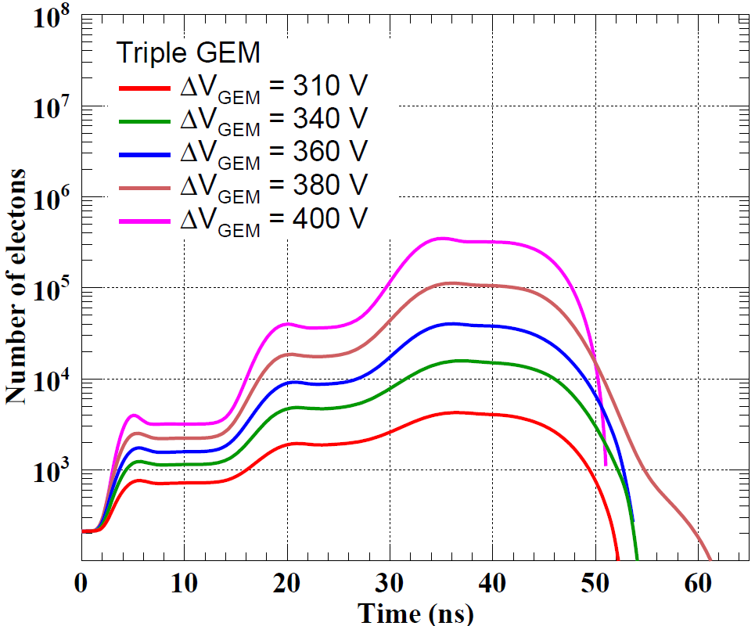
Variation of Electron Numbers with Time in Avalanche
Ref: “Fast simulation of avalanche and streamer in GEM detector using hydrodynamic approach” P.K. Rout et al 2021 JINST 16 P02018

Slide 13
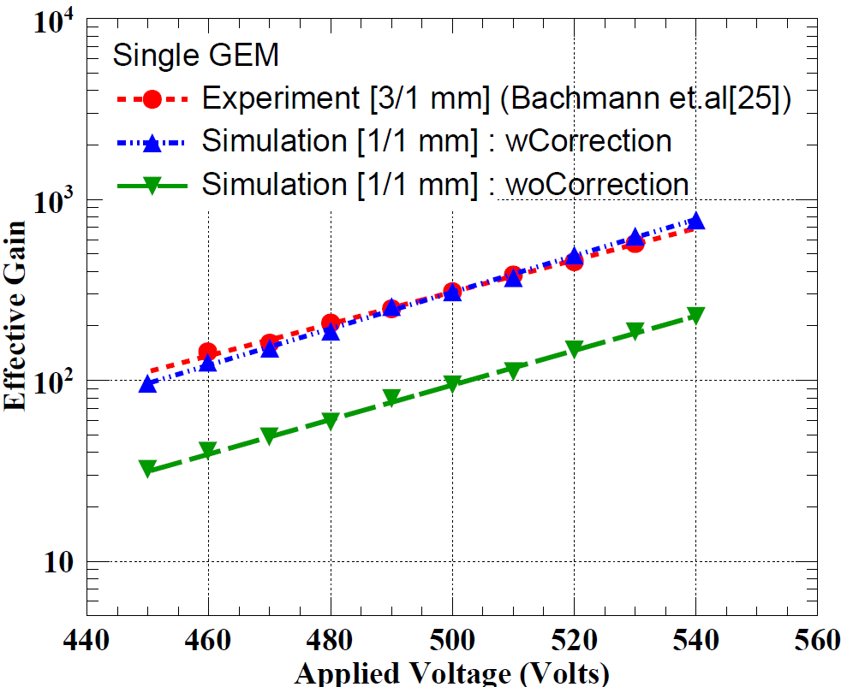
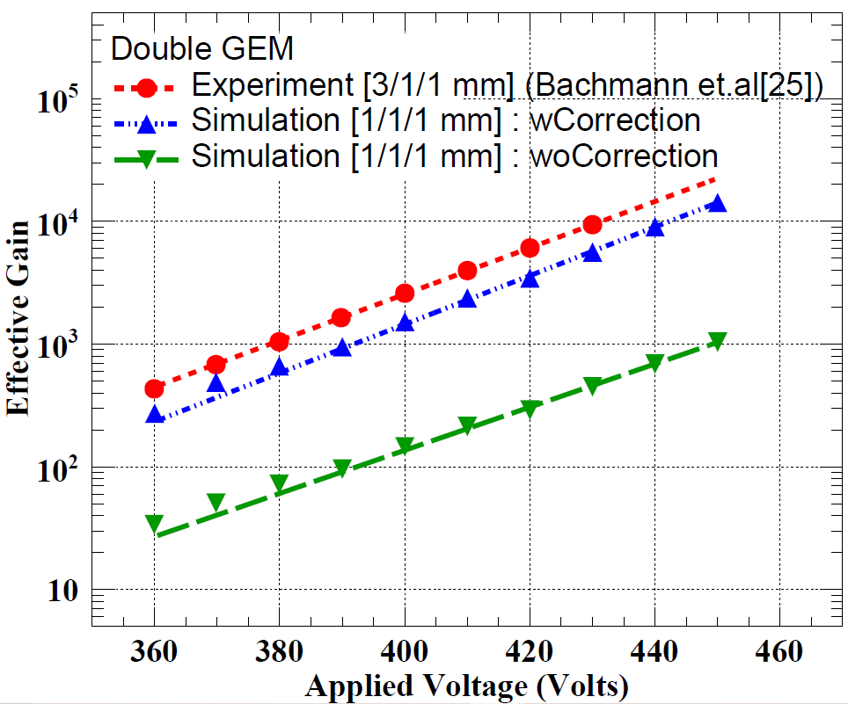
Gain Comparison for Single and Double GEM
Ref:
“Fast simulation of avalanche and streamer in GEM detector using hydrodynamic approach” P.K. Rout et al 2021 JINST 16 P02018
“Discharge mechanisms and their prevention in the gas electron multiplier (GEM)”, S. Bachmann et al.,NIM A479(2002) 294.

Slide 14
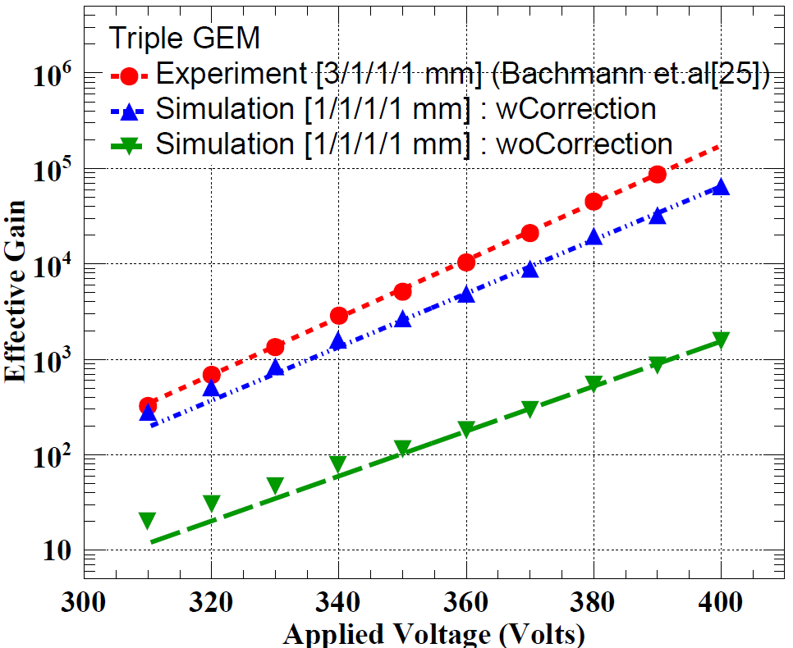
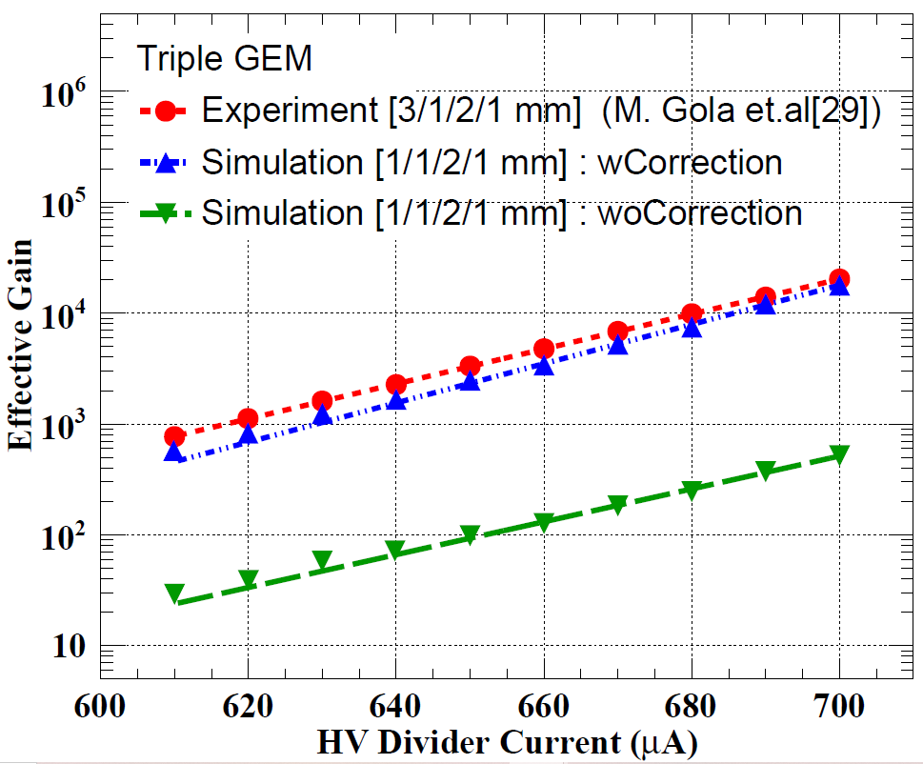
Gain Comparison for Triple GEM
Ref: “Fast simulation of avalanche and streamer in GEM detector using hydrodynamic approach” P.K. Rout et al 2021 JINST 16 P02018
“Discharge mechanisms and their prevention in the gas electron multiplier (GEM)”, S. Bachmann et al.,NIM A479(2002) 294
“Performance of the triple GEM detector built using commercially manufactured GEM foils in India”, M. Gola et al,NIM A951(2020) 162967

Slide 15
Conclusion
The hydrodynamic approach to simulate avalanche and streamer have been discussed.
Space charge effect has been included.
This method is fast and in reasonable time one can simulate both RPC and GEM characteristics with acceptable accuracy.

Slide 16
Our Group
These works have been carried out with
Prasant Kr. Rout^{1, 2}, Sridhar Tripathy^{1, 2}, Promita Roy^{1, 2}, Purba Bhattacharya³, Sandip Sarkar^{1, 2}, Supratik Mukhopadhyay^{1, 2}, Nayana Majumdar^{1, 2}
1. Saha Institue of Nuclear Physics, Kolkata, India
2. Homi Bhabha National Institute, Mumbai, India
3. Department of Physics, University of Calcutta, 92 A.P.C Road, Kolkata 700009, West Bengal, India

Slide 17
Thank you

Slide 18
Back up slides

Slide 19
Boundary Conditions for RPC
The outflow of electrons through anode and that of positive ions through cathode has been taken care of by assuming that there drift of these charged species through respective electrodes.
The dimension of the simulation volume was chosen such a way that it can contain the whole avalanche and streamer.
The electrodes are made of Bakelite or glass, none of which have scintillation property, so the photon flux from the electrodes has been set to zero.

Slide 20
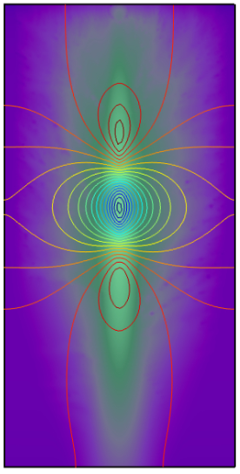
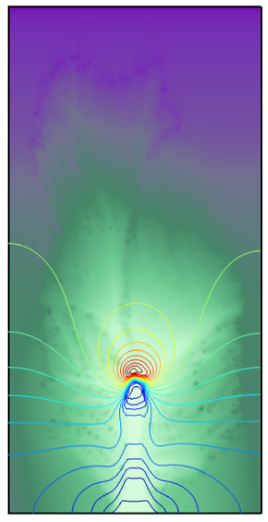
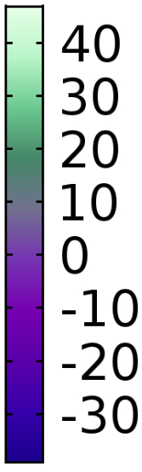
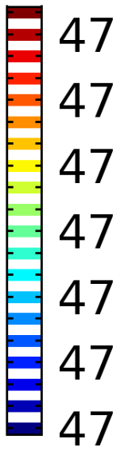
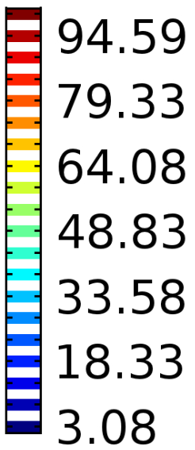
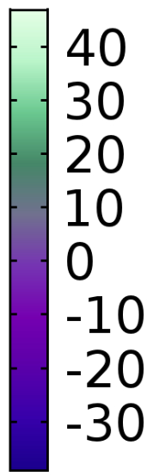
Cathode
ln(Electron Density (in 1/m³))
Electric Field (in kV/cm)
Electric Field (in kV/cm)
ln(Electron Density (in 1/m³))
Anode
Time= 1 ns
Time= 19 ns
Ref: “Study of Streamer Development in Resistive Plate Chamber”, J. Datta, S. Tripathy, N. Majumdar, S. Mukhopadhyay, JINST 15 C12006 (2020)

Slide 21
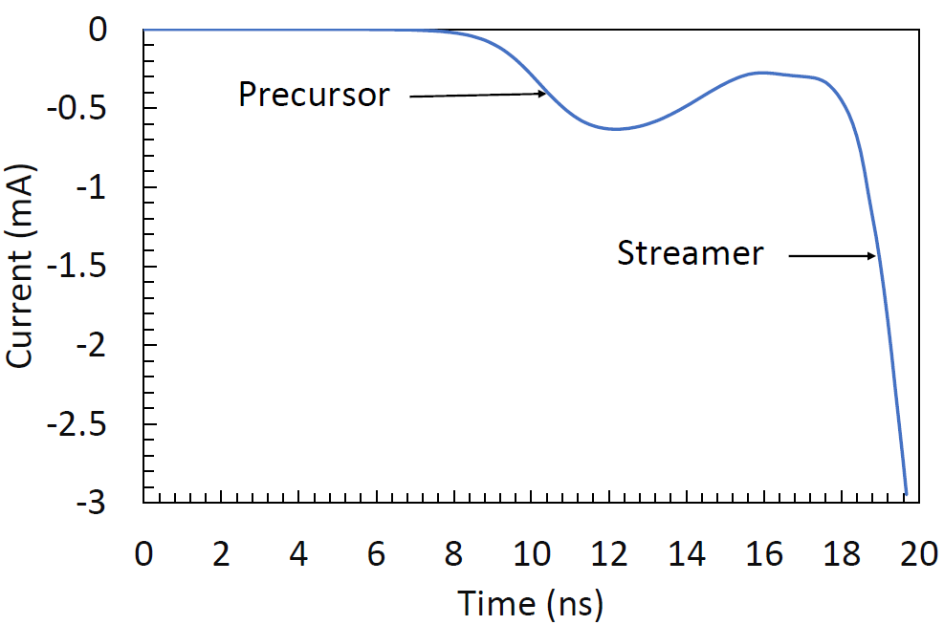
Ref: “Study of Streamer Development in Resistive Plate Chamber”, J. Datta, S. Tripathy, N. Majumdar, S. Mukhopadhyay, JINST 15 C12006 (2020)

Slide 22
Boundary Conditions for GEM
To incorporate the loss of charged species through the electrodes, it was assumed that the electrode boundaries, that are drift cathode, anode, GEM cathode, GEM anode, are open boundaries.
The dimension of the simulation volume was chosen such a way that it can contain the whole avalanche and streamer.
The charged species get accumulated on the surface of the dielectric material. So the dielectric boundaries were chosen to be opaque for them.

Slide 23
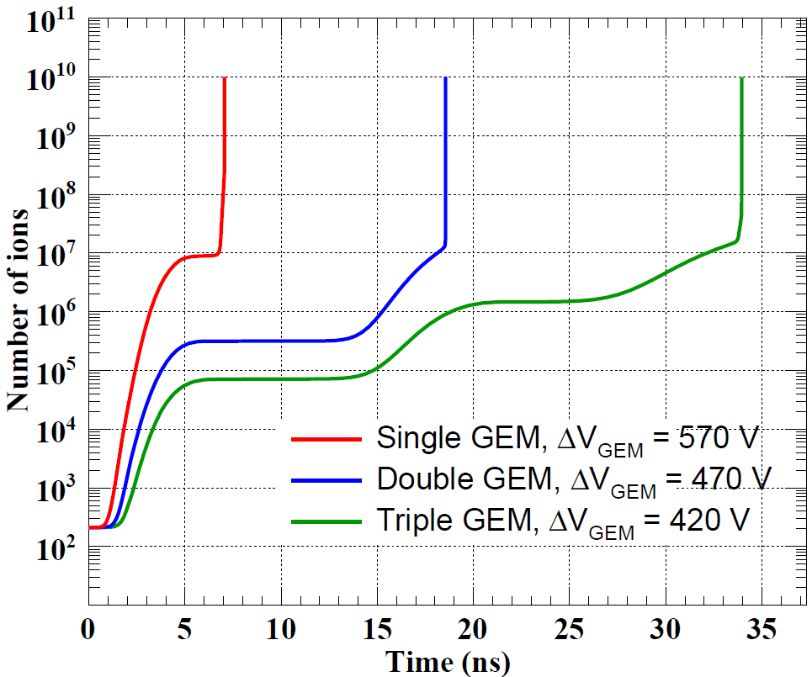
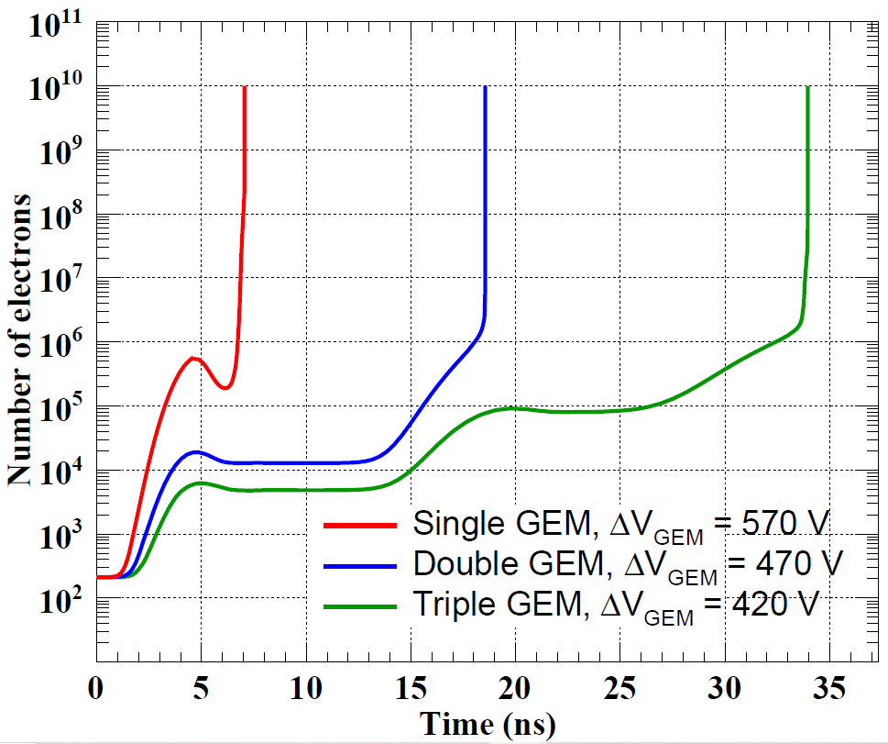
Streamer in GEM
Ref: “Fast simulation of avalanche and streamer in GEM detector using hydrodynamic approach” P.K. Rout et al 2021 JINST 16 P02018

Slide 24
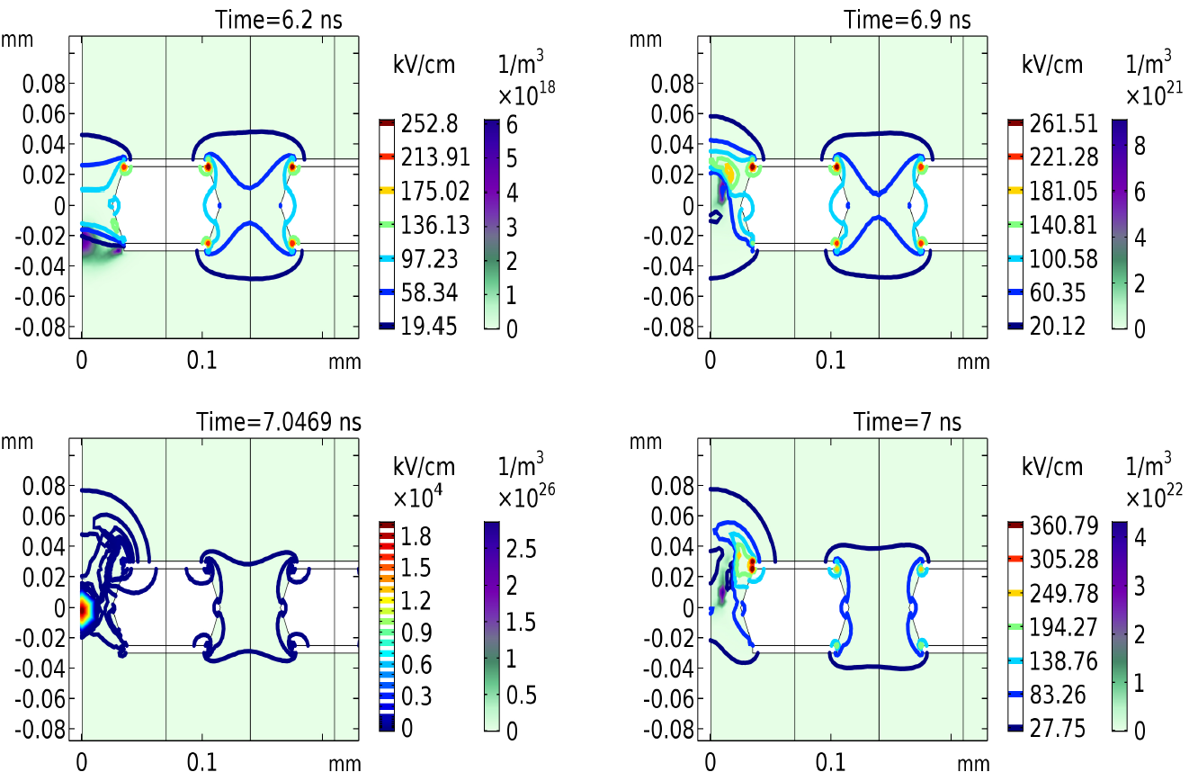
Streamer in GEM
This figure shows the streamer propagation in a single GEM. The plots are clockwise in time starting from top left corner.
Ref: “Fast simulation of avalanche and streamer in GEM detector using hydrodynamic approach” P.K. Rout et al 2021 JINST 16 P02018

