Slide 1

FTM
Test Beam in 2021
RD-51 Mini-Week
Feb 19 2021
Antonello Pellecchia, Piet Verwilligen
INFN Bari
CERN, Feb 19 2021

Slide 2
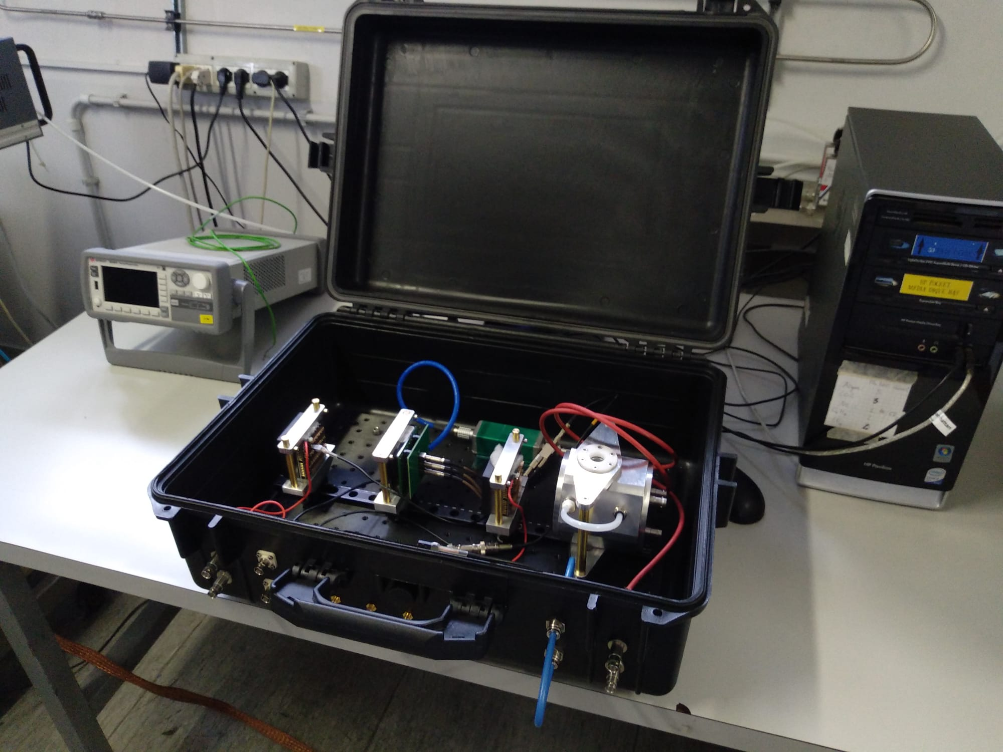

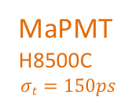
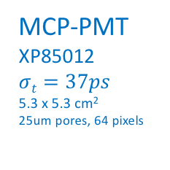
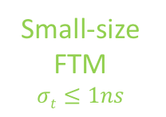
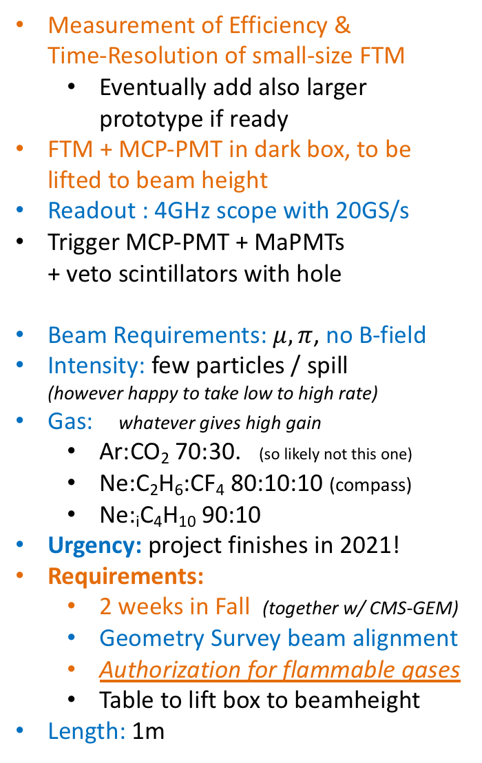
FTM Testbeam
Measurement of Efficiency &
Time-Resolution of small-size FTM
  Eventually add also larger prototype if ready
FTM + MCP-PMT in dark box, to be lifted to beam height
Readout : 4GHz scope with 20GS/s
Trigger MCP-PMT + MaPMTs
+ veto scintillators with hole
Beam Requirements: $μ, π$, no B-field
Intensity: few particles / spill
(however happy to take low to high rate)
Gas: whatever gives high gain
  Ar:CO₂ 70:30. (so likely not this one)
  Ne:C₂H₆:CF₄ 80:10:10 (compass)
  Ne:_{i}C₄H₁₀ 90:10
Urgency: project finishes in 2021!
Requirements:
  2 weeks in Fall (together w/ CMS-GEM)
  Geometry Survey beam alignment
  Authorization for flammable gases
  Table to lift box to beamheight
Length: 1m
MaPMT
H8500C
$$σt=150ps$$
MCP-PMT
XP85012
$$σt=37ps$$
5.3 x 5.3 cm²
^{25um pores, 64 pixels}
Small-size FTM
$$σt≤1ns$$

Slide 3
MaPMT
MCP-PMT
Cosmic Ray tests
Small-size FTM
More info in presentation of Antonello in next RD-51 Meeting
G=4000 achievable
Laser tests --- Searching for Single-Photon regime
Laser tests on Small-size FTM
Ar:CO2 70:30
However need to see single-e⁻ signal on oscilloscope!

Slide 4

If it doesn’t work …
I’ll hide

