Slide 1
Precautions to start a resistive Micromegas detector
Constructor point of view !
Bertrand Mehl
Antonio Teixeira
Olivier Pizzirusso
Serge Ferry
Rui de Oliveira

Slide 2
Introduction
-The MPT workshop have now produced a significant quantity of Micromegas detectors with resistive protections. We have also followed quite precisely large projects like ATLAS NSW.
-All these productions give us a fairly good picture of their operation but also of their limitations.
-We have noticed that the best detector configuration is probably:
-Resistive protective layers in DLC with a value greater than 10Mohms / Square. -45/18 SS mesh.
-Amplification gap of 100 or 128um.
-We have noticed that some detectors fully tested are anyway sometimes suffering from instabilities during the starting up phase . We are now pretty sure that this behaviour greatly depends on how the first power-up is done.

Slide 3
General consideration
-Ambient humidity is probably the most critical parameter creating defects and especially during the first power-up after reception or long storage in non controlled environment.
-The detectors you receive are always tested at their "maximum voltage" in a climatic chamber at 25 deg with a relative humidity of less than 10%. This test is carried out after depositing a hermetic protection on the active area to avoid any subsequent pollution.
-During transport or storage, the humidity can rise to more than 80% RH in summer and drop to 15-20% in winter in our regions , and this for an unknown period of time.
-After removing the protection and closing the detector, the residual humidity in the detector materials is unknown . In addition, accidental pollution with dust or chemicals during handling cannot be ruled out.
-Due to these unknown conditions , during the first start-up, a specific voltage rise sequence must be scrupulously observed in order to be able to reach the "nominal voltage" in a safe manner.

Slide 4
Optimal conditions for first powering up
-You should install a hygrometer on the gas inlet and another on the outlet to get an idea of ​​the residual humidity of your detector.
-You should install a filter at the gas inlet and another at the outlet, to avoid any subsequent contamination from the pipes of your installation. Do not allow pipes permeable to water vapour.
-The detectors must be assembled in a clean environment, class 10,000 minimum. If the detector is small, the quality of the room can be reduced, for really small detectors of less than 5cm x 5cm the clean room is not mandatory.
-Once the two hygrometers indicate a value less than 3% RH, you can apply a voltage corresponding to 1/3 of the "maximum voltage" of the detector (with a current limitation around 1 uA).
-Once the leakage current stabilizes at a few nA (2 to 3 nA with a variation of 1 or 2nA max) you can then increase the voltage in steps of 20V.
- Now let's look at different responses of the detector.

Slide 5
Different responses →Trouble shooting guide
Case number 1: After an increase of 20V, the current stabilizes quickly at a low value (a few nA) without peaks during periods of several minutes.
→ Your detector is dry and dust free!
→ You can increase in steps of 20 V in the direction of your "nominal voltage" without risk.
Case number 2: It is difficult to increase the voltage without obtaining leakage currents of less than 10nA. The time it takes for the current to fall after a step can sometimes take hours. Your detector is still wet! Don’t increase the voltage, this will create real defects. It is important to wait, or lower the voltage. If the detector does not improve over time stop it.
→The detector may have a gas leak or permeable pipes preventing it from drying out over time.
Possible chemical contamination : spit or contact with solvents or other chemicals.
The detector must be cleaned.
Case number 3: the leakage current is good, but it regularly shows fairly large jumps, even if you are far from the "nominal voltage".
→Your detector is dry but there is some dust inside!
→The detector must be cleaned

Slide 6
“Nominal voltage” to “maximum voltage” region
-You have now reached the "nominal voltage" of your detector. This voltage must be 30 to 50V lower than the “maximum voltage” of the detector.
-It is not advisable to go beyond the "nominal voltage" without having the necessary equipment to clean the detector.
-The zone between "nominal voltage" and "maximum voltage" has already been explored by the manufacturer of the detector.
-This is a dangerous area for your detector, staying there could cause permanent damages. However, after a long stabilization at the "nominal voltage" and if the detector shows no instability. It is possible to enter this area.
-This must be done manually with the possibility of immediate shutdown in case it diverges. You should not run a detector having more than 20nA leakage current without attendance in this zone.
-Any detector should be able to reach this "Maximum voltage“ in theory. However, great care must be taken because this limit is not really well defined. You should never imagine being able to go beyond voltage or even stay at this voltage. This is a physical limit, beyond this limit the detector will surely develop permanent damages.

Slide 7
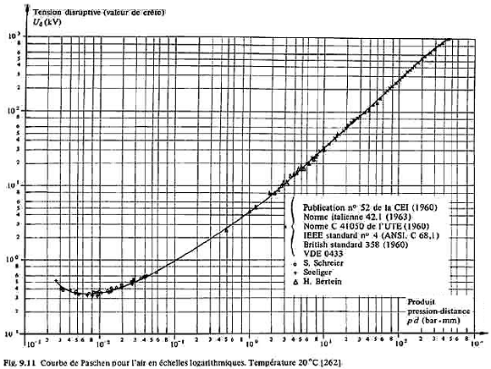
The only gas mixture well documented in terms of “maximum voltage” is Air
!! This maximum voltage change with the size of the detector
!! Pressure and temperature also change this “maximum voltage”
MM BULK
100um gap
930-950 V
GEM-uRwell
50um gap
630 -650 V
THGEM
0.9mm gap
4000 V
MM floating
128um gap
1000-1050 V

Slide 8
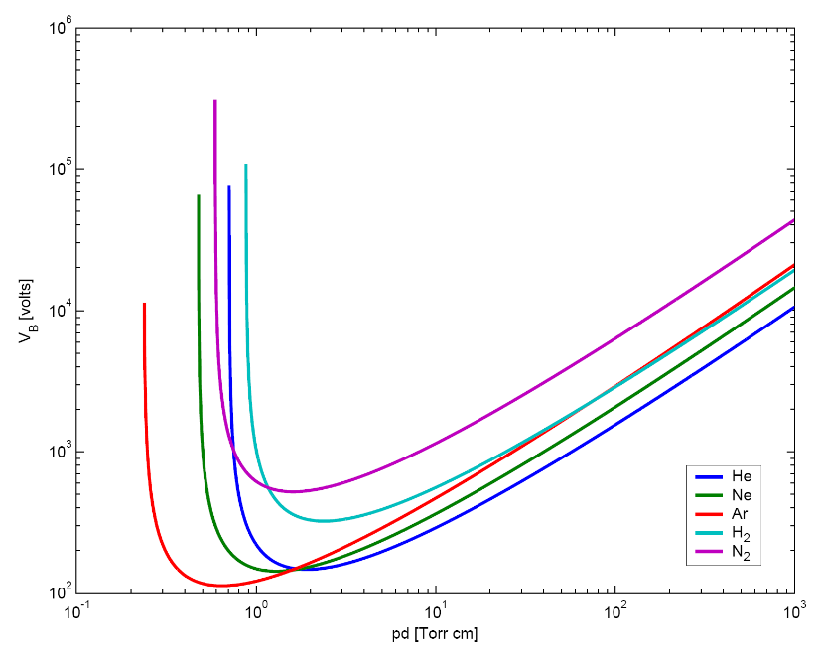
We never found clear data for gas mixtures out of Air !
Only Some “Maximum voltages” based on large
statistics are now known :
-ATLAS NSW Floating MM 128um:
Ar/Co2 97/3 → 590 to 600V
Ar → 470 to 480 V
Air → 980 to 1000V
“Nominal voltage” based on these “maximum voltage”:
ATLAS NSW Floating MM 128um:
Ar/Co2 93/3 → 560 to 570 V
Only pure gases are known
Example: Wikipedia plot
even these curves are not fully showing reality

Slide 9
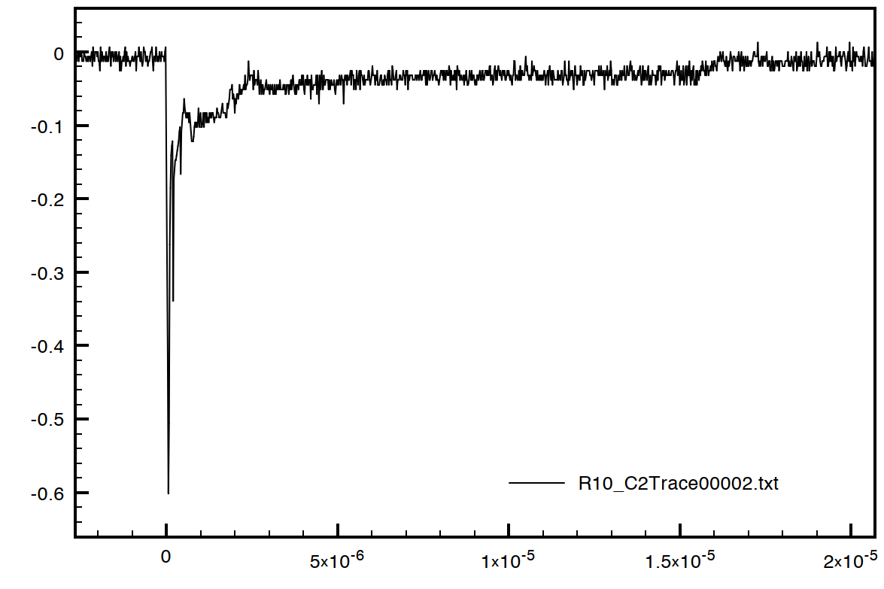
“Normal breakdown ” Vs “Abnormal breakdown”
-A “normal breakdown” is a breakdown linked to a large ionizing event, it only lasts 10 to 20 uS.
Really fast peak followed by R/C local voltage restore.
-The induced current peak is invisible on the power supplies. The duration is too small.
-The energy released during the breakdown is really low . Hard to find any deterioration due to the charges physical impact.
Peak voltage on 50 Ohms
12mA peak current
RD51 Freiburg 2010
-The breakdown is not repetitive because the necessary conditions to create a new breakdown disappear with the event
20uS
-For the user, nothing happens. The breakdown is invisible. In normal operation, only this type of breakdown should occur.

Slide 10
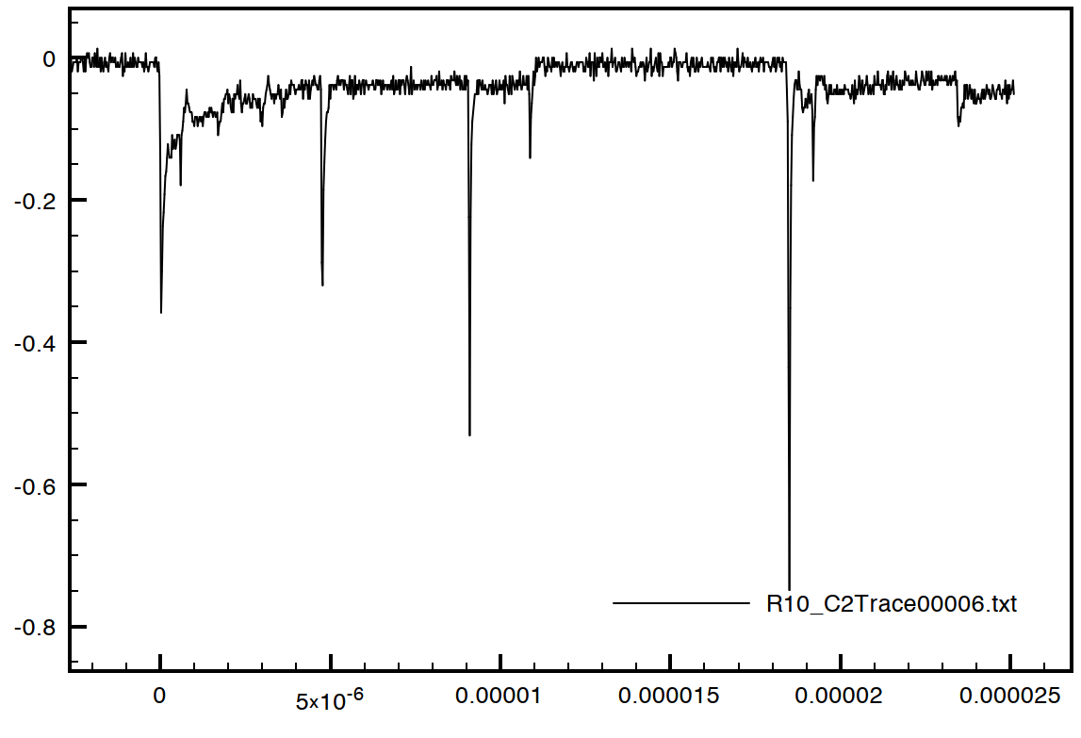
Abnormal breakdown
-An “abnormal breakdown” is a “normal breakdown” which is repeated at High frequency (100Khz) . Humidity , dust or a non appropriate working voltage can trigger this effect.
-The average current becomes significant and visible by the power supplies.
-The energy released locally is important, it induces a significant rise in temperature by Joule effect. This increase of temperature can burn the materials.
-The breakdown is repetitive because the conditions to create a new one are still present (dust or over-voltage).
25uS
-In case of dust, the detector will stop sparking when it has locally modified the shape of the dust by causing it to burn or evaporate. Evaporation cleans, burning damages. It looks like a random process , is it really the case? Are the short repetitions cleaning and long damaging?
-In case of over-voltage, no process can stop repetition, if maintained it will cause a permanent damage

Slide 11
Recent new observation
-The recent introduction of Isobutane has brought many advantages to the operation of the detectors
-On the other hand, in a few isolated cases , some medium quality detector did not develop as usual.
-With air or Ar/Co2 Mix, a detector presenting a problem (defect or dust) always show growing instabilities (abnormal discharges) clearly visible when the voltage is increased, and if we insist the detector may improve or deteriorate.
-This process is not sudden, the detector always gives great signs of instability before creating a permanent resistive connection. One can also observe that before creating a permanent resistive connection , the time duration and the number of the “abnormal discharges” increases.
-With Isobutane, some detectors have shown permanent connections, a priori sudden and without the signs as in air or Ar/Co2 .
-In fact the signs were there but much weaker. They nevertheless remain visible on the power supplies → still due to “abnormal discharges” .

Slide 12
All these observation are triggering a lot of question?
And this will be my conclusion
-Why is it easier to create resistive compounds with Isobutane during abnormal discharges?
-Why these resistive compounds are more difficult to be produced with CO2?
-What would happen with an inert gas (Ar or Ne)?
-Are these compounds related to the gas or the material of the detector? ☺
-Does a short repetition abnormal discharge (low energy release) evaporate materials and therefore clean the detector?
-Can we adjust the energy of an abnormal discharge by limiting the repetitions with the power supply?
-Can we make such power supply? Are they already existing?
-Can we clean a detector using the low energy abnormal discharges in an inert gas? ☺
-Can we clean a detector adjusting the energy of abnormal discharges during operation with any gas?
-What will be the impact of banning long abnormal discharges (high energy release) in real detector operation?

Slide 13
Thank you

