Slide 1
RD51 – NEWs from RD51- MB
Date of next collaboration meetings
  14 – 18 June 2021
  In the context of the Conference MPGD2021: 14-19 November 2021, Rehovot, Israel

Slide 2
RD51 – NEWs from RD51- MB
ECFA process: Detector R&D road-map
  Included in the decisions at the end of of the EPPSU process

Slide 3
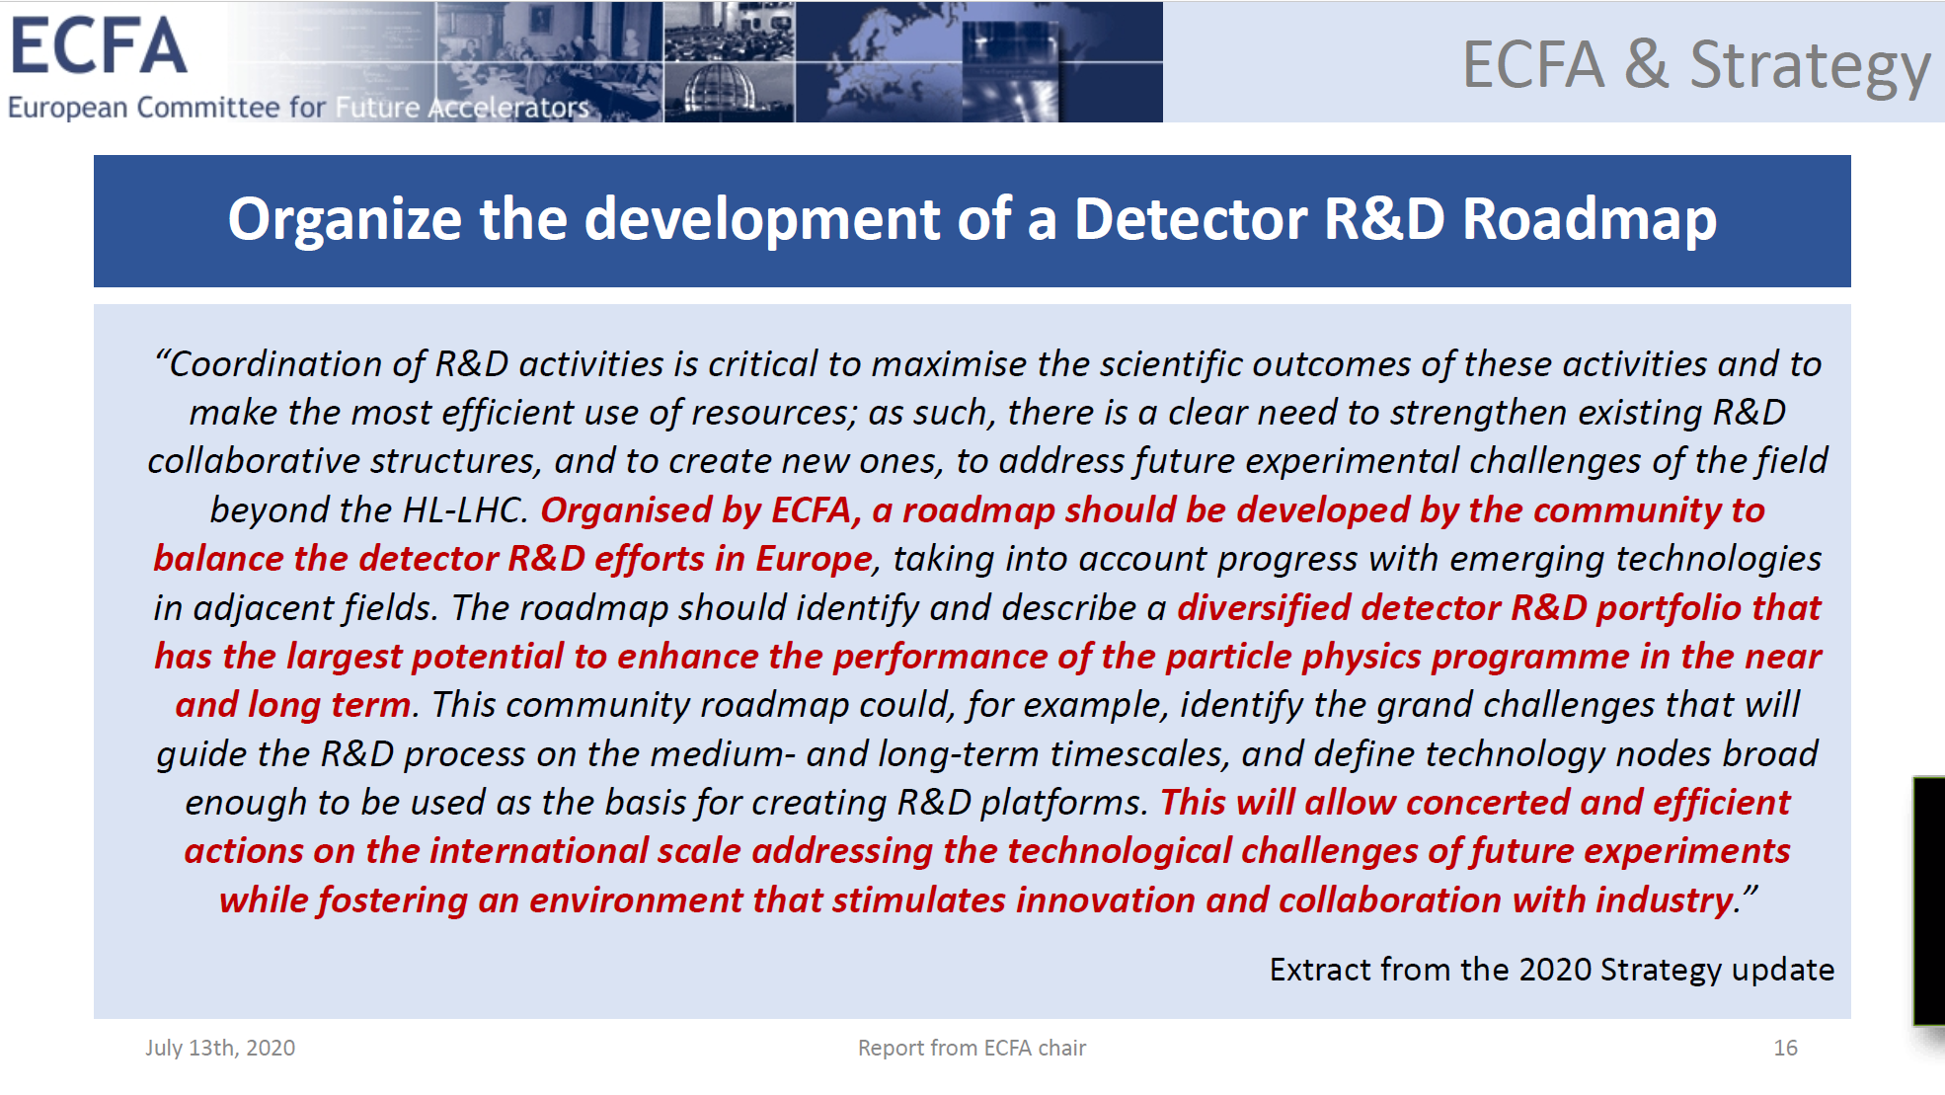

Slide 4
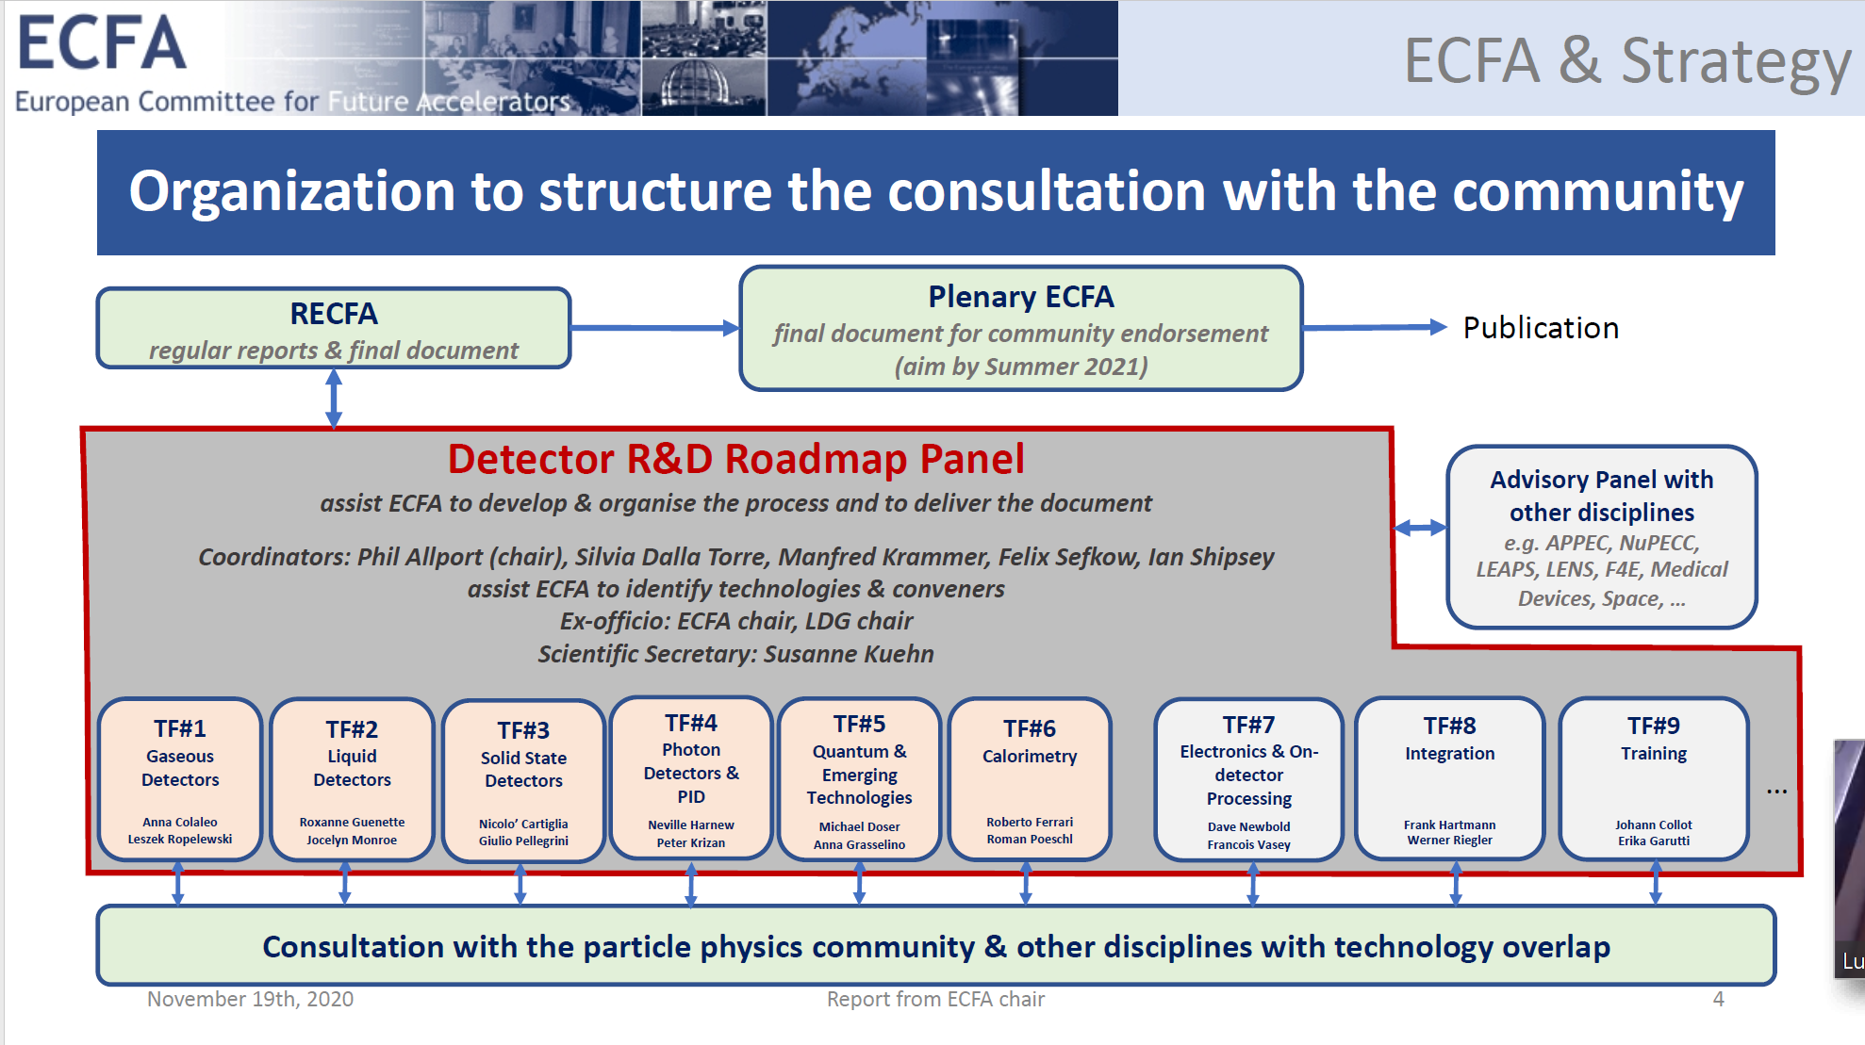

Slide 5
RD51 – NEWs from RD51- MB
ECFA process: Detector R&D road-map
  TF1
    Conveners:
      Anna Colaleo
      Leszek Ropolewsky
    Members:
      Klaus Dehmelt
      Laura Fabietti
      Barbara Liberti
      Joao Veloso

Slide 6
RD51 – NEWs from RD51- MB
ECFA process: Detector R&D road-map
  Timelines
    Pannnel established in second half 2020
    TF preparing symposia
    Symposia in period March-May
      TF1- GASEOUS DETECTORS on TF1: Thursday 29/4/2021
    Report drafting : starting in May
    30 July 2021: Presentation at Joint ECFA-EPS session
    Oct 2021: Detector R&D Roadmap Document submission to RECFA

Slide 7
RD51 – NEWs from RD51- MB
ECFA process: Detector R&D road-map
  Take-away messages
    Soon the agenda of the TF1 symposium will become public
    Let have YOUR input to the invited speakers
    Attend the symposium and contribute to the discussions
The roadmap process is meaningful
if it can collect the input from the whole community !

