Slide 1
Pulsed DC System Update
07/01/2021

Slide 2
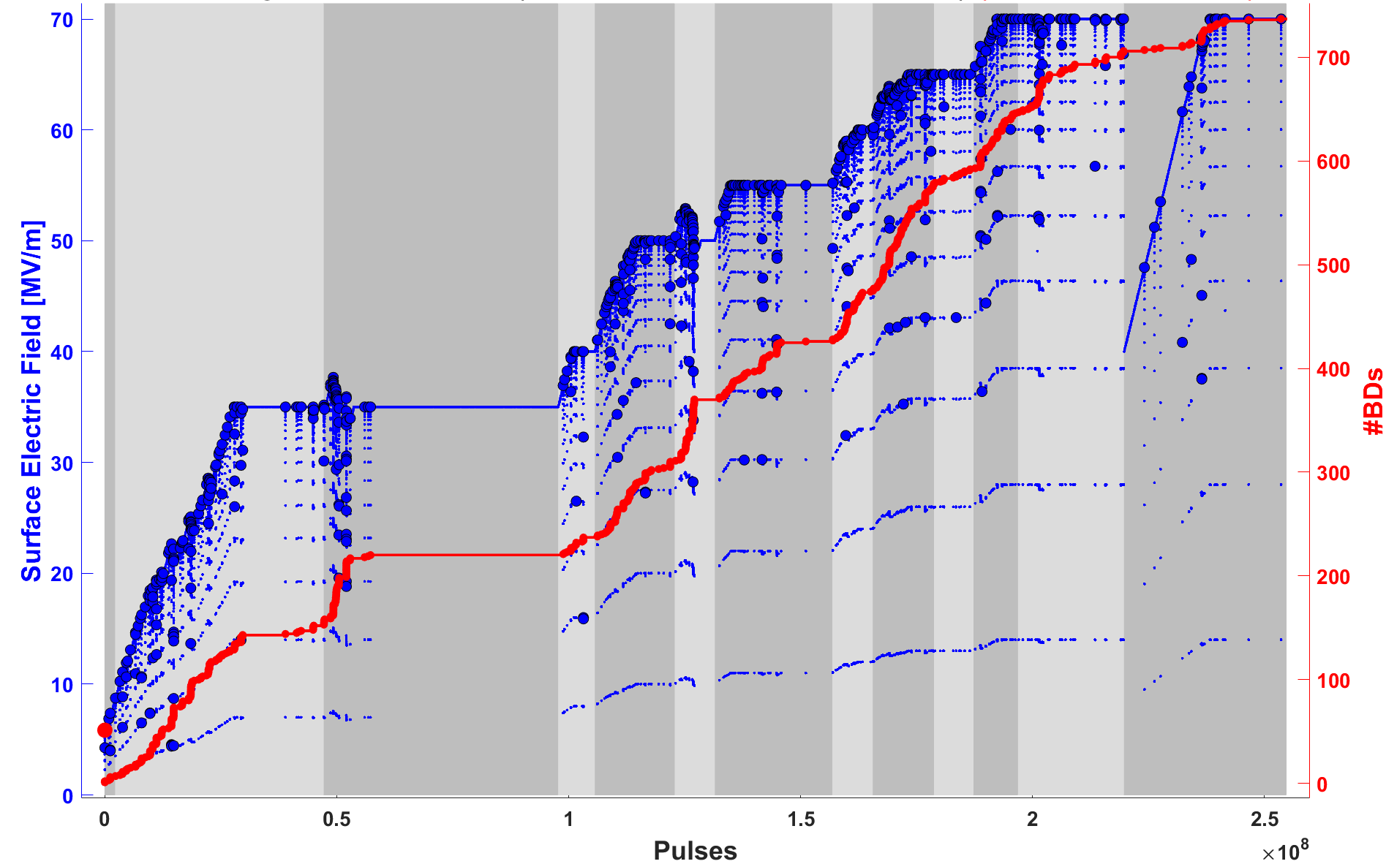
Irradiated Electrode Conditioning

Slide 3
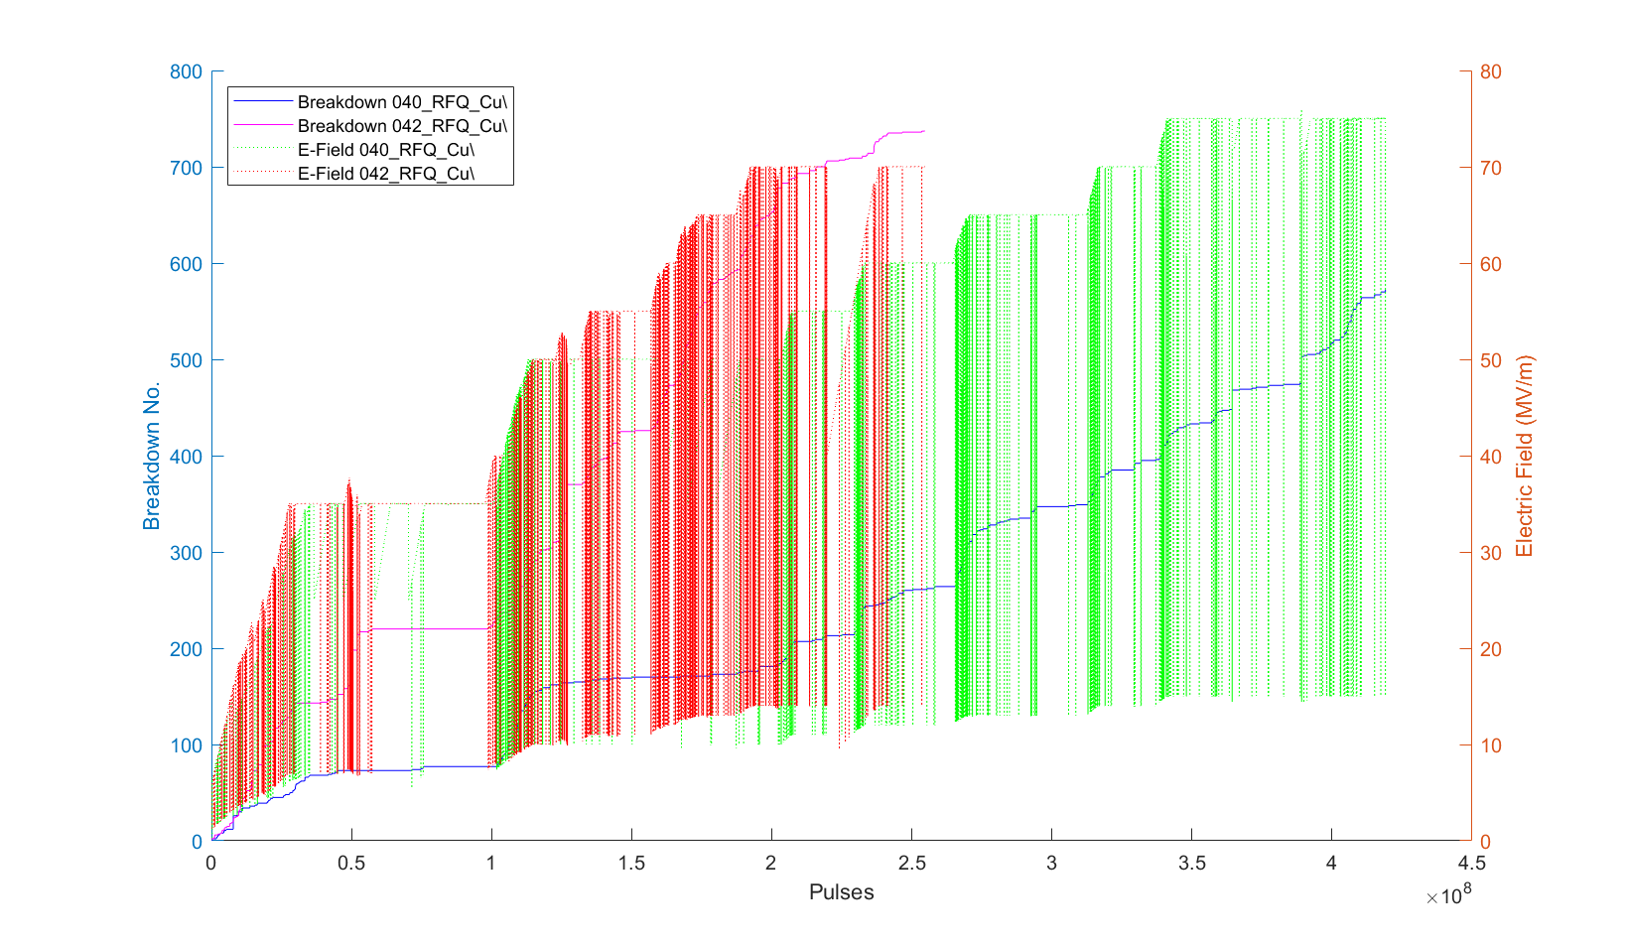
Conditioning of Irradiated and non Irradiated

Slide 4
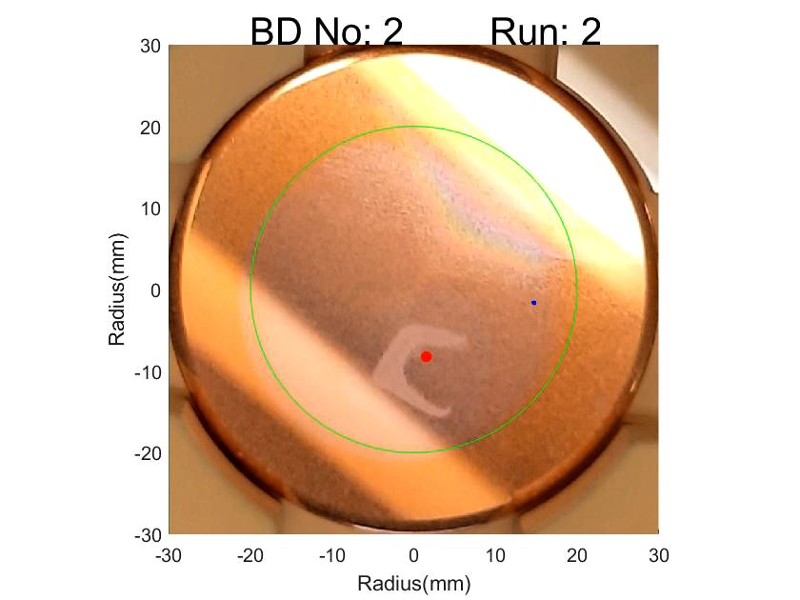
Breakdown Locations Irradiated Electrode

