Slide 1
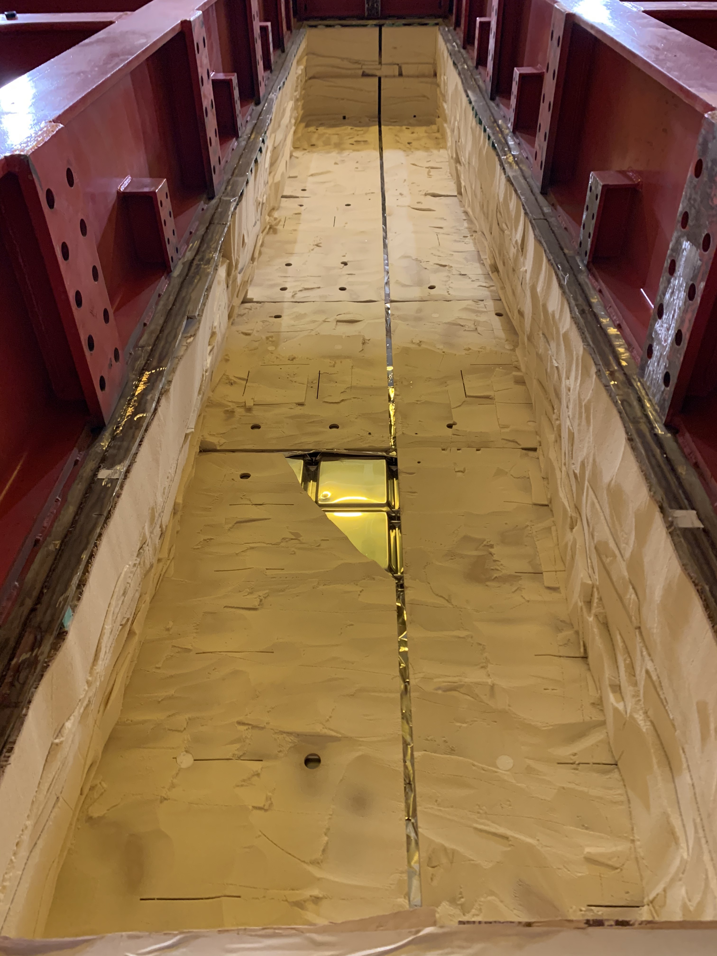
TCO opening
Still to be done:
Remove: last plywood layer and the primary membrane
Cover the lateral sides of the TCO to protect the cryostat insulation
Plan:
Work will resume on February 8th (COVID-19 restriction)
TCO fully removed by ~ middle of February: access from clean-room
4 technicians available to work on the TCO and the detector’s removal
Removal coordinated by Daniela and Bill (daily meetings)
No activities related to the new detectors until the decommissioning is over and the clean room is “clean” and fully operational again (probably ~ April 15th)
Consortia experts welcome for the tests of the removed detectors and for preparation for storage and/or shipping

Slide 2
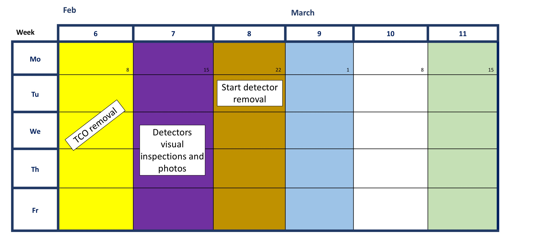
Tentative plan
From now until ~ February 15th:
Get all necessary information from the consortia
Make a list of all tools present at CERN
Finalize the decommissioning procedures
Prepare the documentation for the safety assessment to be approved by CERN Safety
Inspection through manholes if required
Remove external parts on top of the cryostat
Re-install the rail system in the clean room

Slide 3
Visual check with photos and inspections
  APA
  Connections at the top and bottom of the APAs, relative positions, cable strain relief, cold cables etc
  APA with bias voltage connection problem: document the cable connection of the grid plane bias cable on APA3 before removal
  Probe and document the resistivity of the shorted electron diverter channel before APA removal. This could possibly be done now on top of the cryostat on the corresponding CE feedthrough.
  Cold and warm electronics
  FEMB with issues to be inspected and then sent back to BNL (needed list and instruction on how to remove them)
  All 6 flanges + warm electronics crates to be inspected and sent back to BNL
  HV
  Perform a high resolution video scan of the EWFC surface on the upper half of the upstream EWFC near the beam plug to see if there are any unusual features that could have caused the streamers.
  Perform visual and high resolution video scan of the upstream top left (and right) FC modules , where most of the streamers were taking place
  Inspect the failed FC termination cable connection (BL-US-EW, BL-UP-TOP)
When to do the visual checks and inspections of the internal parts?
Some top parts could be reached from a scissor lift placed outside the TCO
The remaining top parts will have to wait until we can place a scaffolding inside the cryostat

Slide 4
Tests
APA-7 in the cold box
  Do we need additional tests?
Wire tension / relaxation. Same test as in 2017-18
  2 APA (high tension and low tension), if not possible at least one.
  work to be done outside the cryostat
  One should be kept for future reference (i.e. wire tension evolution (CERN or Daresbury?))
APA Dead, flaky, noisy channel
  Problem between the end of the wire and the input of the CE
CPA Panels in the cold box
  Cold test CPA panels in the cold box to evaluate deformation in the cold (NP04 data have shown evidence of misalignment between CPA columns in the cold. We need to develop a procedure to move the problematic pairs of the CPA columns into the cold box to verify and quantify the deformation).
  A second test is preferred with added alignment pins installed.

Slide 5
List of parts to be saved or discarded
APAs: keep at least one for future reference (remaining ones kept as a historic pieces?)
Cold and warm electronics: sent back to BNL (what to do with internal cables??)
HV: got detailed list of what to save and what to discard (including beam plug)
CALCI: save all instrumentation as in principle it can be re-used (send all purity monitor back for improvements)
PD: 2 ARAPUCAs, (fiber for diffusers, electronics, feedthroughs ???)
External cables should be removed or kept???
…….

Slide 6
Procedures
Need written detailed procedures for the removal of the various parts especially if it cannot be done by the detector experts…

