Slide 1
RF systems for muon cooling discussion on possible activities and directions
Alexej Grudiev
11/12/2020

Slide 2
Possible activities and directions
Collect parameters for all RF cavities. Complete table together with Muon cooling WG (Chris):
  Voltage, frequency, length, gradient, beam aperture/window, …
Practical design of some cavities at different frequencies, dimensions, etc to have a concept for all possible cavities covering the table above
  Starting point MICE 200 MHz cavity
  RF parameters, RF power and cooling requirements, …
  Gas-filled versus vacuum cavities, High magnetic field
Improvement of the current concept (MICE 200 MHz cavity) to achieve highest gradient in realistic cavity
  Materials (Cu, Be, Al …, Hard Cu ?)
  Operation at Cryogenic temperatures: ~70K:
Assessment of impact of higher (than 25 MV/m) gradient on cavity design, facility layout, power consumption, efficiency, …
Design, construction and testing of prototype cavities
Design and construction of a test stand
…

Slide 3
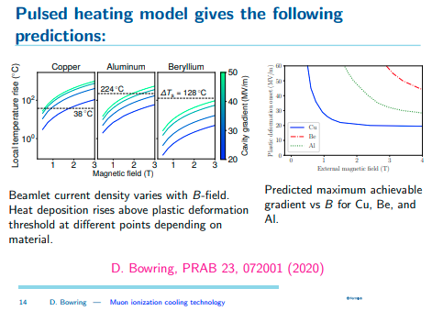
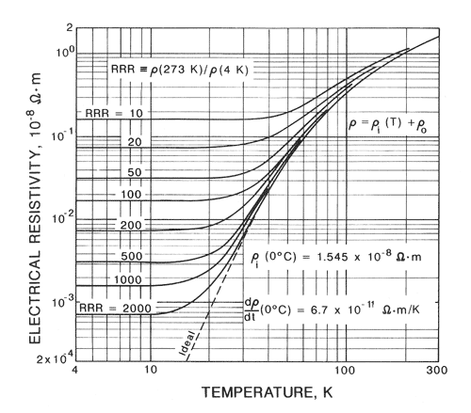
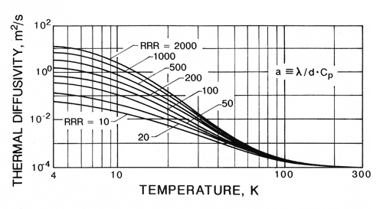
Possible advantages of operation at cryogenic temperatures
Operation at Cryogenic temperatures: ~70K. Improves electrical, thermal and mechanical properties of Cu and other materials
  Reduction of RF losses, increase of Q0, less RF power needed
  Better mechanical properties: Increase in fatigue strength, higher gradient
  Increase of thermal conductivity, more efficient cooling system, higher
  gradient
  …

Slide 4
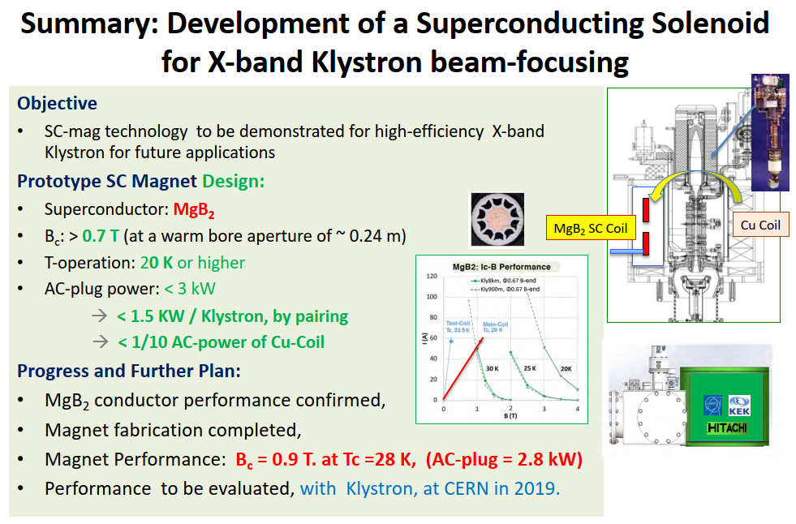
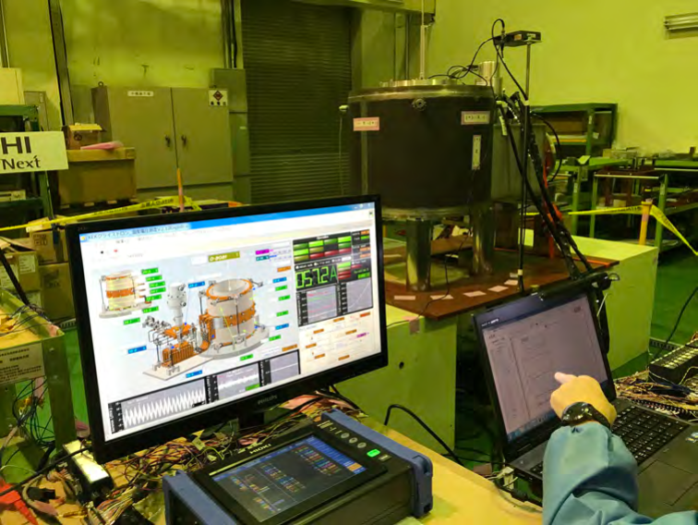
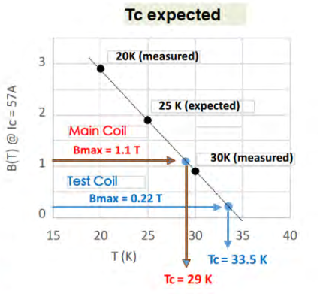
ARIES Workshop on Energy Efficient RF (18-20 June 2019) · (Indico) (uu.se)

