Slide 1

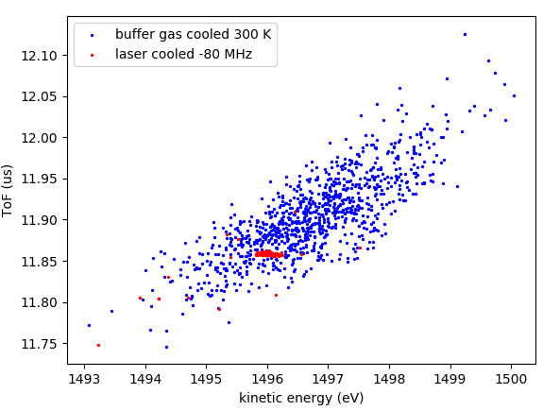
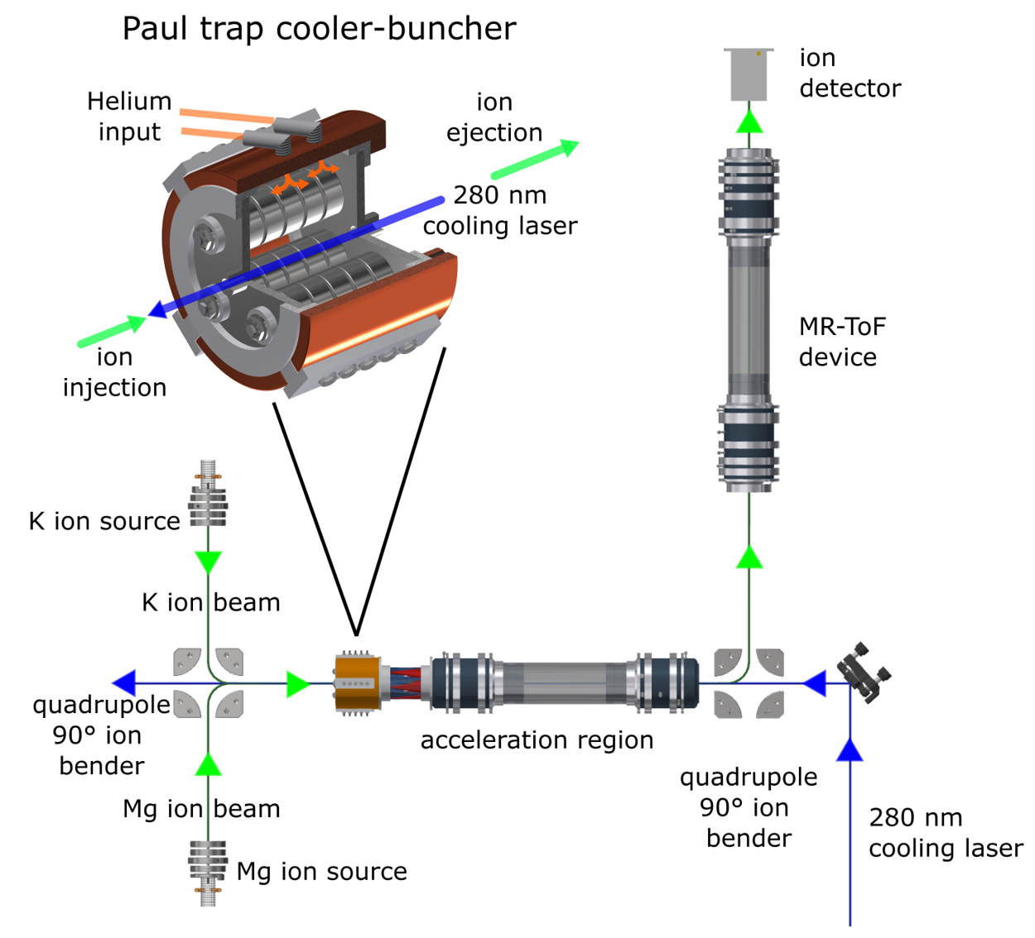

Doppler- and sympathetic cooling for the investigation of short-lived radionuclides
Paul trap:
Buffer-gas cooled
Doppler cooled
ToF (μs)
simulation
S.Sels, F.Maier et al. Doppler- and sympathetic ion cooling for the investigation of short-lived radionuclides. Accepted in Phys. Rev. Research, 2022.
Kinetic energy (eV)
Franziska Maier
CERN PhD Student

Slide 2
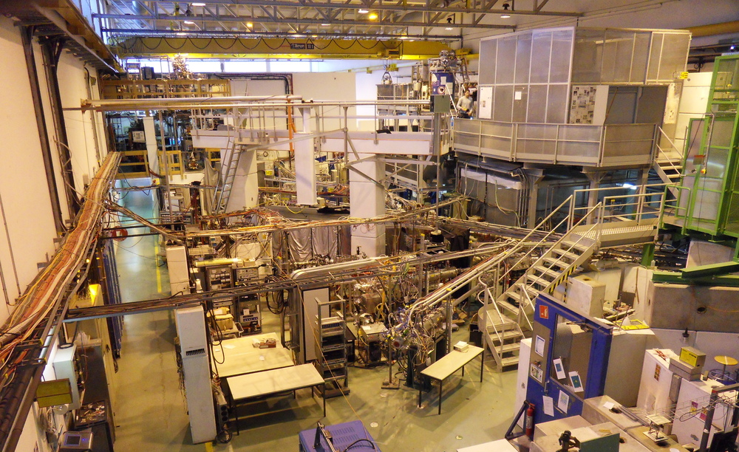
Radioactive Ion Beam Facilities
Production@ISOLDE:
  ~1000 different isotopes
  ~75 different elements
  Half-life: 1 ms – stable
Mass separation, cooling and bunching
Mass Spectrometry
Laser Spectroscopy
…
Nuclear ground state properties:
binding energies
mass
nuclear moments
spin
charge radii
…
Benchmark for modern nuclear theory

Slide 3

Radioactive Ion Beam Facilities
Production@ISOLDE:
  ~1000 different isotopes
  ~75 different elements
  Half-life: 1 ms – stable
Mass separation, cooling and bunching
Mass Spectrometry
Laser Spectroscopy
…
Nuclear ground state properties:
binding energies
mass
nuclear moments
spin
charge radii
…
Benchmark for modern nuclear theory

Slide 4
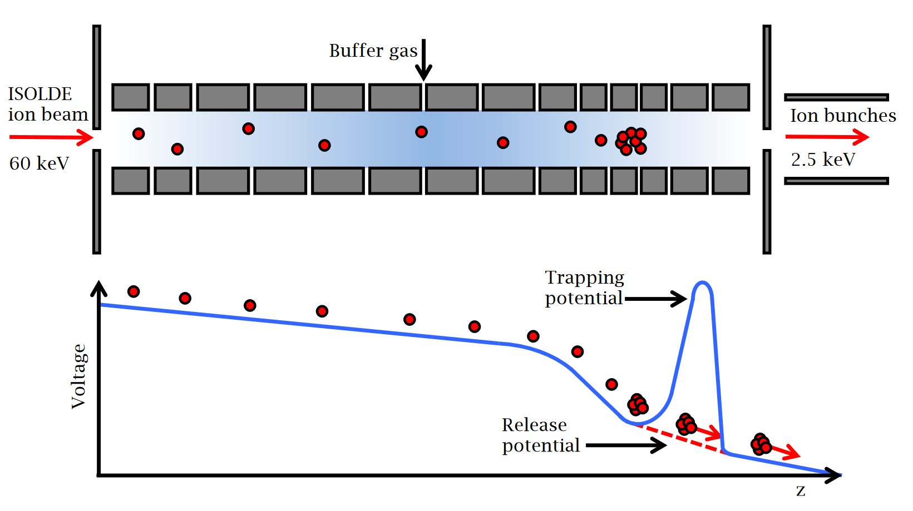
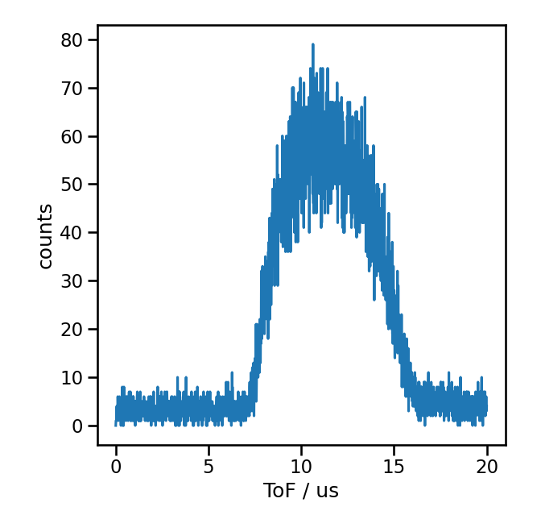
Buffer-gas filled Paul traps
Commonly operated at 300-K buffer gas → Cooling limit: 300 K
[2]
~7 eV
[1]
[1] K. Lynch, PhD thesis, University of Manchester, 2013.
[2] Sb run COLLAPS, 2018.

Slide 5
Doppler Cooling
Buffer-gas cooling (limit: 300 K)
Doppler cooling (limit: 1 mK)
ToF (μs)
simulation
Kinetic energy (eV)

Slide 6
Doppler Cooling at RIB Facilities
Specific applications with RIBs [1]
unexplored as cooling technique to deliver high quality RIBs
External ion source
Downstream experiments
‘hot’ ions with at least 7eV
300 K (up to now)
< 6 K (this work)
< 1 mK (limit)
[1]
G. D. Sprouse and L. A. Orozco, Annu. Rev. Nucl. Part. Sci.. 47, 429 (1997)
J. A. Behr et al., Phys. Rev. Lett. 79, 375 (1997).
M. Trinczek et al., Phys. Rev. Lett. 90, 012501 (2003).
L. B. Wang et al., Phys. Rev. Lett. 93, 142501 (2004).
P. Mueller et al., Phys. Rev. Lett. 99, 252501 (2007).
P. A. Vetter et al., Phys. Rev. C 77, 035502 (2008).
J. R. A. Pitcairn et al., RRC 79, 015501 (2009)
A. Takamine et al., Phys. Rev. Lett. 112, 162502 (2014)
B. Fenker et al., Phys. Rev. Lett. 120, 062502 (2018)

Slide 7
Doppler Cooling at RIB Facilities
Specific applications with RIBs [1]
unexplored as cooling technique to deliver high quality RIBs
External ion source
Downstream experiments
‘hot’ ions with at least 7eV
300 K (up to now)
< 6 K (this work)
< 1 mK (limit)
This work: Demonstration that laser cooling is
  ... compatible with T_{1/2}
  ... compatible with existing instrumentation at RIB facilities
  ... universally applicable (via sympathetic cooling)
  ... improving precision and/or sensitivity of various experimental RIB techniques
[1]
G. D. Sprouse and L. A. Orozco, Annu. Rev. Nucl. Part. Sci.. 47, 429 (1997)
J. A. Behr et al., Phys. Rev. Lett. 79, 375 (1997).
M. Trinczek et al., Phys. Rev. Lett. 90, 012501 (2003).
L. B. Wang et al., Phys. Rev. Lett. 93, 142501 (2004).
P. Mueller et al., Phys. Rev. Lett. 99, 252501 (2007).
P. A. Vetter et al., Phys. Rev. C 77, 035502 (2008).
J. R. A. Pitcairn et al., RRC 79, 015501 (2009)
A. Takamine et al., Phys. Rev. Lett. 112, 162502 (2014)
B. Fenker et al., Phys. Rev. Lett. 120, 062502 (2018)

Slide 8
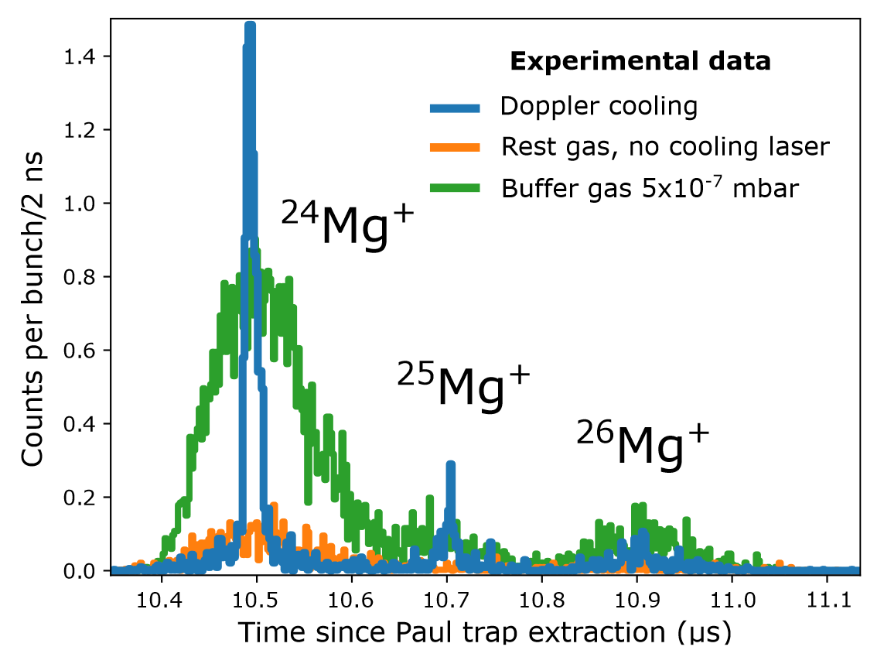
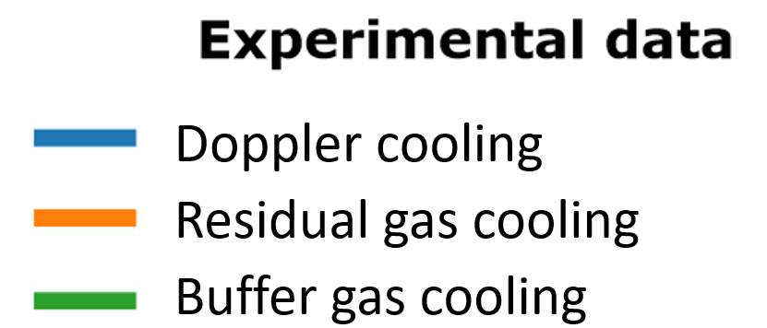
Experimental results
Doppler cooling
Residual gas cooling
Buffer gas cooling
FWHM x10 better
Cooling limit < 6 K

Slide 9
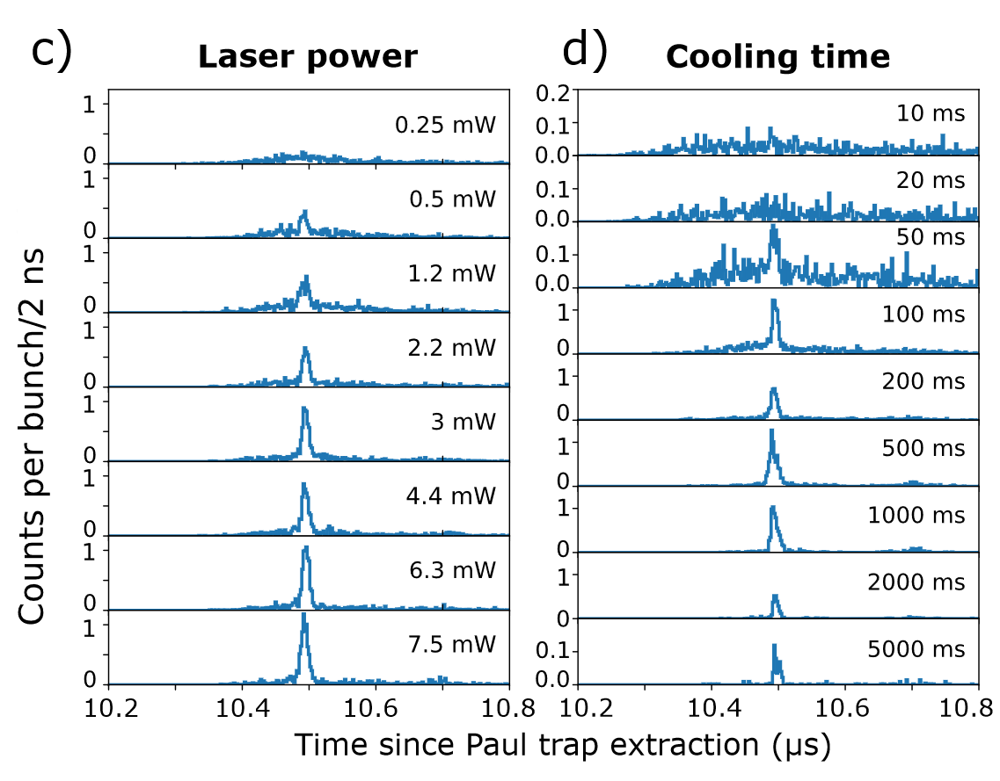
Needed cooling time is compatible with T_{1/2}.
Experiment:
1e-5 to 1e-8 mbar residual gas present within Paul trap
cooling time ≈ 100 ms
3 mW & -200 MHz detuning, varying cooling times:

Slide 10
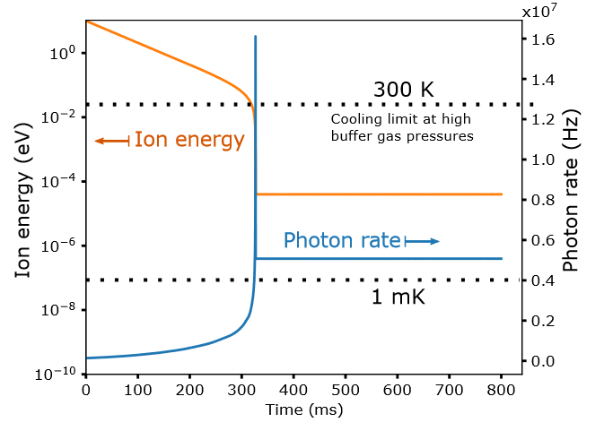
Needed cooling time is compatible with T_{1/2}.
Experiment:
1e-5 to 1e-8 mbar residual gas present within Paul trap
cooling time ≈ 100 ms
Simulations + numerical model:
3 mW & -200 MHz detuning, varying cooling times:
Ion energy (eV)
Photon rate (Hz)
0.5 K
Buffer-gas cooling, 1e-5 mbar
Doppler cooling

Slide 11
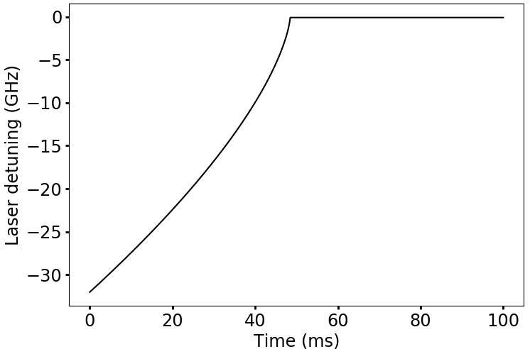
Needed cooling time is compatible with T_{1/2}.
Experiment:
  1e-5 to 1e-8 mbar buffer gas present within Paul trap
  cooling time ≈ 100 ms (T < 6 K)
Numerical model:
  No buffer gas present (T ≈ 1 mK)
    Fixed laser frequency: cooling time > 100 s
    Laser frequency matching to ions’ velocity distribution: cooling time < 50 ms
Optimal laser-frequency detuning for cooling down a 10-eV Mg⁺ ion in absence of a buffer gas

Slide 12
Needed cooling time is compatible with T_{1/2}.
Experiment:
  1e-5 to 1e-8 mbar buffer gas present within Paul trap
  cooling time ≈ 100 ms (T < 6 K)
Numerical model:
  No buffer gas present (T ≈ 1 mK)
    Fixed laser frequency: cooling time > 100 s
    Laser frequency matching to ions’ velocity distribution: cooling time < 50 ms
  1e-5 mbar buffer gas present: (T ≈ 0.5 K)
    Fixed laser frequency: cooling time ≈ 300 ms
Presence of buffer gas speeds up the cooling, but limits achievable temperature.
Optimal setup: multi-stage Paul trap
Optimal laser-frequency detuning for cooling down a 10-eV Mg⁺ ion in absence of a buffer gas

Slide 13
Sympathetic cooling
… extends the availability of cold ion ensembles to ionic systems which cannot be directly laser-cooled.

Slide 14
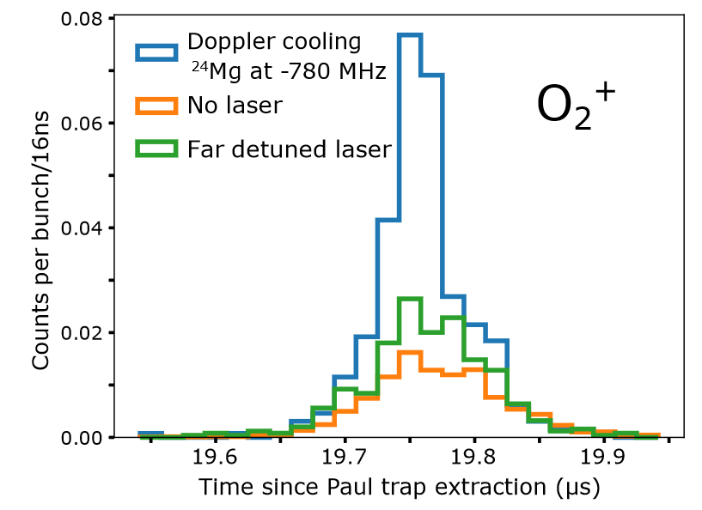
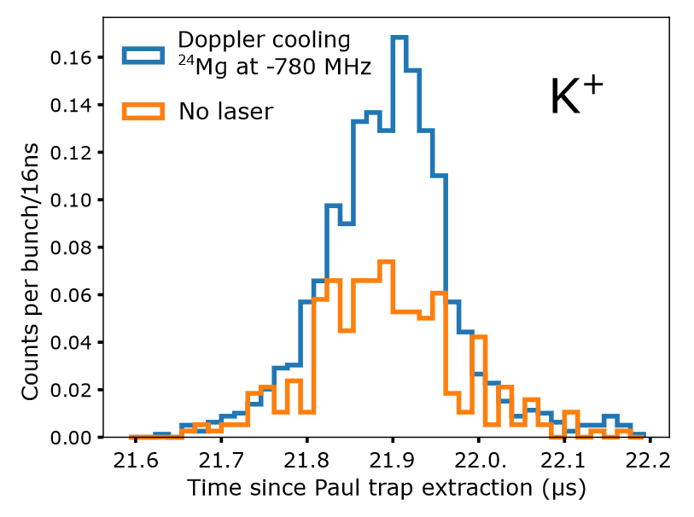
Sympathetic cooling
… extends the availability of cold ion ensembles to ionic systems which cannot be directly laser-cooled.
 | O₂⁺ | K⁺
Peak width residual-gas or buffer-gas cooling | 113(5) ns | 180(13) ns
Sympathetic cooling | 58(4) ns | 145(5) ns
Improvement in countrate | Factor 2.6 | Factor 2
Can be done better analogous to existing work, e.g. [1],[2].
[1] J. Wuebbena et al, Phys. Rev. A 85, 043412,2012.
[2] M. Guggemos. New Journal of Physics 17, 103001, 2015.

Slide 15
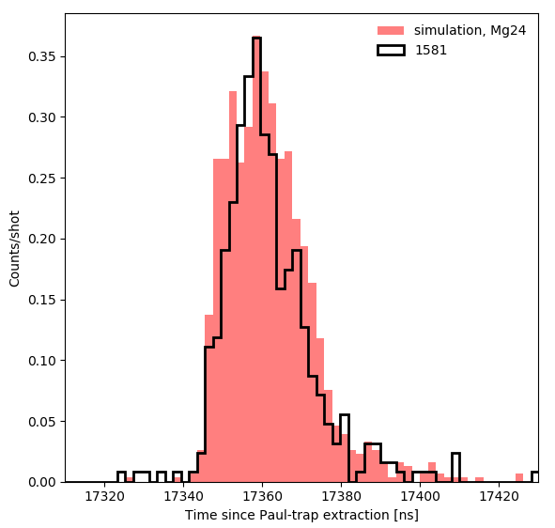
Doppler cooling allows simultaneously small Dt & DE.
Doppler cooling:
²⁴Mg⁺
experiment
simulation
counts
Time since Paul trap extraction (ns)

Slide 16
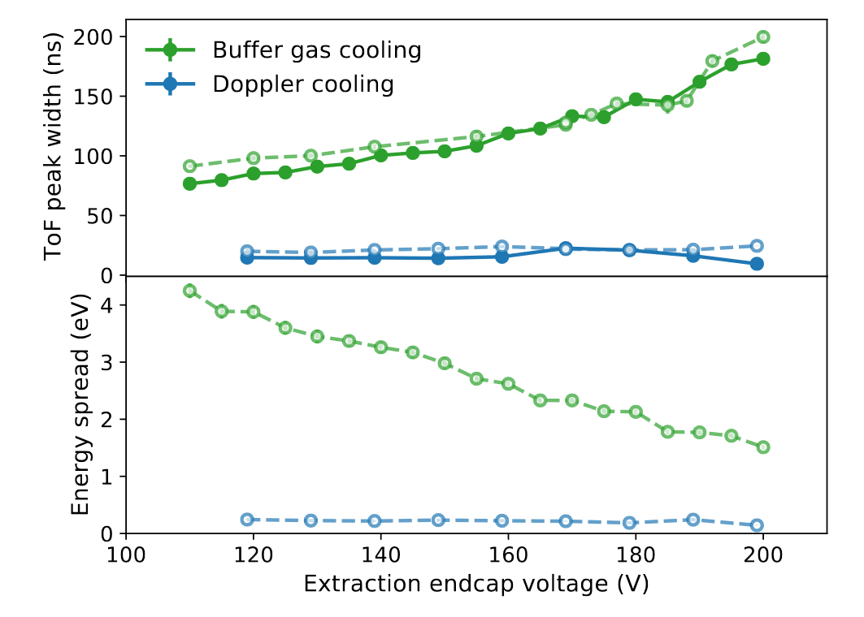
Doppler cooling allows simultaneously small Dt & DE.
Doppler cooling:
simulation & experiment
²⁴Mg⁺
experiment
simulation
counts
simulation
Time since Paul trap extraction (ns)

Slide 17
Doppler cooling allows simultaneously small Dt & DE.
Doppler cooling:
simulation & experiment
²⁴Mg⁺
experiment
simulation
counts
simulation
Time since Paul trap extraction (ns)
  → Improvements in precision and/or sensitivity for various experimental techniques such as collinear laser spectroscopy or mass spectrometry

Slide 18
Applications at RIB facilities
  Improved mass resolution in MR-ToF devices
  Increased precision for mass measurements in Penning traps
  Increased sensitivity for collinear laser spectroscopy
  Cooling option for radioactive molecules for fundamental physics research
  Preparation step for high precision laser spectroscopy (king plot non-linearities)

Slide 19
Applications at RIB facilities
  Improved mass resolution in MR-ToF devices
  Increased precision for mass measurements in Penning traps
  Increased sensitivity for collinear laser spectroscopy
  Cooling option for radioactive molecules for fundamental physics research
  Preparation step for high precision laser spectroscopy (king plot non-linearities)
New publication: S. Sels, F. Maier et al. Doppler- and sympathetic ion cooling for the investigation of short-lived radionuclides. Accepted in Phys. Rev. Research, 2022.

Slide 20
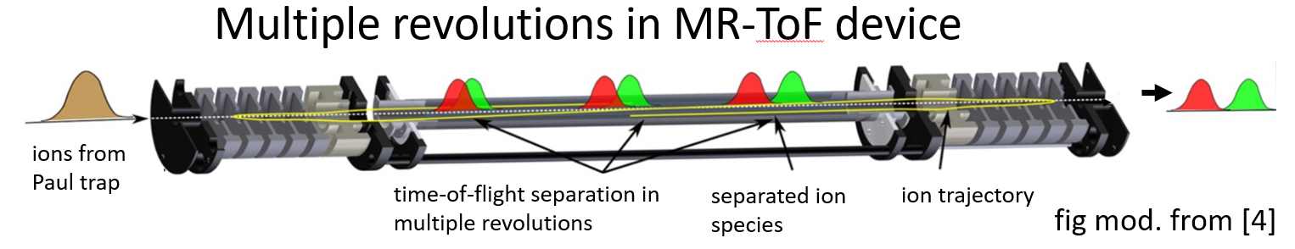
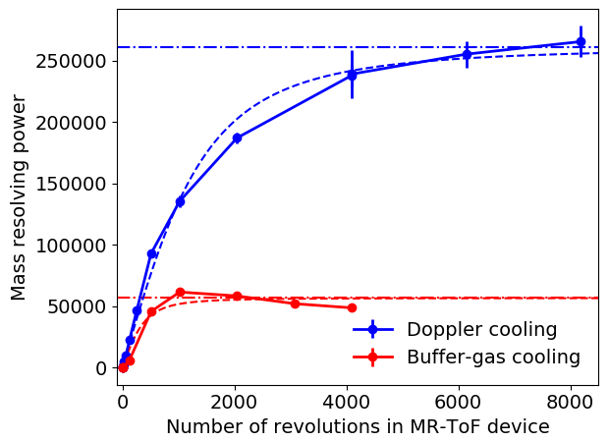
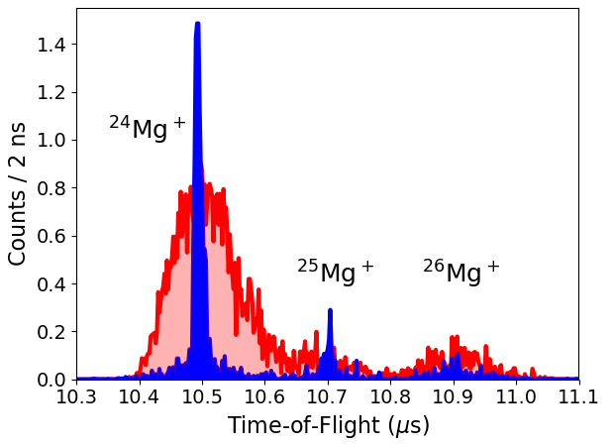


Improved R in MR-ToF devices
Fig. mod. from R.N. Wolf et al. Int. J. Mass Spectrom., 349-350:123 – 133 (2013).
$$R=\frac{m}{Δm}=\frac{t}{2Δt}$$
Factor 3.5 faster initial increase
x4.6

Slide 21
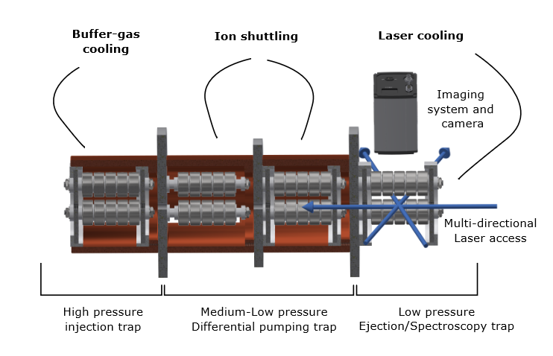
Summary & Outlook
Current setup:
Demonstration that laser cooling is
  ... compatible with T_{1/2}
  ... compatible with instrumentation at RIB facilities
  ... universally applicable (via sympathetic cooling)
  to deliver low-emittance beams
Envisioned applications at RIB facilities:
  Improved mass resolution in MR-ToF devices
  Increased precision for mass measurements in Penning traps
  Increased sensitivity for collinear laser spectroscopy
  Cooling option for radioactive molecules for fundamental physics research
  Preparation step for high precision laser spectroscopy (king plot non-linearities)
improved setup: multi-stage Paul trap:

Slide 22
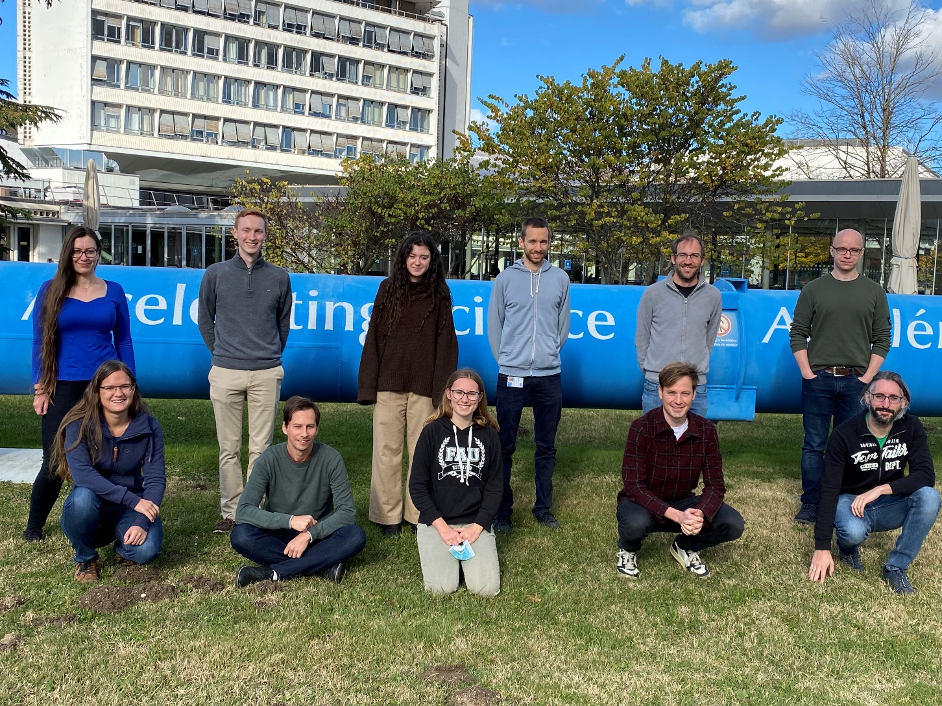
Thanks!
F. Maier, M. Au, P. Fischer, C. Kanitz, V. Lagaki,
S. Lechner, E. Leistenschneider, D. Leimbach,
E.M. Lykiardopoulou, A.A. Kwiatkowski, T. Manovitz, G. Neyens, P. Plattner, M. Rosenbusch, S. Rothe,
L. Schweikhard, S. Sels, M. Vilen, R. Wolf,
S. Malbrunot-Ettenauer
https://miracls.web.cern.ch/
New publication: S. Sels, F. Maier et al. Doppler- and sympathetic ion cooling for the investigation of short-lived radionuclides. Accepted in Phys. Rev. Research, 2022.

Slide 23
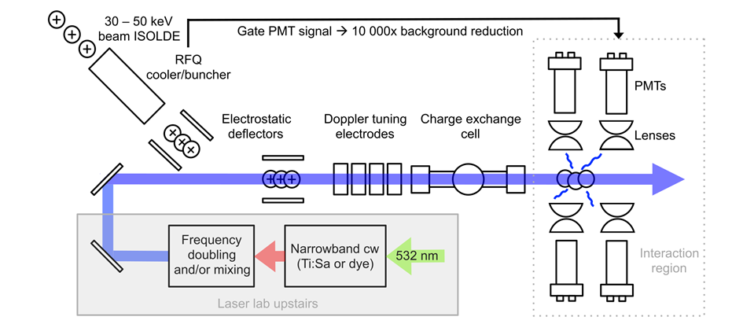
Increased sensitivity for CLS
smaller time spread while maintaining a low energy spread allows to choose narrower time gates:
  currently: time spread ≈ O(μs)
  laser cooling: ≈ O(ns)
  1000x better sensitivity for several smaller subsequent optical detection regions
improved transversal emittance if multi-directional laser access is possible
  maximizing ion-laser overlap, additional increase in sensitivity
Time gate
[2]
[1]
[1] COLLAPS collaboration webpage
[2] Sb run COLLAPS, 2018.

Slide 24
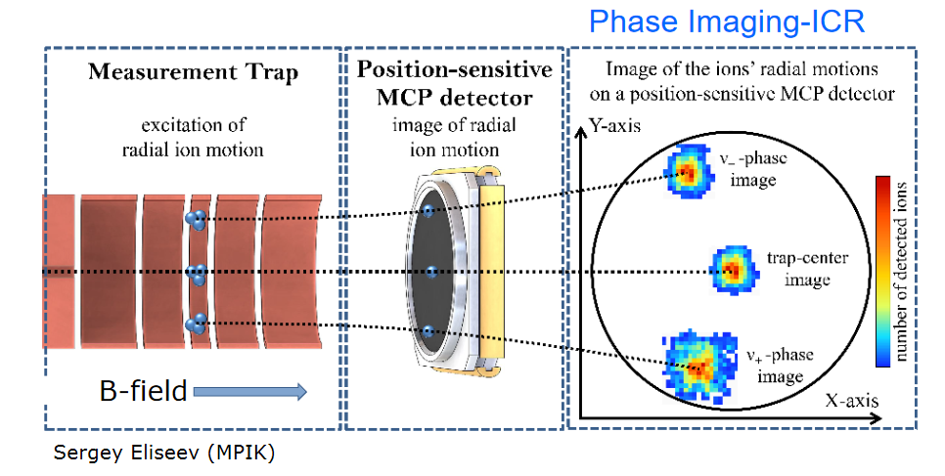
Increased precision in PI-ICR for Penning traps
measurement of cyclotron frequency of an ion confined in a strong and uniform magnetic field
Phase-Imaging Ion Cyclotron Resonance (PI-ICR) technique: measuring phase evolution of ion’s motion inside the Penning trap
ion is ejected from the trap onto a position-sensitive detector which enables to reconstruct phase of motion and hence its cyclotron frequency

Slide 25
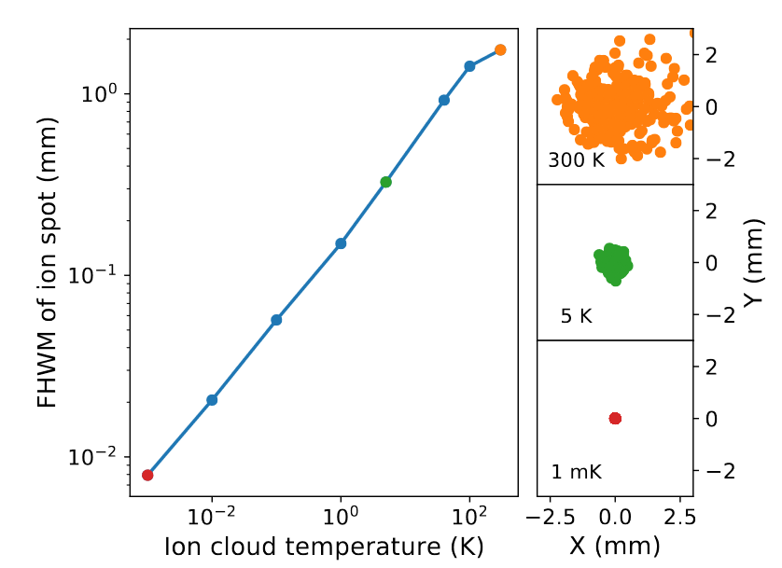
Increased precision in PI-ICR for Penning traps
R is directly proportional to spatial spread of ions hitting detector
spatial spread is proportional to square root of beam temperature
simulation procedure:
buffer gas cooling in Paul trap
ions injected into TITAN Penning trap and captured there until release to a detector
spatial spread reduced by factor 220 between 300 K and 1 mK ion cloud temperature

Slide 26
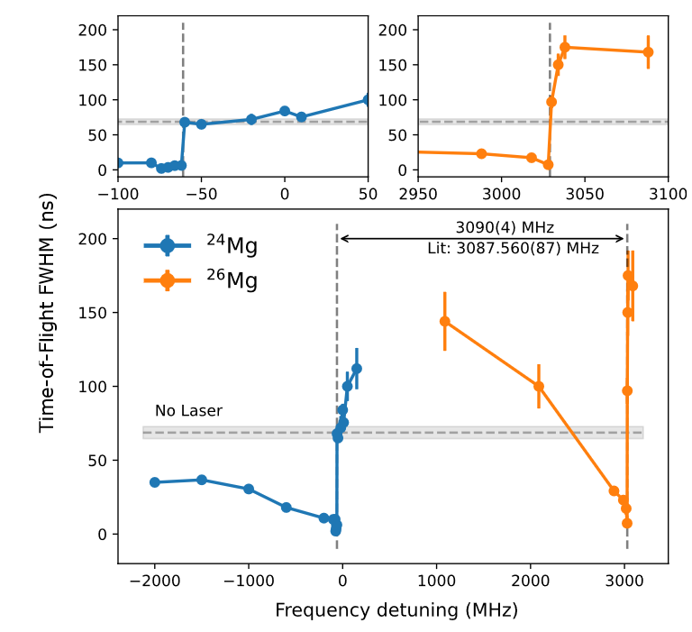
Isotope shift measurements
abrupt transition from cooling to heating can be used to determine isotope shift:
no photon detection or extra laser steps for photoionization required

Slide 27
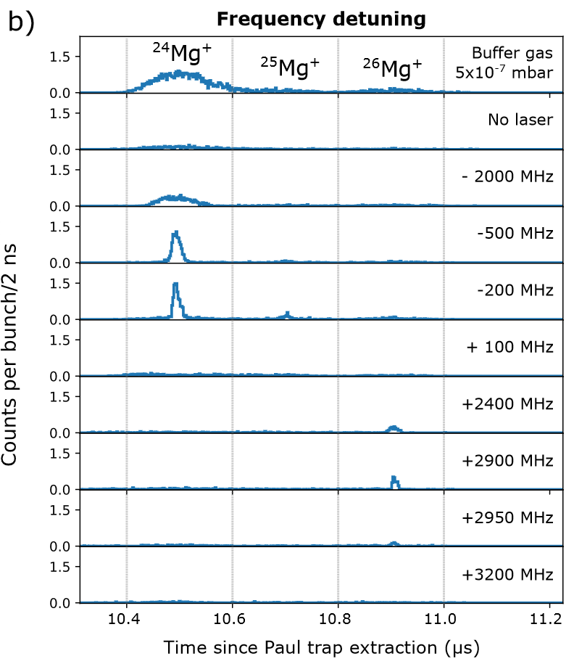
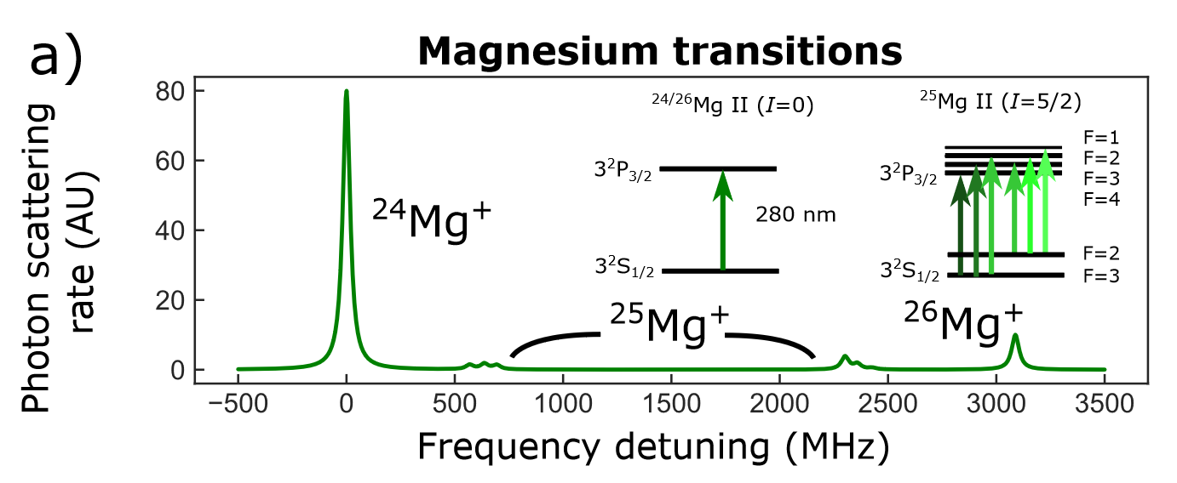
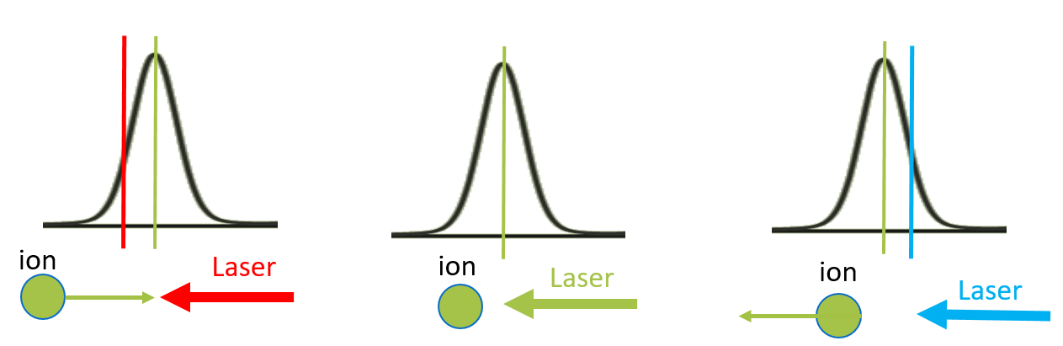
Cooling Systematics
cooling
cooling
cooling
heating
cooling
cooling
cooling
heating
3 mW & 500 ms cooling

Slide 28
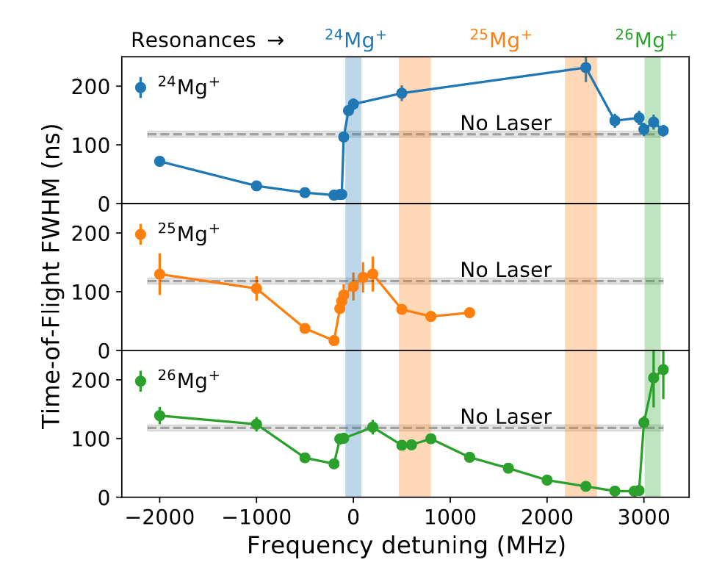
Cooling systematics

Slide 29
Cooling Systematics
200 ms cooling and -200 MHz detuning
3 mW & -200 MHz detuning

Slide 30
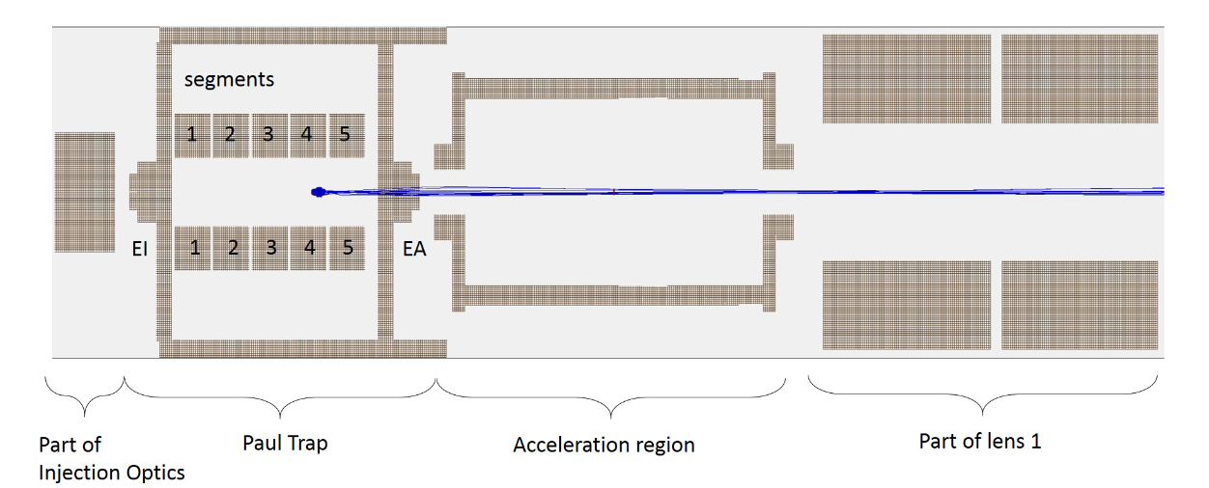
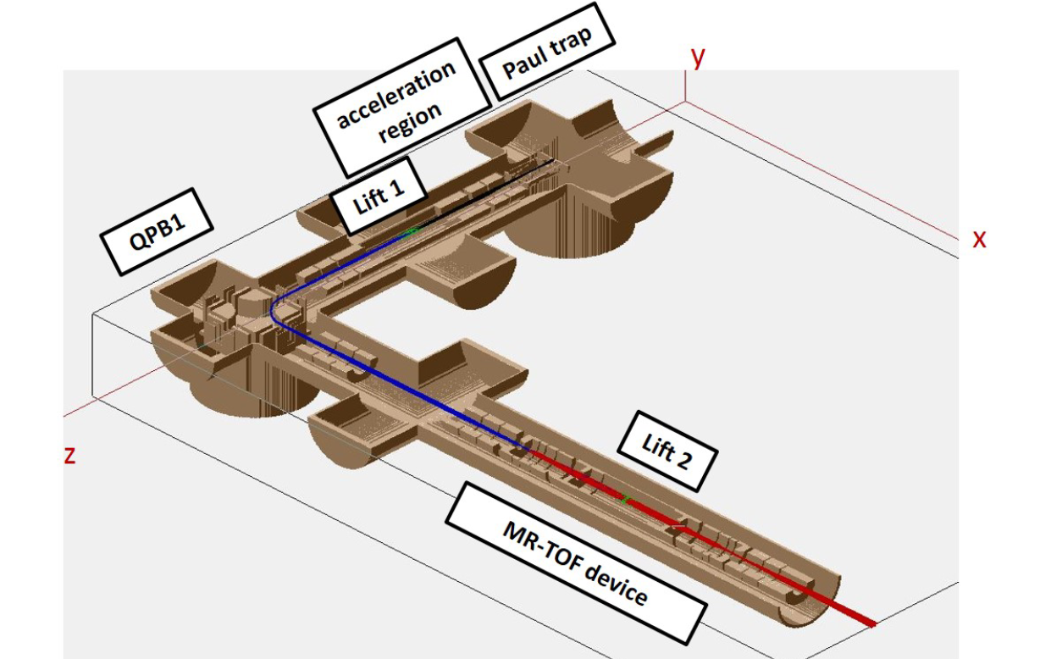
3D ion optical simulations
Paul trap simulations + extraction
transport simulations to MagneToF detector
recording of ToF and energy distribution at MagneToF detector location
MagneToF detector
F. Maier et al. Hyperfine Interactions 240: 54 (2019).
F.M. Maier, MSc thesis, JKU, Austria (2019).

Slide 31
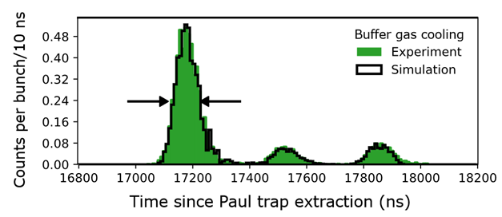
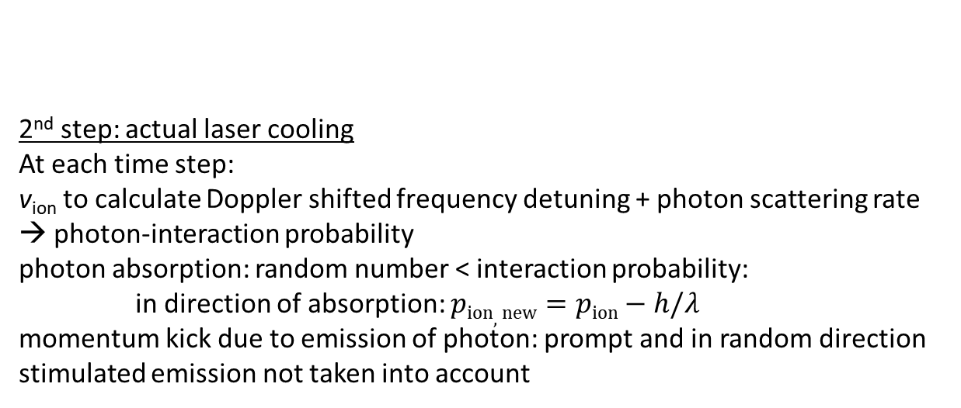
3D ion optical Paul trap simulations
1st step: 300-K buffer gas cooling of ion ensemble with an energy of 0.03 eV via hard-sphere interactions
same procedure as in
F. Maier et al. Hyperfine Interactions 240: 54 (2019).
F.M. Maier, MSc thesis, JKU, Austria (2019).
2nd step: actual laser cooling
At each time step:
v_{ion} to calculate Doppler shifted frequency detuning + photon scattering rate → photon-interaction probability
photon absorption: random number < interaction probability:
in direction of absorption: $pion, new=pion−h/λ$
momentum kick due to emission of photon: prompt and in random direction
stimulated emission not taken into account

Slide 32
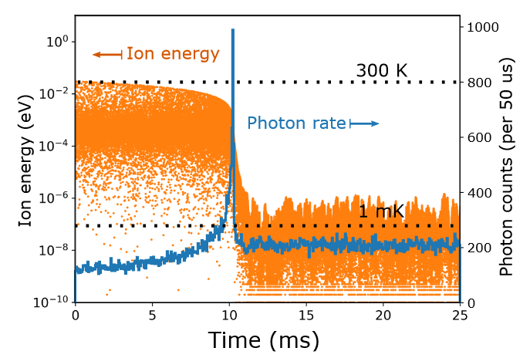
Simulations + Numerical model
3 D ion-optical simulations in SIMION:
buffer gas cooling via hard-sphere interactions
First simulation: buffer gas cooling at 300 K
Second simulation: laser cooling via a semi-classical Monte-Carlo manner
1 D Numerical cooling model [1]:
buffer gas cooling via exponential decay term
10 eV initial energy ion being cooled by a 300-K helium buffer gas at 1e-5 mbar + laser cooling
[1] adopted from
J. H. Wesenberg, Phys. Rev. A 76, 053416 (2007).
T. Murboeck et al, Phys. Rev. A 94, 043410 (2016).

Slide 33
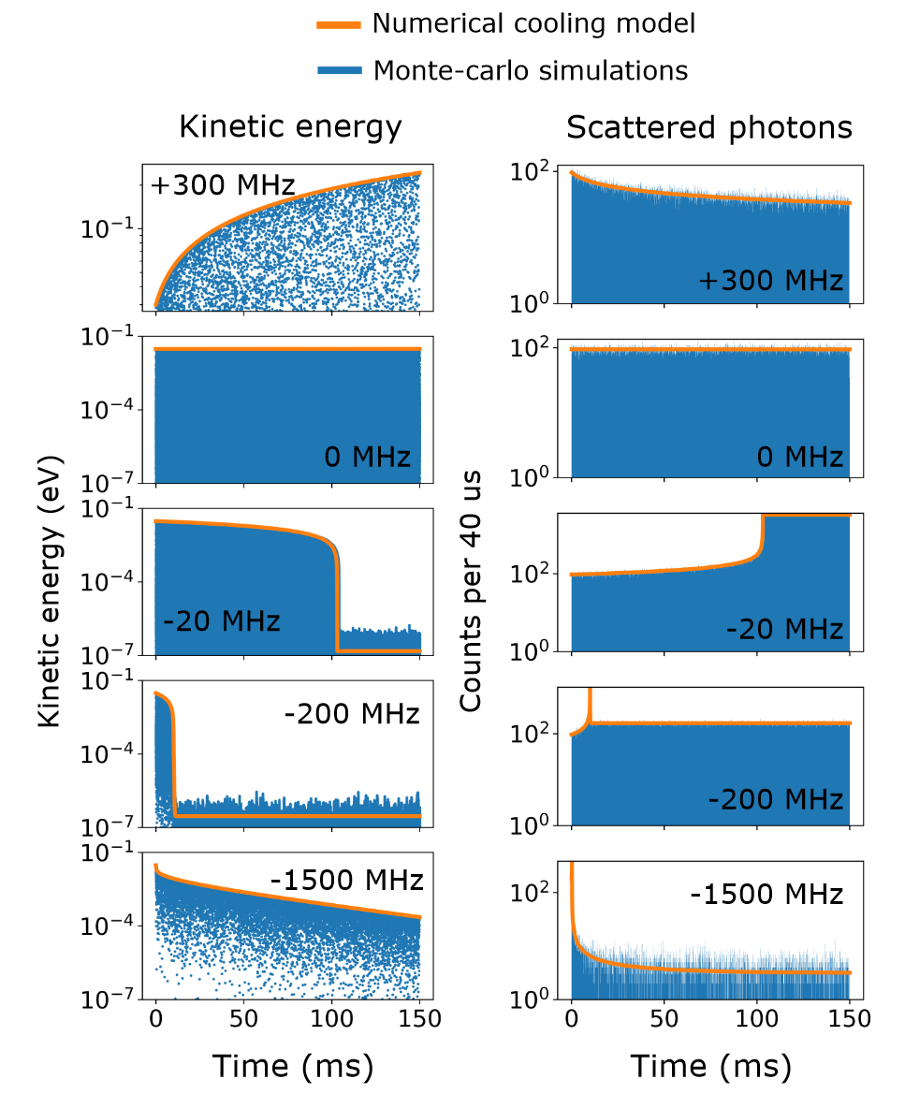
Simulations + Numerical model
1 D comparison between simulations and numerical model:

Slide 34
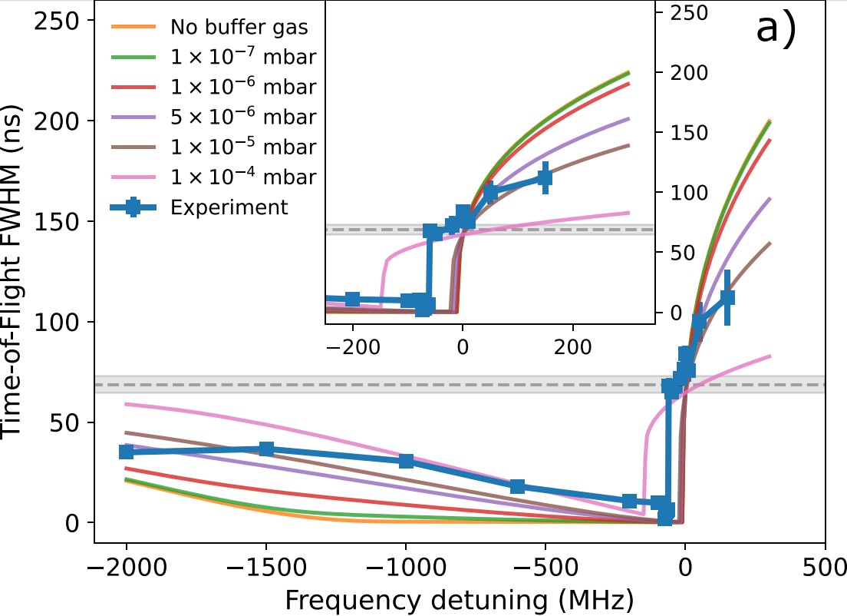
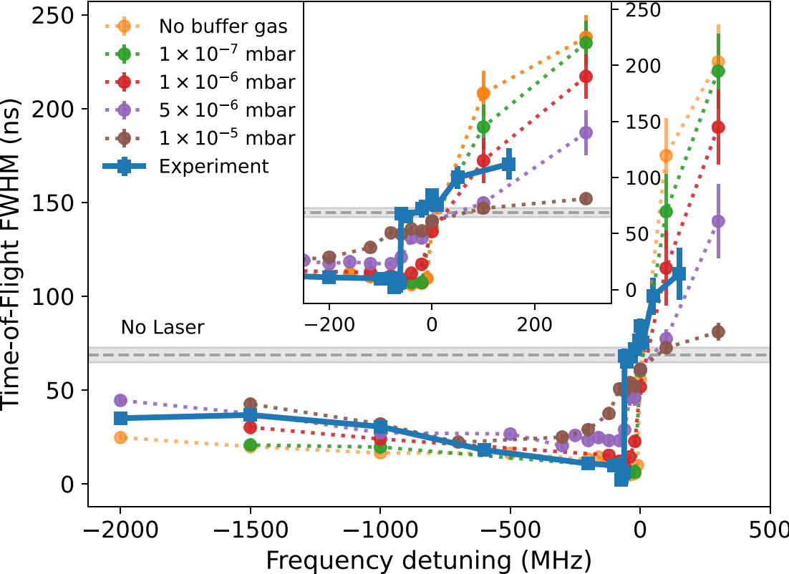
Simulations + numerical model
Comparison of both models with experimental data:
1 D numerical model vs experiment
3D ion-optical simulations vs experiment
Experiment:
1e-5 to 1e-8 mbar buffer gas present within Paul trap according to MolFlow simulations
cooling time ≈ 100 ms, laser power ≈ 25 mW

Slide 35
Simulations vs experiment
-600 MHz, 25 mW, 150 ms cooling
experiment
simulation

Slide 36
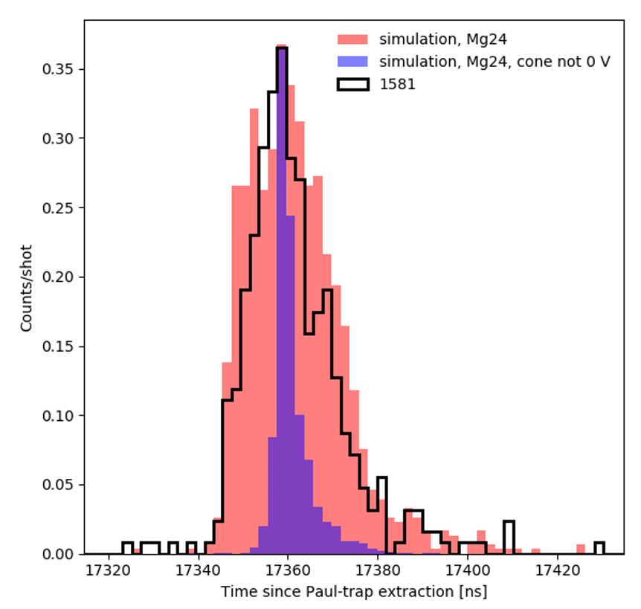
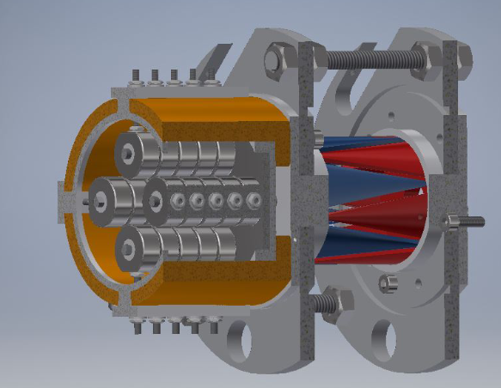
Beam temperature revisited
Improved reacceleration optics would give us significantly smaller peak widths for laser cooled ions.
142 V
0 V due to sparks
experiment
simulation, grounded cone
simulation,
non-grounded cone
Paul trap
reacceleration region
 | Grounded cone | Non-grounded cone
Laser cooling peak width | 16 ns | 3.6 ns
Buffer gas cooling peak width | 102 ns | 106 ns
:4
-600 MHz, 25 mW, 150 ms cooling
3.6 ns peak width corresponds to 0.5 K

Slide 37
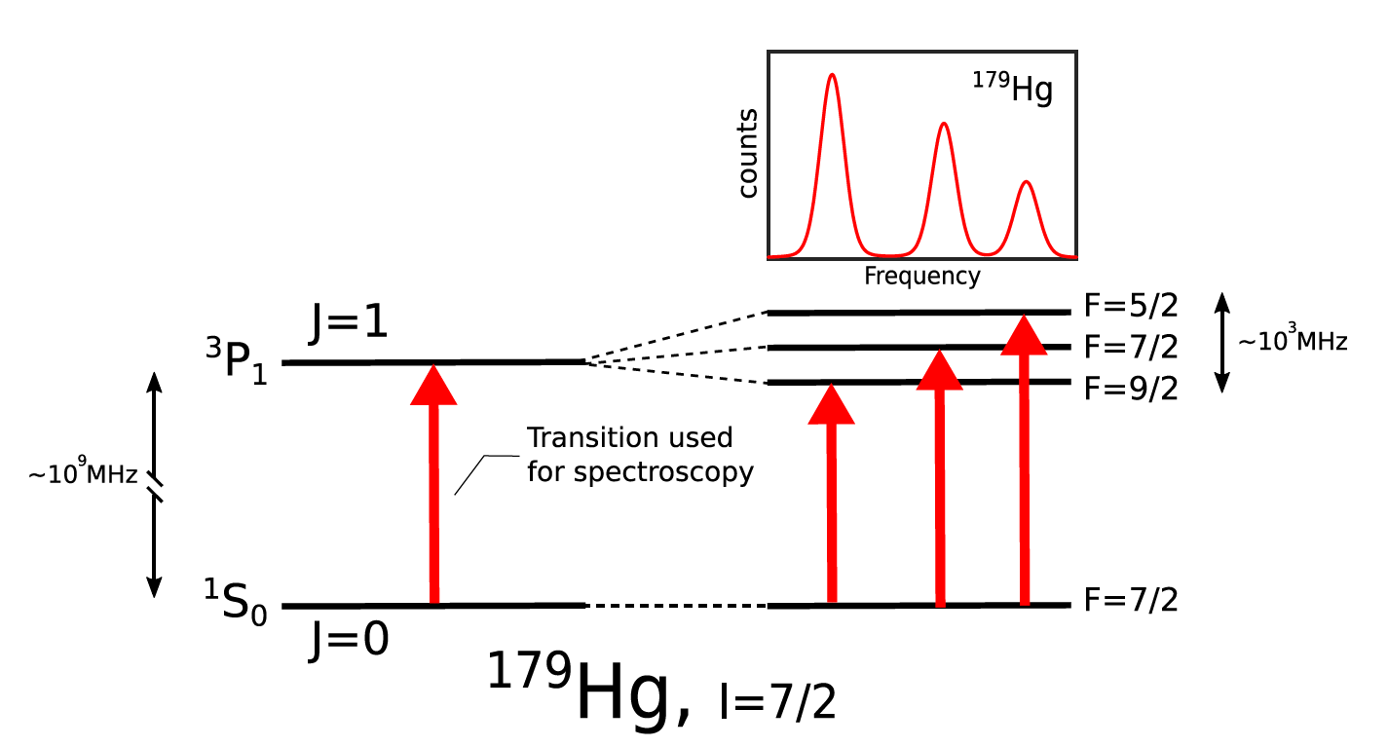
Doppler Cooling principle
ion
Laser
ion
Laser
ion
Laser
Moving ions observe Doppler shift in laser frequency
Absorption of photon in one direction
Spontaneous emission of photon in random direction
Net-cooling or heating effect since photon momentum is subtracted from/added to the Mg ion momentum
  Red-detuning: cooling, blue detuning: heating

