Slide 1
Richard Feynmann:
  “Nature isn't classical, dammit, and if you want to make a simulation of nature, you'd better make it quantum mechanical.”
"Simulating Physics with Computers", International Journal of Theoretical Physics, volume 21, 1982, p. 467-488, at p. 486 (final words)

Slide 2
Why?
  Design new materials
  Design more efficient chemical processes
  Break RSA encryption
  Provide optimization solutions

Slide 3
Quantum Computers
Trapped ions
Superconducting qubits
Majorana Electrons?
Diamond NV centers
Neutral atoms

Slide 4
Collaborative design of a trapped-ion quantum computer with fully interconnected qubits
ECCTI
30.06.2022
Celeste Torkzaban

Slide 5
Outline
Overview of the collaboration
Target specifications for the quantum computer
How to shuttle and entangle specific qubits
Design and fabrication details
Timeline

Slide 6



Quantum Valley Lower Saxony (QVLS)
Collaborate on quantum technologies
Channel expertise from existing research groups
Speed up progress by involving more researchers
25M Euro in funding to create a 50 qubit trapped-ion quantum computer by 2025 and develop additional quantum technologies

Slide 7
Areas of expertise
  Quantum algorithm developments
  Quantum machine learning
  Trap design
  Software integration
  Cryostat design
  Trap fabrication
  Laser setup in 19” racks
  Control routines for operating and benchmarking
  Electronics
  Integrated detectors
  Integrated waveguides
  Compact laser sources
  ....and more

Slide 8
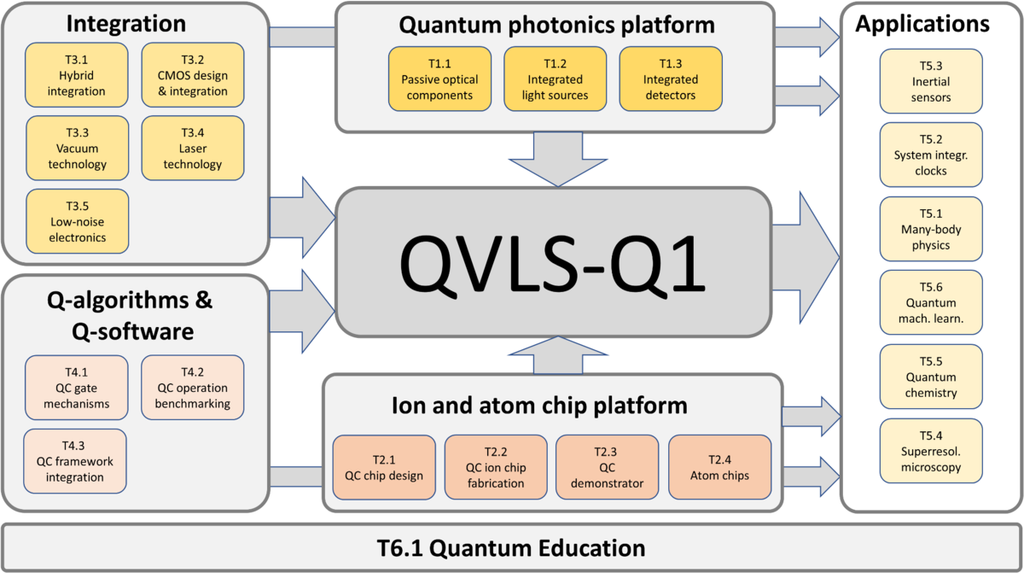
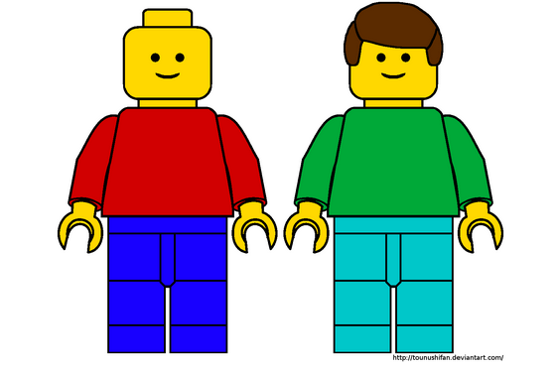
Collaboration
Vs.
http://clipart-library.com/clipart/697107.htm

Slide 9
Usefulness of a Quantum Computer
} Quantum Volume
Number of qubits
Qubit interconnectivity
Coherence time of qubits
Two-qubit gate fidelity
State preparation and measurement (SPAM) error
Speed of gate operations

Slide 10
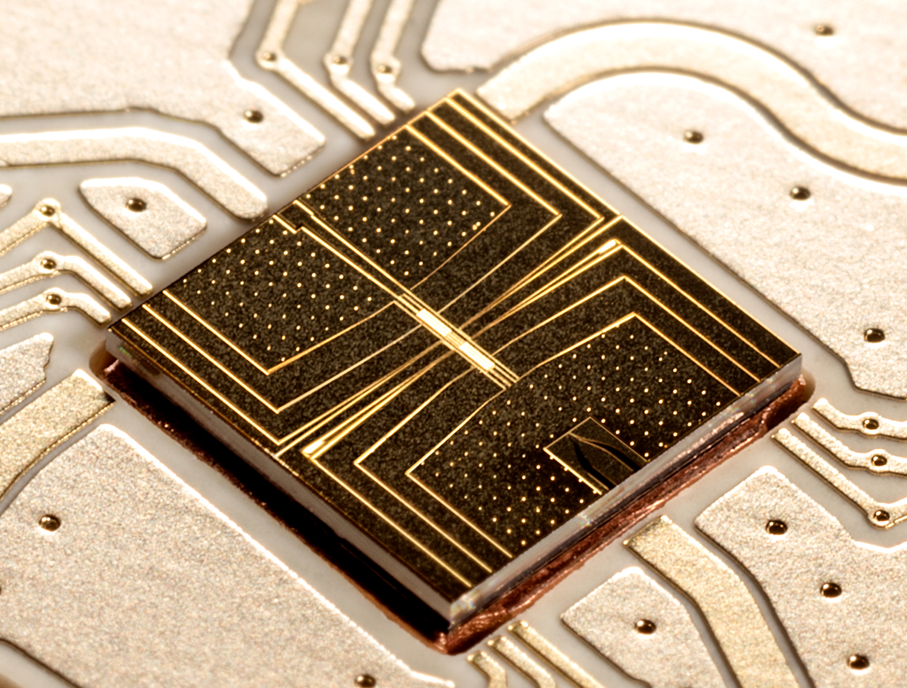
Existing experiments at LUH and PTB
Number of qubits: 1-2
Qubit Interconnectivity: all-to-all
Coherence time: >7s
Two-qubit gate fidelity: ~0.5 % [1]
SPAM error: ~1% [2]
Speed of gate operations: ~2 ms
[1] G. Zarantonello et al., Phys. Rev. Lett. 123, 260503 (2019)
DOI: 10.1103/PhysRevLett.123.260503
[2] S. Halama et al., arXiv:2204.09112 [quant-ph/]

Slide 11

Target parameters of the QVLS Quantum Computing Demonstrator
Number of qubits: 50
Qubit Interconnectivity: all-to-all
Lifetime of qubits: much longer than necessary
Two-qubit gate fidelity: <10⁻⁴
Spam error: better than 1%
Speed of gate operations: ~5-10 ms

Slide 12


Slide 13
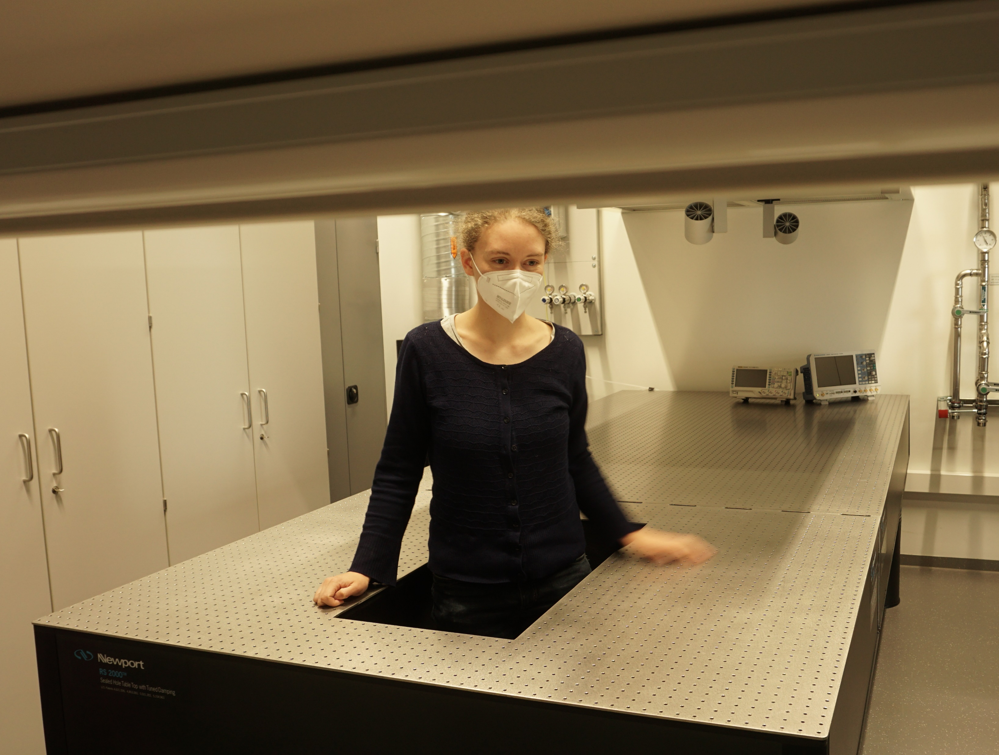
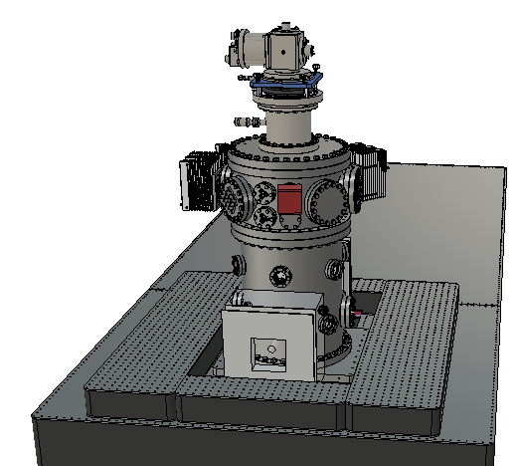
Essential Ingredients
An Empty lab and a plan

Slide 14
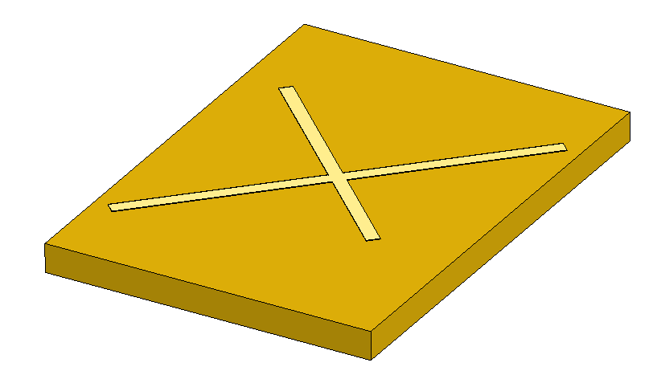
Essential Ingredients
  An empty lab and a plan
  An X-junction RF surface trap
    Be⁺ ion qubits driven by microwaves
    Ca⁺ ion for sympathetic cooling

Slide 15
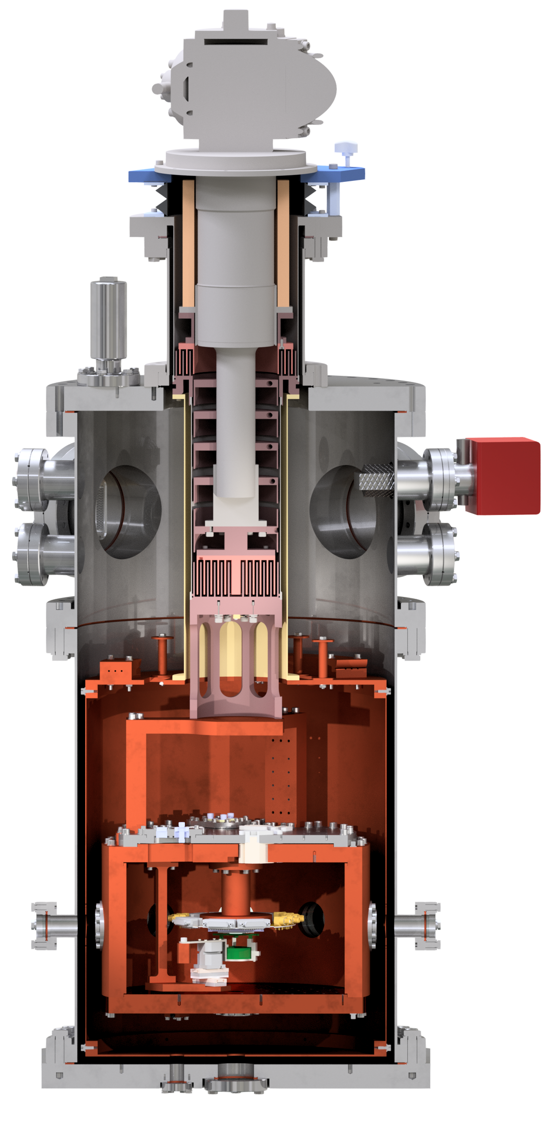
Essential Ingredients
  An empty lab and a plan
  An X-junction RF surface trap
    Be⁺ ion qubits driven by microwaves
    Ca⁺ ion for sympathetic cooling
  Cryogenic environment (5K)
  DC, RF, and microwave electronics
  Free-space lasers for cooling and detection
  Imaging system

Slide 16
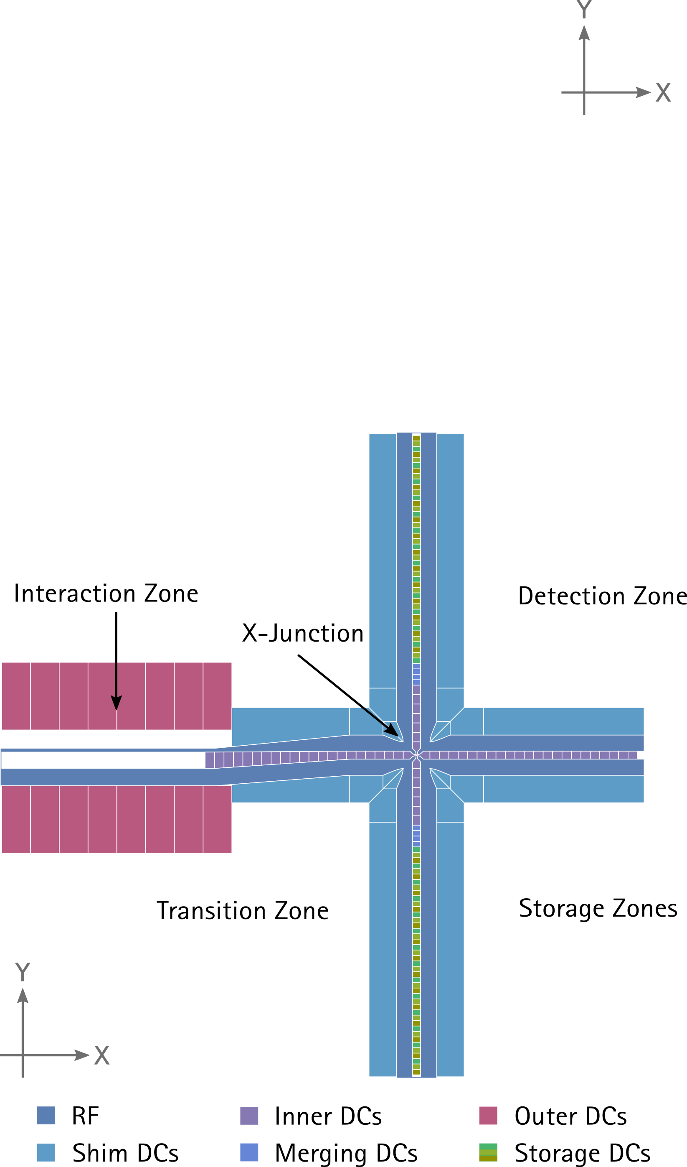
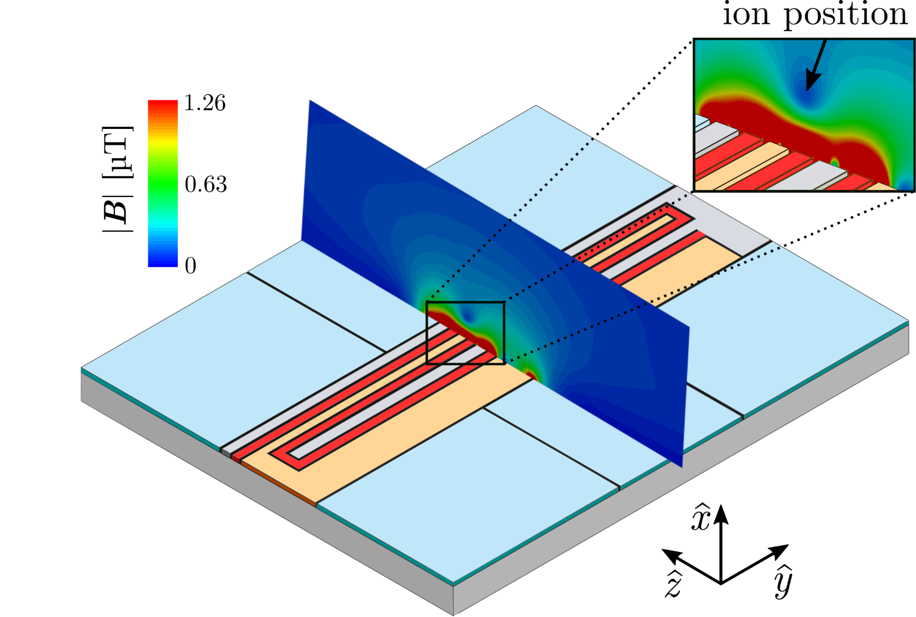
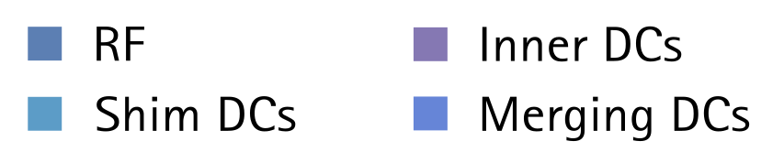

Trap design
M. Carsjens et al., Appl. Phys. B 114, 423-250 (2014)

Slide 17
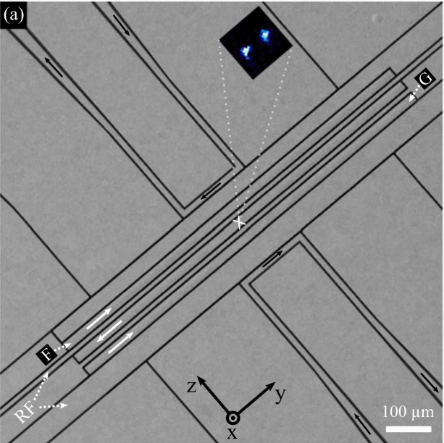
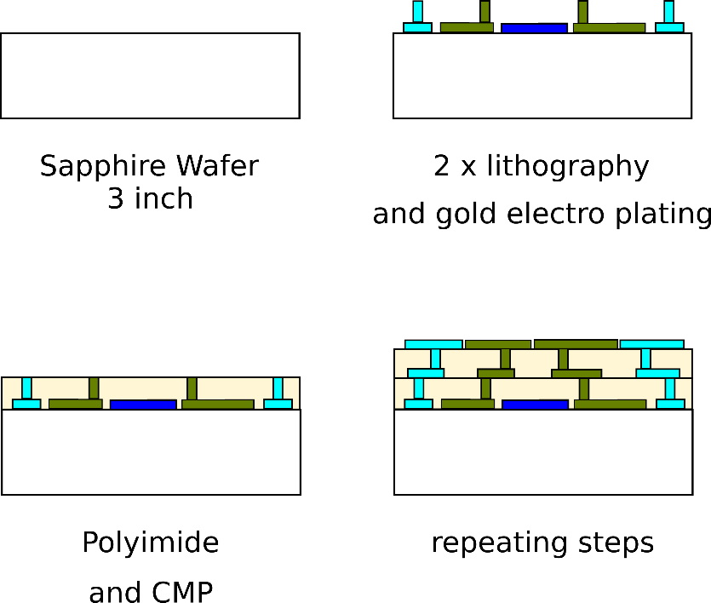
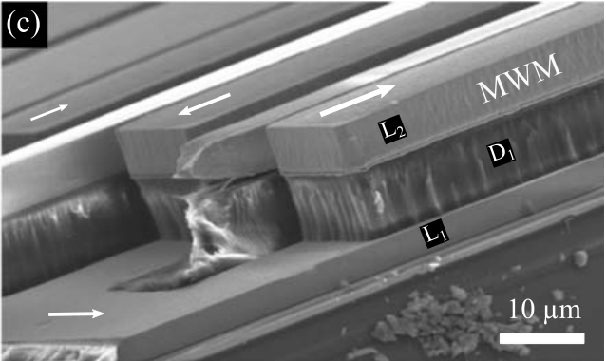
Trap Fabrication
Under development:
Through-Substrate Vias
Socket made of PEEK with Fuzz buttons
State of the Art:
Multi-layer Trap Fabrication
1.
2.
3.
4.
A Bautista-Salvador et al 2019 New J. Phys. 21 043011

Slide 18
Cryostat Design
Closed-cycle cryocooler:
1.8W @ 4.2K
Based on the design of the 1st generation cryogenic experiment at LUH [3]
Ultra-low vibration interface via He buffer gas
Feedthroughs
50K Radiation Shield
Inner vacuum chamber: thick copper walls at 5K
Viewports
[3] T. Dubielzig et al. Rev. Sci. Instr. 92, 043201 (2021)
Imaging system

Slide 19
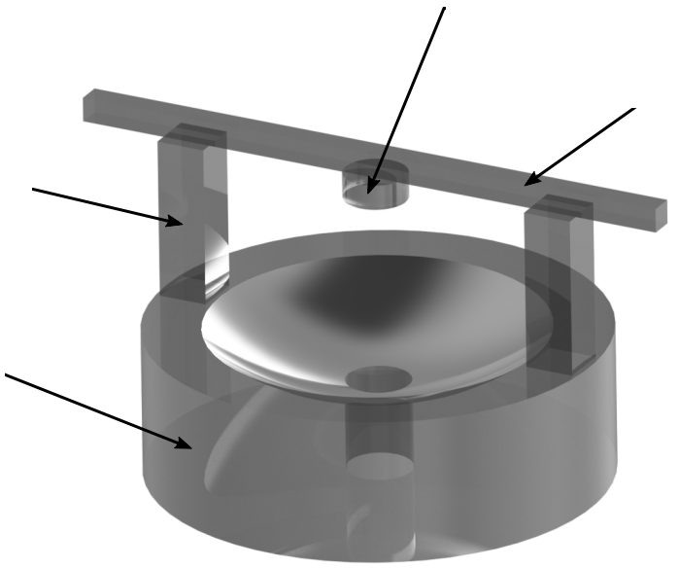
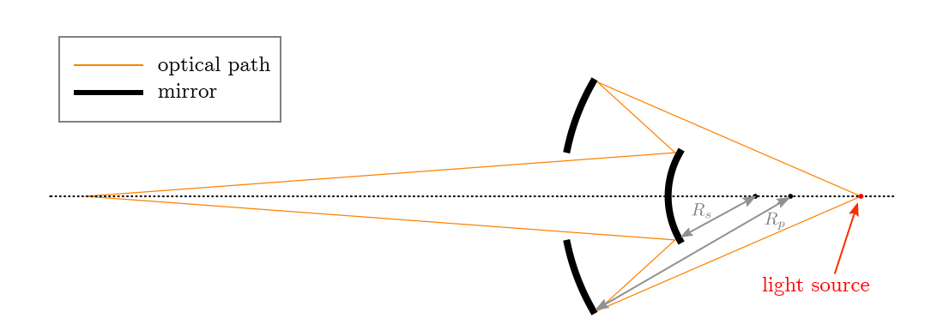
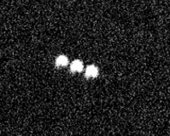
Imaging Design
Primary mirror
Achromatic Schwarzschild lens focuses light from ions onto either an EMCCD camera or a PMT [2]
Glass beam
Pillar
Secondary
mirror
Images from E. Vandrey, Cryogenic Schwarzschild Objective for the Detection of Trapped-ion Qubits, Bachelor thesis, Leibniz Universität Hannover (2021)
 | [2] S. Halama et al., arXiv:2204.09112 [quant-ph/]

Slide 20
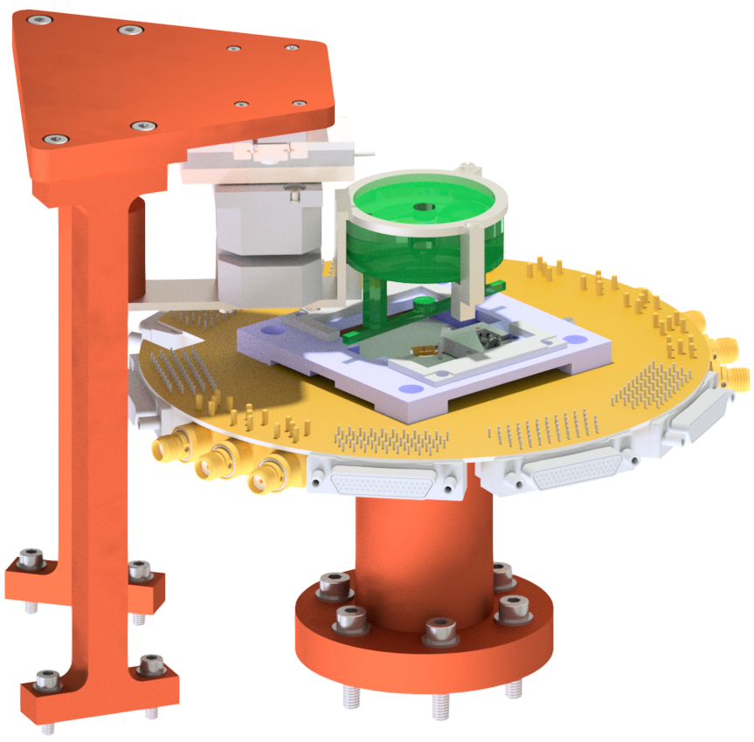
Inner Design
Piezo translation stages
Schwarzschild Objective
Filter board
Socket Socket mount
Trap chip and interposer

Slide 21
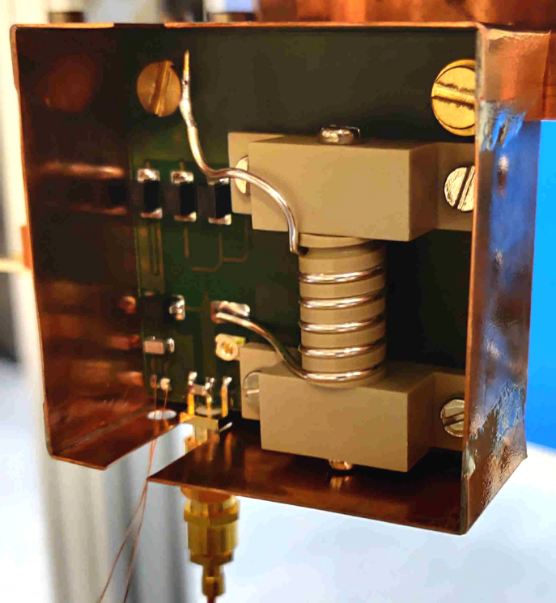
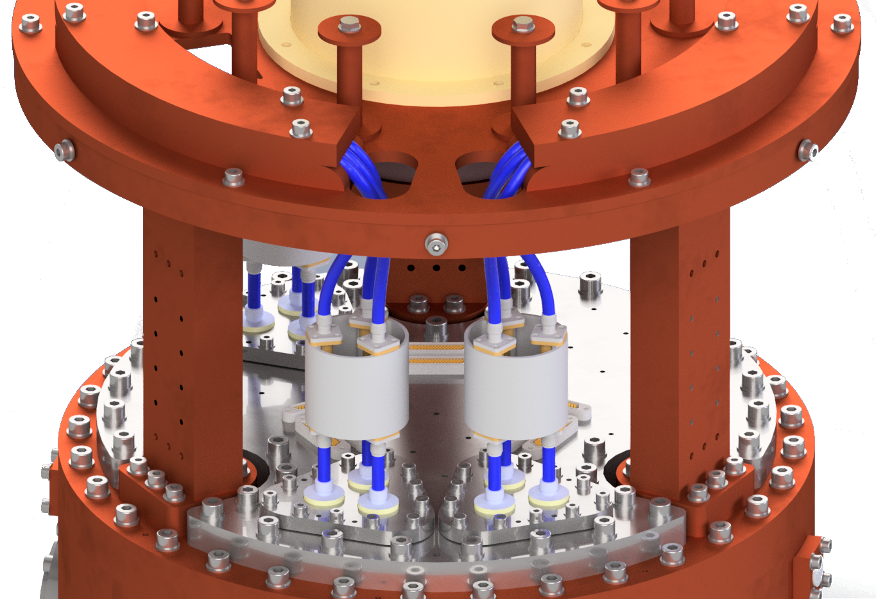
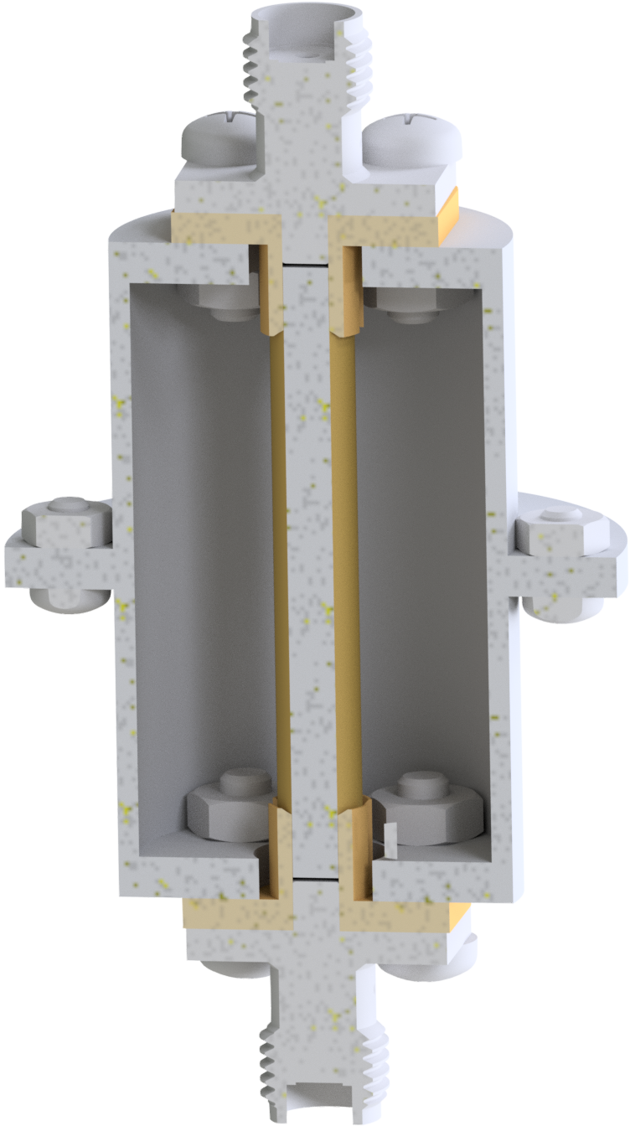
Electronics and thermalization of cables
  ARTIQ control system (Norman’s talk yesterday)
  RF resonator
Bobbins and clamps for thermalizing cables to 50K
Thermalblock: reduce conductive heat
Inner vacuum chamber @ 5K
Notes:
Active impedance matching with resistance change

Slide 22
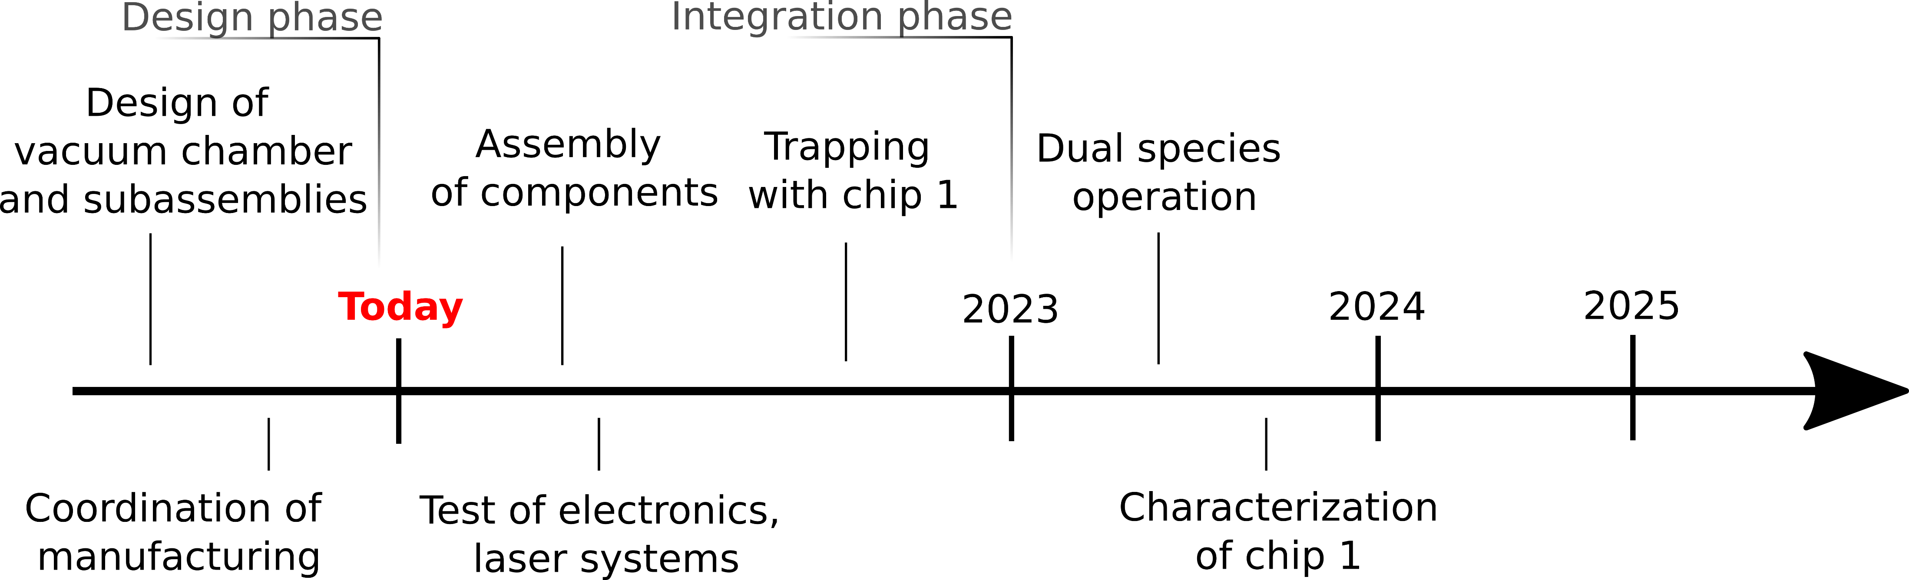
Timeline
Run algorithms with 50 Be+ ions

Slide 23

One design to rule them all
https://static.dw.com/image/15912725_403.jpg

Slide 24


Beyond QVLS
ATIQ

Slide 25
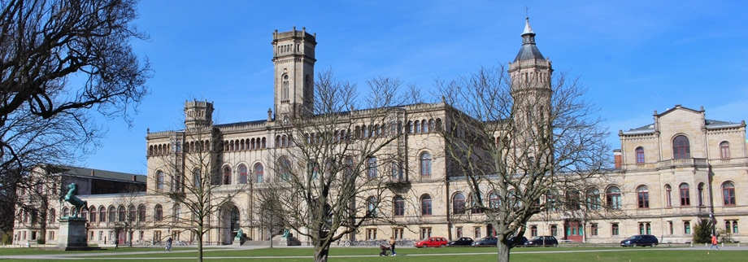
Interested in working with us?
PhD and Postdoc positions available
Contact me: torkzaban@iqo.uni-hannover.de
https://www.castleholic.com/2017/03/welfenschloss.html

