Slide 1

Standing-Wave Mølmer–Sørensen Gate in the Adiabatic and Non-Adiabatic Regime
Sebastian Saner¹, Oana Bazavan, Raghavendra Srinivas, Mariella Minder, Amy Hughes, David Lucas and Chris Ballance
Ion Trap Quantum Computing Group
ECCTI - Quantum Information & Computing, January 2022
[1]: sebastian.saner@physics.ox.ac.uk

Slide 2
Big Picture
Establish entanglement
LS-gate [1], MS-gate [2]
Limitations
Interaction physics from a different angle
LS-gate | MS-gate
Clock qubit incompatibility | Speed limit
Out-of-Lamb-Dicke errors | Optical phase
blue wavelength | σ_{x} -basis
[1]: Ballance et al., 2016. Phys. Rev. Lett.
[2]: Gaebler et al., 2016. Phys. Rev. Lett.
Notes:
No fundamental limitations

Slide 3
Part I: Standing-Wave Mølmer–Sørensen (MS) in Non-adiabatic regime
  Getting rid of the carrier coupling
Part II: novel σ_{z}σ_{z} – spin dependent force
  Using the carrier coupling

Slide 4
Carrier Coupling is welcome or not, it depends!
Sebastian Saner¹, Oana Bazavan, Raghavendra Srinivas, Mariella Minder, Amy Hughes, David Lucas and Chris Ballance
Ion Trap Quantum Computing Group
ECCTI - Quantum Information & Computing, June 2022
[1]: sebastian.saner@physics.ox.ac.uk

Slide 5
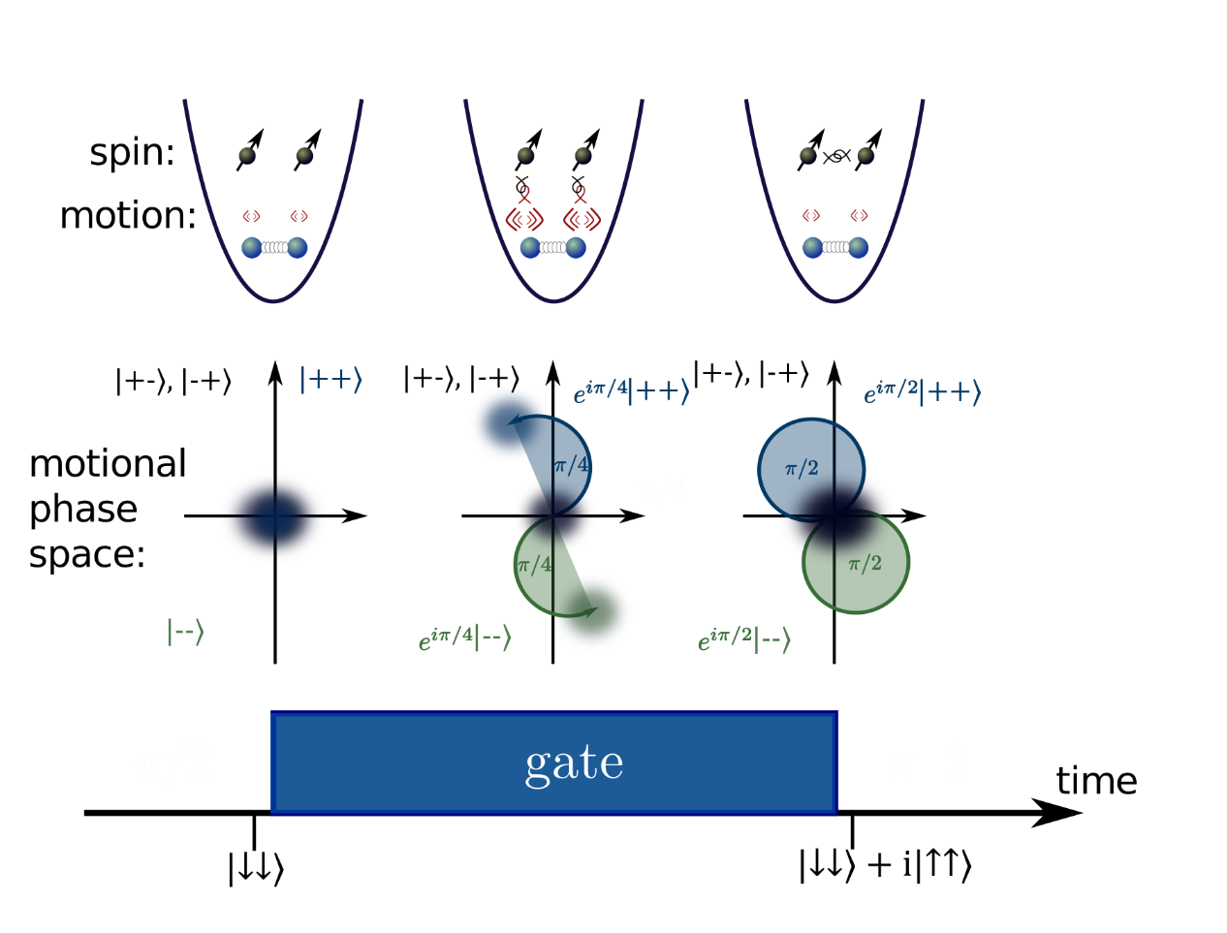
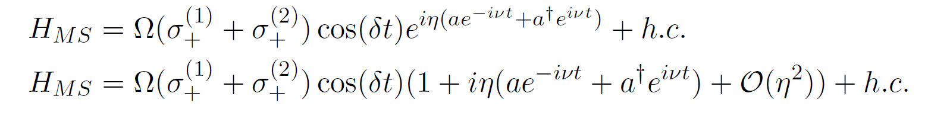
Generating Entanglement
Geometric phase gate
Mølmer–Sørensen (MS)-gate [1,2]
Oscillation
Spin-Dependence
Motional Mode Coupling
[1]: Sørensen et al., 2000. Phys. Rev. A
[2]: Roos et al., 2008. New Journal of Physics
Notes:
Note that this creates a spin dependent force!

Slide 6
Challenges
Carrier term
σ_{x} spin-dependent force

Slide 7
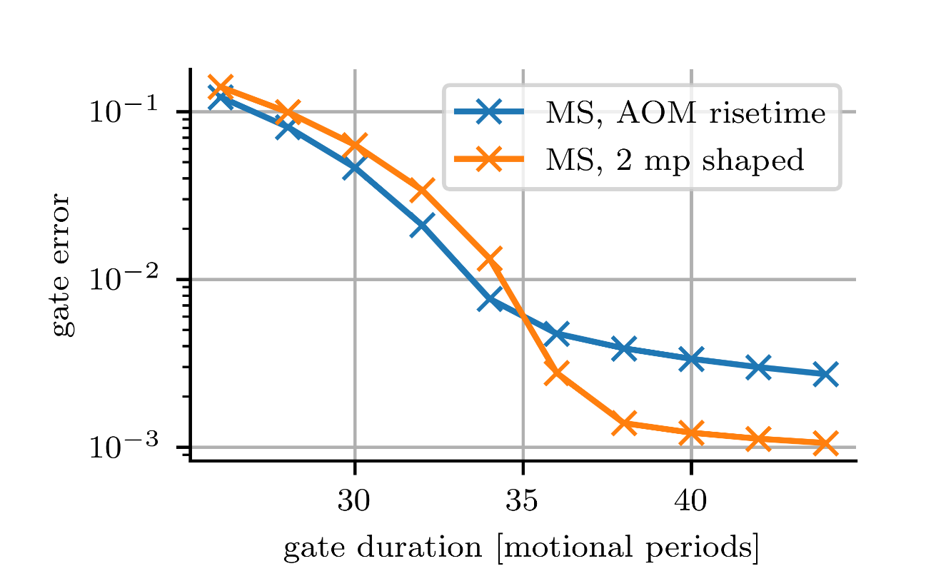
Bichromatic Interaction Picture - Adiabatic Theorem
«Bichromatic Interaction Picture»
Transition smoothly into interaction hamiltonian
  → stays eignestate of intermediate system
  → acquire geometric phase
  → return to original eigenstate
  happy

Slide 8
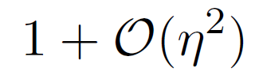
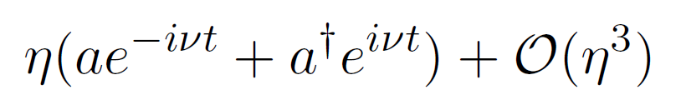
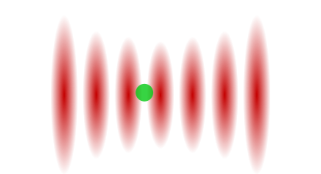
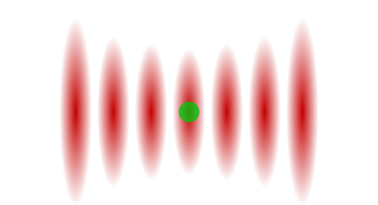
Ion-Lattice Interaction
Counter-propagating beam
Optical lattice
Destructive / Constructive Interference
Carrier coupling maximal
Sideband coupling maximal

Slide 9
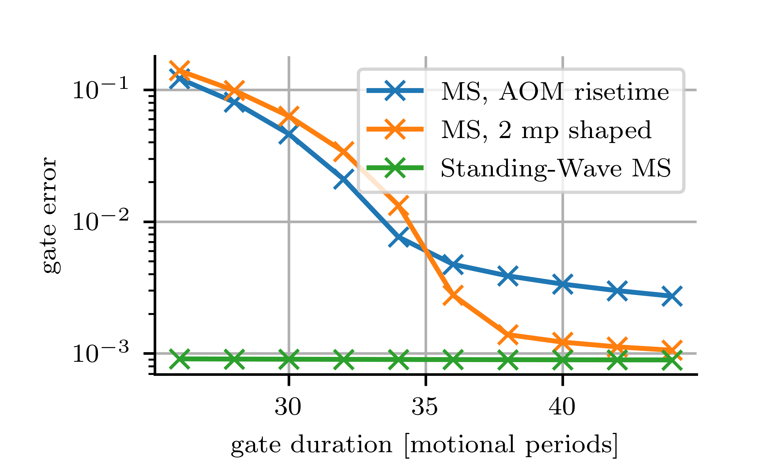
Two-qubit Fidelity
Conventional MS-gate
Standing-Wave MS-gate

Slide 10
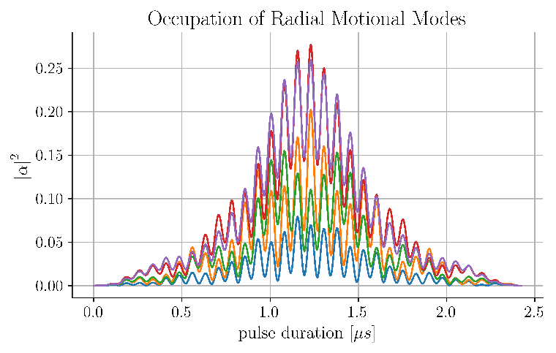
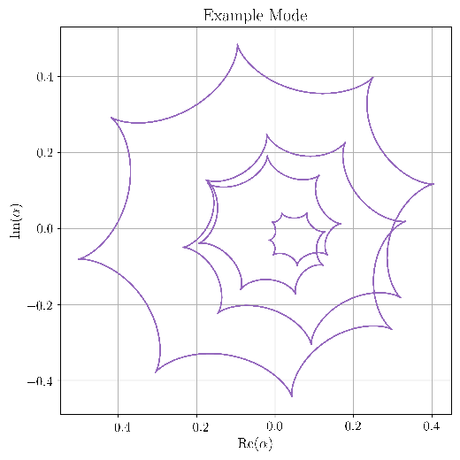
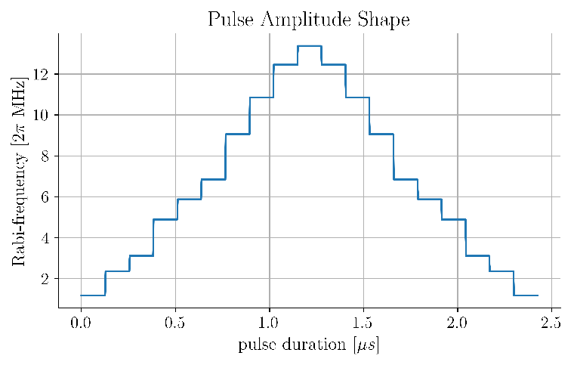
Generate Entanglement in 5 - Ion Crystal
Large detunings
All motional modes couple
Close all motion trajectories
Introduce sufficient degrees of freedom
Amplitude modulation [1,2]
[1]: Steane et al., 2014. New Journal of Physics
[2]: Schäfer et al., 2018. Nature

Slide 11
Part II: σ_{z}σ_{z} – spin dependent force
Create σ_{z}σ_{z} – gate from bichromatic laser-atom interaction
Advantages over conventional schemes
Recent interest in alternative schemes [1,2]
[1]: Clark et al., 2021. Phys. Rev. Lett.
[2]: Baldwin et al., 2021. Phys. Rev. A

Slide 12

Bichromatic Hamiltonian
Carrier term
σ_{Φ} spin-dependent force
Inter-action Picture
[1]: Sørensen et al., 2000. Phys. Rev. A
[2]: Sutherland et al., 2019, New Journal of Physics
[3]: Srinivas et al., 2021 Nature

Slide 13

Bichromatic Hamiltonian
Carrier term
σ_{Φ} spin-dependent force
Inter-action Picture
σ_{z} spin-dependent force
[1]: Sørensen et al., 2000. Phys. Rev. A
[2]: Sutherland et al., 2019, New Journal of Physics
[3]: Srinivas et al., 2021 Nature

Slide 14
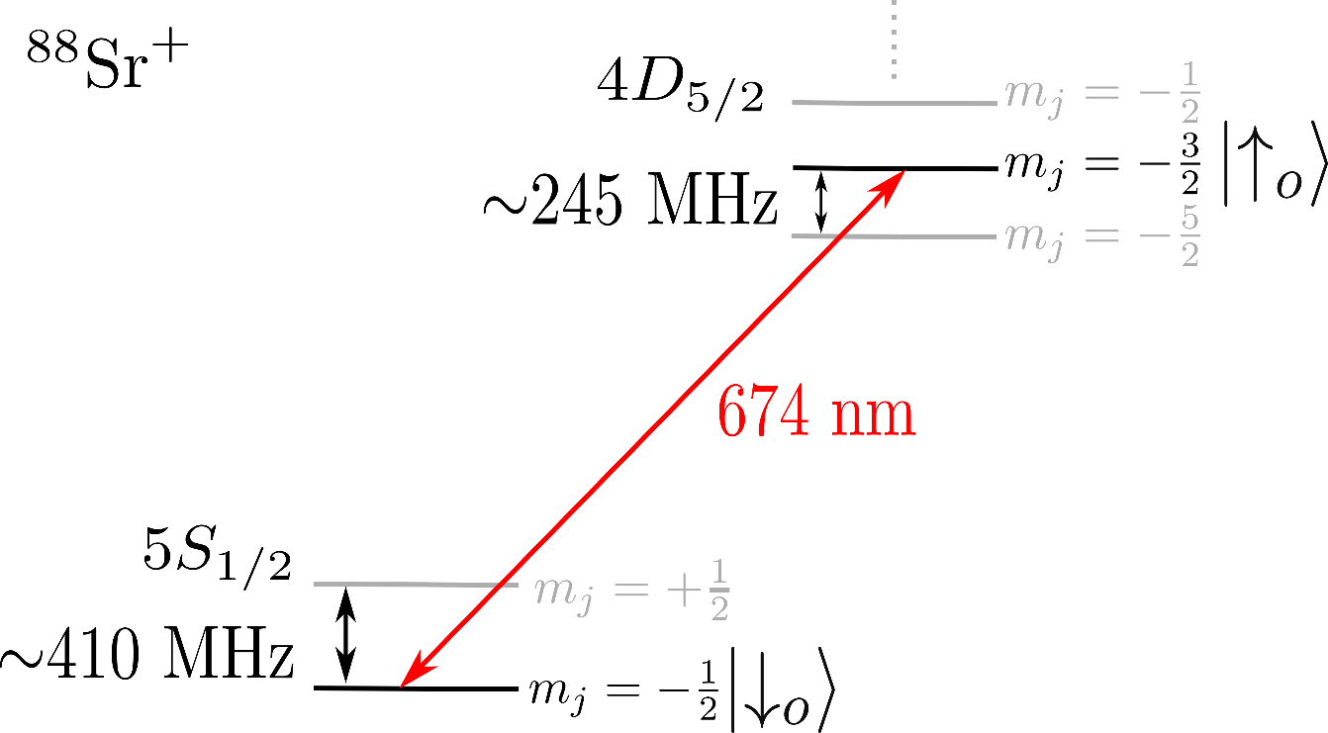
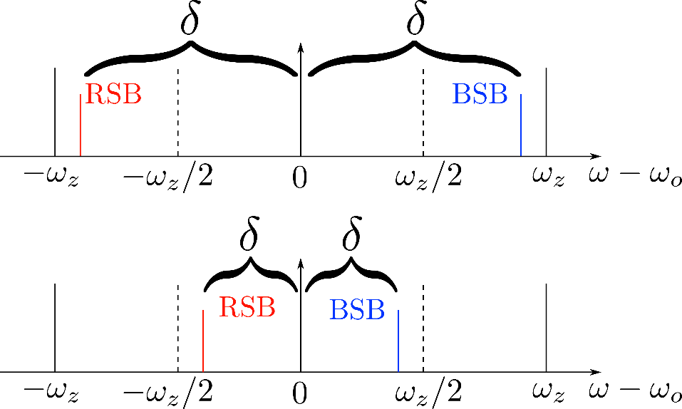
Experimental setup
Same experimental aparatus as
presented by Oana Bazavan, but no lattice
Bichromatic field
MS-gate
σ_{z}σ_{z}–gate

Slide 15
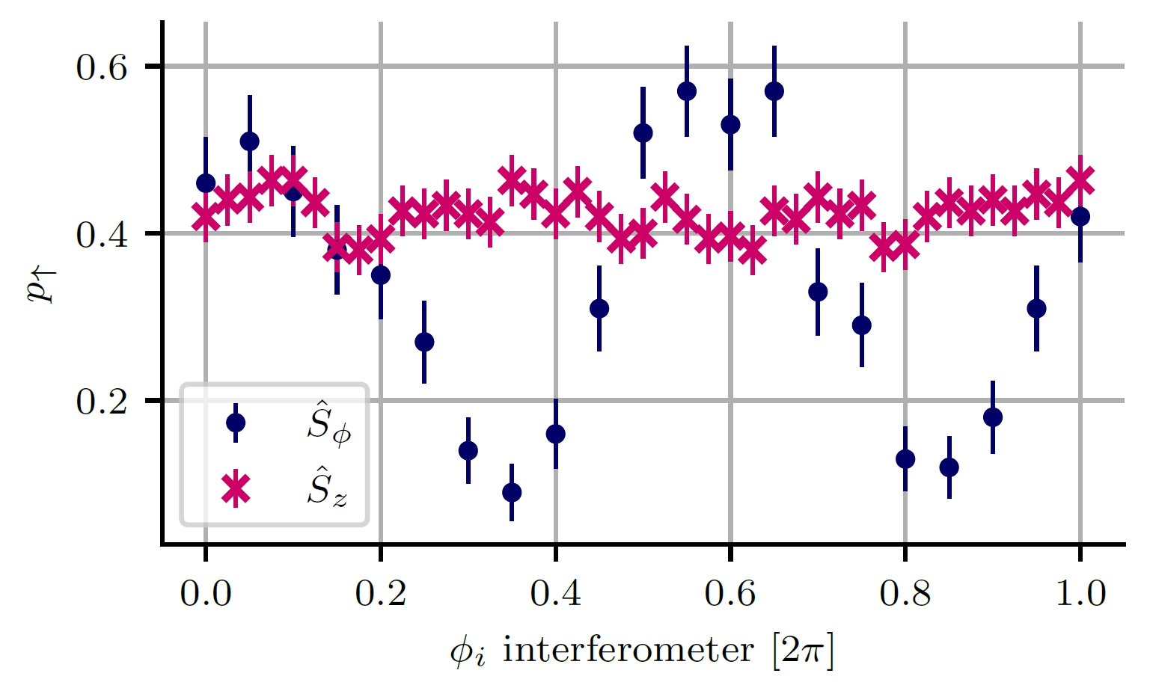
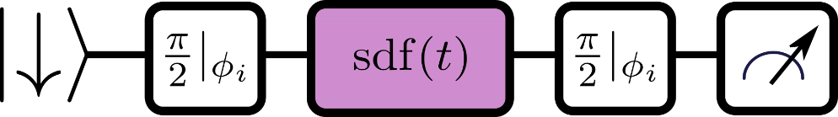
Spin-dependent force properties – σ_{z} basis
Orthogonal basis, Φ = Φ_{i} + π/2
Aligned basis, Φ = Φ_{i}
[1]: Haljan et al., 2005. Phys. Rev. Lett.

Slide 16
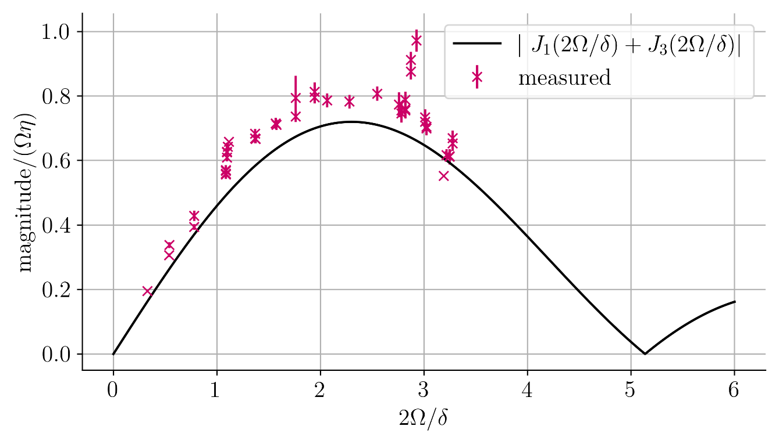
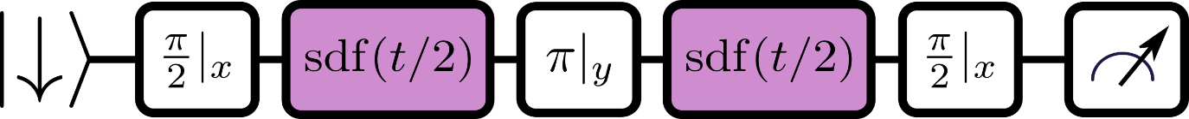
Spin-dependent force properties – Magnitude
Spin-dependent force extraction [1]
[1]: Haljan et al., 2005. Phys. Rev. Lett.

Slide 17
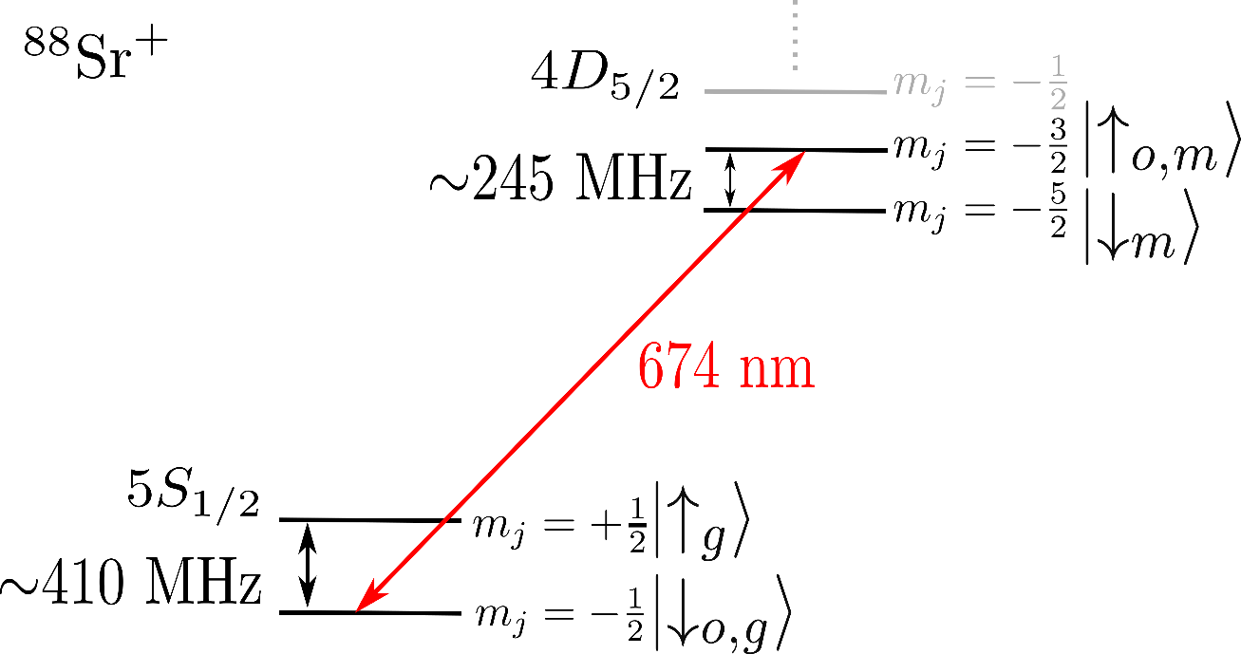
Two-qubit gates - Compatible with optical, metastable and ground level qubit
Independent of Φ_{s} = (Φ_{bsb} + Φ_{rsb} )/2
OMG (optical, metastable, ground level)
architecture^{1,2}
[1]: Allcock et al., 2021. Applied Phys. Lett.
[2]: Yang et al., 2021. ArXiv:2106.14906.

Slide 18
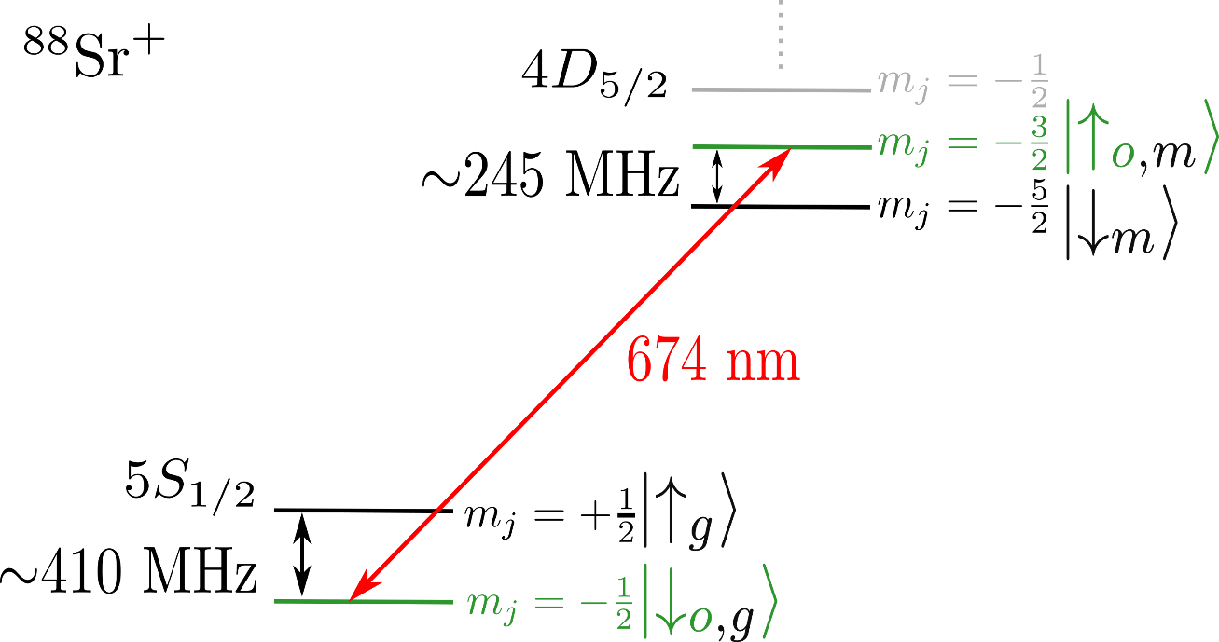
Compatible with optical, metastable and ground level qubit
Qubit | Measured 2-qubit Fidelity | Single Qubit Rotations
Optical | 93.0(3)% | Quadrupole laser

Slide 19
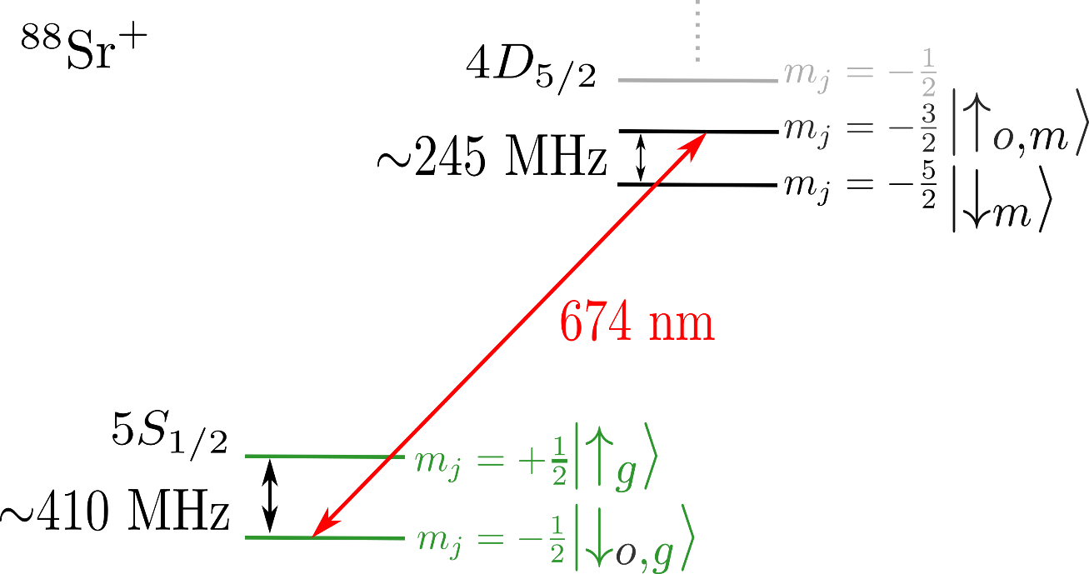
Compatible with optical, metastable and ground level qubit
Qubit | Measured 2-qubit Fidelity | Single Qubit Rotations
Optical | 93.0(3)% | Quadrupole laser
Ground level | 94.9(4)% | RF antenna

Slide 20
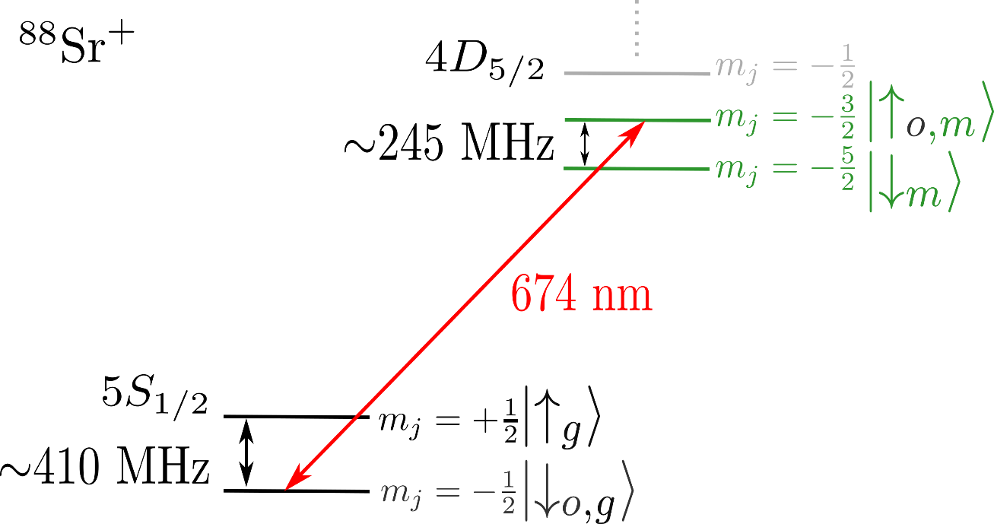
Compatible with optical, metastable and ground level qubit
Qubit | Measured 2-qubit Fidelity | Single Qubit Rotations
Optical | 93.0(3)% | Quadrupole laser
Metastable | 85.9(5)% | RF antenna + Quadrupole laser
Ground level | 94.9(4)% | RF antenna

Slide 21
Summary
Pathway to lattice driven MS-gate
Fast gate solutions
σ_{z}σ_{z}–gate on quadrupole transition
Characterised force amplitude
Compatibility with omg- and clock-qubits
Fidelity mainly limited by laser phase noise
Speedlimit arising from pulse shaping

Slide 22
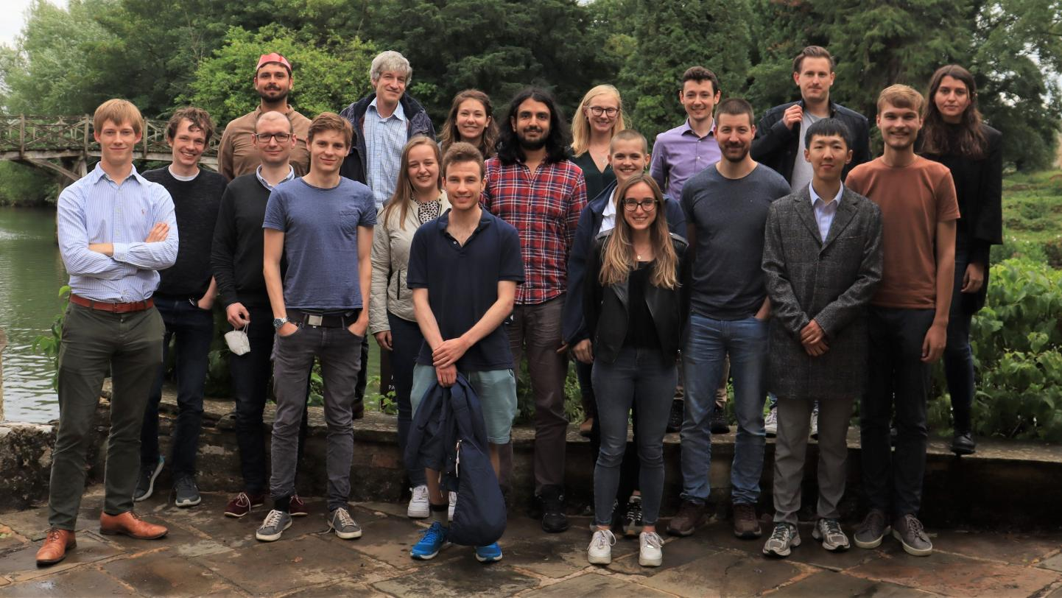



Thank you
Main project:
Oana Bazavan
Raghavendra Srinivas
Mariella Minder
David Lucas (PI)
Chris Ballance (PI)
Useful discussions:
Gabriel Araneda
Marius Weber
Helped with the hardware and software:
Peter Drmota
David Nadlinger

Slide 23
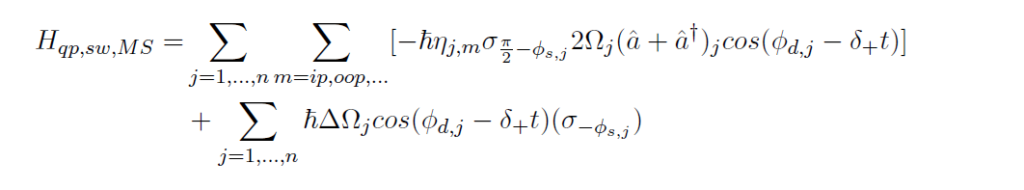
Experimental Parameter Uncertainties
Power
Phase
Discuss resulting parity phase jittering
Impact and Resolutions

Slide 24
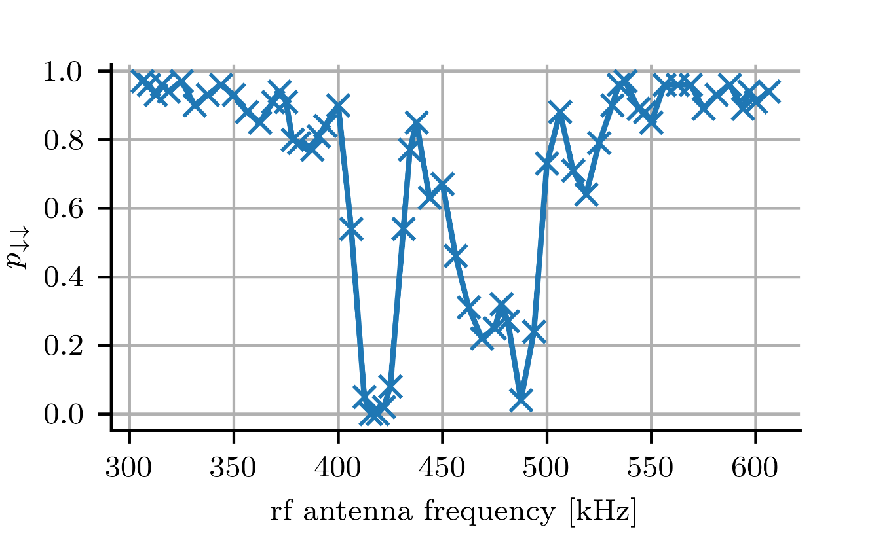
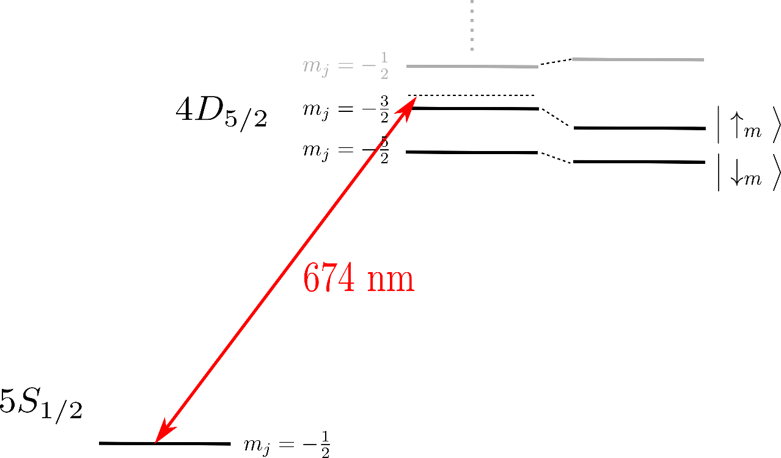
Metastable Single Qubit Rotations - Dressing
|m_{j}= -3/2> ⬄ |m_{j}= -1/2>
+245 MHz
|m_{j}= -5/2> ⬄ |m_{j}= -3/2>

