Slide 1

Towards standing-wave Mølmer-Sørensen gates on a quadrupole transition
Oana Bazavan, Sebastian Saner, Mariella Minder, Amy Hughes, David Lucas, Chris Ballance
June 2022
University of Oxford
Ion Trap Quantum Computing Group

Slide 2
Why?

Slide 3
Why?

Slide 4
Why?
Laser-ion interaction:
  Frequency
  Rabi frequency/Intensity at the ion
  Phase – not that often

Slide 5
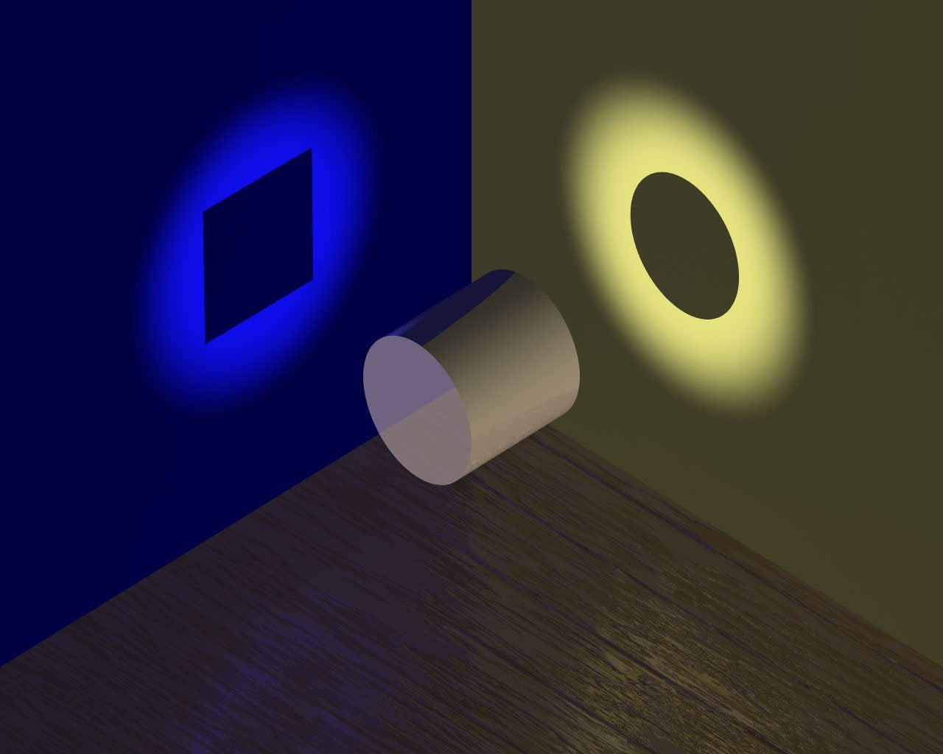

Why?
$$∆φ$$

Slide 6
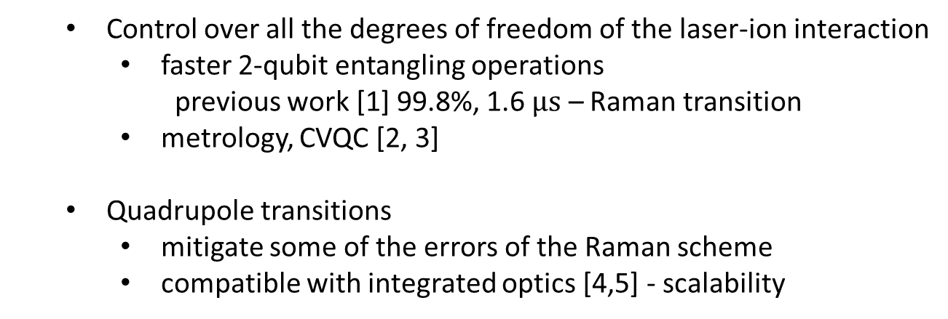
Why?
$$∆φ$$
  Control over all the degrees of freedom of the laser-ion interaction
    faster 2-qubit entangling operations
      previous work [1] 99.8%, 1.6 $μs$ – Raman transition
    metrology, CVQC [2, 3]
  Quadrupole transitions
    mitigate some of the errors of the Raman scheme
    compatible with integrated optics [4,5] - scalability
Sebastian Saner
Talk in a few minutes
[1] Schäfer et al., Nature 2018
[2] C. T. Schmiegelow et al., Phys. Rev. Lett. 2016
[3] M. Drechsler et al., Phys. Rev. A 2020
[4] Mehta et al., Nature 2020
[5] Niffenegger et al., Nature 2020

Slide 7
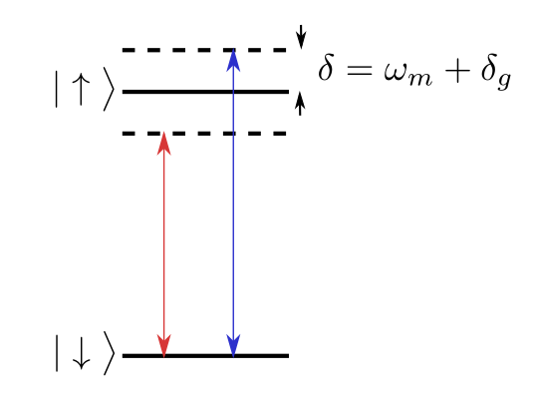
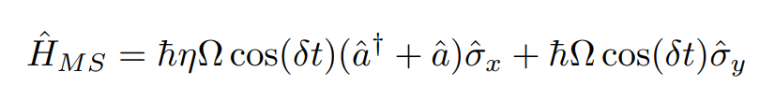

Standard MS
Bichromatic travelling-wave
The motional and carrier term don’t commute - $\left[{\hat{σ}}_{x}, {\hat{σ}}_{y}\right] ≠0$
Carrier term – source of errors: laser spectral impurities, light-shifts, speed limit
motional term
carrier term
Sebastian Saner
Talk in a few minutes

Slide 8


Lattice Physics
Bichromatic standing-wave (phase controlled in the lab)
$$φ_{1}$$
$$φ_{2}$$
motional term
carrier term

Slide 9
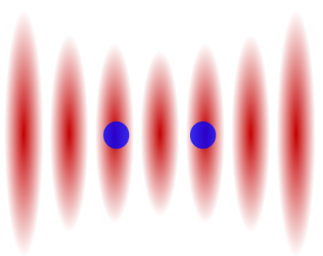
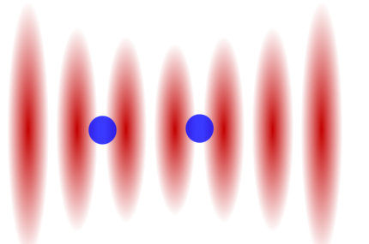
Lattice Physics
Bichromatic standing-wave (phase controlled in the lab)
$$φ_{1}$$
$$φ_{2}$$
motional term
carrier term

Slide 10
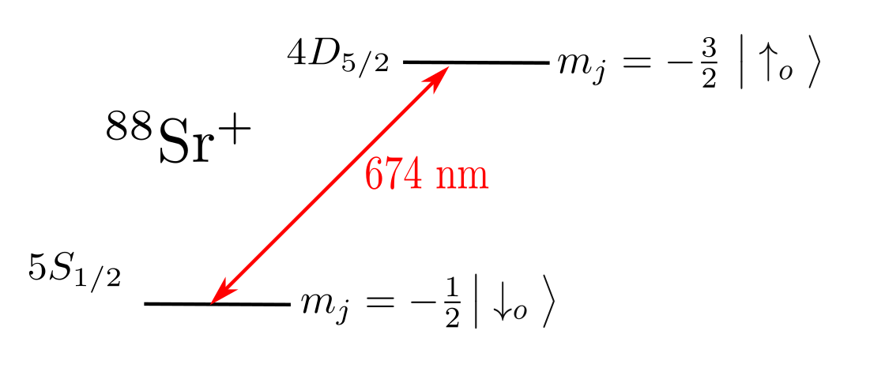
Lattice in the lab

Slide 11
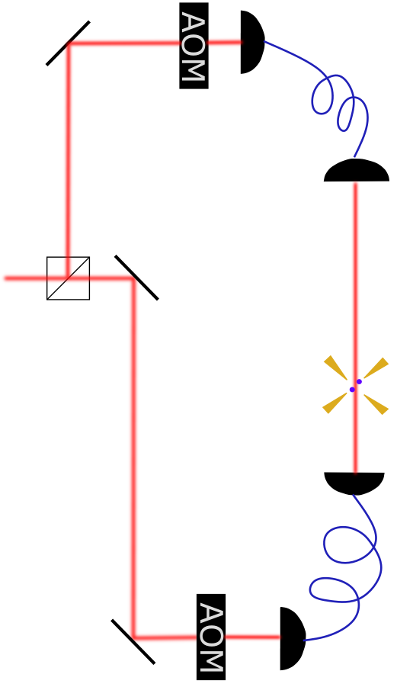


Lattice in the lab
Branch 1
Ω, $φ_{1}$
ion
trap
Branch 2
Ω, $φ_{2}$

Slide 12
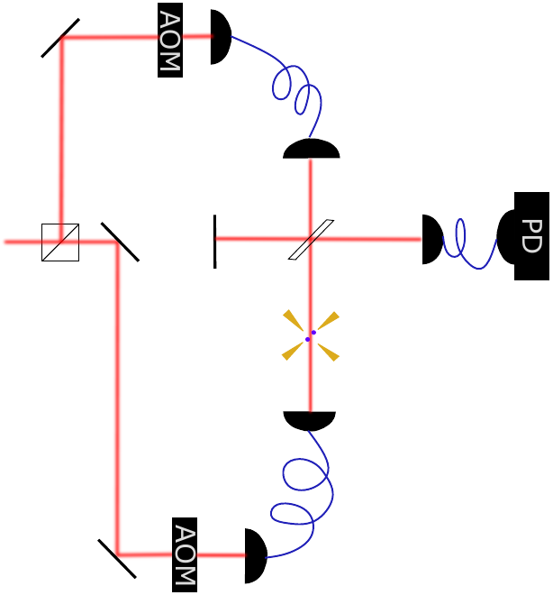
Lattice in the lab
Feedback loop 1: Stabilise phase at photodiode, PD (every ~4 ms)
Branch 1
Ω, $φ_{1}$
30 cm
ion
trap
Branch 2
Ω, $φ_{2}$

Slide 13
Lattice in the lab
Feedback loop 1: Stabilise phase at photodiode, PD (every ~4 ms)
Branch 1
Ω, $φ_{1}$
30 cm
ion
trap
Branch 2
Ω, $φ_{2}$
Feedback loop 2: Measure offset
between photodiode phase and
ion lattice phase and correct for it
(every 0.4 s)

Slide 14
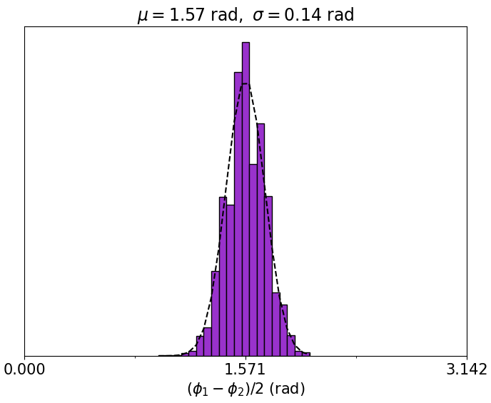
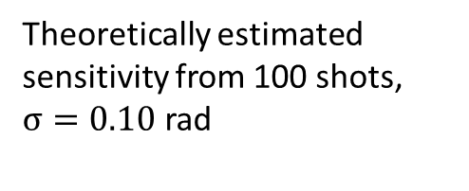
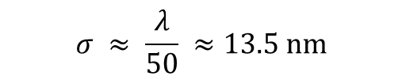
Phase stabilisation performance
$$σ ≈ \frac{λ}{50} ≈13.5 nm$$
Theoretically estimated sensitivity from 100 shots, $σ=0.10$ rad

Slide 15
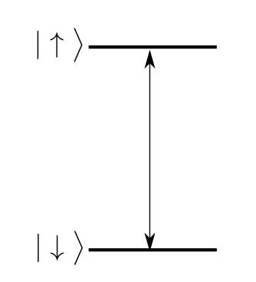
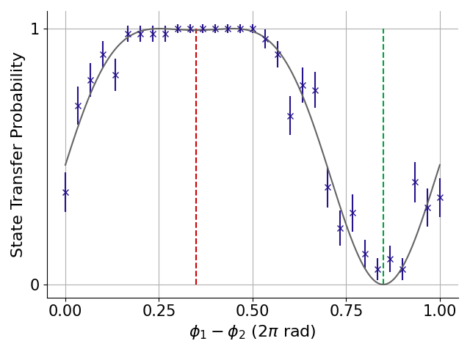


Lattice scans
$$φ_{1}$$
$$φ_{2}$$
Scan the relative phase between the two branches

Slide 16
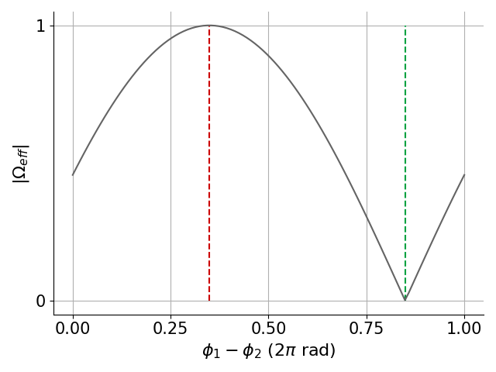
Lattice scans
$$φ_{1}$$
$$φ_{2}$$
Scan the relative phase between the two branches
$${Probability \sim sin}^{2}\left(Ω\sin\left(φ_{1}−φ_{2}\right)\right)=\sin^{2}\left(Ω_{eff}\right)$$

Slide 17
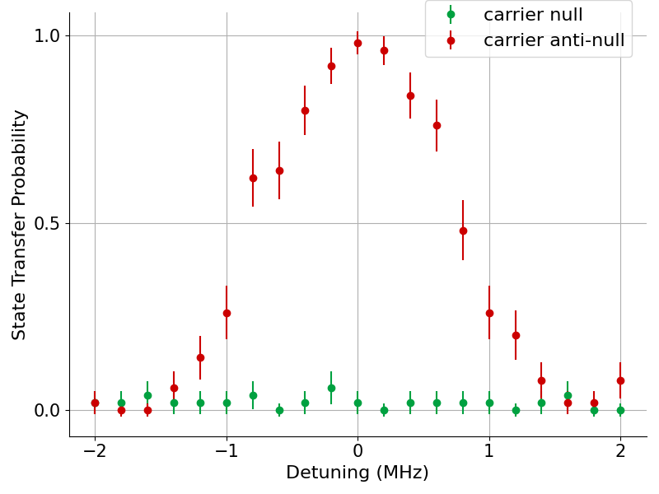
Lattice scans
$$φ_{1}$$
$$φ_{2}$$
Scan the relative phase between the two branches

Slide 18
Lattice scans
$$φ_{1}$$
$$φ_{2}$$
Scan the relative phase between the two branches

Slide 19
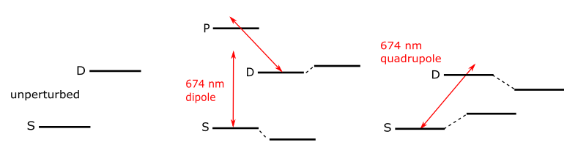
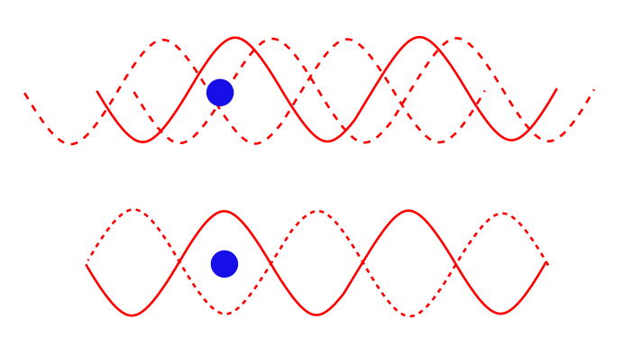


Light-shifts (LS) when sitting at carrier null
Travelling wave (TW)
combined effect: LS dipole + LS quadrupole
LS dipole ~ $E$
Standing wave (SW)
LS quadrupole ~ $∂_{x}E$

Slide 20
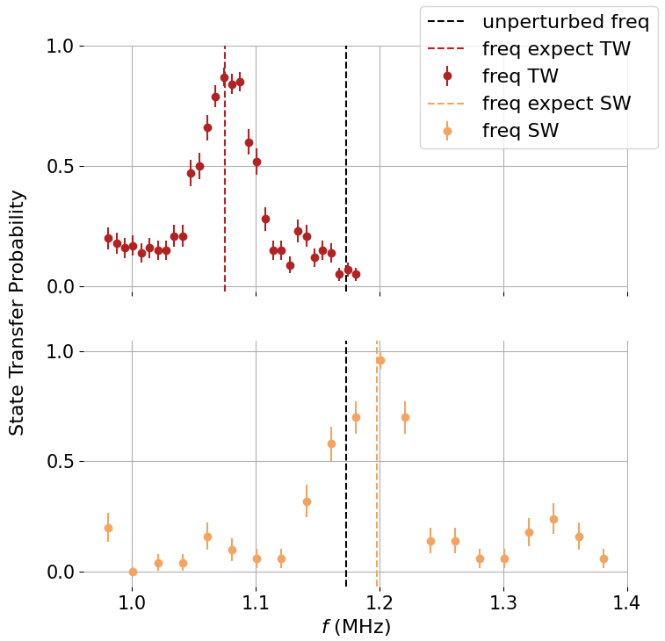


Light-shifts when sitting at carrier null
TW
$$\text{5 }\text{mW}$$
$$∆f=f_{LS_dipole}+ f_{LS_quadrupole}$$
SW
5 mW
5 mW
$$∆f={4f}_{LS_dipole}$$

Slide 21
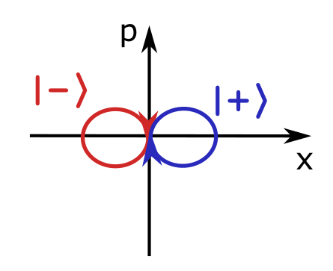
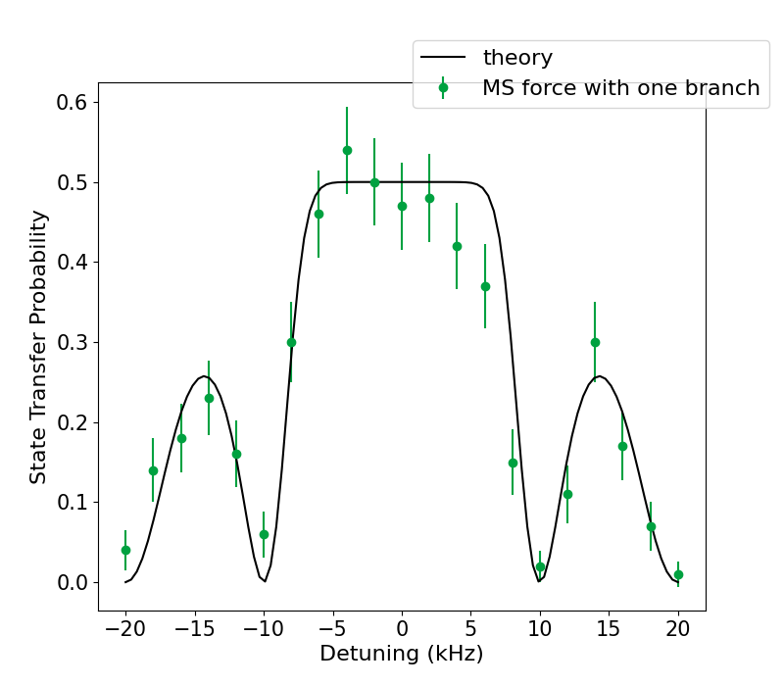
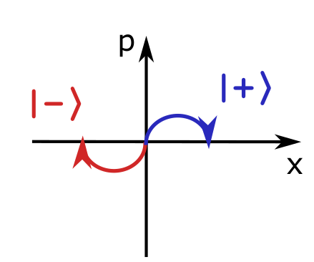
Spin-dependent force with a bichromatic lattice
standard MS
1 mW

Slide 22
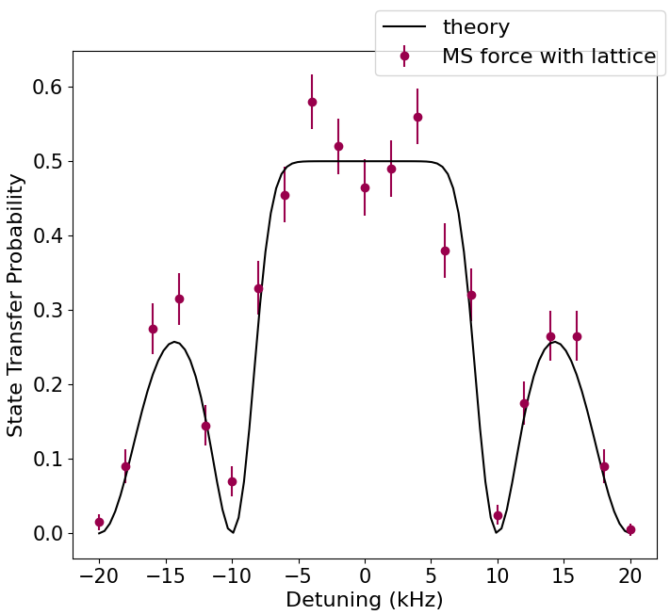


Spin-dependent force with a bichromatic lattice
Standard MS, 1 mW Lattice MS, 0.25 mW each branch
$$φ_{1}$$
$$φ_{2}$$

Slide 23
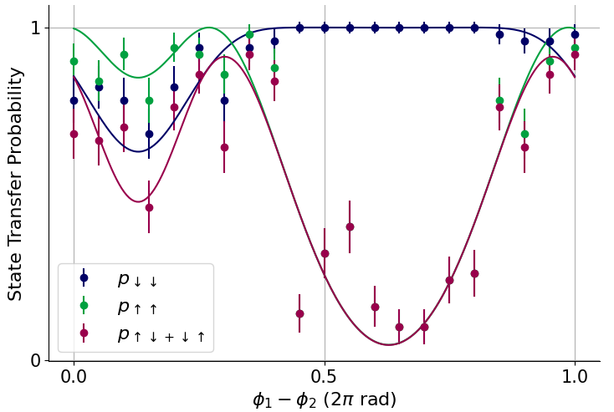
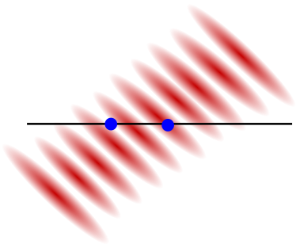
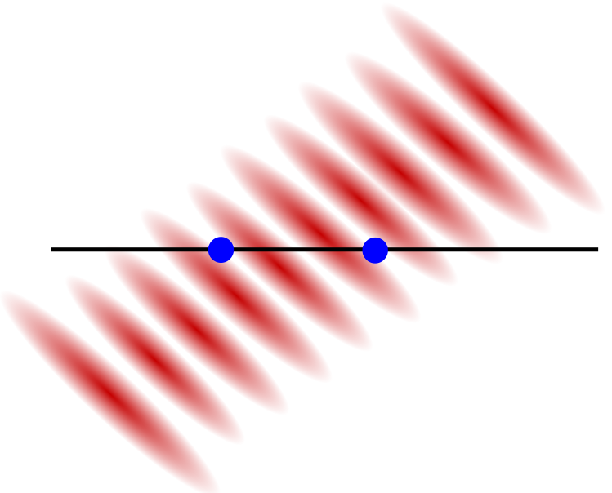
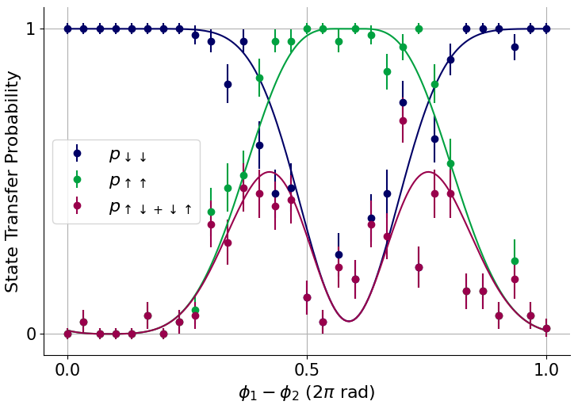


2 ions?
Position in the lattice
$$φ_{1}$$
$$φ_{2}$$

Slide 24
Summary
Understanding of the lattice Physics
Spin–dependent force on a single ion with the lattice
Outlook
Lattice MS on two ions
Lattice MS vs standard MS at high powers

Slide 25
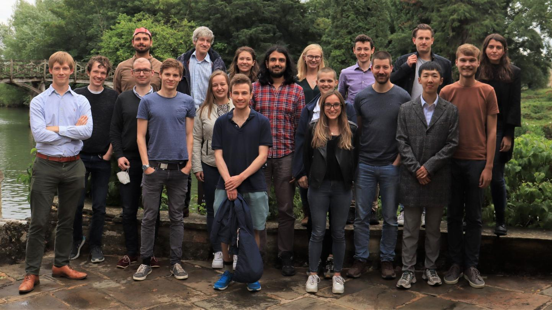




Team
Main project:
Sebastian Saner
Mariella Minder
David Lucas (PI)
Chris Balance (PI)
Useful discussions:
Raghavendra Srinivas
Gabriel Araneda
Marius Weber
Helped with the hardware and software:
Peter Drmota
David Nadlinger

Slide 26
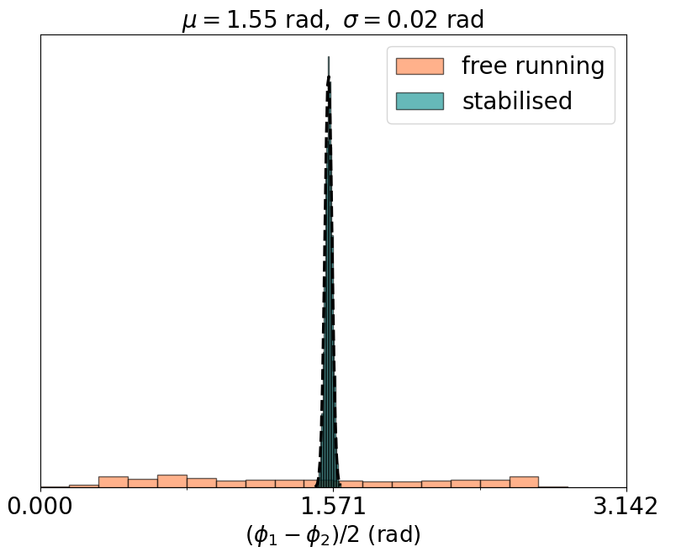

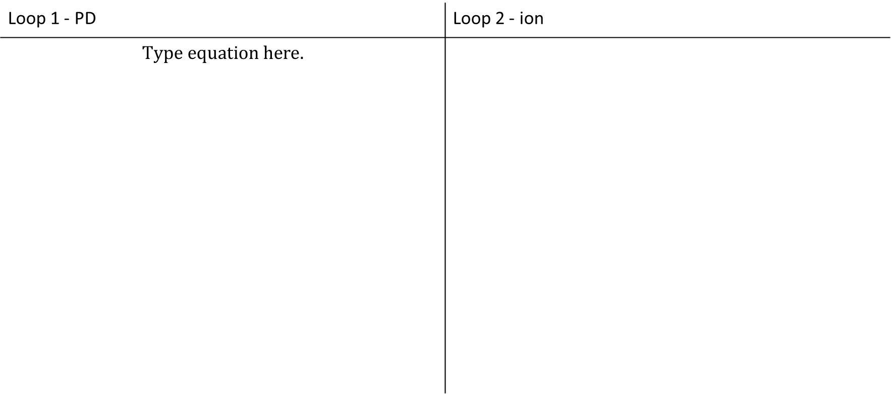
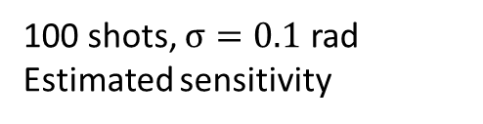
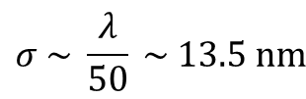
Feedback loops performance
Loop 1 - PD | Loop 2 - ion
$$σ \sim \frac{λ}{300} \sim 2.2 nm$$
Feedback loop applied continuously
$$σ \sim \frac{λ}{50} \sim 13.5 nm$$
100 shots, $σ=0.1$ rad
Estimated sensitivity

