Slide 1

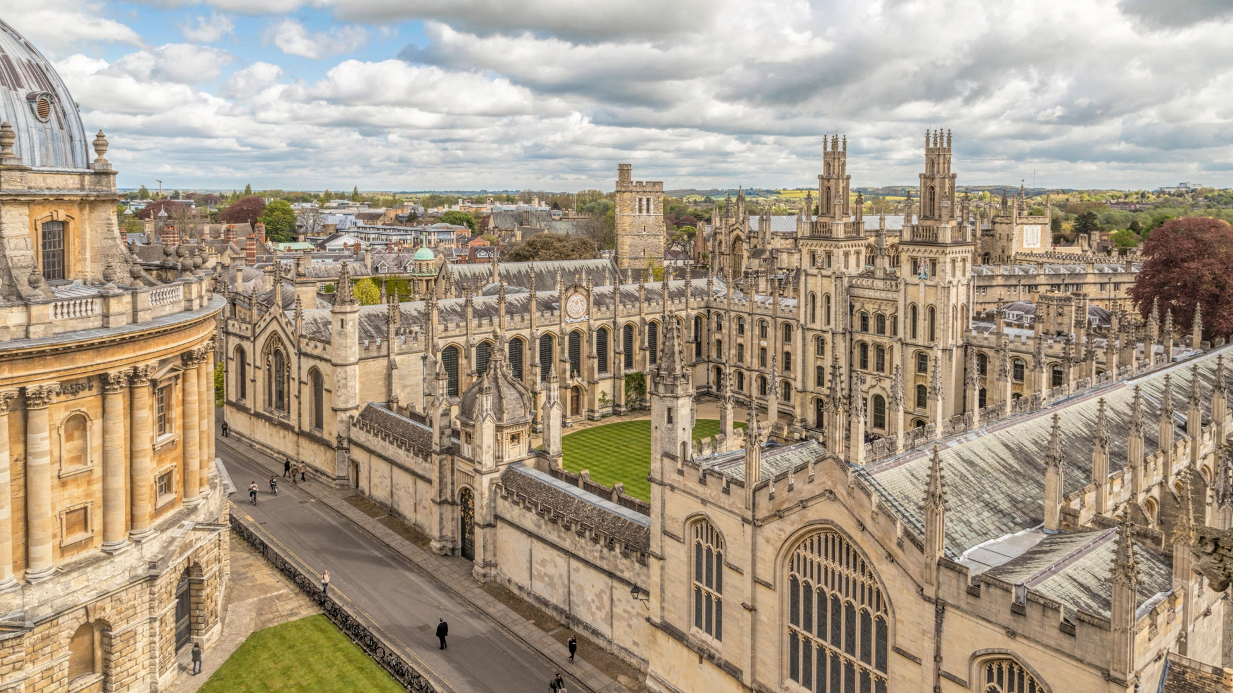


A two-node trapped-ion quantum network with photonics interconnects
Gabriel Araneda

Slide 2
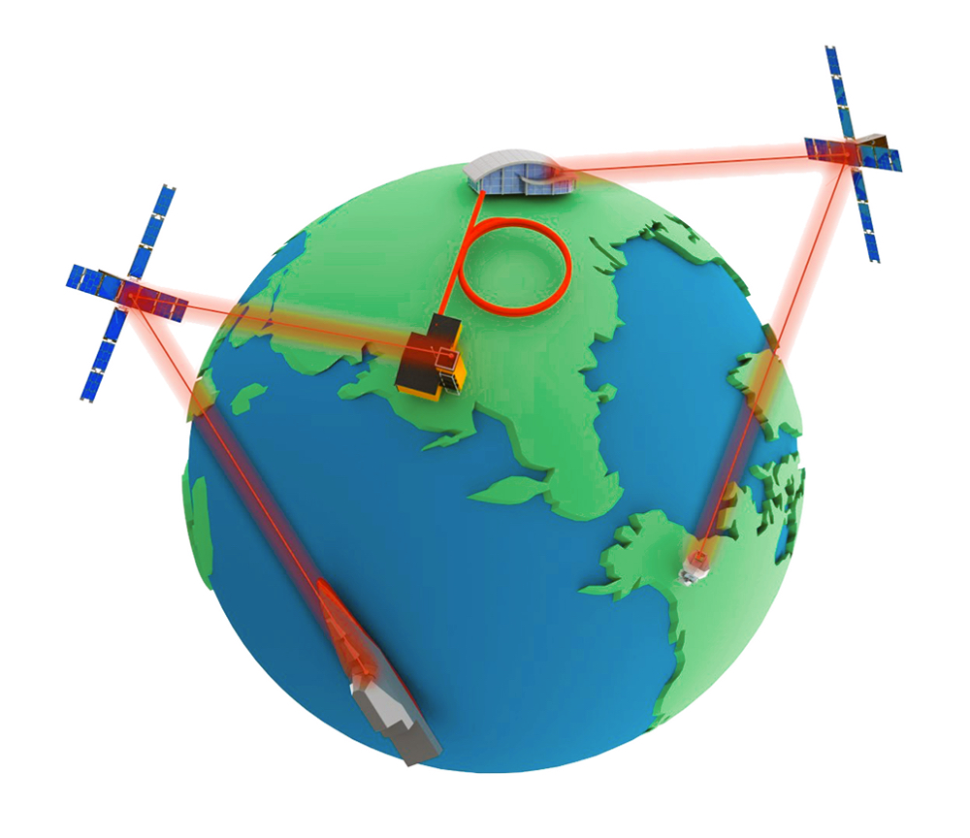
Quantum Networks
Candidates:
Traveling qubits / entanglement bus:
Photons
Memory / processing qubits:
NV-centres / silicon
Single neutral atoms
Super conducting qubits
Doped Crystals
Atomic clouds
Trapped ions
Useful for:
Secure communications
Remote and enhanced metrology
Distributed quantum computing
Blind quantum computing
Clock synchronisation / comparison
We want them all!
Mael Flament, Stony Brook University.

Slide 3
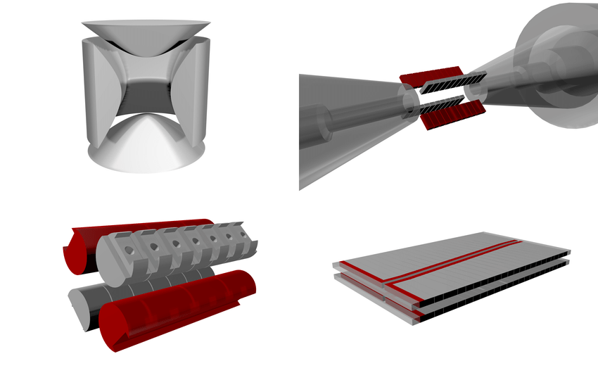
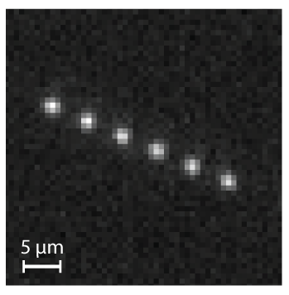
Ions trapped in Paul traps
Single and two qubit gates fidelities > 99,9 %
Gate times ~ 100 us
Coherences times > 1 s
Emission in the UV, V and IR
Make good Quantum Computers
Make excellent Atomic Clocks / sensors
Good network nodes?
Johannes Heinrich
Trapped-ion quantum computing: Progress and challenges
Applied Physics Reviews 6, 021314 (2019);
Colin D. Bruzewicza et al.
Chain of six Barium ions
Notes:
Our group had a great role in developing of applications
About 100 years ago, doing experiments with single atoms or photons was consider impossible
There were even considered mere mathematical objects, useful to describe some macroscopically phenomena
Here we are, doing experiments with single atoms, controlling their internal states, creating entanglement, etc

Slide 4
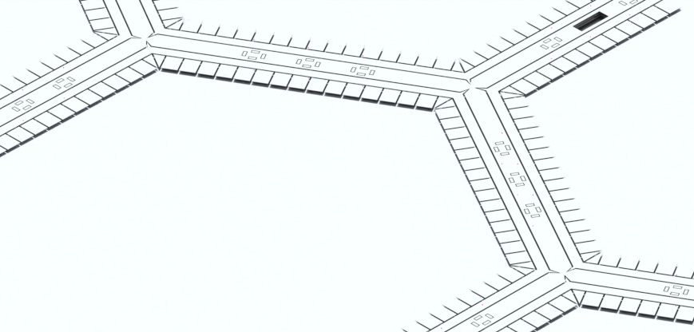
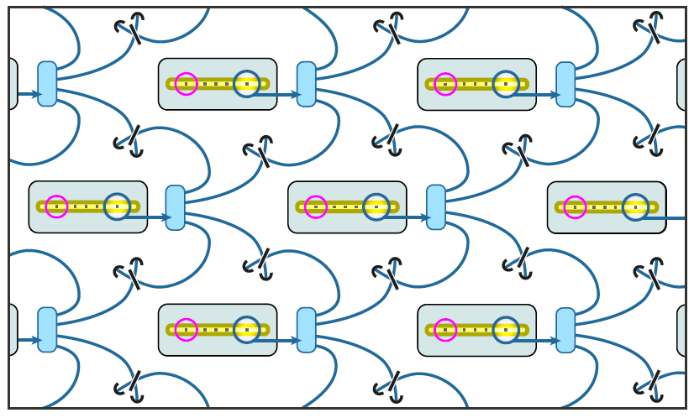
The problem with trapped ions and quantum computing
Building a large scale quantum processor with many ions in the same trap is difficult (spectral crowding, laser control, etc)
Network of ‘big enough’ modules
+ photonic entanglement
Monolithic QCCD
Physically displace the ion qubits
Wineland et al., J.Res.NIST 1998
J.I. Cirac et al., PRL 1997
Notes:
Once crystals cannot get any bigger, need to connect multiple crystals
QCCD -> shuttling slow (motional frequencies)
Optically connected crystals -> connectivity by photons, easier routing, /potentially/ faster

Slide 5
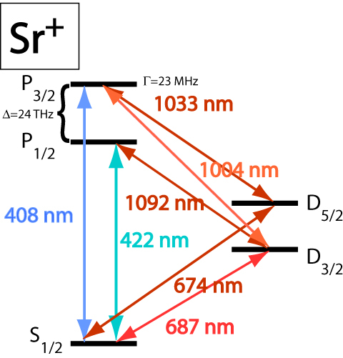
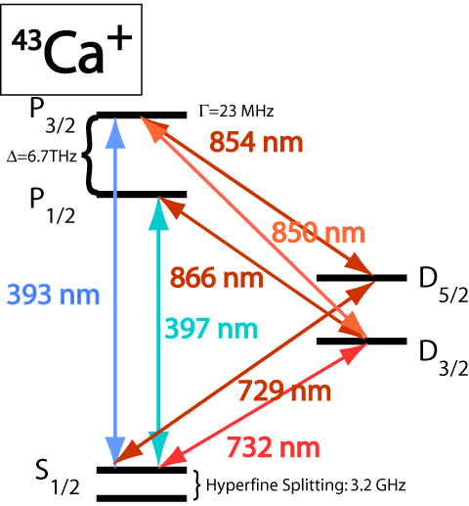
This talk:
A simple two-node quantum computer
Requirements:
~10 qubits in each trap
High fidelity single and two-qubit gates in each trap
  Single species. ☺
  Multispecies (Raman, WORK IN PROGRESS)
High fidelity entanglement between the two-traps.
Remote entanglement ion
Remote entanglement
~ 2 m separation
Expandable and easy to reconfigure to more complex networks, e.g. using optical switches
Computation ion

Slide 6
Contents
1. Remote entanglement via photonic links
2. Towards a two-node quantum computer
3. A quantum network of entangled optical atomic clocks.

Slide 7

Heralded ion-photon entanglement
State preparation
$${}^{88}Sr^{+}$$
Pulsed Excitation
Photon emission
~1 µs
Detector click(s)?
NO
YES
Photon at 422 nm
Entanglement!
Notes:
Pulse 1 ps

Slide 8
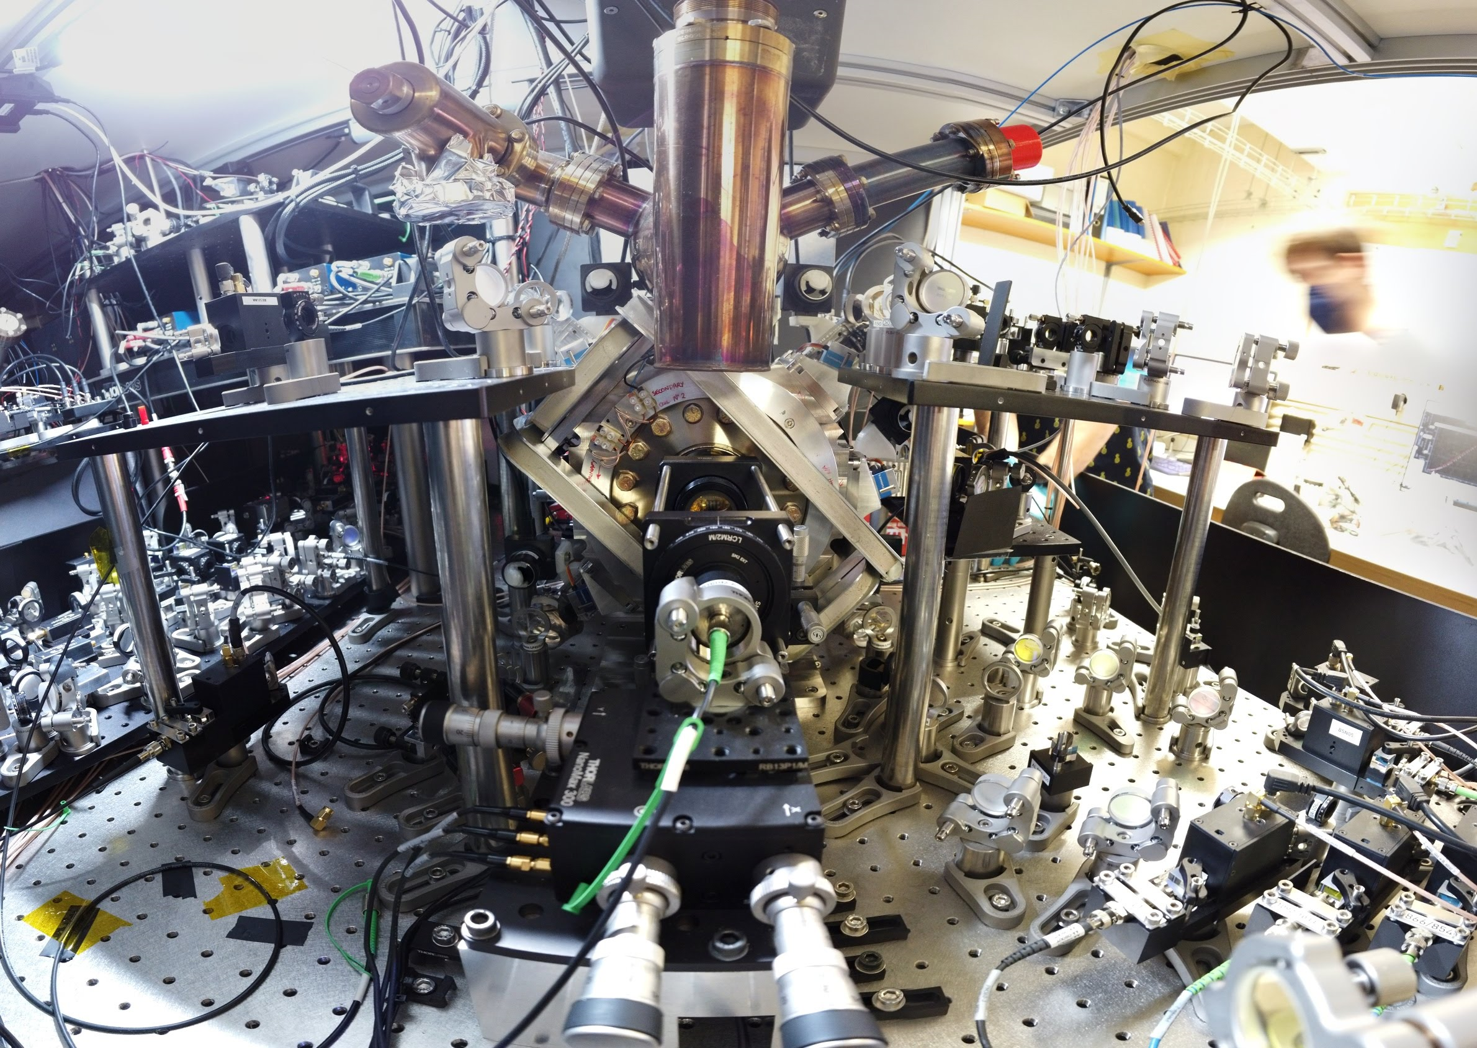
NA = 0.6 lens and fiber + detectors
2 % end-to-end efficiency

Slide 9
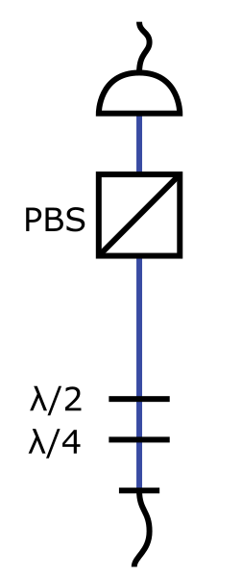
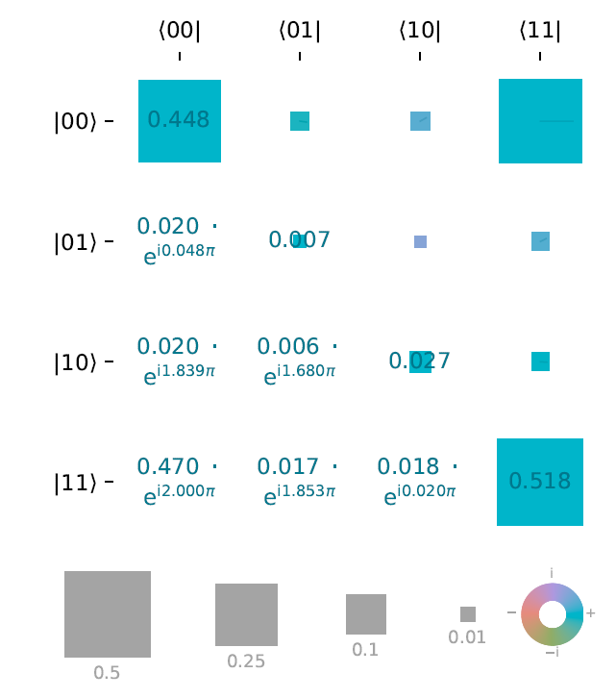

Heralded ion-photon entanglement
Photon from ion:
ion-photon fidelity = 98.0(1)%
At 20k entangled events/s
Notes:
This is already a useful tool: blind quantum computing
3:98 kHz (5:68 kHz)

Slide 10
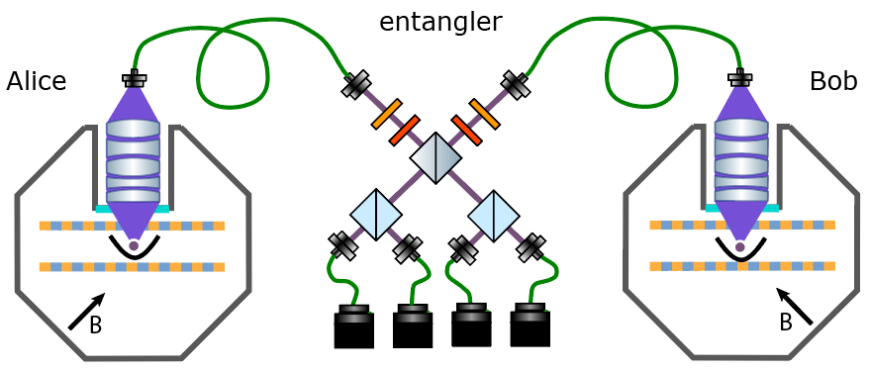
Heralded ion-ion entanglement via swapping
From Alice
From Bob
2 m separation
Bell Measurement of the two-photon state heralded by coincidence clicks
We can detect only 2/4 outcomes
Moehring, D. L. et al., Nature, 449 6871 (2007).
Notes:
Want to connect ions via photons
Cannot connect directly due to loss (no herald)
So project out photons
30 ns window

Slide 11
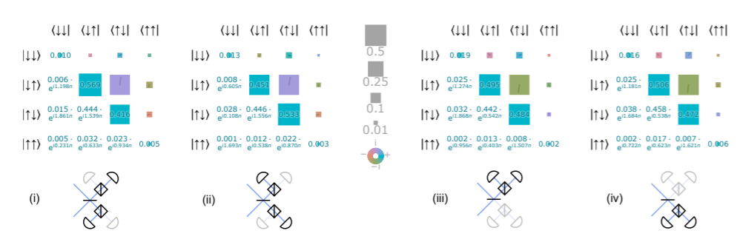


ion-ion tomography
$$\left|ψ^{+}\right\rangle =\frac{1}{\sqrt{2}}(|10⟩+|01⟩)$$
$$\left|ψ^{−}\right\rangle =\frac{1}{\sqrt{2}}(|10⟩−|01⟩)$$
Updated results
Fidelity to Bell state = 96.0(2)%
Bell - CHSH parameter = 2.677(6) (112 sigma violation)
100 entangled events / s
High-rate, high-fidelity entanglement of qubits across an elementary quantum network
L. J. Stephenson, et. Al.
Phys. Rev. Lett. 124, 110501

Slide 12
Contents
1. Remote entanglement via photonic links
2. Towards a two-node quantum computer
3. A quantum network of entangled optical atomic clocks.

Slide 13
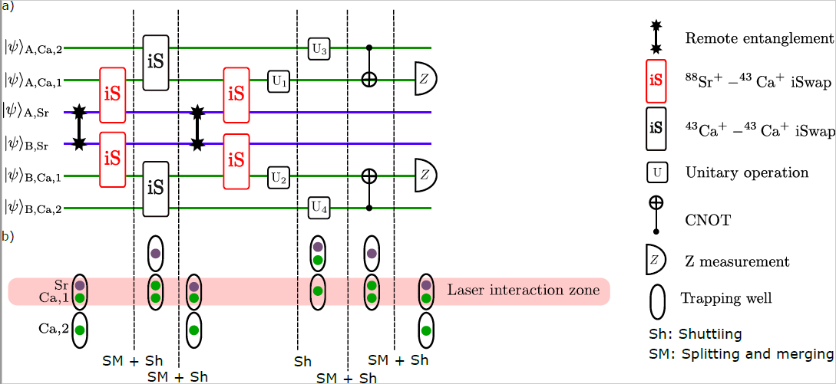
Entanglement swapping
96% fidelity is good, but for QC we need to go beyond 99%
Solution: Convert two pairs of raw entanglement into a pair high fidelity entanglement

Slide 14
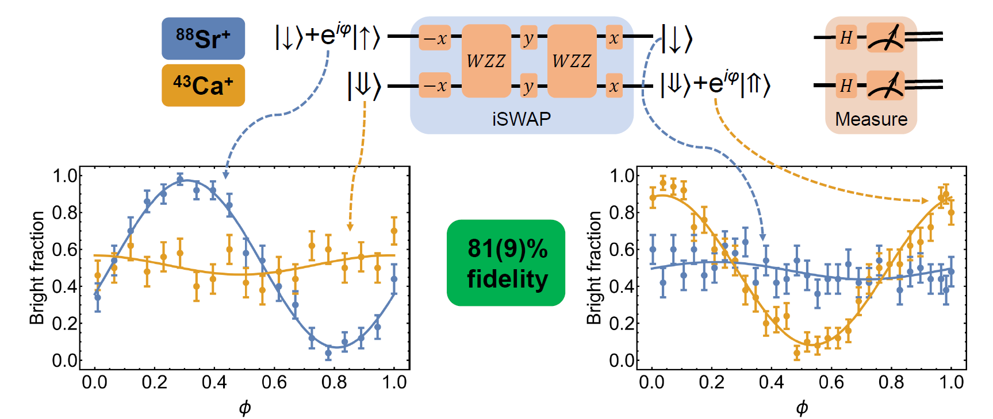
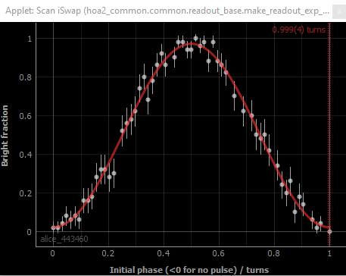
Work in one node:
Multispecies iSwap via Raman interactions
95 % !

Slide 15
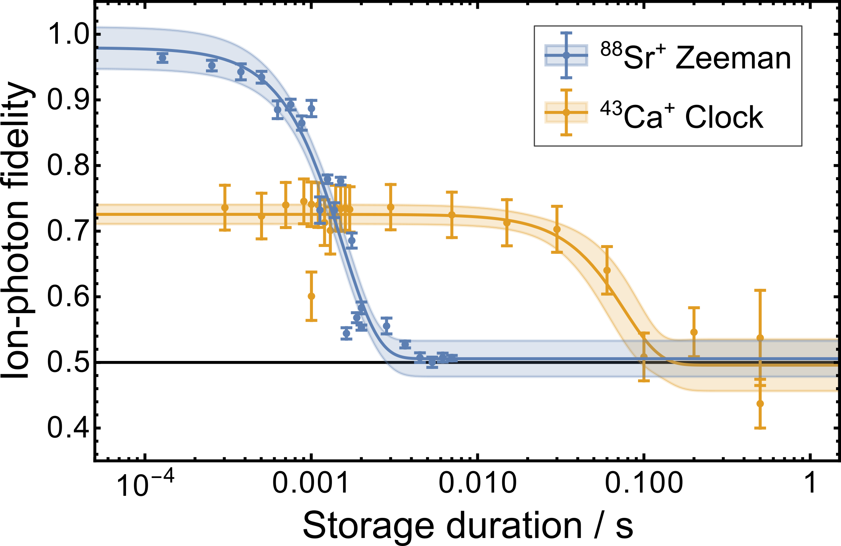
Long-lived ion-photon entanglement in the Ca Clock qubit
Main limitation: Sr-Ca gate (85% fidelity for this measurement, Raman lock was off)
Best so far 90%, and more than 1 s

Slide 16
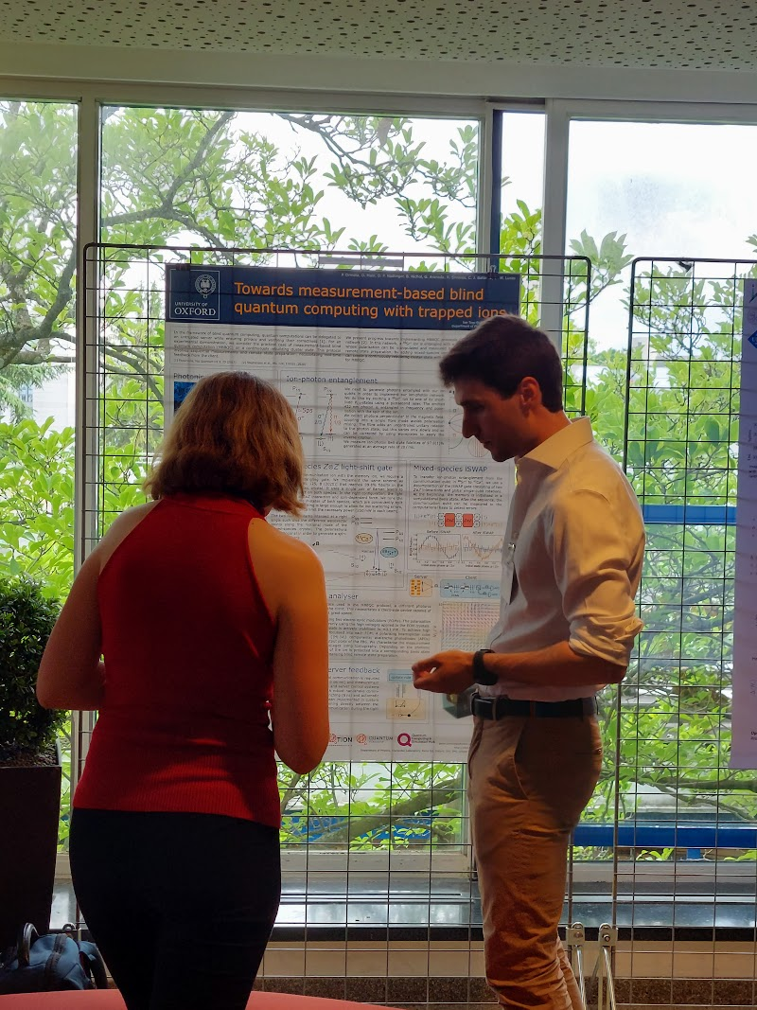
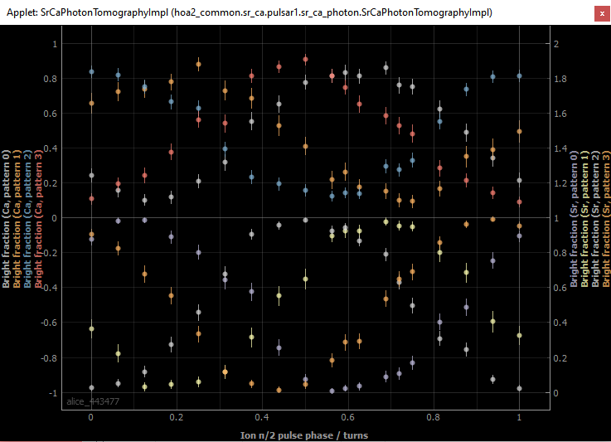
Consecutive generation of two ion-photon pairs
Entangle Sr-photon
Transfer entanglement to Calcium
Measure Calcium
Cool Sr and create a second Sr-photon pair
Measure Sr
More info at Peter Drmota’s poster two days ago .
Preliminary results:
It works

Slide 17
Contents
1. Remote entanglement via photonic links
2. Towards a two-node quantum computer
3. A quantum network of entangled optical atomic clocks.

Slide 18
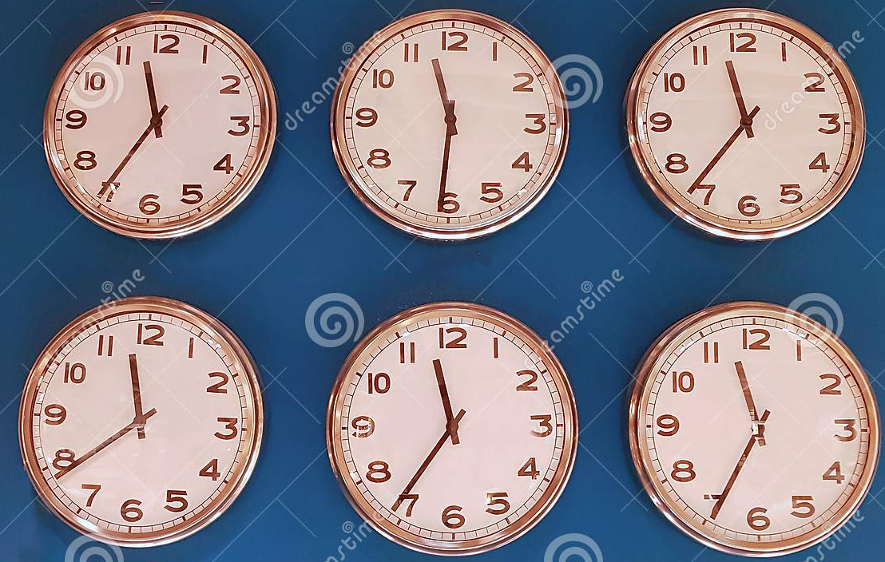
Atomic clock comparison
Tick frequency depends on the environment around.
Comparing clocks is useful for:
Probing the properties of dark matter
Space-time variation of fundamental constants
High precision geodesy
Most accurate optical atomic clock in the world is a trapped ion, fractional uncertainty < 10⁻¹⁸

Slide 19
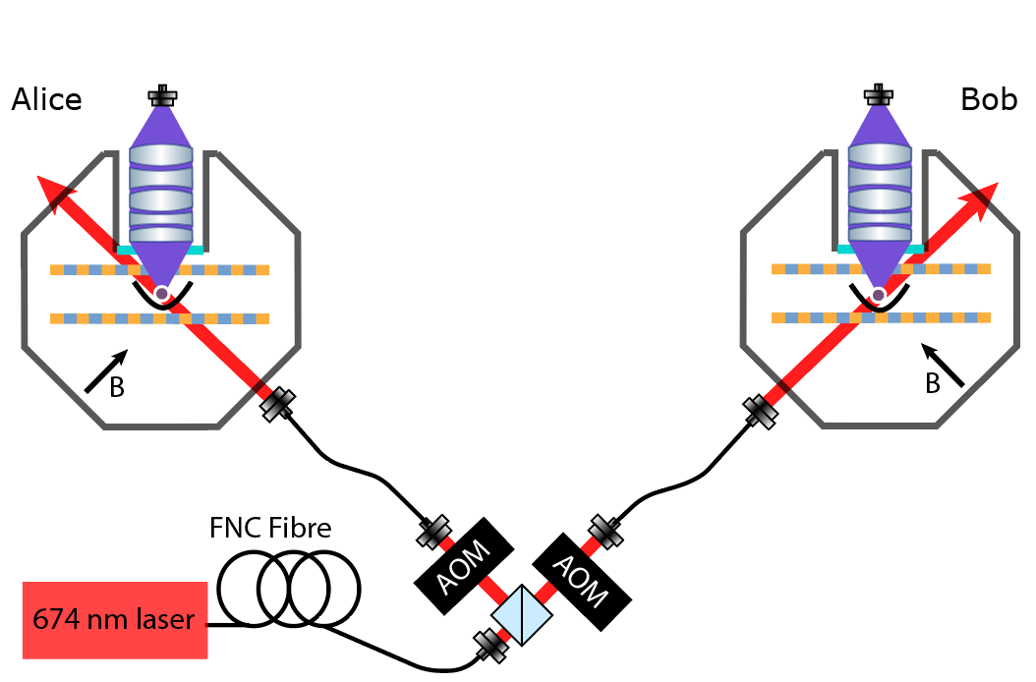
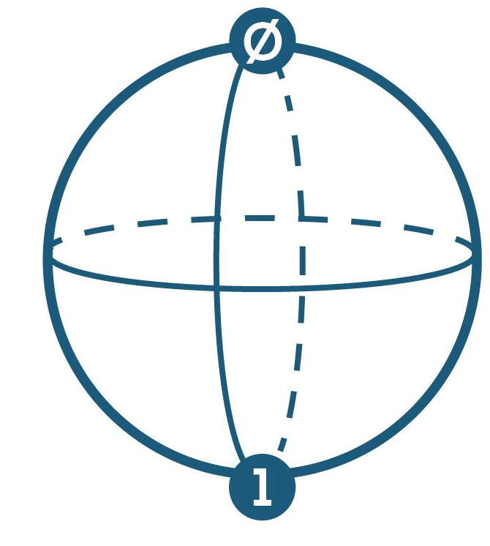
Correlation Spectroscopy
Use correlated Ramsey experiments to measure simultaneously
Main advantage:
Probe times much longer than laser coherence time.
Useful to measure extremely small changes in a transition frequency due to anything, e.g., gravitation
Clements, E. R. et al. Phys. Rev. Lett. 125, 243602 (2020).

Slide 20
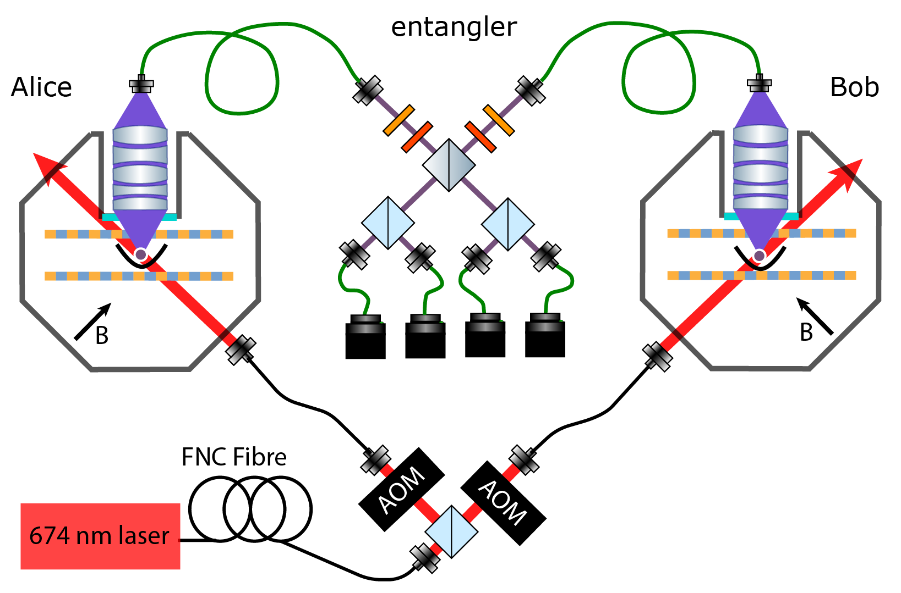
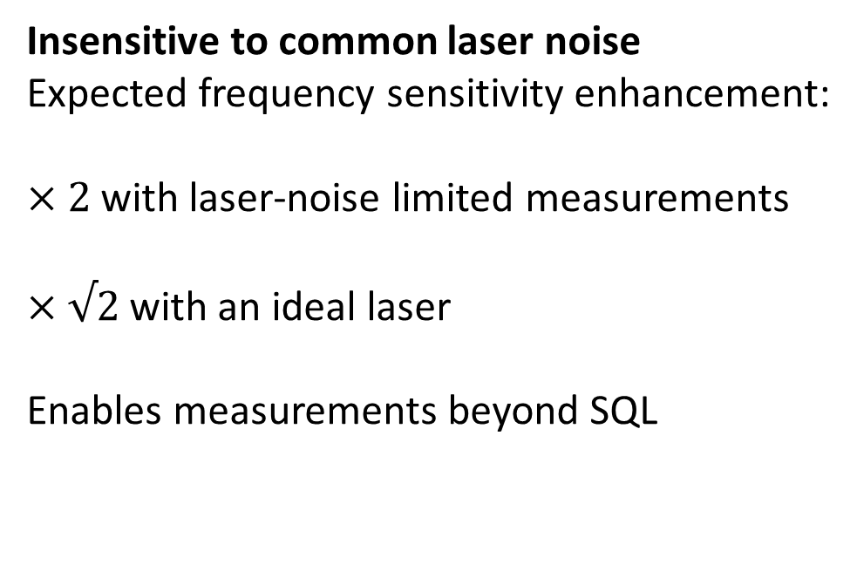
Correlation Spectroscopy with entangled atoms
Insensitive to common laser noise
Expected frequency sensitivity enhancement:
$×2$ with laser-noise limited measurements
$×√2$ with an ideal laser
Enables measurements beyond SQL

Slide 21
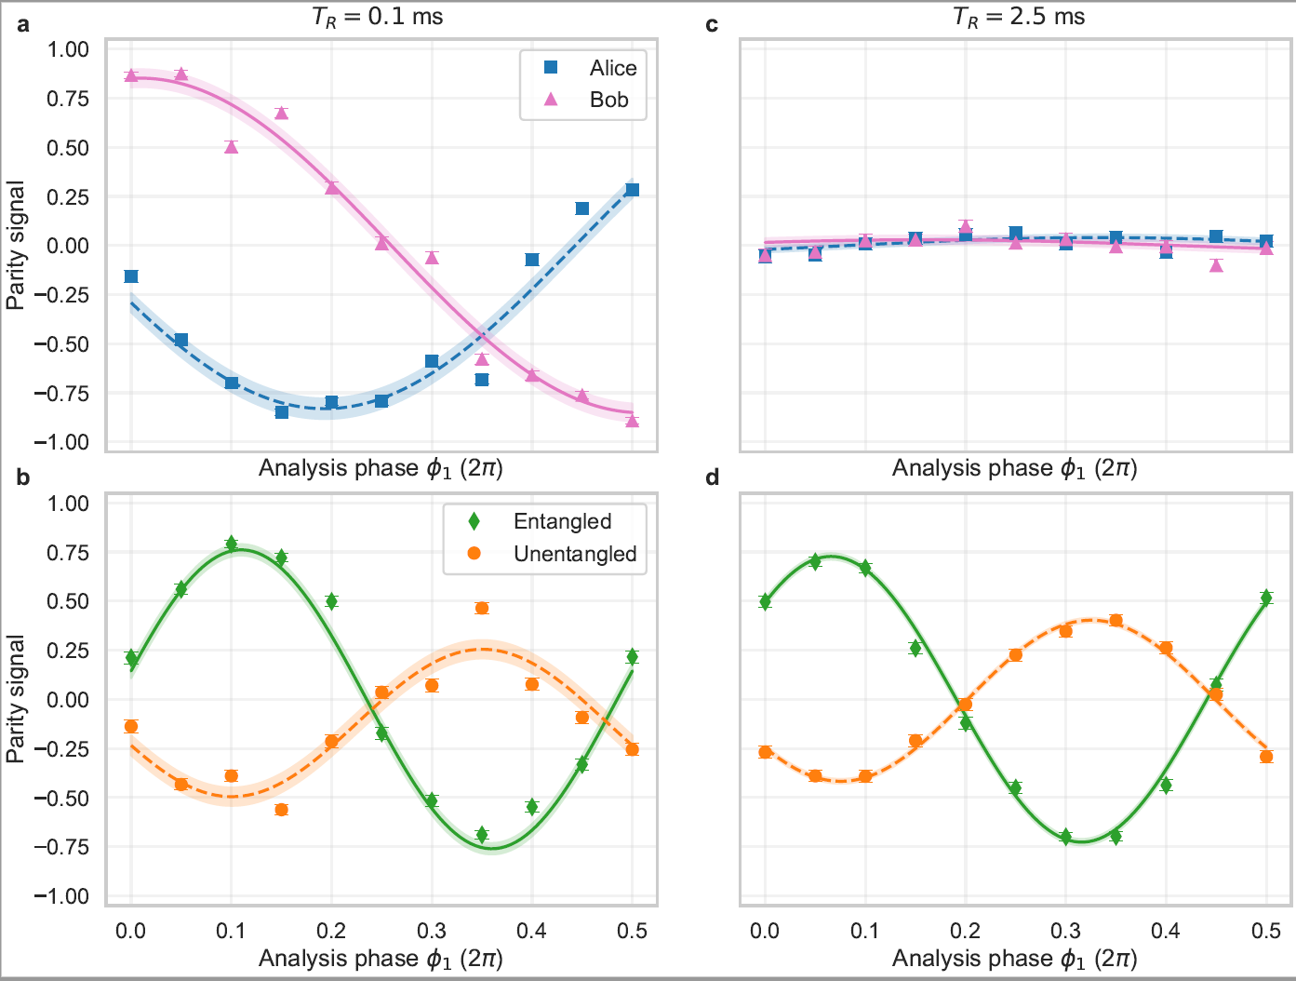

Slide 22
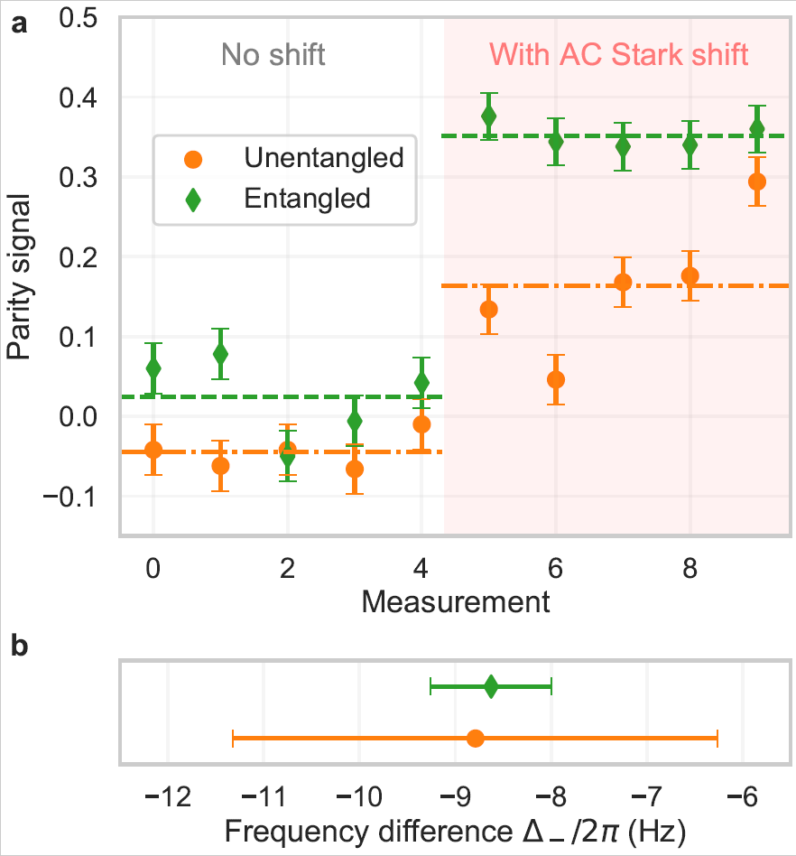
arXiv:2111.10336
Entanglement enhanced frequency comparison
A quantum network of entangled optical atomic clocks.
arXiv:2111.10336
B. C. Nichol, R. Srinivas, D. P. Nadlinger, P. Drmota, D. Main, G. Araneda, C. J. Ballance, D. M. Lucas
Accepted in Nature

Slide 23
Conclusion and outlook
We have build a toy two-node quantum network
And probably, we will have toy two-node quantum computer
We will be using it for quantum information, metrology, computation and communications (NEXT TALK!).
Still a lot of work to do
Connecting more nodes is trivial, but building the nodes is not trivial, nor extending the control system
Build a real remote network will be possible, but not our focus at this point. It will require frequency conversion of the photons.
"Interface between Trapped-Ion Qubits and Traveling Photons with Close-to-Optimal Efficiency"
Josef Schupp et. Al, PRX Quantum 2, 020331 (2021)

Slide 24
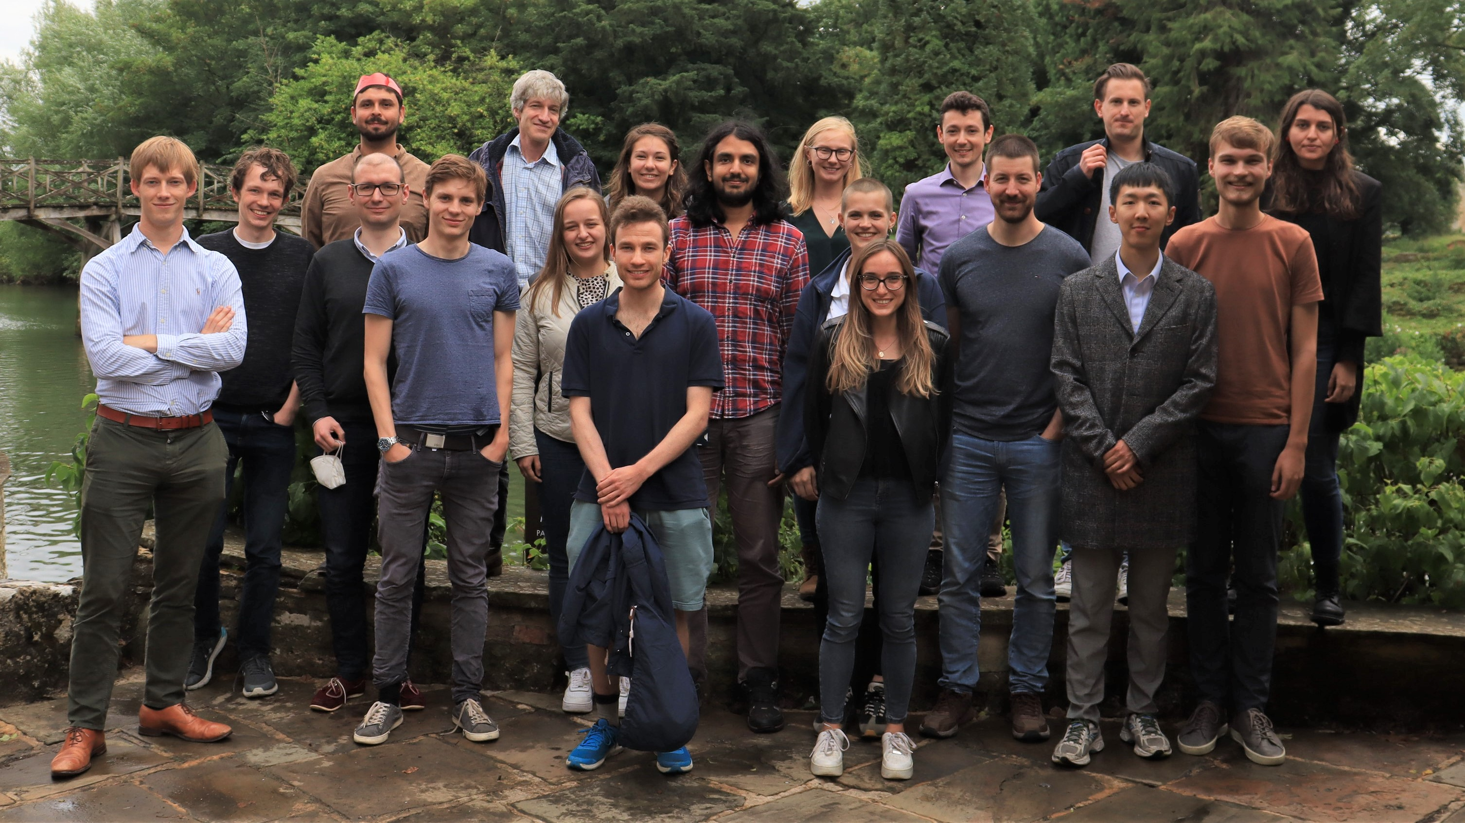


The Oxford team
Students:
D. Nadlinger
B. Nichol
P. Drmota
D. Main
E. Ainley
Postdocs:
R. Srinivas
G. Araneda
Seniors:
C. Ballance
D. Lucas

