Slide 1
NG vs X
LINAC 4
Piotr Skowronski

Slide 2
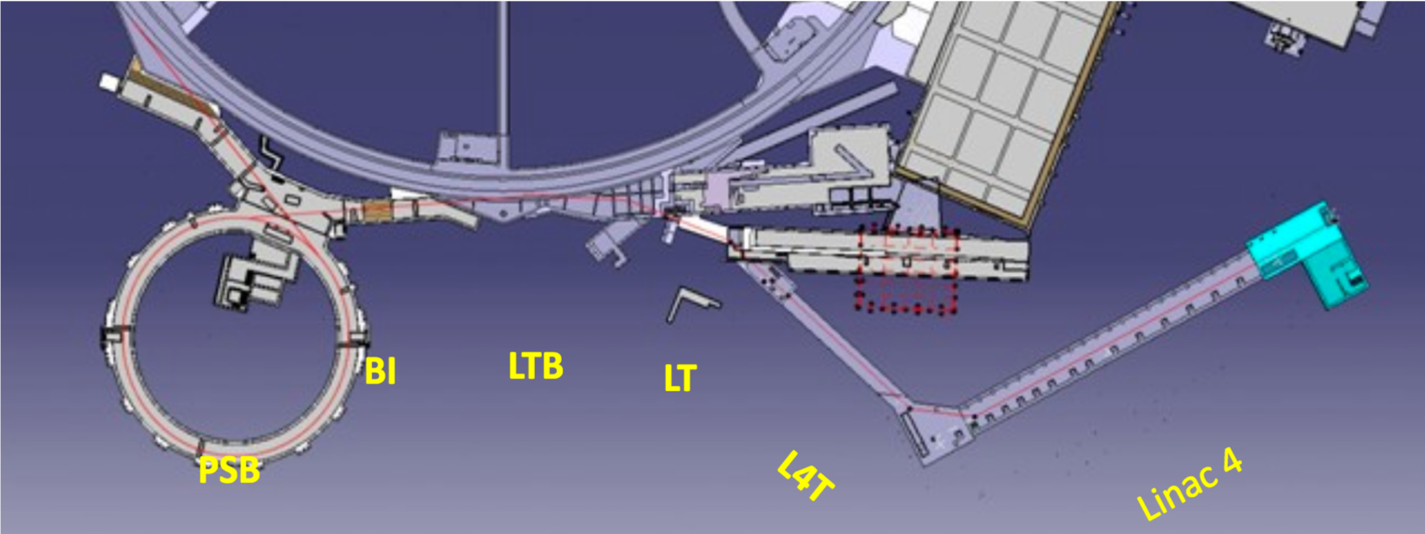
Object under study
Transfer lines from Linac4 to PSB (L4T + LT + LTB + BI)
LBE

Slide 3
Object under study
Transfer lines from Linac4 to PSB (L4T + LT + LTB + BI)
  Linac4 MADX model exists, but it is a complete fake
    No accelerating cavities in MADX, no space charge in MADX nor PTC
    One should compare with TraceWin or TRAVEL/PATH models
H⁻ @ 160.7 MeV (proton with two electrons)
Bends (H & V) and quads, plus one cavity in the middle
to regulate energy spread
  Cavity does not accelerate
  PTC required, because MADX does not have RF focusing
Not a straight forward model
  Dynamically stitched lines, each line defined separately in 2 files
  Model controlled via configuration variables

Slide 4
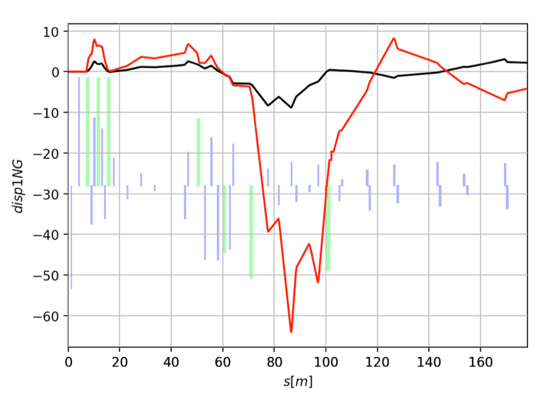
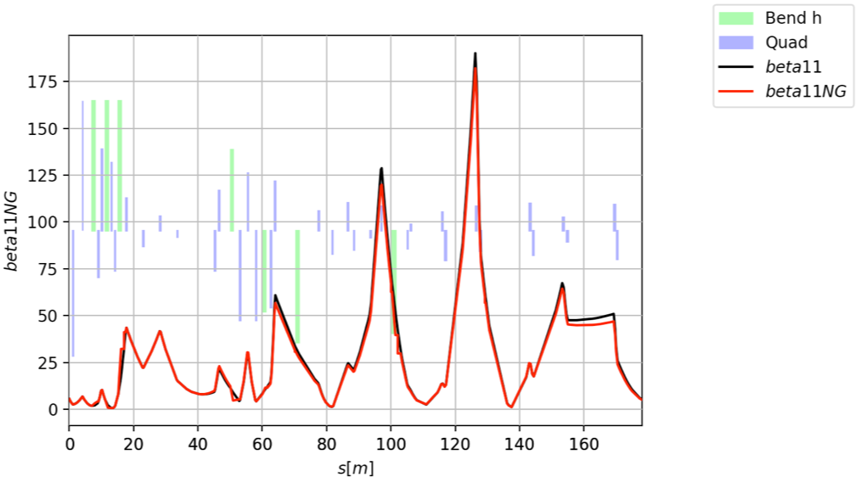
Result
There are big disagreements,
Laurent is investigating

