Slide 1
Experience with FCC-ee Lattice in MAD-NG
Leon van Riesen-Haupt, Laurent Deniau

Slide 2
Previous MADX-SAD Comparisons
Comparison of SAD and MAD-X for FCC-ee studies 11/09/2019
  Linear Optics
  Momentum Detuning
  Amplitude Detuning (Tracking)
Comparison of SAD and MAD-X for FCC-ee studies 06/11/2019
  Radiation effects
  Emittance
Radiation Integrals in MADX 20/05/2020
  Radiation Integrals in General
  Change of Radiation integrals with Momentum

Slide 3
Previous MADX-SAD Comparisons
Comparison of SAD and MAD-X for FCC-ee studies 11/09/2019
  Linear Optics
  Momentum Detuning
  Amplitude Detuning (Tracking)
Comparison of SAD and MAD-X for FCC-ee studies 06/11/2019
  Radiation Effects
  Emittance
Radiation Integrals in MADX 20/05/2020
  Radiation Integrals in General
  Change of Radiation Integrals with Momentum

Slide 4
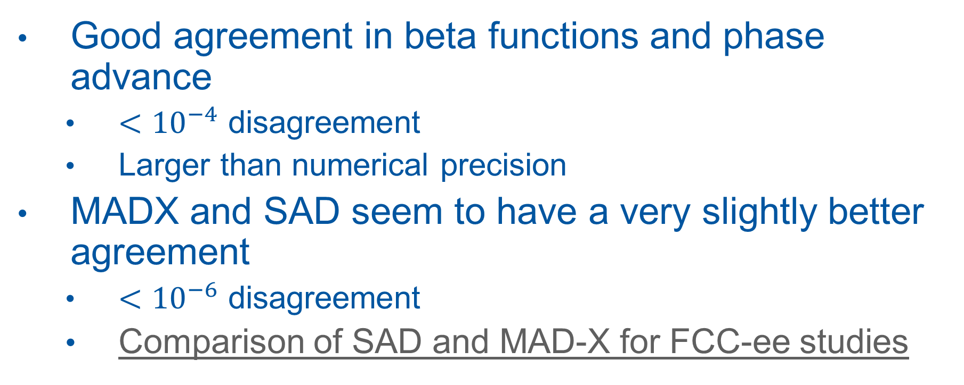
Linear Optics Comments
Good agreement in beta functions and phase advance
  $<{10}^{−4}$ disagreement
  Larger than numerical precision
MADX and SAD seem to have a very slightly better agreement
  $<{10}^{−6}$ disagreement
  Comparison of SAD and MAD-X for FCC-ee studies

Slide 5
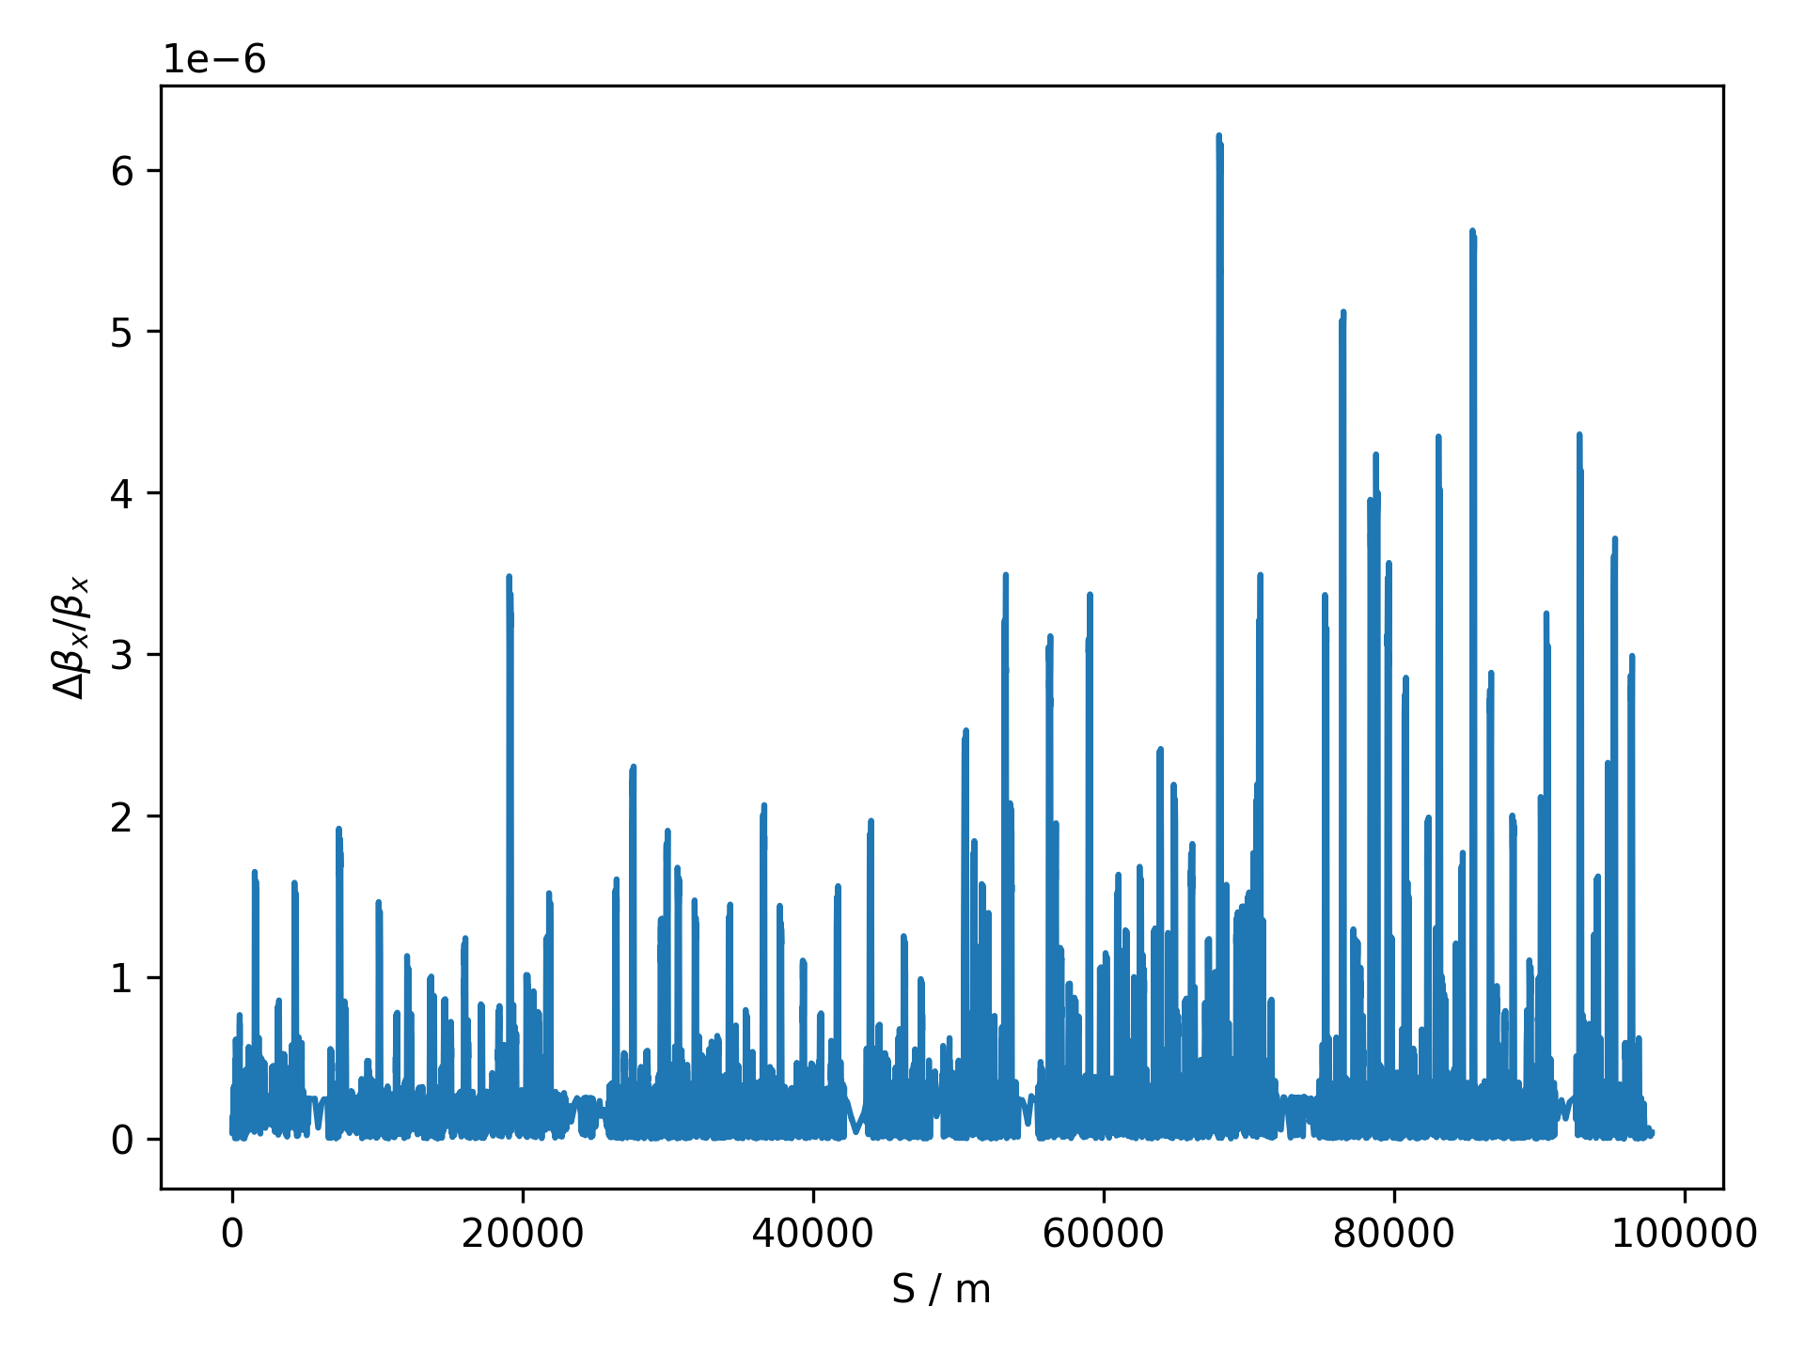
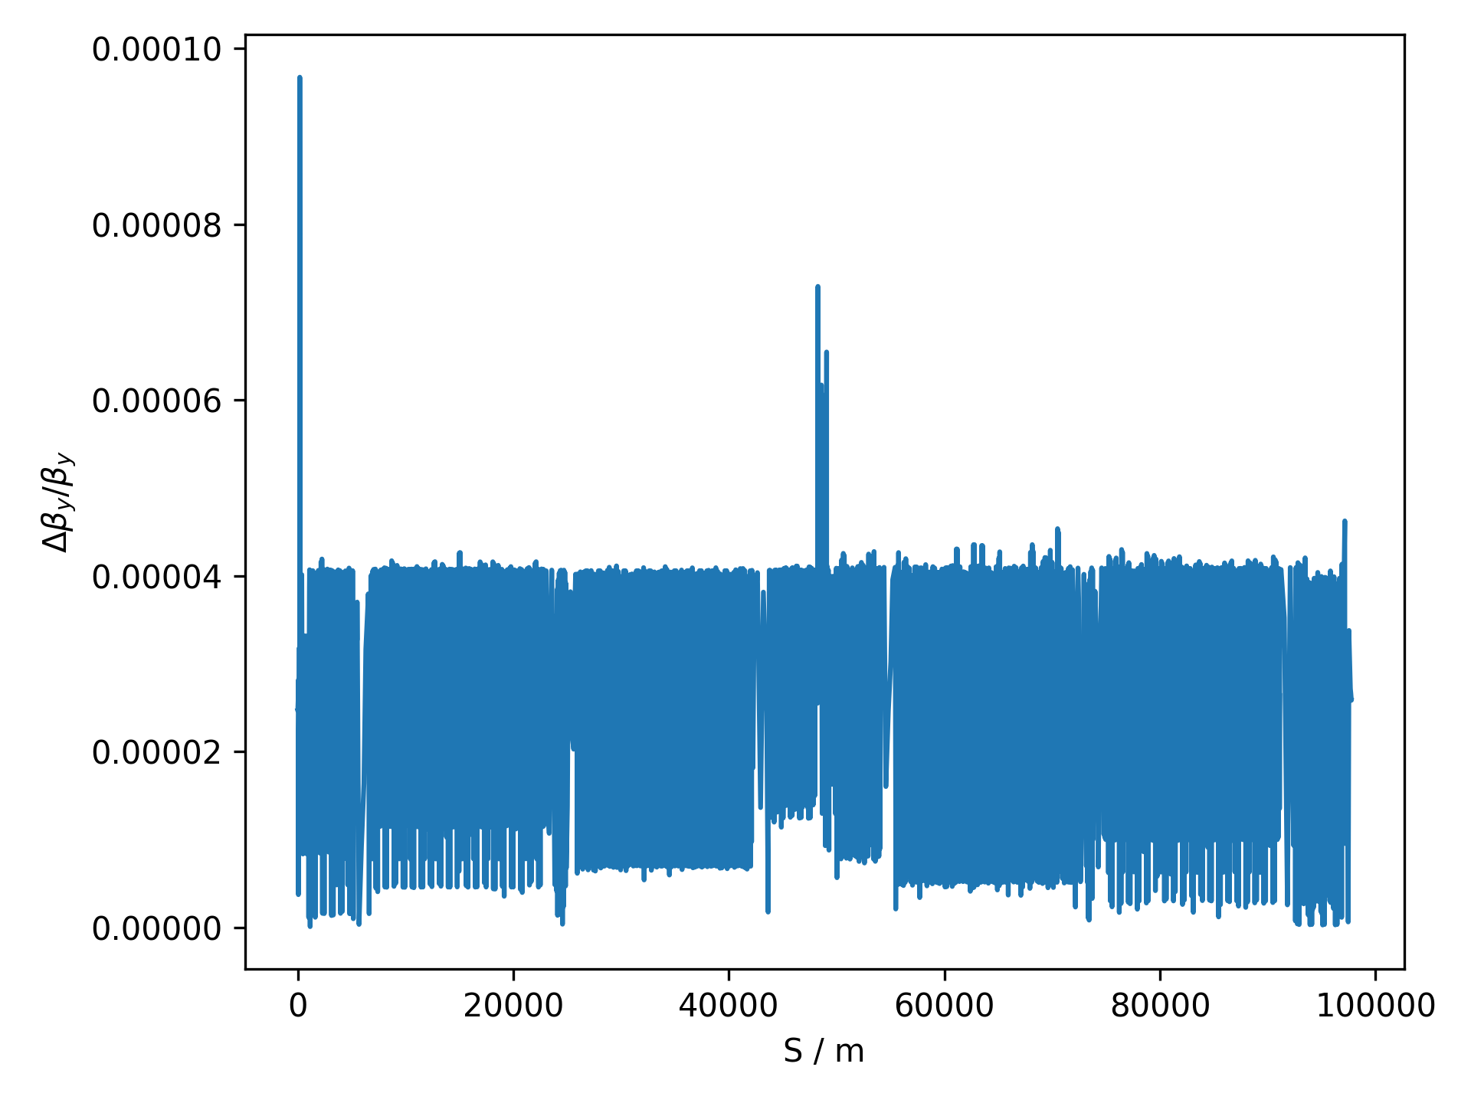
Beta Beat Between MADX and MAD-NG

Slide 6
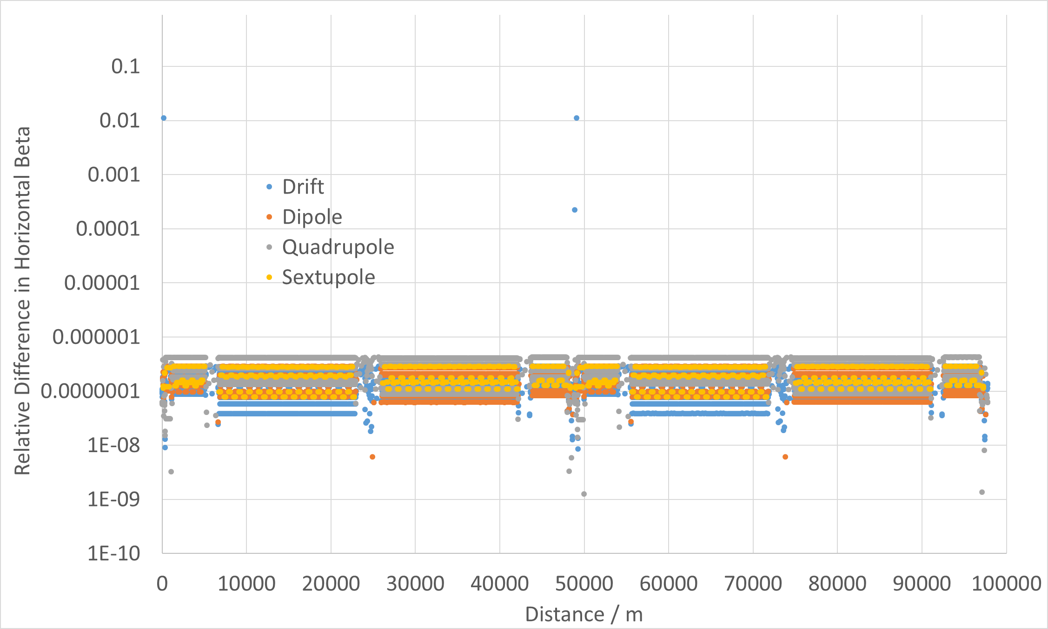
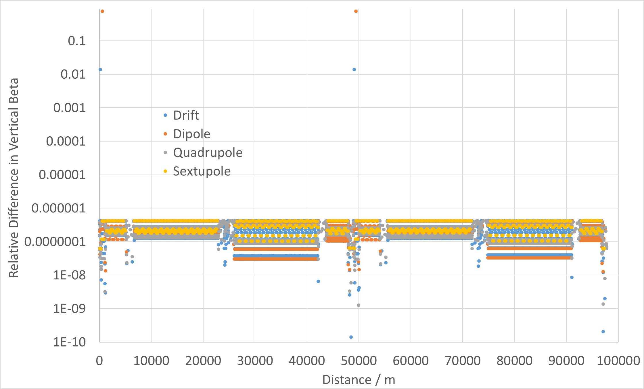
Comparison to MADX-SAD Study
Comparison of SAD and MAD-X for FCC-ee studies 11/09/2019

Slide 7
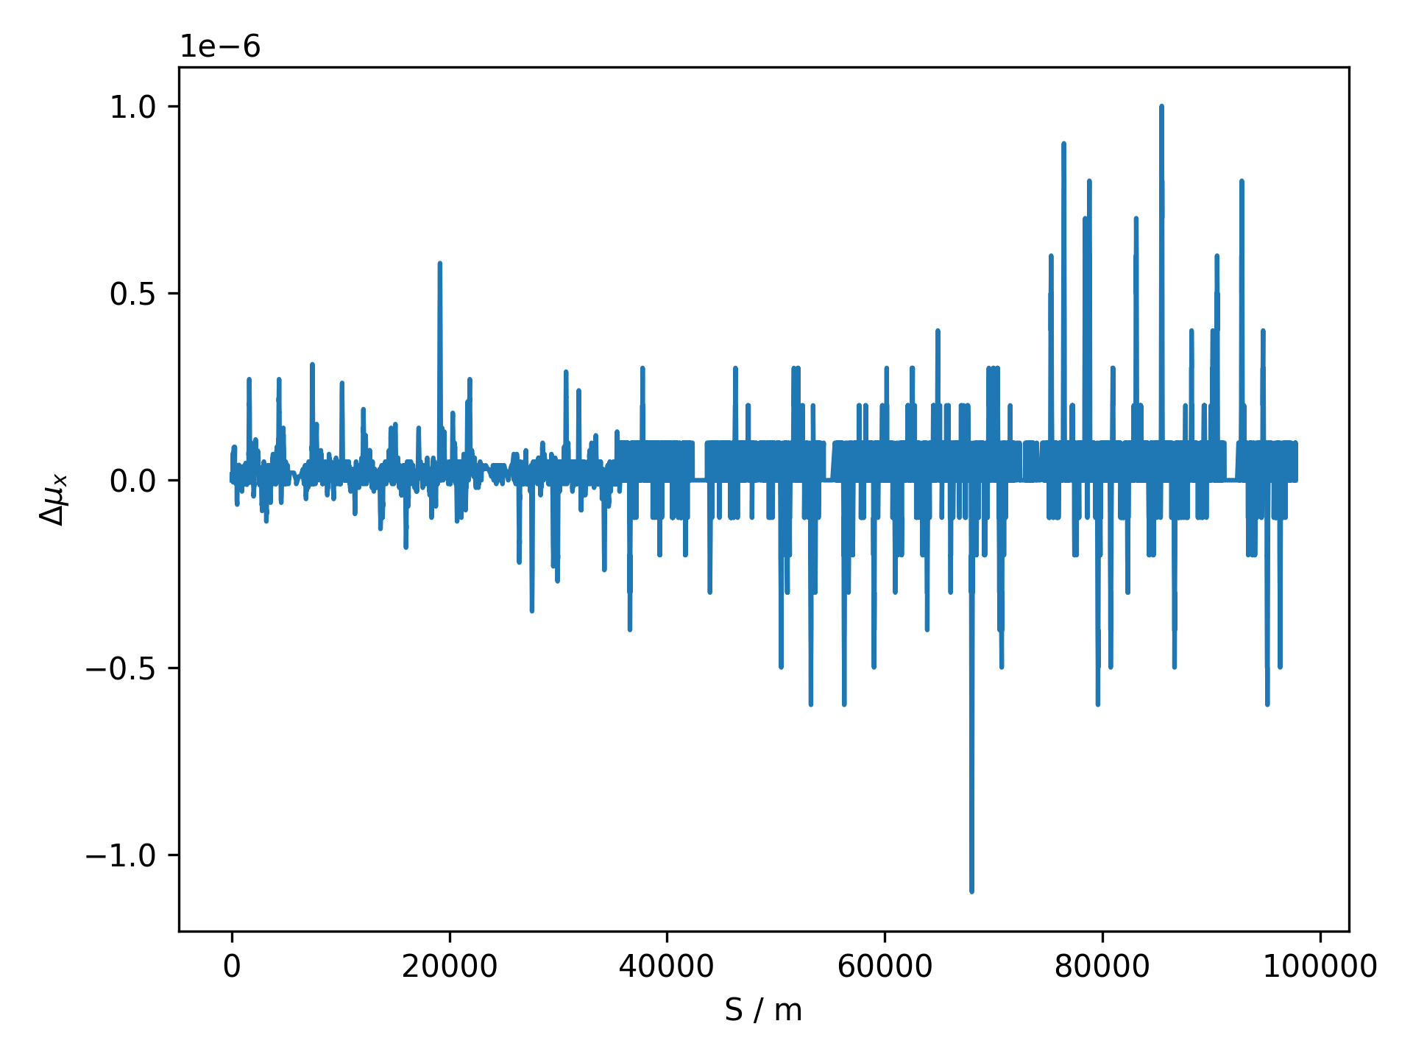
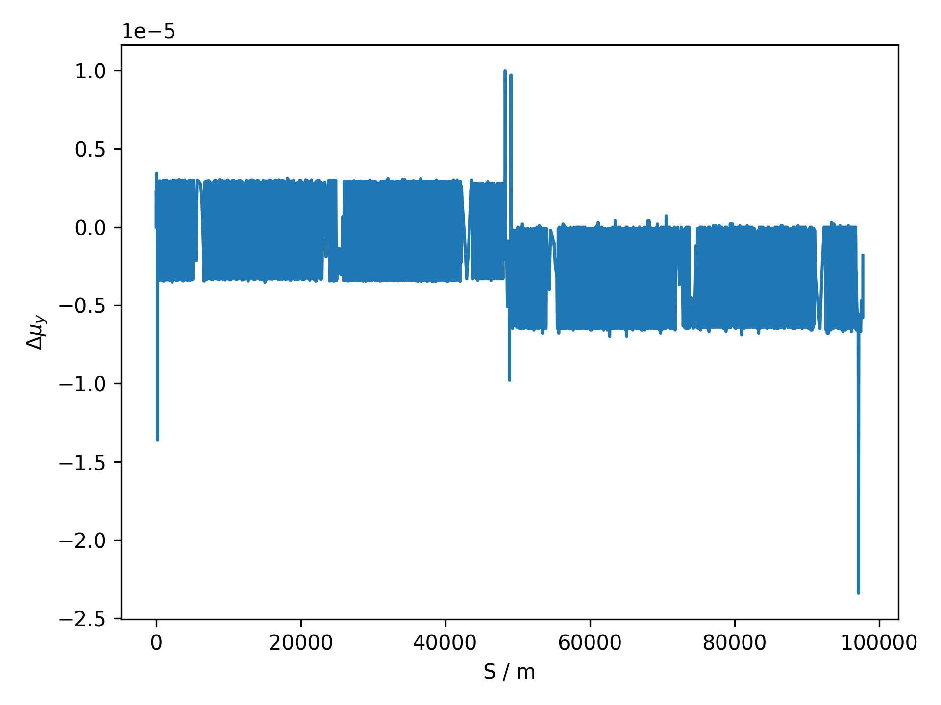
Phase Advance Difference MADX and MAD-NG

Slide 8
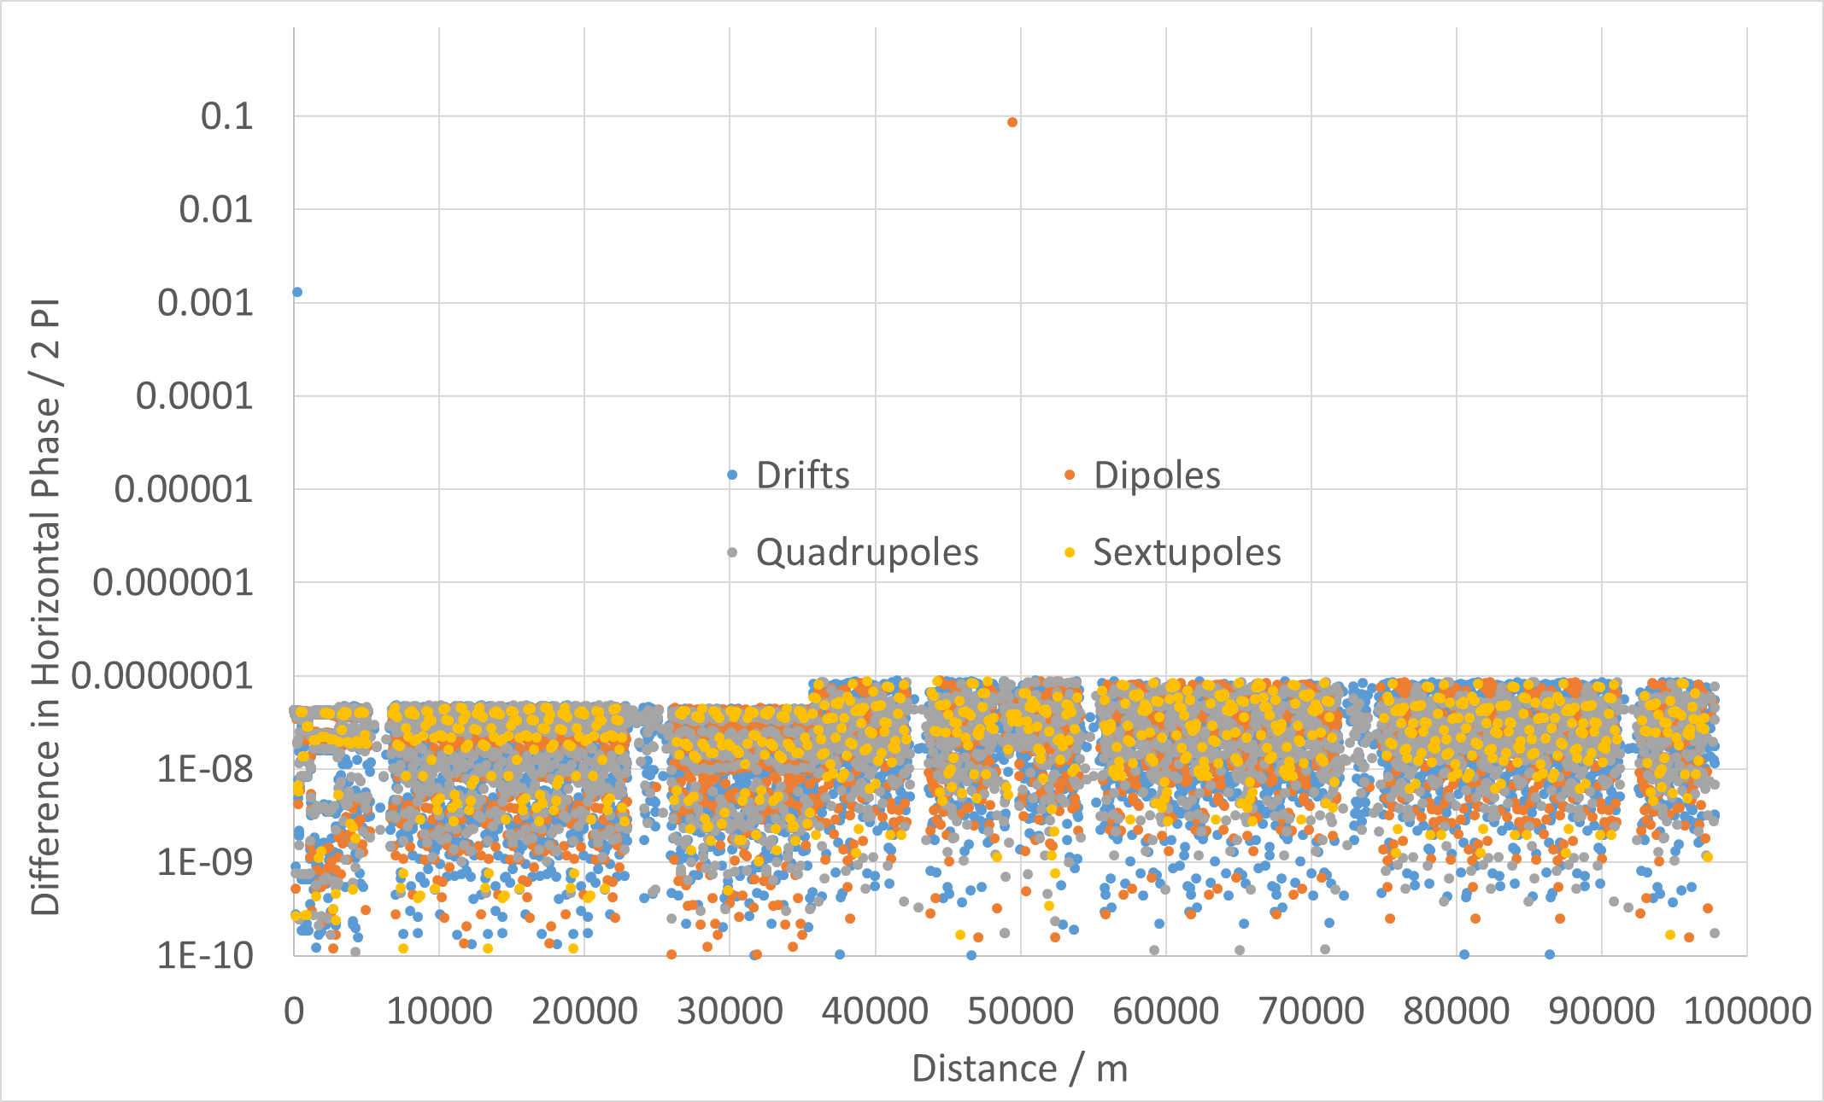
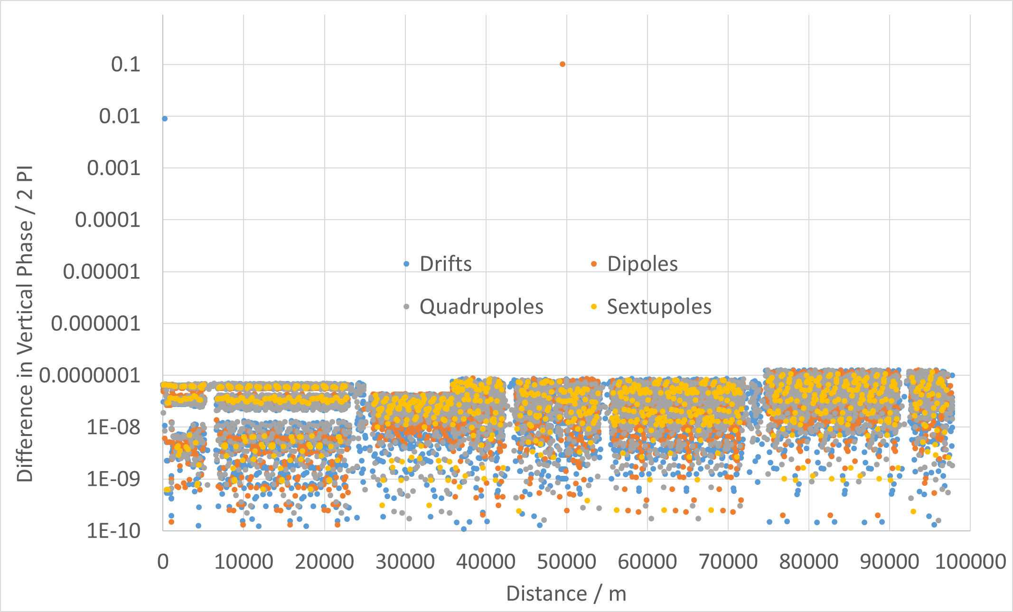
Comparison to MADX-SAD Study
Comparison of SAD and MAD-X for FCC-ee studies 11/09/2019

Slide 9
Momentum Detuning Comments
Very Good agreement with PTC
  Somewhat expected
Good Agreement with MADX
Previously demonstrated MADX, PTC and SAD have good agreement
  Comparison of SAD and MAD-X for FCC-ee studies
Time taken for Twiss at 23 momenta (on lxplus):
Program | MADX | PTC | MAD-NG
Time Taken | 49.309s | 22m39.948s | 2m2.321s

Slide 10
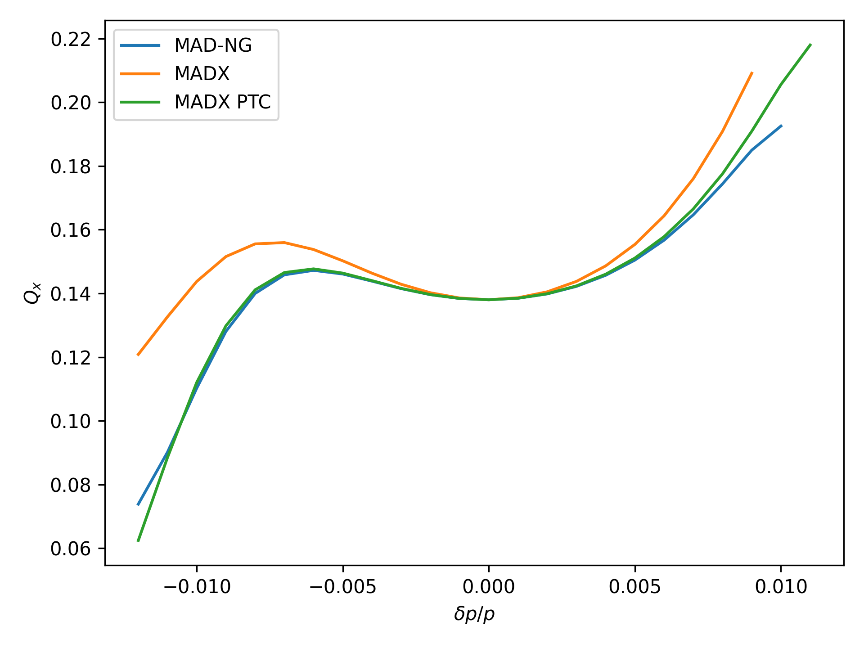
Horizontal Momentum Detuning

Slide 11
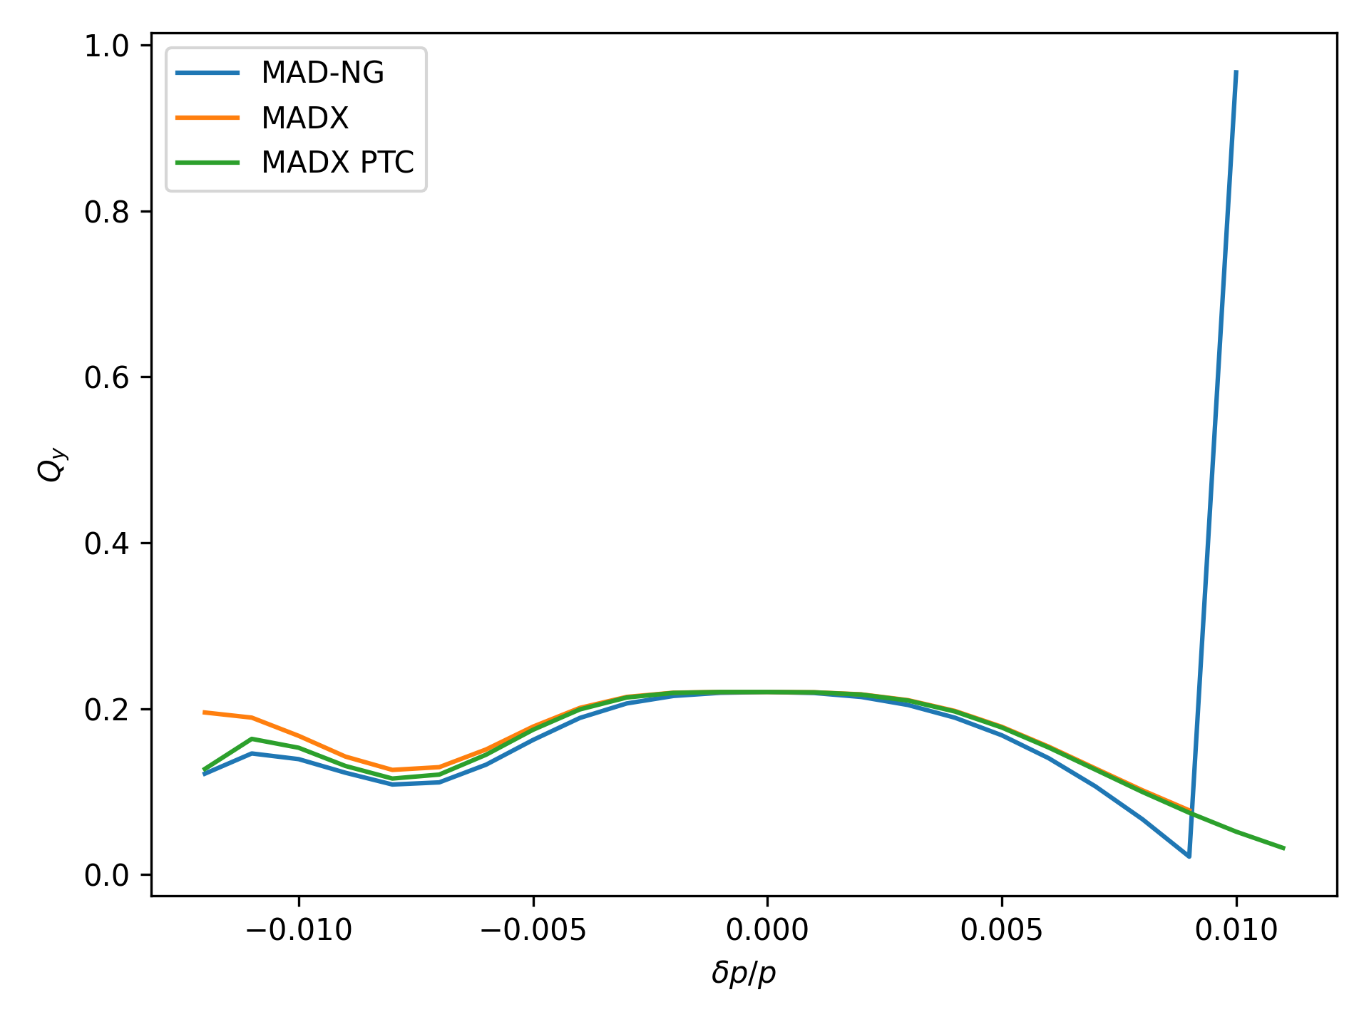
Vertical Momentum Detuning

Slide 12
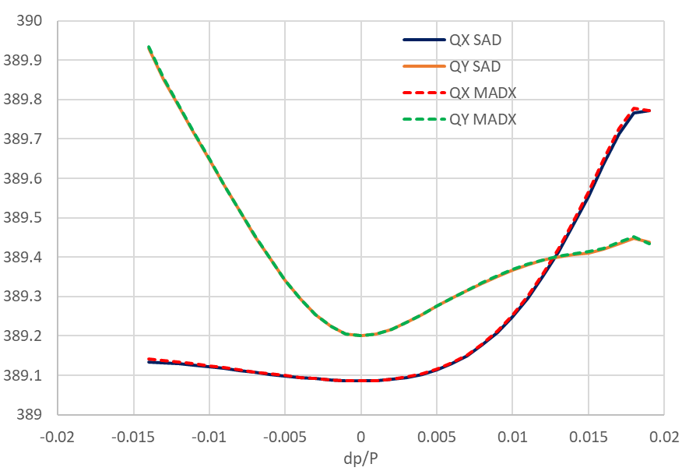
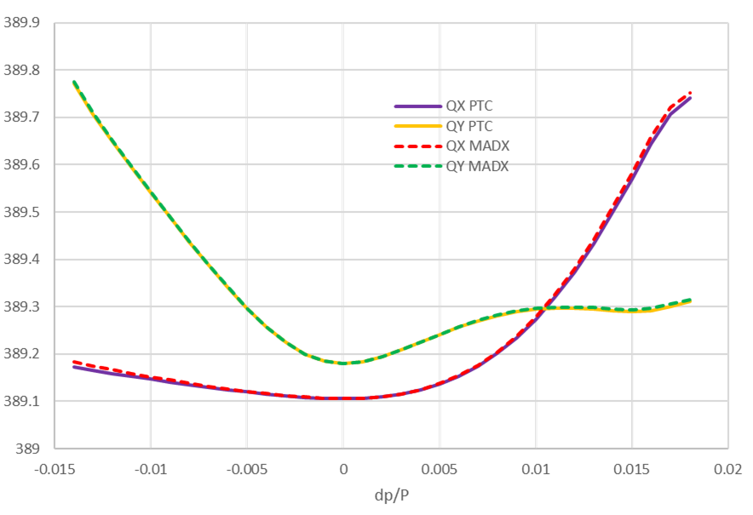
Comparison MADX-SAD (Different Lattice)
Comparison of SAD and MAD-X for FCC-ee studies 11/09/2019

Slide 13
Amplitude Detuning
Computed from tracking
Requires to track various particles over 1000 turns
Slower in MAD-NG than in MADX PTC
  Tracking one particle for 1000 turns takes:
    53.085s in MADX PTC
    6m20.368s in MAD-NG
      (big improvement compared to 0.9.2)
      2m4.257s with optimised LuaJIT settings
Very good agreement with MADX PTC
  And by extension with SAD (Comparison of SAD and MAD-X for FCC-ee studies)

Slide 14
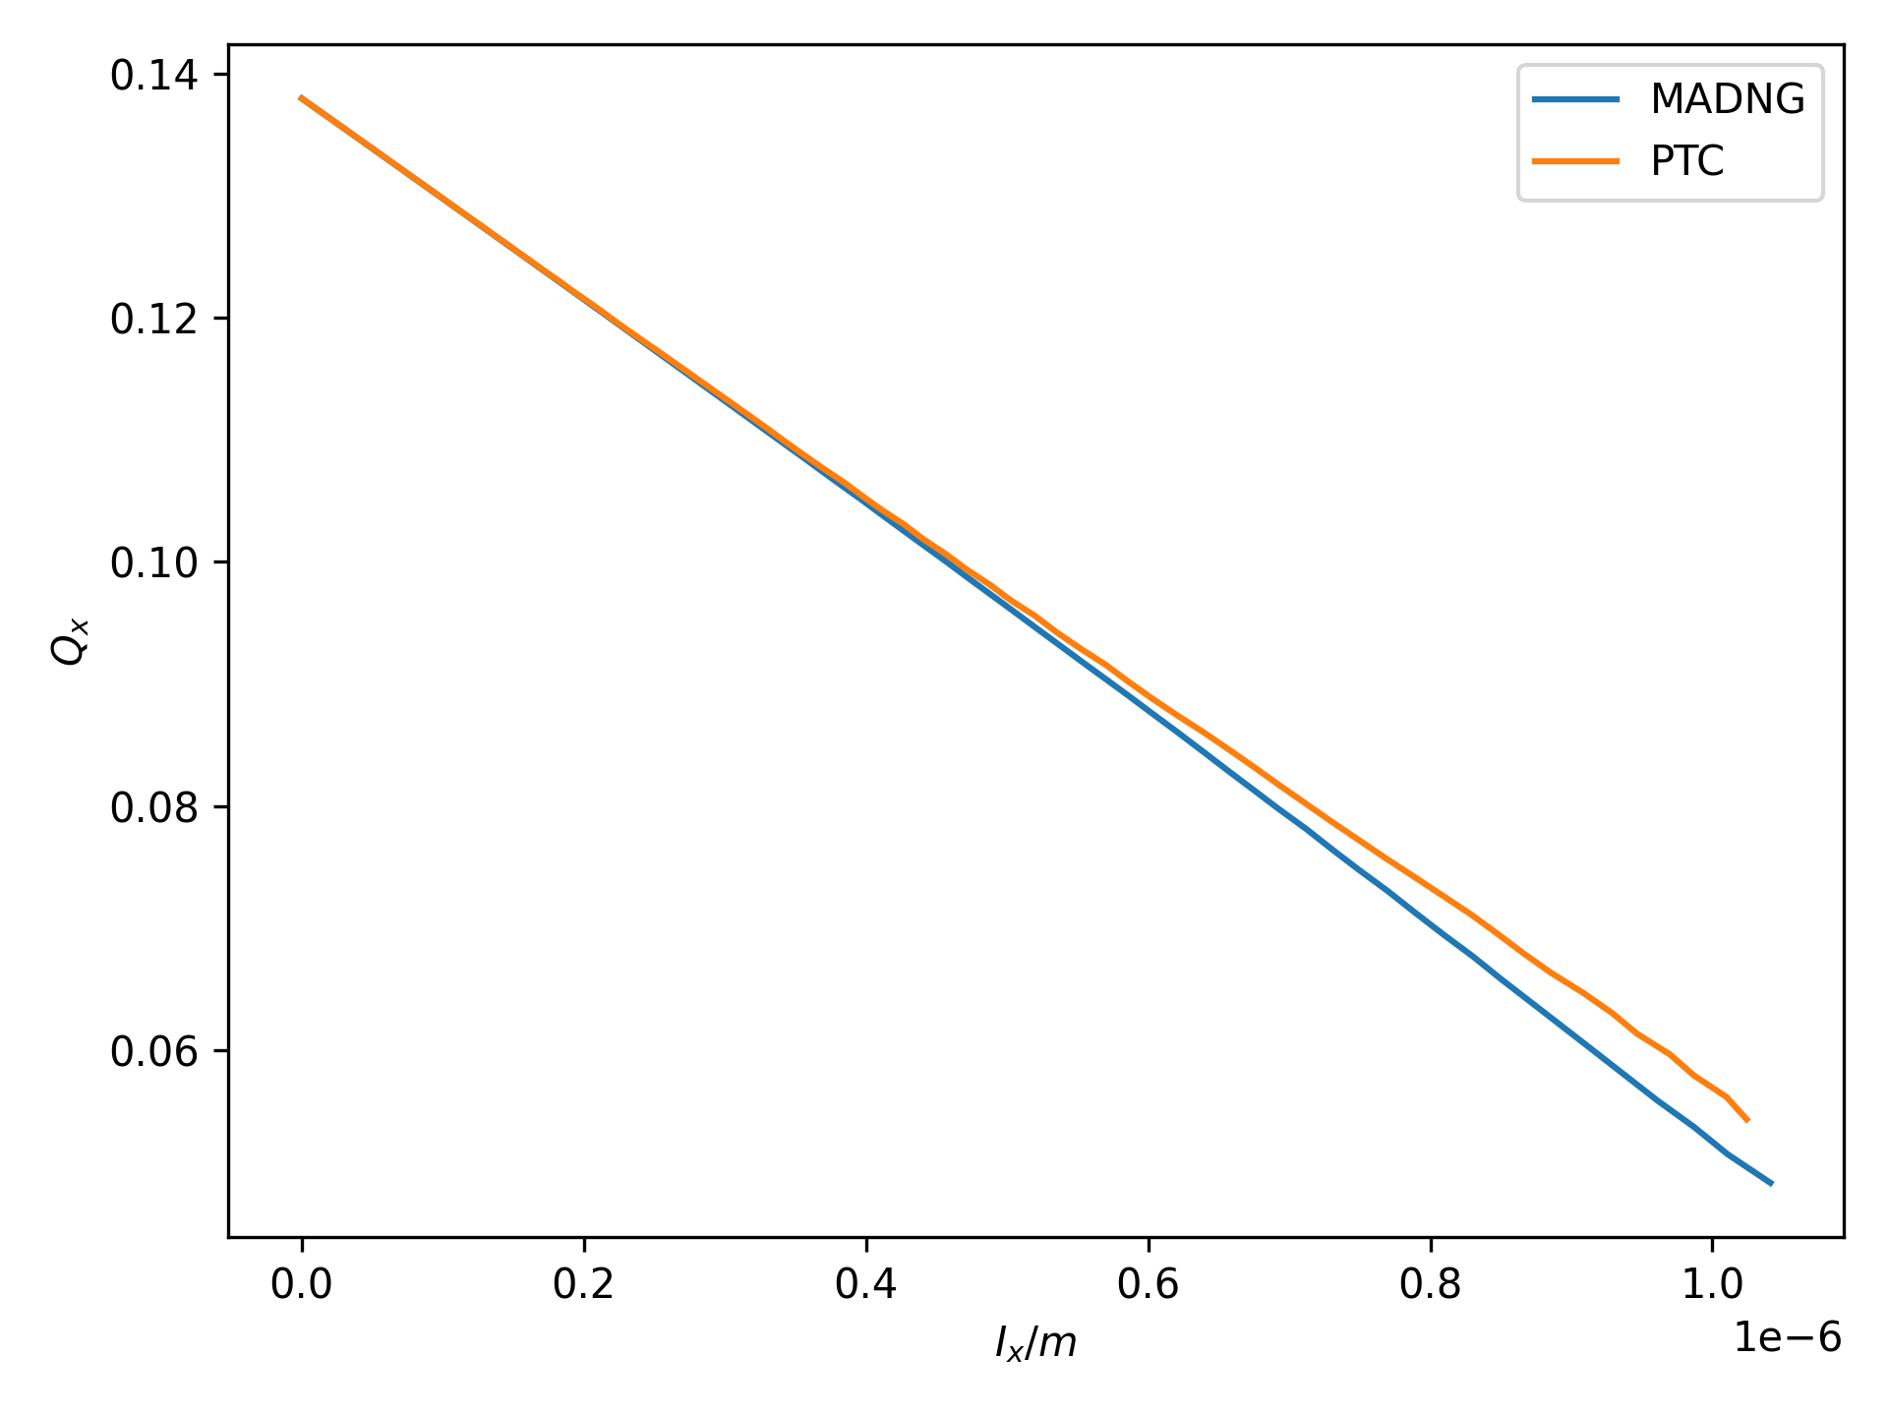
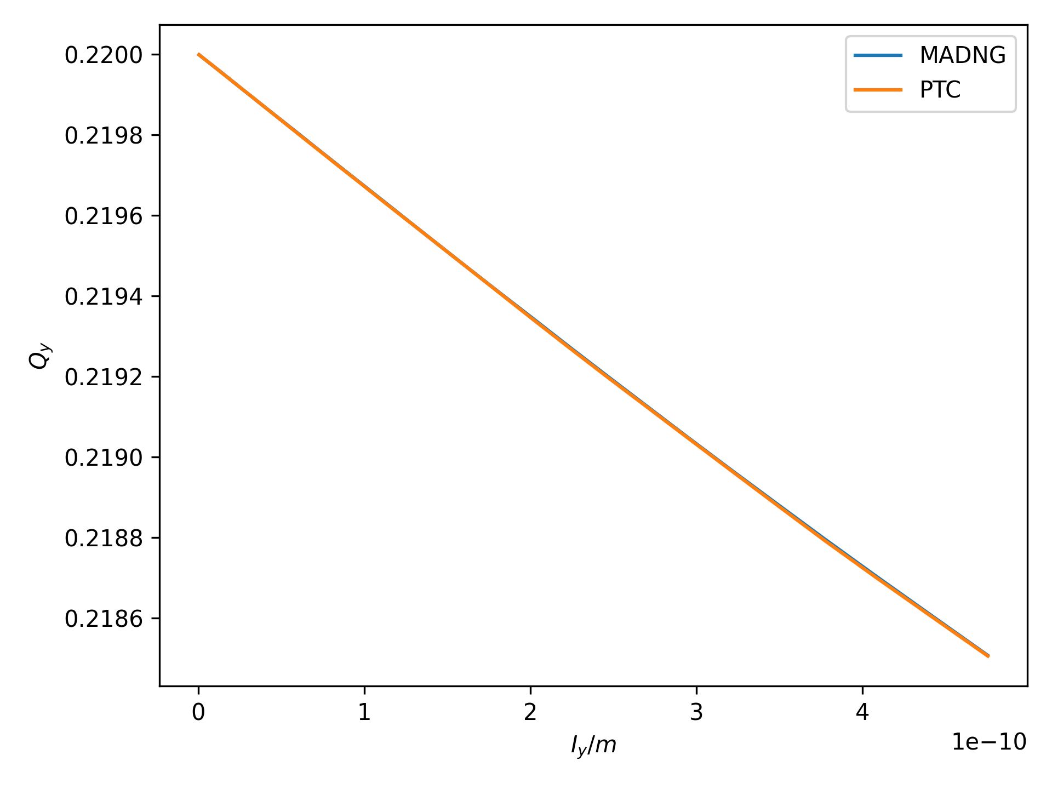
Amplitude Detuning
Horizontal
Vertical

Slide 15
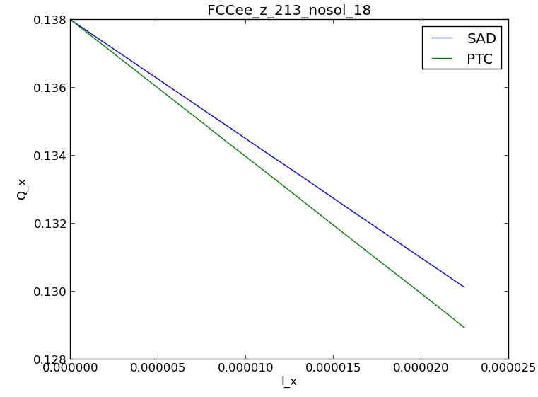
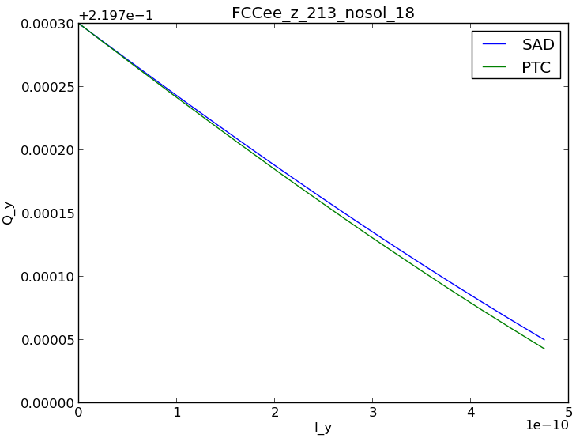
Amplitude Detuning SAD vs PTC
Horizontal
Vertical
Comparison of SAD and MAD-X for FCC-ee studies 06/11/2019

Slide 16
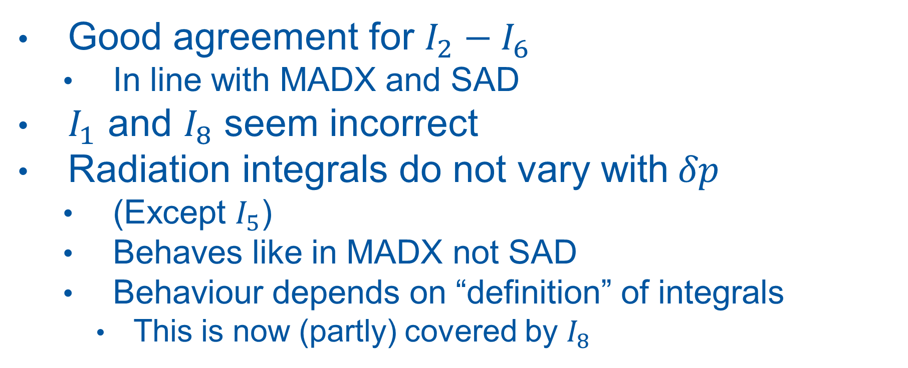
Radiation Integrals Comments
Good agreement for $I_{2}−I_{6}$
  In line with MADX and SAD
$I_{1}$ and $I_{8}$ seem incorrect
Radiation integrals do not vary with$δp$
  (Except $I_{5}$)
  Behaves like in MADX not SAD
  Behaviour depends on “definition” of integrals
    This is now (partly) covered by $I_{8}$

Slide 17
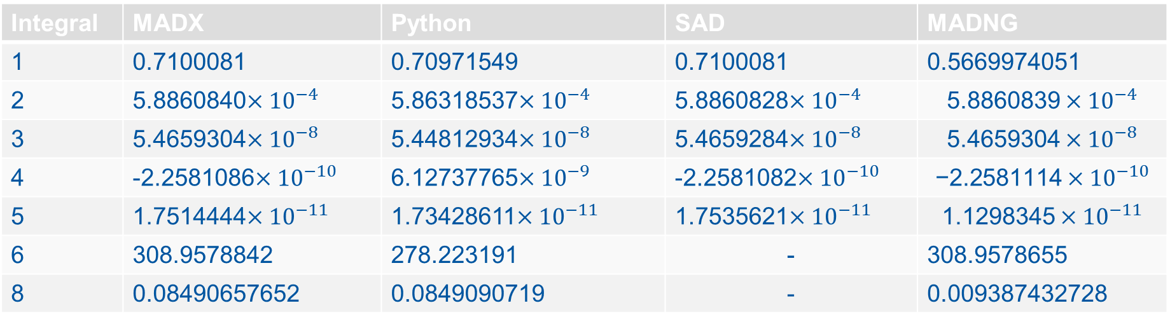
Radiation Integrals
Integral | MADX | Python | SAD | MADNG
1 | 0.7100081 | 0.70971549 | 0.7100081 | 0.5669974051
2 | 5.8860840$×{10}^{−4}$ | 5.86318537$×{10}^{−4}$ | 5.8860828$×{10}^{−4}$ | $$\text{5.8860839}×{10}^{−4}$$
3 | 5.4659304$×{10}^{−8}$ | 5.44812934$×{10}^{−8}$ | 5.4659284$×{10}^{−8}$ | $$\text{5.4659304}×{10}^{−8}$$
4 | -2.2581086$×{10}^{−10}$ | 6.12737765$×{10}^{−9}$ | -2.2581082$×{10}^{−10}$ | $$\text{−2.2581114}×{10}^{−10}$$
5 | 1.7514444$×{10}^{−11}$ | 1.73428611$×{10}^{−11}$ | 1.7535621$×{10}^{−11}$ | $$\text{1.1298345}×{10}^{−11}$$
6 | 308.9578842 | 278.223191 | - | 308.9578655
8 | 0.08490657652 | 0.0849090719 | - | 0.009387432728
Radiation Integrals in MADX 20/05/2020

Slide 18
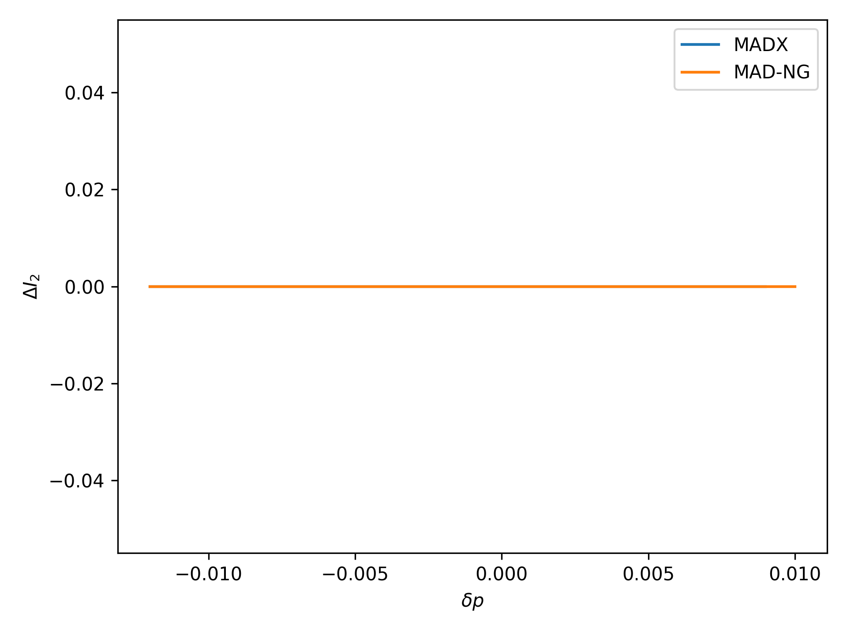
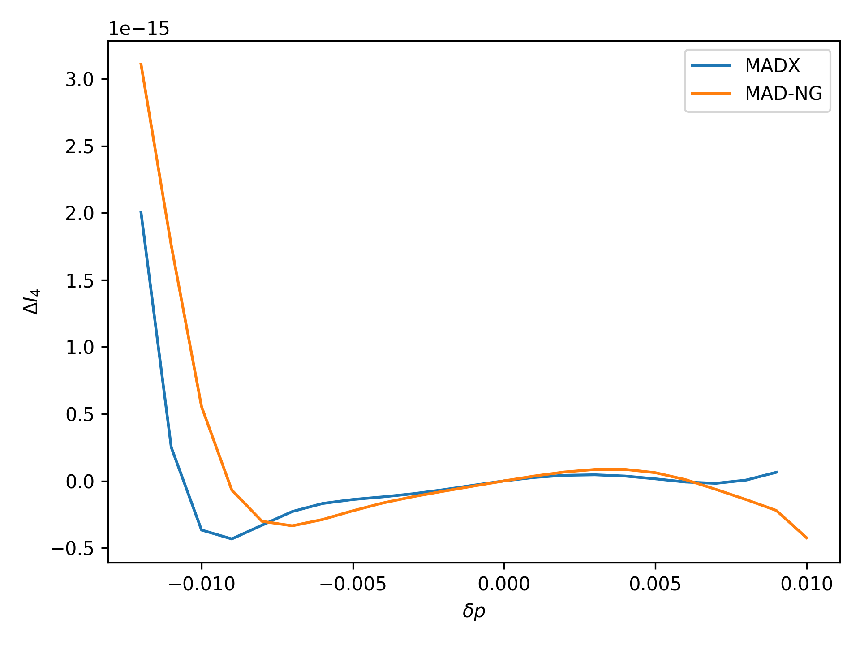

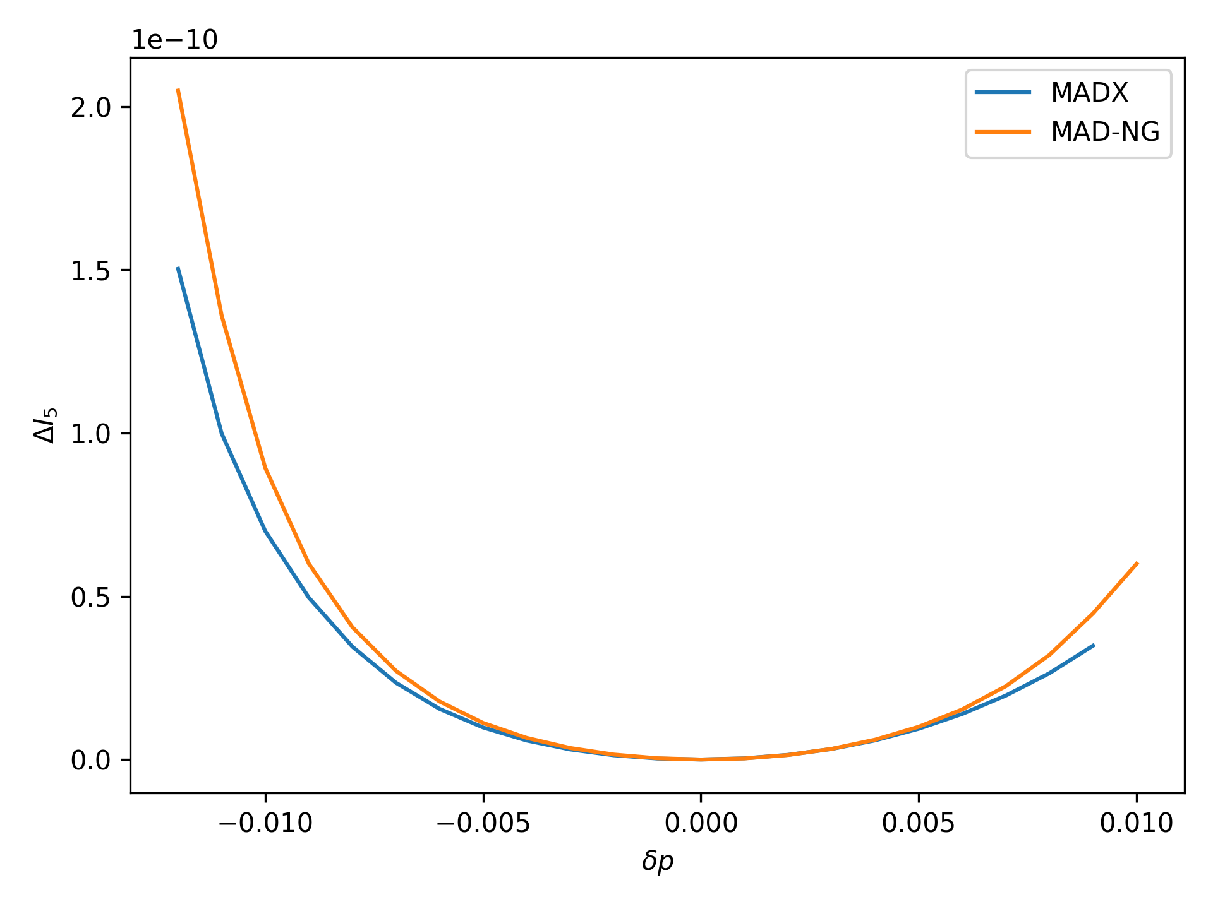
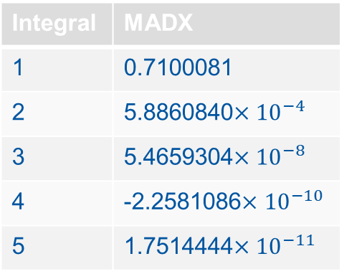
Variation of Radiation Integrals
Integral | MADX
1 | 0.7100081
2 | 5.8860840$×{10}^{−4}$
3 | 5.4659304$×{10}^{−8}$
4 | -2.2581086$×{10}^{−10}$
5 | 1.7514444$×{10}^{−11}$

Slide 19
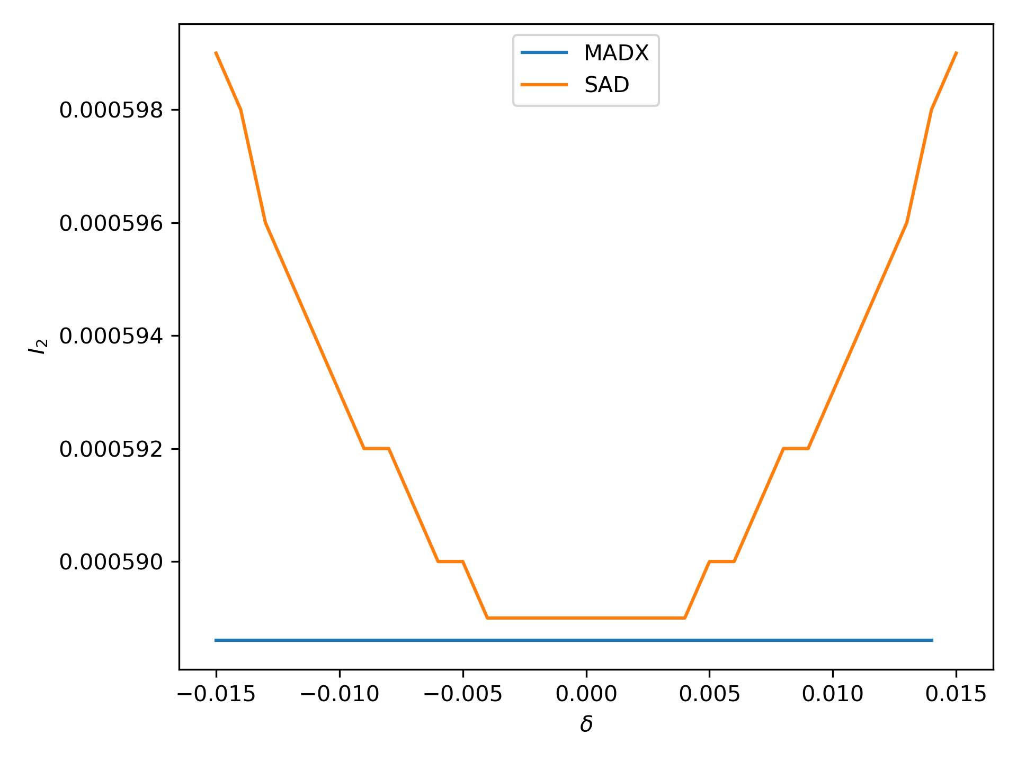
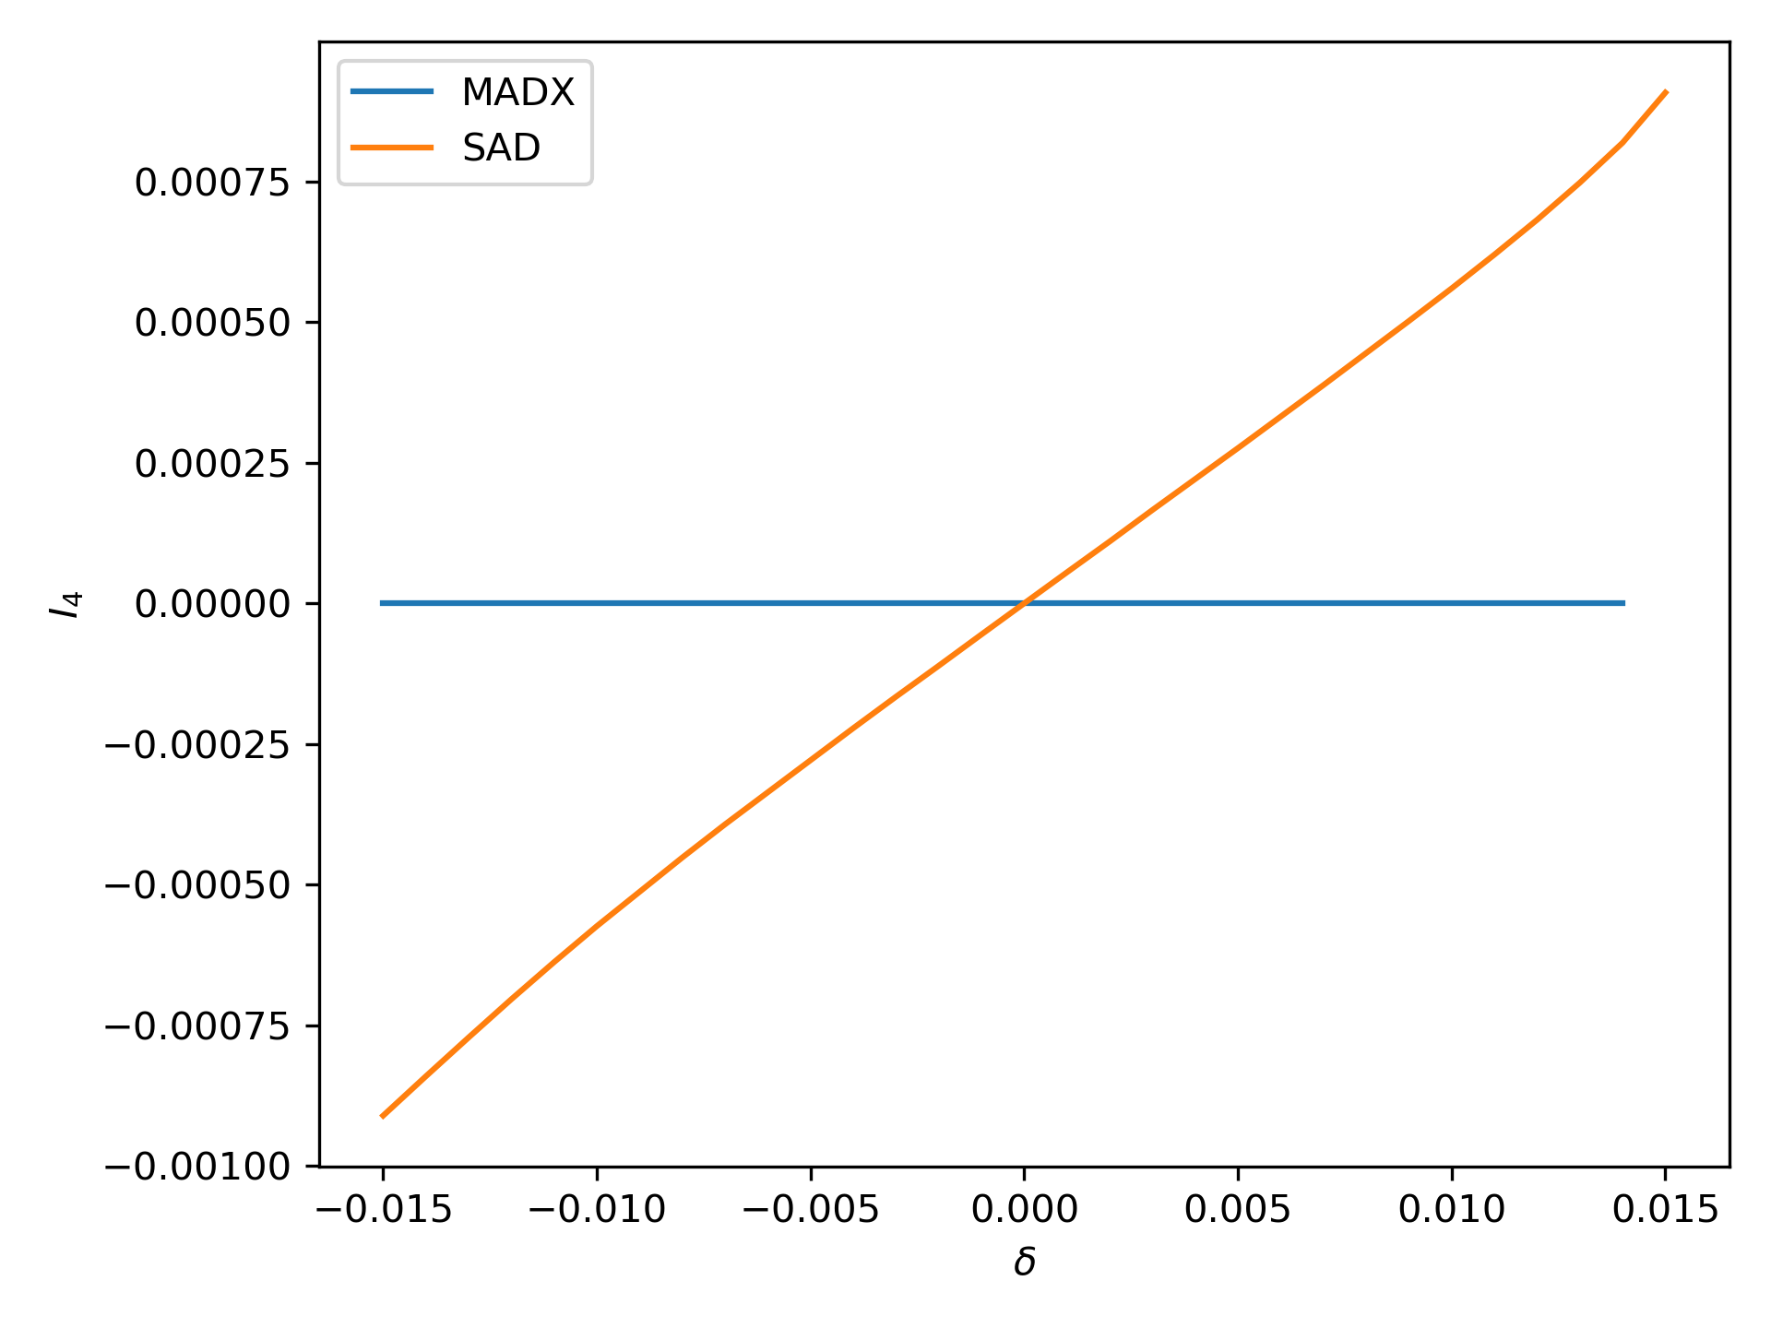
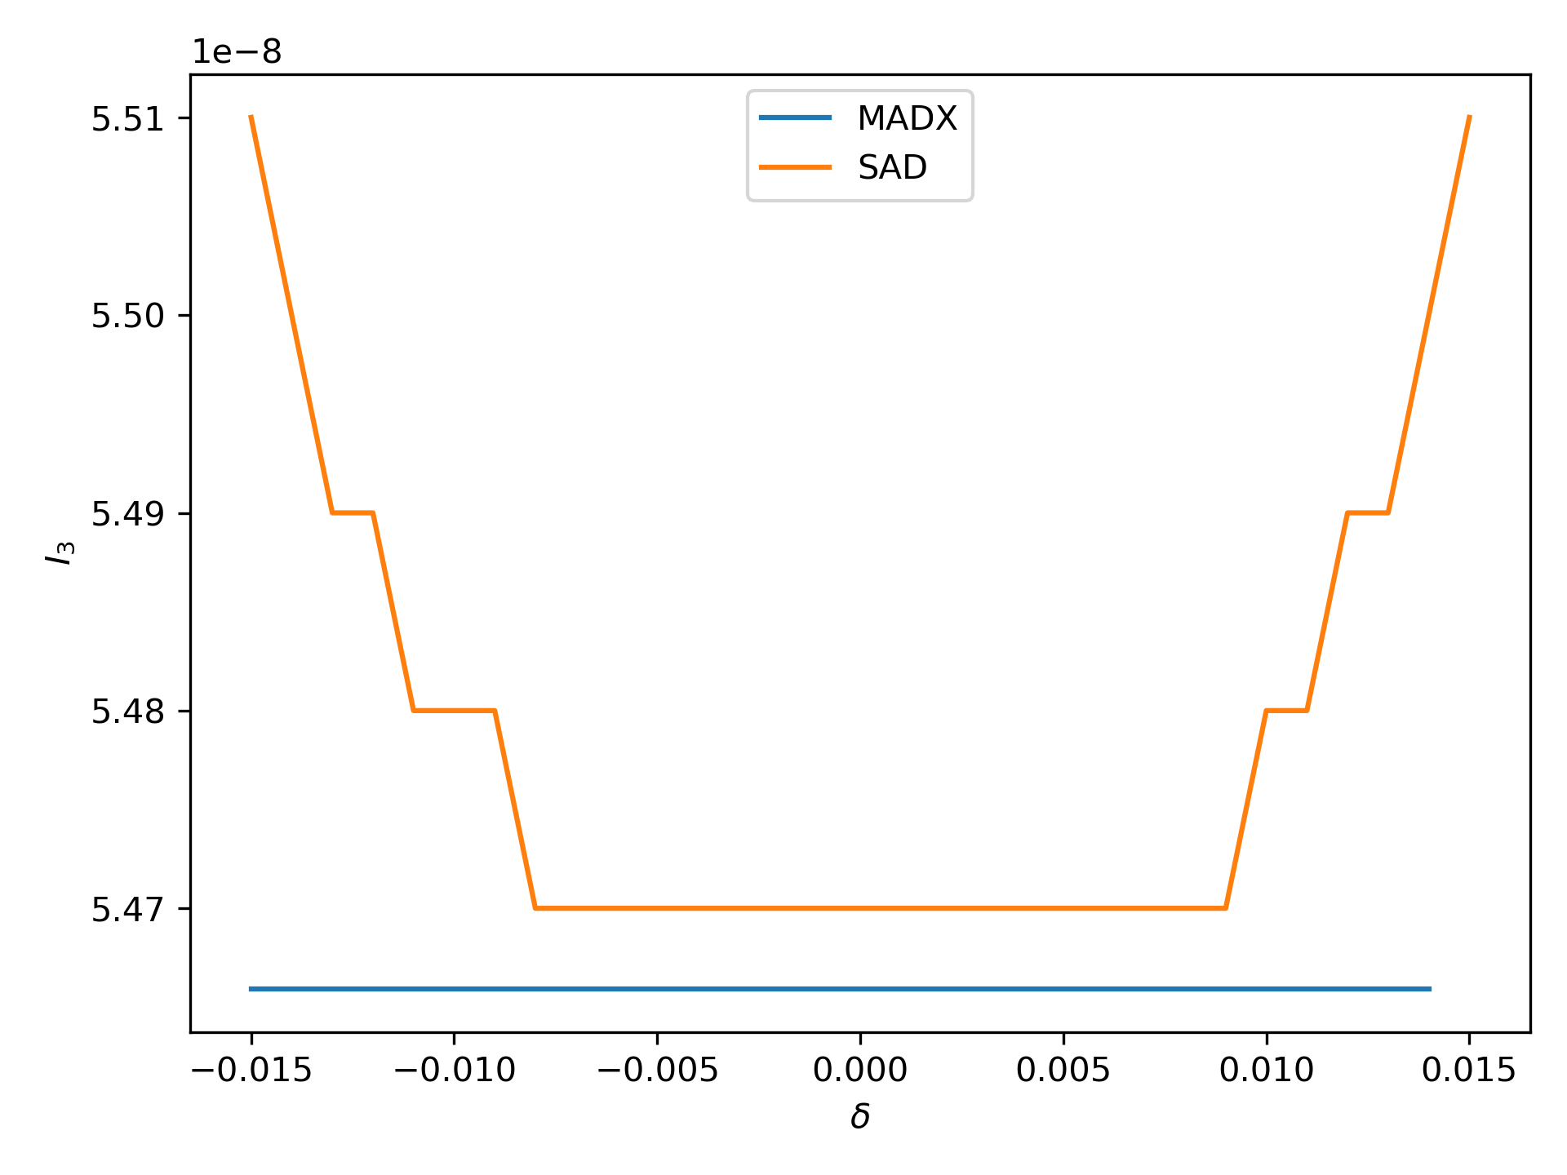
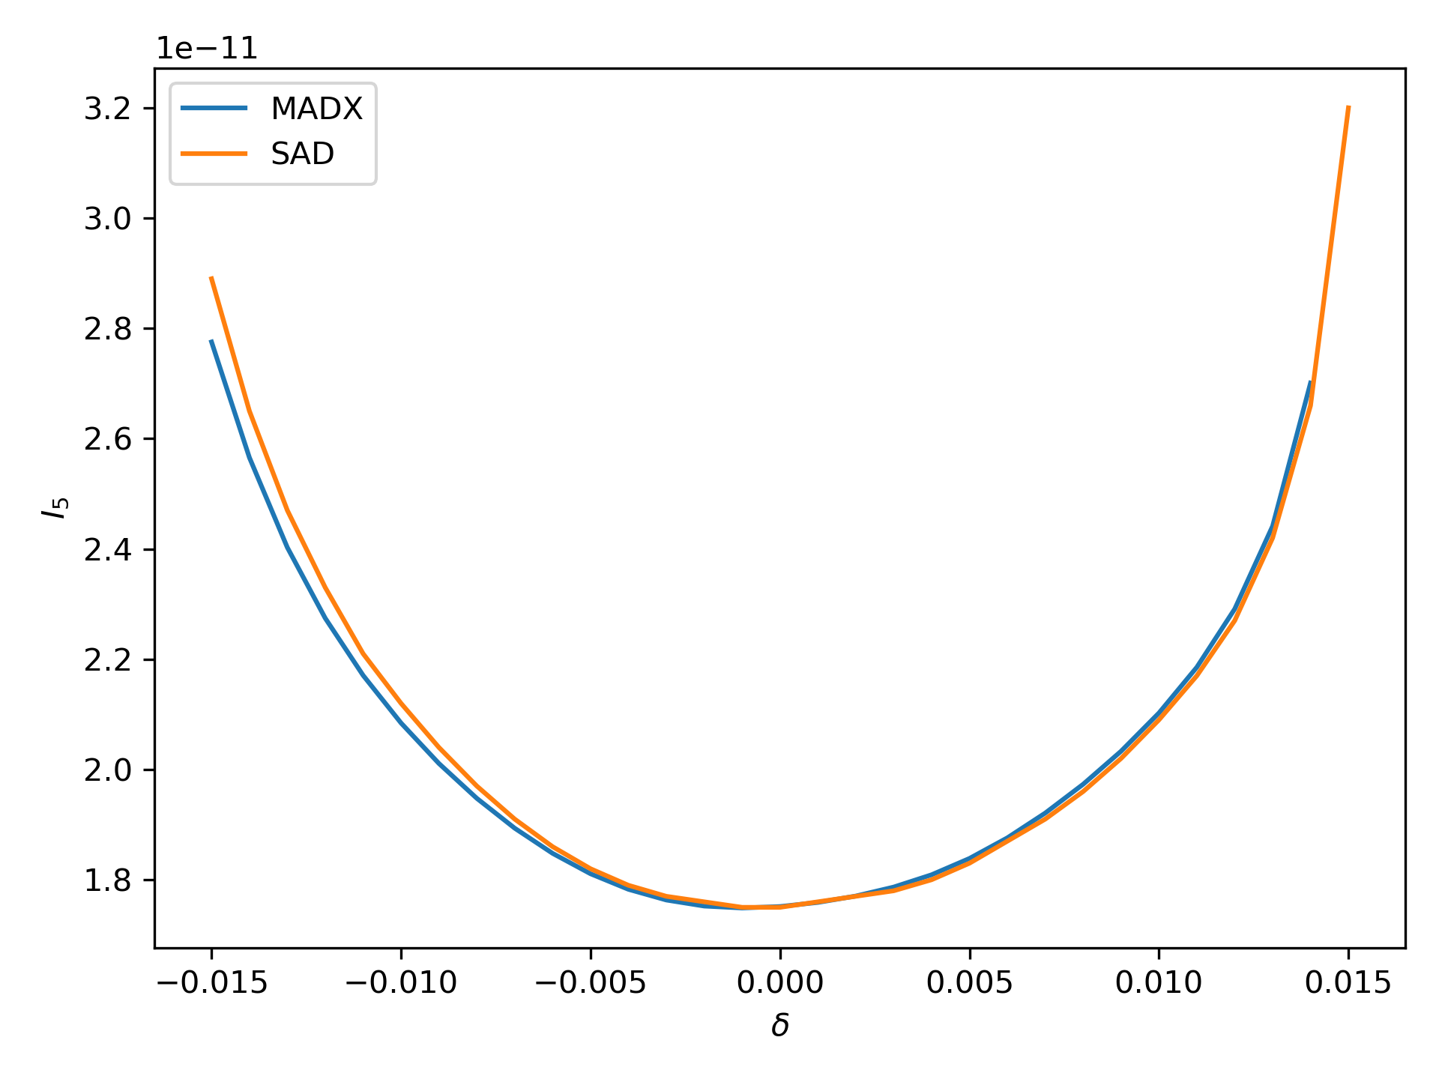
Radiation Integrals in MADX 20/05/2020
Integral | MADX
1 | 0.7100081
2 | 5.8860840$×{10}^{−4}$
3 | 5.4659304$×{10}^{−8}$
4 | -2.2581086$×{10}^{−10}$
5 | 1.7514444$×{10}^{−11}$

Slide 20
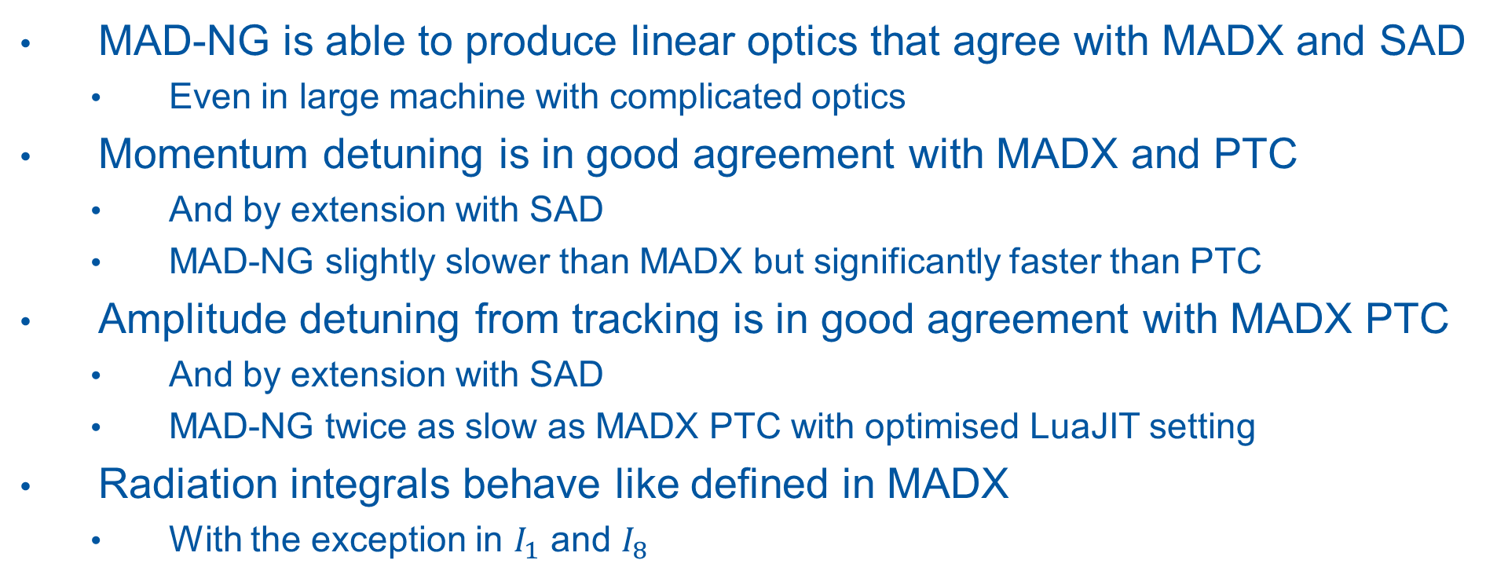
Conclusions
MAD-NG is able to produce linear optics that agree with MADX and SAD
  Even in large machine with complicated optics
Momentum detuning is in good agreement with MADX and PTC
  And by extension with SAD
  MAD-NG slightly slower than MADX but significantly faster than PTC
Amplitude detuning from tracking is in good agreement with MADX PTC
  And by extension with SAD
  MAD-NG twice as slow as MADX PTC with optimised LuaJIT setting
Radiation integrals behave like defined in MADX
  With the exception in $I_{1}$ and $I_{8}$

Slide 21
Backup

Slide 22
Some Technical Details
MADNG version 0.9.3
  Flags used in twiss:
    method=6, nslice=3, cofind=true, ptcmodel=true
  Flags used in tracking:
  method=6, nslice=3, ptcmodel=true
PTC Model Flags:
  time=true,model=2,method=6,nst=3,exact=true
  Flags used in twiss:
    ICASE=6, no=2, closed_orbit=true, deltap_dependency = true
  Flags used in tracking:
    icase=6

