Slide 1



LHCb workloads in the
HEP-SCORE benchmark
Andrea Valassi (IT-SC-RD)
HEP-SCORE Deployment Task Force meeting, 3rd February 2021
https://indico.cern.ch/event/992804
(Thanks to my LHCb colleagues – especially C. Bozzi, M. Cattaneo, G. Corti, B. Couturier, F. Stagni, S. Ponce – for their help!)

Slide 2
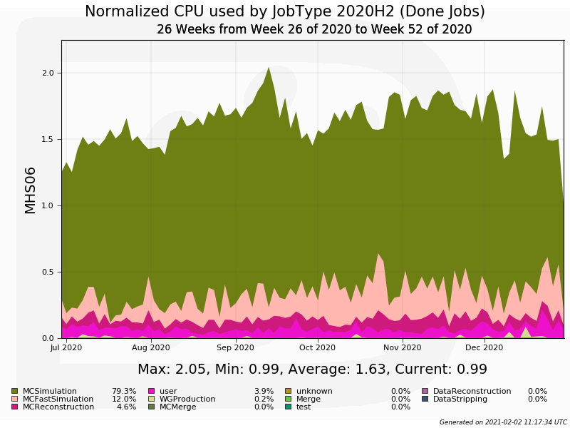
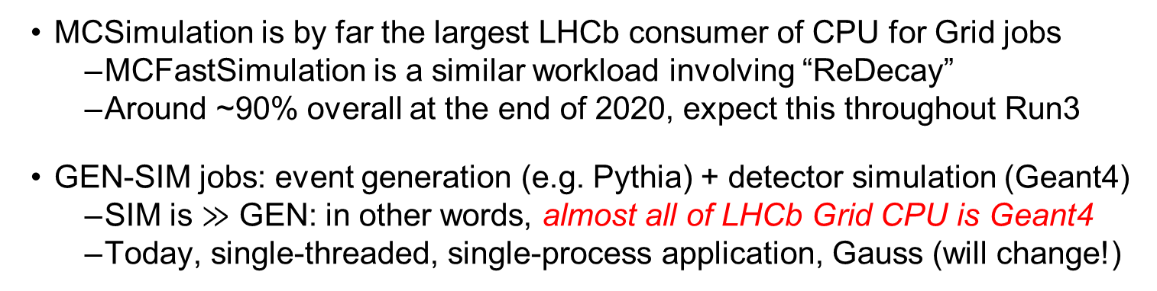
LHCb Grid workloads
MCSimulation is by far the largest LHCb consumer of CPU for Grid jobs
  MCFastSimulation is a similar workload involving “ReDecay”
  Around ~90% overall at the end of 2020, expect this throughout Run3
GEN-SIM jobs: event generation (e.g. Pythia) + detector simulation (Geant4)
  SIM is $≫$ GEN: in other words, almost all of LHCb Grid CPU is Geant4
  Today, single-threaded, single-process application, Gauss (will change!)
In Q3-Q4 2020:
MCSimulation (GEN-SIM): 79%
MCFastSimulation (GEN-SIM with Redecay): 12%

Slide 3
GEN-SIM workloads for HEP-SCORE
The current HEP-SCORE candidate includes an LHCb GEN-SIM workload
  This uses an LHCb software release from three years ago (Jan 2018)
    Gauss v49r9 on x86_64-slc6-gcc48-opt, single process, single threaded (logfile)
    GEN: Pythia8, event 27163076 “[D*(2010)+→(D0→K-pi+)pi+]cc” plus min-bias pileup
    SIM: Geant4 geant4-09-06-patch-04 (January 2015)
    Benchmark is based on 5 (reproducible) events, around 20 minutes on a typical CPU
  HEP-SCORE candidate uses GEN-SIM throughput with initialization in 1st event
    Throughputs are also available for GEN and SIM separately, skipping the 1st event
We will provide a more recent Gauss workload for the production HEP-SCORE21
  Timescale? By when is this needed exactly?
  This will still use single-threaded single-process Gauss
  We still need to agree on the exact details internally in LHCb. Most likely:
    Using the latest Gauss release that we are already using for Run3
    Based on CC7 rather than SLC6, with one of the latest compilers
    HEP-SCORE should use SIM throughput without 1st event (rather than GEN-SIM)
    Using a representative event type, but keeping the GEN step quick
    Focusing on x86 at first, but there is work in progress on ARM (and starting on Power)
  Remember: the goal is to keep this stable for ~3y+ during Run3

Slide 4
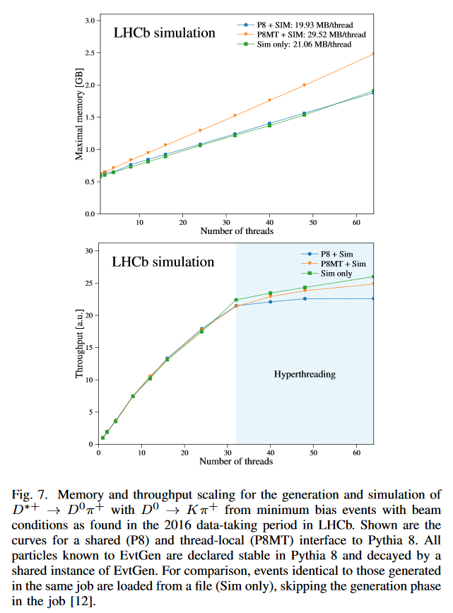
GEN-SIM workloads for the future
LHCb is moving away from single-threaded single-process GEN-SIM workloads
  Multi-process GaussMP was an interim solution for low-memory KNL at CINECA
  The future is multi-threaded, Gaussino: lower memory per core, use MT-Geant4
    This will become the default GEN-SIM sometime before or during Run3
Status: MT Gaussino is progressing well, but not yet production-ready
  We will try to provide a container to the WG, but not in time for HEP-SCORE21
B. Siddi, D. Mueller, Proc IEEE NSS/MIC 2019,
https://doi.org/10.1109/NSS/MIC42101.2019.9060074

Slide 5
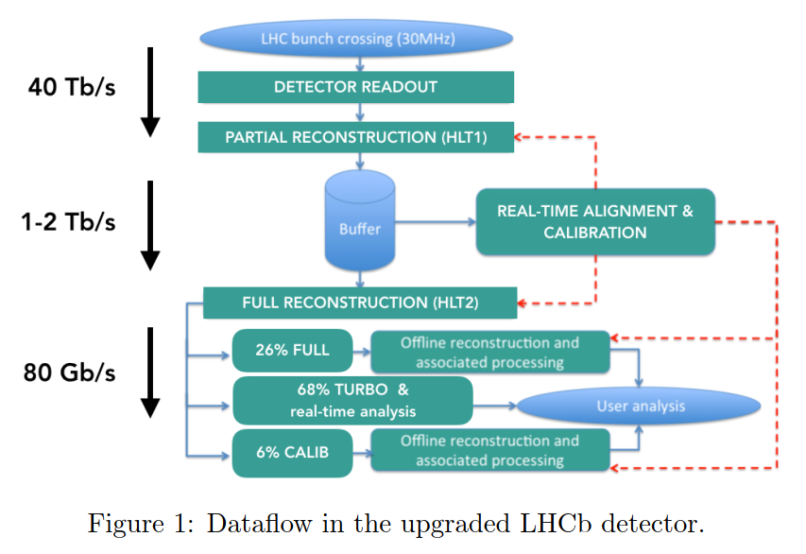
Reconstruction workloads
The LHCb reconstruction software workloads may be interesting for the WG
  But are not very representative of how LHCb uses Grid compute power
    We may try to provide containers if it is useful – but not for HEP-SCORE
  LHCb data reco in Run3 will be done online (HLT1/GPU + HLT2/CPU)
HLT1 data reco on GPUs (Allen)
  Interest for WG: one of the few existing HEP workloads on GPU
  Though no clear use case why this would need to run on Grid GPUs
LHCb Upgrade GPU HLT TDR (May 2020)
https://cds.cern.ch/record/2717938

Slide 6
Job scheduling and fast benchmarks
NB: This slide is more relevant to the WG and WLCG operations than to the TF!
A CPU benchmark is not only useful for pledging and accounting
LHCb uses the ‘CPU power’ of a job slot for job scheduling and masonry
  “How many MC events can I still process if I have 8 hours of CPU left?”
  Optimize scheduling (e.g. in multi-core slots), graceful termination, etc...
    Better than ‘resubmit if failed’ – are we the only experiment who need this?
LHCb requirement: a reliable mechanism to know the HS06 power of a node
  Machine-Job-Features (MJF) is unreliable, and no longer maintained!
Work-around: determine the power of a node in real time from the pilot
  Benchmarking must be fast: use the Dirac Benchmark (DB12)
    Simple but ~good enough: Python random numbers and simple arithmetics
  We could be interested in a fast common Geant4 benchmark (like ~KV)
    But this is still a workaround: no need for it if we could read the node’s HS06!

Slide 7
Summary
LHCb supports the replacement of HS06 by the HEP-SCORE benchmark
  Thanks to all those involved for the good work!
LHCb will provide an updated GEN-SIM workload container
  Still based on the Run2 single-thread/single-process Gauss workflow
  GEN-SIM workloads represent ~80-90% of LHCb Grid CPU usage
Multi-threaded Gaussino will eventually become the default in Run3
  We may try to provide a container, but not in time for HEP-SCORE21
LHCb needs a benchmark also for job scheduling, not only for pledges
  The mechanism for retrieving the power of a slot (MJF) is inadequate
  LHCbDIRAC uses a fast benchmark (DB12) because of this

Slide 8
Backup slides

Slide 9
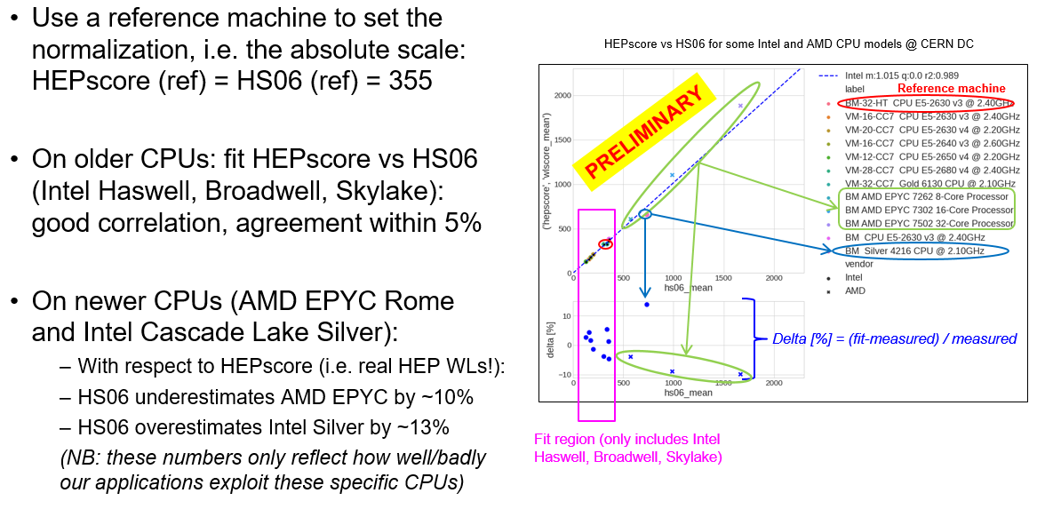
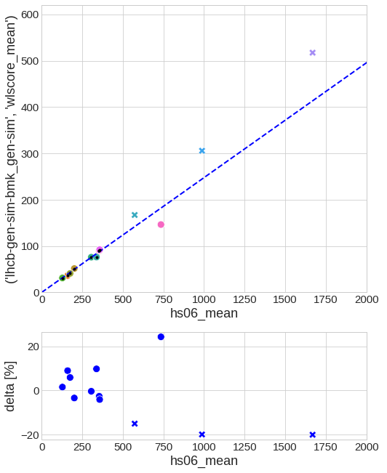
Scaling: HEP-SCORE vs HS06 (and LHCb vs HS06)
  LHCb Gen-Sim vs HS06
A. Valassi, WOSSL Workshop, July 2020
  https://indico.in2p3.fr/event/21698
  Plots from: D. Giordano, WLCG MB, May 2020
  https://indico.cern.ch/event/917098

Slide 10
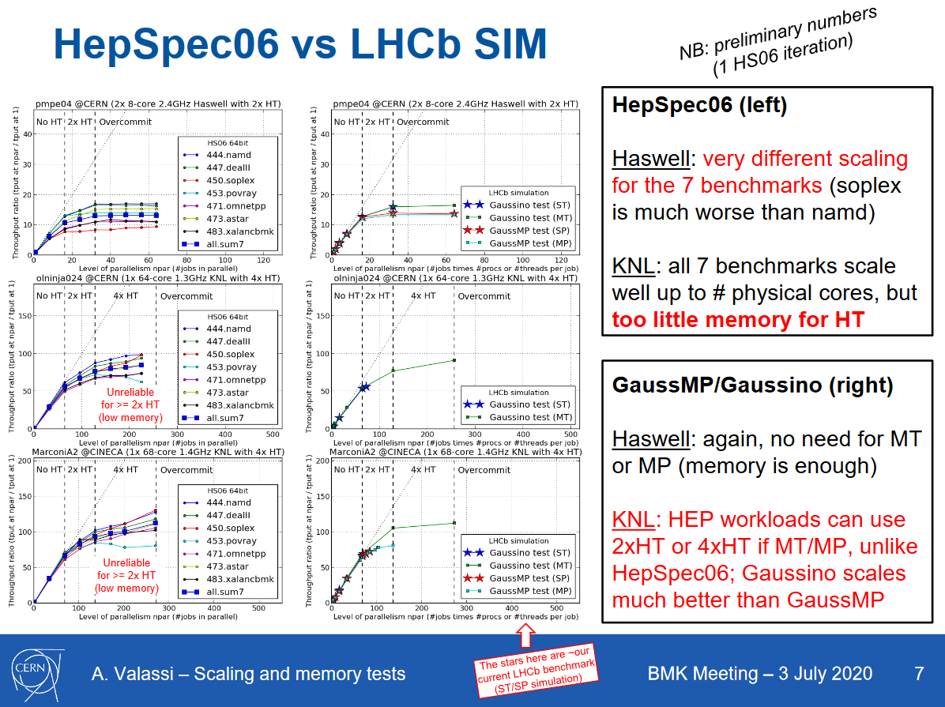
KNL scaling tests (HS06, GaussMP, Gaussino) – HEPIX BMK WG, Jul 2020
https://indico.cern.ch/event/872154

