Slide 1
Update on electron lens impedance studies
(without electrons)
B. Salvant, C. Zannini
Thanks to Antti Kolehmainen, Diego Perini (EN-MME)
and Riccardo de Maria (BE-ABP)

Slide 2
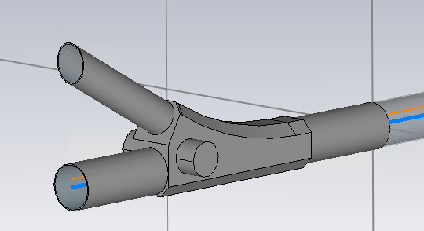
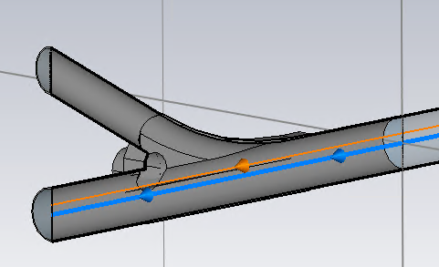
Context
Hollow electron lens for halo control for HL-LHC
Design discussed since a long time with EN-MME
Work in particular in 2017 by a 2-week HSSIP stagiaire Chloe Rakotoalivony in 2017

Slide 3
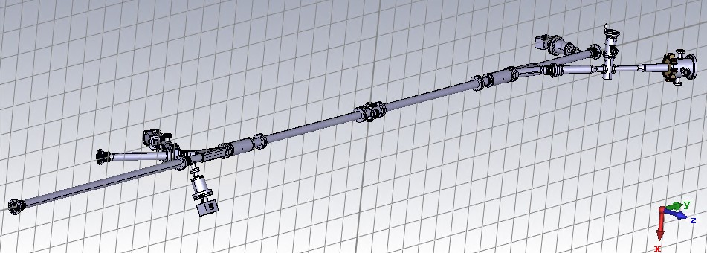
New design (August 2020)
Provided by Antti from EN-MME

Slide 4
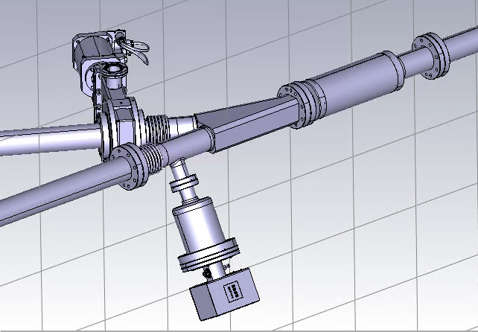
Comments
Bellow should be shielded

Slide 5
Comments
Bellow should be shielded
Pump should be shielded

Slide 6
Comments
Bellow should be shielded
Pump should be shielded
Non-standard BPM (studied)

Slide 7
Comments
Bellow should be shielded
Pump should be shielded
Non-standard BPM (studied)
Y chamber volume could be reduced

Slide 8
Comments
Bellow should be shielded
Pump should be shielded
Non-standard BPM (studied)
Y chamber volume could be reduced
BGC design ongoing and not available
Coatings? ID60 should impose copper
coating in plain tubes.
New request to have 2 bellows around
the BGC
→ Under discussion with EN-MME

Slide 9
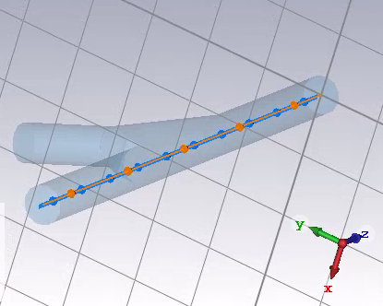
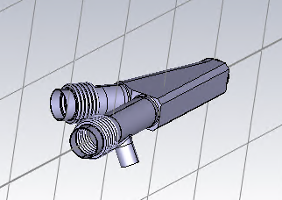
Y chamber
EN-MME followed the guideline we provided to minimize the volume around the incoming pipes
We could theoretically do a bit better, by adding a blade as in the other LHC Y chambers.
Nevetherless, contrary to the other Y chambers, not a simple symmetric merge of two pipes

Slide 10
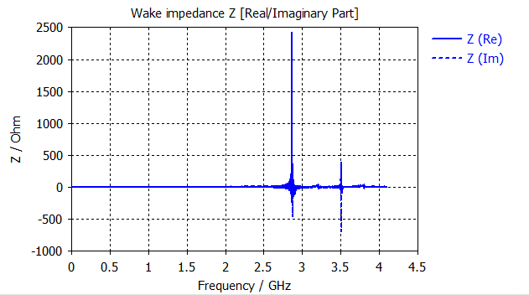
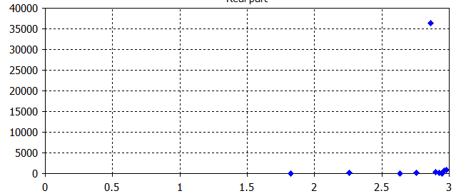
Longitudinal impedance
CST Wakefield solver
CST Eigenmode solver
Z (LinacOhm)
Frequency (GHz)
- First mode at 2.86 GHz (18 kOhm and Q=18,000 if copper coated, 2 kOhm and Q= 2800 if not)
- Im(Z/n)^{eff} ~ 0.02 mOhm for 1 Y chamber (to be compared to 90 mOhm for full LHC)

Slide 11
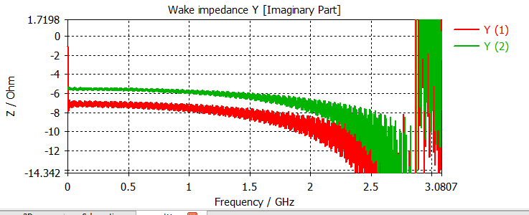
Transverse impedance (y → horizontal)
Beta ~280 m (from Riccardo)
Im(Zx)= 1.5 Ohm per 5 mm = 300 Ohm/m for 1 Y chamber

Slide 12
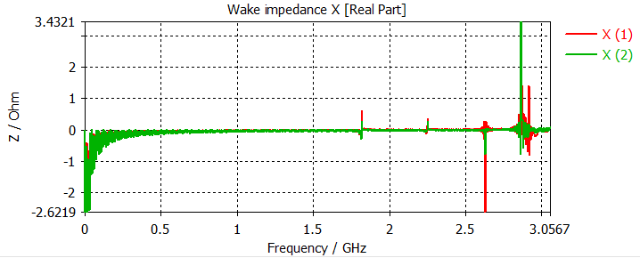
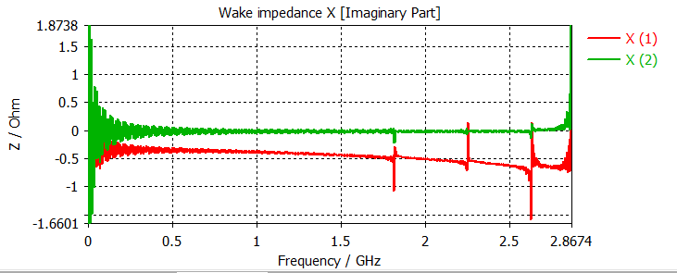
Transverse impedance (x→ vertical)
Beta ~280 m (from Riccardo)
Im (Zy)= 0.5 Ohm per 5 mm = 100 Ohm/m
for 1 Y chamber
First mode at 1.82 GHz
4 kOhm/m and Q=19,000 for copper from eignemode

Slide 13
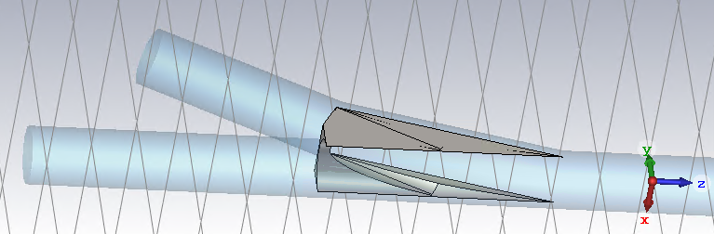
Adding a shielding blade
→ Not a trivial geometry to manufacture

Slide 14
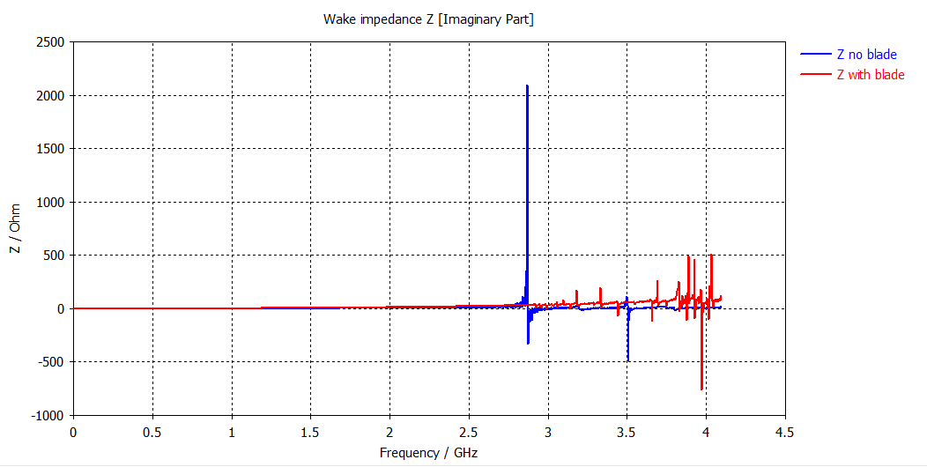
Impact of shielding blade
Mode at 2.86 GHz disappears
No significant beneficial impact on Im(Z/n)
Vertical mode gets worse (30 kOhm/m instead of 4 kOhm/m)

Slide 15
Conclusions for Y chamber
Current model leads to very moderate impedance contribution.
One could reduce longitudinal impedance if it is an issue by adding a blade, but
  (1) It is not clear that the shape is feasible
  (2) The first vertical mode at 1.85 GHz increases from 4 to 30 kOhm/m in simulations.
The additional request of adding two bellows around the BGC needs to be studied.

Slide 16
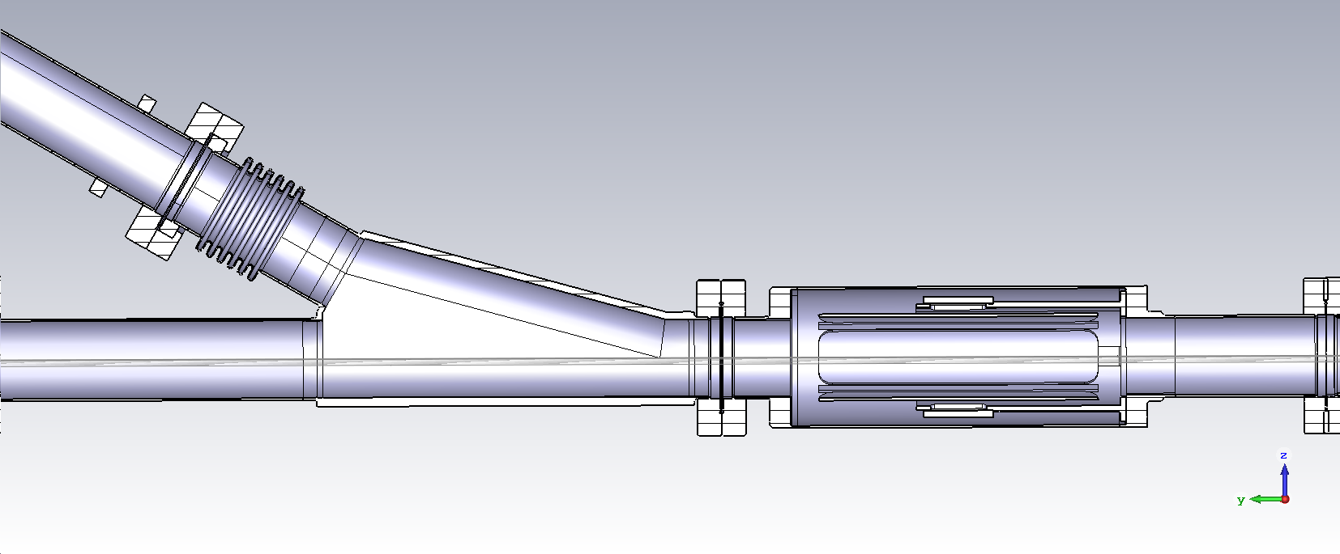
Simulation model
Ychamber
BPM
Design not yet finalized
Beam direction
Geometric impedance of the hollow electron lens
Z_{G-elens}≈ 2*Ychamber + 2*BPM + CBGC

Slide 17
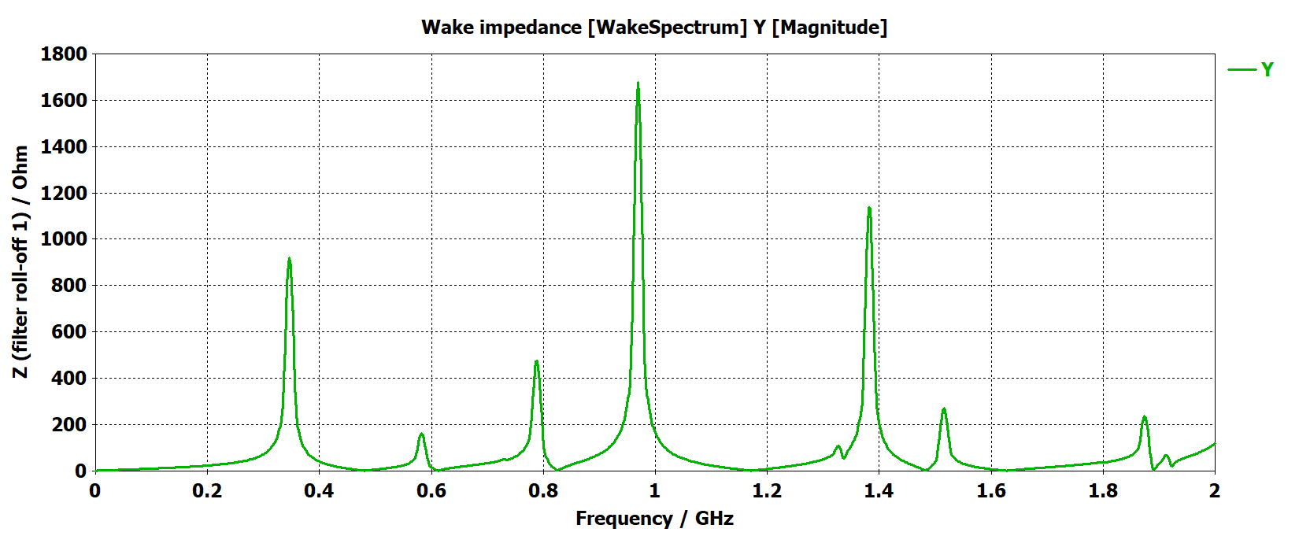
Beam position monitor impedance simulations
Longitudinal impedance
Wakefield solver

Slide 18
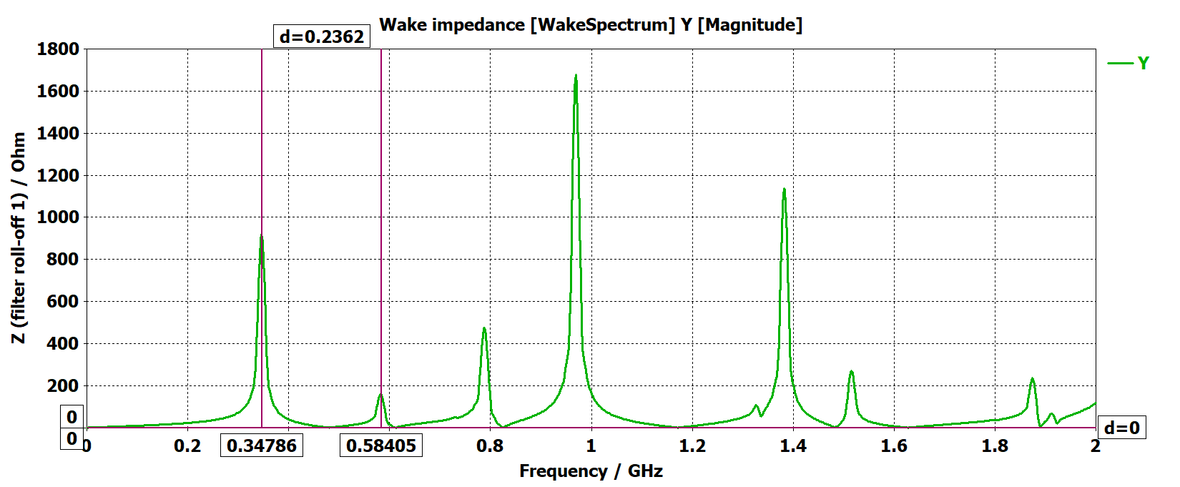
Beam position monitor impedance simulations
Longitudinal impedance
Wakefield solver
Wake is not decayed. Impedance spectrum gives information about the frequency of the impedance resonances. First resonance expected at about 350 MHz. Four significant impedance resonances are expected below 1 GHz

Slide 19
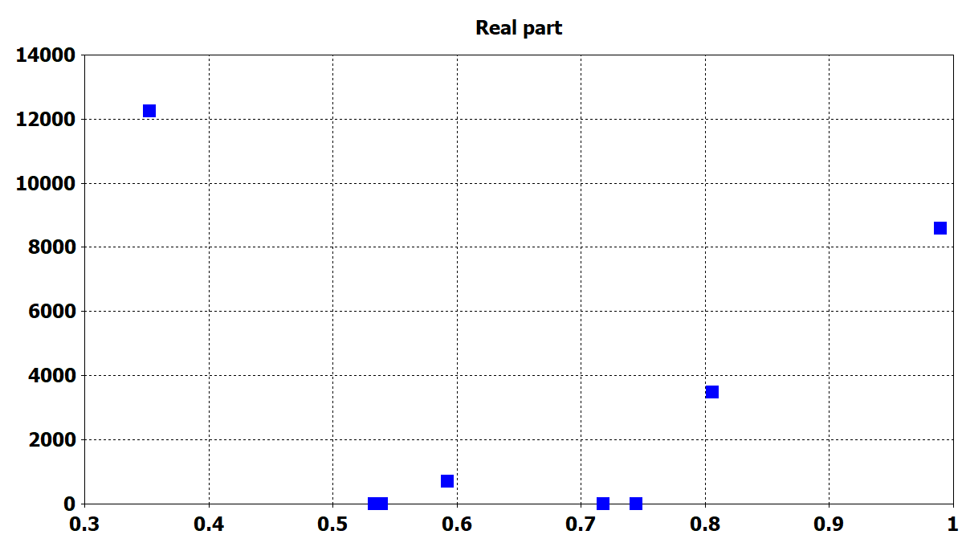
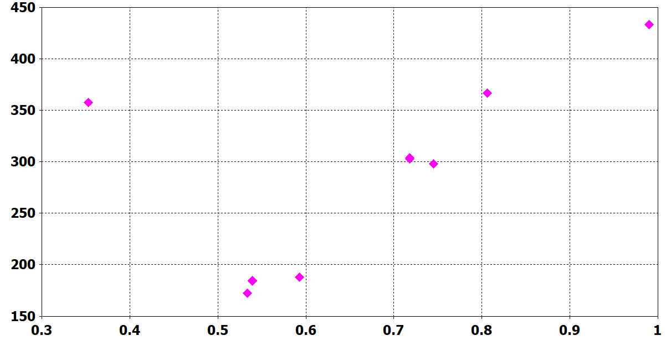
Beam position monitor impedance simulations
Longitudinal impedance magnitude
Wake impedance / Ohm
Wake impedance / LINAC Ohm
Wakefield solver
Eigenmode simulations
Frequency / GHz
Q- factors
Very good agreement between eigenmode and wakefield solver for the frequencies of the impedance resonances

Slide 20
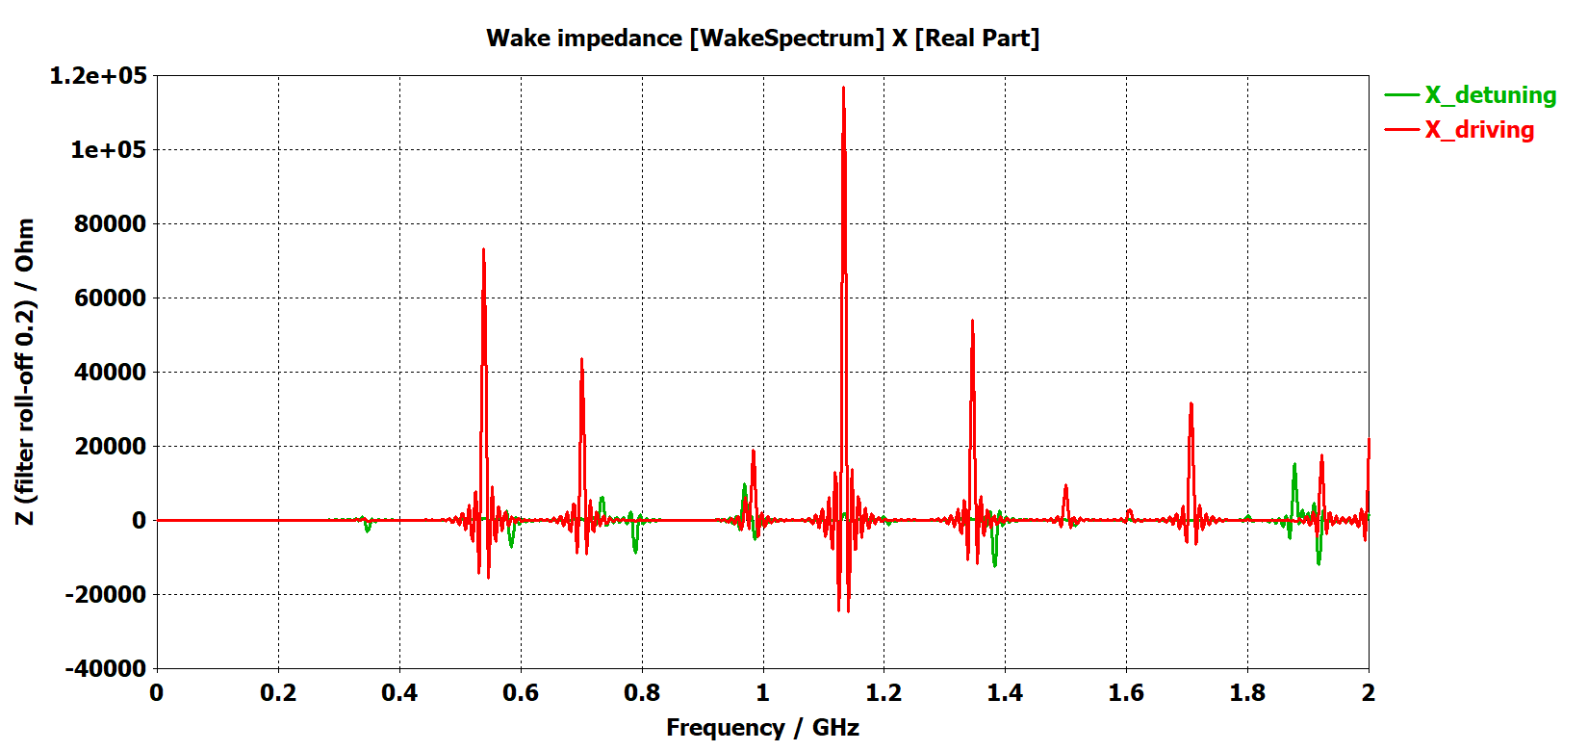
Beam position monitor impedance simulations
Wakefield solver
Transverse impedance
Wake is not decayed. Impedance spectrum gives information about the frequency of the impedance resonances. First detuning resonance expected at about 350 MHz.
First driving resonance expected at about 540 MHz.

Slide 21
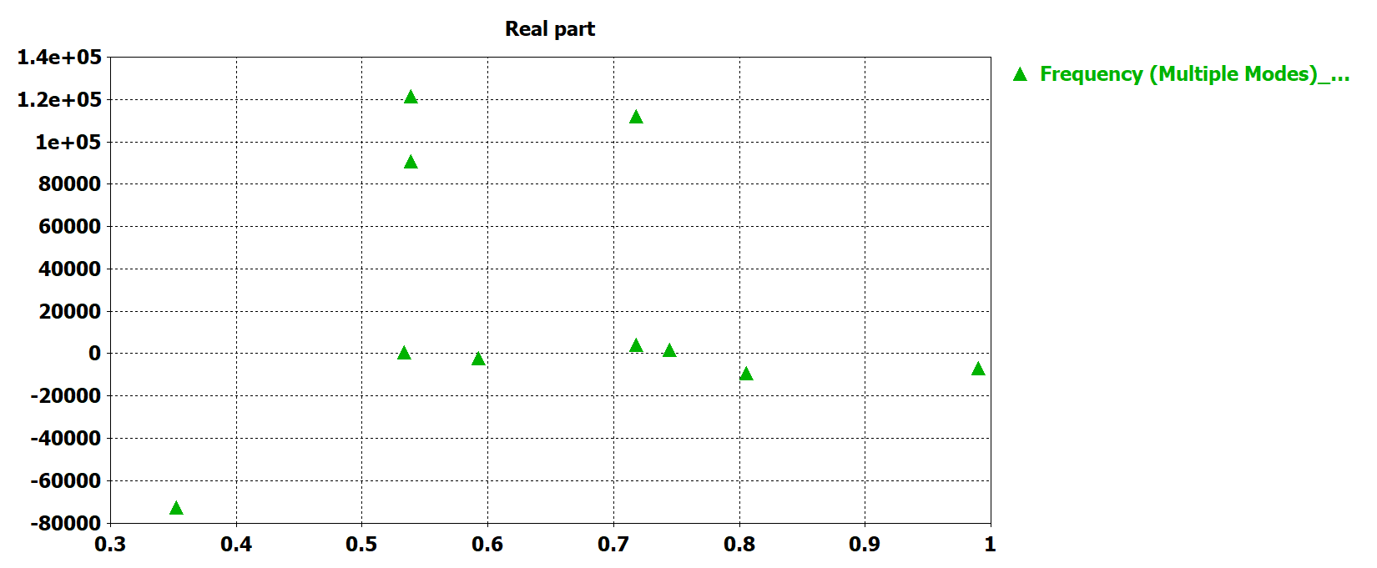
Beam position monitor impedance simulations
Horizontal impedance magnitude
Wake impedance [Ohm/m]
Wake impedance [LINAC Ohm/m]
Wakefield solver
Eigenmode simulations
Frequency / GHz
Very good agreement between eigenmode and wakefield solver for the frequencies of the impedance resonances

Slide 22
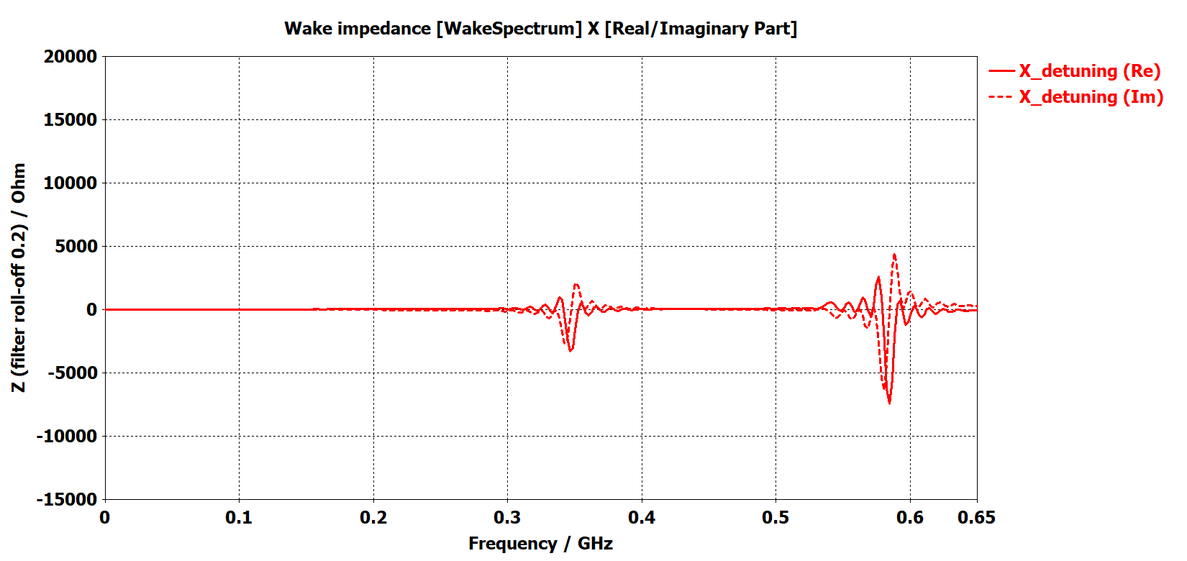
Beam position monitor impedance simulations
Wake impedance [LINAC Ohm/m]
Horizontal detuning impedance
Wakefield solver
Eigenmode simulations
Frequency / GHz
Wake is not decayed. Impedance spectrum gives information about the frequency of the impedance resonances. First resonance expected at about 350 MHz. Four significant impedance resonances are expected below 1 GHz

Slide 23
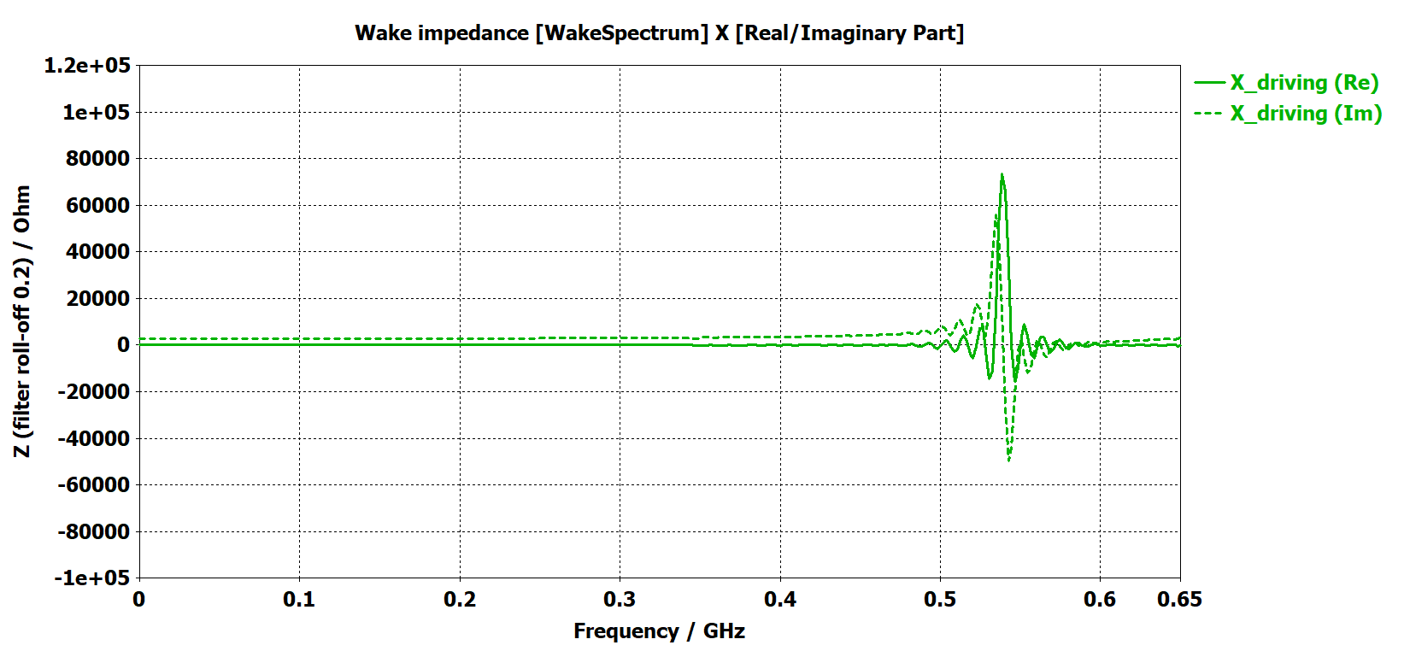
Beam position monitor impedance simulations
Horizontal driving impedance
Wake impedance [LINAC Ohm/m]
≈ 3 kΩ/m
Eigenmode simulations
Wakefield solver
Frequency / GHz
Wake is not decayed. Impedance spectrum gives information about the frequency of the impedance resonances. First resonance expected at about 350 MHz. Four significant impedance resonances are expected below 1 GHz

Slide 24
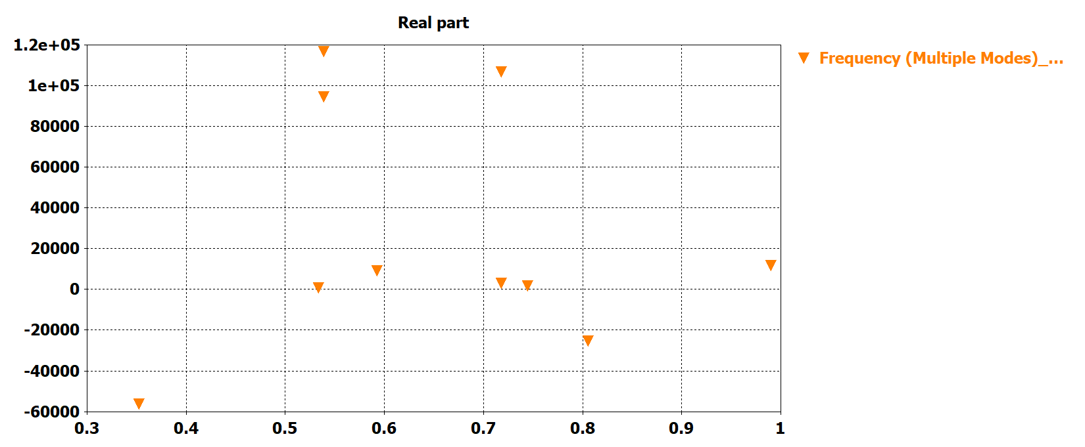
Beam position monitor impedance simulations
Wake impedance [LINAC Ohm/m]
Vertical driving impedance
Wake is not decayed. Impedance spectrum gives information about the frequency of the impedance resonances. First resonance expected at about 350 MHz. Four significant impedance resonances are expected below 1 GHz

Slide 25
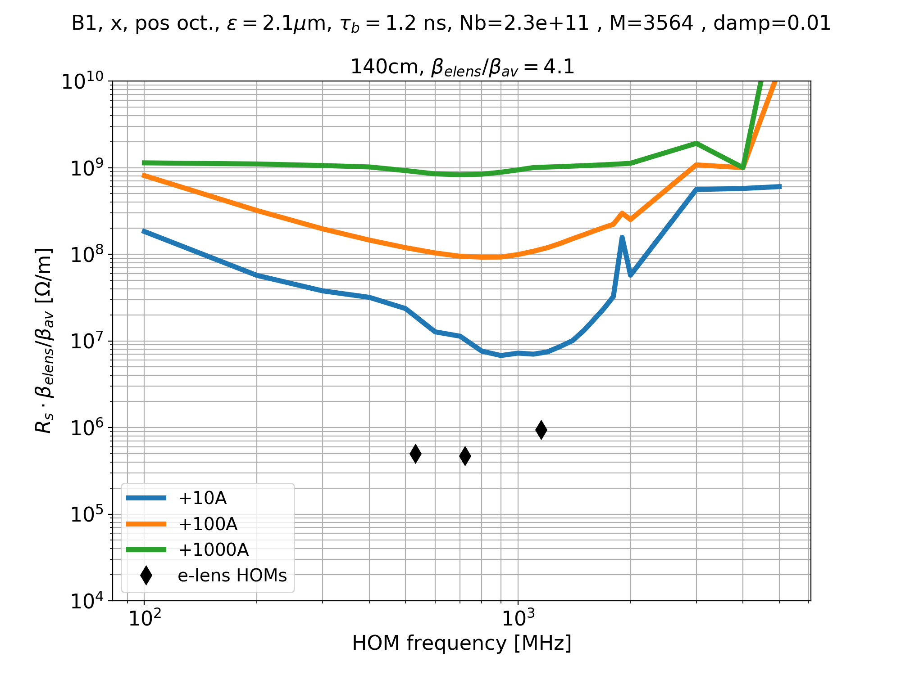
Effect on HL-LHC stability
Large margin on the shunt impedance of the three main HOMs
Courtesy of N. Mounet

Slide 26
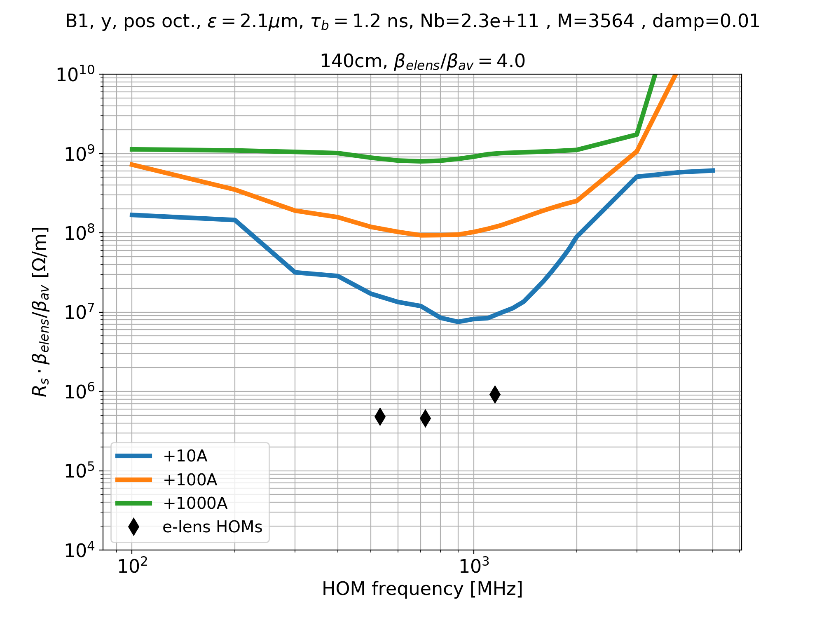
Effect on HL-LHC stability
Large margin on the shunt impedance of the three main HOMs
Courtesy of N. Mounet

Slide 27
Summary
A preliminary beam coupling impedance model of the electron lens including the effect of BPM and Y chamber has been built
The results are not final
  Design not yet finalized:
    BGC not integrated in the CATIA model
    BPM terminations not integrated in the CATIA model

Slide 28
Appendix

Slide 29
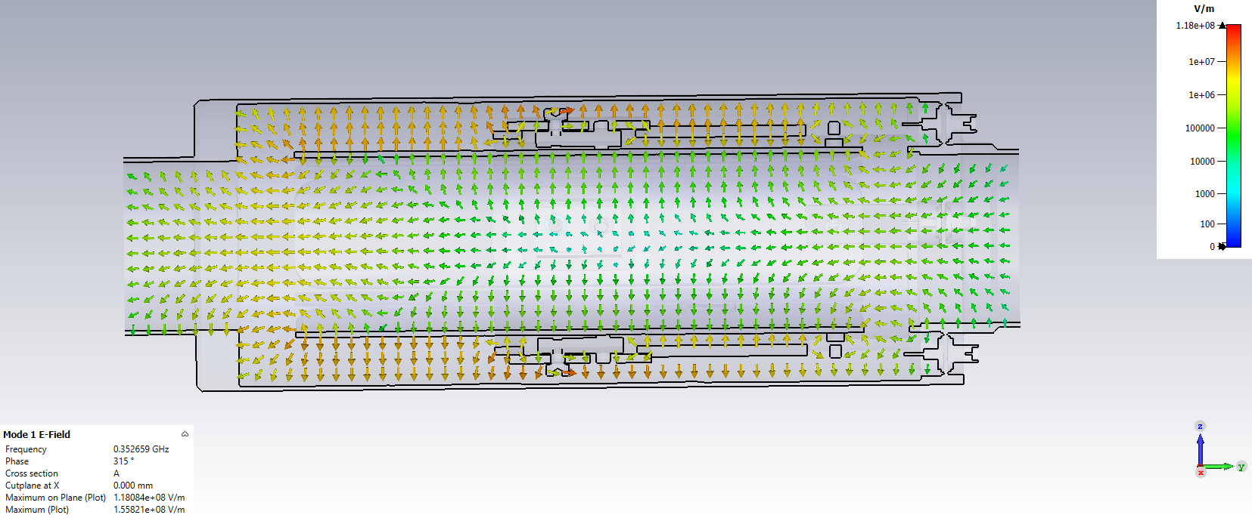
Beam position monitor impedance simulations
First detuning mode

Slide 30
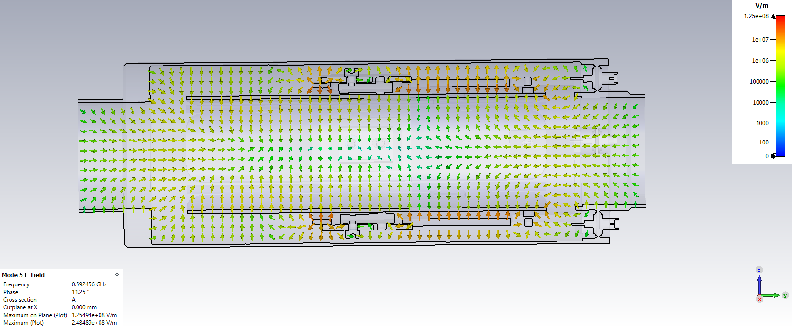
Beam position monitor impedance simulations
Second detuning mode

Slide 31
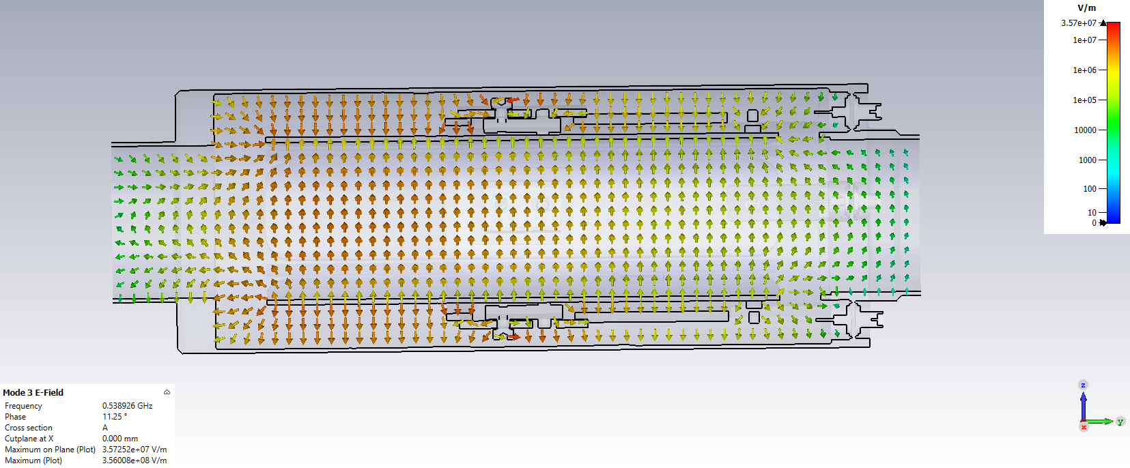
Beam position monitor impedance simulations
First driving mode

Slide 32
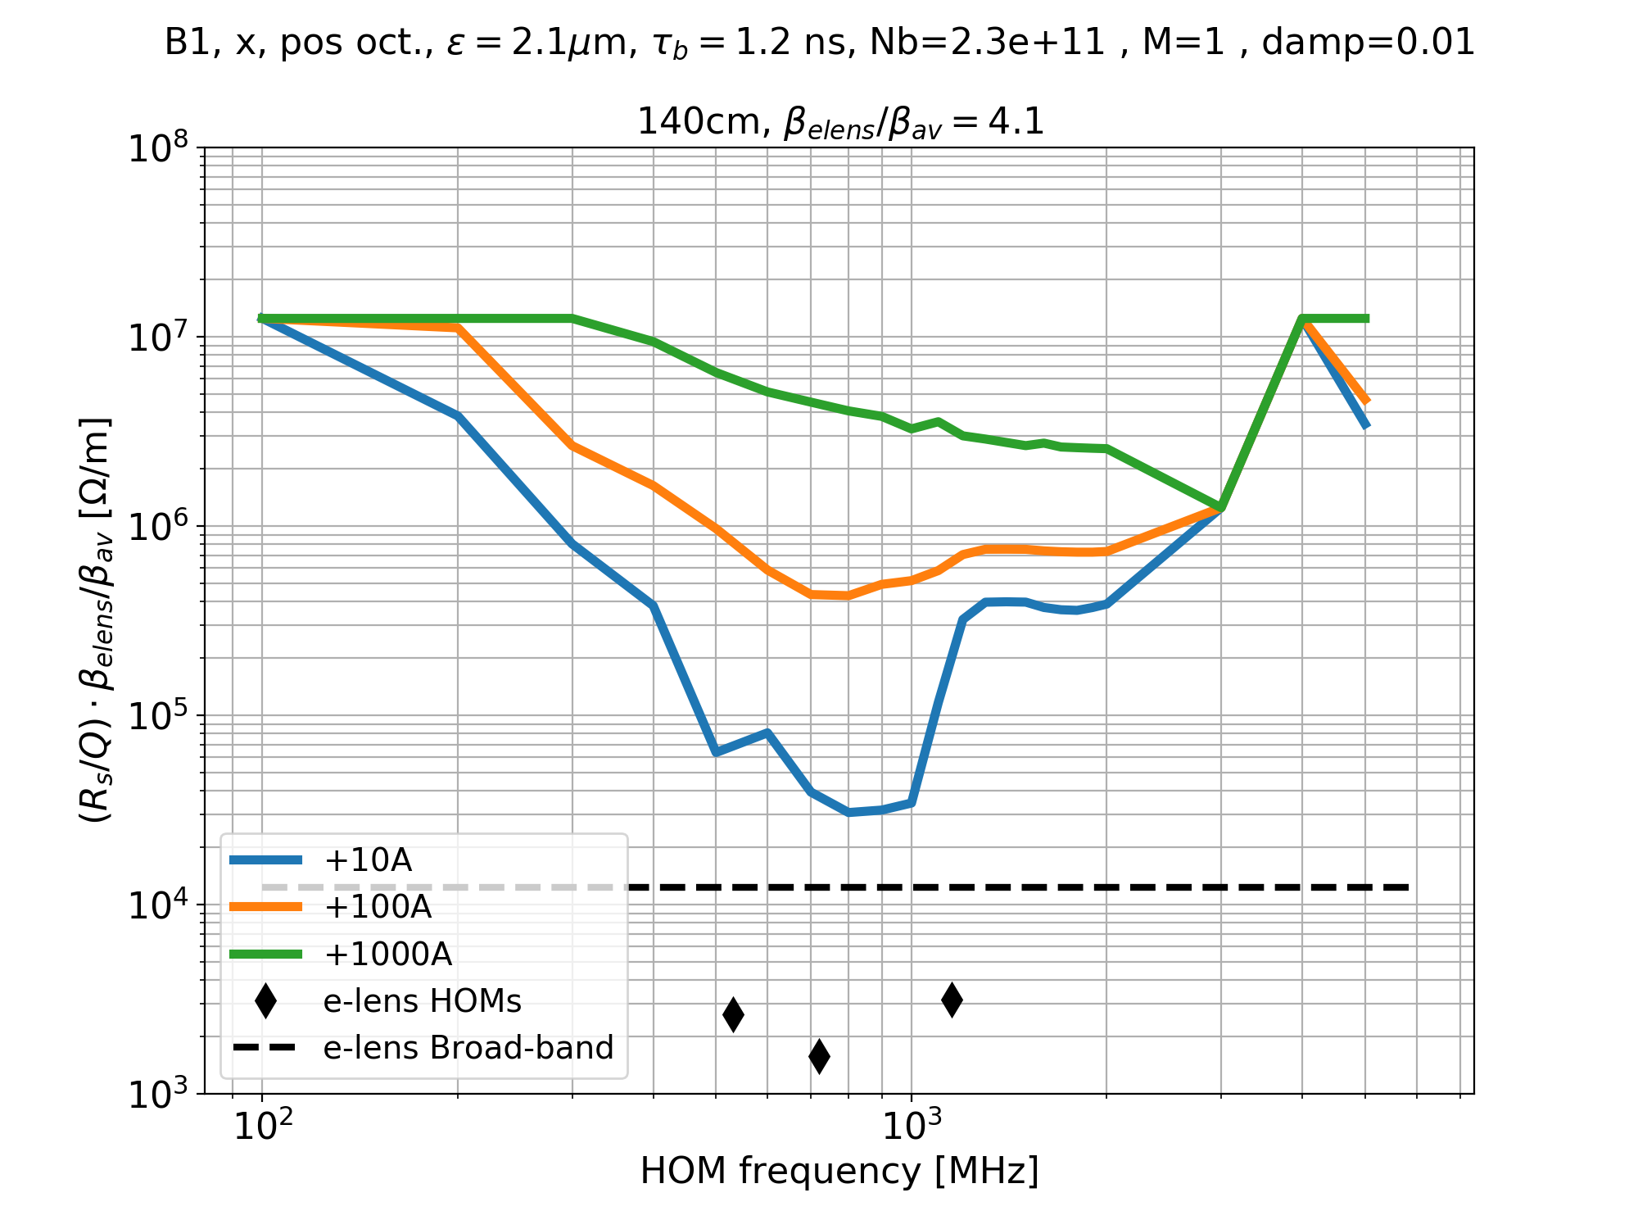
Single bunch stability

Slide 33
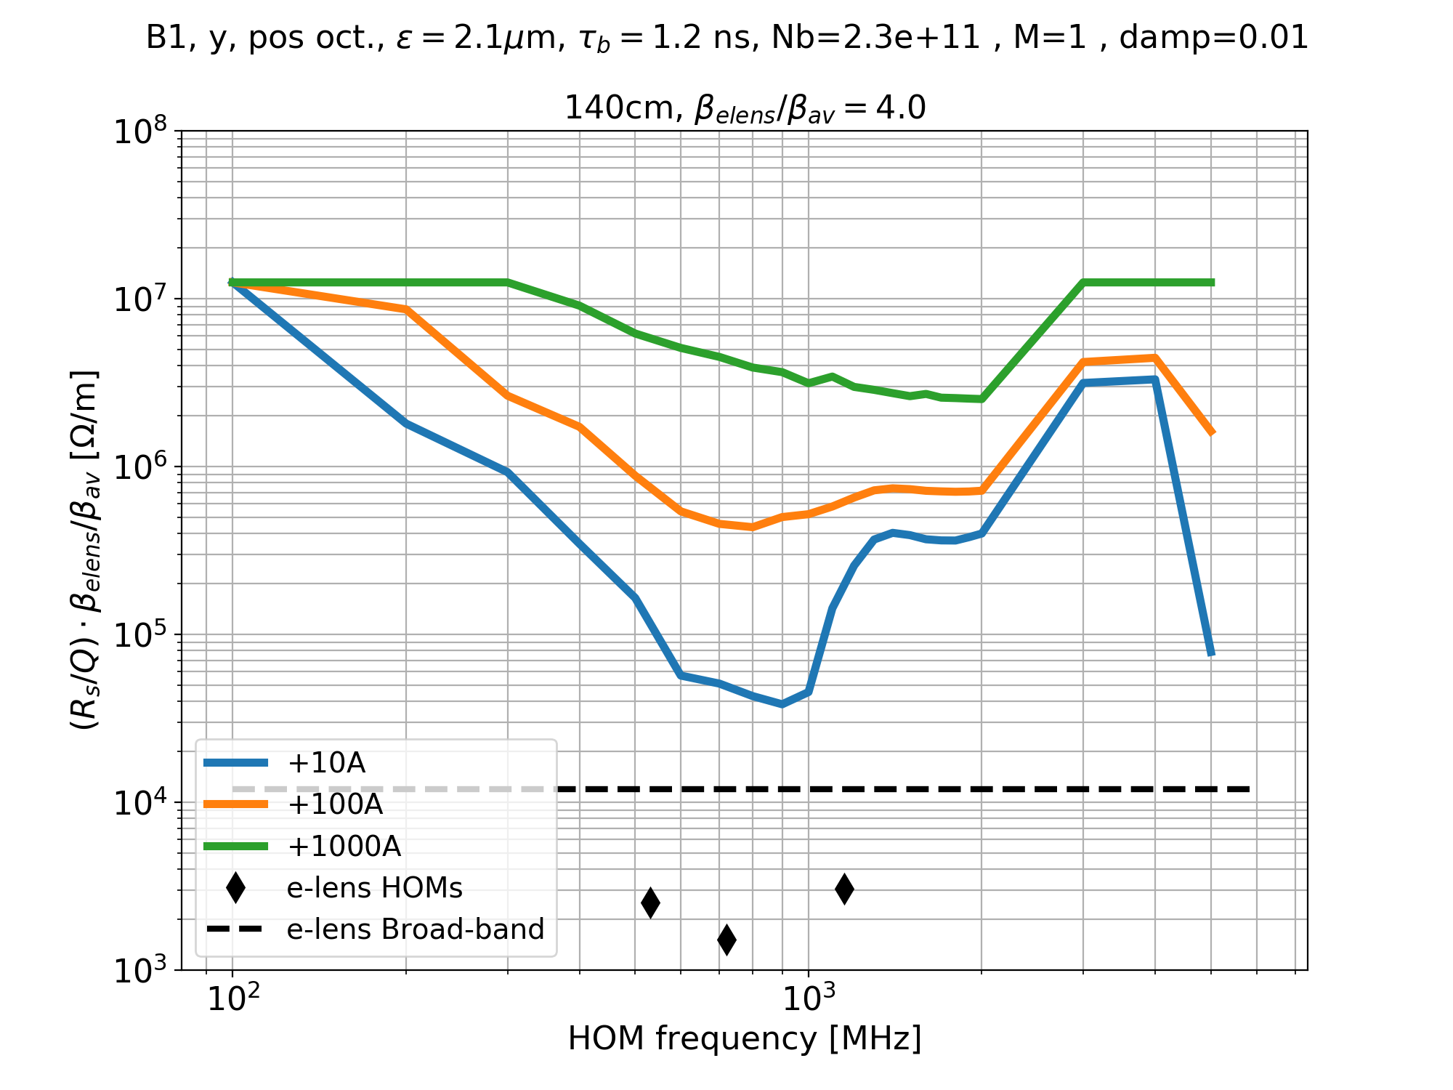
Single bunch stability

