Slide 1
Usability study for the new account portal.
Maria FAVA IT-CDA-IC
22.02.2021

Slide 2
Introduction
  In the process of improving the new account portal provided by the IT-CDA-IC team, a usability study was launched at the end of 2020.
  For the purpose of that study, a series of tasks was handed over to 10 CERN employees who consequently contributed to the project with their feedback regarding their experience with the application.
  In the following slides, we shall present the tools used for the study along with the material which we were able to gather upon completion and finally the actions taken.

Slide 3
Project Setup
  In order to organize a remote usage observation, allowing the users to complete the requested actions on the portal in their desired timeframe, the tool loop11 was used.
  Through this tool, we constructed the scenarios through which the users would be able to exploit the application as much as possible.
  To initiate the test, each subject was required to grant access to their screen, microphone and camera, since verbal input was also taken into account besides written comments throughout the tasks.

Slide 4
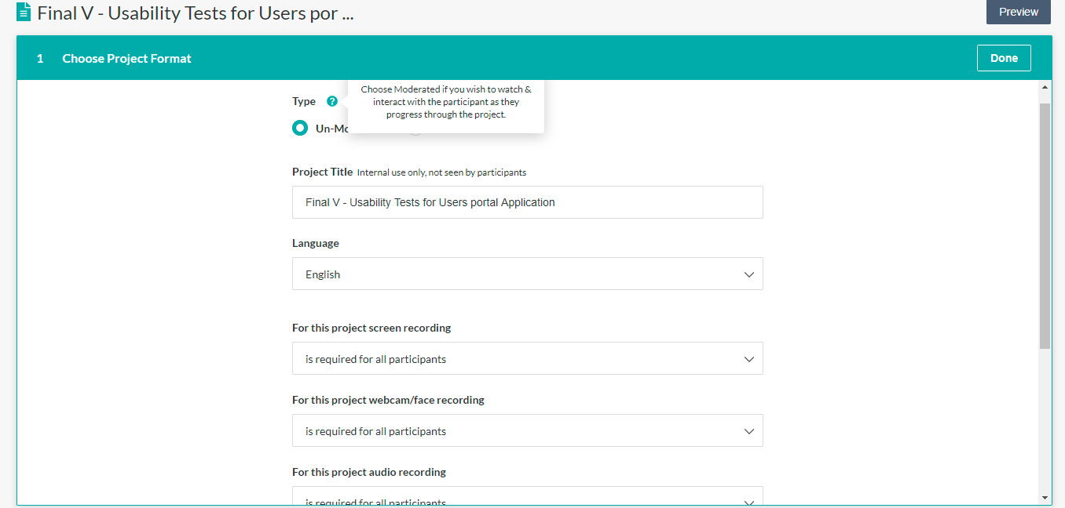
Loop11: Project format.

Slide 5
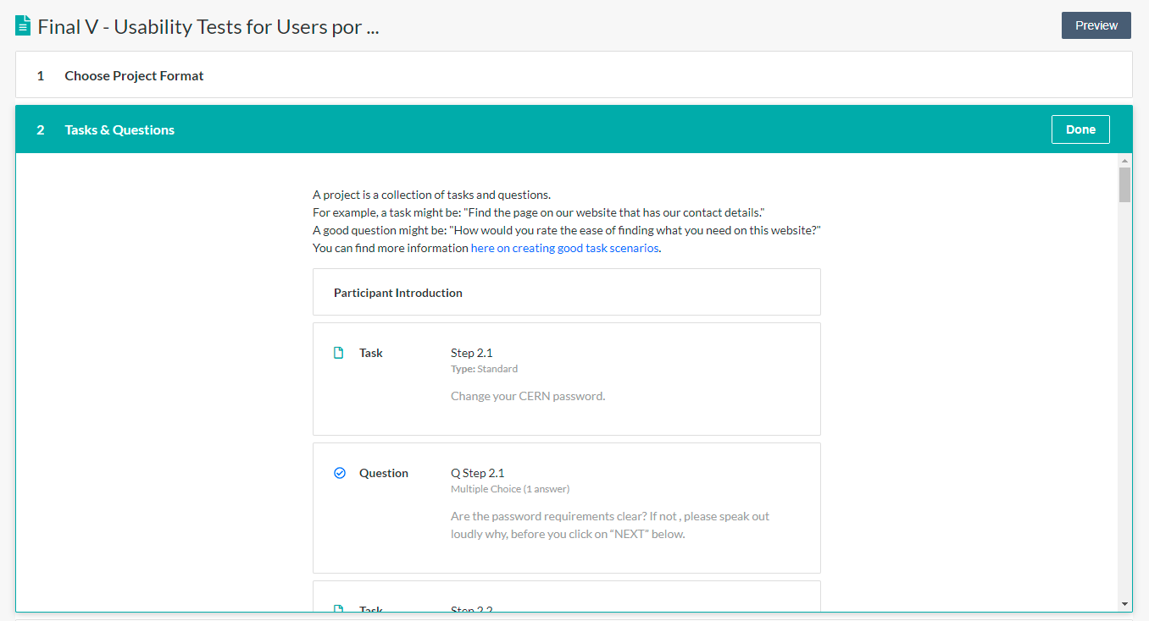
Loop11: Defining the tasks.

Slide 6
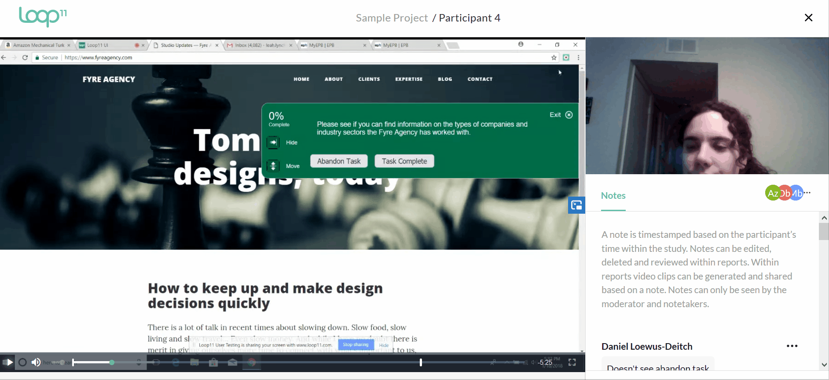
Loop11: Users’ videos.
User video example used from Loop11 tutorial for CERN users’ privacy purposes.

Slide 7
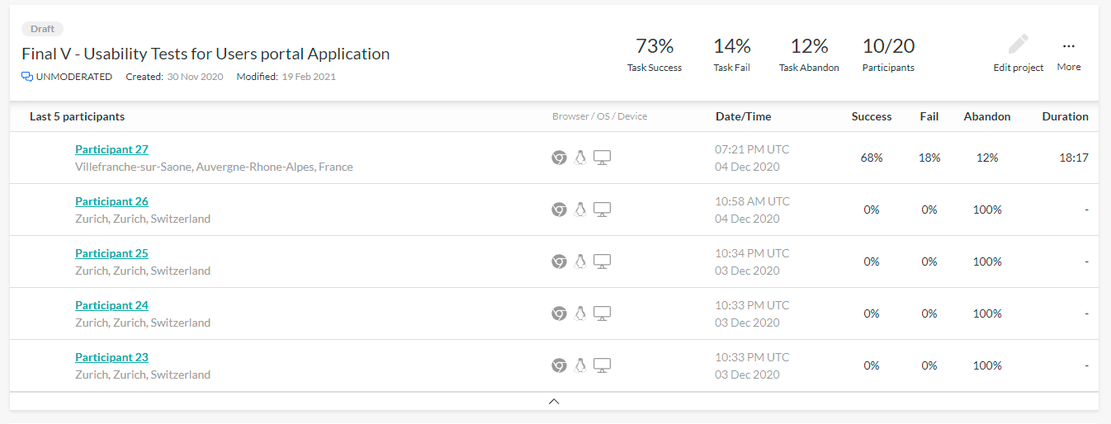
Loop11: Participants overview.

Slide 8
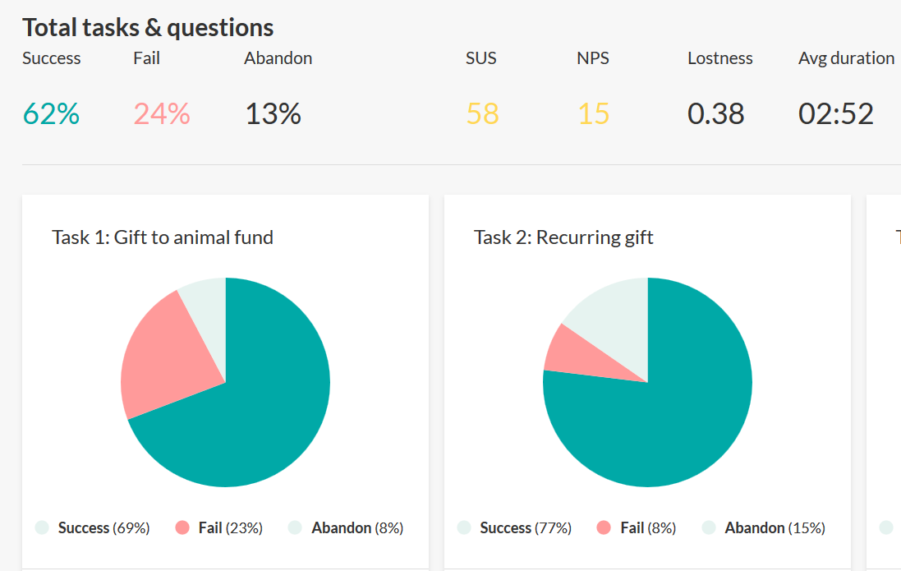
Loop11: Result report.
Result report example used from Loop11 tutorial.

Slide 9

Loop11: Lostness.
  The lostness rate calculation, allows the calculation of the lostness in each task per person. Lostness rate is calculated manually or with a spreadsheet using the formula above.
  Where:
  R is the minimum number of pages (pop-up windows or visible changes on the page included) that must be visited for the task.
  S is the total number of visited pages (pop-up windows or visible changes on the page included).
  N is the number of different pages visited (pop-up windows or visible changes on the page included).
  L varies from 0 to 1 where 0 corresponds to zero losses and 1 to user being fully lost. For the purpose of these tests, we assigned 1 to the tasks were the users failed to complete the task. For a value of L above 0.4 it is recommended to make changes to the website.

Slide 10
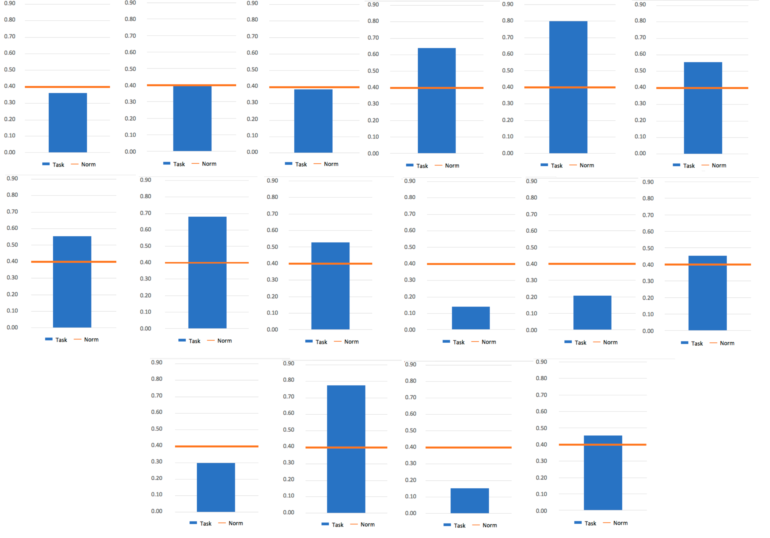
Loop11: Lostness Results Overview.

Slide 11
Tasks and Usability based alterations

Slide 12
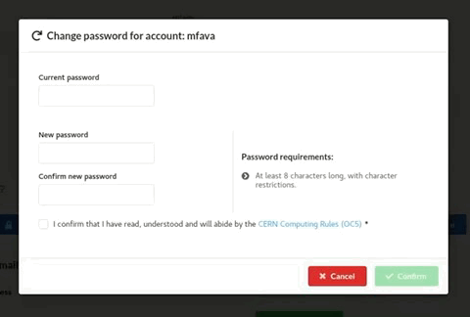
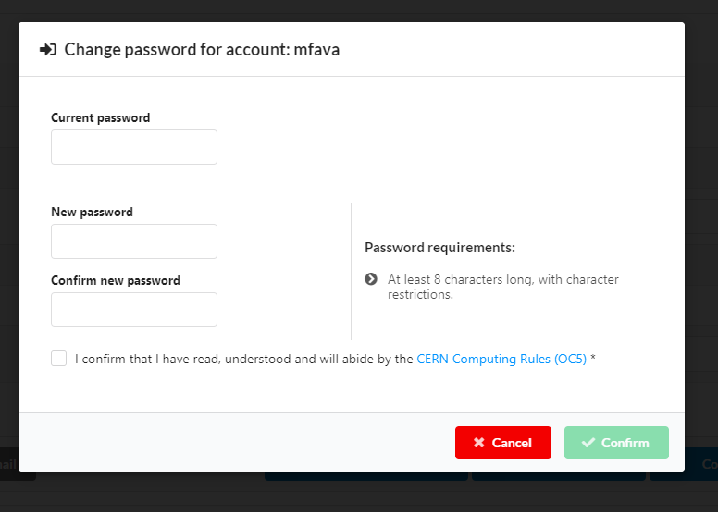

Task: Change your CERN Password.

Slide 13
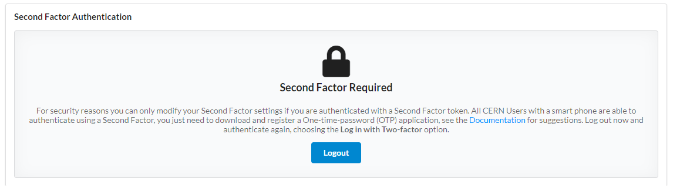
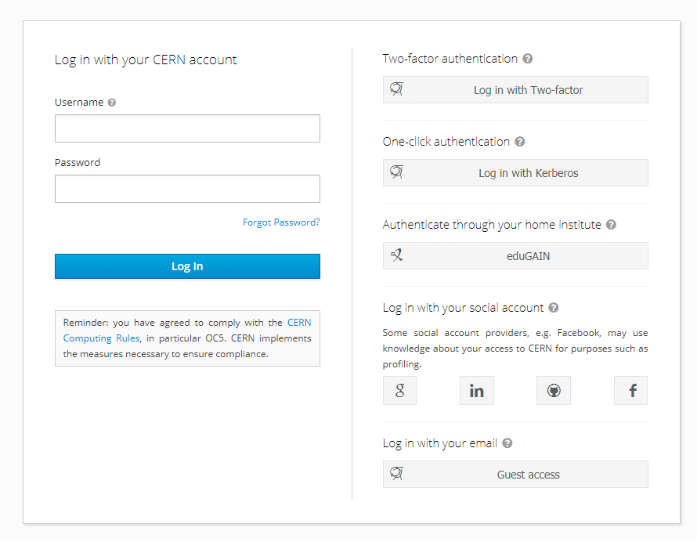
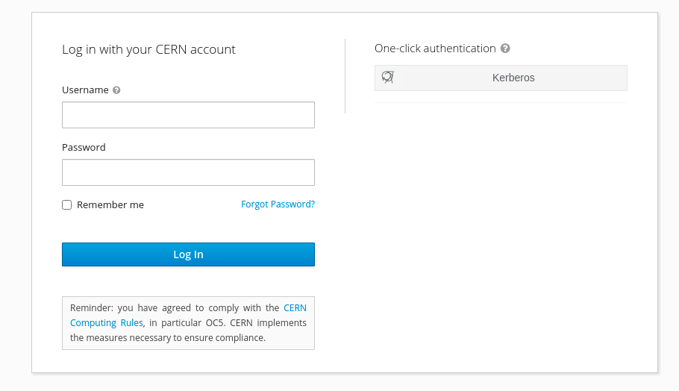
Task: Configure multifactor authentication.

Slide 14
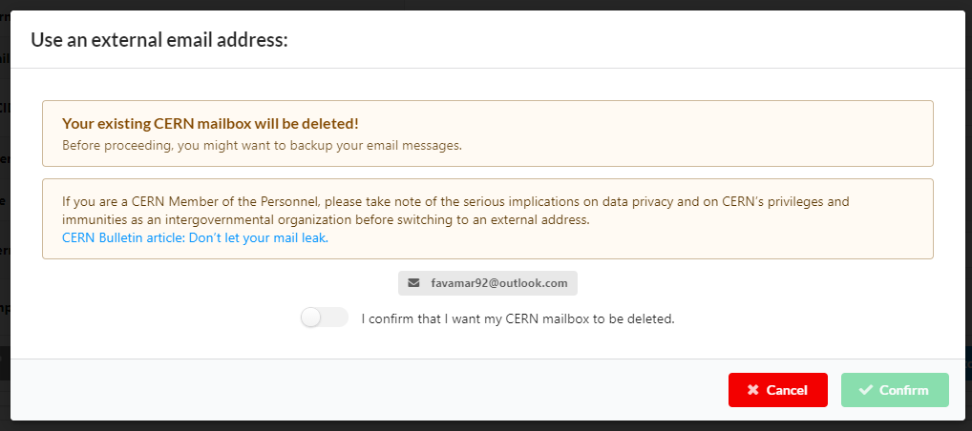
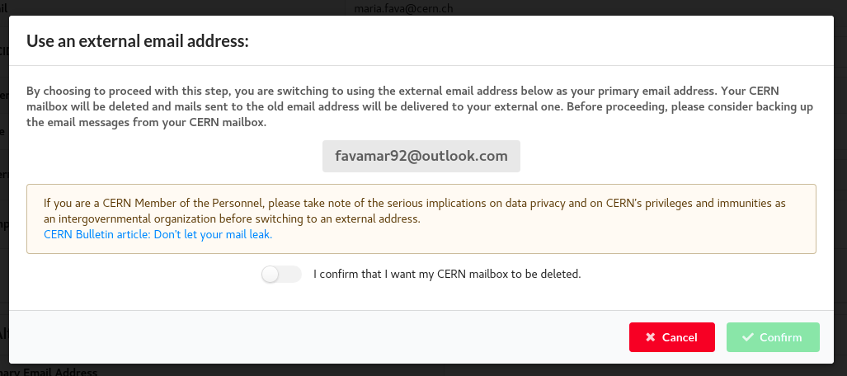
Task: Switch to using an external email instead of your CERN email.

Slide 15
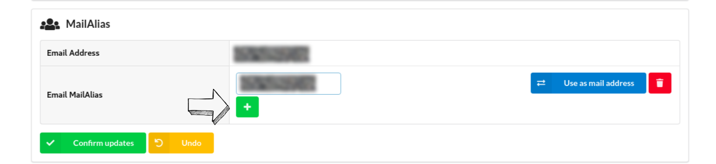
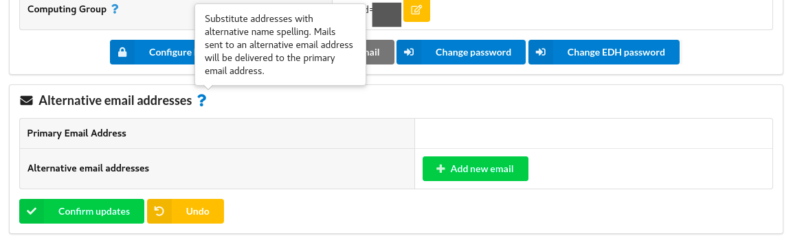
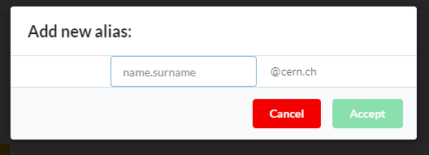
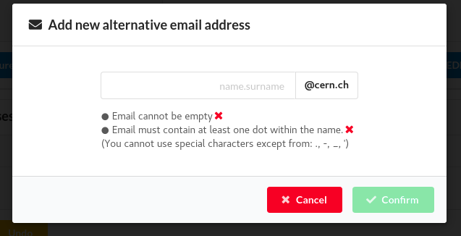
Task: Set up an email Alias.

Slide 16
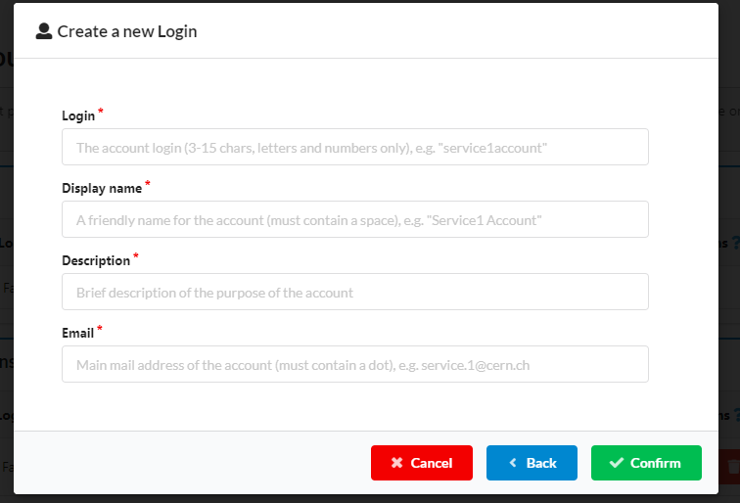
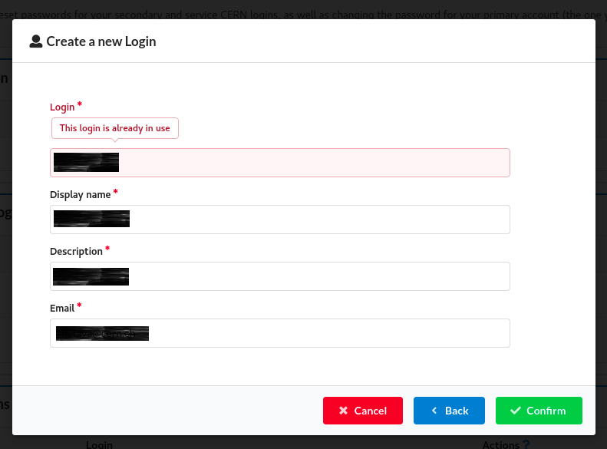
Task: Create a new Service login.

Slide 17
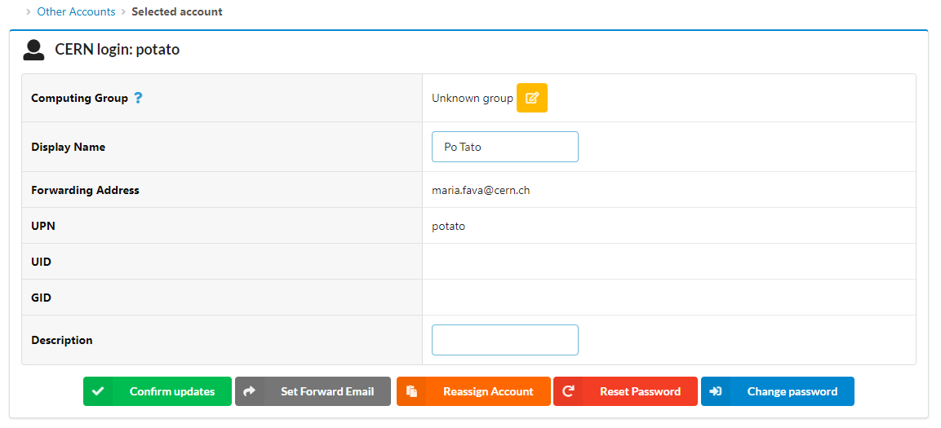
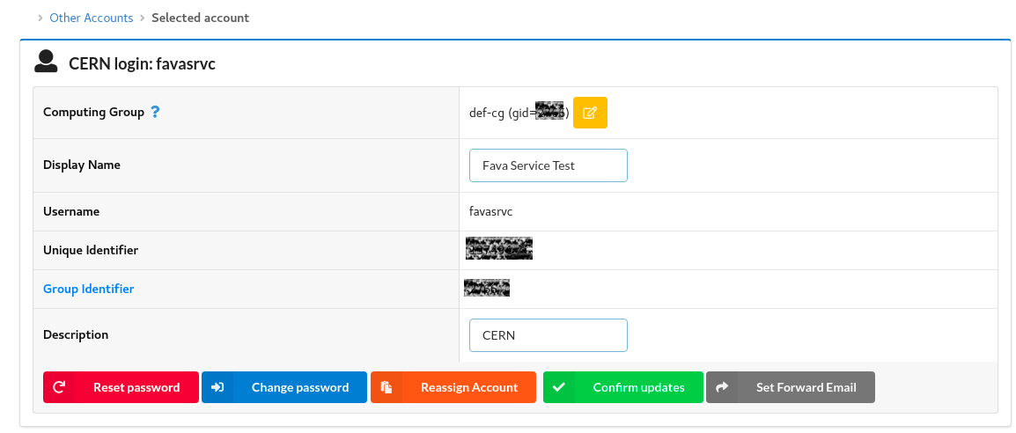
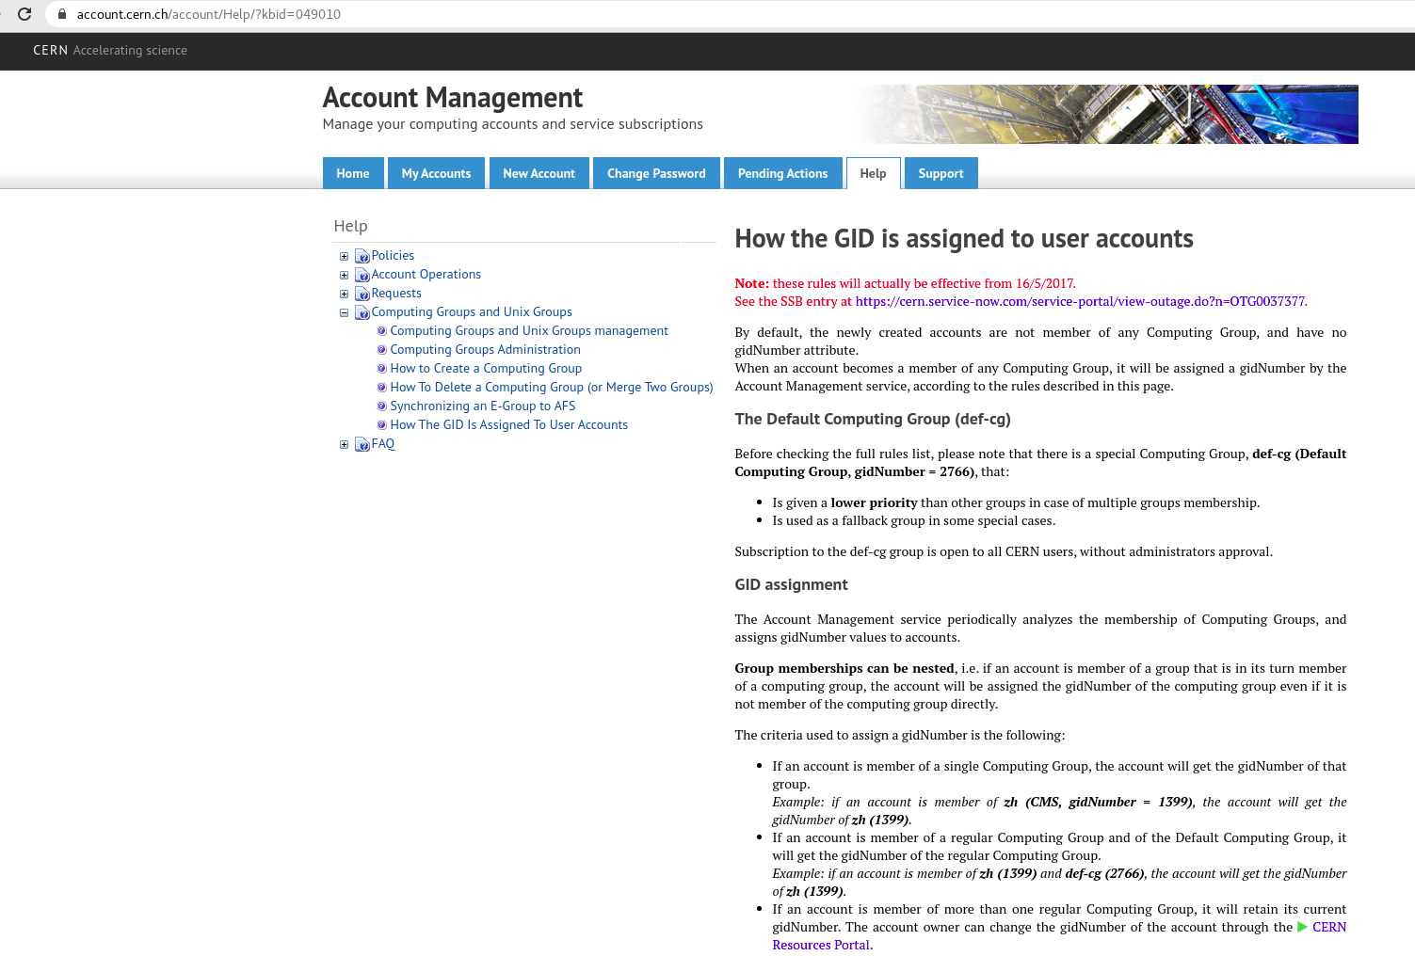
Task: Navigate to the edit page of your newly created Service login.

Slide 18
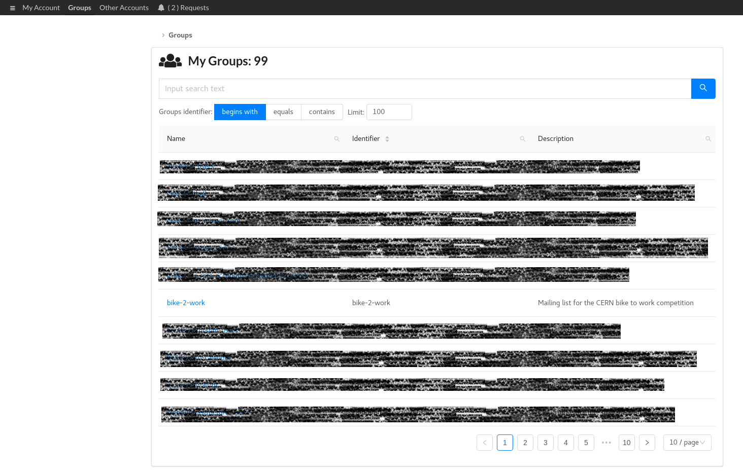
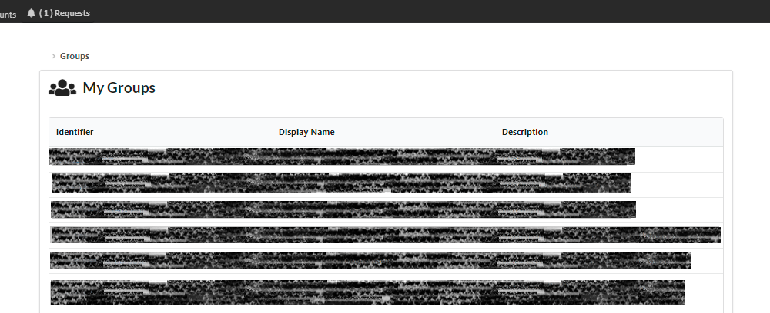
Task: View the groups in which you are a member.

Slide 19
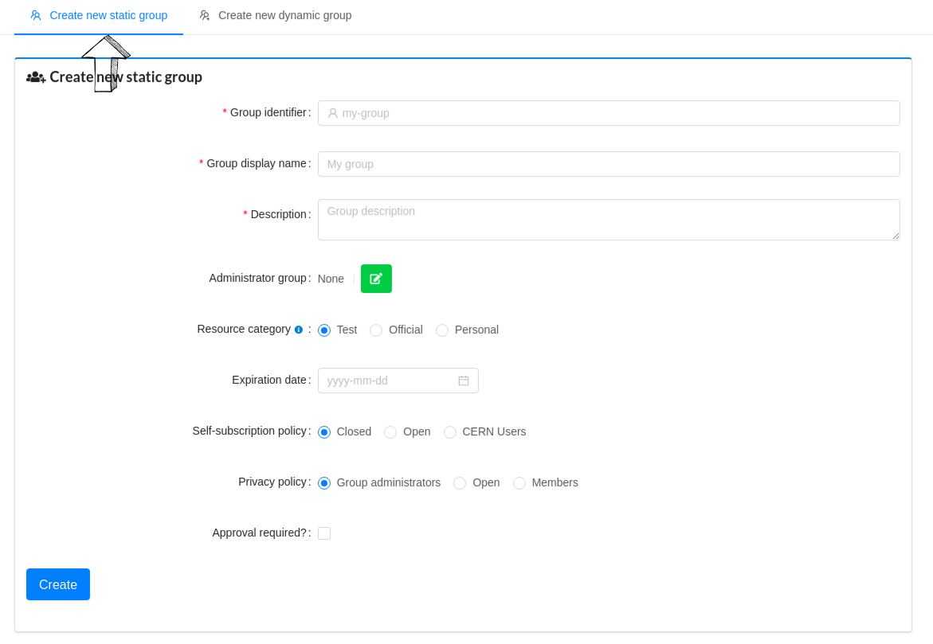
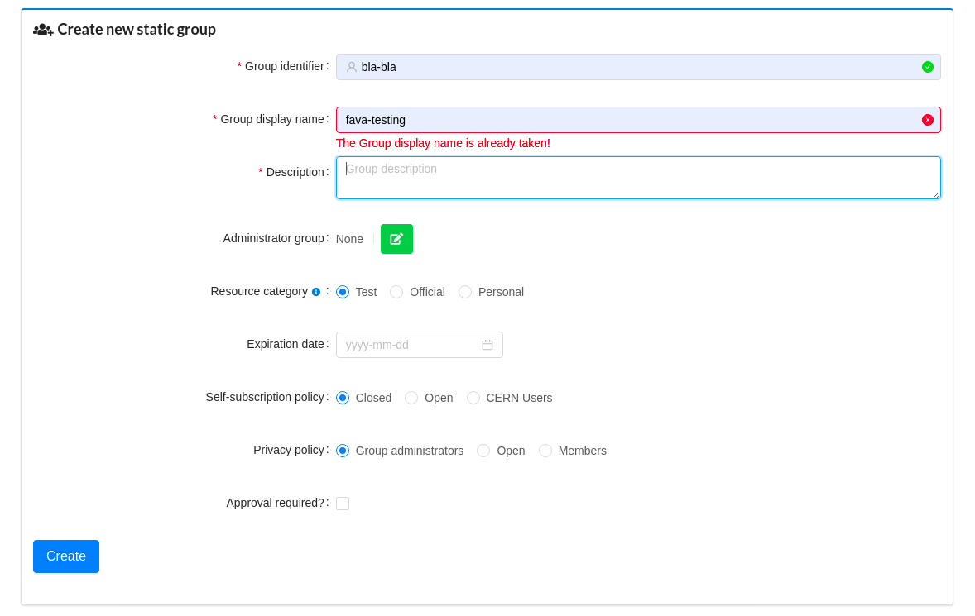
Task: Create a static or dynamic group.

Slide 20
Conclusion
  Overall, the participants showed positive response towards their experience while performing the given tasks.
  The majority of them faced similar difficulties and a strong need for further explanations and guidance was observed.
  By adding tooltips, further input guidance, direct navigation paths etc, we aimed to improve the user experience and we are continuously refining the design and functionality of the application in order to accommodate its users.

Slide 21
References
Loop11 tool: https://www.loop11.com
Lostness guide: https://artplusmarketing.com/the-complete-guide-to-measuring-lostness-c890cc71fe05
Users portal demo application: https://demo-users-portal.web.cern.ch

Slide 22
Thank you!

