Slide 1
RF Power Network – Draft Slides
Matthew Capstick
26-01-2021

Slide 2
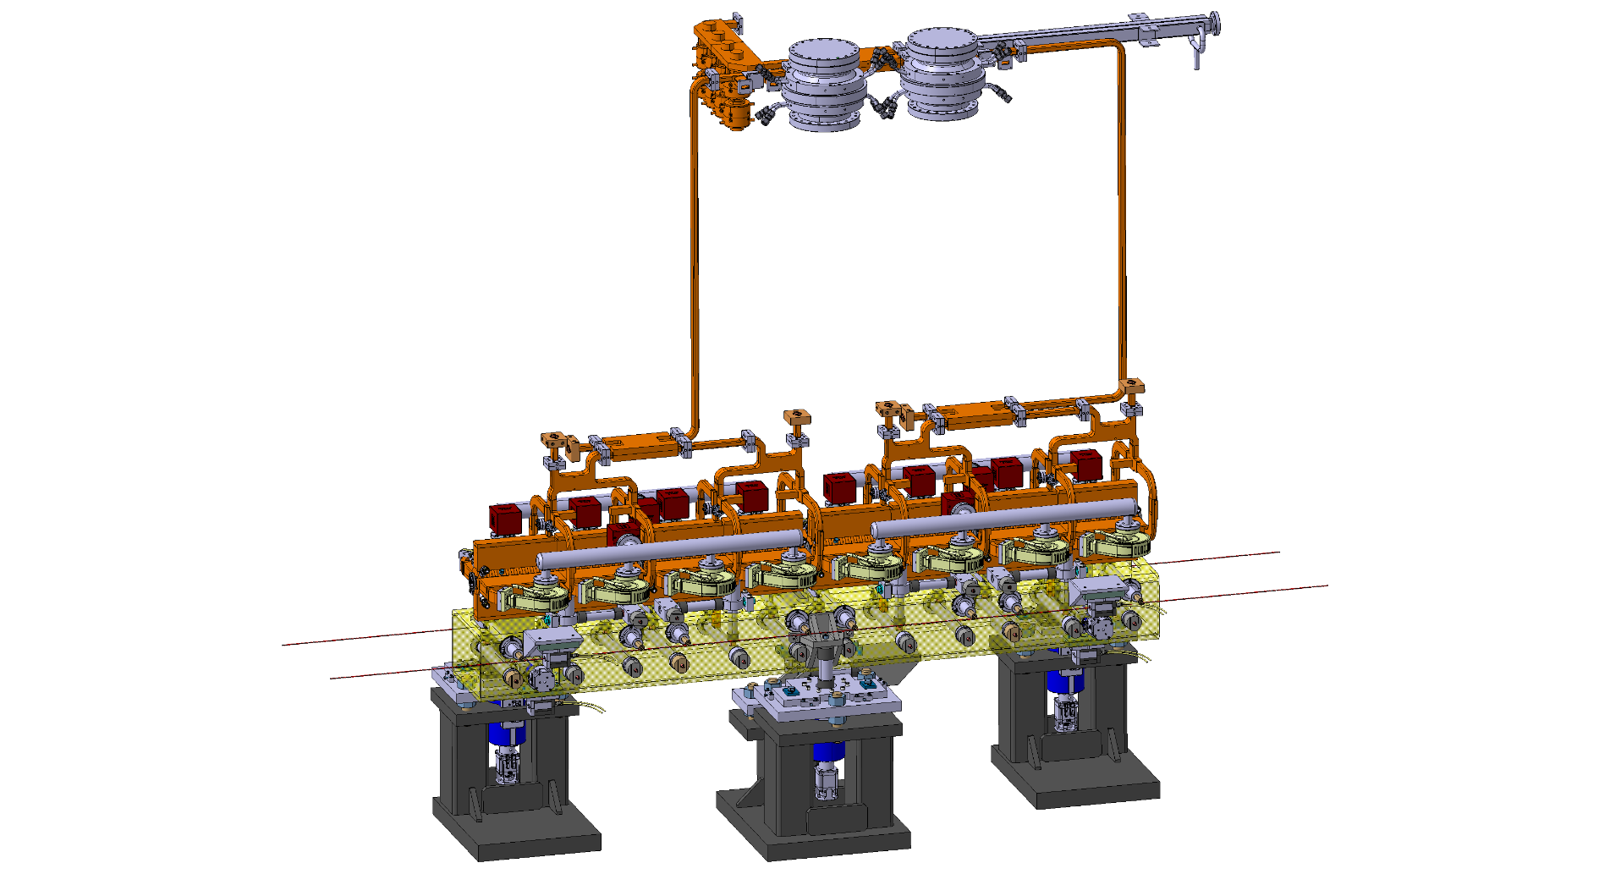
Module

Slide 3
RF Unit
BOC Cavities
x3.5 pulse compression
170MW
334ns
Double Height
Waveguide
40.6MW
334ns
Single Height WR90
Waveguide

Slide 4
RF Components
New components required for the RF unit and waveguide network
Double height waveguide
Double height waveguide flanges
Rectangular X-band WR90 – Bolted
Rectangular X-band WR90 – Clamped
Choke mode circular – Clamped
Bends for DHWG
DH Hybrids

Slide 5
RF Components
New components required for the RF unit and waveguide network
Double height waveguide
Double height waveguide flanges
Rectangular X-band WR90 – Bolted
Rectangular X-band WR90 – Clamped
Choke mode circular – Clamped
Bends for DHWG
DH Hybrids

Slide 6
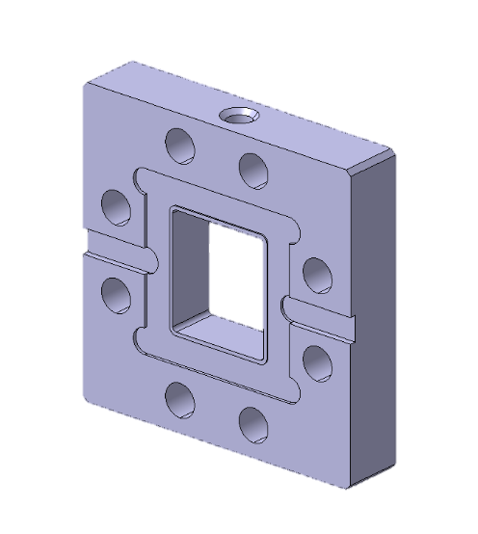
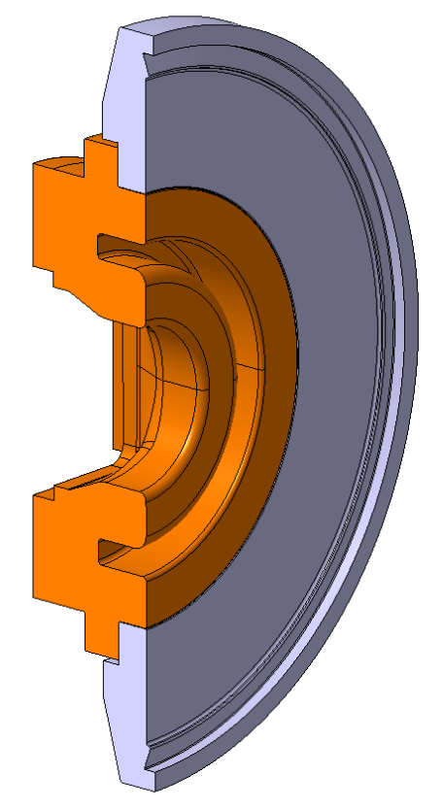
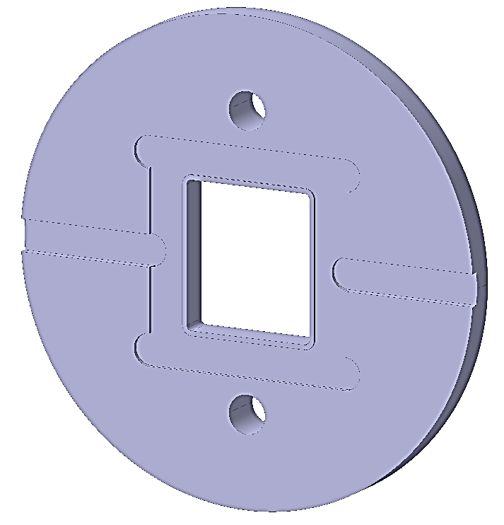
Flanges
DH X-band WR90 – Bolted
DH X-band WR90 – Clamped
Double Height Choke Mode

Slide 7
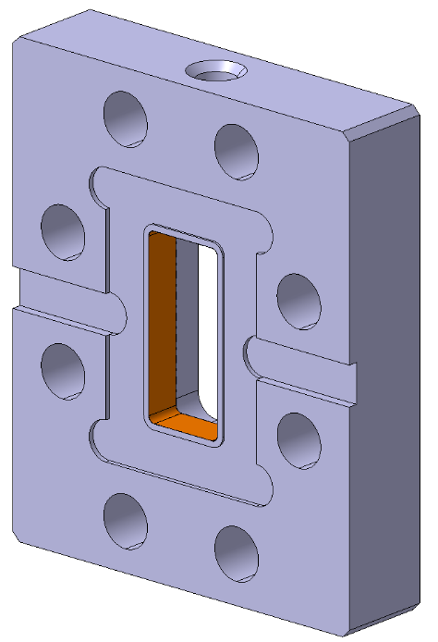
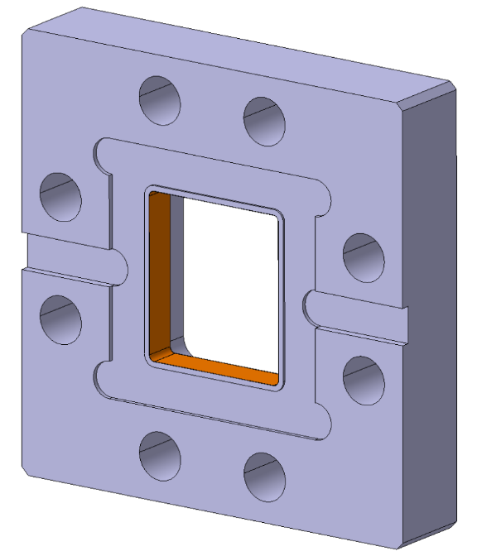
DH X-band WR90 – Bolted
Rectangular Flange design:
Adapted from the current X-band WR90 flange:
Assumes the current ‘square knife edge’ geometry will still work
Assumes that 8 bolts will still provide enough gasket sealing pressure

Slide 8
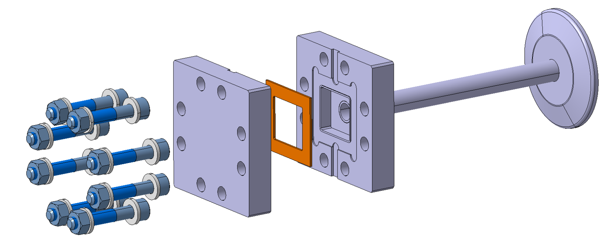
Vacuum Test Pieces
Currently in manufacture for testing:

Slide 9
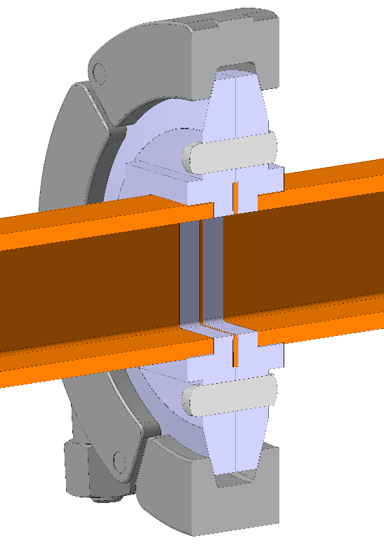
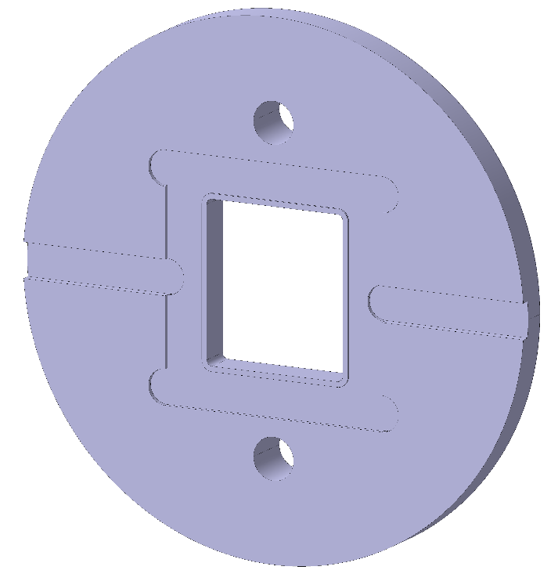
DH X-band WR90 – Clamped
Markus suggested and alternative flange based around the:
IUWR90 gasket RF connection and vacuum seal
KF50 equivalent external geometry
It would require alignment features (pins or dowels) to fix rotation
Whether the KF50 clamp would produce enough clamping force is unknown

Slide 10
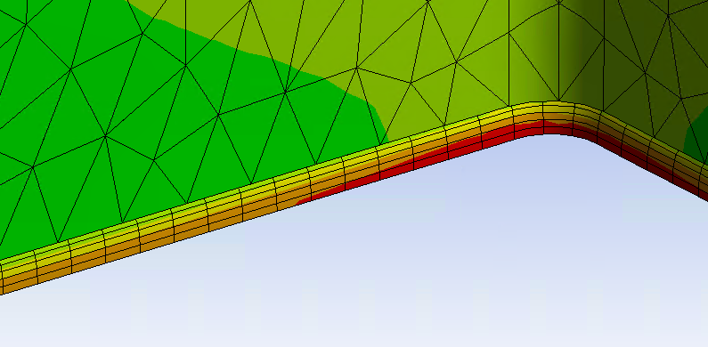
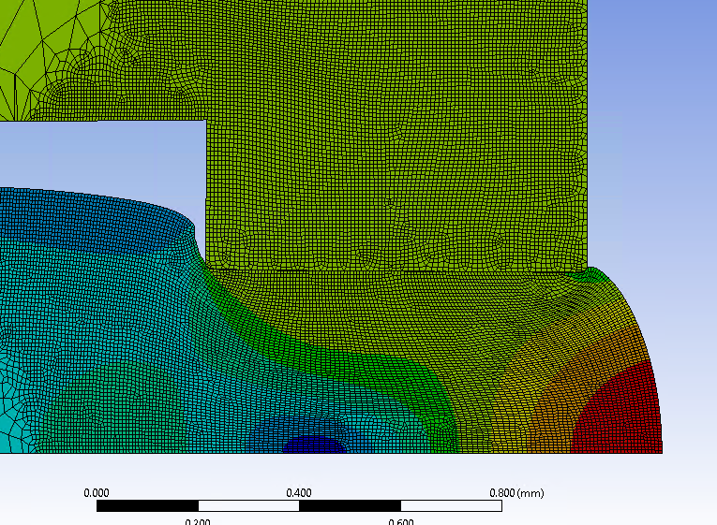
Vacuum Test Pieces
Whether chain clamps can provide the required sealing force is unclear.
In analysis the gasket reaches maximum deformation at 60% of the maximum QCF DN63 Clamp pressure
Currently in manufacture for testing:
Replace with correct
image

Slide 11
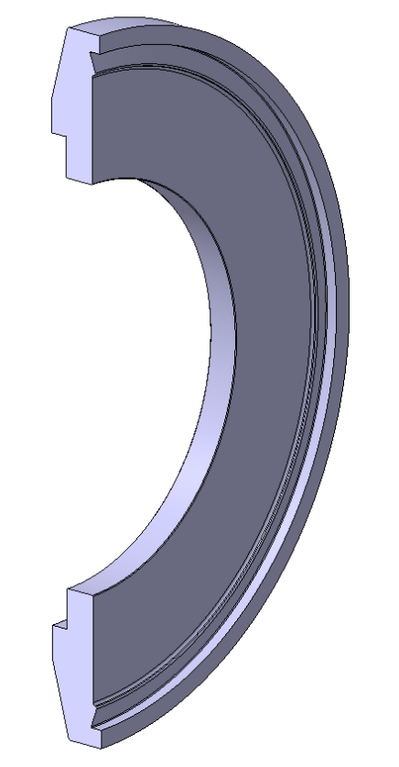
Choke Mode
Advantages
Uses standard CF DN64 Copper gaskets and chain clamps
Vacuum sealing unlikely to be a problem
Separates the RF and Vacuum connections
Axially rotatable
Complications:
Relatively complicated geometry
Introduces additional brazing operations
Status:
Required for waveguide pumping ports
RF Geometry not final

