Slide 1
Prototype Results 30-06-21
Matthew Capstick

Slide 2
Results Summary Table
Average results:
 | Results Summary
 | Wedge Axes |  |  |  |  | Differential Thread Axes
Axis | V1 | V2 | V3 | LN | Design | L1 | L2 | Design
Average Gradient | 29.55 | 30.63 | 29.04 | 29.91 | 30.00 | 36.12 | 32.19 | 40.00
Average Backlash | 9.73 | 9.77 | 12.80 | 13.83 | -- | 8.75 | 3.92 | --
Needs further investigation:
L2 – gradient was a lot lower than expected on certain repeats
Both L1 & L2 experienced ‘positive backlash’ on certain repeats
The total range (not shown) of L1 & L2 was lower than expected
Largest backlash occurred on the longitudinal axis
The cases where the vertical forks lifted from the wedge have been omitted

Slide 3
Results Summary Table
Average results:
 | Results Summary
 | Wedge Axes |  |  |  |  | Differential Thread Axes
Axis | V1 | V2 | V3 | LN | Design | L1 | L2 | Design
Average Gradient | 29.55 | 30.63 | 29.04 | 29.91 | 30.00 | 36.12 | 32.19 | 40.00
Average Backlash | 9.73 | 9.77 | 12.80 | 13.83 | -- | 8.75 | 3.92 | --
All could be a result of the spring becoming almost fully compressed.
Need to repeat with a higher stiffness spring, but less initial compression.
Needs further investigation:
L2 – gradient was a lot lower than expected on certain repeats
Both L1 & L2 experienced ‘positive backlash’ on certain repeats
The total range (not shown) of L1 & L2 was lower than expected
Largest backlash occurred on the longitudinal axis
  This is the only wedge with a return spring, likely spring force is to blame
The cases where the vertical forks lifted from the wedge have been omitted
This could also be due to the point where I am measuring being relatively far from the flexure, and that only one axis is adjusted at one time

Slide 4
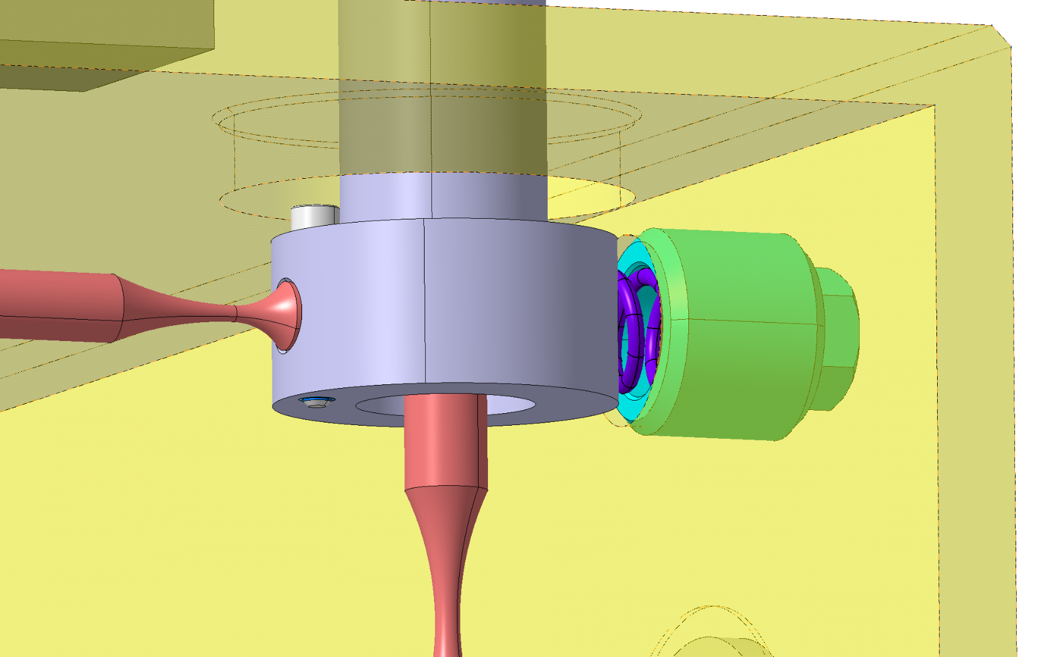
Spring Compression
The spring which was being fully compressed.

Slide 5
Future Tests
Possible future tests in the lab:
  Changing the lateral return springs
    Avoiding over compression
  Increasing the longitudinal return spring force
  Testing multiple axes at the same time
Possible tests with the help of the Survey and Alignment group
  Transport
  More comprehensive performance tests

Slide 6
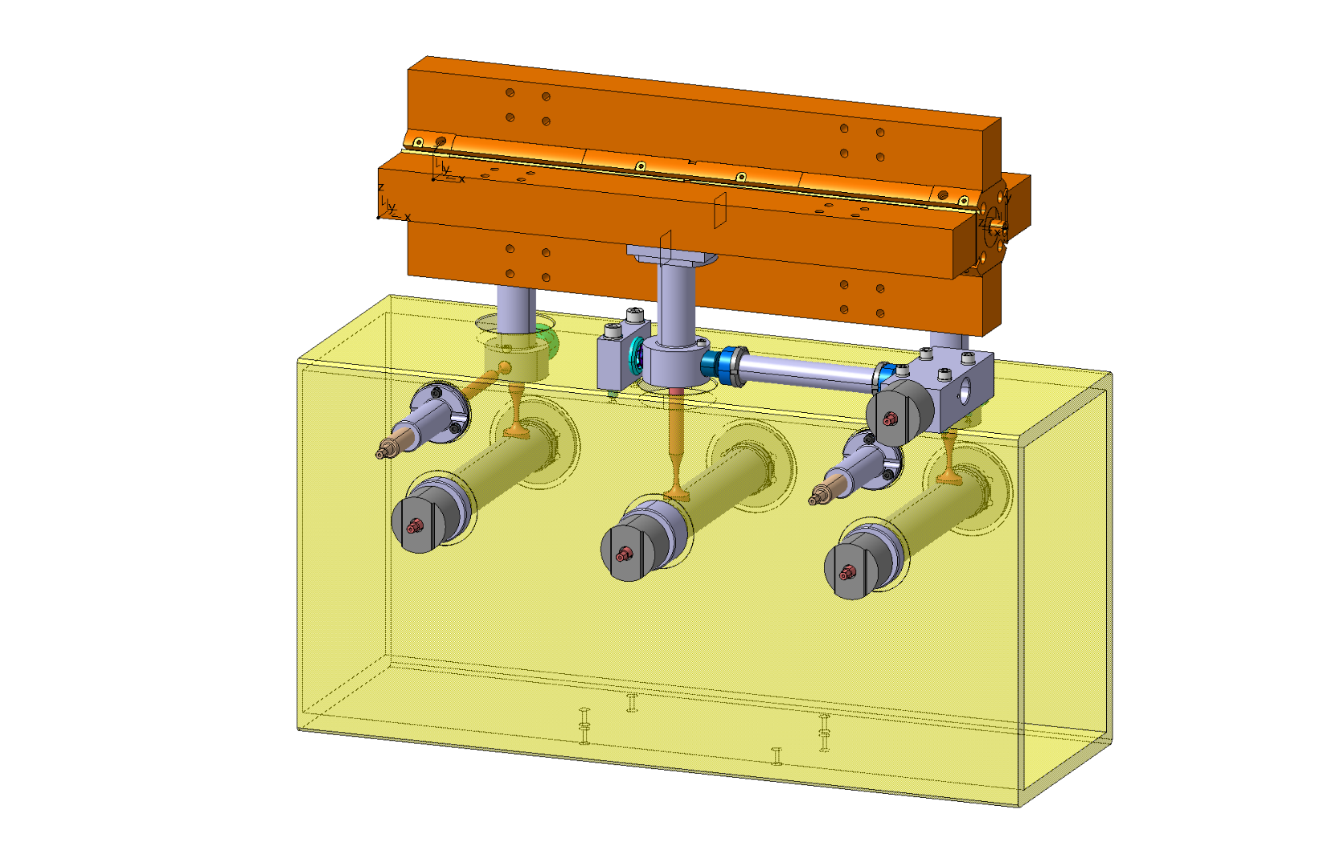
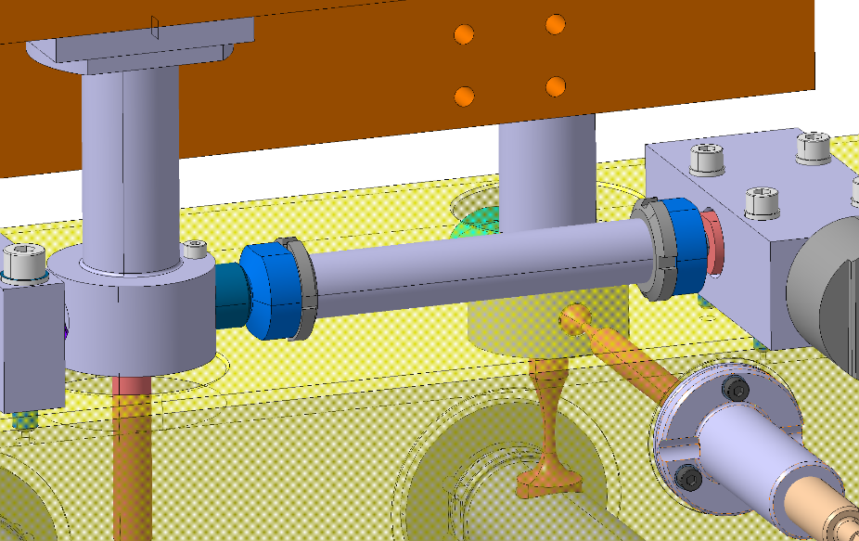
Possible Joint Test
This would check the kinematics are the same between the flexure and the joint
Reusing most of the current prototype

Slide 7
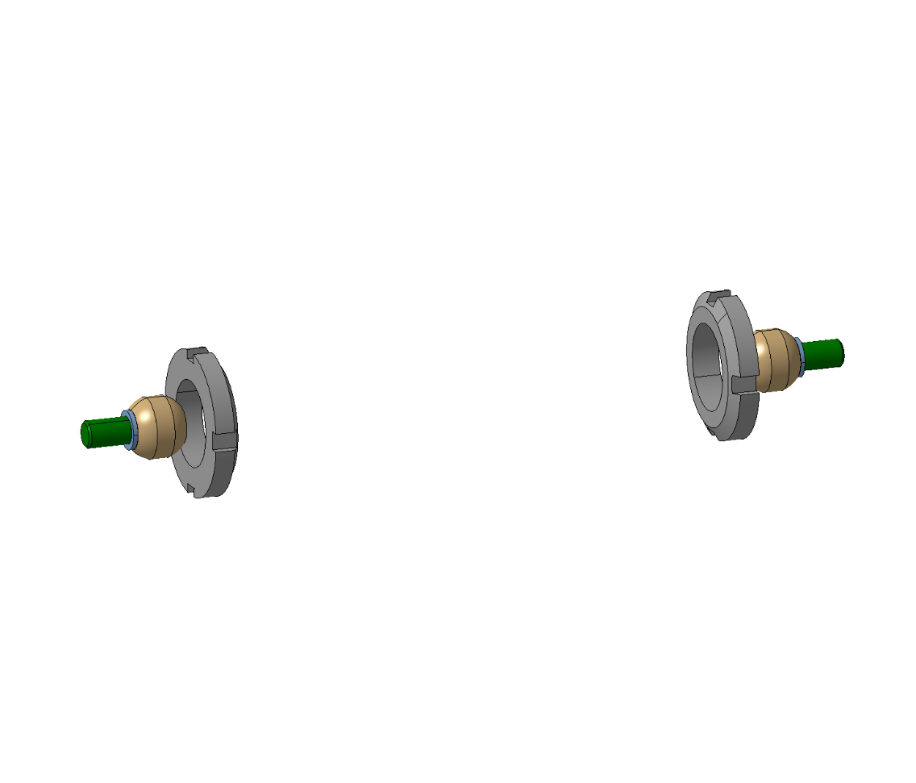
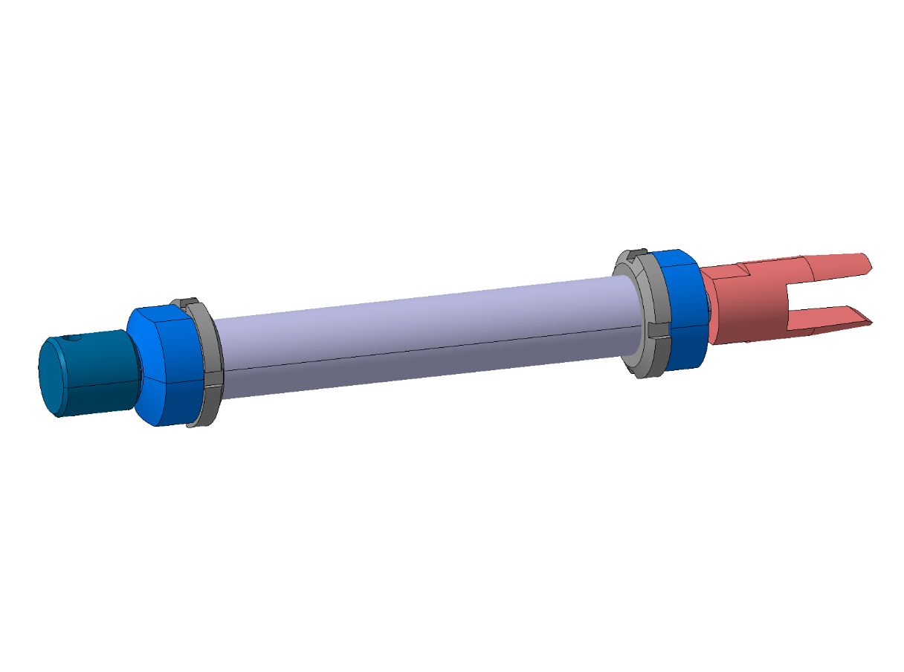
Joint Components
All Components
Standard Components

Slide 8
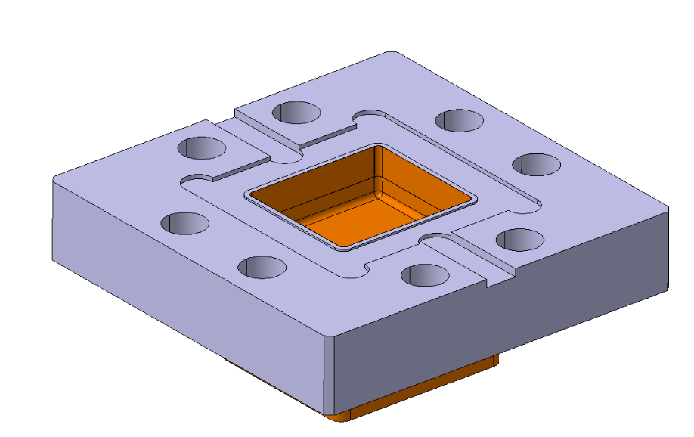
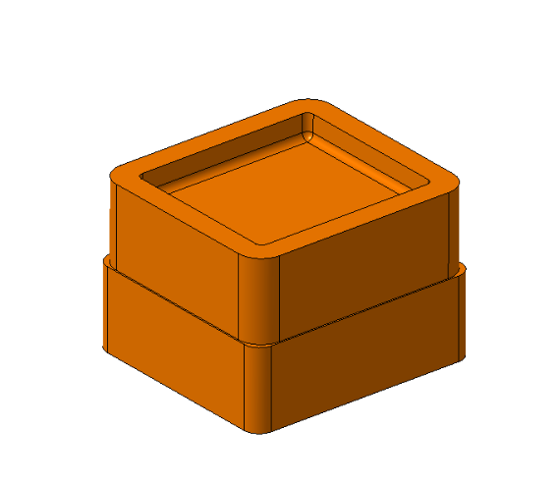
Flange Tests?

