Slide 1
Astro-particle neutrino experiments
KM3NeT, IceCube, GVD (Baikal)
ECFA – 22nd of February 2021
Maarten de Jong

Slide 2
Disclaimer:
Numbers are indicative and should be taken with a pinch of salt;
Visions are meant for discussion and may be biased;

Slide 3
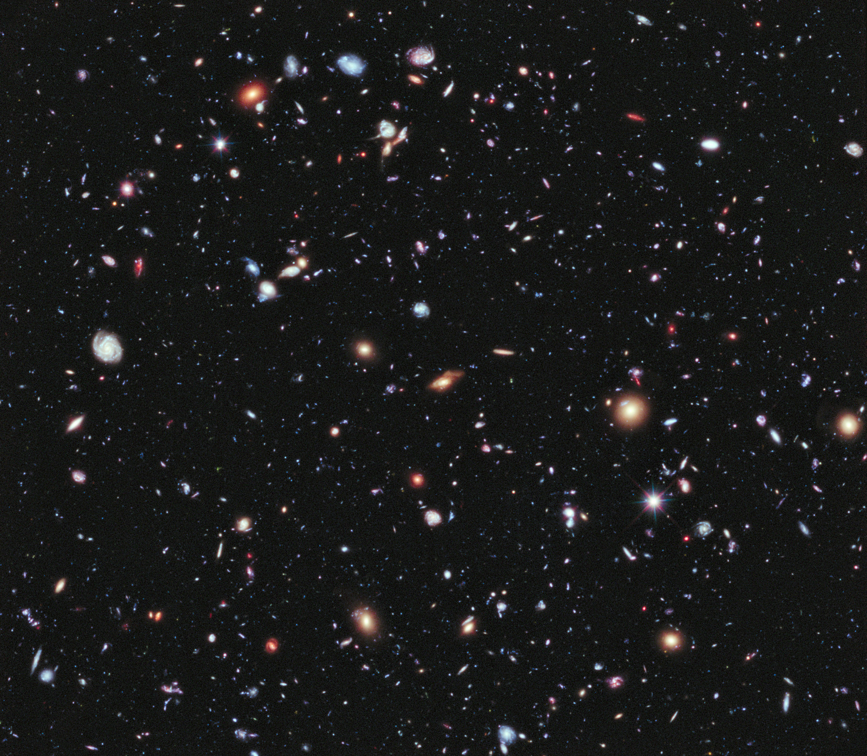
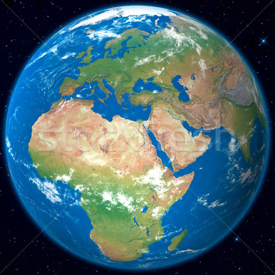
?
neutrinos

Slide 4
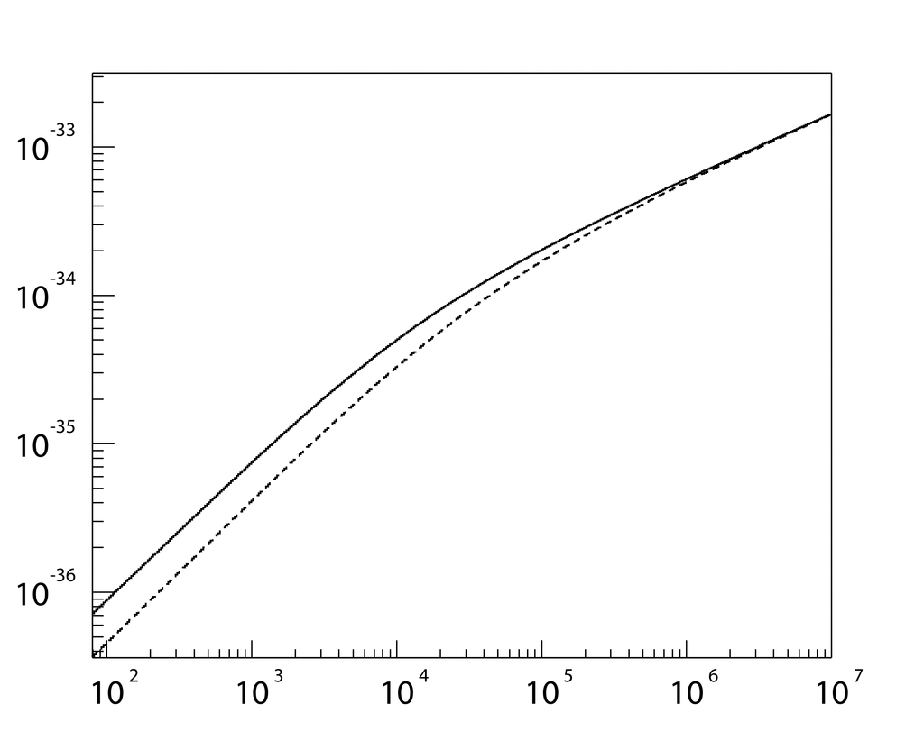
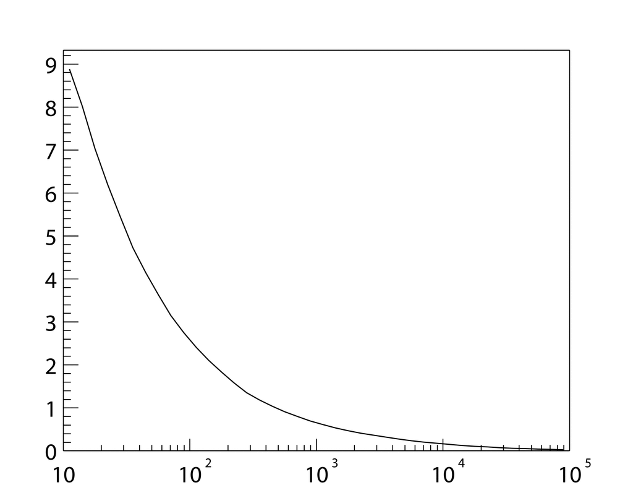



The case for TeV−PeV neutrino astronomy
cross section
scattering angle
background
10⁻³
10⁻⁵
10⁻⁷
10⁻⁹
10⁻¹¹
10⁻¹³
10⁻³³
10⁻³⁴
10⁻³⁵
10⁻³⁶
9
8
7
6
5
4
3
2
1
$$ν_{l}$$
$${\overline{ν}}_{l}$$
median angle
$σ\left(ν_{l}N⟶lX\right)$ [cm²]
$θ_{s}$ [deg]
E² Φ [GeV cm⁻² s⁻¹ sr⁻¹]
ν_{μ} (Honda)
ν_{e} (Honda)
“prompt” (Enberg)
10²
10³
10⁴
10⁵
10⁶
10⁷
10¹
10²
10³
10⁴
10⁵
10²
10³
10⁴
10⁵
10⁶
10⁷
10⁸
E_{ν} [GeV]
E_{ν} [GeV]
E_{ν} [GeV]

Slide 5
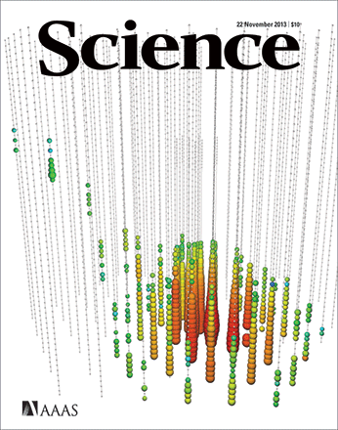
The case for TeV−PeV neutrino astronomy
cross section
scattering angle
background
10⁻³
10⁻⁵
10⁻⁷
10⁻⁹
10⁻¹¹
10⁻¹³
10⁻³³
10⁻³⁴
10⁻³⁵
10⁻³⁶
9
8
7
6
5
4
3
2
1
$$ν_{l}$$
$${\overline{ν}}_{l}$$
median angle
$σ\left(ν_{l}N⟶lX\right)$ [cm²]
$θ_{s}$ [deg]
E² Φ [GeV cm⁻² s⁻¹ sr⁻¹]
ν_{μ} (Honda)
ν_{e} (Honda)
“prompt” (Enberg)
10²
10³
10⁴
10⁵
10⁶
10⁷
10¹
10²
10³
10⁴
10⁵
10²
10³
10⁴
10⁵
10⁶
10⁷
10⁸
E_{ν} [GeV]
E_{ν} [GeV]
E_{ν} [GeV]

Slide 6



Neutrino propagation
weak states
=
“what you see”
mass states
=
“what you get”
$$\left(\begin{matrix}{\text{n}}_{e} \\ {\text{n}}_{μ} \\ {\text{n}}_{τ}\end{matrix}\right)=U×\left(\begin{matrix}{\text{n}}_{1} \\ {\text{n}}_{2} \\ {\text{n}}_{3}\end{matrix}\right)$$
CP-violation
Majorana
U = $\left[\begin{matrix}1 & 0 & 0 \\ 0 & { c}_{23} & s_{23} \\ 0 & {−s}_{23} & c_{23}^{}\end{matrix}\right]\left[\begin{matrix}c_{13} & 0 & s_{13}e^{−iδ} \\ 0 & 1 & 0 \\ {−s}_{13}e^{iδ} & 0 & c_{13}\end{matrix}\right]\left[\begin{matrix}{ c}_{12}^{} & s_{12} & 0 \\ {−s}_{12} & c_{12} & 0 \\ 0 & 0 & 1\end{matrix}\right]\left[\begin{matrix}1 & 0 & 0 \\ 0 & e^{iα_{1}/2} & 0 \\ 0 & 0 & e_{}^{iα_{2}/2}\end{matrix}\right]$
$$c_{ij}=\cos{θ_{ij}} s_{ij}=\sin{θ_{ij}}$$
Test of fundamental physics

Slide 7





Neutrino telescope
Cherenkov (1934):
H₂O as detector
Markov (1960):
H₂O as target
target mass
overcome small x-section
muon range
good angular resolution
transparency
sparse detector
$$l^{−}$$
$$ν_{l}$$
$$θ_{s}$$
$$X$$
$$N$$

Slide 8
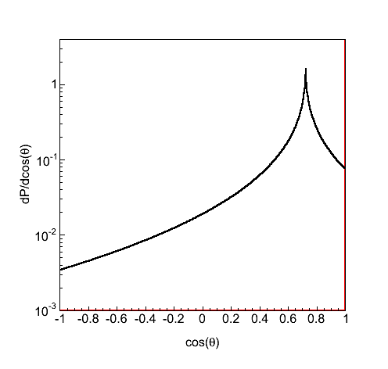
Neutrino detection
muon neutrino
electron neutrino
θ
1
2
3
4
5
~100 m
light
absorption
cos(θ)
~ [km] ln(E/TeV)
~ [m] ln(E/TeV)
muon energy loss
radiation length

Slide 9
Neutrino detector
chromatic
dispersion
1 km
2−3 km
light absorption
intensity
1 km
light
scattering
3D array of photo-sensors
arrival time [ns]

Slide 10
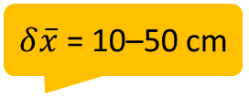
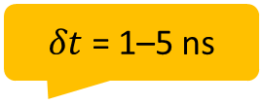
M = 10¹² kg
T = 10–20 years
QE = 25%
$δt$ = 1–5 ns
1 km
ΣA = 250–1,000 m²
$δ\overline{x}$ = 10–50 cm
λ_{abs} = 50–100 m
1 km
20–100 km
GPS
1–100 Gb/s

Slide 11
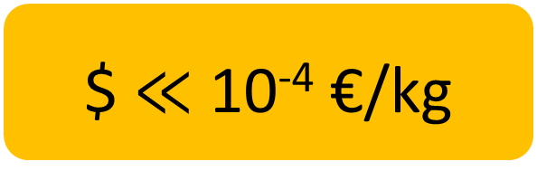
M = 10¹² kg
λ_{abs} = 50–100 m
$ $≪$ 10⁻⁴ €/kg
Artic ice
deep sea

Slide 12
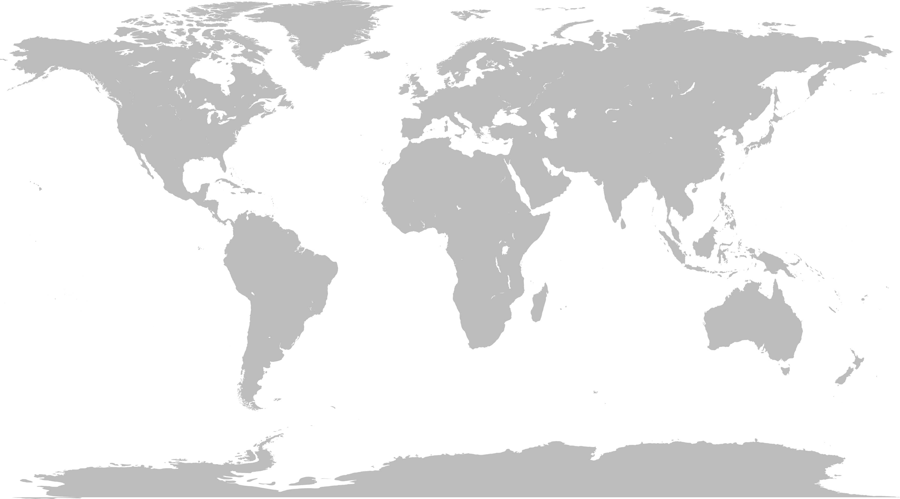





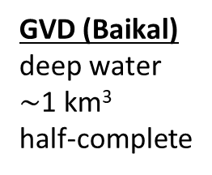
Global Neutrino Network
ANTARES
deep water
0.02 km³
2007 –
GVD (Baikal)
deep water
$\sim$1 km³
half-complete
KM3NeT
deep water
1++ km³
construction
IceCube
deep ice
1 km³
2011 –

Slide 13

Neutrino telescopes
 |  | IceCube | GVD | Antares | KM3NeT
Status |  | completed 2011 | under construction | completed 2007 | under construction
Location |  | South Pole | Lake Baikal | Mediterranean Sea
Medium |  | ice | lake | sea
Light transmission |  | $$λ_{s}<λ_{abs}$$ | $$λ_{s}≫λ_{abs}$$ | $$λ_{s}≫λ_{abs}$$
Resolution | ν_{μ} ν_{e} | 0.4 deg 10 deg | 0.5 deg 2 deg | 0.4 deg 2 deg | 0.05 deg 1.5 deg
Noise |  | extremely low | medium | medium
PMT size (QE) |  | 10” (25%) | 10” (35%) | 10” (20%) | 3” (30%)

Slide 14
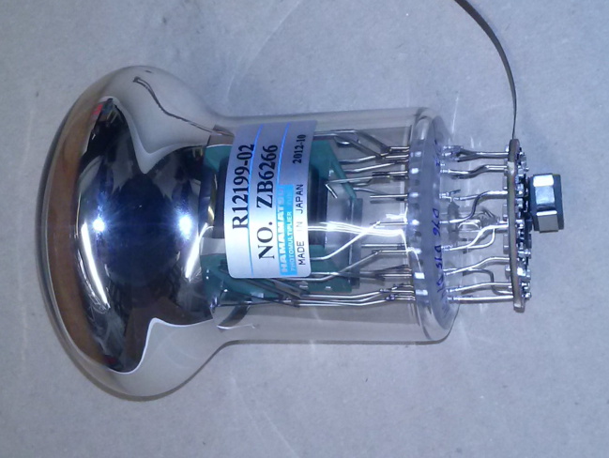
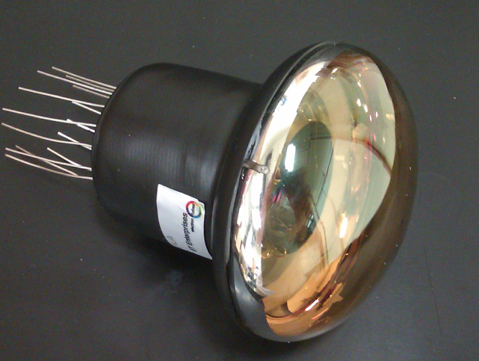

Photo-sensors: 10” $→$ 3” PMTs
  timing ≤ 2.5 ns
  QE ≥ 25–30%
  collection efficiency ≥ 90%
  photon counting purity 100% (by hits, up to 7)
  price/cm² ≤ 10” PMT
more pixels
=
better physics
ETEL
ETEL D792
Hamamatsu R12199
HZC XP53B20

Slide 15
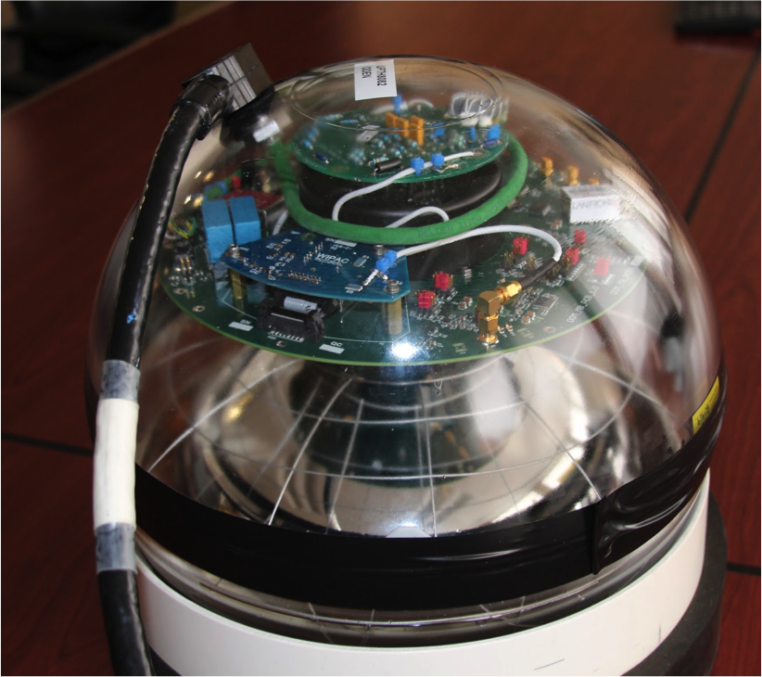
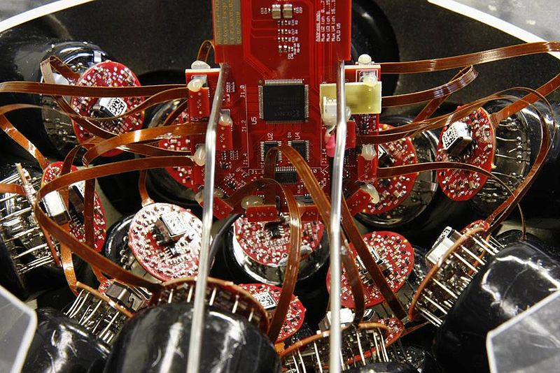
Front-end electronics
IceCube
KM3NeT
custom low-power HV, TDC and ADC

Slide 16
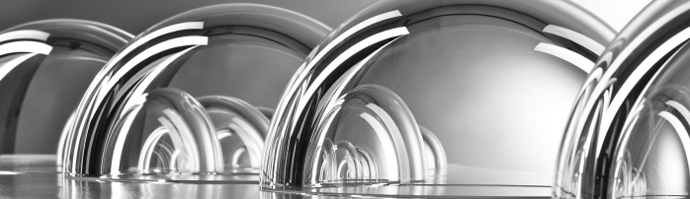
Housing
commercial floatation devices

Slide 17
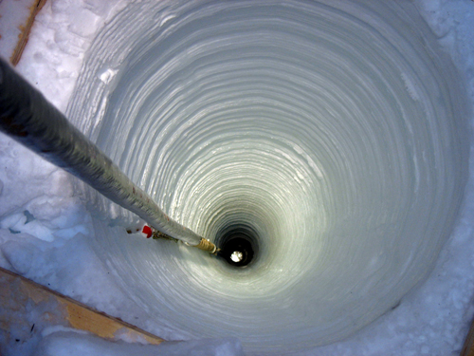
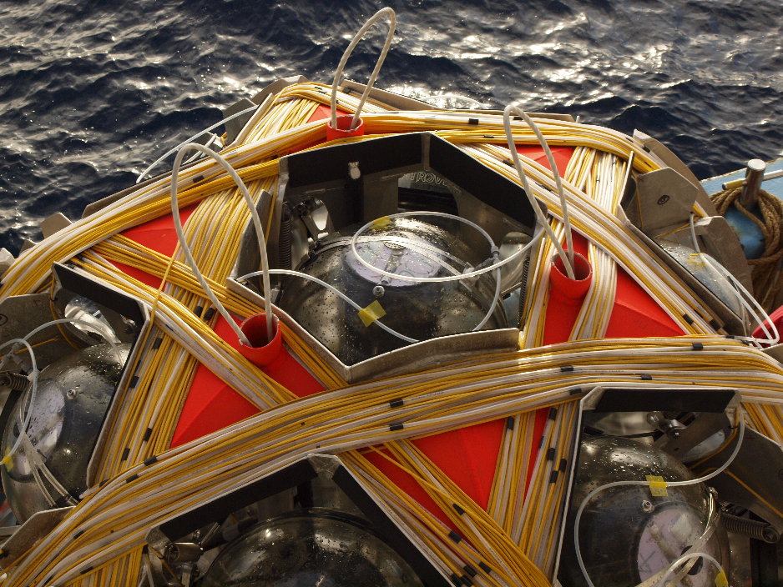

Cabling
IceCube
KM3NeT
commercial
custom $→$ commercial

Slide 18
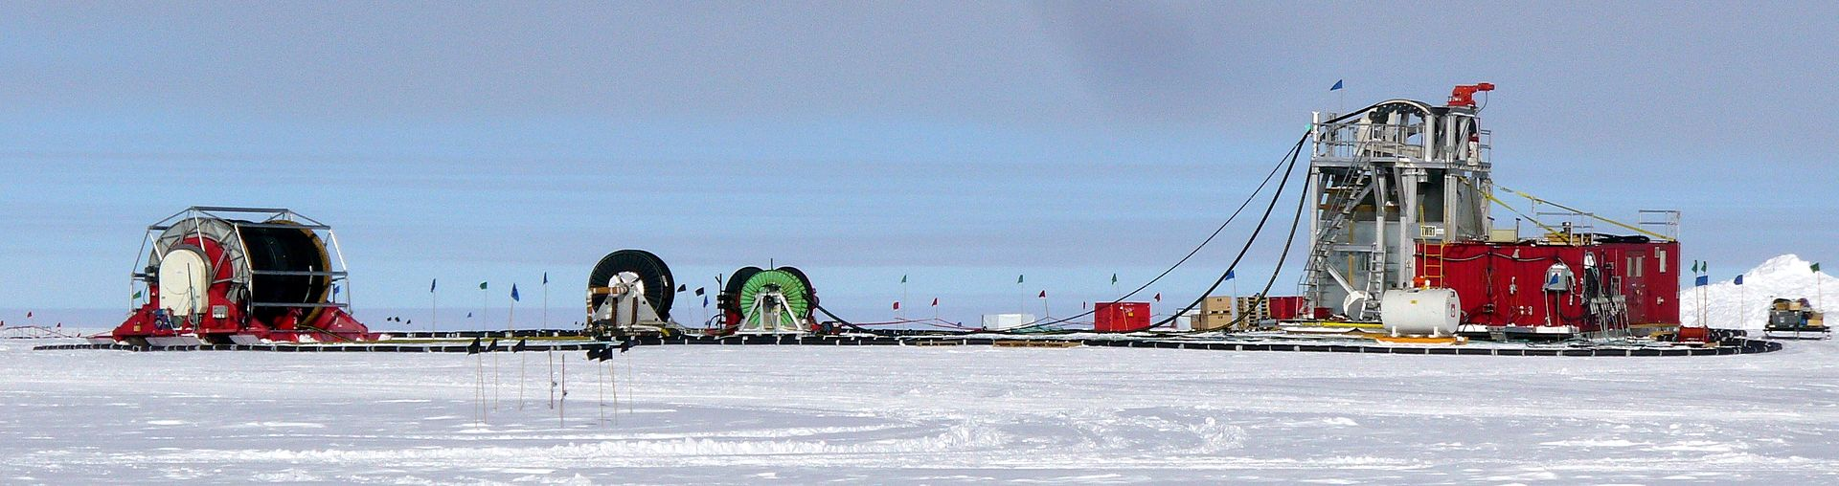
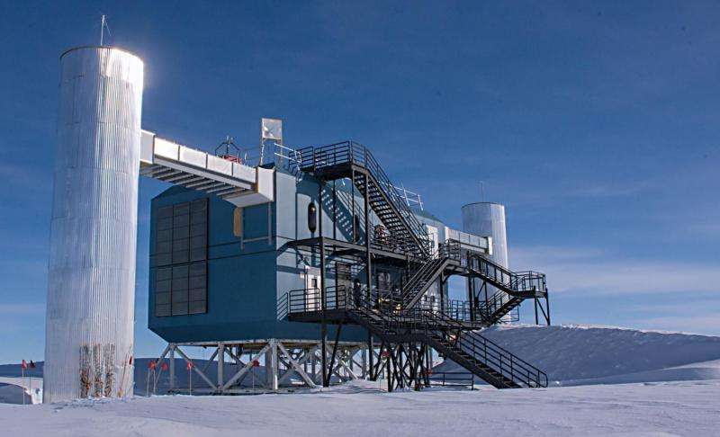
Civil engineering (1/3)
IceCube:
hole drilling in ice (custom)
shore station (custom)

Slide 19
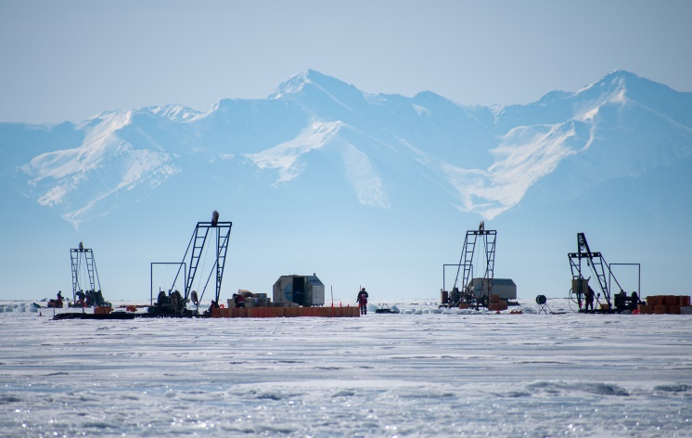
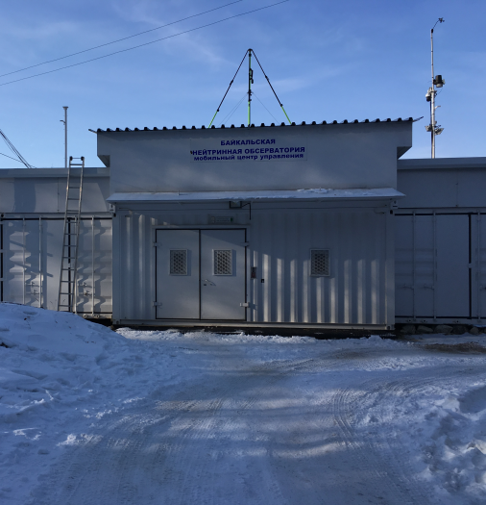
Civil engineering (2/3)
GVD (Baikal):
deployment from ice surface (custom)
shore station (commercial)

Slide 20
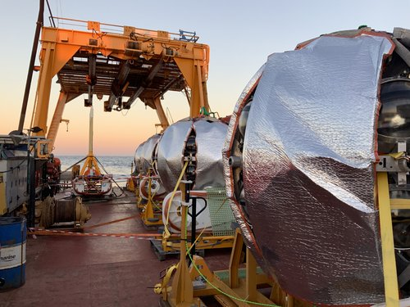
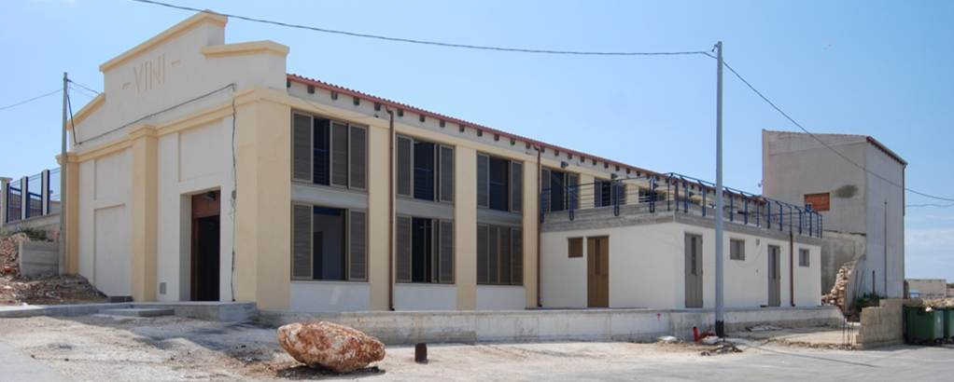
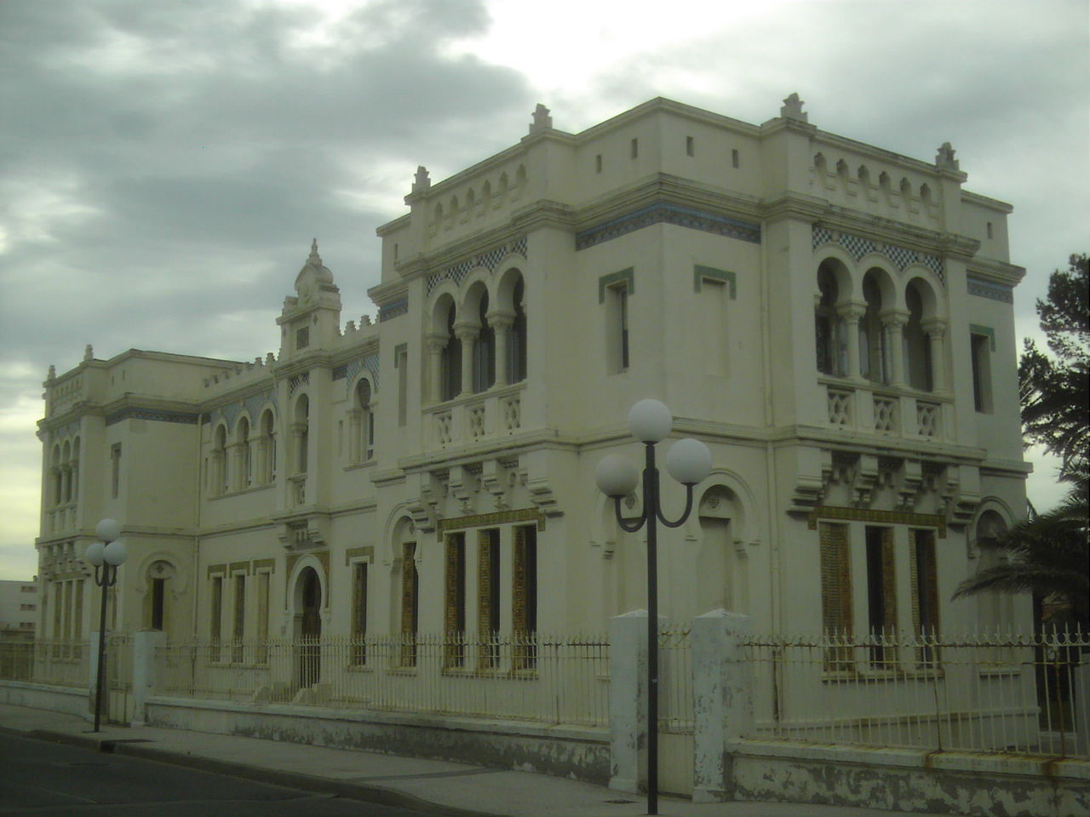
Civil engineering (3/3)
KM3NeT:
deployment with surface vessel (commercial)
shore station (commercial)

Slide 21
Clock – DAQ – Computing
IceCube GVD, Baikal KM3NeT
clock custom custom + White-Rabbit White-Rabbit
data transfer wire wire fibre
Tier-0 custom custom CPU (100)
Tier-1+2 ? CPU (450) CPU (500)
APPEC roadmap (to be published)
“Computing resources are relatively modest …”
“Filtering of the rare neutrino signal from the high background … poses challenges”
“… machine learning and use of GPUs can improve the science output”

Slide 22
Present
Era of multi-messenger astronomy
  EM-radiation – cosmic rays – neutrinos – gravitational waves
  alerts (from astronomy)
    point telescopes world-wide to astrophysical event in real time
Fundamental particle physics with atmospheric and cosmic neutrinos
  neutrino mass ordering
  ν_{τ} appearance
  sterile neutrinos, Lorentz invariance, non-standard interactions, …

Slide 23
Future (1/2)
Benefit from serendipities
  Earth and sea sciences
    climate change
    marine life (e.g. noise pollution)
    tsunami warnings
Explore alternative technologies for EeV neutrino detection
  radio detection (e.g. GRAND, RNO)
  acoustics neutrino detection (e.g. KM3NeT)

Slide 24

Future (2/2)
Make cosmic-ray detector on bottom of sea
  2D-array à la KM3NeT “Pierre Auger in the North”
    involvement of offshore industry
Make long baseline neutrino experiment
  $δ_{CP}$ measurement with [tagged] neutrino beam from Protvino to KM3NeT
    ps-tracking detectors in decay tunnel

Slide 25
Summary & Outlook
Technology for 10¹² kg neutrino detectors now is affordable
  standardise – maximise – capitalise
    price photo-sensors important (high QE – low dark count)
    costs civil engineering significant but much less than excavation
Global Neutrino Network (GNN)
  [European] astro-particle neutrino experiments could benefit from interaction with particle physics centres, in particular CERN
    know-how, reviews, collaboration
Lone baseline neutrino and/or cosmic-ray experiments
  use & push technology to limit

Slide 26
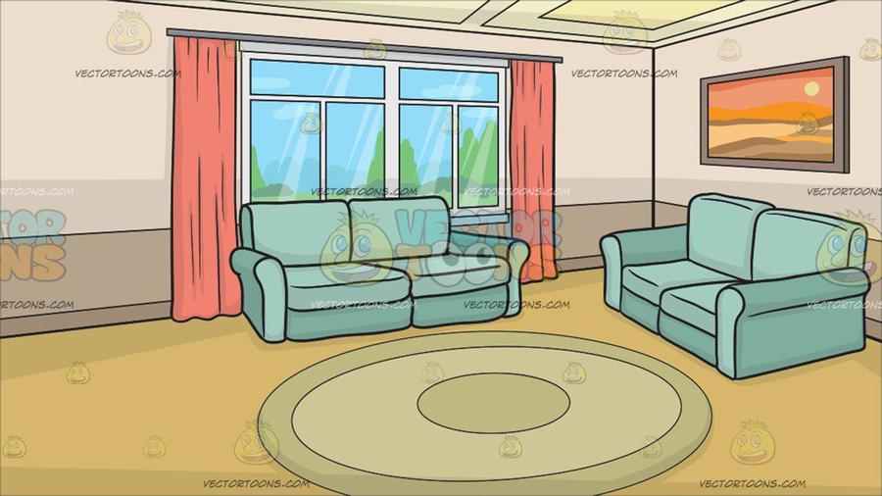
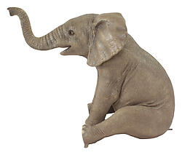
complexity of
funding
limits progress

