Slide 1
Updates on PCB Anode Layouts
Bo Yu
Jan 14, 2021

Slide 2
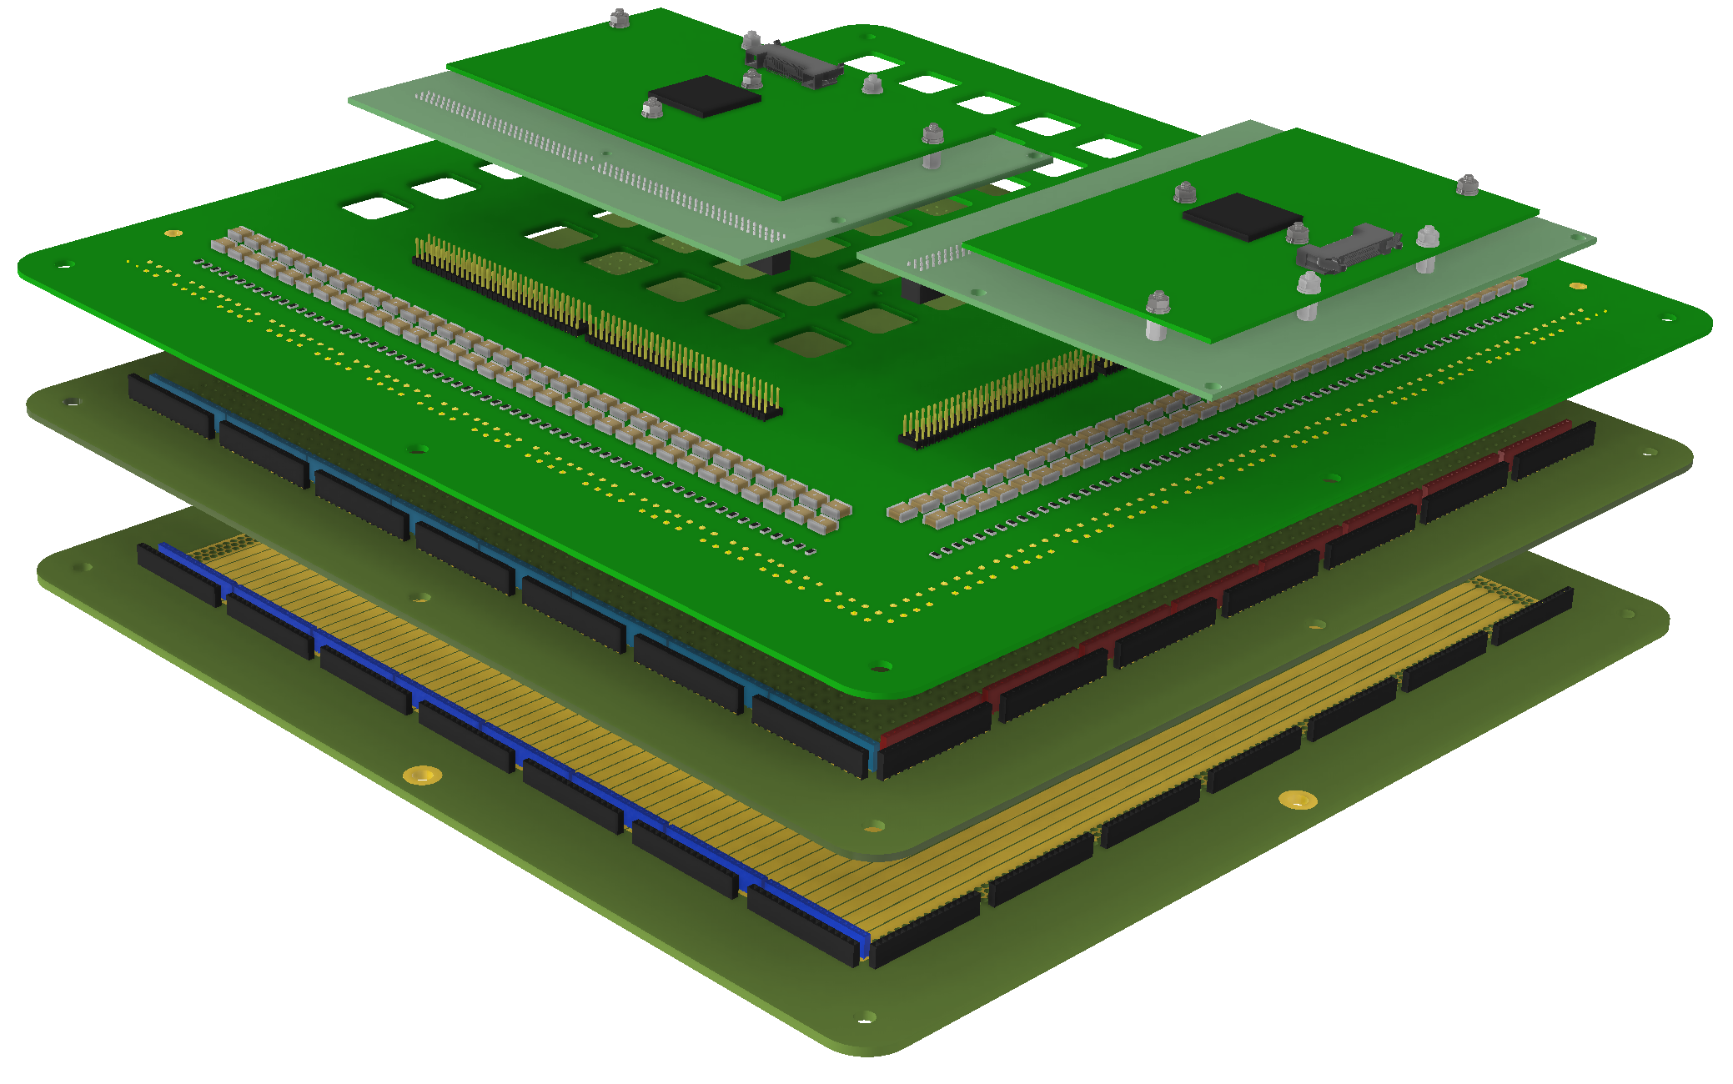
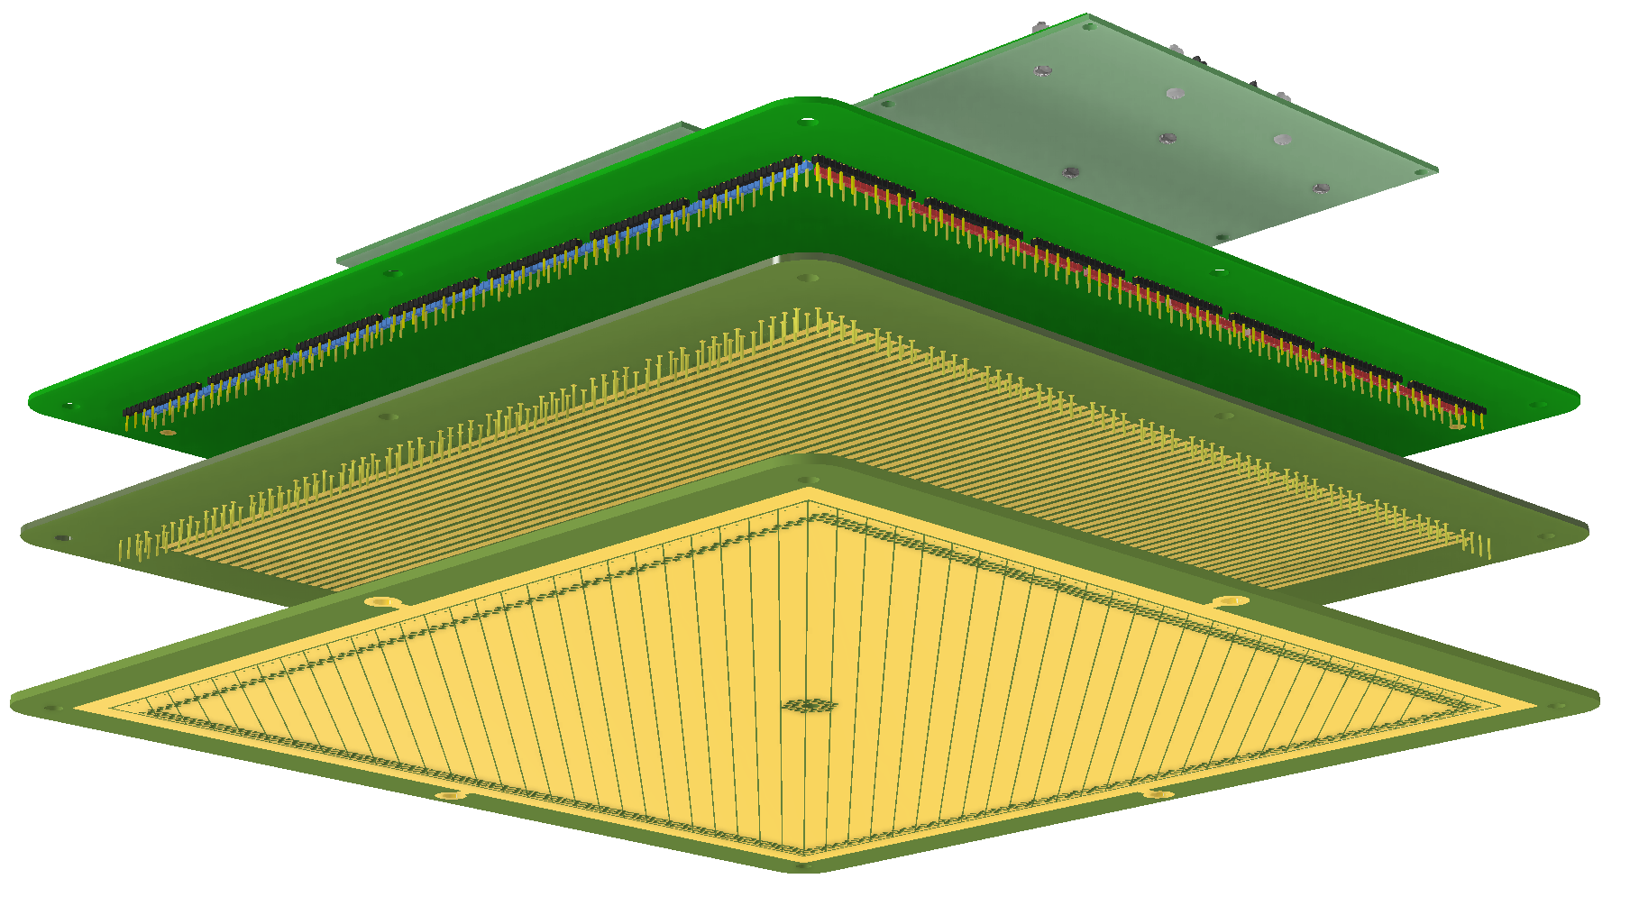
3-View Demo Boards for 50L
The anode and adapter boards for the 3-view 50L demonstrator is being shipped to BNL.
The construction is a 3 PCB assembly, with the readout fan-in and RC circuit on a separate adapter board. This construction reduces the complication of building a large multi-layer PCB with blind vias on the collection plane board.

Slide 3
CE Sensitivity to Cathode Voltage Collapse
I had argued in discussions that the risk of CE damage due to cathode voltage collapse in a discharge is similar between APAs and the 2-view reference design (based on simple area per channel and a factor of 5 shielding from the grid wire plane), and the risk for the 3-view reference design is about a factor of 3 higher due to the wider and longer strips on the 1st induction view in the reference design.
Francesco pointed out that this is off by a factor of 2 because I failed to consider that only half of the 1st induction plane wire length is facing one cathode. So the correct risk factor should be 2x for the 2-view, and 6x for the 3-view, assuming the cathode dV/dt is the same.
Marzio advised us to consider similar shield planes in the anode design to reduce such risks.
How to reduce the dV/dt on the cathode will be a topic for a future discussion.

Slide 4
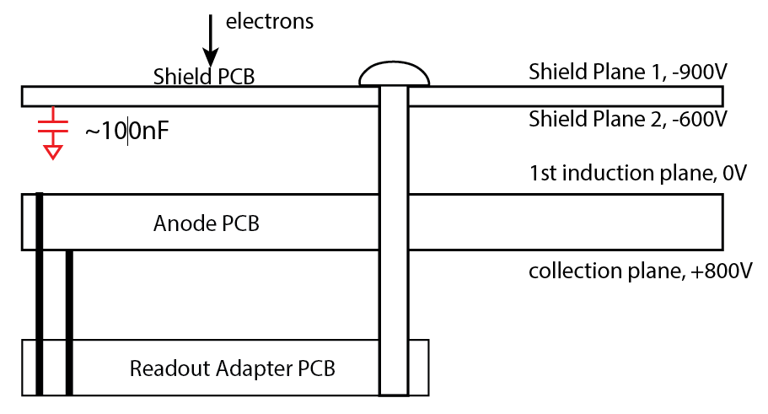
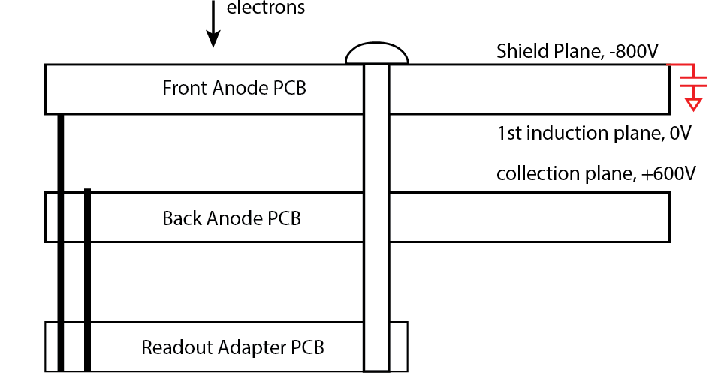
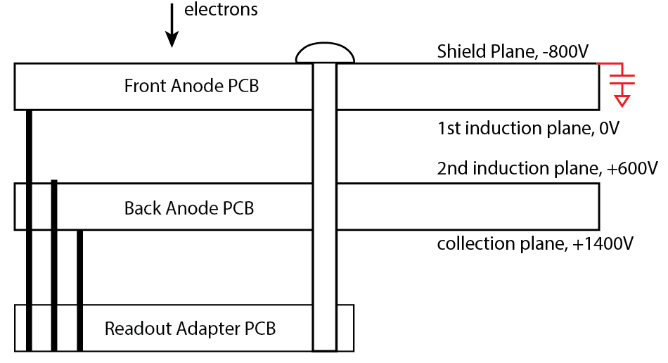
Add a Shield Plane to the PCB Anode Structure
It is relatively straightforward to add a shield plane in front of the 1st induction plane. This can be done by adding a separate perforated double-sided PCB in front of the 2-view PCB (left figure), or adding a front plane and shifting the 2 single planes into a 2 PCB assembly (middle figure). For the 3-view readout, add a shield plane to the front of the double PCB assembly and shift the signal planes back by one layer (right figure).
The overall voltage differential is almost 1kV more, approaching (2-V) or exceeding (3-V) the voltage rating of economical capacitors. We should negatively bias the shield plane(s), and be more careful to the clearances between metallic mounting screws and other electrodes, and explore plastic screws in the PCB assembly.
Note that if we include a shield plane, the anode structure is already there to support a 3-view layout (sans the cost of the additional electronics)
2-view with a shield board
2-view with a shield plane
3-view with a shield plane

Slide 5
Some New Ideas for a Better 3-View Configuration
CERN has identified a drilling machine that can manage two side by side CRU sized PCBs to be drilled simultaneously. This seems to suggest that a PCB the size of 2 CRUs can be drilled.
Even if PCB panel of this size doesn’t exist, such a PCB panel can still be jointed from multiple PCB panels (etched and plated) using the technique CERN is developing, and then perforated in this machine. Screen printing of the conductive ink patches will allow bridging of the PCB tiles in a uniform and controlled manner. This makes the interconnect between CRUs much simpler and free from field distortions.
With the board interconnect issue resolved, we can consider implementing joining strips across CRUs on multiple planes.

Slide 6
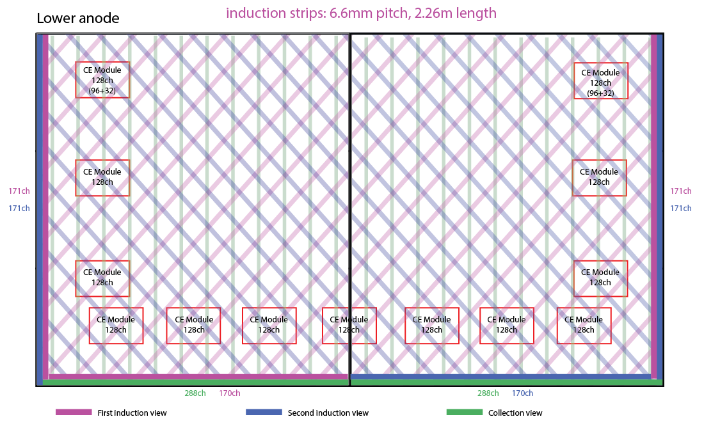
If fabrication of 3m x 1.7m panel is possible, joining two CRUs in the longitudinal direction (of the cryostat), with +/- 48° strip angles gives this configuration, while maintaining the 3200 ch / CRP channel count.
If the strip angles are more than 48°, the middle section will need more than 2 rows of connectors.

Slide 7
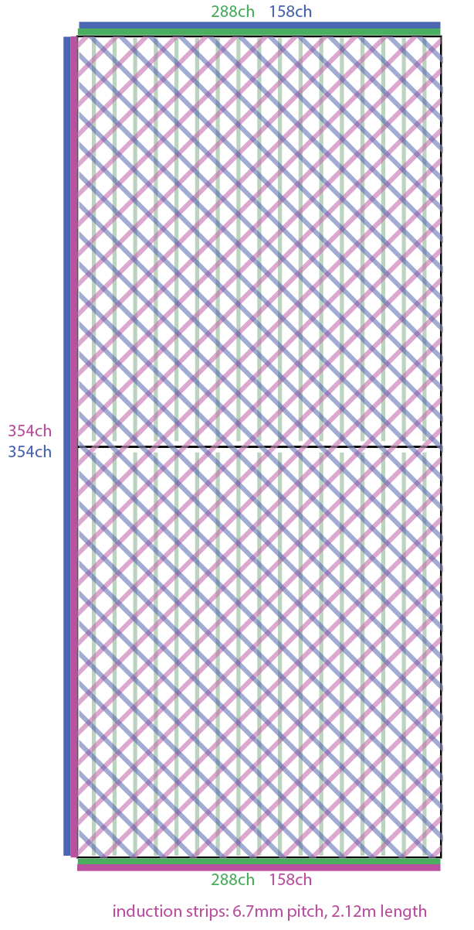
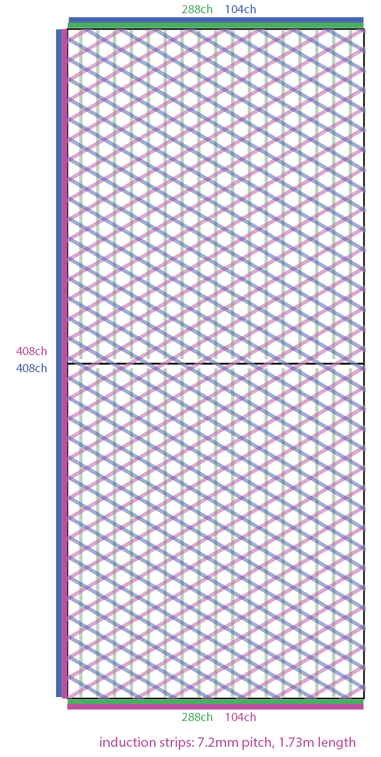
If fabrication of 3.4m x 1.5m panel is possible, joining two CRUs along the transverse direction gives more flexibility in strip angles.
These two configurations have +/- 45° and +/-30° strip angles with 3200ch/CRP total channel count.
Naturally, a 2-view configuration with +/- 45° strips can also be implemented with narrower strip width (down to 4.3mm pitch to maintain the max channel count.)

