Slide 1
Possible benefit of longer L* for detectors
2021/03/15
@LCWS2021
Yasuhiro Sugimoto

Slide 2
QD0 support
In the present design, QD0 is supported by QD0-support put on the platform (ILD), or by detector itself (SiD)
No show-stopper is found so far, but there could be some possible risks
  Vibration from detector
  Position repeatability and time for machine tuning after push-pull operation
  Difficulty in opening detector end-cap (ILD)

Slide 3
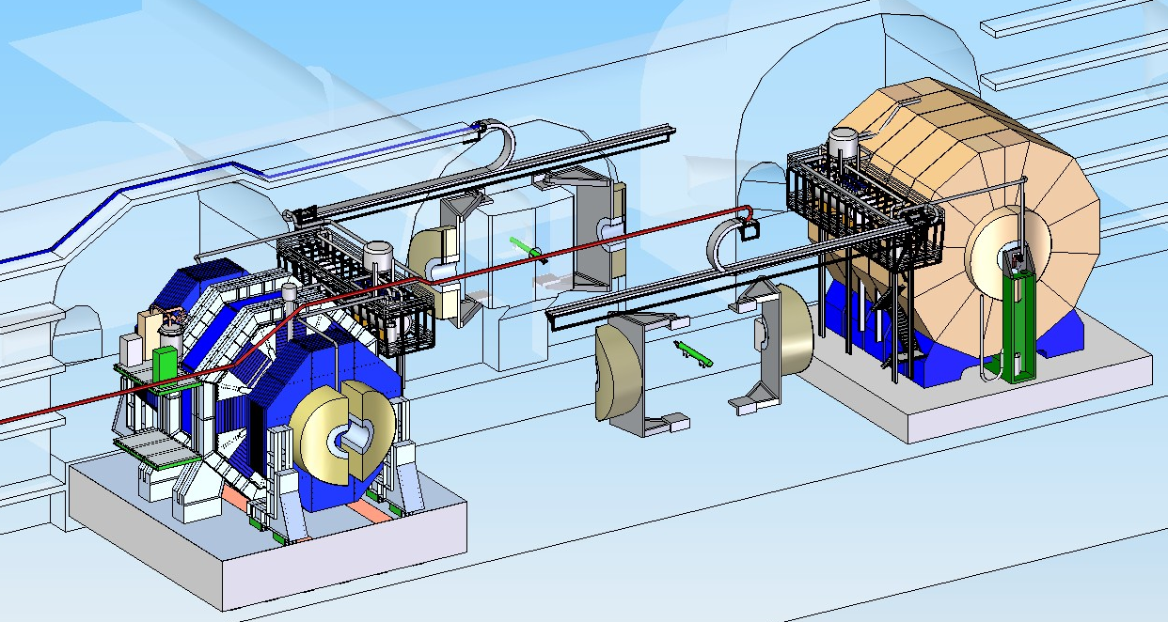
Original design
18m
QD0 pillar

Slide 4
Original design
TDR Vol.3, p146, Vol.4, p40
9.5m (=L* of QF1)

Slide 5
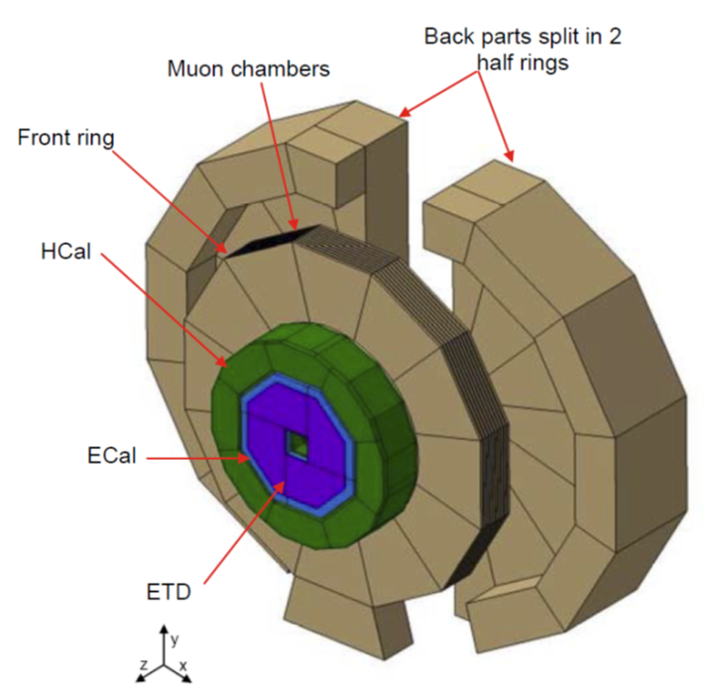
ILD Endcap opening
Rear part of the endcap is split into two parts in order to clear the QD0 support pillar
  Klaus’s talk at Mini-Workshop on 2019/2/28
This scheme could cause several difficulties
  Space for support legs
  Stability against earth quake
  Lowering method using gantry crane
QD0 support has to be movable to fully open the endcap at garage position

Slide 6
Longer L* option
Longer L* option has been studied after TDR
  Large L* optics for ILC: Toshiyuki Okugi, AWLC2014
  Longer L* for ILC: Master Thesis by Fabien Plassard (Feb. 2015)
  Longer L* for CLIC 380: Doctor Thesis by Fabien Plassard (Jul. 2018)
If L*>6m is feasible, many engineering difficulties and risks will be reduced

Slide 7
ILD @L*=6m
QD0 can be supported from the BDS tunnel
  We can get rid of QD0 pillar if L*=6m
  QD0 may have to be retractable like QSC of SuperKEKB
  Much more stable than the support from the pillar on the platform
  Much better position repeatability after push-pull
    Pillar on the platform: ~0.5mm
    Support from BDS tunnel: 10~20um (SuperKEKB)
  Much faster machine tuning after push-pull
  Only one pair of QD0 is necessary (3 pairs; for ILD, SiD, and machine study, are necessary for TDR design)
ILD needs some modification
  Cut the End-cap iron to make access to flanges at Z~6m possible, and/or remote vacuum connection (RVC) like SuperKEKB
  FCAL support has to be re-considered (telescopic support?)
  No need for split endcap

Slide 8
QCS of Super KEKB
Sliding mount
Sliding mount

Slide 9
Endcap closed

Slide 10
Endcap open

Slide 11
Another merit of longer L*
BeamCAL can be placed far from IP
  →Weaker magnetic field at BCAL (and QD0 front surface) causes less back-scattering of pair background
  →No need for AntiDID (?)
  →Less cost, less construction period, and less risk
Simulation study is necessary

Slide 12
Summary
QD0 support design in TDR has possible risks in stable and smooth operation of ILC, as well as difficulties in detector maintenance
QD0 support from beam tunnel with longer L* could solve these issues
Longer L* could also contribute to cost (and possibly construction time) reduction
This option should be seriously studied during early phase of Pre-Lab period, both from the accelerator and detector point of view

Slide 13
Backup slides

Slide 14
How to open ILD Endcap (1)
(Procedure to fully open the ILD endcap at garage position)
Rear part of the End-cap is split into two parts to clear the QD0 pillar
  Klaus’s talk at Mini-Workshop on 2019/2/28

Slide 15
How to open ILD Endcap (2)
About 1m gap between end-cap CAL and the barrel
People get into the detector through the small gap

Slide 16
How to open ILD Endcap (3)
Remove ECAL ring and LumiCAL
Cut the beam pipe between QD0 support tube and Inner support tube
Draw out the QD0 and FCALs together with the QD0 support
Fully open the End-cap
LumiCAL
Flange
QD0
ECAL ring

Slide 17
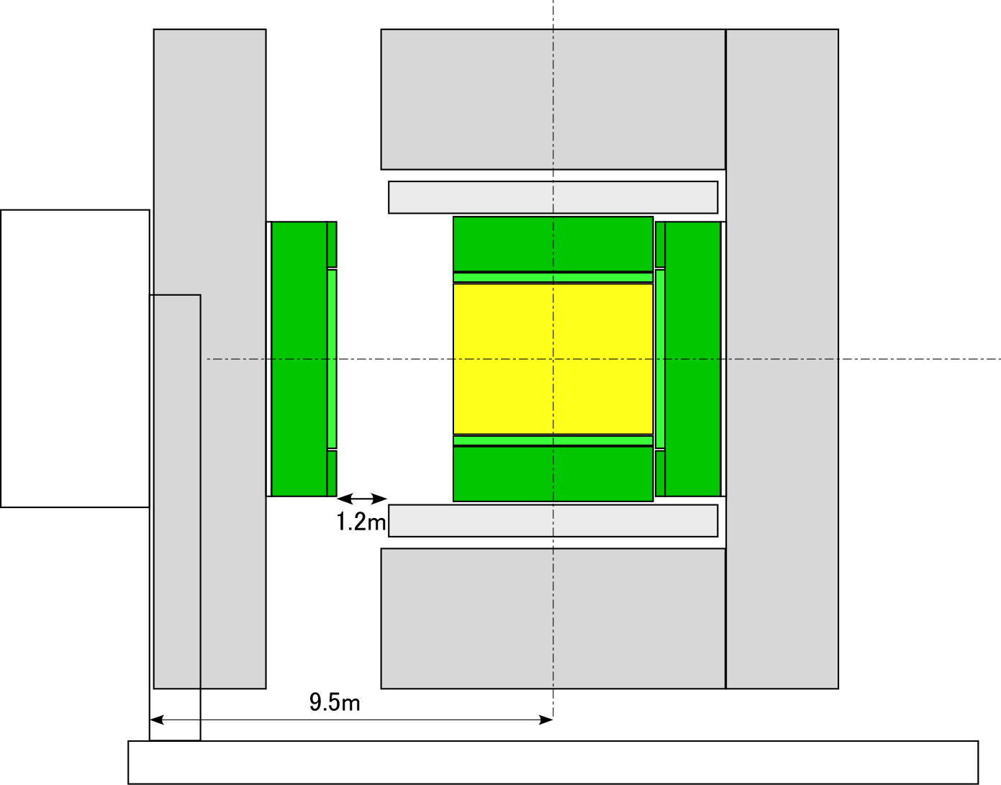
How to open ILD Endcap (4)

Slide 18
Problem (1)
This procedure ignores the pac-man adapter (t~1.2m) on the detector, which hit the wall when we want to open the endcap at beam position
  Solution 1: Movable adapter
  Solution 2: Sliding pac-man instead of rotating pac-man

Slide 19
Sliding Pac-man
Plan view
Side view

Slide 20
Problem (2)
Is splitting endcap realistic?
  Space for support legs
  Stability against earth quake
  Lowering method using gantry crane

