Slide 1
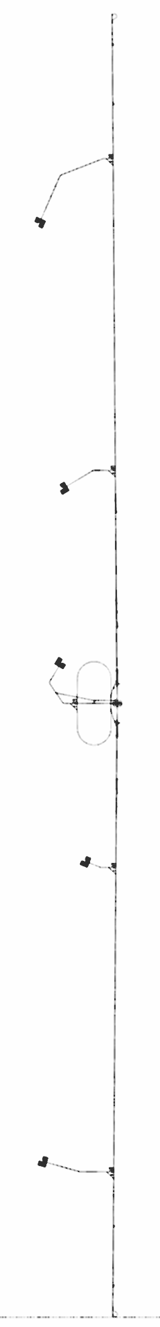
Progress of overall tunnel design toward the basic design
CFS-WG LCWS2021 03172021
H. Hayano KEK

Slide 2
CFS design flow, currently on-going
Revise the lattice for ILC250 and create geometry file
Optics Deck (as of Feb. 2020) -> Geometry file ( CSV format)
Create 3D arrangement of accelerator components
Geometry file -> 3D accelerator components ( by step format )
Create 3D tunnel arrangement, draw out 2D arrangement
Check any interference and check tunnel shape,
then feedback to the tunnel design
This presentation

Slide 3
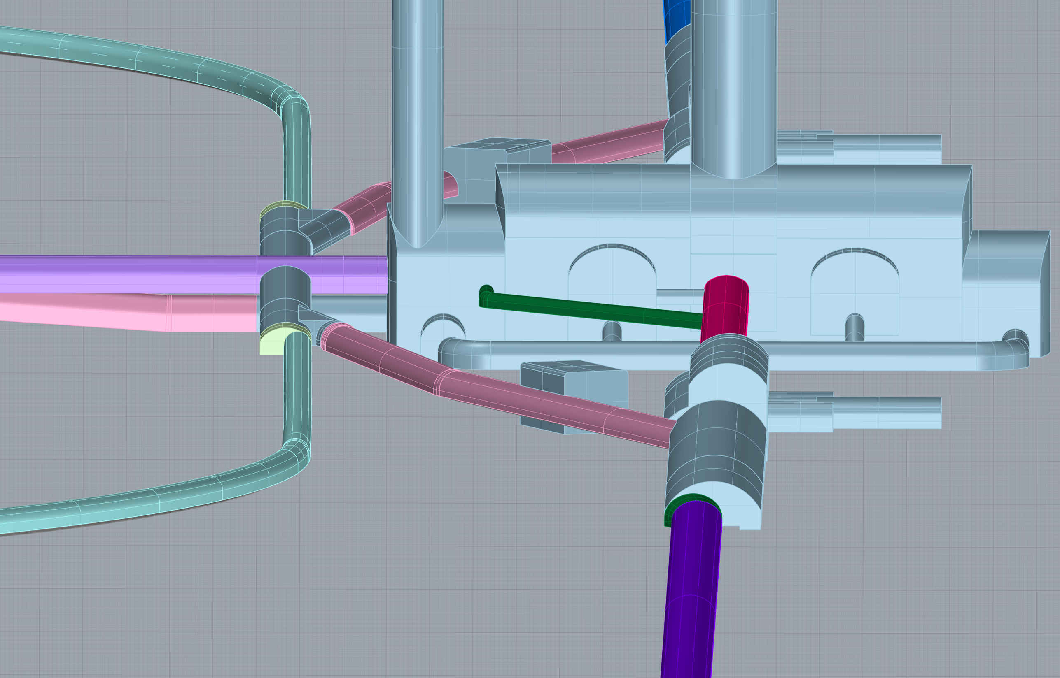
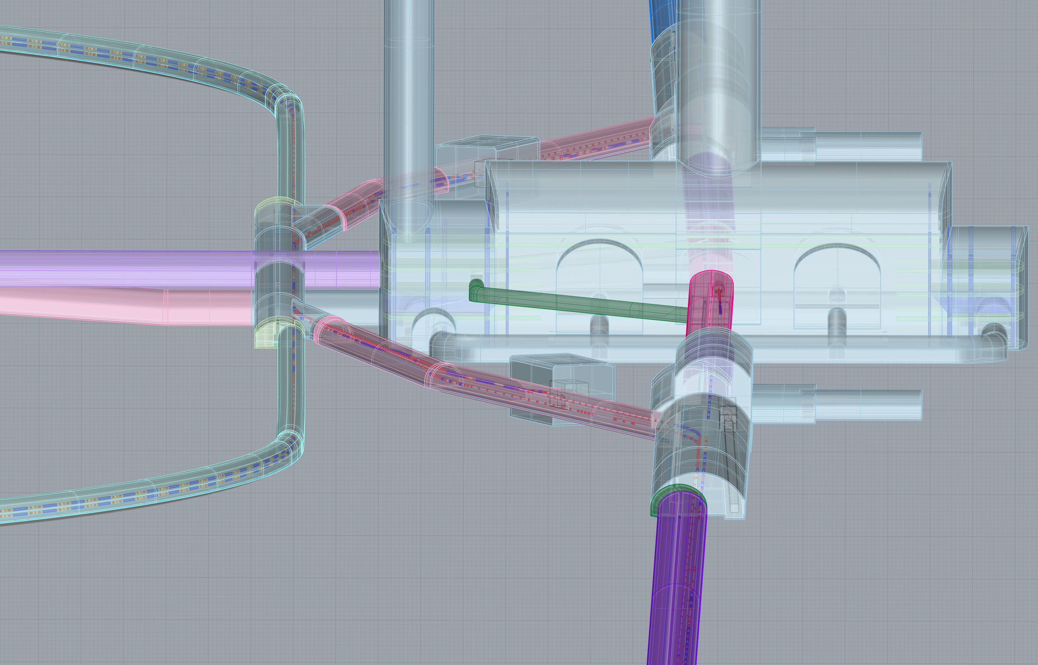
created 3D arrangement
(accelerator and tunnel wall)
Central Region
(3D View)

Slide 4
created 2D arrangement
(Detector Hall Region)

Slide 5
created 2D arrangement
(Detector Hall cross section)

Slide 6
plain view
side view
plain view
side view
created 2D arrangement
(Interaction Point to main beam dump)

Slide 7
Check any interference, any issue during accelerator construction
Check was started on Nov. 2020, biweekly base, with optics group and CFS group.
Major concerns are listed.
1)Target room space, e+ capture device, e- beam dump
for undulator-base-positron is not considered in tunnel layout
and optics deck.
2)How to support the RTML beam line 1.65m above the BDS beam line
is not yet considered.
3)How to connect tunnels with different widths and hights?
4)Chicanes of e- LTR interfere with e+ BDS.
5)tune-up dump line of e- LTR interfere with e+ BDS.

Slide 8
6)Polarized e- gun region may interfere with e+ RTML, 1.65m above.
7)Place of e- source and booster Linac are far away from access hall.
Gun laser need daily base maintenance, SC booster Linac is better
to close to He supply at access hall.
8)Tunnel connection at turn-around seem better to use over-sized hall,
not like just a tunnel-to-tunnel connection.
9)Tunnel shape of dump room might have not flat ceiling, but round ceiling.
10)There are spin rotator SC magnet at turn around region.
They require He supply. It should be noted.

Slide 9
11)There need precise estimation of magnet power supply space,
electric substaion, cooling water and air-cooling device space
for damping ring. More space may be required.
12)Current damping ring tunnel design require crossing of maintenance
root with accelerator. Need to change the access hall location.
13)There need to check the space between Q and SX at arc section.
14)There need to consider the installation pass way of big main dump.
Direct connection between BDS tunnel and detector hall circular tunnel
might be a solution.
Concern examples ( red squared items ) are explained, in this report.

Slide 10
4)Chicane of e- LTR interfere with e+ BDS.

Slide 11
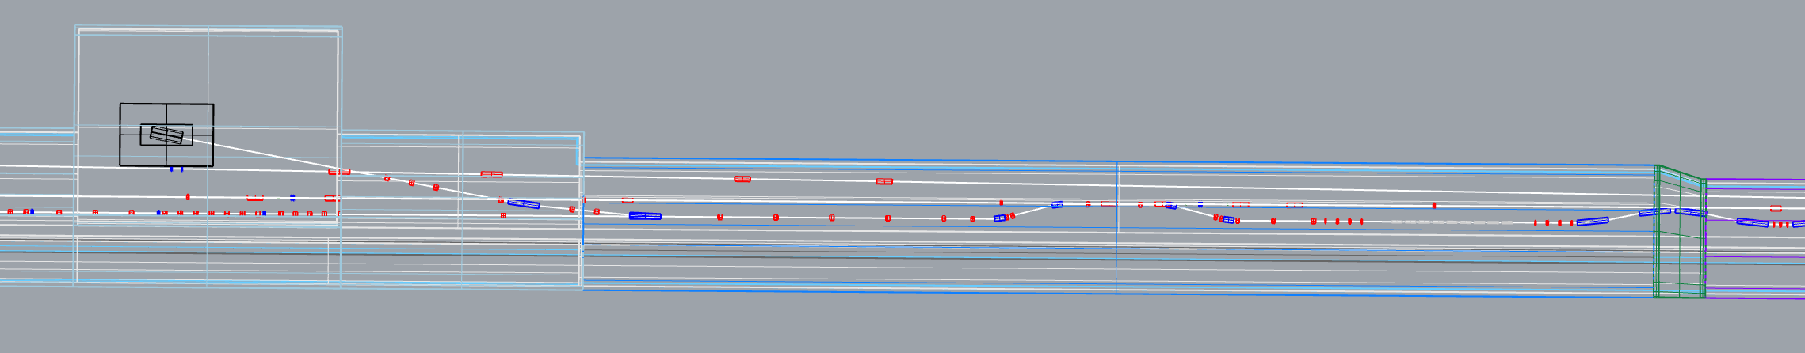
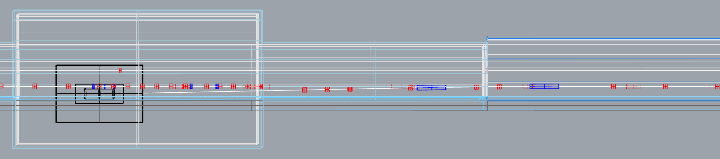
positron BDS-dump
positron RTML
positron BDS
electron DR-Injection
electron tune-up dump
electron tune-up dump line
positron RTML(high position)
positron BDS
positron BDS-dump line
plane view
shield wall
klystron room
electron DR-Injection
side view (expanded)
Beam lines interfere
tune-up dump line is going down to dump

Slide 12
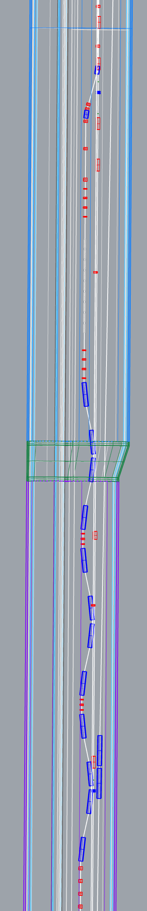
positron BDS-dump
positron RTML
positron BDS
electron DR-Injection（chicane）
positron BDS-dump line
positron RTML(high position)
positron BDS
shield wall
klystron room
electron DR-Injection
Beam lines interfare

Slide 13
6)Polarized e- gun region may interfere with e+ RTML, 1.65m above.
7)Place of e- source and booster Linac are far away from access hall.
Gun laser need daily base maintenance, SC booster Linac is better
to close to He supply at access hall.

Slide 14
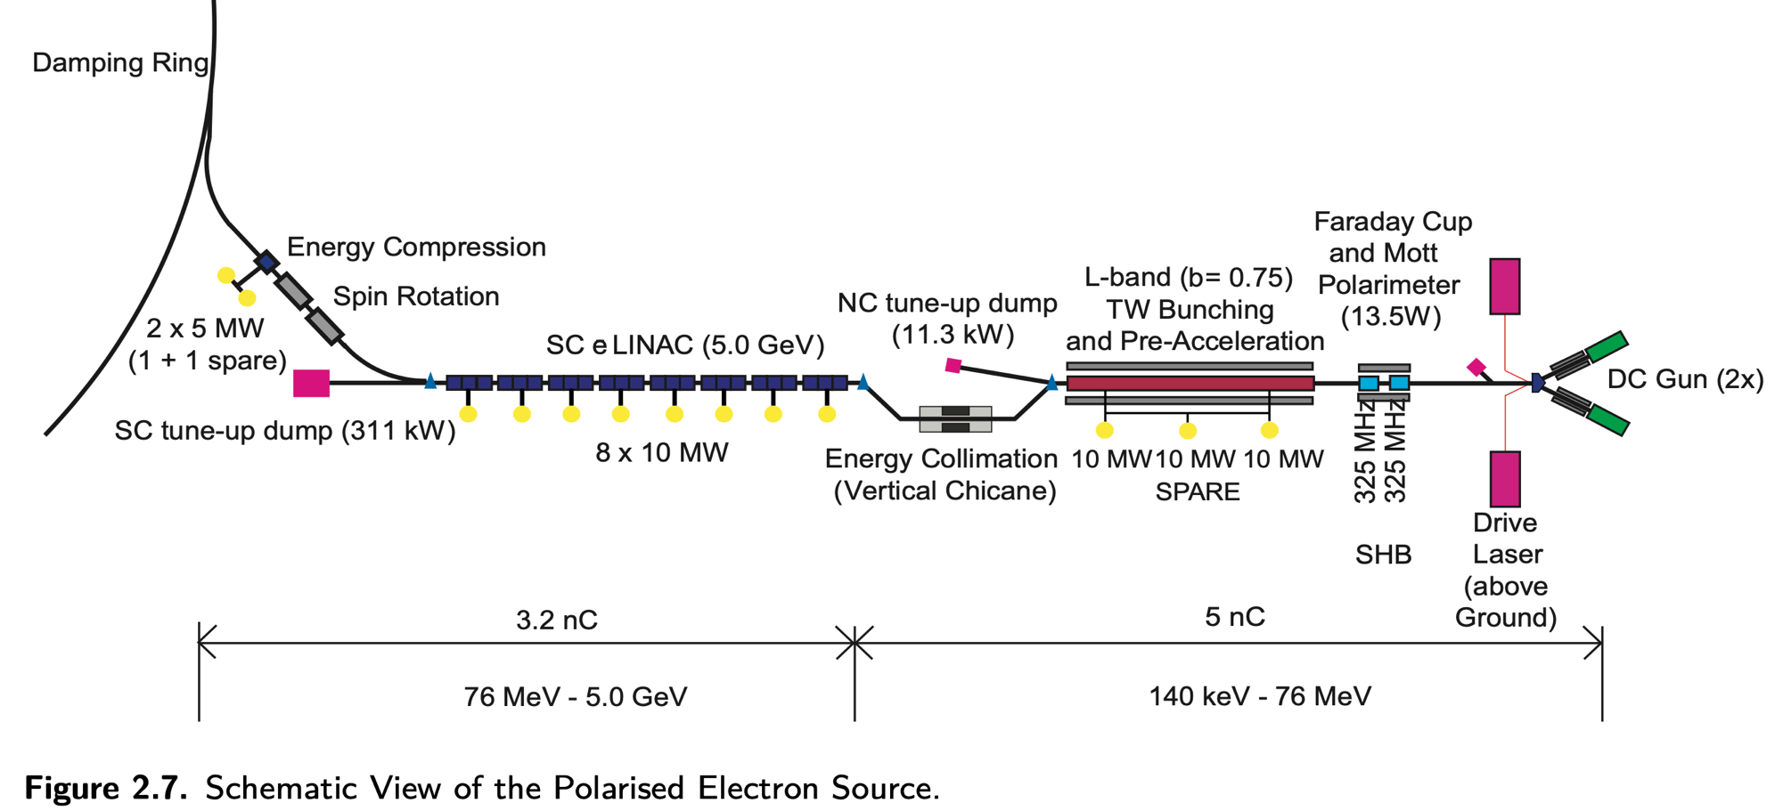
TDR electron source

Slide 15
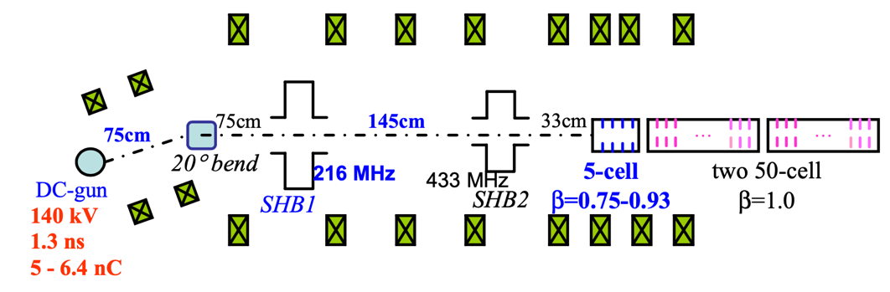
Power supplies of 76MeV Injector
Vacuum
Pol. meter
Solenoid power supply
Magnet PS
Beam Monitor
DC gun
200kV DC
50kV
50kV
5.5MV/m
8.5MV/m
8.5MV/m
76MeV electron beam
200kV DC
20kW
SSA
20kW
SSA
10MW L-band klystron
Laser
optical fiber transport
Modulator
Laser
13m

Slide 16
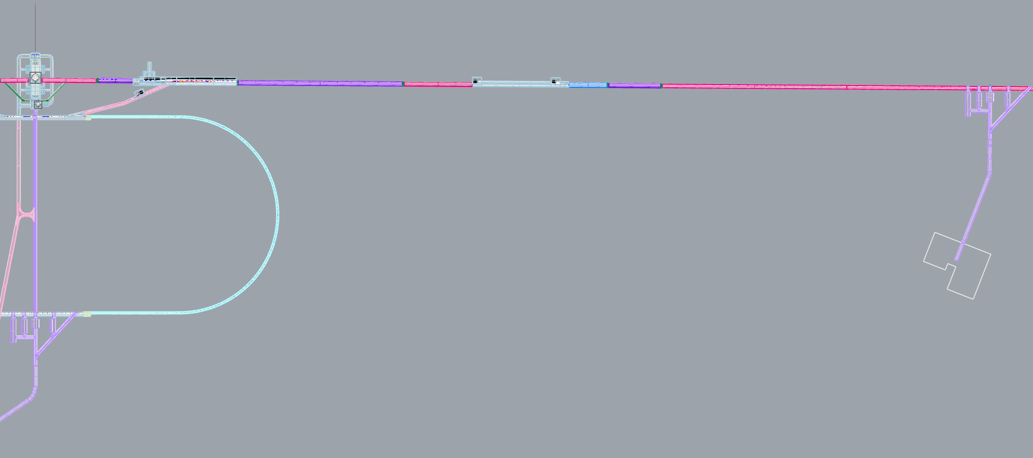
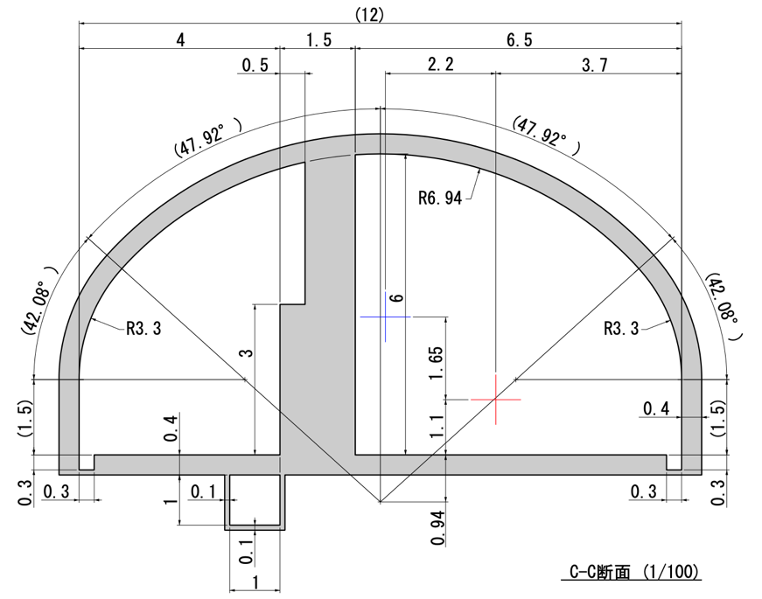
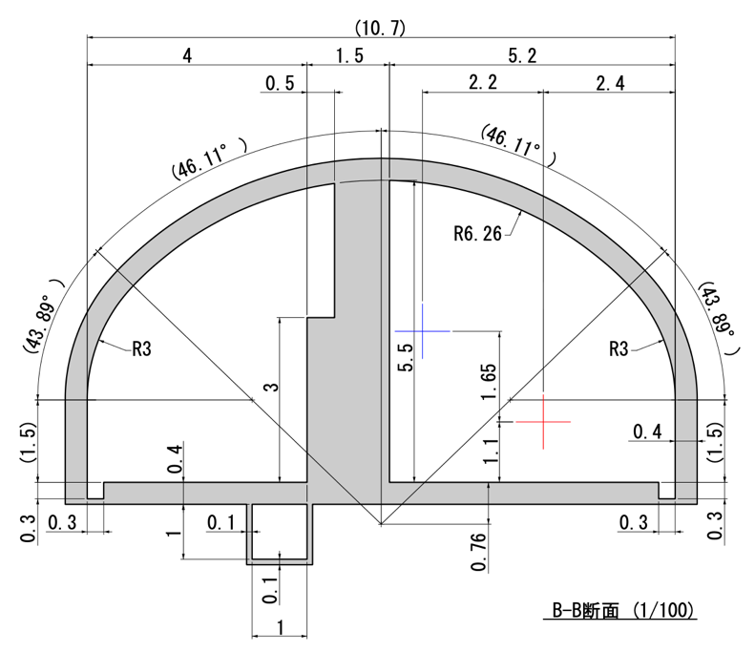
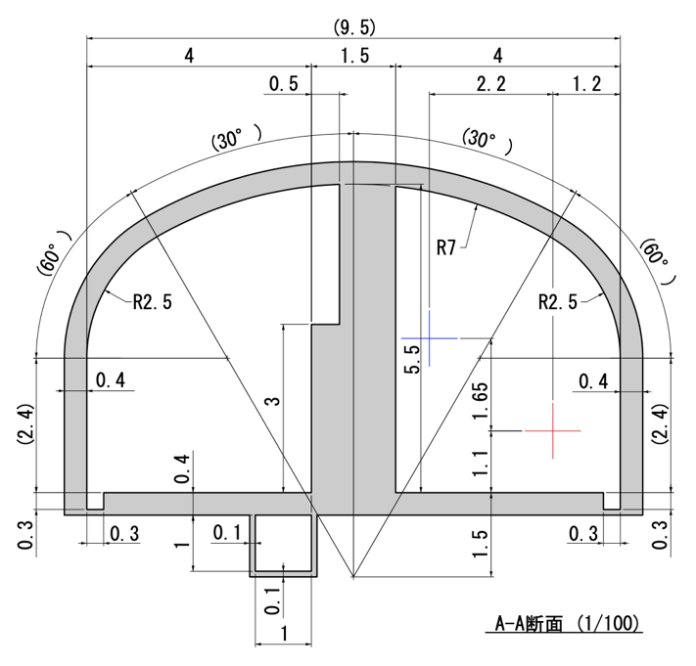
2588m
1994m
594m
e- Injector cryomodule place
IP
Move e- source to PM+8
positron BDS region
306m
-1630m
-1936m
e-gun position
C-C cross section
(width 12m)
B-B
cross section
(width 10.7m)
A-A cross section
(width 9.5m)
C-C
cross section
(width 12m)
B-B
cross section
(width 10.7m)
A-A
cross section
(width 9.5m)
Location of e- source and booster Linac (yellow arrow)

Slide 17
Moved e- source to PM+8 (plain view)
13m
1.2m
positron BDS
5.5m
1.5m
76MeV beam dump
2.2m
electron booster SC Linac
2.2m
accelerator tunnel
2.2m
Injector
RTML（high position）
shield wall
1.5m
9.5m
4m
klystron tunnel
11m
11m
Laser room
〜364m
LTR curved position
〜2200m
PM+8

Slide 18
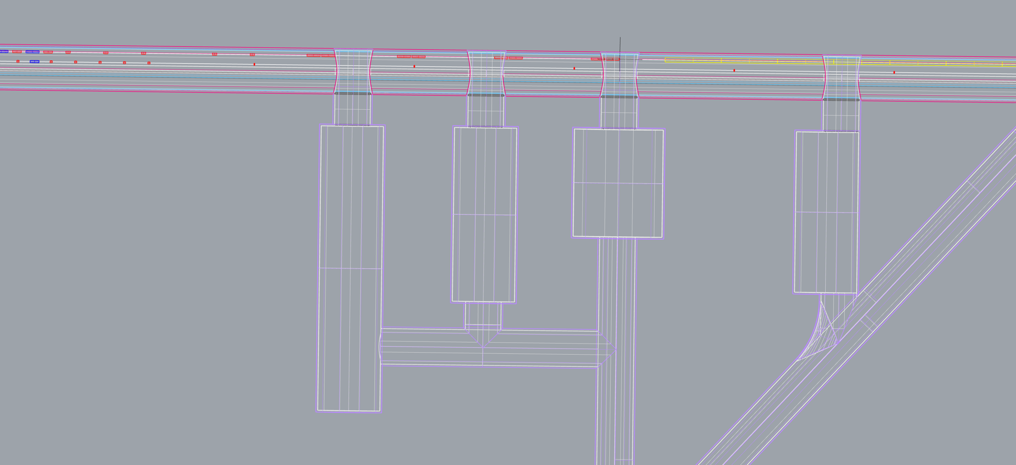
PM+8 region
e- Injector
Mark Point
e- Gun
e+ ML cryomodule end
tunnel width
expansion
He dome
Electric dome
Utility dome
Gun Laser dome
installation
tunnel
30m
30m
30m
colling water,
air dome

Slide 19
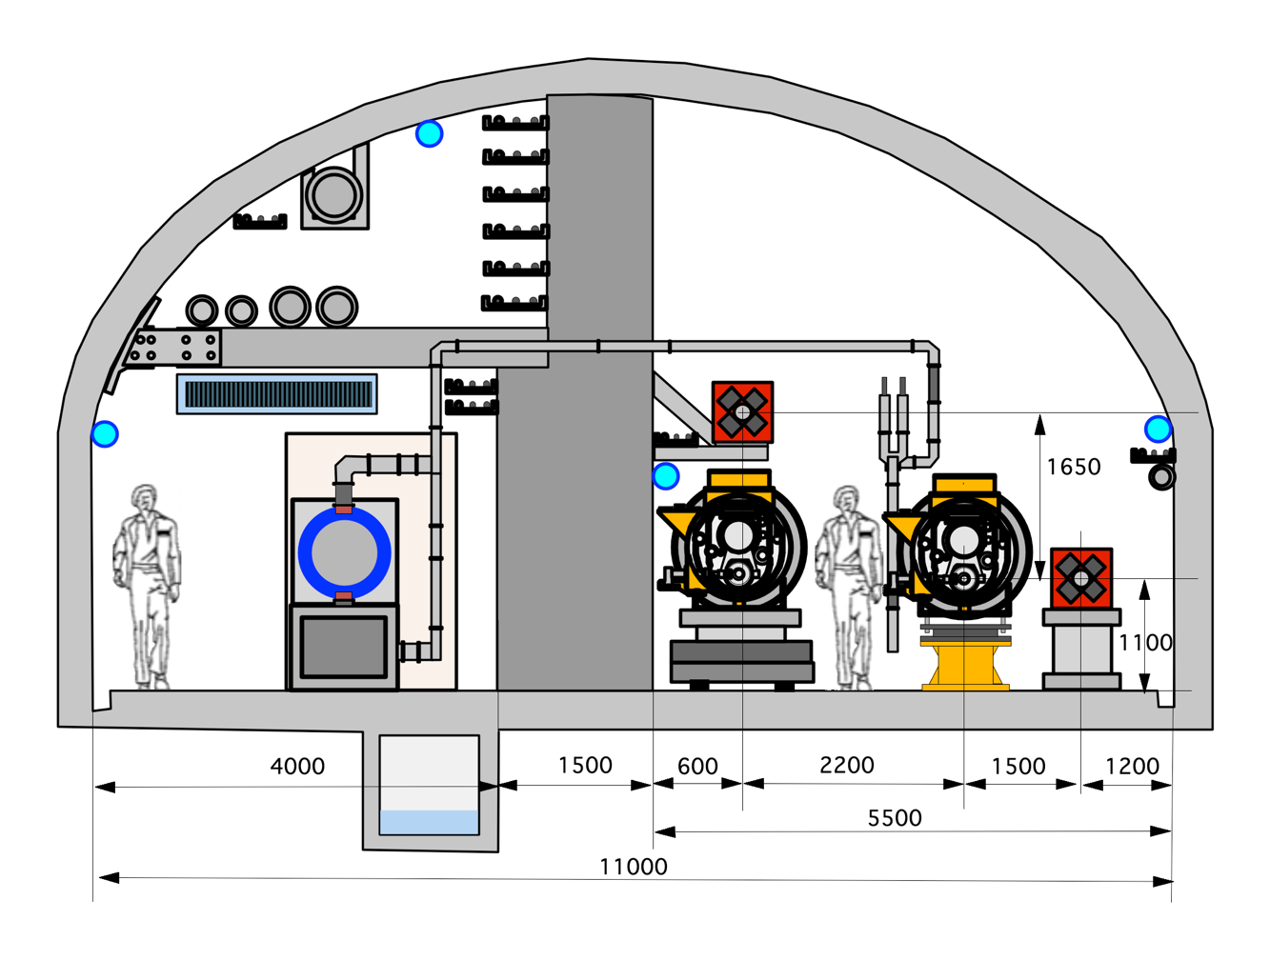
Cross section of 11m width tunnel for e- booster LINAC, e+BDS, e+RTML
e+ RTML
e- Injector
e+ BDS
Cryomodule transport
More consideration to the alignment work on BDS, behind the cryomodule, is necessary.

Slide 20
12)Current damping ring tunnel design require crossing of maintenance
root with accelerator. Need to change the access hall location.

Slide 21
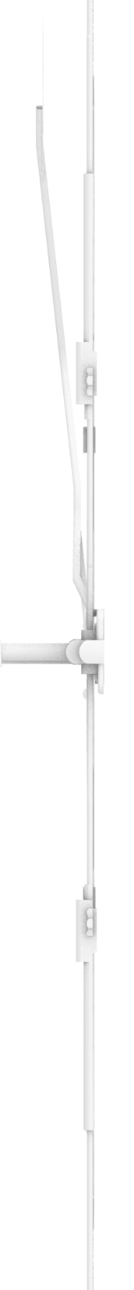
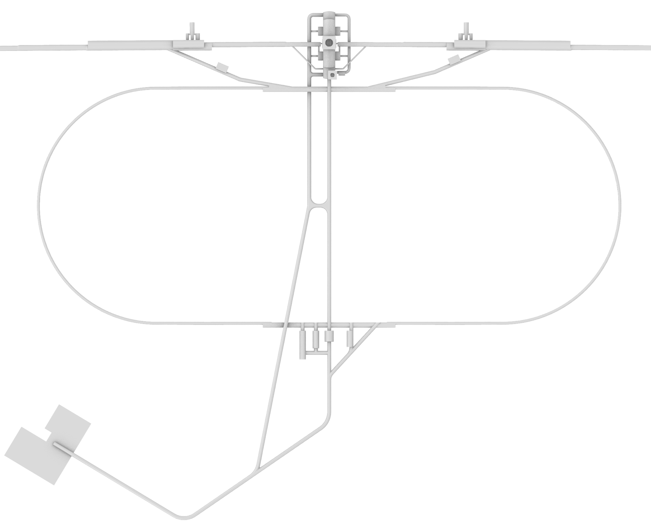
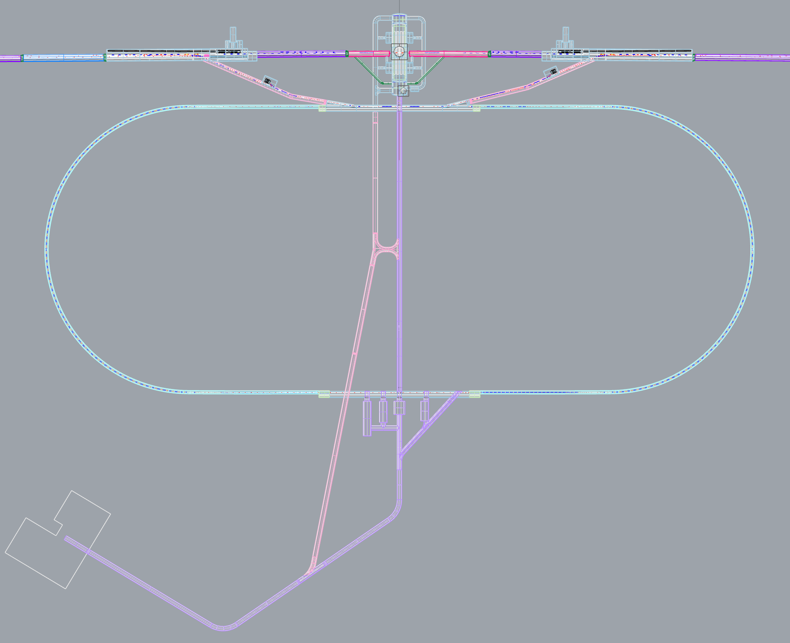
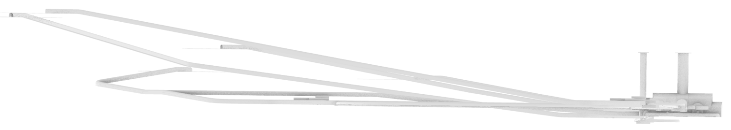
Damping Ring

Slide 22
2D drawing
of
Damping Ring

Slide 23
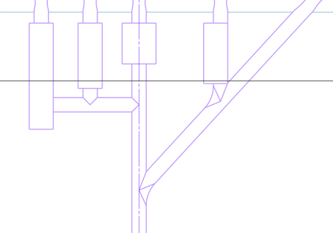
Simplified
Damping Ring Tunnel
transport passway
300m
magnet power supply room
crossing !
crossing !
300m
klystron room
Transport passway cross the accelerator

Slide 24
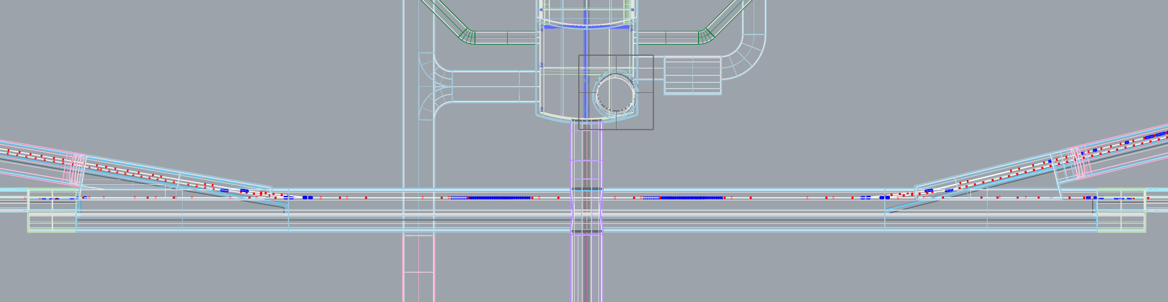
Damping Ring
East Straight
Detector Hall
Accelerator room (Injection/extraction section)
shield wall
300m
magnet power supply room
access tunnel
to detector hall
DR crossover tunnel

Slide 25
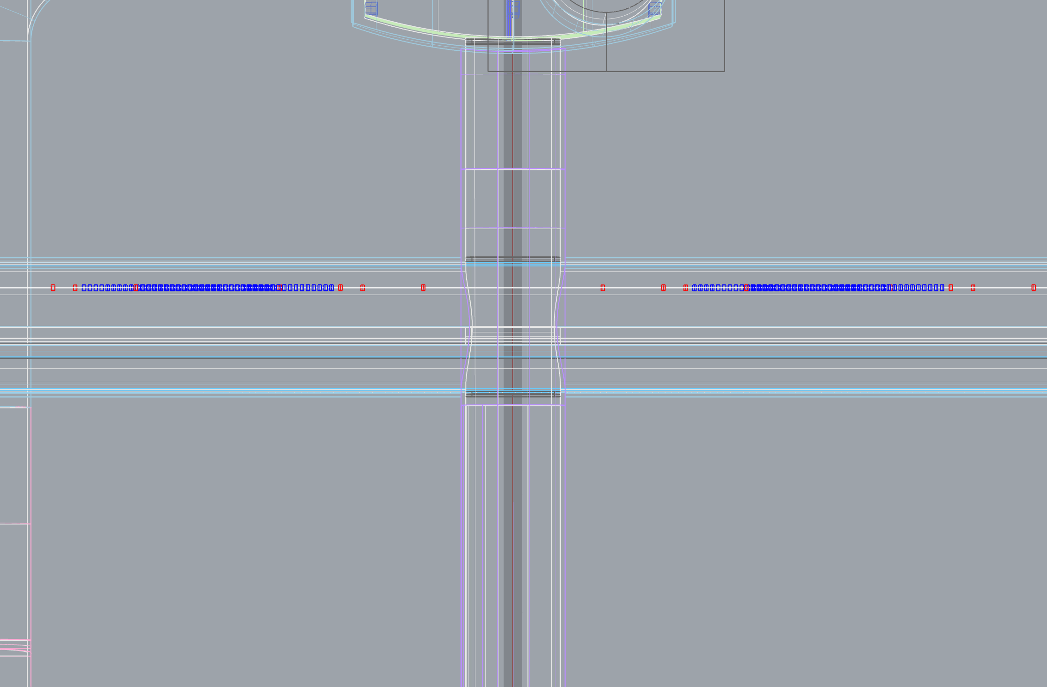
Damping Ring
East Straight
Center
Expanded View
Detector Hall
accelerator room
shield wall
magnet PS room
DR crossover tunnel

Slide 26
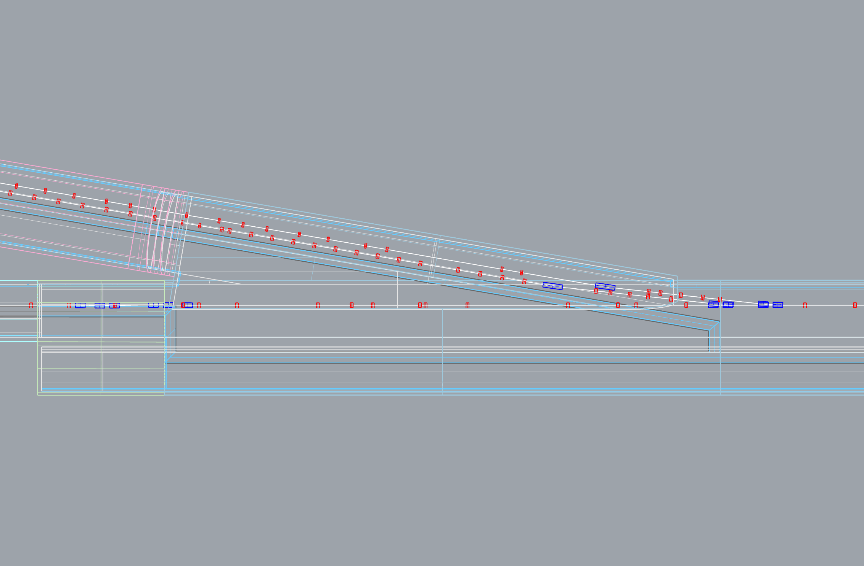
Damping Ring
East Straight
North
Expanded View
positron LTR
electron RTML
accelerator room
DR
accelerator room
shield wall
magnet PS room

Slide 27
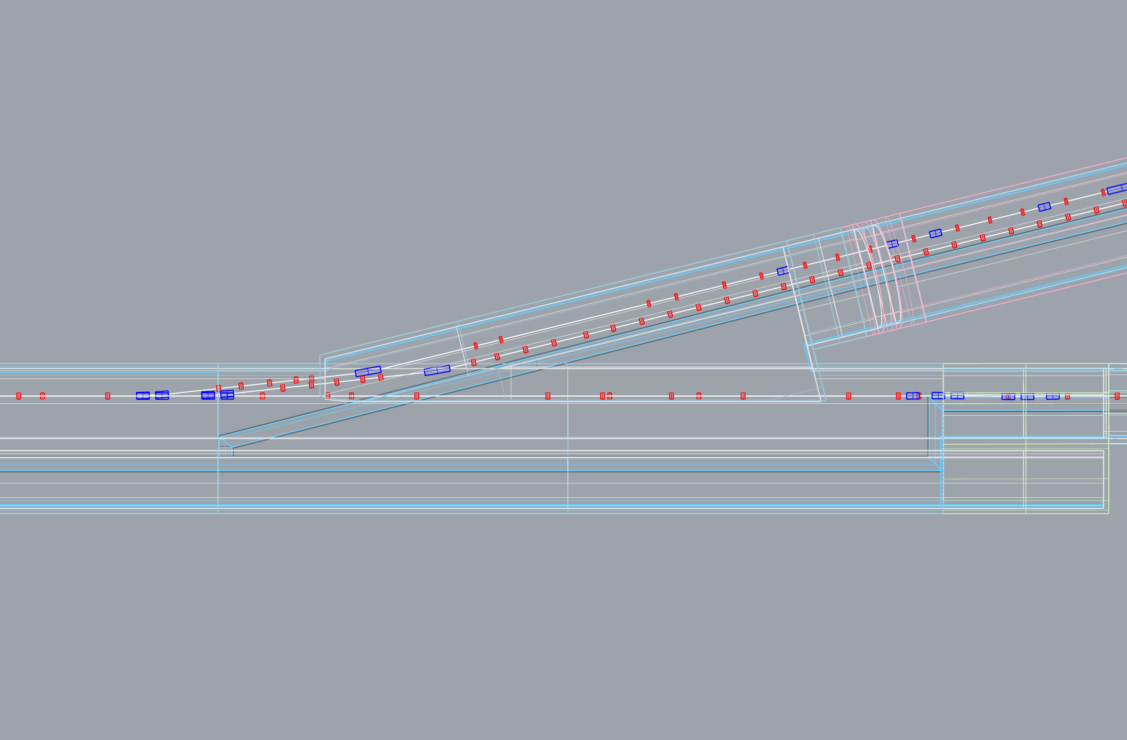
Damping Ring
East Straight
South
Expanded View
positron RTML
electron LTR
accelerator room
DR
accelerator room
shield wall
magnet PS room

Slide 28
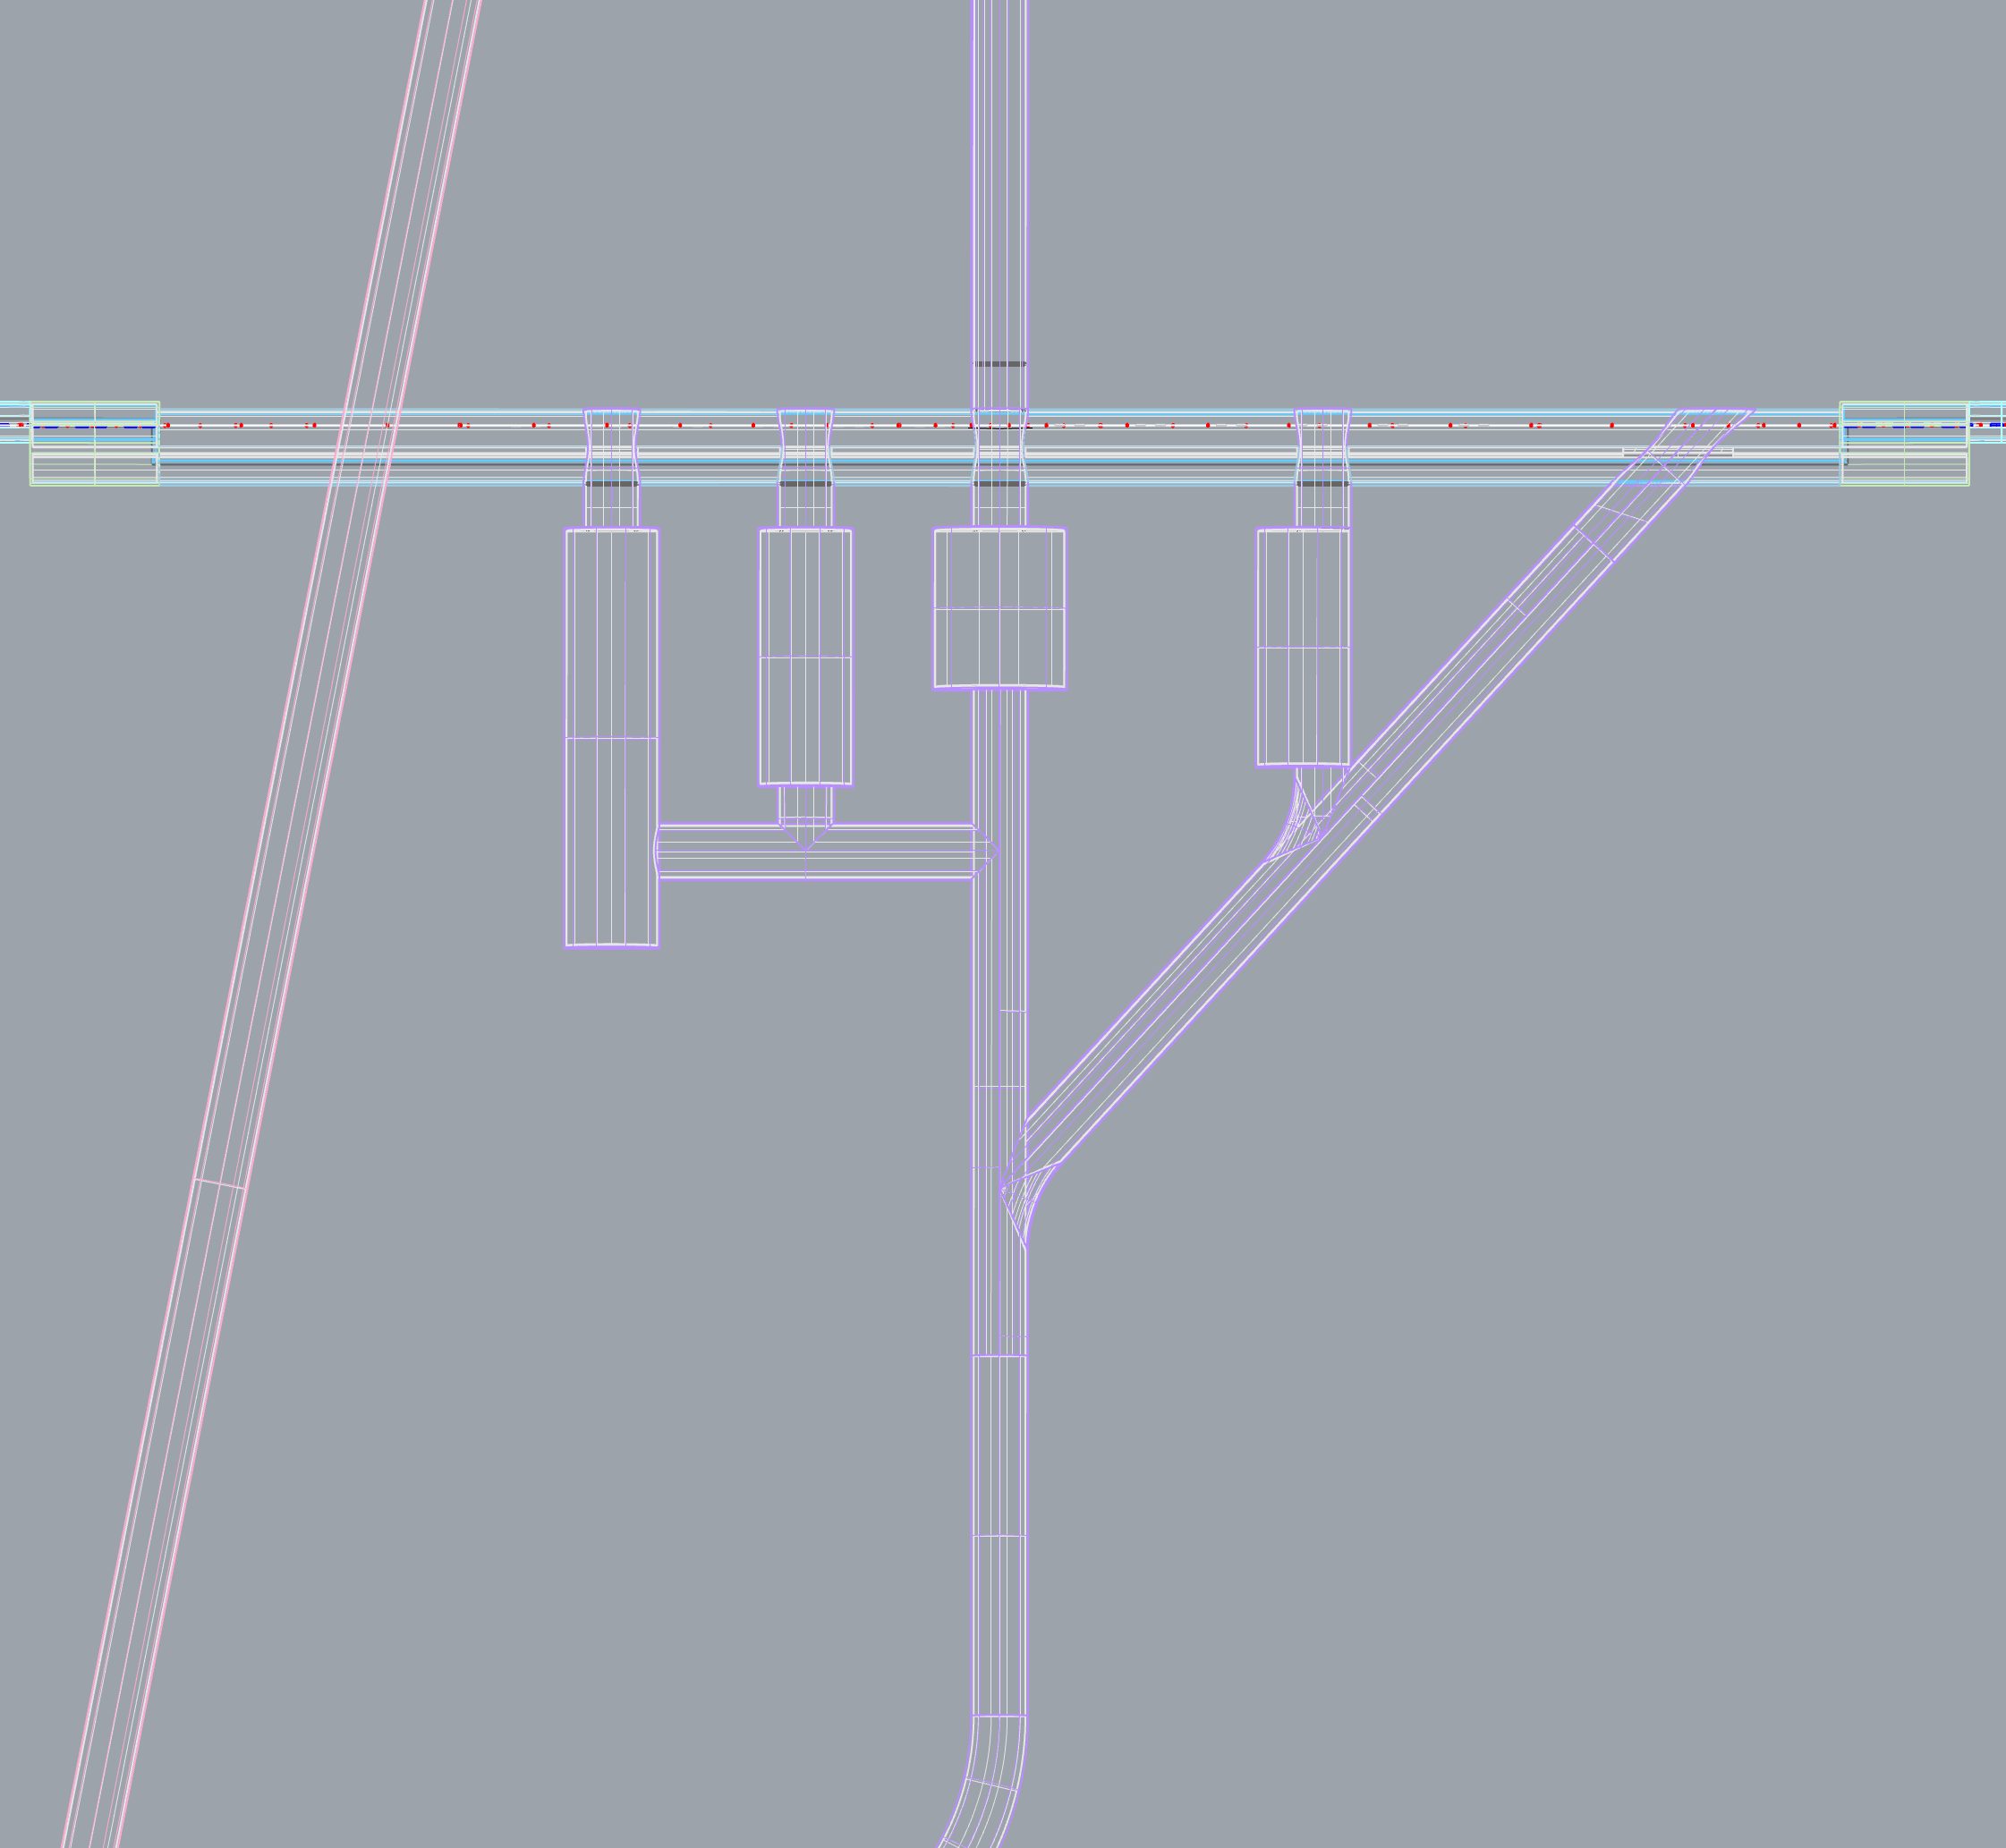
Damping Ring
West Straight
DR crossover tunnel
accelerator room
shield wall
He dome
utility dome
300m
klystron room
electric dome
carry in
colling water,
air dome
detector hall access tunnel
DR access tunnel

Slide 29
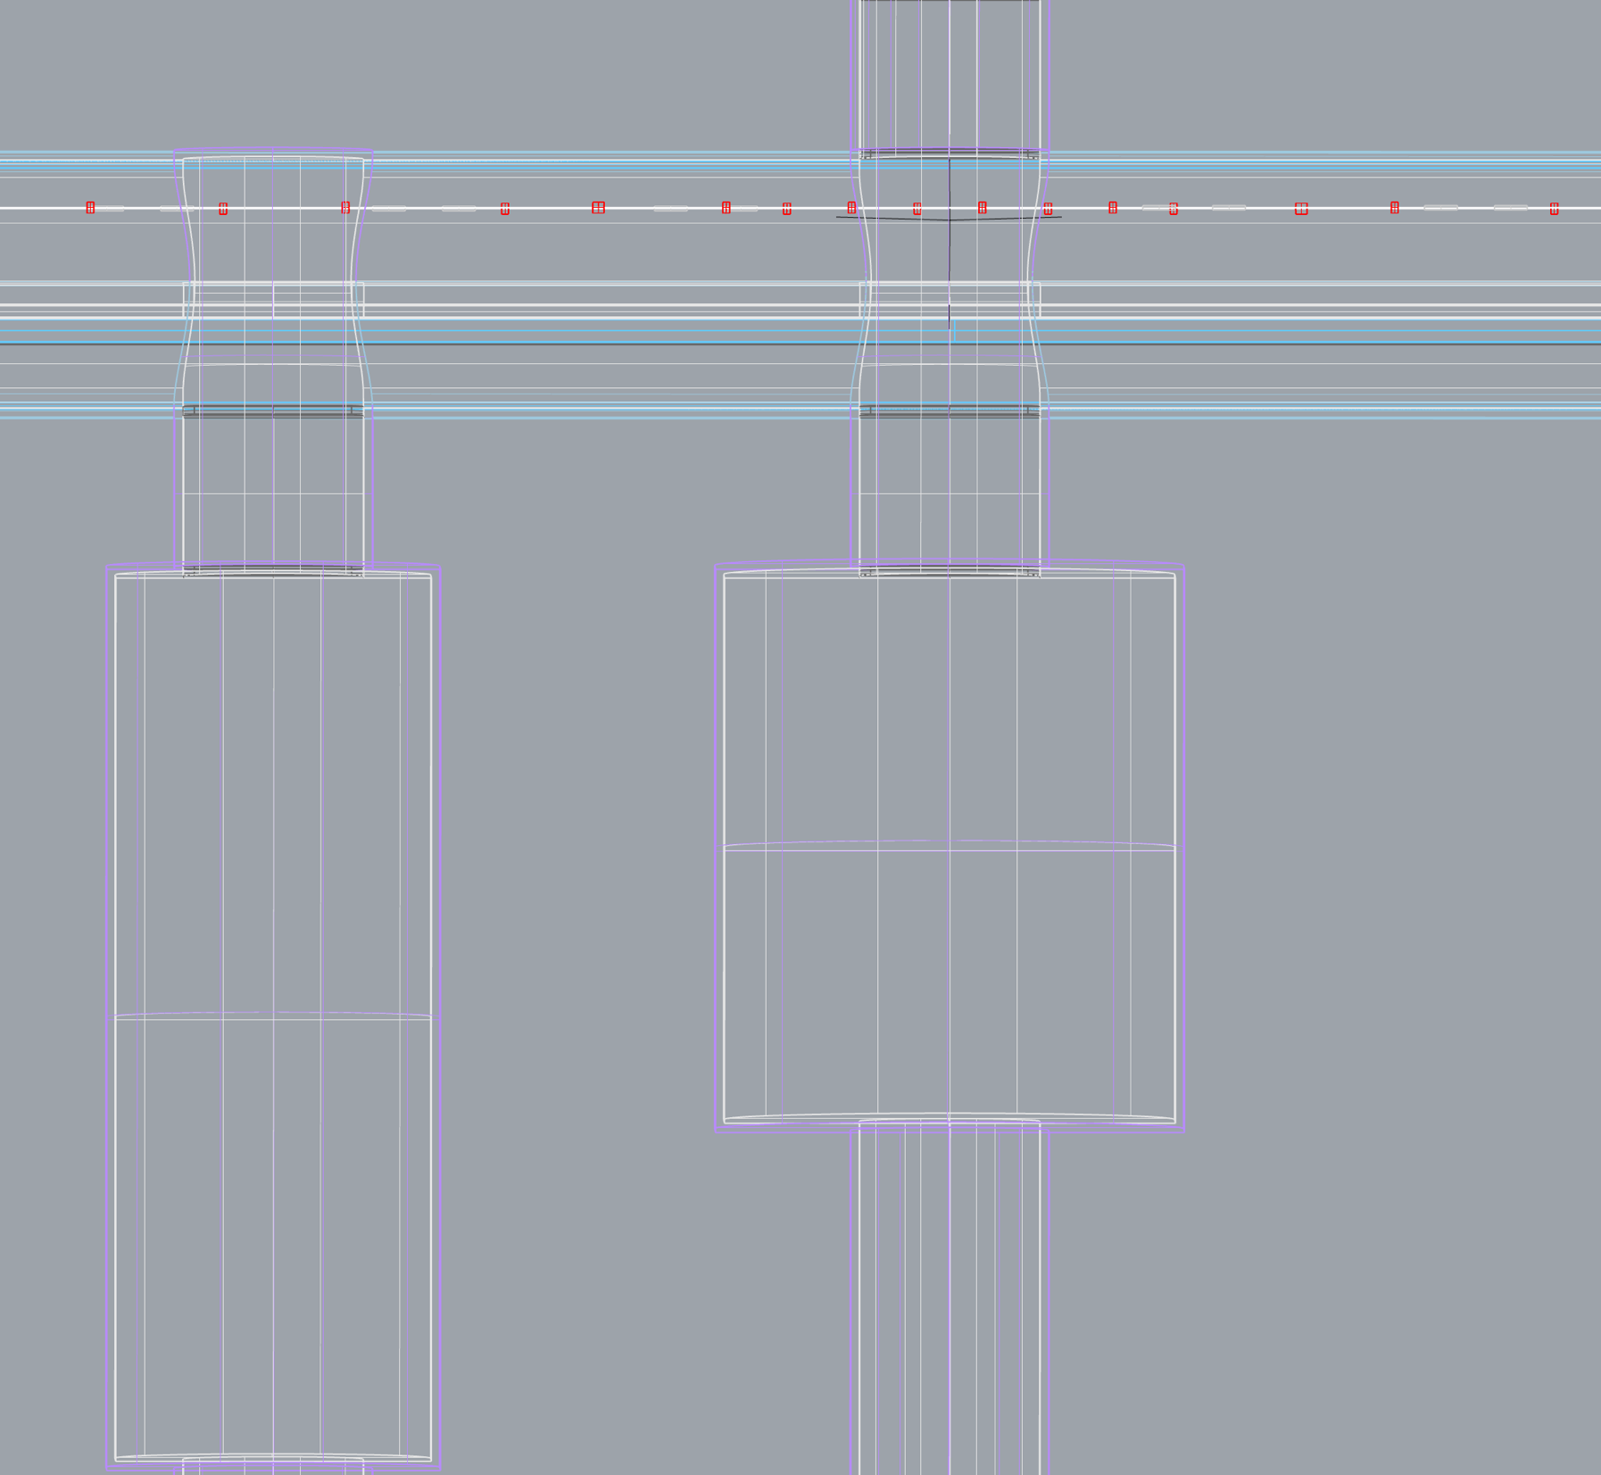
Damping Ring
West Straight
Expanded View
DR crossover tunnel
accelerator room
(RF/wiggler section)
shield wall
klystron room
He dome
Electric dome

Slide 30

2D drawing
of
Damping Ring
proposal of
access hall
movement
Move access halls to DR inside

Slide 31
Summary
1. The arrangement of accelerator components and tunnel wall
housing were made by 3D-CAD base. And extracting 2D
drawing from them for checking interference and tunnel shape.
2. First round of cheking was almost done. More than 14 issues
were found, and explained in this report.
3. Feedback to optics deck and tunnel drawings is on-going.

Slide 32
End of slide

