Slide 1
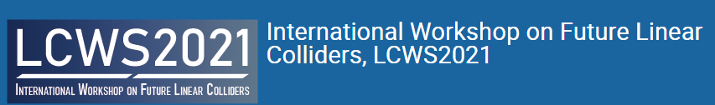

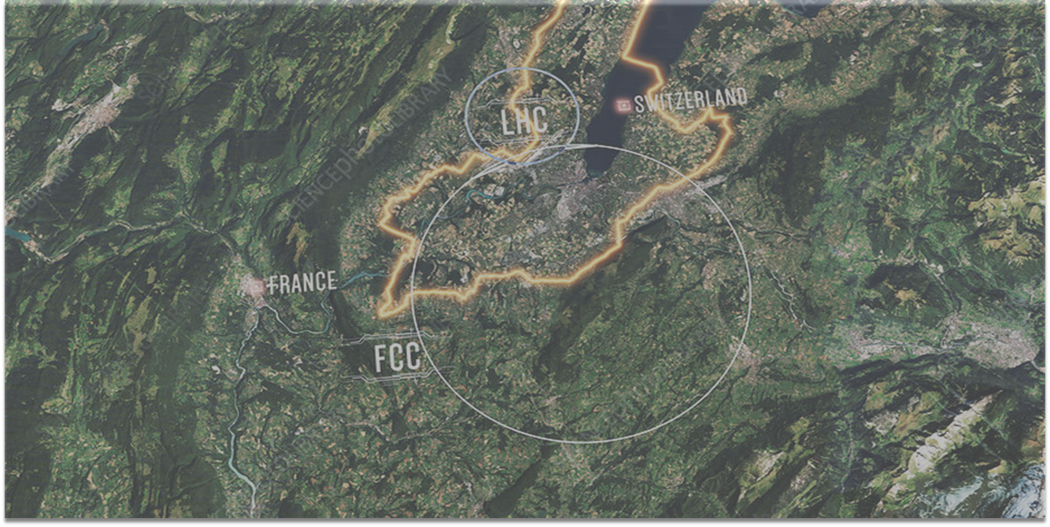

Civil Engineering Status and Plans for CERN’s Future Circular Collider (FCC)
John Osborne CERN
17 March 2021
Acknowledgement of SCE CE team and Infrastructure WG members, in particular, Alexandre Tudora and Volker Mertens

Slide 2
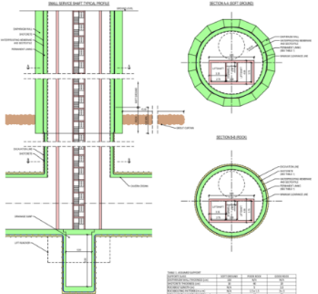
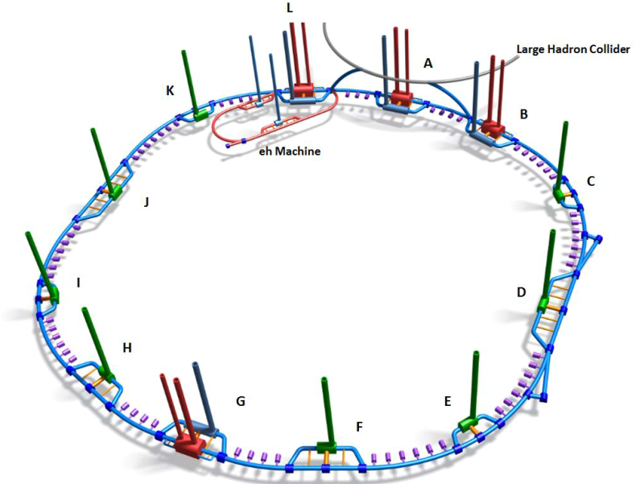
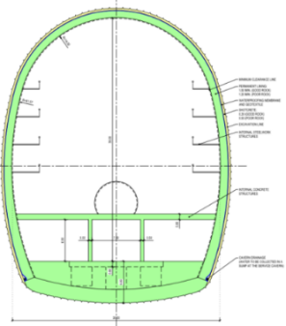
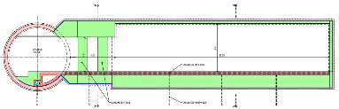
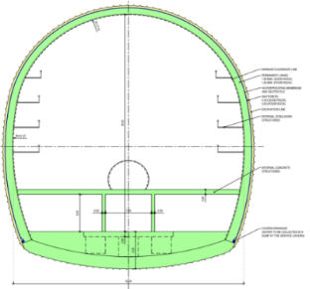
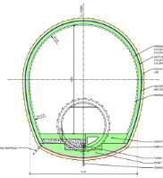
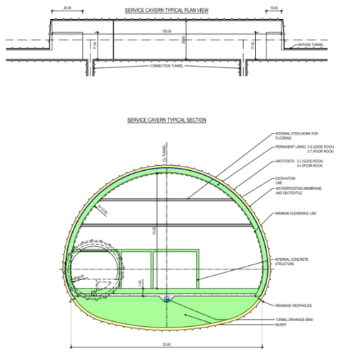

FCC civil engineering overview
Underground civil infrastructure for FCC - 3D schematic (not to scale)
Shafts:
Experimental Shafts:
15 m dia. + 10 m dia.
Service shafts:
12 m dia.
Magnet delivery shaft:18 m
Small Experimental Caverns
30 m x 35 m x 66m
Alcoves
25 m x 6 m x 6 m
Located at 1.5km spacing
Large Experimental Caverns
35 m x 35 m x 66 m
Beam Dump Caverns
10 m x 10 m x 50 m
Tunnels:
97.75 km of 5.5 dia. machine tunnel
Approx. 8 km 5.5 dia by-pass tunnels
Service Caverns
25 m x 15 m x 100 m

Slide 3
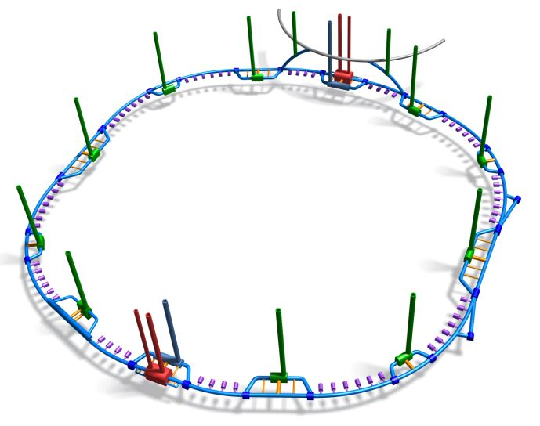
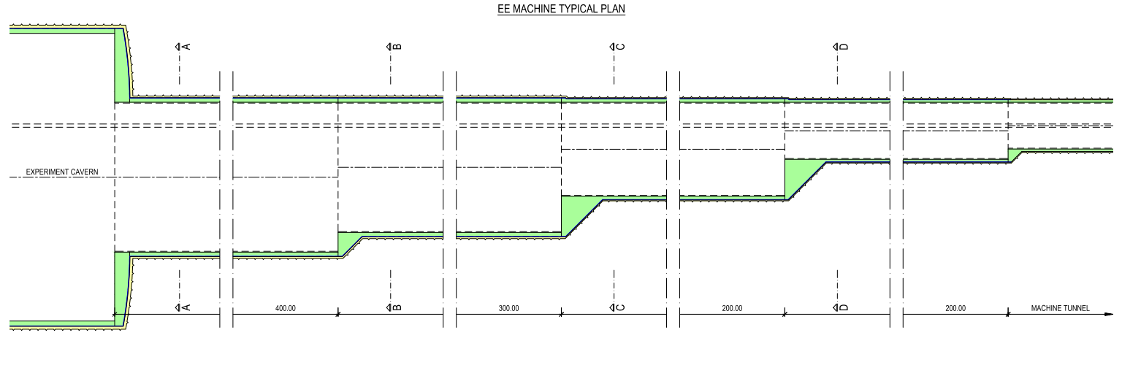
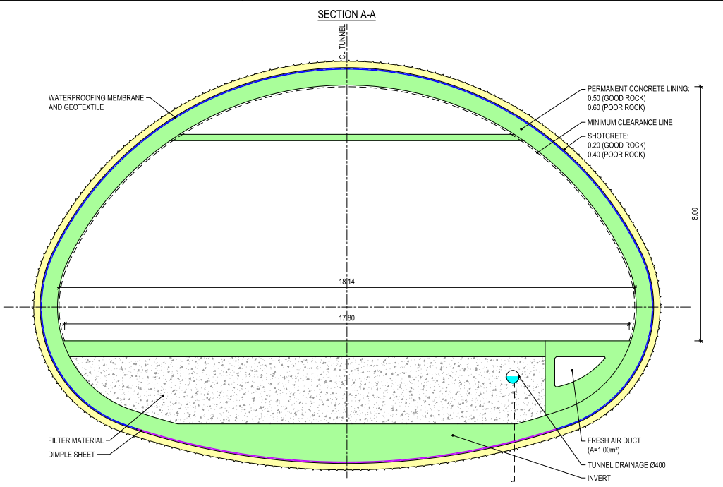
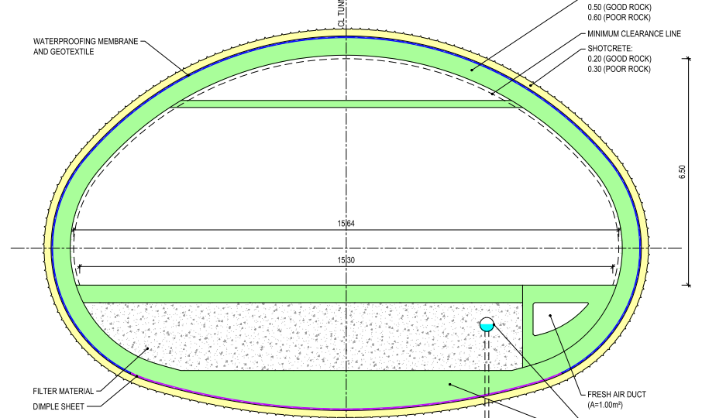
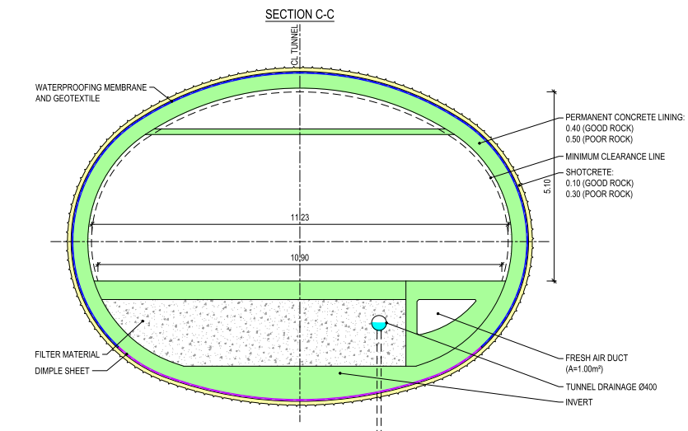
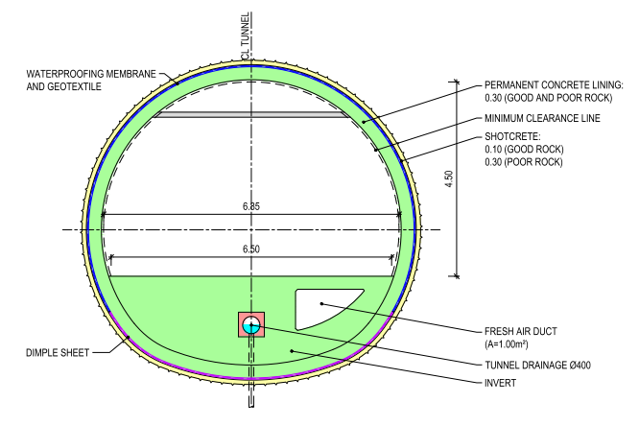
FCC-ee
Would be constructed at the same time as FCC-hh
Infrastructure must be able to accommodate both machines.
Enlargements required at experiment points A and G.

Slide 4

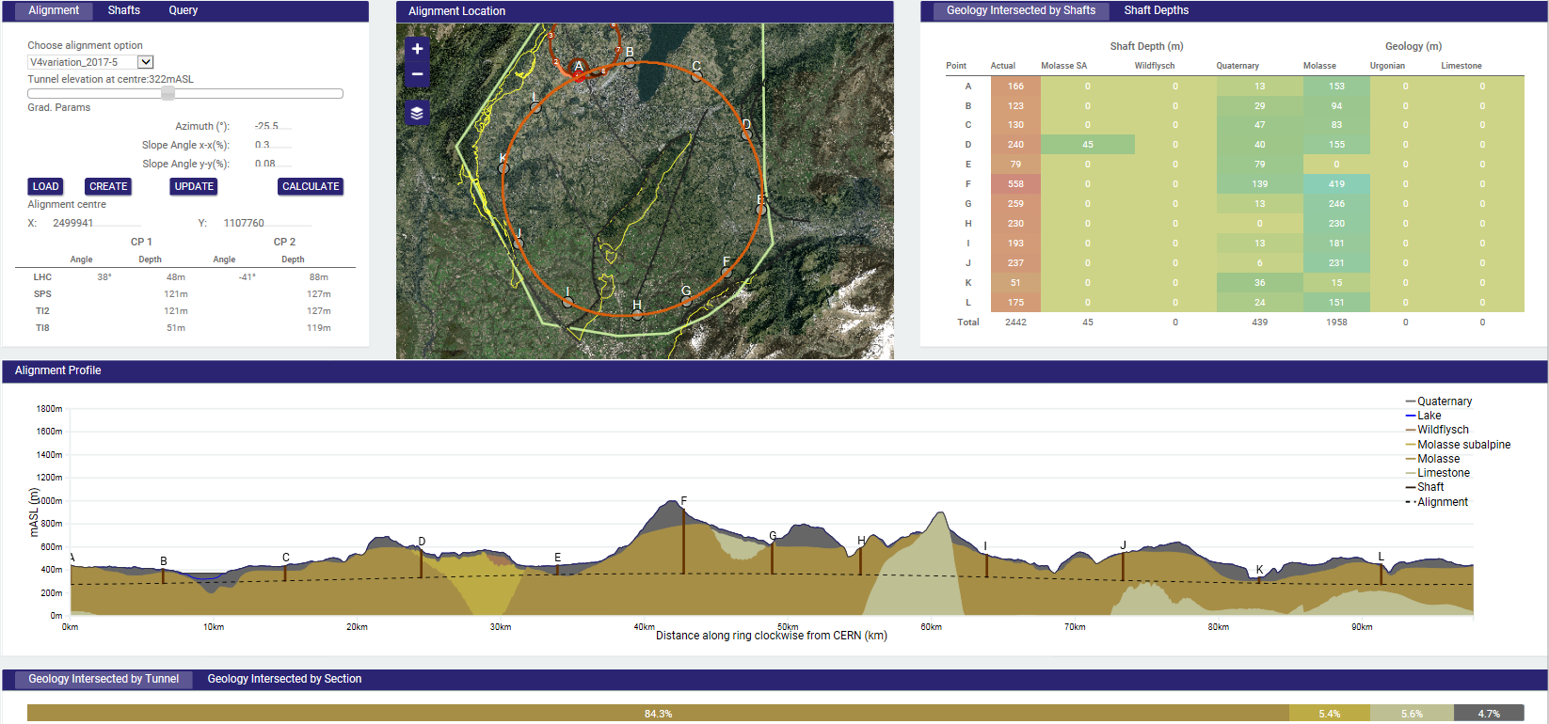
FCC CDR baseline footprint
97.75km tunnel circumference
~90 % molasse – suitable ground for tunneling. Only one sector in limestone.
3720 m sum of shaft depths
558 m deepest shaft (F): proposed to be replaced with an inclined tunnel

Slide 5
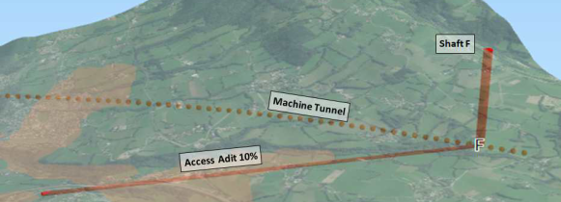
Inclined access tunnel at point F
Option | 558 m Shaft | 10% inclined access | 15% inclined access
Excavation length | 558 m (12 mID) | 3820 m (9.0mID) | 2750 m (9.0mID)
Total duration (months) | 22.2 | 25.8 | 23.2
Relative CE Cost | 1 | 1.08 | 0.78
Advantages | Shorted length of services | Improved surface site location and access TBM ready in cavern for tunnel excavation | Improved surface site location and access TBM ready in cavern for tunnel excavation
Disadvantages | Baseline lift mechanism not feasible Surface site has difficult access | Increased length of services | Increased length of services Transport method at 15% to be confirmed
Existing LEP transfer tunnel TI18 15% from SPS to LHC
Whole project cost and schedule implications, including transport and services, still to be evaluated.

Slide 6

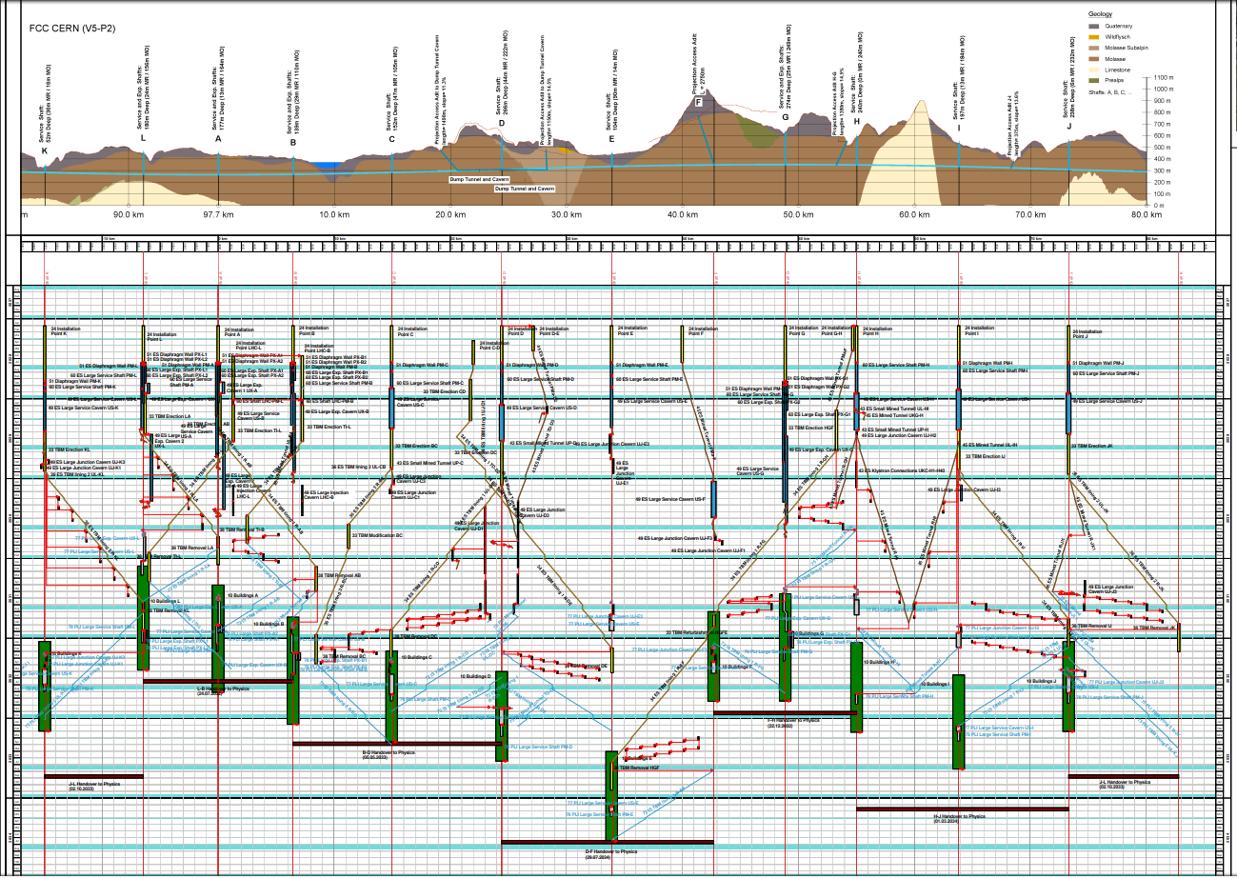
Construction Schedule
Sector L-A-B : 4.5 years
Sector D-E-F : 6.5 years

Slide 7
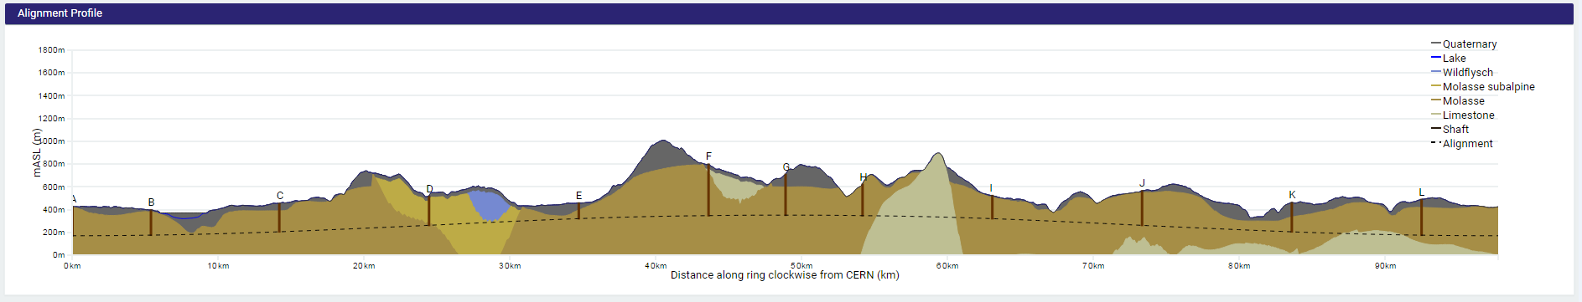
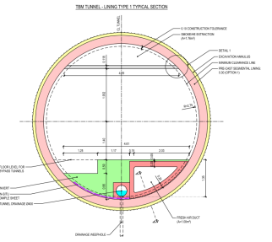
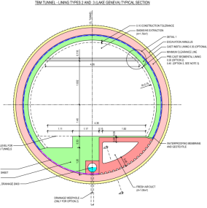
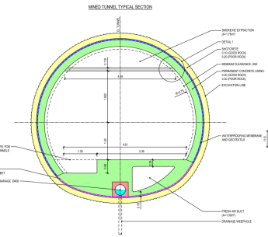
FCC Machine Tunnel – Lining concept
Lining concept assumptions per sector:
Lining Type
1
2/3
1
2
1
1
1
4
1
2
4
1
TBM Tunnel Types
Mined Tunnel Type
Type 1
Type 2 / 3
Type 4
*
*It is assumed 50% will have optional inner lining

Slide 8
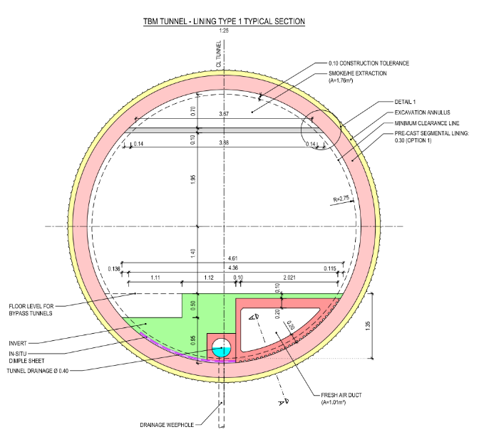
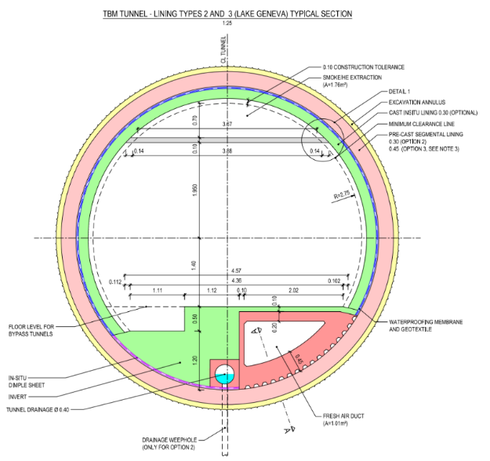
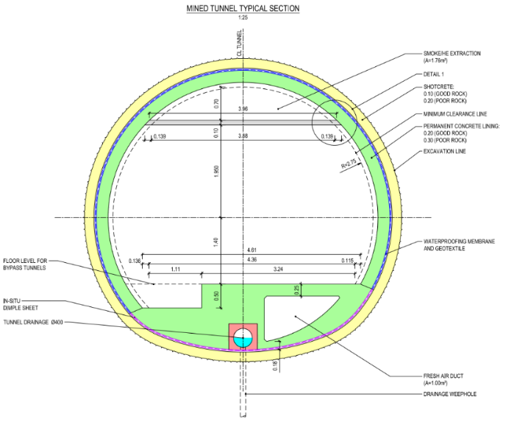
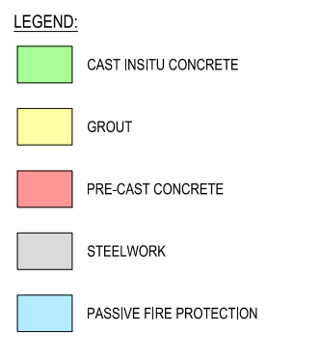
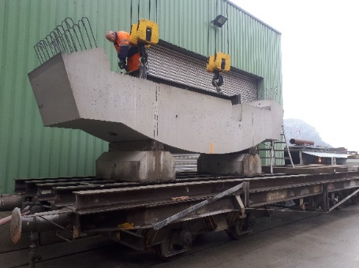
Machine tunnel cross sections and lining concepts
Lining Type 1
TBM tunnel in ‘good’ molasses
Lining Type 2 & 3
Lining type 4
Mined tunnels in limestone
Cast-in-situ concrete invert
Pre-cast concrete element
Lining types 2
TBM tunnel in jointed molasse with high risk of groundwater infiltration
In sectors where there is relatively low rock cover to the water bearing moraine deposits
Precast concrete thickness: 30cm
Lining type 3 (under Geneva Lake)
Precast concrete thickness: 45cm
Segments with higher steel bar density
Pre-cast concrete invert (HL-LHC)
Currently being studied
Future Circular Collider Study
FCC Week 2019, Brussels
Alexandra Tudora

Slide 9
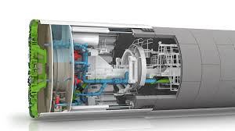
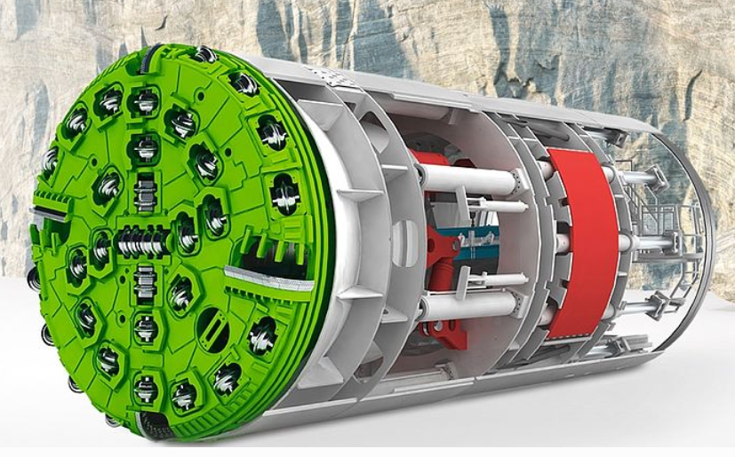

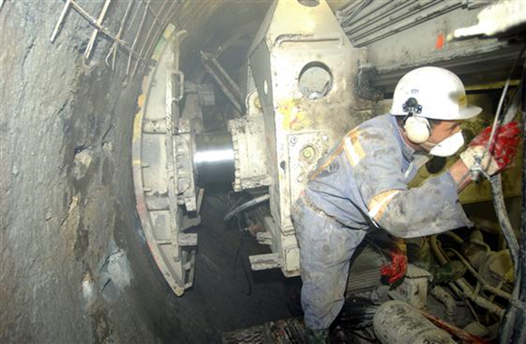
Tunnel Boring Machines
Double-Shield TBM
Mixshield TBM
CERN CNGS tunnel : Gripper machine in Molasse
In the conceptual design, ‘double shield’ TBM’s have been proposed for FCC, except for in Moraines under the lake (Slurry/Mixshield TBM)
(For LEP and LHC works ‘Gripper’ and ‘Double shield’ TBM’s were deployed)

Slide 10
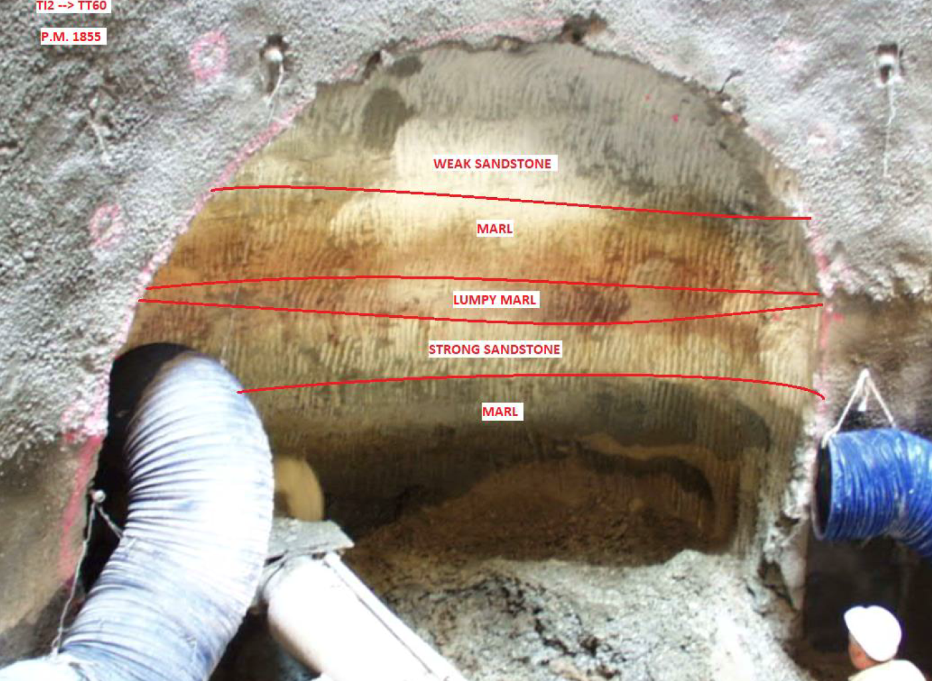
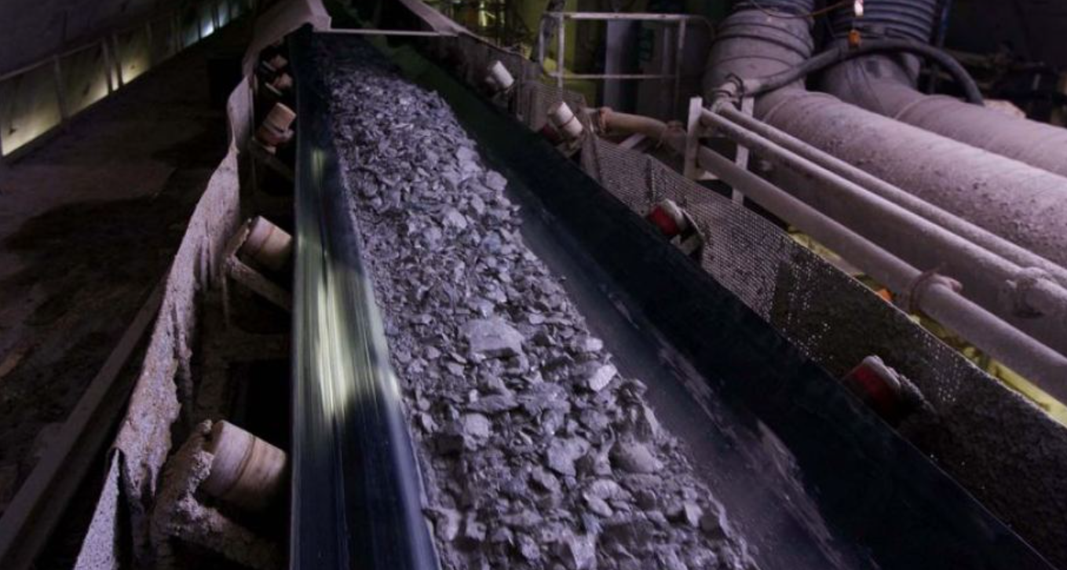
Typical ‘Molasse’ tunnel/cavern cross section from LHC construction. Individual units typically vary in thickness between approximately 0.1m and 3.0m.
Spoil from TBM’s will be a mixture of Marls, Sandstones etc. which makes ‘filtering’ for re-use challenging

Slide 11
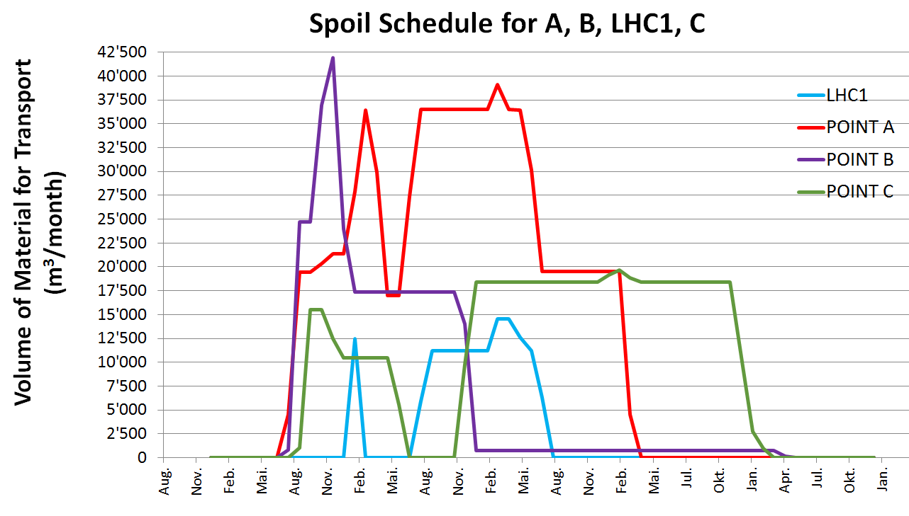
Planning – Spoil Disposal
Extraction Site | Volume (m³)
 | Soft Ground | Limestone | Molasse | Total
Shaft at LHC1 | 11,031 | 0 | 133,735 | 144,765
Shaft at LHC2 | 0 | 0 | 202,589 | 202,589
Shafts at Point A | 26,469 | 0 | 791,948 | 818,417
Shafts at Point B | 35,161 | 0 | 326,482 | 361,643
Shaft at Point C | 181,807 | 0 | 385,920 | 567,727
First Construction Tunnel at Point D | 0 | 0 | 709,452 | 709,452
Shaft at Point D | 15,992 | 8,806 | 668,961 | 693,760
Second Construction Tunnel at Point D | 0 | 0 | 235,355 | 235,355
Shaft at Point E | 6,528 | 0 | 174,792 | 181,320
Tunnel at Point F | 0 | 1,206 | 375,414 | 376,621
Shaft at Point G | 33,086 |  | 471,215 | 504,301
Tunnel at Point H | 0 | 244,081 | 750,620 | 994,701
Shaft at Point H | 0 | 7,329 | 421,401 | 428,730
Shaft at Point I | 6,528 | 0 | 796,634 | 803,161
Shaft at Point J | 6,528 | 0 | 805,629 | 812,157
Shaft at Point K | 13,381 | 0 | 610,972 | 624,353
Shafts at Point L | 29,990 | 0 | 671,700 | 701,690
Total Spoil Volume | 366,500 | 261,422 | 8,532,821 | 9,160,743
Production of up to 42,000m³ per month
9million cubic meters to dispose
A competition “mining the future” will soon be published (15th April).

Slide 12
FCC CE study progress
Footprint exploration (ongoing):

Slide 13
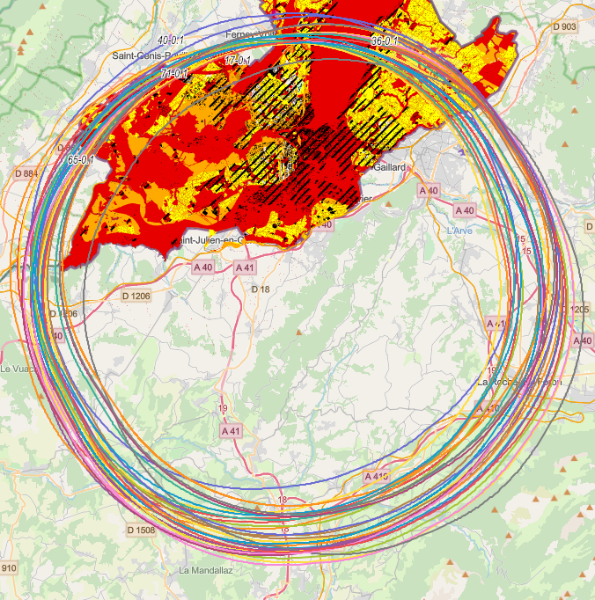
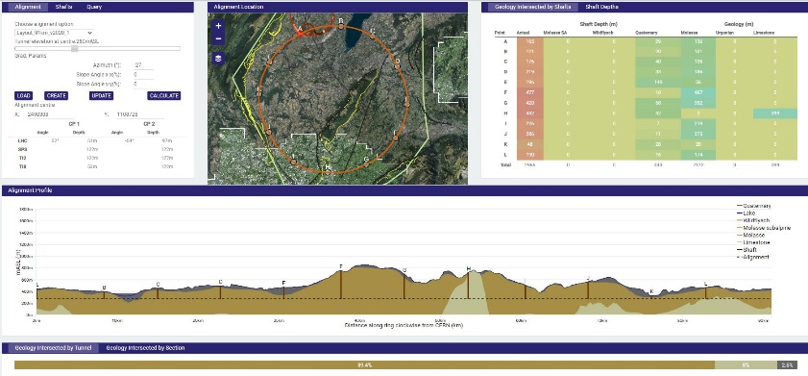
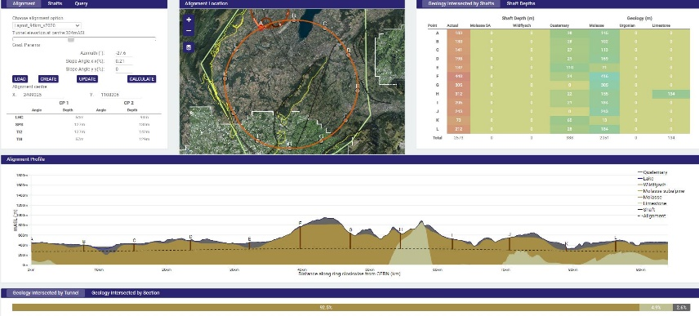
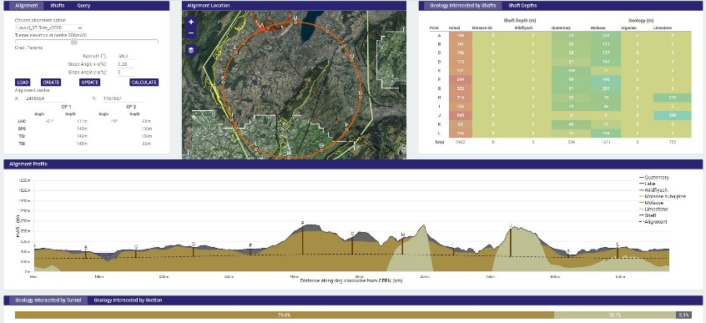
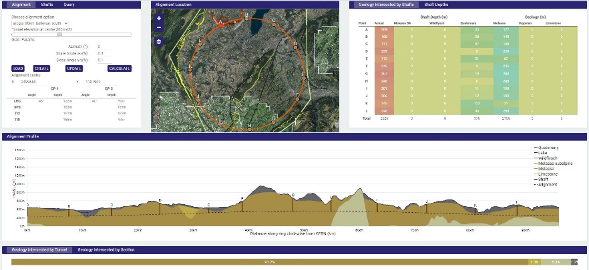
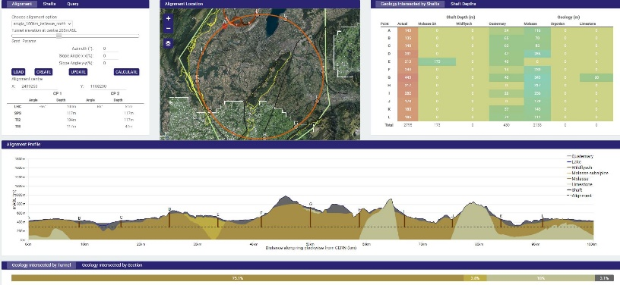
FCC Footprint Exploration
Surface sites placement optimization – administrative and legal requirements from the host states
Input from civil engineering is essential to evaluate the feasibility of tunnel alignments and caverns and shaft locations
Currently still using TOT, though exploring additional software options
The main focus is to identify max. 3 preferred scenarios by the end of Q1 2021 and one feasible scenario before starting tendering for SI
91 km
94 km
97.5 km
96 km
100.3 km

Slide 14
FCC CE study progress
Footprint exploration (ongoing):
FCC Rail Mounted Robot arm study

Slide 15

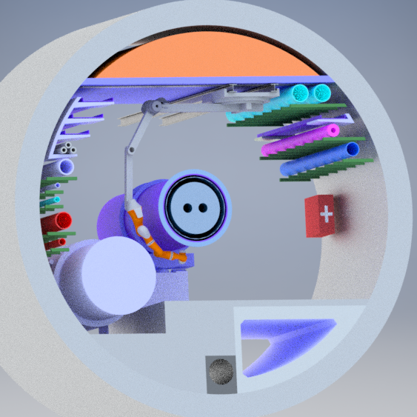
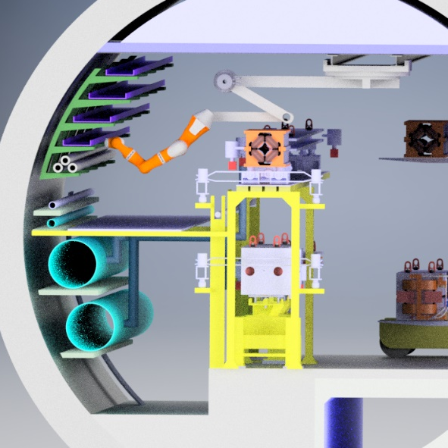
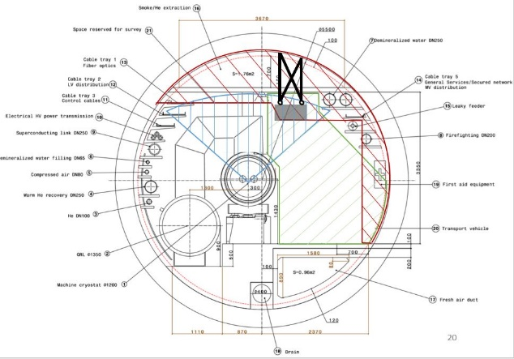
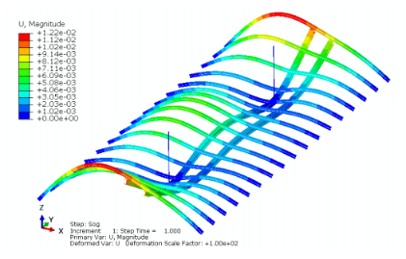
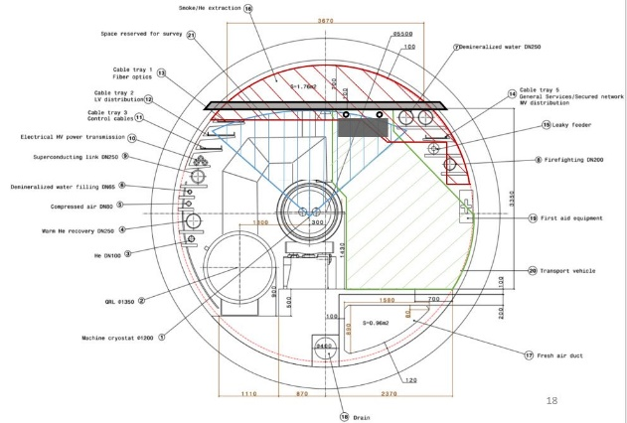
FCC Rail mounted robot
Deformation and Stress analysis
Proposed tasks for the robot:
Tunnel inspections
Carrying tools/materials
Preventive maintenance
Performs repair work and reach areas which are difficult to be accessed by people
Hazard detection (e.g. Measure radiation, oxygen levels, smoke, Helium leaks)
Fire-fighting intervention
Tests Sensors
Alignment measurements
Disconnects broken devices of the collimator
H. Gamper (CERN)
Different layout options for the robot have been studied taking into account the allowable space and load increase.
Civil engineering ILF study: Deformation and stress analysis of the tunnel ceiling / ventilation duct.

Slide 16
FCC CE study progress
Footprint exploration (ongoing):
European Strategy for Particle Physics Update
FCC Rail Mounted Robot arm study

Slide 17
European Strategy objectives for civil engineering
ESPPU 2020
More comprehensive feasibility study to be delivered end 2025 as input for ESPP Update expected for 2026/2027:
  Feasibility study of the 100 km tunnel
  High-risk areas site investigations, to confirm principle feasibility - 10-15MCHF approved
Additionally, a CDR+ will be prepared as an input into the next ESPPU.
To achieve these objectives, the CERN civil engineering team are launching a site investigation campaign for High-Risk Areas for FCC.
High Risk Areas include:
  Areas along the FCC tunnel alignment where there is high uncertainty in the geological boundary layers and ground conditions, critical to determine the vertical and the horizontal alignment of the FCC tunnel.
  Areas to avoid where the complexity of the ground and hydrogeological conditions would dramatically increase the costs/risks during construction works and/or maintenance
  Shafts locations situated in the vicinity of aquifers and where construction works could impact the environmentally sensitive areas
ILF/GADZ will deliver a preliminary study to identify these High-Risk Areas, propose necessary SI as well as providing a cost and schedule for the SI works.
Additionally, ILF/GADZ will provide input into the technical specifications to define the scope of services for “the JV” (CE experts, geotechnical engineers, geologists) for the HRASI.
University of Geneva to develop a 3D subsurface model and a GIS database for FCC studies.

Slide 18
FCC CE study progress
Footprint exploration (ongoing):
European Strategy for Particle Physics Update
FCC Rail Mounted Robot arm study
CE cost estimate for FCC-ee with 4IPs and 8 access points

Slide 19
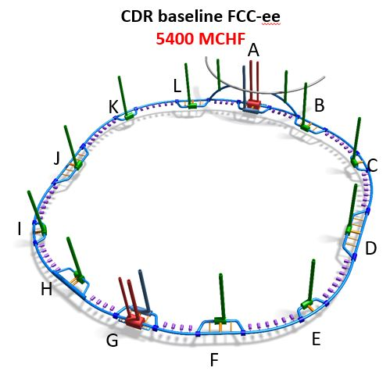
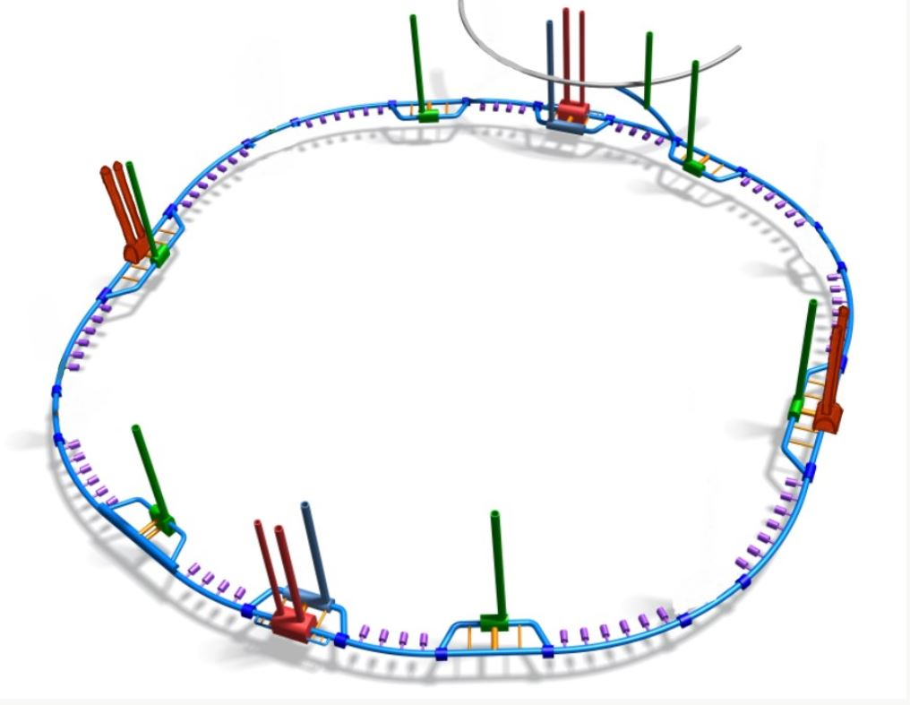
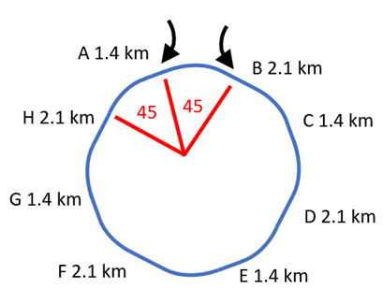
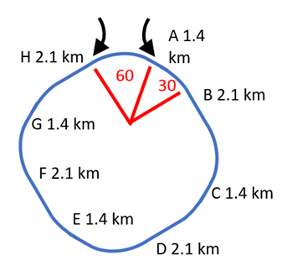
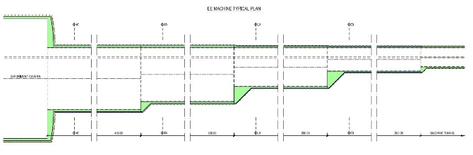
CE Cost estimate for FCC-ee
with 8 access points and 4 IPs
5800 MCHF
Higher cost for CE than the FCC-ee CDR baseline due to the tunnel enlargements at each experimental point and additional shafts and caverns for the experiments.
A
H
B
G
C
F
E
D
injections
injections
FCC-ee 6m ID (8 points, 4IPs (PA+PE, PC+PG), with tunnel enlargements)
arc lengths all identical
SARC ≠ LARC
V. Mertens (CERN)
Largest distance between two points: approx. 12km for 45˚-45˚ option and approx. 16km for 30˚-60˚ option

Slide 20
FCC CE study progress
Footprint exploration (ongoing):
Collaboration with University of Geneva
European Strategy for Particle Physics Update
FCC Rail Mounted Robot arm study
CE cost estimate for FCC-ee with 4IPs and 8 access points

Slide 21


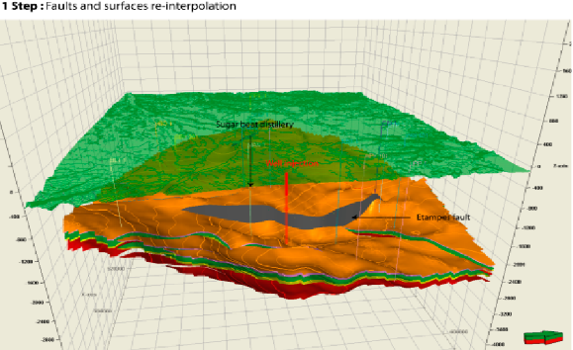


University of Geneva Collaboration
(UNIGE)
UNIGE and CERN to act as research/scientific partners, whereby UNIGE’s expertise and knowledge will be used to assist CERN on FCC technical matters w.r.t. geology and hydrogeology
Establish a database (ArcGIS) in support of the feasibility and execution of FCC CE works (geological data from France and Switzerland, faults, hydrogeology etc)
Develop a consistent 3D geological model which will be continuously updated with new emerging data
Petrel
ArcgisPro
Y. Robert (CERN)

Slide 22
FCC CE study progress
Footprint exploration (ongoing):
Collaboration with University of Geneva
European Strategy for Particle Physics Update
Alignment Review
Workshop
FCC Rail Mounted Robot arm study
CE cost estimate for FCC-ee with 4IPs and 8 access points
High-Risk Areas Site Investigation Study

Slide 23




High-Risk Areas
Site Investigations
ILF/GADZ High Risk Areas SI preliminary study (November 2020 – June 2021)
Input into footprint exploration – Civil Engineering Risks Assessment of the preferred scenarios
Definition of ‘high risk areas’ for the preferred scenario(s)
Propose site investigations in the HRA to reduce the uncertainty of the geological condition
Cost estimates and schedule of the SI in the HRA
Procurement strategy for HRA SI and Main SI
Technical Specifications for the JV and cost estimate and schedule of the JV deliverables
Some seismic and borehole information for lake crossing from proposed road tunnel, but layered nature of lake bed leads to uncertainty.
Reliable borehole data missing.
Information near to CERN is strong due to previous experience on LEP/LHC.
Multiple deep boreholes in the area.
B
Location of the interface between molasse and molasse subalpine not certain, tunnel alignment in proximity.
Alignment close to limestone rockhead
The exact location and angle of the limestone/molasse interface undefined.
A
C
L
D
Moraine/molasse interface not certain, cavern close to interface.
Lack of deep boreholes in area.
Moraine/molasse interface not certain, cavern close to interface.
Proximity to protected area
K
E
No deep borehole information available in the area.
Complex faulted region.
Quality of molasse is uncertain. Large span experimental caverns should be constructed in good molasse.
Molasse/limestone interface not certain.
J
Limestone formation known, but characteristics and locations of karsts unknown.
F
I
G
H
Lake Geneva
Vallée de l‘Arve
Mandallaz
Le Rhône

Slide 24




CE Pre-construction schedule
Geophysical Survey
Exploration Drillings
Market Survey/Tender for a joint venture consortium (“The JV”) between a general consultant/ geotechnical/ geologist experts will have a mandate to :
  prepare the very detailed technical specifications and tender documents to procure contractors to do all site investigations
  Supervise the works on site
  produce factual and interpretive reports further to the testing
  given the results of the site investigations, provide reports on the suitability of the geology for the siting of the machine/caverns and plan the main site investigations

Slide 25
Next steps for FCC civil engineering
Site Investigation in ‘High Risk Areas’
Market Survey for SI consultants will be issued in April 2021.
On-site investigation works in 2023/24
At the same time tunnel alignment optimisation is on-going looking both at situation on surface and underground
Construction strategy/methods will be adapted to take account of any alignment changes and any new geological data
John Osborne CERN – LCWS2021

