Slide 1
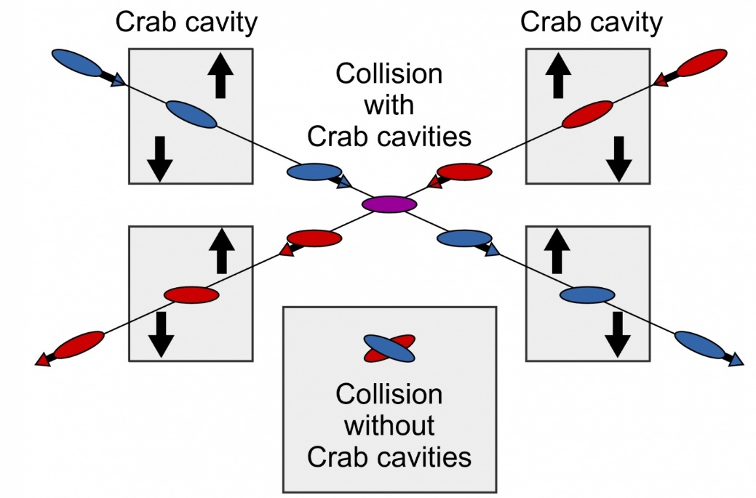

WP-3: Summary of Crab Cavity Workshop
Peter McIntosh,
UKRI-STFC Daresbury Laboratory
LCWS2021
15th -18th March 2021

Slide 2
Overview
ILC Crab Cavity (CC) Requirements
ILC Technical Preparation (Pre-Lab)
Crab Cavity Workshop
Workshop Discussion/Questions
Conclusions

Slide 3
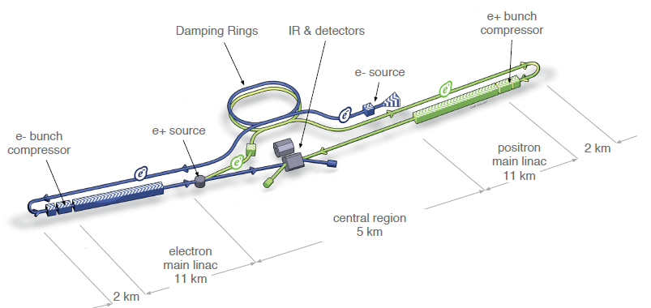
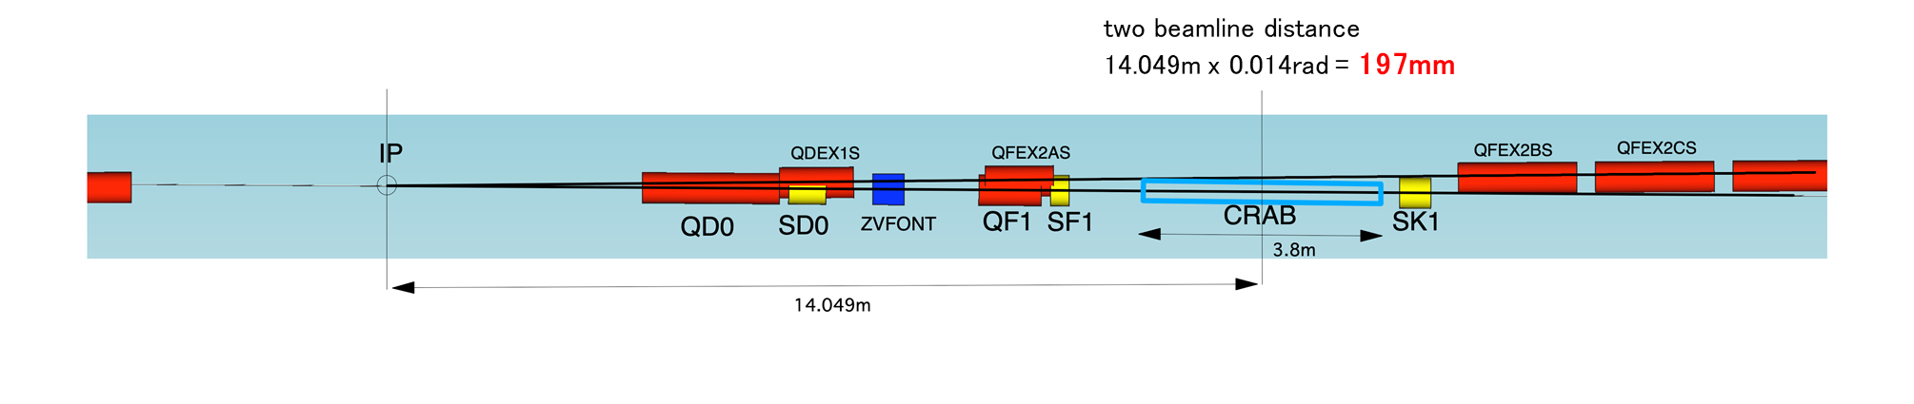

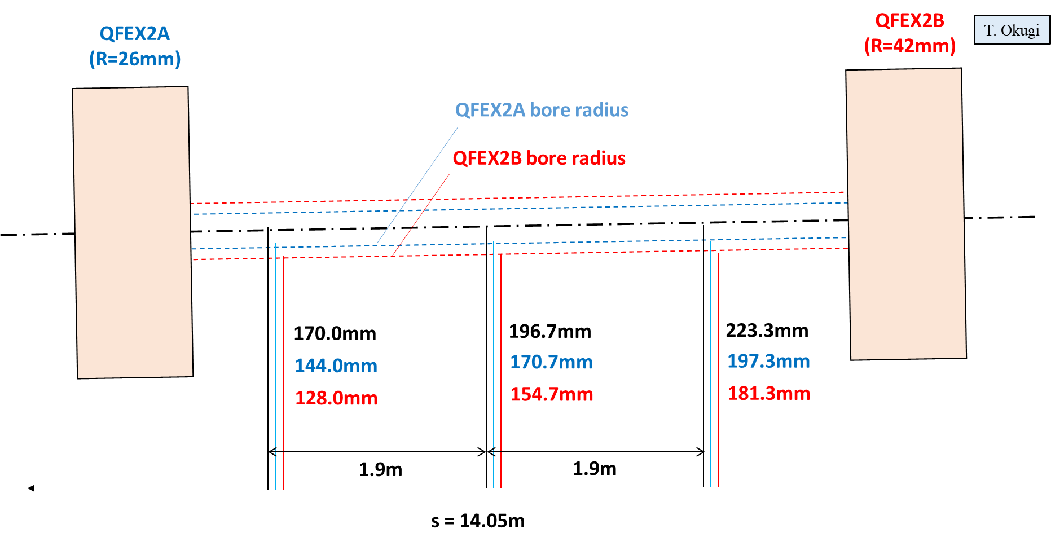
ILC Crab Cavity (CC) Requirements
ILC RDR parameter, by CAIN simulation
CC system is indispensable for ILC:
  Luminosity reduced by 80% without CCs!
No development progress since TDR (2013).
Further development required (Nomura Research Institute, Ltd. considered CC as not-matured technology):
  During the technical preparation period (Pre-Lab), prototype CM should be constructed and tested.
Two beamline separation
14.049m x 0.014rad = 197mm
3.8m
14.049m
IDT has provisionally restarted the ILC-CC activity:
  5th Meeting of SRF subgroup including crab kick-off meeting – 24th Nov 2020
  2nd Crab Cavity Meeting as joint meeting of BDS and SRF subgroups – 30th Nov 2020
  Workshop for crab cavity – 18th Feb 2021
S = 14.05 m

Slide 4
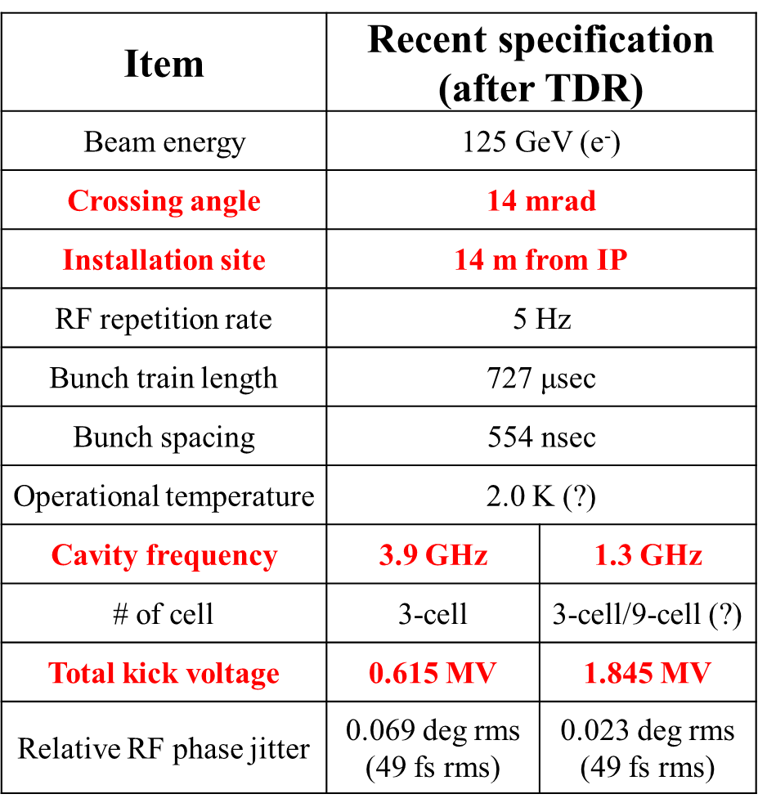
ILC Technical Preparation (Pre-Lab)
WP3 Crab Cavity System
ILC Pre-Lab phase aims to produce and test a prototype CM (pCM) system containing two cavities.
Necessary to demonstrate synchronized operation with two sets of cavities in one pCM.
If installed 14 m from the IP, the beam-pipe for counter-beam extraction will need to pass through the pCM.
The cavity, power coupler, tuner and pCM will be designed and developed.
The pCM containing the two cavities will be assembled.
In final year, a synchronized operation with two CC’s to be performed to complete the technical demonstration of the CC system.
A collaboration is expected to be formed and the preparation to be advanced mainly abroad (i.e. not based in Japan).

Slide 5
CC Scope for Pre-Lab
 | Work package | Items | Quantity
WP-3 | Crab Cavity (CC) for BDS # CC production: 4 # CC-CM production: 1 | Decision of installation location with cryogenics/RF location accelerator tunnel | −
 |  | Design and development of prototype cavity/coupler/tune/CM including beam extraction line | −
 |  | Cavity production, including cavities w/ He tank + mag. shield for CM, high-pressure gas regulation, EP/HT/Clean work, including VT | 4
 |  | Coupler production including preparation/RF processing readiness (excluding klystron, baking furnace, clean room) | 4
 |  | Tuner production readiness | 4
 |  | CM production including High-pressure gas, vacuum vessel, cold-mass, and assembly (cavity-string, coupler/tuner, SCM, etc.) | 1
 |  | CM test including harmonized operation with two cavities | 1
 |  | CC-CM transport cage and shock damper | 1
 |  | CC-CM transport tests | 1
 |  | Infrastructure for CC and CM development and test (with each regional responsibility.) | −
Note: Above assumes preferred CC solution defined for Pre-Lab.

Slide 6
WP-3: Crab Cavity Workshop: 18th February 2021
Title | Speaker | Lab
Crab Cavity Workshop for ILC - Introduction | Kirk Yamamoto | KEK
UK ILC Crab Design | Graeme Burt | Lancaster University
ILC Crab Cavities, First Thoughts | Rama Calaga | CERN
Crab Cavity R&D Activities at Old Dominion University and Jefferson Lab | Jean Delayen | ODU/JLab
QMIR Deflecting cavity for ILC | Vyacheslav Yakovlev | FNAL
Crab Cavity Effort at BNL | Binping Xiao | BNL
Discussions and Preparation for International Review | ALL
Attendees:
S. Belomestnykh, P. Burrows, G. Burt, R. Calaga, J. Delayen, S. De Silva, D. Delikaris, A. Faus-Golfe, M. Harrison, A. Lankford, N.C. Lasheras, R. Laxdal, T. Luo, T. Markiewicz, P. McIntosh, S. Michizono, T. Nakada, S. Posen, B. Rimmer, K. Umemori, B. Xiao, V. Yakovlev, A. Yamamoto, K. Yamamoto.
Development Groups:
BNL, CERN, FNAL, Jlab, Lancaster University, ODU, SLAC, TRIUMF, UKRI-STFC
https://agenda.linearcollider.org/event/9090/

Slide 7
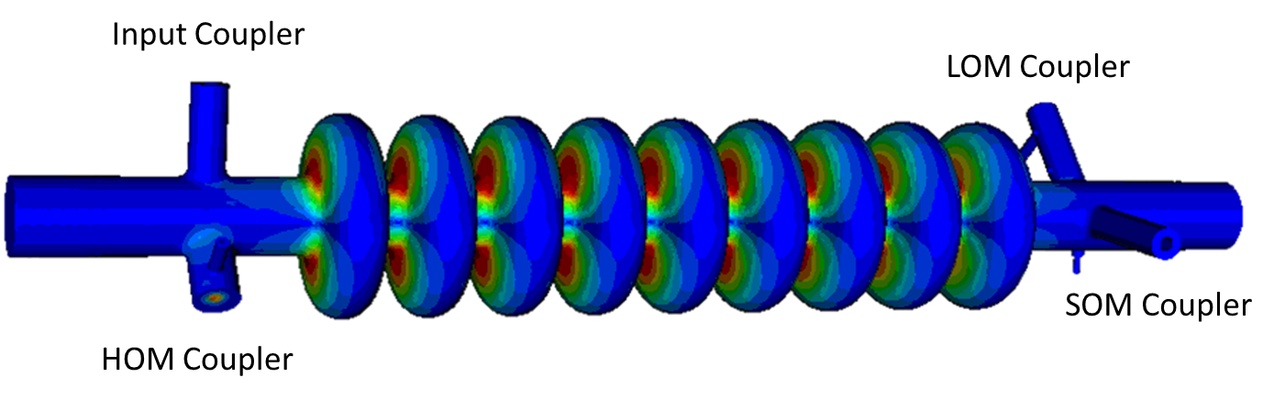
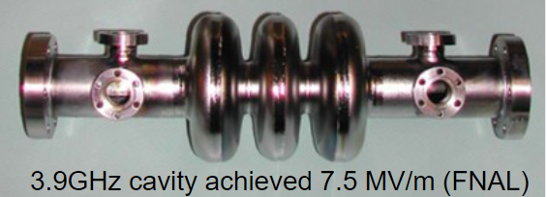
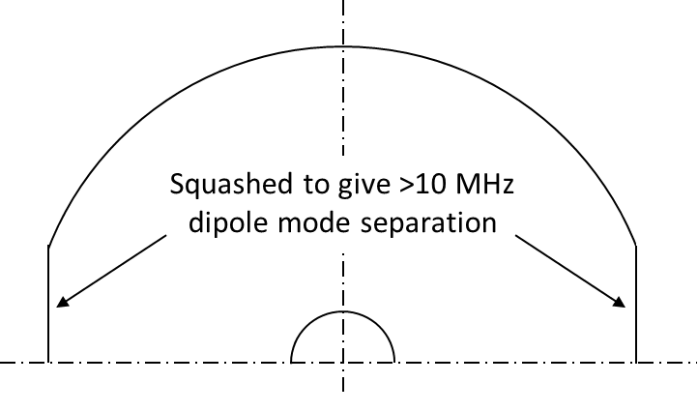




ILC-CC Design (RDR 2008: TDR 2013)
G Burt (Lancaster University)
9-cell 3.9 GHz elliptical
Beam-pipe radius = 18mm
Cavity iris radius = 15mm
Equator Radius = 47.37mm
Crossing angle | 14 mrad
Cavity frequency, GHz | 3.9
Amplitude at 1TeV CoM, MV | 2.6
Max amplitude with operational margin, MV | 4.1
RMS relative phase stability for 2% rms Luminosity drop | 0.094°
RMS amplitude stability for 2% rms Luminosity drop | 6.6%
Horizontal beam clearance, mm | 15
Vertical beam clearance, mm | 10
Allowable X beam jitter at crab cavity, μm | 500
Allowable Y beam jitter at crab cavity, μm | 35
Nb: Larger polarisation separation feasible with racetrack solution.

Slide 8
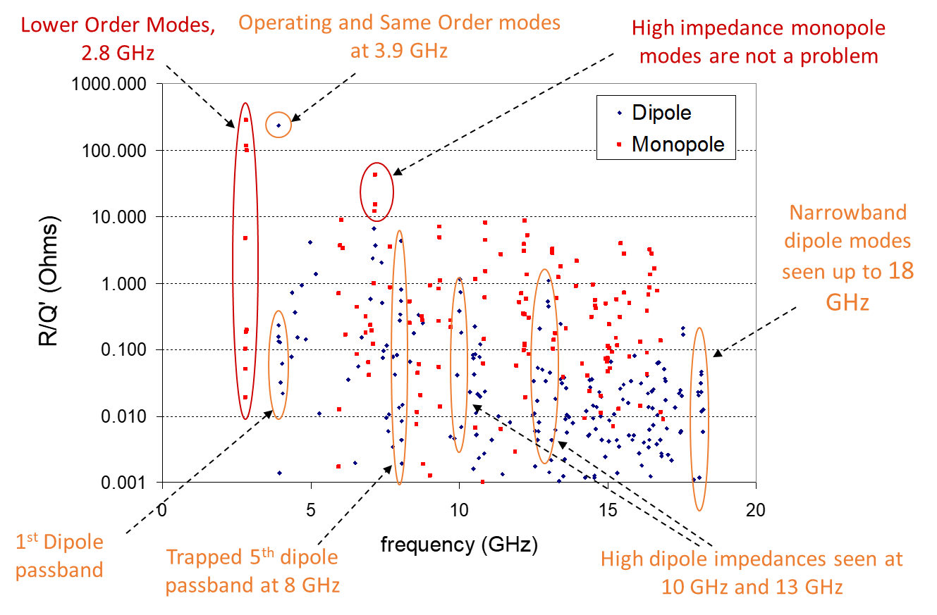
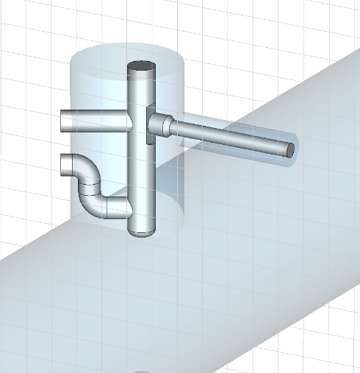
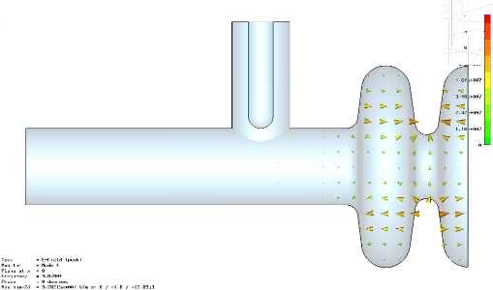
Modal Calculations in MAFIA
G Burt (Lancaster University)
HOM
SOM
LOM

Slide 9
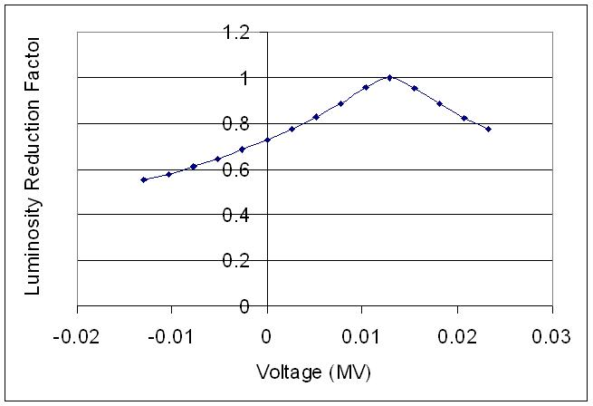
Cavity Alignment (Anti-crabbing)
G Burt (Lancaster University)
As we vary the anti-crab cavity voltage we can see the luminosity increasing back to the optimum value. 100% of the luminosity can be recovered in this way.
If the cavity has a roll misalignment it will cause a small crossing angle in the vertical plane.
This will significantly reduce the luminosity.
As we only require 10’s kV this can be performed with a normal conducting cavity.

Slide 10
ODU/Jlab RF Dipole (RFD) Developments
J Delayen (ODU/Jlab)

Slide 11
RFD Cavity Tests
J Delayen (ODU/Jlab)
400 MHz HL-LHC
499 MHz Jlab Upgrade
750 MHz Jlab MEIC

Slide 13
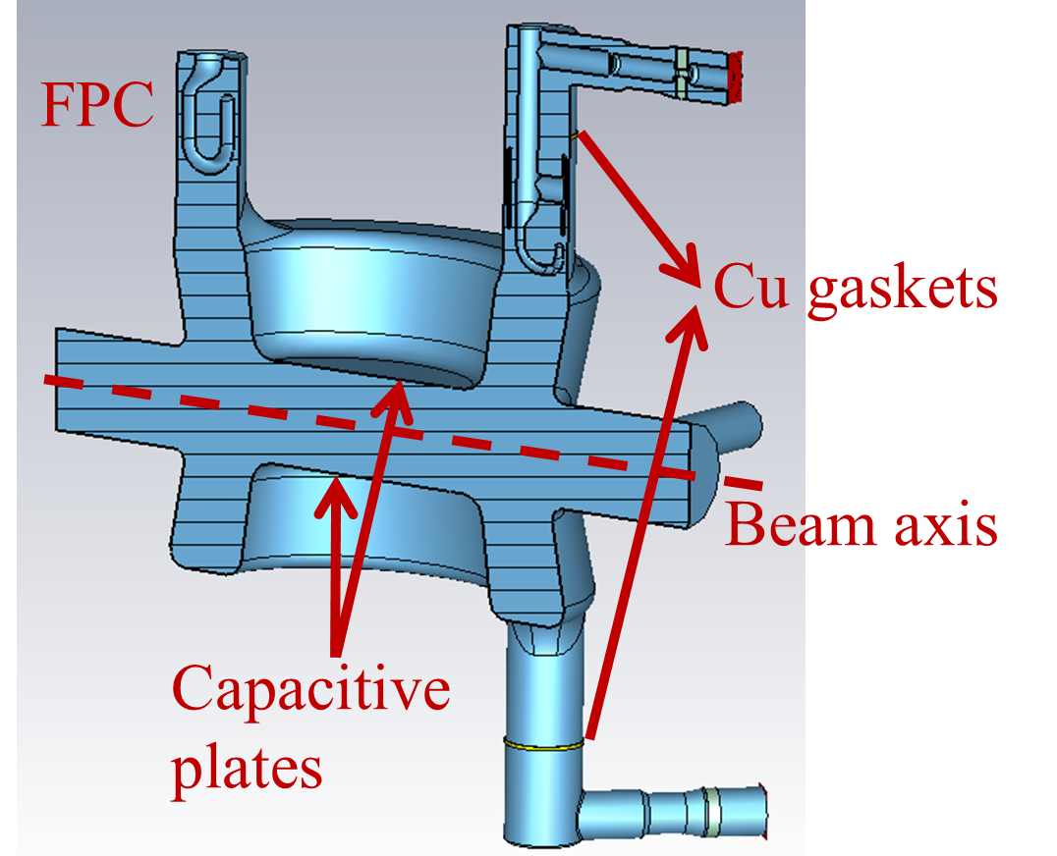
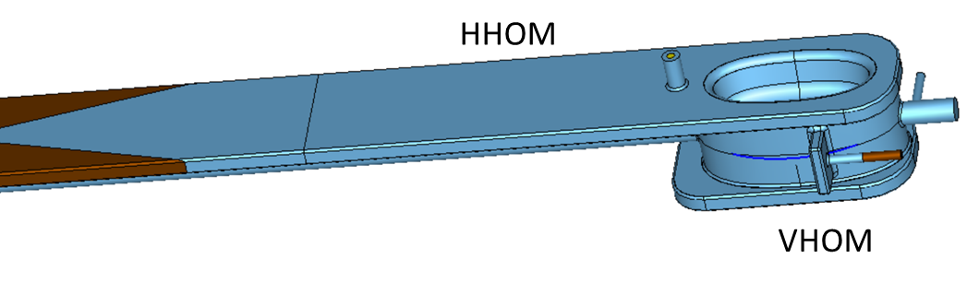
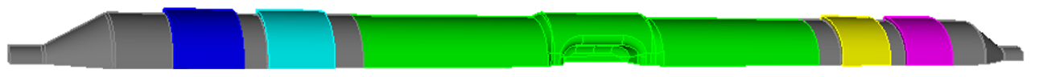
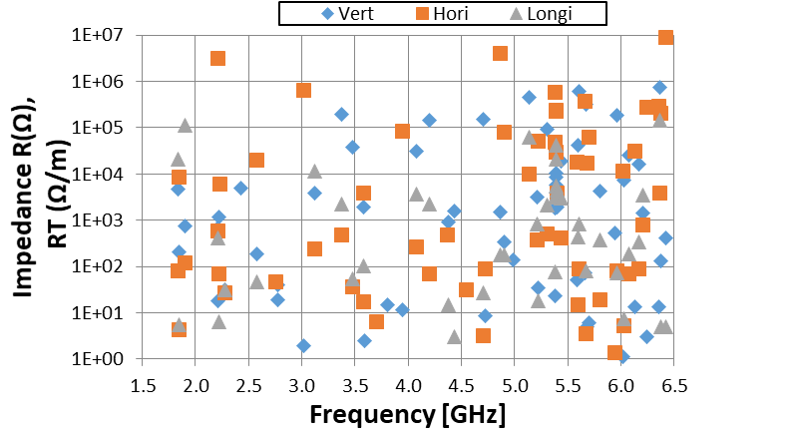
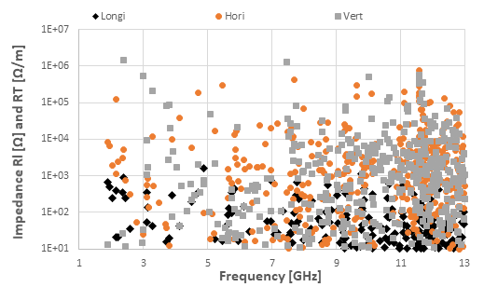
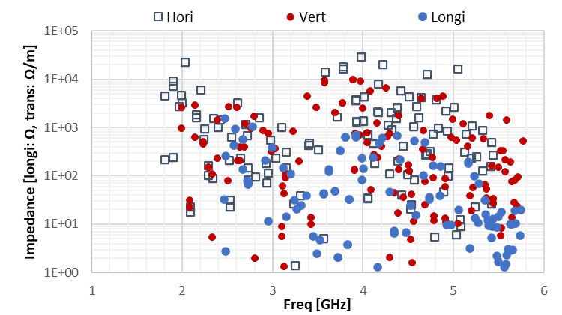
BNL CCs Scaled for ILC at 1.3 GHz
B Xiao (BNL)
Double Quarter Wave (DQW)
Wide Open Waveguide (WOW)
 | LHC DQW | EIC DQW | EIC WOW
Couplers | 3 x coax (with filter) | 1 x waveguide 1 x rect/coax | 2 x SiC beampipe
ID Beam Pipe (mm) | 25.8 | 15.2 (too small) | 30.3
V_{t} (MV) | 1.15 | 2 | 1.27
E_{p} (MV/m) | 41.3 | 51.6 | 50.4
B_{p} (mT) | 80 | 80 | 80
Max Long Imp (MΩ) | 0.12 | 0.0016 | 0.0015
Max Trans Imp (MΩ/m) | 8.8 | 1.5 | 0.029
LHC DQW
EIC DQW
EIC WOW (BNL/SLAC)

Slide 14
Quasi-Waveguide Multicell Deflecting Resonator (QMiR)
V Yakovlev (FNAL)
Freq | 2815 MHz
V_{kick} | 2 MV
E_{max} | 54 MV/m
B_{max} | 75 mT
(R/Q)_{Y} | 521 Ω
G | 130
Q_{ext} | 5.3E5
P_{out} | 7.2 kW
Length (excl SiC absorbers) | 0.45 m
ANL/SPX:
No HOMs above cut off (5.2 GHz for monopoles and 4.2 GHz for dipoles).
High (R/Q)_{t}
Small loss factor, k// = 0.7 V/pC for σ_{z} = 10 mm.
No MP up to 3 MV.
No issues with thermal breakdown.
Note that “circuit” impedance definitions are used.
A. Lunin, I. Gonin, M. Awida, t. Khabiboulline, V. Yakovlev, A. Zholents, Physics Procedia 79 ( 2015) 54 –62

Slide 15
QMiR SOM/HOM Management
Same Order Mode (SOM)
Higher Order Modes (Monopole)

Slide 16
QMiR Scaled for ILC
V Yakovlev (FNAL)
Loss Factor:
k// ~ 1/ σ and for σ = 0.3mm, k// = 45 V/pC or ~3 W radiated power
Dissipated in beam channel, not in the cavity itself (50% each direction) – Not an issue!
Cryo Losses:
At 2K for N2-doped cavity would expect:
  2.6 GHz @ 0.135 MV: R_{s} = 30 nΩ, P_{c} = 0.6 mW
  3.9 GHz @ 0.9 MV: R_{s} = 68 n Ω, P_{c} = 0.6 mW
Surface Fields:
For 2.8 GHz @ 0.9 MV, E_{p} = 25 MV/m and B_{p} = 35 mT
Expect 3.9 GHz to be similar; as V~1/f and gap ~f (expect to be wider gap).
Poles to be profiled for optimum EM-field parameters (known procedure)
Kick Factor:
For ANL/SPX QMIR k_{t} = 0.5 V/pC/m; so for a 1 mm displacement, vertical kick ~ 1.6 V – Negligible
RF Power:
For ILC: I_{b} of 5.8 mA and offset x = 1 mm, deflecting voltage (V) power P_{g} = 2(kx)VI_{b} = 300 W
}
Not an issue!

Slide 17







HL-LHC CC Global Collaboration
Cavities
Cryomodules

Slide 18
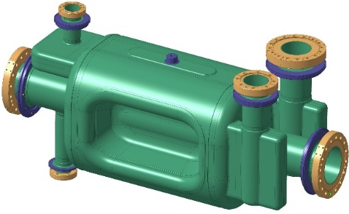
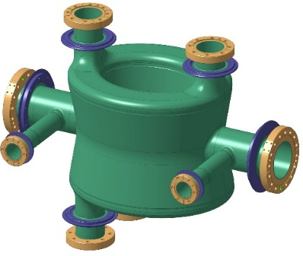
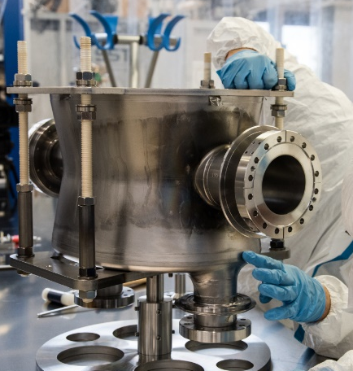
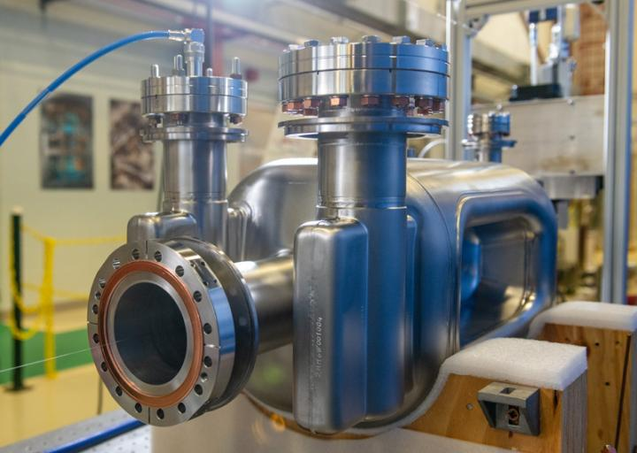
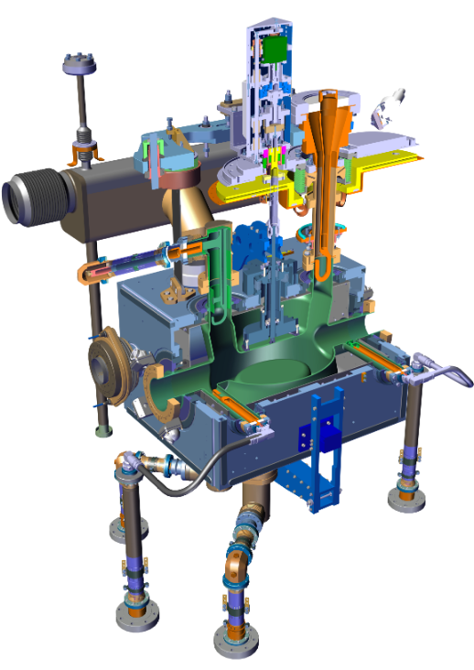
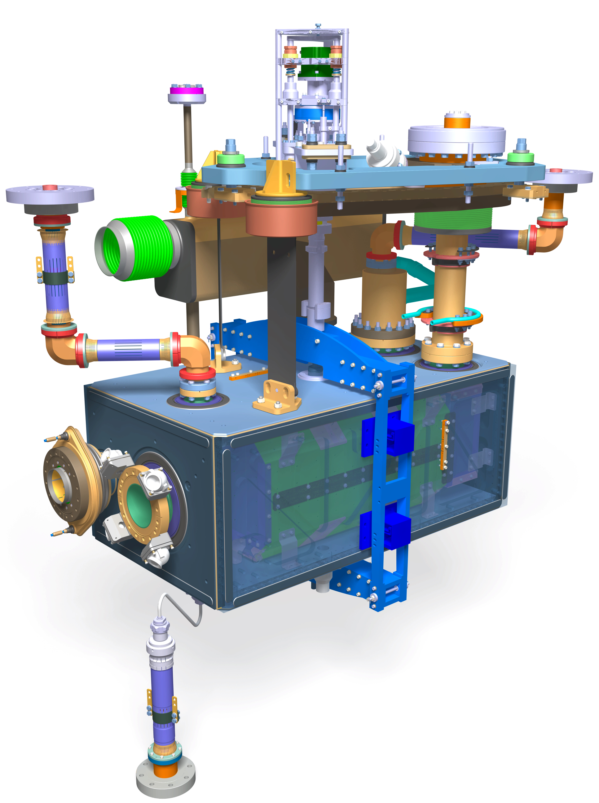
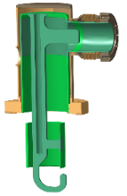
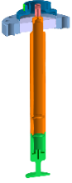
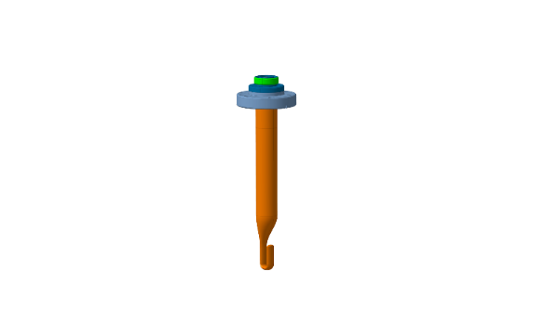
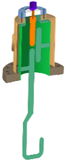
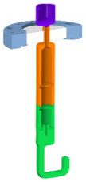
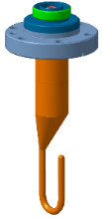
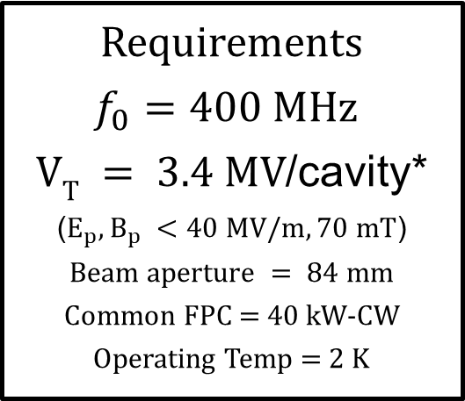
HL-LHC Crab Cavities (DQW and RFD)
R Calaga (CERN)
DQW (V-ATLAS)
(up to to 6 MV)
RFD (H-CMS)
(up to 7 MV)
Requirements
$f_{0}=400 MHz$
$VT = 3.4 MV$/cavity*
($E_{p}, B_{p} <40 MV/m, 70 mT$)
$$Beam aperture = 84 mm$$
Common FPC = 40 kW-CW
Operating Temp = 2 K
Both cavities use 2K cryperm magnetic shield inside helium jacket

Slide 19
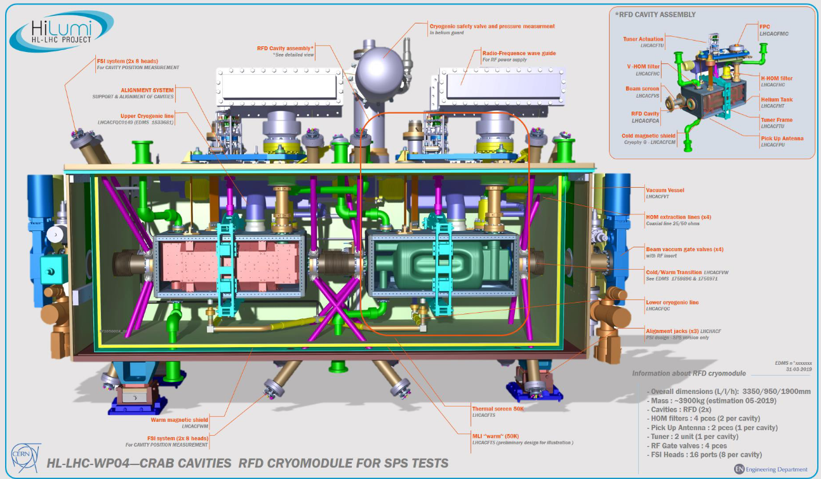
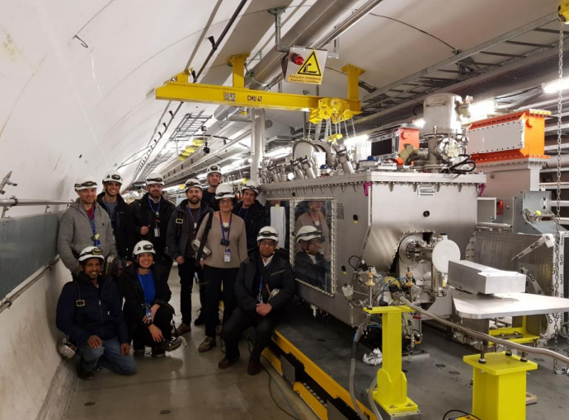
HL-LHC Crab Cavity Cryomodule (RFD)
R Calaga (CERN)
Length ~ 3m
DQW CM test in SPS (2018)
HOM lines (green), alignment (magenta)

Slide 20
ILC CC Workshop Discussion/Questions
BDS Implications for the various CC technology and frequency options:
Expected noise sources.
IR optics configuration and impact on CC’s.
Beam dynamics impacts; bunch-by-bunch, bunch trains etc.
Luminosity performance and expected tolerances - cavity roll and appropriate mitigation.
CC Solution:
HOM damping and impedance requirements.
Manufacturing simplification by direct machining from Nb ingot.
Cryomodule integration options – main linac compatible or top-loaded (i.e. HL-LHC).
Energy upgrade provisions, impact on 250Gev CC solution – space, modularisation etc
Pre-Lab Planning:
R&D, prototyping and CC down-selection process – how/when.
Collective contributions and expectations for Pre-Lab activities.
Realistic scope, timescales and responsibilities for the Pre-Lab phase.
}
Refined CC specifications?
Discussion points for next session!

Slide 21
Conclusions
Various CC technology solutions feasible for ILC:
  Elliptical – ILC (RDR and TDR)
  DQW – EIC, HL-LHC
  RFD – EIC, HL-LHC, Jlab Upgrade, JLEIC and MEIC
  QMiR – SPX
  WOW – EIC
Significant alternative CC developments since ILC TDR in 2013.
Must note that the CC system is not as ‘mature’ as the Main Linac.
A number of organisations identified as potential collaborators for ILC Pre-Lab phase for CC system developments.
HL-LHC demonstrates highly effective collaborative approach for global CC technology development (SPS CC CM R&D and test 2018):
  BNL, CERN, FNAL, Lancaster University, ODU/Jlab, SLAC, TRIUMF and UKRI-STFC.
ILC Pre-Lab has a strong possibility to follow this successful realisation!

Slide 22
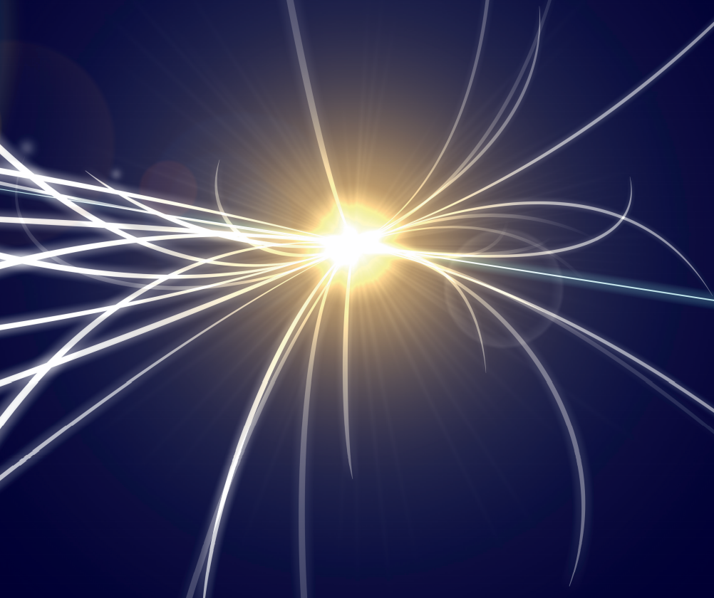

MANY THANKS
Questions?

