Slide 1
Annealing R&D at FNAL
Daniel Bafia
LCWS’21
17th March 2021

Slide 2
Outline
Introduction
High Temperature N-Doping (>800C)
Low Temperature in-situ bake (90-200C)
Mid Temperature in-situ bake (200-400C)
Conclusions & Future Work

Slide 3
Outline
Introduction
High Temperature N-Doping (>800C)
Low Temperature in-situ bake (90-200C)
Mid Temperature in-situ bake (200-400C)
Conclusions & Future Work

Slide 4
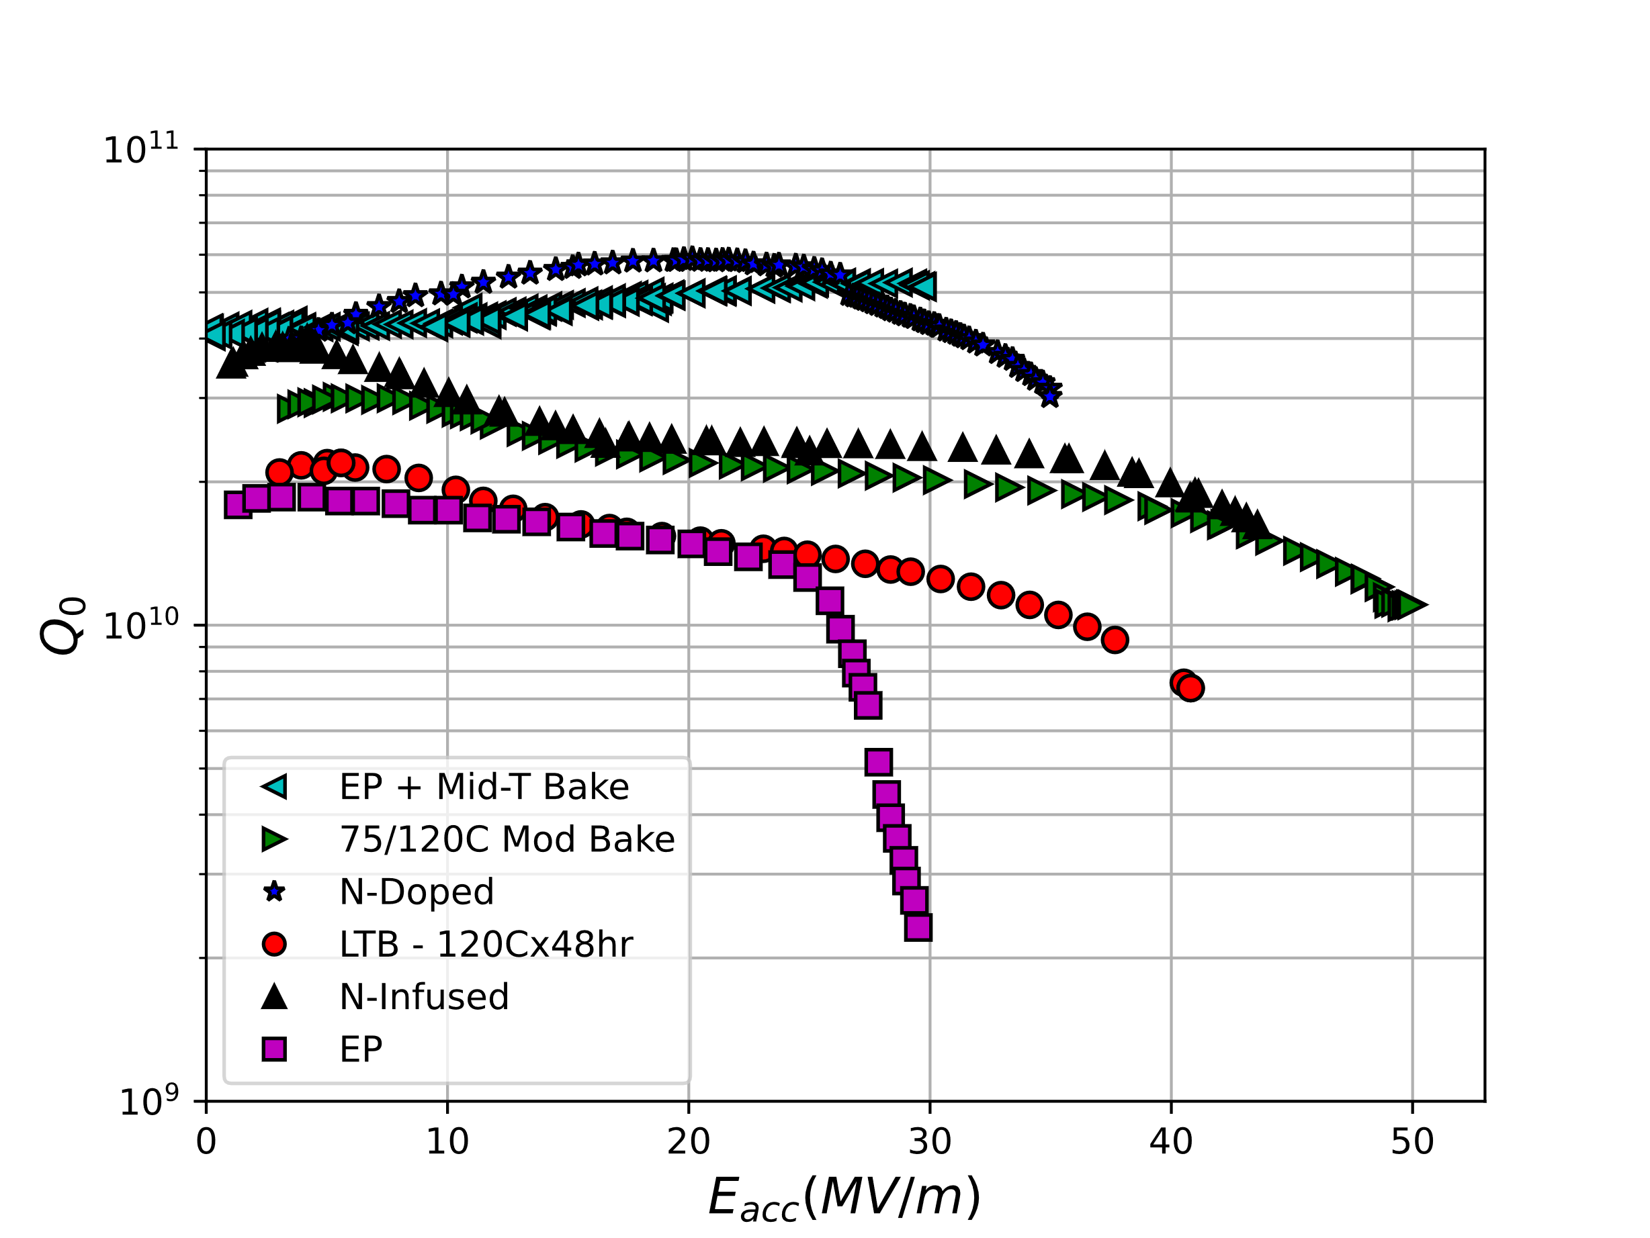
State-of-the-art in High Q₀ and High G
Dramatic increase in performance of Nb SRF cavities in recent years
N-Doping: Q₀>3e10 @ 38 MV/m
Mid-T Bake: Q₀>4E11 @ T<1.5 K!
75/120C ‘Modified’ Low T bake: record quench >50 MV/m (213mT)
Lessons learned on drivers for high Q₀ and High G
What limits quench in high Q₀ cavities?
What ‘heals’ HFQS post LTB?
What enables ultra-high gradients?
Mid-T Bake
N-doped
75/120C Mod Bake
LTB
EP
T = 2 K
f₀ = 1.3 GHz

Slide 5
Outline
Introduction
High Temperature N-Doping (>800C)
Low Temperature in-situ bake (90-200C)
Mid Temperature in-situ bake (200-400C)
Conclusions & Future Work

Slide 6
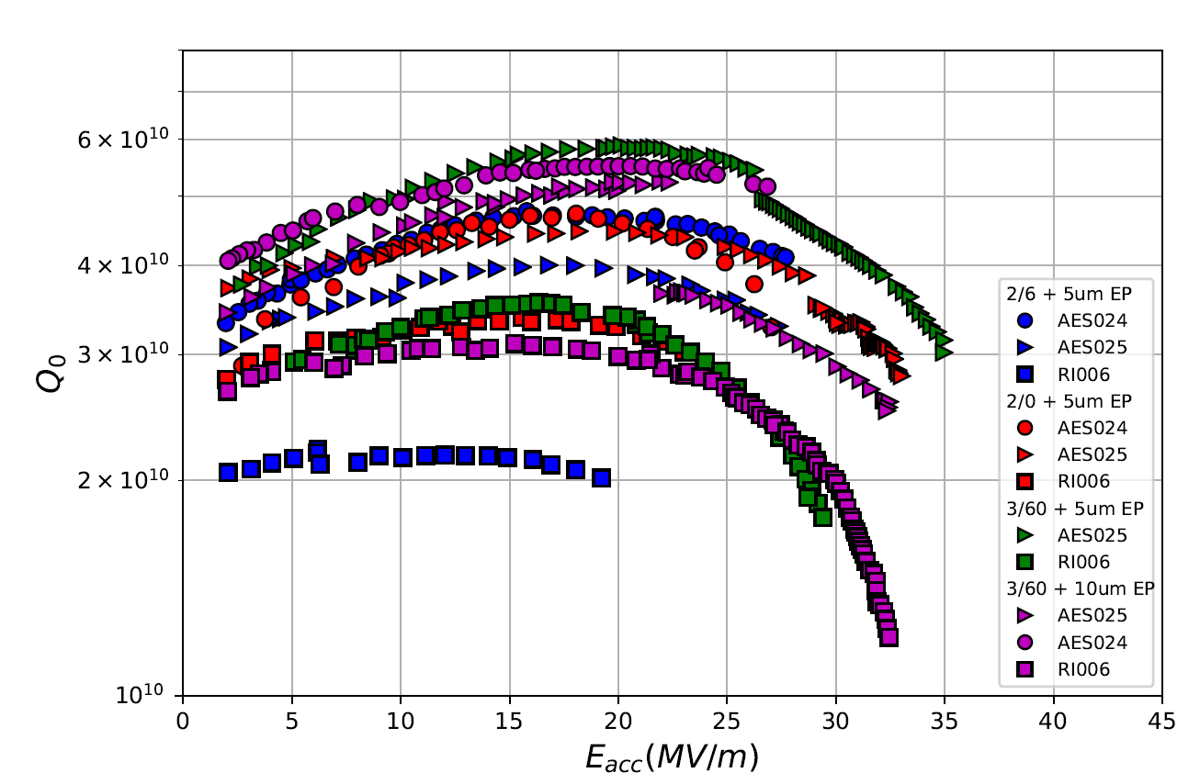
Our Current Stand in High T N-Doping Quench Fields
Achievable quench field has evolved: 17 – 20 MV/m [2013]
➔ 30 – 38 MV/m [today]
2013 N-Doping Performance, Single Cells
2021 N-Doping Performance, Single Cells
T = 2 K
f₀ =1.3 GHz
D. Bafia et al., SRF’19
Improvements enabled by tweaking the doping ‘recipes’ But what drives quench in N-doped cavities?
T = 2 K
f₀ =1.3 GHz

Slide 7
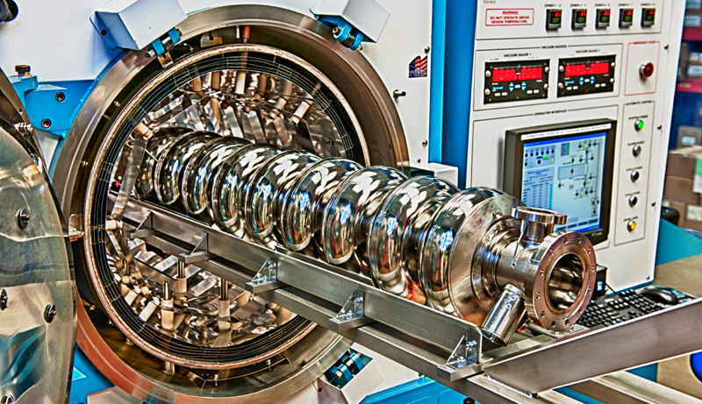
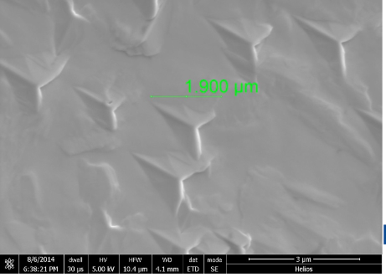

Key Knobs in Nitrogen Doping
800C N₂
p = 25 mTorr XX minutes
800C UHV, XX hours
800C N₂
p = 25 mTorr XX minutes
800C UHV, XX minutes
800C UHV, XX minutes
UHV cooling
UHV cooling
XX um EP
XX um EP
Depth Profile of Nitrogen Impurities
Final RF Surface
Nb_{x}N_{y}
Nb
2/6
Different recipes =
different N concentrations =
different performance
2/0
N₂
N Interstitial
Y. Trenikhina et al, Proc. of SRF 2015
N
A. Grassellino, SRF 2019
Slides adapted from M. Martinello

Slide 8
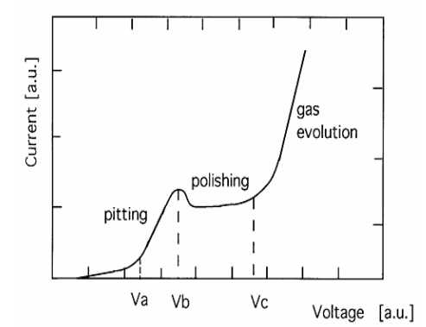
Possible Cause for Quench in Doped Cavities: Surface Roughness
I-V Curve for EP
One possible origin of quench in N-doped cavities may stem from surface roughness present after the final EP
Typically optimize EP using clean, bulk Nb
However, cavities have a heavily nitrided surface after the N-doping furnace run → substantially altered chemical potential
  → Shifts electropolishing to the etching/pitting regime
May create rough surface; preferential etching at some grains?
V. Palmieri, SRF’03
SEM Images of FNAL N-Doped 9-Cell Cavity Cutout
One possible fix: by lowering electrolyte temperature, may slow down removal, remain in polishing regime, and produce a smoother surface
Rough, recessed grains

Slide 9
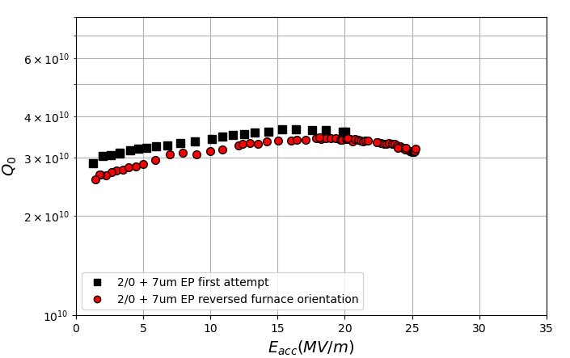
Investigating Quench Field Post Standard vs Cold EP
A 9-cell cavity was subjected to the 2/0 nitrogen doping surface treatment with different final EP temperatures at FNAL with a surface reset in between
Standard temperature EP:
Quench at 20 MV/m
Quench at 25 MV/m
T=2 K
f₀ = 1.3 GHz

Slide 10
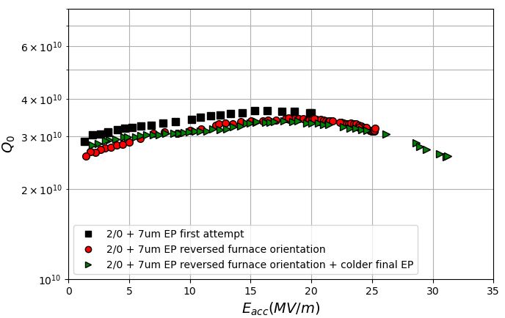
Investigating Quench Field Post Standard vs Cold EP
A 9-cell cavity was subjected to the 2/0 nitrogen doping surface treatment with different final EP temperatures at FNAL with a surface reset in between
Standard temperature EP:
Quench at 20 MV/m
Quench at 25 MV/m
Cold EP:
Quench at 32 MV/m!
T=2 K
f₀ = 1.3 GHz

Slide 11
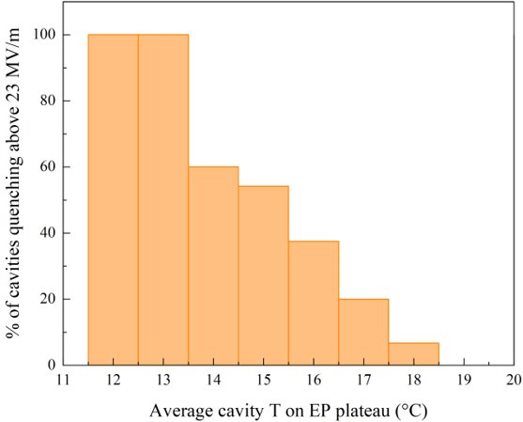
A Possible Path for Higher Fields in N-Doped Cavities: Cold EP
Qual. Threshold: 23 MV/m
M. Checchin, TTC’2020, CERN
The lower the EP temperature, the higher the max gradient
In the context of LCLS-II HE R&D, found that 9-cell cavities with lower final EP temperatures quenched at higher fields!
Cold final EP may slow down Nb etching, ensures a smoother surface

Slide 12
Conclusions for High Temperature N-Doping
Although all steps of N-doping are important, optimization of electropolishing parameters is critical to unlock higher gradients
Performing the final electropolishing step post the N-doping furnace run at lower temperatures likely slows down the removal process and ensures a smoother surface

Slide 13
Outline
Introduction
High Temperature N-Doping (>800C)
Low Temperature in-situ bake (90-200C)
Mid Temperature in-situ bake (200-400C)
Conclusions & Future Work

Slide 14
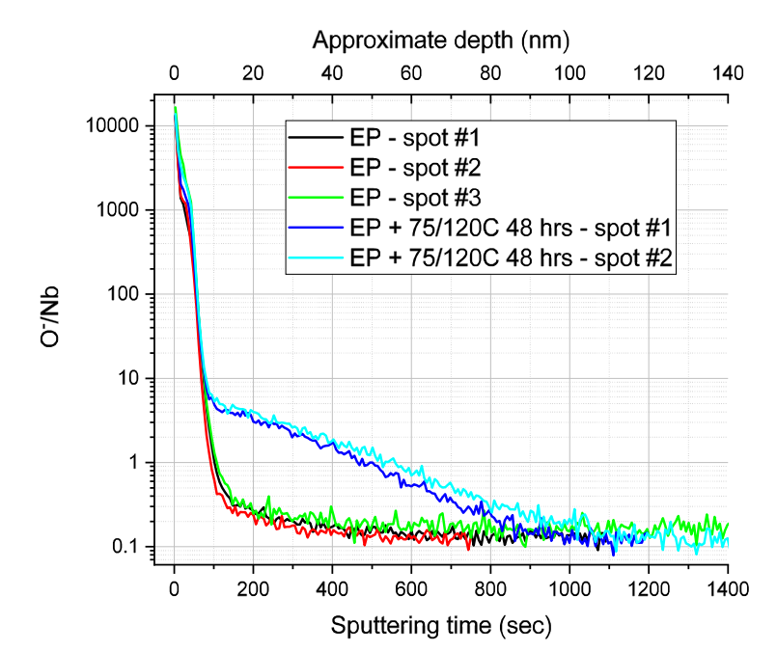
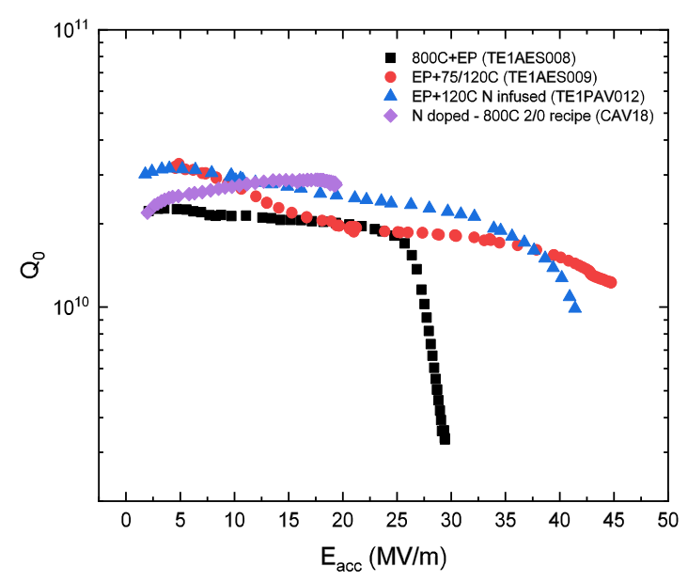
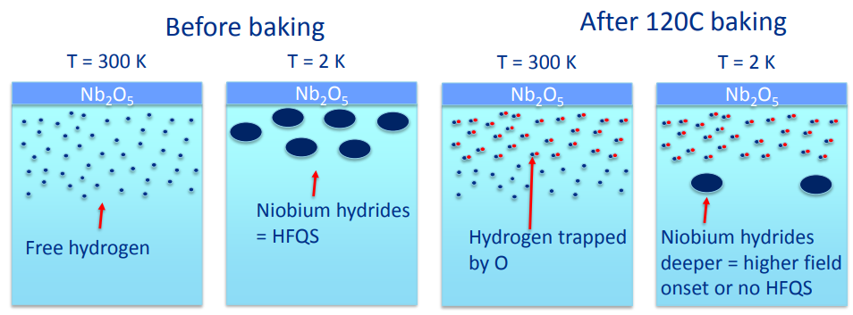
Finding #1: Role of Oxygen in HFQS Mitigation/Mild Baking
Cut out TOF-SIMS studies revealed oxygen diffusion as a driver for the 120C baking effect
EP cavity: no O⁻ signal beneath oxide
Mod bake: substantial O⁻ below oxide
  O diffusion in Nb follows Fick’s law, Benvenuti, SRF’01
T = 2 K
f₀ =1.3 GHz
Mod bake
EP
A. Romanenko, TTC’20, CERN
Implications: HFQS in SRF cavities is mitigated by O diffusing from oxide and trapping free H
Any LTB should mitigate HFQS, not just 120C

Slide 15
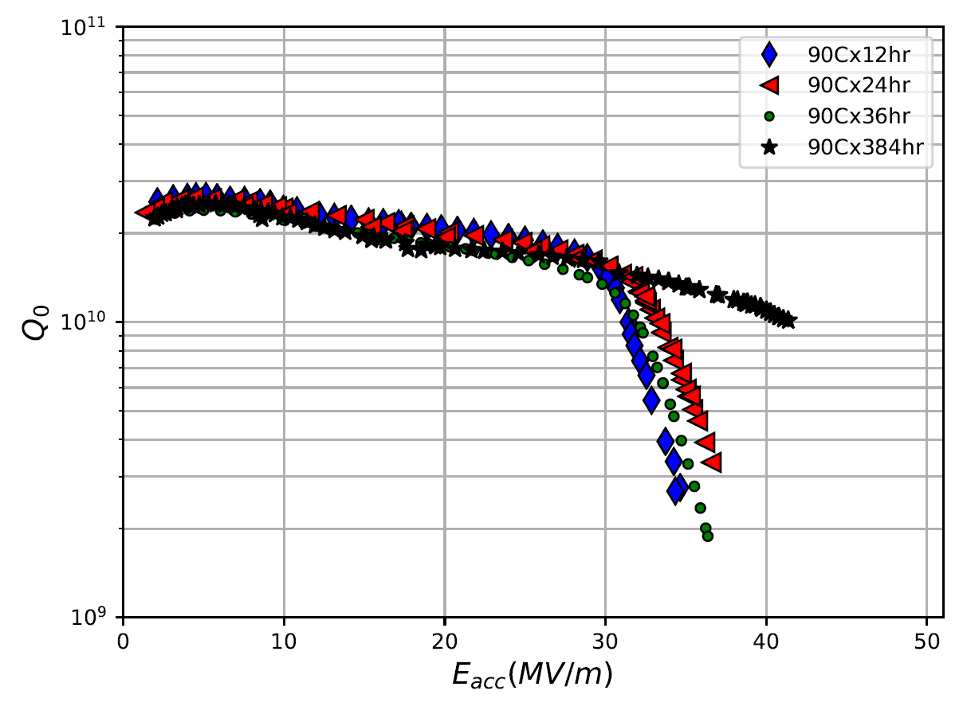
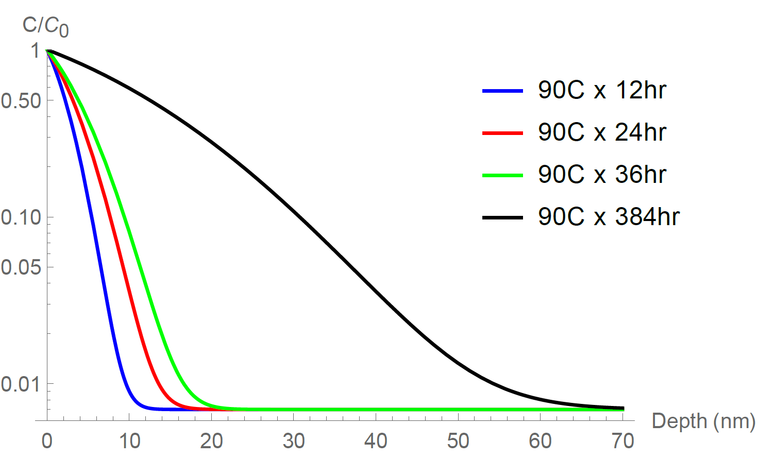
Evolution of HFQS with Sequential in-situ Baking Treatments
A cavity was sequentially baked in-situ at 90C (x 12hr, x 24hr, etc.) without disassembly/ever losing vacuum
Observe gradual increase in HFQS onset after each step
HFQS absent up to quench after 90C x 384 hr (16 days)!
Calculated O concentration with depth after each step
  As oxygen diffuses deeper, HFQS moves up in field
HFQS eliminated after 90 C x 16 days!
Calculated O Profile
T = 2 K
f₀ =1.3 GHz

Slide 16
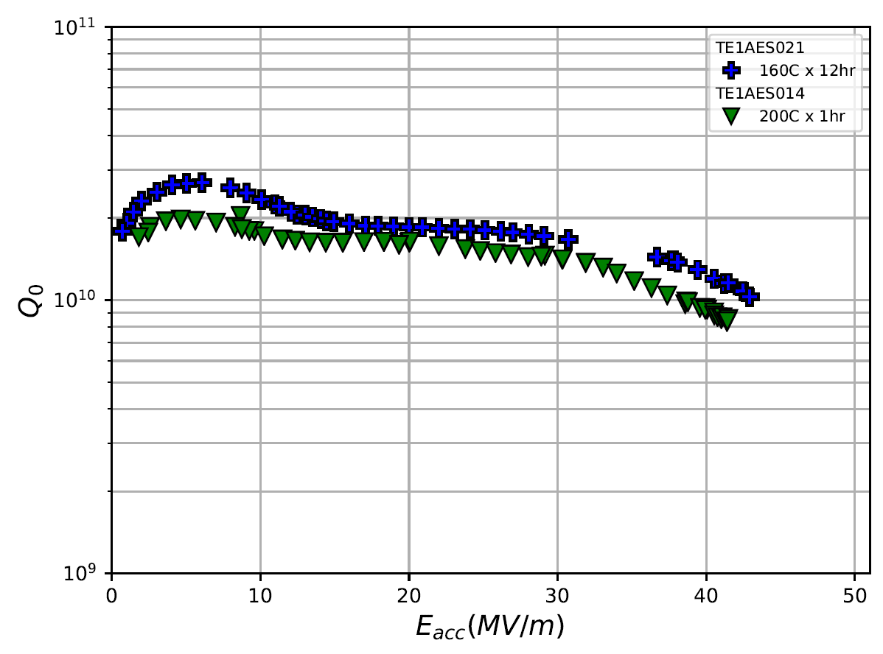
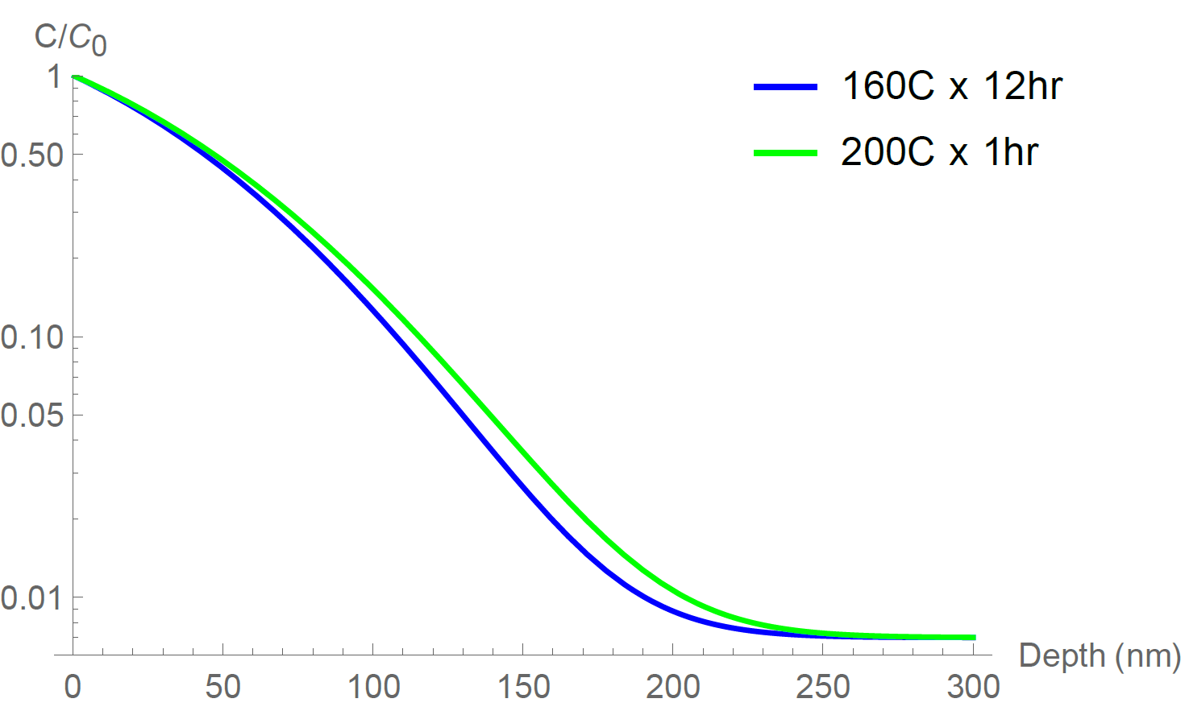
Recreating Performance by Tailoring Same O Profile
Baked two cavities with different treatments that produce the same oxygen profile with depth
160C x 12hr
200C x 1hr
90 C x 384 hr, 160 C x 12 hr, 200 C x 1 hr all work just as well as 120 C!
O diffusion plays critical role in HFQS mitigation - supports Romanenko model of hydrides
Calculated O Profile
Identical oxygen profiles produce identical RF performance!
T = 2 K
f₀ =1.3 GHz

Slide 17
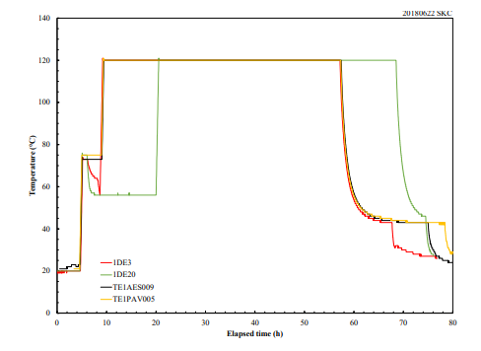
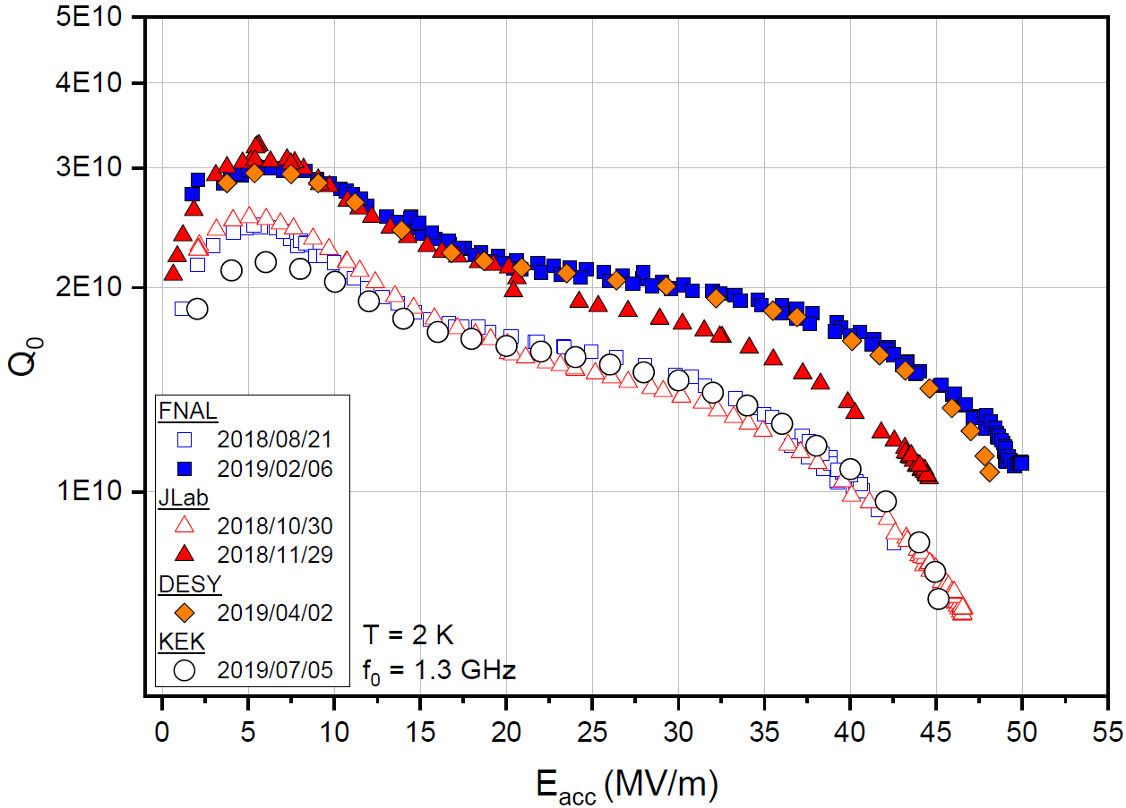
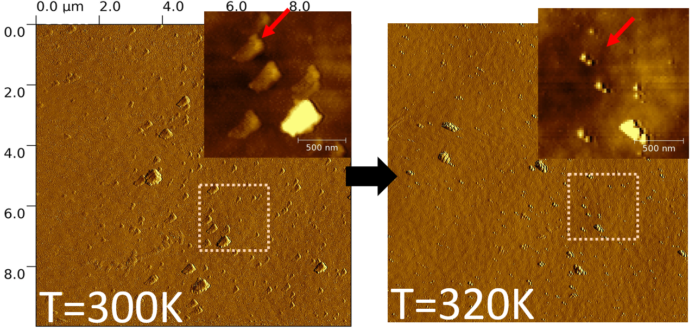
Finding #2: Record Gradients via 75/120C Bake + Cold EP
FNAL developed 75/120C modified low T bake treatment + cold EP:
1) Record-breaking quench fields
2) Bifurcation phenomenon
Produces two phenomena
120C x 48hrs
- growth and dissipation of room
temperature Nb nano-hydrides
75C x 4hrs
Cavity Post 75/120C Baking at FNAL Sent to Other Labs Around the World
See talk by Sam Posen from Monday of this conference for application of this treatment in a prototype High Gradient Cryomodule for ILC!
50 MV/m!
AFM studies by Z. Sung et al., SRF’19
D. Bafia et al., SRF’19

Slide 18
Conclusions for Low Temperature Baking
The diffusion of oxygen in low temperature (90C – 200C) in-situ baking is responsible for the mitigation of high field Q slope and enables higher quench fields in cavities
Record-breaking gradients achieved via 75/120C modified low temperature baking + cold EP

Slide 19
Outline
Introduction
High Temperature N-Doping (>800C)
Low Temperature in-situ bake (90-200C)
Mid Temperature in-situ bake (200-400C)
Conclusions & Future Work

Slide 20
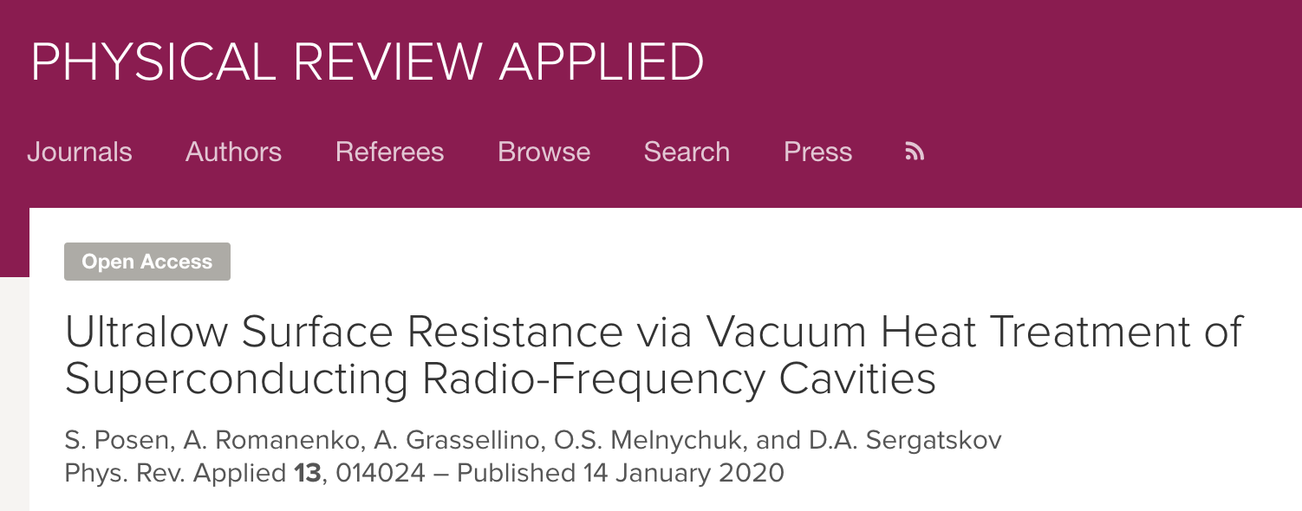
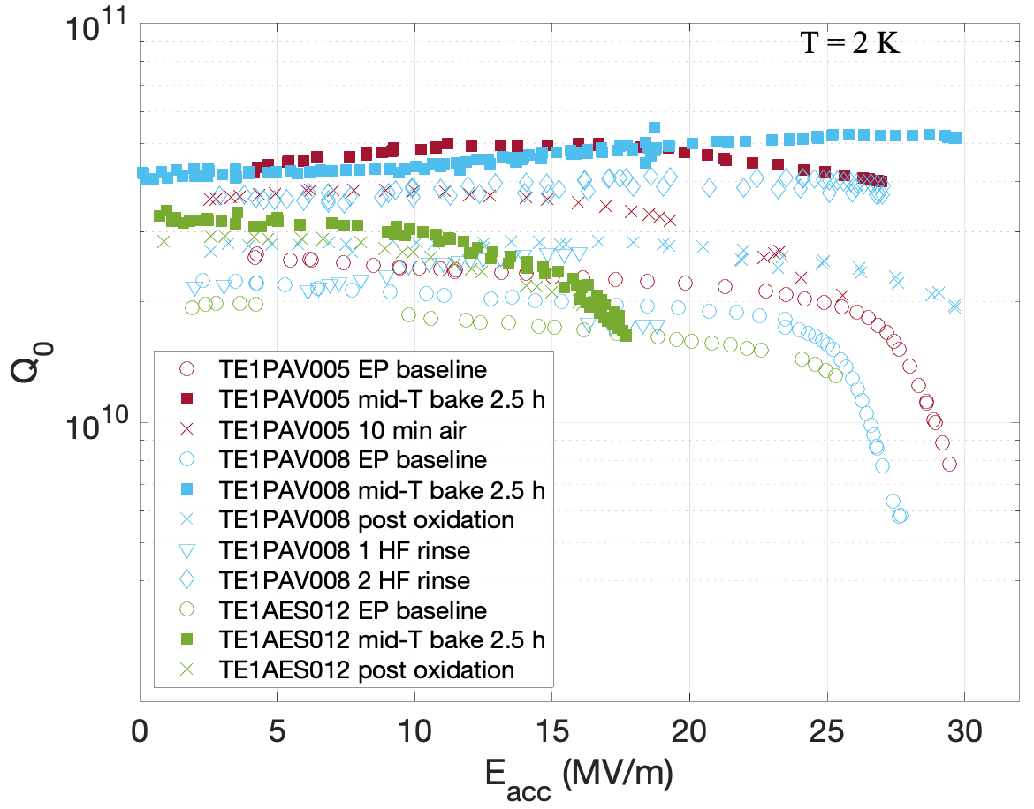
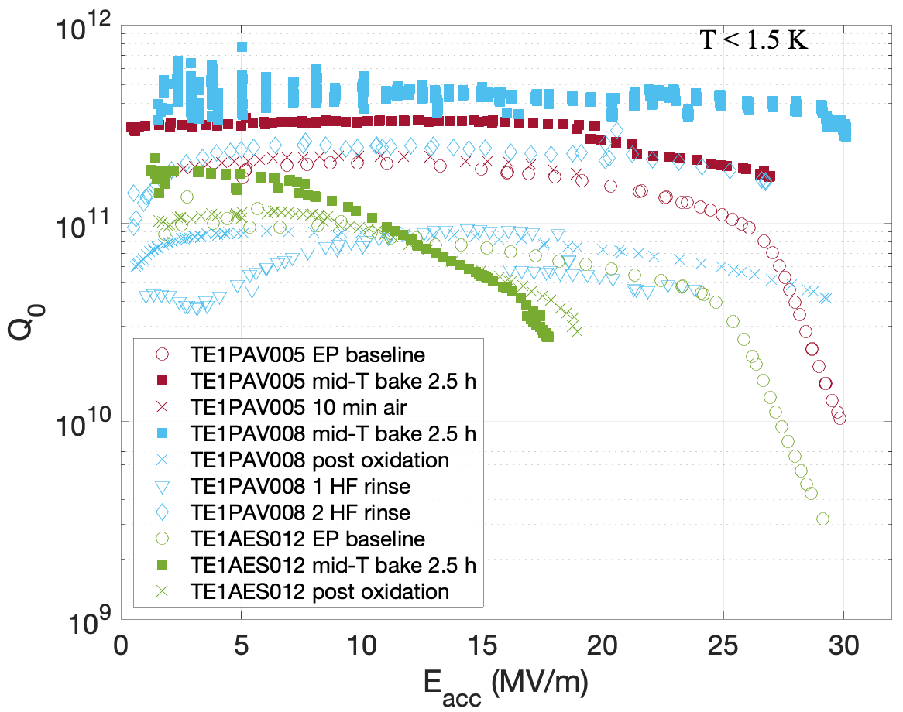
New Mid-T Bake Developed at FNAL
Pioneered a new mid-T (300C – 400C) in-situ bake that produces Q₀>5e10 @ 2 K and Q₀>4e11 at T<1.5 K
Yields performance between N-doping and N-infusion
5e10!
4e11!

Slide 21
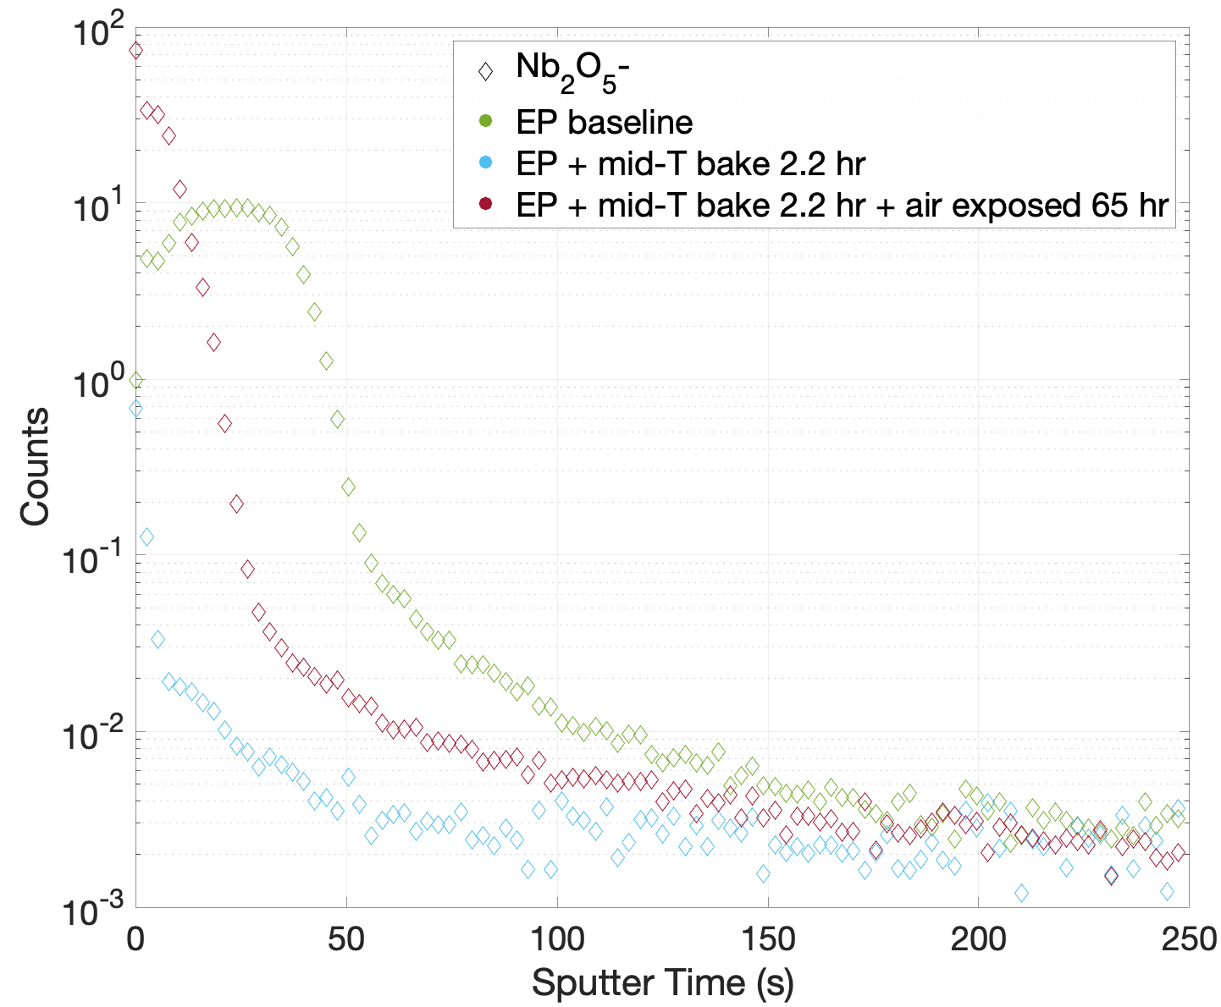
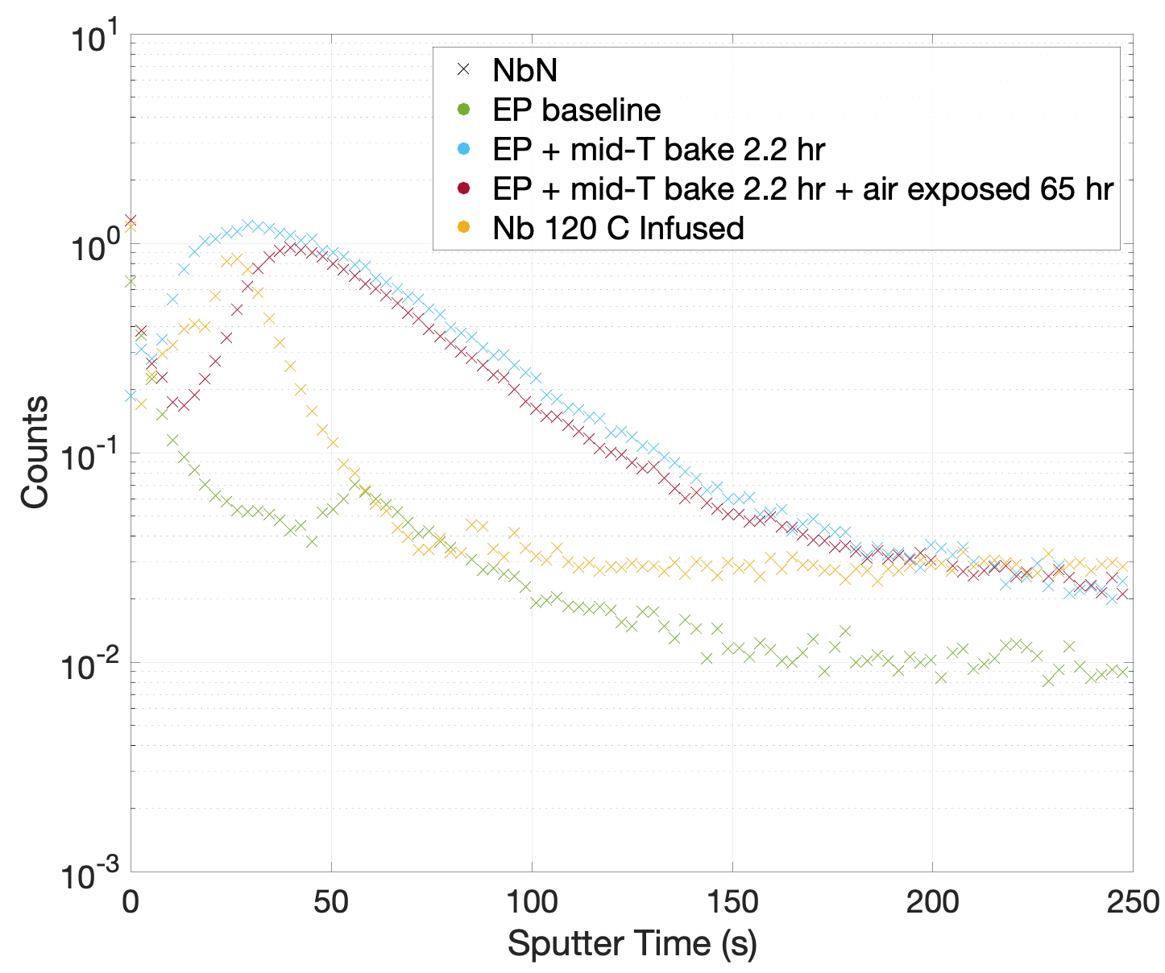
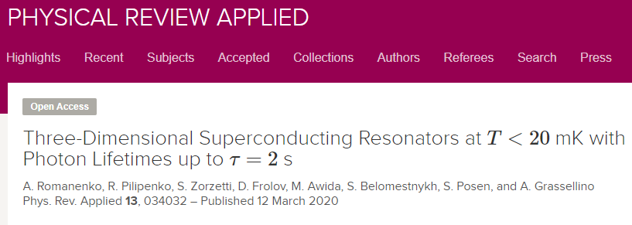
Origins of Ultra-High Q Post Mid-T Baking: SIMS Studies
Originally developed for quantum applications to dissolve oxides
In-situ mid-T baking performed on EP samples in SIMS
Nb₂O₅⁻ Signal
NbN⁻ Signal
Oxide removed by mid-T bake
However, quench is still limited to ~30 MV/m; is there an optimal temperature and duration that yields both high Q₀ and quench field?
Creates infusion-like N profile
S. Posen et al., PRA 13, 014024 (2020)
Mid-T baking provides a simple way to effectively perform N-doping without final EP ➔ yields ultra-high Q₀!

Slide 22
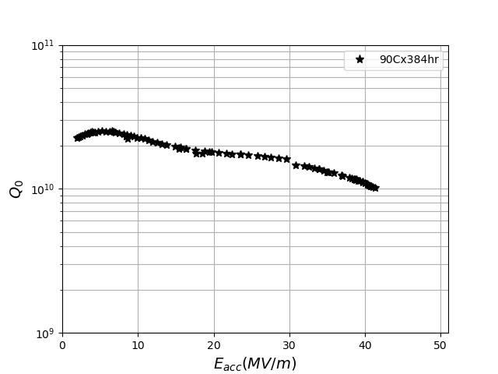
Optimizing Mid-T Baking for High Q₀/High G: Sequential Studies
A single 1.3 GHz SRF cavity is currently being subjected to sequential treatments of mid-T baking (200C) without disassembly/ever losing vacuum
Cavity was baselined with the 90 C x 384 hr in-situ bake to remove HFQS
f₀ =1.3 GHz
T = 2 K

Slide 23
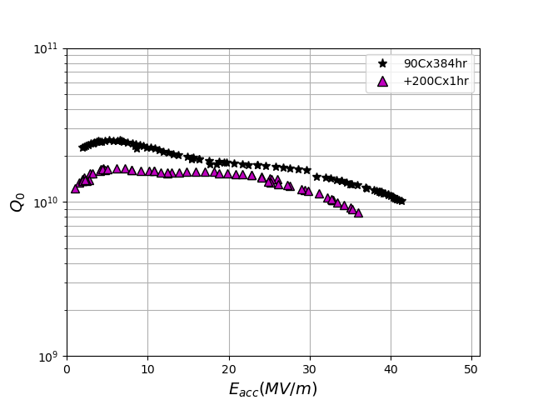
Optimizing Mid-T Baking for High Q₀/High G: Sequential Studies
A single 1.3 GHz SRF cavity is currently being subjected to sequential treatments of mid-T baking (200C) without disassembly/ever losing vacuum
Cavity was baselined with the 90 C x 384 hr in-situ bake to remove HFQS
200C x 1 hr mid-T bake decreased Q₀ and reduced quench field, curve shape changed
Estimate that oxide reduced by 0.25 nm – 0.5 nm
Suggests that partial oxide dissolution leads to substantial degradation
Performance gets worse before it gets better? Study ongoing
f₀ =1.3 GHz
T = 2 K

Slide 24
Outline
Introduction
High Temperature N-Doping (>800C)
Low Temperature in-situ bake (90-200C)
Mid Temperature in-situ bake (200-400C)
Conclusions & Future Work

Slide 25
Conclusions
Substantial progress made in the understanding of High Q and High G
High temperature N-doping: EP parameters are important in surface finish ➔ difference in achieving 17 MV/m and 30 MV/m!
Oxygen is a key player in the mitigation of HFQS in low temperature baking
75/120 C modified low temperature bake + cold EP shows record-breaking gradients
Mid-T baking: ultra-high Q’s already systematically achieved, currently taking steps to optimize further

Slide 26
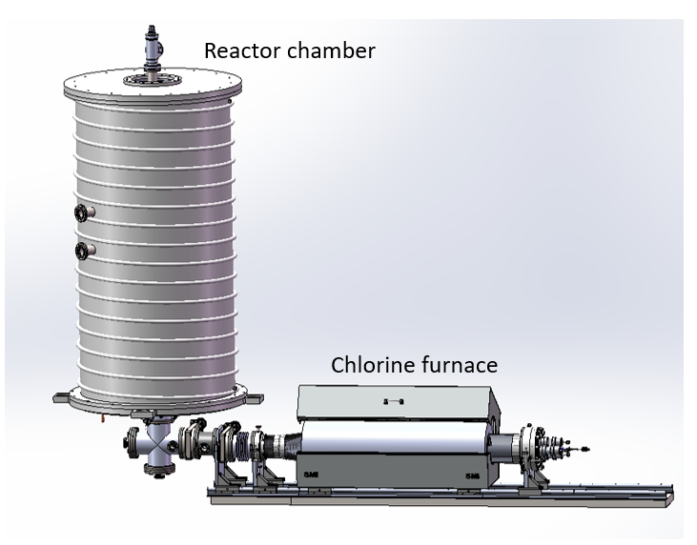
Future Work: Investigating New Surface Treatments with CVD/ALD
Fermilab will soon commission a new CVD/ALD furnace that will enable previously difficult surface treatments:
  Doping with different gases/elements
  A15 thin film deposition
  Baking in different atmospheres
Lots of new knobs to turn!
Will further optimize new recipes!
Notes:
Quantum – deposit oxide (S-I-S, S-S structures)

Slide 27
Thank you for your attention

Slide 28
Backup

Slide 29
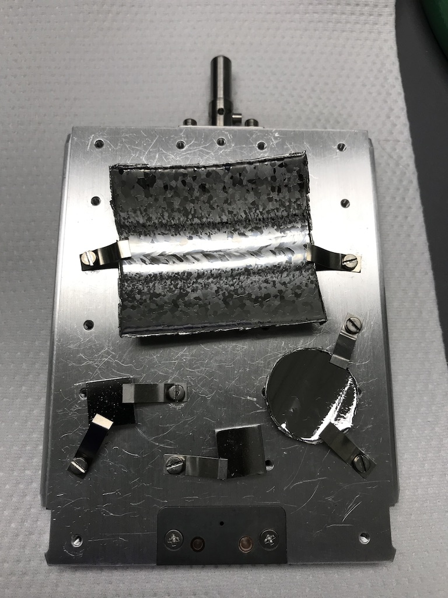
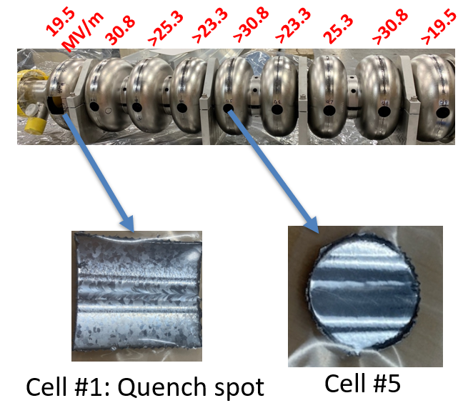
Correlating Quench Field with SIMS Studies – 9 - Cell
Samples cut from each cell and studied in TOF-SIMS to obtain depth profile
Grassellino et al., SRF 2019
NbN/Nb
O/Nb
C/Nb
Quench area – cell #1
Spot #1 – cell #5
Spot #2 – cell #5
S/Nb
F/Nb

Slide 30
Low Temperature Bake

Slide 31

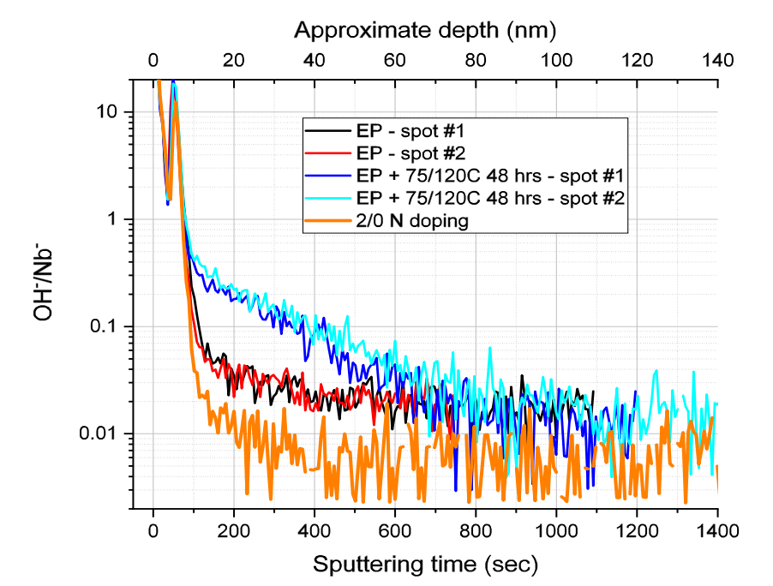
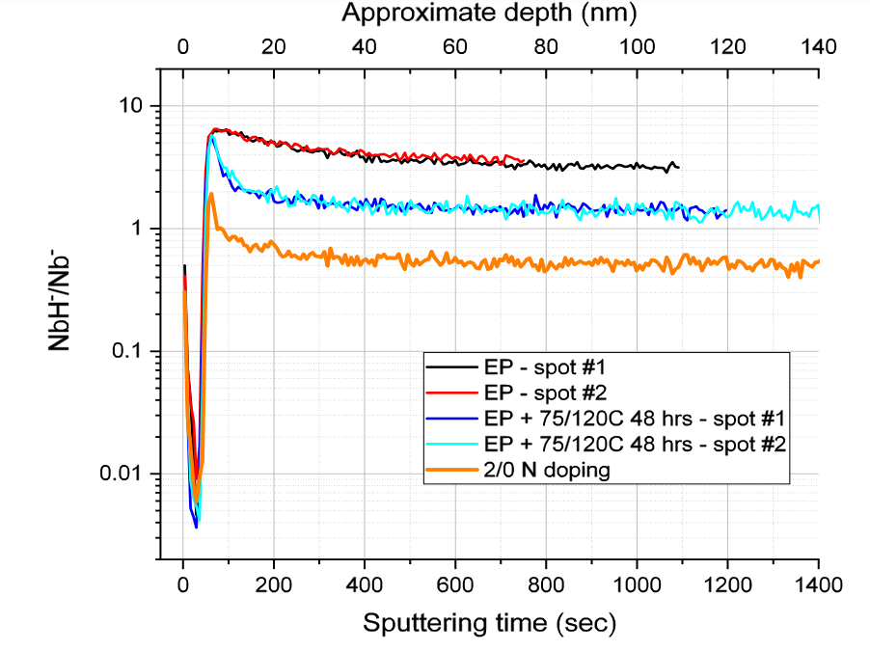
Role of Oxygen in Trapping of Hydrogen
A. Romanenko et al., Proc. of SRF’19, THP014

Slide 32
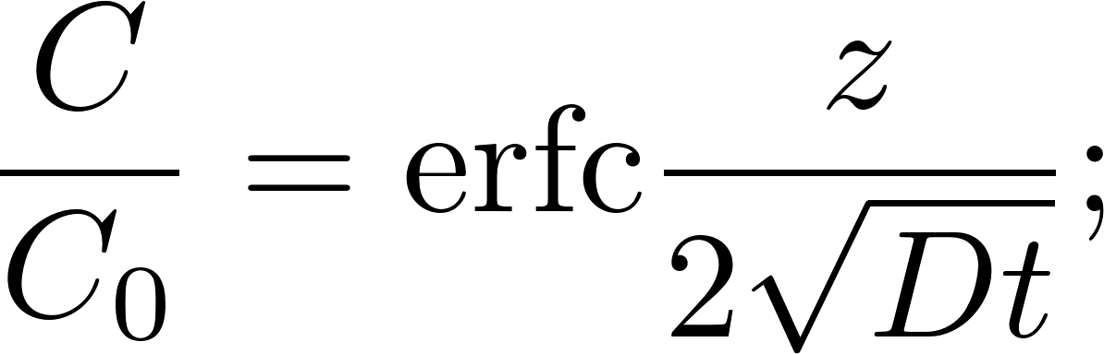
Model of Oxygen Diffusion
Diffusion of oxygen in Nb very well modelled by assuming oxide serves as an infinite source
Benvenuti et al. SRF’01:
A. Romanenko, TTC’20, CERN

Slide 33
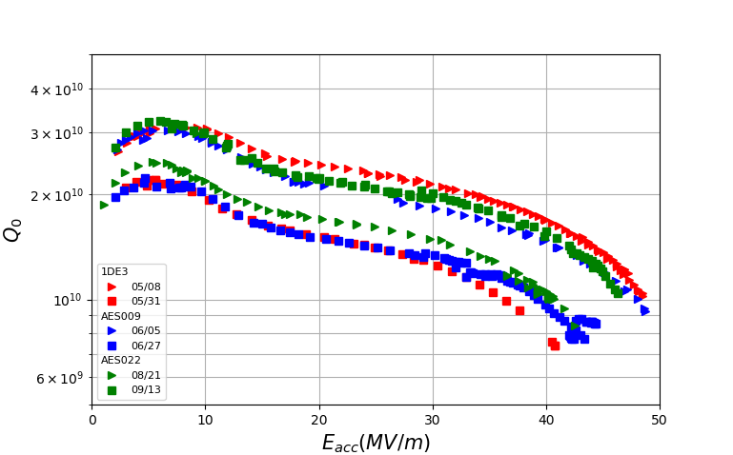
Bifurcation in Performance
3 single-cell cavities post 75/120C baking were tested several times without disassembly
Possible Causes for Branching | Likely Candidate?
Dewar | NO – observed in 2 separate dewars
Top Plate | NO
Cables | NO
Calibration | NO - Qext 2 does not explain branching in Q and G
Flux trapping | NO – MOST were cooled in zero compensated field
Observed branching behavior in cavities retested without disassembly in between (always under vacuum)
f=1.3GHz
T=2K
B_{trapped} = 5.88mG to account for branching; not possible with compensation coils in VTS
D. Bafia et al., SRF’19

Slide 34
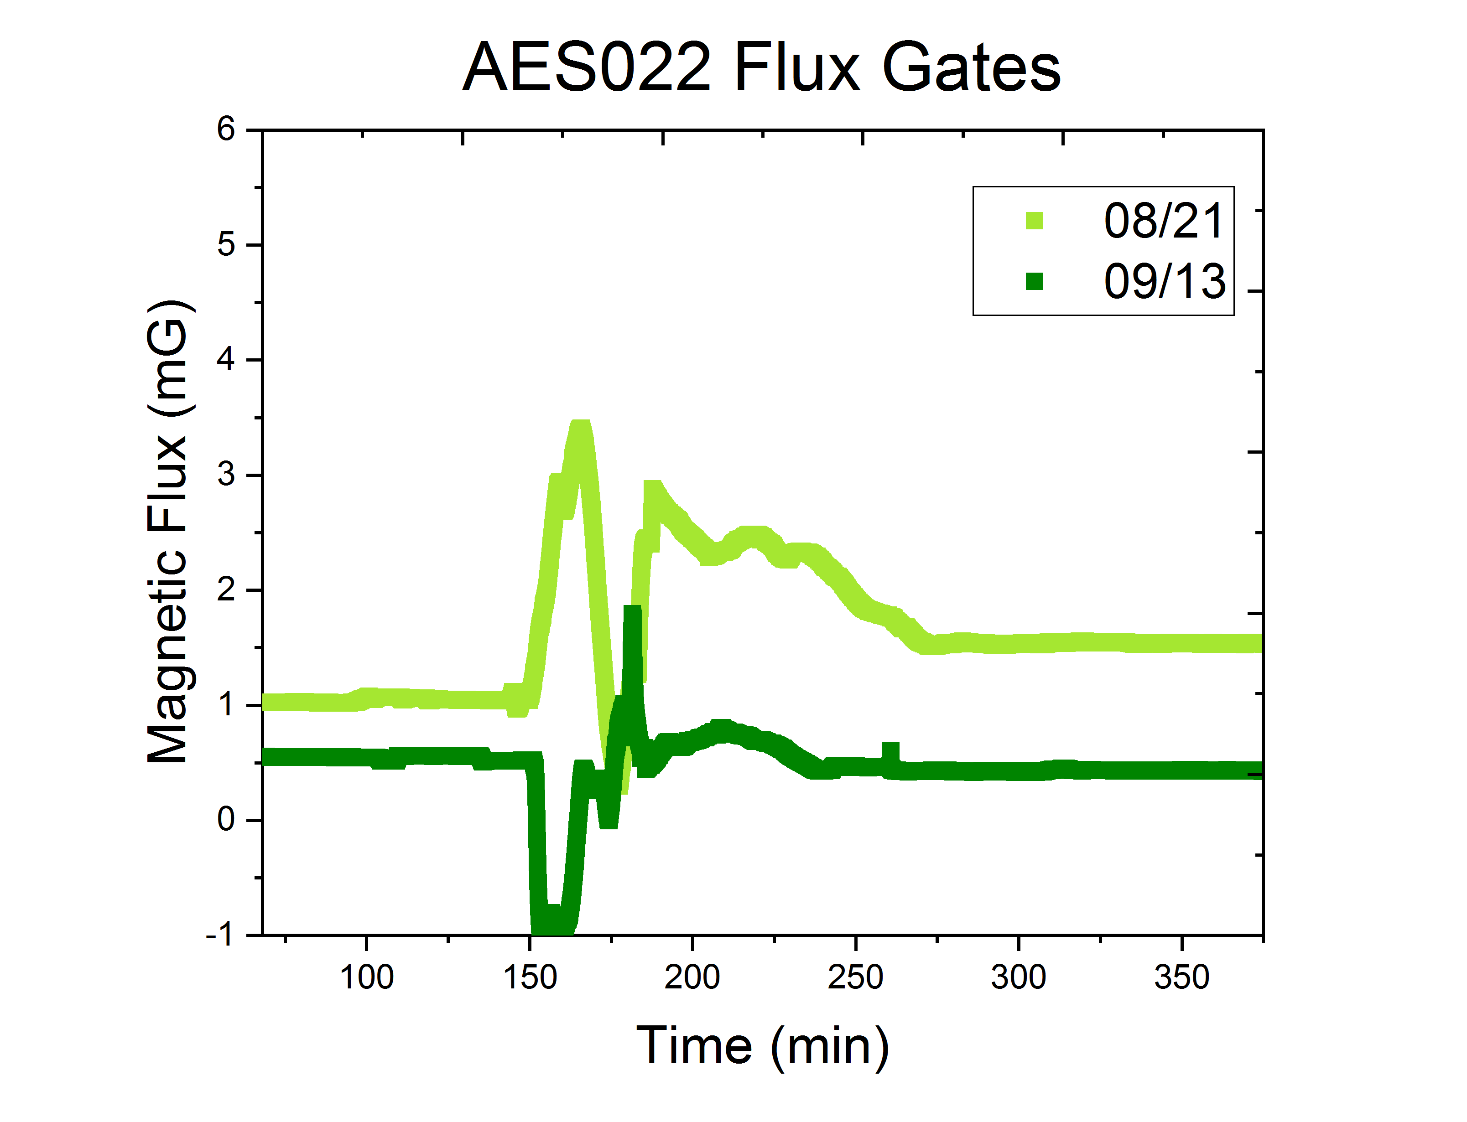
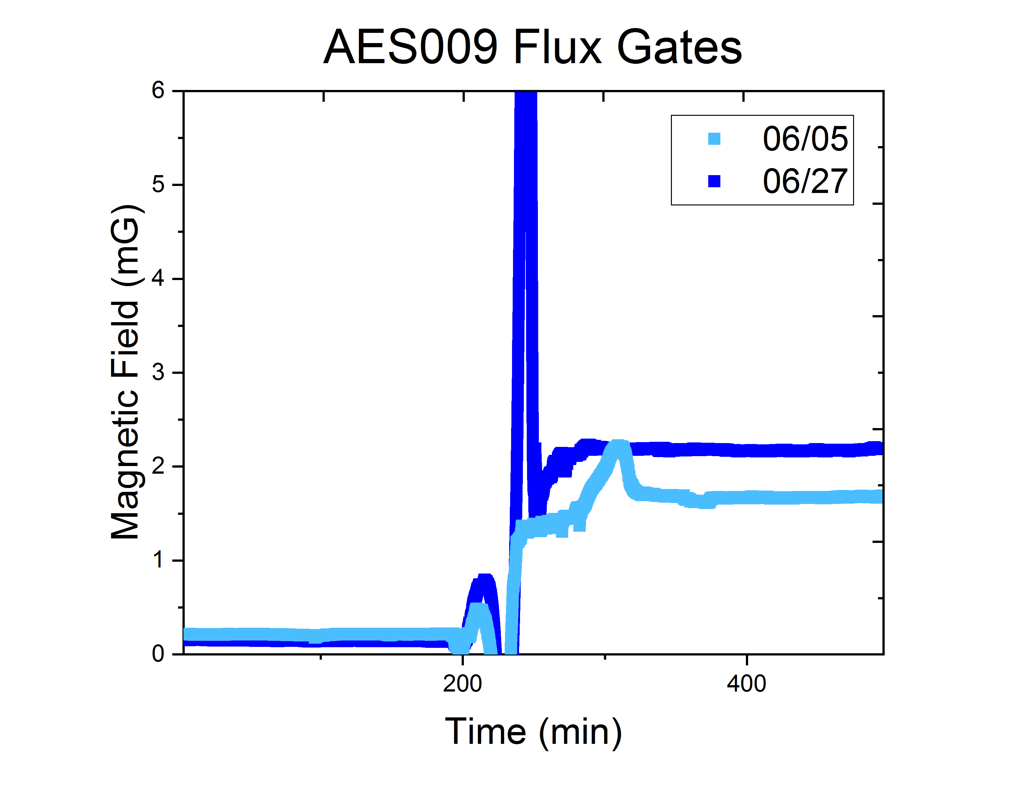
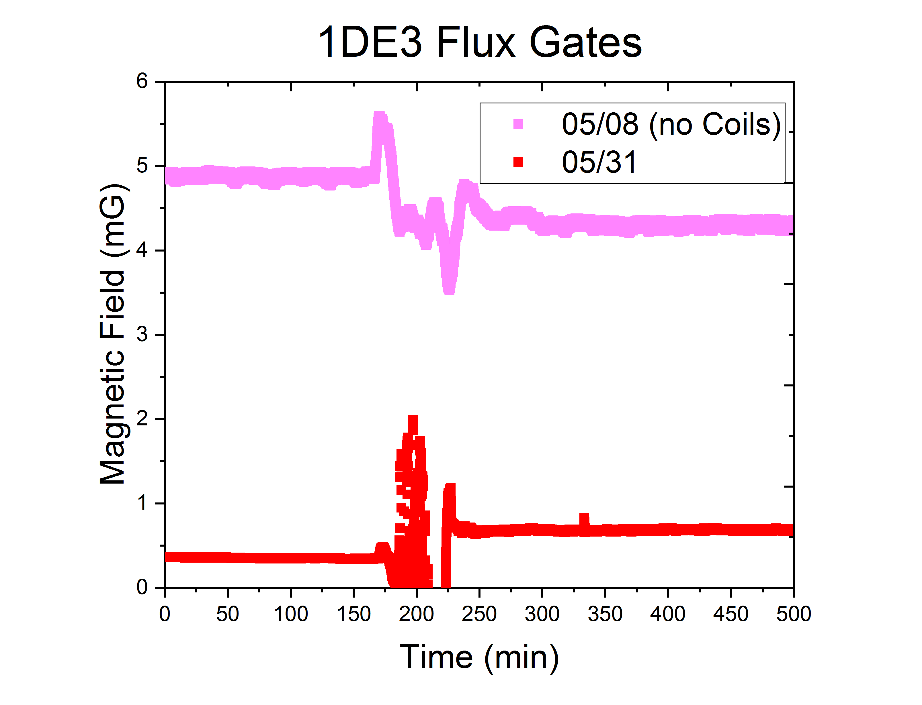
Likelihood of Trapped Flux Causing Bifurcation
No transverse field compensation/fluxgates for these tests – but transverse fields measured to be <1mG in the past
Estimate of field necessary to cause bifurcation @ 40MV/m:
R_{upper} =270/1.56E10 = 17.3nΩ
B_{trapped} =10nΩ /1.7nΩ /mG = 5.88mG
R_{lower} =270nΩ/1E10 = 27nΩ
T_{c}
T_{c}
T_{c}
≤1mG before T_{c}
≤0.2mG before T_{c}
05/08 – no coils – 49MV/m
5/31 – coils – 41MV/m!

Slide 35
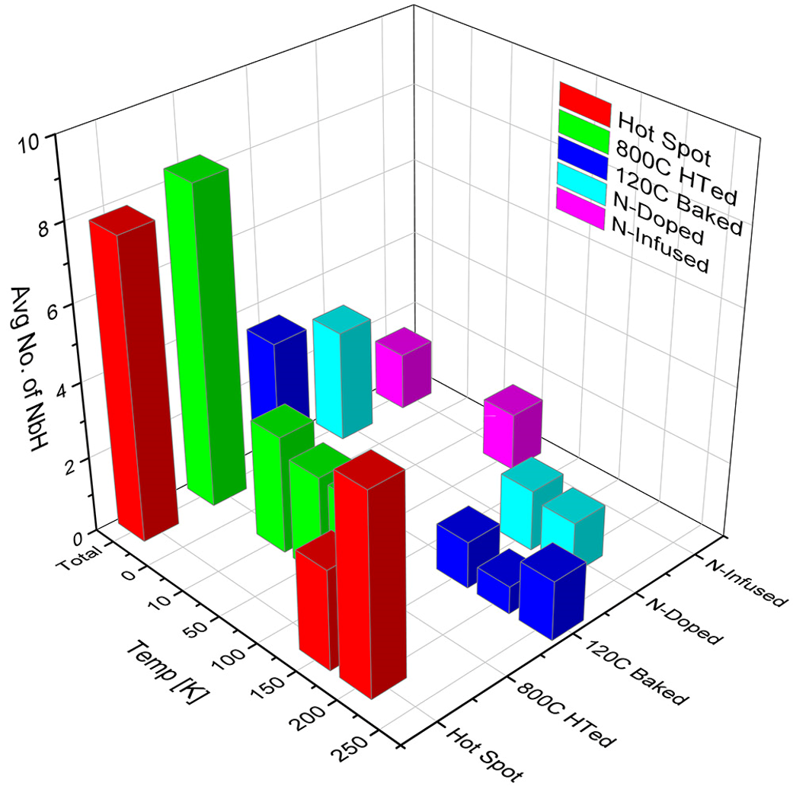
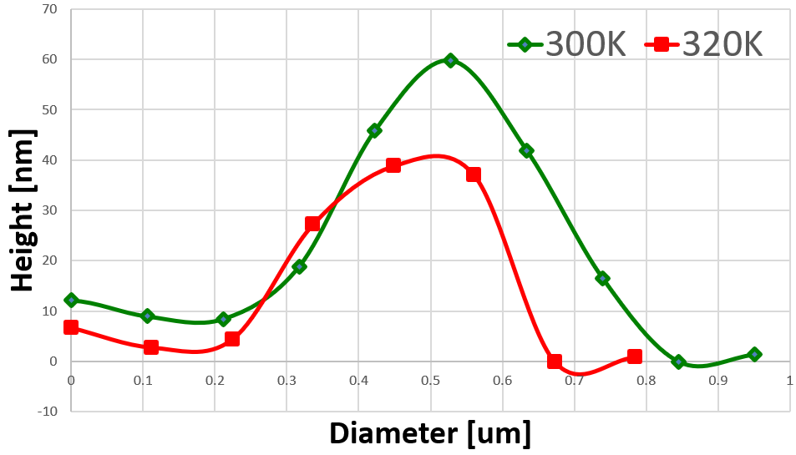
Cryo-AFM Studies on 120C Bake Cavity Cutouts by Sung et al.
Cryogenic Atomic force microscopy studies by Sung et al. found presence of previously unobserved room temperature niobium nano-hydrides on LTB samples
Warming to 320K caused room temperature niobium nano-hydrides to shrink in size
Applied similar protocol to cavities
Avg. No. of NbH Precipitates within 10 x 10 μm² unit area during cooling
Hydrides found near room temp for 120C baked cutout
Z. Sung et al., SRF’19

Slide 36
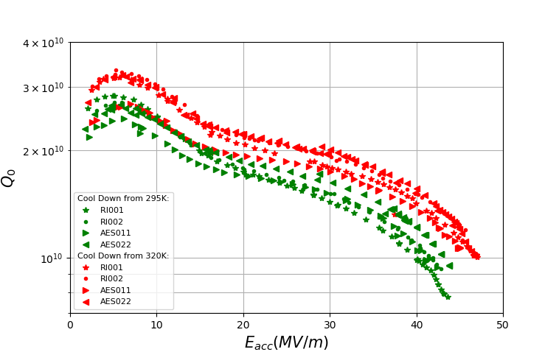
Comparison of 75/120 Bake Cavities Cooled From 295K vs 320K
QvsE of Cavities Post 75/120 Bake
f=1.3GHz
T=2K
AFM finds minimum Nb-H size @ 320K
Courtesy of Zuhawn Sung
Cooling cavities from 320K shows consistently higher quench field and Q₀ at high fields for cavities post 75/120 bake when compared to cooling from 295K.
In-situ 320K may be dissociating non-superconducting niobium hydrides

Slide 37
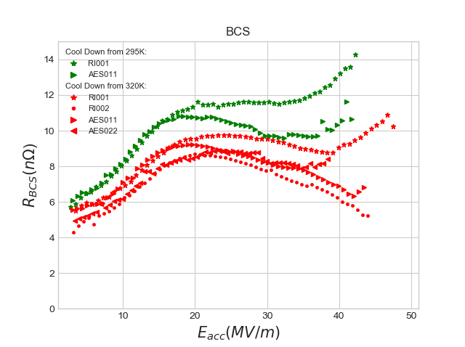
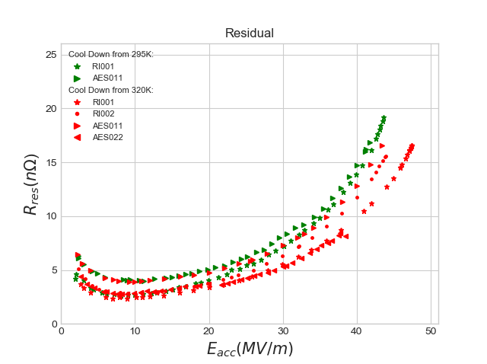
Decomposition of 75/120 Bake Cavities Cooled from 295K vs 320K
Branching in both BCS and residual components – not due to trapped flux
Cooling down from 320K gives a BCS similar to that of infusion

Slide 38
Mid – T Baking

Slide 39
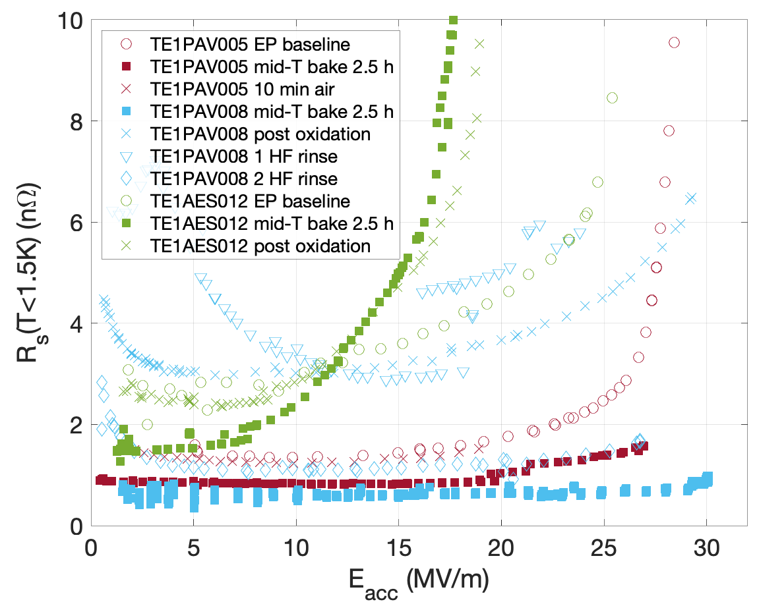
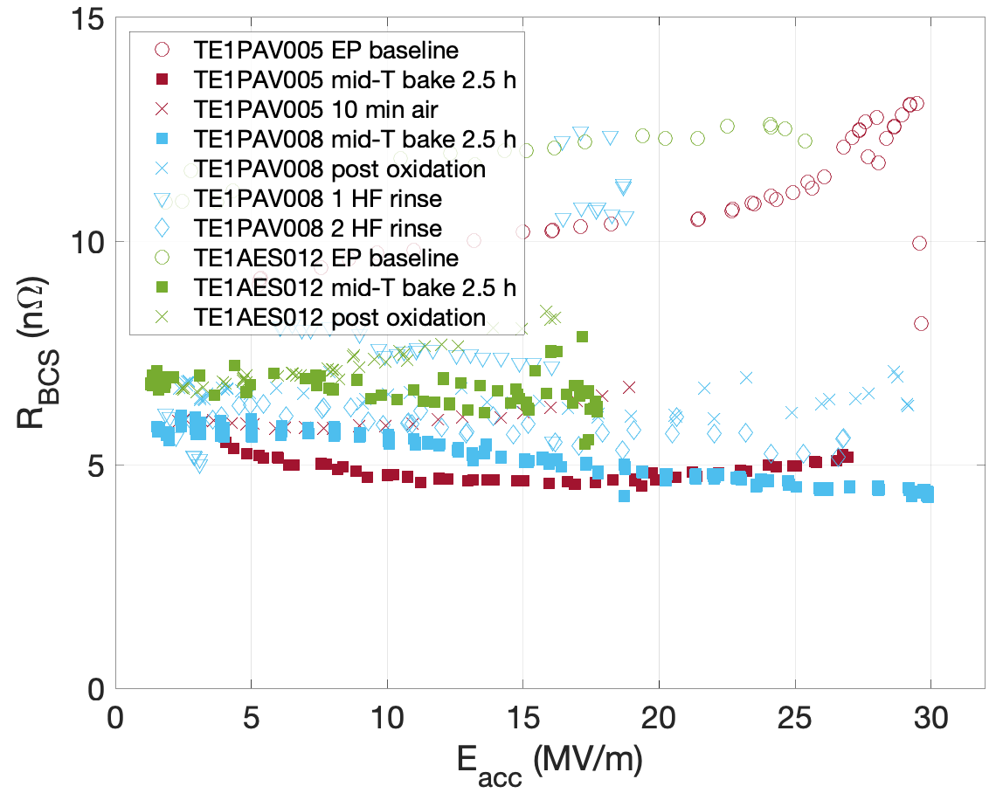
Decomposition – EP Baseline

Slide 40
Q(E) curves at 2K and lowest temperature
400 C x 3 hr – exhibited N-doping behavior
800C x 3 hr followed by 400C x 3 hr – exhibited standard EP behavior
500C x 1 hr – EP behavior at 2K
T =2K

Slide 41
Pressure Data From the in situ SIMS Runs – Nitrogen Origin
400C first ramp up
800C first, then 400C
A. Romanenko, TTC’2020 - CERN
Performed same treatments in SIMS
400 C x 3 hr – strong spike in pressure
800C x 3 hr then 400C x 3 hr – smaller spike in pressure
400C without re-exposure – substantially smaller peak
Another 400C without re-exposure
Nitrogen seems to be coming from the outgassing

Slide 42
SIMS in-situ Results on EP Cutouts
After 400C 1 hr straight
NbN/Nb
Only the “400C x 1hr straight” treatment introduced a substantial level of N in the RF layer
+400C 1hr + air
+800C 4 hr + 400C 1 hr
before
A. Romanenko, TTC’2020 - CERN

