Slide 1
Status of SupreKEKB positron source
Yoshinori Enomoto
KEK electron positron injector LINAC group

Slide 2
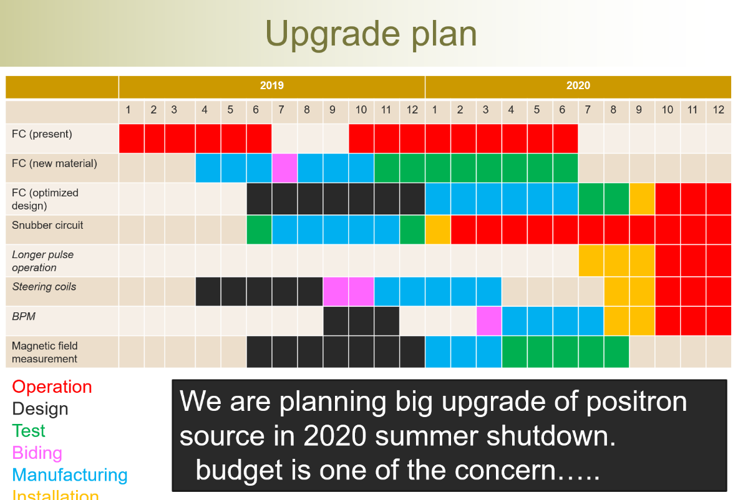
Last page of my presentation in LCWS2019

Slide 3
Outline
Introduction
  SuperKEKB positron source
Upgrade works in 2020 summer shutdown
  New FC, steering coils, BPMs
Magnetic field measurement
Future plan

Slide 4
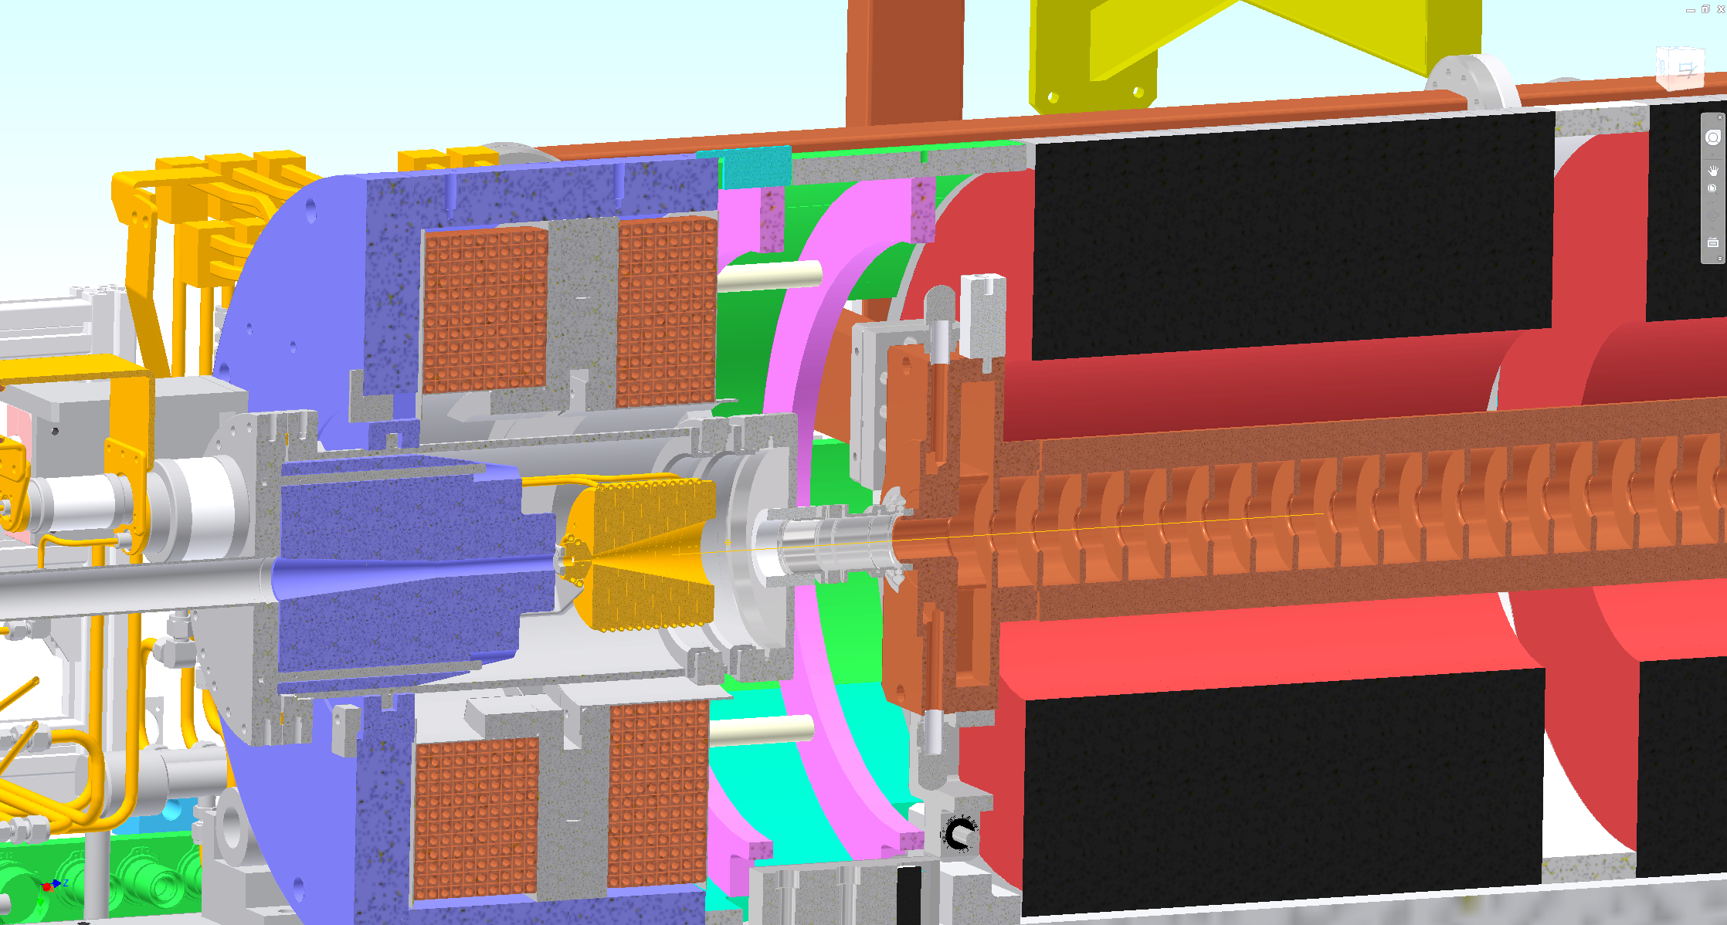
SuperKEKB positron source
FC head + BC + target = FC assembly
BC (bridge coil)
LAS (large aperture S-band)
W target
FC(flux concentrator) head
solenoid

Slide 5
Injection requirement
Life in ring | 360 s
Current | 3.6 A
Injection bunch charge | 4 nC
Injection rate | 25 Hz x 2 bunch
Injection efficiency | 50 %
Circulation frequency | 10⁵
$$\frac{dI}{dt}=\frac{3.6 [A]}{360 [s]}=10 [mA/s]$$
$$4 \left[nC\right]×25 \left[Hz\right]×2 \left[bunch\right]×50\left[\%\right]×{10}^{5}\left[Hz\right]$$
$$=10 [mA/s]$$
Short storage time and high storage current in the ring
→high intensity positron injection is desired

Slide 6
Problems to be solved
Discharge of FC
  FC made of New material
  Optimization of support structure (done before 2020)
  External circuit to reduce voltage (done before 2020)
  Longer pulse width (will be done after 2021)
Orbit correction in solenoid
  Steering coils
  BPMs

Slide 7
Outline
Introduction
  SuperKEKB positron source
Upgrade works in 2020 summer shutdown
  New FC, steering coils, BPMs
Magnetic field measurement
Future plan

Slide 8
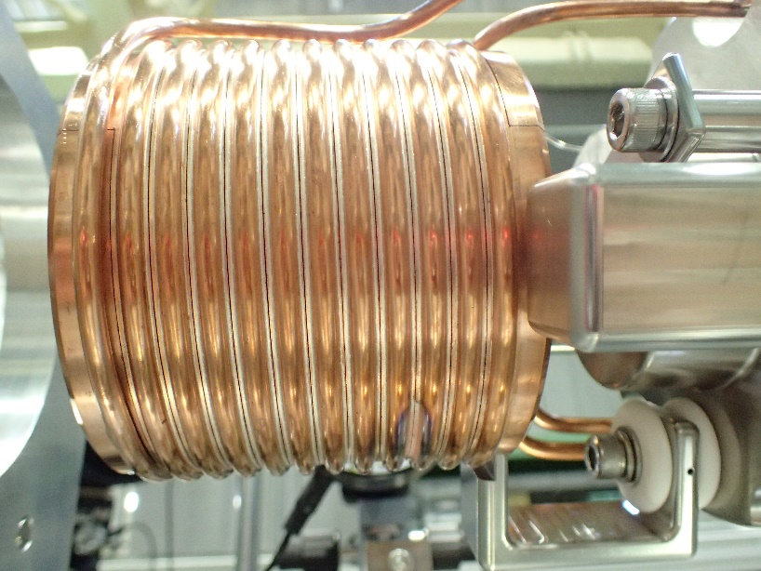
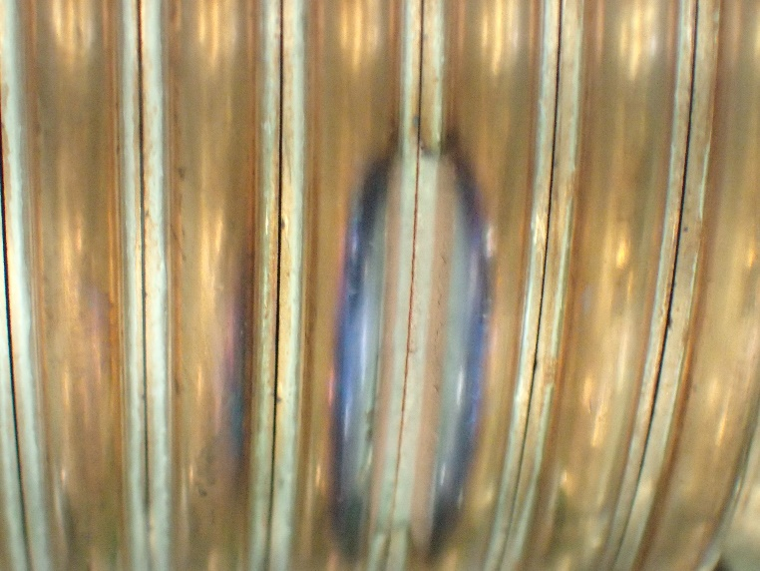
After large discharge…
Slit gap got narrow.
Not possible to apply high voltage unless the gap will be expanded.

Slide 9
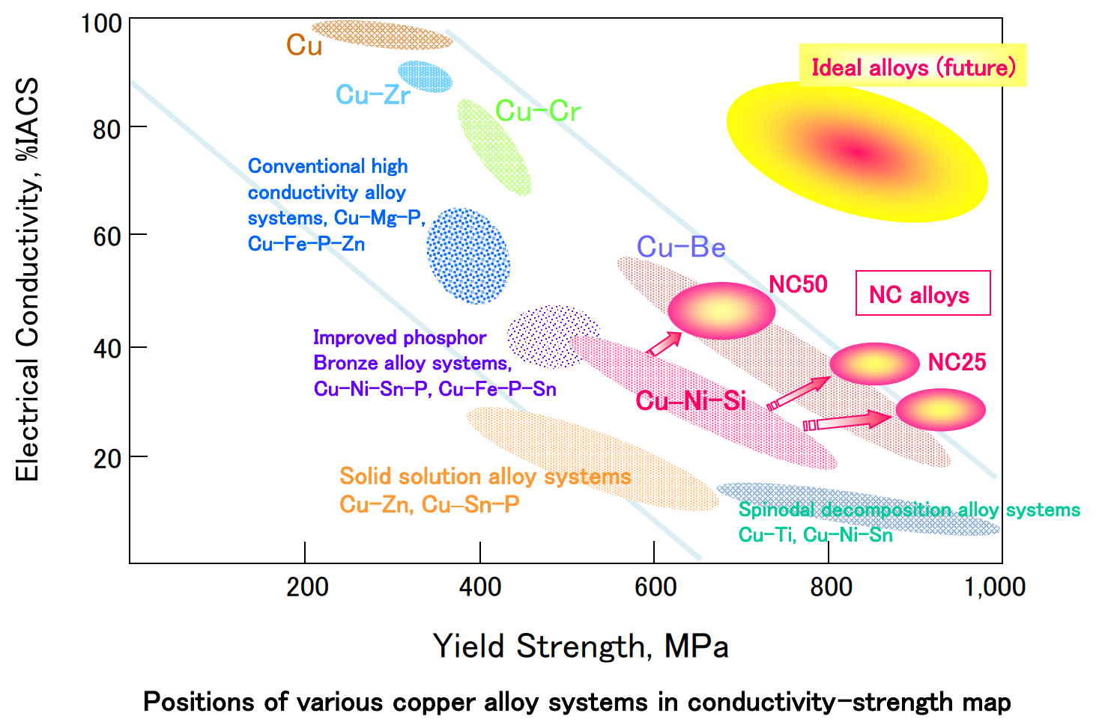
Cu alloys
Cu
Cu - Zr
Cu - Cr
Cu - Ni - Si
were tested

Slide 10
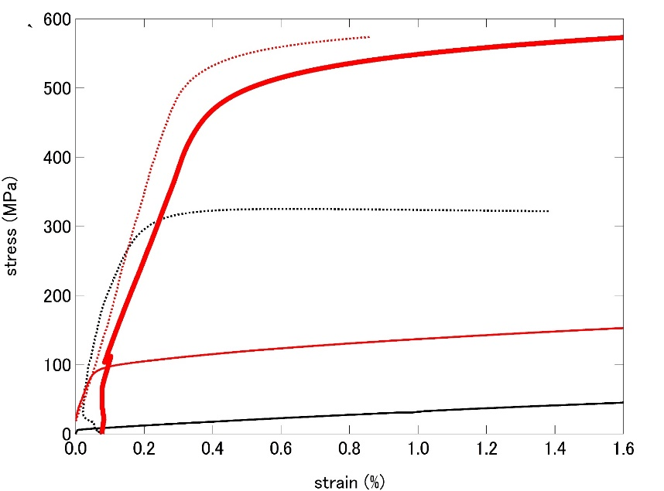
Yield strength
NC50
NC50 after aging
(precipitation hardening)
x40
C1020
NC50 after brazing
C1020 after brazing

Slide 11
Assembly, base management (2021/1 ver.)
 | Phase 1 | Phase 2 | Phase 3 | 2019 Q4 | 2020 ab | 2020c | delivered | removed | present | Note
Assembly 1 |  |  |  |  |  |  | <2015 | 2017/3 | In tunnel
Assembly 2 |  |  |  |  |  |  | 2016/3 |  | In operation
Assembly 3 |  |  |  |  |  |  | 2017/11 |  | Test bench
FC base 1 |  |  |  |  |  |  | <2015 |  |  | Test
FC base 2 |  |  |  |  |  |  | <2015 |  |  | Test
FC base 3 |  |  |  |  |  |  | <2015 | 2017/3 | In tunnel
FC base 4 |  |  |  |  |  |  |  | 2018/9 | In tunnel
FC base 5 |  |  |  |  |  |  | 2016/7 | 2020/9 | In tunnel
FC base 6 |  |  |  |  |  |  | 2017/11 |  | Test bench | bad quality
FC base 7 |  |  |  |  |  |  | 2019/10 |  | Test bench | New material
FC base 8 |  |  |  |  |  |  | 2020/6 |  | In operation | Final version
FC base 9 |  |  |  |  |  |  | 2021/3 |  | In production | Saper for Final version
Material test started in 2018/10
in operation
spare
test bench

Slide 12
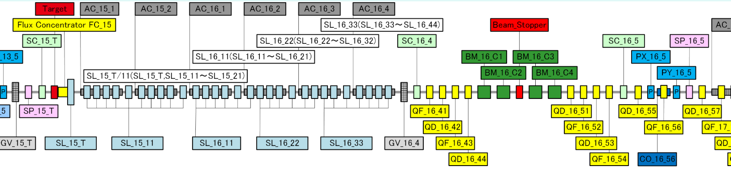
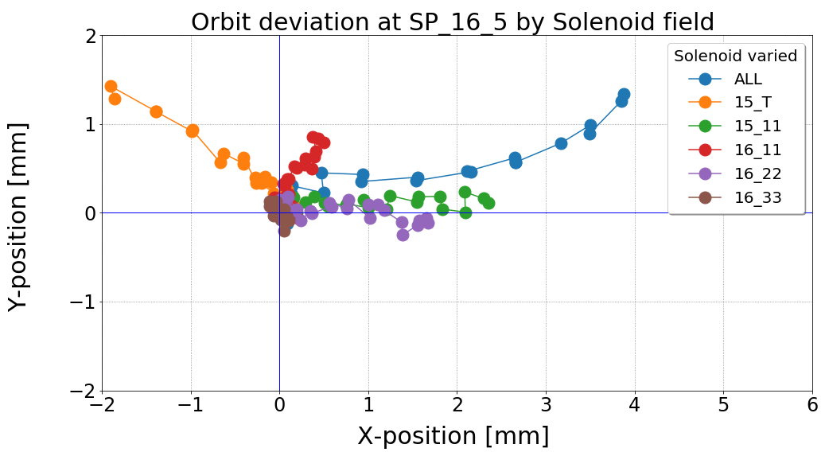
Orbit deflection in solenoid section
Measured by T. Kamitani
SP : BPM
SL : solenoid
QF/QD : quad
PX/PY : pusled steering
BM : bend
SC : screen
AC : acc. structure
Measurement of deflection amount of 3 GeV electron beam
by asymmetric field in solenoid section
1,Prepare ballistic beam between SP_15_T and SP_16_5
2,Energize a part of solenoid by
1/10* max. value step.
3, Monitor beam position at SP_16_5

Slide 13
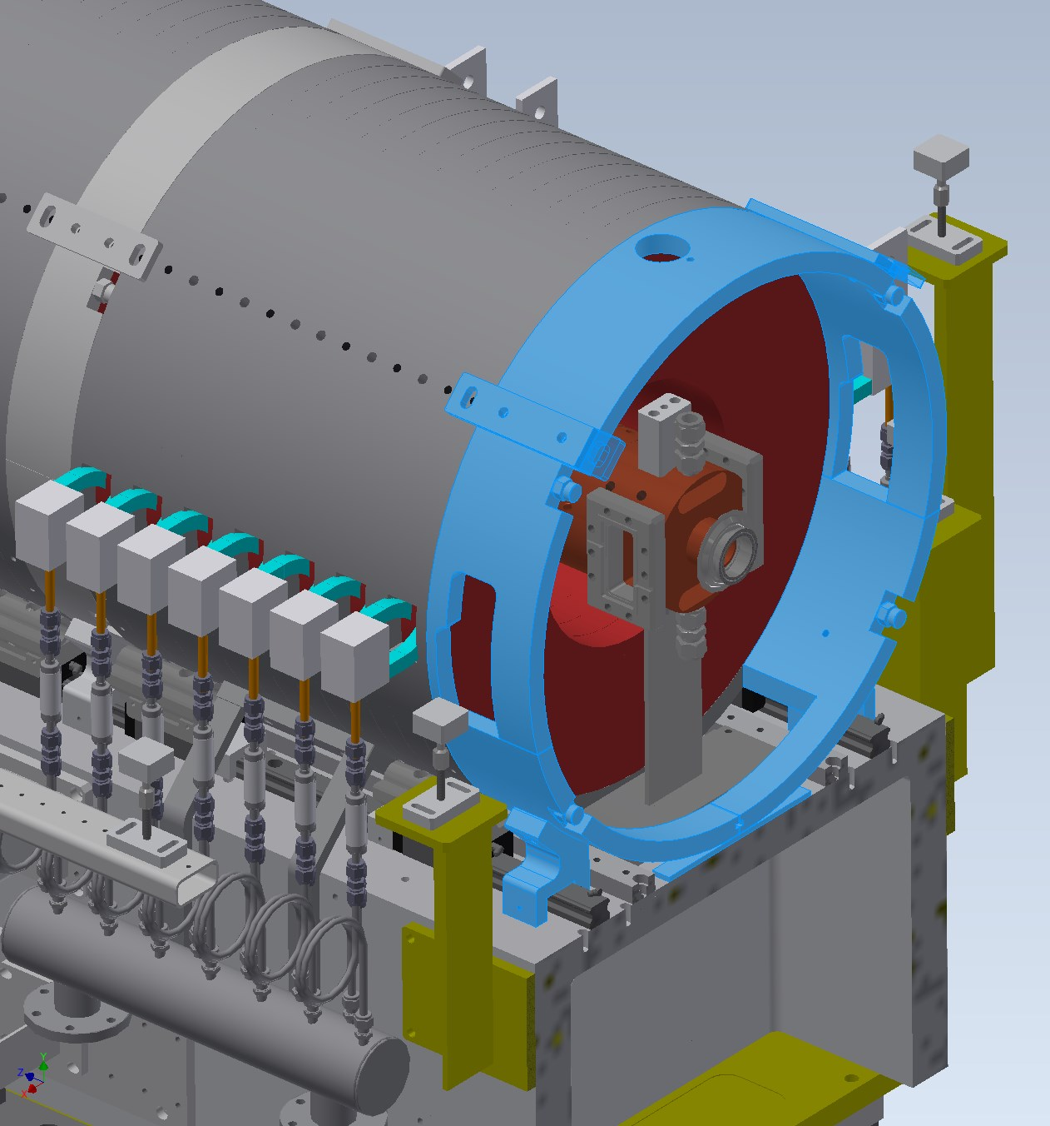
Asymmetry of magnetic connection
Iron yoke to connect flux of solenoid
need space for waveguide and support
Inner diameter of solenoid changes
Bx
By

Slide 14
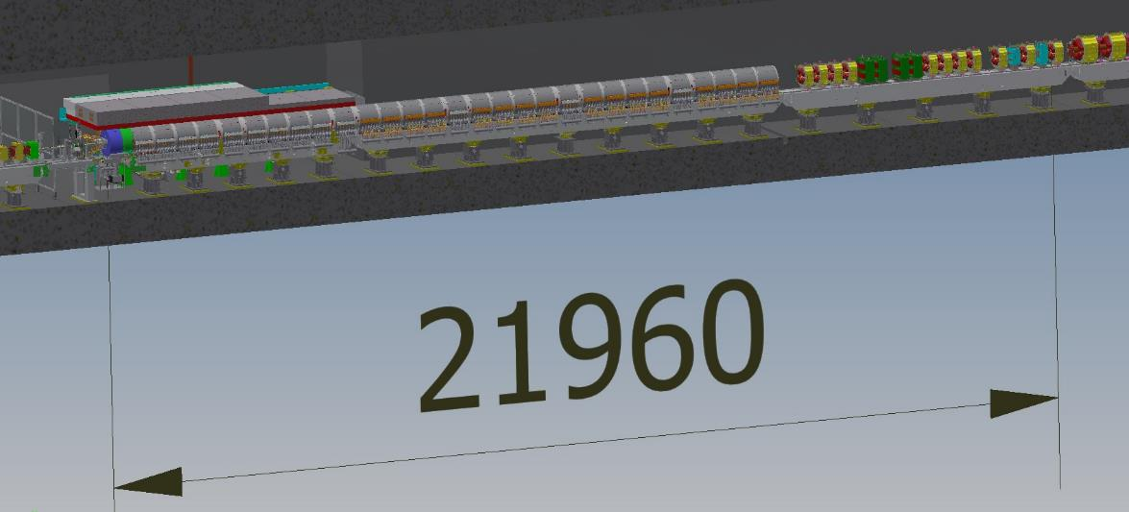
target
BPM and 1st steering
There were no BPMs and steerings for 22 m after the target

Slide 15
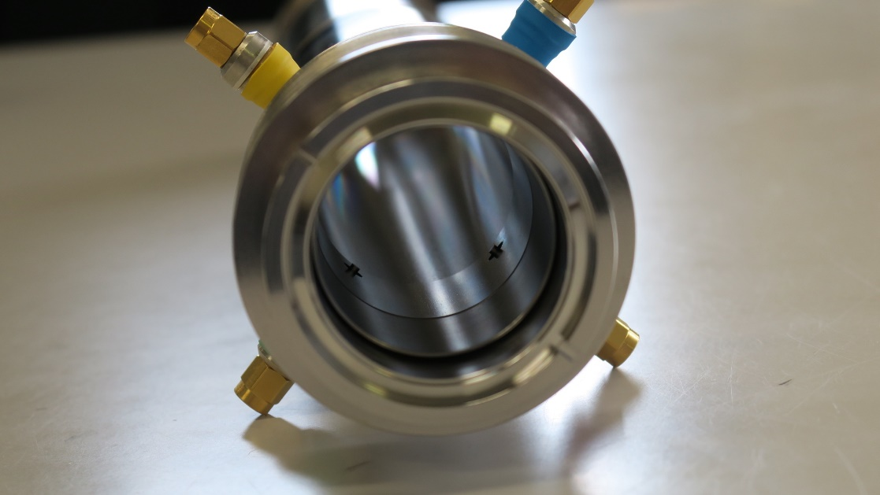
BPMs and steering coils inside solenoid
e+/e- separation chicane
Steering coils
BPM
Fast BPM
175 ps
Simulation by F. Miyahara
electron
positron
Small antenna
To monitor positron in solenoid section, very fast response BPM was developed by
Monitor group (T. Suwada, F. Miyahara, M. A. Rehman)

Slide 16
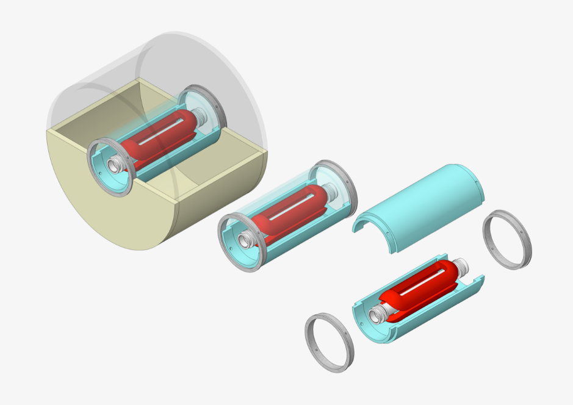
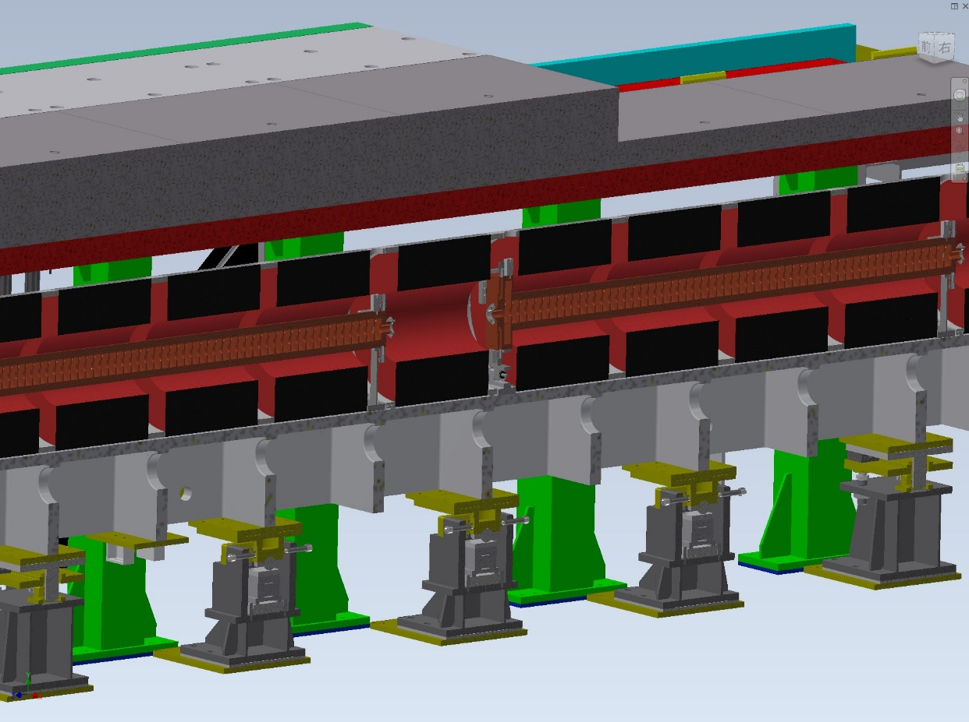
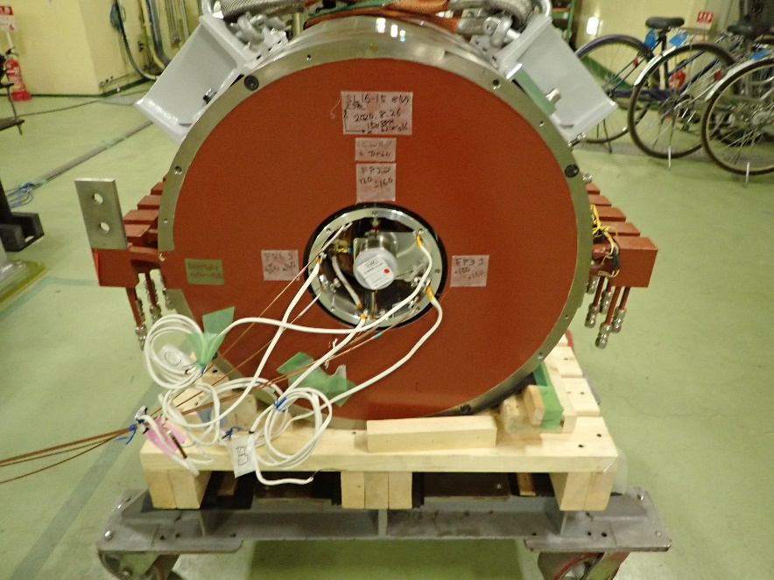
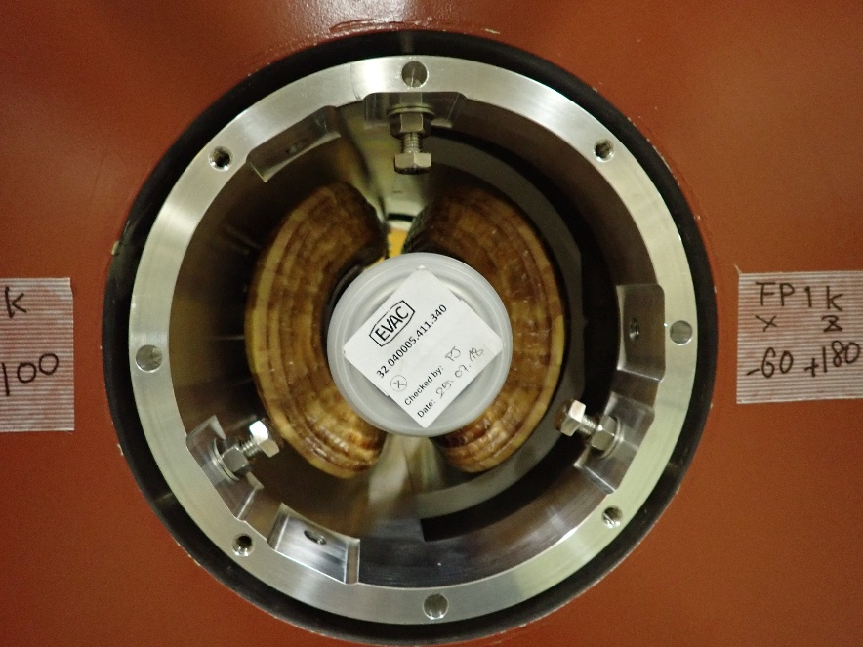
BPM and steering coils inside solenoid
Steering coil
support
BPM
K. Yokoyama and K. Kakihara

Slide 17
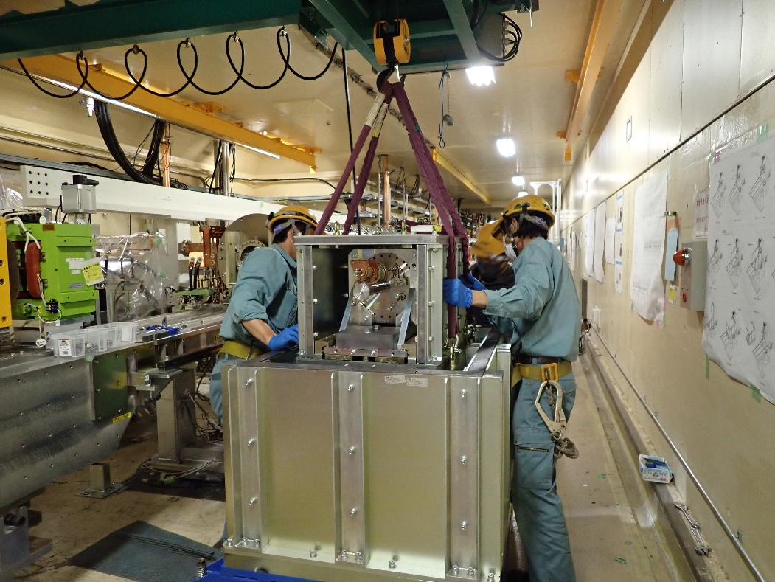
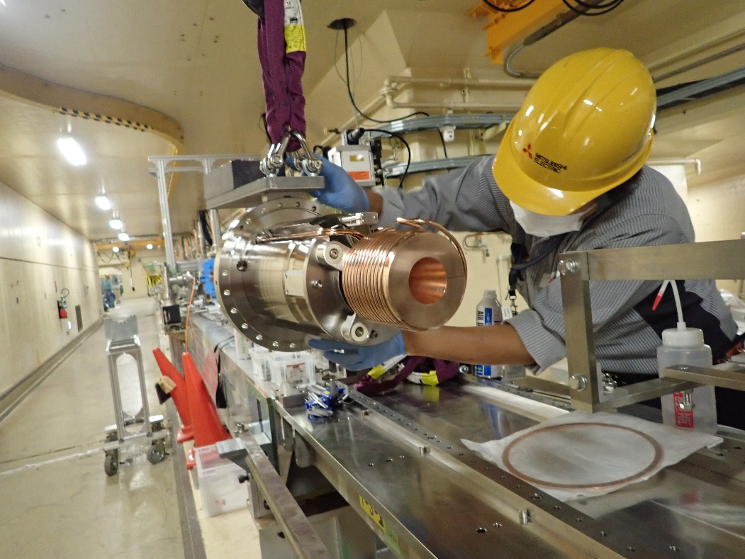
installation
Remove old positron source
During 2020 summer shutdown,
  A new FC
  Two fast BPMs
  Two ordinary BPMs
  One vertical steering coil
  Three horizontal steering coils
Install new positron source

Slide 18
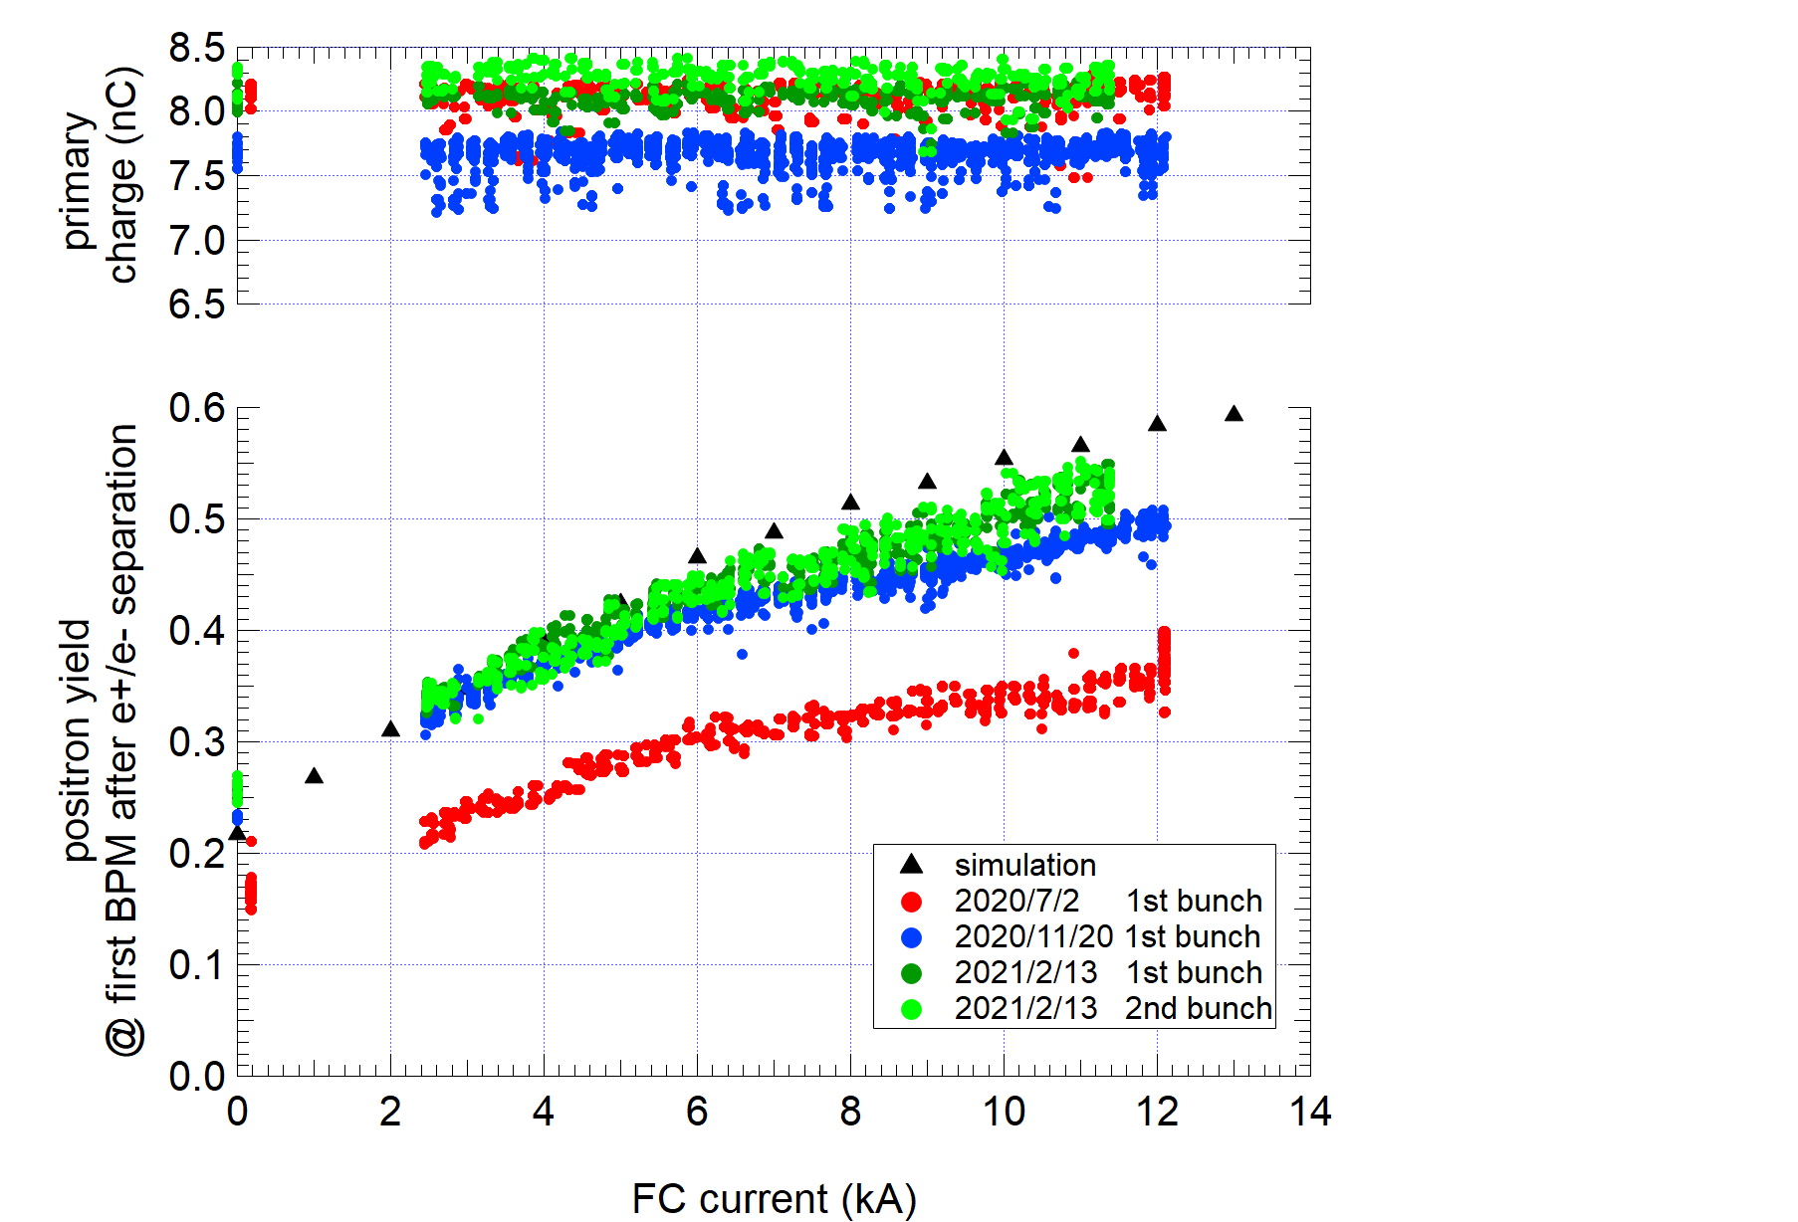
Positron yield vs FC current
Design (0.58)
Present
(Further tuning was done after this measurement. Now the yield almost reached design value. See next page)
Before upgrade
(To avoid discharge,
FC current was limited very low)

Slide 19
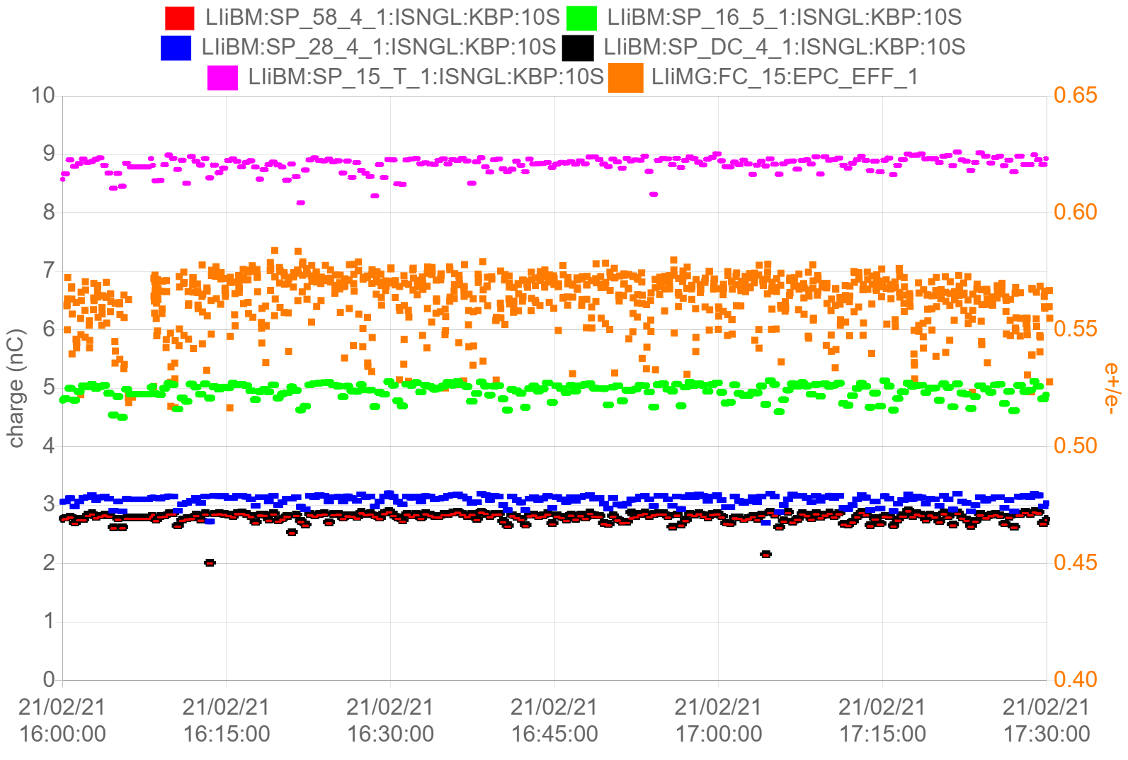
Achievement rate
Primary beam
  90% (9 nC / 10 nC)
Positron yield（e+/e-）
  100% (0.58 / 0.58)
transport
  Assuming 5.8 nC (design value) @ first BPM after the target and present transport efficiency, charge @ Linac end is expected to be 3.3 nC.
  There is still room for improvement
Primary electron
e+/e- design
Before DR
First BMP after target
After DR
Linac end
Hardware upgrade
Further beam tuning
 | design | 2020ab | 2020c | 2021a | 2021a (10 nC, 0.58)
Energy (e-) | 3.5 GeV | 3.5 GeV | 3.5 GeV | 3.5 GeV
primary charge (e-) | 10 nC | 8.4 nC | 8 nC | 9 nC
e+/e- | 0.58 | 0.24 | 0.51 | 0.58
e+ @ first BPM after the target | 5.8 nC | 2.0 nC | 4.1 nC | 5.1 nC | 5.8 nC (assume)
e+ @ before DR | - | 1.6 nC | 2.5 nC | 3.2 nC | 4.2 nC
e+ @ after DR | - | 1.4 nC | 2.1 nC | 2.9 nC | 3.3 nC
e+ @ Linac end | 4 nC | 1.4 nC | 2.1 nC | 2.9 nC | 3.3 nC

Slide 20
Outline
Introduction
  SuperKEKB positron source
Upgrade works in 2020 summer shutdown
  New FC, steering coils, BPMs
Magnetic field measurement
Future plan

Slide 21
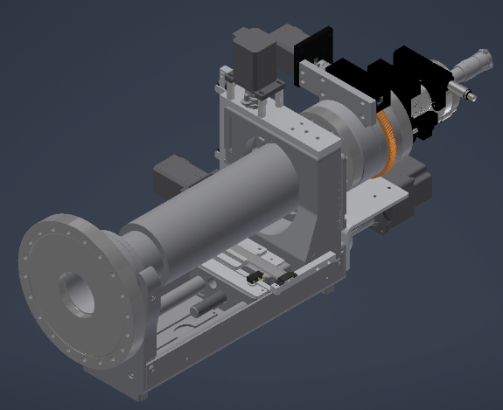
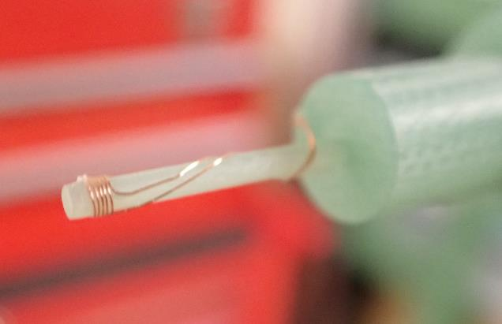
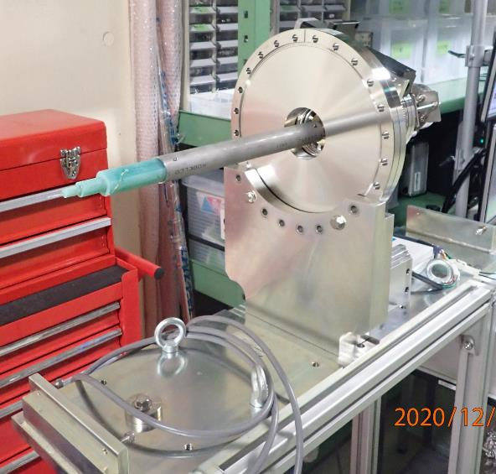
Magnetic field measurement
XYZ stage with motor drive
Rotary stage with motor drive
XYZ positions are monitored by linear gauge by 10um precision
Pick up coil is mounted on FRP rod.

Slide 22
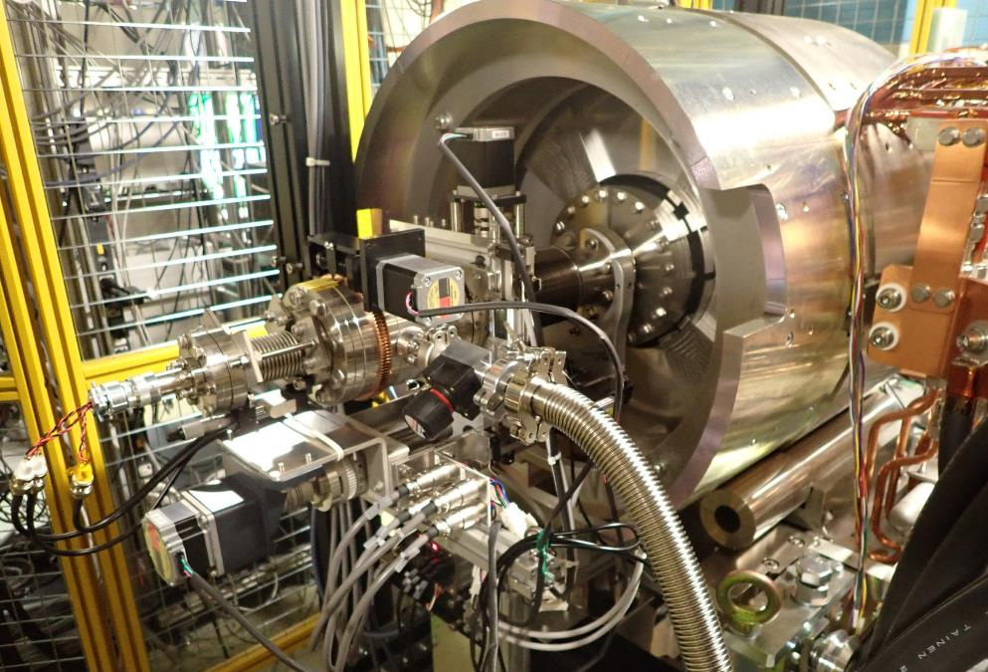
Looking from downstream side with the measurement system attached

Slide 23
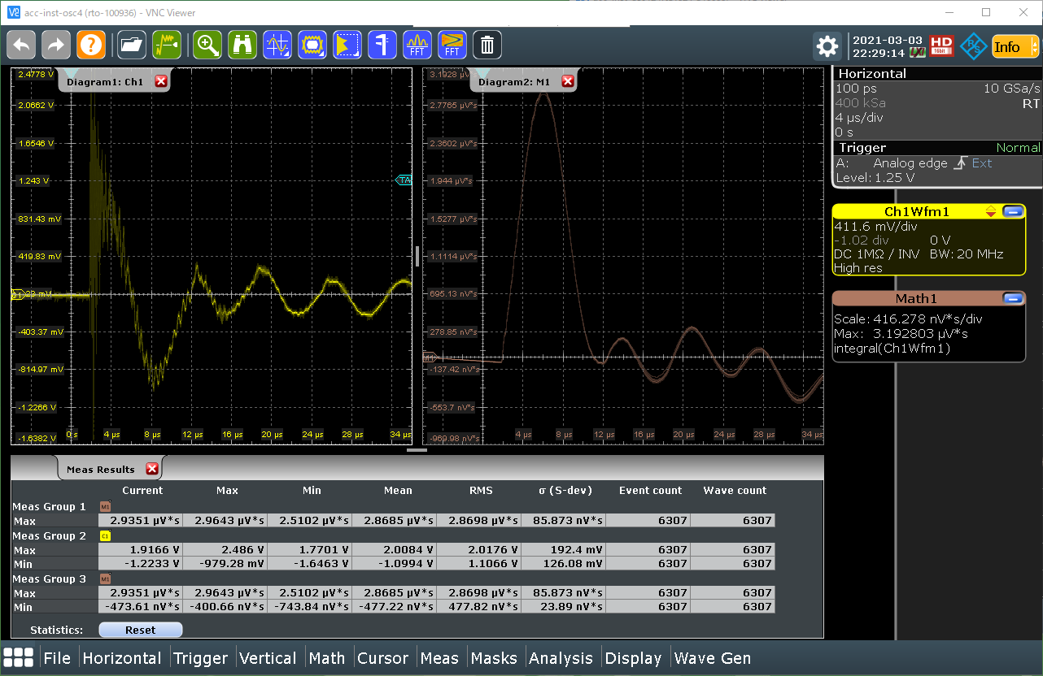
Typical waveform from pick up coil
Signal from the coil
Integration of left waveform

Slide 24
Comparison between simulation and measurement
Vertical axis is normalize at peak value to 100%
Target exit surface is z = 0
Distance between FC and target is 2 mm
Solid line shows simulation using CST

Slide 25
Outline
Introduction
  SuperKEKB positron source
Upgrade works in 2020 summer shutdown
  New FC, steering coils, BPMs
Magnetic field measurement
Future plan

Slide 26
Future plan
Major upgrade works were successfully done in 2020.
Now it’s time for us to consider future plan.
Phase 1 (1 ~ 2 years)
  Higher FC current operation
    Max. current is limited by capacity of the pulsed power supply
  Optimization of transport to the DR
    Several DC magnets will be replaced pulsed magnets
  Increase primary electron charge
    Possible but care must be taken evaporation of cathode material which lead to increase of dark current from the gun.
Phase 2 (2 ~ 3 years)
  Optimization of FC shape
    In collaboration with CERN (H. Bajas).
  Moving target
    To bring both hole for electron path and target for positron production online
  Shorten the distance between FC and the first Acc. structure
Phase 3 (3 ~ 5 years and more, if there is a requirement from the ring…)
  New electron gun for higher charge?
  Replace LAS with L-band acc. structure??
  Superconducting solenoid???
We hope closer collaboration with people working on the future projects.

Slide 27
backup

Slide 28
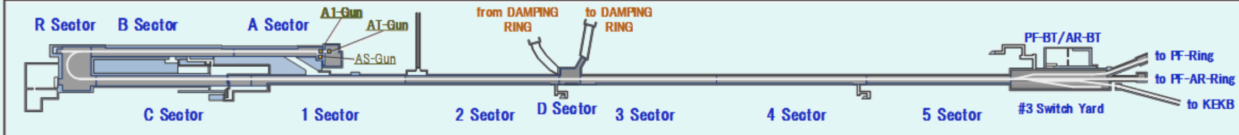
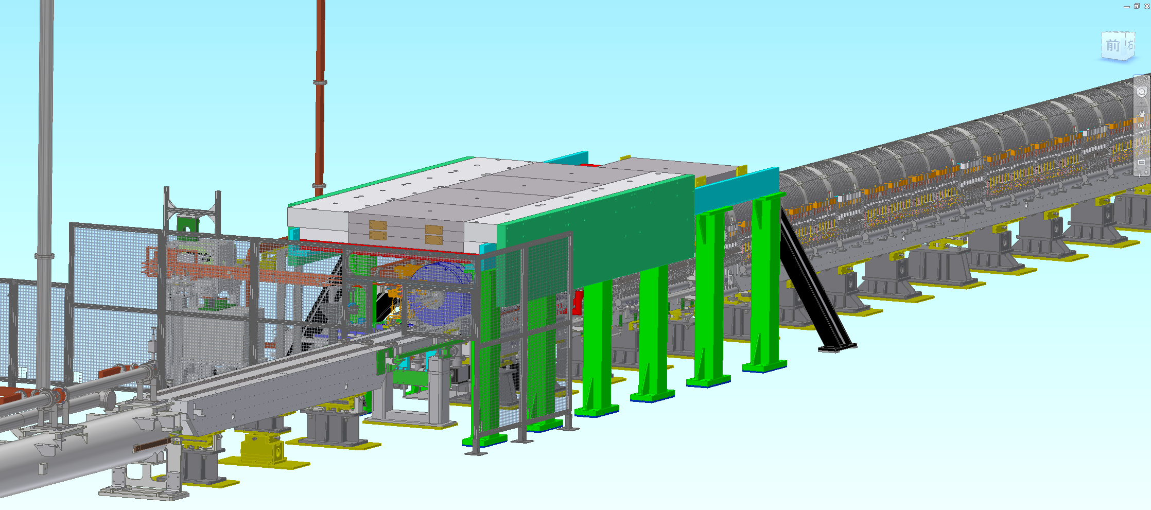
Positron source setup 1
Positron target and capture section

Slide 29
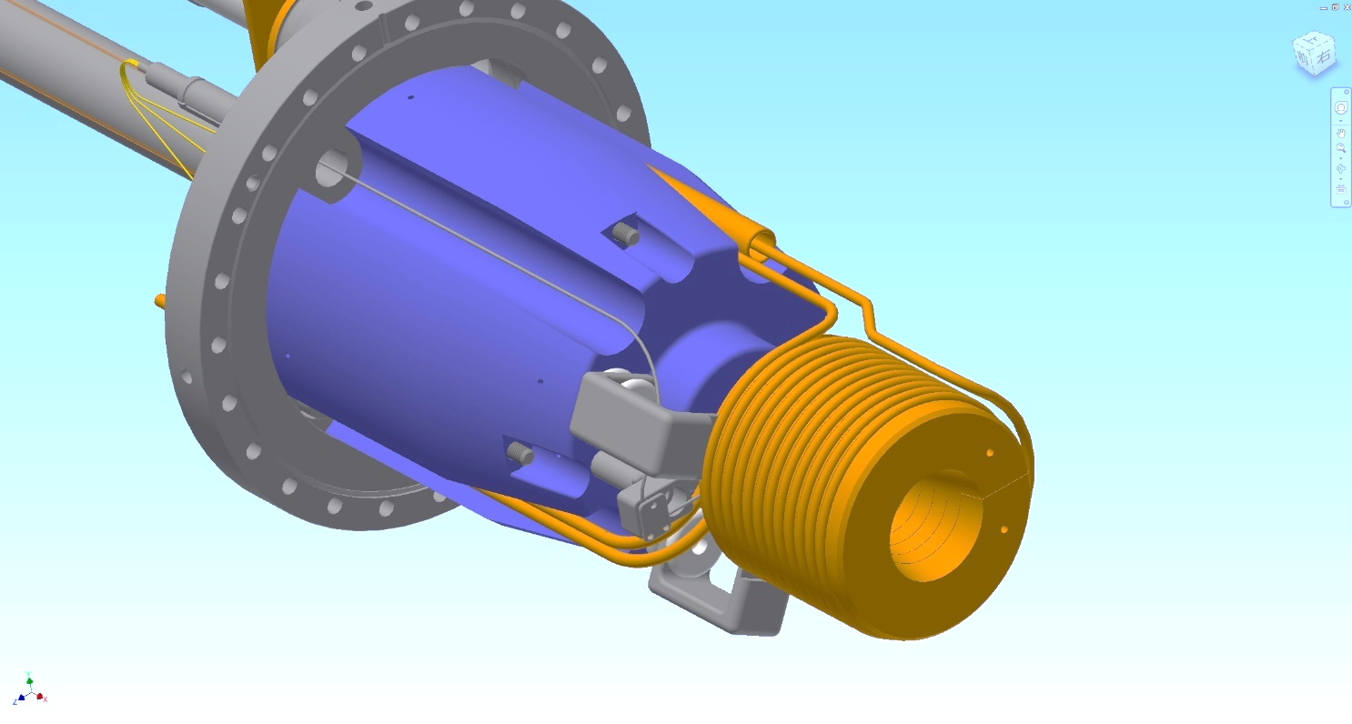
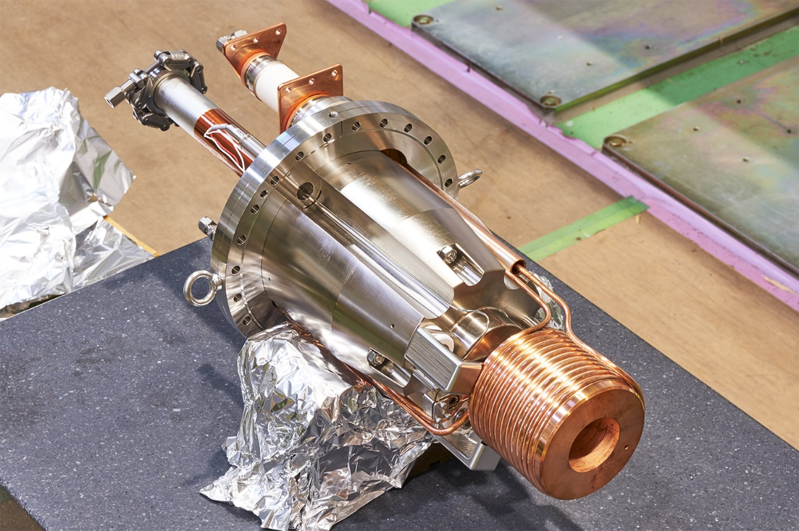
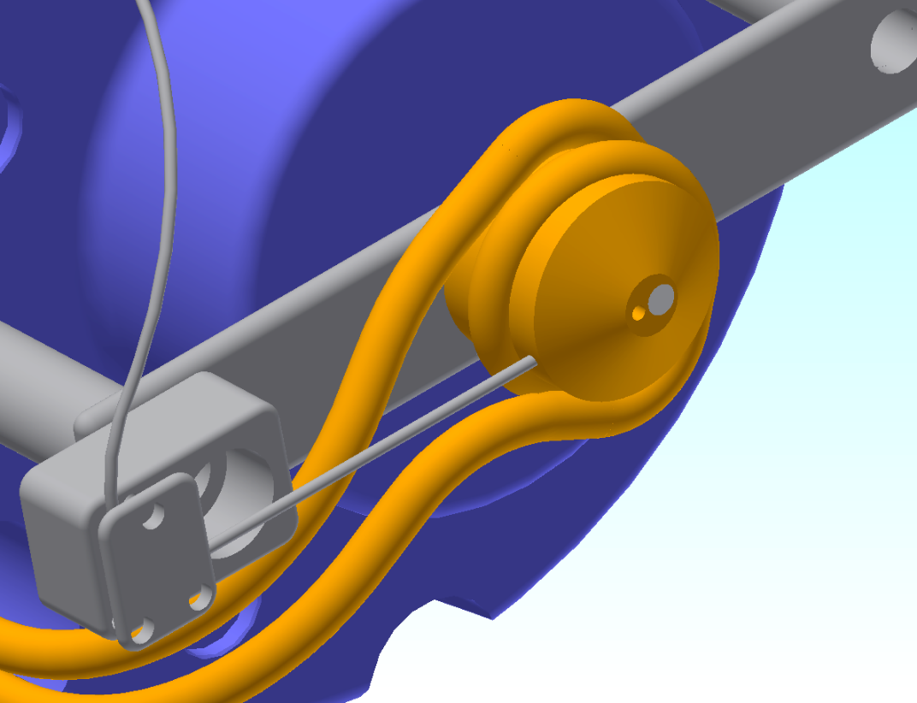
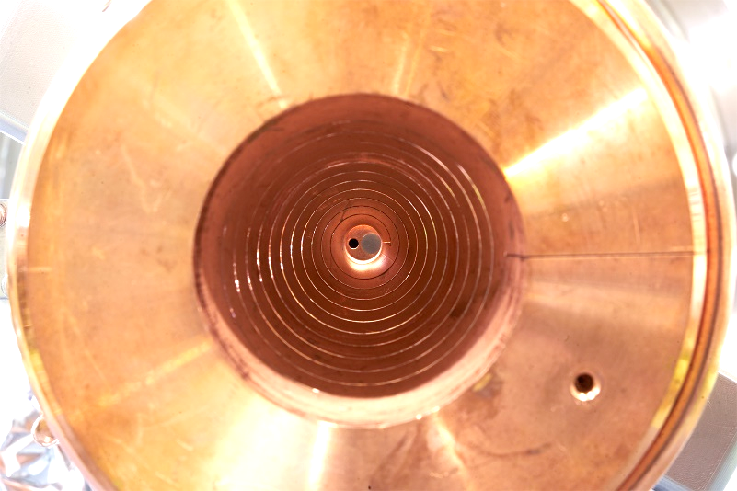
Positron source setup 3
beam
W target
Φ2 mm hole for electron
Temp sensor
Cooling water pipe

Slide 30
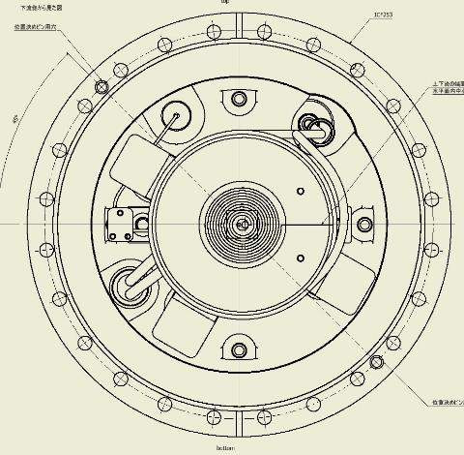
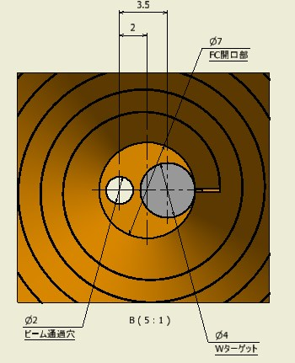
Target detail
Target material : W
Target size : Φ4 x 14
Inserted in the pule Cu block
Connected by HIP process
X = 0 hole for electron
X = 2 center of the FC
X = 3.5 center of the W target
looking from downstream side
X = 0

Slide 31
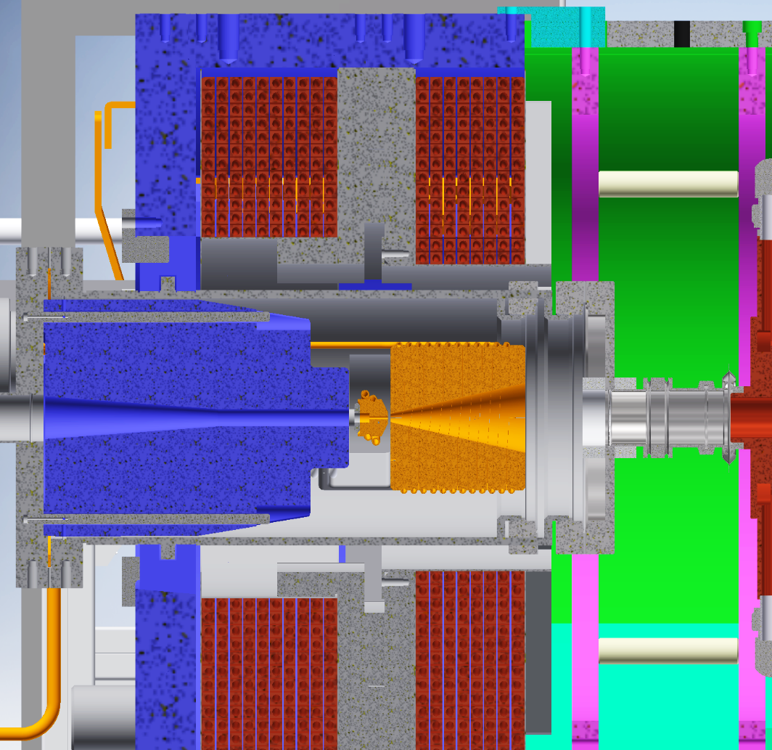
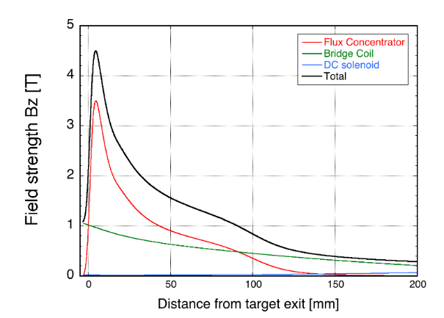
Positron source setup for SuperKEKB 4
Bridge coil
DC magnet
I = 650 A
Flux Concentrator
pulsed magnet
I = 12 kA
Calculated by T. Kamitani
Ratio B @ target / B @ entrance of the LAS is important
stronger field is preferred in the following solenoid section
much stronger field is required @ target

Slide 32
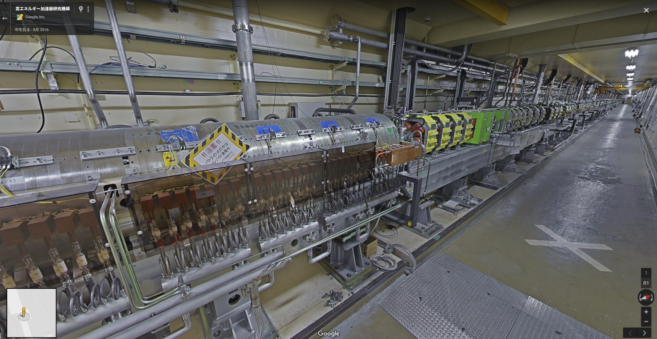
Capture section after the target 1
FC
+
target
solenoid
LAS
AC_15_1
AC_15_2
AC_16_1
AC_16_2
AC_16_3
AC_16_4
Normal
solenoid
Q
AC_17_1
AC_17_2
AC_17_3
AC_17_4
AC_18_1
AC_18_2
AC_18_3
AC_18_4
Quad section (115 m)
Solenoid section (15 m)
 | LAS | Normal S band
Acc. Gradient (MV/m) | 14/10 | 20
Aperture (mm) | 30 | 20
Electron / positron separator

Slide 33
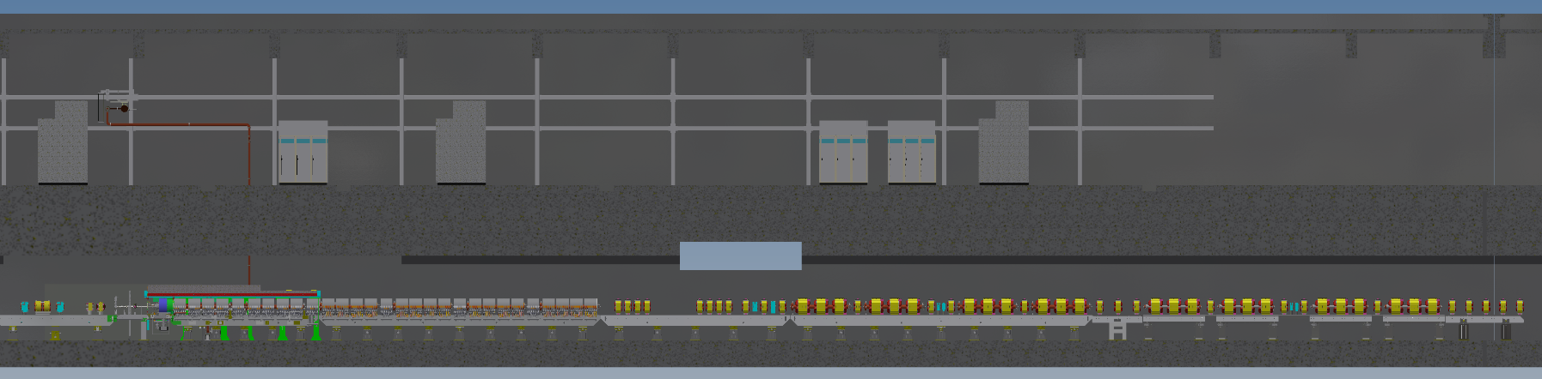
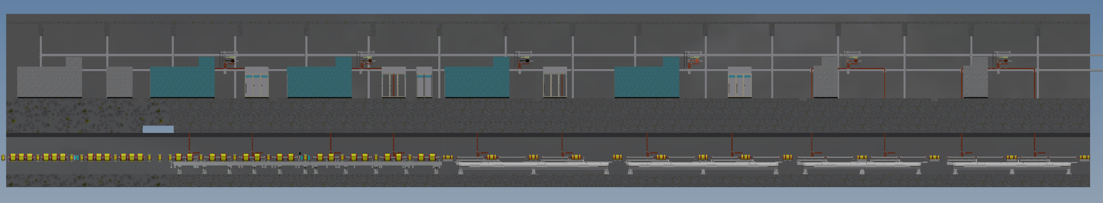
Capture section after the target 2
Target & FC
15m long solenoid
About 100 Quad magnet
1.1 GeV @ DR
LAS x 10
Normal x 32
1-5
1-6
1-7
1-8
To dumping ring
2-1
2-2
2-3
2-4
2-6
2-7
2-8
10m

Slide 34
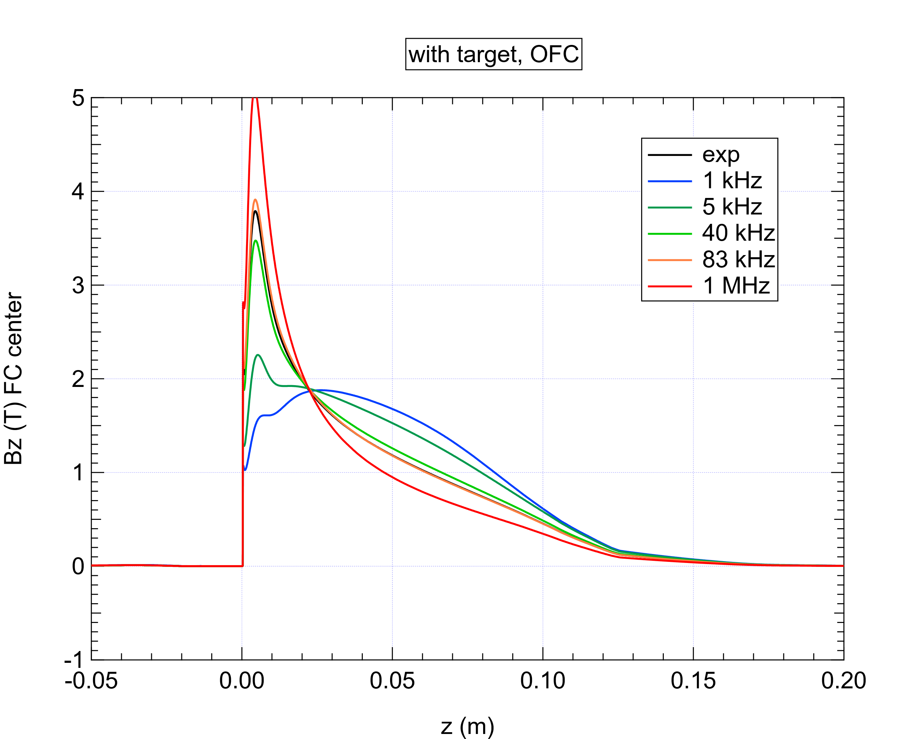
Pulse width dependence
Magnetic field shape is determined by skin depth
It is important to use realistic current waveform for simulation.

Slide 35
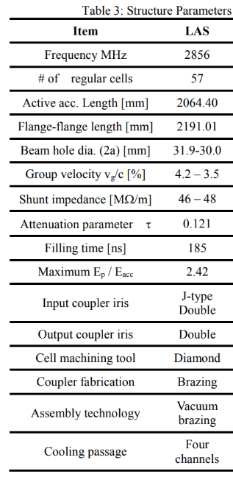
Gradient after the target
name | Design gradient (MV/m) | Operation gradient (MV/m) 2020/10/30 | Max gradient @ KLY power = 40 MW
AC_15_1 | 14.0 | 7.3 | 17.0
AC_15_2 | 14.0 | 7.3 | 17.0
AC_16_1 | 10.0 | 11.3 | 12.2
AC_16_2 | 10.0 | 11.3 | 12.2
AC_16_3 | 10.0 | 11.3 | 12.2
AC_16_4 | 10.0 | 11.3 | 12.2
Data from H. Ego
Due to the load problem, gradient of the first and second acc. structure after the target is low.
This may cause poor bunching which can be one of the reason for large beam loss during transportation to the DR.
https://www.pasj.jp/web_publish/pasj2014/proceedings/PDF/SAP0/SAP045.pdf
https://doi.org/10.18429/JACoW-IPAC2014-THPRI047

Slide 36
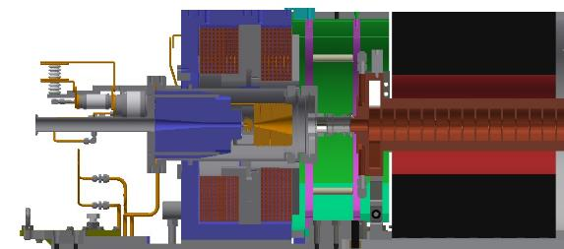
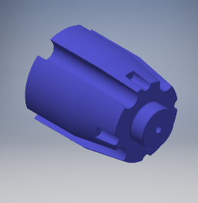
Orbit deflection by yoke
A Yoke to concentrate magnetic flux by the BC to the target
Asymmetric shape of yoke and saturation of magnetic field generate Bx, By inside yoke.
Simulation explain experimental results well.
Transvers magnetic field on beam axis (center) is not proportional to BC current.
If permeability is infinite, Bx, By is zero inside the yoke even if the shape is not symmetric

Slide 37
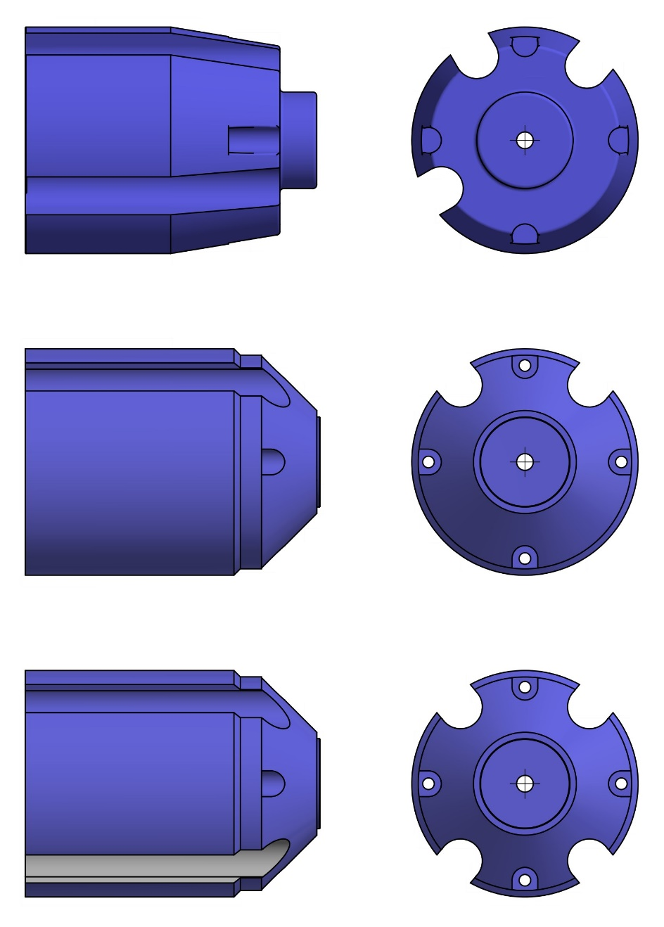
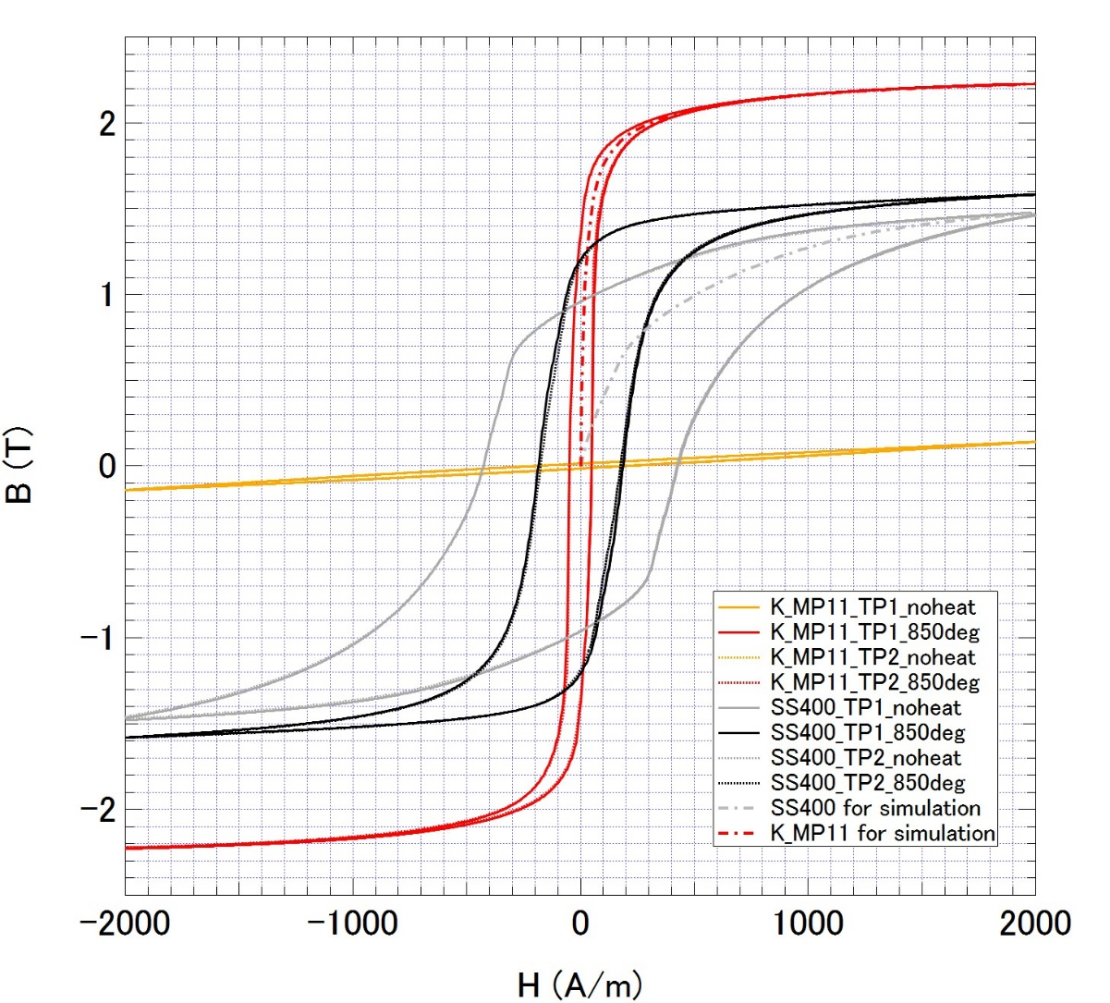
Upgrade the yoke
old
Shape was optimized
new
To increase Saturation magnetic flux density,
material was changed from
ordinary steel (SS400, 1.5 T) to
permendur (K_MP11, 2.2 T)

Slide 38
Comparison between simulation and measurement
Simulation by CST
measurement
Vertical axis is normalize at peak value to 100%
Target exit surface is z = 0
Distance between FC and target is 2 mm

Slide 39
Target detail
Target material : W
Target size : Φ4 x 14
Inserted in the pule Cu block
Connected by HIP process
X = 0 hole for electron
X = 2 center of the FC
X = 3.5 center of the W target
looking from downstream side
X = 0

Slide 40
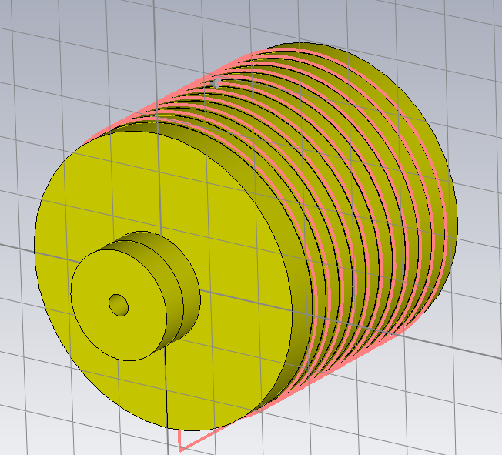
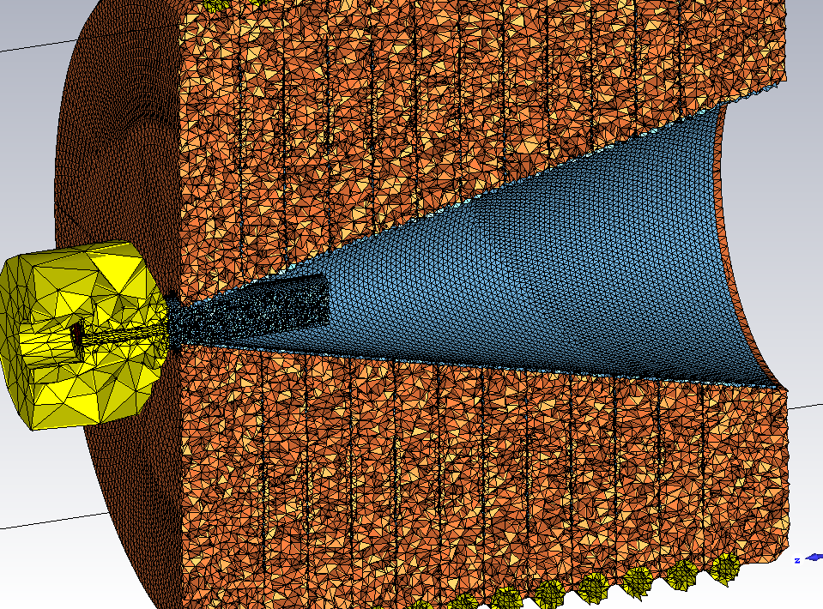
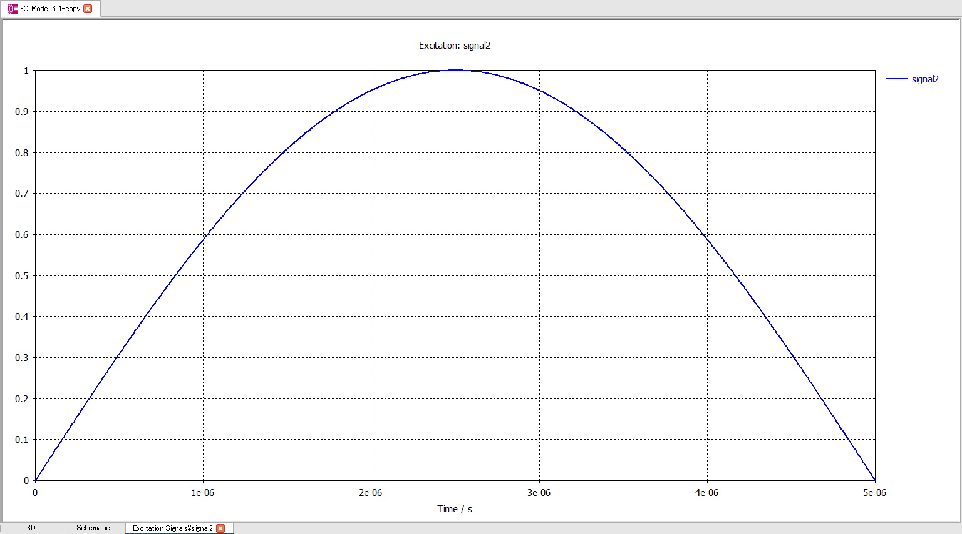
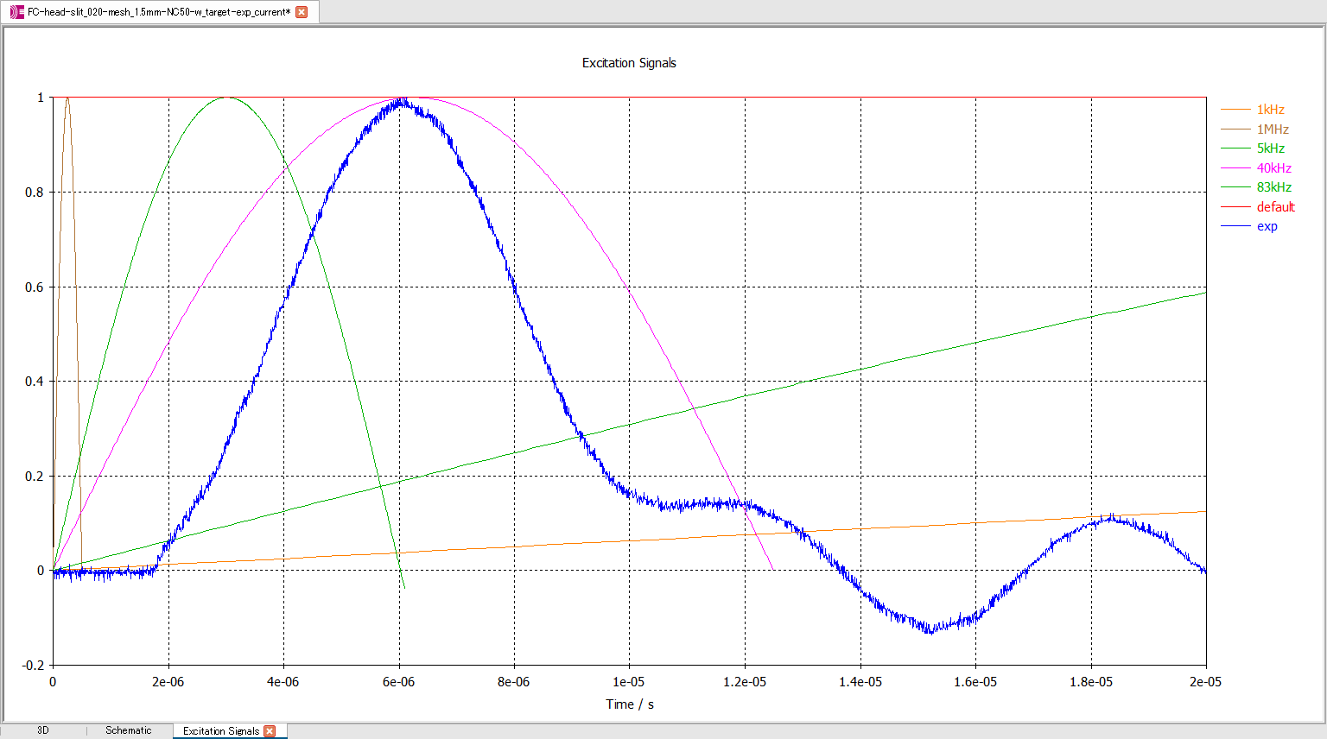
Magnetic field simulation
~ 2014
Now
Excitation current
Simulation using realistic model and measured current shape was established

