Slide 1
Compensation of the transient beam-loading effect in the capture linac of E-Driven positron source
ILC電子ビームドライブ陽電子源におけるoff-crest加速条件でのビームローディング補償
Masao KURIKI、Shun Konno, Tohru Takahashi, Zachary Liptack (Hiroshima U.）
Tsunehiko Omori, Kaoru Yokoya, Junji Urakawa, Masafumi Fukuda（KEK)

Slide 2
Outline
Beam Loading Compensation for Off crest Acceleration of the Capture Linac
Linear collider requires a large amount of electron and positron comparing to ring collider.
In ILC E-Driven positron source, the positron is generated in a multi-bunch format, 66 bunches with 6.15 ns spacing.
Positron rides initially on the deceleration phase and slips to the acceleration phase.
The phase of the heavy beam loading is moving from cos(π) to cos(0). It causes the voltage and phase variation of acceleration field.

Slide 3
CONTENTS
Overview of the capture linac of ILC E-Driven Positron Source
The capture linac is composed from APS standing wave cavities.
Beam Loading Compensation
Beam loading voltage for SW cavity with the off-crest acceleration and the compensation.
Linac tuning method
Consider an actual tuning method with lack of information.
Summary and conclusion

Slide 4
Overview of the Capture Linac

Slide 5

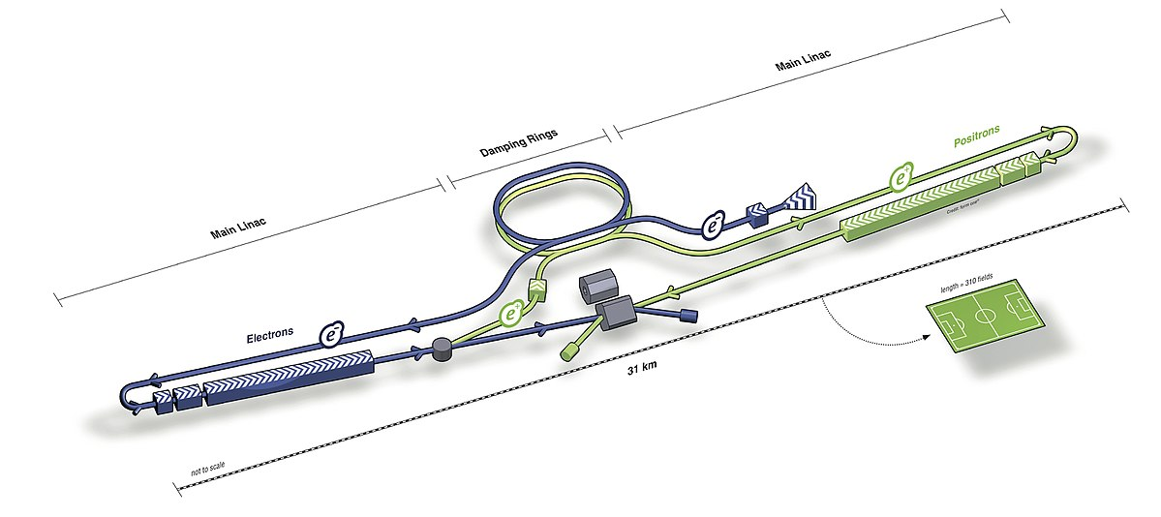
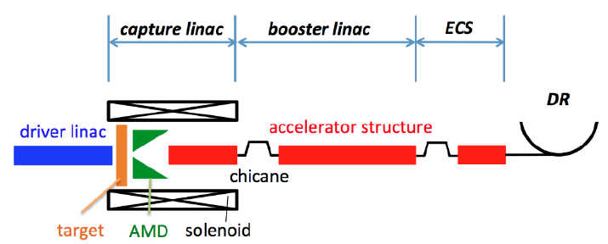
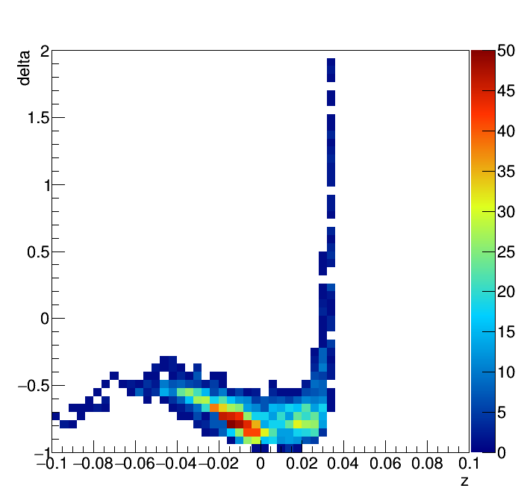
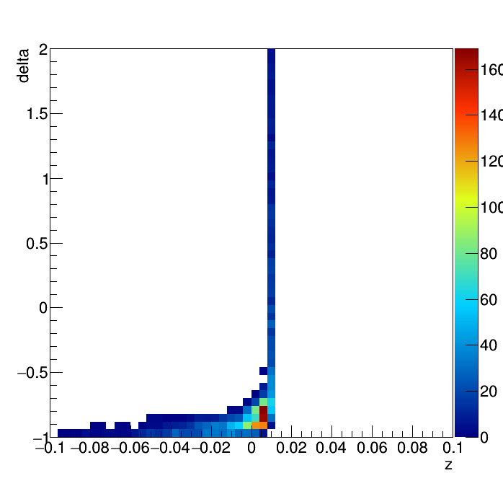
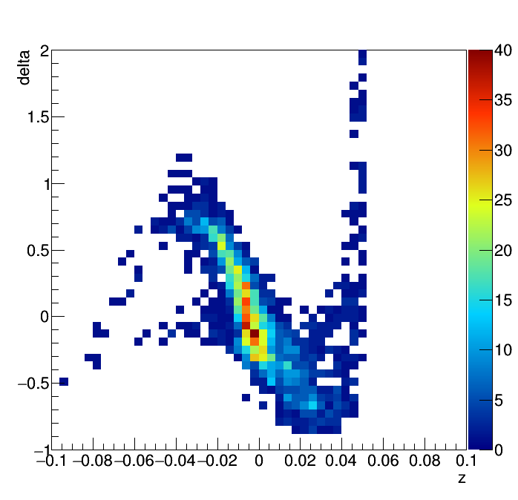
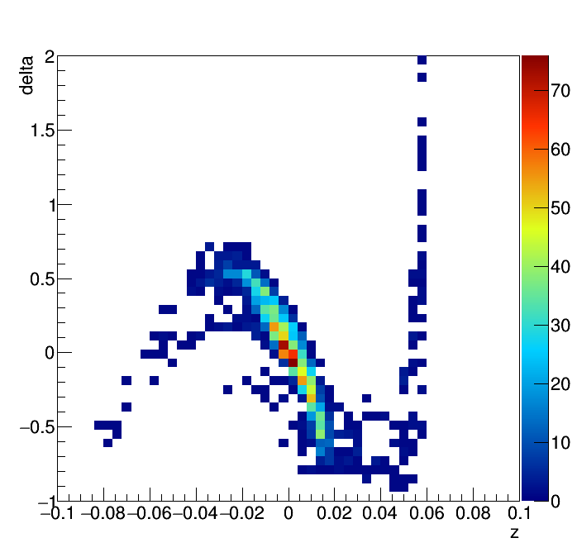
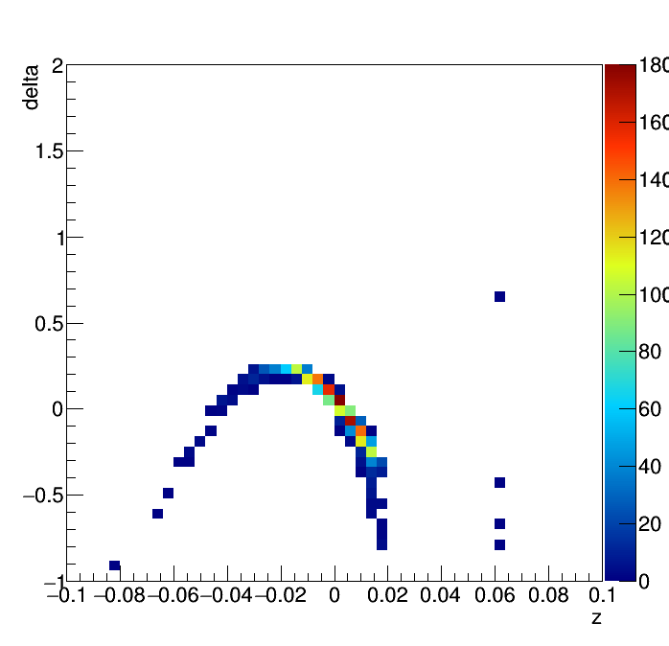
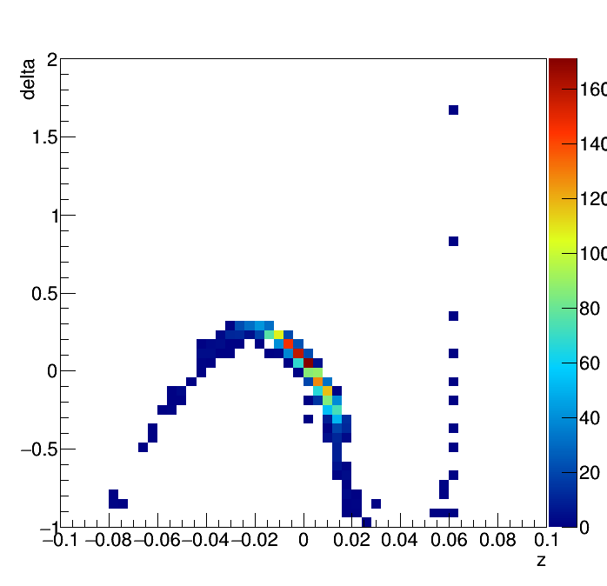
Overview of Capture linac
3 GeV 4.0 nC electron driver
19 mm W-Re rotating Target
37of L-Band SW (11cell APS) Linac
Chicane to remove electron
Booster : L and S-Band TW Linac
ECS (Energy Compressor Section)
Positrons are placed at the deceleration phase and captured at the acceleration phase by slippage.
Positrons are handled as 66 multi-bunch format with 6.15 ns spacing.
Detail of the capture simulation: H. Nagoshi, et al., NIMA(953)163134(2020)
APS cavity property : Next talk by S. Konno
Parameter | Number | Unit
Frequency | 1300 | MHz
Shunt Impedance | 31.5 | MΩ/m
Aperture (2a) | 60 | mm
Q Value | 24970
Length | 1.27 | m
RF power | 22.5 | MW

Slide 6
Beam Loading Compensation

Slide 7











Transient property of SW cavity (Single cell model)
Acceleration field by RF input
Energy Conservation
$$\frac{dW}{dt}=P_{in}−P_{r}−P−IV$$
By voltage,
$$W=\frac{Q}{ωR}V^{2}, P=\frac{V^{2}}{R}$$
$$P_{in}=\frac{{βV}^{2}}{R}, P_{r}=\frac{β{\left(V_{in}−V\right)}^{2}}{R}$$
$$\frac{dV}{dt}=−\frac{\left(1+β\right)ω}{2Q}V+\frac{ω}{Q}\sqrt{βRP}$$
$V\left(t=0\right)=0, P=P_{o}u(t)$, $I=I_{0}u\left(t−t_{b}\right),$
$u(t)$: step function
$$V(t)=\frac{2\sqrt{βP_{o}R}}{1+β}\left(1−e^{−\frac{t}{τ}}\right)−\frac{RI_{B}}{1+β}\left(1−e^{−\frac{t−t_{b}}{τ}}\right)$$
$$τ=2Q/(1+β)ω$$
$$RF input$$
$$P_{in}$$
$$P_{r}$$
$$E_{in}$$
$$E_{r}$$
$$E_{}$$
$$I_{B}$$
$$W$$
$$P$$
$$V=EL$$

Slide 8
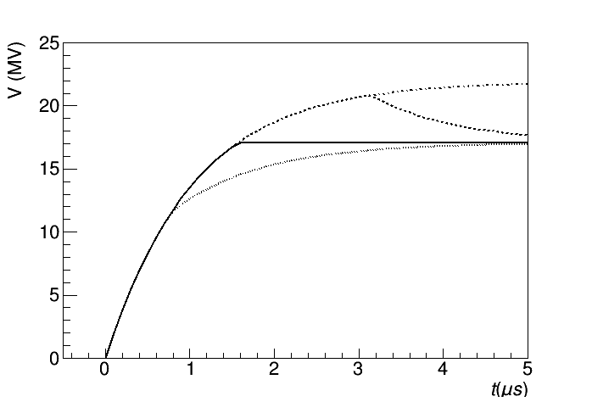




Beam Loading Compensation
On crest acceleration
$$V(t)=\frac{2\sqrt{βP_{o}R}}{1+β}\left(1−e^{−\frac{t}{τ}}\right)e^{ıωt}−\frac{ωRI_{B0}}{1+β}\left(1−e^{−\frac{t−t_{b}}{τ}}\right)e^{ıωt}$$
$$RF input$$
Voltage is uniform, if $t_{b}=−τln\left(\frac{I_{B0}}{2}\sqrt{\frac{RL}{BP_{0}}}\right)$
$$P_{in}$$
$$P_{r}$$
$$E_{in}$$
$$E_{r}$$
$$E_{}$$
$$I_{B}$$
$$W$$
$$P$$
$$V=EL$$

Slide 9
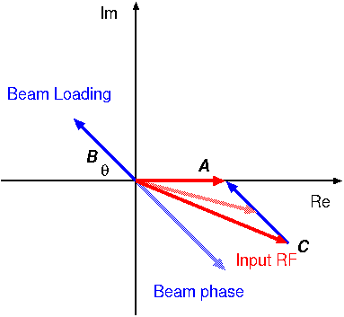
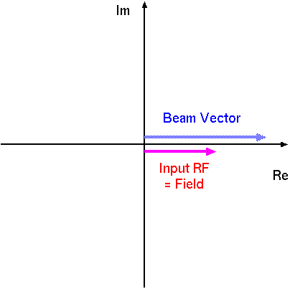
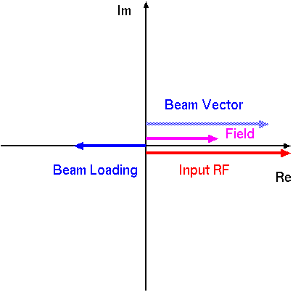
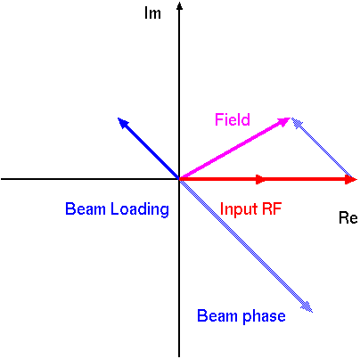

Beam Loading Compensataion : Off crest
Off crest acceleration with a phase $θ$,
$$V\left(t\right)=\frac{2\sqrt{βPrL}}{1+β}\left(1−e^{−\frac{t}{T}}\right)e^{ıωt}$$
$−\frac{IrL}{1+β}\left(1−e^{−\frac{t−t_{b}}{T}}\right)e^{ı\left(ωt+θ\right)}$
The phase is varied over the pulse. The phase should be controlled for the compensation.
Off crest BL
with PM
1st bunch
On crest BL
Off crest BL
In this treatment, the crest acceleration (θ=0) is assumed, i.e. field by input RF and beam are in the same phase. If the phase is different,

Slide 10

RF input Phase Modulation
Acceleration voltage of the off-crest acceleration with phase q,
$$V(t)=V_{0}\left(1−e^{−\frac{t}{τ}}\right)\cos{ωt}−V_{b0}\left(1−e^{−\frac{t−t_{b}}{τ}}\right)\cos\left(ωt+θ\right)$$
The voltage and phase are varied, even the envelope is matched. To cancel the beam loading voltage, the RF input voltage has to be,
$$V_{RF}\left(t\right)=V_{10}\cos{ωt}+V_{b0}\left(1−e^{−\frac{t−t_{b}}{τ}}\right)cos\left(ωt+θ\right)$$
In this case, $V\left(t\right){=V}_{10}\cos{ωt}.$ $V_{RF}\left(t\right)$ is rewritten as
$$V_{RF}\left(t\right)=\sqrt{A^{2}+B^{2}}\cos\left(ωt+ς\right)$$
$$V_{2}=V_{b0}\left(1−e^{−\frac{t−t_{b}}{τ}}\right)$$
$$A=V_{10}+V_{2}\cos{θ}$$
$$B=V_{2}\sin{θ}$$
$$ς=\tan^{−1}{B/A}$$

Slide 11

$$V\left(t\right)=\sqrt{A^{2}+B^{2}}\cos\left(ωt+ς\right)$$
The asymptotic value of the envelope has to be equal to the envelope of the input RF as
$$\lim_{t→∞}{\sqrt{A^{2}+B^{2}}}=\frac{2\sqrt{βP_{o}R}}{1+β}=V_{0}$$
$V_{10}$ (Voltage at the first bunch) is obtained as
$$V_{10}^{2}+2V_{b0}\cos{θ}V_{10}+V_{b0}^{2}−V_{0}^{2}=0$$
$$V_{10}=−V_{b0}\cos{θ}+\sqrt{V_{0}^{2}+V_{b0}^{2}\left({\cos{θ}}^{2}−1\right)}$$
Time to start the beam acceleration $t_{b}$is
$$t_{b}=−T_{0}\ln\left(1−\frac{V_{10}}{V_{0}}\right)$$
$$V\left(t\right)=V_{0}\left(1−e^{−\frac{t}{τ}}\right)\cos\left(ωt+ς\right)$$
$ς=\left\{\begin{matrix}0 \left(t<t_{b}\right) \\ \tan^{−1}{\frac{V_{2}\sin{θ}}{V_{10}+V_{2}\cos{θ}} \left(t>t_{b}\right)}\end{matrix}\right.$

Slide 12
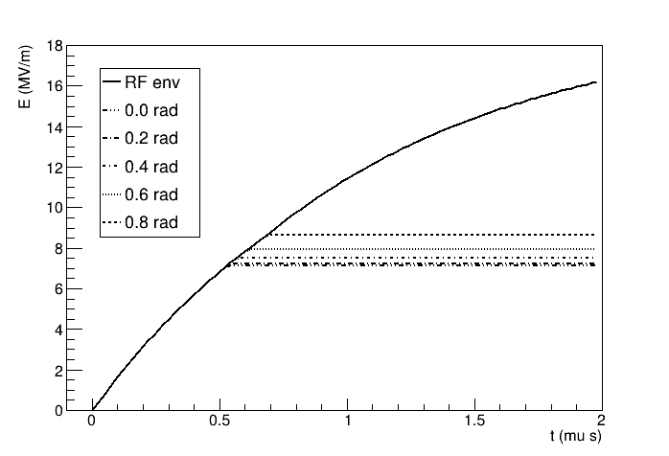
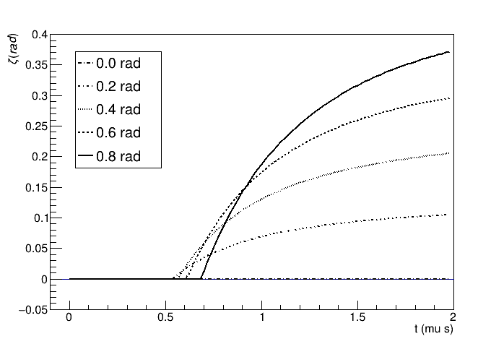
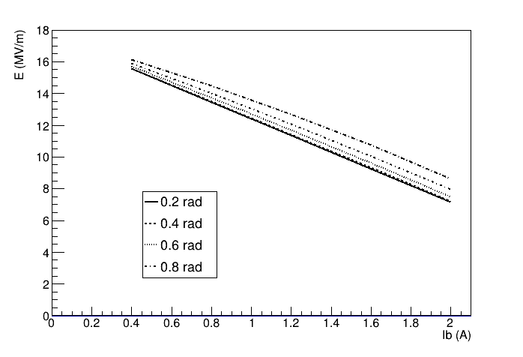
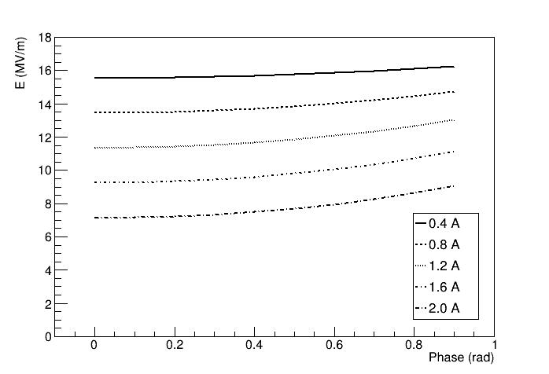
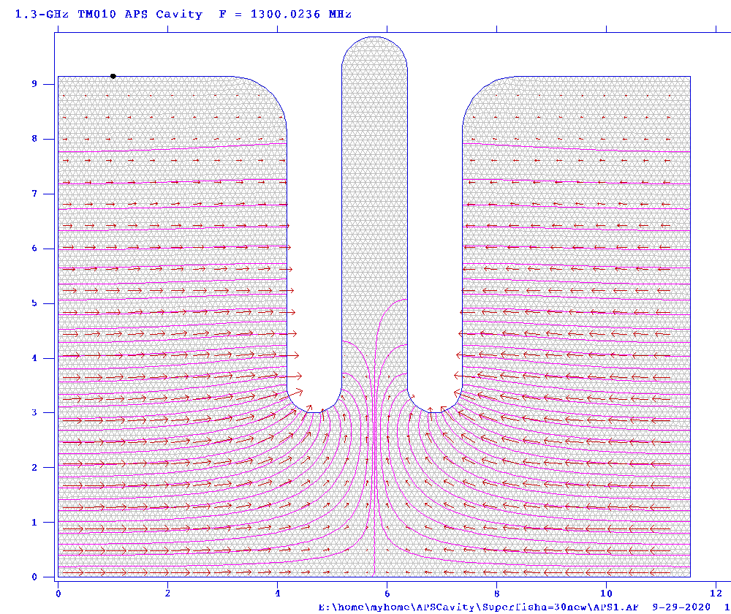

APS cavity
π/2 mode SW
$$r_{sh}=31.5\frac{MΩ}{m}$$
$$Q_{0}=25000$$
$$β=5.0$$
P_{RF}=22.5 MW
Ib=2.0A

Slide 13
Linac Tuning

Slide 14
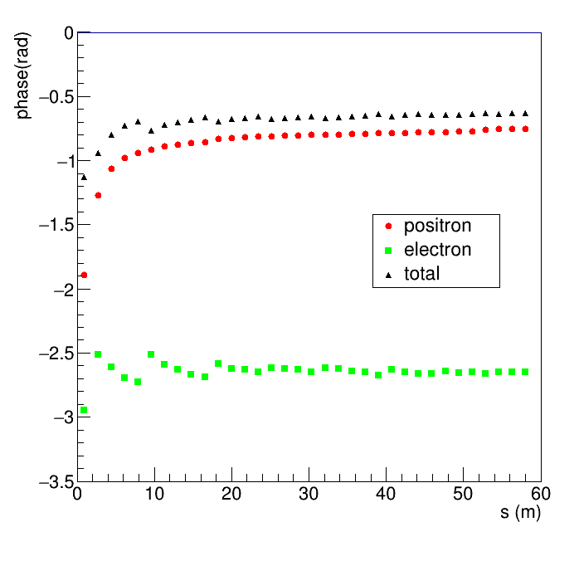
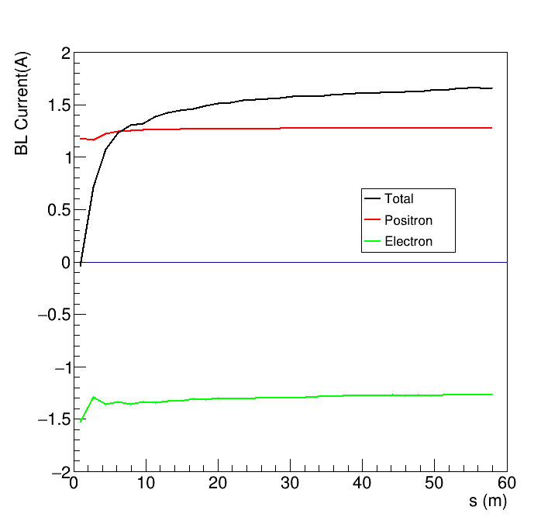
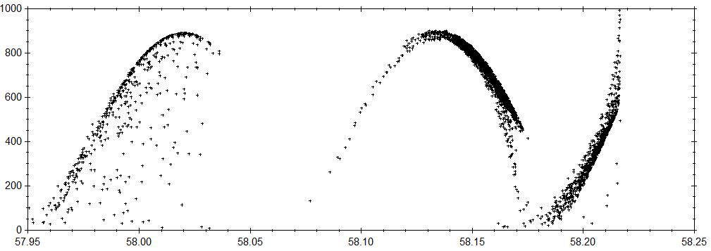
Beam profile at the capture linac
BL電流
ビームの相対位相
Positrons and electrons are initially placed at cos(-p), Ez<0 phase.
Positrons moved to the acceleration phase by slippage.
Beamloading current is initially zero, and increased up to <2A.
GEANT for particle generation (Bremsstralung + pair-creation) , GPT for particle tracking in the capture linac, BL is evaluated by a C program.
加速エネルギー
加速管の加速電圧
Electron
Positron

Slide 15
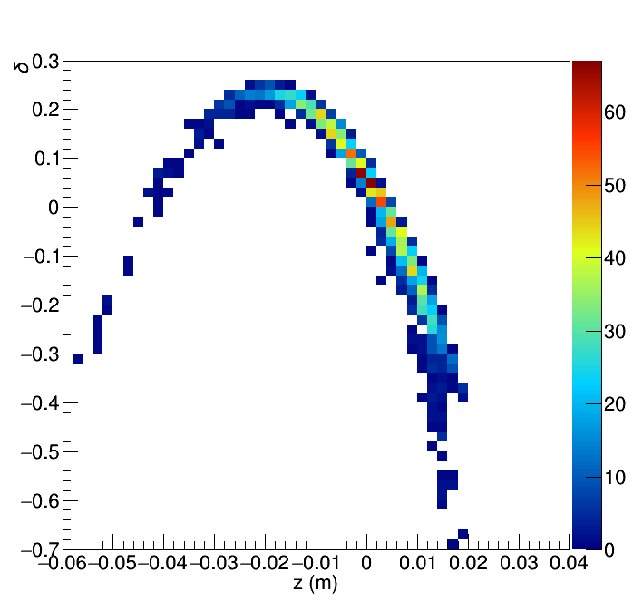
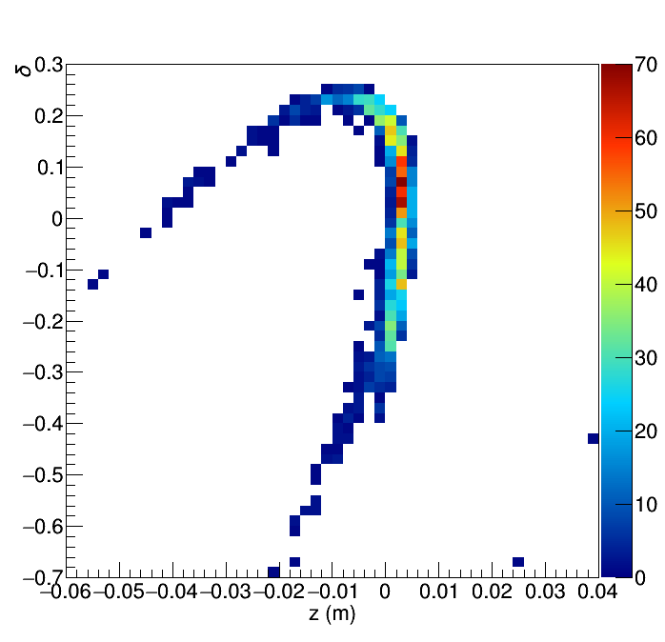
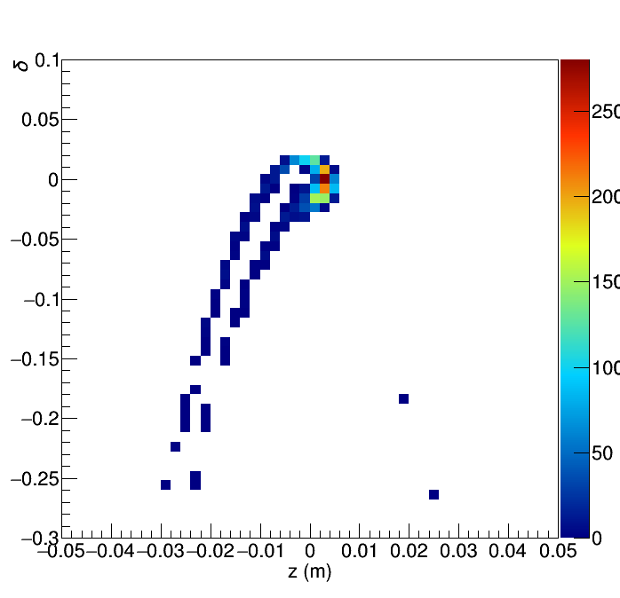
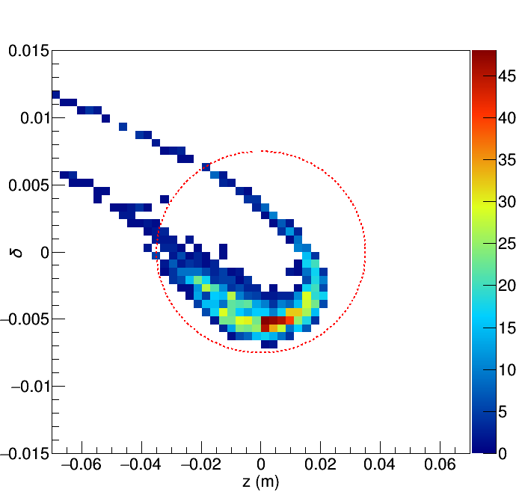

Positron yield evaluation
Capture Linac Exit
Chicane Exit
After the capture linac, chicane, booster, and ECS are simulated as a linear transformation.
Chicane ($R_{56}$=0.053)、Booster (L and S-band acceleration)、ECS ($R_{56}$ $=$-0.90, $R_{56}$=1.14).
Phase space distribution (z, $δ$) is examined with the dynamic aperture of DR as
$$\frac{z^{2}}{{0.035}^{2}}+\frac{δ^{2}}{{0.0075}^{2}}<1$$
$$η=\frac{\# of e+in aperture}{\# of electron on target (1000)}$$
Transverse acceptance, beam loss after the chicane is not considered.
Booster Exit
ECS Exit

Slide 16
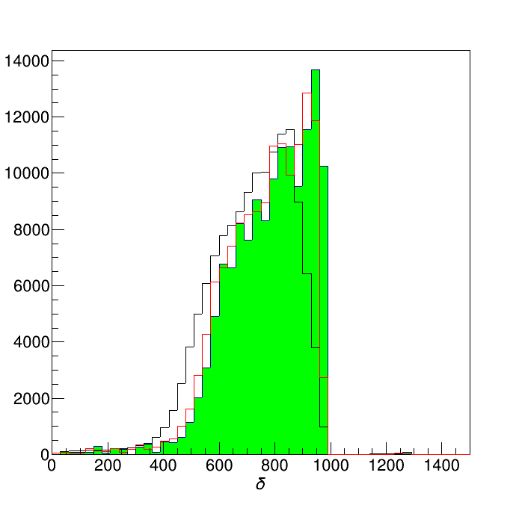
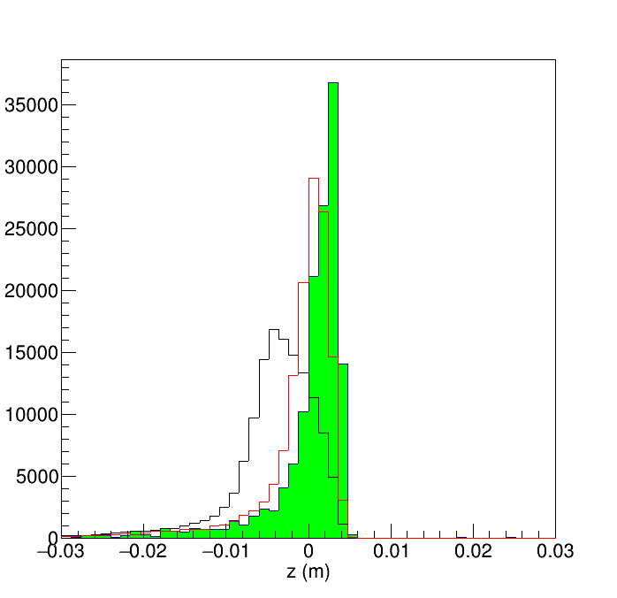
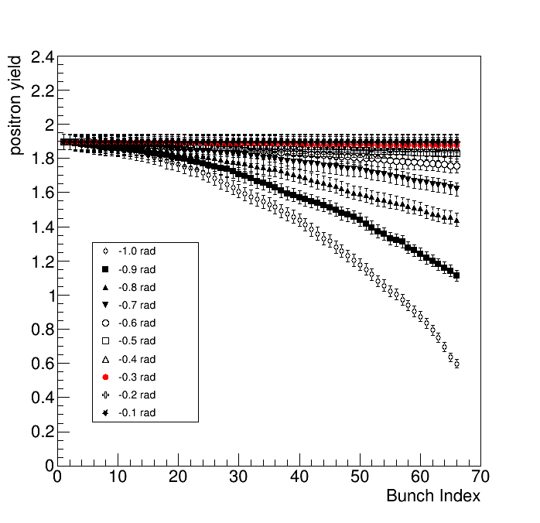

Global phase modulation
Assumptions
  Beam loading current is average over the linac.
  We assume a global phase.
${δ and σ}_{z}$ are improved.
The yield over the pulse (66 bunches) is uniform with the optimum phase modulation.
The tuning parameters for the beam loading compensations are only two: phase and current.
10th Bunch
20th Bunch

Slide 17
Summary
Beam loading compensation for the off-crest acceleration of SW cavity is considered.
A simple envelop adjustment by the timing does not work.
The timing adjustment with PM works well.
The linac tuning for the beam loading compensation is possible only with a couple of global parameters, current and phase.
In this method, we treat the cavity as a single cell.
Effect of the cell couplings is discussed in the next Konno’s presentation.

Slide 18
THANK YOU!
Any Questions?

