Slide 1
Outline
Undulator
Target cooling
Material test
Design of Rotating Wheel system
Summary
Target for the Undulator e⁺ source
S. Riemann, G. Moortgat-Pick, P. Sievers

Slide 2
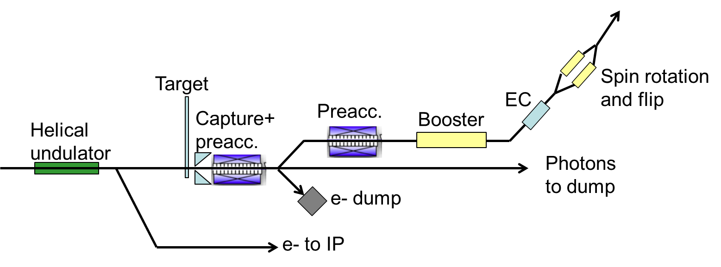
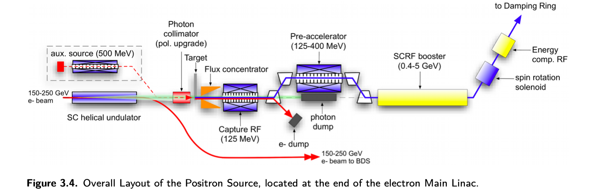
TDR baseline layout of the e+ source
The polarized e+ source scheme
Required positron yield: Y = 1.5e+/e- at damping ring
To be done until e+ source decision:
  Undulator: Simulation (field,errors, alignment)
  target system design
  Design of the magnetic focusing system

Slide 3
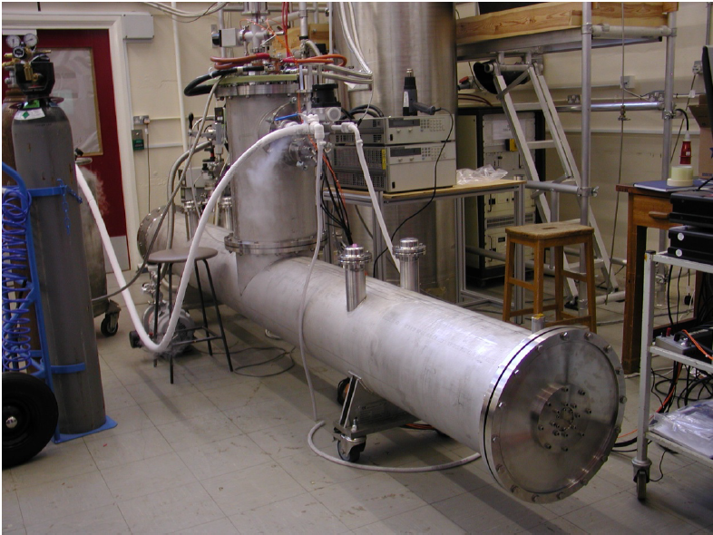
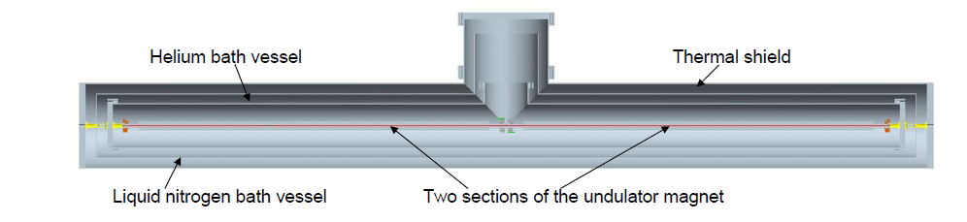
Superconducting helical undulator
Helical undulator
  period, λ_{U} =11.5mm
  strength K ≤ 0.92 (B ≤ 0.86T); K ~ B⋅λ_{U}
  aperture 5.85mm
4m prototype built and tested (UK)
  Cryomodule, contains 2 undulator modules of 1.75m length each
ILC TDR:
  Max 231m active undulator length (132 undulator modules in 66 cryomodules]
  Quadrupoles every 3 cryomodules → total length of undulator system is 320m
Narrow photon beam (θ ~ 1/γ), few 10¹⁶ γ/sec, ~60-70kW
D.Scott et al.,Phys. Rev. Lett. 107,
174803 (2011)

Slide 4
The conversion target
Located ~240m downstream the undulator exit
Only few % of the photon beam power is deposited in the target
Target: Ti6Al4V
  Wheel (~1m diameter) spinning in vacuum with 2000rpm (100m/s tangential speed) to distribute heat load
Target thickness:
  ILC250
    Av. photon energy is O(7.5 MeV);
    target thickness of 7mm (0.2X₀)
    Power deposition ~2kW (nominal Lumi)
  ILC500:
    Av. photon energy is O(27 MeV);
    target thickness of 14.8mm (0.4X₀)
    Power deposition ~2kW (nominal L)
Photon beam hits wheel at r=0.5m
  One pulse with1312 bunches occupies ~7cm (2625 bunches ~10cm)
  Every ~7-8sec load at same target position
  in 5000h roughly 2.5×10⁶ load cycles at same spot
1 pulse
photons
Photon beam path on
spinning target wheel

Slide 5
e+ source parameters
 |  | ILC250
Electron beam energy | GeV | 126.5
Active (total) undulator length L_{und} | m | 231 (320)
Undulator K |  | 0.85 (FC) | 0.92 (QWT)
Photon energy (1st harmonic) | MeV | 7.7 | 7.2
Average photon beam power | kW | 63 | 72
Distance target – middle undulator | m | 401
Photon beam spot size on target (σ) | mm | 1.2 | 1.45
Average power deposited in target (1312 bunches/pulse) | kW | 1.94 | 2.20
Peak energy deposition density in rotating target (1312 b/pulse) | J/g | 61.2 | 59.8
Positron polarization | % | ~30
so far, e+ source simulations assumed ideal undulator
yield with QWT below 1e+/e- ➔ alternatives see P. Sievers’ talk

Slide 6
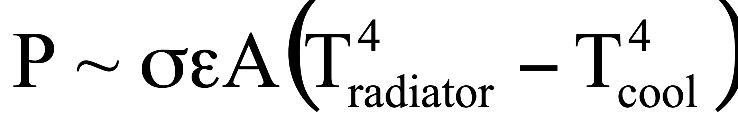
Cooling of the target wheel
Water cooling (TDR) does not work
Few kW heat deposition can be removed with thermal radiation:
  heat radiates from spinning target to a stationary water-cooled cooler
  ε = effective emissivity
Ti alloys have low thermal conductivity (λ = 0.06 – 0.15 K/cm/s)
  heat propagation ~ 0.5cm in 7sec (load cycle)
  heat accumulates in the rim near to beam path
Side view cutout e+ target
OMD
Rotating
Target wheel
stationary water-cooled cooler, T_{cool}

Slide 7
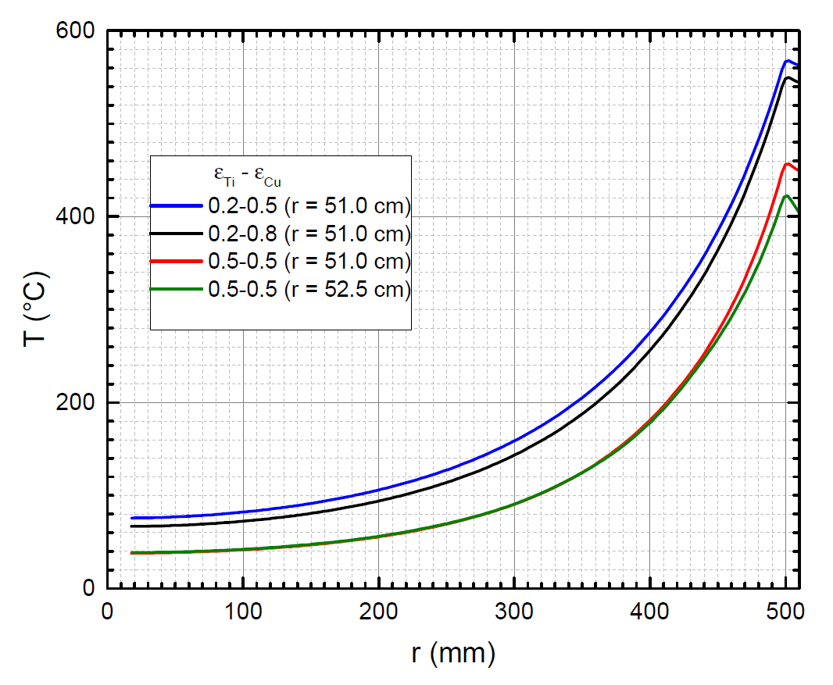
Temperature distribution in target
Average temperature in Ti6Al4V wheel as function of radius r for different surface emissivity of target and cooler (Cu); Target wheel assumed as disk
Photon beam impact at r=50cm
Deposited power = 2kW
e_{eff}= 0.33 for e_{Ti} = e_{Cu}=0.5
T_{ave} ≤ 460˚C
max average temperatures
can be decreased for larger
wheel radius
Main cooling power from area
with r₀ ±5cm
F. Dietrich
Studies (FLUKA, ANSYS) show that such spinning disk stands heat and stress load

Slide 8
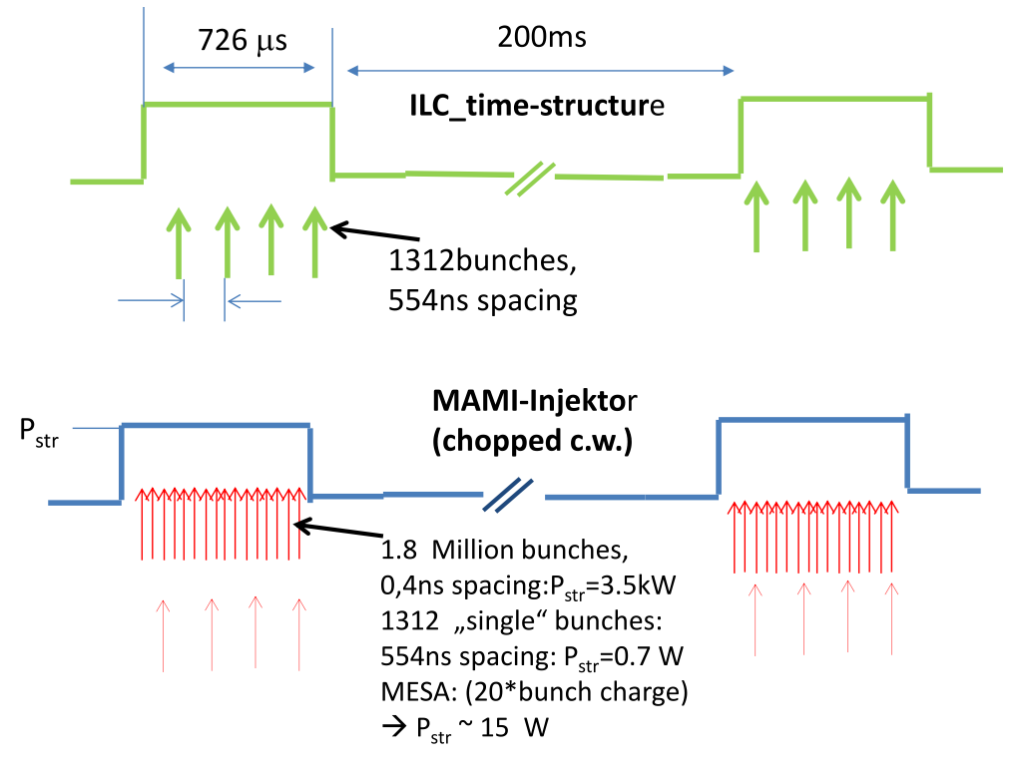
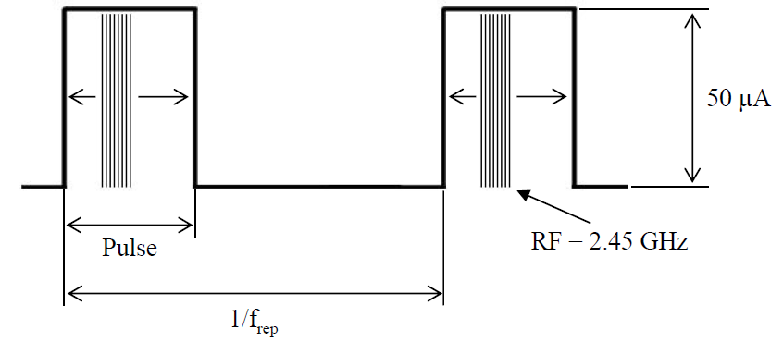
Material Tests
ILC e+ target MAMI
Beam particles photons electrons
Average energy 7.5…40MeV 14MeV, 3.5MeV, 180MeV(plan)
DT_{max} /pulse 60-120K 50-350K
Max energy deposition density ~60J/g ~50-200J/g *
Eff. pulse length on material 25-55μs 1-5ms O(50μs)
Eff. pulse rep rate on material 0.17 Hz 1Hz …120Hz
Displacement per atom (dpa) ~0.3-0.5 per year ~0.33/24h (14MeV)
~0.22/24h (4MeV)
* Load adjusted by beam spot size,

Slide 9
Tests performed for Ti6Al5V (choice)
year | thickness [mm] | Pulse length [ms] | Rep. rate [Hz] | ΔT/pulse [K] | T_{ave} @ spot [C] | # load cycles
2016 | 1 | 2.0 | 100 | ~60-80 | ≥630 | 6.8×10⁶
 | 2 | 2.0 | 100 | ~60-80 | 710…~1000 | 5.2×10⁶
2017 | 0.2 | 2 | 100 | 455 | 40 | 6.2×10⁶
2018 | 0.2 | 1.5 | 10 | 350 | 98 | 54,000
2018 | 0.2 | 1.5 | 20 | 335 | 155 | 48,000
 | 0.2 | 1.0 | 100 | 240 | 365 | 100,000
 | 0.25 | 1.0 | 120 | 230 | 425 | 324,000
 | 0.25 | 0.5 | 140 | 170 | 300 | 336,000
 | 0.5 | 1.00 | 100 | 230 | 435 | 240,000
 | 0.5 | 0.5 | 100 | 170 | 280 | 240,000
 | 0.5 | 0.5 | 140 | 160 | 345 | 336,000
Plan: use the e- beam with 180MeV
Tests with shorter pulse length (ms → ~50 microsec)
use samples of ~5mm thickness
Test also alternative high temperature Ti alloys, e.g. Ti SF61

Slide 10
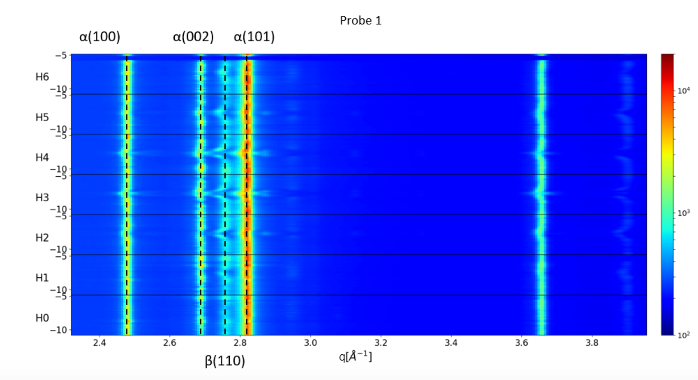
Analyses of irradiated samples
Surface inspection by laser scanning
Scanning electron microscope
synchrotron diffraction methods performed
  Used in transmission as well as in reflection geometry
  Phase transitions between α- and β-phase in Ti-alloy observed in case of heavy overloading
  Overloading yields grain growth in Ti alloy
  Thin foils of Ti and Ti alloys stand high PEDD
Target material will stand the load by photon beam
A. Ushakov et al.
TUPAB002 IPAC2017
See also Bachelor
Thesis of T. Lengler

Slide 11
Upgrades (E, L)
Ecm | GeV | 250 | 350 | 500
Active undulator length | m | 231 | 147
Undulator K |  | 0.85 | 0.66 | 0.45
Photon yield | g/e- | 393 | 157 | 76.1
Photon energy (1st harmonic) | MeV | 7.7 | 17.6 | 42.8
Average photon beam power | kW | 62.6 | 45.2 | 42.9
Distance target – middle undulator | m | 401 | 500
Target (Ti6Al4V)thickness | mm | 7 | 14.8
Average power deposition in target | kW | 1.94 | 3.3 | 2.3
Photon beam spot size on target (σ) | mm | 1.2 | 0.89 | 0.5
Peak Energy Deposition Density (PEDD) in spinning target per pulse | J/g | 61.0 | 42.4 | 45.8
Polarization of captured positrons | % | 29.5 | 30.8 | 24.9
Luminosity upgrade
  doubles the power deposited in target ⬄ average T(in K) is increased by factor ~1.2
  PEDD is increased by factor ~1.5

Slide 12
Target wheel design (1)
Continue material tests to test and confirm robustness of baseline and alternative target material
    Remark: irradiation of thin foils test the performance of material for the exit window to the photon dump
Optimize target geometry
  Keep temperatures, stresses, etc. well below the limits while maintaining the required e+ yield
  Study influence of eddy currents (heating, drag forces) caused by B field at target from OMD
  Studies to be done with ANSYS, COMSOL,…
  Lab test of target sector to confirm cooling performance

Slide 13
Set up for the lab test to confirm the radiation cooling performance using a target sector
Test robust connection of target material (low heat conductivity) to a “radiator” with high heat conductivity to achieve higher cooling efficiency
Vacuum Tank
Side View
Multi Layer Super Insulation
Conductor to bring heat to target
$$°$$
Electrical Heater (~1kW), simulating the average beam power.
$$°$$
$$°$$
«Ti-Target»
Thermo-Couples
$$°$$
«Ti-Radiator»
Water Cooled Cooler

Slide 14
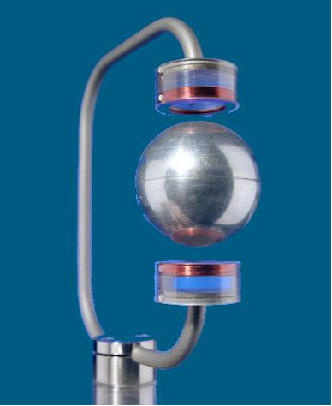

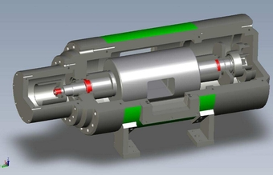
Target wheel design (2)
Drive and bearings
Radiation cooling allows magnetic bearings
  A standard component to support elements rotating in vacuum.
  The axis is «floating» in a magnetic field, provided by permanent or electro magnets
  Allows long time operation at high rotation speed without maintenance
  Among other things, magnetic bearings are used as Fermi-choppers in Neutron Physics and Spallation Sources.
  Breidenbach et al. presented at ICHEP2016 a design proposal using magnetic bearing (see backup) for the undulator target
For the specific ILC-application, a technical specification of the required performance and boundary conditions has to be negotiated with the supplier.
  Specification to be done based on simulation studies
Fermi-Choppers für BRISP
Copyright: Prof. Dr. Pilgrim, Philipps-Universität Marburg
More details and
considerations
see also: M. Fukuda,
LCWS2017

Slide 15
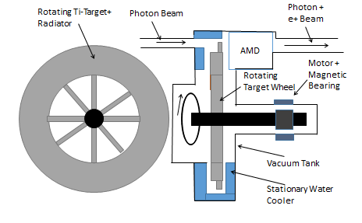
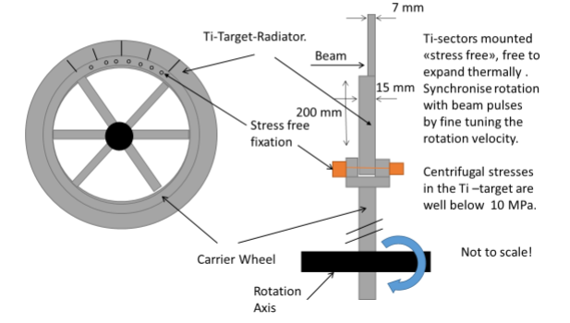
Principle layout: Ti wheel with diameter 1m, rotating at 100m/s, 2000rpm
Main components: cooling system, magnetic bearing , OMD
Target can be connected with carrier wheel of appropriate material to optimize cooling performance
Layout of wheel and details of target sectors detail mounted onto carrier wheel
free thermal expansion
Reduced eddy current
synchronize rotation with beam pulses by fine tuning to avoid luminosity loss by expansion slots

Slide 16
Summary
Sc helical undulator: consider realistic undulator spectrum (see talk K. Alharbi)
Target wheel design:
  Cooling by thermal radiation, thus avoiding a vacuum tight rotating seal (organic oil and iron powder).
    Demonstrate the robustness of the target material against cyclic load at high temperatures
    Laboratory test of the efficiency of the cooling by radiation on a small sector of the wheel under vacuum
  Wheel completely, hermetically sealed in UHV-vacuum.
  Rotating axis supported by contactless, maintenance free magnetic bearings.
Develop a design for the capture optics (see P. Sievers’ talk)
Target wheel + OMD design:
  Minimize temperatures and stresses in the spinning wheel including the magnetic field of the capture optics
  optimize volume and weight
  Magnetic bearing + drive: Specification for the a technical specification of the required performance and boundary conditions has to be negotiated with the supplier
Prepare design of mock-up for system target+OMD, tests

Slide 17
Back-up

Slide 18
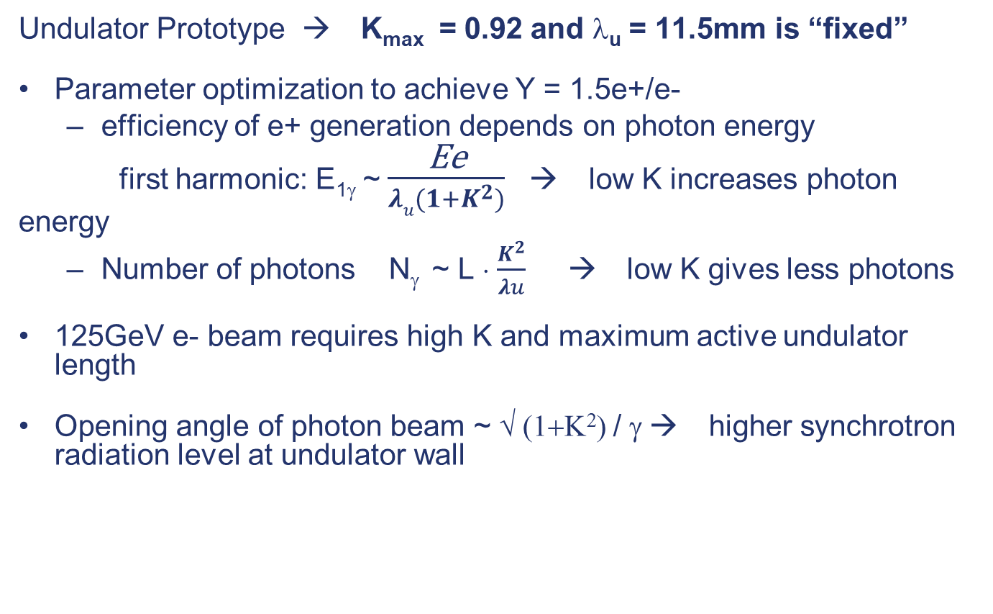
ILC250: parameters of undulator and photon beam
Undulator Prototype → K_{max} = 0.92 and λ_{u} = 11.5mm is “fixed”
Parameter optimization to achieve Y = 1.5e+/e-
  efficiency of e+ generation depends on photon energy
    first harmonic: E_{1γ} ~ $\frac{\text{Ee}}{λu(1+K^{2})}$→ low K increases photon energy
  Number of photons N_{γ} ~ L ⋅ $\frac{K^{2}}{λu}$ → low K gives less photons
125GeV e- beam requires high K and maximum active undulator length
Opening angle of photon beam ~ √ (1+Κ²) / γ → higher synchrotron radiation level at undulator wall

Slide 19
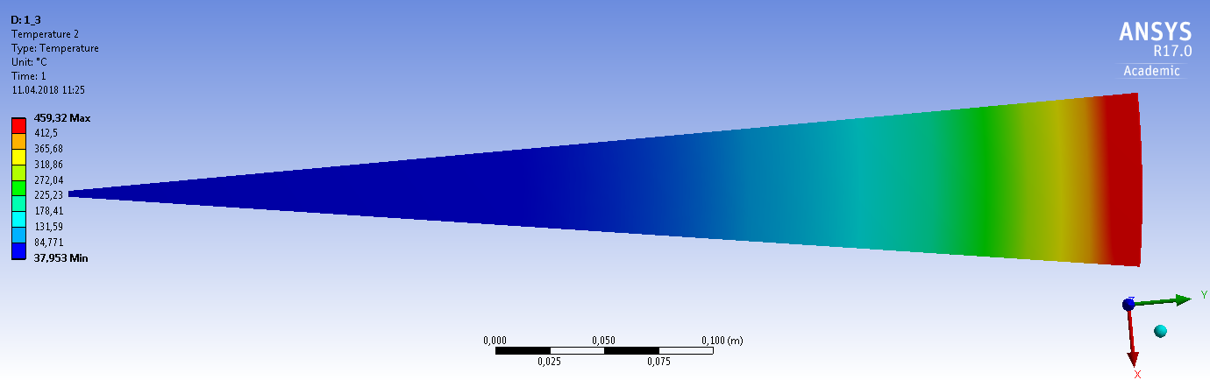
Temperature distribution in target wheel
Average energy deposition in target ~2kW (ILC250, ILC500)
ANSYS simulations for radiative cooling of target wheel
  Efficiency of cooling depends on emissivity of surfaces of wheel and cooler (ε_{Ti} and ε_{Cu})
Temperature distribution in target piece corresponding to 1 pulse length; ILC250
(ε_{eff}= 0.33; ε_{Ti} = ε_{Cu}=0.5)
Photon
beam pulse
Wheel radius = 51cm
F. Dietrich

Slide 20
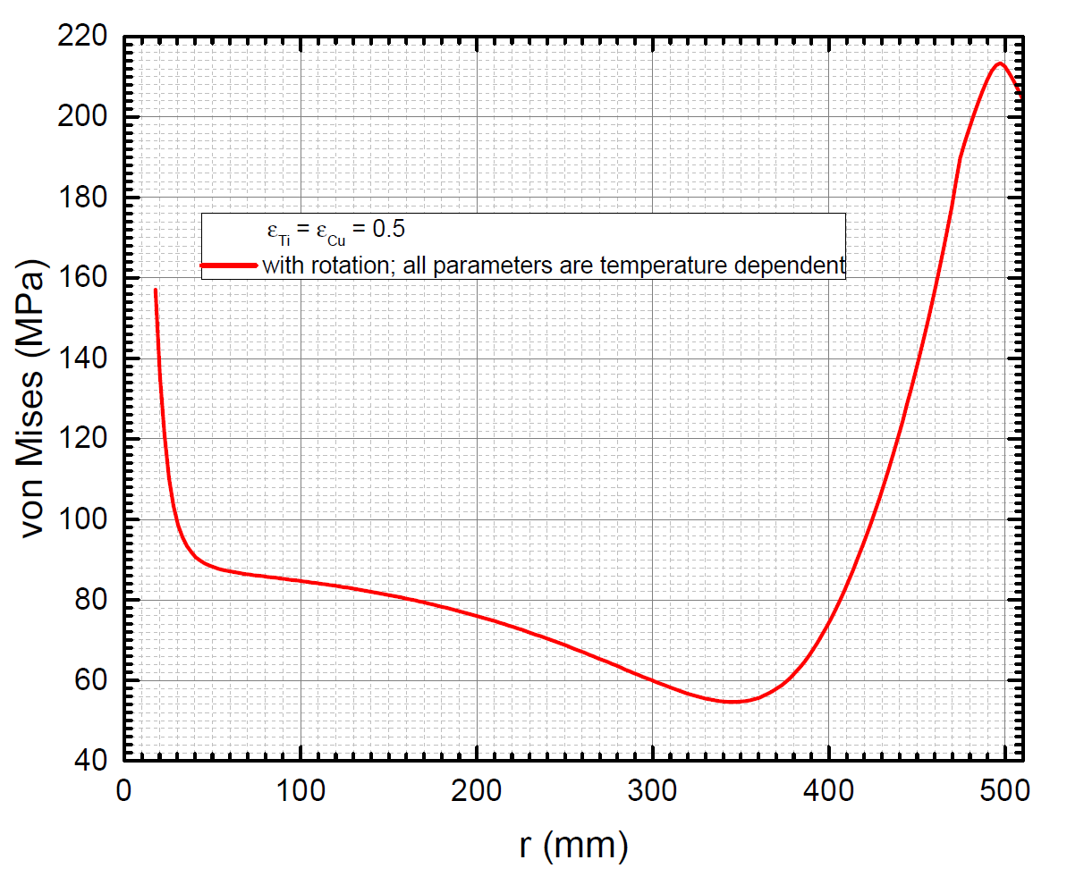
Average stress in target, ILC250, 1312b/pulse
ANSYS simulations: Consider spinning target disc, thickness 7mm, r_{out}= 51cm ,beam hits target at r=50cm
Material expansion ⬄ high thermal stress in beam impact region
Stress due to rotation (hoop and radial) is <50MPa, in the rim region <10MPa
Average von Mises stress
along wheel radius r
s_{vM} < 220MPa
Photon beam
impact
at r=50cm
F. Dietrich

Slide 21
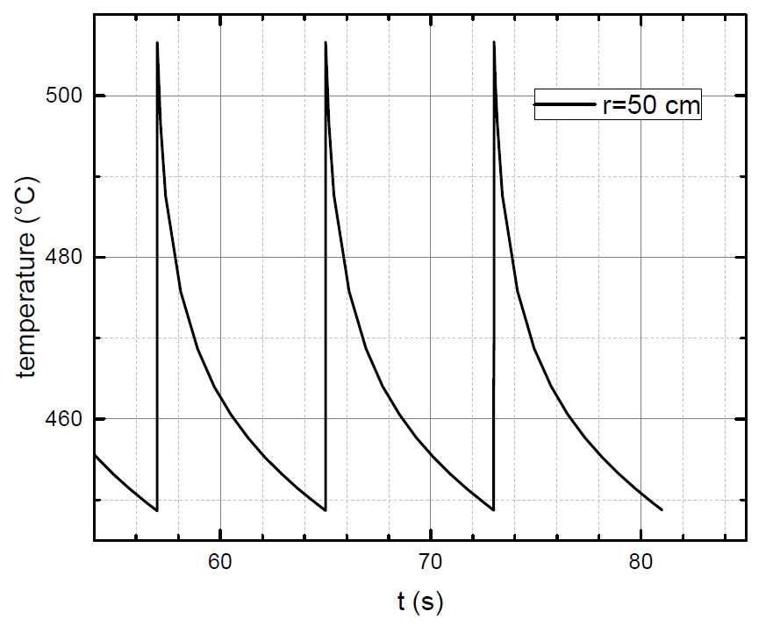
Cyclic load at the target - peak temperature
Max temperature evolution along rim
  if wheel has equilibrium temperature distribution reached, photon pulse increases temperature up to ~510C (2kW, ε_{eff}= 0.33 for ε_{Ti} =ε_{Cu}=0.5)
Resulting peak stress at beam path
  Time of energy deposition is to slow, intensity to small to create shock waves, thermal expansion along z is possible, restricted along r
  Estimate stress by pulse: σ_{peak} = E α ΔT / (1-ν)
  s_{peak} ≈ 75 MPa (ILC250, 1312b/pulse)
  In total:
  s_{peak} < 220MPa (ave) + 75MPa (pulse) ≈ 300MPa (full target disk)
  The stress is compressive

Slide 22
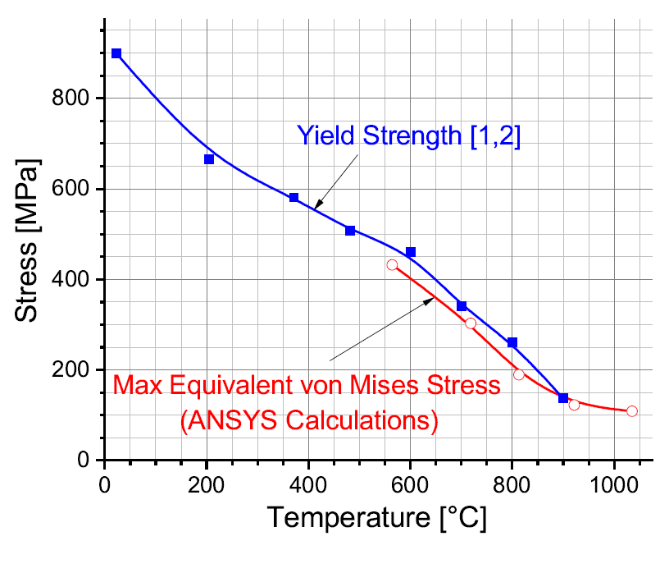
Following the tests at MAMI and Andriy’s studies (see his talk), we are safe with the von Mises stress of 300 MPa for ILC250 (nom.Lumi)
Lumi upgrade → Peak stress values could exceed limits
Stress reduction is possible with expansion slots

Slide 23
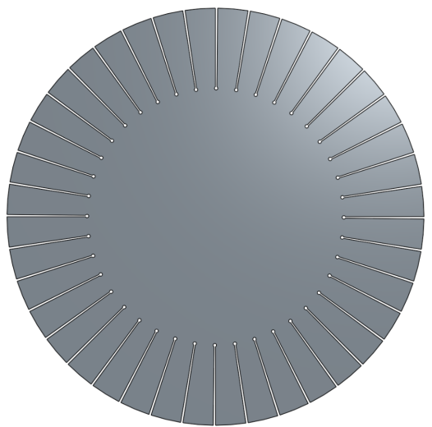
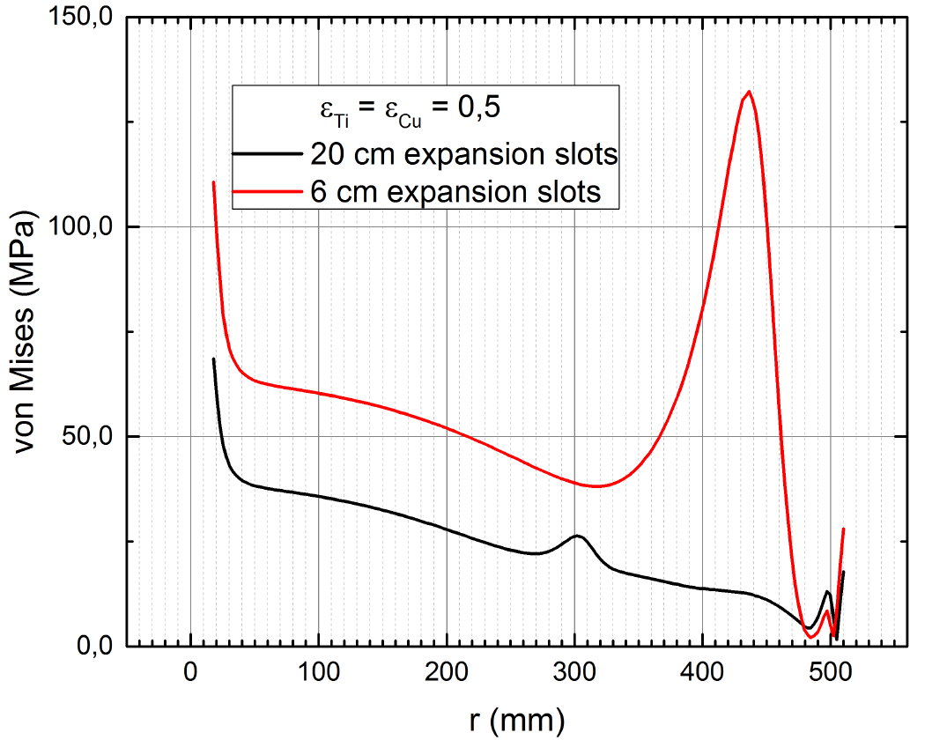
Average stress in target, ILC250, 1312 b/pulse
ANSYS simulations: Consider consider target disc, thickness 7mm, r_{out}= 51cm, beam hits target at r=50cm
Expansion slots (6cm and 20cm long)
→ stress substantially reduced, σ_{vM} ≤ 20MPa in
rim region
Expansion slots require
synchronization
with beam e- pulses ⬄
timing constraints!
Photon beam
impact at r=50cm
F. Dietrich

Slide 24
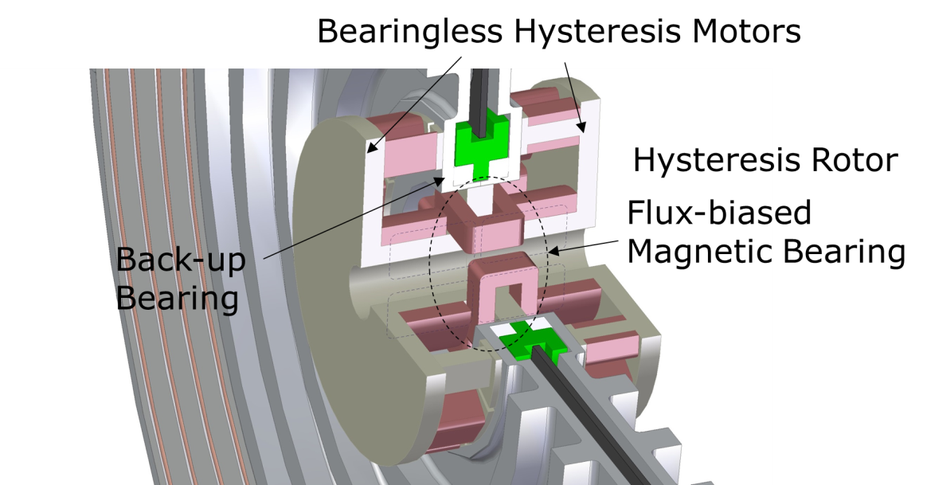
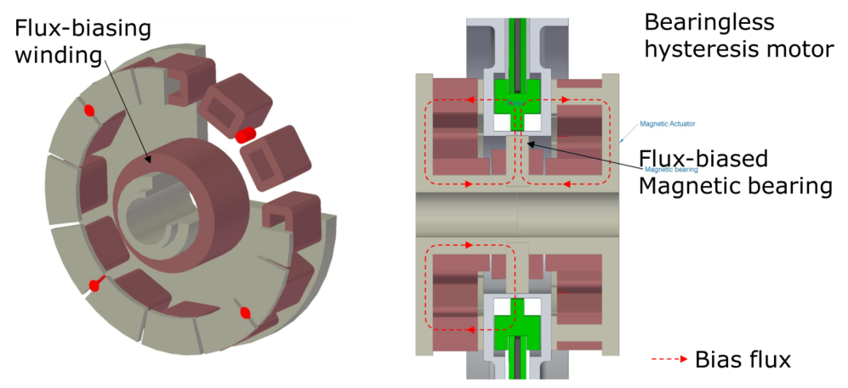
Drive and bearing
Design Proposal by M. Breidenbach et al, ICHEP 2016:

