Slide 1

https://indico.cern.ch/event/980103

Slide 2
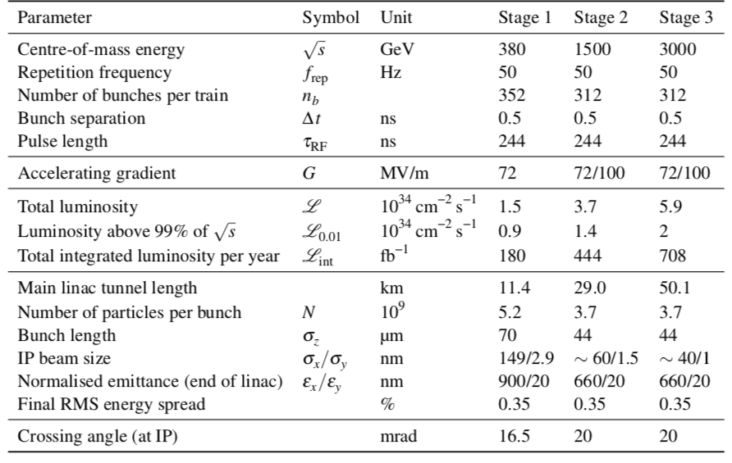
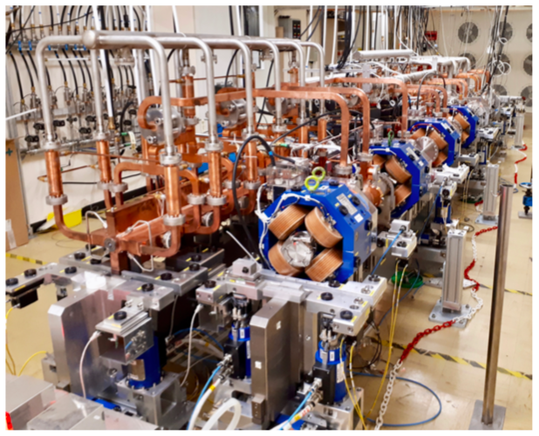
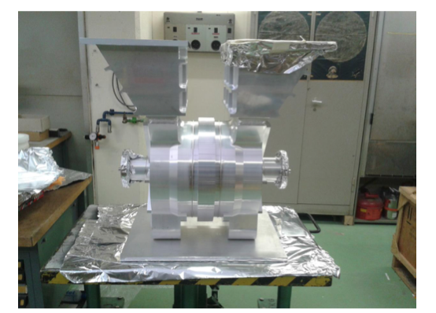
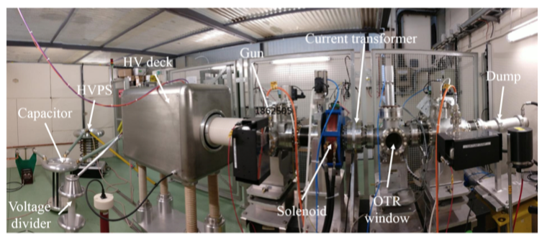
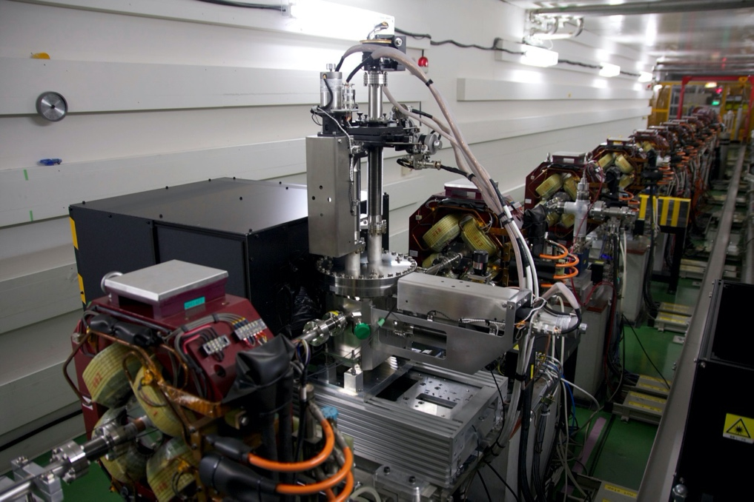
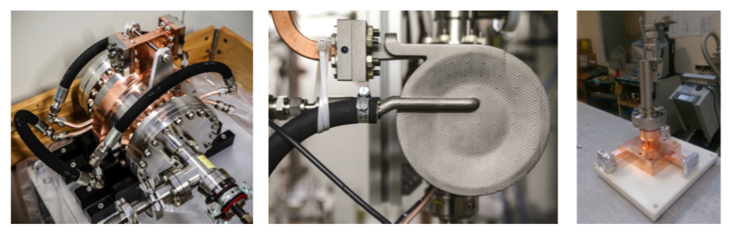
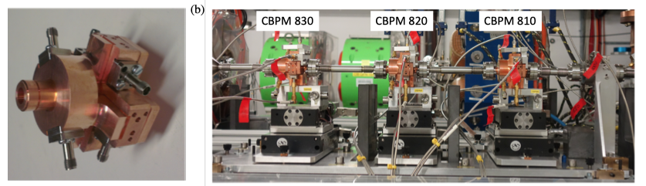
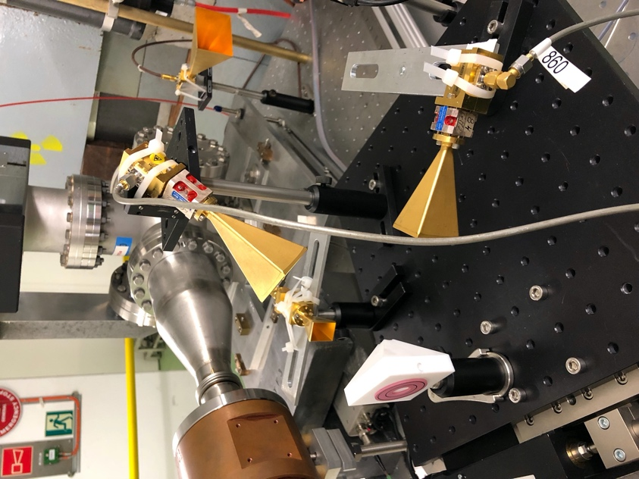
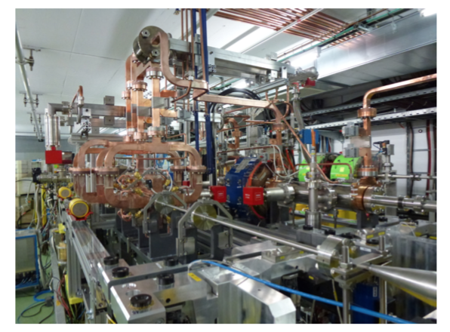
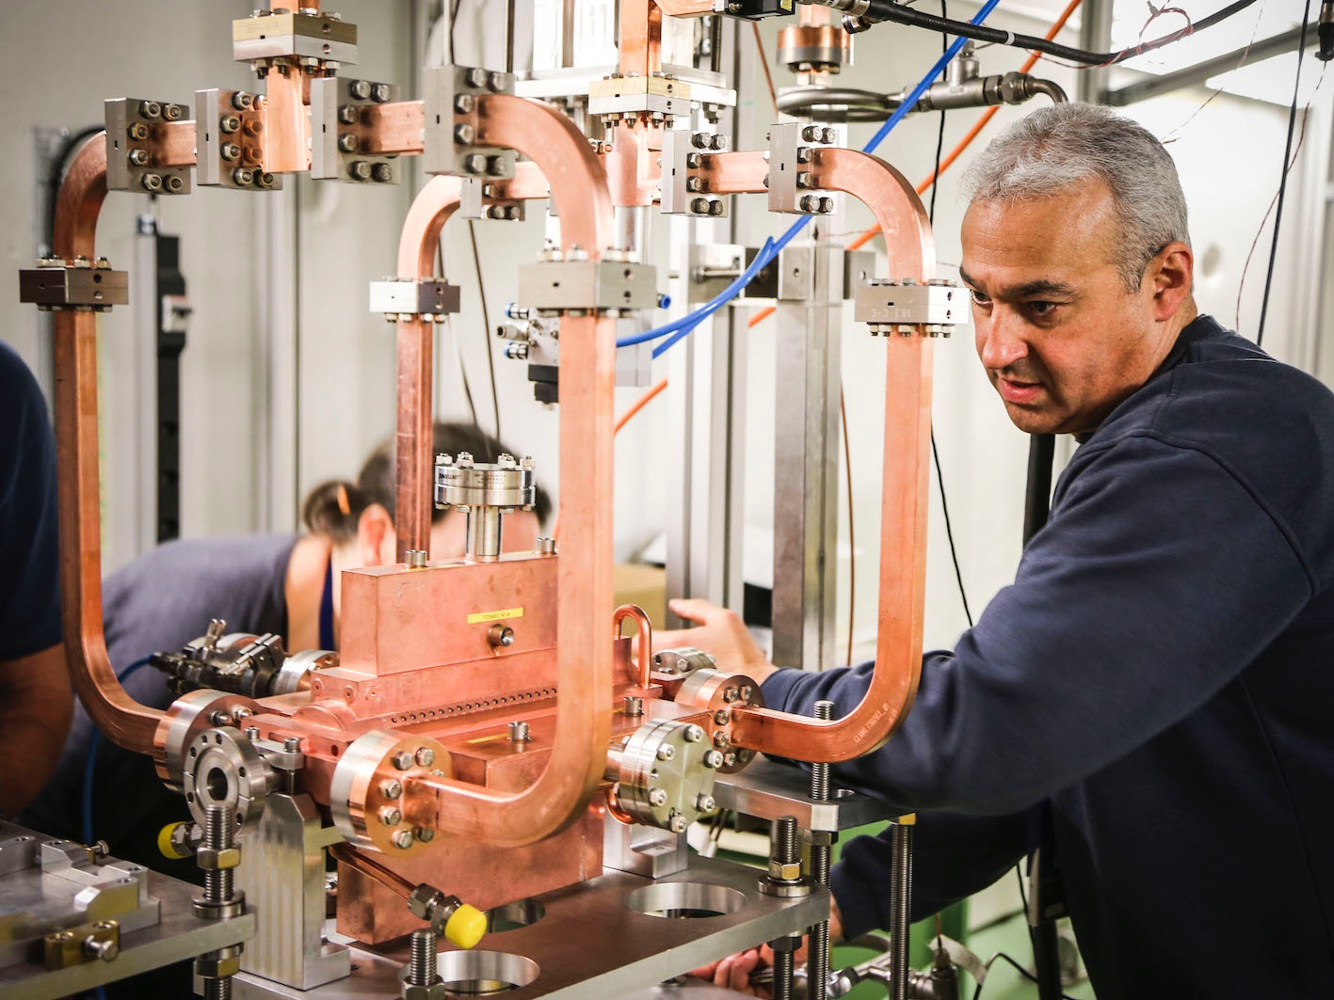
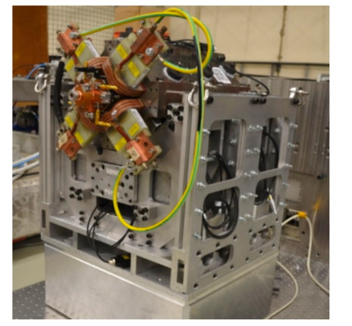
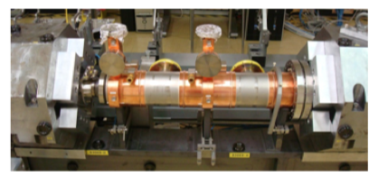
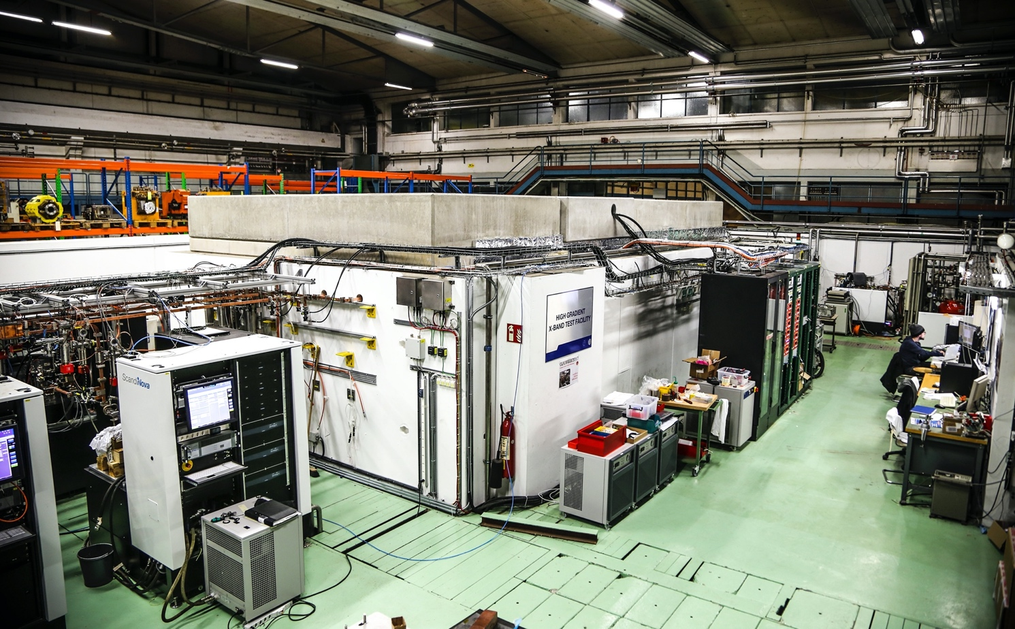
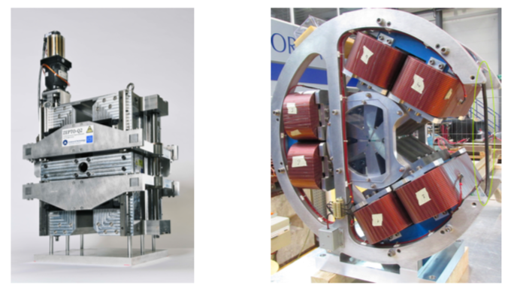
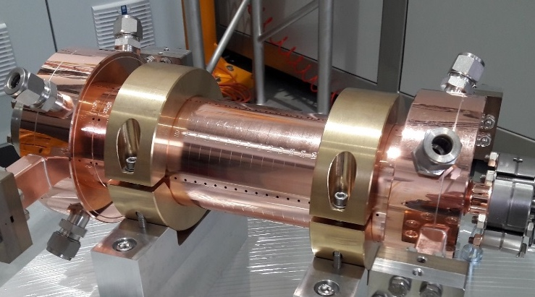
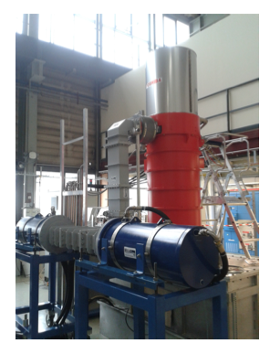
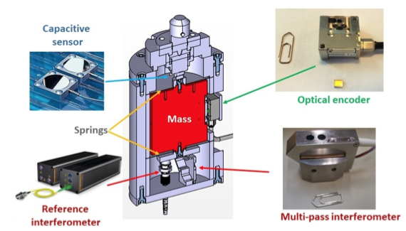
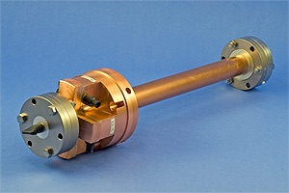
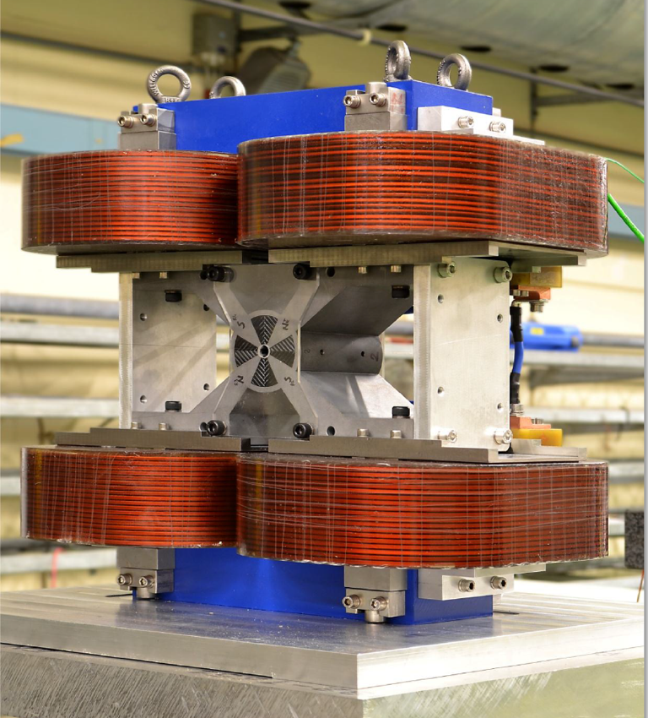
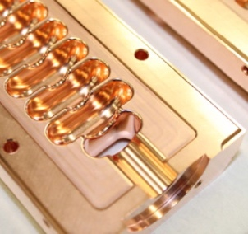
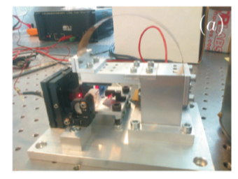
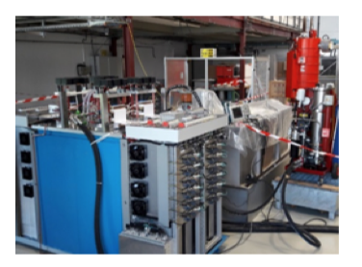
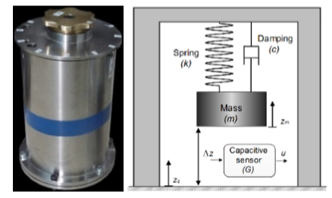
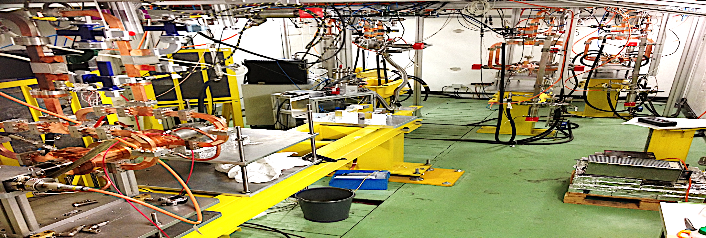
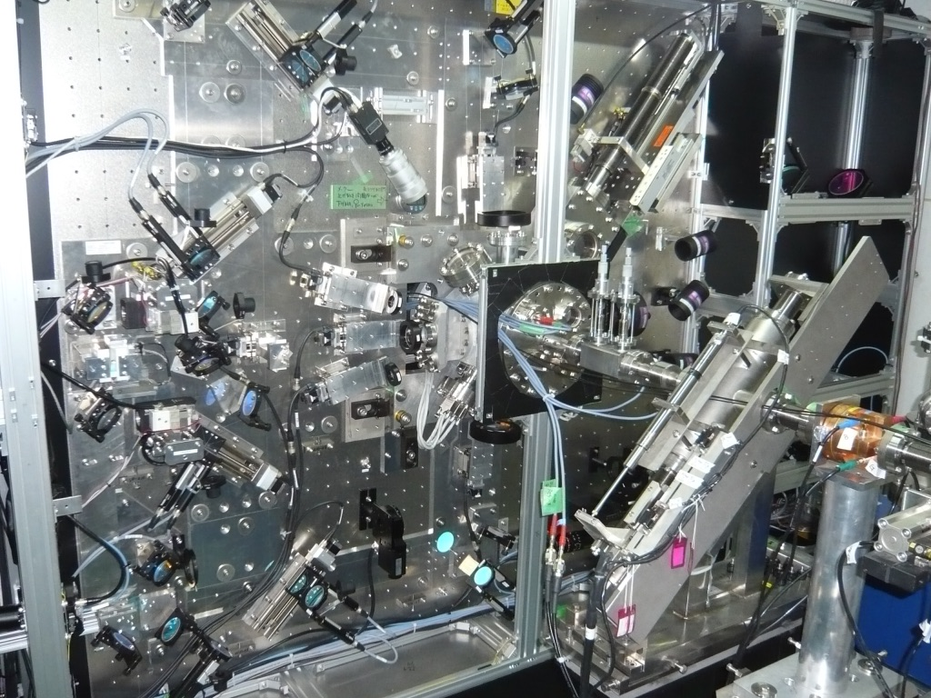
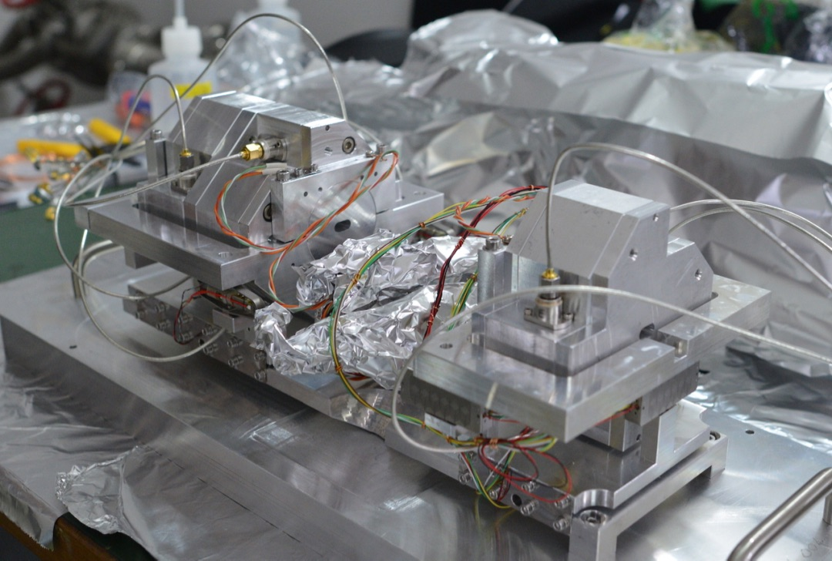
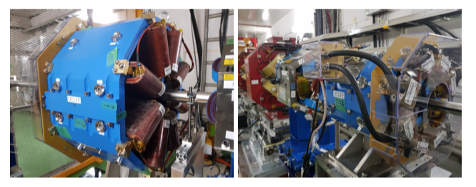
Motivation
In the coming years “nanobeams” will be a priority area – for CLIC and many other existing and future projects
… more from other Higgs factories, and other accelerators with similar challenges, other technologies
We hope the workshop will be a success – and will consider to make it annual
We also hope it will increase knowledge exchange and foster further collaboration in this area S. Stapnes
Technical Developments

Slide 3
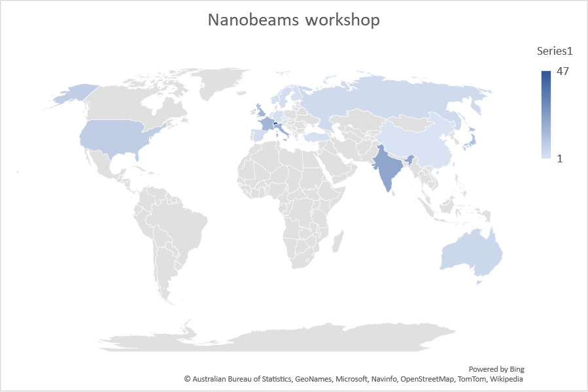
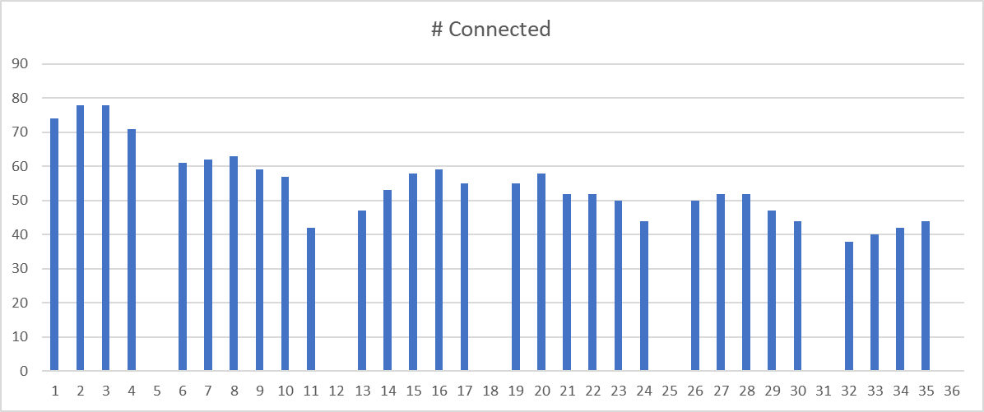
Participants
168 registered participants from 47 Institutions
31 talks for around 10 hours..
Apologies to you and the speakers for flying over the slides…

Slide 4
Program and organization team
Nuria Catalan-Lasheras
Angeles Faus-Golfe
Thibaut Lefevre
Helene Mainaud-Durand
Yannis Papaphilippou
Nobuhiro Terunuma
Alexia Augier
Grace Fern Jackson
Damping rings, radio-frequency, magnets, alignment, stabilization, Injection/extraction, vacuum and impedance, instrumentation

Slide 5
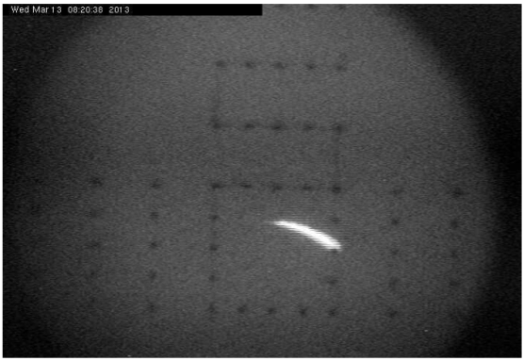
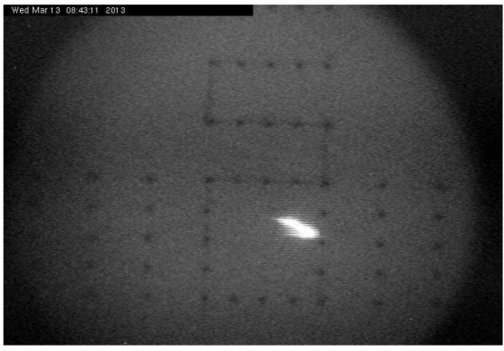
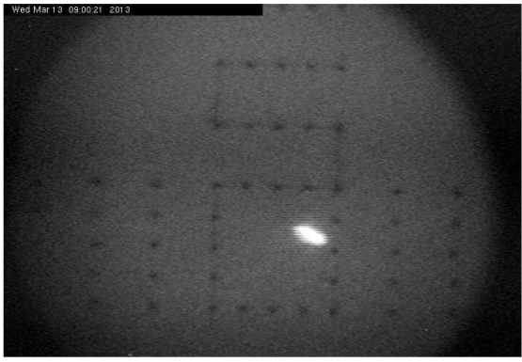
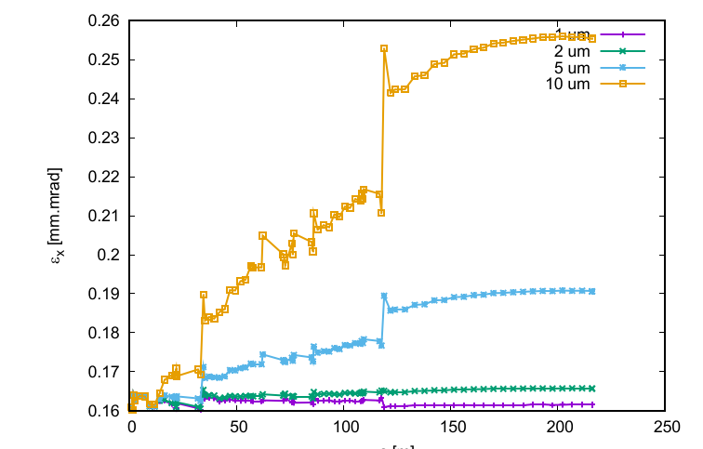
“Beam dynamics tolerances for Linear Colliders and FELs”, A. Latina
1. Orbit correction
2. Dispersion-free / wakefield-free steering
3. RF alignment
4. Sextupoles
Beam-based alignment tests at FACET@SLAC
[ Gohil, Burrows, Blaskovic, Latina, Ögren, Schulte, D.. (2020). Luminosity Performance of the Compact Linear Collider at 380 GeV with Static and Dynamic Imperfections. Phys. Rev. Accel. Beams 23, 101001 ]
Expected luminosity:
Target:
  L = 2.3 x 10³⁴ cm⁻²s⁻¹
Average (simulation):
  L = 3.4 x 10³⁴ cm⁻²s⁻¹
90% has luminosity above:
  L = 2.7 x 10³⁴ cm⁻²s⁻¹

Slide 6

“Beam dynamics tolerances for (Low Emittance) Rings”, Y. Papaphilippou
High-bunch brightness in all three dimensions
  Intra-beam Scattering effect reduced by choice of ring energy, lattice design, wiggler technology, alignment tolerances
  Electron cloud in e⁺ rings mitigated by chamber coatings and efficient photon absorption
  Fast Ion Instability in the e⁻ rings reduced by low vacuum pressure and train gaps
  Space charge vertical tune-shift limited by energy choice, reduced circumference, bunch length increase
  Other collective instabilities controlled by low –impedance requirements on machine components
Repetition rate and bunch structure
  Fast damping times achieved with SC wigglers
  RF frequency reduction @ 1GHz considered due to many challenges @ 2GHz (power source, high peak and average current, transient beam loading)
Output emittance stability
  Tight jitter tolerance driving kicker technology
Positron beam dimensions from source
  Pre-damping ring challenges (energy acceptance, dynamic aperture) solved with lattice design
2020
Operation
Design
2008
Operation
Design
(8) Low emittance rings workshops

Slide 7
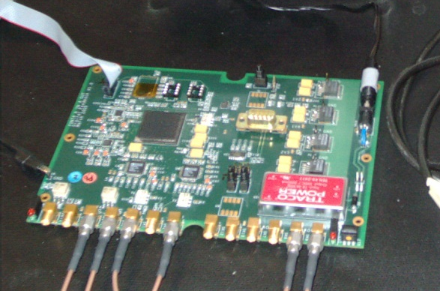
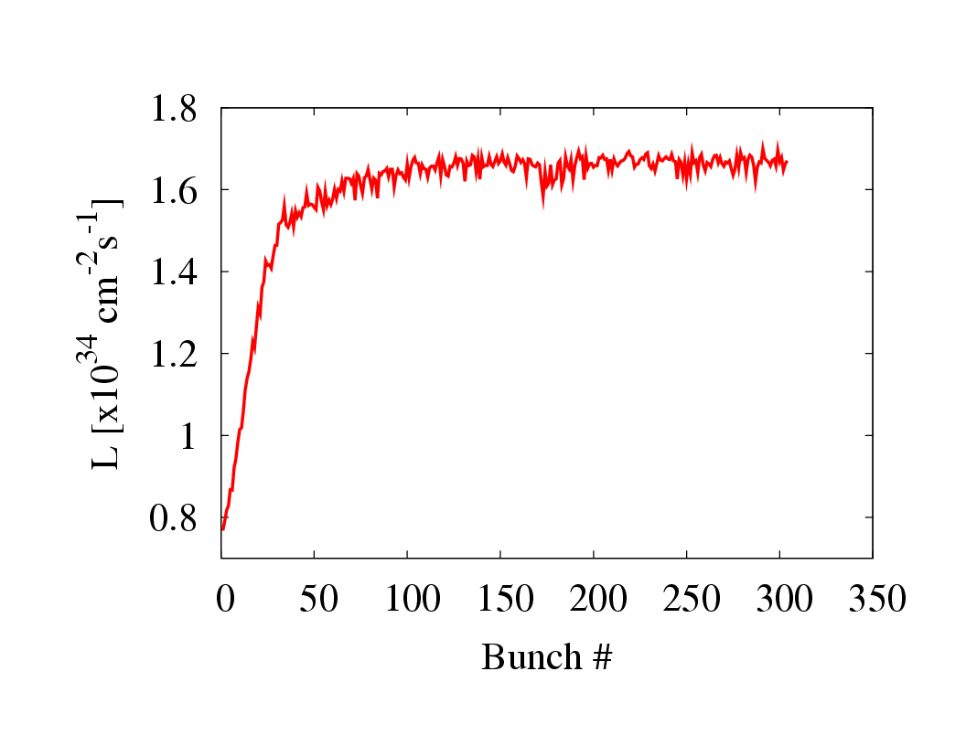
“Beam Fast Jitter Control and Feedback”, Ph. Burrows
Feedback On Nanosecond Timescales O(10-100ns)
IP FB and ground motion FF in ATF
Phase FF in CTF3
Wake-field effect reduction in ATF
Simulations for CLIC 3TeV
Low latency ~150 ns
FONT performance in ATF
Simulated ILC IP FB performance (500 GeV)
Trajectory control of wakefield effects

Slide 8
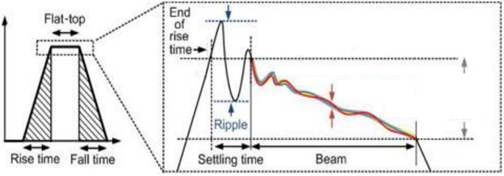
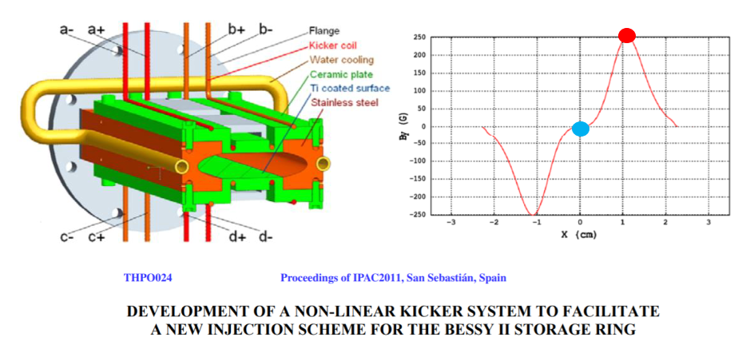
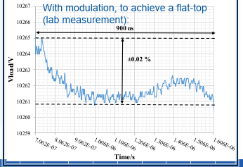
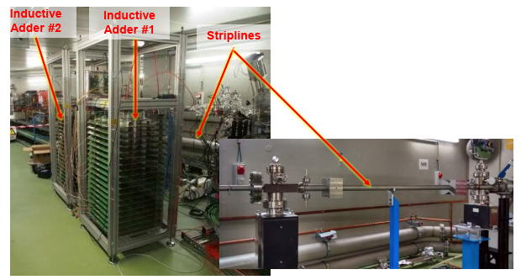
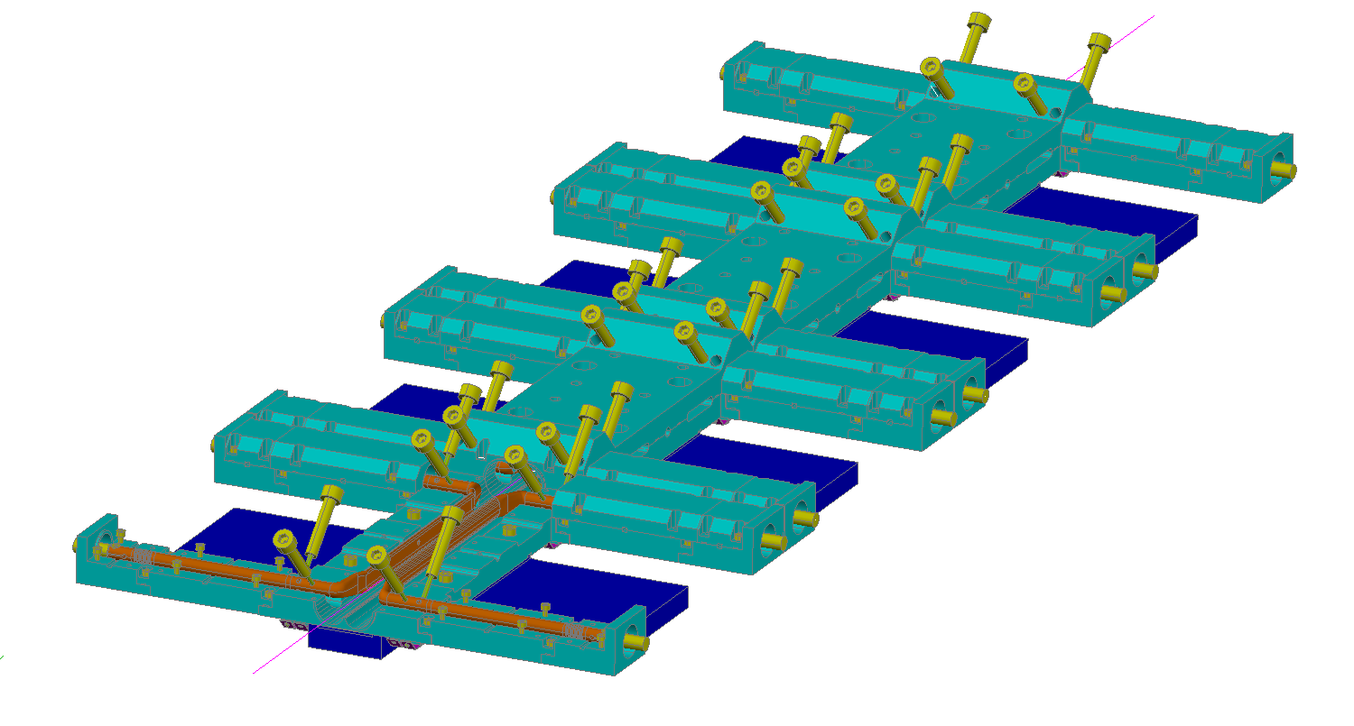
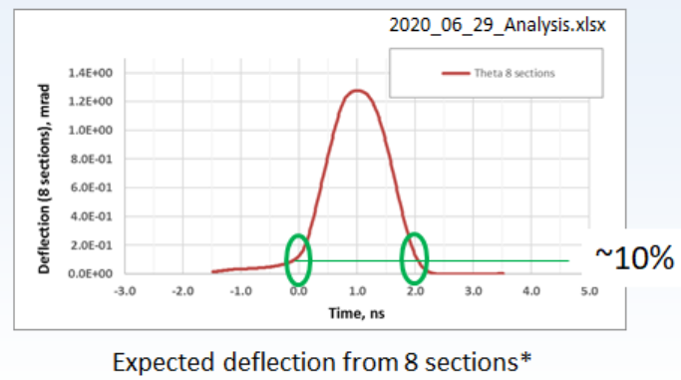
“Kicker design with tight kick tolerances and Pulser with ultra-fast rise-time”, M. Barnes
“Injection/extraction systems and methods for ultra-low emittance rings ”, M. Aiba
Flat-top
End of rise time
Repeatability
±0.01 %
Stability (allowed instability)
±0.02 %
Ripple
Rise time
Fall time
Settling time
Beam to be extracted
Rise/Fall time
~100 ns
Flat-top duration
160 | 900 ns
Ultra short pulse kicker

Slide 9
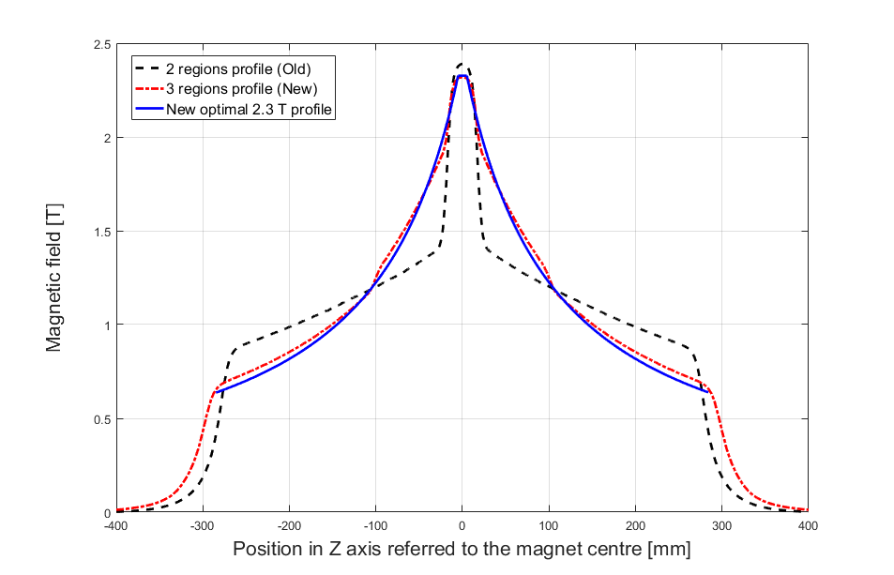
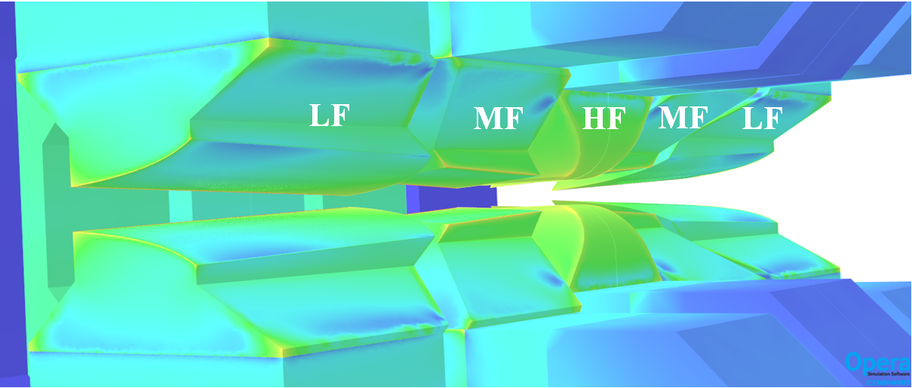
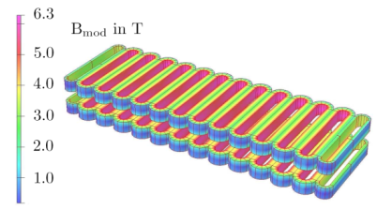
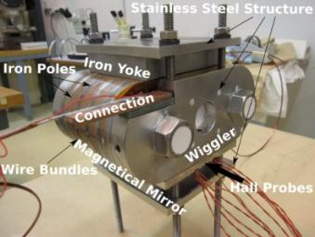
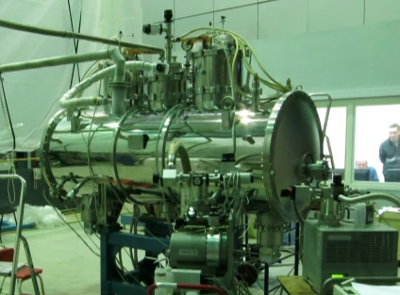
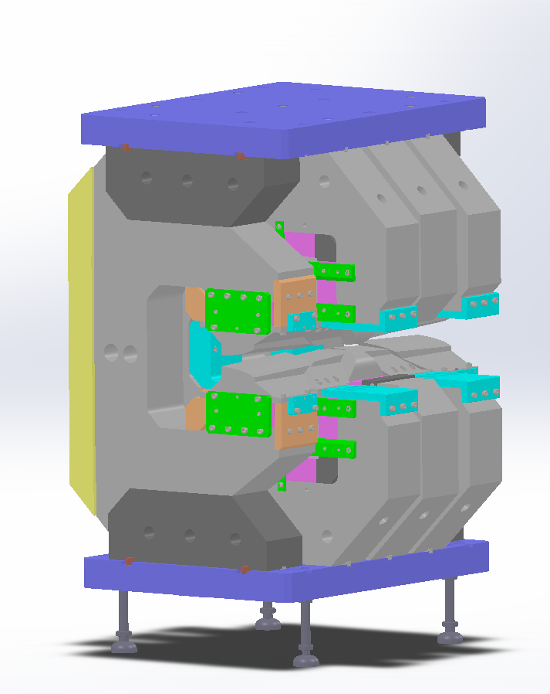
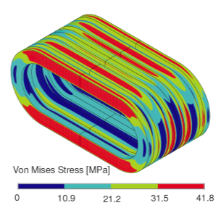
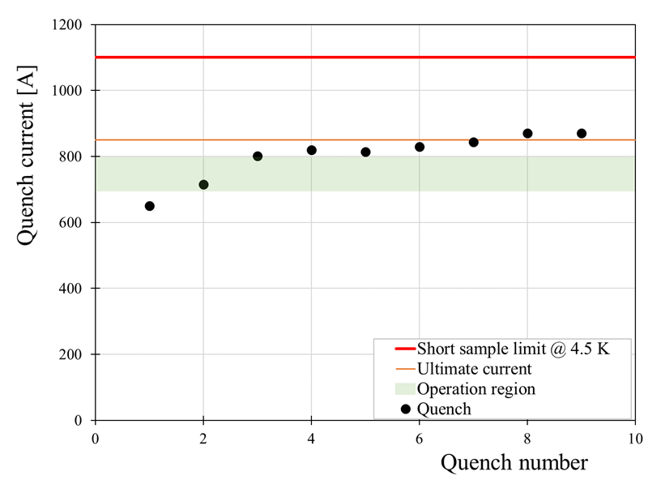
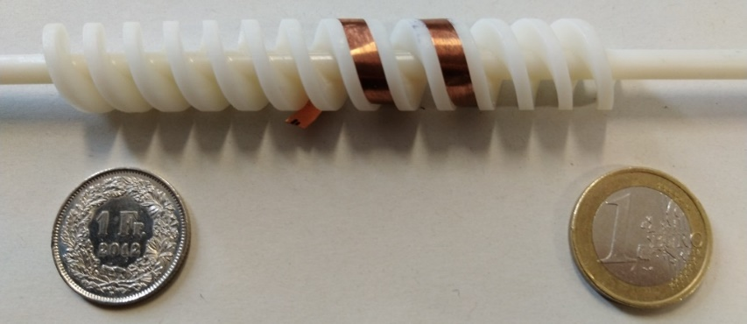
“The HTS undulator and wiggler development”,
D. Schoerling
Combined function magnets: dipolar and quadrupolar field. Hyperbolic pole tip profiles
Multiple backup solutions and adjustments implemented to achieve the desired field quality and specifications
98% of the pieces produced
Remaining 2% already under production
A new version of these magnets will be used in the Elettra new upgrade!
NbTi Wiggler design ad built. Under operation in ANKA/KARA
The presence of non-allowed harmonics, measured with beam, indicates an asymmetry of the wiggler. For a future CLIC damping ring, the manufacturing and assembly tolerances shall be revisited
Nb3Ti Wiggler prototype, manufactured and tested
New ideas, HTS development, helical, planar undulators…
“Development of a high-field longitudinal
gradient dipole at CIEMAT”,
M. Dominguez

Slide 10













“Adjustable permanent magnets”, B. Shepherd
“Developments in Superconducting Final Focus Technology”, B. Parker
“Special magnets”, M. Modena
Laser ports with view to cold mass
Cold and Warm Geophones
X/Y Pickup Coil
QD0 Cryostat
Double Sided Active / Passive Isolation Support
QD0 R&D Prototype Vibration Test Setup

Slide 11












“Beam specifications impact on RF and LLRF design The CLIC Damping Rings LLRF”,
T. Mastoridis
probability of collision
head-on
kissing
z (m)
$$θ_{C}$$
y
$$φ\text{ : }\text{roll} \text{angle}$$
$${θ′}_{C}$$
$δV≠$ 0
$δφ≠$ 0
x
$${\text{Total} V}_{cc}= \frac{cE_{s}\tan\left({θ_{c}}/2\right)}{qω_{RF} \sqrt{β^{∗}β_{cc}}\sin\left(μ\right)}$$
The system performance will greatly depend on the klystron frequency response and to a lesser extent on the measurement noise from the beam pickup and on the accurate and precise feedforward gain setting.
The peak power requirements are strongly related to the instantaneous beam power, which is rather demanding and dominates the size and cost of the Damping Rings RF system.
Crab crossing with NANOBEAMS in colliders requires careful study of:
  Implications on required kick voltage (via 𝛽), frequency choice
  HOM power, impedances (esp. short bunches)
  Effects of detector solenoid
  Demanding installation tolerances, RF noise control
  Consider crab kissing, crab waist scheme
“Power RF systems for low emittance rings“, E. Jensen
“Crab cavities for colliders.” S. Verdú-Andrés

Slide 12








“X-band transverse deflection structure with variable polarisation“, B. Marchetti
“Wakefield Monitors and
Wakefield Mitigation“, K. Sjobak
Collaboration between PSI, CERN and DESY on X-band technology
Alignment of RF structures according to WFM measurements
For CLIC luminosity target: Need accuracy better than 3.5 µm
Resolution of the WFM at micron level
Different center location
In TM and TE mode
Look simultaneously
into position and kick
Screen 3
Screen 1
Screen 2
Kicker
Kicker
Accelerating structure

Slide 13

















“Overview of profile measurements for nanobeams ”, T. Lefevre
“High resolution cavity BPMs: From prototype to production”, A. Lyapin
sub-micrometer resolution wire scanner
X-band LCLS-1 (36)
200nm precision
C-band commercial
RHUL- FMB Oxford
Digital electronics
“Measuring nanometer beam size at final focus”, T. Okugi
Compton scattering with a 532nm
Considering an upgrade for ATF3
New laser and new crossing angle

Slide 14








“Non-invasive beam measurement using polarization radiation“, P. Karataev
250nm
250nm
Curcio et al, PRAB 23, 022802 (2020)
Measured at CLEAR/CERN
“Measuring femtosecond bunches using electro-optical techniques“, S . Bielawski
High repetition rate
Femto-second resolution

Slide 15












“Structured Laser Beam… towards an alignment system“, J-C. Gayde
Gaussian Beam
Bessel Beam
Structured Beam
Beam diameter | 3 m distance | 100 m distance
Gaussian Beam | 0.8 mm | 240 mm
Structured Beam | 0.01 mm | 1.4 mm
“The PACMAN project results”,
H. Mainaud-Durand.

Slide 16






“Machine detector interface alignment techniques for nanobeams machines“, L. Watrelot
“Development of low-cost alignment systems“, M. Sosin
MDI alignment systems involving:
  Hydrostatic levelling systems
  Wire positioning sensors
  Distance offset measurements
  Remote CAM movers
HL-LHC:
  External and internal monitoring
  Using FSI
  Inclinometers
  Improved network
However, no solution for LC or FCC-ee
“Girder Stability“, G. Balik

Slide 17












“Very thin Non-Evaporable Getter
coatings for particle accelerators“, P. Costa-Pinto
“Development of thin-walled copper electroformed vacuum chambers for undulators“, L. Lain Amador
How thin can it be and still withstand 4 venting / activation cycles?
“Measuring conductivity of coated surfaces at high frequency“, A. Passarelli
Circular waveguide
Pyramidal Horns

Slide 18
“Thoughts on Tolerances for the Next Colliders“, D. Schulte

Slide 19

“Thoughts on Tolerances for the Next Colliders“, D. Schulte
Thank you all!!

